Slide 1
-1aU and Machine History/Status Research Operations Update
Stefan Gerhardt
NSTX-U Team Meeting
B-318 PPPL
7/15/2016

Slide 2
Slide title
PF-1aU Status and Plans
Other Research Operations

Slide 3
Slide title
PF-1aU Status and Plans
Other Research Operations

Slide 4
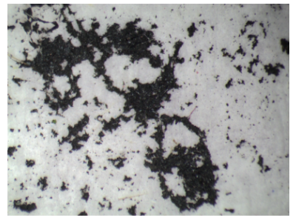
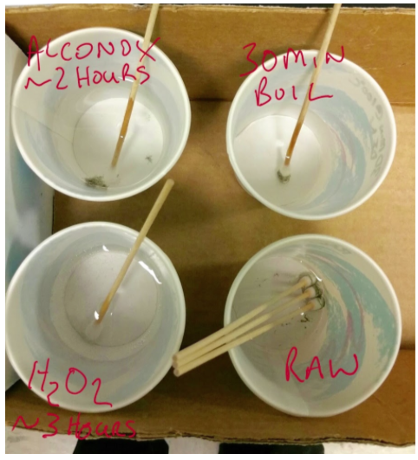
Chronology on PF-1aU Problems (I)
Flow restriction noted via flow switch on final shot of Tuesday 6/28/2016.
Found to be a true flow restriction that evening.
Wednesday 6/29-Friday 7/1 spend trying to understand and flush the flow blockage.
A component of the blockage material appeared like graphite, smelled “burnt”
A component of the blockage was likely determined to be biological.
Flush with water mixed with Dawn, Alconox
Appeared to be making progress, but stopped for the long weekend.
Left coil filled with soapy water

Slide 5
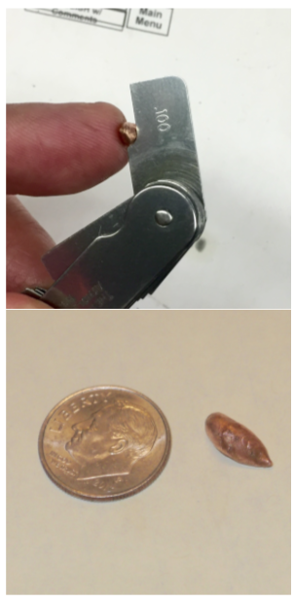
Chronology on PF-1aU Problems (II)
Tuesday 7/5/2016
Found a copper piece in a bucked that was used to collect water on 7/1/2016
While using DI water to push the apparent flow restriction out, a large water leak developed on the coil.
Water moved in the volume between the OH coil and CS, soaking the bottom of the machine.
To dry machine, did a CS bake at ~90 C from Friday 7/8 to Monday 7/11
TF and OH insulation resistance continued to be too low, so resumed inspections.
Found much more water in the vicinity of the lower TF and CS pedestal on Tuesday 7/12/16.
This area deliberately kept cool during bakeout
Cleaned that up and started circulating additional air in the lower part of the machine.

Slide 6
A Few Other Observations
There were no obvious electrical deviations in the coil:
On the test shot on 6/28, compared to previous test shots.
On the final plasma shots.
There were no obvious deviations in the coil cooling water temperature until after the final shot.
There were no signs of water leaks on the vessel GFM on 6/28
But large leak on 7/5 was easily observed by the GFM
Upshot: could not find any warning signs in the data that would lead us to stop operations.

Slide 7
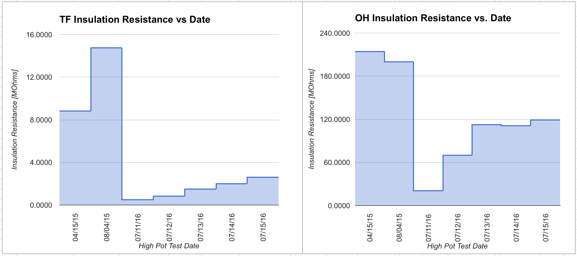
Present Status: CS Coils
TF insulation resistance is improving…targeting ~4-8 MOhms.
Endeavoring to improve the resistance by more targeted air flow.
OH insulation resistance is back to previous values
Desired Range

Slide 8
Present Status: PF-1aU
Working Hypothesis:
There is a breach in the cooling path of the coil itself, that opens at high(er) pressure.
Status
Has 6 MOhm insulation resistance.
May still have water/soap in it
Will keep connected to FCPC ground-fault monitoring, but disable connection to any rectifier.
Path forward
Have “budgetary guidance” quotes for both the mandrel fabrication and the winding.
Are assessing the most expedient path for each of these items/steps…in house at PPPL vs outside vendors.
Would likely be willing to fabricate a mandrel before examining the existing coil. May not be comfortable with doing winding until after dissection.

Slide 9
Slide title
PF-1aU Status and Plans
Other Research Operations

Slide 10
Operations Updates: RF Physics and Boundary Physics Operations
RF:
Vacuum conditioning of sources 1 and 2 achieved 24/23 kV operation for 200 ms
Ready to do tuning into plasma at ~ 100 kW in piggyback mode.
Will then perform XMP-026 conditioning using dedicated discharges.
Boundary Operations
LITER
Testing of motion control for LITERs completed with successful synchronization to shot clock
Bakeout completed for LITERs on Fill Stand in South High Bay and ready for lithium loading
Successful ACC review
MAPP
Remote position control being tested as final step in sample exposure and analysis capability during plasma operations

Slide 11
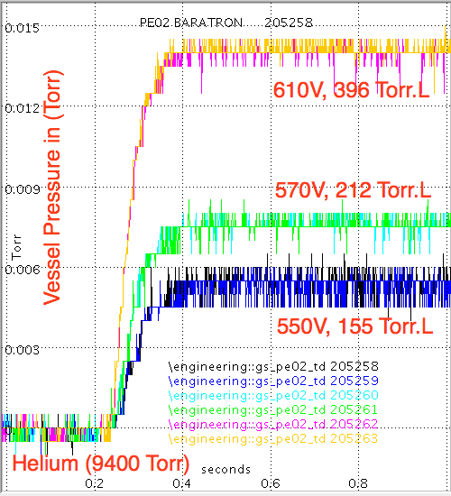
Operations Updates: Physics Ops.
PCS largely uncharged as we wait to resume operations.
Biggest recent update was improved definition of boundary flux and successful inner gap control.
Some evidence that the optimal error field correction early in the shot differs from that later.
Need to assess better to determine the optimal strategy.
Mid-Plane and lower divertor MGI valves commissioned in nitrogen, helium, and neon at full operating pressure.
Calibrations with TF on (XMP-136) to be followed by MGI gas injection into plasma
assess gains on diagnostics

Slide 12
Operations Resumption
Operations will resume when the TF insulation resistance is deemed acceptable, and when there is no sign of water on the machine.
Will be w/o PF-1aU or either PF-1cU/L
Are working on the -1c flex bus restraints.
First plasma activity will be XMP-155
“L-Mode Development w/o PF-1aU” (Battaglia et al.).
Should facilitate completing some unfinished tasks:
EFC
L-mode NB characterization
LGI commissioning
MGI commissioning.
Is a stepping stone to continued H-mode development.

