Slide 1
NSTX-U Team Meeting
J. Menard, R. Hawryluk, M. Ono, S. Gerhardt, S. Kaye
MBG Auditorium
December 2, 2016

Slide 2
Agenda
Masa (for Jerry) - Safety update
Rich, Jon, and Masa - NSTX-U organizational changes, new roles for Masa
Rich - Overview of Recovery Project
Stefan - Outage status, PF1AU forensics
Jon - Program status, collaborations, 5YP prep

Slide 3
Safely, Safely, Safely
• Safety message from Jerry Levine – It is timely for everyone to review his or her areas for housekeeping issues and clutter that have arisen, and to take the time to clean them up. Having lots of clutter around is not only unsightly, but can cause safety problems such as trip, slip and fall hazards and possibly fire hazards, to name a few consequences. Also, when our housekeeping improves, we work more efficiently. So please take the time to clean your workspaces regularly.
• You can find the lessons learned link on the PPPL Employee Home Page, 2nd bullet under "Environment, Safety & Health (ES&H)". The direct link is https://fmp-srv.pppl.gov/fmi/webd#LessonsLearned .
• Winter weather is here!
Ware proper protective clothing / equipment for outdoor work, and keep warm!
Slippery road and walk-way conditions – Wear rubber sole shoes and be mindful of surfaces conditions – slips and falls are most frequent cause of injuries!
Proper exercise – to relax muscles and warm up to reduce the chance of injury

Slide 4
NSTX-U Organizational Changes
NSTX-U Recovery Project
NSTX-U Research
To be described by Rich Hawryluk
Head: Jon Menard
Deputy: Stan Kaye
Motivations for Org changes
Recovery Project has grown sufficiently far-reaching in scope and institutionally important to require its own department
Organization should reflect department responsibility and functionality, and have single line of authority in dept.
Organization needs to be changeable to be responsive to present needs, and is also subject to change in the future
Run Coordination
TBD for next run
Deputy: TBD
Science Groups, Task Forces, and Working Groups
Experimental
Research Operations
Stefan Gerhardt
Deputy: Robert Kaita
Physics Analysis
Stan Kaye
Boundary Science
R. Maingi
Publications &
Presentations
Physics Operations
D. Mueller
Core Science
S. Kaye
Computational
Support
W. Davis
RF Operations
J. Hosea
Integrated Scenarios
S. Gerhardt
Diagnostic
Operations & R&D
B. Stratton
Particle Control Task Force
J. Canik
Theory &
Simulation
A. Bhattacharjee
Research and Recovery will work closely to incorporate research priorities into NSTX-U recovery
Boundary Physics
Operations
R. Kaita
Disruption PAM Working Group
S. Sabbagh

Slide 5
Roles and Goals for Masa Ono
Assist Research and Recovery efforts as requested
Aid long-term planning for facility and diagnostics
Begin prep of diagnostic and actuator plan for next Five Year Plan
Work with team by holding brainstorming meeting(s) spring of 2017
Continue exploring 1-2MW gyrotron, associated JA collaborations
Assist in outgoing collaboration management during Outage
Aid in improving NSTX-U facility as a collaboration / user facility
Advance international collaboration on Asian STs
Participate in CHI experiment on QUEST
Develop opportunities for ECH / EBW and hot wall collaboration experiments on QUEST
Explore collaboration on other STs in Japan, Korea, also JT60-SA
Integrate lithium divertor and lithium loop concept research into PPPL liquid metal strategy and plan(s)
Aid assessment of options / impacts for NSTX-U LM divertor

Slide 6
NSTX-U weekly highlights note
Starting this week (i.e. today!), please send:
NSTX-U Research highlights to Jon
Recovery Project highlights to Rich

Slide 7
Agenda
Masa (for Jerry) - Safety update
Rich, Jon, and Masa - NSTX-U organizational changes, new roles for Masa
Rich - Overview of Recovery Project
Stefan - Outage status, PF1AU forensics
Jon - Program status, collaborations, 5YP prep

Slide 8
NSTX-U Team Meeting
R. J. Hawryluk
Dec. 2, 2016
This presentation describes plans and approaches that are under development and should be considered preliminary.

Slide 9
What are My Aspirations?
NSTX-U be the facility that scientists from around the world will want to work on.
Safe, reliable and predictable operation
NSTX-U be renown for world-class research
Strive to define the standard in research

Slide 10
Notable Outcomes Issued Sept 20, 2016
EXTENT OF CONDITION
FES: Complete an extensive extent-of-condition review of NSTX-U to identify all design, construction, and operational issues. Prepare corrective action plan (CAP) to include cost, schedule, scope, and technical specifications of actions. Complete the CAP review and report to DOE by March 31, 2017.
EXTENT OF CAUSE
SC/PSO: Conduct a review of policies and procedures for design, construction, installation, commissioning and operations of NSTX-U and other construction activities and projects. Develop corrective actions to ensure the highest quality project management across the lab.

Slide 11
Strategy - Extent of Condition Process
Strategy
Structured process to identify issues with NSTX-U
Update and generate Systems Design Descriptions
Collect data describing the design and existing components
Identify all issues with the components
Perform “Design Validation & Verification Reviews” to identify other potential issues
Develop Corrective Action Plan (CAP)
Risk based approach
Convene External Extent of Condition Review
Revise Corrective Action Plan in response to review findings and deliver to DOE
Imperative that we get moving on this immediately.
Training will occur next week.

Slide 12
We need everyone’s input to ensure safe and predictable operation!

Slide 13
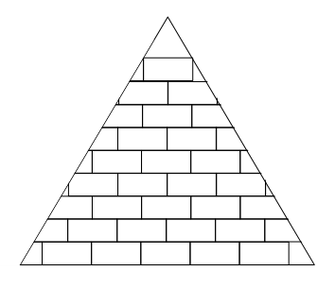
Design Verification & Validation Review (DVVR)
DVVR looks for potential gaps in design basis or as-built configuration
Corrective Action Plan (CAP) determines path forward
Does the design satisfy project requirements?
Is the component fit for function?
Design Verification
Component Validation
SDD
Certification
CAP
CAP
Requirements, calculations,
reports, drawings, etc
Mfg. + installation records,
test reports, NCRs, ECNs, etc.
GAP
GAP
GAP
GAP
System Design Description (SDD)
As-Built Documentation,
Physical Inspections

Slide 14
Component Classification Strategy
Category 1 | Category 2 | Category 3 | Category 4
Design OK: Y Function OK: Y Remaining life: Y No further action required | Design OK: Y Function OK: Y Remaining life: N Deferred maintenance plan | Design OK: U Function OK: U Remaining life: U Testing or analysis plan required | Design OK: N Function OK: N Remaining life: N Replacement plan required
Risk-based decisions required

Slide 15
Need to Define Scope of Recovery Project
Without a well defined scope, we cannot organize this as a project.
Scope
Cost
Schedule
This is a critical and urgent first step
Needed to establish a baseline
Responsible Engineers will take the lead on this but we will be involving many many people in this effort.

Slide 16
Strategy - Extent of Cause (L. Hill)
Objective: Review and develop plan to revise/realign programmatic infrastructure as needed to deliver PPPL project outcomes that consistently meet high standards of performance
Program review is project management-centric but will necessarily extend to supporting policies, programs, procedures and work practices in areas such as engineering design, configuration management, conduct of operations, etc.
Phase approach adopted to support NSTX-U recovery, restart
Phase I: Critical review of NSTX-U issues and identification/implementation of near-term actions to preclude recurrence of equipment deficiencies on time line needed to support NSTX-U recovery schedule
Phase II: Balance of program reviews and development of corrective action plan by end of FY17

Slide 17
NSTX-U Recovery Project
Project Director
R. J. Hawryluk
Engineering Director
C. Neumeyer
Deputy: S. Gerhardt
Planning & Control
T. Egebo
S. Langish
Quality Assurance
F. Malinowski
Procurement Liaison
TBD
Systems Engineering &
Integration
C. Neumeyer
Engineering
C. Neumeyer
Operations
A. von Halle
T. Stevenson (deputy)
Outage Manager
D. Loesser
Integrated Design
& Analysis
P. Titus
VV & Internal Hdwe
M. Sibilia
Magnets
S. Raftopoulos
COEs
Vacuum & Fueling
Systems
W. Blanchard
Cooling Systems
N. Atnafu
Power Systems
J. Dellas
Heating Systems
T. Stevenson
Real Time Control
& Protection
F. Hoffmann
Central I&C
G. Tchilinguirian
Diagnostics
R. Ellis III
Bakeout Systems
J. Petrella
Test Cell
E. Perry

Slide 18
Safety
Yes, there will be a great deal of work to do.
Safety must and will take precedence over schedule pressure.
Cannot afford to take shortcuts that endanger anyone.

Slide 19
Thank you!
Any questions on Recovery Project?

Slide 20
Agenda
Masa (for Jerry) - Safety update
Rich, Jon, and Masa - NSTX-U organizational changes, new roles for Masa
Rich - Overview of Recovery Project
Stefan - Outage status, PF1AU forensics
Jon - Program status, collaborations, 5YP prep

Slide 21
NSTX-U Team Meeting Some Research & Engineering Operations Updates
Stefan Gerhardt
NSTX-U Team Meeting
MBG Auditorium
12/2/2016

Slide 22
Outline of This Talk
Field work since the last team meeting
PF-1aU forensic analysis
Metrology results
Other updates

Slide 23
Outline of This Talk
Field work since the last team meeting
PF-1aU forensic analysis
Metrology results
Other updates

Slide 24
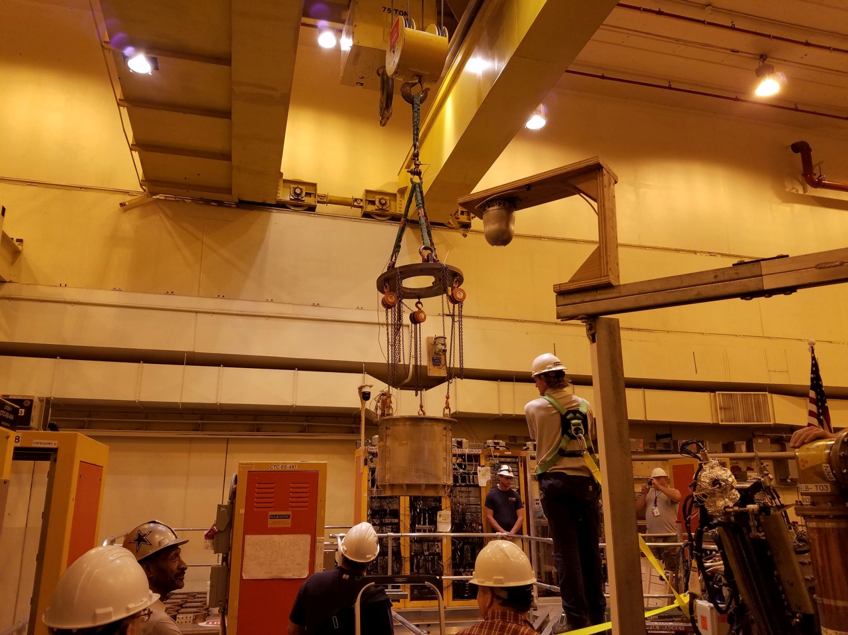
PF-1aU Was Removed on 8/24/16
Forensic Analysis of this Coil Discussed Later in the Talk

Slide 25
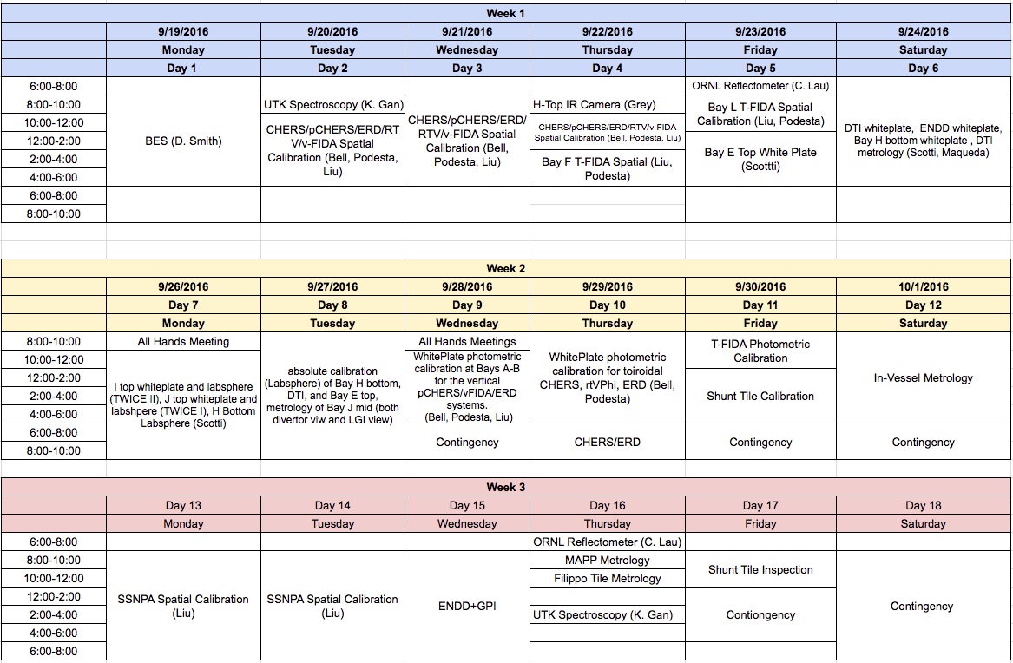
Diagnostic Calibrations Were Complete on the Advertised 3 Week Schedule
Thanks to everybody who worked together to make this efficient.

Slide 26
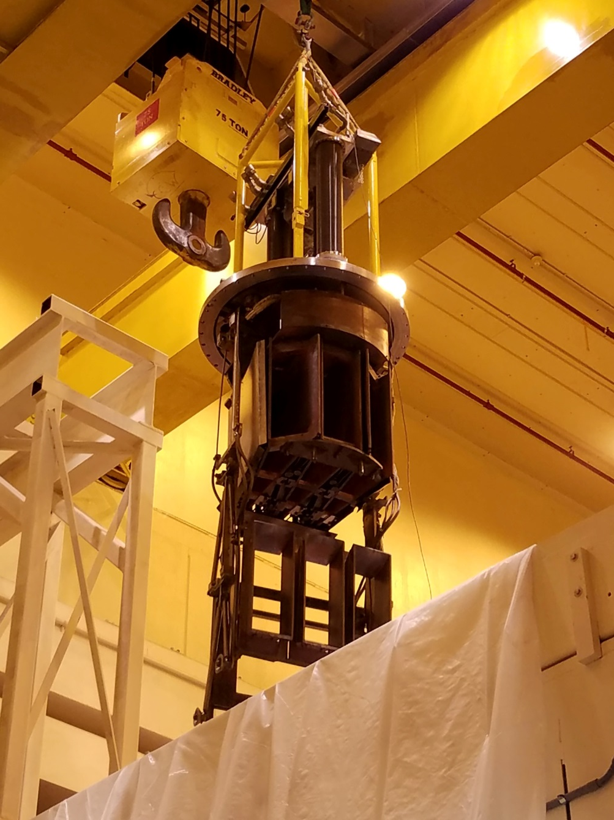
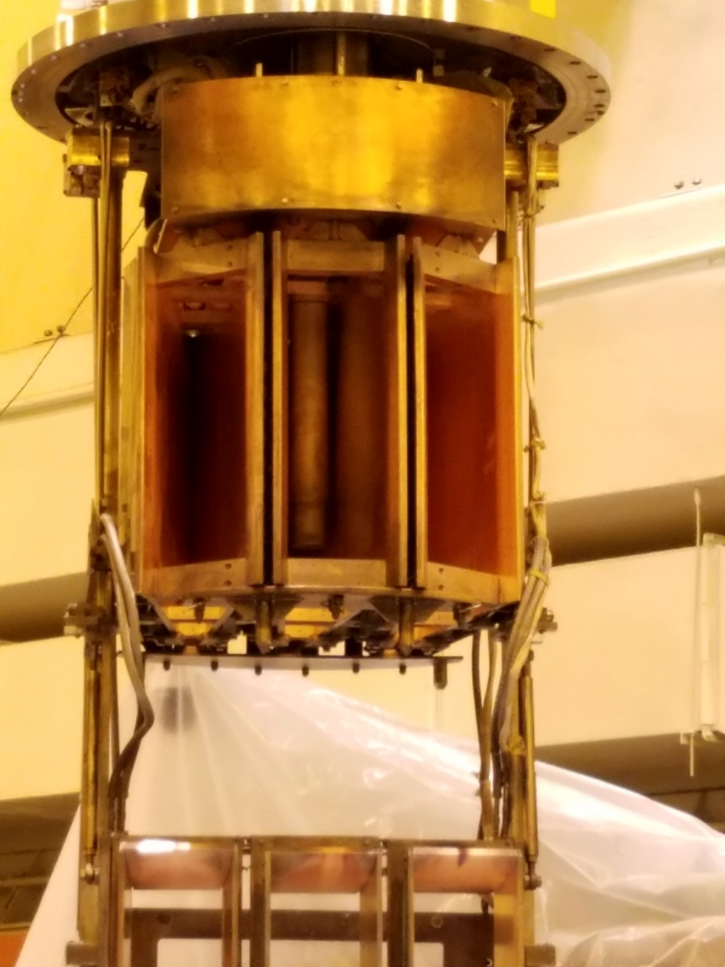
Calorimeter Removals Followed on 10/12 & 10/13

Slide 27
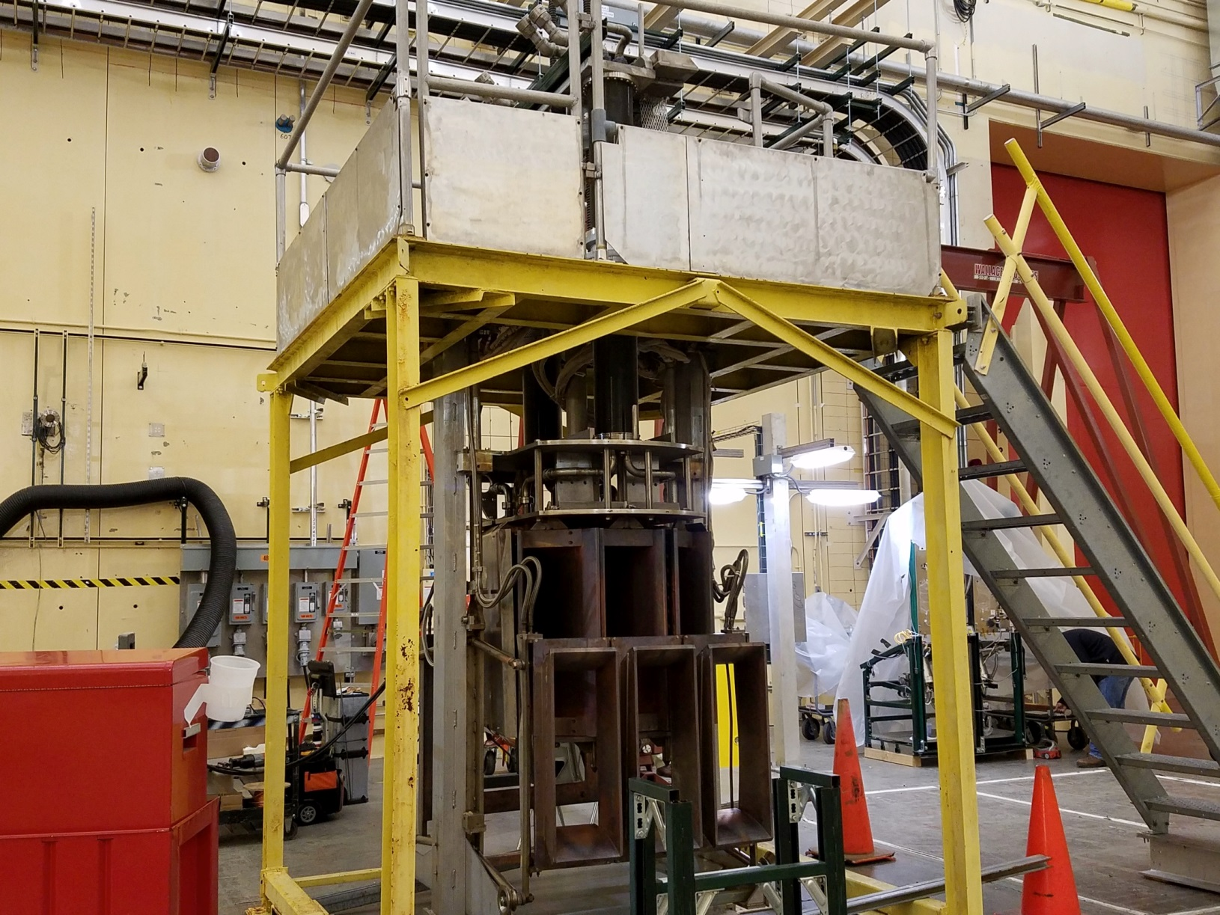
Calorimeters Are Now Located in TTC For Repairs
Calorimeter #1
Water leaks under repair
Calorimeter #2
Bearings and alignment have been repaired

Slide 28
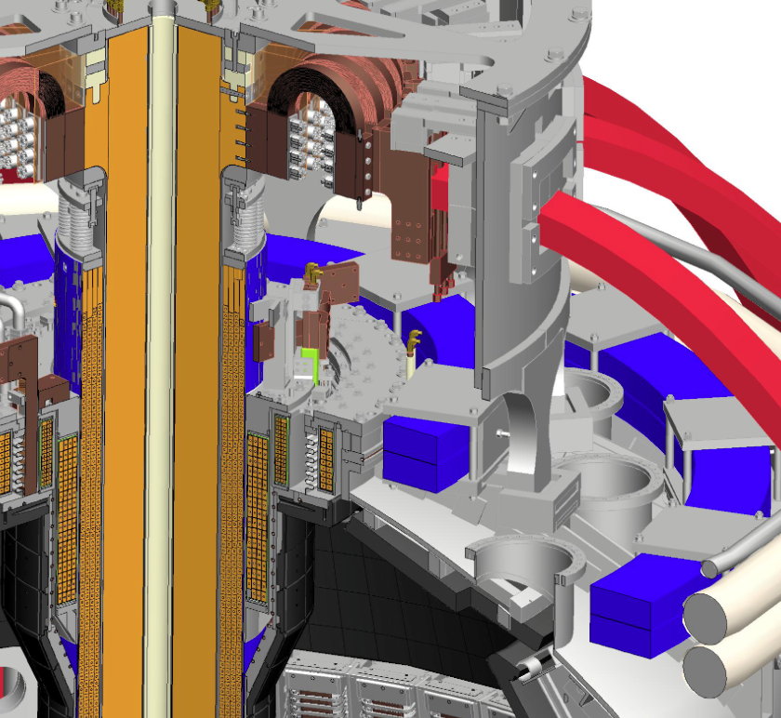
Ceramic Break Assembly Holds the Inner-Outer Vessel Insulator, the PF-1c Coil, and Various Connection Parts
Top Flange
Ceramic Break
PF-1c Coil

Slide 29
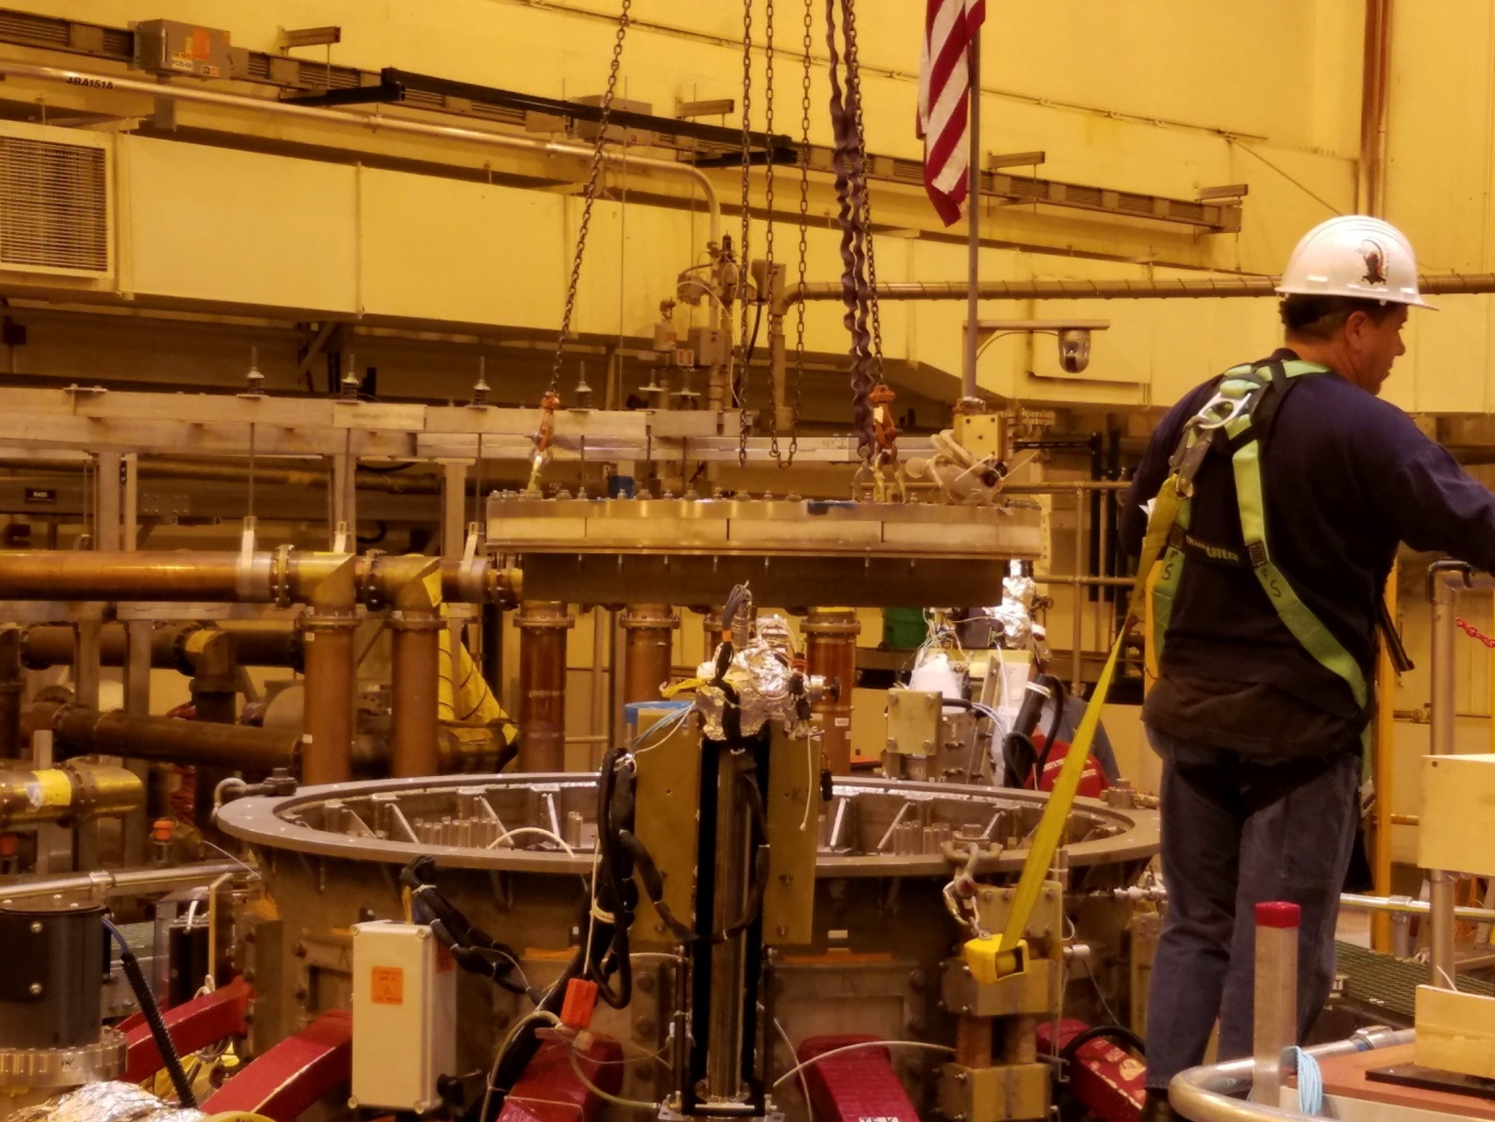
Upper Ceramic Break was Removed on 11/14/16

Slide 30
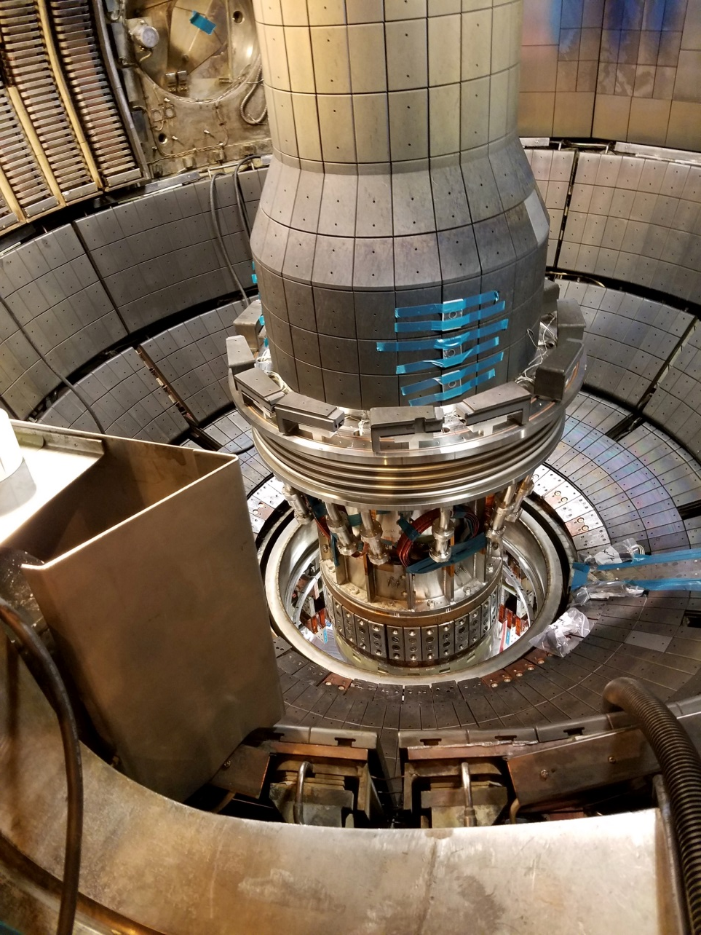
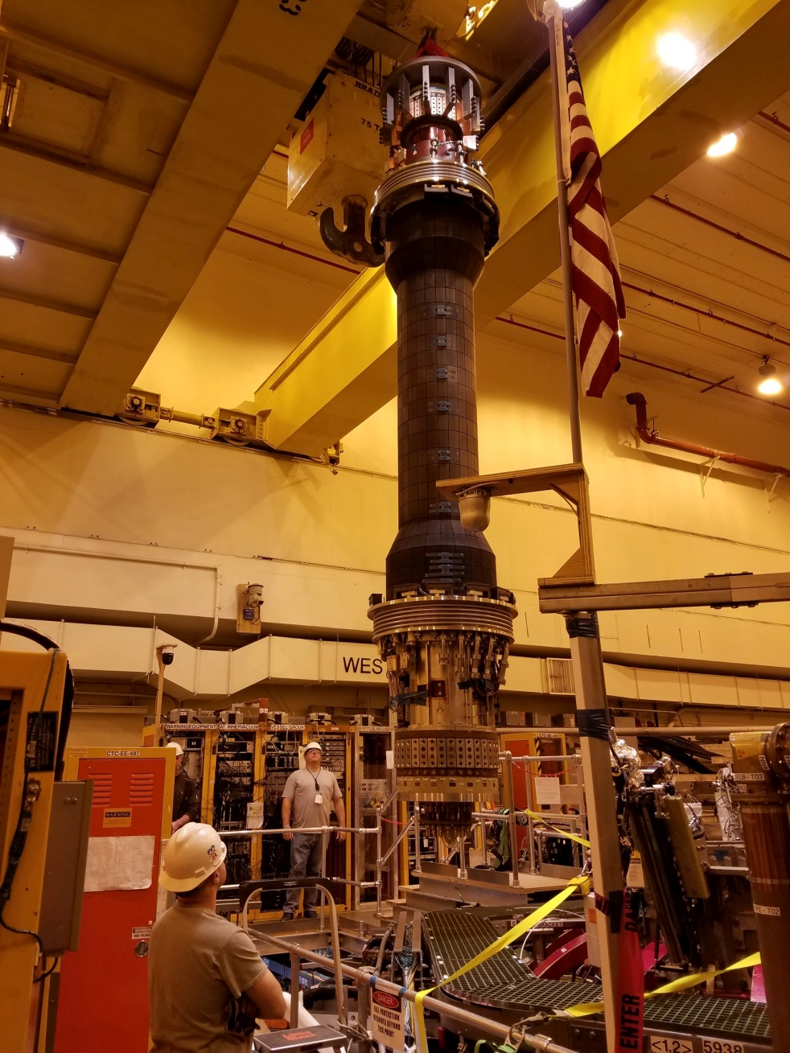
CS Was Removed on 11/17

Slide 31
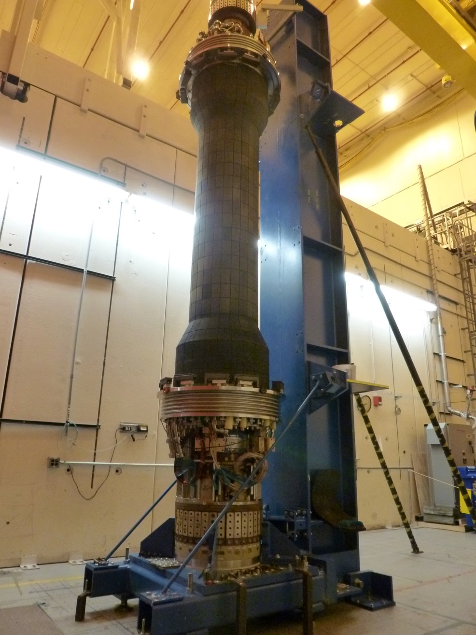
CS on Stand
This is what you will see if you go to the south high bay right now
Inspections showed that one of the PF-1aL leads was bent
Will be addressed as an extent-of-condition issue

Slide 32
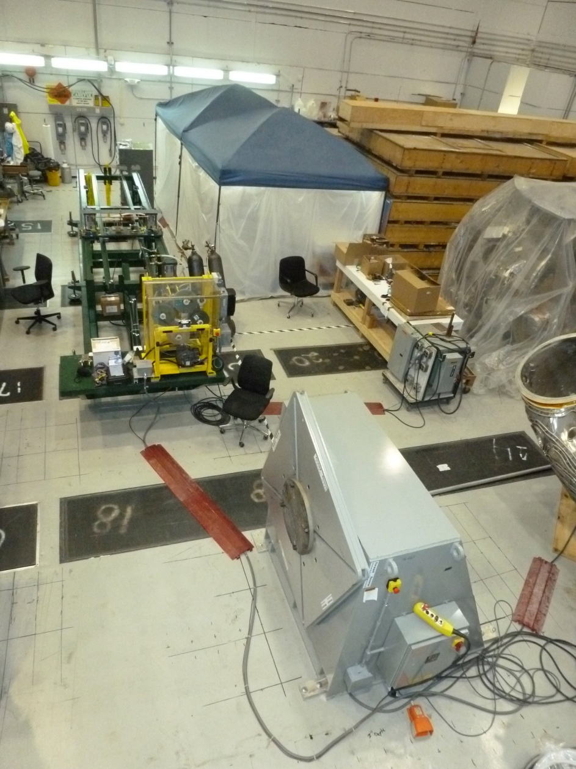
Coil Shop is Preparing to to Wind PF-1a Coils Following their FDR
Winding line set up in the C-Site Test Cell
Winding line uses parts from the OH coil winding system.
In process of making modifications to account for single conductor
OH was wound two in hand.
Conductor has arrived at PPPL
we are now working on SoW/RFP on the grit blasting and priming

Slide 33
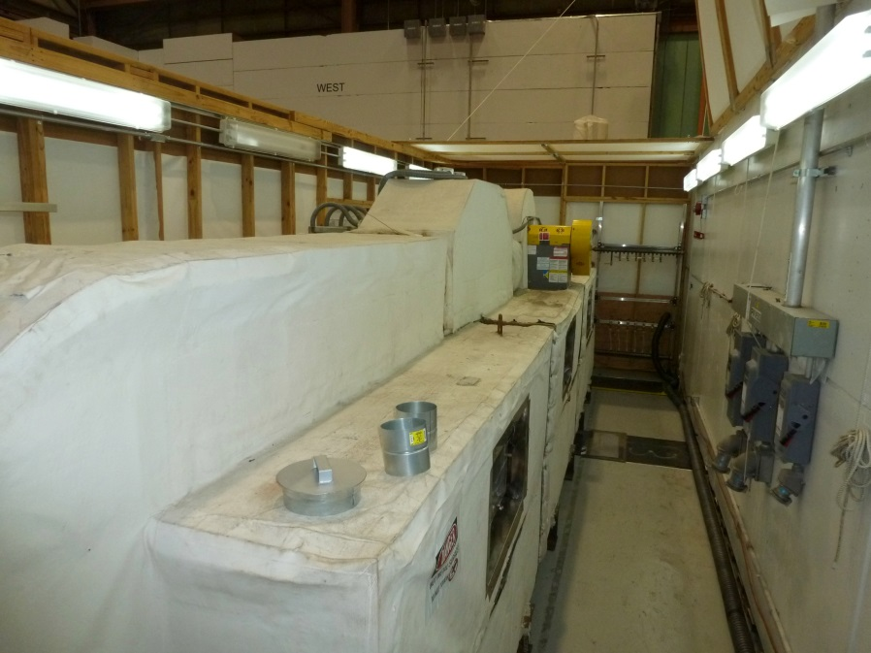
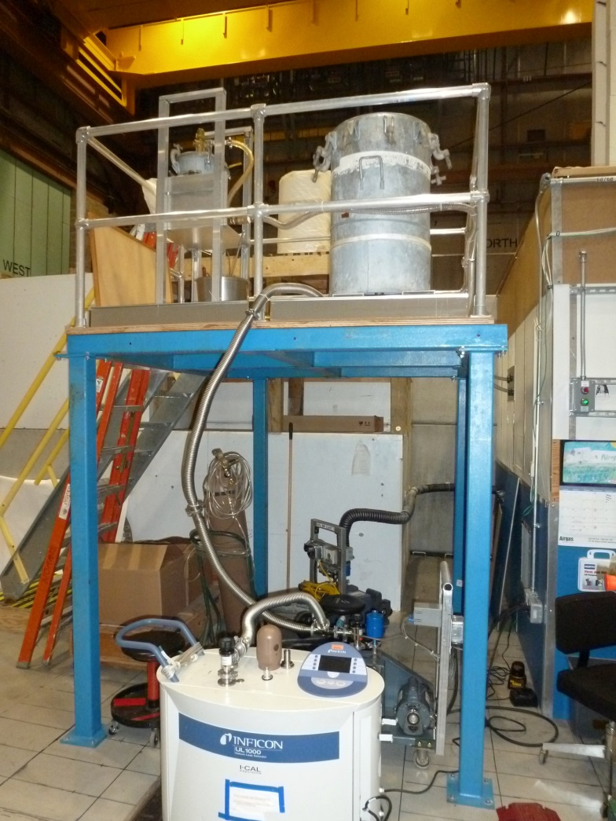
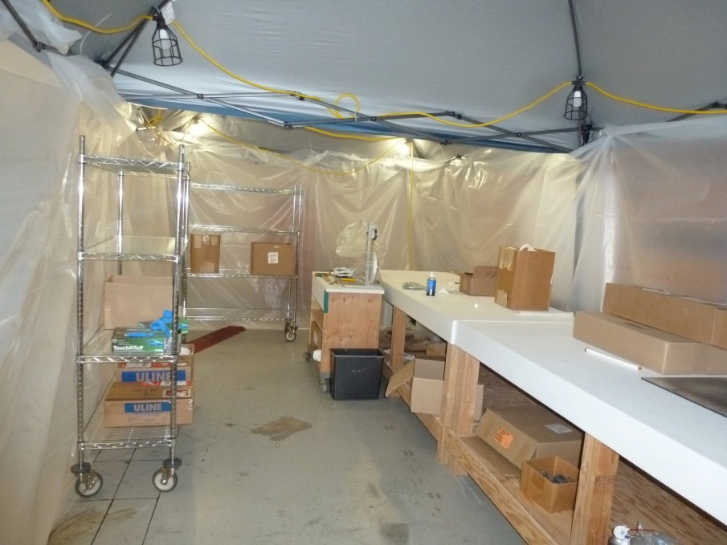
Considerable Progress Has Been Made in Preparation for Coil Fabrication
Setup for mixing the CTD-425 Epoxy/Cyanate Ester for VPI
Oven for curing following VPI
Clean room for preparing kapton/glass tape combination

Slide 34
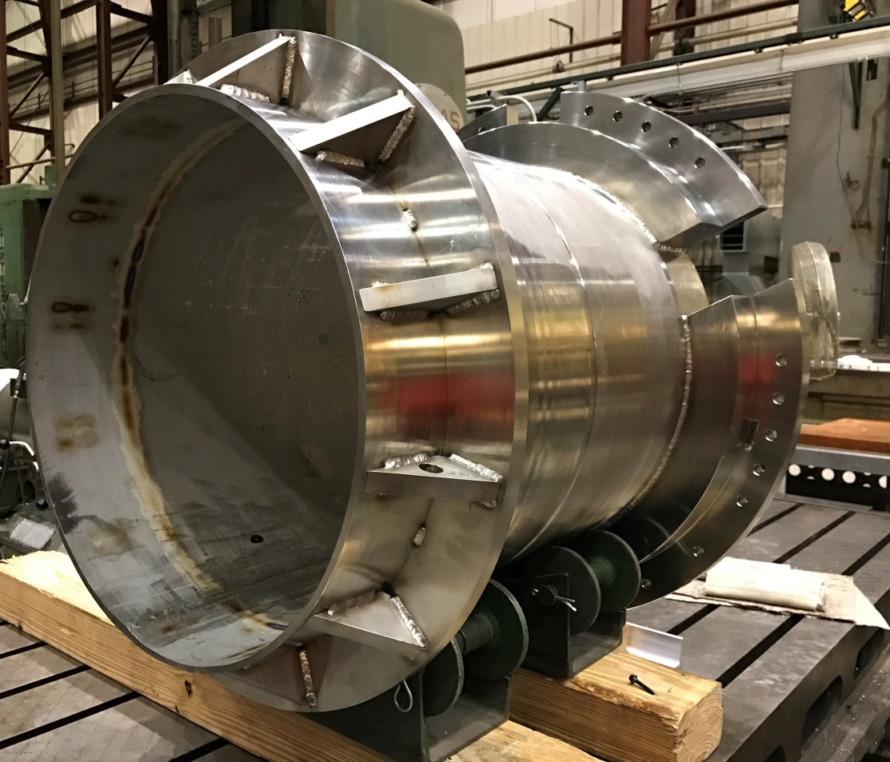
PF-1a Mandrels are Nearly Finished
PF-1aU Mandrel in Final Machining at Vendor, Shipping in ~2 Weeks
PF-1aL Mandrel Ready for Final Machining at the PPPL Shop

Slide 35
Near Term Activities
Week of December 5th: Begin installation of OH water heater in NTC
There will be significant access restrictions next Tuesday-Thursday due to some stair removals.
Week of December 5th: Remove casing from magnet bundle
Week of December 12th: Remove the PF-1aL coil

Slide 36
Outline of This Talk
Field work since the last team meeting
PF-1a forensic analysis
Metrology results
Other updates

Slide 37
Forensic Analysis Overview
Goal of Phase 1:
Identify locations with potential issue
Section the coil in ways that do not destroy regions of interest
Do visual, electrical, pressure, and vacuum testing on the section.
Desired to not destroy any faulted regions in the coil.
Have documented the results of these tests, discussed with various parties, developing next step plans.
Effort led by Joe Petrella and Irv Zatz
Lots of great help from tech shop, FCPC techs

Slide 38
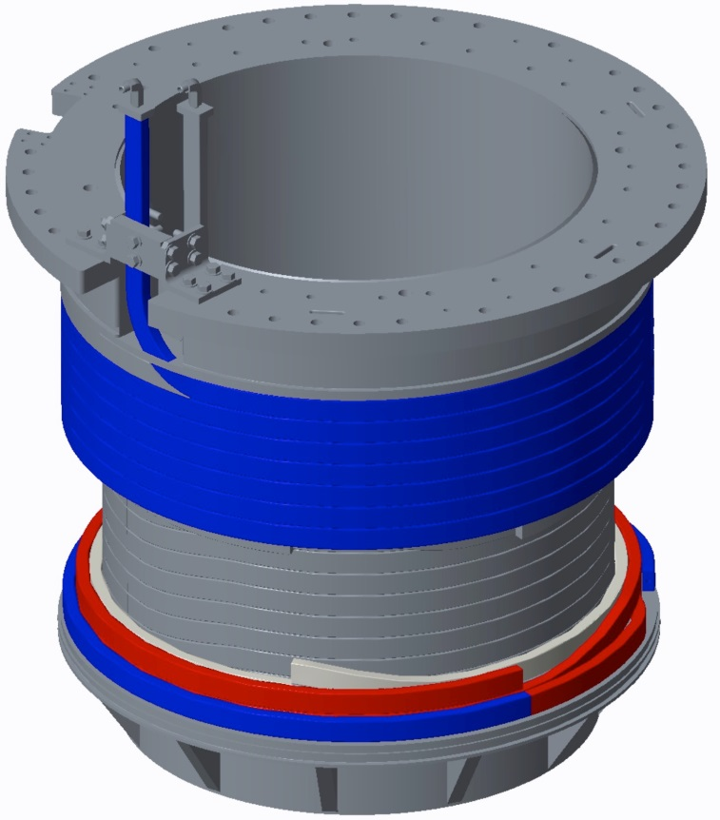
X-Rays Identified a Number of Anomalies (9/1/16, 9/8/16)
Image shows:
Joggles (semi-abrupt transitions in conductor height)
Region of apparent lower density
Other X-rays located all braze joints.

Slide 39
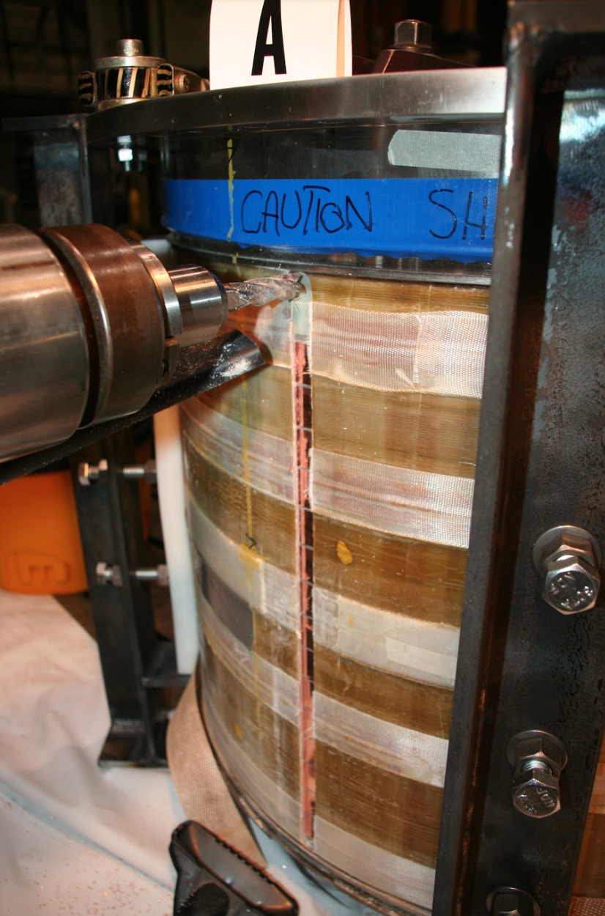
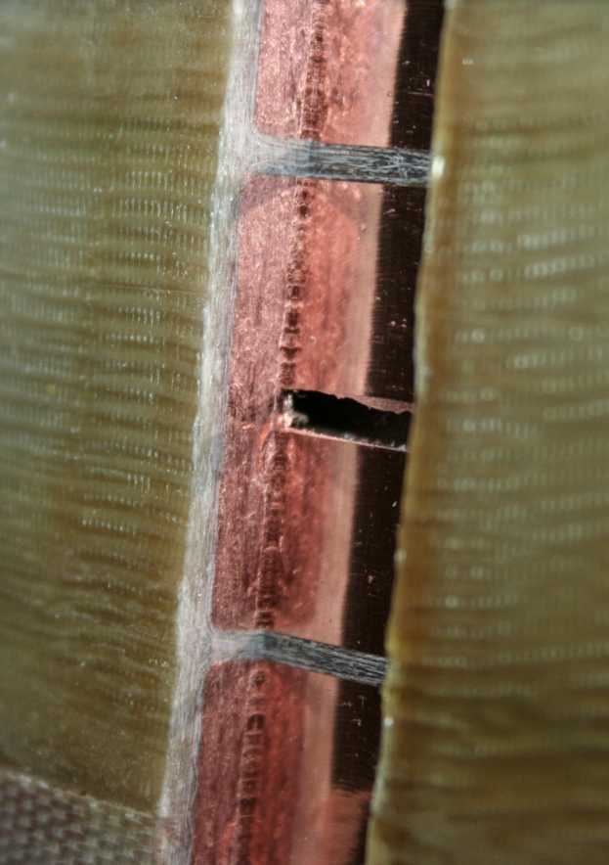
Coil Was Sectioned Using a Milling Machine
Section Planes Chosen to Avoid Any Regions of Interest
Detail of an Initial Cut

Slide 40
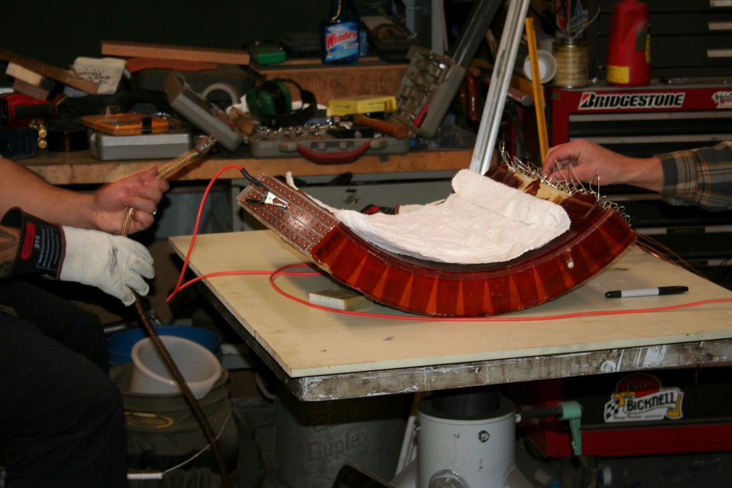
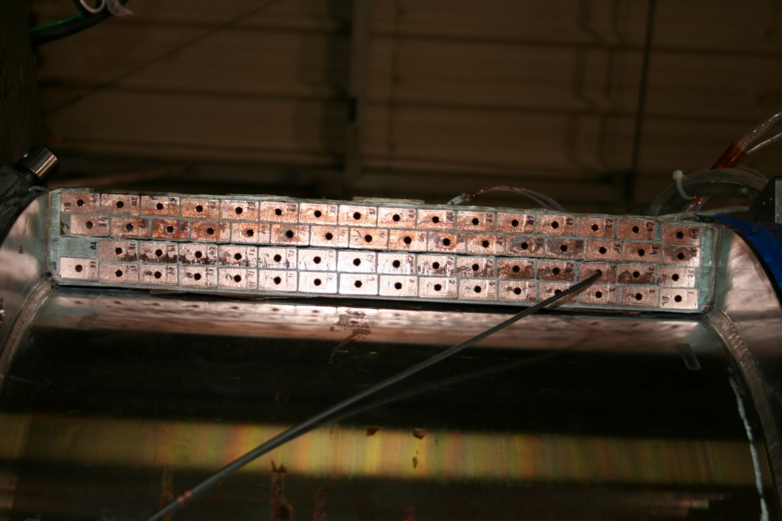
A Battery of Tests Was Performed on the Three Sections
Electrical Tests
Videoscope Tests
Also vacuum & pressure testing on individual channels

Slide 41
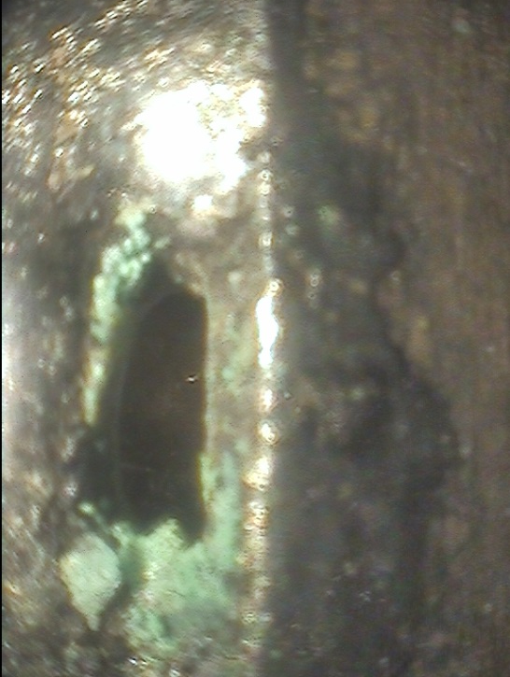
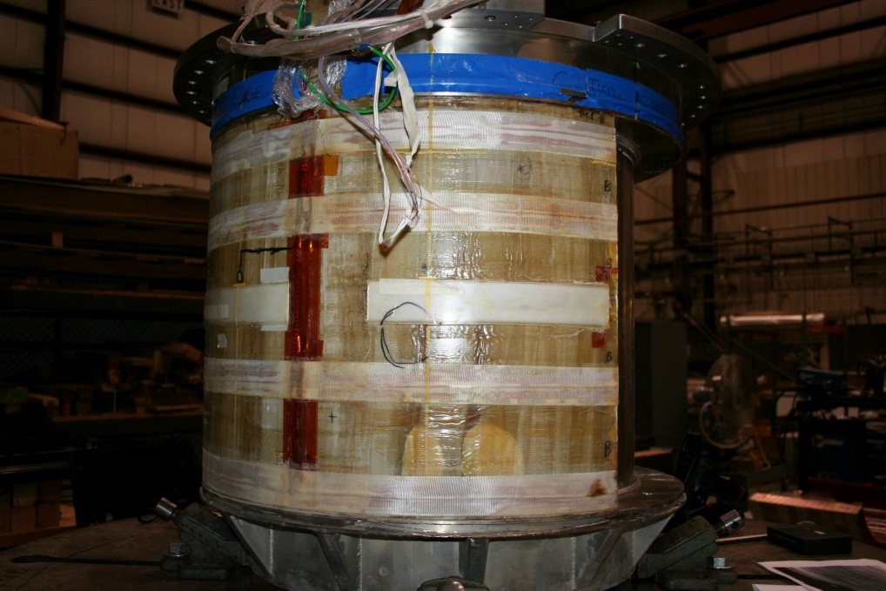
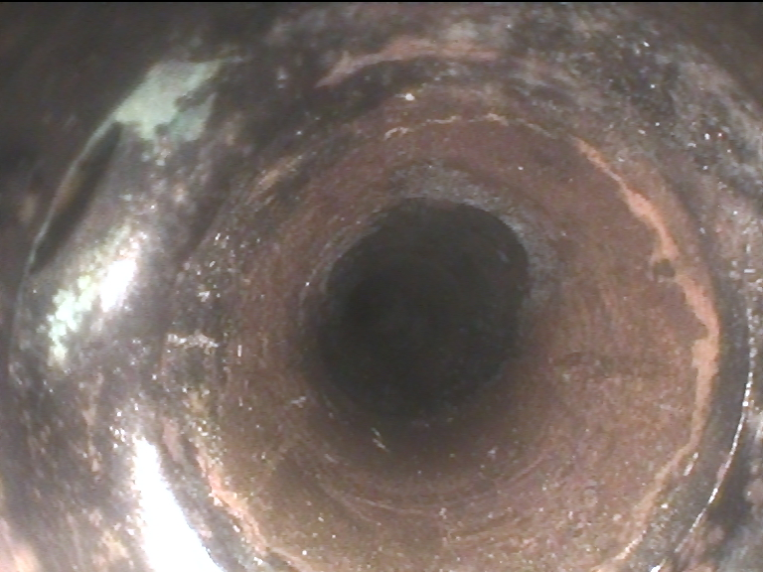
Anomalies Found Via Videoscope in Four Locations (1)
Section A-B, Layer 2, Row 3
Anomaly in Braze Joint
Braze joint passed pressure & vacuum test

Slide 42
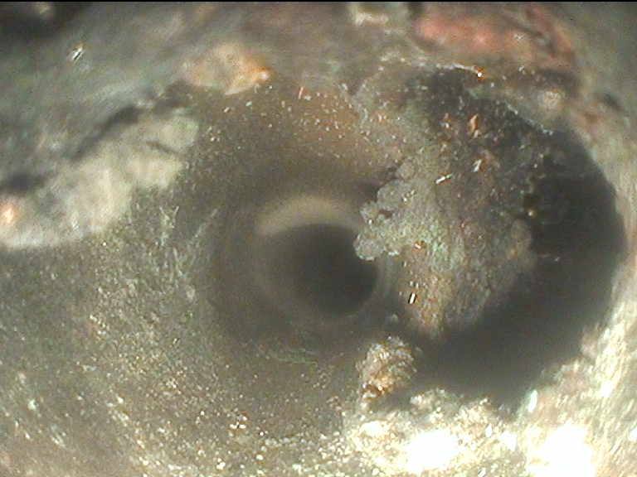
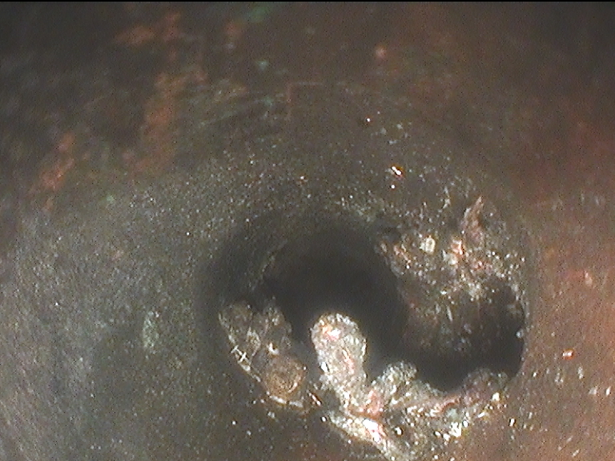
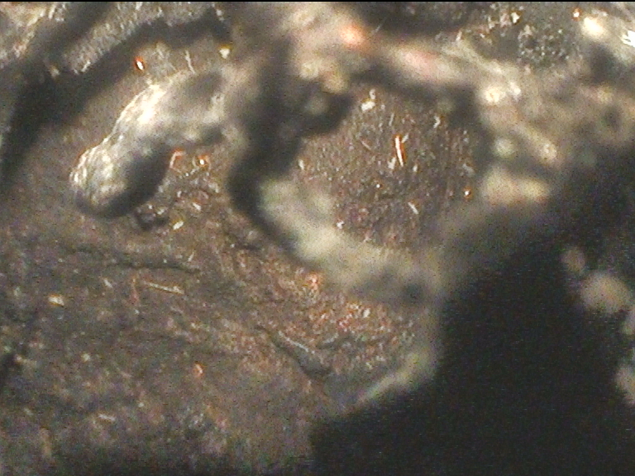
Anomalies Found Via Videoscope in Four Locations (2)
Section A-B, Layer 3, Row 9 Void Anomaly
Note: this turn did not hold vacuum
This is at the void location identified by X-rays
Side View

Slide 43
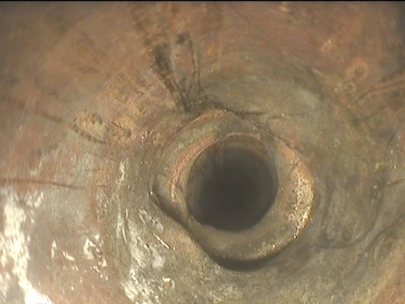
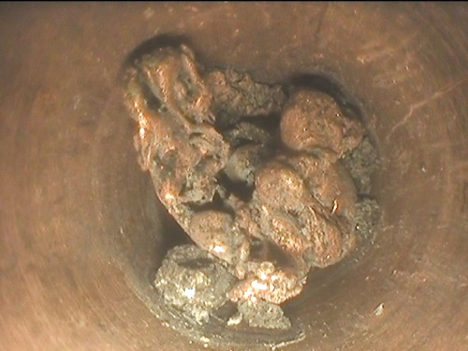
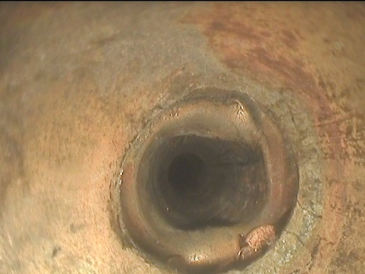
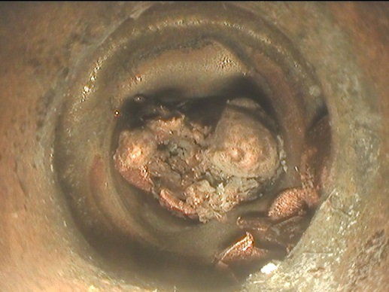
Anomalies Found Via Videoscope in Four Locations (3)
Section A-B, Layer 3, Row 13
Material Anomaly at Braze Joint
After Debris Removal
Before Debris Removal
Braze joint passed pressure & vacuum test

Slide 44
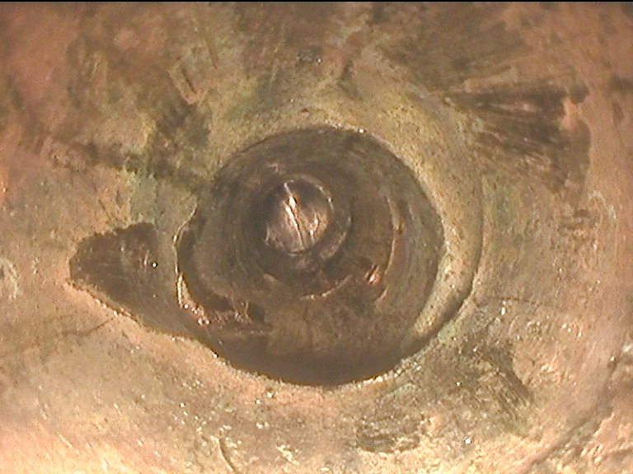
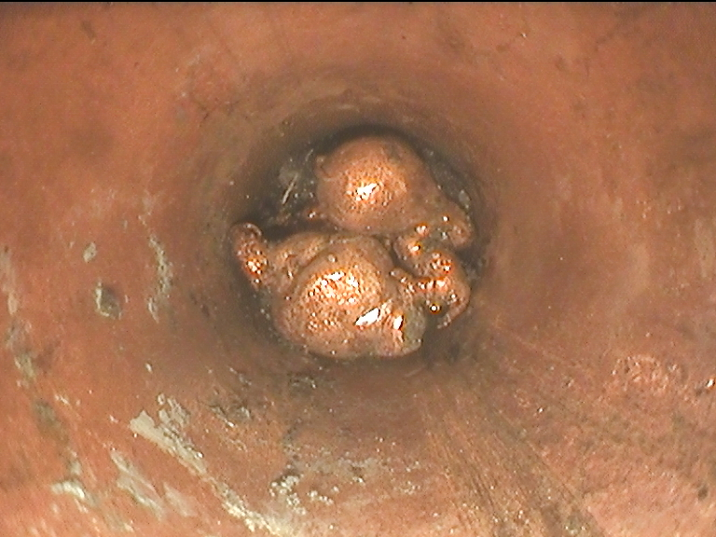
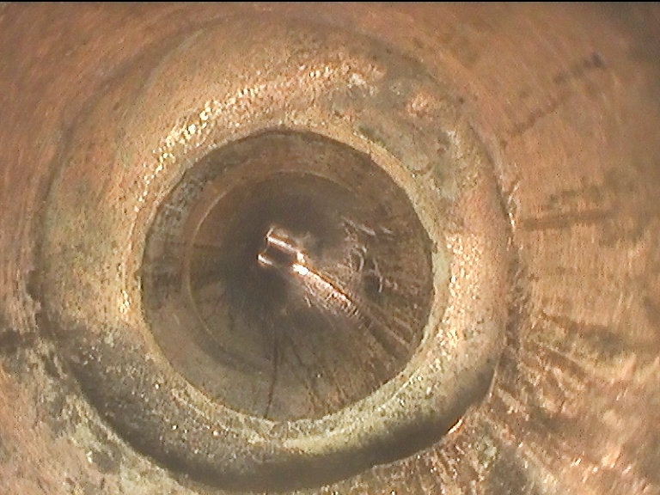
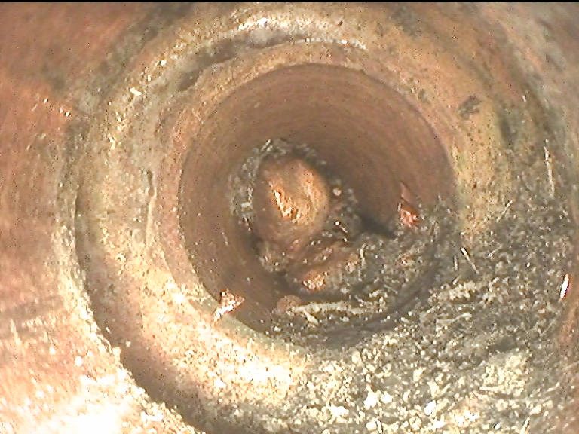
Anomalies Found Via Videoscope in Four Locations (4)
After Debris Removal
Before Debris Removal
Proximal to Braze Joint #1 (Section C-A, Layer 1, Row 15)
Material Anomaly at Braze Joint
Braze joint passed pressure & vacuum test

Slide 45
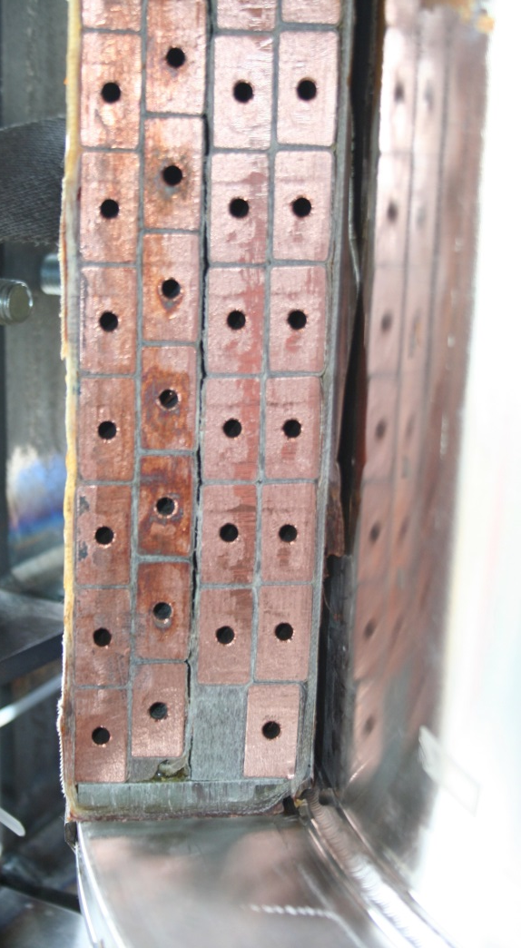
Other Observations
Some apparent separation between layers 2 & 3 at some locations
Large group of turns are electrically communicating
Approximately in red box region
Some regions of dry glass and imperfect VPI.
Preliminary Observations
The large breach is not near any braze joint, “joggle”, or lead…no clear cause yet determined.
Considering strategy for further disassembly of the section with the breach, following consultation with all interested parties
Region of Shorted Turns
Layer 2-3 Separation
Large Void on This Turn

Slide 46
Outline of This Talk
Field work since the last team meeting
PF-1a forensic analysis
Metrology results
Other updates

Slide 47
Precision Metrology Done on Magnetic Field Coils and Passive Structures
The performance of the plasma is maddeningly sensitive to small field errors.
The plasma behavior in NSTX-U indicates multiple error field sources
Need to identify and correct
Leading candidates: PF5, TF tilt
Use a precision probe (a ROMER Arm) to measure in-vessel components
Used rulers to measure from the vessel outer wall to the PF-5 ID & OD
Can thus assess the PF-5 (non-)circularity in the same frame
In-vessel ROMER Arm measurements
NSTX-U – October 2016
C. Myers

Slide 48
This Week: Tilt of the TF center rod
The TF bundle (gold) is slightly tilted inside the casing (black)
Performed metrology to quantify the tilt:
Laser tracker used to measure the tile surface (red) and the TF bundle (blue)
Note: tile surfaces previously located via ROMER arm
The tilt is ~5 mm over ~5 m
Seems small, but the plasma cares
The tilt can be corrected since the center stack is out for repairs.
Thanks to the crew that supported this activity
C. Myers

Slide 49
Outline of This Talk
Field work since the last team meeting
PF-1a forensic analysis
Metrology results
Other updates

Slide 50
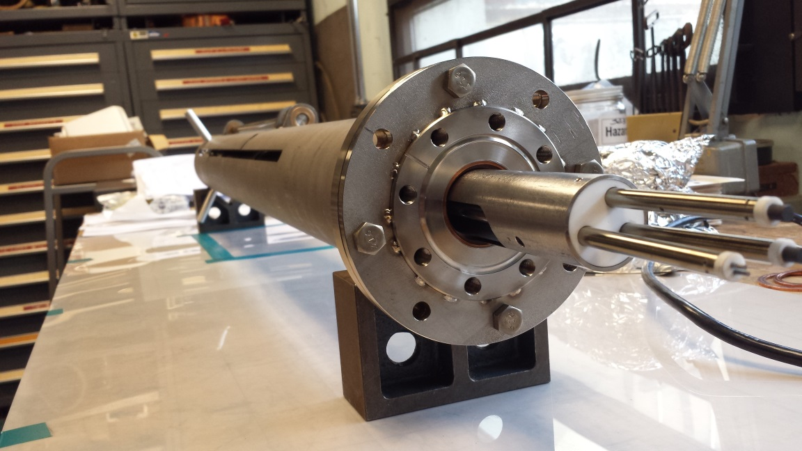
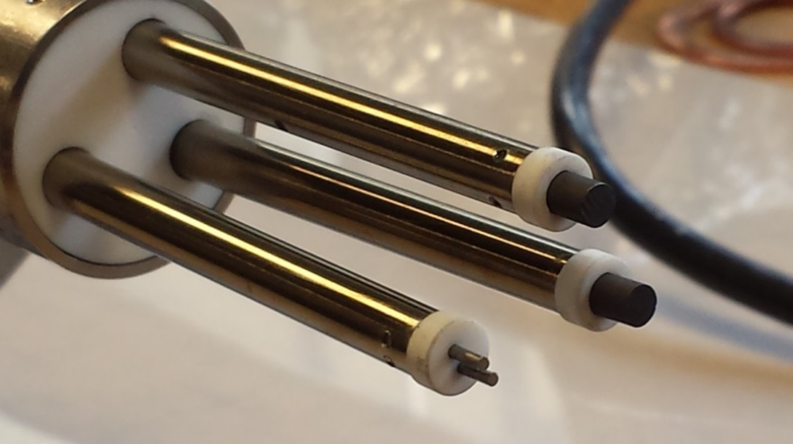
The RF Probe for Bay D has been assembled and vacuum prepped
ORNL-PPPL collaboration.
Based on existing RF probes.
Three tips – two single and one double.
Will be installed between antenna boxes at Bay D midplane.
Testing on RF test stand in January 2017.
Probe electronics installation is underway
Double probe
J. Hosea
Two single probes

Slide 51
Diagnostics and Boundary Physics Operations
Diagnostics
Continuing as possible with installations that were initiated during the run: FIReTIP, Charged Fusion Products, Divertor SPRED, others…
Working on a number of new systems to support the next run: Resistive Bolometers, High-k Scattering, PBLS,…
Boundary Physics Operations
Electrical installation for LITER Filling Station in TFTR Test Cell nearly complete
Initial lithium loading tests of porous reservoir for new upward evaporator (ULITER) concept completed
B. Stratton, R. Ellis, R. Kaita

Slide 52
Update: Tritium Contamination in the Vessel
On 10/10/16, some “debris” was collected from inside the vessel, placed on survey racks for release.
Flaking aerodag, some gold-toned flaking material on some diagnostics
Tritium contamination was found in that material.
All bioassays of potentially impacted employees showed no uptake.
Two significant follow-on actions:
Vessel went through two rounds of cleaning
Vessel is no longer contaminated
Access is restored, but with enhanced HP-related controls and requirements.
Investigative committee was formed, lead by C. Gentile
Also D. Niemenski, G. Ascione, S. Gerhardt
Investigation focused on both the first-entry process (9/16/16) and the material sampling process (10/10/16)
Report is in near-final form, will be delivered to the director’s office very soon.

Slide 53
Agenda
Masa (for Jerry) - Safety update
Rich, Jon, and Masa - NSTX-U organizational changes, new roles for Masa
Rich - Overview of Recovery Project
Stefan - Outage status, PF1AU forensics
Jon - Program status, collaborations, 5YP prep

Slide 54
Thank you for your many excellent NSTX/NSTX-U scientific contributions to IAEA and APS!
IAEA-FEC
3 invited
OV/5-2 - J. Menard, “Overview of First Results from NSTX-U and Analysis Highlights from NSTX”
FIP/2-5 - M. Ono, “Liquid Lithium Loop System to Solve Challenging Technology Issues for Fusion Power Plant”
EX/5-3 - A. Diallo, “Energy Exchange Dynamics across L-H Transitions in NSTX”
26 Posters
APS
4 invited
J. Berkery: Resistive wall modes stability forecasting in NSTX and NSTX-U
I. Goumiri: A plasma rotation control scheme for NSTX and NSTX-U
F. Ebrahimi: Plasmoid formation in the laboratory and large-volume flux closure during simulations of Coaxial Helicity Injection in NSTX
J. Menard: Impact of physics and technology innovations on compact tokamak fusion power plants
12 contributed orals + 1 ITER
50+ poster presentations
Now is time to start preparing for APS invited nomination ideas
REMINDER: Publish your results! (+ do outreach seminars)

Slide 55
NSTX-U Program Status / Schedule
Continue efforts with U.S. University Fusion Association (UFA) working group to enhance University opportunities on major facilities
Planning Jan 2017 PAC video-conference to update PAC on NSTX-U status
Likely PAC charge on how to broaden university participation in defining and choosing scientific goals for next 5YP
Spring 2017 – kick-off preparatory activities for development of next NSTX-U 5 year plan
Full PAC - late spring / summer 2017
Research Forum 2-3 months before next ops

Slide 56
Example enhanced collaborations for outage period Building upon and informing NSTX-U research
EAST: Edge physics, plasma material interactions (high-Z, Li)
Maingi + collaborators leading experiments this month / early next year
JET: Energetic particle studies and plasma ramp-down scenario development and modelling
Podesta, Darrow, Poli
KSTAR: Core MHD and rotation physics, plasma control
Sabbagh (Columbia) + group, J-K Park, J-W Ahn (ORNL)
MAST-U: Control, scenario modelling supporting 1st plasma
Battaglia (+Boyer) tentatively planning visits/stays summer/fall 2017
W7-X: 3D confinement and stability
Lunsford - alternate wall conditioning using boron powder dropper
WEST: start-up, RF physics, high-Z PMI, real-time wall protection
Mueller going in spring, Reinke (ORNL) in fall, possibly PPPL RF physicists
LAPD at UCLA - RF coupling and heating physics, cavity modes
R. Perkins leading RF development efforts
HL2A in China offering significant run-time
Y. Ren will present capabilities/opportunities on 12/12

Slide 57
DIII-D National Campaign proposals assessed by NSTX-U
3+1 week guideline for campaign (4-day weeks)
Solicited & received proposal synopses from team
Run-time over-subscribed by factor of two to three
Boundary: 17 proposals, 17 days req.
Core: 12 proposals, 12 days req.
Integrated Scenario: 8 proposals, 7.5 days req.
Prioritization process
NSTX-U recommendations: Based on near-term NSTX-U goals, well-defined ideas that require minimal operational development, Early Career considerations
Break into Priority 1 (12 days), Priority 2 (4 days)
Final selections thru discussions with GA, FFCC this month
Questions or comments? See Stan + Steve Sabbagh

Slide 58
Note on FES-funded collaborators
FES recently requested research plans for NSTX-U funded collaborators for Outage period
FES will share plans with NSTX-U management
Will allow us to look for possible synergies, opportunities to field larger and more coordinated and impactful teams
Should feel free to talk to / brainstorm with NSTX-U management on collaboration ideas

Slide 59
Notes on 5 year plan (5YP) process
May have only 10 run weeks (mostly commissioning) for FY14-18 5YP
FY19-23 plan due spring 2018, peer-reviewed summer 2018
Begin brainstorming early 2017, then writing in summer / fall
Need to generate research goals, prioritize facility enhancements
Mission Elements and Present 5 Year Plan 5 Highest Priorities
Explore unique ST parameter regimes to advance predictive capability - for ITER and beyond
Study energetic particle physics prototypical of ITER/FNSF burning plasmas
Understand energy confinement and MHD stability at high normalized pressure
Develop solutions for PMI challenge
Dissipate high edge heat loads using expanded magnetic fields + radiation
Compare performance of solid vs. liquid metal plasma facing components
Advance ST as possible FNSF / DEMO
Form and sustain plasma current without transformer for steady-state ST
Are these still the best missions and priorities for the next 5 year plan?

Slide 60
Thank you!
Any questions?

