Slide 1




NSTX-U
Supported by
Fast-Ion-D-Alpha and Solid-State NPA Diagnostics for NSTX-U
Coll of Wm & Mary
Columbia U
CompX
General Atomics
FIU
INL
Johns Hopkins U
LANL
LLNL
Lodestar
MIT
Lehigh U
Nova Photonics
ORNL
PPPL
Princeton U
Purdue U
SNL
Think Tank, Inc.
UC Davis
UC Irvine
UCLA
UCSD
U Colorado
U Illinois
U Maryland
U Rochester
U Tennessee
U Tulsa
U Washington
U Wisconsin
X Science LLC
Culham Sci Ctr
York U
Chubu U
Fukui U
Hiroshima U
Hyogo U
Kyoto U
Kyushu U
Kyushu Tokai U
NIFS
Niigata U
U Tokyo
JAEA
Inst for Nucl Res, Kiev
Ioffe Inst
TRINITI
Chonbuk Natl U
NFRI
KAIST
POSTECH
Seoul Natl U
ASIPP
CIEMAT
FOM Inst DIFFER
ENEA, Frascati
CEA, Cadarache
IPP, Jülich
IPP, Garching
ASCR, Czech Rep
W.W. Heidbrink, D. Liu, A. Bortolon
UC Irvine
NSTX-U Diagnostic Plan Meeting
July 26, 2012

Slide 2
Multiple Fast Ion Diagnostics are Needed to Constrain/Invert Fast Ion Distribution Function
Goal: measure beam ion distribution in NSTX-U
→ transport of beam ions due to MHD and Alfven eigenmode activity
→ interaction between high-harmonic fast waves and beam ions
→ neutral beam current drive
Different fast ion diagnostics weight phase space differently
FIDA: sensitive to a swath in velocity space
NPA: very localized in pitch;
ssNPA: measure trapped fast ions at different radii; fast time resolution, no energy resolution
E||B NPA: diagnose co-passing fast ions; excellent energy resolution
Neutron: strongly weighted toward high energy fast ions; insensitive to pitch angle; volume averaged
Charged fusion product diagnostic: strongly weighted toward high energy fast ions; spatial profile
Fast ion loss detector: lost fast ions; narrow in pitch
…

Slide 3
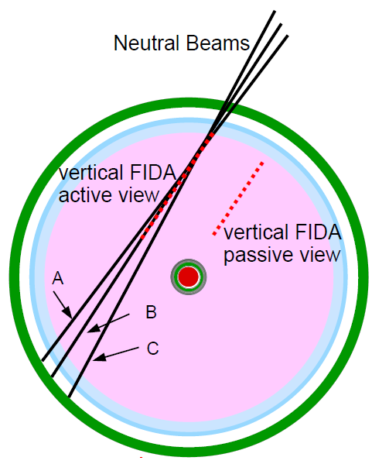
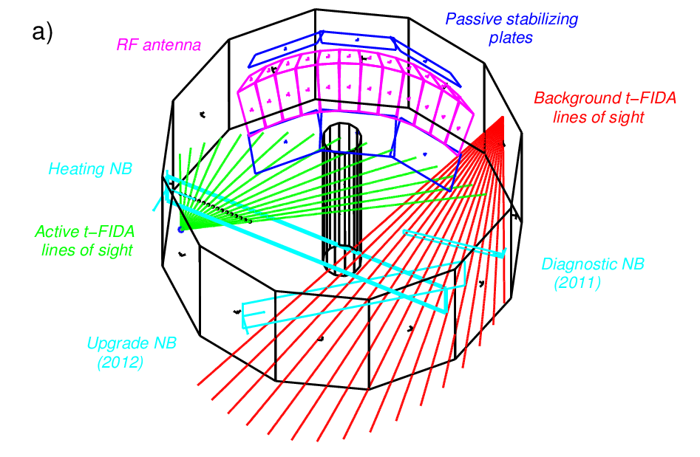
Both Vertical and Tangential FIDA Diagnostics are Nearly Ready for Operation in NSTX-U
Vertical FIDA
Tangential FIDA
Vertical and tangential FIDA diagnostics consist of two systems
- spectrometer-FIDA, full Dα spectrum , 16 channels R=0.86-1.66m, 100Hz
- band-pass filter-FIDA, 3 channels at R=1.0, 1.2, 1.4m, 50kHz
The vertical FIDA diagnostic has worked routinely since 2008.
The new tangential FIDA diagnostic was installed in 2011, but didn’t collect any data due to the failure of toroidal field coil.
During the NSTX upgrade construction, FIDA fibers & optics are protected and secured.

Slide 4
Minor Improvements Needed for FIDA Diagnostics
Input lens
BP filter
Acquire a shutter for the camera in the tangential FIDA system; (Liu, 2013)
Install a fiber patch panel for the vertical FIDA system; (Liu, 2013)
Reduce strayed cold D-alpha light by replacing the neutral density filter with a narrow band (~2nm) notch filter? Depending on the availability and cost.
(Liu, 2012, do a survey of such notch filter and purchase it if affordable)
Transmission
grating
Fibers from
NSTX
Curved
Entrance Slit
Neutral density filter
Double Lens
Demagnifier
Chopper
CCD

Slide 5
Pre-design of New Solid-State Neutral Particle Analyzer
Goal: Measure trapped fast ions at several radial locations
Same concept as the ssNPA in NSTX and DIII-D (i.e. using silicon photodiode to detect CX neutrals directly)
Work in current mode
→ fast time response (>100kHz), but no energy resolution
Could incorporate pulse-counting mode to get some energy resolution
Select radial viewlines on the mid-plane
→ minimize path length of escaping CX neutrals
5 chords intersect a NB at different radii, 2 chords miss any NBs
→ separate active and passive CX signals and obtain spatial profile
Use pair of “active” and “blind” detectors for EM noise subtraction

Slide 6
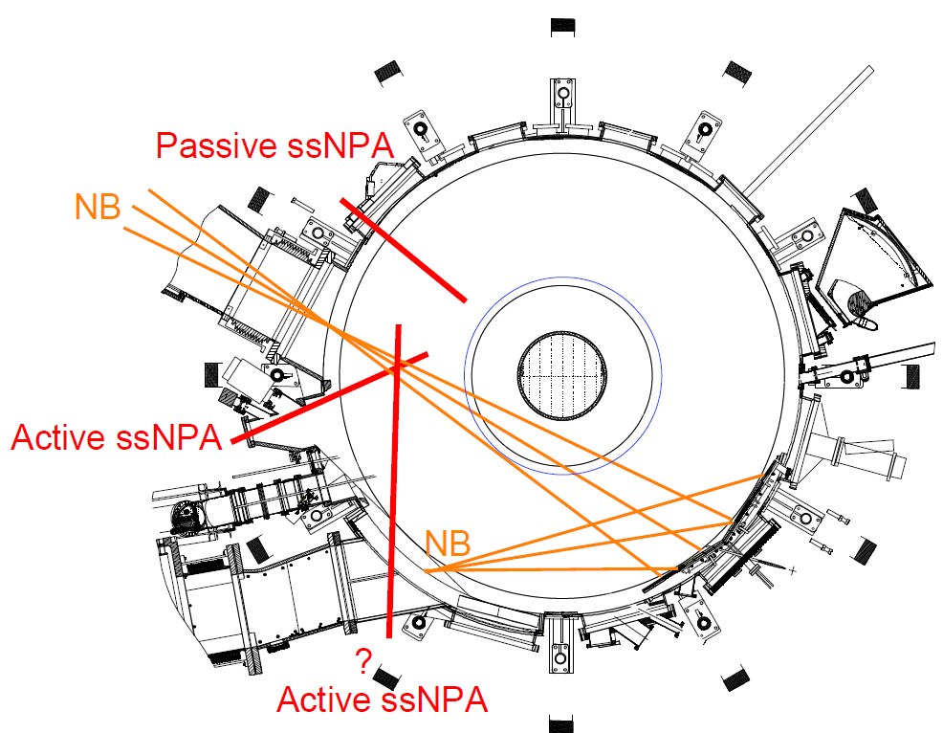
Ports Identified for Solid-State Neutral Particle Analyzer
Available
If possible, another chord measures co-passing beam ions.

Slide 7
Overall Schedule
Vertical and tangential FIDA diagnostics
minor improvements i.e. shutter, fiber patch panel , notch filter
reinstallation of fibers on NSTX-U; calibration;
data acquisition and data analysis tool
solid-state NPA
2012-2013 Spring ports selection, concept design
2013 Spring-2014 fabrication and testing;
2014 installation;
data acquisition and data analysis tool
Modeling
conversion of synthetic diagnostic code FIDAsim from IDL to Fortran
2013-2014 a reduced model for FIDA emission analysis (Heidbrink and Grierson)
2012-2014 fast ion distribution inversion project (Heidbrink, Salewski, Stagner)

