Slide 1


A Charged Fusion Product Diagnostic for NSTX
W.U Boeglin and R. Valenzuela-Perez
Department of Physics, Florida International University ^{a)}
D. Darrow
Princeton Plasma Physics Laboratory ^{b)}
This work is supported by US Department of Energy contract numbers (a) DE-SC0001157 and (b) DE-AC02-09CH11466

Slide 2
Goal of the Diagnostic:
Obtain time-dependent information on the proton emission profile
Achieve a time resolution down to 1-2 ms
Extract neutral beam ion density profile
New data on fast ion transport
New data on instabilities driven by NB/plasma interaction
Complementary data for other fast ion loss diagnostics
Explore the potential for other ion detection:
³He, ³H
Rev. Sci. Instrum. 81, 10D301 (2010)

Slide 3
Principle
detect protons from:
T_{p} = 3.02 MeV
T_{T} = 1.01 MeV
p = 75 MeV/c
dominated by neutral beam and plasma ion interactions
Advantage at NSTX and MAST:
proton is not confined in the magnetic field of NSTX/MAST
proton frequently does not complete a full gyro orbit before it exits the plasma
proton trajectory similar to a view chord of an X-ray camera
observed proton rate is a measure of the integrated emissivity along the view path
Proton measurements have been carried out previously:
W.W.Heidbrink, J.D.Strachan, Rev. Sci. Instrum, 56, 501 (1985)
J.D. Strachan, Rev. Sci. Instrum., 57, 1771 (1986)

Slide 4
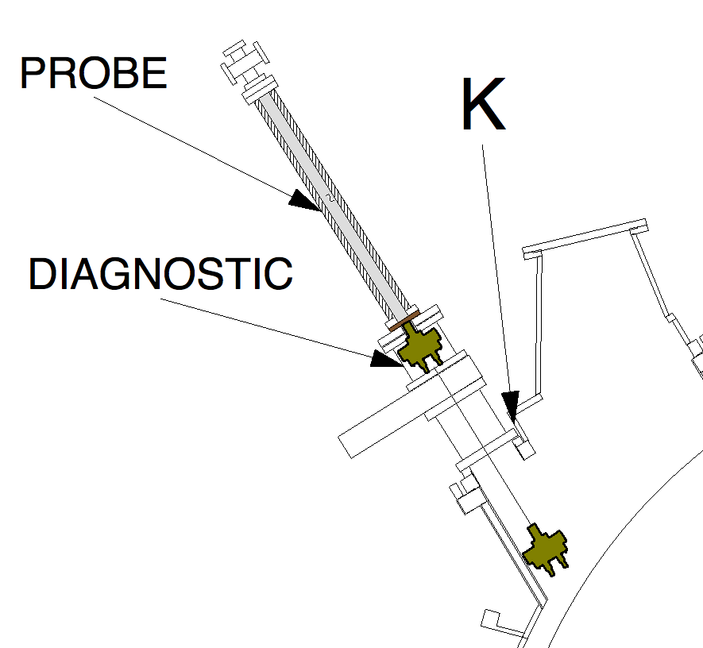
Original Prototype
Prototype: 2 detectors
Flexible orientation around 3 axes
Study signals and rates
Optimize detector arrangement and location for full array of 8 detectors
Location: Bay K
Mounted on moveable probe shaft
IN-position: R=1.7m, Z = 0.286m
But then NSTX broke
Detector at R = 1.7m

Slide 5
Test at MAST
4 channel system
Detector fixed, array can be moved radially
To be tested in the November campaign.

Slide 6
16 Channel System for NSTX-U/MAST
2 units of 8 channels each
2 fixed units
One fixed, one on probe drive (with axial rotation)
Various collimator arrays possible, can be optimized for
specific experiments
Allows for determination of shifts of the profile in 2 dimensions
Estimated orbit bundles
for NSTX-U
B scaled by a factor of 2

Slide 7
Profile Reconstruction
Orbits cross central plasma region
Act like ‘curved’ sight chords in X-ray tomography

Slide 8
Compact 8 channel module

Slide 9
Summary
New data on proton emissivity profile
(similar to neutron detector)
2D information accessible
Good time resolution
Access to the plasma core at high density and large current
Complements current fast ion diagnostics
Will be applying via:
Diagnostic Systems for Magnetic Fusion Energy Sciences
Funding Opportunity Number: DE-FOA-0000744
Practical experience this Fall at MAST (hopefully)

Slide 10
Backup: DAQ setup

