Slide 1




NSTX-U
Supported by
NSTX-U Project Status and
5 Year Plan Facility Overview
Culham Sci Ctr
U St. Andrews
York U
Chubu U
Fukui U
Hiroshima U
Hyogo U
Kyoto U
Kyushu U
Kyushu Tokai U
NIFS
Niigata U
U Tokyo
JAEA
Tsukuba U
Hebrew U
Ioffe Inst
RRC Kurchatov Inst
TRINITI
NFRI
KAIST
POSTECH
SNU
ASIPP
ENEA, Frascati
CEA, Cadarache
IPP, Jülich
IPP, Garching
ASCR, Czech Rep
Columbia U
CompX
General Atomics
FIU
INL
Johns Hopkins U
LANL
LLNL
Lodestar
MIT
Nova Photonics
New York U
ORNL
PPPL
Princeton U
Purdue U
SNL
Think Tank, Inc.
UC Davis
UC Irvine
UCLA
UCSD
U Colorado
U Illinois
U Maryland
U Rochester
U Washington
U Wisconsin
Masa Ono
for the NSTX-U Team
NSTX-U PAC 33 Meeting
February 19 - 21, 2013

Slide 2
Talk Outline
FY 2012-13 Operations Summary and Status
NSTX Upgrade Project Overview
NSTX-U Facility and Diagnostic Five Year Plans
Budget
Summary

Slide 3
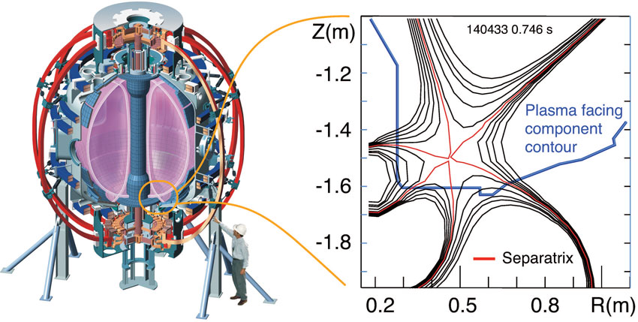
NSTX-U Research Team Has Been Scientifically Productive
Very Active in Scientific Conferences, Publications, and Collaborations
NSTX “Snow-flake Divertor” team won the R&D 100 Award for 2012! Also featured in Oct. 2012 FES Science Highlights
NSTX well represented at PSI, High Temperature Plasma Diagnostic, and EPS meetings.
Strong presentations at the IAEA. Most IAEA Presentations (30) given by the NSTX-Team. Prominent contributions to the post-deadline IAEA papers.
Image courtesy of Vlad Soukhanovskii
The National Spherical Torus Experiment Device at Princeton Plasma Physics Laboratory (left), and a schematic of magnetic field lines in the snowflake divertor configuration (right).
Strong presence at fall APS with 63 presentations. Three NSTX APS-DPP press releases are available on the web.
All of the FY 2012 milestones completed on schedule.
Significant collaboration research contributions are being made in diverse science areas by the NSTX-U research team. A summary is available on the web: http://nstx.pppl.gov/DragNDrop/Collaboration/
NSTX-U research team published 52 papers in refereed journals.

Slide 4
Engineering and Research Operations Activities
In Preparation for the NSTX-U Operations
Upgrading the Plasma Control System (PCS) for NSTX-U.
  Upgrading to new 32-core computer.
  Switching to 64 bit real-time Linux with advanced debugging tools.
  Upgrading shape-control codes for new divertor coils, gas injector controls for new/additional injectors, additional physics algorithms
  Improving the real-time data-stream.
  Assisting with development of a new Digital Coil Protection System (DCPS).
Upgrading HHFW antenna feedthroughs for higher disruption forces.
Boundary Physics Operations
  Improving the PFC geometry in the vicinity of the CHI gap to protect the vessel and coils.
  Developing an upgraded Boronization system.
  Developing lithium technologies (granule injector, upward LITER).
Diagnostic Upgrades
  Fabricating new port covers to support high-priority diagnostics.
  Installing additional, redundant magnetic sensors.
  Upgrading diagnostics: Bolometry (PPPL), ssNPAs, spectroscopy (collaborators)
Physics & Engineering Operations
  Replacing electronics that control & protect rectifiers.
  Upgrading the poloidal field coil supplies to support up-down symmetric snowflake divertors.
  Developing PF null/breakdown scenario w/ new CS.

Slide 5
Talk Outline
FY 2012-13 Operations Summary and Status
NSTX Upgrade Project Overview
NSTX-U Facility and Diagnostic Five Year Plans
Budget
Summary

Slide 6
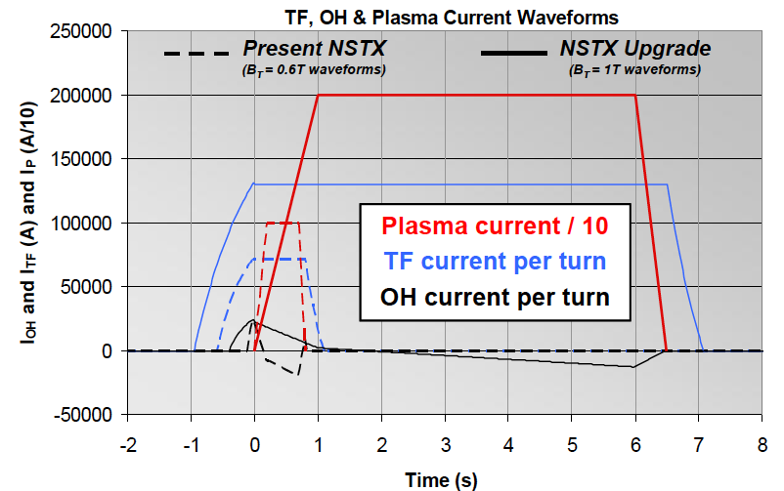


Substantial Increase in NSTX-U Device / Plasma Performance
Higher performance requires facility / infrastructure enhancements
Previous
center-stack
New
center-stack
TF OD = 20cm
TF OD = 40cm
NSTX
 | R₀ (m) | A_{min} | I_{p} (MA) | B_{T} (T) | T_{TF} (s) | R_{CS} (m) | R_{OB} (m) | OH flux (Wb)
NSTX | 0.854 | 1.28 | 1 | 0.55 | 1 | 0.185 | 1.574 | 0.75
NSTX-U | 0.934 | 1.5 | 2 | 1 | 6.5 | 0.315 | 1.574 | 2.1
Present NBI
New 2nd NBI

Slide 7
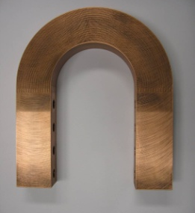
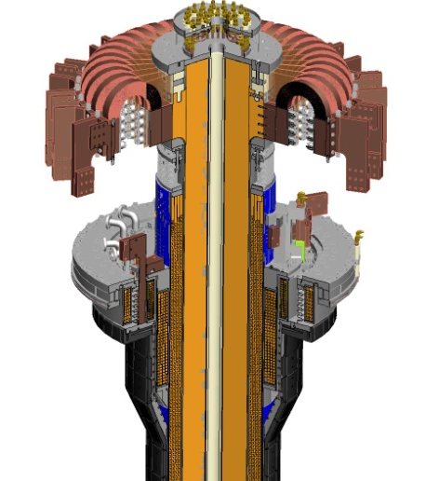
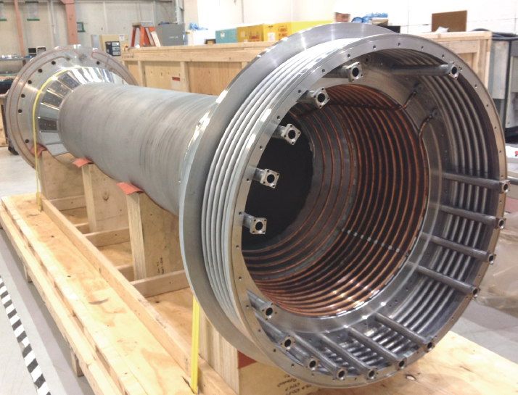
Improved Center-Stack Design to Handle Increased Forces
Identical 36 TF Bars and Innovative Flex-Bus Design
TF cooling lines
EDM Cuts
TF flex-bus
Tested for
300 k cycles
TF Coil
CHI bus
PF Coil 1c
PF Coil 1b
PF Coil 1a
CS Casing
OH Coil

Slide 8
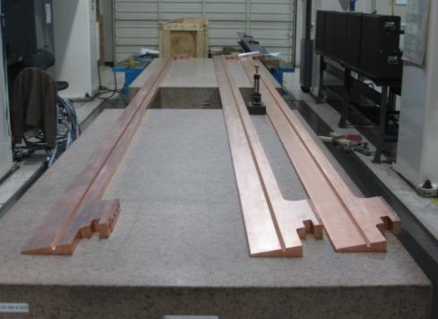
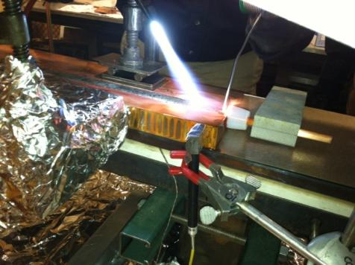
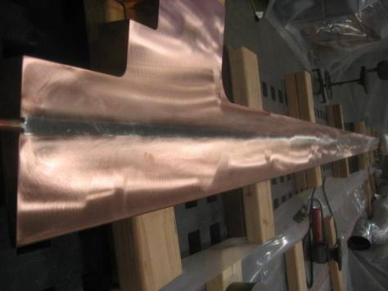
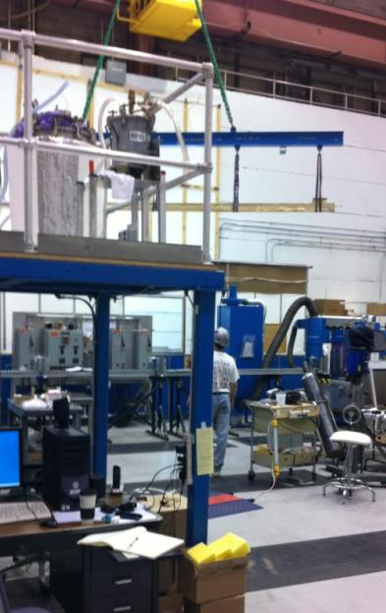
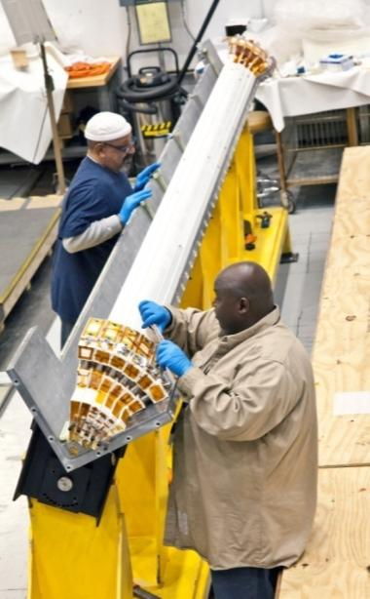
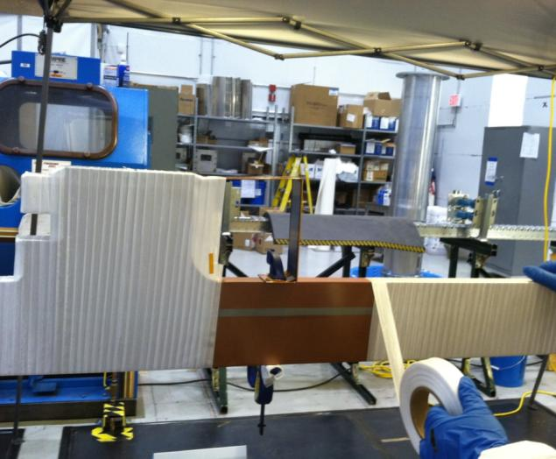
The NSTX-U Inner TF Bundle Manufacturing Stages
Friction Stir-Welding and Zn-Cl-Free Soldering Techniques Developed
Friction Stir-Welding
Zn-Cl-Free Soldering
Conductors placed in a quadrant mold for VPI
Fiber glass insulation

Slide 9
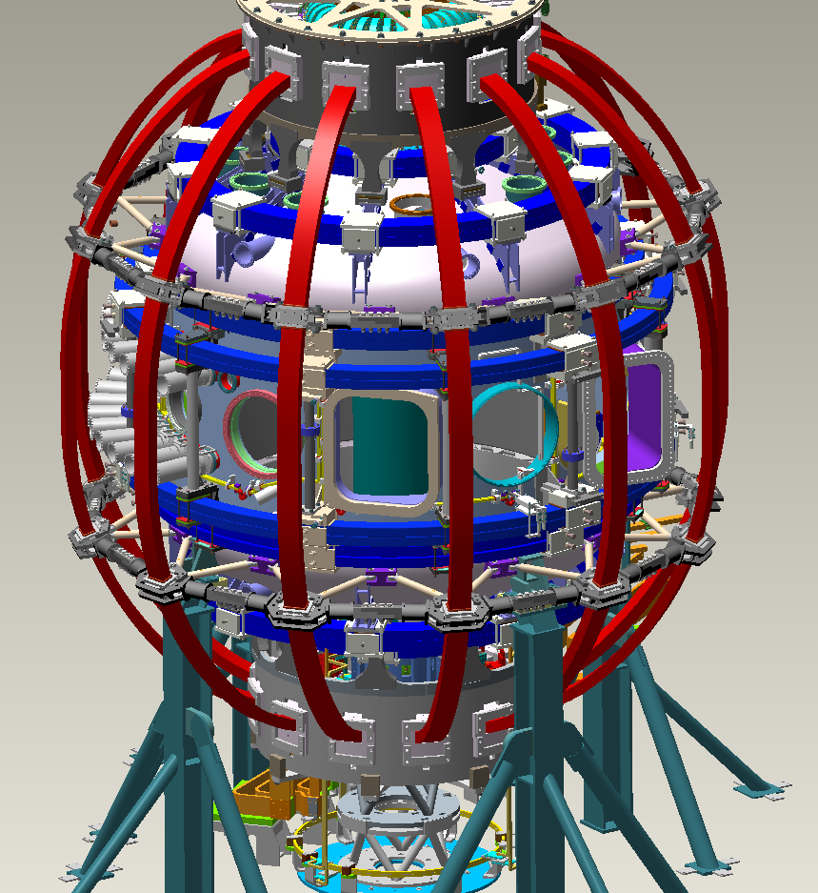
NSTX-U Support Structures Enhanced
To Handle 4x Electromagnetic Forces
Install Upper & Lower Al Block External-Internal Reinforcements
Install New Upper Lid
Replace Upper & Lower PF2/3 clamp hardware
Install Upper & Lower Umbrella Arch Reinforcements
Install additional (upper & lower) PF2 Clamp
Install New TF Outer Leg (TFOL) Support
Install new TF-VV Clevis
Replace existing Upper & Lower Pf4/5 clamp hardware
Install New Pf4/5 Support
Replace existing Pf4/5 Support Column
Install new TFOL Connecting Rods & Rod Ends
Modify support to provide clearance for connecting rod
Install New Upper & Lower Umbrella Leg/Foot/Slide
Install New Lower Lid
Add Extensions & Anchors to Supports
Install New Pedestal

Slide 10
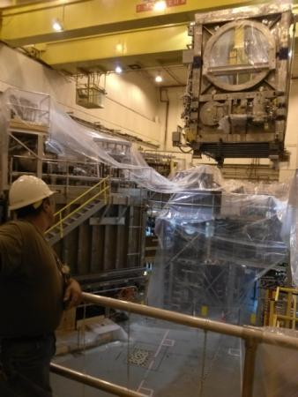
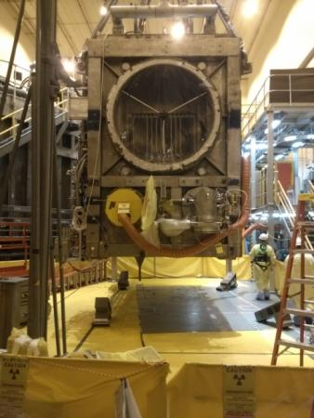
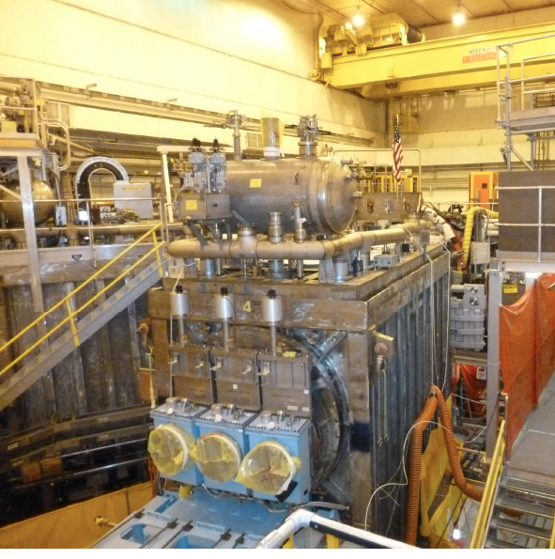
Relocation of the 2nd NBI beam line box from the TFTR test cell into the NSTX-U Test Cell Complete.
Beam Box being lifted over NSTX
Beam Box placed in its final location and aligned
Beam Box being populated with components

Slide 11
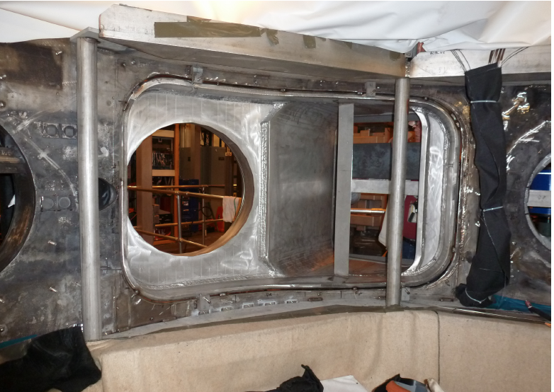
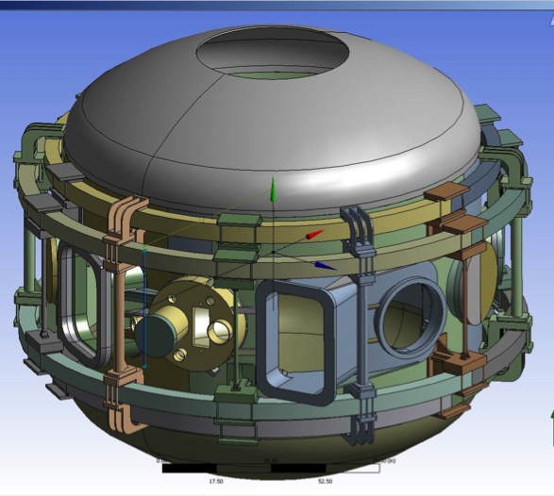
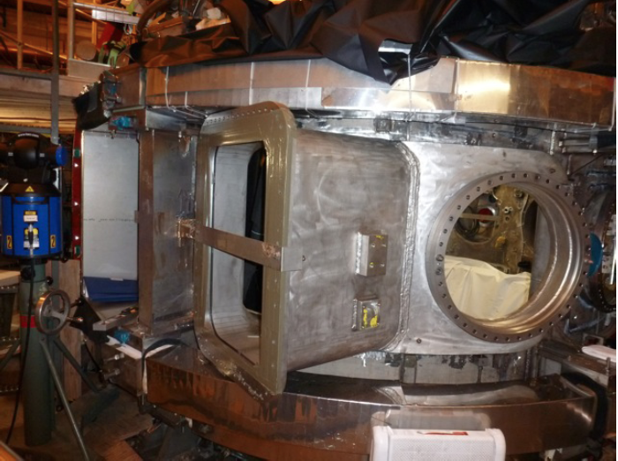
Highly Tangential 2nd NBI Enabled by JK-Cap
Outer Wall Radius Moved Outward to Avoid Beam Clipping
• Bay JK cap successfully welded to the vacuum vessel.
• Bay L cap is also being installed.
Interior View of Bay J-K
Exterior View of Bay J-K
JK cap

Slide 12
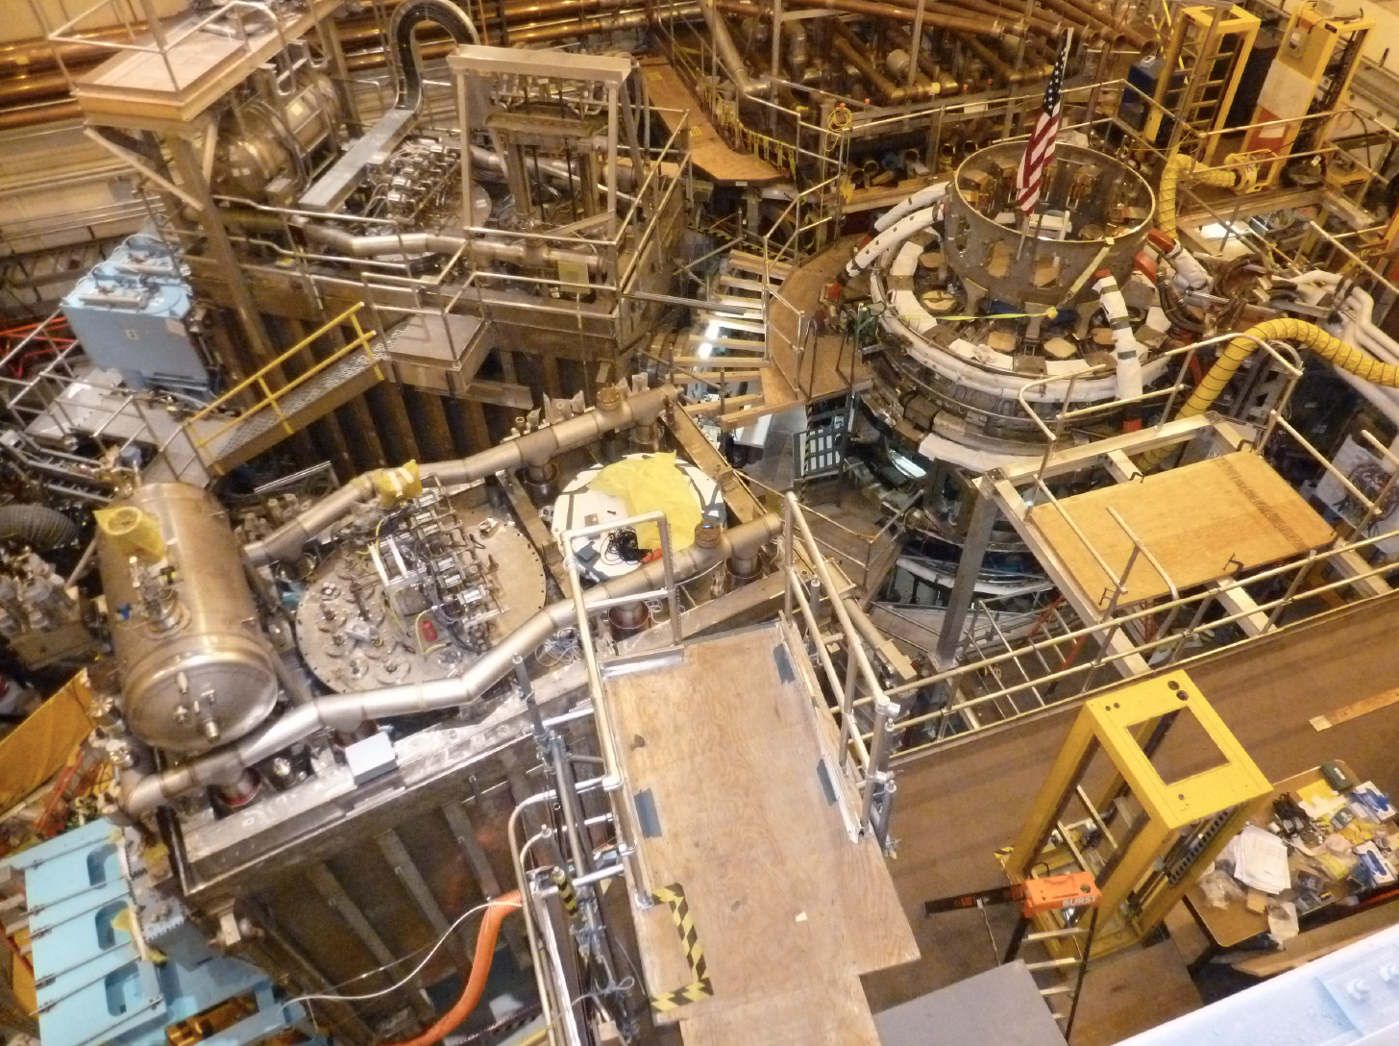
Aerial View of the NSTX-U Test Cell (Feb. 2013)
HHFW
System
1st NBI
2nd NBI

Slide 13
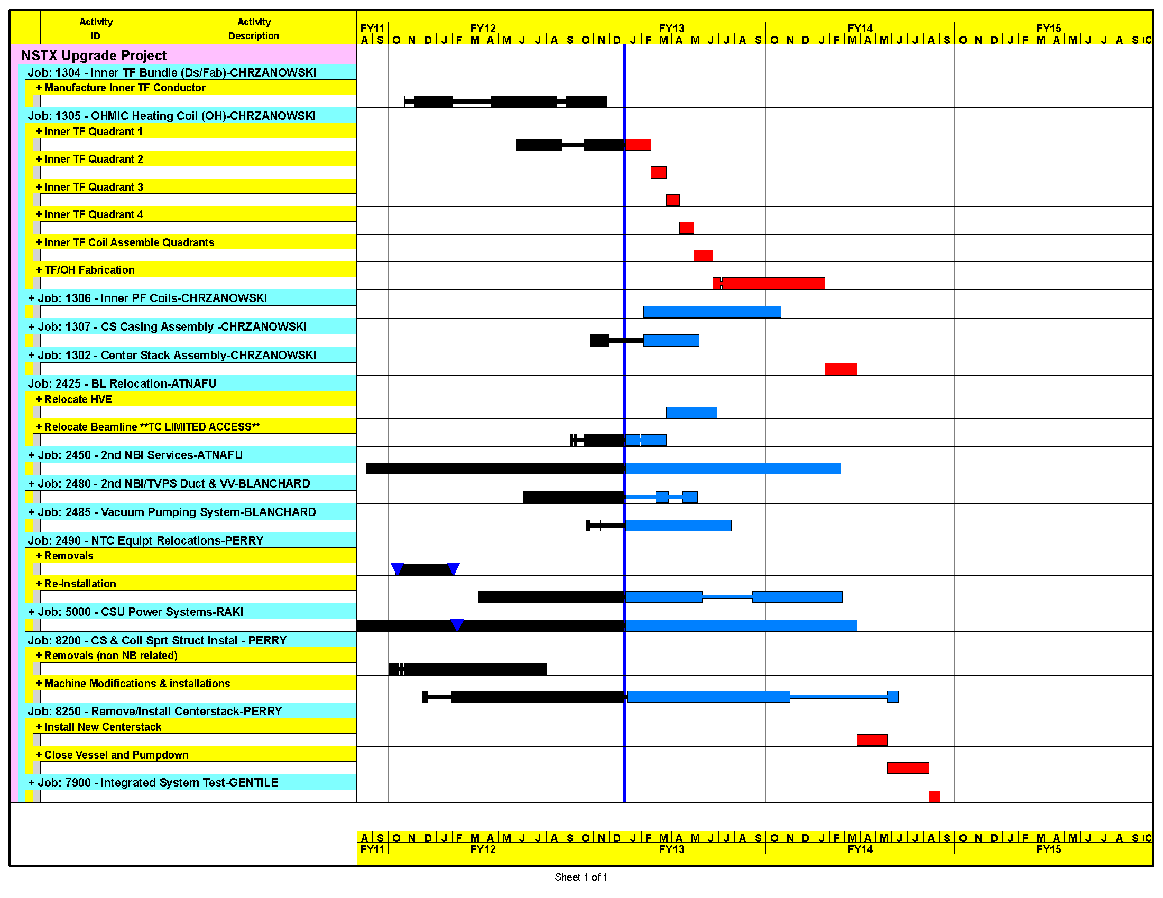
Upgrade Schedule on track for early finish
Aiming to start research operation in FY 2015
Good Progress!
Up to 60 % of scopes complete.
On schedule and on budget for Early Finish Date of Sept. 30, 2012.
FY 2013 Presidential Budget will cause 6 months delay in the NSTX-U operation.
Forecast Sep 14, 2014
Early Finish Sept 30 2014
Project Completion DOE Milestone
SEPT 30 2015

Slide 14
Formulating Strategy Toward Full NSTX-U Parameters
After CD-4, the plasma operation could enter quickly into new regimes
 | NSTX | Year 1 NSTX-U | Year 2 NSTX-U | Year 3 NSTX-U | Ultimate Goal
I_{P} [MA] | 1.4 | 1.6 | 2.0 | 2.0 | 2.0
I_{P}I_{P} [MA²] | 2.0 | 2.5 | 4.0 | 4.0 | 4.0
B_{T} [T] | 0.55 | 0.8 | 1.0 | 1.0 | 1.0
B_{T}B_{T} [T²] | 0.3 | 0.65 | 1.0 | 1.0 | 1.0
I_{P}B_{T} [MA*T] | 0.61 | 1.3 | 2 | 2.0 | 2
Allowed TF Coil I²t [MA²-s] | 7.3 | 80 | 120 | 160 | 160
I_{P} Flat-Top at max. allowed I²t, I_{P}, and B_{T} [s] | ~0.7 | ~3.5 | ~3 | 5 | 5
Table based on assessment of physics needs for first year of operations
1st year goal: operating points with forces 1/2 the way between NSTX and NSTX-U, ½ the design-point heating of any coil
2nd year goal: Full field and current, but still limiting the coil heating
3rd year goal: Full capability

Slide 15
Talk Outline
FY 2012-13 Operations Summary and Status
NSTX Upgrade Project Overview
NSTX-U Facility and Diagnostic Five Year Plans
Budget
Summary

Slide 16


NSTX-U research program aims to establish ST physics and scenario basis, then transition to integrating long-pulse + PMI
2014 | 2015 | 2016 | 2017 | 2018 | 2019 | 2020 | 2021 | 2022 | 2023
Upgrade Outage
Establish ST physics, scenarios
Integrate long-pulse + PMI solutions
Start-up and Ramp-up
Increase CHI closed-flux current
Achieve NI start-up/ramp-up
New
center-stack
Assess plasma gun start-up at increased device size
Increase/extend ramp-up heating and off-axis current-drive for advanced scenarios
Develop/understand ECH/EBW H&CD for ST
Boundary Physics
Establish main-ion density and ν* control
Understand snowflake divertor performance
Understand high-Z first-wall erosion, migration, particle sources & sinks
Inform U.S.
next-step conceptual design including aspect ratio and divertor optimization
Materials and PFCs
Assess baseline graphite PFC performance
Assess high-Z tile/divertor impact and performance
Assess high-Z divertor and/or first-wall
Assess impact of high-temperature first-wall
Liquid
metals / lithium
Establish low impurities / Z_{eff} , assess increased Li coverage, replenishment
Test flowing liquid metal for heat-flux mitigation, surface replenishment
Assess flowing LM PFC with full toroidal coverage
MHD
Understand kinetic MHD, extend mode and disruption detection, develop mitigation
Enhance non-axisymmetric field spectrum and capabilities with off-midplane coils for control of: RWM, EF, RMP, rotation, NTM, EP
Transport & Turbulence
Understand ES and EM turbulence at high β, low ν*, emphasizing e-transport
Extend wave-number coverage of turbulence measurements
Waves and Energetic Particles
Characterize AE stability, fast-ion transport, NBI-CD, support plasma start-up, assess effectiveness of fast-wave in NBI H-modes
Prototype driving edge-harmonic oscillations (EHOs) and/or *AE
2nd NBI
Scenarios and Control
Demonstrate full non-inductive, high I_{P} & P_{AUX} operation Control: boundary, β, divertor heat flux, Ω & q profiles
Assess integrated control of long-pulse / high-performance

Slide 17
NSTX-U diagnostics to be installed during first 2 years
Half of NSTX-U Diagnostics Are Collaboration Led
MHD/Magnetics/Reconstruction
  Magnetics for equilibrium reconstruction
  Halo current detectors
  High-n and high-frequency Mirnov arrays
  Locked-mode detectors
  RWM sensors
Profile Diagnostics
  MPTS (42 ch, 60 Hz)
  T-CHERS: T_{i}(R), V_{φ}(r), n_{C}(R), n_{Li}(R), (51 ch)
  P-CHERS: V_{θ}(r) (71 ch)
  MSE-CIF (18 ch)
  MSE-LIF (20 ch)
  ME-SXR (40 xh)
  Midplane tangential bolometer array (16 ch)
Turbulence/Modes Diagnostics
  Poloidal Microwave high-k scattering
  Beam Emission Spectroscopy (48 ch)
  Microwave Reflectometer,
  Microwave Polarimeter
  Ultra-soft x-ray arrays – multi-color
Energetic Particle Diagnostics
  Fast Ion D_{α} profile measurement (perp + tang)
  Solid-State neutral particle analyzer
  Fast lost-ion probe (energy/pitch angle resolving)
  Neutron measurements
  Neutral particle analyzer (single channel)
Edge Divertor Physics
  Gas-puff Imaging (500kHz)
  Langmuir probe array
  Edge Rotation Diagnostics (T_{i}, V_{φ}, V_{pol})
  1-D CCD H_{α} cameras (divertor, midplane)
  2-D divertor fast visible camera
  Metal foil divertor bolometer
  AXUV-based Divertor Bolometer
  IR cameras (30Hz) (3)
  Fast IR camera (two color)
  Tile temperature thermocouple array
  Divertor fast eroding thermocouple
  Dust detector
  Edge Deposition Monitors
  Scrape-off layer reflectometer
  Edge neutral pressure gauges
  Material Analysis and Particle Probe
  Divertor VUV Spectrometer
Plasma Monitoring
  FIReTIP interferometer
  Fast visible cameras
  Visible bremsstrahlung radiometer
  Visible and UV survey spectrometers
  VUV transmission grating spectrometer
  Visible filterscopes (hydrogen & impurity lines)
  Wall coupon analysis
New capability

Slide 18
5 year plan tools with 5YP base funding
(FY2012 + 2.5% inflation)
2014 | 2015 | 2016 | 2017 | 2018
Upgrade Outage
1.5 → 2 MA, 1s → 5s
Upgraded CHI for ~0.5MA
Cryo-pump, high-Z tile row on cryo-baffle, and partial NCC would be installed in-vessel during ~1 year outage between FY2016 and FY2017
  NSTX-U would operate 1st half of FY2016 and 2nd half of FY2017
Start-up and Ramp-up
New
center-stack
Up to 0.5 MA plasma gun
ECH/EBW
1MW
Boundary Physics
Lower divertor cryo-pump
Materials and PFCs
High-Z tile row on lower OBD
High-Z tile row on cryo-baffle
Lower high-Z divertor
Liquid
metals / lithium
Upward
LiTER
LLD using bakeable cryo-baffle
Li granule injector
MHD
MGI disruption mitigation
Partial NCC
Enhanced MHD sensors
Transport & Turbulence
δB polarimetry
High k_{θ}
Waves and Energetic Particles
HHFW limiter upgrade
2nd NBI
1 coil AE antenna
4 coil AE antenna
Scenarios and Control
Establish control of:
n_{e}
q_{min}
Snowflake
Rotation
Divertor P_{rad}

Slide 19
10 year plan tools with 5YP incremental funding
1.1 × (FY2012 + 2.5% inflation)
2014 | 2015 | 2016 | 2017 | 2018 | 2019 | 2020 | 2021 | 2022 | 2023
Upgrade Outage
1.5 → 2 MA, 1s → 5s
Metallic PFCs, 5s → 10-20s
Start-up and Ramp-up
Upgraded CHI for ~0.5MA
0.5-1 MA CHI
New
center-stack
Extend NBI duration to 10-20s and/or implement 2-4 MW off-axis EBW H&CD
up to 1 MA plasma gun
ECH/EBW
1MW
2 MW
Boundary Physics
Lower divertor cryo-pump
Diagnostics for high-Z wall studies
Inform U.S.
next-step conceptual design including aspect ratio and divertor optimization
Divertor Thomson
Materials and PFCs
High-Z tile row on lower OBD
Lower high-Z divertor
U + L high-Z divertors
All high-Z PFCs
Hot high-Z FW PFCs using bake-out system
Liquid
metals / lithium
Upward
LiTER
LLD using bakeable cryo-baffle
Flowing Li divertor
or limiter module
Full toroidal flowing Li divertor
Li granule injector
MGI disruption mitigation
Partial NCC
Full NCC
NCC SPA upgrade
MHD
Enhanced MHD sensors
Transport & Turbulence
δB polarimetry
DBS, PCI, or other intermediate-k
High k_{θ}
Waves and Energetic Particles
HHFW limiter upgrade
HHFW straps to excite EHO
High-power AE antenna
2nd NBI
1 coil AE antenna
4 coil AE antenna
Neutron-collimator, fusion source profile array
Scenarios and Control
Establish control of:
Control integration, optimization
Control integration, optimization with long-pulse and full metal wall
n_{e}
q_{min}
Divertor P_{rad}
Snowflake
Rotation

Slide 20
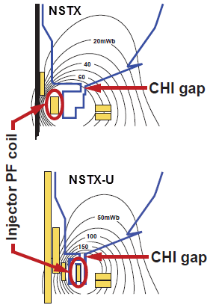
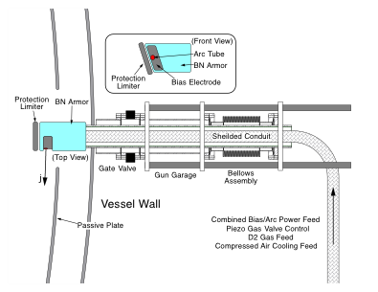
Solenoid-free Start-up
High priority goal for NSTX-U in support of FNSF
CHI Start-Up
PEGASUS Point Source
• Inj. Flux in NSTX-U is about 2.5 times higher than in NSTX
• NSTX-U coil insulation greatly enhanced for higher voltage ~ 3 kV operation
PEGASUS Plasma Gun
U. Washington
U. Wisconsin
FY 2013-14 Non-Inductive Start-up Systems Design for Post-Upgrade Operations
• CHI will start with the present 2 kV capability then enhanced to ~ 3 kV higher voltage as needed.
• PEGASUS gun start-up producing exciting results Ip ~ 160 kA. The PEGASUS gun concept is technically flexible to implement on NSTX once fully developed. High current gun for the NSTX-U will be developed utilizing the PEGASUS facility in collaboration with University of Wisconsin.

Slide 21
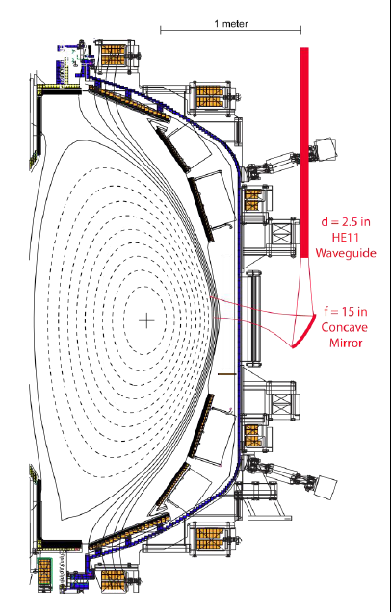
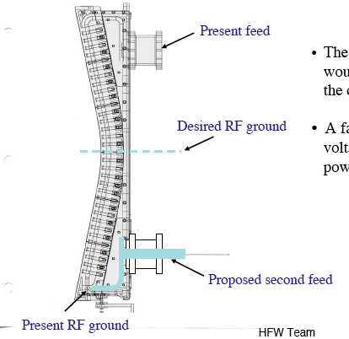
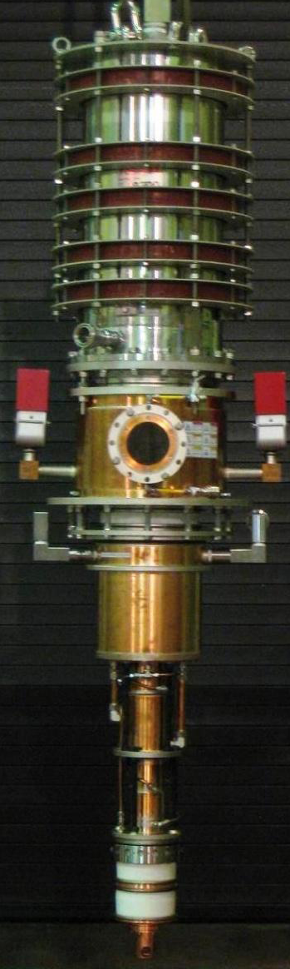
Harden HHFW Antenna Feeds for Disruption Load
A MW-Class 28 GHz ECH System for Non-Inductive Operation
HHFW antenna enhancement in the feedthru area
28 GHz, 1.5 MW Tsukuba Gyrotron
28 GHz ECH/EBWH waveguide and mirror concept
• FY 2013/14 - HHFW Antenna feed enhancements against disruptive loads
• FY 2013/15 – Start MW-class ECH/EBW system conceptual design for non-inductive operations (MOU with Tsukuba University)

Slide 22
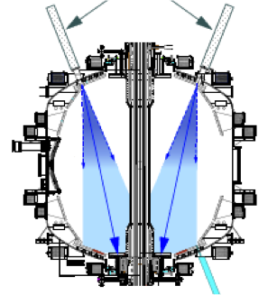
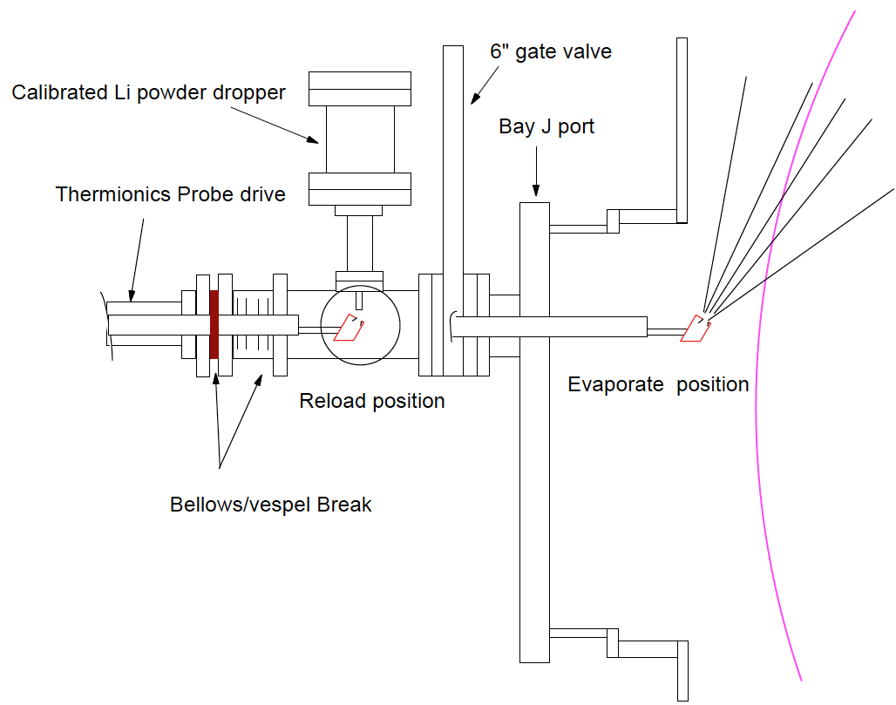
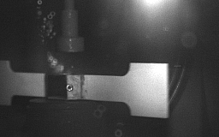
NSTX-U Lithium Capability During Initial Two Years
Lithium Evaporators and Granular Injector
Existing LITERS
New Upward Evaporating LITER
LLD
LLD
• Upward Evaporating LITER to increase Li coverage for increased plasma performance
NSTX-U lithium granular injector
for ELM pacing
• High frequency ELM pacing with a relatively simple tool.
• ELM pacing successfully demonstrated on EAST (D. Mansfield, IAEA 2012)
Granule Reservoir
Struck Granule Horizontally
Redirected at 70 m/s
t = 800 μs

Slide 23
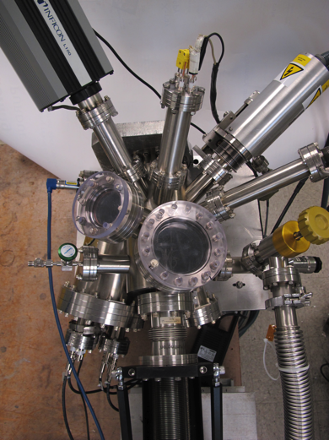
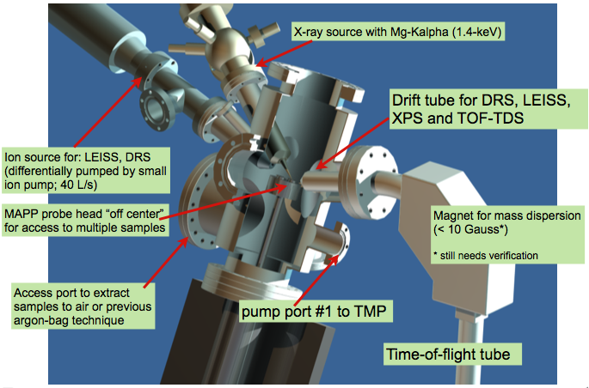
Materials Analysis and Particle Probe – MAPP –
to relate PFC surface conditions and plasma behavior in “real time”
PFC analysis after run is difficult to relate to plasma behavior
  Reflects cumulative effect of multiple evaporations and surface compound formation
  Hard to determine determine surface conditions during any specific discharge
MAPP provides in-situ and between-shots solution
  PFC sample can be exposed during shot and withdrawn for between-shots analysis
MAPP chamber showing diagnostics for sample analysis
MAPP will be tested on LTX during outage
J.P. Allain (Purdue), R. Kaita, et al.,

Slide 24
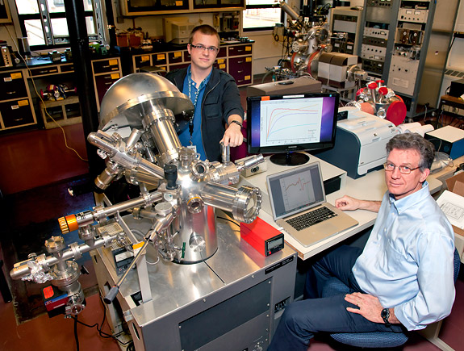
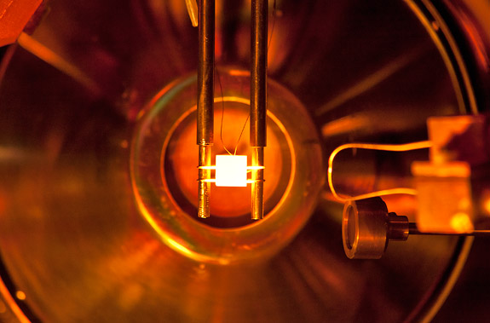
Surface Analysis Facilities to Elucidate Plasma-Surface Interactions
PPPL Collaboration with B. Koel et al., Princeton University
The Surface Science and Technology Laboratory (SSTL) with three surface analysis systems and an ultrahigh vacuum deposition chamber.
The Surface Imaging and Microanalysis Laboratory (SIML) with a Thermo VG Scientific Microlab 310-F High Performance Field Emission Auger and Multi-technique Surface Microanalysis Instrument.
Recently solid lithium and Li coated TZM were examined using X-ray photoelectron spectroscopy (XPS), temperature programmed desorption (TPD), and Auger electron spectroscopy (AES) in ultrahigh vacuum conditions and after exposure to trace gases.
Experiment on SSTL determined that lithiated PFC surfaces in tokamaks will be oxidized in about 100 s in the expected NSTX-U vacuum conditions. (C. H. Skinner et al., PSI_20 accepted to J. Nucl. Mater. )
X-ray photo-electron spectroscopy
Lithium coated TZM being examined by TPD and AES.

Slide 25
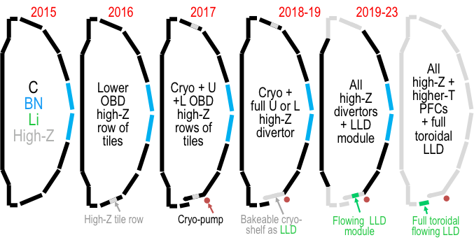
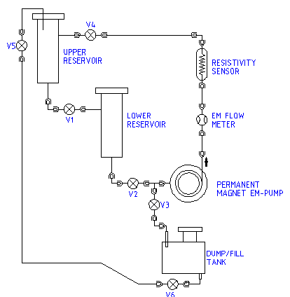
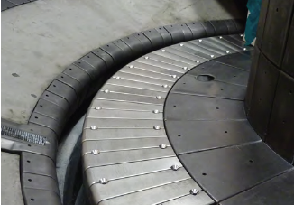
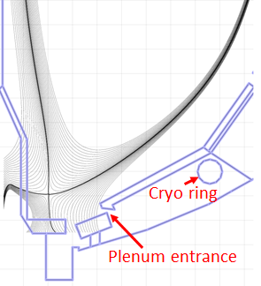
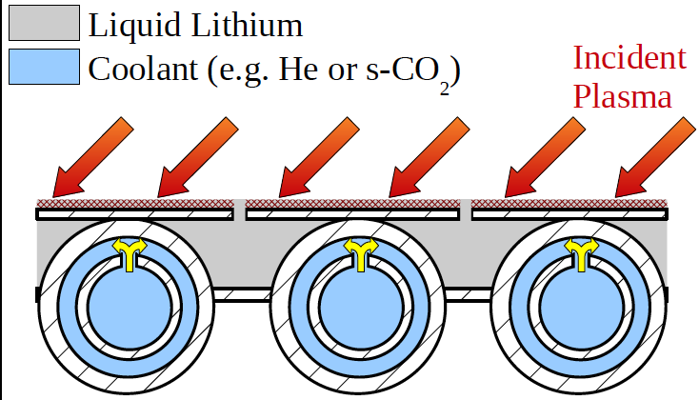
Boundary Facility Capability Evolution
NSTX-U will have very high divertor heat flux capability of ~ 40 MW/m²
Flowing LL Test Loop
NSTX Moly Tiles
A Possible LLD Module
ORNL
• For FY 13 - 15, advanced divertor upgrade conceptual design work will commence for moly-based PFCs, and closed divertor with cryo-pump.
• For FY 13 - 15, flowing liquid lithium PFC R&D will be conducted at PPPL.

Slide 26
New MHD and Plasma Control Tools for NSTX-U
Sustain β_{N} and Understand MHD Behavior Near Ideal Limit
Partial NCC option (1 x 12)
Partial NCC option (2 x 6 odd parity)
Full NCC
Existing
RWM
coils
Non-axisymmetric Control Coils (NCC)
Columbia U., GA
• NCC can provide expanded RWM, NTV, RMP, and EF selectivity physics studies with more flexible field spectrum (n ≤ 6, or n ≤ 3 depending on set).
• 2nd 3-channel Switching Power Amplifier (SPA) commissioned in July 2011 to power 6 independent currents in existing midplane RWM and NCC coils.
• An extended MHD sensor set to measure theoretically predicted poloidal mode structure and to improve mode control.
• A Real-Time Velocity (RTV) diagnostic in a new plasma rotation control system for active instability avoidance by controlling rotation profile.
• Multi-poloidal location massive gas injector system will be implemented.

Slide 27
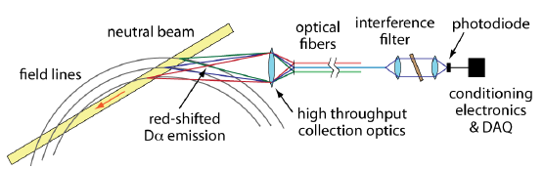
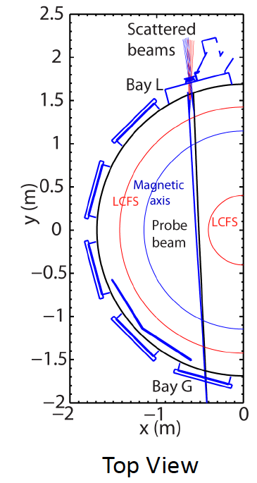
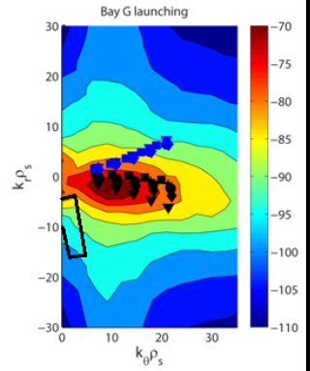
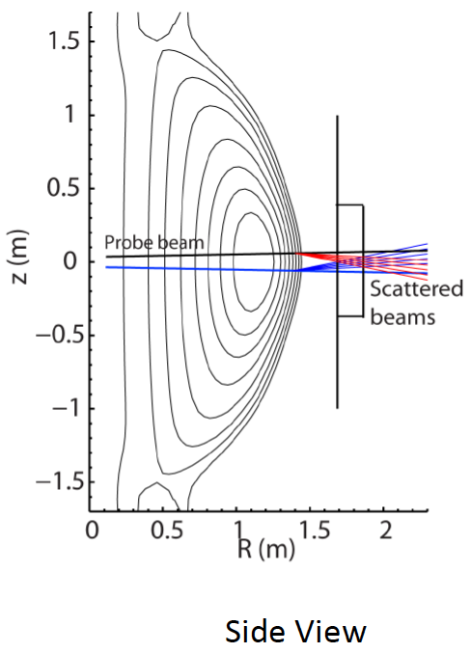
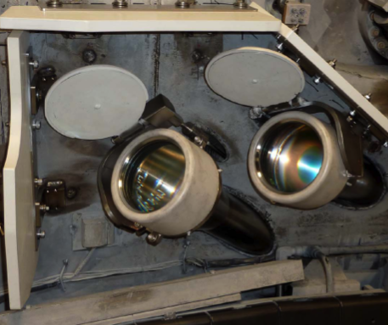
Transport and Turbulence
BES together with high-k to provide comprehensive turbulence diagnostic
Modes
0.1
1
k⊥(cm⁻¹)
10
100
μTEARING
ITG/TEM
ETG
BES, pol
BES
BES, Polarimeter
μwave Scattering
48 ch BES available for NSTX-U
(24 ch BES available in 2011)
New high-k scattering system for allowing
2-D k spectrum
Optical fibers
UCD
Neutral Beam
field lines
red-shited
Dα emission
High throughput collection optics
U. Wisconsin
A 288 GHz polarimetry system for magnetic fluctuation measurements is being tested on DIII-D.
UCLA
Notes:
Here is an overview of the NSTX facility operation and upgrade plan for FY 10-12. We plan to run 14 run weeks in each of fiscal year. We will conduct one extra ARRA week this year using the carry over from last fiscal year. For incremental, we propose to run up to 6 run weeks each in FY 11 and 12. We have a very strong set of upgrade becoming available this year . In FY 11, our base upgrade activities are either supported by ARRA funding or by the collaborators. Our base upgrade resources will be mostly devoted to the preparation for the major upgrade outage planned in FY 13-14 to install a new center-stack and the 2nd NBI which will be described by Ron Strykowsky our upgrade project manager.

Slide 28
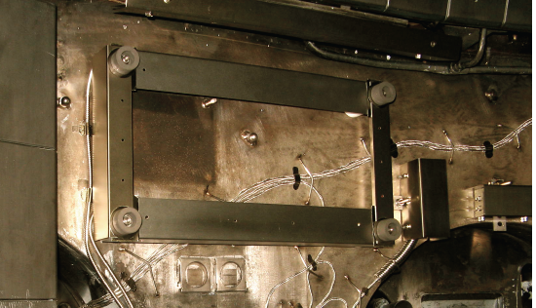
Energetic Particle Research Capabilities
For NBI fast ion transport and current drive physics
Fast Ion D-Alpha Diagnostics
FIDA Views
UCI
• A vertical FIDA system measures fast ions with small pitch, corresponding to trapped or barely passing (co-going) particles.
• A new tangential FIDA system measures co-passing fast ions with pitch ~0.4 at the magnetic axis up to 1 at the plasma edge.
• Both FIDA systems have time resolution of 10 ms, spatial resolution ≈5 cm and energy resolution ≈10 keV.
Vertical
Tangential
FY 2013 - 14 Energetic Particle Conceptual Design and Diagnostic Upgrade
  SS-NPA enhancement due to removal of scanning NPA
  Proto-type active TAE antenna
UCI
5-turn radial active TAE antenna installed in 2011

Slide 29
Talk Outline
FY 2012-13 Operations Summary and Status
NSTX Upgrade Project Overview
NSTX-U Facility and Diagnostic Five Year Plans
Budget
Summary

Slide 30
Base NSTX-U Five Year Plan Budget Summary
Base Budget is Highly Constrained Particularly in FY 14
Base DOE Guidance Budget – Inflation adjusted flat FY 2012 budget
• FY12 budget + 2.5% inflation
Base Budget
Collaborations
Collaboration Diagnostic Interface
PPPL Research
Upgrade Project
Facility Enhancement
Facility Ops
0
15
15
15
15
Run Weeks
FY 14
FY 15
FY 16
FY 17
FY 18
In FY 14, the Upgrade Project needs to be completed.
In FY 14, very little budget for 5 year plan facility enhancement causing difficulty to fund long lead facility enhancements (e.g., ECH, Cryo-pump, and NCC) in a timely manner.
For FY 15 and beyond, the budget facility operations and PPPL/Collaboration research are based on similar operations and research staff coverage to NSTX.

Slide 31
Incremental NSTX-U Five Year Plan Budget Summary
10 % Incremental Budget Greatly Enhances Facility Capability
10% Incremental Budget
Total Base + Incremental Budget
+9
20
18
18
24
+5
+3
+3
0
FY 14
FY 15
FY 16
FY 17
FY 18
Run Weeks
FY 14
FY 15
FY 16
FY 17
FY 18
10% Incremental Budget: 1.1 × (FY2012 + 2.5% inflation)
Enables timely implementation of the facility / diagnostic capability to support the 5 year research plan. Particularly high leverage in FY 14 prior to the start of NSTX-U operation.
Dedicates more resources for facility enhancements up front to make them available in a timely manner.
Increase run weeks to take advantage of enhanced facility capability
Enhance NSTX-U research capability for both PPPL and collaborators to support increased research activities
Collaborations
Coll. Diag. Int.
PPPL Res.
Upgrade Project
Facility Enhance.
Facility Op.

Slide 32
Large Budget Cut in FY 2013 Presidential Budget
Serious Impacts on NSTX-U Program and Staff
 | FY2012 | FY2013
Budget Cases | BA | BA | Incr
Facility Ops | $13.2 | $8.5 | $12.7
Facility Enhancements | $0.3 | $0.5 | $1.7
CS & 2nd NBI | $20.4 | $22.7 | $24.3
Facility Total | $34.0 | $31.7 | $38.6
PPPL Research | $10.5 | $8.3 | $9.9
Collab Diag Interf | $0.4 | $0.3 | $0.4
Collaborations | $6.1 | $5.9 | $6.5
Science Total | $17.0 | $14.5 | $16.9
NSTX Total | $50.9 | $46.2 | $55.5
• President's FY 2013 budget represents ~ $ 5M cut from FY 2012.
• Sufficient fund was provided for the first half of the year to make planned progress on the NSTX Upgrade Project and retain necessary staff level.
• Waiting for the congressional action for the final FY 2013 budget.
• Incremental budget was also proposed to support the preparation for the NSTX-U Operation and reduce the Upgrade Project risks.
• If President's FY 2013 budget is realized, it will result in a significant loss of both research and technical skills on NSTX-U.
• It will delay the NSTX-U research operation by about 6 months.
• If the FY 2013 budget can be restored to the FY 2012 level, the staff loss and NSTX-U delay can be prevented provided FY 2014 budget is also maintained at FY 2012 level.

Slide 33
Optimized NSTX-U Five Year Plan Being Developed
Exciting Opportunities and Challenges Ahead
• NSTX upgrade outage activities are progressing well
  Diagnostics were stored and secured for the upgrade activities.
  Researchers are working productively on data analysis, collaboration, next five year plan and preparation for the NSTX-U operation.
  NSTX operations technical staff were shifted to the Upgrade Project tasks in FY 2012 – 13.
  NSTX Upgrade Project is thus far progressing on budget and on schedule.
• Exciting 5 Year Plan (FY 2014 – 18) being developed
  Aiming to provide necessary data base for FNSF design and construction.
  Strong contribution to toroidal physics, ITER, and fusion energy development.
  10% incremental budget would enable timely implementation of facility capabilities to support the exciting NSTX-U Five Year Plan.
• Presidential budget guidance will delay the NSTX-U research operations and negatively impact the NSTX-U Five Year Plan
  FY 2013 presidential base budget is ~ $ 5 M lower than the FY 2012 budget which will result in loss of research and technical staff and will delay the NSTX-U start date to mid FY 2015.
  Incremental funding restores the NSTX-U first plasma date accordingly with enhanced capabilities.

Slide 34
Back-up Slides

Slide 35
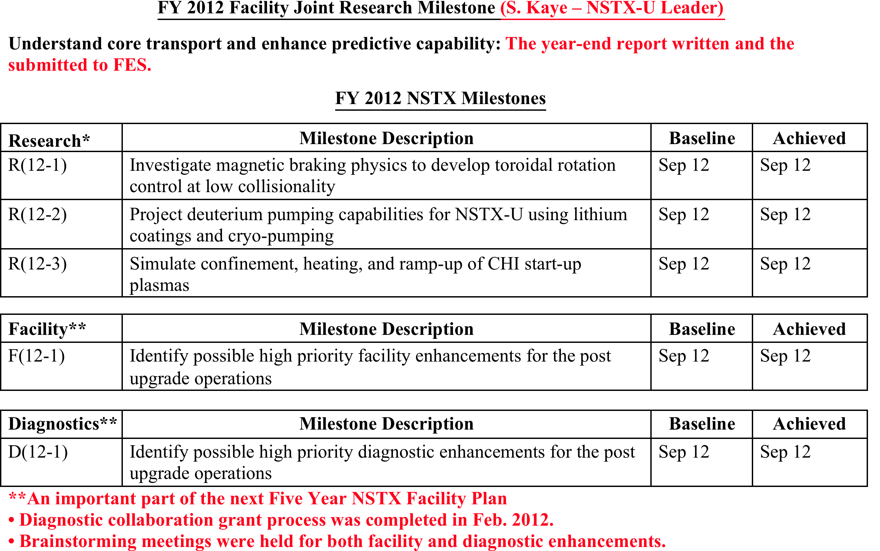
All of the FY12 Milestones Completed On Schedule
Through Data Analyses, Theory/Modeling, and Collaborations
Notes:
35

Slide 36
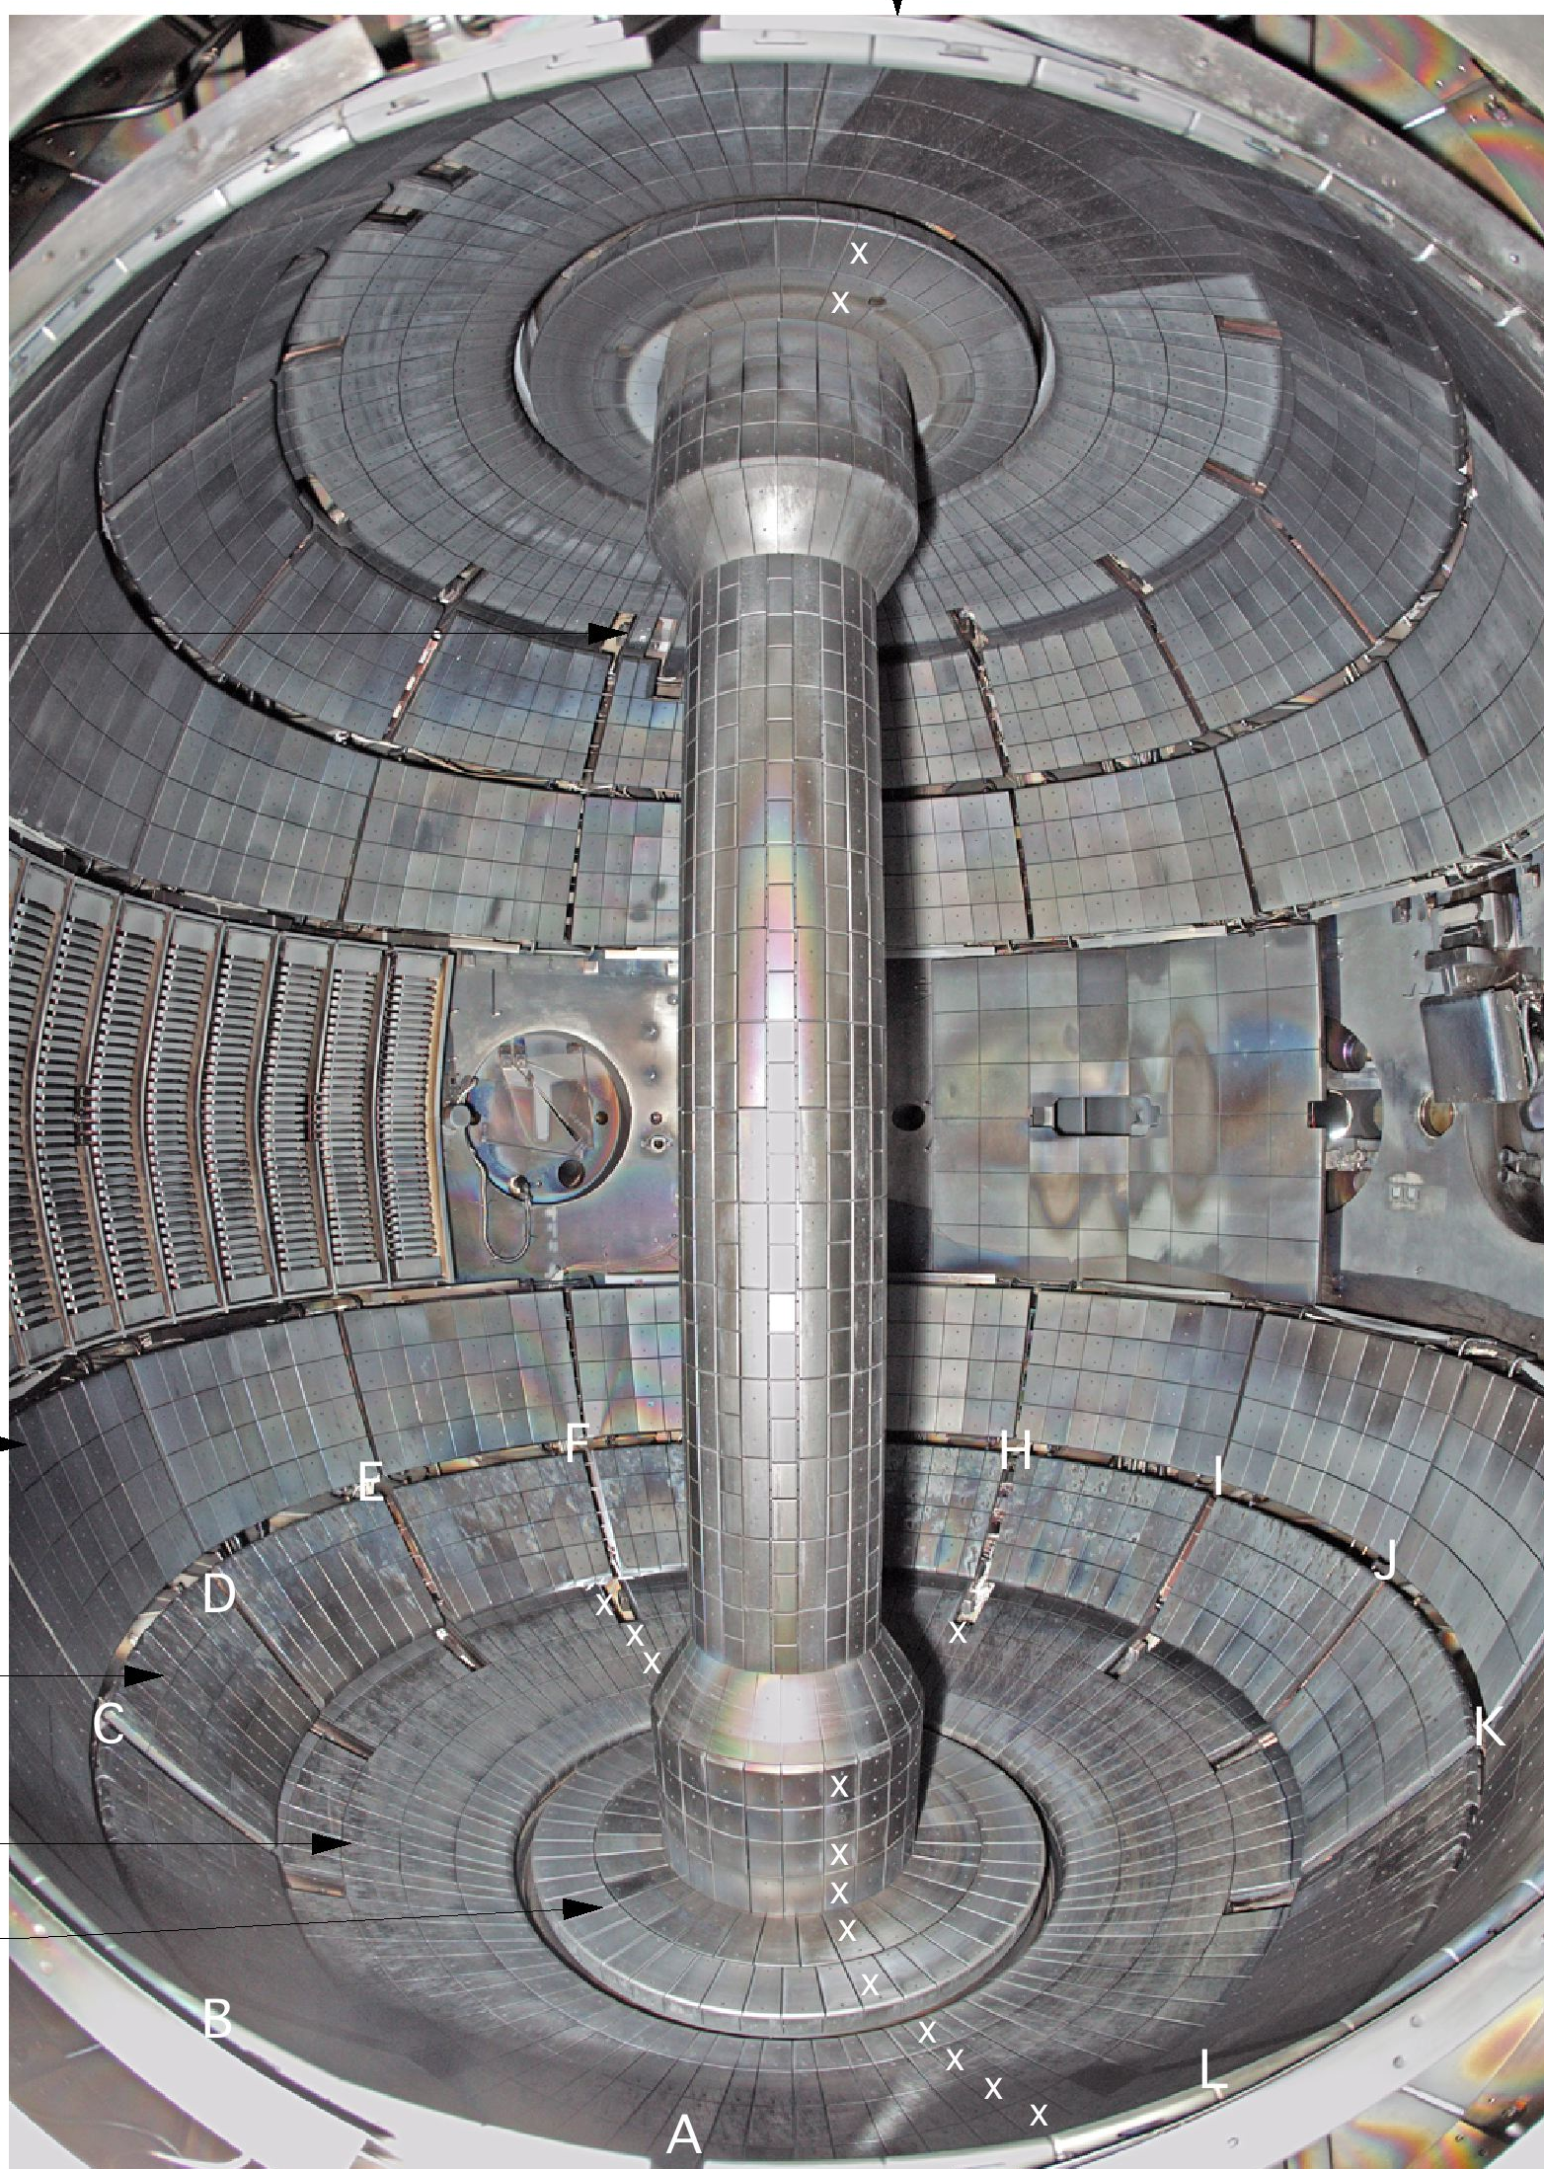
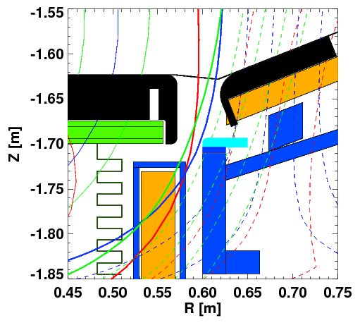
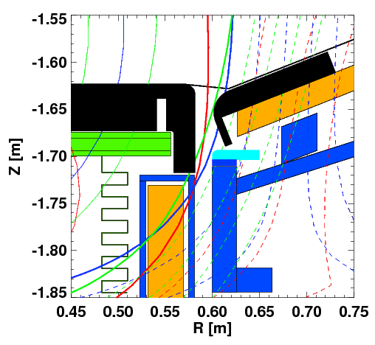
All Graphite PFC Day-1 NSTX-U Configuration
Improved gap tiles to protect PF1C and Exposed SS surfaces
Existing Tile Design
CHI Gap
• NSTX-U plasma operation may increase the gap area thermal loading by ~ x 10
Center Stack
Secondary Passive Plates
PF 1C
HHFW
Antenna
NBI Armor
Improved Tile Design
Primary Passive Plates
CHI Gap
New Gap Overhung Tiles to provides necessary protection
CHI Gap
In-board
Divertor
PF 1C
Out-board
Divertor

Slide 37
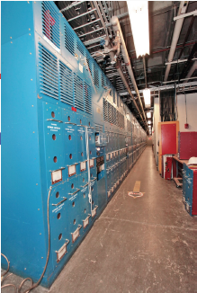
Transrex AC/DC Convertors of the NSTX FCPC
Upgrading of Firing Generators and Fault Detectors
Transrex AC/DC Convertors of the NSTX Field Coil Power conversion System (FCPC) provide a pulsed power capability of 1800 MVA for 6 seconds. The modular converter concept of 74 identical (with a paired sections A & B), electrically isolated 6-pulse “power supply sections” was originally used on TFTR, and then adapted to NSTX.
  Many parts from 1984 are nearing end-of-life due to age and wear, replacement parts are rare or unavailable, and that performance can be improved using more modern equipment.
  Precise control of thyrister firing angles by the FCPC firing generators becomes more critical for the new 8-parallel, 130kA TF system configuration.
  Ability to separately control the “A” and “B” sections of each power supply unit allows for more efficient utilization of the 74 available sections.
  The new Firing Generator (FG) will deliver firing pulses with greater resolution, precision, and repeatability, and can receive and process separate commands to the A and B sections
Status:
The prototype FG has been fully tested in a Transrex rectifier, and production units are being fabricated.
The new Fault Detector (FD) provides improved external interface compatible with the NSTX-U data acquisition system.
The FD prototype has been completed in conjunction with the new FG in a Transrex rectifier.

Slide 38
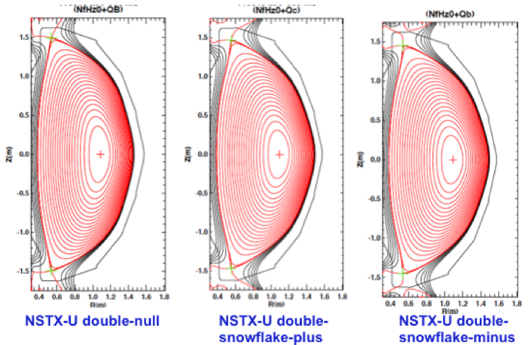
NSTX-U PF Coil Power System Upgrade
Enables up-down symmetric divertor operations
The first-year power supply capabilities of NSTX-Upgrade will yield considerable experimental flexibility, namely, up-down symmetric PF-1C coils compared to only at the bottom.
By powering the PF-1A & PF-1C coils, it will be possible to generate up-down symmetric snowflake divertors
  Capability did not exist in NSTX.
  Bipolar PF-1C allows easy comparison between snowflake and standard divertors.
The new configuration should provide better control for the CHI absorber region.
Longer-term, upgrades to the power supply systems may add considerable new capability:
  - The PF-2 coils may be upgraded to bipolar operations. This will allow those coils to either create the snowflake divertor or to control the lower plasma-wall gap in the high-triangularity shapes, without changes to the power supply links.
  - The PF-1B coil, which will not be powered during initial upgrade operations, may be important for maintaining a steady snowflake divertor through the full OH swing.

Slide 39
NSTX-U Plasma Control System Upgrade
Migration to more modern computer for real-time applications
Sample rate: 5 → 20 KHz
Added 32 channels
PC Links replaced with much faster “Firing Generator” Serial Links
Analog Inputs
Coil Currents
Power Supplies
Magnetics
(including upgrades)
Neutral Beams
(1st and 2nd BLs)
Gas Injection
Vacuum
Rotation data
Pitch angle data
FPDP: 1 → 4 links
Analog Inputs
416 channels
PC Links
Power Supplies
(inc. 3 new coils)
Neutral Beams
(including new BL)
Gas Injection
Real-Time
Computer
Digital Inputs
12 words
FPDP
FPDP
Digital Outputs
Time Stamp
micro seconds
Analog Outputs
Hardware Upgrades
New computer: cores: 8 → 32
Commercial Linux Real-Time operating system & advanced real-time debug tools.
New quad-port fiber optic FPDP I/O boards.
Software Upgrades
Ported PPPL code and GA PCS to 64-bit.
Generate commands for new firing generators .
Coil Protection (DCPS) functions incorporated in PSRTC.
Numerous new control algorithms.
PCS algorithms re-written using GA format.
PSRTC to be re-written.
Physics Algorithms For Development Once Hardware/Software Infrastructure is Complete
Modified shape control
Snowflake Control
Dud Detection & Soft Landings
Rotation, Current, β_{N}
SGI and density control
new diagnostic algorithms
A second instance of this real-time computer will be acquired before operation providing a backup for NSTX-U operations and allowing parallel testing of control code during NSTX-U operations.

Slide 40
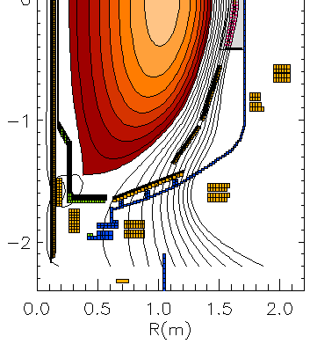


3D analysis of extended MHD sensors show significant mode amplitude off-midplane, approaching divertor region
n = 1 ideal eigenfunction for high beta plasma
Z(m)
Present sensor locations
B_{R} sensors (nominally normal, B_{norm})
B_{p} sensors (nominally tangential, B_{tan})
θ
New sensor locations (includes
one new location above midplane)
R(m)
B_{norm} vs. theta (normalized to present Br sensors)
Z_{plasma} = -10 cm
Model characteristics
  New 3D model of divertor plate
  3D sensors with finite toroidal extent; n*A of existing sensors
Results summary
  Field amplitude up to factor of 6 larger with new sensors
  Perturbed field reversals observed with new sensors
  Signals sufficient with plasma shifted off-midplane
= -5 cm
= 0 cm
Present sensors
B_{norm}(normalized)
Φ = 0 deg
Φ = 0 deg
θ (deg)
θ (deg)

