Slide 1




NSTX-U
Supported by
NSTX-U 5 Year Plan for Pedestal, Scrape-off Layer and Divertor Physics
Coll of Wm & Mary
Columbia U
CompX
General Atomics
FIU
INL
Johns Hopkins U
LANL
LLNL
Lodestar
MIT
Lehigh U
Nova Photonics
Old Dominion
ORNL
PPPL
Princeton U
Purdue U
SNL
Think Tank, Inc.
UC Davis
UC Irvine
UCLA
UCSD
U Colorado
U Illinois
U Maryland
U Rochester
U Tennessee
U Tulsa
U Washington
U Wisconsin
X Science LLC
V. A. Soukhanovskii (LLNL)
Diallo, R. Maingi, C. S. Chang (PPPL)
for the NSTX-U Research Team
Culham Sci Ctr
York U
Chubu U
Fukui U
Hiroshima U
Hyogo U
Kyoto U
Kyushu U
Kyushu Tokai U
NIFS
Niigata U
U Tokyo
JAEA
Inst for Nucl Res, Kiev
Ioffe Inst
TRINITI
Chonbuk Natl U
NFRI
KAIST
POSTECH
Seoul Natl U
ASIPP
CIEMAT
FOM Inst DIFFER
ENEA, Frascati
CEA, Cadarache
IPP, Jülich
IPP, Garching
ASCR, Czech Rep
NSTX-U PAC-33 Meeting
PPPL – B318
February 19-21, 2013

Slide 2
Boundary Physics program in NSTX-U contributes to critical research areas for ITER/tokamaks and STs
High-level goals for NSTX-U 5 year plan
Demonstrate stationary non-inductive operation
Access reduced ν* and high-β
Develop and understand non-inductive start-up/ramp-up
Develop and utilize high-flux-expansion snowflake divertor and radiative detachment for mitigating very high heat fluxes
Begin to assess high-Z PFCs + liquid lithium

Slide 3
Boundary Physics program in NSTX-U contributes to critical research areas for ITER/tokamaks and STs
Boundary Physics Thrusts (and outline of the talk)
  BP-1: Assess and control pedestal structure, edge transport and stability
    Pedestal structure, transport and turbulence studies
    ELM characterization and control
  BP-2: Assess and control divertor heat and particle fluxes
    SOL transport and turbulence, impurity transport
    Divertor heat flux mitigation with impurity seeding and divertor geometry
This talk: Recent NSTX Boundary Physics progress, Goals and Plans for Pedestal, ELM, SOL and divertor research in 2014-2018

Slide 4
Planned NSTX-U facility upgrades enable access to new parameter space and unique capabilities
Planned upgrades (NSTX → NSTX-U ) | Operations year available | Boundary Physics area
P_{NBI} = 5 → 12 MW (5 s) 7.5 →15 MW (1.5 s) | 1-2 | Pedestal structure and ELM stability, L-H, divertor heat flux (12 → 15-20 MW/m²) P/R ~ 10 → 20 P/S ~ 0.2 → 0.4
I_{p} = 1.3 → 2 MA B_{t} = 0.5 → 1 T | 1-2 | L-H transition, pedestal structure and stability, SOL width, divertor heat flux
Pulse length 1.5 → 5-10 s | 1-2 | Steady-state divertor heat flux mitigation, density and impurity control
Axisymmetric PF (divertor) coils PF1A, 1B, 1C, 2L | 1-3 | Plasma shaping, L-H, divertor configuration control
Non-axisymmetric control coils | 3 | ELM control and pedestal transport
Divertor cryogenic panel | 3 | Pedestal stability, density control, radiative divertor with impurity seeding
Molybdenum plasma-facing components | 2 | Core and pedestal impurity density, divertor heat transport regimes

Slide 5
Boundary Physics program in NSTX-U contributes to critical research areas for ITER/tokamaks and STs
Boundary Physics Thrusts (and outline of the talk)
  BP-1: Assess and control pedestal structure, edge transport and stability
    Pedestal structure, transport and turbulence studies
    ELM characterization and control
  BP-2: Assess and control divertor heat and particle fluxes
    SOL transport and turbulence, impurity transport
    Divertor heat flux mitigation with impurity seeding and divertor geometry

Slide 6
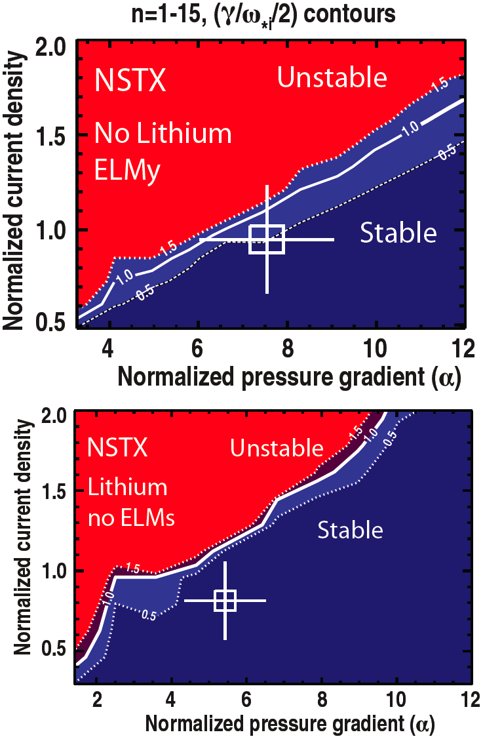

Pedestal studies focus on testing applicability of peeling ballooning and kinetic ballooning to limit pedestal heights widths, and gradients
BP-1
  Peeling ballooning limits on pedestal height consistent with ELMy/ELM-free operation
  Challenge: applicability of diamagnetic stabilization
  Lithium and 3-D fields used to manipulate profiles
Kinetic ballooning being tested as a mechanism to limit width
  Scaling with β_{pol}^{ped} stronger in STs than higher R/a
  No evidence yet of KBM fluctuation
0.16
0.4 (β_{θ}^{ped})
^{1.05}
NSTX
0.12
Pedestal width (ψ_{N})
0.08
C-Mod
DIII-D
0.04
~ 0.08 (β_{θ}^{ped})
^{0.5}
  Diagnostics:
  30 point MPTS (NSTX) → 42 point MPTS (NSTX-U)
0.00
0.1
0.3
0.5
0.7

Slide 7
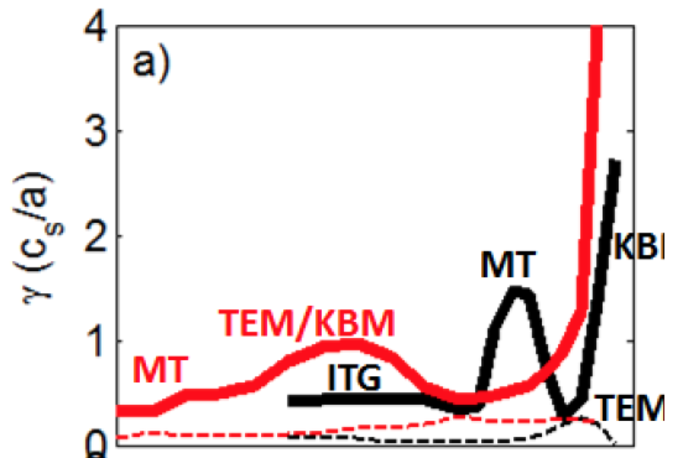
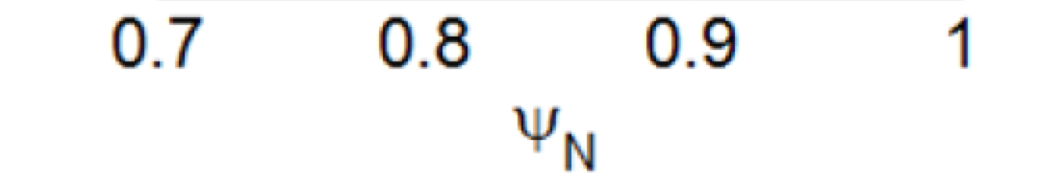
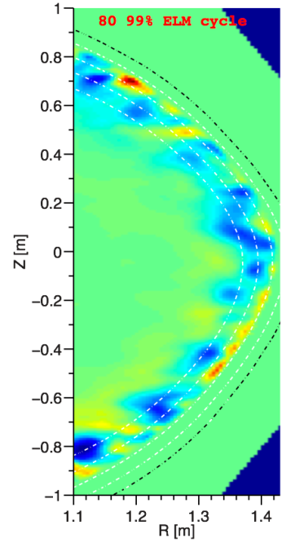
Understand role of different microinstabilities for different transport channels for pedestal control
BP-1
TEM / KBM modes appear dominant in near-edge region of NSTX pedestal
  GENE: ITG/KBM-TEM hybrid modes and microtearing
  GS2: hybrid TEM/KBM dominant
    No lithium: microtearing modes linearly unstable
    Lithium: microtearing stable, TEM unstable, ETG unstable near separatrix
Lithium
No lithium
Measured correlation lengths at pedestal top are consistent with theory (XGC1)
  Spatial structure exhibits ion-scale microturbulence
  Compatible with ITG modes and/or KBM
Theory
(non-linear
XGC1 code)
3 cm | 2 – 4 cm (reflecto-metery)
11 cm | 10 – 14 cm (BES)
Experiment
radial
poloidal
  Diagnostics (NSTX-U):
  42 point MPTS, reflectometry, 48 point BES
80% - 99% ELM cycle
139047
R = 1.38m

Slide 8
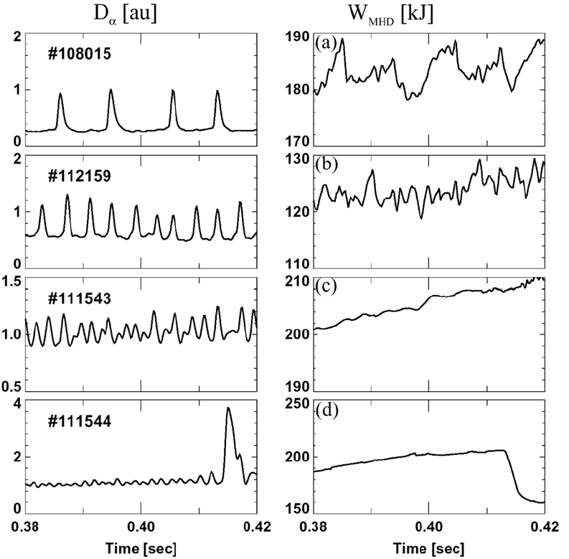
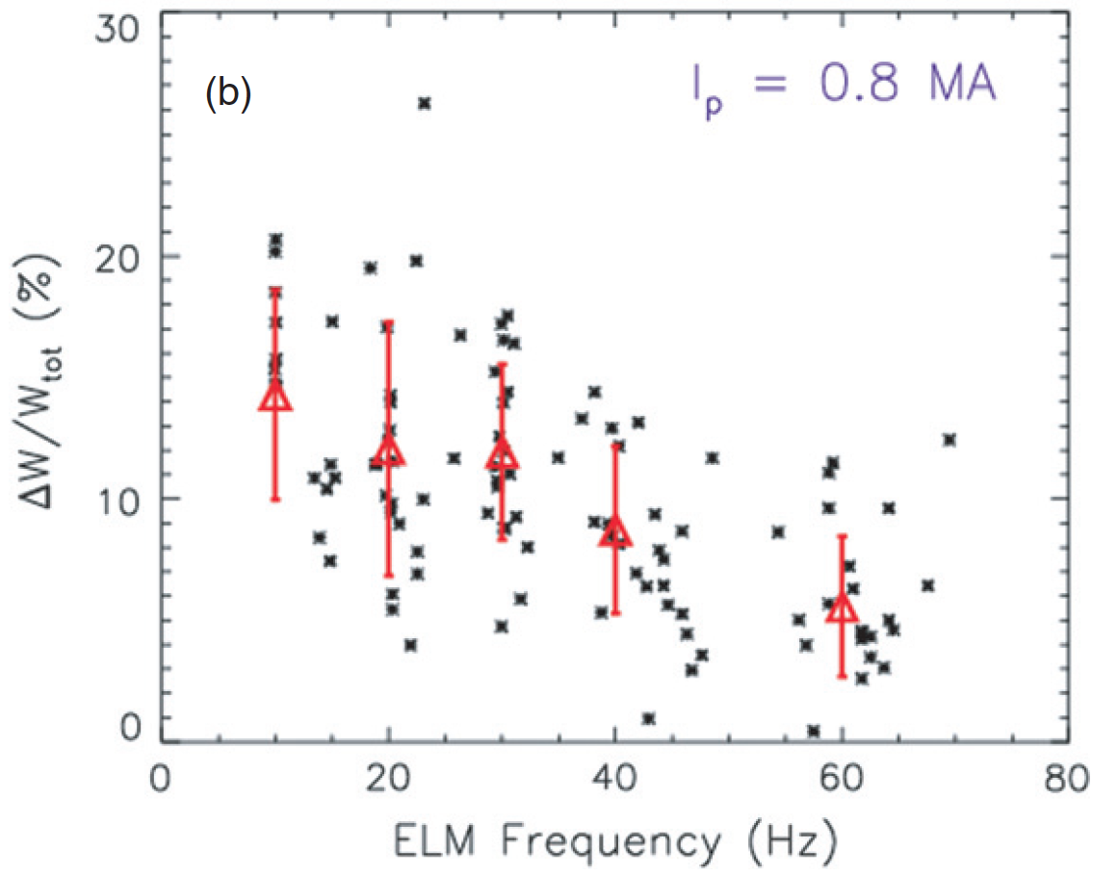
ELM evolution and divertor/wall heat flux studies in NSTX-U to focus on acceptable ELM heat flux scenarios
  Many ELM regimes observed in NSTX: Type I, III, V, mixed, (and also Type II in narrow operational windows)
    Phenomenology dependent on ν*_{ped}, P_{SOL}, I_{p,} shaping
ELM control techniques
  Lithium granule injector (tested at EAST)
  Lithium evaporation
  Enhanced Pedestal (ELM-free) H-mode
  3-D fields (n=3 RMP)
  Heat flux from Type I & III ELMs measured to be very high; small Type V ELMs have low heat flux
  Type I ELMs triggered with 3-D fields can reduce per ELM energy loss and peak heat flux, but slower than 1/ν_{ELM}
  Toroidal asymmetry increases with ELM peak heat flux
Type I
Type III
Type V
Mixed

Slide 9
Plans for pedestal transport, turbulence and ELM control research
Year 1 of 5 Year Plan
  Continue cross-machine comparison of pedestal structure with DIII-D and Alcator C-Mod
  Continue gyro-kinetic modeling of electromagnetic turbulence
Years 2-3 of 5 Year Plan
  Pedestal structure and turbulence vs engineering and physics parameters
  ELM control with lithium coatings, lithium granule injector, and 3D fields\
  Access to new operational regimes (enhanced pedestal H-mode, I-mode)
  Initiate assessment of SOL current generation and impact on ELM models and control
  Re-establish parameter regime for observation of edge harmonic oscillations
Years 4-5 of 5 Year Plan
  ELM control with off-midplane non-axisymmetric control coils
  Compare pedestal structure and turbulence with edge transport models, XGC0 and XGC1
  Assess cryopump and molybdenum PFC impact on pedestal collisionality and control
  Diagnostics: MPTS, CHERS, BES, reflectometry, GPI

Slide 10
Boundary Physics program in NSTX-U contributes to critical research areas for ITER/tokamaks and STs
Boundary Physics Thrusts (and outline of the talk)
  BP-1: Assess and control pedestal structure, edge transport and stability
    Pedestal structure, transport and turbulence studies
    ELM characterization and control
  BP-2: Assess and control divertor heat and particle fluxes
    SOL transport and turbulence, impurity transport
    Divertor heat flux mitigation with impurity seeding and divertor geometry

Slide 11
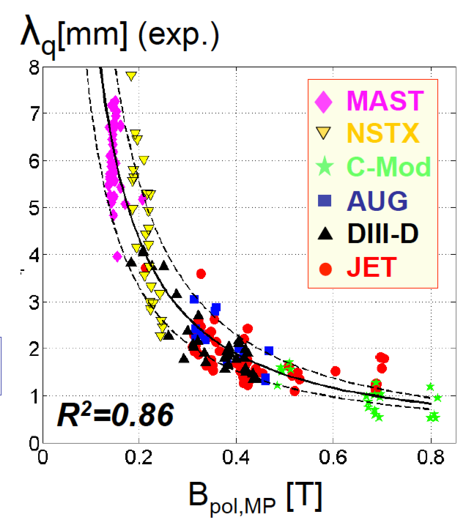
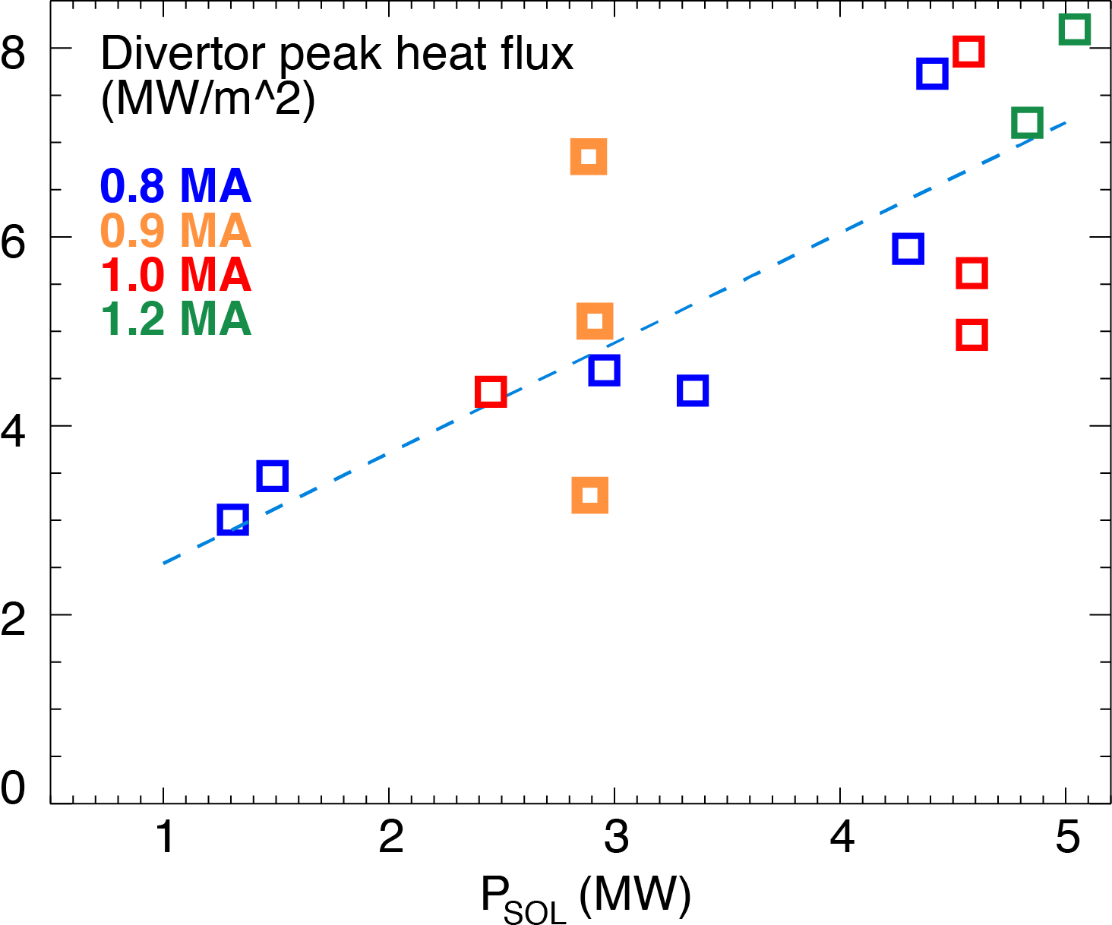
NSTX-U data will help reduce SOL width scaling uncertainties for ST-FNSF and ITER
BP-2
SOL width scaling
  In NSTX: λ_{q}^{mid} ~ I_{p}^{-1.6}, independent of P_{SOL} and B_{t}
    For NSTX-U (2 MA): λ_{q}^{mid} = 3±0.5 mm
  Multi-machine database (Eich IAEA FEC 2012):
  λ_{q}^{mid} (mm) = (0.63+/-0.08)x B_{pol,MP}^{-1.19}
    For NSTX-U (B_{p}~0.55 T): λ_{q}^{mid} ~ 1.3 mm
  Divertor peak heat flux scaling
    q_{peak}~ P_{SOL} and q_{peak} ~ I_{p}
    For NSTX-U q_{peak} ~ 20-30 MW/m²
Diagnostics: IR cameras, MPTS, Langmuir probes
  Divertor Thomson scattering (incremental) valuable for pressure/temperature balance between midplane, x-point, and divertor regions for heat transport studies

Slide 12
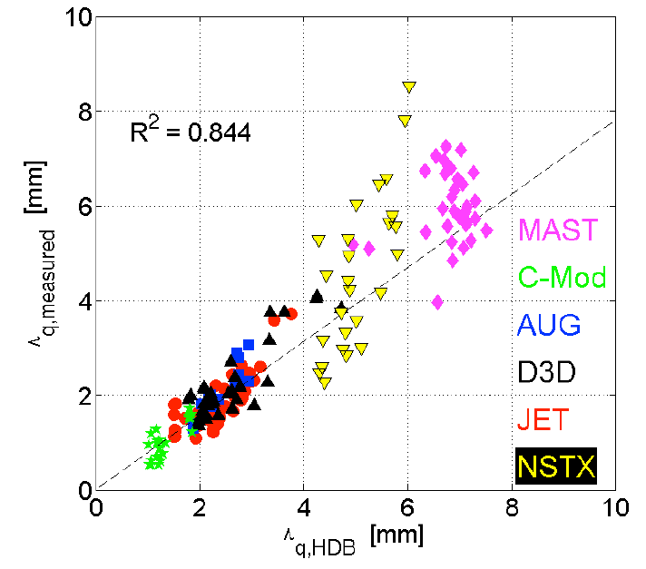
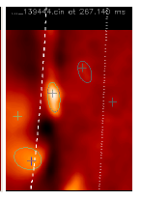
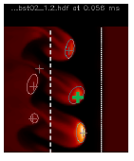
SOL turbulence studies will help assess relative importance of turbulent and drift-based transport
BP-2
Comparison of λ_{SOL} with SOL models
  Parallel transport: conductive/convective, cross-field : collisional / turbulent / drift
  Goldston drift-based model
    λ_{SOL} ~ (2a/R) ρ_{θ,} for NSTX-U: λ_{q}^{mid} ~ 6 mm
  Exploring mechanisms setting steep pressure gradient region and connection to SOL width
  XGC0 (drift-kinetic): λ_{q}^{mid} ~ I_{p}^{-1.0}
  SOLT (fluid turbulence): I_{p} scaling is weaker than observed
Comparison of GPI, BES data and simulations elucidate on SOL transport and L-H transition
  Blob formation, motion, interaction with sheared flows
  Role of magnetic X-point geometry
  Effects of 3-D fields on turbulence
  Role of atomic physics
GPI SOLT
Diagnostics: MPTS, GPI – multiple views, BES, reflectometry, Langmuir probes

Slide 13
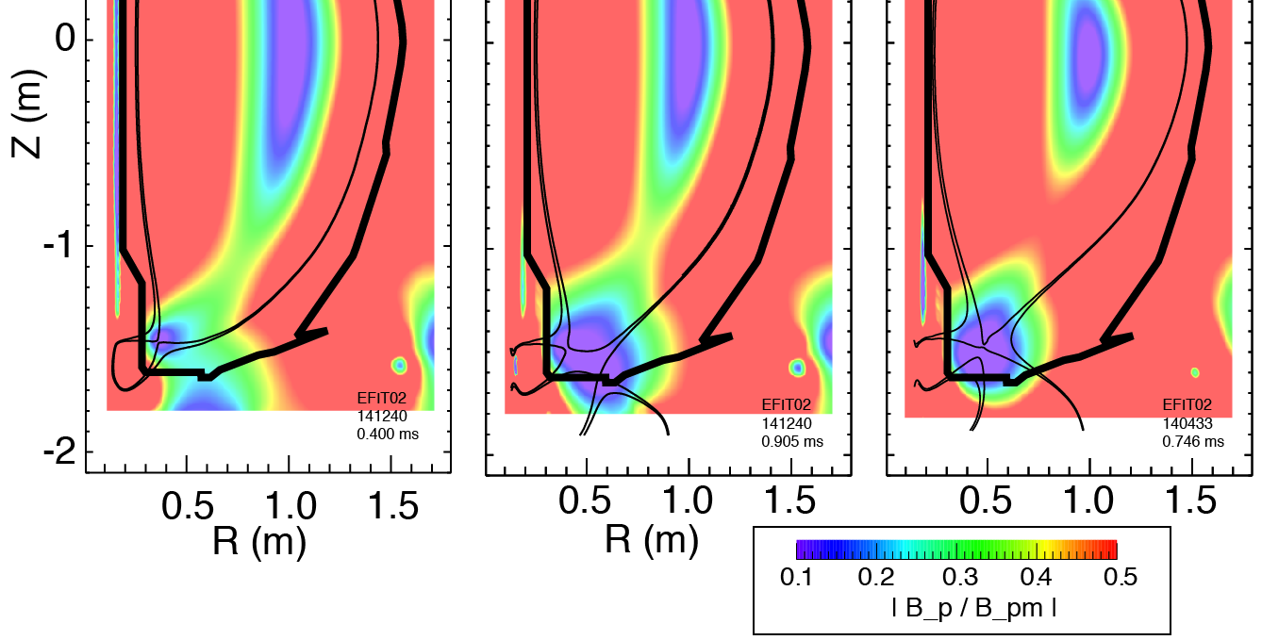
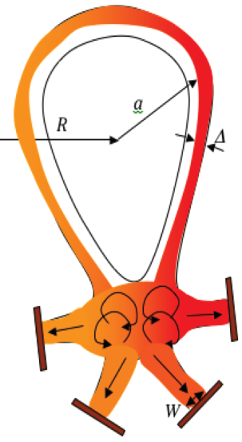
Snowflake divertor geometry has benefits over standard divertor
BP-2
Standard divertor Snowflake-minus Exact snowflake
Second-order null
  B_{p} ~ 0 and grad B_{p} ~ 0
Significant divertor heat flux reduction due to geometry confirmed in NSTX and DIII-D
Outstanding questions
  Magnetic control of up-down symmetric snowflake
  Effect on pedestal and ELMs
  ELM convective heat transport in null point region
  SOL and divertor turbulence disconnection
  X-point transport and drifts
  Compatibility with cryopumping

Slide 14
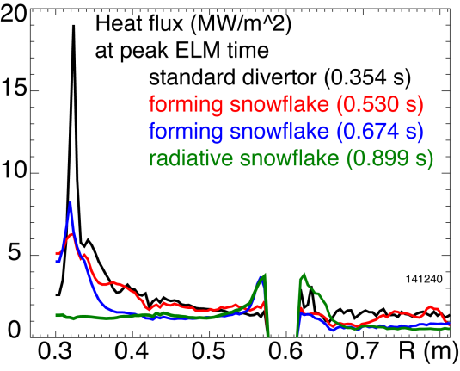


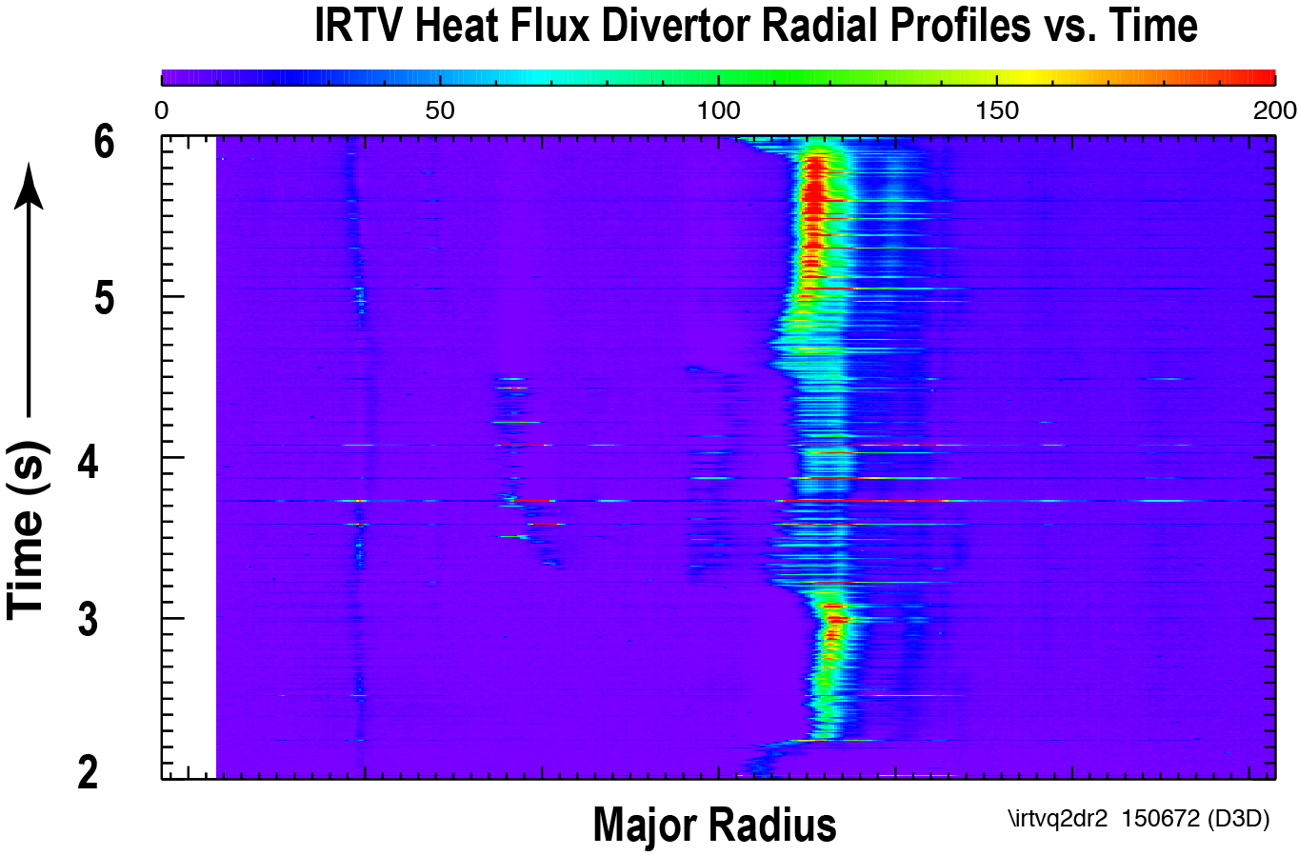
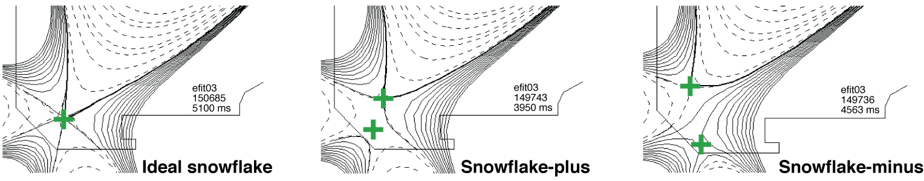
Multi-machine snowflake divertor studies validate the snowflake divertor concept for NSTX-U and ST-FNSF
BP-2
Snowflake divertor in NSTX (2009-2010)
  High confinement, core impurity reduction
  Destabilized ELMs suppressed by lithium
  Reduced heat flux by x 2-5 between and during ELMs
  Outer strike point radiatively detached
Initial DIII-D experiments (2012)
  Used NSTX-style snowflake control scenario
  Long pulse (3s) snowflake, high τ_{E}, H(89P) ≥ 2
  Heat flux reduced x 2-3, strike point attached
  Reduced ΔW_{ELM} and q^{ELM}_{pk} (with D₂ seeding)
Snowflake
Snowflake

Slide 15
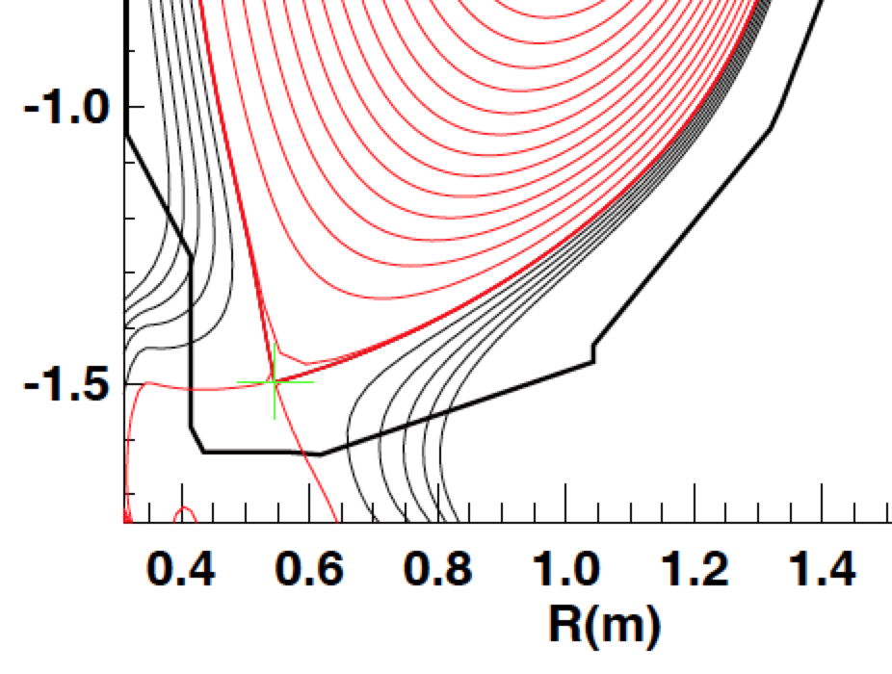
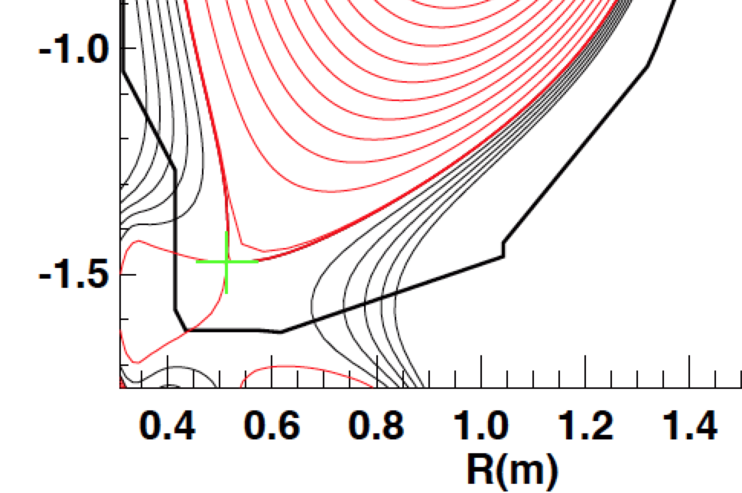
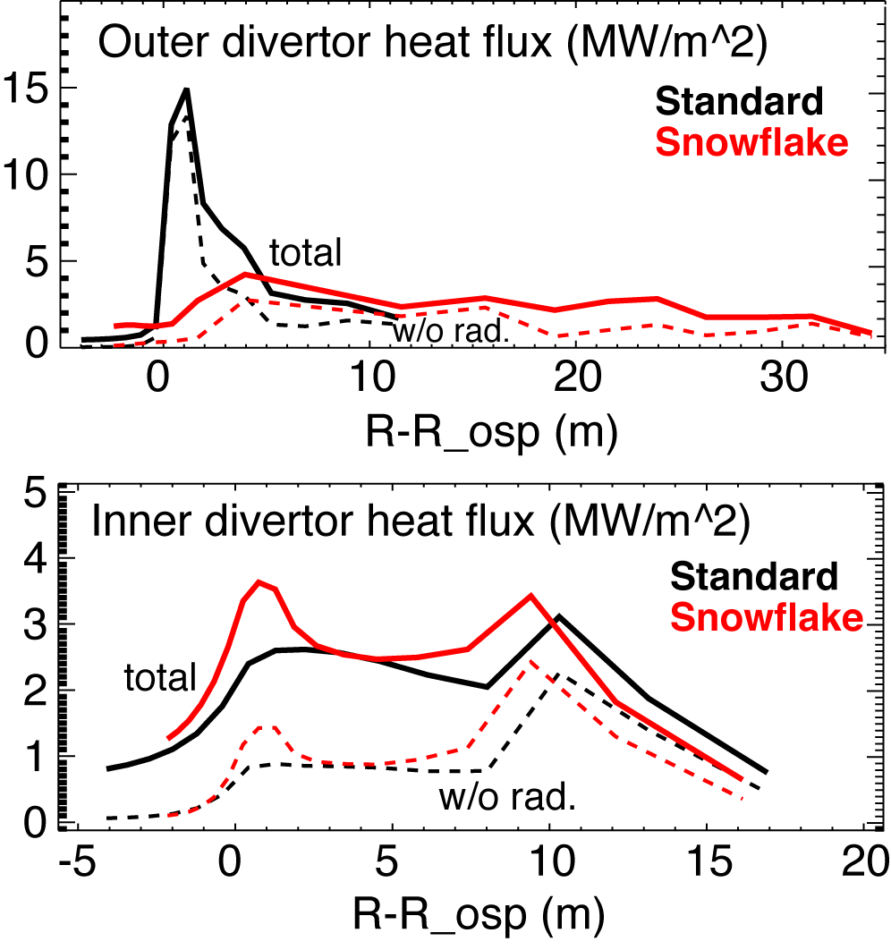
Simulations of snowflake divertor configuration for NSTX-U yield optimistic projections
BP-2
Significant geometry effects
Multi-fluid edge transport model (UEDGE)
  Heat flux reduction with 4% carbon by geometry and radiation in outer strike point
    for 12 MW NBI case from 15 MW/m² to 2-3 MW/m²
  Inner divertor detached
  Particle removal by cryopump results in reduced radiation
    But still significant heat flux reduction due to geometry
 | Standard | Snowflake
L_{X} (m) | 5 | 17
f_{exp} | 20 | 60-100
V_{div} (m³) | 0.070 | 0.128

Slide 16
Impurity-seeded radiative divertor with feedback control is planned for NSTX-U
BP-2
In NSTX, heat flux reduction in radiative divertor compatible with H-mode confinement was demonstrated with D₂ or CD₄ puffing
Seeded impurity choice dictated by Z_{imp} and PFC
  Li/C PFCs compatible with D₂, CD₄, Ne, Ar seeding
  UEDGE simulations show Ar most effective
    Too much argon causes radiation collapse of pedestal
Feedback control of divertor radiation via impurity particle balance control
  Cryopump for particle removal + divertor gas injectors
  Real-time control signal diagnostics identified for NSTX-U
    PFC temperature via IR thermography or thermocouple
    Thermoelectric current between inner and outer divertor
    Impurity VUV spectroscopy or bolometry
    Neutral gas pressure or electron-ion recombination rate

Slide 17
SOL and divertor studies will focus on model validation and heat flux mitigation
BP-2
Year 1
  Continue analysis of SOL width database and comparison with models
  Collaboration with DIII-D on snowflake and radiative divertor experiments
Years 2-3
  Establish SOL width and divertor database vs. engineering and physics parameters
  Re-establish edge turbulence measurements (GPI, BES, cameras, probes)
  Initial radiative divertor experiments with D₂, CD₄ and Ar seeding and lithium
  Develop snowflake divertor magnetic control and assess pedestal stability, divertor power balance, turbulence, 3D fields as functions of engineering parameters
  Comparison with multi-fluid and gyro-kinetic models
Years 4-5
  3D edge/SOL turbulence structure vs. edge plasma parameters, magnetic divertor geometry, and 3D fields and comparison with 3-D turbulence models
  Snowflake divertor with cryopumping and molybdenum PFCs in H-mode scenarios
  Radiative divertor with feedback control of impurity seeding and cryo-pumping
Diagnostics: MPTS, CHERS, BES, GPI, IR cameras, Langmuir probes, spectroscopy
Divertor Thomson scattering (incremental) highly beneficial for model validation

Slide 18
Boundary program focuses on advancing pedestal physics, power and particle handling with new NSTX-U capabilities
  Pedestal physics: confirm consistency with peeling ballooning, and test applicability of kinetic ballooning
  Use lithium conditioning and 3-D fields as a way to manipulate the density and pressure profile
Power and particle handling: further develop snowflake and radiative divertors
  Test key predictions of snowflake configuration, and evaluate synergy with radiative divertors, graphite and molybdenum plasma facing components
  Evaluate compatibility with cryopumping
  Planned research aims at providing pedestal and divertor physics basis for ST-FNSF

Slide 19
Backup

Slide 20
Thrust BP-1: Assess, optimize, and control pedestal structure, edge transport and stability
Characterize pedestal structure using the extended parameter range of NSTX-U
  Measure turbulence and zonal flow dynamics with beam emission spectroscopy, reflectometry, and gas-puff imaging diagnostics
  Assess maximum achievable pedestal height, variation in pedestal structure with increased field, current, power and shaping
Increase control of pedestal transport and stability
  Density profile modification with improved impurity and density control
  ELM triggering/suppression with 3D fields from mid-plane and off-midplane partial-NCC coil-sets and triggering with Li granule injection
  Optimize enhanced-pedestal H-modes with above tools
  Excite edge harmonic oscillations to increase particle x-port (increm.)

Slide 21
Thrust BP-2: Assess and control divertor heat and particle fluxes
Investigate SOL heat and particle transport and turbulence
  Extend heat flux width studies to lower ν, higher B_{T}, I_{P}, and P_{SOL}
  Compare data to multi-fluid turbulence and gyro-kinetic models
Investigate the snowflake divertor for power and particle control
  Develop magnetic control of conventional and snowflake divertors
  Study steady-state & transient heat & particle transport, divertor loads
    Vary magnetic balance, feedback-controlled impurity seeding rate
Develop highly-radiating boundary solutions with feedback control, determine divertor detachment operating window
Validate cryo-pump physics assumptions, perform initial density control studies, determine range of accessible density
Assess impact of high-Z metal divertor PFCs on H-mode confinement, impurity accumulation, power exhaust

Slide 22
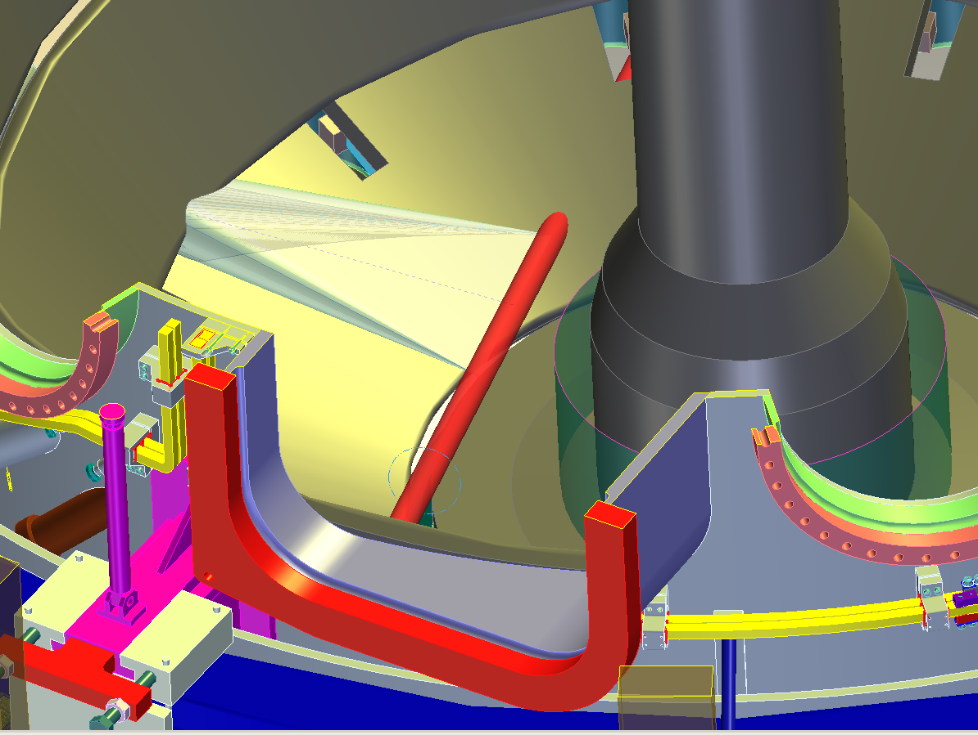
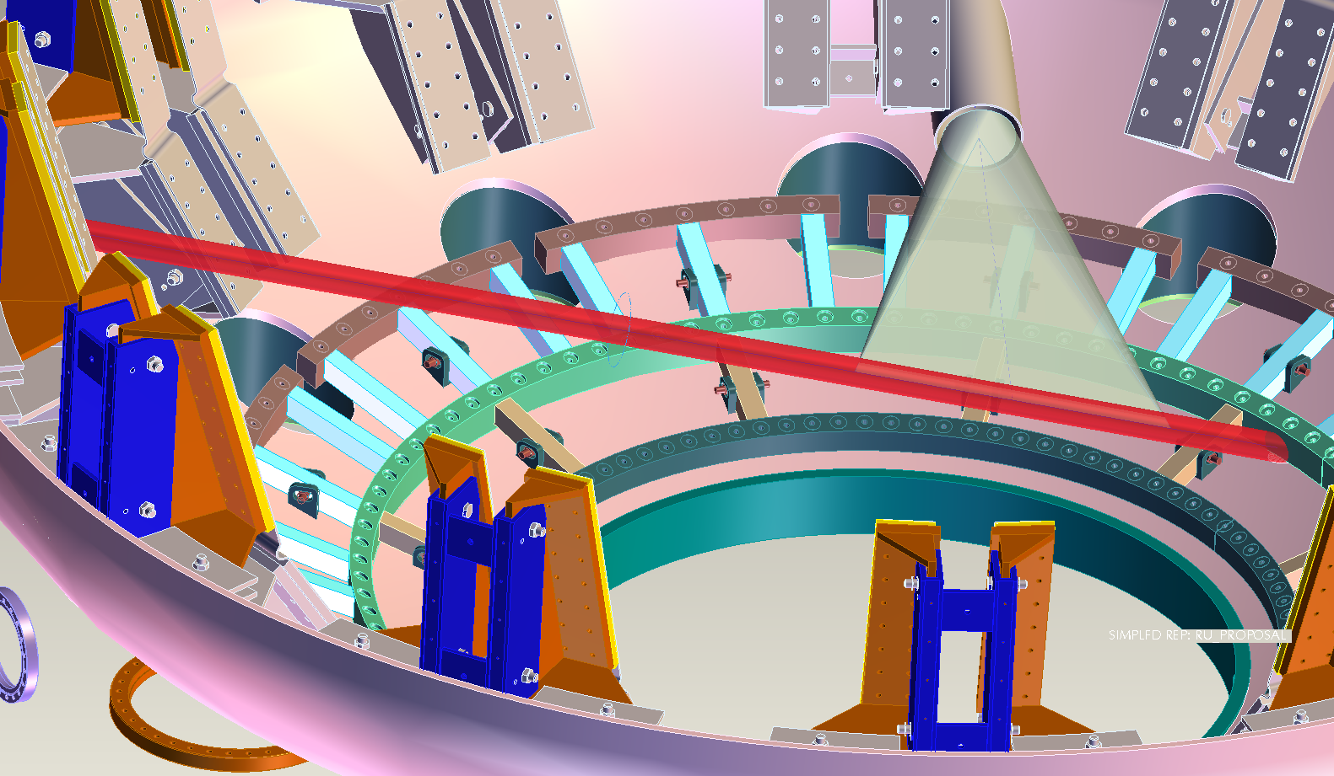
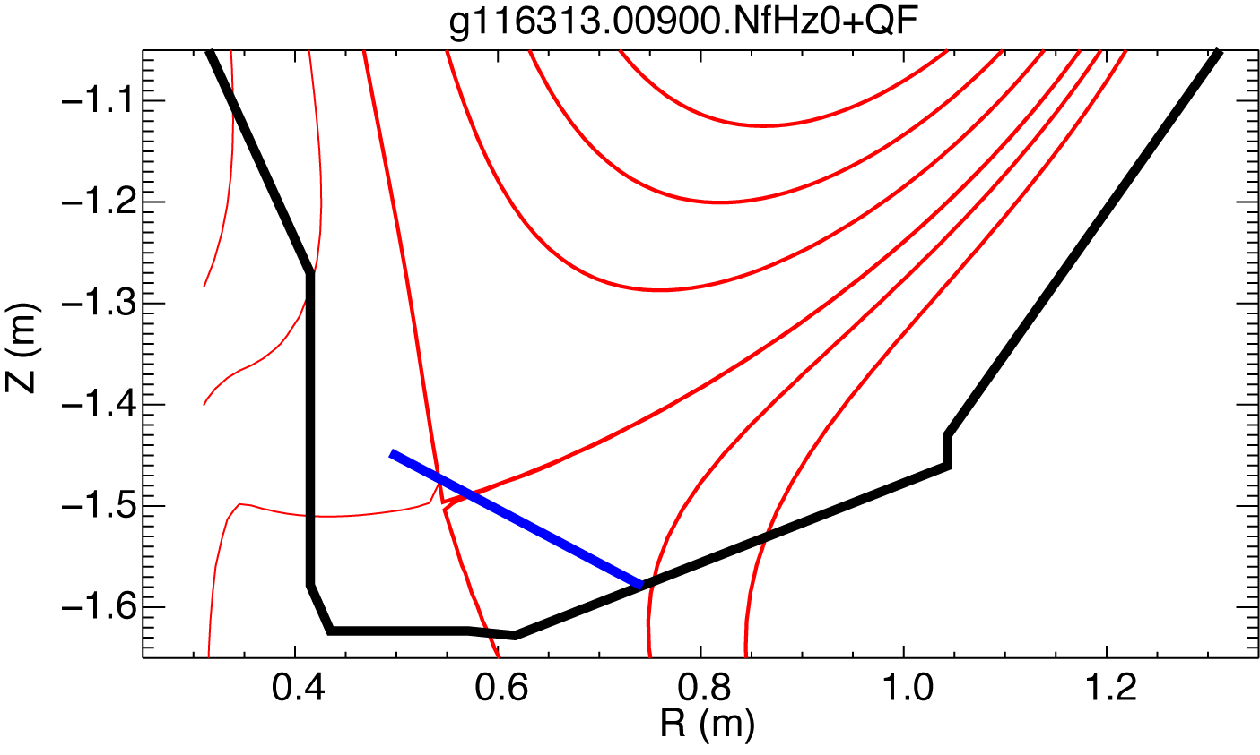
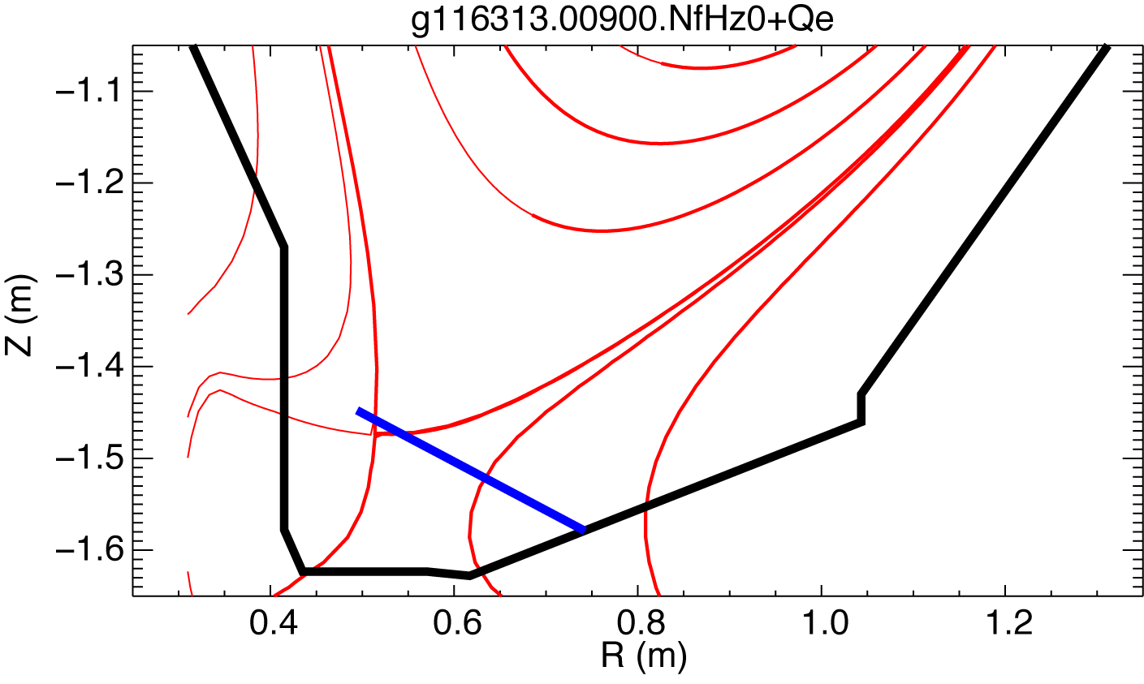
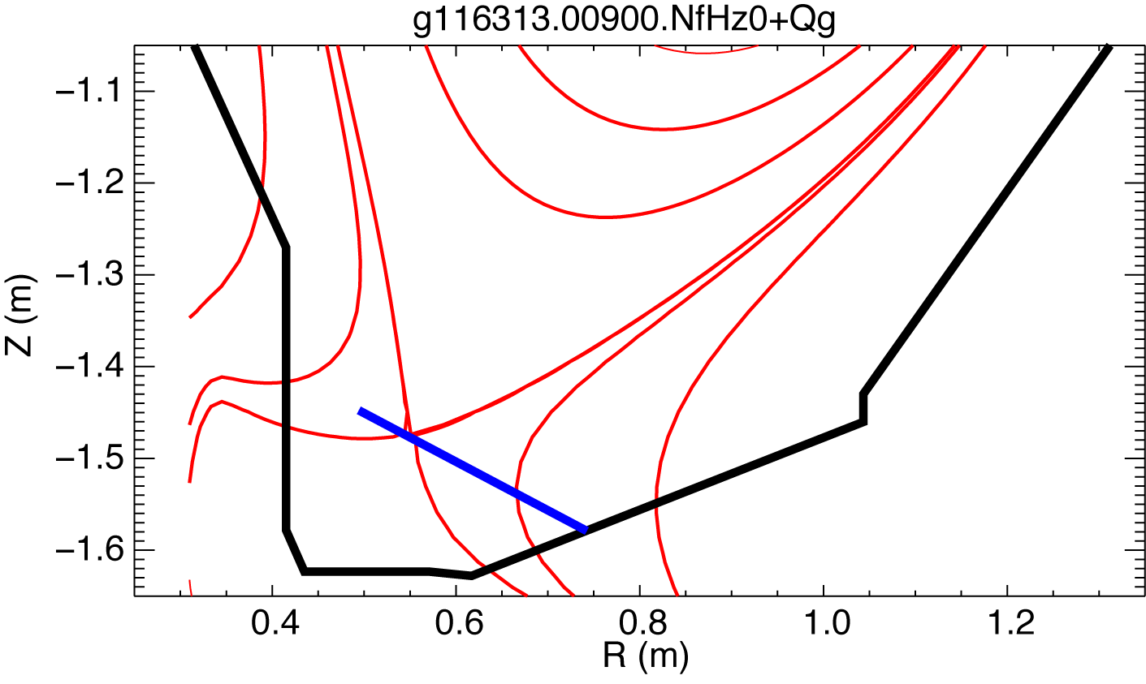
Divertor Thomson Scattering system would significantly enhance NSTX-U Boundary research capabilities
Physics contributions
  ELM and inter-ELM divertor transport
  SOL width scaling, role of X-point heat transport
  Radiative detachment model validation
  Snowflake divertor properties, incl. X-pt β_{p} measurements
  Divertor plasma-surface interaction and impurity transport studies, erosion rates via spectroscopy
A conceptual geometry identified for NSTX-U
Conceptual system design underway

Slide 23
Edge Harmonic Oscillations
Rob Goldston, Eric Fredrickson, Neal Crocker, Mike Jaworski
Mirnov
Reflectometry
Langmuir Probes
EHO’s limit density rise in QH modes on DIII-D. They are observed on NSTX with Li, but don’t seem to limit density.
However EHOs do affect the edge and SOL strongly.

Slide 24
Driving Edge Harmonic Oscillations
Key to Active Edge Control?
Jong-Kyu Park
MHD calculations indicate we can amplify edge kinks by driving HHFW antenna straps at audio frequencies.
Can this give us external control over edge pressure gradient
(and so ELMs) and/or the SOL width?

Slide 25
Snowflake divertor geometry has benefits over standard X-point divertor geometry
Predicted geometry properties in snowflake divertor (cf. standard divertor)
  Increased edge shear :ped. stability
  Add’l null: H-mode power threshold, ion loss
  Larger plasma wetted-area A_{wet} : reduce q_{div}
  Four strike points : share q_{II}
  Larger X-point connection length L_{x} : reduce q_{II}
  Larger effective divertor volume V_{div} : incr. P_{rad} , P_{CX}
  D. D. Ryutov, PoP 14, 064502 2007

Slide 26
Snowflake divertor geometry takes advantage of second-order poloidal field null properties
BP-2
Standard divertor Snowflake-minus Exact snowflake
Second-order null
  B_{p} ~ 0 and grad B_{p} ~ 0 (Cf. first-order null: B_{p} ~ 0)
Obtained with existing divertor coils (min. 2)
Exact snowflake topologically unstable
Predicted geometry properties in snowflake divertor (cf. standard divertor)
  Increased edge shear :ped. stability
  Add’l null: H-mode power threshold, ion loss
  Larger plasma wetted-area A_{wet} : reduce q_{div}
  Four strike points : share q_{II}
  Larger X-point connection length L_{x} : reduce q_{II}
  Larger effective divertor volume V_{div} : incr. P_{rad} , P_{CX}

Slide 27
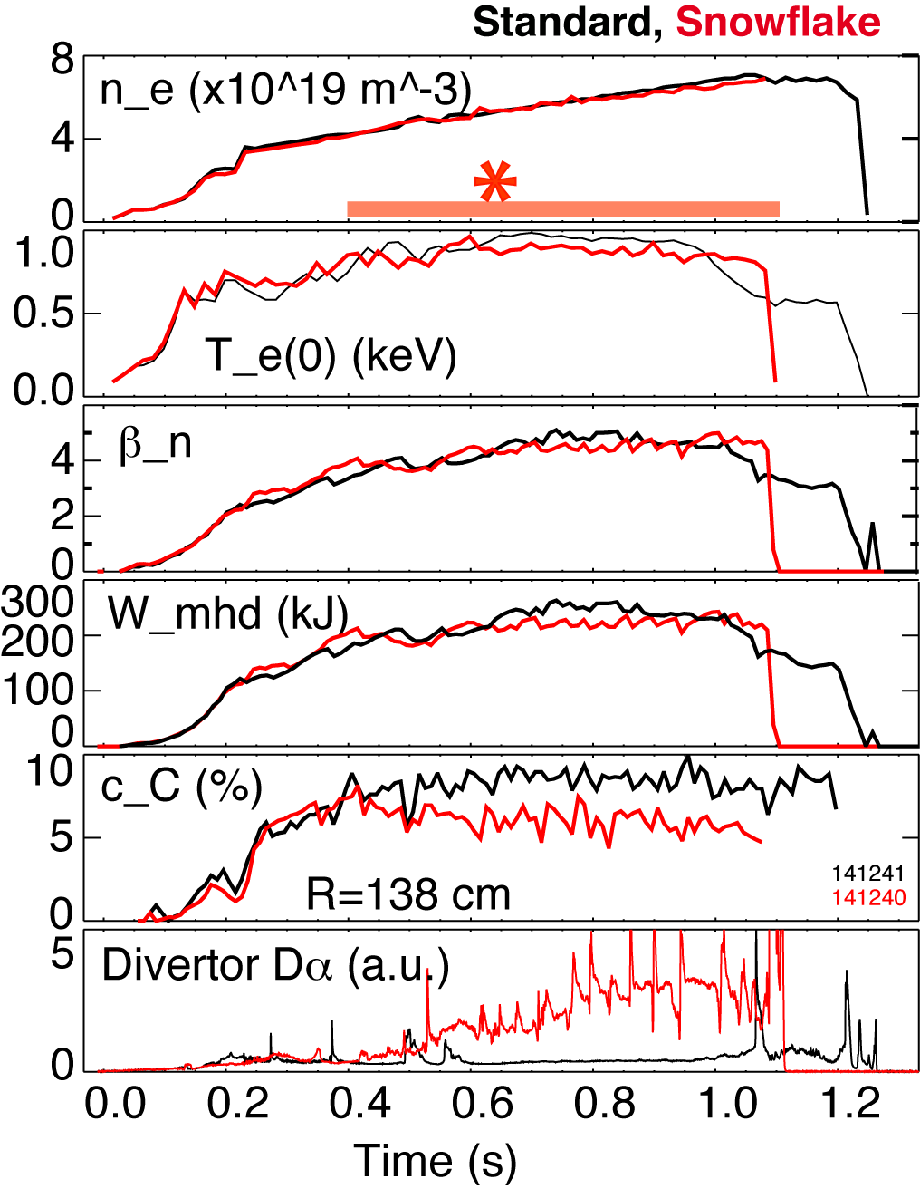
  NSTX: good H-mode confinement properties and core impurity reduction obtained with snowflake divertor
0.8 MA, 4 MW H-mode
κ=2.1, δ=0.8
Core T_{e} ~ 0.8-1 keV, T_{i} ~ 1 keV
β_{N} ~ 4-5
Plasma stored energy ~ 250 kJ
H98(y,2) ~ 1 (from TRANSP)
ELMs
  Suppressed in standard divertor H-mode via lithium conditioning
  Re-appeared in snowflake H-mode
Core carbon reduction due to
  Type I ELMs
  Edge source reduction
    Divertor sputtering rates reduced due to partial detachment

Slide 28
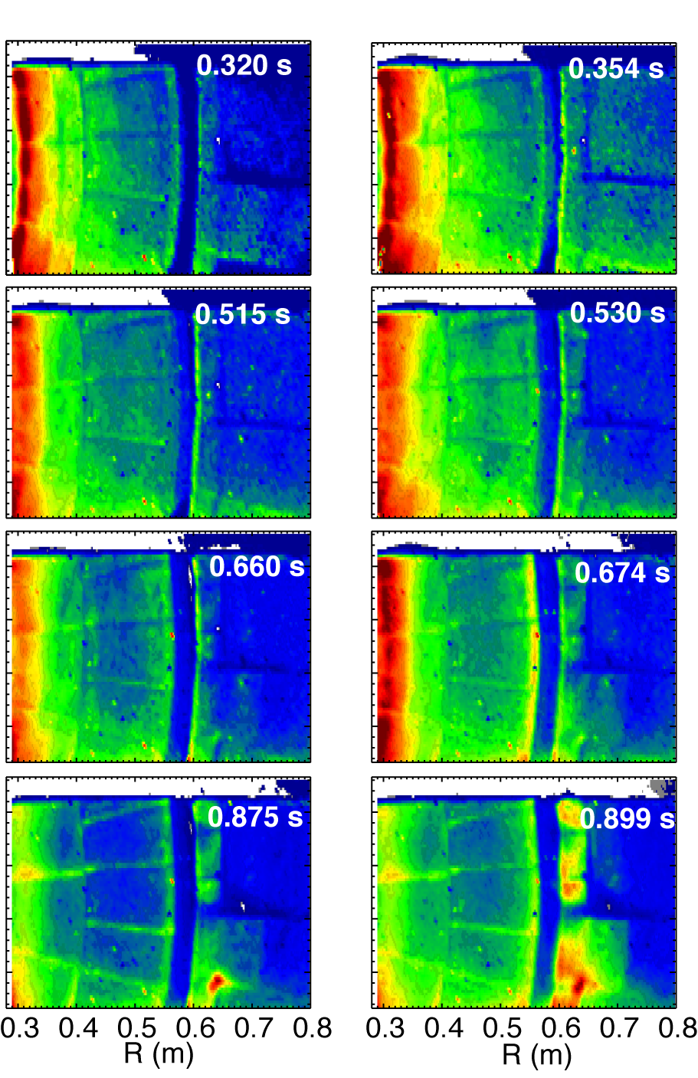
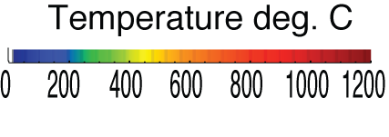
Impulsive heat loads due to Type I ELMs are mitigated in snowflake divertor
Steady-state At ELM peak

Slide 29
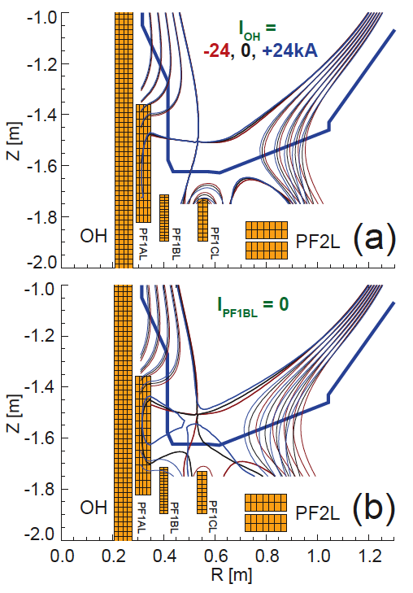
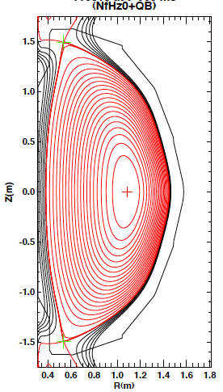
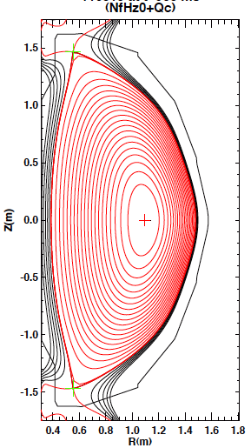
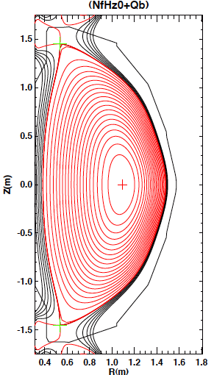
Snowflake divertor is a leading heat flux mitigation candidate for NSTX-U
Single and double-null radiative divertors and upper-lower snowflake configurations considered
  Supported by NSTX-U divertor coils and compatible with coil current limits
  ISOLVER modeling shows many possible equilibria
    Impact of changing I_{OH} on snowflake minimal
    Reduced divertor coil set can be used for snowflakes
NSTX-U simulation
NSTX-U double-null
NSTX-U double-snowflake-plus
NSTX-U double-snowflake-minus

Slide 30
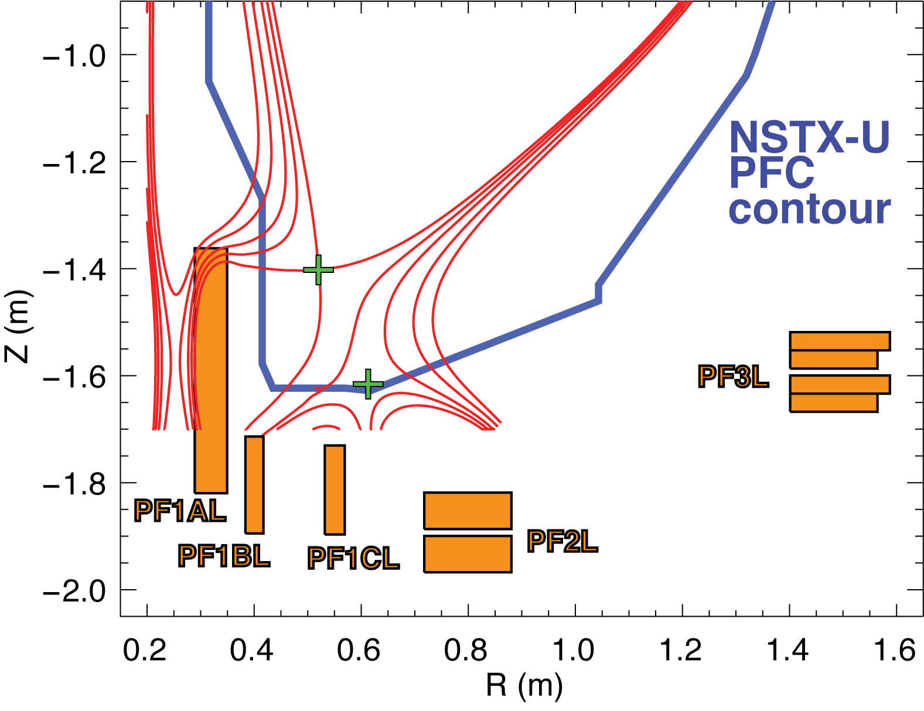
Four divertor coils should enable flexibility in boundary shaping and control in NSTX-U
A variety of lower and both lower and upper divertor snowflake configurations are possible in NSTX-U with four coils per divertor
  ISOLVER free-boundary Grad-Shafranov solver used
  Four coils can be used to control up to four parameters (X-pts, OSP, etc)
Midplane flux surface | 0.0 | 1.5 mm | 3.0 mm | 6.0 mm | 9.0 mm
L_{tot} (m) | 38.3 | 20.4 | 13.9 | 9.9 | 8.3
L_{X} (m) | 16.5 | 4.0 | 2.2 | 1.6 | 1.5
Angle (deg.) | 1.6 | 0.8 | 0.99 | 3.0 | 3.9
X 2-3 in plasma wetted surface area and connection length vs standard divertor

Slide 31
Simulations of snowflake divertor configuration inform heat flux mitigation scenarios in NSTX-U
ISOLVER modeling shows a variety of up-down symmetric snowflake (+/-) configurations possible
  Impact of changing I_{OH} on snowflake minimal
  Reduced divertor coil set can be used for snowflakes
UEDGE simulations predict heat flux reduction with carbon by geometry and radiation
Particle removal by cryopump results in reduced radiation in snowflake

Slide 32
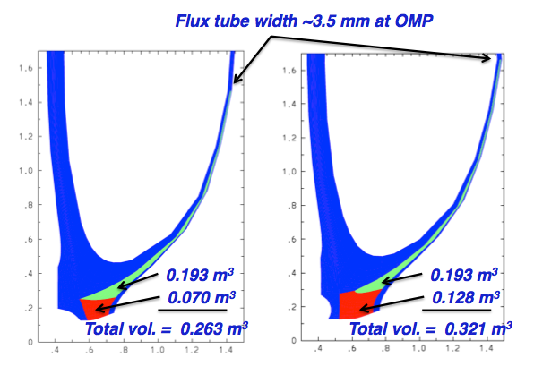
UEDGE settings
Single null grid based on LRDFIT equilibria (129x129)
Inertial neutral model is used with recycm=-.5
Fixed fraction Argon is varied from 0.5 to 3.5%
Fixed fraction Neon is varied from 0.5 to 6%
0.9 < ψ < 1.055
D_{perp} = .1 (in core) → 0.5 (in SOL) m²/s
  Cubic rise from core boundary to separatrix
Thermal diffusivity χ_{i,e} = 1 (in core) → 3 (in SOL) m²/s
  Cubic rise from core boundary to separatrix
Recycling = 0.99
Power across ψ=0.9 surface P₉₀ = 9 MW
Zero flux BC for neutral D at core
Psi=0.9 density value determined by fixing particle flux through core; based on 60 A for 4 MW NBI power → 180 A at P₉₀=9 MW
300 A centerstack puff at inner midplane.
No drift effects
Heat flux width analyzed for STD divertor only.
  ~3 mm heat flux width expected; f_{χ}=1.0 (5 mm) is not unrealistic

Slide 33
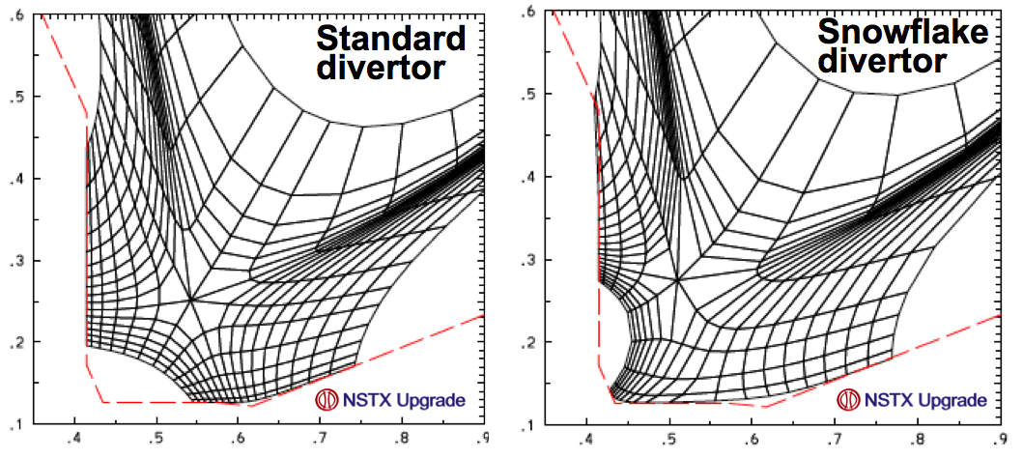
Projections with UEDGE edge multi-fluid model for NSTX-U are optimistic
Fluid (Braginskii) model for ions and electrons
Fluid for neutrals
Classical parallel transport, anomalous radial transport
Core interface:
  P_{SOL90} = 5; 7; 9 MW
D = 0.1-0.5 m²/s
χ_{e,i} = 1-2 m²/s
R_{recy} = 0.99
Carbon 5 %
Grids extend from psi=0.9 to psi=1.2
STD grid covers 3.1 cm outside the separatrix at the outer MP
SNF grid covers 3.4 cm outside the separatrix at the outer MP.

Slide 34
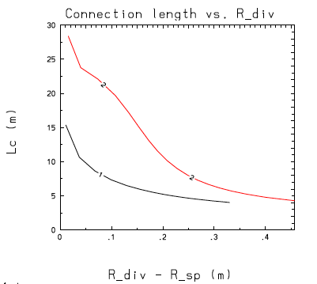
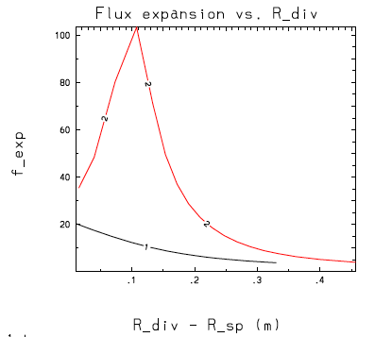
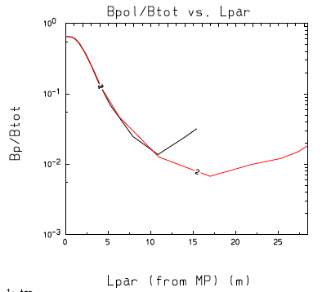
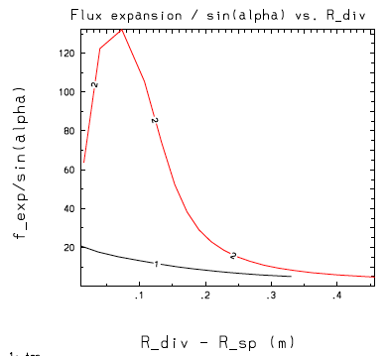
In modeled NSTX-U snowflake configuration magnetic geometry shows clear benefits (cf. standard divertor)

Slide 35
SOL width studies elucidate on heat flux scaling projections for NSTX-U, ST-FNSF and ITER
BP-2
Goal: compare SOL width scalings with models
SOL width scaling
  In NSTX: λ_{q}^{mid} ~ I_{p}^{-1.6}
    For NSTX-U (2 MA): λ_{q}^{mid} = 3±0.5 mm
  Multi-machine database (Eich IAEA FEC 2012):
  λ_{q}^{mid} (mm) (0.63+/-0.08)x B_{pol,MP}^{-1.19}
    For NSTX-U (B_{p}~0.55 T): λ_{q}^{mid} ~ 1.3 mm
  Comparison with SOL models
    Parallel transport: conductive/convective, cross-field : collisional / turbulent / drift
    Goldston heuristic model: ∇B and curvature drift motion sets SOL width λ_{SOL} ~ (2a/R) ρ_{i}, Spitzer thermal conduction sets T_{sep}
      For NSTX-U: λ_{q}^{mid} ~ 6 mm
Diagnostics: IR cameras, MPTS, Langmuir probes
  Divertor Thomson scattering (incremental) desirable

Slide 36
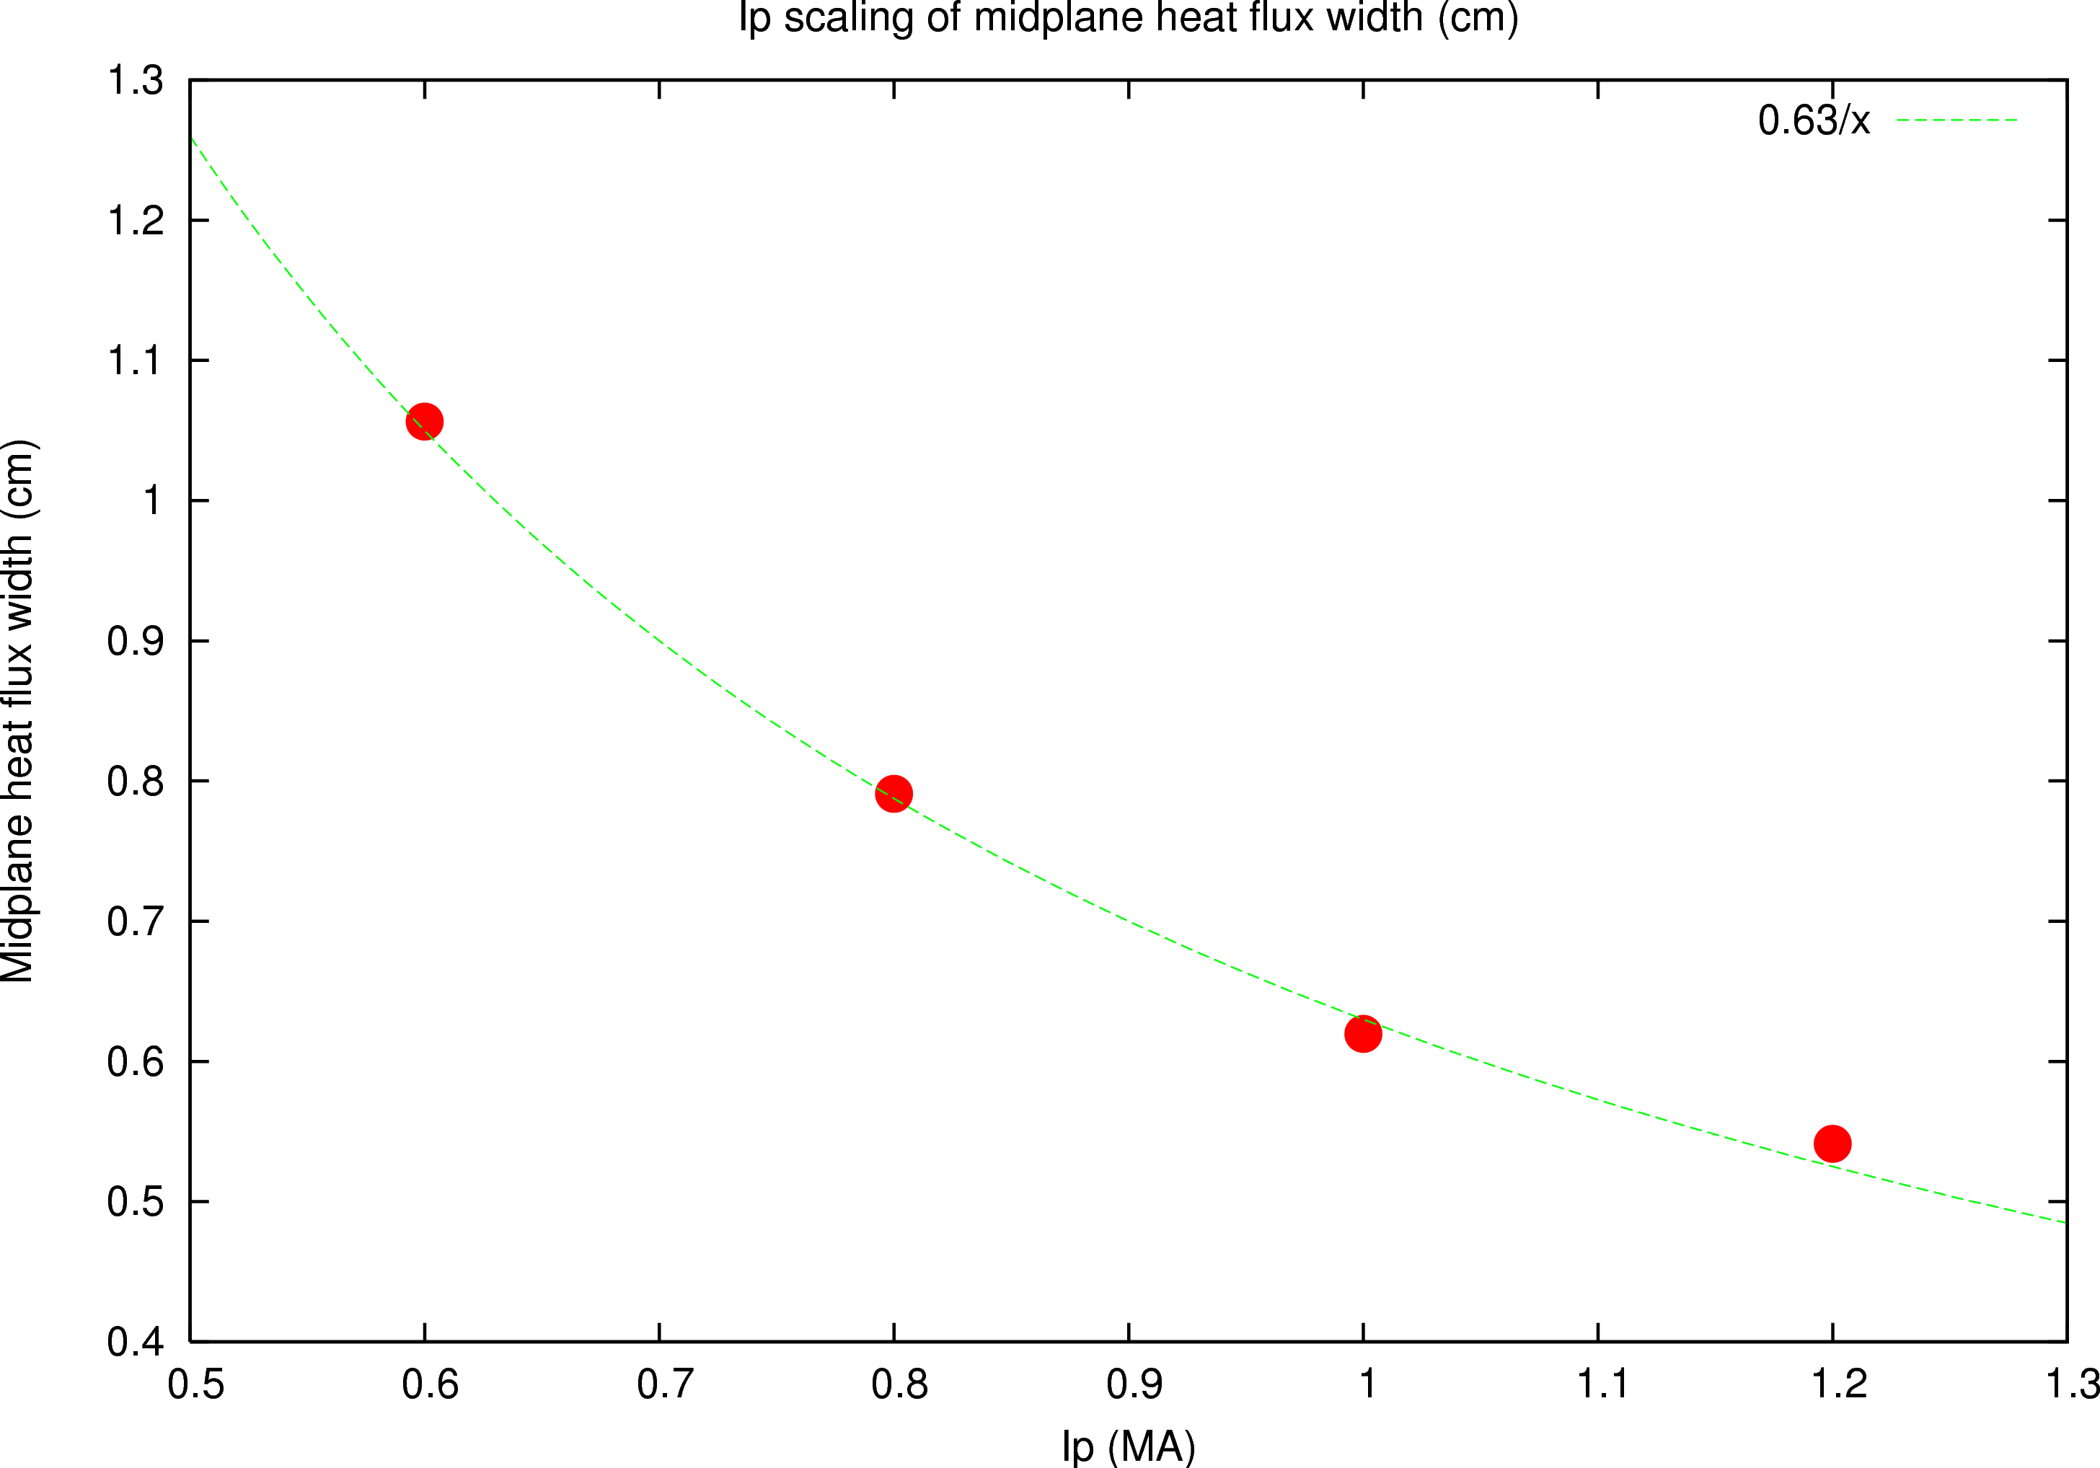
SOL width and divertor heat flux studies in NSTX inform NSTX-U and ITER divertor projections
Completed FY 2010 DOE JRT
  λ_{q}^{mid} characterized in experiment
    independent of P_{SOL} and B_{t}
    constant with increasing f_{exp}
    contracts with increasing drsep; and I_{p}: λ_{q}^{mid} ~ I_{p}^{-1.6}
    (DIII-D: λ_{q}^{mid} ~ I_{p}^{-1.2} ; Alcator C-Mod: λ_{q}^{mid} ~ I_{p}^{-1.0})
    λ_{q} contracts with increasing lithium deposition
  and modeled
    XGC0 modeling reproduced I_{p} dependence
    (NSTX: λ_{q}^{mid} ~ I_{p}^{-1.0} ; DIII-D: ~ I_{p}^{-0.8} ; C-Mod: ~ I_{p}^{-0.3} )
    SOLT modeling: weak λ_{q} scaling with P_{in}; I_{p} scaling is weaker than observed
Further studies
  Connect λ_{q}^{mid} to pedestal width and edge turbulence
  λ_{q}^{mid} data analysis for ITER / future STs
    For NSTX-U parameters, λ_{q}^{mid} = 3±0.5 mm
λ (I_{p})
NSTX 128013
PAC27-10
PAC27-11

Slide 37
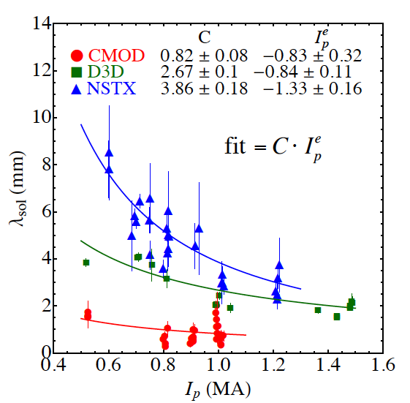
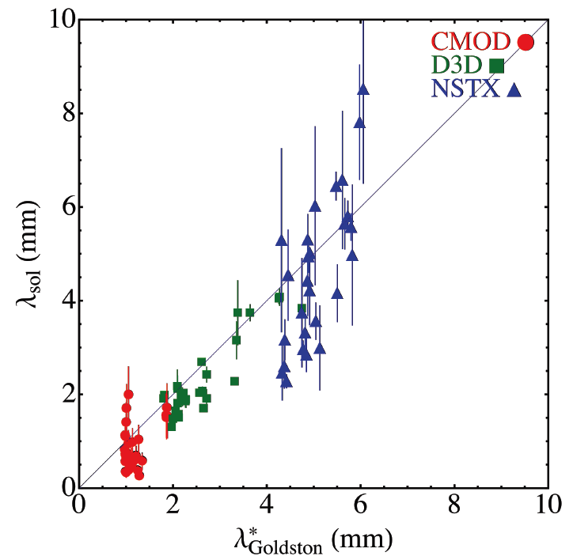
SOL width studies in NSTX elucidate on divertor projections for NSTX-U, ST-FNSF and ITER
JRT 2010 on heat transport
  λ_{q}^{mid} contracts with increasing I_{p}: λ_{q}^{mid} ~ I_{p}^{-1.6}
Comparison with SOL models
  Parallel transport: conductive/convective, cross-field : collisional / turbulent / drift
  XGC0 reproduced I_{p} dependence λ_{q}^{mid} ~ I_{p}^{-1.0}
  SOLT: I_{p} scaling is weaker than observed
    P_{SOL}, collisionality, L_{II} /R set cross-field transport and turbulence structure that affect λ_{q}
  Goldston drift-based model of SOL flows
    Attached H-mode regimes
    ∇B and curvature drift motion sets SOL width λ_{SOL} ~ (2a/R) ρ_{i}, Spitzer thermal conduction sets T_{sep}
  Exploring mechanisms setting steep pressure gradient region and connection to SOL width
Projections to NSTX-U
  λ_{q}^{mid} = 3±0.5 mm
  As q_{peak} ~ I_{p} and q_{peak}~P_{SOL}, q_{peak} ~ 20-30 MW/m²
M. Makowski, APS 2011
PAC29-12
PAC29-14

