Slide 1




NSTX-U
Supported by
NSTX-U 5 Year Plan for Plasma Start-up and Current Ramp-up
Coll of Wm & Mary
Columbia U
CompX
General Atomics
FIU
INL
Johns Hopkins U
LANL
LLNL
Lodestar
MIT
Lehigh U
Nova Photonics
Old Dominion
ORNL
PPPL
Princeton U
Purdue U
SNL
Think Tank, Inc.
UC Davis
UC Irvine
UCLA
UCSD
U Colorado
U Illinois
U Maryland
U Rochester
U Tennessee
U Tulsa
U Washington
U Wisconsin
X Science LLC
R. Raman
D. Mueller, S.C. Jardin
for the NSTX Research Team
Culham Sci Ctr
York U
Chubu U
Fukui U
Hiroshima U
Hyogo U
Kyoto U
Kyushu U
Kyushu Tokai U
NIFS
Niigata U
U Tokyo
JAEA
Inst for Nucl Res, Kiev
Ioffe Inst
TRINITI
Chonbuk Natl U
NFRI
KAIST
POSTECH
Seoul Natl U
ASIPP
CIEMAT
FOM Inst DIFFER
ENEA, Frascati
CEA, Cadarache
IPP, Jülich
IPP, Garching
ASCR, Czech Rep
NSTX-U PAC-33 Meeting
PPPL – B318
February 19-21, 2013

Slide 2
Outline
Motivation & Goals
Transient CHI Plasma Start-up
Point Source Helicity Injection Plasma Start-up
Supporting modeling work
Research Thrusts
Hardware preparation
External collaboration activities
Summary

Slide 3
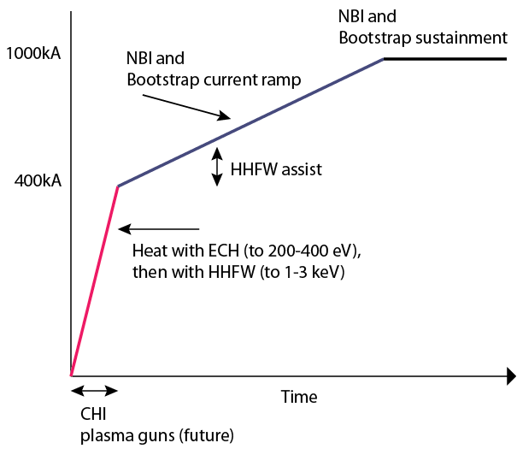
Goal: Develop and understand non-inductive start-up/ramp-up to project to ST-FNSF operation with small or no solenoid
Aligned with OFES program vision for FNSF requirements
  Establish physics basis for ST-FNSF, and non-inductive start-up is essential in ST
  Simplify the tokamak concept to reduce cost
High level NSTX-U Thrusts:
  Establish and extend solenoid-free plasma start-up and test NBI ramp-up
  Ramp-up CHI plasma discharges using NBI and HHFW and test plasma gun start-up
NSTX-U Start-up and
Ramp-up strategy
NSTX-U is striving for fully non-inductive operations
CHI start-up and ramp-up is the front end of that objective

Slide 4

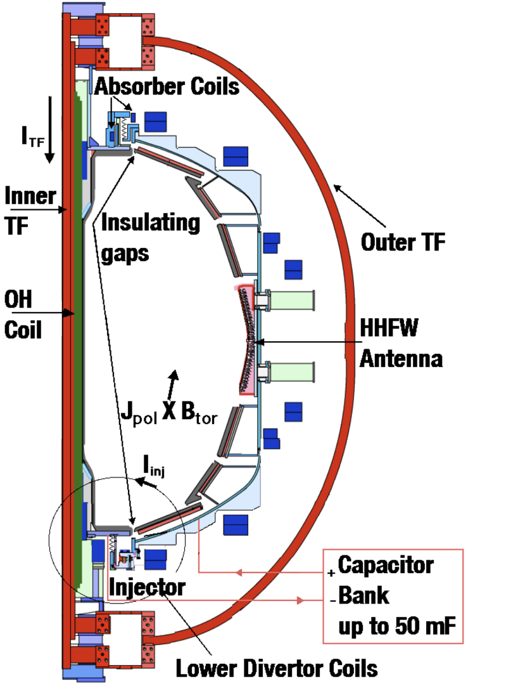
CHI is planned to be used as initial current seed for subsequent non-inductive current ramp-up in NSTX-U
TSC (axisymmetric 2D ) simulation of CHI startup
CHI in NSTX/NSTX-U
1.0 ms
1.6 ms
2.7 ms
2
1 MW ECH
1
Z (m)
0
-1
-2
0
1
2
0
1
2
0
1
2
R (m)
R (m)
R (m)
Plasma Guns
New Tools for CHI
  > 2.5 x Injector Flux (proportional to I_{p} )
  TF = 1 T (increases current multiplication)
  ECH (increases T_{e})
  > 2kV CHI voltage (increases flux injection)
  Full Li coverage (reduces low-Z imp.)
  Metal divertor, Cryo pump (increases T_{e})
Cryo pump

Slide 5
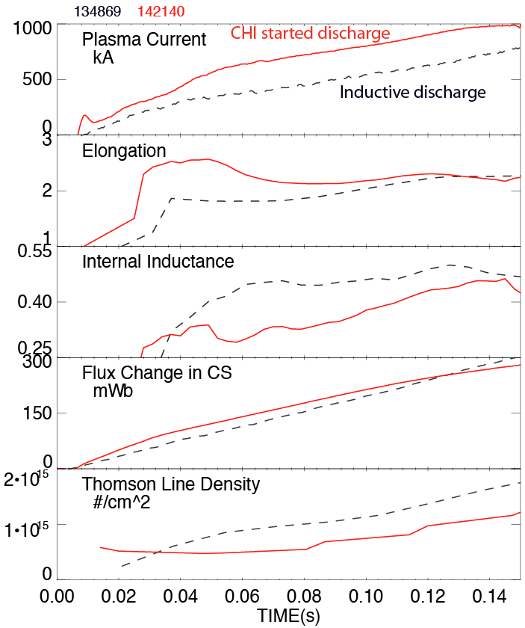
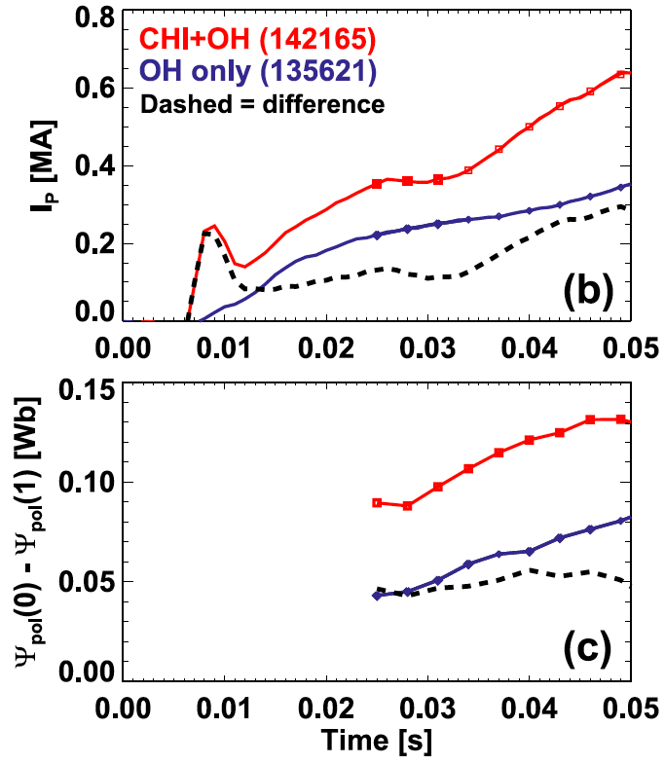
Plasma discharge ramping to 1MA requires 35% less inductive flux when coaxial helicity injection (CHI) is used
CHI assisted startup in NSTX
CHI produces closed flux
change of ~ 50 mWb
High elongation
Low inductance
Low density
CHI generates plasmas with low n_{e} below ECH cut-off

Slide 6
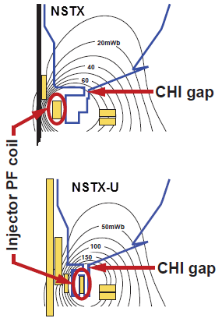
CHI start-up to ~0.4MA is projected for NSTX-U, and projects to ~20% start-up current in next-step STs
Parameters | NSTX | NSTX-U | ST-FNSF | ST Pilot Plant
Major radius [m] | 0.86 | 0.93 | 1.2 | 2.2
Minor radius [m] | 0.66 | 0.62 | 0.80 | 1.29
B_{T} [T] | 0.55 | 1.0 | 2.2 | 2.4
Toroidal flux [Wb] | 2.5 | 3.9 | 15.8 | 45.7
Sustained I_{p} [MA] | 1 | 2 | 10 | 18
Injector flux (Wb) | 0.047 | 0.1 | 0.66 | 2.18
Projected Start-up current (MA) | 0.2 | 0.4 | 2.0 | 3.6
Incremental programmatic goal:
FY15: Establish CHI start-up and Ramp-up a 300-600kA inductively generated plasma using RF and NBI (with Wave Particle TSG)
Injector flux in NSTX-U is ~ 2.5 times higher than in NSTX → supports increased CHI current

Slide 7
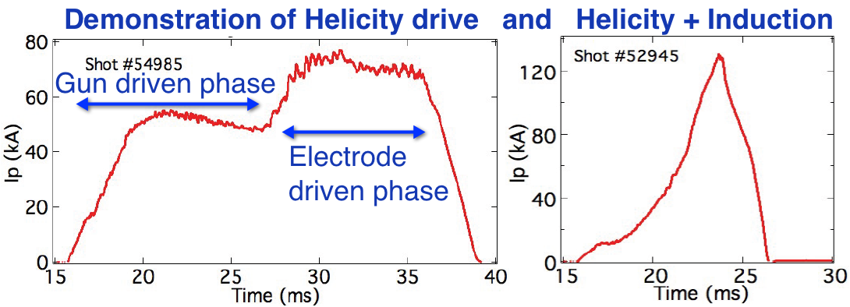

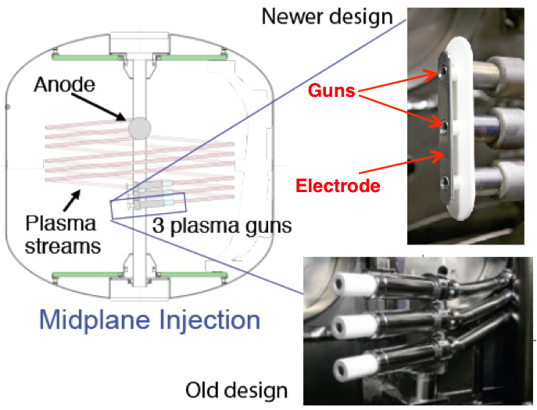
Local helicity injection being developed by PEGASUS is an alternate method for plasma start-up in NSTX-U
Retractability of guns potentially advantageous in FNSF/Demo nuclear environment
Plasma guns(s) & electrodes biased relative to anode or vessel
  Helicity injection rate
  I_{p} ~ (I_{inj} I_{TF} / electrode width)^0.5:
Issues being addressed by Pegasus to achieve high I_{p}
  Effective voltage scales with electrode area
  Large-area electrode with uniform current density
  Characterization of plasma confinement/dissipation and injector impedance
  Pegasus wants to deliver MA-class (I_{p} > 0.5 MA) to NSTX-U

Slide 8
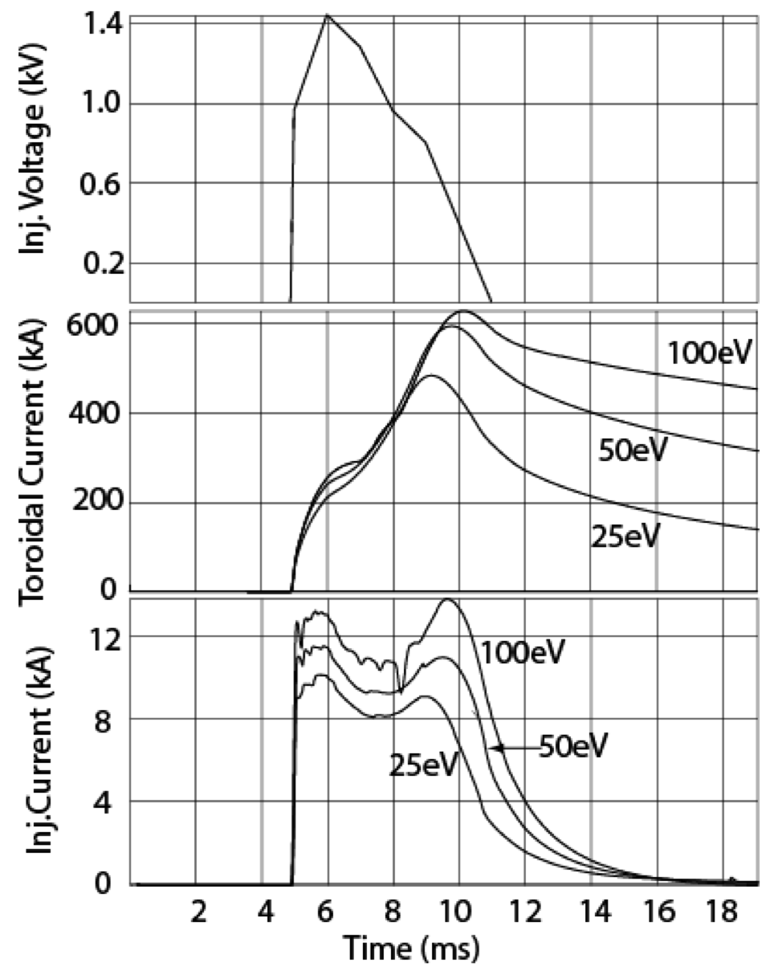
Ramp-up strategy significantly benefits from
1-2 MW ECH to heat CHI plasma
  GENRAY
GENRAY
In a 500kA decaying inductive discharge, TSC simulations indicate 0.6MW of absorbed ECH power could increase T_{e} to ~400eV in 20ms (with 50% ITER L-mode scaling)
  ECH absorption and deposition profile being modeled using GENRAY
  CHI discharge densities at T_{e} = 70 eV would allow 60% first-pass absorption by 28 GHz ECH in NSTX-U
Increased T_{e} predicted to significantly reduce I_{p} decay rate
  ECH heated plasma can be further heated with HHFW
  Maximum HHFW power < 4MW, higher B_{T} in NSTX-U would improve coupling
  HHFW has demonstrated heating a 300 kA / 300 eV plasma to > 1 keV in 40ms

Slide 9
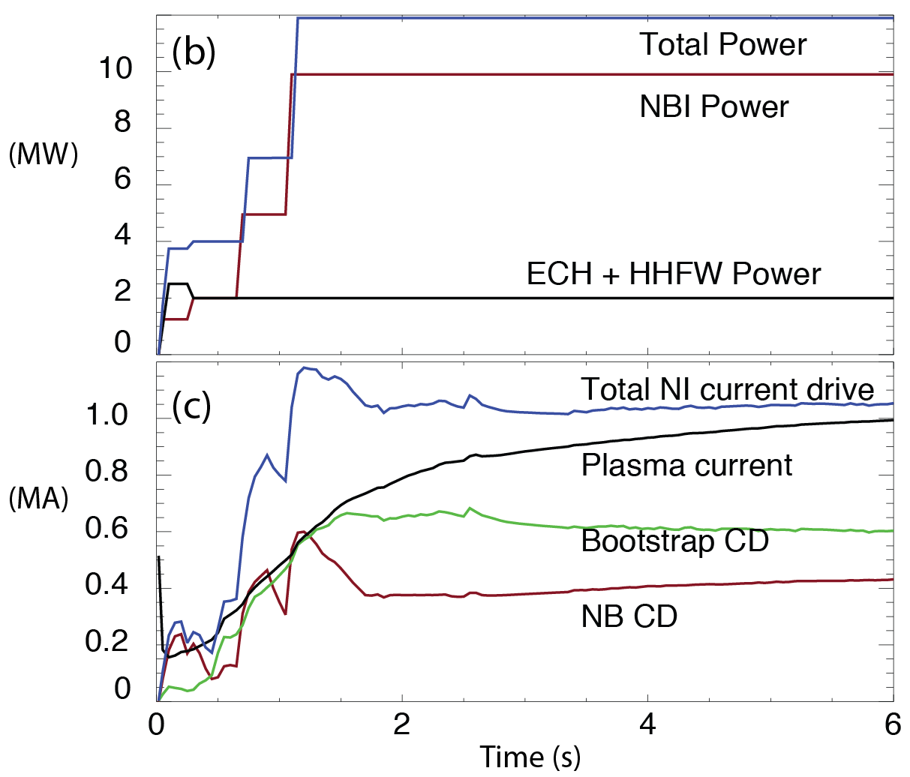
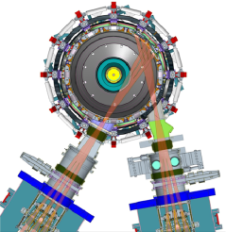
Non-inductive ramp-up from ~0.4MA to ~1MA projected to be possible with new CS + more tangential 2nd NBI
More tangential NBI provides 3-4x higher CD at low I_{P}:
  2x higher absorption (40→80%) at low I_{P} = 0.4MA
    Now modeling coupling to 0.2-0.3MA targets (TRANSP)
  1.5-2x higher current drive efficiency
TSC simulation of non-inductive ramp-up from initial CHI target
  Simulations now being improved to use TRANSP/NUBEAM loop within TSC
  Experimental challenges:
    - Maximum NBI power in low inductance CHI plasma
Present NBI
More tangential 2nd NBI
R. Raman, F. Poli, C.E. Kessel, S.C. Jardin

Slide 10
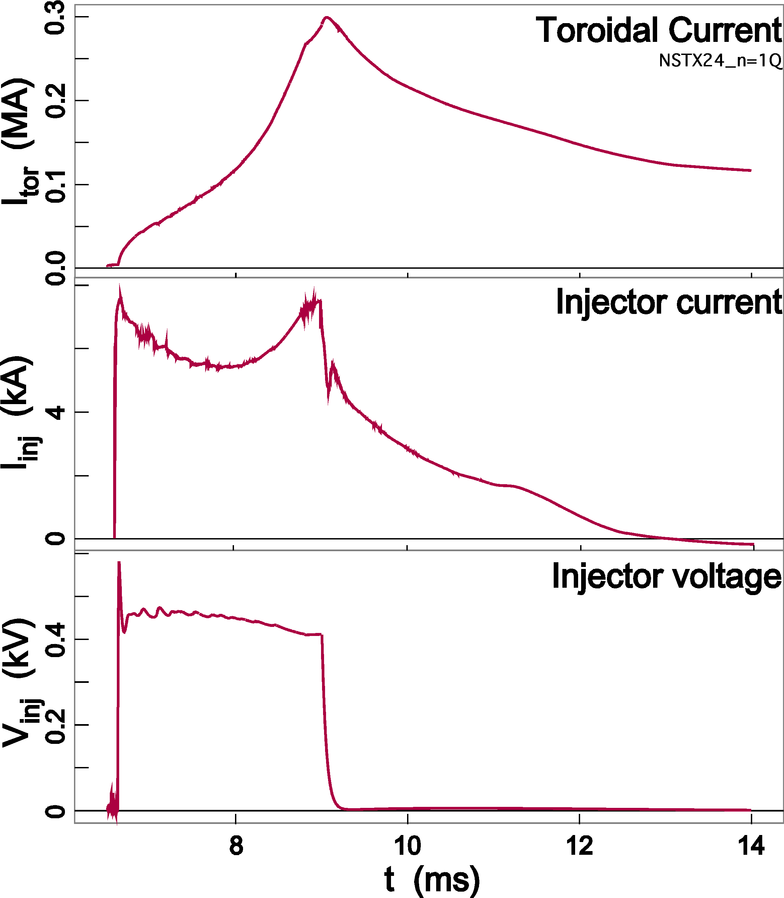
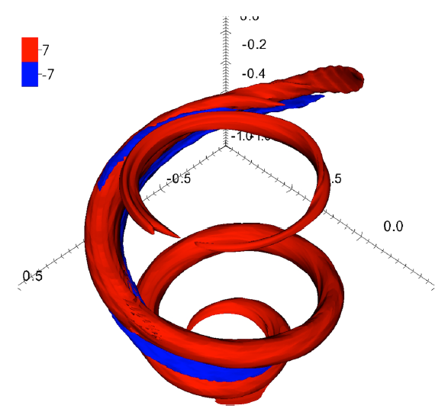
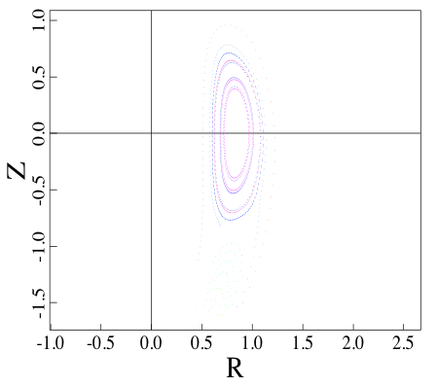
Simulations using Nimrod making good progress in modeling helicity injection start-up in NSTX
Will 3D physics in NIMROD alter our present expectations for scaling to next-step devices?
  Additional physics (T_{e} evolution, transport, ohmic heating)
Ongoing simulations show promising results
  Now starting to show flux closure on experimental time scales
  Next step is to develop a realistic model for NSTX
Simulations of an NSTX CHI
discharge (E.B. Hooper)
Point source (local) helicity injection simulations show release of a current ring following reconnection
(J.B. O’ Bryan)
E.B. Hooper (LLNL)
F. Ebrahimi (Princeton University)
J. B. O’Bryan (Univ. of Wisconsin)
C. Sovinec (Univ. of Wisconsin)
Flux closure 0.87 ms after voltage turn-off in a CHI simulation with constant coil currents (F. Ebrahimi)

Slide 11
Thrust PSR-1: Establish and extend solenoid-free plasma start-up and test NBI ramp-up
Re-establish transient CHI discharges utilizing: YR1 NSTX-U Ops
  Graphite lower divertor tiles, increased toroidal field capability
  Full Li coating of lower divertor tiles + Li conditioning of upper divertor
Determine maximum toroidal currents generated with CHI: YR2
  Vary and increase the amount of injector flux, the size of the capacitor bank, and the CHI voltage (up to 2 kV).
  Use upper divertor buffer coils to suppress absorber arcs
  Study coupling of the CHI generated plasma to inductive drive
Assess NBI coupling + current drive efficiency in 300-400kA flat-top current inductive plasmas, compare to TSC/TRANSP (YR3)
  Also inject new more tangential beams into CHI targets and assess current-drive and compare to simulation
Use combinations of NBI and HHFW to attempt non-inductive ramp-up of I_{P} = 0.3-0.6MA (inductive target) to 0.8-1MA (YR2,3)

Slide 12
Thrust PSR-2: Ramp-up CHI Plasma discharges using NBI and HHFW and Test Plasma Gun Start-up
Maximize the levels of CHI-produced plasma currents using:
  1 MW 28GHz ECH (YR3)
  Metallic divertor plates (as available) to reduce low-Z impurity radiation
  2.5-3 kV CHI capability (YR4)
Extend duration of high-current CHI target using ECH/HHFW and test effectiveness of NBI coupling to CHI-target (YR3)
Ramp-up of CHI target + ECH/HHFW → HHFW+NBI (YR4+5)
Perform detailed comparisons of CHI current drive results to 2D TSC/TRANSP and 3D NIMROD simulations (YR4)
  Develop a TSC/NIMROD model of CHI for FNSF design studies.
If guns ready, commission plasma guns on NSTX-U (YR4+5)
  Compare point-helicity injection (plasma gun) current formation on NSTX-U to Pegasus results, assess implications for FNSF

Slide 13
Plans for start-up/ramp-up simulations
(TSC-TRANSP/NUBEAM/GENRAY, NIMROD)
FY13 Start-up and Ramp-up of CHI-started discharge
  Use TRANSP analysis of NSTX CHI discharges with inductive ramp to obtain electron transport model
    Use TSC generated CHI equilibrium to obtain ECH absorption and heat deposition profiles and extend to 1T (GENRAY)
    Assess requirements for electron heating by HHFW (with ECH heating
    Requirements for NBI ramp-up to1 MA of CHI target with ECH + HHFW
  With NIMROD obtain good agreement with an NSTX transient CHI discharge
    Requirements for voltage/injector current programming and injector flux footprint shaping

Slide 14
Plans for start-up/ramp-up simulations
FY13-14 Extend to NSTX-U geometry
  Develop start-up scenarios for YR1-2 Ops.
  Couple TSC directly to TRANSP/NUBEAM/GENRAY codes to self-consistently calculate deposition profiles
  Assess impact of including additional parameters (n_{e} and Z_{eff}) and impact of injector gap width in NIMROD simulations
FY15-18 Support NSTX-U Ops. & Extend to FNSF/ST Demo
  Use experimental results to improve model & extend to FNSF
  Use in predictive mode to support experiments
  Incorporate CHI model in free-boundary predictive TRANSP
  Understand plasma growth rate implications for electron heating
  Understand 3D effects on fast flux closure as I_{p} is increased to MA levels
  Requirements for establishing a start-up discharge in next step devices

Slide 15
Hardware preparations for NSTX-U Start-up
Diagnostics [FY 13 - 14]
  New additional fast voltage monitors for upper divertor
  Additional dedicated current monitors near injector
  Special set of EMI shielded inner vessel magnetics
  Additional flux loops and Mirnov coils on lower and upper divertor
    Langmuir probe array on lower divertor
  Multipoint Thomson scattering, Filter scopes, multi chord bolometers and SXR arrays
Capacitor bank power supply [FY 13 - 14] – Baseline capability
  Voltage increased to ~2 kV & improve voltage snubbing systems
  NSTX-U to support 4kV Ops. including transients
Capacitor bank power supply [YR 16-18] – Upgraded capability
  Voltage increased to ~2.5-3 kV
  Additional modules for improved voltage control

Slide 16
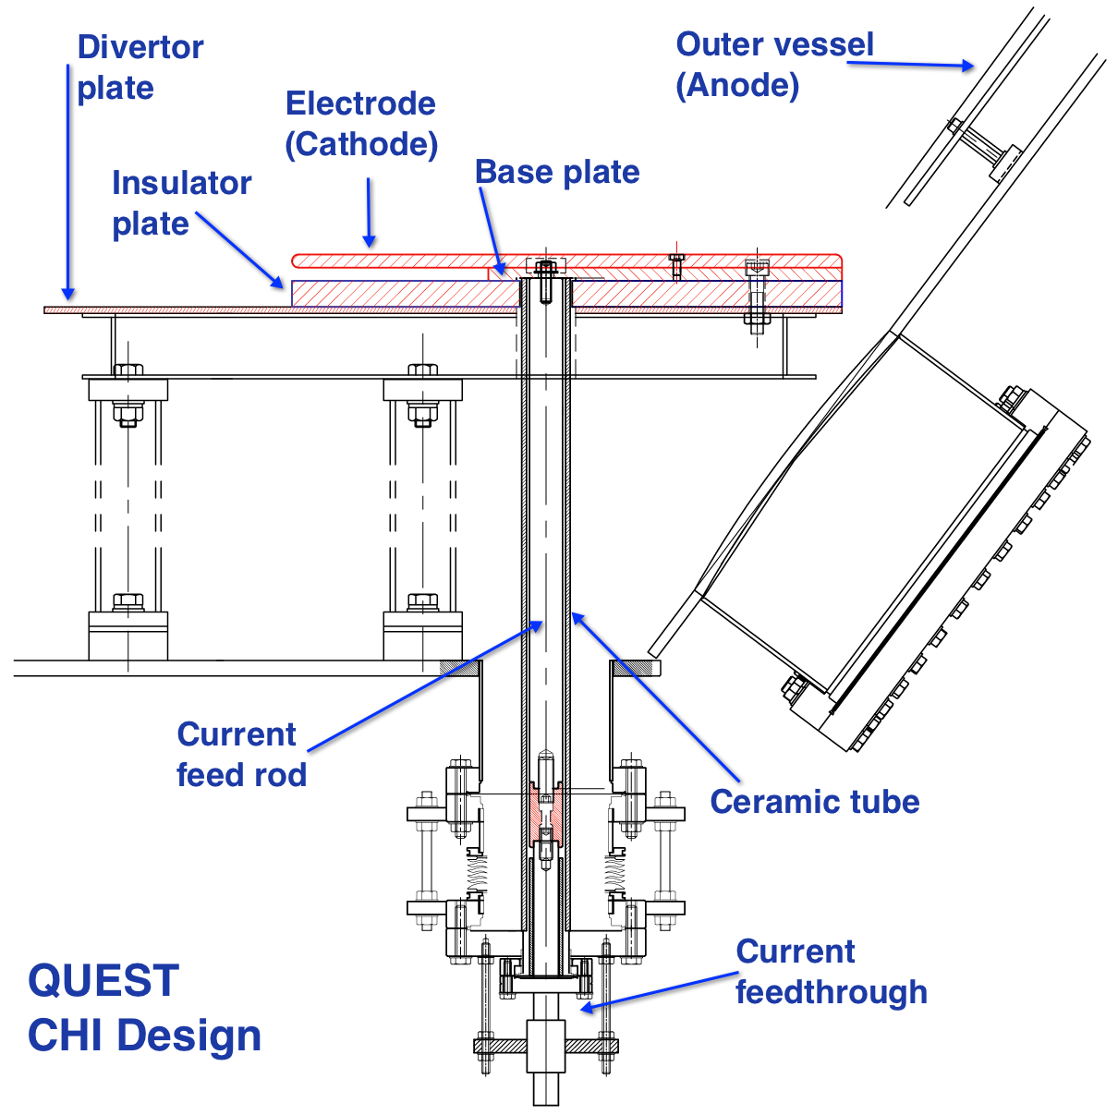
CHI design for QUEST supports NSTX-U research
(Collaboration with Japan)
Preliminary design completed (January 2013)
  Now working on finalizing design and pricing
Electrode mounted on top of divertor plate
  Insulators not part of vacuum structure
  CHI operation at up to 3kV
  Metallic electrodes (SS + Mo/W)
    Provides data for NSTX-U metal electrodes

Slide 17
Plans for external collaboration & design studies
FY 13-15
  Finalize CHI design for QUEST
  CHI system design for FNSF
  Participation with HIST device for CHI (device size scaling)
  Participation with PEGASUS on plasma gun start-up
    Assessment of requirements for NSTX-U
  Possible installation of CHI capability on QUEST
    Establish Transient CHI discharges on QUEST
Years 16-18
  Assessment of benefits of metal electrodes on QUEST (for NSTX-U)
  Test of edge current drive & steady-state CHI on QUEST

Slide 18
NSTX-U is well poised to demonstrate full non-inductive
start-up and ramp-up in support of next steps devices
CHI start-up achieves record-low flux consumption on NSTX to get to 1MA
  Compatibility with H-mode operation demonstrated
  Generates discharges with low internal inductance and density needed for ECH heating and non-inductive ramp-up with NBI on NSTX-U
  Favorable scaling with machine size (HIT-II, NSTX)
~1MW 28 GHz ECH would greatly enhance start-up/ramp-up capabilities
  Helicity injected plasmas require early heating to avoid rapid current decay
MHD codes now starting to reproduce NSTX CHI discharges
  TSC being used to develop initial start-up scenarios for NSTX-U
  NIMROD (and possibly M3D-C1) to improve understanding of flux closure mechanisms and the early dynamic phase of CHI
External collaboration aids NSTX-U, FNSF & ST Demo
  Plan to test metal electrodes and new electrode design on QUEST
  PEGASUS developing plasma gun start-up for implementation on NSTX-U

Slide 19
Back-up slides

Slide 20
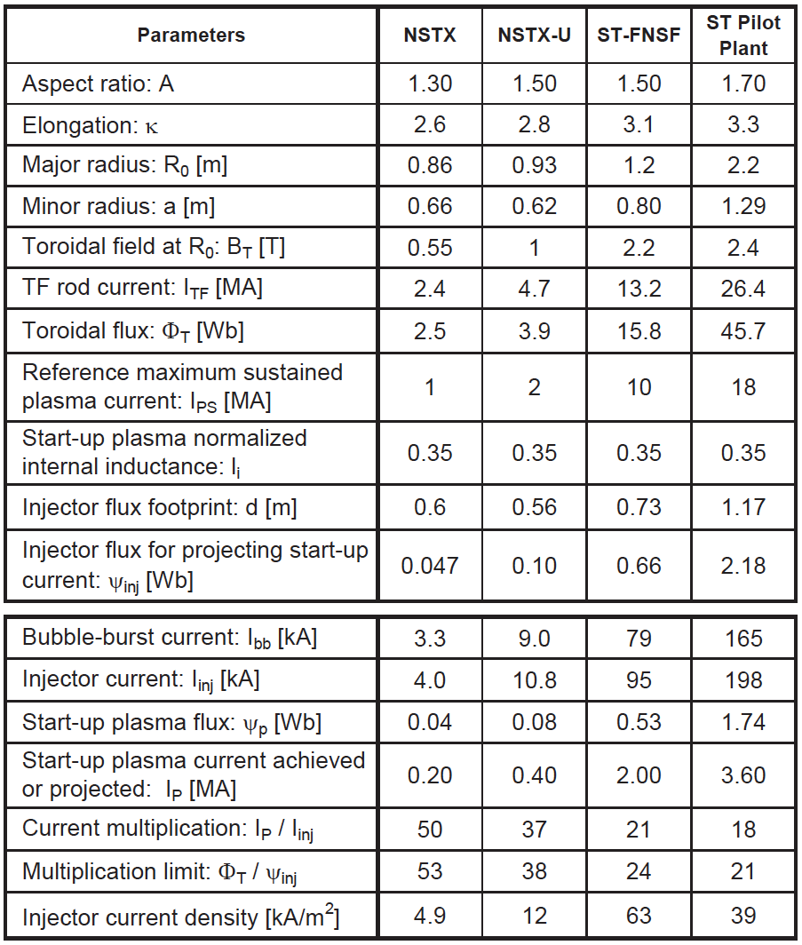
CHI start-up to ~0.4MA is projected for NSTX-U, and is projected to scale favorably to next-step STs
Injector flux in NSTX-U is ~ 2.5 times higher than in NSTX → supports increased CHI current
J. E. Menard et al., NF 52 (2012) 083015

