Slide 1




NSTX-U
Supported by
NSTX-U/PPPL Theory Partnership
Stan Kaye
NSTX-U Deputy Program Director
Amitava Bhattacharjee
Head, PPPL Theory Dept.
Coll of Wm & Mary
Columbia U
CompX
General Atomics
FIU
INL
Johns Hopkins U
LANL
LLNL
Lodestar
MIT
Lehigh U
Nova Photonics
ORNL
PPPL
Princeton U
Purdue U
SNL
Think Tank, Inc.
UC Davis
UC Irvine
UCLA
UCSD
U Colorado
U Illinois
U Maryland
U Rochester
U Tennessee
U Tulsa
U Washington
U Wisconsin
X Science LLC
Culham Sci Ctr
York U
Chubu U
Fukui U
Hiroshima U
Hyogo U
Kyoto U
Kyushu U
Kyushu Tokai U
NIFS
Niigata U
U Tokyo
JAEA
Inst for Nucl Res, Kiev
Ioffe Inst
TRINITI
Chonbuk Natl U
NFRI
KAIST
POSTECH
Seoul Natl U
ASIPP
CIEMAT
FOM Inst DIFFER
ENEA, Frascati
CEA, Cadarache
IPP, Jülich
IPP, Garching
ASCR, Czech Rep
NSTX-U PAC-35
PPPL, Princeton University
11 – 13 June 2014
*This work supported by the US DOE Contract No. DE-AC02-09CH11466

Slide 2
Longstanding NSTX(-U)/Theory Partnership
Coordinated partnership with NSTX-U team within the NSTX/NSTX-U Topical Science Group framework
  Macroscopic stability: J. Berkery, A. Boozer (Theory), J.-K. Park
  Waves and energetic particles: N. Gorelenkov, M. Podesta, G. Taylor
  Transport and turbulence: W. Guttenfelder, G. Hammett, Y. Ren
  Boundary physics: C-S. Chang, A, Diallo, V. Soukhanovskii
  Lithium physics: M. Jaworski, C. Skinner, D. Stotler
  Solenoid-free startup: S. Jardin, D. Mueller, R. Raman
Partnership strengthened by ~$1M increment in 2014
  Increase in direct funding of Theory by NSTX-U by ~2.5 FTE (4.9 FTE total)
  Greatly expands range of topics that can be studied
  Allows coverage of greater fraction for each researcher (generally >0.4 FTE each)
  Synergistic support through Base Theory/SciDAC funding

Slide 3
PPPL Theory work is addressing topics critical to achieving the NSTX-U Five Year Plan Priorities
Advance ST for Fusion Nuclear Science Facility (FNSF), including non-inductive operation
  CHI reconnection physics (NI startup)
  Non-linear wave-particle coupling (NI rampup)
  MHD effects on NB current drive (NI sustainment)
Develop solutions for plasma-material interface challenge
  Processes setting SOL heat flux widths
  Neutral particle distribution – edge atomic physics
Explore unique ST parameter regimes to advance predictive capability - for ITER and beyond
  Processes affecting electron transport in core
  Role of high ExB and parallel flow shear
  Understanding source and ramifications of soft and hard β-limits

Slide 4
The NSTX-U/Theory Partnership facilitates collaboration over a range of topics
Waves and energetic particles: E. Belova, G.Y. Fu, N. Gorelenkov, E. Valeo, R. White
  CAE/KAW coupling, development of reduced model for fast ion transport, coupling of kinks to AEs, non-linear wave-fast ion coupling
Macrostability: J. Breslau, F. Ebrahimi, S. Jardin, S. Lazerson, L. Zakharov
  Soft and hard (disruptive) beta limits, VDEs, CHI physics, NCC coil design
Transport and Turbulence: S. Ethier, E. Startsev, W. Wang
  Source of ion, electron & momentum transport, source of collisionality dependence, development of e-m effects for global GTS
Edge physics: C.S. Chang, S.-H. Ku, D. Stotler
  SOL heat flux width, edge bootstrap current, edge momentum source, neutral transport, GPI interpretation
Theory support also provided directly through the NSTX program as well as by collaborators
  Will show representative examples from each area

Slide 5
The NSTX-U/Theory Partnership facilitates collaboration over a range of topics
Waves and energetic particles: E. Belova, G.Y. Fu, N. Gorelenkov, E. Valeo, R. White
  CAE/KAW coupling, development of reduced model for fast ion transport, coupling of kinks to AEs, non-linear wave-fast ion coupling
Macrostability: J. Breslau, F. Ebrahimi, S. Jardin, S. Lazerson, L. Zakharov
  Soft and hard (disruptive) beta limits, VDEs, CHI physics, NCC coil design
Transport and Turbulence: S. Ethier, E. Startsev, W. Wang
  Source of ion, electron & momentum transport, source of collisionality dependence, development of e-m effects for global GTS
Edge physics: C.S. Chang, S.-H. Ku, D. Stotler
  SOL heat flux width, edge bootstrap current, edge momentum source, neutral transport, GPI interpretation

Slide 6
EXP’T: Large inferred anomalous core electron transport in presence of CAE/GAEs
Observation of high frequency CAE/GAE modes in plasma core associated with flattening of T_{e} profile (Stutman et al., Tritz et al.)
  High level of transport (10-100 m²/s) inferred assuming classical beam physics
BES spectra show mode amplitudes peaking from R=115 to 120 cm (r/a~0.2 to 0.3), in region of enhanced transport
CAE/GAE
~δn amplitude of 738 kHZ CAE/GAE
Stutman
Smith

Slide 7
EXP’T: Large inferred anomalous core electron transport in presence of CAE/GAEs
Observation of high frequency CAE/GAE modes in plasma core associated with flattening of T_{e} profile (Stutman et al., Tritz et al.)
  High level of transport (10-100 m²/s) inferred assuming classical beam physics
BES spectra show mode amplitudes peaking from R=115 to 120 cm (r/a~0.2 to 0.3), in region of enhanced transport
CAE/GAE
~δn amplitude of 738 kHZ CAE/GAE
Stutman
Smith
Is enhanced transport the full picture?

Slide 8
THEORY: New results suggest additional mechanism: energy channeling from NBI CAE KAW electrons
Fast ion physics may not be classical
HYM simulations indicate Kinetic Alfvén Wave driven by CAE outside plasma center (at r/a~0.3)
Some core NB power redistributed to this radius via energy channeling from NBI to CAE to KAW
  KAW damps primarily on electrons
Estimate power channeling of up to ~ 0.4 MW over range of realistic (inferred) mode amplitudes (for one mode)
  Change in T_{e} profile due to both transport and heating profile modifications
CAE
KAW
Belova

Slide 9
THEORY: New results suggest additional mechanism: energy channeling from NBI CAE KAW electrons
Fast ion physics may not be classical
HYM simulations indicate Kinetic Alfvén Wave driven by CAE outside plasma center (at r/a~0.3)
Some core NB power redistributed to this radius via energy channeling from NBI to CAE to KAW
  KAW damps primarily on electrons
Estimate power channeling of up to ~ 0.4 MW over range of realistic (inferred) mode amplitudes (for one mode)
  Change in T_{e} profile due to both transport and heating profile modifications
CAE
KAW
Belova
Future Work: Perform non-linear HYM simulations to calculate actual level of energy transfer and effect on T_{e}; develop predictive capability

Slide 10
The NSTX-U/Theory Partnership facilitates collaboration over a range of topics
Waves and energetic particles: E. Belova, G.Y. Fu, N. Gorelenkov, E. Valeo, R. White
  CAE/KAW coupling, development of reduced model for fast ion transport, coupling of kinks to AEs, non-linear wave-fast ion coupling
Macrostability: J. Breslau, F. Ebrahimi, S. Jardin, S. Lazerson, L. Zakharov
  Soft and hard (disruptive) beta limits, VDEs, CHI physics, NCC coil design
Transport and Turbulence: S. Ethier, E. Startsev, W. Wang
  Source of ion, electron & momentum transport, source of collisionality dependence, development of e-m effects for global GTS
Edge physics: C.S. Chang, S.-H. Ku, D. Stotler
  SOL heat flux width, edge bootstrap current, edge momentum source, neutral transport, GPI interpretation

Slide 11
EXP’T: Soft beta limits and VDEs
Soft β limit
  Drop in β_{n} in response to onset of low-n internal MHD activity
Menard
VDEs
  Both upward and downward VDEs observed
  VDEs can lead to halo currents having up to 80 kA on the wall (downward)
Gerhardt

Slide 12
EXP’T: Soft beta limits and VDEs
Soft β limit
  Drop in β_{n} in response to onset of low-n internal MHD activity
Menard
VDEs
  Both upward and downward VDEs observed
  VDEs can lead to halo currents having up to 80 kA on the wall (downward)
Gerhardt

Slide 13
EXP’T: Soft beta limits and VDEs
Soft β limit
  Drop in β_{n} in response to onset of low-n internal MHD activity
Menard
VDEs
  Both upward and downward VDEs observed
  VDEs can lead to halo currents having up to 80 kA on the wall (downward)
Gerhardt
Can we develop an understanding of the sources and ramifications of these β limiting processes?

Slide 14
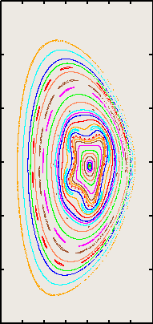
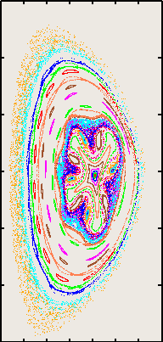
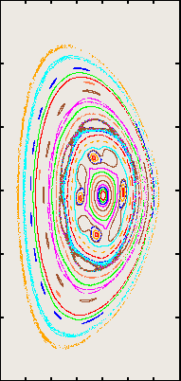
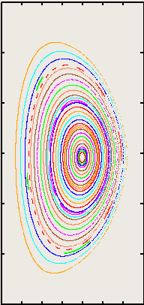
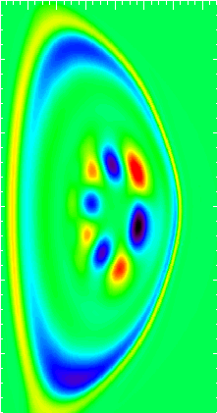
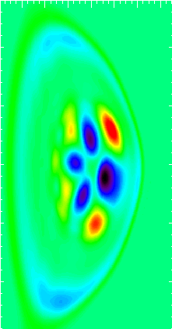
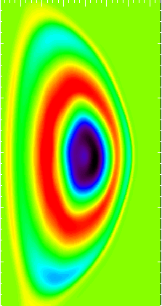
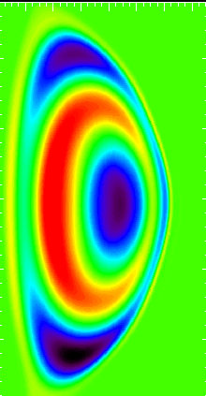
THEORY: M3D-C¹ used to study both types of beta limiting processes
M3D-C¹ affords unique opportunity to study of stability on transport time scale for realistic η
Linear/Non-linear, 2D/3D
  Used for scoping control systems, transport models, etc.
  Very well benchmarked against NIMROD for ideal & resistive stability
  Also against GATO, ELITE
Poincare plots
3D Non-linear simulation of soft β limit
As β limit is exceeded in center, surfaces deform, become stochastic, then heal
First, pure n=3 (4/3 resonance), then non-linear, finally axisymmetric torus
Net effect is enhanced transport
Jardin
ΔT_{e}

Slide 15
THEORY: M3D-C¹ used to study both types of beta limiting processes
M3D-C¹ affords unique opportunity to study of stability on transport time scale for realistic η
Linear/Non-linear, 2D/3D
  Used for scoping control systems, transport models, etc.
  Very well benchmarked against NIMROD for ideal & resistive stability
  Also against GATO, ELITE
Poincare plots
3D Non-linear simulation of soft β limit
As β limit is exceeded in center, surfaces deform, become stochastic, then heal
First, pure n=3 (4/3 resonance), then non-linear, finally axisymmetric torus
Net effect is enhanced transport
Jardin
Future work: Perform calculations to determine effects of q-profile, rotation, etc. on modes
ΔT_{e}

Slide 16
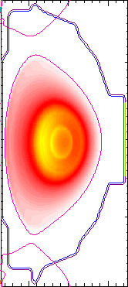
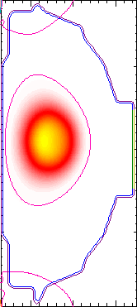
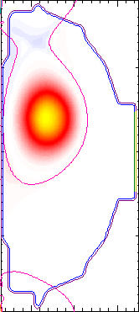
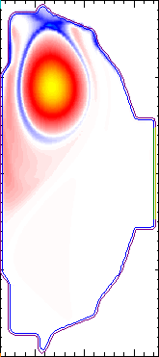
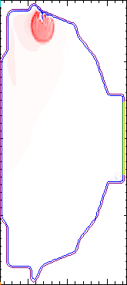
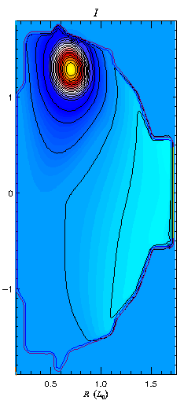
Simulations of VDEs have begun using M3D-C¹
Initial simulations from 2D low resolution calculation
  Benchmark against earlier TSC results
New capability is finite thickness wall
Note halo currents
Toroidal Current Density Evolution
(a)
(b)
(c)
(d)
(e)
Jardin

Slide 17
Simulations of VDEs have begun using M3D-C¹
Initial simulations from 2D low resolution calculation
  Benchmark against earlier TSC results
New capability is finite thickness wall
Note halo currents
Toroidal Current Density Evolution
(a)
(b)
(c)
(d)
(e)
Future work: Extend to 3D and realistic η to compute non-axisymmetric halo current distribution for validation against experimental measurements
Jardin

Slide 18
JRT-16: Assess MGI disruption mitigation, disruption detection and avoidance
Study gas assimilation efficiencies for MGI injection from multiple poloidal locations and evaluate impacts on divertor heat loads and halo currents
  XGC1/DEGAS-2 to determine amount and distribution of radiation, runaway electron current, resulting edge profiles
  M3D-C¹ to determine the dynamics of the MHD modes and their interactions with (e.g.) halo currents
Develop algorithms for real-time MGI triggering based on disruption warning system such as locked mode sensors, state-space observers and RFA
  Couple M3D-C¹ to a wall current code for designing sensors/probes, followed by verification and validation when NSTX-U starts to operate
  Resistive wall/RFA capability has been added to M3D-C¹ (N. Ferraro/S. Jardin)
    NSTX cases being studied

Slide 19
The NSTX-U/Theory Partnership facilitates collaboration over a range of topics
Waves and energetic particles: E. Belova, G.Y. Fu, N. Gorelenkov, E. Valeo, R. White
  CAE/KAW coupling, development of reduced model for fast ion transport, coupling of kinks to AEs, non-linear wave-fast ion coupling
Macrostability: J. Breslau, F. Ebrahimi, S. Jardin, S. Lazerson, L. Zakharov
  Soft and hard (disruptive) beta limits, VDEs, CHI physics, NCC coil design
Transport and Turbulence: S. Ethier, E. Startsev, W. Wang
  Source of ion, electron & momentum transport, source of collisionality dependence, development of e-m effects for global GTS
Edge physics: C.S. Chang, S.-H. Ku, D. Stotler
  SOL heat flux width, edge bootstrap current, edge momentum source, neutral transport, GPI interpretation

Slide 20
EXP’T: Source of anomalous transport in
L- and H-modes
Ions: Anomalous in L-mode, ~neoclassical in H-mode
Electrons: R/L_{Te}-driven ETG (low β), microtearing (high ν_{e}∗) in L and H
H-mode
L-mode
(NCLASS)
Ren

Slide 21
EXP’T: Source of anomalous transport in
L- and H-modes
Ions: Anomalous in L-mode, ~neoclassical in H-mode
Electrons: R/L_{Te}-driven ETG (low β), microtearing (high ν_{e}∗) in L and H
Strong v_{φ} (ExB) shear can suppress low-k (ITG/TEM) instabilities (γ_{E}>>γ_{lin} from GK)
L-mode
(NCLASS)
H-mode
Kaye

Slide 22
EXP’T: Source of anomalous transport in
L- and H-modes
Ions: Anomalous in L-mode, ~neoclassical in H-mode
Electrons: R/L_{Te}-driven ETG (low β), microtearing (high ν_{e}∗) in L and H
Strong v_{φ} (ExB) shear can suppress low-k (ITG/TEM) instabilities (γ_{E}>>γ_{lin} from GK)
L-mode
Can global gyrokinetic simulations shed more light on the transport processes with the relatively large scales and large ExB shears in low-B_{T} in NSTX plasmas?
(NCLASS)
H-mode
Kaye

Slide 23
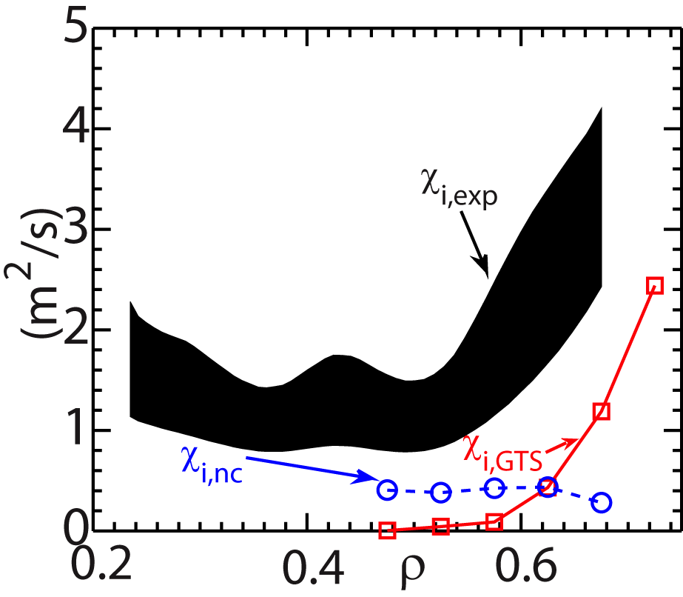
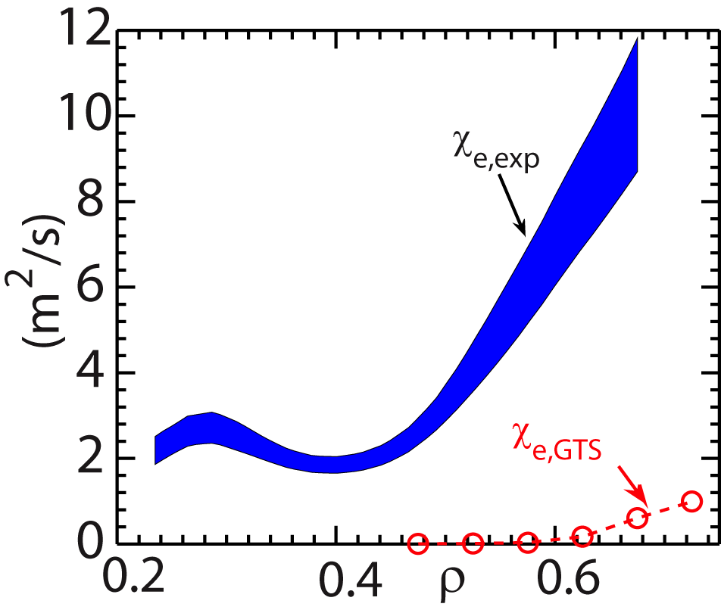
THEORY: Strong flow shear can destabilize
Kelvin-Helmholtz instability
Linear theory: |ML_{n}/L_{ω}|>1 for instability
  Non-linear global GTS simulations reveal presence of K-H in L-mode
  K-H identified in simulation by finite k||
K-H/ITG + neo ion transport within factor of ~2 of expt’l level
  e⁻ transport seriously underestimated
Ions
Electrons
~
φ
Future Work: K-H in H-mode -driven DTEM as source of collisionality scaling in H-mode
Wang

Slide 24
The NSTX-U/Theory Partnership facilitates collaboration over a range of topics
Waves and energetic particles: E. Belova, G.Y. Fu, N. Gorelenkov, E. Valeo, R. White
  CAE/KAW coupling, development of reduced model for fast ion transport, coupling of kinks to AEs, non-linear wave-fast ion coupling
Macrostability: J. Breslau, F. Ebrahimi, S. Jardin, S. Lazerson, L. Zakharov
  Soft and hard (disruptive) beta limits, VDEs, CHI physics, NCC coil design
Transport and Turbulence: S. Ethier, E. Startsev, W. Wang
  Source of ion, electron & momentum transport, source of collisionality dependence, development of e-m effects for global GTS
Edge physics: C.S. Chang, S.-H. Ku, D. Stotler
  SOL heat flux width, edge bootstrap current, edge momentum source, neutral transport, GPI interpretation

Slide 25
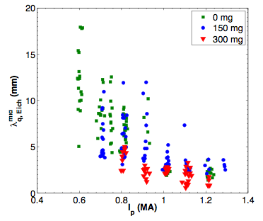
EXP’T: SOL heat flux width shows strong dependence on plasma current
Li wall conditioning impacts heat flux width and magnitude
Strong contraction of SOL heat flux width at midplane with I_{p}
Gray

Slide 26
EXP’T: SOL heat flux width shows strong dependence on plasma current
Li wall conditioning impacts heat flux width and magnitude
Strong contraction of SOL heat flux width at midplane with I_{p}
Gray
What is the underlying physics setting the SOL heat flux width and its scaling with I_{p}?

Slide 27
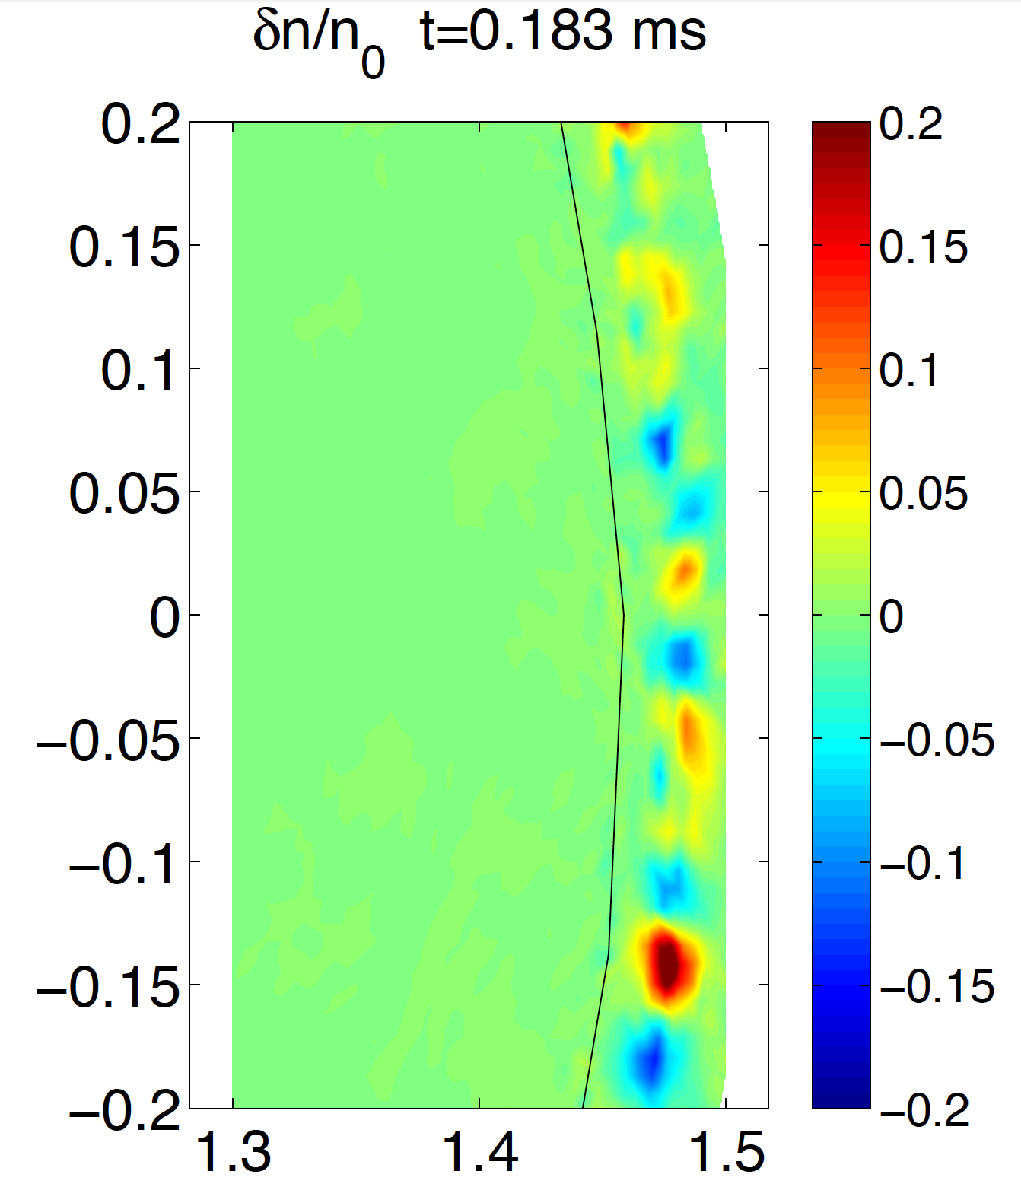
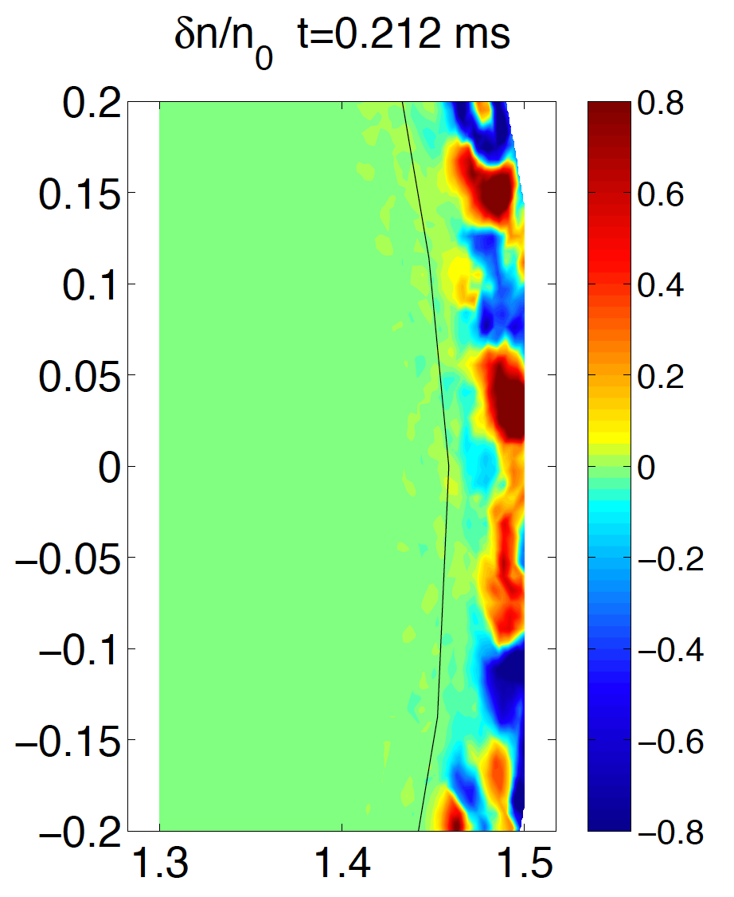
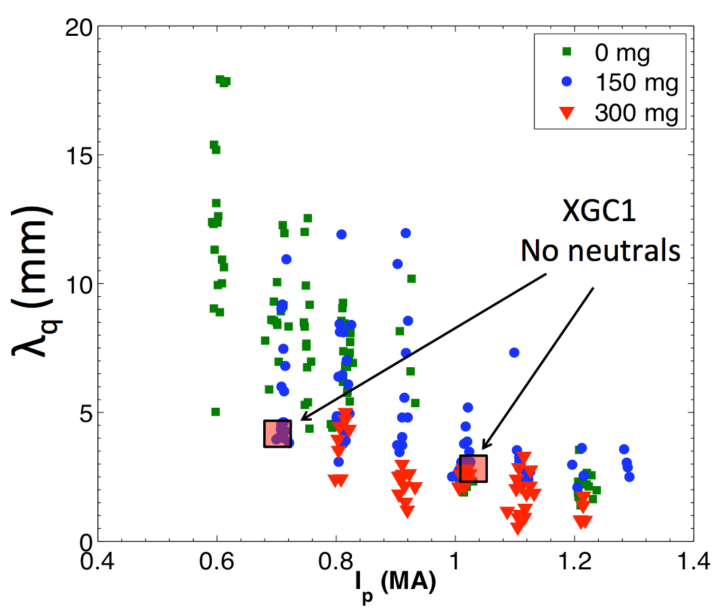
Theory: Collisionless XGC1 simulations indicate that the SOL heat flux width is set primarily by neoclassical processes
XGC1 (collisionless) predicts “blob” related turbulence
Blobs are stronger in SOL than in pedestal, and they are stronger at higher I_{p}
Blobs do not appear to widen the heat load width above the neoclassical width (~Δ_{banana} ~1/I_{p} from XGC0)
Predicted variation of I_{p}^{-0.8} is consistent with observation (for 300 mg Li dep.)
300 mg Li deposition
λ_{q,mid} (mm)
I_{p} = 0.7 MA
I_{p} = 1.0 MA

Slide 28
Theory: Collisionless XGC1 simulations indicate that the SOL heat flux width is set primarily by neoclassical processes
XGC1 (collisionless) predicts “blob” related turbulence
Blobs are stronger in SOL than in pedestal, and they are stronger at higher I_{p}
Blobs do not appear to widen the heat load width above the neoclassical width (~Δ_{banana} ~1/I_{p} from XGC0)
Predicted variation of I_{p}^{-0.8} is consistent with observation (for 300 mg Li dep.)
300 mg Li deposition
λ_{q,mid} (mm)
I_{p} = 0.7 MA
I_{p} = 1.0 MA
Future Work: Extend to finite collisionality and recycling to determine effect on SOL λ_{q}

Slide 29
NSTX(-U)/PPPL Partnership is focusing on issues critical to understanding ST physics and projecting to future devices
Targeted funding from DOE has allowed for participation by a critical mass of people, and critical fraction of each person
Theory integrated into NSTX physics results dissemination
  Six theory-based NSTX contributions to IAEA
Wish to continue effort (with cont’d incremental). High priority topics include:
  Macro: Extend M3D-C¹ disruption studies to resistive 3D
  T&T: Incorporate e-m effects into GTS, XGC-1 for microtearing
  EP: Implement reduced model for fast ion transport in TRANSP
  Edge: SOL heat flux widths from turbulence (XGC-1)
  Leverage off theory work for experimental research planning
  Expand integration of experimentalists into theoretical studies Enhanced synergy with DIII-D work (S. Jardin/N. Ferraro, W. Wang/C. Chrystal, C.S. Chang/D. Battaglia)

Slide 30
Backup Slides

Slide 31
THEORY: Explore CAE/GAE induced transport levels
Initial studies focused on direct impact of modes on electron transport
  Radial mode amplitude profiles taken from scattering, BES measurements
  Electron transport inferred from ORBIT calculations in which amplitude of modes was varied
α parameter related to δn/n
α=4x10⁻⁴ corresponds to δn/n~10⁻³
Modes bursting: max amplitudes may be 2 to 3x greater
Brings inferred transport up to experimentally inferred values
Gorelenkov

Slide 32
EXP’T: Strong kink/Alfvén activity driven by NBs in NSTX
Expect similar activity in NSTX-U
Can impact beam current drive profiles (positively or negatively) and goal of achieving 100% non-inductive ops
Kink/fishbone modes
TAE modes/avalanches
Fredrickson

Slide 33
THEORY: Physics of modes and impact on fast ion distribution
M3D-K to model modes and resulting fast ion transport
Good agreement between model results and measured mode structure (radial, frequency)
Substantial fast ion transport from kinks/fishbones/TAEs
Multiple TAE-induced fast ion redistribution
E=E_{inj}
Ψ
Fu

Slide 34
EXP’T: Non-inductive current startup
Critical issue for fully non-inductive operation in next-step STs
Co-axial Helicity Injection being studied on NSTX
CHI has produced up to 300 kA startup current with large current multiplication factor (I_{p}/I_{inj})
  Successfully coupled to induction for ramp-up
Raman

Slide 35
THEORY: Understand reconnection physics to extrapolate CHI performance to next-steps
Resistive simulations have been performed using the extended-MHD NIMROD code
Simulations with magnetic diffusivities similar to expt produce flux closure
Flux closure/plasma current scales with injector voltage time decay, flux footprint as in experiment
Simulations indicate Sweet-Parker type reconnection
  Elongated current sheet
  Current sheet width
  Inflow/outflow
Ebrahimi

Slide 36
THEORY: Understand reconnection physics to extrapolate CHI performance to next-steps
Resistive simulations have been performed using the extended-MHD NIMROD code
Simulations with magnetic diffusivities similar to expt produce flux closure
Flux closure/plasma current scales with injector voltage time decay, flux footprint as in experiment
Simulations indicate Sweet-Parker type reconnection
  Elongated current sheet
  Current sheet width
  Inflow/outflow
Ebrahimi

Slide 37
EXP’T: Knowledge of the thermal neutrals is critical to edge and core physics
Thermal neutral density profiles impact: NB power deposition, fast ion c-x efflux to wall, drag on rotation/ZFs
GPI gas puff leads to small effect in edge temperature and density
  No immediate effect
  Slow change inside location of Δn₀
UEDGE simulations indicate immediate changes in n, T should be observed
Zweben
Meier

Slide 38
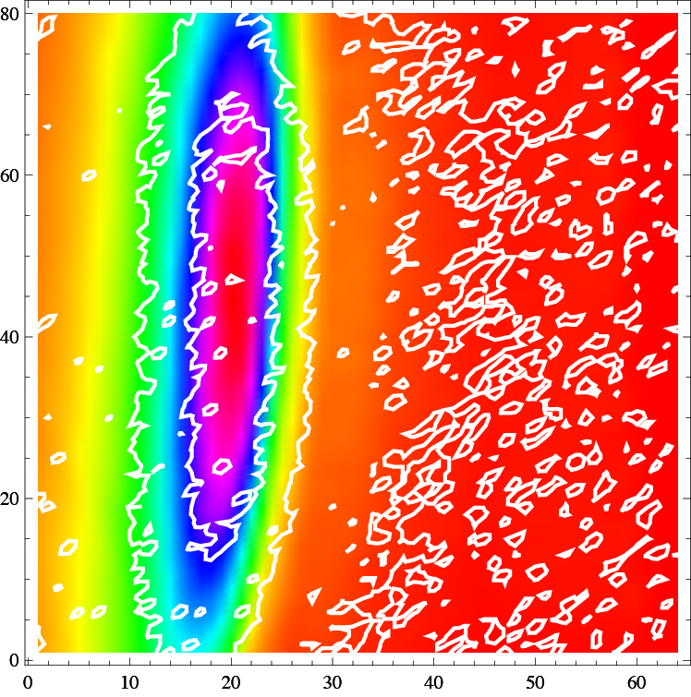
THEORY: Detailed DEGAS-2 simulations agree with the GPI results
3-D simulations input EFIT, n_{e}, T_{e}, n_{D} and gas puff rate from GPI
Simulated power loss due to puff atomic physics negligible
  Electron loss: 21 kW, Ion loss: 4 kW
  Consistent with small effect on profiles
Basis for understanding difference between DEGAS-2 and UEDGE results (study ongoing)
2D GPI light emission: expt’l contours (white) superimposed on DEGAS2 simulation results
Separatrix
Poloidal (30 cm)
Stotler
Radial (25 cm)

