Slide 1




NSTX-U
Supported by
Progress and Plans for Macroscopic Stability
Coll of Wm & Mary
Columbia U
CompX
General Atomics
FIU
INL
Johns Hopkins U
LANL
LLNL
Lodestar
MIT
Lehigh U
Nova Photonics
Old Dominion
ORNL
PPPL
Princeton U
Purdue U
SNL
Think Tank, Inc.
UC Davis
UC Irvine
UCLA
UCSD
U Colorado
U Illinois
U Maryland
U Rochester
U Tennessee
U Tulsa
U Washington
U Wisconsin
X Science LLC
Jack Berkery (Columbia University)
Jong-Kyu Park, Allen Boozer
and the NSTX-U Research Team
Culham Sci Ctr
York U
Chubu U
Fukui U
Hiroshima U
Hyogo U
Kyoto U
Kyushu U
Kyushu Tokai U
NIFS
Niigata U
U Tokyo
JAEA
Inst for Nucl Res, Kiev
Ioffe Inst
TRINITI
Chonbuk Natl U
NFRI
KAIST
POSTECH
Seoul Natl U
ASIPP
CIEMAT
FOM Inst DIFFER
ENEA, Frascati
CEA, Cadarache
IPP, Jülich
IPP, Garching
ASCR, Czech Rep
NSTX-U PAC-35 Meeting
PPPL – B318
June 11-13, 2014

Slide 2
Outline
Introduction
  Macroscopic stability (MS) group research in stability, 3D fields, and disruptions is key for NSTX-U, ITER, and FNSF
  MS research is prominent in NSTX-U milestones as well as JRTs
Progress in the last year – in preparation for upcoming run
  Collaborations at KSTAR and DIII-D
  Three main areas: Stability, 3D fields, and disruptions
  Non-axisymmetric control coil (NCC) design
MS research goals and plans for FY15
MS research goals and plans for FY16
Key results expected by the end of the FY16 run, and how they will impact further NSTX-U operation and future devices

Slide 3
  Macroscopic stability research is crucial for the successful sustainment of high performance in future devices
Demonstrate 100% non-inductive sustainment at performance that extrapolates to ≥ 1MW/m² neutron wall loading in FNSF
Access reduced ν* and high-β combined with ability to vary q and rotation to dramatically extend ST physics understanding
Macroscopic stability research is in three key areas:
  Thrust 1, Stability:
  Understand and advance passive and active feedback control to sustain macroscopic stability at low collisionality
  Thrust 2, 3D Fields:
  Understand 3D field effects and provide physics basis for optimizing stability through equilibrium profile control by 3D fields
  Thrust 3, Disruptions:
  Understand disruption dynamics and develop techniques for disruption prediction, avoidance, and mitigation in high-performance ST plasmas

Slide 4
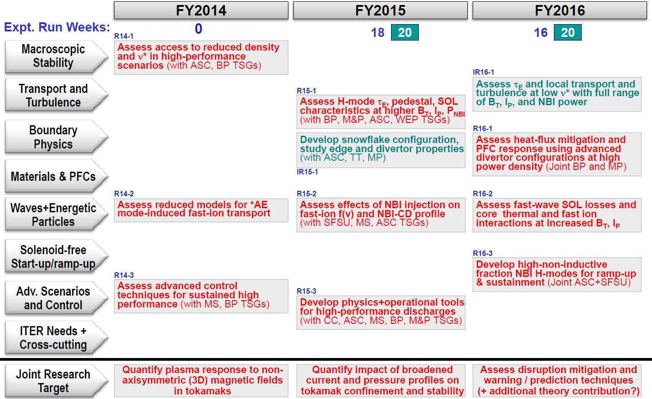
  Macroscopic stability research and capabilities play an instrumental role in the success of NSTX-U
MS group’s crucial role is reflected in milestones and JRTs in:
  Preparation for high performance in NSTX-U
  Development of NSTX-U capabilities
  U.S. program-wide high priority research
Develop physics+operational tools for high-performance (κ, δ, β, EF/RWM)
Quantify impact of broadened J(r) and p(r) on tokamak confinement, stability
Assess disruption mitigation, initial tests of real-time warning, prediction

Slide 5
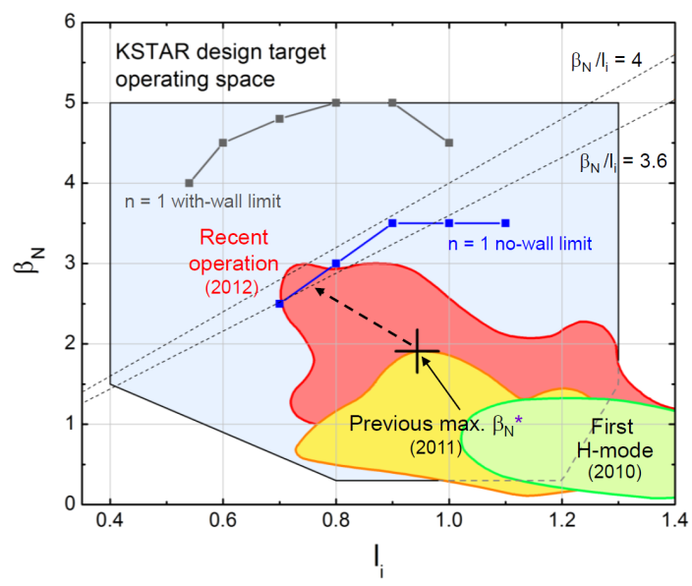
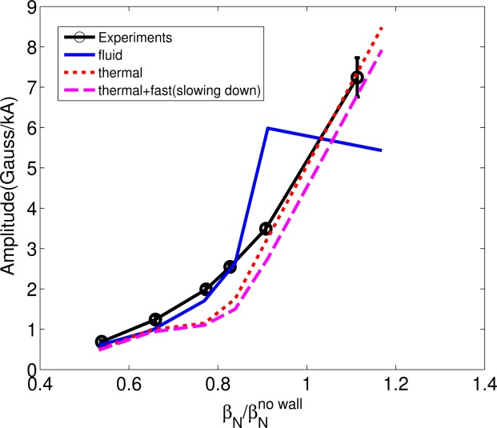
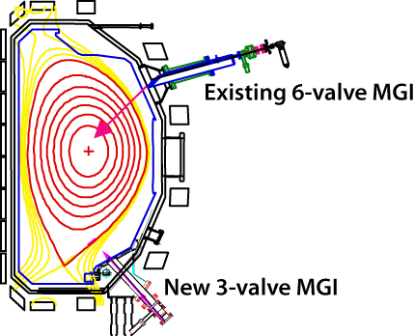
  Collaborations at KSTAR and DIII-D support macroscopic stability research thrusts on NSTX-U
KSTAR collaboration
  Improved control and ran XPs accessing β_{N}^{no-wall}
  Pitch-crossing field drives n=1 NTV with bounce harmonic resonances
  Non-resonant NTV slows ω_{φ} (no hysteresis)
DIII-D collaboration
  Participated in radiation asymmetry campaign: # of injectors had little effect on TQ/CQ P_{rad} asymmetry
  Kinetic effects explain RFA experiments (MARS-K)
  XP and MISK calcs. to understand kinetic RWM stability and enable high β
MGI1
Fluid
DIII-D
Kinetic
DIII-D
MGI2

Slide 6
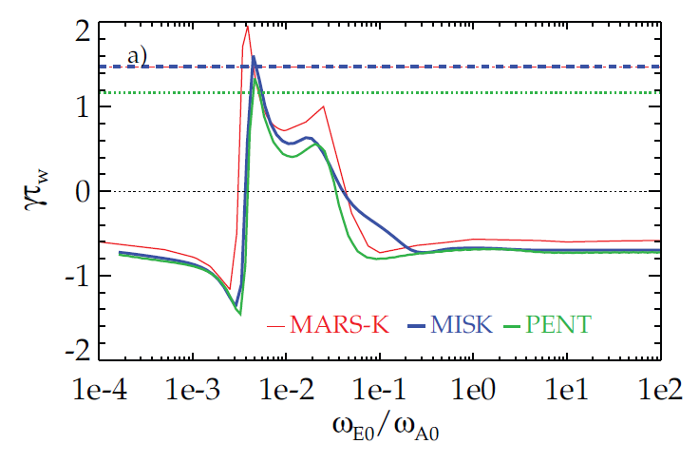
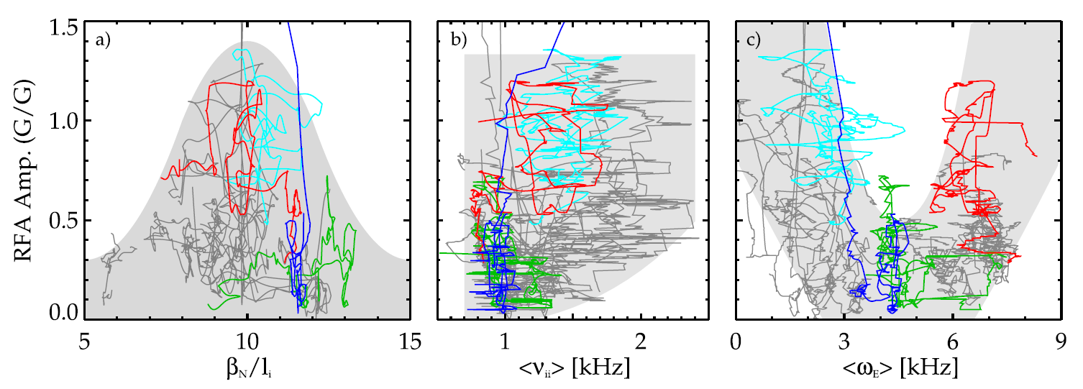
  Kinetic stability theory and comparison to NSTX is setting the stage for practical use in NSTX-U for disruption avoidance
  Moving kinetic RWM stability theory from successful theory/experiment comparison to actual implementation
Instability measure (RFA) vs. exp. ω_{E} for NSTX
Growth rate vs. ω_{E} for ITER case
    MISK (perturbative) benchmarked with other leading codes
    A simplified model based on these results will be implemented in the NSTX-U disruption avoidance algorithm
  Ideal Wall Mode destabilization by rotational shear vs. stabilization by kinetic effects explained with MARS-K
    Also may help explain low-density/ramp-up disruptions in NSTX in prep for low ν operation (fast ions important)
β_{N}
exp

Slide 7
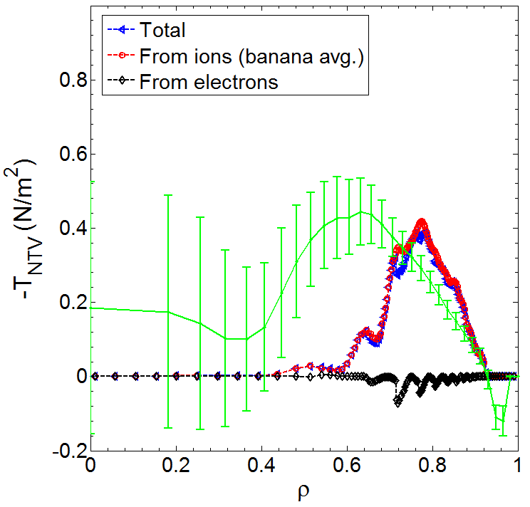
Non-resonant Neoclassical Toroidal Viscosity (NTV) physics analysis progresses, will be used for rotation feedback control
NTV torque profile (n = 3)
Leading theory/codes under active development
  IPEC-PENT, MARS-K, MARS-Q, and POCA (δf guiding-center particle code) have been benchmarked
NTVTOK code analysis
  NTVTOK modified, incl. Shaing’s connected NTV model, covers all ν, superbanana plateau regimes (like MARS-Q)
  Full 3D geometry and coil, ion & ele. effects
  Plasma response from penetrated 3D field used in exp. analysis matches M3D-C¹ single fluid model
  FY14: Analyzing NTV data from 6 experiments on ν dependence and other NTV characteristics
NTVTOK
1.6
Experimental
-dL/dt
Scaled x2
1.2
0.8
0.4
-0.4
(NTVTOK)
(n = 3 configuration)
<δB> (G)
core
edge
Strong T_{NTV} region
(Columbia U., GA)
JRT-14

Slide 8
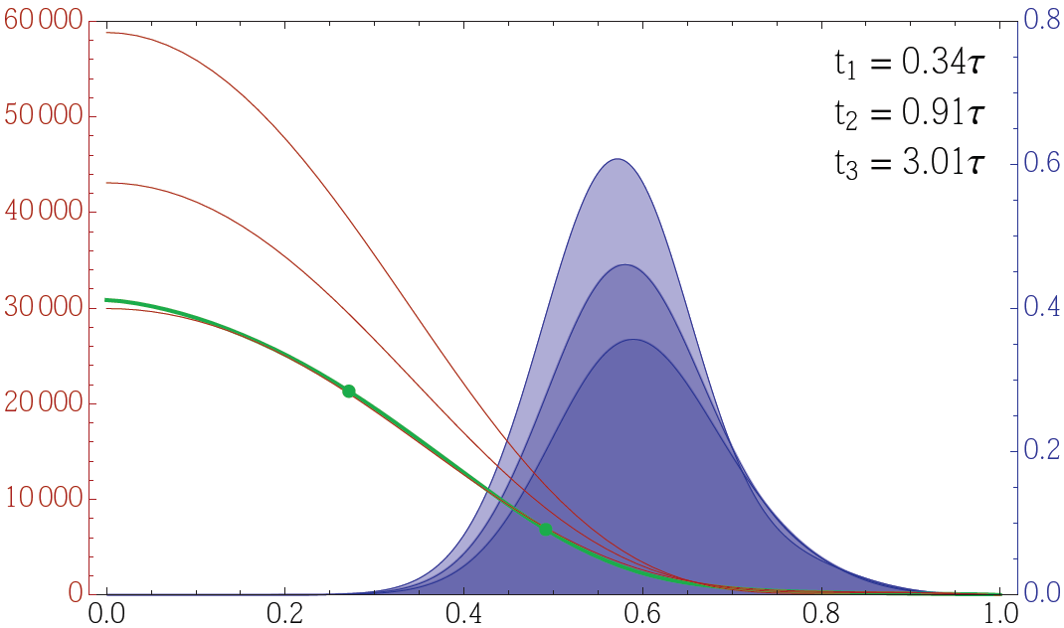
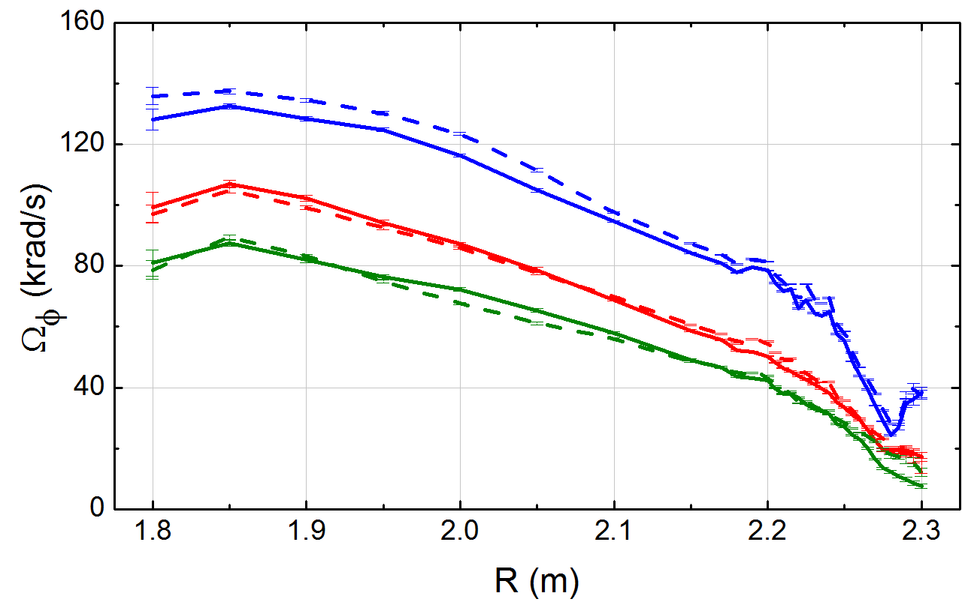
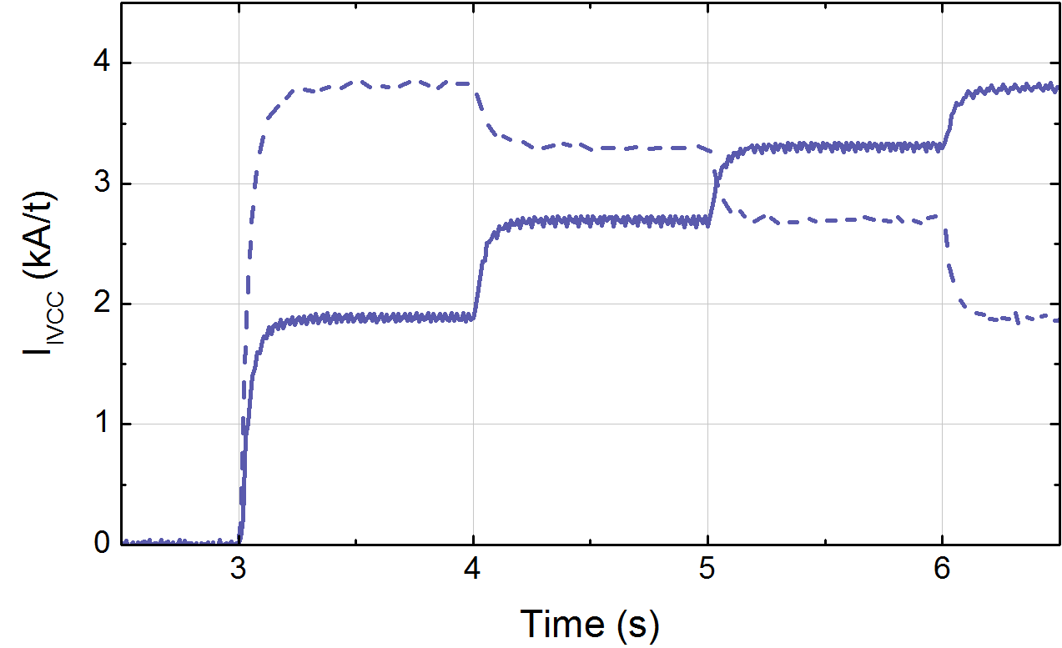
Rotation feedback controller using NTV designed; supported by key results from international collaboration research
NSTX-U controller will use Neoclassical Toroidal Viscosity (NTV) physics for the first time in rotation feedback control
Dedicated long-pulse KSTAR experiments show no hysteresis in ω_{φ} profile vs. applied 3D field strength (important for control)
NSTX-U state-space ω_{φ} controller w/NTV as actuator
6
10⁴
t₁
t₂
4
t₃
NTV
region
Plasma rotation (rad/s)
NTV torque density (N/m²)
2
desired ω_{φ}
0
Radial coordinate
KSTAR non-resonant (“n = 2”) NTV experiments
Plasma rotation profiles
0 kA/t
3.3 kA/t
2.7 kA/t
ω_{φ} (krad/s)
2.7 kA/t
3D field current (kA/t)
3.3 kA/t
3D current stepped up / down
(Columbia U.)

Slide 9
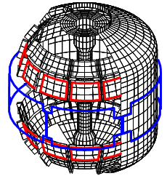
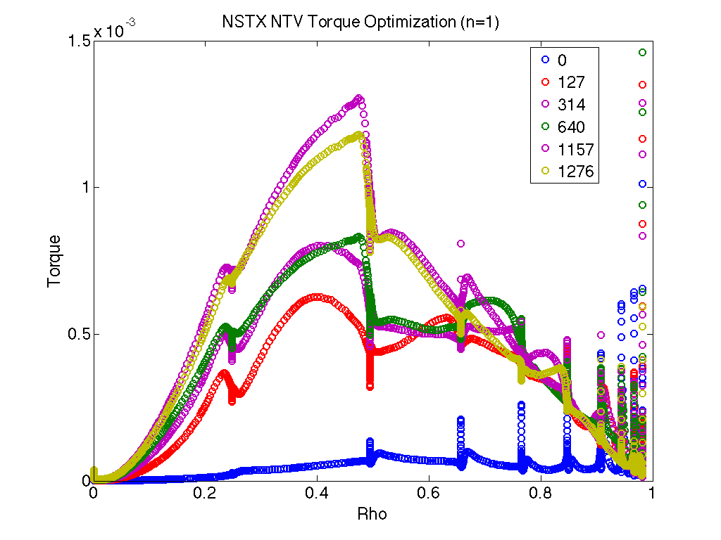
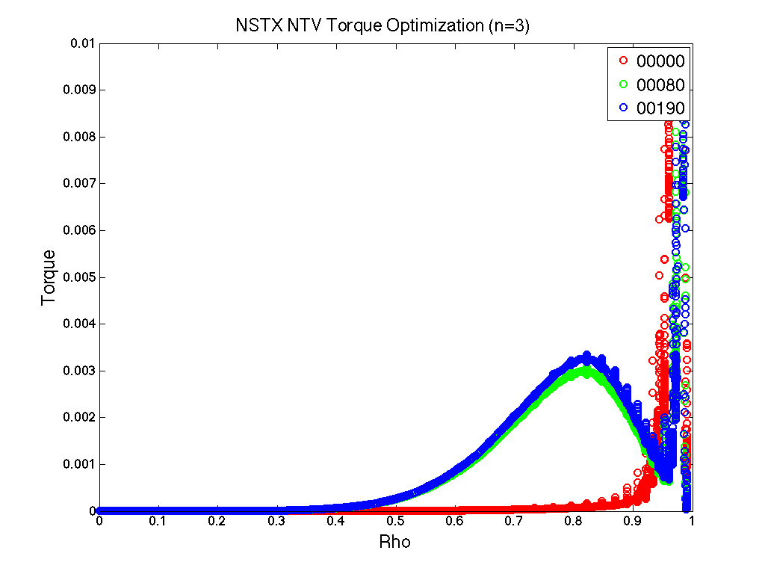
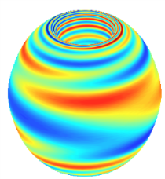
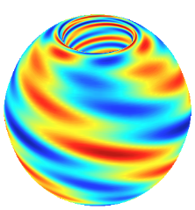
  Non-axisymmetric control coils (NCC) (incremental) will enhance physics studies and control
NCC designed with multiple physics metrics for error field, RWM, rotation control by NTV, and RMP characteristics
  Analysis updated with IPEC-PENT and more NSTX-U targets (see back-up)
NCC design (on passive plates)
Existing coils
Now utilizing stellarator optimization tools without coil constraints to determine theoretical max performance (PAC recommendation)
  The IPECOPT code developed (from STELLOPT) to optimize IPEC equilibrium for core and edge NTV Torque
  IPECOPT will be extended to analyze additional figures of merit: EF, RMP
  Deliverable: assess physics benefits of potentially improved coil sets within 9 months to drive subsequent engineering analysis
PPPL Theory Partnership,
JRT-14
Examples of initial IPECOPT NTV torque profile localization optimization
n=1
n=3
Torque
Iteration count
Optimized for 0.5<Ψ<0.9
Optimized for core
Rho
Rho

Slide 10
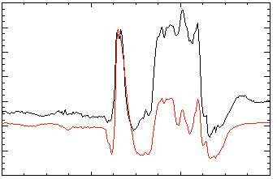
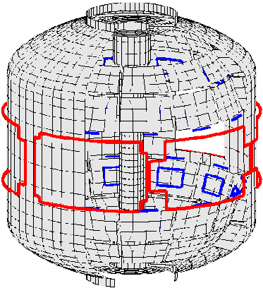
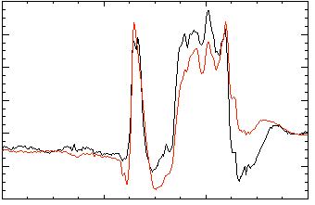
Active control techniques (B_{r} + B_{p}, RWM state-space (RWMSC)) will enable long pulse, high β operation
FY14:
  Offline RWMSC already expanded for 6 coil control and n > 1 physics
    Now comparing past 3 coil algorithm with open-loop 6 coil tests in generalized code
Stability plans, FY15:
  EFIT, available Day 0
    New parallel CPUs implemented, increased between-shots spatial / time resolution
  Examine RWMSC with:
    six control coils and multi-mode control with n up to 3
  Establish B_{r} + B_{p} active control capability in new operational regime
No NBI Port:
80
δB_{p}⁹⁰
Measurement
RWMSC
40
Controller
(observer)
0
-40
137722
80
δB_{p}⁹⁰
t (s)
40
With NBI Port:
0
137722
0.56
0.58
0.60
0.62
t (s)
Active n = 1 B_{p} + B_{R} feedback control
6
β_{N}
Feedback on
140124
140125
140126
140127
4
2
B_{r} phase = 225º
0
6
B_{r}^{n = 1} (G)
JRT-16
4
2
B_{r} phase = 180º
0
0.0
0.2
0.4
0.6
0.8
1.0
1.2
t (s)
B_{r} phase = 0º
B_{r} phase = 90º

Slide 11
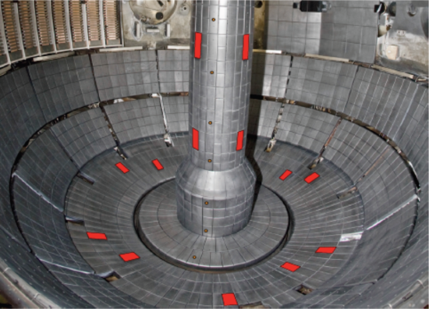
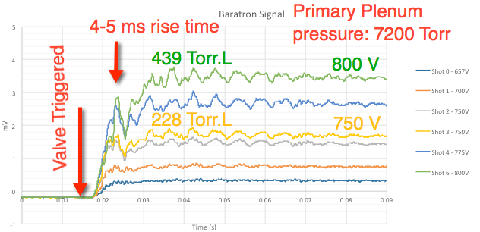
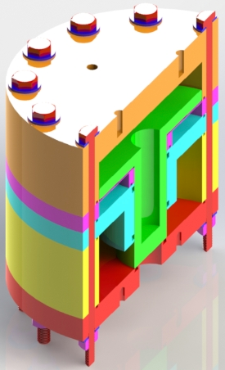
  Correction of intrinsic error fields is critical for performance; NSTX-U will have new disruption research capabilities
3D fields research plans, FY15:
  Assess intrinsic EFs in NSTX-U
  Optimize dynamic EF correction, including n>1 and using 6 SPAs and RWMSC
  Resonant EF effects on tearing mode onset (+Resistive DCON)
Disruption research plans, FY15:
  FY14: substantial contributions to the ITPA disruption database
  Investigate halo current toroidal asymmetry and loading on the center column, using 18 newly installed shunt tiles
  Commission MGI system
    ITER-like valves tested to pressure above spec: fast rise time
Dynamic error field correction in NSTX
Gain
Planned normal current tiles
PPPL Theory: optimal sensor position/type
NSTX-U ITER-like MGI Valve
Pressure
0
10
20
30
40
50
60
70
80
Time (ms)

Slide 12
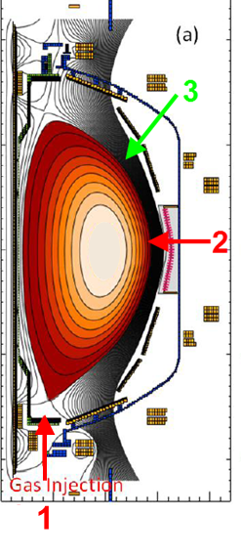
  Disruption prediction by multiple means will enable avoidance via profile or mode control or mitigation by MGI
Disruption research plans, FY16:
  Compare the mismatch between the RWMSC observer model and sensor measurements, and disruption occurrence
  Study spatial extent and timing of the heat deposition during VDEs
    Eroding thermocouples and new IR cameras
  Characterize density assimilation vs. poloidal location of MGI system
    JRT-16 support, DEGAS-2 modelling
    Valves in poloidal location 2 & 3 identical to location 1 or 4 (locations 1, 2 & 4 for FY15)
    Injection into the private flux region is possible
4
Divertor fast eroding thermocouples
Divertor fast pressure gauge
Dual-band fast IR cameras

Slide 13
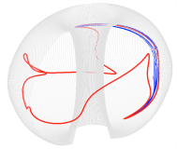
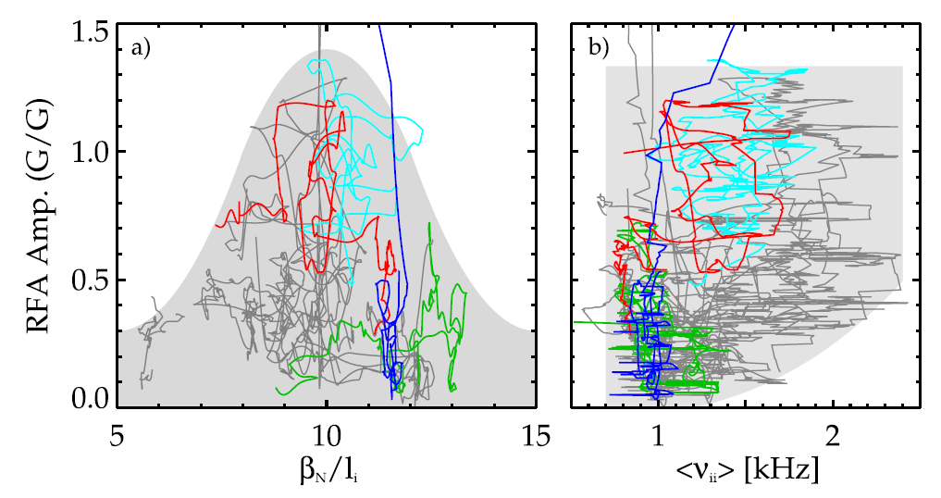
  NSTX-U will investigate NTV and stability theory in lower ν regime for implementation in active rotation control
3D fields plans, FY16:
  Assess NTV profile and strength at reduced ν, examine NTV offset rotation at long pulse, at zero torque
  Prepare an initial real-time model of NTV profile for use in initial tests of the plasma rotation control system
Stability plans, FY16:
  Examine RWMSC with rotational stabilization in the controller model
  Investigate the dependence of stability on reduced ν through MHD spectroscopy; compare to kinetic stabilization theory
n=3 experiment
n=3 POCA
n=2 POCA
NSTX -> NSTX-U
(Bounce freq. ⬆ ,
Collisionality ⬇)
Modified bounce orbits may be strongly resonant at low collisionality
JRT-16

Slide 14
  Summary: MS research during FY2015-16 will enable long-pulse high performance in NSTX-U and future devices
Advancing passive stability and active feedback control will be integrated into a disruption avoidance system, allowing us to sustain macroscopic stability in the new low collisionality regime
Understanding 3D field effects will provide a physics basis for optimizing stability through new capabilities of equilibrium profile control
Understanding disruption dynamics, and development of techniques for disruption prediction, avoidance, and mitigation in high-performance ST plasmas will be greatly beneficial to future devices

Slide 15
  Backup

Slide 16
Disruption prediction by multiple means will enable avoidance via profile or mode control or mitigation by MGI
Predictors (Measurements)
Shape/position
Eq. properties (β, l_{i}, V_{loop},…)
Profiles (p(r), j(r), v_{φ}(r),…..)
Plasma response (n=0-3, RFA, …)
Divertor heat flux
General framework & algorithms applicable to ITER
Plasma Operations
Control Algorithms: Steer
Towards Stable Operation
Isoflux and vertical position ctl
LM, NTM avoidance
RWM and dynamic EF control
RWMSC (plasma response)
Divertor radiation control
Avoidance Actuators
PF coils
2nd NBI: q, v_{φ}, p control
3D fields (upgraded + NCC):
EF, v_{φ} control
n=1-3 feedback
Divertor gas injection
Loss of Control
Disruption Warning
System
Mitigation
Early shutdown
Massive Gas Injection
EPI (tbp)

Slide 17
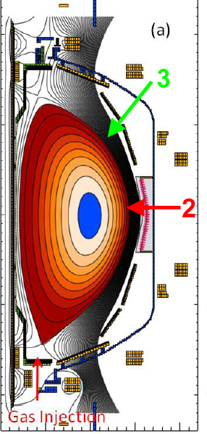
Disruption prediction by multiple means will enable avoidance via profile or mode control or mitigation by MGI (2)
Predictors
Disruption Warning System
Mitigation
γ contours
Control Algorithms
Kinetic Physics
Evaluate simple physics criteria for global mode marginal stability in real-time
Avoidance Actuators
MHD Spectroscopy
Use real-time MHD spectroscopy while varying rotation, q_{min}, and β_{N} to predict disruptions
q, v_{φ} , β_{N} control
Resonant Field
Amplification (G/G)
1
RWMSC observer
Compare mismatch between the RWMSC observer and sensor measurements, and disruption occurrence
  ITER gas-loading :
  Injection into private flux region with higher assimilation efficiency?
3D fields, feedback

Slide 18
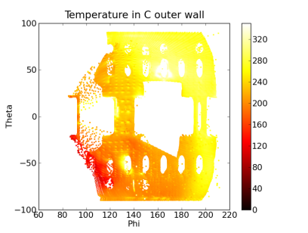
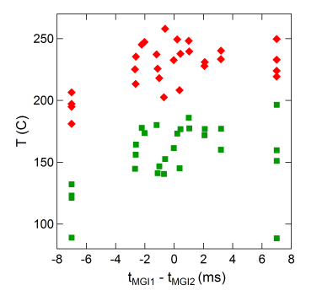
  Participated in DIII-D National Campaign on Radiation Asymmetry XP
Thermal imaging indicates MGI location cooler than nearby wall
  ITER concerned about localized melting near gas injection port location
# of injectors had little effect on TQ/CQ P_{rad} asymmetry
  No significant variation with valve delay
MGI1
MGI2
N.W. Eidietis, et al, G04-2, APS2013
MGI2
MGI2

Slide 19
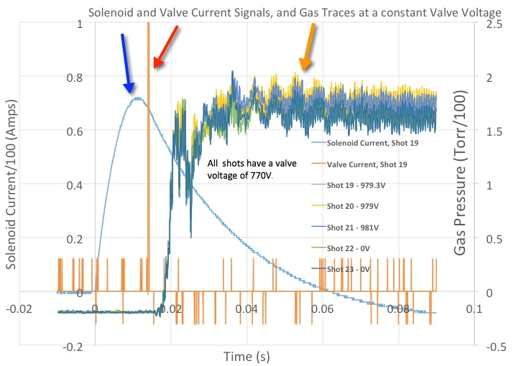
Valve has same time response for operation in <0.4T magnetic fields
Shots 19,20, 21 are with solenoid energized
Shots 22 and 23 are comparison shots without solenoid
Vacuum solenoid field is 0.67T
Skin depth in Al is 2.2cm, valve wall thickness is 1cm. Fields inside valve side wall ~0.4T
Future tests will use SS304L valve and further slow down solenoid current waveform

Slide 20
  ITER-like MGI Valve Designed, Built and Tested for Installation on NSTX-U
NSTX-U MGI Valve
FY15 MGI Research Plans
  Operate valves at ~5000 Torr (200 Torr.L Neon)
  Compare mid-plane and PFR locations for gas assimilations studies using identical gas injection set-up
  Possible Poloidal injection effect on VDE (multi-machine experiment with DIII-D & C-MOD)
  3 valves to be installed for FY15 Experiments

Slide 21
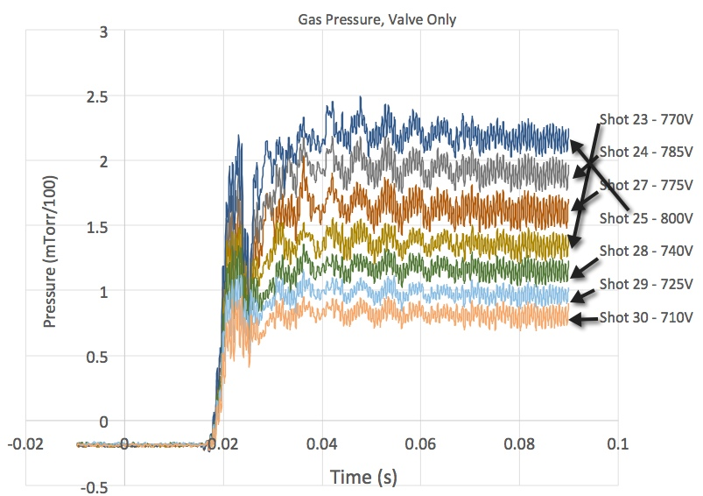
Version 4 Valve evacuates into chamber in < 3ms, for gas injection amounts of 200 Torr.L N₂
NSTX-U MGI Valve

Slide 22
  Physics analysis for Non-axisymmetric Control Coil (NCC) has been updated with IPEC-PENT and more NSTX-U targets
NTV calculations are updated using IPEC-PENT, without previous large-aspect-ratio approximation and pitch-angle simplification
  In NSTX and NSTX-U, PENT torque is typically larger than previous analysis by a factor of 2~3
1.5MA~2MA NSTX-U targets were studied
  2x6-odd is better than 12U or 2x6-even in general, but its advantages decrease when I_{P}= 1.5➔2MA
  FOM table updated accordingly (Purple : 2MA)
Figures of Merit | Favorable values | MID | 12U | 2x6-Odd | 2x12
EF (n=1) | High F_{N-R} | 0.07 | 0.13 | 1.24 | 1.24
RWM (n=1) | High F_{β} | 1.25 | 1.54 | 1.61 | 1.70
NTV (n≥3) | Wide ΔF_{N-N} | 1.00 | 1.44~6.08 | 1.75~11.33 | 6.38~59.4
RMP (n≥3) | High F_{N-C} | 0.25~0.30 | 0.31~1.04 | 0.43~0.77 | 1.18~3.53
 | Wide ΔF_{N-C} | 1.00 | 2.20~12.3 | 10.4~17.4 | 888~14400

Slide 23
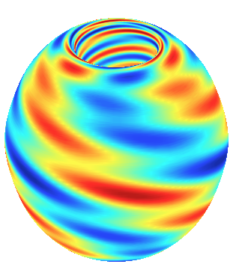
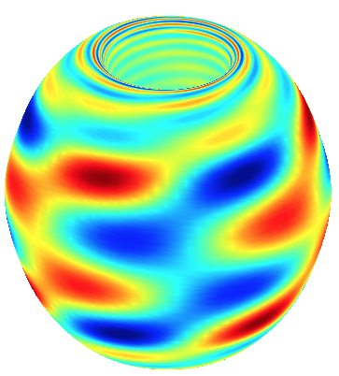
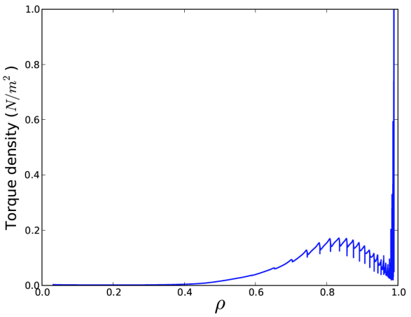
  Non-axisymmetric Control Coil (NCC) capability on NTV braking has been successfully studied with STELLOPT
The IPECOPT code has been developed from STELLOPT to optimize IPEC equilibrium for NTV Torque
  Initial attempts focus on variation of boundary harmonics for core and edge torque
  The applied n=1 spectrum shows the possibility to drive core (rho < 0.5) torque while minimizing edge torque
  The applied n=3 spectrum shows the ability to drive a broad edge torque
NCC design (on passive plates)
Existing coils
Unconstrained
Constrained to partial NCC + Midplane coil
n=3
Levenberg-Marquardt (Modified) optimization
n=3
Partial NCC (2x6-only) 4kAt,
Midplane coil 4kAt
Total torque ~2Nm
Torque
Rho
Total normal δB
on the plasma boundary
PPPL Theory Partnership, JRT-14

Slide 24
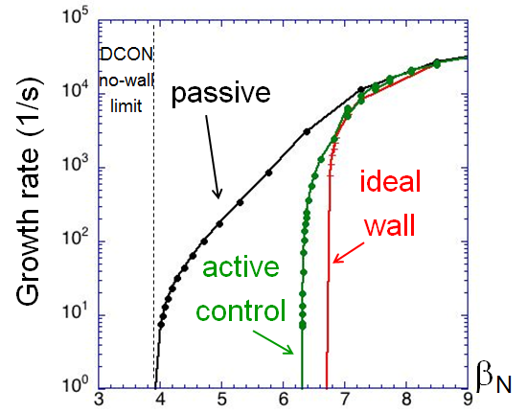
RWM active control capability of the NCC continues to be assessed
NCC 2x6 odd parity, with favorable sensors
NCC 2x12 with favorable sensors, optimal gain
Full NCC coil set allows control close to ideal wall limit
  NCC 2x6 odd parity coils: active control to β_{N}/β_{N}^{no-wall} = 1.61
  NCC 2x12 coils, optimal sensors: active control to β_{N}/β_{N}^{no-wall} = 1.70
  (RWM coil β_{N}/β_{N}^{no-wall} = 1.25)
NCC full
2x12 coils
Existing
RWM
coils
NCC partial
2x6 coils
  Design now needs sensor assessment

Slide 25
  Extensive benchmark among various NTV codes has been active and successful
There are three main branches in semi-analytic NTV codes as described in details below
All three have been successfully benchmarked
A particle code POCA also shows consistent trends with semi-analytic NTV codes, with some quantitative differences depending on regimes
Connected NTV formula | Combined NTV theory | Drift kinetic energy theory
Analytic NTV formulation is derived in the collisionality regimes, SBP, ν-√ν regime and 1/ν regime separately. Pade approximation to smoothly connect the formulations in different colisionality regimes. | NTV torque due to different particle motions are combined by a generalized equation. No need to separate the collisionality regimes | Drift kinetic energy is studied to determine ideal MHD instabilities e.g. Resistive Wall Modes. The torque is calculated based on the equivalence between NTV torque and drift kinetic energy. T_{Φ}=2inδW_{K}
Precession resonance | Precession resonance + Bounce-harmonic resonance
Pitch angle scattering collisional operator (accurate in the ν-√ν regime) | Krook collisional operator (allows to derive one generic equation of NTV torque and drift kinetic energy)
Geometric simplification | Full toroidal geometry
MARS-Q | IPEC-PENT | MARS-K
Liu and Sun, PoP 20 (2013) 022505 Sun et al, NF 51 (2011) 053015 Shaing et al, NF 50 (2010) 025022 | Park et al, PRL 102 (2009) 065002 Logan et al, PoP 20 (2013) 122507 | Park, PoP 18 (2011) 110702 Liu et al, PoP 15 (2008) 112503

Slide 26
  In lower ν regime, NSTX-U will investigate NTV for rotation control and stability theory implemented in active control
3D fields research plans, FY16:
  Assess NTV profile and strength at reduced ν and examine the NTV offset rotation at long pulse
  Prepare an initial real-time model of NTV profile for use in initial tests of the plasma rotation control system
Stability research plans, FY16:
  Examine RWMSC with:
    rotational stabilization in the controller model
  Investigate the dependence of stability on reduced ν through MHD spectroscopy; compare to kinetic stabilization theory
Dominant transport mechanism
NSTX
Resonance between ExB and Bounce motion
Collision (1/ν)
Modified bounce motion
n=3 exp.
n=3 POCA
n=2 POCA
NSTX-U
(Bounce freq. ⬆
Collision ⬇)
Bounce-harmonics become important and SBP too if ExB is low
SBP becomes important and offset too if ExB is low

Slide 27
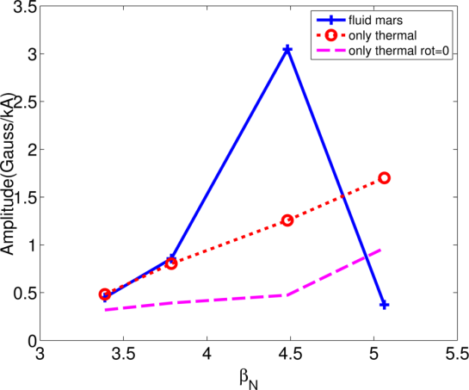
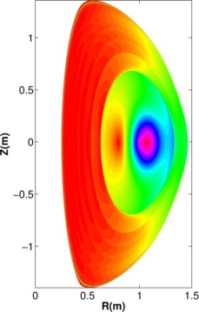
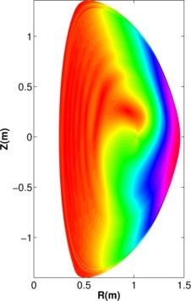
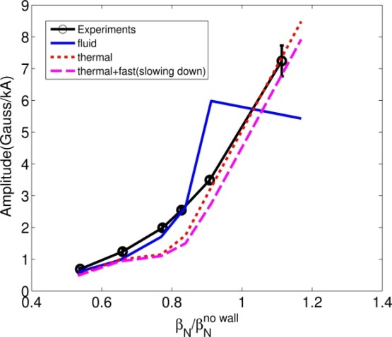
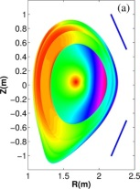
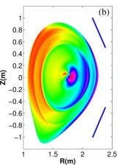
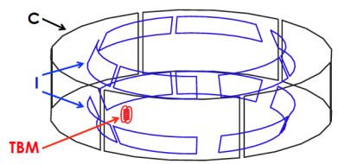
  Drift-kinetic effects on 3D plasma response and non-resonant error field effects are being actively investigated
Drift-kinetic 3D plasma response
  MARS-K self-consistent calculations
  successfully compared with n=1 DIII-D RFA
  Preliminary NSTX RFA calculations indicate kinetic stabilization effects important (especially near no-wall limit), and rotation can be destabilizing
Res. and non-res. error field effects
  Resonant-coupling schemes (IPEC-PENT) are being used to optimize n=2 error field correction in DIII-D and n=1-4 correction in TBM mock-up
  Extremely small resonant errors were found so far in KSTAR, and non-resonant error field will be investigated
  Non-resonant error field effects on locking/tearing are being investigated in NSTX, with newly developed resistive DCON
NSTX
Ideal
Kinetic
DIII-D
I+C-coil circuit optimization for TBM n=1-4 correction

Slide 28
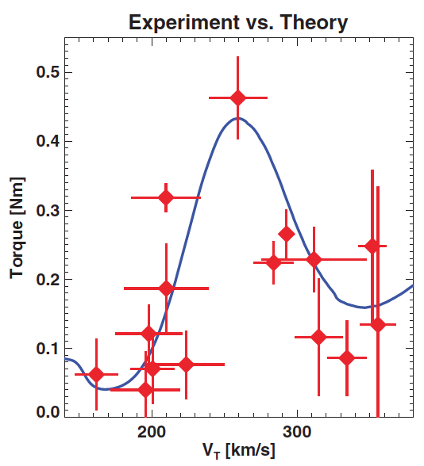
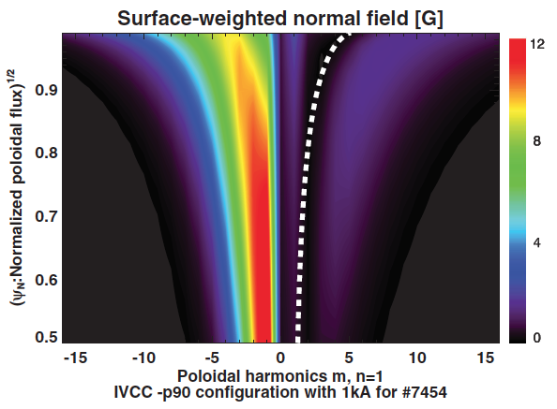
  KSTAR 3 rows of internal coils were used to produce n=1 pitch-crossing field lines and to find rotational resonances
The unique 3 rows of internal coils in KSTAR were utilized to produce pitch-crossing field lines (orthogonal to pitch-aligned field lines)
This n=1 field is almost purely non-resonant :
  Successfully induced NTV without n=1 resonant perturbation
  Used to find the 1st bounce-harmonic rotational resonance, as the gap to 2nd resonance is the widest with n=1 (predicted by and agreed with theory and computation)
Mirror image to RMP
m~nq
J.-K. Park, PRL 111, 095002 (2013)

Slide 29
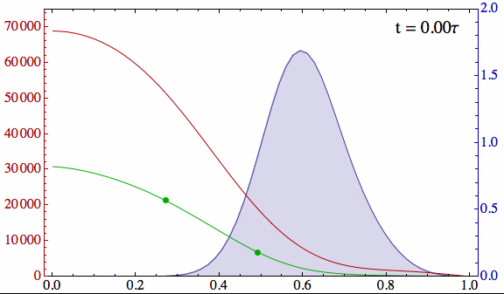
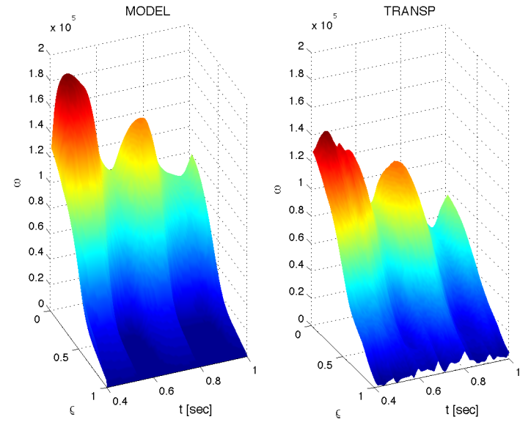
Non-resonant Neoclassical Toroidal Viscosity (NTV) physics will be used for the first time in rotation feedback control
Momentum force balance – ω_{φ} decomposed into Bessel function states
NTV torque:
(non-linear)
Feedback using NTV: “n=3” δB(ρ) spectrum
State-space model
TRANSP run
10⁴
133743
6
Desired
Computed
Plasma rotation (rad/s)
NTV torque density (N/m²)
Plasma rotation (rad/s)
4
NTV
region
2
radius
t(s)
t(s)
0
I. Goumiri (PU), S.A. Sabbagh (Columbia U.), D.A. Gates, S.P. Gerhardt (PPPL)
Radial coordinate

Slide 30
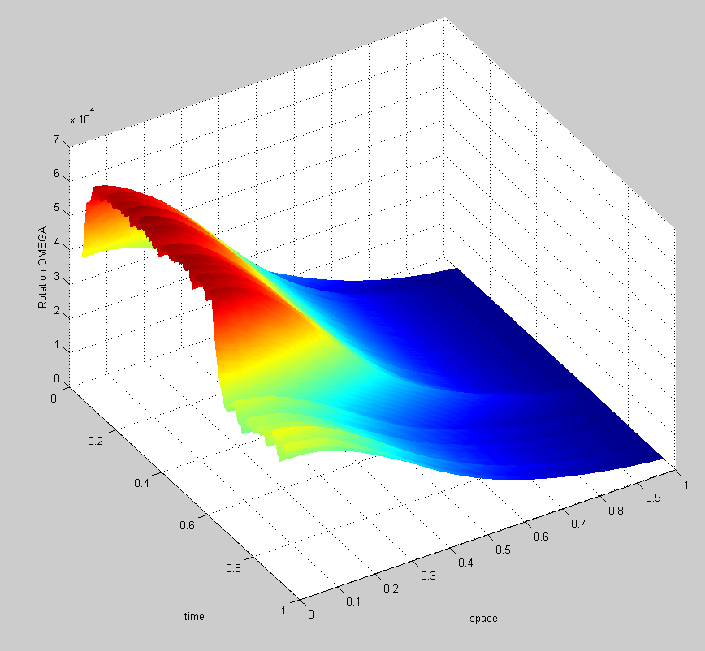
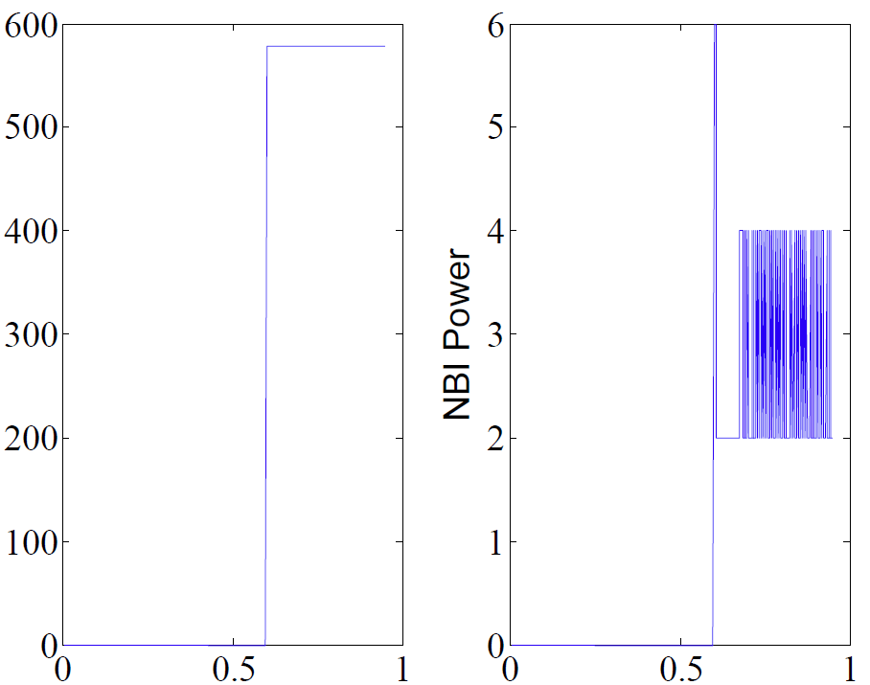
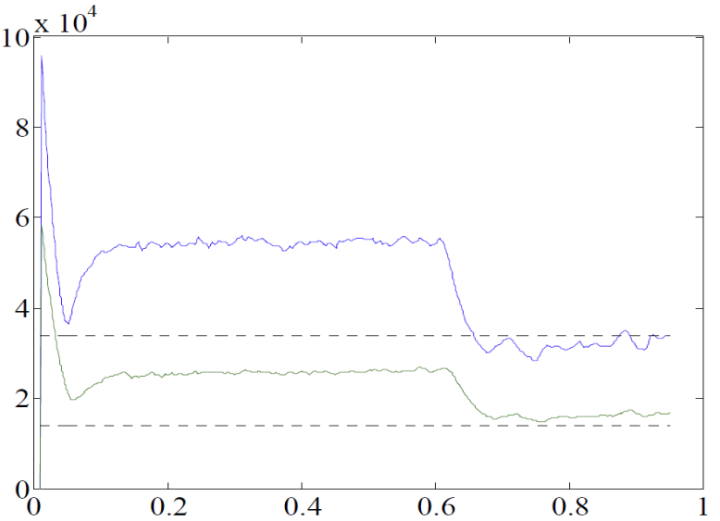
Plasma rotation control has been demonstrated for the first time with TRANSP using NBI and NTV actuators
3D coil current and NBI power (actuators)
3D Coil Current (A)
NBI power (MW)
feedback on
Plasma rotation (rad/s)
t (s)
t (s)
Rotation evolution vs. desired
rotation setpoints
feedback on
t (s)
Plasma rotation (rad/s)
Normalized radius
desired ω_{φ} (#1)
desired ω_{φ} (#2)
This case uses pre-programmed 3D coil current and NBI feedback
t (s)

Slide 31
Plasma response from fully-penetrated 3D field used in NTV experimental analysis matches M3D-C¹ single fluid model
NTV experimental data is a strong quantitative constraint on plasma response of δB
  Because the measured NTV scales as T_{NTV} ∝ δB²,
Level of agreement varies with profile
  Good agreement between NTVTOK / M3D-C¹ single fluid models in strong NTV region
  M3D-C¹ core <δB> larger than NTVTOK
    Core mode in M3D-C¹
  M3D-C¹ edge <δB> smaller
    Experimental T_{NTV} too small in this region to constraint δB
Analysis ongoing in 2014
Surface-averaged δB from fully penetrated model vs. M3D-C¹ single fluid model
(NTVTOK)
(n = 3 configuration)
Flux surface-avg <δB> (G)
core
edge
Strong T_{NTV} region
  NTVTOK analysis (S.A. Sabbagh)
  M3D-C¹ analysis (Evans/Ferraro (GA), Jardin (PPPL))

Slide 32
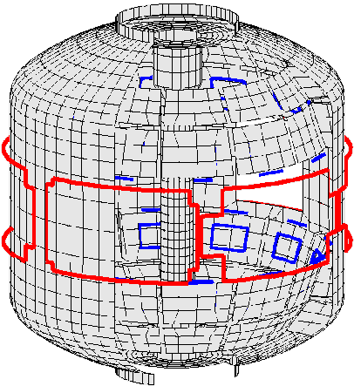
Model-based RWM state space controller including 3D plasma response and wall currents used at high β_{N} in NSTX
RWM state space controller in NSTX at high β_{N}
Effect of 3D Model Used
No NBI Port
80
δB_{p}⁹⁰
Measurement
40
Controller
(observer)
0
-40
137722
0.56
0.58
0.60
0.62
t (s)
With NBI Port
80
δB_{p}⁹⁰
40
Potential to allow more flexible control coil positioning
  May allow control coils to be moved further from plasma, and be shielded (e.g. for ITER)
0
137722
0.56
0.58
0.60
0.62
t (s)
3D detail of model is important to improve sensor agreement
Katsuro-Hopkins, et al., NF 47 (2007) 1157
S.A. Sabbagh, et al., Nucl. Fusion 53 (2013) 104007

Slide 33
Dual-component PID (B_{r} + B_{p}) and model-based RWM state-space (RWMSC) active control will enable long pulse, high β operation
2014:
  Expand/analyze RWMSC for 6 coil control and n > 1 physics
Active n = 1 B_{p} + B_{R} feedback control
6
β_{N}
Feedback on
140124
140125
140126
140127
4
2
B_{r} phase = 225º
0
6
B_{r}^{n = 1} (G)
2015 and 2016:
  Establish B_{r} + B_{p} active control capability in new machine, use with snowflake divertor
4
2
B_{r} phase = 180º
0
0.0
0.2
0.4
0.6
0.8
1.0
1.2
t (s)
B_{r} phase = 0º
B_{r} phase = 90º
  Examine RWMSC with:
    independent actuation of six coils
    multi-mode control with n up to 3
    rotational stabilization in the model
RWMSC
  Advantages:
  potential for use of external coils with less power
2017 and 2018:
  Upgrade for NCC, utilize model-based active control with the new NCC to demonstrate improved global MHD mode stability and very low plasma disruptivity, producing highest-performance, longest-pulse plasmas

Slide 34
Research plans and needs for this year (FY2014) in preparation for NSTX-U operations in FY2015
RWM State-space Controller generalization – available “Day 0”
  Offline IDL version of code already generalized
  Changes to r/t version to be made. Small PCS programming support will be needed
NSTX EFIT (of course, “Day 0”)
  Plan to upgrade to faster processing to support increased between-shots spatial resolution / time resolution (eta 2014-2015); present code available as default
  New code components acquired Dec 2013; new dedicated prototype 32 core CPU computer online at PPPL (planned to be expanded); consistent with PPPL IT plan
NSTX rotation control
  Continuing work with PU student (I. Goumiri) on rotation control algorithm
  Present quantitative NTV analysis of Columbia U. NSTX experiments supports this

Slide 35
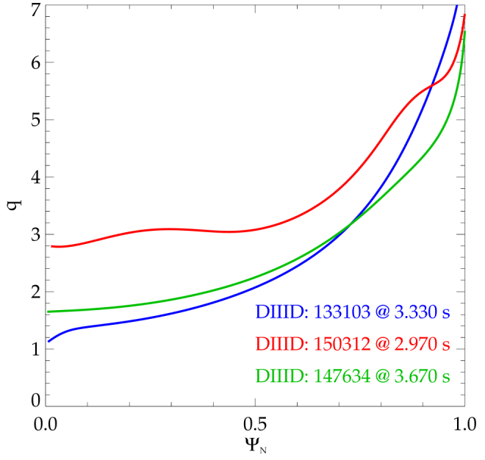
MISK analysis of DIII-D discharges is helping to enable their path to high beta operation
High β_{N}, high q_{min} shots with similar, relatively high plasma rotation have varied stability due to q profile variation and related changes to bounce resonance stabilization
Educated follow-on experiment forthcoming
MISK stability vs. rotation
150312
t = 2.990s
t = 2.970s
Unstable
Stable
147634
133103
Experimental rotation magnitude

Slide 36
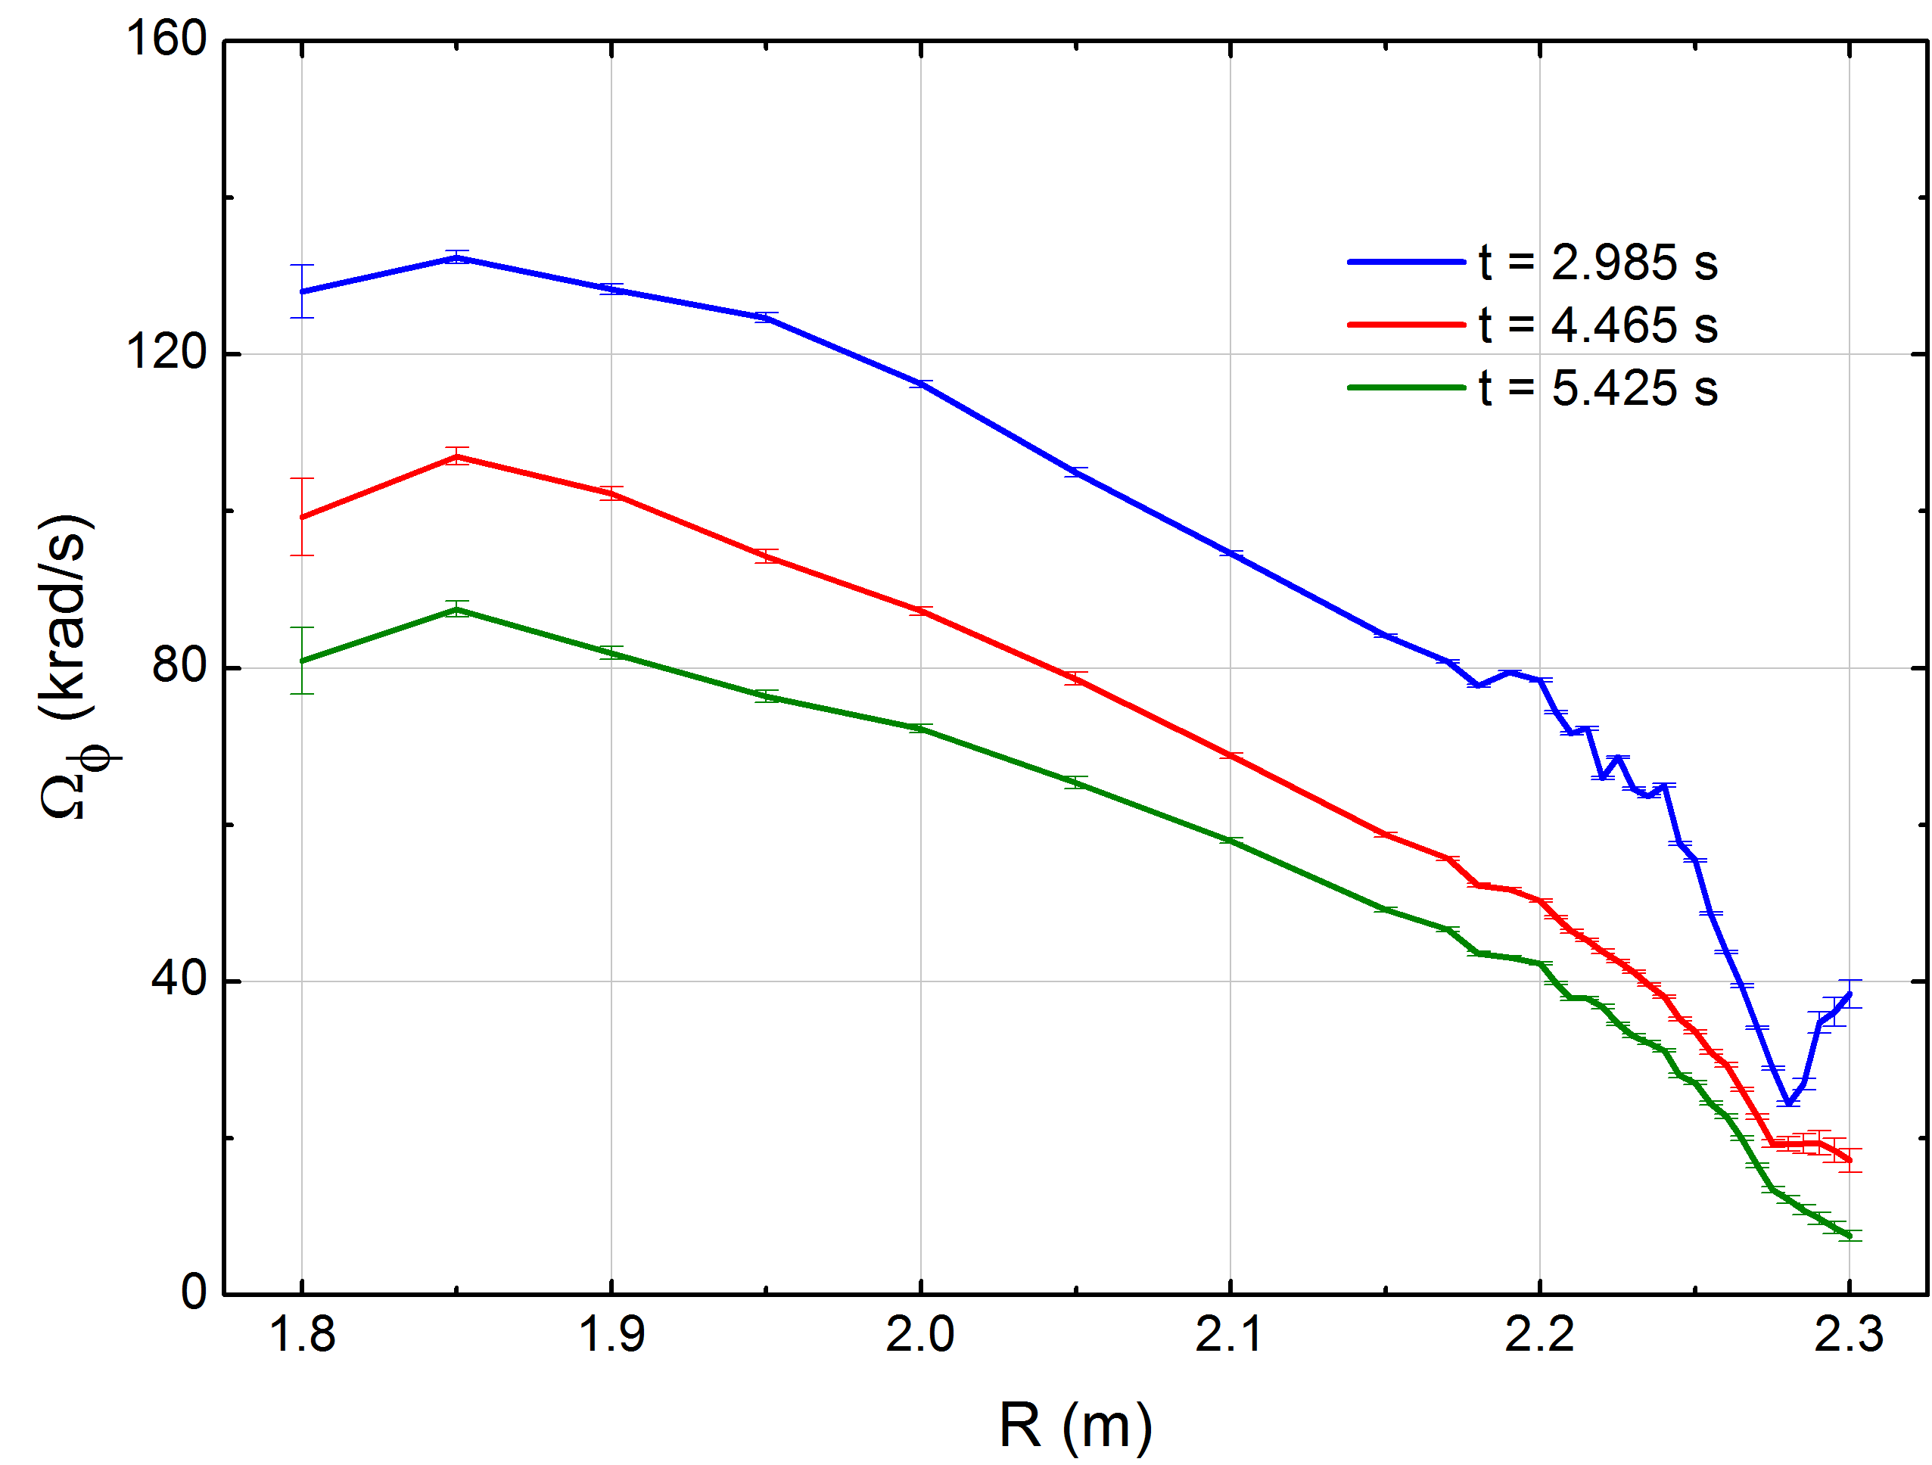



Measured toroidal plasma rotation profile shows non-resonant NTV rotation control using n = 2 field
1
1
2
3
3
2
With n = 2 field
(step current up)
With n = 2 field
(step current down)
8062
8064
IVCC n = 2 current
At same IVCC
current, rotation
profile shows no hysteresis – important for control
1
2
3
1
2
3
S.A. Sabbagh,
Y.S. Park (Columbia U.)

Slide 37
  Collaborations at KSTAR have aided high beta operation
KSTAR collaboration
  High β_{N}, over no-wall limit has been achieved

