Slide 1

NSTX-U PAC-39
Program Overview
J. Menard
For the NSTX-U Research and Recovery Teams
PPPL
January 9, 2018

Slide 2
Outline
PAC Members and charge questions
ST and NSTX-U research goals
Program impacts from extended outage
Key questions addressed by NSTX-U
World-leading ST capabilities during initial ops
Summary

Slide 3
Outline
PAC Members and charge questions
ST and NSTX-U research goals
Program impacts from extended outage
Key questions addressed by NSTX-U
World-leading ST capabilities during initial ops
Summary

Slide 4
Thank you to PAC-39 members
new
Remote
new
Unavailable
new
Unavailable

Slide 5
Process for this PAC
We request “real-time” PAC assistance in helping our team put forward the most compelling arguments for NSTX-U – the mission, program, facility / Recovery
  We encourage the PAC to request improved arguments and slide content homework - overnight especially, longer-term
  It would be most valuable to have any PAC consensus and endorsement of NSTX-U major strengths in the PPT debrief
Technical discussions should focus on the charges
Keep questions until end of talks to help stay on time

Slide 6
PAC-39 Charge Questions
The NSTX-U research program requests PAC-39 comments and recommendations on:
Quality and importance of recent NSTX / NSTX-U research results
Uniqueness / timeliness of important questions NSTX-U will answer for fusion science
How / whether NSTX-U will be world-leading when operation resumes in 2020
Important scientific and technological findings since:
  Original physics design of NSTX-U (2009)
  And/or since the last 5 year plan was written (2014)
  And how such findings influence the impact of medium-term research on NSTX-U (2020-2025) and the long-term NSTX-U vision (2025-2030).

Slide 7
Outline
PAC Members and charge questions
ST and NSTX-U research goals
Program impacts from extended outage
Key questions addressed by NSTX-U
World-leading ST capabilities during initial ops
Summary

Slide 8
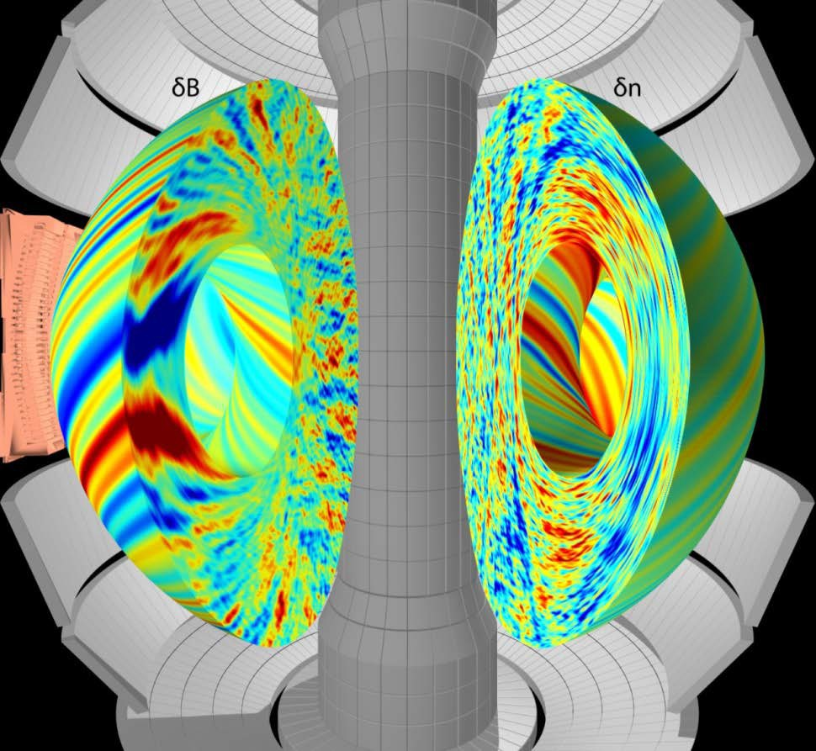
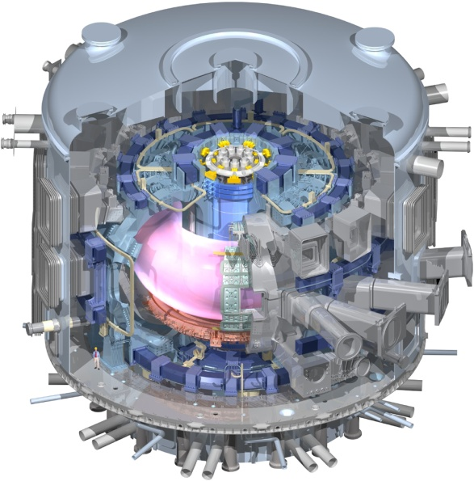
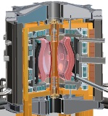
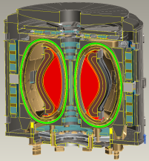
Low aspect ratio “Spherical Torus / Tokamak” (ST) vital for predictive capability for toroidal science and fusion energy
Electromagnetic turbulence
ST accesses unique regime of high normalized p
  Fundamental changes in nature of turbulence, MHD stability → Enhanced electromagnetic and super-Alfvénic effects
  STs can more easily study electron-scale turbulence at high temperature → Important for all toroidal configurations
  Neutral beam fast-ions in present STs mimic ITER DT fusion products → Study burning plasma science
If physics results favorable, STs could provide more economical fusion development & energy systems
  Potentially reduced magnet and device size and cost
ITER
Pilot Plant
FNSF / CTF

Slide 9
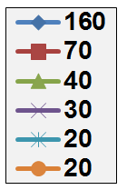
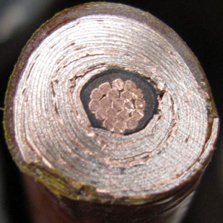
High-current-density rare earth barium copper oxide (REBCO) superconductors motivate consideration of low-A pilot plants
Conductor on Round Core Cables (CORC): High winding pack current density at high magnetic field
J_{WP} ~ 70MA/m² at 19T
Higher current densities, B likely possible…
A ~ 2 attractive at high J_{WP}
Increasing J_{WP}
J_{WP} [MA/m²]
19T
10 mm
12T
6 mm
10 mm
7 kA CORC (4.2K, 19 T) cable
R = 3m
TBR ~ 1
P_{NBI} = 50MW
100% non-inductive
β_{N} (A) at no-wall limit
Base cable: 50 tapes YBCO Tapes with 38 μm substrate
(Van Der Laan, HTS4Fusion, 2015)

Slide 10

Example: A=2, R₀ = 3m HTS-TF Pilot Plant
B_{T} = 4T, I_{P} = 12.5MA
κ = 2.5, δ = 0.55
β_{N} = 4.2, β_{T} = 9%, f_{gw} = 0.8
H₉₈ = 1.75, H_{Petty-08} = 1.3
H_{ST} = 0.7-0.9
f_{NI} = 100%, f_{BS} = 0.76
Startup I_{P} (OH)~2MA
J_{WP} = 70MA/m²
B_{T-max} = 17.5T
No joints in TF
Vertical maintenance
P_{fusion} = 520 MW
P_{NBI} = 50 MW
E_{NBI}=0.5MeV
Q_{DT} = 10.4
Q_{eng} = 1.35
P_{net} = 73 MW
⟨W_{n}⟩ = 1.3 MW/m²
Peak n-flux = 2.4 MW/m²
Peak n-fluence: 7MWy/m²
TBR ≥ 1
ST confinement scaling uncertain, but potentially favorable
ST non-inductive sustainment at high performance remains to be demonstrated
Cryostat volume ~ 1/3 of ITER
J. Menard, et al., Nucl. Fusion 56 (2016) 106023

Slide 11
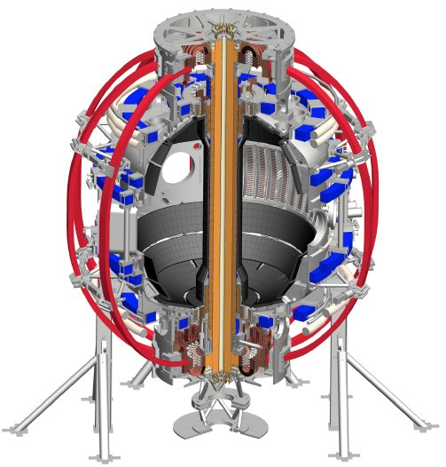
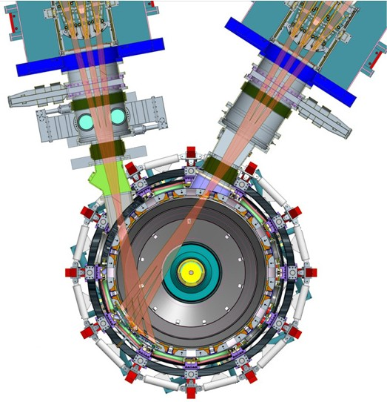
NSTX-U vital for predictive capability, fusion science
Will access new physics with 2 new tools:
1. New Central Magnet
2. Tangential 2nd Neutral Beam
High normalized pressure at high T
→ Unique regime, study new transport and stability physics
Sustain plasma without transformer
→ Not yet achieved at high-β_{T,} low ν*
Essential for any future steady-state ST

Slide 12
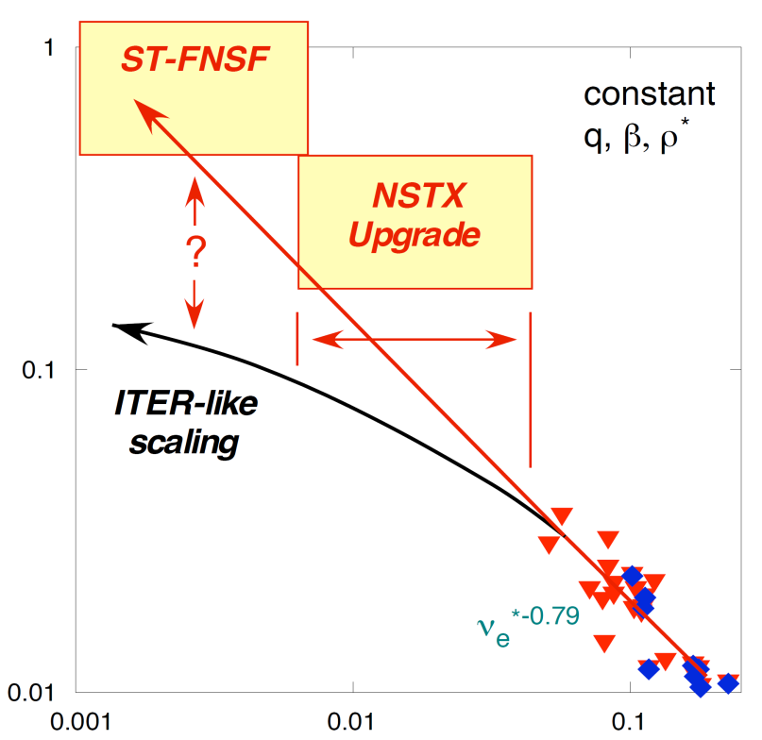
NSTX / MAST confinement increased at higher T_{e}
Will confinement trend continue, or look like conventional A?
ST scaling: τ_{E, th} ∝ ν_{*e}^{-0.8} β^{-0.0}
ITER 98y,2: τ_{E, th} ∝ ν_{*e}^{-0.1} β^{-0.9}
B_{T}τ_{E}
[T-s]
Continued favorable confinement trends could lead to more compact ST reactors
Normalized electron collisionality ν_{e}* ∝ n_{e} / T_{e}²
Low ν* → need higher plasma current, toroidal field, heating power, density control

Slide 13
NSTX-U will access and measure novel regimes of electron turbulent transport driven by high beta
Energy confinement scaling from “micro-tearing” modes simulated to be similar to NSTX results
10
NSTX experiment
1
NSTX-U regime
Normalized transport rate
χ_{e} (ρ_{s}²c_{s}/a)
simulation
0.1
0.1
1
10
Normalized collision frequency
Guttenfelder, PRL (2011), PoP (2012)
Visualization courtesy F. Scotti (LLNL)
Dissipative trapped electron modes (DTEM) → similar scaling

Slide 14
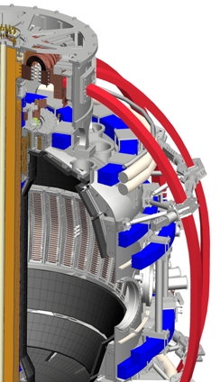
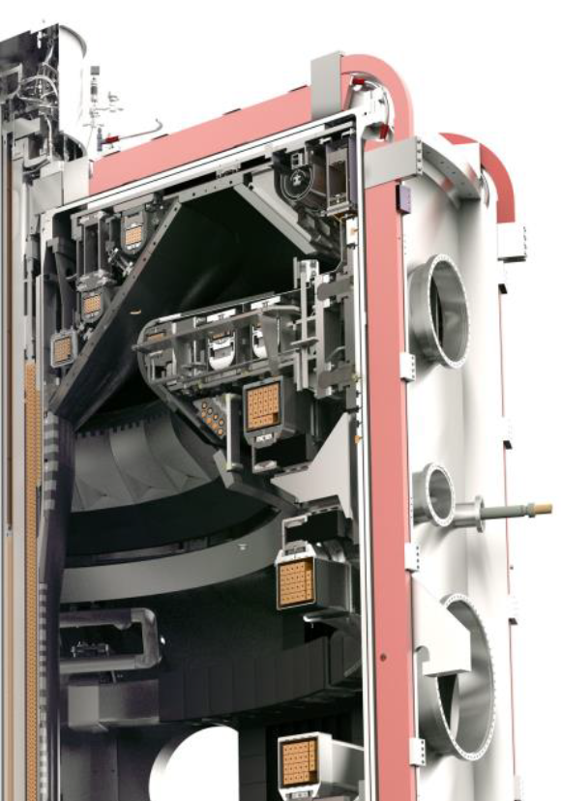
NSTX-U design enables access to 3× higher plasma pressure, temperature than MAST-U
NSTX-U
NSTX-U design provides 1.4× higher B_{T} and
2× higher B_{T}²
MAST-U
Conducting plates suppress kink instabilities,
1.5× higher β_{N}, β_{T}
p ∝ β_{T} B_{T}²
3× higher

Slide 15
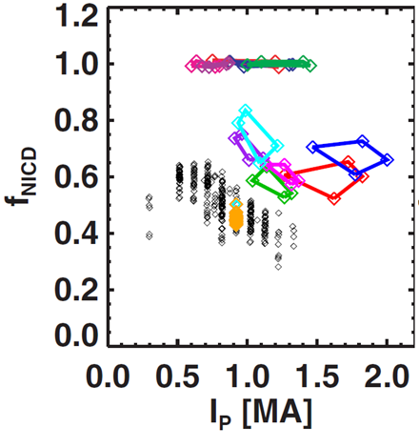
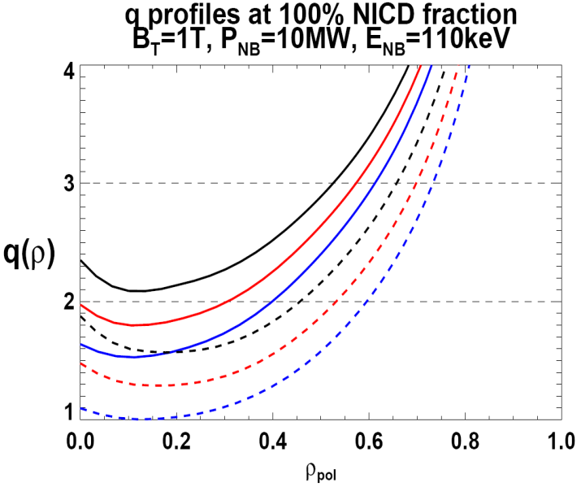
NSTX-U will test whether high-performance STs can be sustained for future fusion applications
NSTX-U greatly expands plasma current operating space:
100% non-inductive at ~1MA, 5s
Plasma current up to 2MA for 5s
Non-inductive current fraction
NSTX-U projections
NSTX ≤ 65% non-inductive
I_{P} = 1MA for ~1s, 1.3MA for 0.2s
I_{P}=0.95MA, β_{N}=5, β_{T} = 10%, B_{T} = 1T, P_{NBI} = 10MW
NSTX data
Boyer, NF (2015)
n
e
/
n
Greenwald
Vary & control q_{min} via:
beam source
plasma density
outer gap (not shown)
0.95
1st
NBI
New
2nd
NBI
0.72
R_{TAN} [cm]
__________________
50, 60, 70, 130
60, 70,120,130
70,110,120,130
Gerhardt,
NF (2012)

Slide 16
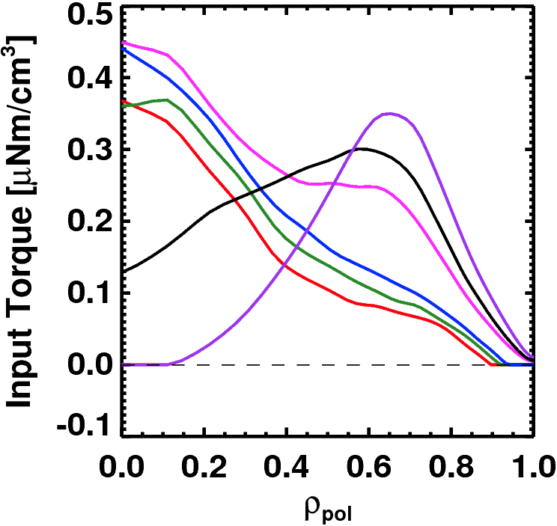
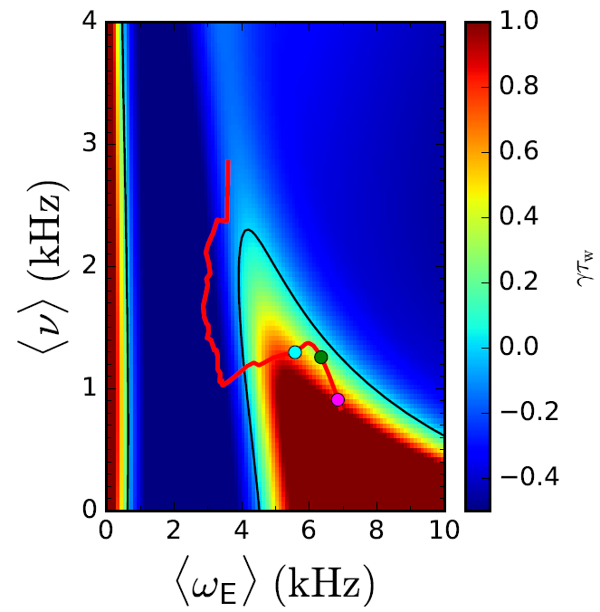
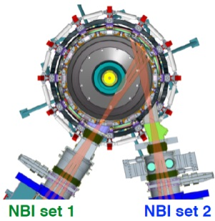
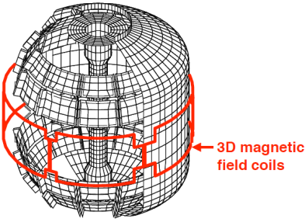
NSTX-U will be leading (only) ST able to access and study kinetic RWM physics in-depth
NSTX showed that resonant damping can stabilize resistive wall mode (RWM)
Passive stabilizing plates:
β_{N} ≈ 4 (no-wall) → 6 (with-wall)
Reduced drift-kinetic MHD
RWM stability map
Torque Profiles From 6
Different NBI Sources
Largest R_{tan}
γτ_{wall}
Neutral
Beams
(TRANSP)
Use neutral beams, rotation damping from 3D fields, other actuators to control rotation for RWM stability
Smallest R_{tan}
J. Berkery, Phys. Plasmas (2017)

Slide 17
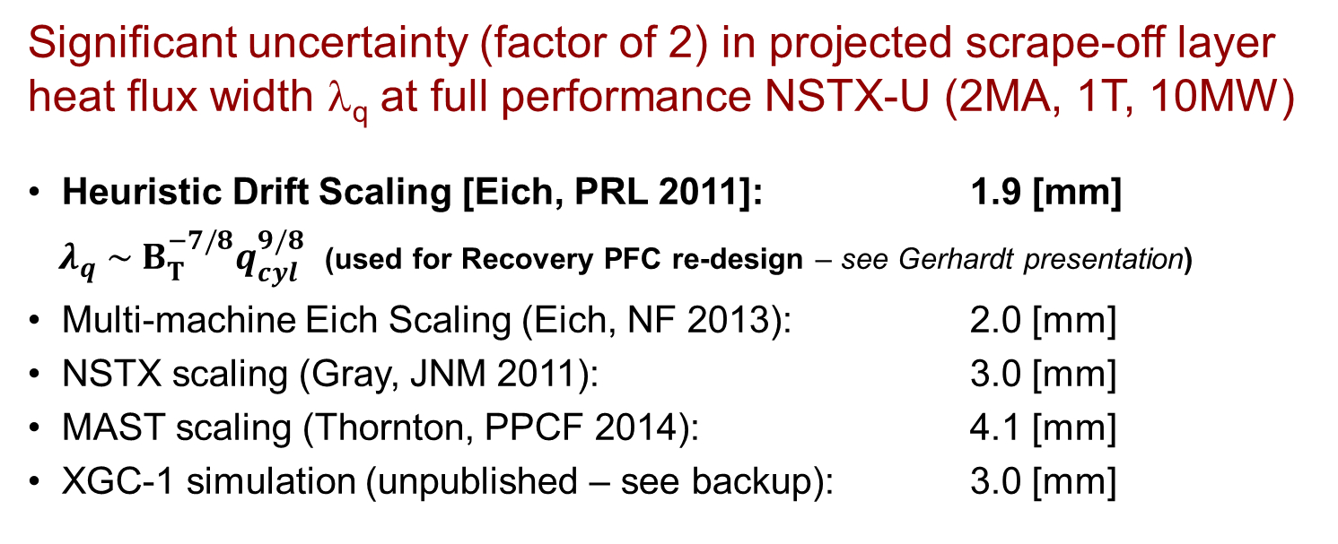
NSTX-U at high plasma current will play important role in understanding power exhaust width scaling
Significant uncertainty (factor of 2) in projected scrape-off layer heat flux width λ_{q} at full performance NSTX-U (2MA, 1T, 10MW)
Heuristic Drift Scaling [Eich, PRL 2011]: 1.9 [mm]
$λ_{q} \sim B_{T}^{−7/8}q_{cyl}^{9/8}$ (used for Recovery PFC re-design – see Gerhardt presentation)
Multi-machine Eich Scaling (Eich, NF 2013): 2.0 [mm]
NSTX scaling (Gray, JNM 2011): 3.0 [mm]
MAST scaling (Thornton, PPCF 2014): 4.1 [mm]
XGC-1 simulation (unpublished – see backup): 3.0 [mm]
See M. Reinke presentation for more detail

Slide 18
Outline
PAC Members and charge questions
ST and NSTX-U research goals
Program impacts from extended outage
Key questions addressed by NSTX-U
World-leading ST capabilities during initial ops
Summary

Slide 19
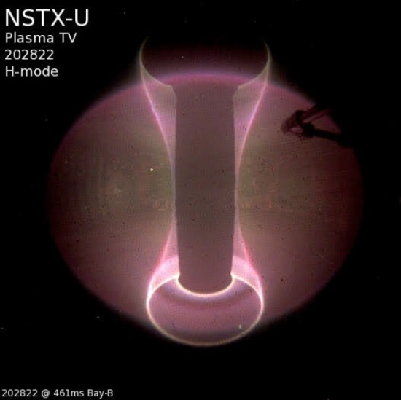
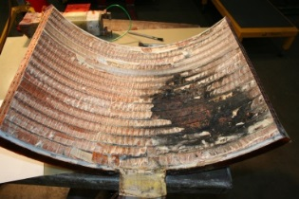
REMINDER: In FY2016 NSTX-U had scientifically productive 1st year, but had to cease operations due to failed divertor PF coil
Achieved H-mode on 8th day of 10 weeks of operation
Surpassed magnetic field and pulse-duration of NSTX
Matched best NSTX H-mode performance at ~1MA
Identified, corrected dominant error fields (more to do…)
Commissioned all magnetic and kinetic profile diagnostics
New 2nd NBI suppresses Global Alfven Eigenmodes (GAE)
  Fredrickson – APS invited, PRL 2017
Implemented techniques for controlled plasma shut down, disruption detection, commissioned new tools for mitigation
PF1A upper coil failed very slowly over ~1000 pulses
Section of failed PF1AU
Several papers on NSTX-U results published, in-press, or submitted

Slide 20
NSTX-U targeting major increase in performance
1. New Central Magnet
2. Tangential 2nd Neutral Beam
Ultimate Performance Goals:
➢2× heating power (5 → 10MW)
Tangential NBI → 2× current drive efficiency
➢Up to 10× higher nTτ_{E} (~MJ plasmas)
➢4× divertor heat flux (→ ITER levels)
➢2× toroidal field (0.5 → 1T)
➢2× plasma current (1 → 2MA)
➢5× longer pulse (1 → 5s)

Slide 21
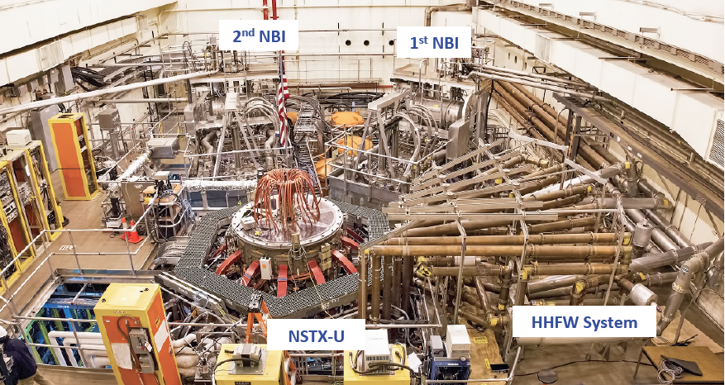
Achieving NSTX-U Ultimate Performance Goals requires Recovery Project (see S. Gerhardt presentation)
FY2017: DOE requested PPPL to review “Extent of Condition” of entire NSTX-U facility including reliability, submit Corrective Action Plan (CAP)
Recovery = Implement CAP using operations funding: $48M base + $15M contingency
Normal / planned maintenance and run preparation: $34M base + $4M contingency
Recovery following DOE 413.3b guidelines

Slide 22
Major program impacts due to Recovery (1)
Research operations delayed until sometime in FY20
  Several FY17 and FY18-19 research Milestones redirected toward Recovery / future operations
  In April, FES redirected NSTX-U funded “science” collaborators to new FES “ST” solicitation (international) and DIII-D solicitation
  NSTX-U University and Industry diagnostic collaborations remain funded in FY18, but smaller diagnostics can be relocated to other facilities
    Modest Recovery scope/funding for collaborating national labs – PFCs, diagnostics
  Within PPPL, NSTX-U researchers redirected to find collaboration opportunities – preferably aligned with NSTX-U research goals
  S. Kaye helped coordinate DIII-D National Campaign (FY17 only)
    S. Kaye also coordinating PPPL MAST-U collaborations, M. Ono for QUEST

Slide 23
Major program impacts due to Recovery (2)
Improved / more in-depth understanding of divertor heat and halo loads requires re-design of some plasma facing components (Gerhardt presentation)
Changes to “polar regions” to minimize vacuum and magnet risk eliminate lower insulator, reduce inboard-outboard gap → no Coaxial Helicity Injection (Gerhardt presentation)
  Non-inductive start-up research carried out through collaborations → NSTX-U implementation deferred (Raman presentation)
No high-harmonic fast-wave (HHFW) enhancement scope in Recovery + budget uncertainty
  HHFW program on hiatus, retaining staff for re-start (budget-dependent)
  Recovery: modeling / projections of antenna limiter heat loading
  Possible future activities: Design of dedicated non-HHFW outboard limiter, RF test-stand activities to improve voltage stand-off / RF power coupling

Slide 24
NSTX-U researchers actively engaged in Recovery
Aided Extent of Condition reviews:
  Aided in System Design Description (SDD) formulation, edits
  Design Validation and Verification Reviews (DVVRs)
    Aided in preparation of presentations, chit submission, chit response
New PFC requirements working group (click here for more info)
  Extent of Condition review process identified PFC power handling issues
    Narrower SOL width not incorporated in General Requirements Document (2009-2012)
    Increased halo peaking on IBDH → T-bar design insufficient
  Extensive equilibrium & heat-flux scans performed, more to come
Topical Science Group contributions:
  Re-assessed scenario needs: first 2yrs of ops + 5/7 year plan
    Magnetic balance and δ variations influence PFC design considerations
  Assessed impact of polar region mods on research plans

Slide 25
Overall NSTX-U goals balanced and coordinated across Recovery and Research departments
Deliver reliable facility to support science goals within available resources
Chief Engineer
V. Riccardo
NSTX-U Recovery
Director: J. Menard
Deputy: S. Gerhardt
Project Administration
K. Lukazik
NSTX-U Research
Director: J. Menard
Deputy: S. Kaye
Planning & Control
T. Egebo
ES&H
J. Levine
Quality Assurance
F. Malinowski
Project Manager
R. Feder
Planning & Control
S. Langish
Run Coordination
TBD for next run
Deputy: TBD
Requirements to achieve operational scenarios (example: magnet alignment vs error-fields)
Science Groups, Task Forces,
Working Groups
Procurement Liaison
A. White
Red = OBS
Project Engineer
C. Neumeyer
Boundary Science
R. Maingi
Experimental
Research
Operations
S. Gerhardt
Physics Analysis
S. Kaye
Systems Engineering
and Integration
S. Gerhardt
Operations, ASO
T. Stevenson
Construction
L. Dudek
Core Science
S. Kaye
Publications &
Presentations
Integrated
Analysis
P. Titus
CAD
Integration
J. Mitchell
Tokamak
Core
D. Loesser
COEs
Work Control
Center
F. Jones
Physics Operations
D. Battaglia
Integrated Scenarios
S. Gerhardt
Computational
Support
G. Tchilinguirian
Power Systems
J. Dellas
Real Time Control
& Protection
F. Hoffmann
RF Operations
R. Perkins
VV & Internal Hdwe
M. Smith
PFC Requirements Working Group
M. Reinke
(Oak Ridge National Lab)
Cooling & Bakeout
Systems
J. Petrella
PFC RE is physicist ensuring requirements and research goals are met
Heating Systems
T. Stevenson
Diagnostic
Operations & R&D
B. Stratton
Plasma Facing
Components
M. Jaworski
Responsible Engineers
Theory &
Simulation
A. Bhattacharjee
Diagnostics
R. Ellis III
Central I&C
G. Tchilinguirian
Disruption PAM Working Group
S. Sabbagh
(Columbia University)
Magnets
S. Raftopoulos
Boundary Physics
Operations
M. Jaworski
Test Cell
N. Atnafu
Vacuum & Fueling
Systems
D. Cai
Particle Control
Task Force - TBD

Slide 26
FY18 Recovery Notable Outcomes
(Notable Outcome = annual DOE management contract goal)
Complete final design reviews for the 6 PF1 coils 3/31/2018
Prepare Recovery project to be ready for baselining (4/30/2018)
Build at least one prototype PF1A coil (7/15/2018)
  Qualify coil by operating at both max required current, max heating
  Verify the quality of the coil's insulation system through electrical testing followed by destructive sectioning and inspection
Build and test at least one of each type (PF1A, B, C) of production inner poloidal field coil (9/30/2018)
  Qualify a PF1A coil by operating at both max required current, max heating

Slide 27
FY18 Research Milestones
Notable Outcome: Provide leadership, coordination, support to FES joint research target (JRT) with goal of testing predictive models of fast-ion transport by multiple Alfven eigenmodes.
Research:
  Develop/benchmark reduced heat flux & thermo-mech. models for PFC monitoring
  Develop simulation framework for ST breakdown and current ramp-up
  Validate & further develop reduced transport models for electron thermal transport
  Optimize energetic particle distribution function for improved plasma performance
Facility: Evaluate PFC operational limits and develop integrated diagnostic plans for operations

Slide 28
Outline
PAC Members and charge questions
ST and NSTX-U research goals
Program impacts from extended outage
Key questions addressed by NSTX-U
World-leading ST capabilities during initial ops
Summary

Slide 29
Science Group presentations address key questions
Science Group and presenter
Key research questions: First 1-3 years, 3-5 years, 5-10 years
Can a high-performance ST have 100% non-inductive current, equilibrated?
Does “ST” confinement scaling persist to (3× to 6×) lower collisionality ν*?
Can Alfvénic instabilities be modelled/understood, manipulated to control core?
Can passive & active RWM stabilization be achieved at low ν* and sustained?
How will pedestal transport & turbulence vary vs lower ν*, higher I_{P}, Li coatings
How does heat-flux width scale? Can n_{e} control be sustained? (see backup)
Can heat fluxes be mitigated consistent with high core performance?
Can liquid metals provide a solution for higher confinement, power exhaust?
Can high-harmonic fast-waves provide reliable heating and CD in H-mode?
Can NSTX-U demonstrate solenoidal-free initiation, ramp-up, and flat-top?
Scenarios
D. Battaglia
Core
W. Guttenfelder
M. Podesta
S. Sabbagh
Boundary
A. Diallo
M. Reinke
M. Jaworski
Scenarios
R. Perkins
R. Raman

Slide 30
NSTX-U will be world-leading ST in several research areas when operations resume
Access up to 3× higher ST pressure, temperature
Study transport physics in unique regime: high β, low ν*
  Advanced diagnostics for electron and ion-scale turbulence
  Li-coatings (on C) for confinement vs. recycling in large ST
Only ST to access to wall-stabilized regime, highest β values through kinetic stabilization, advanced control
High-power NBI heating and current drive tools ready to:
  Pursue 100% non-inductive scenarios at high-performance
  Study high divertor heat flux mitigation (sweep, flare, detach, …)
  Explore fast-ion instabilities and control for burning plasmas
Complement DIII-D higher-A, MAST-U boundary emphasis

Slide 31

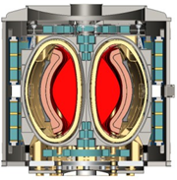
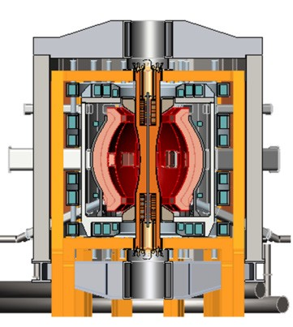
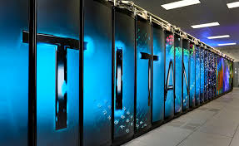
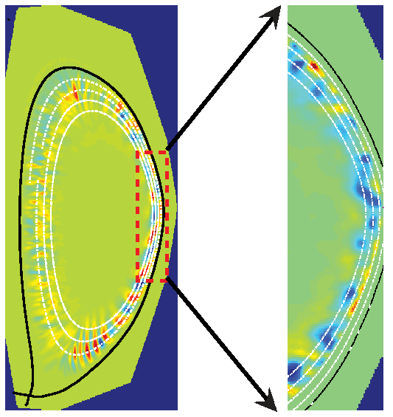
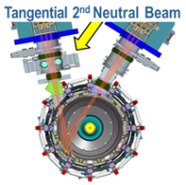
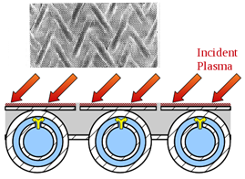
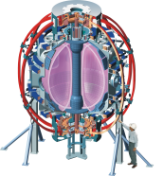
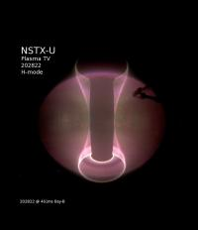
Summary: NSTX-U will address key scientific issues to accelerate fusion science understanding, performance
ST = Spherical Torus:
A magnetic confinement configuration that could lead to a smaller and more cost-competitive fusion energy source
High-temperature superconductors for compact and efficient ST fusion core
ST Pilot Plant for
net electricity
ST-based fusion neutron source
Provide steady-state fusion neutron environment for nuclear material and component R&D
Liquid metal blankets for high thermal efficiency
NSTX Upgrade Facility and Research Program
Fusion Technology and Performance
Extend ST confinement understanding to fusion-relevant temperatures
Demonstrate sustainment for future steady-state operation
Longer-term: High-power tests of liquid metals as transformative wall solution
Advanced diagnostics + computation provide fundamental understanding and basis for next-step ST devices
NSTX Explored ST stability & confinement
Fundamental Plasma and Materials Science

Slide 32
NSTX-U Backup

Slide 33

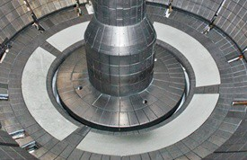
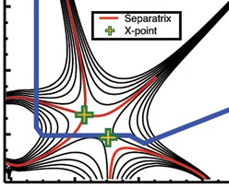
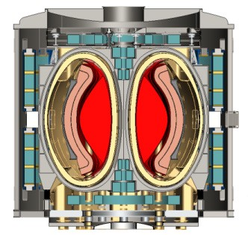
NSTX-U Mission Elements
Explore unique ST parameter regimes to advance predictive capability for burning plasmas and beyond
Develop solutions for plasma- material interface challenge
Liquid metals / Lithium
Snowflake / X
ST-FNSF /
Pilot-Plant
Advance ST as Fusion Nuclear Science Facility and Pilot Plant

Slide 34
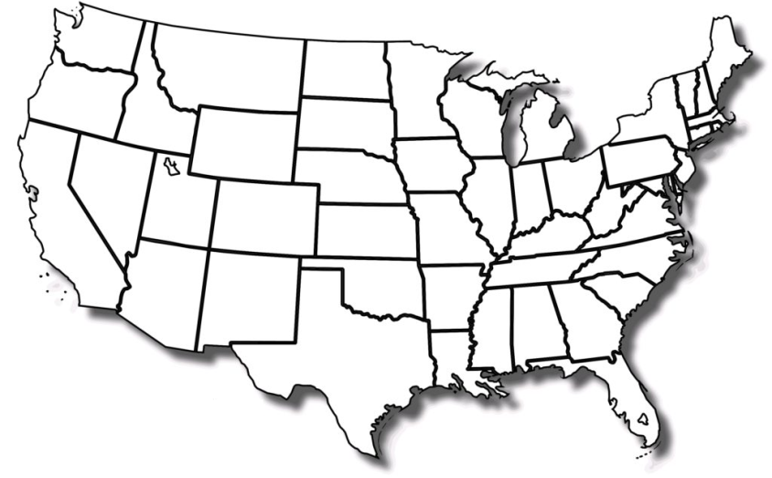
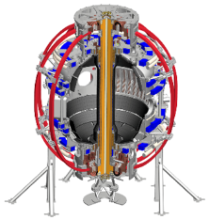

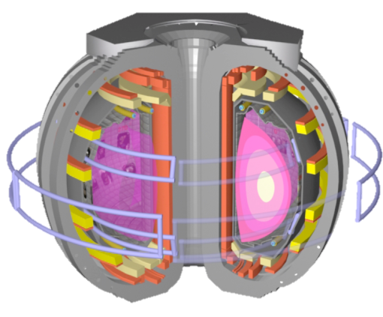

NSTX-U and DIII-D are powerful and complementary tools enabling U.S. leadership in core fusion science
DIII-D
A = 3
San Diego, CA
NSTX-U
A = 1.6
Princeton, NJ
Variation of aspect ratio A provides robust physics validation
  Understand tokamak MHD stability, thermal and fast ion transport, pedestal structure
Together, NSTX-U and DIII-D provide the U.S. world-leading and complementary capabilities to address core physics issues
  Both have excellent diagnostics, strong and flexible beam and wave heating systems
  Complementary boundary approaches: cryo-pumping vs. lithium, solid vs. liquid
  Together, can identify optimal aspect ratio for possible fusion next-steps

Slide 35
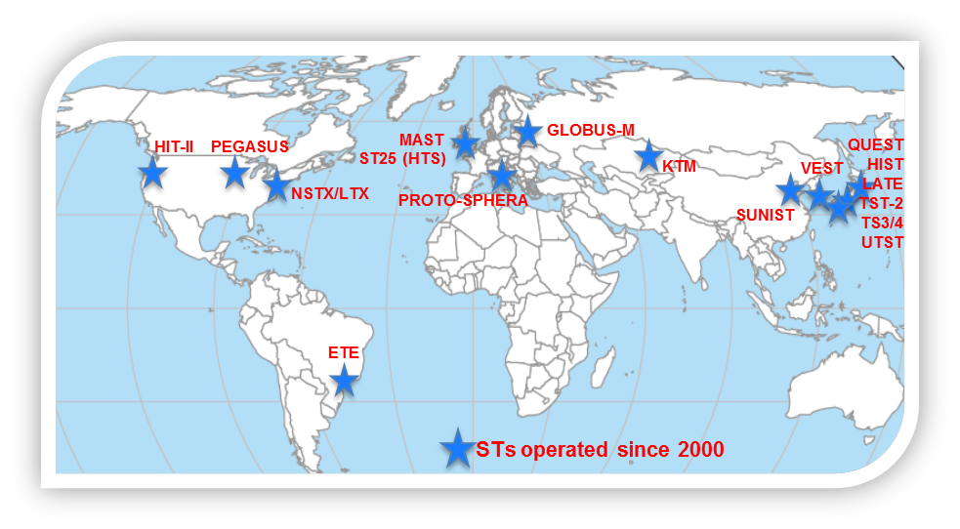


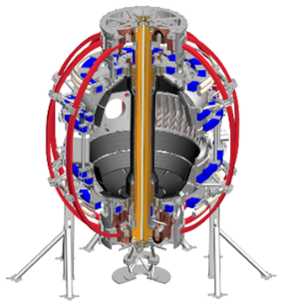
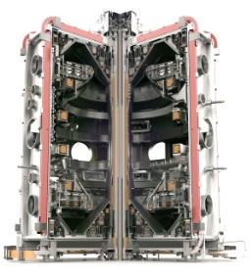
NSTX-U and MAST-U are the most capable ST devices in a world-wide ST research program
NSTX-U
Princeton, NJ
MAST-U
Culham, UK
Complementary Research:
NSTX-U – emphasis on core
  Designed to access highest ST plasma pressure, temperature by 3×, β_{T} & β_{N} by 1.5×
  Diagnose, understand core transport and turbulence, stability, sustainment
MAST-U – emphasis on boundary
  Designed with world’s most flexible, well-diagnosed power exhaust system (super-X divertor) for heat-flux mitigation studies
Together, NSTX-U and MAST-U will provide majority of ST physics basis

Slide 36
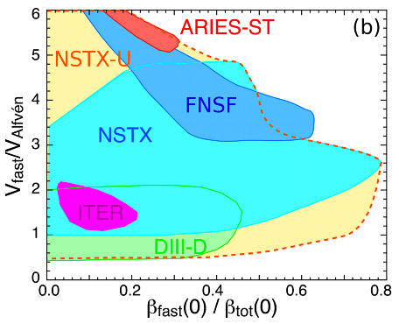
NSTX-U excellent testbed for α-particle physics
NSTX-U: larger fast-ion dynamic range spanning ST and conventional A
  Toroidal field 2× NSTX → can stabilize modes (V_{f} < V_{A} )
  Tangential 2nd NBI → highly flexible fast-ion distribution
    Vary pitch angle, pressure profile
Are fast-ions well confined in high-performance ST regimes?
Can we predict fast-ion confinement for burning plasmas / ITER?

Slide 37
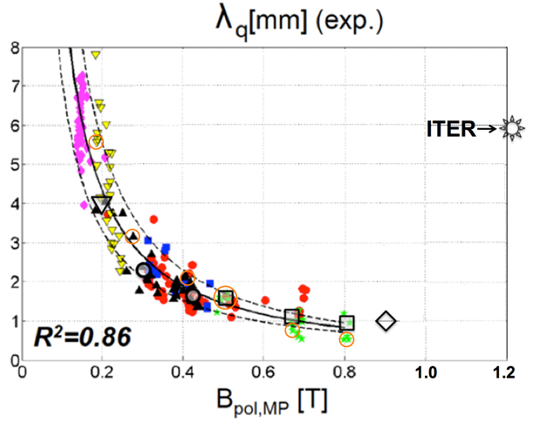

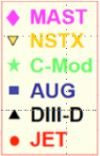
NSTX-U experiments at higher plasma current will play important role in understanding power exhaust width
XGC1 simulations predict turbulence will widen edge heat flux in ITER
C.S. Chang et al 2017 Nucl. Fusion 57 116023
1MA NSTX-U
2MA NSTX-U
Preliminary XGC1 shows deviation from λ_{q} ~ I_{P}⁻¹ for full current (2MA) NSTX-U
Need additional simulations and analysis to better understand underlying physics, implications for STs

Slide 38
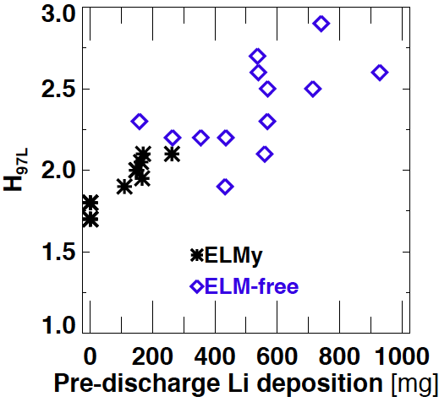
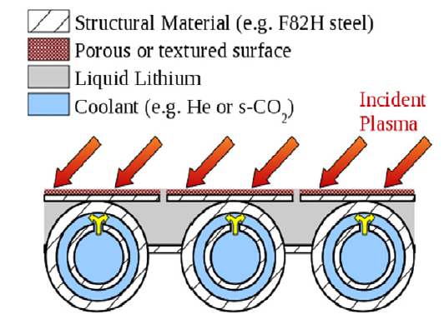
NSTX-U will study confinement improvement from Li wall coatings, and power exhaust on liquid metal divertors
NSTX: Higher lithium deposition → higher confinement
H₉₈~1
Example: Capillary Porous System
M. Jaworski, PPCF (2013)
D.P. Boyle, et al., J. Nucl. Mater. 438 (2013) S979
NSTX-U: Will double Li deposition, increase confinement
Test liquid metals for power handling

Slide 39
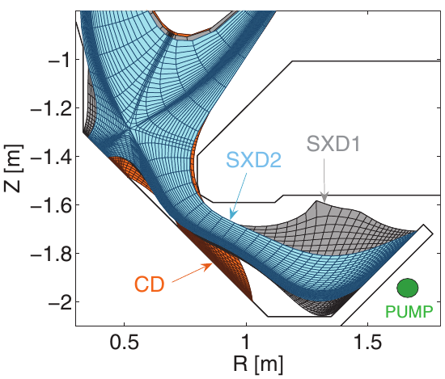
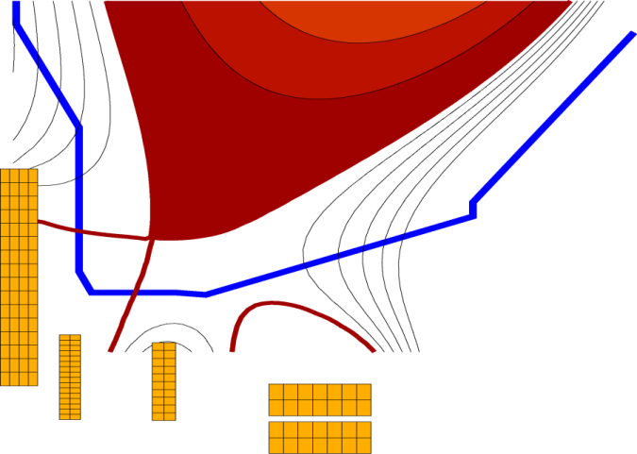
STs leading advanced divertor development
NSTX-U / MAST-U collaborating on 1st plasma, scenarios, divertors
NSTX-U: Flared divertor using “snowflake / X” + radiation
MAST-U: world-leading tests of long-leg/super-X w/ variable flaring
New PF1 coils in NSTX-U central magnet
E. Havlickova, et al., Plasma Phys. Control. Fusion 56 (2014) 075008

Slide 40
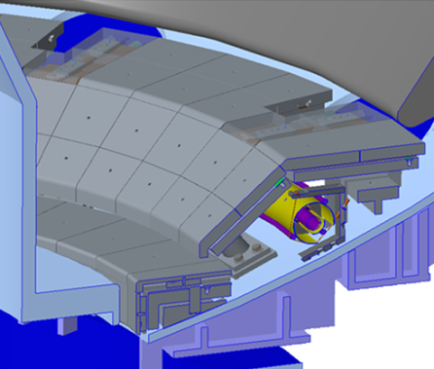
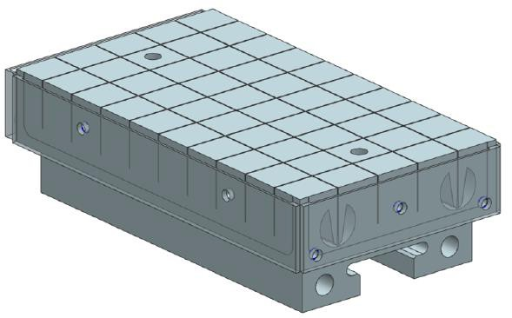
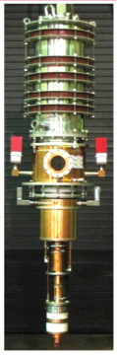
Motivations for future facility enhancements
Divertor cryo-pump (graphite → high-Z PFCs)
  Control density and ν* without Li, compare to Li wall-coatings
  Use bakeable baffle + high-Z PFCs for initial liquid metal tests
Transition from all graphite to W/TZM PFCs
  Assess integration of high-performance ST with reactor-relevant wall
  Implement wall compatible with bulk / flowing liquid metals
  Extend LTX-β liquid-Li confinement experiments to higher performance
28GHz / 1-2MW gyrotron (Tsukuba)
  EC/EBW-only current-drive for start-up
  Heat helicity injection target with ECH for HHFW/NBI
  Longer-term: EBW CD for sustainment
Full toroidal
array (2×12)
NCC
Existing
RWM/EFC coils
Non-axisymmetric control coils (NCC)
  Resonant/non-resonant NTV rotation control, enhanced RWM/EF control
  Assess RMP ELM suppression (not yet achieved in ST)

Slide 41
FNSF / Pilot Plant Backup

Slide 42
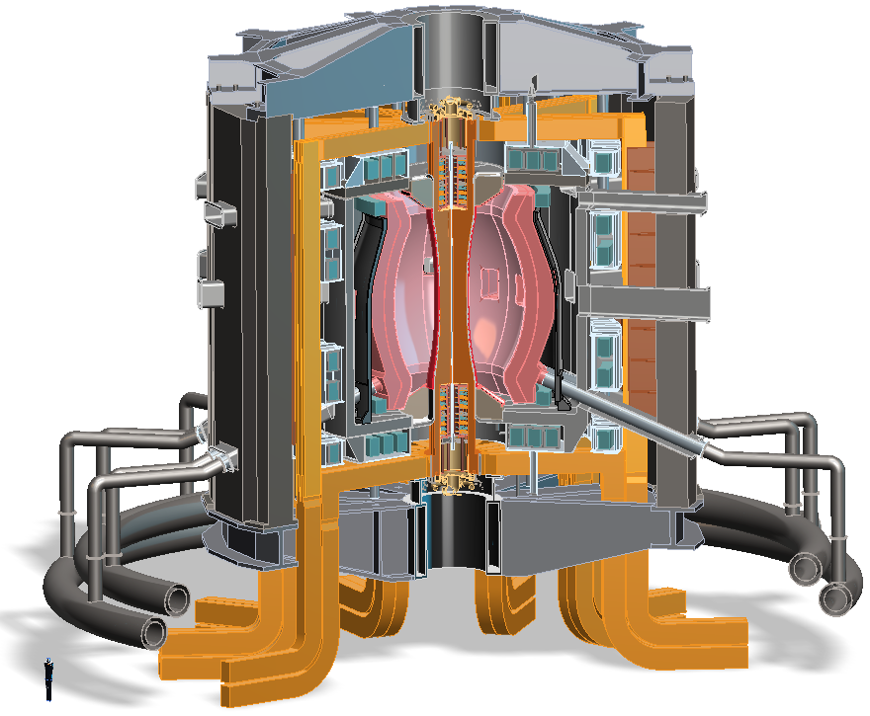
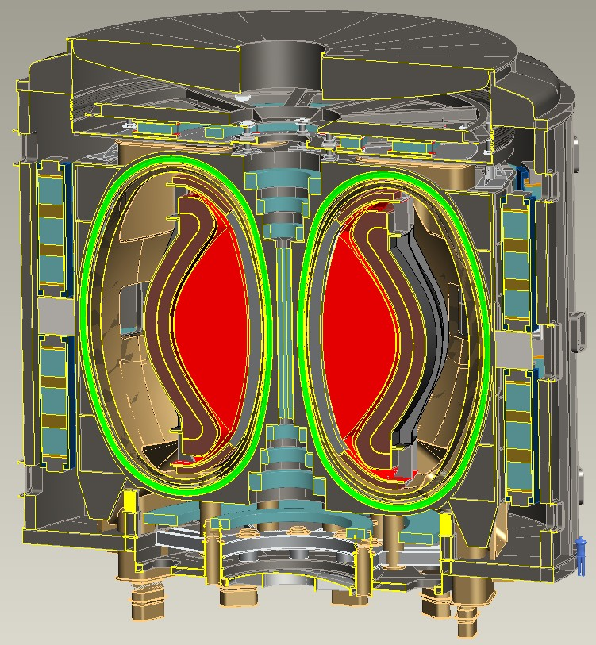
Design studies show ST potentially attractive as
Fusion Nuclear Science Facility (FNSF) or Pilot Plant
FNSF: Provide neutron fluence for material/component R&D (+ T self-sufficiency?)
Pilot Plant: Electrical self-sufficiency: Q_{eng} = P_{elec} / P_{consumed} ≥ 1 (+ FNSF mission?)
FNSF with copper TF coils
A=1.7, R₀ = 1.7m, κ_{x} = 2.7
Fluence = 6MWy/m², TBR ~ 1
FNSF / Pilot Plant with HTS TF coils
A=2, R₀ = 3m, κ_{x} = 2.5
6MWy/m², TBR ~ 1, Q_{eng} ~ 1

Slide 43
At lower A, high TF winding-pack current density enables access to maximum allowed B_{T} at coil
J_{WP} [MA/m²]
19T: Present CORC HTS limit
12T: ITER-like TF coil limit
(Nb₃Sn, 11.8T)
(12T)
Coil structure sized to maintain ≤ 0.3% strain on winding pack
Effective inboard tungsten carbide (WC) neutron shield thickness = 60cm

Slide 44

A = 1.8-2.3 maximizes TF magnet utilization, and TF will be significant fraction of core cost
Eff. shield
thickness:
J_{WP} = 70MA/m²
0.3m
0.4m
0.5m
0.6m
0.7m
A=4 utilization ~1/3-1/2 of maximum at low A
Optimal range

Slide 45

A ≥ 3 maximizes blanket volume utilization
Eff. shield
thickness:
0.3m
0.4m
0.5m
0.6m
0.7m
J_{WP} = 70MA/m²

