Slide 1

NSTX-U Transport & Turbulence (T&T) research
Walter Guttenfelder for the NSTX-U Team
NSTX-U PAC-39
Jan. 9-10, 2018

Slide 2
OUTLINE
Background and research goals
Recent highlights supporting research plans
Near term and longer-term research plans
Summary

Slide 3
OUTLINE
Background and research goals
Recent highlights supporting research plans
Near term and longer-term research plans
Summary

Slide 4
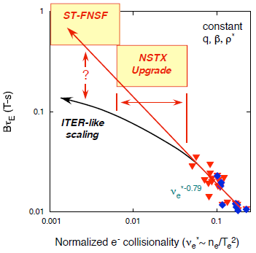
Understanding confinement scaling (τ_{E}~1/ν) at low collisionality is critical for future spherical tokamaks (ST)
In NSTX and MAST H-modes, dimensionless confinement time scales inversely with collisionality, Ω_{ci}τ_{E}~ν*^{-0.8} [Kaye, NF (2007, 2013); Valovic, NF (2011)]
Next generation STs (Pilot Plant, FNSF, CTF) will operate at lower ν*
What determines transport & confinement scaling?
  How does this influence access to operational scenario goals (e.g. 100% non-inductive)? [see Battaglia talk]
Conventional (R/a~3) tokamak H-modes are thought to be governed by electrostatic toroidal drift waves:
  (k⊥ρ_{i}~1) Ion temperature gradient (ITG, γ~∇T_{i}) & trapped electron mode (TEM, γ~∇T_{e},∇n_{e})
  (k⊥ρ_{e}~1) Electron temperature gradient (ETG, γ~∇T_{e})

Slide 5
Many features of low aspect ratio + high beta are stabilizing to electrostatic toroidal drift waves
Stabilizing effect
Impact
Short connection length | ⇒ | Smaller average “bad curvature”
Quasi-isodynamic (~constant B) at high β, strong Shafranov shift |  | Grad-B drifts stabilizing [Peng & Strickler, NF 1986]
Large fraction of trapped electrons, BUT precession weaker at low A |  | Reduced TEM drive [Rewoldt, PoP 1996]
Strong coupling to δB⊥ at high β |  | Stabilizing to ES-ITG [Kim, Horton, Dong, PoFB 1993]
Small inertia (nmR²) & uni-directional NBI heating gives strong toroidal flow & flow shear |  | E×B shear stabilization (dv⊥/dr) [Biglari, Diamond, Terry PoFB 1990]
Stabilization of ITG consistent with observed neoclassical ion transport: Q_{i}≈Q_{i,NC} & Γ_{imp}≈Γ_{imp,NC}
BUT high beta drives electromagnetic instabilities:
  Microtearing modes (MTM) ~ β_{e}⋅∇T_{e}
  Kinetic ballooning modes (KBM) & energetic particle modes (EPM) ~ α_{MHD}~q²∇P/B² & ∇P_{fast}
Large shear in parallel velocity can also drive parallel velocity gradient (PVG) instability ~dv||/dr

Slide 6
NSTX-U T&T research addresses high-priority ST-specific transport issues
T&T RESEARCH GOALS (thrusts from five-year plan):
Extend confinement scaling to much lower collisionality at high beta & strong shaping
Distinguish mechanism(s) underlying ST energy confinement scaling, as well as particle, impurity & momentum transport
Validate first-principle and reduced models using a range of scenarios, e.g. from L-mode to 100% non-inductive H-mode
Enable more reliable extrapolation & prediction to future ST-based devices
Leverage cutting-edge ST capabilities of NSTX-U:
Highest field and heating power with strong shaping → access to highest β at lower ν*
Unique current, flow profile & fast-ion phase space control from 2nd off-axis NBI + 3D coils
RF heating (HHFW) for flexible thermal & impurity transport studies (see Perkins talk)
Comprehensive suite of turbulence diagnostics
  Multi-scale density fluctuations (δn): BES (low-k), FIR high-k_{θ} scattering system, DBS (low- to intermediate-k)
  Magnetic field fluctuations (δB): CPS

Slide 7
The challenges confronted by NSTX-U T&T research benefit the broader tokamak community & burning plasma regimes
Unique in accessing wide range in (β, ν) → requires validating a variety of theoretical drift wave transport mechanisms
  Predominantly in electron-loss dominated regimes (burning plasma relevant)
Local GYRO NSTX analyses at r/a~2/3
KBM
NSTX-U
MTM
H-mode
ITG, TEM, ETG
L-mode
Guttenfelder, NF (2013)

Slide 8
The challenges confronted by NSTX-U T&T research benefit the broader tokamak community & burning plasma regimes
Unique in accessing wide range in (β, ν) → requires validating a variety of theoretical drift wave transport mechanisms
  Predominantly in electron-loss dominated regimes (burning plasma relevant)
High beta, strong shaping & significant fast ion content challenges numerical codes → requires improved EM simulations & reduced transport models
  Important for high performance AT scenarios & burning plasma regimes (significant ITPA T&C activity)
Global & compressional Alfvén eigenmodes (GAE/CAE) influence thermal electron transport* → requires validating stability thresholds & saturation mechanisms
  Important to understand dependence on V_{fast}/V_{Alfvén}, β_{fast}/β_{tot}, and fast-ion phase space and consequences in burning plasma regimes (see Podestà talk)
    *Transport occurs through stochastic electron orbits & CAE-KAW coupling (backup slides)

Slide 9
OUTLINE
Background and research goals
Recent highlights supporting research plans
Near term and longer-term research plans
Summary
See Y. Ren, NF (2017) for recent review paper

Slide 10
FY18 Milestone & collaborations address priority T&T issues in preparation for NSTX-U operations
R(18-3) milestone: “Validate & develop electron thermal transport models in STs”
  Model validation (TGLF, MMM, Rafiq-MTM)
  Model qualification by comparing with first-principles gyrokinetics
  Data analysis & uncertainty quantification
Active DIII-D collaboration from 2017 “NSTX-U campaign” (see Kaye talk)
  “Investigate ν* scaling at ST-relevant q95” → Clarify role of R/a & q95 on τ_{E}~ν*^{α}
  “Validate electromagnetic turbulence predictions” → Validate GK w/ CPS (~δB) + synth. diagnostic
  “CAE ω and k dependence on beam pitch angle and energy” → Measure onset, validate sims.
MAST-U collaboration in FY18-20
  Transport analysis & confinement scaling at increased B_{T}, I_{P}
Collaboration with GA & Lehigh U.

Slide 11
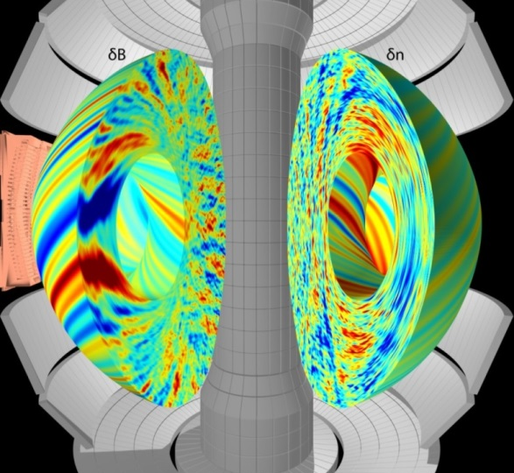
High β NSTX transport validation studies highlight the importance of electromagnetic microturbulence
Nonlinear simulations of core MTM turbulence predict significant transport at high β & ν; collisionality scaling (χ_{e,MTM}~ν_{e}) consistent with global confinement (τ_{E}~1/ν)
At high β & lower ν, KBM modes are predicted in the core ⇒ may set ultimate limit to confinement scaling -- many similarities to DIII-D/EAST high-β_{pol} (Staebler APS 2017, Guttenfelder APS 2015)
NSTX MTM simulation (high-ν)
KBM linear growth rates (low-ν)
exp. value (ρ=0.7)
Higher level message?
Guttenfelder, PRL (2011), PoP (2012), NF (2013)
High priority goal of T&T research is to directly measure internal δB via cross polarization scattering (CPS) to validate simulations (collaboration with DIII-D & UCLA) [see Kaye talk]

Slide 12
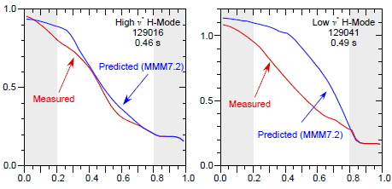
Nonlinear gyrokinetic simulations & transport models are evolving to address challenges at high β
Global electrostatic simulations illustrate importance of non-local effects at finite-ρ*=ρ_{i}/a (Ren, NF 2013, IAEA 2016) (backup slides)
  Global GTS simulations have also uncovered unique DTEM mechanism with χ_{e,DTEM}~ν* scaling (Wang, PoP 2015, NF 2015)
  Development of global electromagnetic GK codes GTS, XGC1 is advancing (PPPL theory)
TRANSP+MMM prediction
T_{e} (keV)
Recently developed kinetic/fluid MTM model recovers many gyrokinetic trends (Rafiq, PoP 2016, APS 2016); profile predictions being tested
  T_{e} predictions using Rebut-Lallia-Watkins MTM model useful for high-ν* discharges, but does not capture correct parametric scalings (Kaye, PoP 2014)
  Updating TGLF by qualifying with gyrokinetics over broader range of ST scenarios, β & R/a (R18-3 Milestone)
  Is there an optimal aspect ratio for core performance goals? (see Menard talk)
T_{e} (keV)
ρ

Slide 13
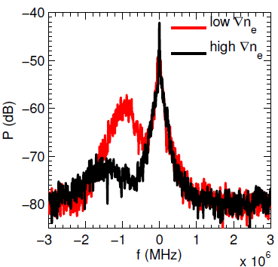
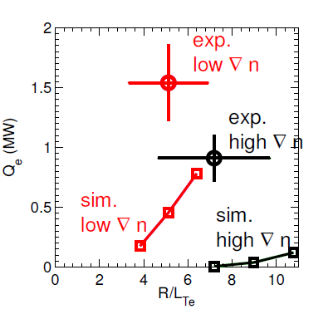
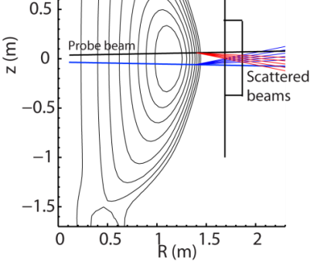
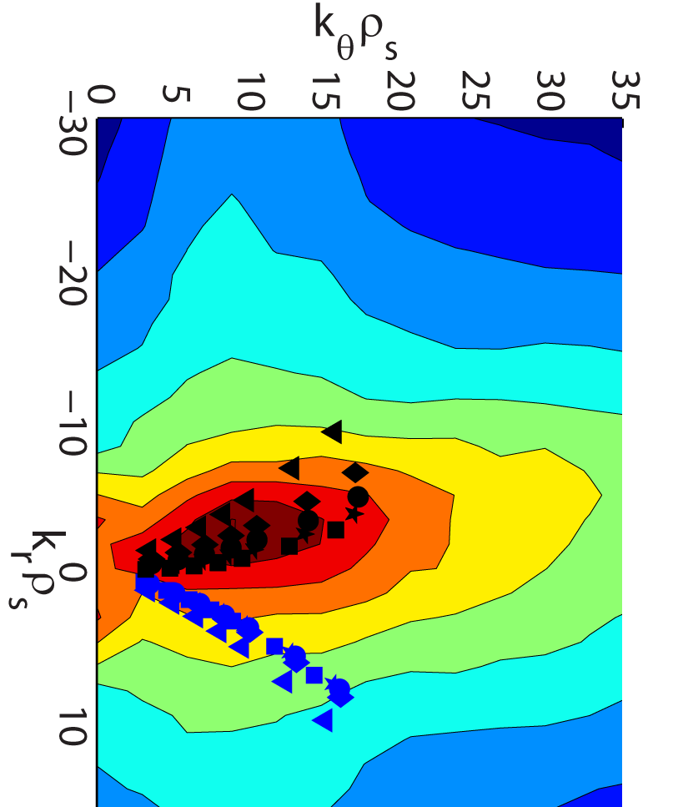
NSTX-U research will advance high-k measurement for validating ETG & multi-scale simulations
Measured trends in high-k fluctuations (with ∇T_{e}, ∇n_{e}, s, γ_{E}) consistent with ETG theory (backup)
BUT majority of nonlinear gyrokinetic ETG simulations predict Q_{e} too small to explain experiment
New FIR high-k_{θ} scattering FDR done
  Laser table & waveguide installed (UC-Davis)
Unique dual-scattering-scheme allows for flexible measurements in 2D wavenumber space (k_{θ},k_{r})
Measured high-k power spectra
Electron heat flux (exp & sim)
New high-k scattering geometry
Simulated ETG spectra
Measurable
(k_{θ},k_{r})
Ruiz-Ruiz, PoP (2015)
Unique synthetic diagnostic developed to validate GK simulations (Ruiz-Ruiz, APS 2017) (MIT collaboration) and to enable projections for NSTX-U
Progressing towards multiscale simulations to investigate Q_{e} underprediction
  Guided by TGLF multi-scale transport model (R18-3 milestone)

Slide 14
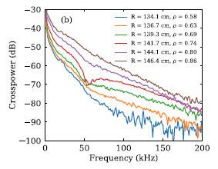
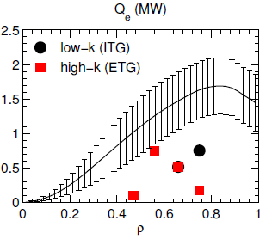
NSTX-U L-mode operation provides valuable flexibility for physics validation studies
NSTX-U L-mode
BES cross-power spectra
New centerstack allows for stationary L-mode studies
  Was not possible in NSTX
Ion scale turbulence data (BES) shows broadband fluctuations
Local, single-scale GK simulations fail to capture L-mode transport
  Complicated by multi-mode and possible multi-scale effects
Provides low-A complement to numerous R/a=3 validation studies
ρ=0.58-0.86
Electron heat flux
TRANSP
MTM
?
GYRO
Guttenfelder (submitted)

Slide 15
OUTLINE
Background and research goals
Recent highlights supporting research plans
Near-term and longer-term research plans
Summary

Slide 16
Near-term NSTX-U operational & research T&T plans focus predominantly on electron thermal transport
Characterize H-mode confinement scaling at increased B_{T}, I_{p}, P_{NBI} → lower ν*
  First operation milestone (R19-1); Multiple run days scheduled for FY16
Investigate parametric turbulence & transport dependencies and validate GK simulations and transport models
  Exploit 2nd NBI, 3D coils and operational flexibility (see Battaglia talk) + comprehensive turbulence measurements
Measure CAE/GAE activity, mode frequencies and structure
  Exploit 2nd NBI for GAE/CAE stabilization to study impact on T_{e}, χ_{e} (see Podesta EP talk)
Investigate pinch & residual stress momentum transport contributions (follows prior ITPA work)
  Exploit 2nd NBI, 3D coils & long-pulse capability with new centerstack

Slide 17
Longer-term T&T research plans will use facility enhancements to support integrated operational goals
Address electron particle transport in long-pulse H-modes
  Exploit lithium and cryopump (as available) to modify sourcing (see boundary talks)
Dimensionless (ν*, β, q, ρ*) scaling studies (requires density control)
Measure high-Z impurity transport using LBO
  Investigate prior to any high-Z PFC coverage (see Jaworski talk)
Use RF heating (HHFW) for flexible transport studies (see Perkins Talk)
Continued model validation enhancing predictive capability (continuous process)
  Improved drift wave models (MMM, TGLF)
  Develop & test χ_{e,EP} model using ORBIT + measurement/HYM predictions

Slide 18
OUTLINE
Background and research goals
Recent highlights supporting research plans
Near term and longer-term research plans
Summary

Slide 19
Summary: NSTX-U T&T research is addressing key issues for ST & MFE research
Measure and understand energy confinement scaling at high field, high power to improve confidence in future ST projections (high β, low ν*)
  Possible due to cutting-edge facility and diagnostic capabilities
  Will also improve integrated transport understanding to support operational goals
Unique range of NSTX-U operational space (β, ν) complements tokamak and burning plasma research
  Validating multiple drift wave and AE transport mechanisms in electron-loss dominated conditions
  Improving theory & modeling for physics validation relevant to both ST & AT high-performance scenarios
Validating transport models over range of β & R/a will allow for integrated optimization (performance & engineering) of future devices

Slide 20
BACKUP SLIDES

Slide 21
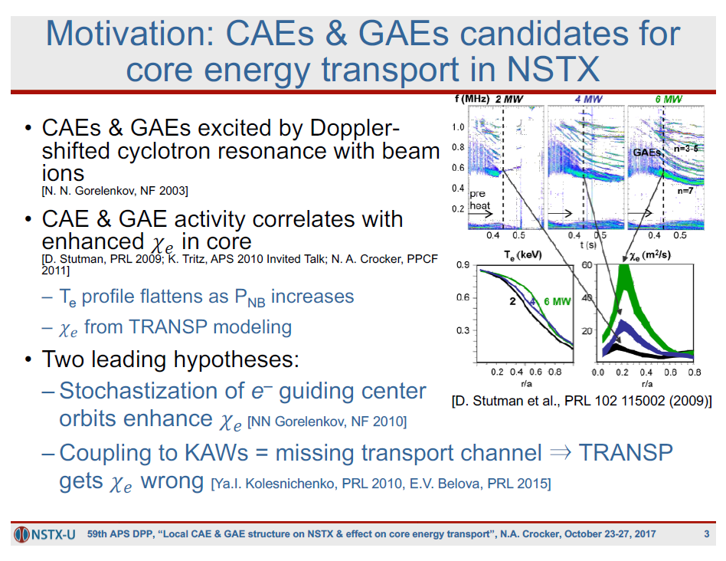

Slide 22
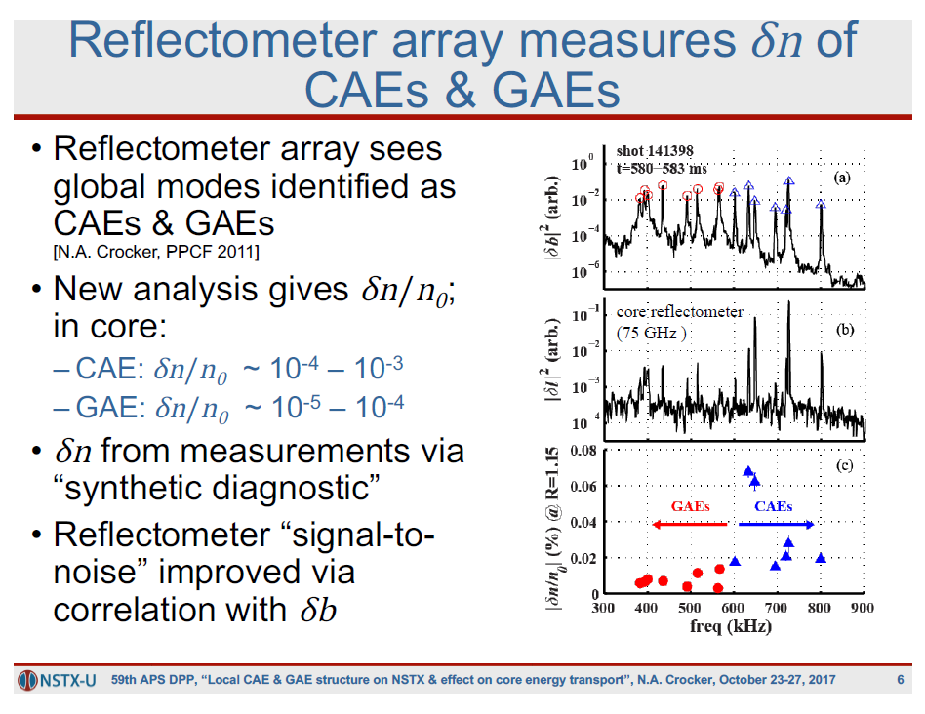
Crocker, NF (2013)

Slide 23
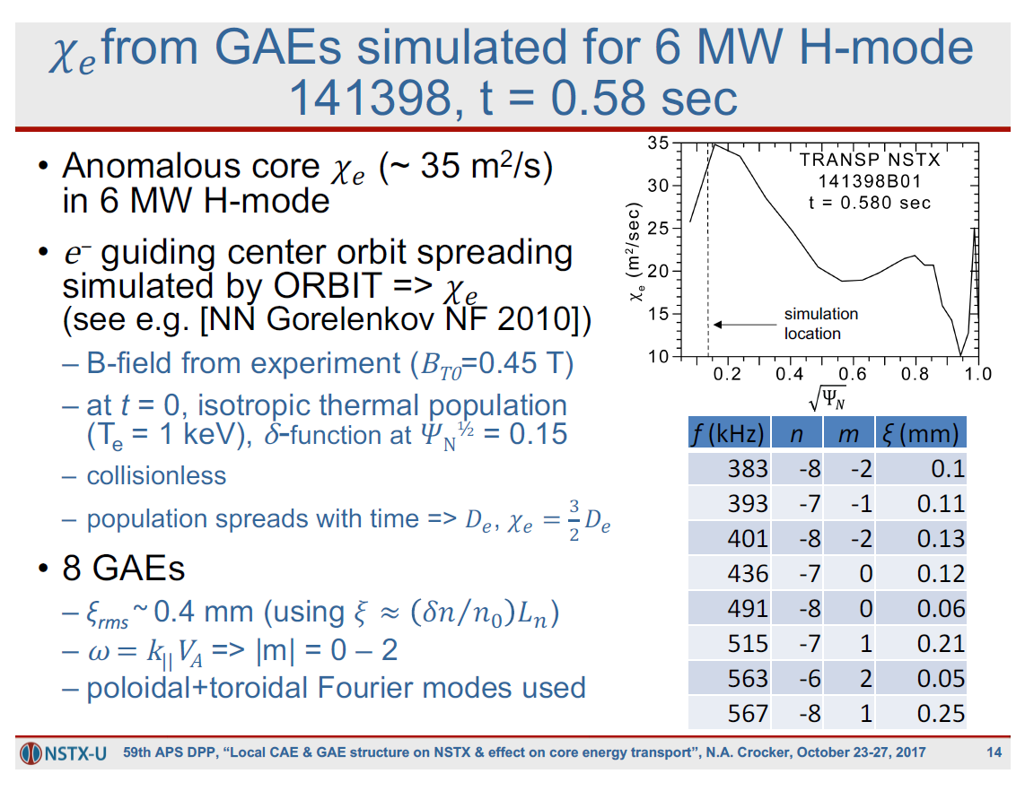
Crocker, NF (2017)

Slide 24

Nonlinear simulations of core MTM turbulence predict significant transport at high β & ν
Large δB/B~10⁻³ leads to flutter transport (~v||⋅δB²) consistent w/ stochastic transport
  In the core, driven by ∇T_{e} with time-dependent thermal force (e.g. Hassam, 1980)
  Requires collisionality → not explicitly driven by toroidal “bad-curvature”
Collisionality scaling (χ_{e,MTM}~ν_{e}) consistent with global confinement (τ_{E}~1/ν)
NSTX MTM simulation
Predicted transport
exp.
sim.
(γ_{E}=0)

Slide 25
At high β & lower ν, KBM modes are predicted in the core ⇒ may set limit to NSTX-U confinement scaling
KBM expected to set maximum ∇P
Smooth transition from ITG/TEM (no hard onset) – distinct from conventional tokamaks
Nonlinear simulations predict significant transport, strong compressional magnetic component (δB||/B~10⁻³)
Linear growth rates
Nonlinear simulation
exp.
values
(ρ=0.7)
Exp.
TEM KBM
Guttenfelder, NF (2013)

Slide 26
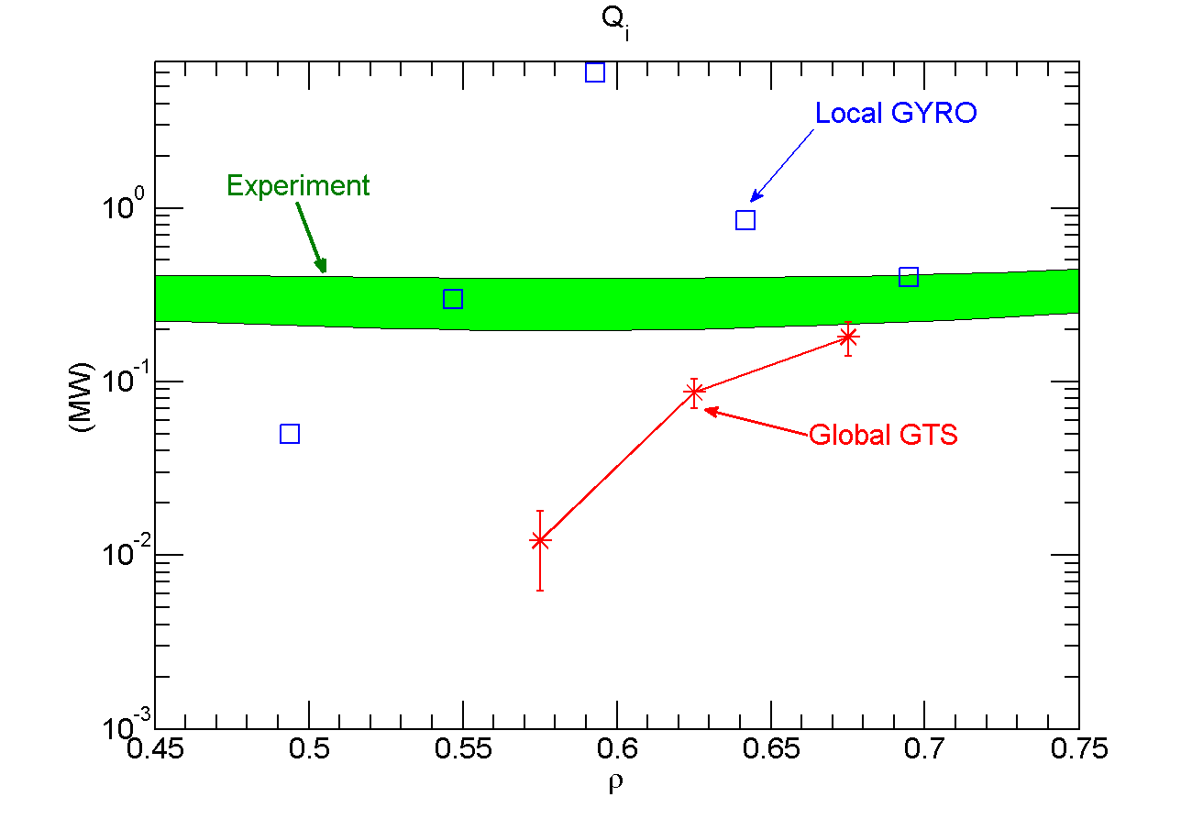
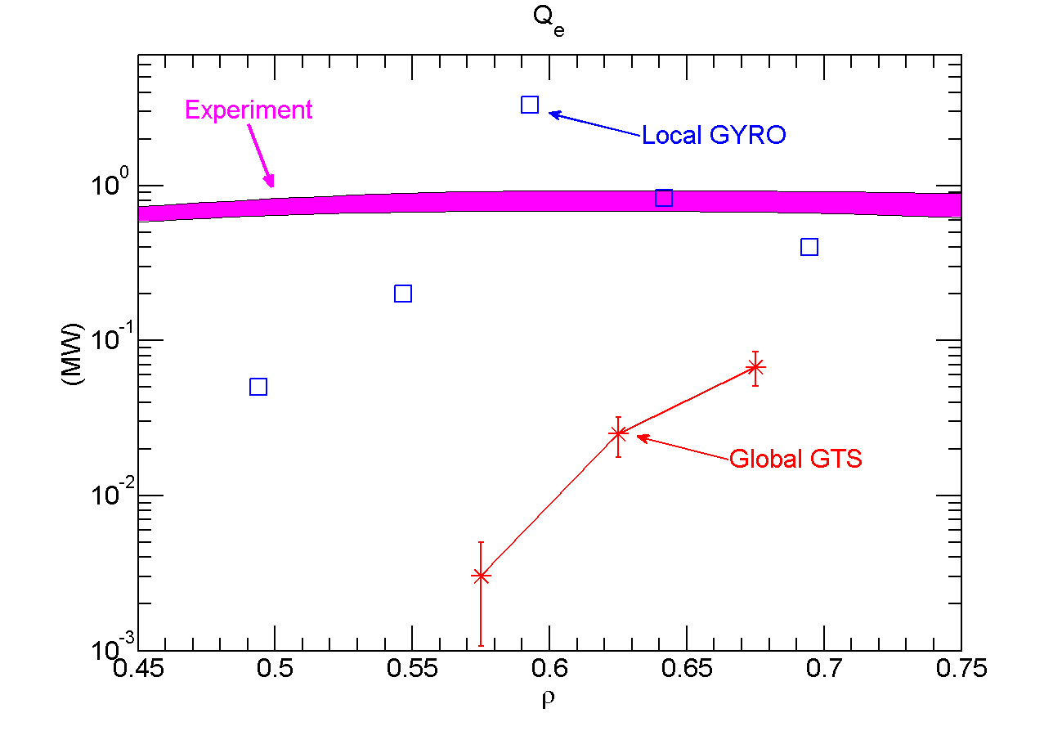
Global electrostatic simulations illustrate importance of non-local effects at finite-ρ*=ρ_{i}/a
  Significant variation in predicted L-mode heat fluxes between local (GYRO) and non-local (GTS) electrostatic simulations (Ren, NF 2013, IAEA 2016)
  Global effects also important for high beta → development of global electromagnetic GK codes GTS, XGC1 is advancing (PPPL theory)

Slide 27
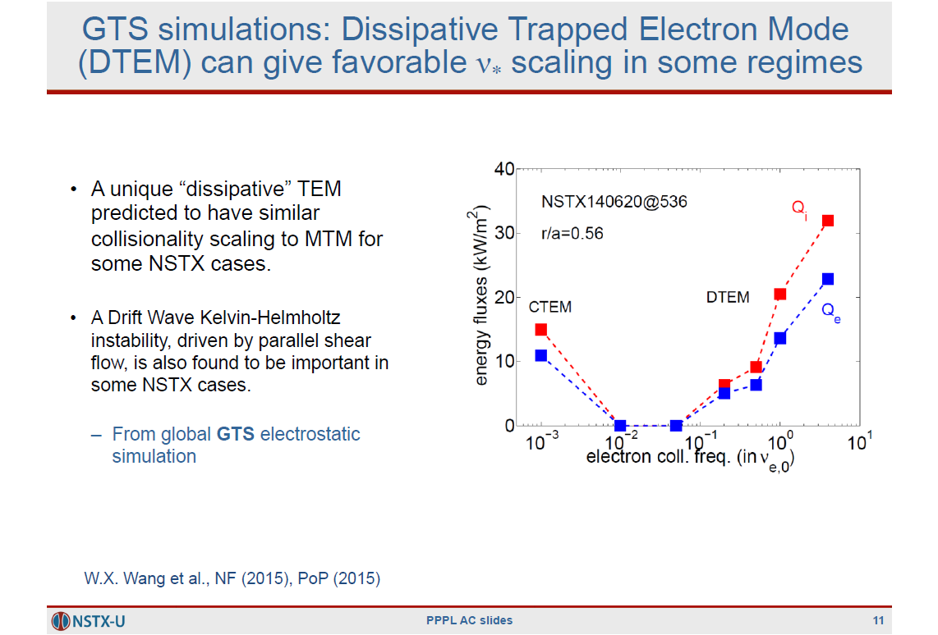

Slide 28
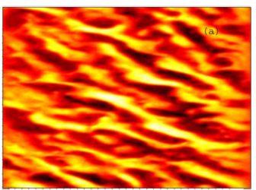
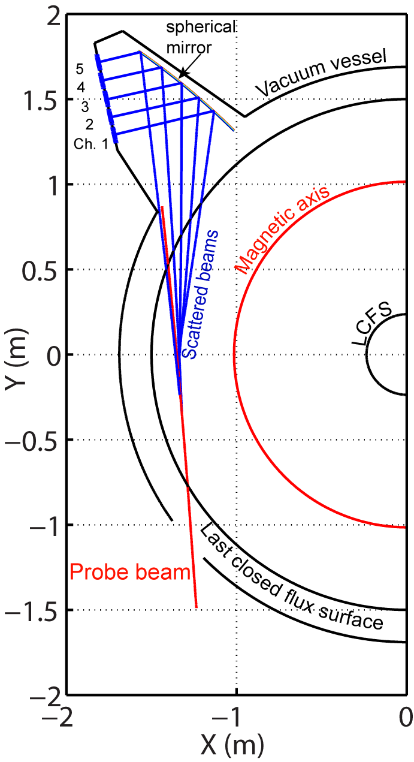
Microwave scattering used to detect high-k⊥ (~mm) fluctuations in NSTX
ETG simulation
NSTX high-k scattering geometry
Mazzucato, PRL (2008)
Smith, RSI (2008)
6 ion radii
360 electron radii
~2 cm
280 GHz probe beam
NSTX
Guttenfelder, PoP (2011)
Notes:
Can no longer image, not enough resolution
Use scattering, like scattering x-rays off crystals, sound waves

Slide 29
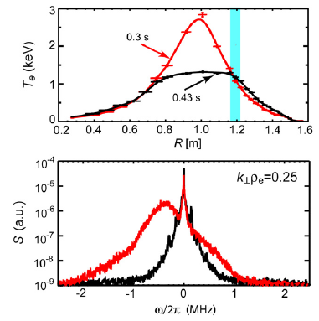
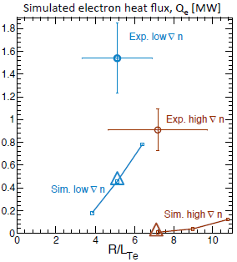
NSTX research has extended understanding the role of high-k turbulence on electron transport
RF heated plasma
Measured high-k fluctuations increase with ∇T_{e} (R/L_{Te}>R/L_{Te,crit}) as expected for ETG turbulence
Other measured trends are consistent with ETG theory, e.g. reduction of high-k scattering fluctuations with:
  Strongly reversed magnetic shear (Yuh, PRL 2011)
    Simulations predict comparable suppression (Peterson, PoP 2012)
  Increasing density gradient (Ren, PRL 2011)
    Simulations predict trend (Ren, PoP 2012, Guttenfelder NF, 2013, Ruiz-Ruiz PoP 2015)
  Sufficiently large E×B shear (Smith, PRL 2009)
    Observed in ETG simulations (Roach, PPCF 2009; Guttenfelder, PoP 2011)
BUT majority of nonlinear gyrokinetic ETG simulations predict Q_{e} too small to explain experiment
Mazzucato, NF (2009)
ω_{*e}
direction
Ruiz-Ruiz, PoP (2015)

Slide 30
Priority NSTX-U operational & research T&T plans will focus on electron thermal transport
Characterize H-mode confinement scaling at increased B_{T}, I_{p}, P_{NBI} → lower ν*
  First operation milestone (R19-1); Multiple run days scheduled for FY16
    Q: Will Bτ_{E}~1/ν* remain valid (ST vs. H98 scaling)?
    Q: Will χ_{i}≈χ_{i,NC} remain? (Hints of χ_{i}>χ_{i,NC} in lowest ν* NSTX discharges, Kaye NF 2013)
    How favorable are projections to next-step ST devices?
Investigate parametric turbulence & transport dependencies and validate GK simulations and transport models
  Exploit 2nd NBI, 3D coils and operational flexibility (see Battaglia talk), comprehensive turbulence measurements and updated transport models (e.g. TGLF)
    Q: Does MTM set 1/ν* scaling and/or does DTEM (Wang, PoP 2015) play a role?
    Q: Does KBM set ultimate τ_{E} limit at low ν*?
    Q: What role does ETG play?
    Can understanding be used to optimize transport characteristics?
Measure CAE/GAE activity, mode frequencies and structure (BES, reflectometry)
  Exploit 2nd NBI for GAE/CAE stabilization to study impact on T_{e,0}, χ_{e} (see Podesta EP talk)
  Develop & test χ_{e,EP} model using ORBIT + measurement/HYM predictions
    Q: What is role of GAE/CAE in setting T_{e,0}?

Slide 31
Long-term T&T research plans will use facility enhancements to support integrated operational goals
Address electron particle transport in long-pulse H-modes
  Exploit lithium and cryopump (as available) to modify sourcing (see boundary talks)
    Q: How does density control/stationarity vary with transport regime? Does this influence operational goals?
Investigate momentum transport using NBI modulation & 3D coils
  Exploit 2nd NBI & long-pulse capability with new centerstack
    Q: Do momentum pinch and residual stress play any significant role in setting rotation profile?
    Follows previous work motivated by ITPA T&C (backup slides XX)
Measure high-Z impurity transport using LBO
  Investigate prior to any high-Z PFC coverage (see Jaworski talk)
    Q: Will D_{imp}=D_{imp,NC} hold? What are implications for high-Z density profile?
Use RF heating (HHFW) for flexible transport studies
    Q: Can impurity transport be controlled with RF?
    Q: Can role of drift wave vs. GAE/CAE on T_{e} be better understood?
Study ρ* scaling (requires density control)
    Q: How important are finite-ρ* non-local effects? Can they be accurately modeled?

Slide 32
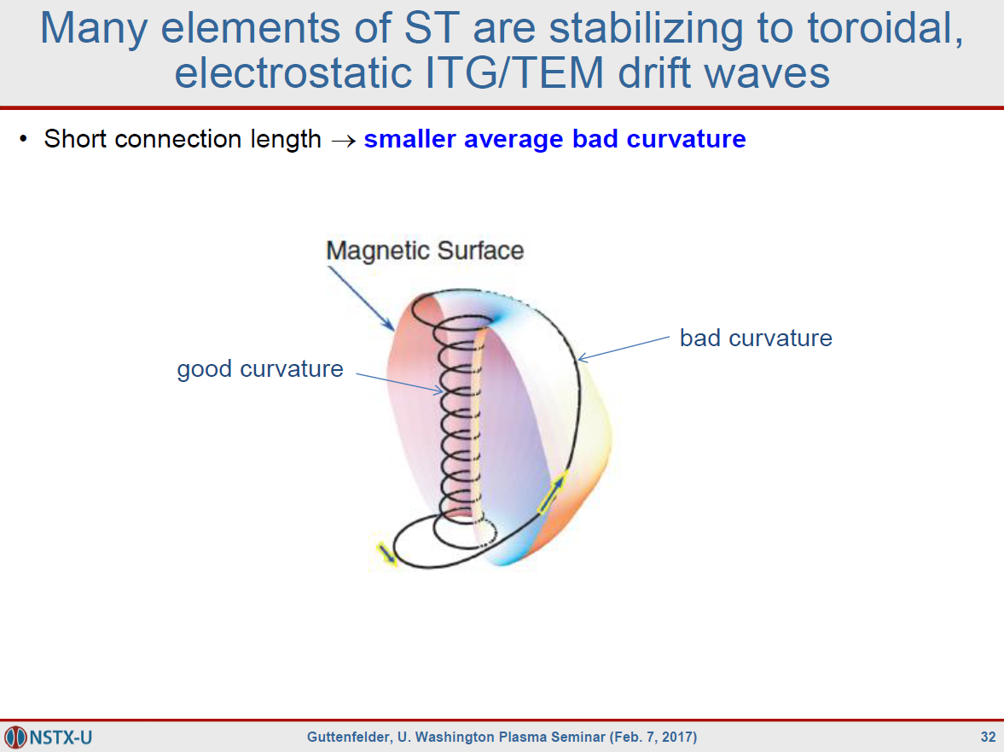

Slide 33
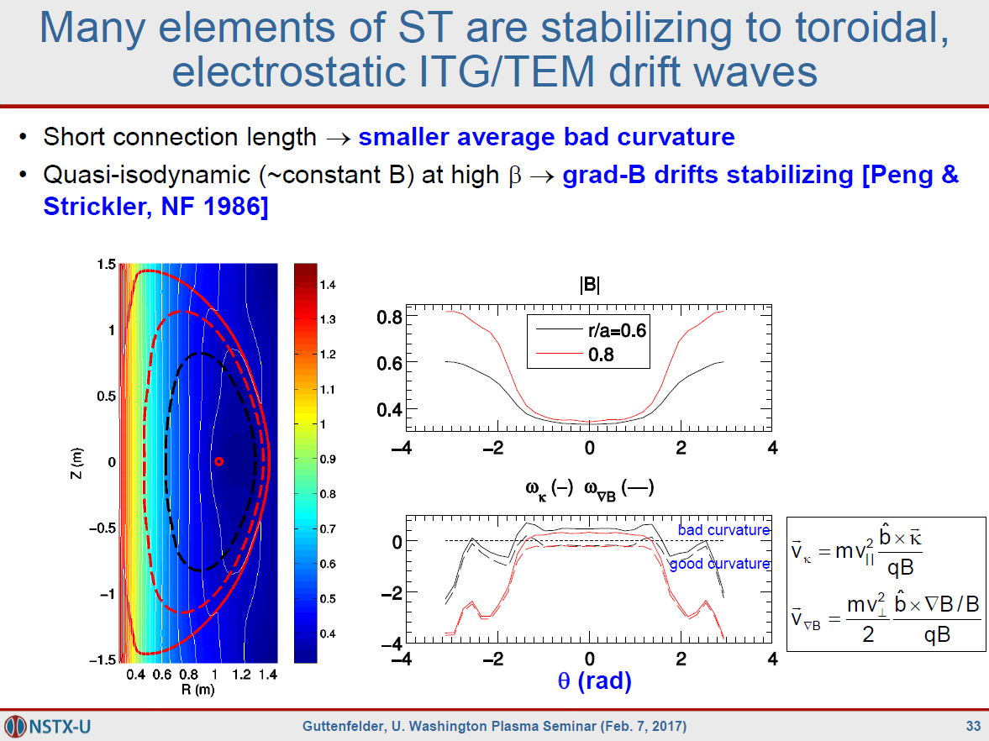

Slide 34
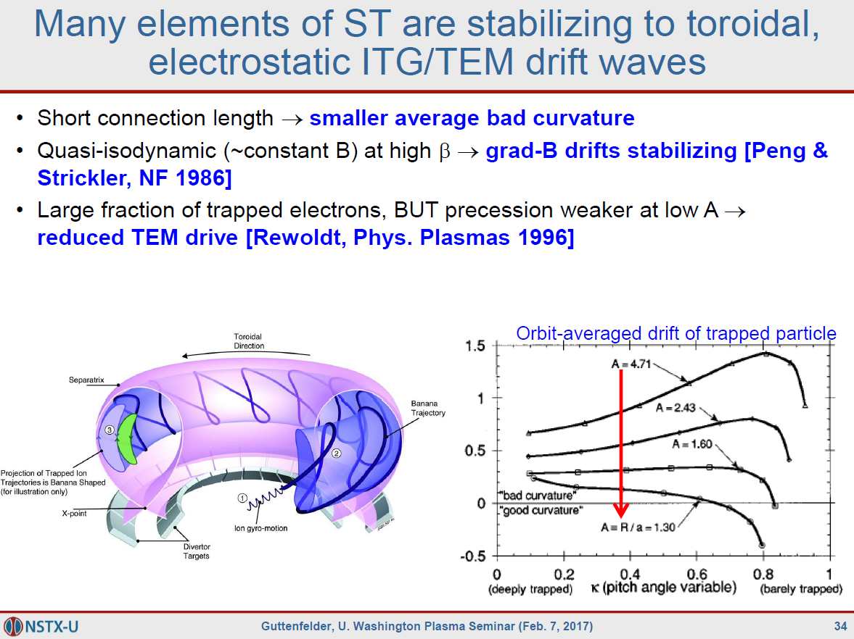

Slide 35
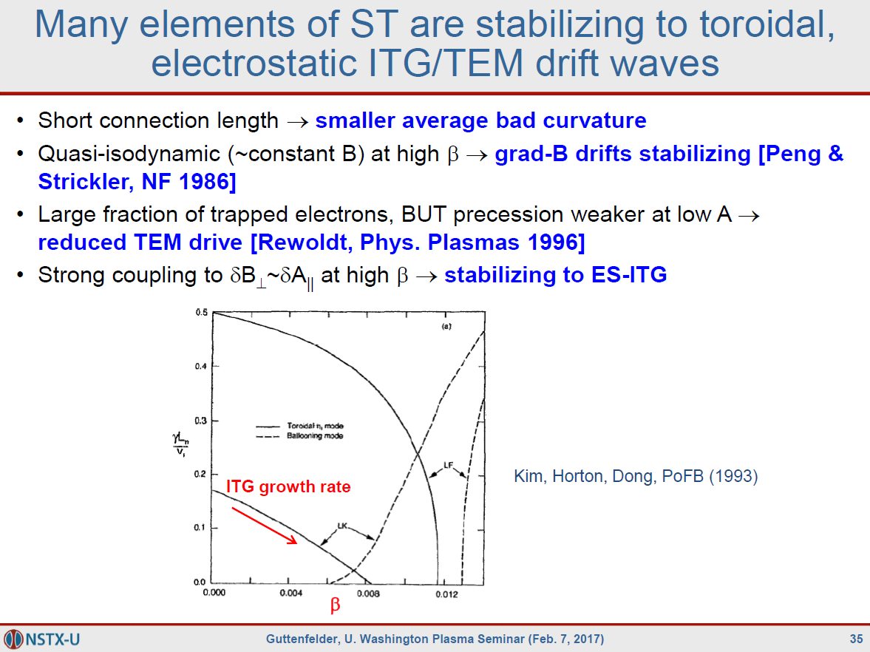

Slide 36
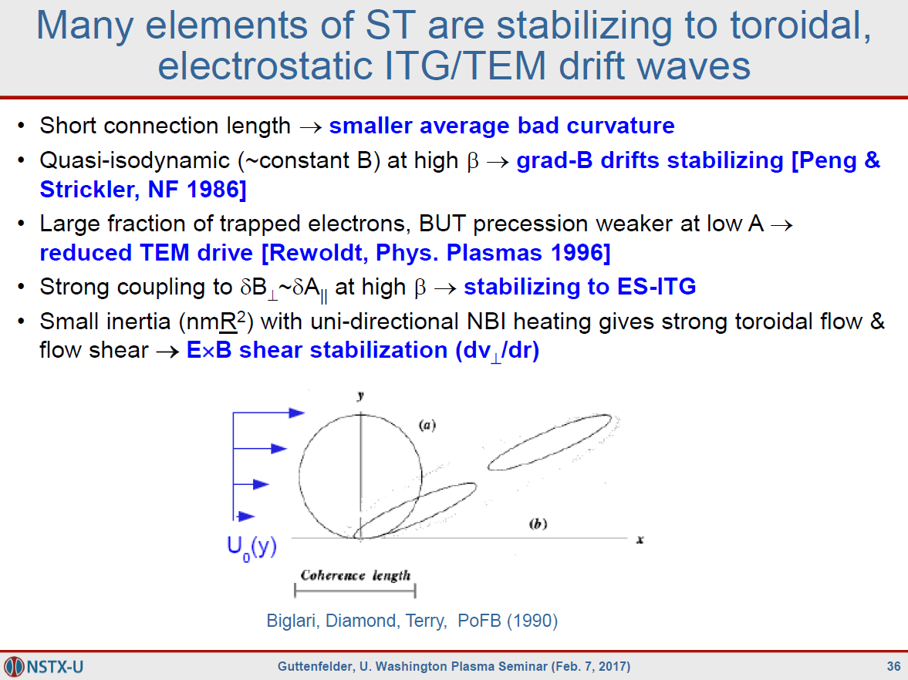

Slide 37
