Slide 1


Liquid metal PFC program for NSTX-U
NSTX-U PAC40 – Sept. 11, 2019
Rajesh Maingi
(Partial response to Charge #3 and comments in the last PAC report)

Slide 2
Substantial excitement and opportunities with an accelerated liquid metal PFC program in NSTX-U
Liquid metal PFCs are a PPPL strategic initiative
  PPPL effort engages multiple departments: PS&T, I&T, NSTX-U
This talk motivates near-term deployment concepts, but the elements are presently unfunded
Motivation and recent developments
  New FES domestic liquid metal PFC development program: FY20-FY22
Near term acceleration options and next step vision
  ‘Phase 1’ options: pre-filled Li plugs in high-Z tiles, flowing Li limiters
  ‘Phase 2’ vision: all high-Z tiles with flowing Li divertor modules
Summary

Slide 3
Liquid metal plasma-facing components should be vigorously pursued as an alternative to solid PFCs
High-Z solids are the leading PFC design choice, but have serious challenges for long-pulse reactors
  Performance under intense PMI and neutron load
Liquid metal PFCs offer the promise of self-healing PFCs that do not suffer from lifetime erosion & re-constitution limits
  Remove surface heat load requirements on solid PFCs
  Remove requirement that solid PFCs handle simultaneously PMI and neutrons
  Aim to remove microscopic PMI-generated debris in LM flow
  Li PFCs provide access to high τ_{E}, one path to a compact fusion pilot plant
  NSTX
Pre-discharge Li Evaporation (mg)
R. Maingi, Nucl. Fusion 52 (2012) 083001

Slide 4
Developments since PAC-39 (1/18)
DoE/SC Phase 2 Assessment of NSTX-U Recovery Plans strongly endorsed the liquid metal PFC program for NSTX-U (3/18)
Transformative potential of LM PFCs identified in reports (2018 FESAC TEC, 2019 NAS Fusion Strategy)
DoE LM Fusion Energy Systems Study (FESS- 2/19) identified general R&D needs and those specific to liquid metals of interest: Li, Sn, Sn-Li
  Follow-on FES LM PFC design program launched (FY20-22, PPPL lead)
PPPL interest centers on using flowing liquid Li, but leaving flow speed as a design choice
  Slow flow (cm/sec): capillary porous system or vapor box
  Fast flow (m/sec): LM flow augmented by j x B drive

Slide 5
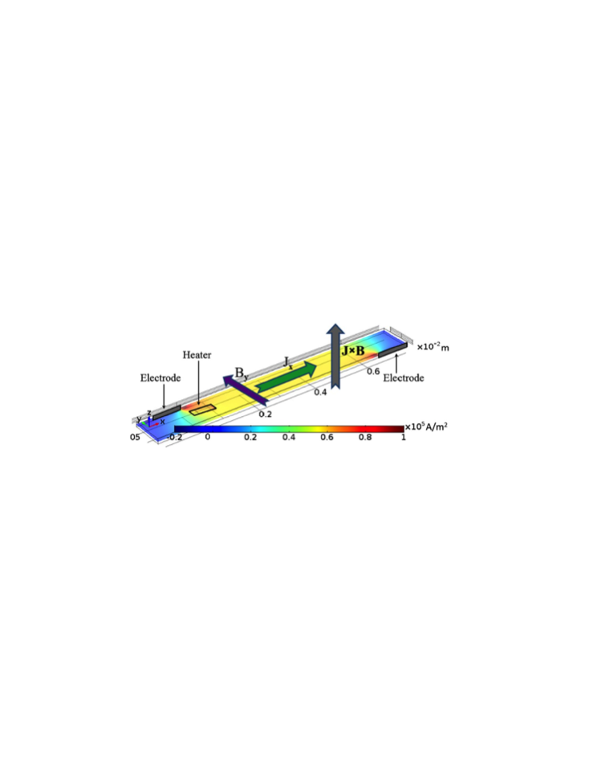

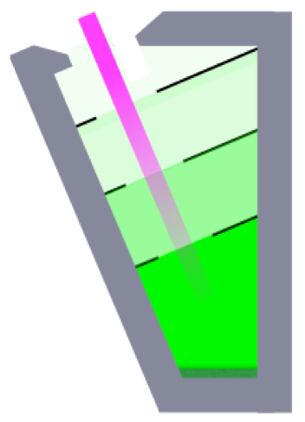
Elements of PPPL liquid metal PFC program
LTX-β
(NBI)
FES LM PFC
LMX (PPPL)
NSTX-U
Li Vapor Box (MAGNUM)
FLIT design - unfunded

Slide 6
A LM PFC Development Program has been initiated, following the FESS LM PFC study
What: three-year program ($1M/year) toward engineering concept design for LM PFCs for reactors [PPPL, ORNL, UIUC, UCLA]
Why: because it is uncertain that solid PFCs can survive plasma-material interactions at reactor scale, and LMs may provide a solution
Goal: Develop and evaluate a LM PFC concept for an FNSF / compact fusion pilot plant (CFPP) core plasma via
  Engineering design and plasma interface calculations
  Appropriate lab experiments (single-effect and prototypical flowing LM) to simulate the concept and answer questions
NSTX-U Relevance: new designs applicable to a CFPP could be scaled and tested in NSTX-U if resources become available
  Path to close gaps for CFPP plasma exhaust design

Slide 7
Down selections for the initial LM PFC program
Engineering concept design for a flowing liquid lithium PFC for the divertor only
  Flowing liquid walls are a future consideration
First option: low temperature below the strongly evaporative limit (expand to higher temp. in years 2-3)
Evaluate several flow rates: slow, medium and fast

Slide 8
Science and Engineering Open Questions
What are the trade-offs for slow-flow (< 10 cm/s) and fast-flow (> 1 m/s) concepts? Is there an optimum intermediate flow rate? What are safety implication of each? How are they integrated into the plant?
How can we insure maximum wetting on the substrate? How can we avoid dryout? How can we minimize droplets?
What reactor-relevant design features can be simulated by an open-channel chute experiment?
Can we remove hydrogen from the flowing Li sufficiently fast? Can we pump He?

Slide 9
Plan, FY 20
Concept Development: Engineering Concept Design & Plasma Interface for flowing liquid Li divertor PFCs for future devices (FNSF/CFPP) – 675k [ORNL, PPPL, UCLA, UIUC]
    Three flow rates: slow, medium, fast – open questions as a function of flow rate?
    PFC surface temperatures for low evaporative solutions: T < 400-450º C
    2D SOL/divertor and PMI near surface modeling a critical part
Lab Experiments: Single effect and Prototypical Experiments – 325k
    Experiments on wetting, continuous flow, dryout, texturing [UIUC]
    LMX experiments to determine range of flow rates and dependence on B, thickness, heating [PPPL]
    Liquid Metal Embrittlement [ORNL]
3 year goal: develop design and identify design trade-offs for FNSF/CPP consistent with LM MHD, substrate thermo-mechanics and CFD, plasma interface, and accessible experimental validations

Slide 10
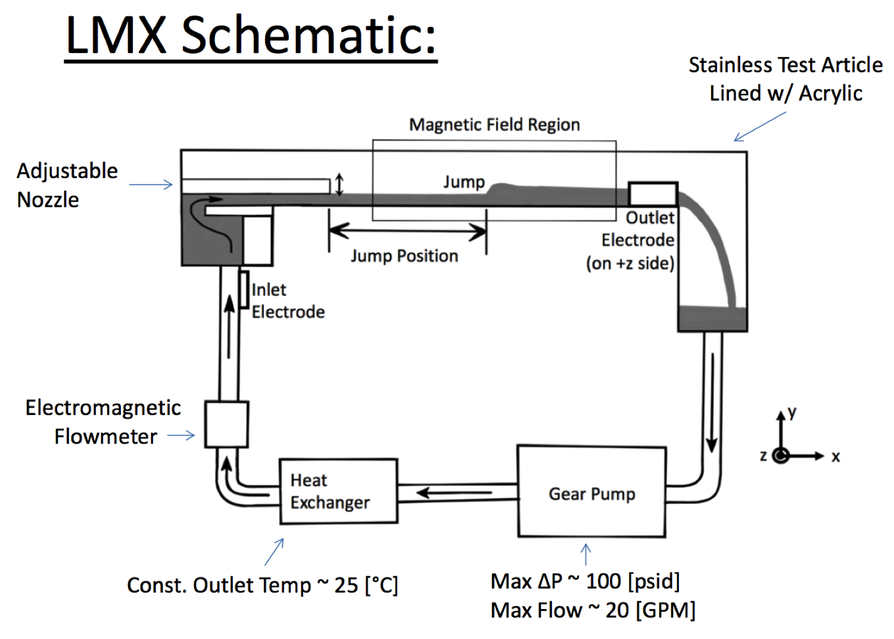
Liquid Metal Experiment: LM Flow Experiment at PPPL
LMX is a chute flowing experiment, using GaInSn (safe, can be open to air or water)
B_{max} = 0.33 T, uniform, perpendicular to flow
Chute width, length = 10.9 cm, 70 cm
LM thickness ~ 2 cm, v ~ 1-3 m/s
Electrodes for driving currents
Piping, chute, other parts are plastic
Low temperature (25 C)
Year 1 experiments
  LM MHD flow vs simulations
  Heating/mixing vs simulations
  Nozzle size/flow speed vs simulations
  Detailed examination of upgrades/parameter space accessible/what is prototypical of concept design
M. Hvasta et al., Nucl. Fusion 58 (2018) 016022
M. Modestov et al., Nucl. Fusion 58 (2018) 016009

Slide 11

Elements of PPPL liquid metal PFC program
Legend:
PPPL
Offsite
Unfunded
  2015 2020 2025 2030
LTX
LTX-β with NBI
FESS LM PFC
(Kessel)
FES LM PFC design for CPP/FNSF
and LMX expts
FES LM PFC prototype?
EAST slow flowing LM PFCs
test vapor box in MAGNUM
Pre-filled Li tiles
?
NSTX-U LM
divertor module(s)
Midplane Li limiter
LM MHD flow in LMX
NSTX-U coatings & surface science
Fast flow walls & divertor: full torus, no plasma
Slow flow LM test stand; with plasma

Slide 12
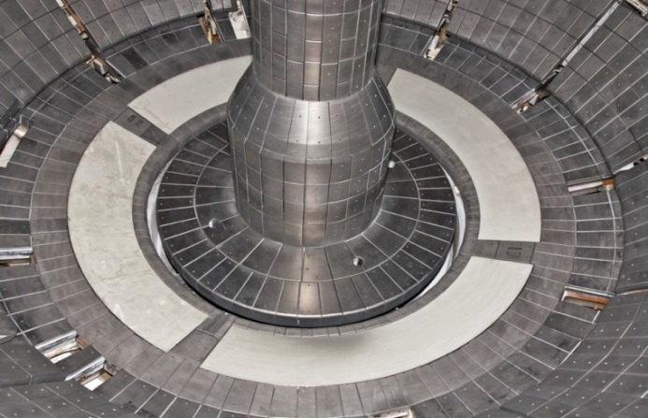
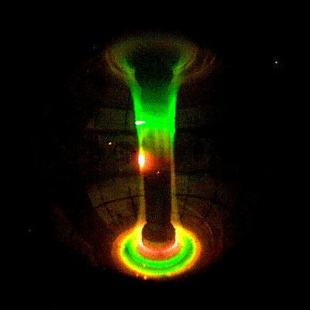
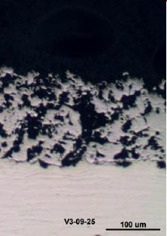
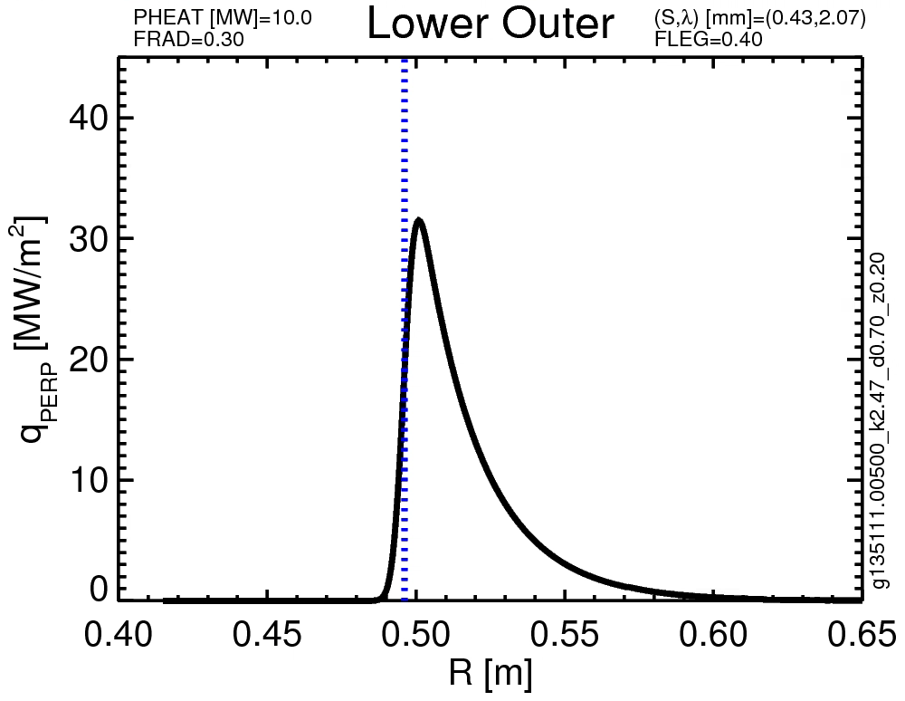
The need for integrated solutions, coupled with NSTX & PPPL expertise, motivates liquid metal PFC mission in NSTX-U
NSTX Liquid Li Divertor
Li science and technology developed in NSTX & PPPL
  NSTX LLD: Diagnostics, Theory, and Surface Science
  CDX-U, LTX, LTX-β, collaborations
NSTX-U can access q┴ < 30 MW/m²
  Full heating power: P/R~20
NSTX-U projections
Notes:
Why NOW?
The PMI workshop process was designed to identify the key scientific questions that need to be answered TODAY if they are to be cooked into TOMORROW’s reactor.
IN reviewing them, though, I was again amazed at how nearly all of them use the word “reactor”.
These were covered by Matt, but if you look in the text, nearly all of them had some reference also to liquids
[Go through A-E]
In addtion to the PRDs, the workshop also identified several cross-cutting activities that reach across PRDs:
A research thrust on NSTX-U on liquids is highly cross-cutting.
That addresses why NOW? But why NSTX-U?

Slide 13
Outline
Motivation and Goals
Near term acceleration options and long term vision
  Phase 1 Option: pre-filled lithium plugs in high-z tiles
  Phase 1 Option: upgraded flowing liquid lithium limiters
  Phase 2 Vision: all high-Z tiles with flowing Li divertor modules
Summary

Slide 14
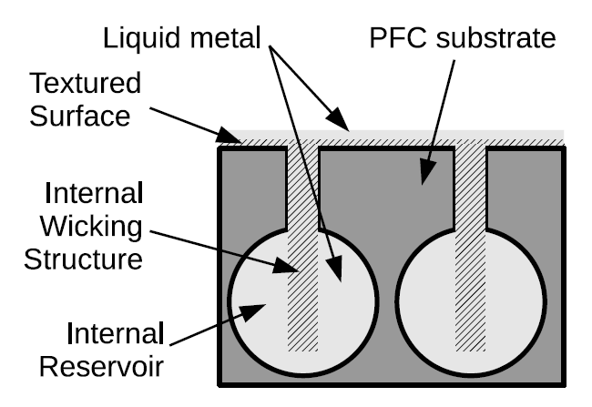
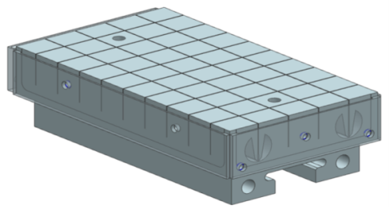
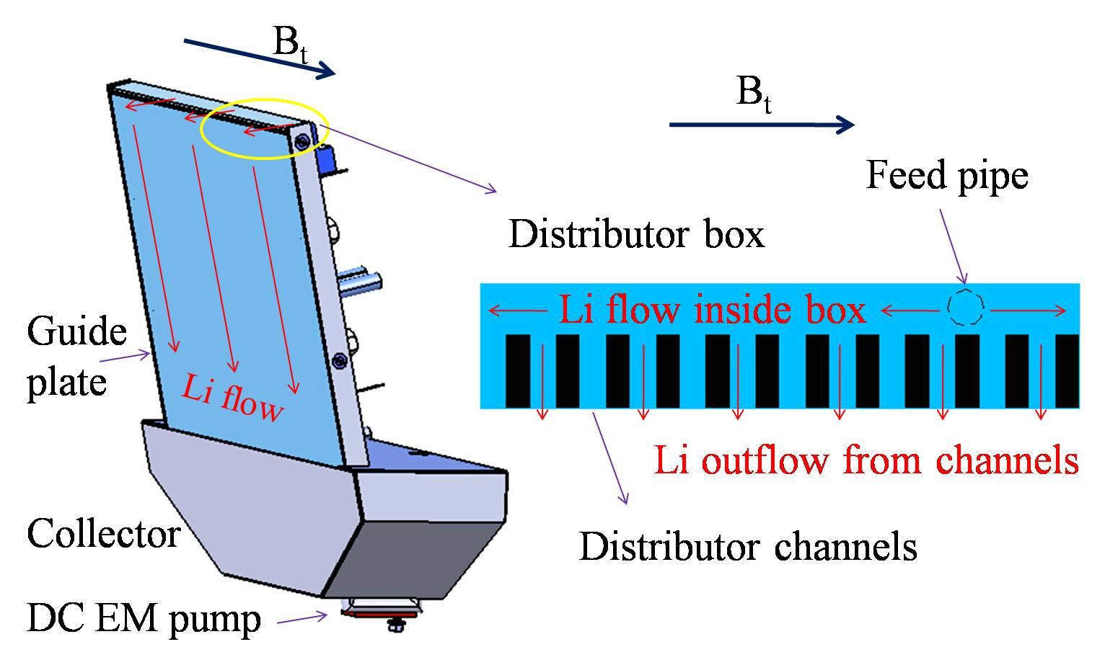
Two Phase 1 liquid Li options for deployment in NSTX-U in 2024
  Introduce Li atoms into divertor for particle and power exhaust
  Pre-filled lithium plugs embedded in a high-Z substrate
  Previously reviewed step (CDR) on path toward liquid metals in NSTX
Use flowing liquid lithium system for power and particle exhaust
  First step: limiter inserted in midplane
  Knowledge from three versions tested in EAST enables fast NSTX-U deployment

Slide 15
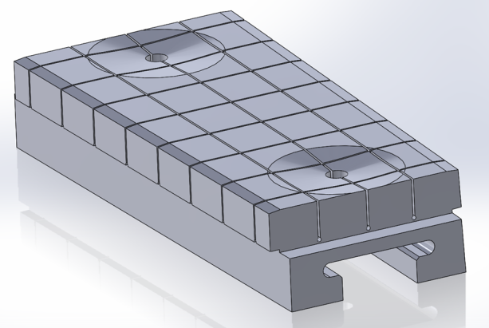
Pre-filled Li plugs in high-Z tiles were a previously reviewed step toward liquid metal PFCs
Pre-filled targets build on
high-Z, high-heat flux designs
Use pre-heating to bring tiles to 200-300 ºC, and strike point incidence to increase temperature for high evaporation rates
  How to avoid surface contamination?
Detachment physics: can Li evaporated into SOL and/or private flux region dissipate power?
  Connect to simple Li vapor box concept
Slow progress since 1/18 due to staff loss of critical expertise (M. Jaworski)
2015-16 NSTX-U High-Z Design

Slide 16
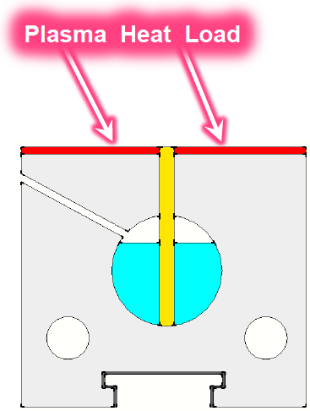
Pre-filled Li plugs in high-Z tiles aim to provide Li atoms into the divertor in NSTX-U
Detachment physics: can Li evaporated into SOL and/or private flux region dissipate power?
  Low temperature: pumping?
  High temperature: power dissipation and detachment control?
  Informing Li vapor box designs for NSTX-U in Phase 2
  Can HeGDC clean surface contamination?
Use strike point incidence to control local temperature
  Capillary forces cause Li to wick up
P. Rindt, ISLA 2017, FED 2016

Slide 17
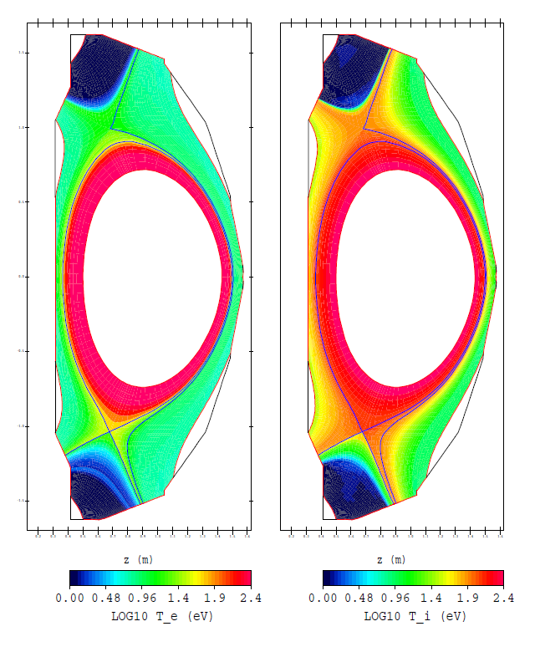
Pre-filled Li plugs in high-Z tiles aim to introduce Li atoms into the divertor
P. Rindt, ISLA 2017, FED 2016

Slide 18
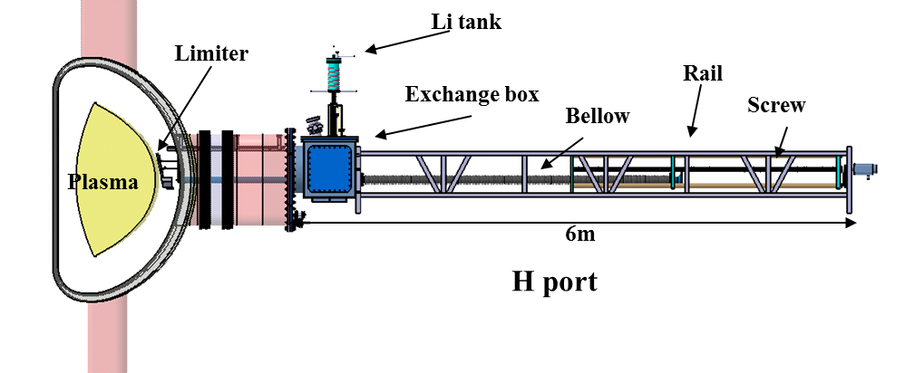
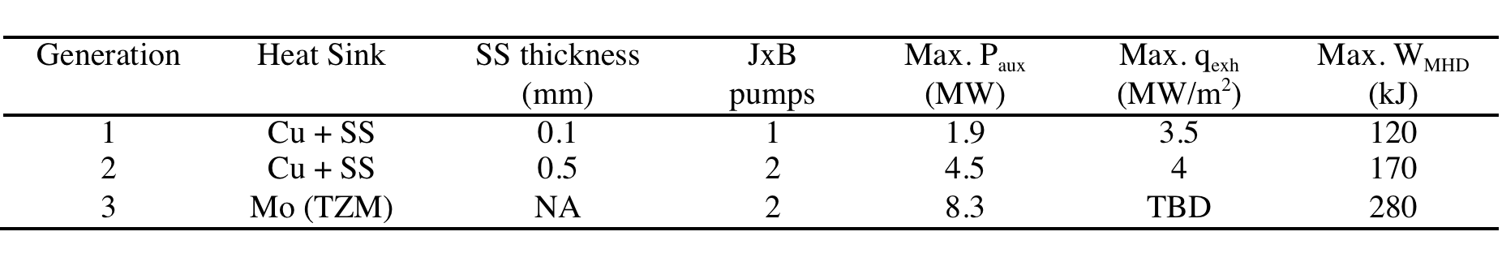
The science and technology of flowing liquid lithium limiters has been advanced via US-PRC PMI collaboration on EAST
Three generations of midplane liquid lithium limiters tested in EAST
  Prototype SS plate tested in HT-7
  Gen. 1 (12/2014) tested in EAST
  Gen. 2 (12/2016) tested in EAST
  Gen. 3 (8/2018) tested at UI-UC and PPPL and then EAST
    Increasing P_{aux}, W_{MHD}
J. Ren, Rev. Sci. Instrum. 86 (2015) 023504 J.S. Hu, Nucl. Fusion 56 (2016) 046011
G.Z. Zuo, Nucl. Fusion 57 (2017) 046017 R. Maingi, IAEA FEC 2018 paper FIP/3-5Ra

Slide 19
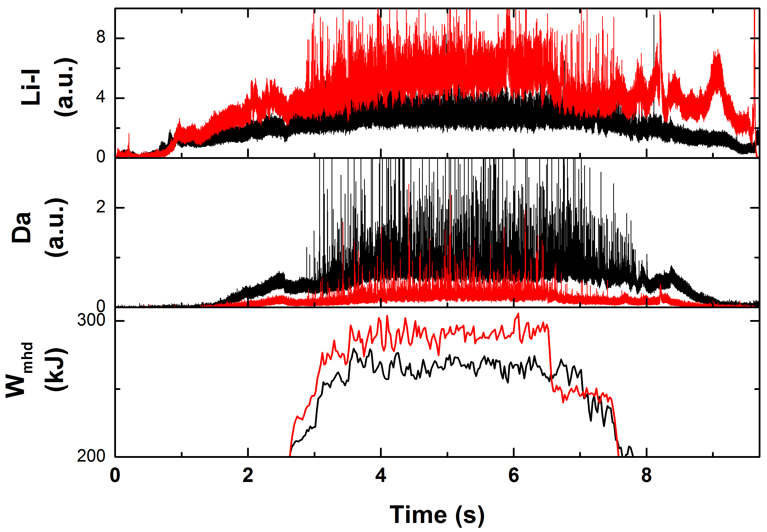
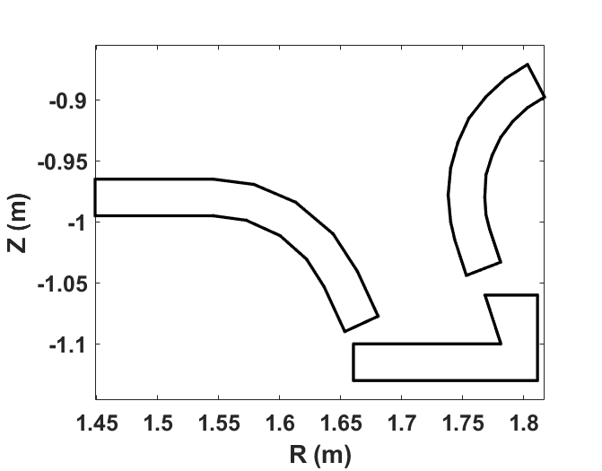
EAST: 3rd generation flowing liquid Li limiter fabricated; shipped to EAST 6/18 and exposed to plasma 8/18
Made of Mo for Li compatibility
  One plate sent to EAST, second plate sent to UI-UC for testing in HIDRA
  Extensive heater testing at UI-UC
  Stainless steel distributor and collector brazed onto plate
Experiment in 8/18 exposed FLiLi limiter to plasmas with P_{aux}=8.3 MW @ 3cm from separatrix
  Reduced recycling, slightly higher stored energy, low or no sputtering, ELM mitigation
  Future versions: 3D printed W PFC, limiter and/or divertor sector(s)?
Ref.
FLiLi
R. Maingi, IAEA FEC 2018 paper FIP/3-5Ra

Slide 20
Flowing liquid Li midplane limiters, based on FLiLi technology developed collaboratively on EAST, can be designed for NSTX-U
Potential upgrades – technology that enables science
  Increase flow rate from cm/s to m/s with e.g. j x B forces or LM jets to increase convective heat removal
  Increase range of temperatures up to strong evaporation limits (650 ºC) to augment power dissipation and detachment
  Increase range of Li film thickness from 0.1mm to 1 cm for improved protection of substrate
Can we restart flow after stopping?
Can we improve wetting and reduce creep with texturing?
Can we extend these concepts to a flowing divertor system?

Slide 21
Phase 2: Long term vision and directions of LM program in NSTX-U
NSTX-U would transition to all high-Z PFCS
  Avoid carbon, due to formation of compounds that contaminate Li (LTX, NSTX LLD experience)
  Aiming for very high τ_{E}, flat temperature profiles as observed in LTX
  Coming LTX-β results will highlight importance of liquid vs solid walls
High heat flux regions would have flowing liquid lithium module(s) for power exhaust
  Multiple concepts can be tested over the years
Low heat flux regions would have pre-filled tiles or evaporated coatings for particle control
  Cryopump could be installed as a future option for a detailed comparison with Li pumping
The new FES LM PFC Development Program should lead to natural collaborations during design and deployment
All high-Z FW +
divertors
+ flowing LLD
module
Flowing Li module (Concept, location, size TBD)

Slide 22
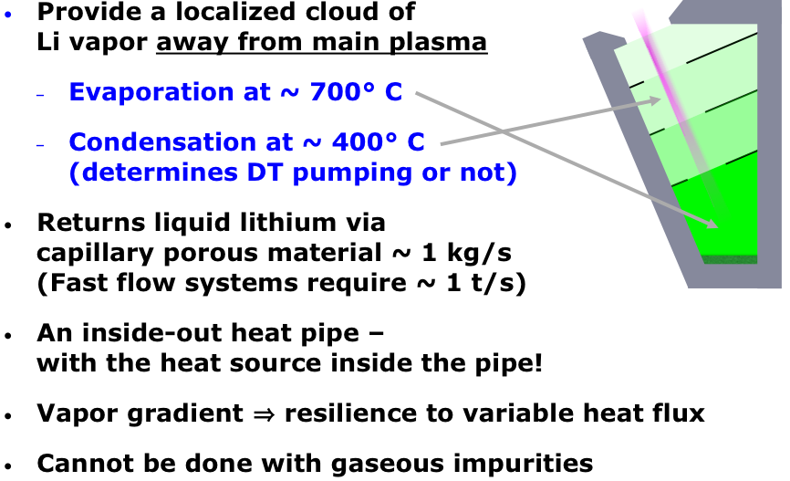
Li vapor box (LVB) divertor concept
R. Goldston, Phys. Scr. T167 (2016) 014017
R. Goldston, Nucl. Mater. Energy 12 (2017) 118
E. Emdee, Nucl. Mater. Energy 19 (2019) 244

Slide 23
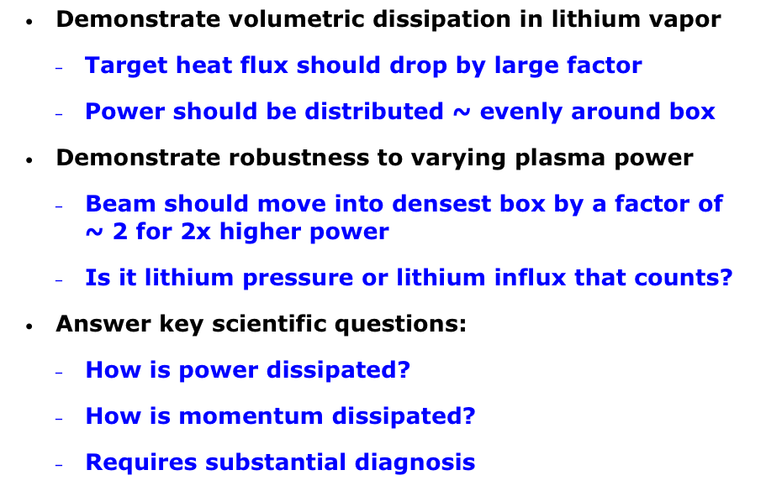
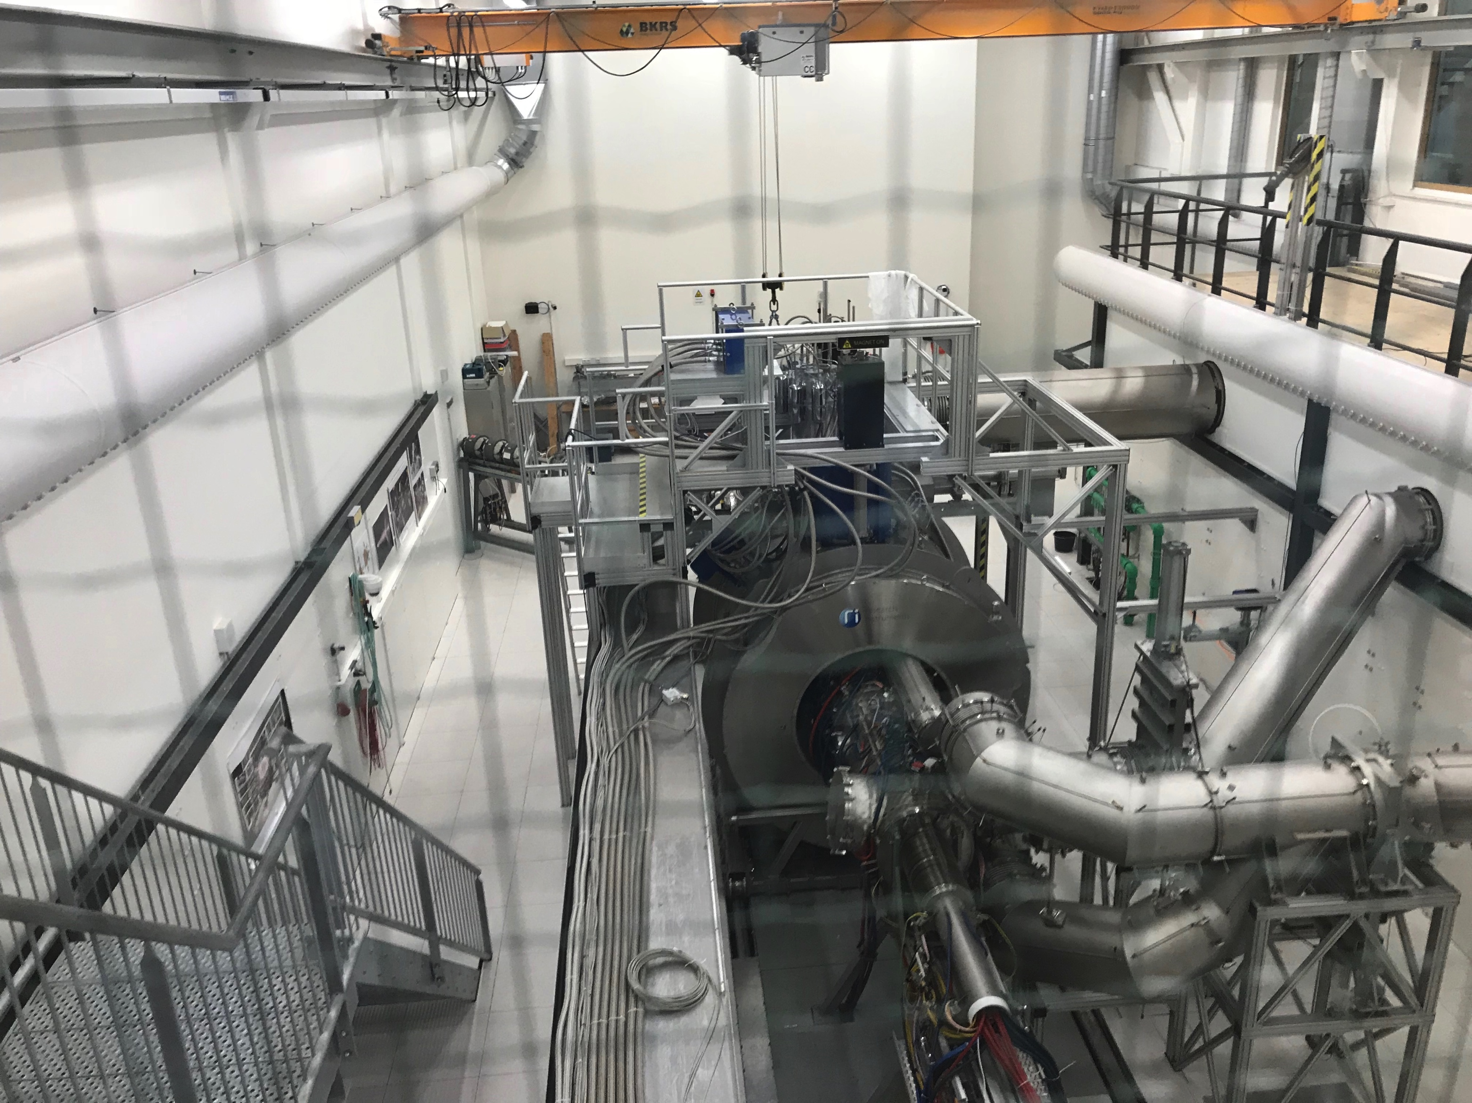
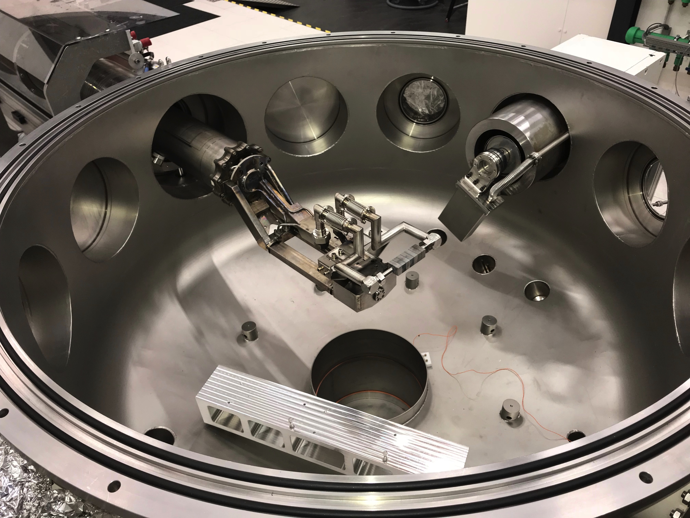
LVB Proof-of-Principle Experiment at MAGNUM-PSI (LDRD)
MAGNUM-PSI
New LDRD supports postdoc to participate in LVB design and experiments
Target Staging Area

Slide 24
Liquid lithium experiments on NSTX-U can begin as early as 2024
Phase 1 requires immediate design effort
  Would need FES agreement to deploy a few NSTX-U Recovery engineers and designers (in 2020) for these upgrades
Preparation for phase 2 vision by 2026-2027 needs to commence
  NSTX-U engineers and designers also needed for qualifying high-Z tile designs on divertor and wall
  The FES LM PFC development program will naturally provide CFPP relevant designs, which require engineering and scaling to NSTX-U, as well providing a pool of engaged collaborators

Slide 25
Backup

Slide 26
US PMI workshop 2015 and FESAC TEC 2018 reports highlighted the importance of developing LM PFCs
PMI Workshop: Multiple priority research directions (PRDs) highlight need to advance concepts (including liquids):
  PRD-A: limits on power and particle handling, including liquids
  PRD-B: demonstrate dissipative divertor solutions, including liquids
  PRD-C: develop solutions for main chamber components and tools for sustained operation
  PRD-D: science of evolving materials, including liquids
  PRD-E: understand impact of materials on core performance
FESAC TEC: identified both slow flow and fast flow LM systems as transformative enabling capabilities (TEC)
  Slow flow and hybrid solid-liquid systems described in advanced material and manufacturing chapter
  Fast flow LM systems described in a stand-alone chapter
Notes:
Why NOW?
The PMI workshop process was designed to identify the key scientific questions that need to be answered TODAY if they are to be cooked into TOMORROW’s reactor.
IN reviewing them, though, I was again amazed at how nearly all of them use the word “reactor”.
These were covered by Matt, but if you look in the text, nearly all of them had some reference also to liquids
[Go through A-E]
In addtion to the PRDs, the workshop also identified several cross-cutting activities that reach across PRDs:
A research thrust on NSTX-U on liquids is highly cross-cutting.
That addresses why NOW? But why NSTX-U?

Slide 27
Goal: deploy flowing LM PFCs in a high power plasma device that are applicable to compact fusion pilot plants
Design options for flowing LM PFC:
  What LM should be used? Near-term focus on Li, but interest in Sn-Li and Sn
  LM PFC designs can provide particle exhaust, power exhaust, or both
    Particle exhaust requires Li < 300-400 ºC; a fast-flow system (m/s) or a slow-flow system (cm/s), restricted to low heat flux regions, can do this
    Power exhaust: either a fast-flow system, or a slow-flow system at high operating temperature and vapor pressure can do this
    Both power and particle exhaust: a fast-flow system can do this; a high temp. slow-flow system may get pumping from low heat flux regions
  PPPL program has parallel efforts on slow- and fast-flow Li systems
*** Fast-flow systems augment the normal conductive power exhaust with convection, but fast-flow systems have more technical challenges (MHD drag, stable flow)

Slide 28
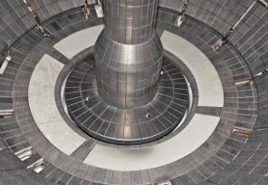
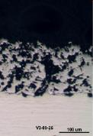
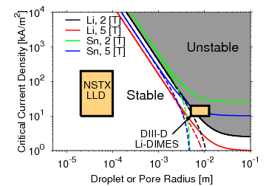
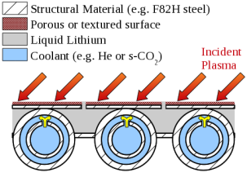
PPPL developing science and technology of liquid-metal targets for fusion devices: reactor-relevant concepts
NSTX demonstrated stable liquid lithium divertor target
  Stability predicted for structured substrates
Heat-flux and cooling results in novel configurations: continuous vapor shielding of targets
Impact: candidate reactor concept (T-(“T-tube”) shown below
NSTX Liquid Li Divertor
M. Jaworski, Nucl. Fusion 53 (2013) 083032
M.A. Jaworski, PPCF 55 (2013) 124040

Slide 29
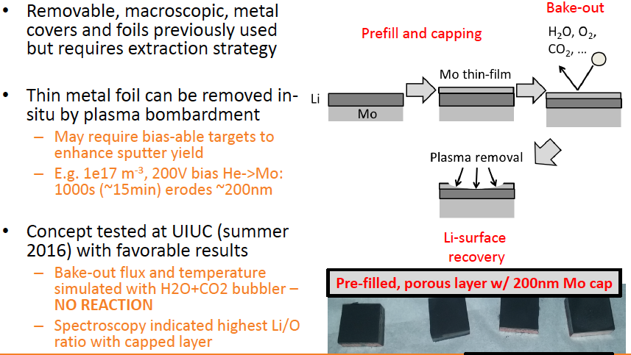
Mo caps on pre-filled Li plugs would enable survival during bakeout

Slide 30
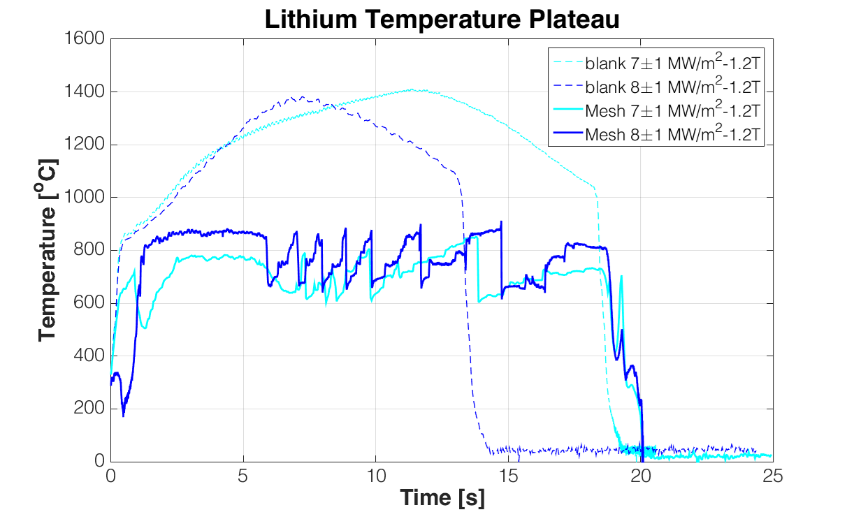
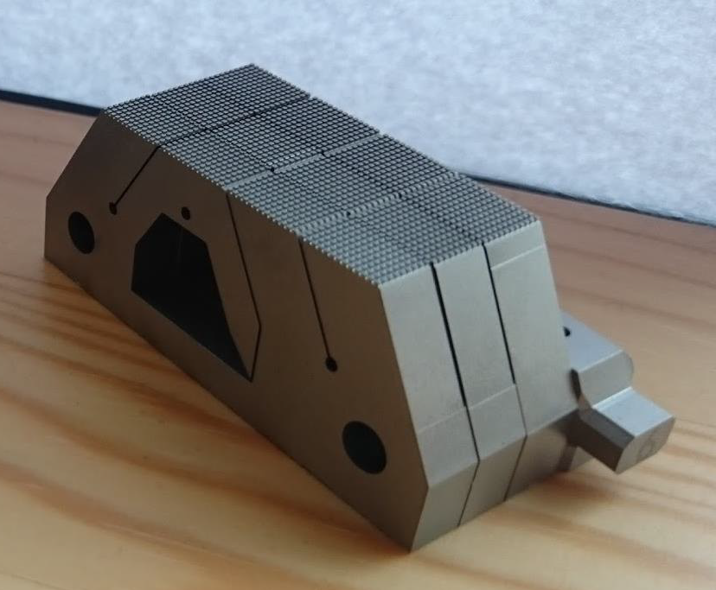
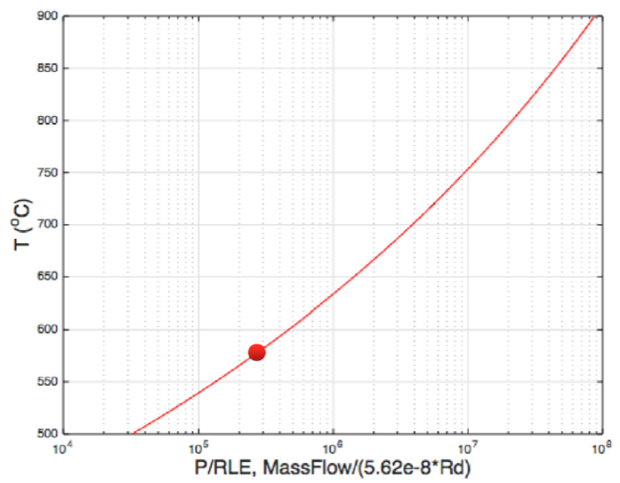
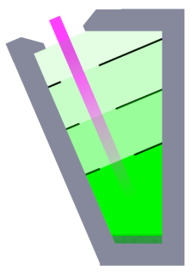
Power dissipation of Li pre-filled targets evaluated in MAGUM-PSI linear plasma device
Li-target tested based on pre-filled concept for NSTX tested in MAGNUM-PSI linear plasma device
  Temperature clamping exhibited
  Similar behavior for Liquid Sn target
  Supports idea of power exhaust via Li vapor
Lithium vapor box 0D calculation indicates high power exhaust potential for DEMO
P. Rindt et al., ISLA 2017
900
DEMO reference pt.
2.5GW fusion power
200MW to outer div.
R=6m, l_{p,box}=0.5m
ε_{cool}=250eV
800
700
600
P/R~33
R. Goldston et al., Nucl. Mater. Energy 12 (2017) 1118
500

Slide 31
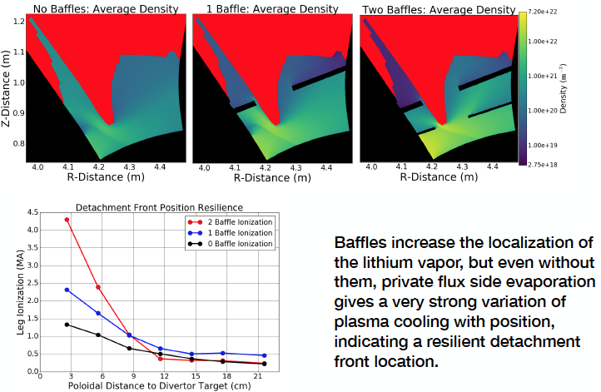
Power dissipation science via lithium vapor boxes being evaluated for FNSF

Slide 32
Flowing Liquid Metal Torus (FLIT)
Axisymmetric free surface flow
Test axisymmetric liquid metal flows in toroidal fields in realistic B to show feasibility of fast LM divertor concept for NSTX-U at high heat fluxes
  Present: LDRD for design study, construction is unfunded
Proof of principle R&D at PPPL:
  Develop the engineering for fast flow system (jxB pumps, nozzles – jets/open surface, etc)
  Use Gallinstan (Ga, In, Sn); No plasma in FLIT
J x B pumping to high-field side nozzle
E. Kolemen, Nucl. Mater. Energy 19 (2019) 524

