Slide 1
Wave Heating and Current Drive TSG
R. Perkins and J. Hosea
Limiter at end of antenna
Polar region change impact:
Research objectives will be compromised if changes are made to rows 2 – 4 of the outer divertor tiles that require removal of the divertor RF probes
These probes are necessary for quantifying heat deposition due to far field RF rectification
Plasma Parameters needed for HHFW experiments
HHFW experiments are compatible with all plasma parameters except for the outboard antenna/separatrix gap
An outboard limiter is needed to shield the antenna from energetic ions in the SOL
An outboard limiter located away from the antenna should also result in less gas entering the antenna and thus in more robust coupling into high power NB heating conditions.
Limiter tiles in NB armor

Slide 2
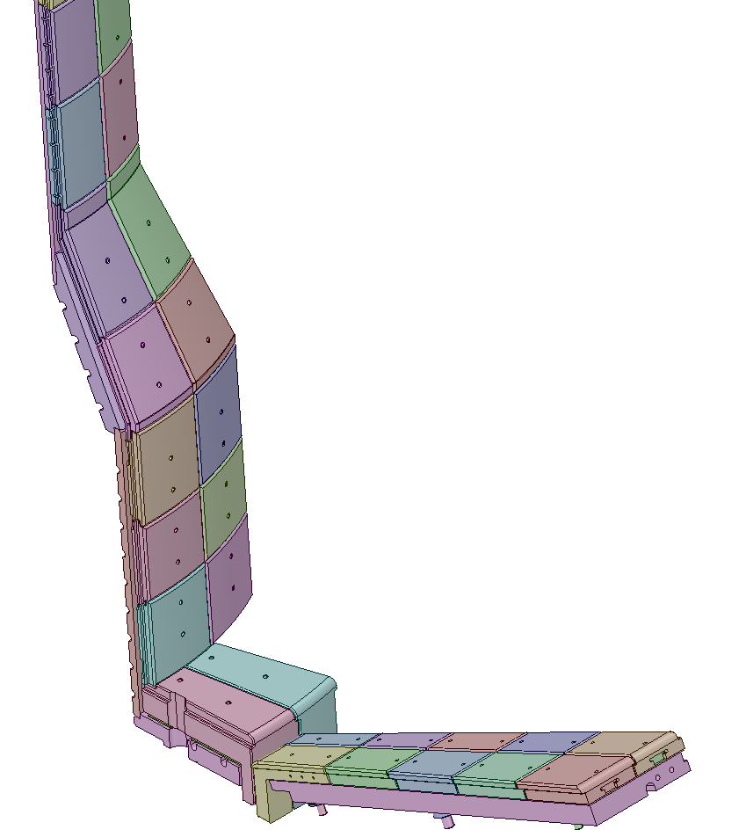
Impact of possible PFC changes for rows 2 – 4 of the outer divertor tiles
Limiter at end of antenna
RF probes in outboard divertor tiles need to be maintained to support RF deposition physics in the SOL
Limiter tiles in NB armor
Recovery project is still working to determine requirements for the tiles shown
Initial studies indicate that their may be sufficient thermal margin in an average sense.
Risk of strong leading edge heating on vertical target
Recently revised both physics and analysis assumptions regarding halo currents on the CS.
Halo current loads are large and likely problematic
Refining both the requirements and the analysis to better assess this issue.
A. Brooks
Outboard divertor tiles
Rows 2 - 4

Slide 3
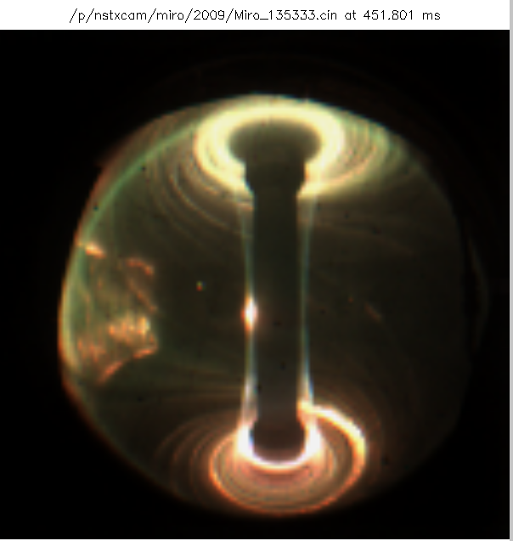
IR camera and probes are critical for documenting RF edge heating
135333
-90°
135325
Bay G
IR view
Bay I
Wide angle IR view
Antenna probes,
reflectometer
Antenna
IR view
& visible view
Bay J probes (Langmuir and RF)
6 poloidal Langmuir probe array for radial coverage top and bottom
452 ms
B_{T} = 4.5 kG, I_{P} = 0.8 MA
Probes for measuring IV characteristics and RF fields: Coaxial Langmuir at Bay J top and bottom tiles in Rows 2 - 4

Slide 4
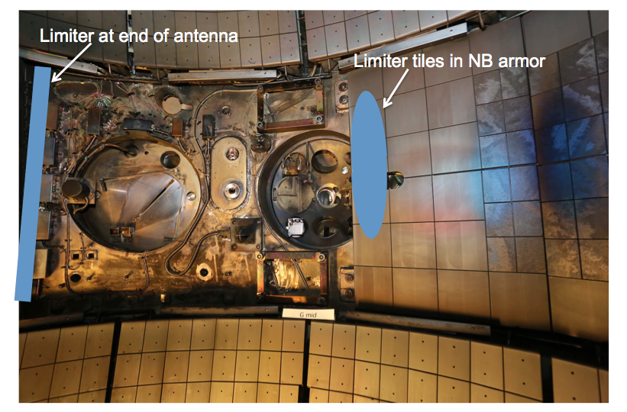
Plasma parameter needed for HHFW experiments is a controlled outer gap to the antenna
NB energetic ions bombard the HHFW antenna when the gap is too small
Limiter on NB armor should prevent this and excessive gas flow into the antenna

Slide 5
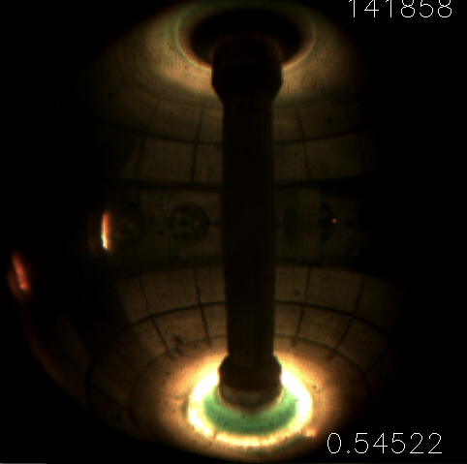
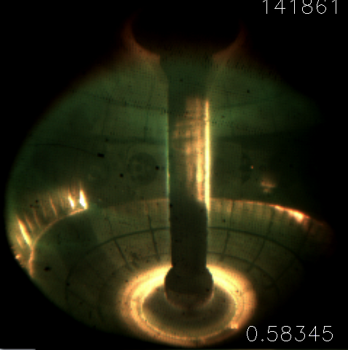
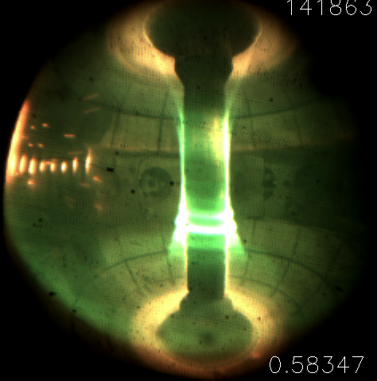
NB bombardment of antenna follows the center of the plasma (smallest gap)
Scan of Z position of plasma with P_{NB} = 2 MW, P_{RF} ~ 1 MW, I_{P} ~ 0.65 MA
141858
141861
141863
Antenna
Antenna
Antenna
0.545 s
0.583 s
0.583 s
Midplane gap ~ 6 cm ~ 6 cm ~ 5 cm
Gap at interaction zone
~ 6 cm ~ 4 cm ~ 4 cm
Z_{C} position ~ -3.5 cm ~ - 20 cm ~ + 16 cm
A central mid-plane limiter on the NB armor should be sufficient to protect the antenna

