Slide 1
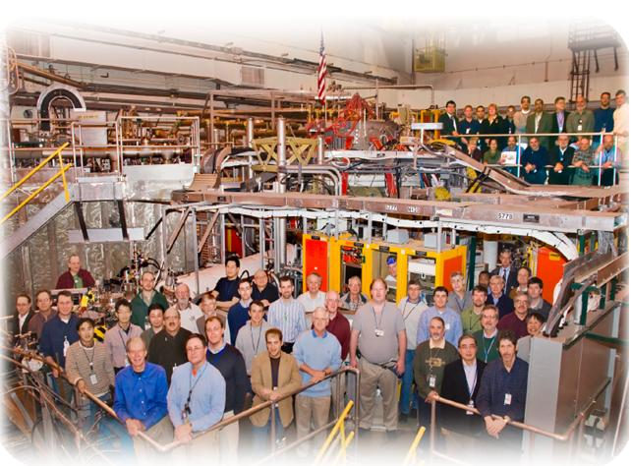

NSTX
Supported by
The Role of Kinetic Effects, Including Fast Particles, in Resistive Wall Mode Stability
College W&M
Colorado Sch Mines
Columbia U
CompX
General Atomics
INEL
Johns Hopkins U
LANL
LLNL
Lodestar
MIT
Nova Photonics
New York U
Old Dominion U
ORNL
PPPL
PSI
Princeton U
Purdue U
SNL
Think Tank, Inc.
UC Davis
UC Irvine
UCLA
UCSD
U Colorado
U Illinois
U Maryland
U Rochester
U Washington
U Wisconsin
Jack Berkery
Department of Applied Physics, Columbia University, New York, NY, USA
Culham Sci Ctr
U St. Andrews
York U
Chubu U
Fukui U
Hiroshima U
Hyogo U
Kyoto U
Kyushu U
Kyushu Tokai U
NIFS
Niigata U
U Tokyo
JAEA
Hebrew U
Ioffe Inst
RRC Kurchatov Inst
TRINITI
KBSI
KAIST
POSTECH
ASIPP
ENEA, Frascati
CEA, Cadarache
IPP, Jülich
IPP, Garching
ASCR, Czech Rep
U Quebec
51st Annual Meeting of the Division of Plasma Physics
Atlanta, Georgia
November 3, 2009

Slide 2
NSTX
Supported by
In collaboration with:
S.A. Sabbagh, H. Reimerdes
Department of Applied Physics, Columbia University, New York, NY, USA
R. Betti, B. Hu
Laboratory for Laser Energetics, University of Rochester, Rochester, NY, USA
R.E. Bell, S.P. Gerhardt, N. Gorelenkov,
J. Manickam, M. Podesta, R. White
Princeton Plasma Physics Laboratory, Princeton University, Princeton, NJ, USA
K. Tritz
Dept. of Physics and Astronomy, Johns Hopkins University, Baltimore, MD, USA
… and the NSTX team
Supported by:
U.S. Department of Energy Contracts
DE-FG02-99ER54524, DE-AC02-09CH11466, and DE-FG02-93ER54215
College W&M
Colorado Sch Mines
Columbia U
CompX
General Atomics
INEL
Johns Hopkins U
LANL
LLNL
Lodestar
MIT
Nova Photonics
New York U
Old Dominion U
ORNL
PPPL
PSI
Princeton U
Purdue U
SNL
Think Tank, Inc.
UC Davis
UC Irvine
UCLA
UCSD
U Colorado
U Illinois
U Maryland
U Rochester
U Washington
U Wisconsin
Culham Sci Ctr
U St. Andrews
York U
Chubu U
Fukui U
Hiroshima U
Hyogo U
Kyoto U
Kyushu U
Kyushu Tokai U
NIFS
Niigata U
U Tokyo
JAEA
Hebrew U
Ioffe Inst
RRC Kurchatov Inst
TRINITI
KBSI
KAIST
POSTECH
ASIPP
ENEA, Frascati
CEA, Cadarache
IPP, Jülich
IPP, Garching
ASCR, Czech Rep
U Quebec

Slide 3
Stabilization from kinetic effects has the potential to explain experimental resistive wall mode (RWM) stability
  The RWM limits plasma pressure and leads to disruptions.
  Physics of RWM stabilization is key for extrapolation to:
  sustained operation of a future NBI driven ST-CTF, and
  disruption-free operation of a low rotation burning plasma (ITER).
A kinetic theory is explored to explain experiments.
  In NSTX, the RWM can go unstable with a wide range of rotation.
  Stable discharges can have very low ω_{φ} (NSTX braking, DIII-D balanced beam).
  Simple “critical rotation” model is insufficient.
  A theoretical model broad enough in scope to explain these results is needed.
Outline
RWM experimental characteristics
Kinetic RWM stabilization theory: window of ω_{φ} with weakened stability
  Comparison of theory and NSTX experimental results
  The role of energetic particles
3

Slide 4
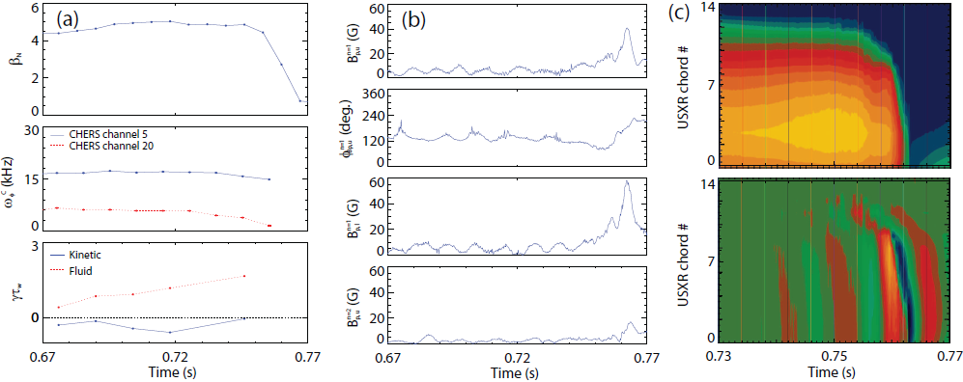
The RWM is identified in NSTX by a variety of observations
upper B_{p} n=1 sensor
NSTX 130235 @ 0.746 s
upper B_{p} n=1 phase
lower B_{p} n=1 sensor
upper B_{p} n=2 sensor
  Change in plasma rotation frequency, ω_{φ}
  Growing signal on low frequency poloidal magnetic sensors
  Global collapse in USXR signals, with no clear phase inversion
  Causes a collapse in β and disruption of the plasma
4

Slide 5
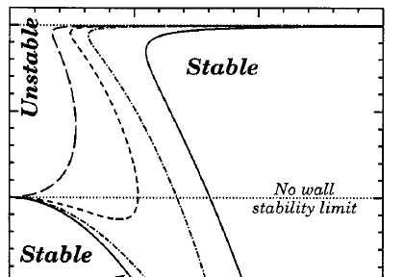
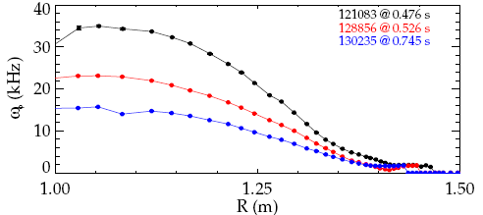
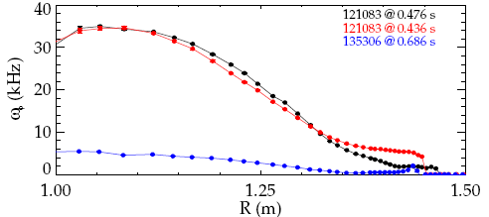
NSTX experimental results can not be explained with simple theories, but can potentially be explained by kinetic theory
1
κ
unstable
0
wide range of marginal profiles
critical ω_{φ}
ω_{φ}
Simple theories: “critical” rotation
Kinetic theory can potentially explain NSTX experimental results
stable
stable!!
unstable
5

Slide 6



Kinetic δW_{K} term in the RWM dispersion relation provides dissipation that enables stabilization
Ideal theory alone shows instability above the no-wall limit:
Perturbative calculation of δW_{K} includes:
  Trapped Ions and Electrons
  Circulating Ions
  Alfven Layers
  Trapped Energetic Particles
Dissipation enables stabilization:
  Thermal Particles:
PEST MISK
(Hu, Betti, and Manickam, PoP, 2005)
precession drift
bounce
collisionality
6

Slide 7
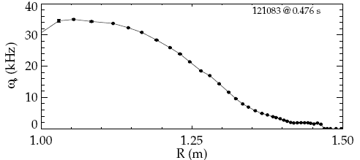
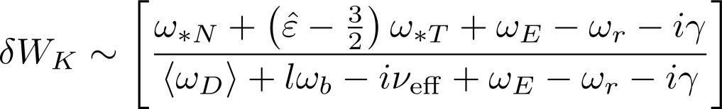

A window of weakened stability can be found between the bounce and precession drift stabilizing resonances
marginally stable profile
What causes this rotation profile to be marginally stable to the RWM?
  Examine its relation to bounce and precession drift frequencies.
7

Slide 8
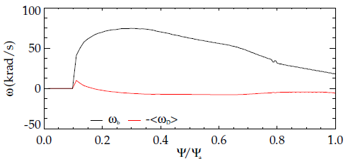


A window of weakened stability can be found between the bounce and precession drift stabilizing resonances
Resonance with bounce frequency:
  l=-1 harmonic
Resonance with precession drift frequency:
7

Slide 9
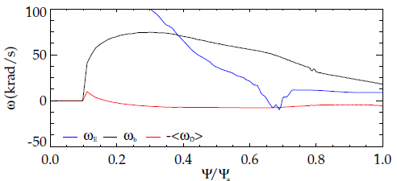
A window of weakened stability can be found between the bounce and precession drift stabilizing resonances
The experimentally marginally stable ω_{E} profile is in-between the stabilizing resonances.
7

Slide 10
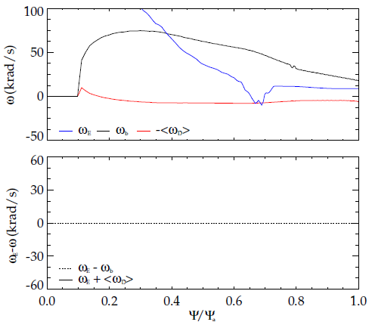
A window of weakened stability can be found between the bounce and precession drift stabilizing resonances
The experimentally marginally stable ω_{E} profile is in-between the stabilizing resonances.
7

Slide 11
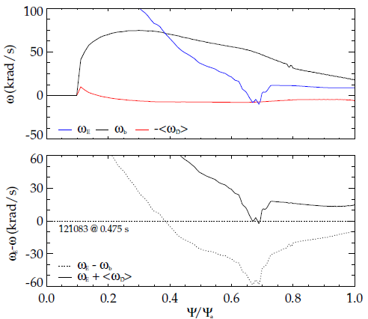
A window of weakened stability can be found between the bounce and precession drift stabilizing resonances
The experimentally marginally stable ω_{E} profile is in-between the stabilizing resonances.
7

Slide 12
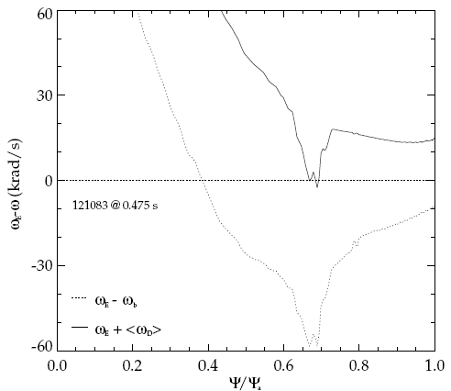
A window of weakened stability can be found between the bounce and precession drift stabilizing resonances
The experimentally marginally stable ω_{E} profile is in-between the stabilizing resonances.
  Is this true for each of the widely different unstable profiles?
7

Slide 13
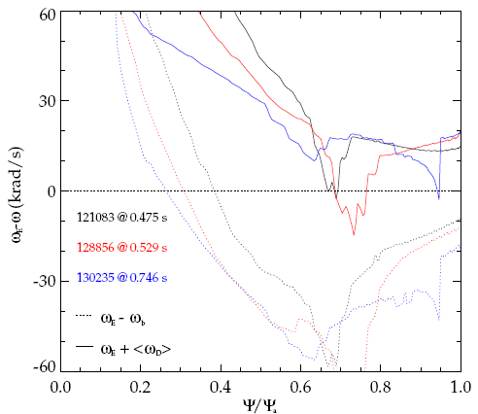
A window of weakened stability can be found between the bounce and precession drift stabilizing resonances
The experimentally marginally stable ω_{E} profile is in-between the stabilizing resonances.
  Is this true for each of the widely different unstable profiles: Yes
7

Slide 14
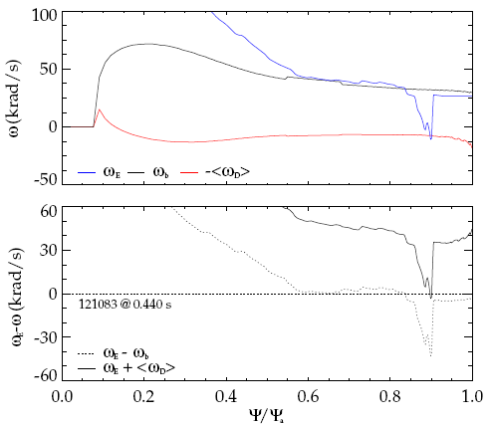
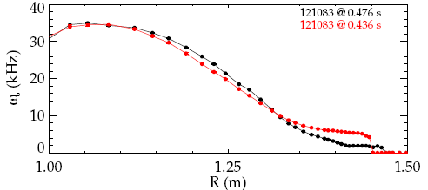
A window of weakened stability can be found between the bounce and precession drift stabilizing resonances
stable
unstable
Stable cases in bounce resonance at “high” rotation
7

Slide 15
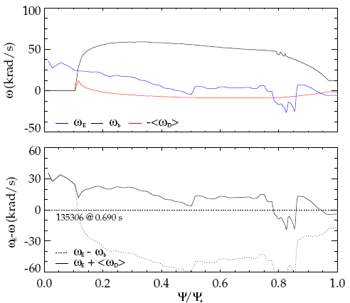
A window of weakened stability can be found between the bounce and precession drift stabilizing resonances
Stable cases in precession drift resonance at “low” rotation
7

Slide 16
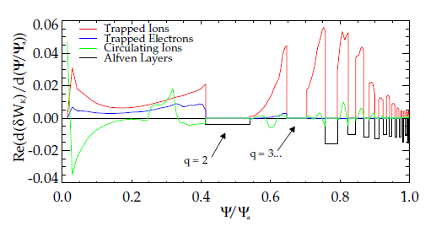
Thermal ions are most important contributors to stability
Examine δW_{K} from each particle type vs. Ψ
  Flat areas are rational surface layers (integer q ± 0.2).
  Thermal ions are the most important contributor to stability.
Entire profile is important, but q > 2 contributes ~60%
  RWM eigenfunction is large in this region.
  Temperature and density gradients are large (ω_{*N}, ω_{*T} large).
8

Slide 17
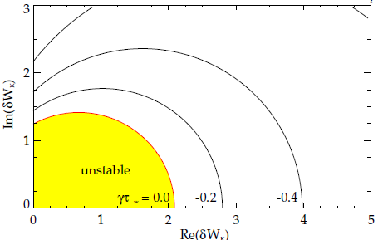

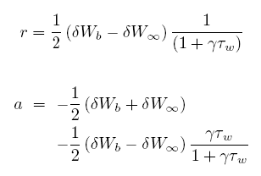
The dispersion relation can be rewritten in a form convenient for making stability diagrams
Solve for γ in terms of Re(δW_{K}) and Im(δW_{K}).
  Contours of constant γ form circles on a stability diagram of Im(δW_{K}) vs. Re(δW_{K}).
9

Slide 18
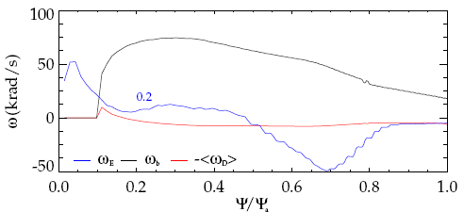
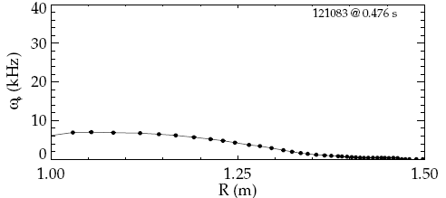
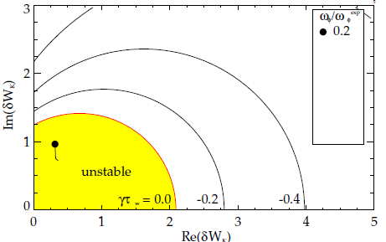
Scaling the experimental rotation profile illuminates the complex relationship between rotation and stability
0.2
Rotation profile scan:
  0.2: Instability at low rotation.
10

Slide 19
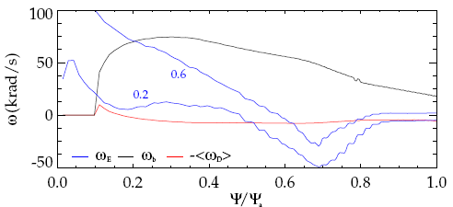
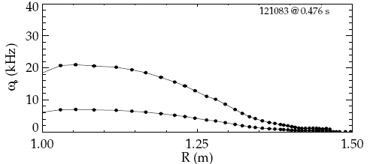
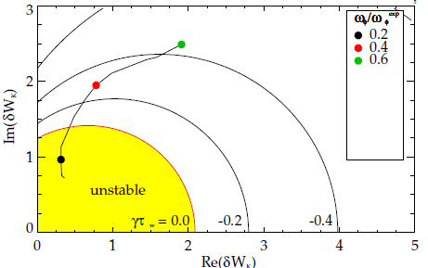
Scaling the experimental rotation profile illuminates the complex relationship between rotation and stability
0.6
0.2
Rotation profile scan:
  0.2: Instability at low rotation.
  0.6: Stable: ω_{D} resonance.
10

Slide 20
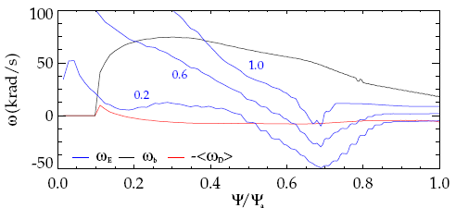
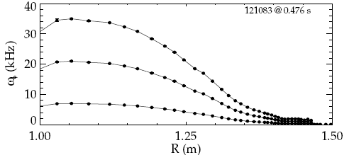
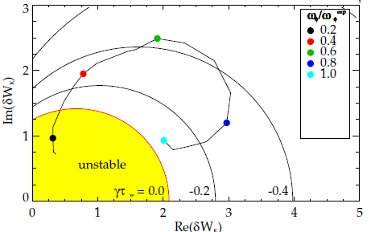
Scaling the experimental rotation profile illuminates the complex relationship between rotation and stability
1.0
0.6
0.2
Rotation profile scan:
  0.2: Instability at low rotation.
  0.6: Stable: ω_{D} resonance.
  1.0: Marginal: in-between resonances (actual experimental instability).
10

Slide 21
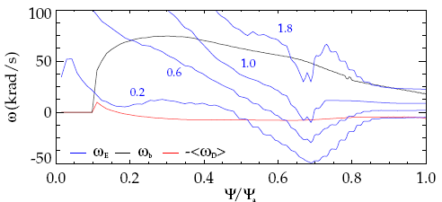
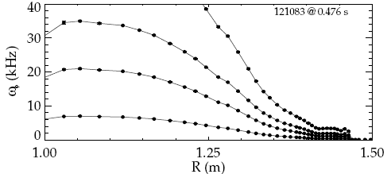
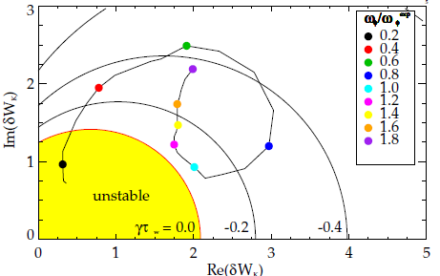
Scaling the experimental rotation profile illuminates the complex relationship between rotation and stability
1.0
1.8
0.6
0.2
Rotation profile scan:
  0.2: Instability at low rotation.
  0.6: Stable: ω_{D} resonance.
  1.0: Marginal: in-between resonances (actual experimental instability).
  1.8: Stable: ω_{b} resonance.
10

Slide 22
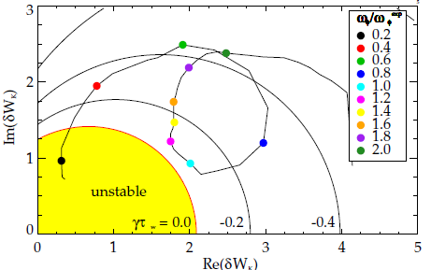
Scaling the experimental rotation profile illuminates the complex relationship between rotation and stability
1.0
1.8
0.6
0.2
Rotation profile scan:
  0.2: Instability at low rotation.
  0.6: Stable: ω_{D} resonance.
  1.0: Marginal: in-between resonances (actual experimental instability).
  1.8: Stable: ω_{b} resonance.
10

Slide 23
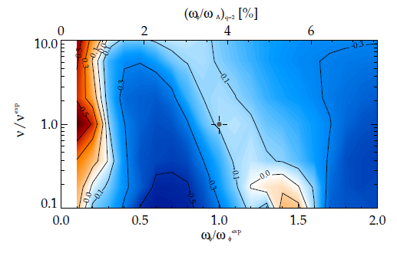
The weakened stability rotation gap is altered by changing collisionality
Scan of ω_{φ} and collisionality
  scale n & T at constant β
  Changing ν shifts the rotation of weakened stability.
11

Slide 24
The weakened stability rotation gap is altered by changing collisionality
Scan of ω_{φ} and collisionality
  scale n & T at constant β
  Changing ν shifts the rotation of weakened stability.
ω_{D}
ω_{b}
weakened stability
11

Slide 25
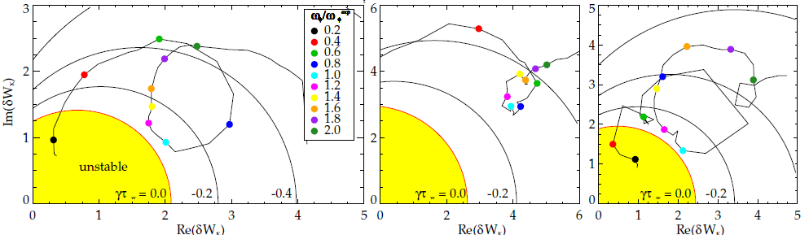
Widely different experimentally marginally stable rotation profiles each are in the gap between stabilizing resonances
Each shot has a ω_{φ} with weakened stability.
  Sometimes that stability reduction is not enough to quantitatively reach marginal.
xxx
  xxx
121083 @ 0.475 s
128856 @ 0.526 s
130235 @ 0.745 s
12

Slide 26

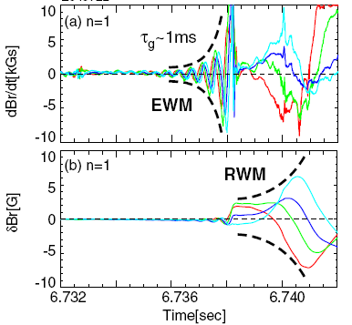
Improvements to the theory and calculation, to use as a quantitative predictor of instability
1. Examine sensitivity of calc.
  Non-linear inclusion of ω_{r} and γ: Iteration (τ_{w} = 1ms)
  Sensitivities to inputs: ex: Δq = 0.15 – 0.25
2. Include energetic particles
  Important stabilizing kinetic effects in theory
  E.P. modes known to “trigger” RWM in experiment
(Matsunaga et al., PRL, 2009)
121083 @ 0.475 s
13

Slide 27

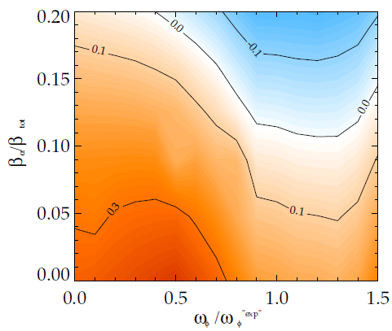
Present inclusion of energetic particles in MISK: isotropic slowing down distribution (ex. alphas in ITER)
Thermal Particles: Maxwellian
E.P.s: Slowing-down
  E.P. resonances add to δW_{K}, lead to greater stability
  May be overestimating thermal part, E.P. part may lead to marginal
  Example: α particles in ITER
  Higher β_{α} leads to greater stability
  Isotropic f is a good approx.
14

Slide 28
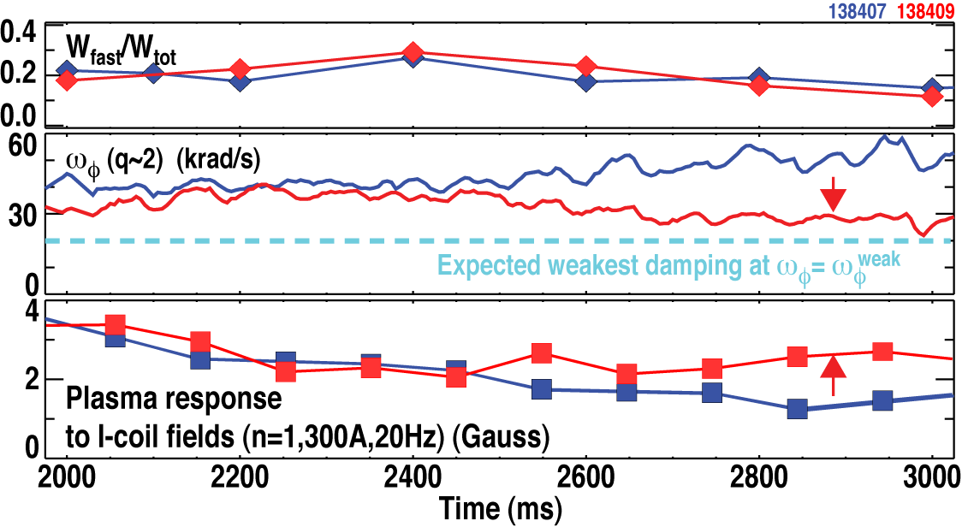
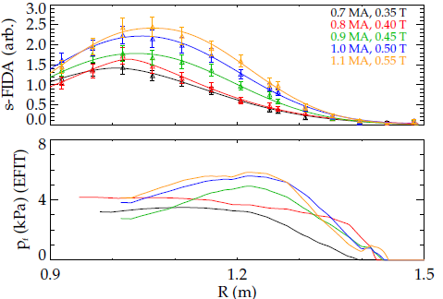
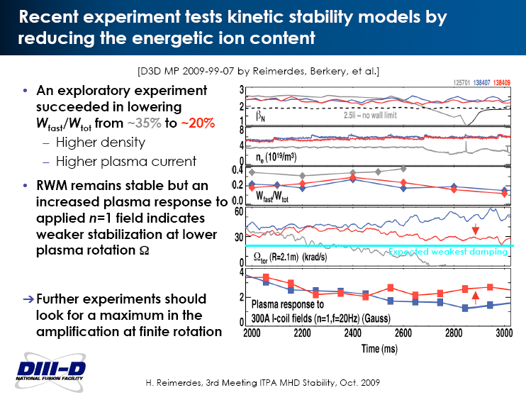

NSTX and DIII-D experiments in 2009 explored the effect of energetic particles on RWM stability
DIII-D Experiment (with Reimerdes)
NSTX Experiment
@ ~0.23 s
Higher n_{e} and I_{p} reduced W_{f}/W_{t} by 40% over previous exp.
FIDA, EFIT, and TRANSP confirm p_{f} scan with B_{t}, I_{p}
RWM unstable cases found for each p_{f}.
RWM remains stable, but response higher as ω_{φ}→ω_{φ}^{weak}
15

Slide 29
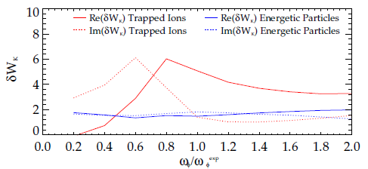
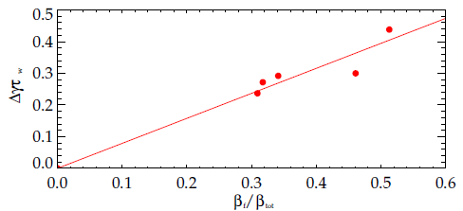
Energetic particles contribute linearly to RWM stability in NSTX
  Adding energetic particles adds a significant Δγ
  independent of ω_{φ}, since ω_{D}(ε) and ω_{b}(ε^{½}) >> ω_{E}, meaning energetic particles are not in mode resonance
  Despite this, these shots experimentally went unstable
  Weakened thermal particle stabilization at marginal ω_{φ} is enough to destabilize the mode
NSTX 121090 @ 0.6 s
Various NSTX discharges at marginal stability (Note: ignores profile effects)
16

Slide 30
In NSTX…
  xxx
  xxx
  xxx
  xxx
17

Slide 31
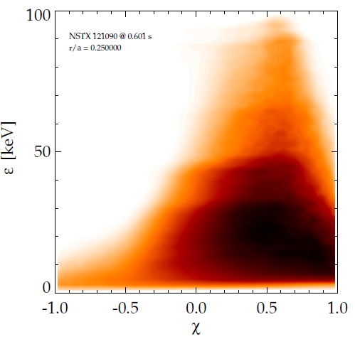
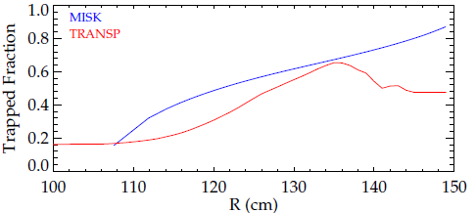
A new, more accurate energetic particle distribution function is being implemented
  Presently f is considered independent of χ.
  Not a good approximation for beam ions
  Overpredicts trapped frac.:
injection
f from TRANSP
NSTX 121090
@ 0.6s
r/a = 0.25
slowing down
NSTX 121090 @ 0.59-0.60 s
  Future:
  Use f from TRANSP directly
  Consider circulating E.P.s as well
pitch angle (χ=v‖/v)
18

Slide 32
Kinetic RWM stability theory has a more complex relationship with ω_{φ} than simple theories.
High plasma rotation alone is inadequate to ensure RWM stability in future devices
  A weakened stability gap exists between ω_{b} and ω_{D} resonances.
  Can use ω_{φ} control to stay away from gap and/or RWM active control to navigate through gap.
Favorable comparison between NSTX exp. results and theory
  Multiple NSTX discharges with widely different marginally stable ω_{φ} profiles fall in this gap.
  Energetic particles provide an important stabilizing effect
ω_{D}
ω_{b}
weakened stability
NSTX exp. instability
  Visit the poster this afternoon for more detail
19

Slide 34
NSTX and DIII-D joint experiment in 2009 explored the effect of energetic particles on RWM stability
DIII-D Experiment (with Reimerdes)
Higher n_{e} and I_{p} reduced W_{f}/W_{t} by 40% over previous exp.
RWM remains stable, but response higher as ω_{φ}→ω_{φ}^{weak}
15

Slide 35
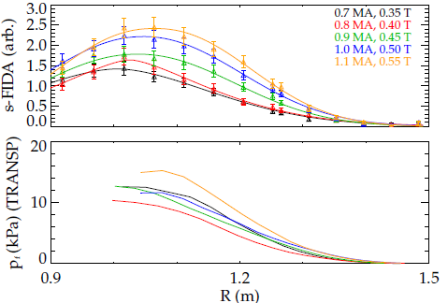
NSTX and DIII-D experiments in 2009 explored the effect of energetic particles on RWM stability
DIII-D Experiment (with Reimerdes)
NSTX Experiment
@ ~0.23 s
Higher n_{e} and I_{p} reduced W_{f}/W_{t} by 40% over previous exp.
FIDA, EFIT, and TRANSP confirm p_{f} scan with B_{t}, I_{p}
RWM unstable cases found for each p_{f}.
RWM remains stable, but response higher as ω_{φ}→ω_{φ}^{weak}
15

Slide 36
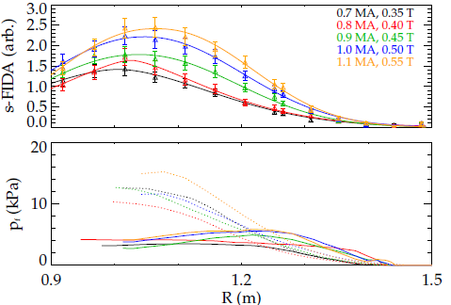
NSTX and DIII-D experiments in 2009 explored the effect of energetic particles on RWM stability
DIII-D Experiment (with Reimerdes)
NSTX Experiment
@ ~0.23 s
Higher n_{e} and I_{p} reduced W_{f}/W_{t} by 40% over previous exp.
FIDA, EFIT, and TRANSP confirm p_{f} scan with B_{t}, I_{p}
RWM unstable cases found for each p_{f}.
RWM remains stable, but response higher as ω_{φ}→ω_{φ}^{weak}
15

Slide 37
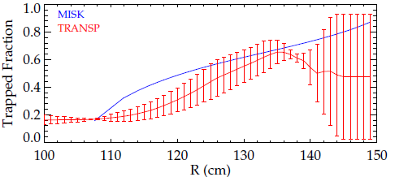
A new, more accurate energetic particle distribution function is being implemented
  Presently f is considered independent of χ.
  Not a good approximation for beam ions
  Overpredicts trapped frac.:
injection
f from TRANSP
NSTX 121090
@ 0.6s
r/a = 0.25
slowing down
NSTX 121090 @ 0.59-0.60 s
  Future:
  Use f from TRANSP directly
  Consider circulating E.P.s as well
pitch angle (χ=v‖/v)
18

Slide 39
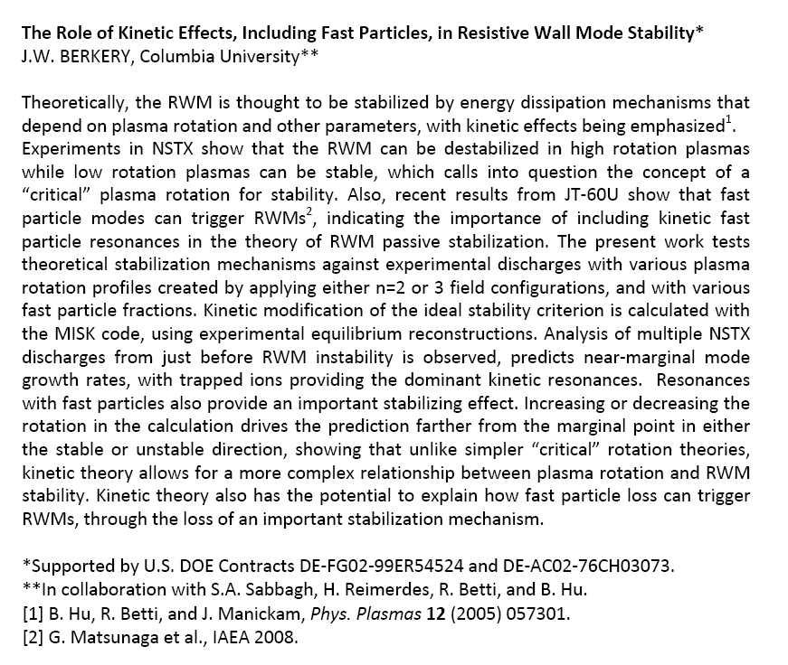
Abstract

Slide 40
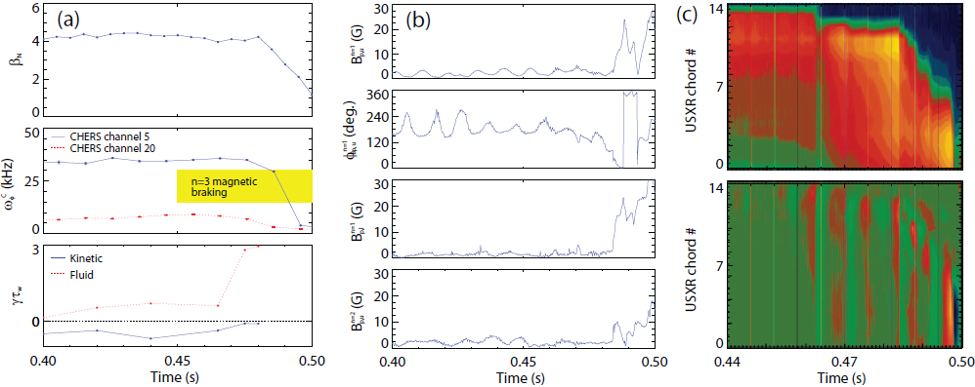
NSTX 121083 @ 0.475 RWM characteristics

Slide 41
Present isotropic distribution function for energetic particles overestimates the trapped ion fraction
  First-order check:
  MISK isotropic f overestimates the trapped ion fraction (compared to TRANSP).
NSTX 121090 @ 0.59-0.60 s

Slide 42
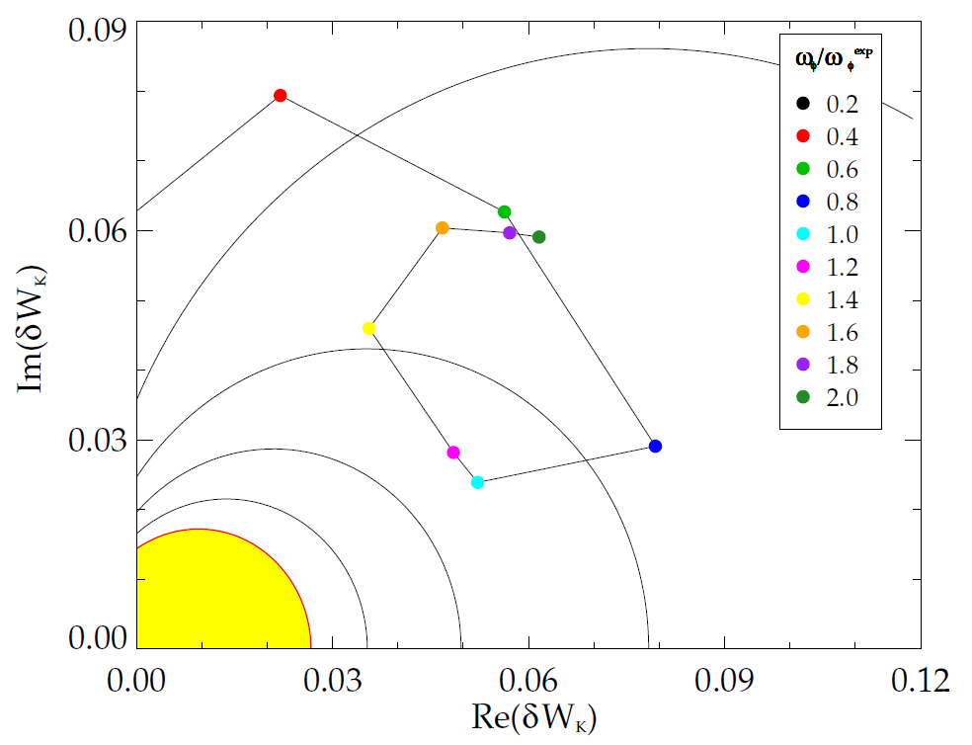
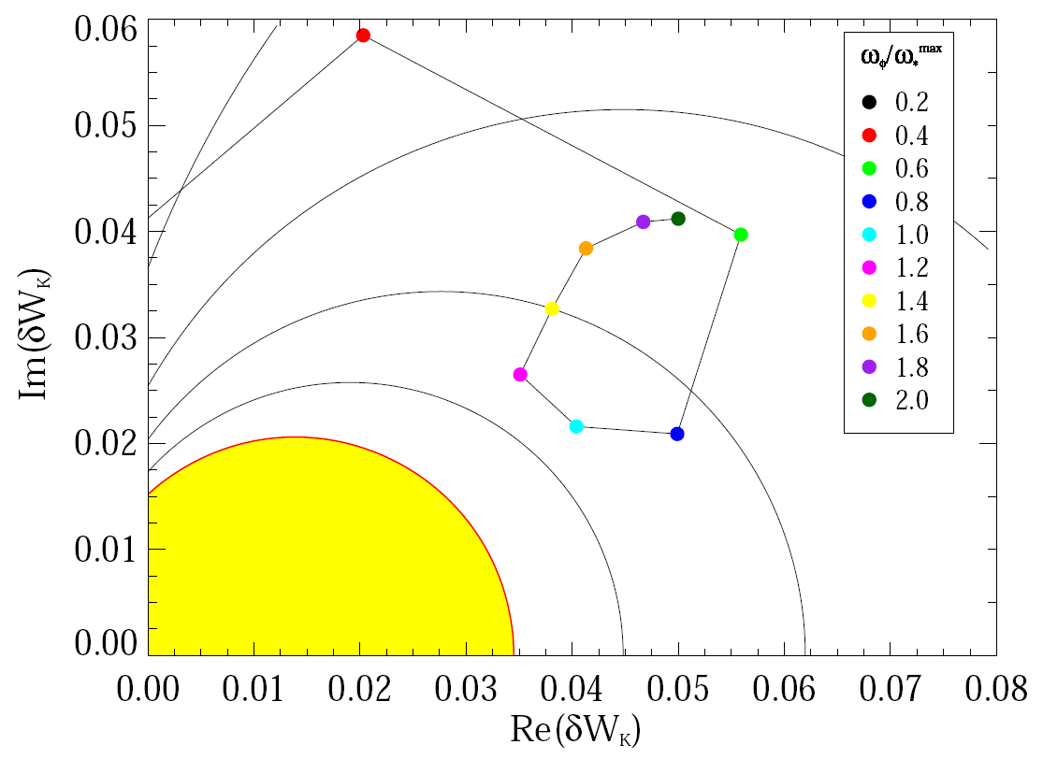
MISK sometimes overpredicts stability
unstable
stable
128856 @ 0.529
133367 @ 0.635

Slide 43
Perturbative vs. Self-consistent Approaches
and
Three Roots of the RWM Dispersion Relation

Slide 44


γ is found with a self-consistent or perturbative approach
The self-consistent (MARS) approach: solve for γ and ω from:
The perturbative (MISK) approach: solve for γ and ω from:
with δW∞ and δW_{b} from PEST. There are three main differences between the approaches:
The way that rational surfaces are treated.
Whether ξ is changed or unchanged by kinetic effects.
Whether γ and ω are non-linearly included in the calculation.

Slide 45
Rational surfaces are treated differently
The self-consistent (MARS) approach: solve for γ and ω from:
MARS-K: “continuum damping included through MHD terms”. This term includes parallel sound wave damping.
In MISK a layer of surfaces at a rational ±Δq is removed from the calculation and treated separately through shear Alfvén damping.

Slide 46

Unchanging ξ may be a good assumption
For DIII-D shot 125701, the eignfunction doesn’t change due to kinetic effects.
(Y. Liu, APS DPP 2008)

Slide 47
Non-linear inclusion of γ and ω can be achieved in the perturbative approach through iteration
Example: NSTX 121083 @ 0.475
 | τ_{w} = 0.1ms |  | τ_{w} = 0.5ms |  | τ_{w} = 1.0ms
Iteration | γ | ω | γ | ω | γ | ω
0 | -2577 | -1576 | -515 | -315 | -258 | -158
1 | -4906 | 431 | -508 | -172 | -256 | -139
2 | -5619 | 800 | -505 | -177 | -257 | -140
3 | -5745 | 828 | -504 | -179
4 | -5834 | 835
5 | -5855 | 838
6 | -5835 | 819

Slide 48
The effect of iteration depends on the magnitudes of γ, ω

Slide 49

The dispersion relation has three roots
Liu’s simple example: a=0, c₂ = 0.18, ω_{*T} = 0
Plot contours of 1/|D|
γ
(Y. Liu, APS DPP 2008)
ω

Slide 50
MISK and MARS-K Benchmarking

Slide 51



MISK and MARS-K were benchmarked using a Solov’ev equilibrium
  Simple, analytical solution to the Grad-Shafranov equation.
  Flat density profile means ω_{*N} = 0.
  Also, ω, γ, and ν_{eff} are taken to be zero for this comparison, so the frequency resonance term is simply:
  MARS-K: (Liu, Phys. Plasmas, 2008)
(Liu, ITPA MHD TG Meeting, Feb. 25-29, 2008)

Slide 52


Drift frequency calculations match for MISK and MARS-K
MARS
MISK
(Liu, ITPA MHD TG Meeting, Feb. 25-29, 2008)
large aspect ratio approximation (Jucker et al., PPCF, 2008)
here, є_{r} is the inverse aspect ratio, s is the magnetic shear, K and E are the complete elliptic integrals of the first and second kind, and Λ = μB₀/ε, where μ is the magnetic moment and ε is the kinetic energy.

Slide 53


Bounce frequency calculations match for MISK and MARS-K
MARS
MISK
(Liu, ITPA MHD TG Meeting, Feb. 25-29, 2008)
large aspect ratio approximation (Bondeson and Chu, PoP, 1996)

Slide 54
MISK and MARS-K match well at reasonable rotation
Good match for trapped ions and electrons at high rotation, but poor at low rotation.
The simple frequency resonance term denominator causes numerical integration problems with MISK that don’t happen with realistic equilibria.

Slide 55
DIII-D Energetic Particle Experiment

Slide 56

xxx

Slide 57
xxx

Slide 58
δW_{K} in the limit of high particle energy
Writing δW_{K} without specifying f:
Rewriting with explicit energy dependence:
So that, for energetic particles, where ε is very large:
large
large
large
Note: this term is independent of ε.

Slide 59
xxx

