Slide 1

Progress and plans for NSTX Upgrade and prospects for next-step spherical tori
Jonathan Menard, PPPL
Plasma Physics Seminar (Physics/ECE/NE 922)
Physics Building, Room 2241
September 14, 2015

Slide 2
Outline
ST Overview and Motivation
NSTX-U Mission and Status
NSTX/NSTX-U Research Highlights
  Global MHD Stability
  Transport and Turbulence
  Energetic Particles
  Power Exhaust
  Plasma Start-up
Brief Overview of NSTX-U Research Plans
Summary

Slide 3
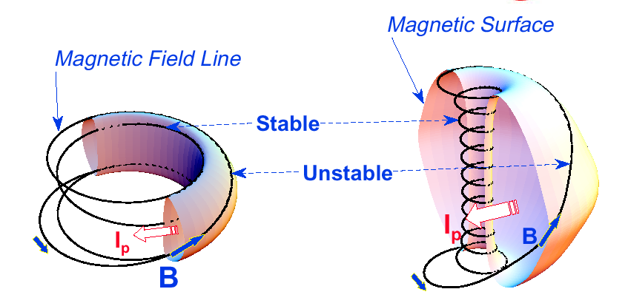
“Spherical” tokamak (ST) has aspect ratio A < 2
Aspect Ratio A = R /a
Elongation κ = b/a
Toroidal Beta β_{T} = ⟨p⟩ / (B_{T0}²/ 2μ₀)
Natural elongation makes its spherical appearance
Favorable average curvature improves stability at high beta → access high normalized pressure, rapid rotation, low collisionality
Tokamak
ST
A ~ 3-4,
κ = 1.5-2,
q₉₅ = 3-4,
β_{T} = 3-10%
A ~ 1.2-2,
κ = 2-3,
q₉₅ = 6-20,
β_{T} = 10-40%
Notes:
A spherical tokamak is a low aspect ratio tokamak. Tokamak is a donut like aspect ratio of about 3 where as ST is aspect ratio of about 1.5. As the aspect ratio is reduced, the hole of the donut is reduced and it disappears entirely at A = 1. As the aspect ratio is reduced, the plasma elongate naturally takes on the spherical shape due to self fields. Another important property is the magnetic field line. The tokamak magnetic field line goes around torus at relatively constant pitch where as the ST geometry, the field line transit the outboard unstable region quickly but spend many toroidal transits in the inboard stable region. This makes ST plasma stable for high beta and also makes the edge safety factor high ~ 10 compared to ~ 3 for tokamak.
As a result, there are a number of new unique physics regimes which can be accessed at low aspect ratio, which can be utilized to enhance the understanding of toroidal confinement physics and improve predictive capabilities for ITER and future fusion facilities.

Slide 4
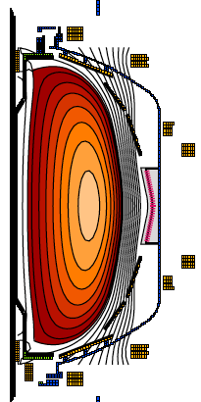
ST can be compact, high β, and high confinement
Higher elongation κ and low A lead to higher I_{P} , β_{T} and τ_{E}
Aspect Ratio A = R /a
Elongation κ = b/a
Toroidal beta β_{T} = ⟨p⟩ / (B_{T0}²/2μ₀)
• ST has high I_{P} due to high κ and low A
High κ ∼ 3.0 equilibrium in NSTX
I_{P} ~ I_{TF} (1 + κ²) / (2 A² q*)
• I_{P} increases tokamak performance
Energy confinement time τ_{E} ∝ I_{P}
Normalized pressure β_{T} [%] ≡ β_{N} I_{P} / (aB_{T0})
• ST achieves high performance cost effectively
I_{P} ~ I_{TF} for ST due to low A and high κ
$
Notes:
A spherical tokamak is a low aspect ratio tokamak. Tokamak is a donut like aspect ratio of about 3 where as ST is aspect ratio of about 1.5. As the aspect ratio is reduced, the hole of the donut is reduced and it disappears entirely at A = 1. As the aspect ratio is reduced, the plasma elongate naturally takes on the spherical shape due to self fields. Another important property is the magnetic field line. The tokamak magnetic field line goes around torus at relatively constant pitch where as the ST geometry, the field line transit the outboard unstable region quickly but spend many toroidal transits in the inboard stable region. This makes ST plasma stable for high beta and also makes the edge safety factor high ~ 10 compared to ~ 3 for tokamak.
As a result, there are a number of new unique physics regimes which can be accessed at low aspect ratio, which can be utilized to enhance the understanding of toroidal confinement physics and improve predictive capabilities for ITER and future fusion facilities.

Slide 5
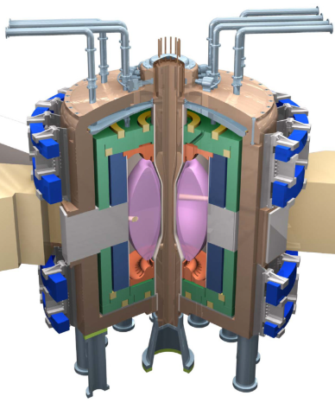
Fusion technology development is major challenge
Fusion Nuclear Science Facility (FNSF) could aid development
Need to develop reliable, qualified nuclear and other components unique to fusion:
Divertor, plasma facing components
Blanket and Integral First Wall
Vacuum Vessel and Shield
Tritium Fuel Cycle
Remote Maintenance Components
ST-FNSF
Without R&D, fusion components could fail prematurely
FNSF can help develop reliable fusion components
FNSF facilities must be: modest cost, low T, and reliable

Slide 6
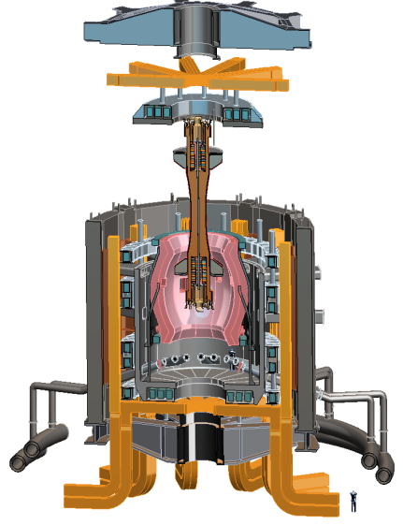
Design studies show ST potentially attractive as FNSF
PPPL ST-FNSF concept
Projected to access high neutron wall loading at moderate R, P_{fusion}
  W_{n} ~ 1-2 MW/m² , P_{fus} ~ 50-200MW, R ~ 0.8-1.8m
Modular, simplified maintenance
Tritium breeding ratio (TBR) near 1
  Requires sufficiently large R, careful design

Slide 7
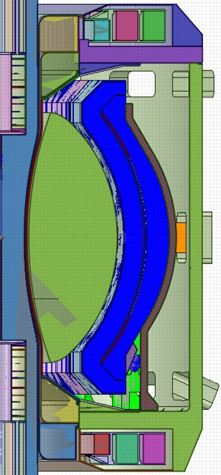

Tritium breeding at top/bottom of ST device important for achieving high Tritium Breeding Ratio (TBR) > 1
0.0004
Breeding at CS ends important:
ΔTBR = +0.07
0.034
R=1.7m configuration
Inner Blanket Segment = 0.81
Outer Blanket Segment = 0.15
Total TBR ~ 1.03 with no penetrations or ports
(heterogenous outboard blanket)
0.034
0.0004
Compatible with long-leg / Super-X divertor

Slide 8
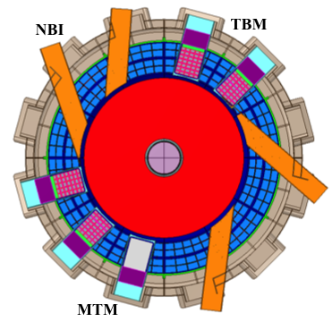
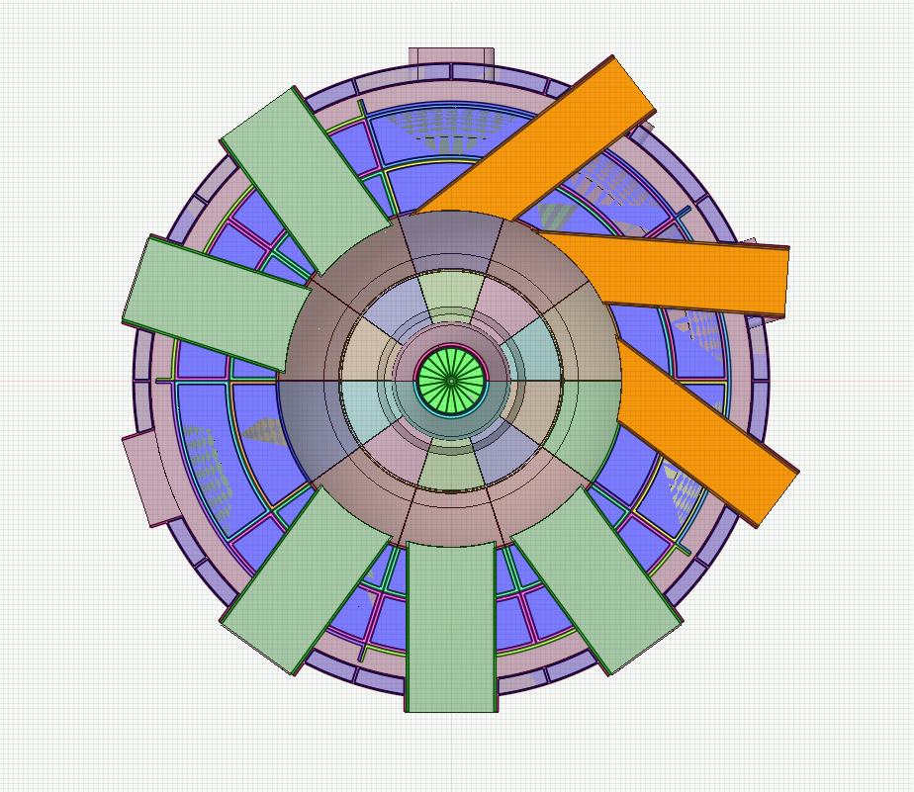



Recent studies show sufficiently large major radius ST-FNSF can be tritium self-sufficient
R=1.7m: TBR ≥ 1
R=1.0m: TBR < 1 (≈ 0.9)
NBI
TBM
NBI
TBM
MTM
1m device cannot achieve TBR > 1 even with design changes
Requirement: purchase ~0.4-0.55kg of T/FPY from outside sources
MTM
NBI = Neutral Beam Injector,
TBM = Test Blanket Module, MTM = Materials Test Module

Slide 9
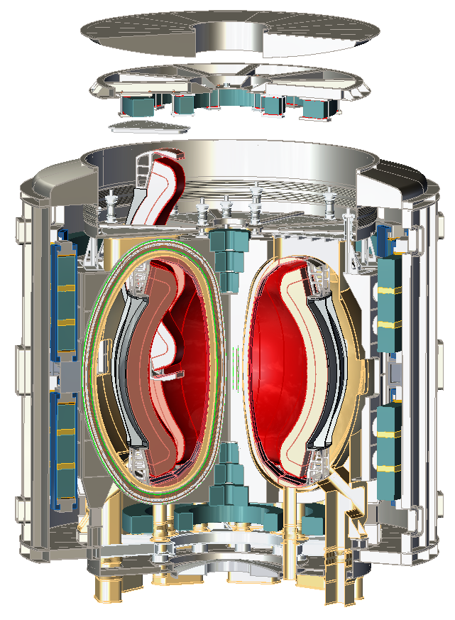

HTS potentially attractive for making electrically efficient ST* (~10× lower magnet cooling power vs. copper)
Possible missions:
  Steady-state toroidal PMI facility, FNSF
  ST Pilot Plant (Q_{eng}~1 for weeks/months)
    Requires high H_{98y2} = 1.7-2
Initial configurations favorable:
  A=1.8-2, strong shaping: κ~2.5-2.7, δ~0.5
  All equilibrium PF coils outside TF
    No joints needed for HTS TF coils
  Long-legged divertor for q_{div-pk} < 5MW/m²
  Vertical port-based maintenance
  WC inboard thermal shield for TF
Now actively investigating:
  HTS lifetime in radiation environment
  Blanket/shield thickness, location, TBR
R₀ = 1.4m, B_{T} = 3.2T, I_{P} = 7-8MA, P_{fusion-DT} = 100MW
*Work supported by Tokamak Energy (UK) - 2014

Slide 10
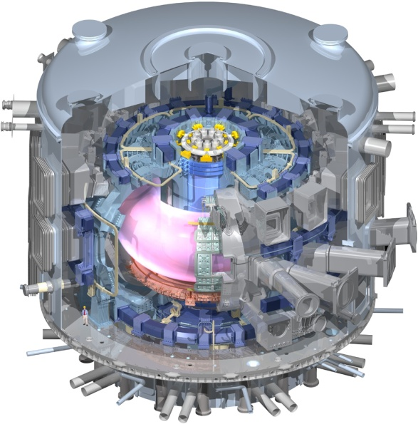
Unique ST properties also support ITER
ST Extends Predictive Capability for ITER and Toroidal Science
  High β physics, rotation, shaping extend stability, transport knowledge
  NBI fast-ions in present STs mimic DT fusion product parameters in ITER → study burning plasma science
  STs can more easily study electron scale turbulence at low collisionality → important for all magnetic fusion
Burning Plasma Physics - ITER

Slide 11
Outline
ST Overview and Motivation
NSTX-U Mission and Status
NSTX/NSTX-U Research Highlights
  Global MHD Stability
  Transport and Turbulence
  Energetic Particles
  Power Exhaust
  Plasma Start-up
Brief Overview of NSTX-U Research Plans
Summary

Slide 12

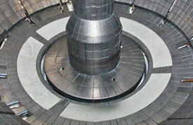
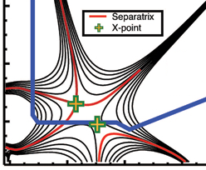
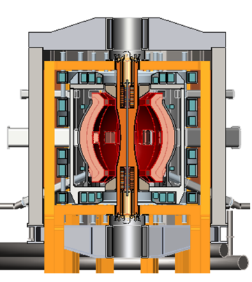
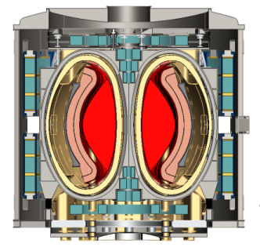
NSTX Upgrade mission elements
Explore unique ST parameter regimes to advance predictive capability - for ITER and beyond
Develop solutions for the plasma-material interface (PMI) challenge
Advance ST as candidate for Fusion Nuclear Science Facility (FNSF)
Develop ST as fusion energy system
ITER
Lithium
“Snowflake”
ST-FNSF / Pilot-Plant

Slide 13
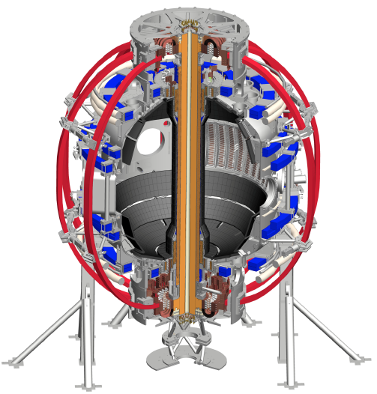
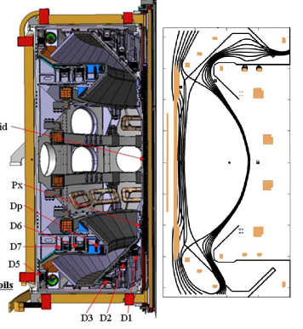
NSTX and MAST are undergoing major upgrades
~2x higher B_{T}, I_{p}, P_{NBI} and ~5x pulse length vs. NSTX / MAST
NSTX-U
MAST-U
Super-X
Conventional
Tangential 2nd NBI + high β_{N} and f_{BS}
for full non-inductive sustainment, ramp-up
Super-X divertor configuration for FNSF/DEMO divertor solution
First test plasma ~1 month ago
First test plasma 2017

Slide 14
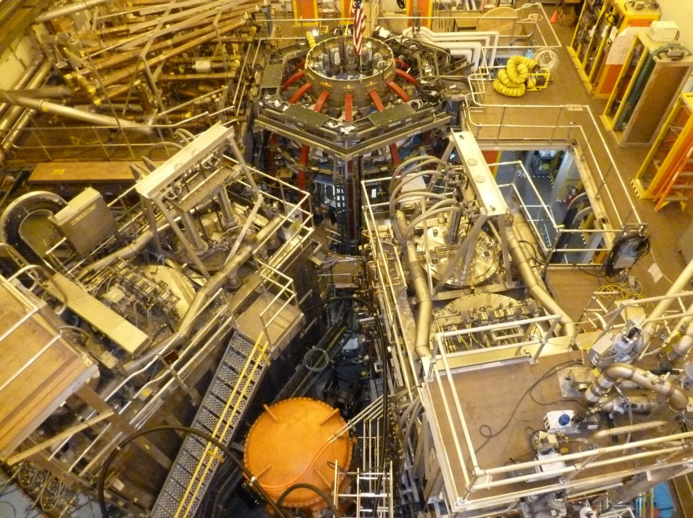
NSTX Upgrade project recently completed
On cost and schedule, first test plasma ~100kA (Aug. 10, 2015)
1st NBI
New 2nd NBI

Slide 15
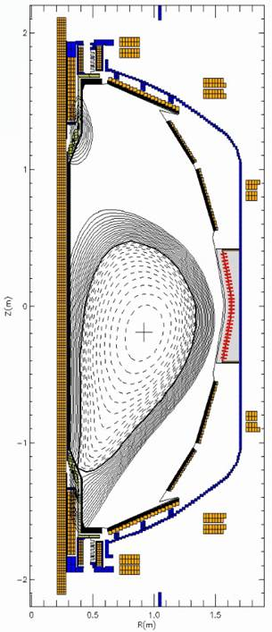
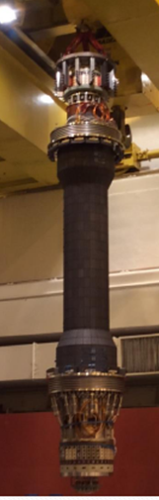
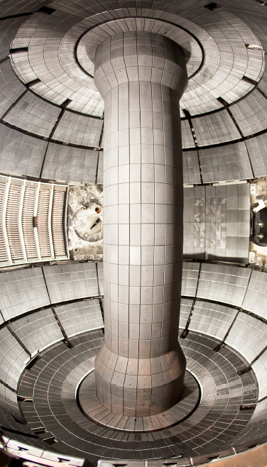
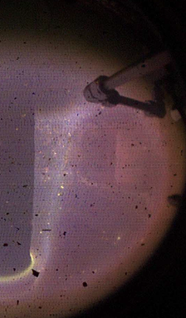
New centerstack (CS) highlights: Jan – Aug 2015
CS crane lift
Magnetics functional → EFIT reconstructions
CS installed
First test plasma
(Ohmic heating only)

Slide 16
Outline
ST Overview and Motivation
NSTX-U Mission and Status
NSTX/NSTX-U Research Highlights
  Global MHD Stability
  Transport and Turbulence
  Energetic Particles
  Power Exhaust
  Plasma Start-up
Brief Overview of NSTX-U Research Plans
Summary

Slide 17
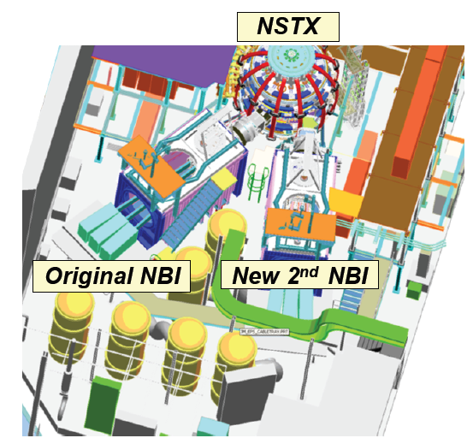
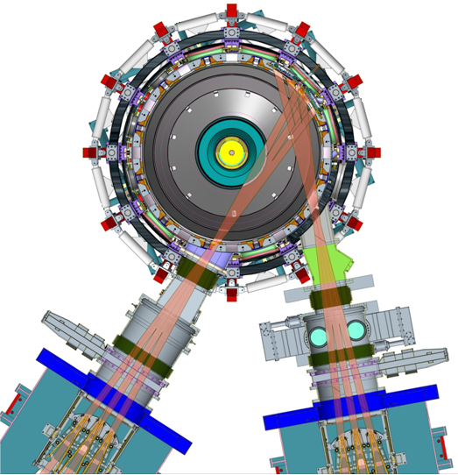
Mega-ampere-class STs rely heavily on co-injected neutral beams for heating, current drive
NSTX-U
Original NBI
(R_{TAN} = 50, 60, 70cm)
5MW, 5s, 80keV
New 2nd NBI
(R_{TAN}=110, 120, 130cm)
5MW, 5s, 80keV

Slide 18
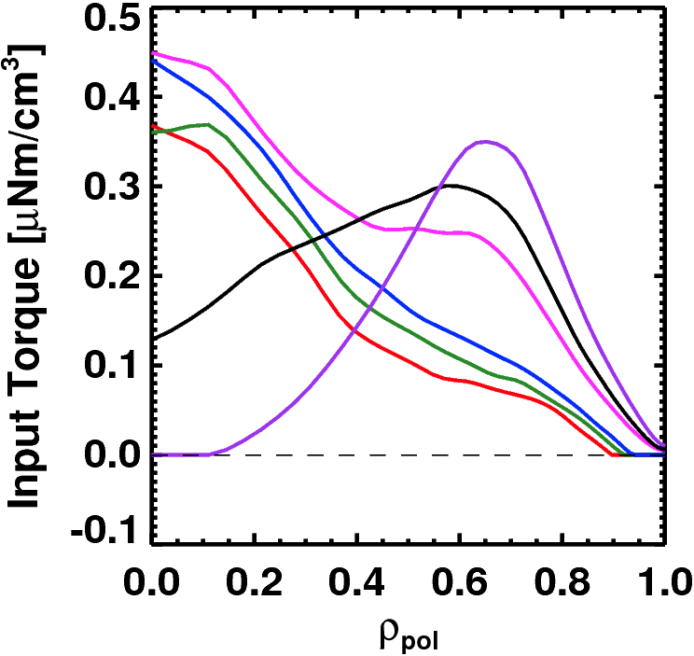
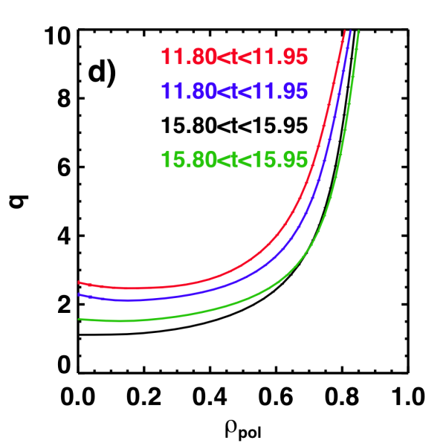
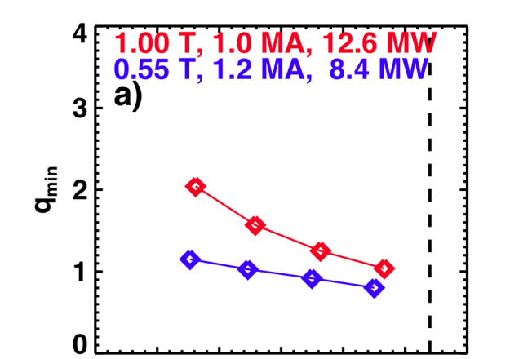
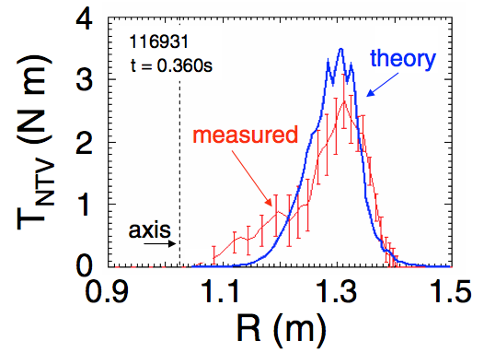
NSTX-U developing a range of profile control actuators for physics studies, scenario optimization for FNSF/Pilot
q-Profile Actuators
Rotation Profile Actuators
Variations in Beam Sources
800 kA Partial Inductive, 87% < f_{NI} < 100%
Torque Profiles From 6 Different NB Sources
Largest R_{tan}
800 kA and 1 T
[50,60,70,130] cm
[50,60,120,130] cm
[60,70,110,120] cm
[70,110,120,130] cm
Neutral
Beams
(TRANSP)
Smallest R_{tan}
Measured and Calculated Torque Profiles from 3D Fields
Variations in Outer Gap
(n=3)
27 22 17 12 7 2
Outer Gap

Slide 19
Record β_{N} and β_{N} / l_{i} accessed in NSTX using passive + active resistive wall mode stabilization
High β_{N} regime is important for bootstrap current generation.
High β_{N} / l_{i} regime important since high f_{BS} regime has low l_{i}.
ST-FNSF
Unstable RWM
Stable / controlled RWM
S. Sabbagh, PRL 2006
J. Berkery, PRL 2011
W. Zhu, PRL 2006
Major NSTX-U mission is to achieve fully non-inductive operation at high β

Slide 20
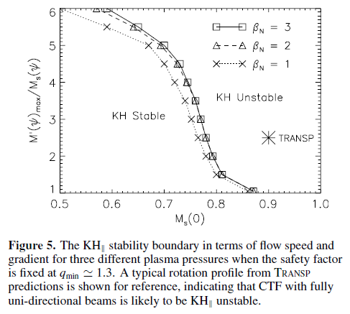
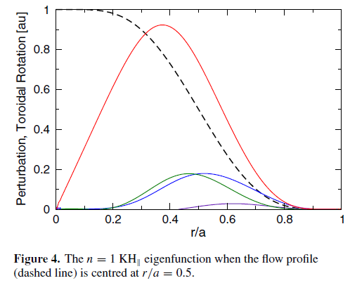
Kelvin-Helmholtz (KH) instabilities predicted when central sound-speed Mach number M_{s} ≈ 0.7-0.8
Rotation profile
n=1 K-H
Eigenfunction
I. Chapman, NF 2012

Slide 21
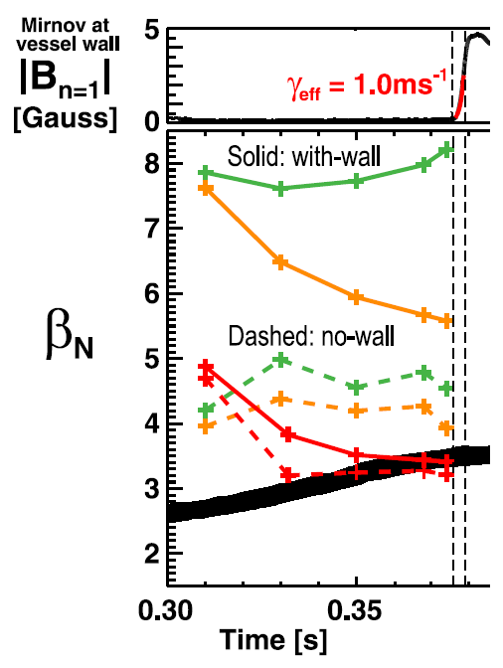
Hybrid MHD-drift-kinetic stability calculations find rotation + fast-ions reduce stability of ∇p-driven Ideal Wall Mode
MARS-K code needed to explain NSTX Ideal Wall Mode (IWM) onset at highest rotation, β_{fast}
Low-rotation fluid with-wall limit is very high → marginal β_{N} ~ 7-8
Increasing rotation lowers max β_{N} to ~5.5 at mode onset time
Full kinetic treatment including fast-ions → marginal β_{N} ~3.5 → most consistent with experiment
Experimental β_{N}
Rotation, rotation shear, fast-ion content must be optimized to maximize RWM and IWM limits
J. Menard, PRL 2014

Slide 22
Outline
ST Overview and Motivation
NSTX-U Mission and Status
NSTX/NSTX-U Research Highlights
  Global MHD Stability
  Transport and Turbulence
  Energetic Particles
  Power Exhaust
  Plasma Start-up
Brief Overview of NSTX-U Research Plans
Summary

Slide 23
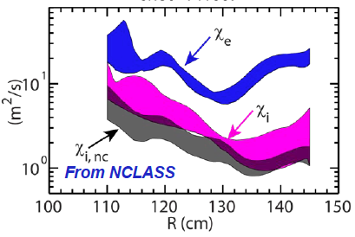
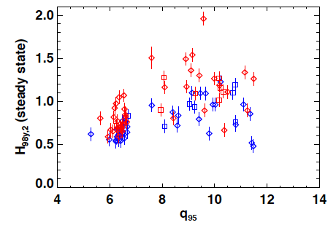
High confinement multiplier H needed for compact ST
Fusion gain Q depends strongly on “H”, Q ∝ H ⁵⁻⁷
• Ion energy transport in H-mode ST plasmas near neoclassical level due to high shear flow and favorable curvature
• Electron energy transport anomalous (as for all tokamaks)
Enhanced pedestal H-mode (EPH) has H up to 1.5-2 → attractive for ST-FNSF
NSTX
NSTX
EPH
ST-FNSF
H-mode
R. Maingi, PRL 2010
S. Gerhardt NF 2014
Y. Ren (PPPL)

Slide 24
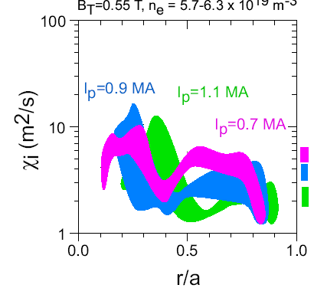
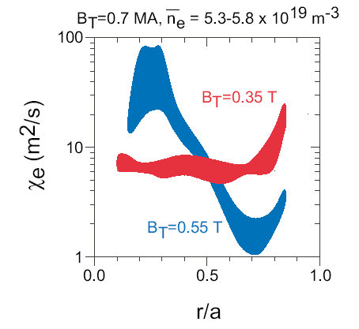
Electron and ion τ_{E} scale differently in ST, and different than at higher aspect ratio
Ions: τ_{E} ∼ I_{p}
Ion τ_{E} ∼ I_{P}, consistent with neoclassical ion transport
  Implies ion turb. suppressed by high E×B shear → possibility of isolating causes of e-transport
Electron τ_{E} ∼ B_{T}
  Could imply Electron Temperature Gradient (ETG) modes, and/or electromagnetic turbulence
Neoclassical
(r/a=0.5-0.8)
Electrons: τ_{E} ∼ B_{T}
3.5 kG
5.5 kG
S.M. Kaye, PRL 2007

Slide 25
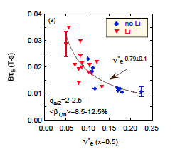
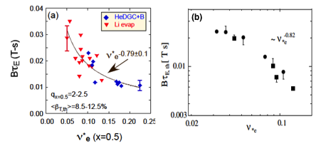

Favorable confinement trend with collisionality, β found
Important implications for future ST FNSF, Demo with lower ν*
τ_{E, th} ∝ ν_{*e}^{-0.1} β^{-0.9} tokamak empirical scaling (ITER 98_{y,2})
τ_{E, th} ∝ ν_{*e}^{-0.8} β^{-0.0} ST scaling
NSTX
Fig. 70. (a) Normalized confinement time as a function of collisionality at mid-radius in NSTX. Blue points are from discharges that used HeGDC+B wall conditioning, while red points are from discharges that used Li. Reprinted with permission from S.M. Kaye et al., Nucl. Fusion 53 063005 (2013). Copyright (2013). Institute of Physics.
(b) Collisionality scan of thermal energy confinement time in MAST. Reprinted with permission from M. Valovic et al., Nucl. Fusion 51 073045 (2011). Copyright (2011) Institute of Physics.
NSTX
MAST
~ ν_{*e} ^{-0.82}
B τ_{E,th} [ T s]
ν_{*e}
S.M. Kaye, NF 2007, 2013
M. Valovic, NF 2011
Very promising ST scaling to reactor condition, if continues on NSTX-U/MAST-U

Slide 26
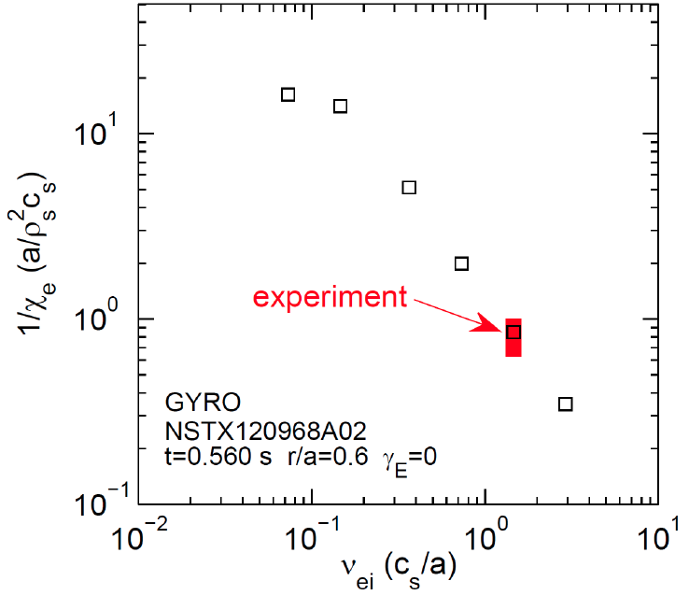


Micro-tearing-driven (MT) transport
may explain ST τ_{E} collisionality scaling
MT-driven χ_{e} vs. ν_{ei} using the GYRO code
MT growth rate decreases with reduced collisionality in qualitative agreement with the NSTX experiment.
Further electron confinement improvement expected due to reduced collisionality.
NSTX-U
NSTX
W. Guttenfelder, PoP 2013, PoP 2012, PRL 2011
W. Wang: Recently found dissipative TEM has similar ν* scaling (GTS)

Slide 27
Outline
ST Overview and Motivation
NSTX-U Mission and Status
NSTX/NSTX-U Research Highlights
  Global MHD Stability
  Transport and Turbulence
  Energetic Particles
  Power Exhaust
  Plasma Start-up
Brief Overview of NSTX-U Research Plans
Summary

Slide 28
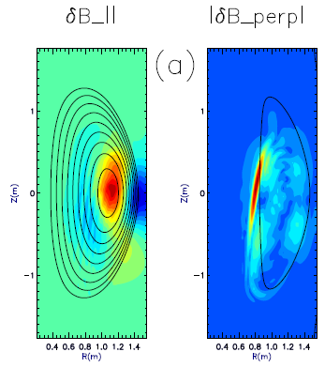
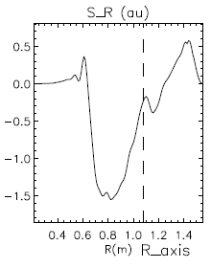
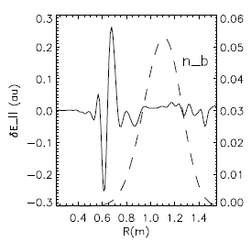
CAE mode-conversion to kinetic Alfvén waves (KAW) predicted to transfer core NBI power to mid-ρ electrons
GAE/CAEs cause large χ_{e} through stochastic orbits (N. Gorelenkov, NF 2010)
CAEs also couple to KAW - Poynting flux redistributes fast ion energy near mid-radius, E|| resistively dissipates energy to thermal electrons
  P_{CAE→KAW} ~ 0.4 MW from QL estimate + experimental mode amplitudes
  P_{e,NBI} ~ 1.7 MW for ρ <0.3, NBI power deposited on core electrons
Radial Poynting flux
⟨E×B⟩_{R}
CAE
(n=8)
KAW
Up to 25% of electron heating power transferred to KAW off-axis
~ρ_{beam}
HYM code
E. Belova, PRL 2015
ω_{A}(R,Z)=ω_{CAE}

Slide 29
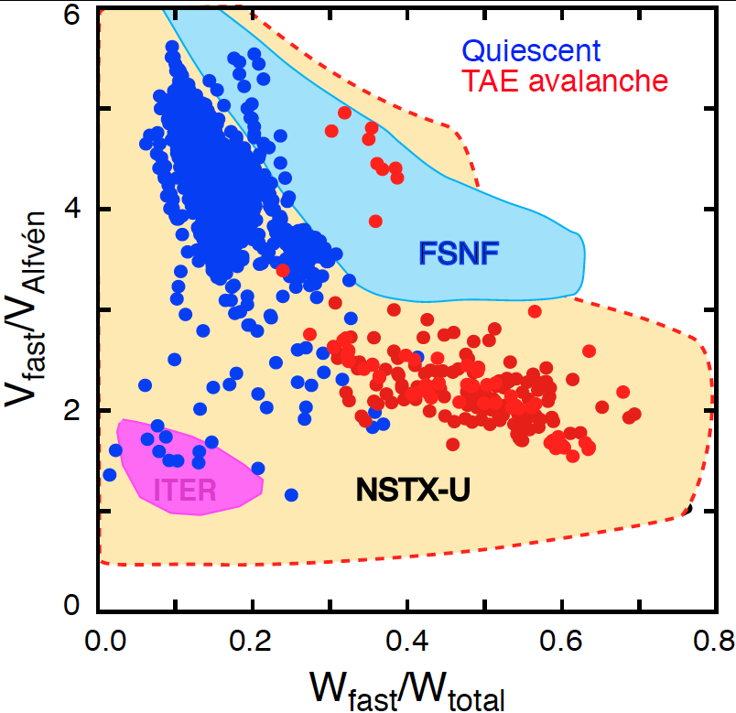
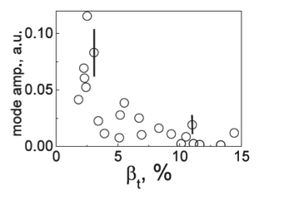
NBI-heated STs excellent testbed for α-particle physics
Alfvenic modes readily accessible due to high V_{fast} > V_{Alfvén}
α-particles couple to Alfvénic modes strongly when V_{α} > V_{A} ~ β^{−0.5} C_{s}
V_{α} > V_{A} in ITER and reactors: condition easily satisfied in ST due to high β
Fast-particle-driven Alfvén Eigenmodes: Toroidal, Global, Compressional
NSTX-U will also explore V_{fast} < V_{A} regime giving more flexibility
EP parameter space
TAEs significantly modified at high β as V_{A} → C_{s}
NSTX data:
Stabilization of TAEs at high β in MAST
  M.P. Gryaznevich, PPCF 2004
  E. Fredrickson, NF 2013

Slide 30
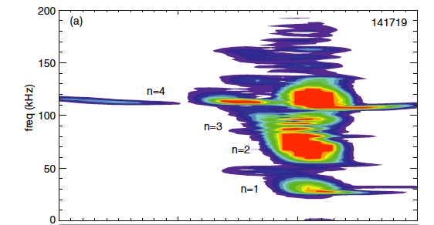
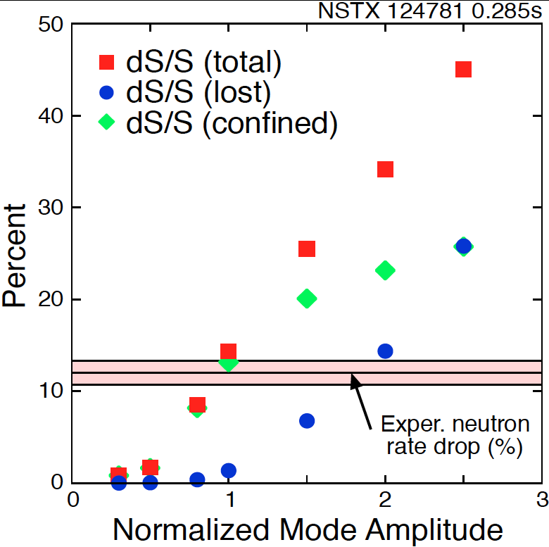
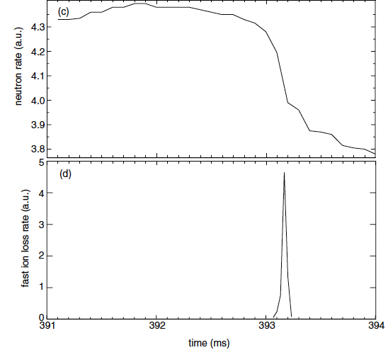
“TAE avalanche” shown to cause energetic particle loss
Uncontrolled α-particle loss could cause reactor first wall damage
Multi-mode TAE avalanche can cause significant EP losses as in “sea”of TAEs expected in ITER
Progress in simulation of neutron rate drop
due to TAE avalanche
(a)
Frequency (kHz)
Neutron rate (a.u.)
Fast ion loss rate (a.u.)
Time (ms)
Time (ms)
  E. Fredrickson, NF 2013
D.S. Darrow, NF (2013)

Slide 31
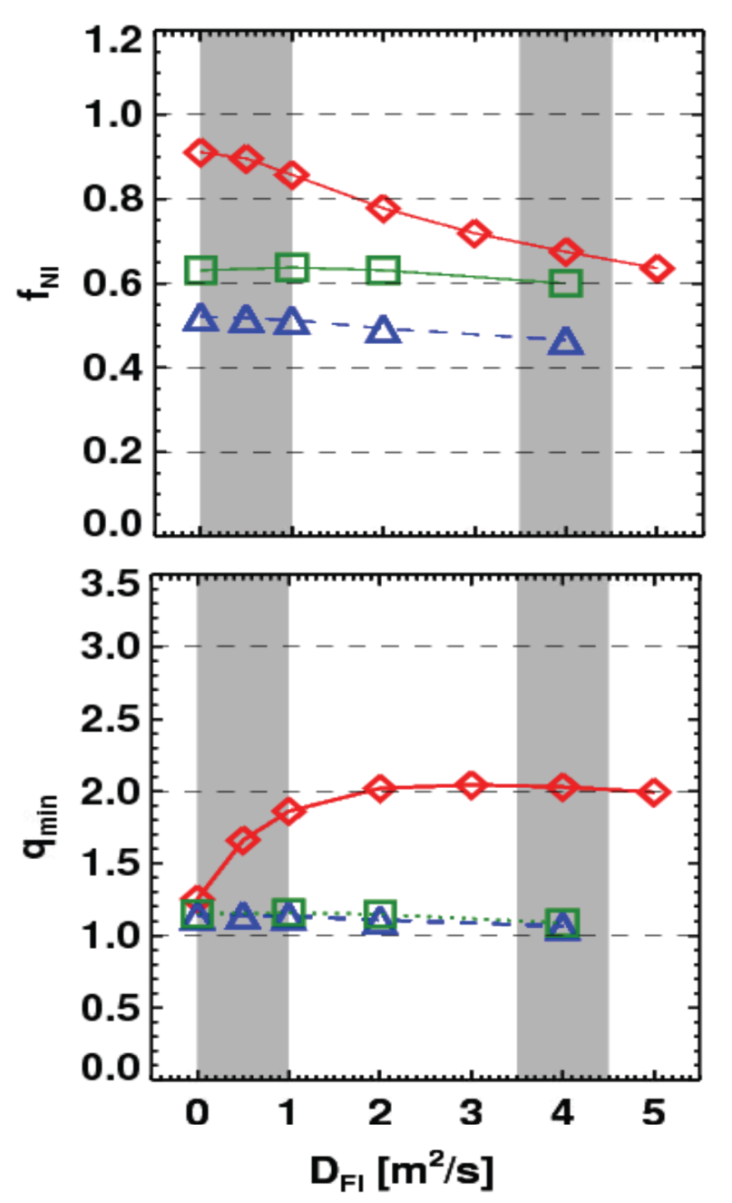
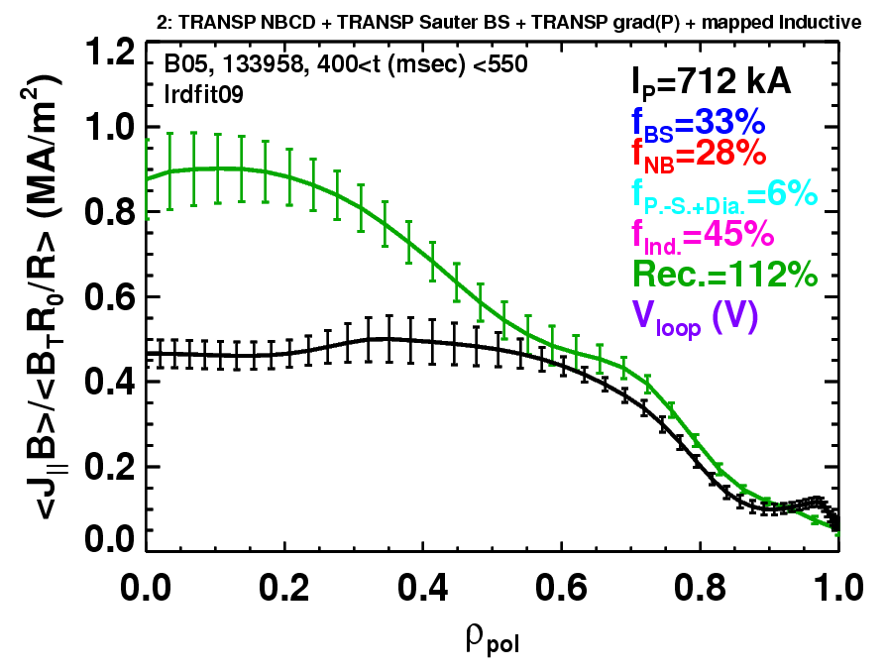
Rapid TAE avalanches could impact NBI current-drive in advanced scenarios for NSTX-U, FNSF, ITER AT
NSTX-U TRANSP simulations
NSTX: rapid avalanches can lead to
redistribution/loss of NBI current drive
Discrepancy between reconstruction and total assuming
classical J_{NBCD}
1 MA, 1T, H₉₈=1, near non-inductive
1.6 MA, 1T, partial inductive
1.2 MA, 0.55T, high β_{T}
All: f_{GW}=0.7, H₉₈=1
Minor radius
700kA high-β_{P} plasma with rapid
TAE avalanches has time-average D_{FI} = 2-4m²/s
S. Gerhardt NF 2011, NF 2012

Slide 32
Outline
ST Overview and Motivation
NSTX-U Mission and Status
NSTX/NSTX-U Research Highlights
  Global MHD Stability
  Transport and Turbulence
  Energetic Particles
  Power Exhaust
  Plasma Start-up
Brief Overview of NSTX-U Research Plans
Summary

Slide 33
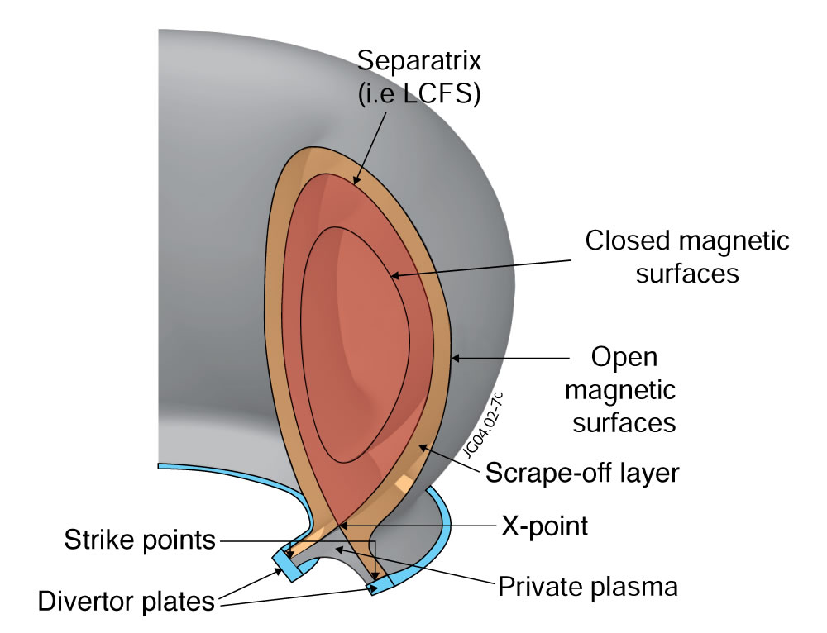
All modern tokamaks / STs use a “divertor” to control where power and particles are exhausted
Power exhaust width outside main plasma can be very narrow (few mm)
Power / particles contact target plates here

Slide 34
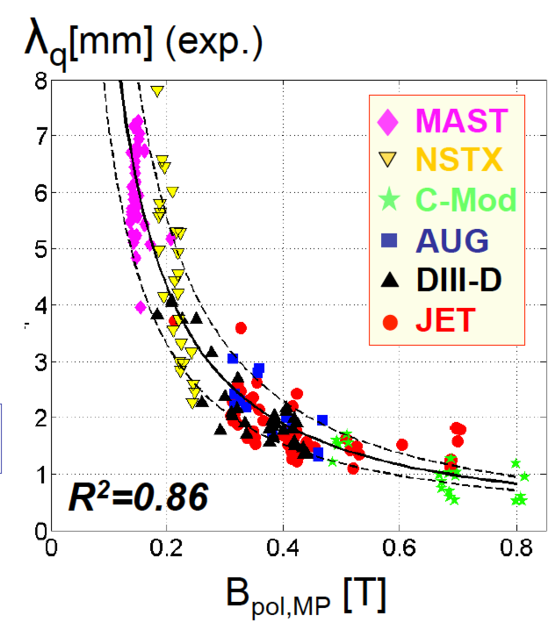
Tokamak + ST data: power exhaust width varies as 1 / B_{poloidal}
Will previous ST trend continue at 2× I_{P} , B_{P} , B_{T}, power?
ST data breaks aspect ratio degeneracy of data set
Issue: If peak heat flux in divertor region exceeds 10 MW/m² → material damage
Wider heat-flux width may offset smaller R → maybe better than tokamak?

Slide 35
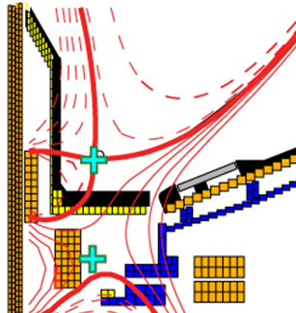
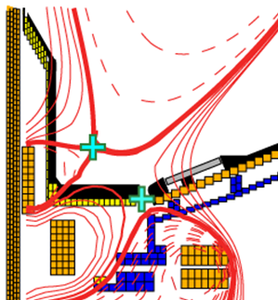


NSTX-U will test ability of radiation and advanced divertors to mitigate very high heat-fluxes
NSTX: reduced heat flux 2-4×via radiation (partial detachment)
Additional null-point in divertor expands field, reduces heat flux
Standard Divertor
Snowflake/X Divertor
NSTX-U peak heat fluxes will be up to 4-8× higher than in NSTX
NSTX-U has additional coils for up-down symmetric snowflake/X, improved control

Slide 36
Outline
ST Overview and Motivation
NSTX-U Mission and Status
NSTX/NSTX-U Research Highlights
  Global MHD Stability
  Transport and Turbulence
  Energetic Particles
  Power Exhaust
  Plasma Start-up
Brief Overview of NSTX-U Research Plans
Summary

Slide 37

I_{P} Start-up/Ramp-up Critical Issue for ST-FNSF/Demo
Compact ST-FNSF has no/small central solenoid
ST-FNSF Scenarios
high β_{T}, β_{N}, κ, disruption avoidance, high H, heat flux mitigation
I_{P} [MA]
Current ramp-up and profile control
NBI
Solenoid-free
Start-up
HHFW
EC/EBW, HI, PF
Time
• Two novel techniques for solenoid-free start-up and ramp-up will be investigated
  RF: ECH/EBW and HHFW
  Helicity Injection
~ 1-2 MA of solenoid-free start-up current needed for FNSF
Notes:
ST has been addressing critical issues for FNSF: A compact FNSF facility does not have solenoid. So, the solenoid-free start-up is a critical issue for ST-FNSF. But solenoid-free start-up is attractive for tokamak reactor design as well. Other issues are ramp-up….

Slide 38



Helicity Injection is efficient method for current initiation
Coaxial Helicity Injection (CHI) concepts being developed
CHI developed on HIT, HIT-II
Transferred to NSTX / NSTX-U
Discharge evolution of 160 kA closed flux current produced by CHI alone in NSTX
R. Raman et al., PRL 2006

Slide 39


NIMROD simulations → CHI in NSTX has resemblance to 2D Sweet-Parker reconnection
Toroidal electric field generated in injector region by reduction of injector voltage and current
  E_{toroidal} × B_{poloidal} drift brings oppositely directed field lines closer and causes reconnection, generating closed flux
Direction of plasma flows
In Injector Region only
Elongated Sweet-Parker-type current sheet
n > 0 modes / MHD not strongly impacting 2D reconnection
Current
sheet
F. Ebrahimi, PoP 2013, PoP 2014

Slide 40




CHI current sheet unstable → plasmoids → merging
Possible lab observation of plasmoids → contribute to lab-astro
F. Ebrahimi , PRL 2015
Possible plasmoids during NSTX CHI

Slide 41
Outline
ST Overview and Motivation
NSTX-U Mission and Status
NSTX/NSTX-U Research Highlights
  Global MHD Stability
  Transport and Turbulence
  Energetic Particles
  Power Exhaust
  Plasma Start-up
Brief Overview of NSTX-U Research Plans
Summary

Slide 42
Brief Overview of FY2016-18 NSTX-U Goals
FY2016
  Obtain first data at 60% higher field/current, 2-3× longer pulse:
    Re-establish sustained low l_{i} / high-κ operation above no-wall limit
    Study thermal confinement, pedestal structure, SOL widths
    Assess current-drive, fast-ion instabilities from new 2nd NBI
FY2017
  Extend NSTX-U performance to full field, current (1T, 2MA)
    Assess divertor heat flux mitigation, confinement at full parameters
  Access full non-inductive, test small current over-drive
  First data with 2D high-k scattering, prototype high-Z tiles
FY2018
  Assess causes of core electron thermal transport
  Test advanced q profile and rotation profile control
  Assess CHI plasma current start-up performance
  Study low-Z and high-Z impurity transport
    Possibly test/compare pre-filled liquid-Li tiles/PFCs vs. high-Z solid

Slide 43






Five Year Facility Enhancement Plan (green = ongoing)
2015: Engineering design for high-Z tiles, Cryo-Pump, NCC, ECH
Fiscal Year:
2015 | 2016 | 2017 | 2018 | 2019
Major enhancements:
Base funding
+15% incremental
Upgrade Outage
1.5 → 2 MA, 1s → 5s
Run Weeks:
14-16
16-18
12-16
10-12
New
center-stack
Pulse-burst MPTS
Lower divertor cryo-pump
Boundary Science
+ Particle Control
Boronization
High-Z tile row on lower OBD
High-Z PFC diagnostics
Li granule injector
Upward
LiTER
LLD using bakeable cryo-baffle
MAPP
MGI disruption mitigation
Upgraded halo sensors
Off-midplane 3D coils (NCC)
Core Science
δB diag. - incremental
Enhanced MHD sensors
Laser blow-off
42 ch MPTS
DBS, PCI, or other intermediate-k
48 ch BES
High k_{θ}
MSE/LIF
Charged fusion product
Neutron collimator
4 coil AE antenna
Establish control of:
Rotation
q_{min}
HHFW limiter upgrade
Snowflake
Integrated Scenarios
FIReTIP
n_{e}
Divertor P_{rad}
2nd NBI
1 MW ECH/EBW
Upgraded CHI for ~0.5MA
0.5-1 MA CHI
up to 1 MA plasma gun

Slide 44
Summary
NSTX-U will provide many opportunities to study toroidal confinement physics in novel regimes:
  Low aspect ratio, strong shaping, high β, low collisionality
  Access strong fast-ion instability drive, high rotation
  Advanced divertors, high-Z PFCs, lithium walls
NSTX-U/ST results will inform optimal configuration, aspect ratio for next-step PMI, FNSF, Pilot devices
Physics research to begin in Nov/Dec 2015
  Many UW researchers already collaborating on NSTX-U!
Thank you!
Notes:
Here is the outline of this review to give you an overview of the world ST research.

Slide 45
Backup

Slide 46
NSTX-U Milestone Schedule for FY2016-18
FY2016
FY2017
FY2018
Run Weeks:
Incremental
14
16
16
18
12
16
R16-1
R17-1
R18-1
Boundary Science
+ Particle Control
Assess H-mode confinement, pedestal, SOL characteristics at higher B_{T}, I_{P}, P_{NBI}
Assess scaling, mitigation of steady-state, transient heat-fluxes w/ advanced divertor operation at high power density
Assess impurity sources and edge and core impurity transport
R17-2
IR18-1
Assess high-Z divertor PFC performance and impact on operating scenarios
Investigation of power and momentum balance for high density and impurity fraction divertor operation
R16-2
R17-3
IR18-2
Assess effects of NBI injection on fast-ion f(v) and NBI-CD profile
Assess τ_{E} and local transport and turbulence at low ν* with full confinement and diagnostic capabilities
Assess role of fast-ion driven instabilities versus micro-turbulence in plasma thermal energy transport
Core Science
Begin ~1 year outage for
major facility enhancement(s) sometime during FY2018
IR17-1
R18-2
R16-3
Assess fast-wave SOL losses, core thermal and fast ion interactions at increased field and current
Control of current and rotation profiles to improve global stability limits and extend high performance operation
Integrated Scenarios
Develop physics + operational tools for high-performance: κ, δ, β, EF/RWM
R17-4
R18-3
Develop high-non-inductive fraction NBI H-modes for sustainment and ramp-up
Assess transient CHI current start-up potential in NSTX-U
FES 3 Facility Joint Research Target (JRT)
C-Mod leads JRT
DIII-D leads JRT
NSTX-U leads JRT
Assess disruption mitigation, initial
tests of real-time warning, prediction
TBD… possibly something
on energetic particles
TBD

Slide 47
Backup
NSTX Physics Results

Slide 48

Kinetic RWM theory consistent with RWM destabilization at intermediate plasma rotation; stability altered by collisionality
γτ_{w} contours vs. ν and ω_{φ}
MISK code
(marginal stability)
Plasma evolution
Precession drift resonance stabilization
Marginal stability
Bounce/transit resonance stabilization
ν_{eff}/ν^{exp (marginal stability)}
instability
(experiment)
unstable
NSTX 121083
unstable
ω_{φ}/ω_{φ}^{exp (marginal stability)}
Destabilization appears between precession drift resonance at low ω_{φ}, bounce/transit resonance at high ω_{φ}
Destabilization moves to increased ω_{φ} as ν decreases
S. Sabbagh, NF 2010
J. Berkery, PRL 2010

Slide 49


NCC Physics Design completed: Optimization for NTV braking performed with IPEC coupling matrix
NCC and midplane coils can be combined to remove the dominant resonant modes up to the second, giving the optimized NTV for core
  NCC 2x12 provides n=1,2,3,4,6 optimized NTV, and 2x6 provides n=1,2,6
  Optimized NTV can be used to control local torque with minimized resonance
n=1
*Ratio of coil currents (phasing)
*T_{max} is based on max. 3kAt
Higher n’s
n=6

Slide 50


Study of RMP characteristics with NCC extended with TRIP3D (T. Evans, GA) – 2x12 NCC (and 2x7) favorable for RMP
Vacuum Island Overlap Width (VIOW) analysis shows full NCC 1kAt can produce sufficient VIOW in a wide range of q₉₅, but partial NCC needs more currents with low q₉₅ targets
  Also shows 2x7, with “one” more additional array upon partial NCC can provide the greater VIOW by toroidal coupling (n=2,4,9)

Slide 51



Excellent Agreement between TRANSP and FIDAsim when Using the Same ADAS Ground State Cross Section Tables (2)
rotation
halo neutral
beam neutral
Halo neutral
beam neutral
The peak of halo neutrals shifts in the same direction as toroidal rotation, as expected

Slide 52



Linear stability analysis of fishbones with M3D-K finds rotation / rotation shear destabilizing at elevated q
Guoyong Fu, Feng Wang
NSTX-U / theory partnership
Eigenfunction broadens with rotation
  Enhanced fast-ion transport or triggering / seeding of tearing modes?
  Next step: investigate with non-linear runs.

Slide 53

New “kick” model for fast-ion transport predicts different
J_{NB}, ion/electron power split, inferred thermal transport

Slide 54

Major motivation for NSTX/MAST Upgrades: Determine if confinement trend continues, or is like conventional A
ST-FNSF
constant q, β, ρ∗
NSTX Upgrade
?
NSTX
ITER-like scaling
Normalized electron collisionality ν_{e}* ∝ n_{e} / T_{e}²
Favorable confinement results could lead to more compact ST reactors

Slide 55
NSTX achieved 70% “transformer-less” current drive
Will NSTX-U achieve 100% as predicted by simulations?
TRANSP Contours of Non-Inductive Fraction
H_{98y2}
ITER H-mode confinement scaling multiplier
I_{P}=1 MA, B_{T}=1.0 T, P_{NBI}=12.6 MW
Steady-state operation required for ST, tokamak, or stellarator FNSF

Slide 56
Progress in predicting T_{e} using reduced χ_{e} models in regimes where single micro-instability is dominant
Linear gyrokinetic simulations find microtearing unstable in mid-radius region of high-collisionality H-modes
Micro-tearing
  Other micro-instabilities subdominant at this location for this class of discharge
ExB
Reduced model for micro-tearing χ_{e} (Rebut-Lallia-Watkins (RLW) - 1988) shows reasonable agreement between predicted & measured T_{e} for r/a > 0.3
  χ_{e} >> RLW must be used in core to match central T_{e} - may be due to GAE/CAE
Reduced ETG models in low-β L-modes also show reasonable T_{e} agreement for r/a > 0.3 (not shown)
r/a
ν
H
*
i
g
h
H
-
0
M
o
d
e
.
8
1
2
0
9
6
7
0
.
5
1
s
)
V
M
e
a
s
u
r
e
e
d
k
(
P
r
e
d
i
c
t
0
e
d
.
e
4
T
A
d
χ
-
h
o
c
e
2
0
2
-
3
0
m
/
(
s
G
A
E
p
r
o
x
y
)
χ
R
L
W
0
e
(
)
.
0
0
.
0
0
.
2
0
.
4
0
.
6
0
.
8
1
.
0
S. Kaye
r/a

Slide 57





Strong flow shear can destabilize Kelvin-Helmholtz (K-H) instability in NSTX (Wang, TTF 2014)
K-H instability expected for |ML_{n}/L_{ω}|>1 from linear analytic theory (Catto, 1973; Garbet, 1999)
K-H identified in global electrostatic ITG simulations for NSTX low β L-mode (Ren, 2013)
  Mostly unstable K-H modes have finite k|| (shifted away from nq=m)
K-H/ITG + neoclassical close to experiment χ_{i}
  χ_{e} underpredicted
  ETG possibly important
GTS code
nq=m
Nonlinear ETG simulations to be run in FY14-15 to investigate contribution in NSTX L-modes

Slide 58


Collaborating with QUEST to explore CHI + ECH solenoid-free start-up in support of ST-FNSF
CHI Start-Up
CHI Implementation on QUEST
showing installed electrodes
• Inj. Flux in NSTX-U is about 2.5 times higher than in NSTX
• NSTX-U coil insulation greatly enhanced for higher voltage ~ 3 kV operation
U. Washington
Refurbishment of CHI Cap Bank completed.
Fabrication of the CHI gas injection system and operation procedure for the QUEST ST experiment in Japan completed.
Fabrication of the CHI capacitor bank for QUEST is nearing completion.

Slide 59


Magnum-PSI experiments on high-temperature Li show strongly reduced erosion and stable cloud production
Gross erosion measured spectro-scopically in divertor-like plasma
  Neon plasma reproduces Langmuir Law
  Deuterium suppresses erosion
Reduced gross erosion and strong re-deposition result in 10× longer lifetime of 1 micron coating
  Consistent with Li trapping in pre-sheath
  Pre-sheath scale length consistent with neutral Li emission region (~3mm)
Abrams, PSI 2014
Neutral Li emission, t=2.5s
Incident Plasma
Target
Jaworski, PSI 2014

Slide 60
Backup
Copper TF ST-FNSF

Slide 61
High β_{T} enables compact Fusion Nuclear Science Facility (FNSF) with high neutron wall loading
P_{fusion} ∝ ⟨p⟩ ² x Vol
Database from START, MAST, PEGASUS, NSTX
β_{N} = 6
40
5
P_{fusion} ∝ β_{T}² B_{T0}⁴ x Vol
ST-FNSF
4
Toroidal β (%)
3
20
Tokamak
$
2
Physics limited
ITER
Investment & engineering limited
0
0
4
8
W_{n} ∝ P_{fusion} / Area
I_{p}/aB_{T0} (MA/mT)
W_{n} ∝ β_{T}² B_{T0}⁴ a (not strongly size dependent)
W_{n} ~ 1-2 MW/m² with R ~ 1-2m FNSF feasible!

Slide 62



ST-FNSF shielding and TBR analyzed with sophisticated 3-D neutronics codes
CAD coupled with MCNP using UW DAGMC code
Fully accurate representation of entire torus
No approximation/simplification involved at any step:
  Internals of two OB DCLL blanket segments modeled in great detail, including:
    FW, side, top/bottom, and back walls, cooling channels, SiC FCI
  2 cm wide assembly gaps between toroidal sectors
  2 cm thick W vertical stabilizing shell between OB blanket segments
  Ports and FS walls for test blanket / materials test modules (TBM/MTM) and NNBI
LiPb,
cooling channel,
FCI
TBM
NBI
Heterogeneous OB Blanket Model,
including FW, side/back/top/bottom walls, cooling channels, and SiC FCI

Slide 63

Two sizes (R=1.7m, 1m) assessed for shielding, TBR
Parameter:
Major Radius 1.68m 1.0m
Minor Radius 0.95m 0.6m
Fusion Power 162MW 62MW
Wall loading (avg) 1MW/m² 1MW/m²
TF coils 12 10
TBM ports 4 4
MTM ports 1 1
NBI ports 4 3
Plant Lifetime ~20 years
Availability 10-50%
30% avg
6 Full Power Years
(FPY)
Neutron source distribution

Slide 64

Peak Damage at OB FW and Insulator of Cu Magnets
R=1.7m configuration
Dose to MgO insulator = 2x10⁸ Gy @ 6 FPY < 10¹¹ Gy limit
Dose to MgO insulator = 6x10⁹ Gy @ 6 FPY < 10¹¹ Gy limit
OB Blanket
Center Stack
Peak dpa at OB midplane = 15.5 dpa / FPY
Peak He production at OB midplane = 174 appm/FPY
He/dpa ratio = 11.2
3-D Neutronics Model of Entire Torus

Slide 65


Mapping of dpa and FW/blanket lifetime
(R=1.7 m Device)
R=1.7m configuration
Peak =
15.5 dpa / FPY
FW/blanket could operate for 6 FPY
if allowable damage limit is 95 dpa
dpa / FPY
→ Peak EOL Fluence = 11 MWy/m²

Slide 66

Options to increase TBR > 1
PF Coils
Add to PF coil shield a thin breeding blanket (ΔTBR ~ +3%)
Smaller opening to divertor to reduce neutron leakage
Uniform OB blanket (1m thick everywhere; no thinning)
Reduce cooling channels and FCIs within blanket (need thermal analysis to confirm)
Thicker IB VV with breeding
Potential for TBR > 1 at R=1.7m

Slide 67




UW has carried out most advanced and detailed analysis of Dual-Coolant Lead-Lithium (DCLL) blanket for ST-FNSF
No ports or penetrations,
homogeneous breeding zones:
TBR = 1.03
Add 4 Test Blanket
Modules (TBMs)
TBR = 1.02 (ΔTBR = -0.01)
TBM
LiPb,
cooling channel,
FCI
MTM
Approx. ΔTBR per port:
TBM: -0.25%
MTM: -2.0%
NBI: -0.75%
Ferritic Steel
1 Materials Test Module (MTM)
TBR = 1.01 (ΔTBR = -0.02)
4 TBM + 1 MTM + 4 NBI
TBR = 0.97

Slide 68


R₀ = 1m ST-FNSF achieves TBR = 0.88
Distribution of T production
TBM
NBI
1m device cannot achieve TBR > 1 even with design changes
Solution: purchase ~0.4-0.55kg of T/FPY from outside sources at $30-100k/g of T, costing $12-55M/FPY
MTM

Slide 69
Backup
HTS-ST Pilot Plant Study

Slide 70

Q_{eng} = P_{electric} / P_{consumed} is maximized between
A = 1.8-2.5 for tokamak using HTS magnets
Assumes fixed major radius R₀
Elongation κ and β_{N} increase with increasing ε=A⁻¹
Assumes no inboard tritium breeding (WC shield only)
R₀ = 2.5m
Shield
thickness:
0.3m
0.4m
0.5m
0.6m
0.7m
Assumes damage fluence limit of 10²³ n / m²
Result: Want Δ_{shield} / R₀ < ~20% for Q_{eng} > 1

Slide 71
HTS-ST Plasma constraints
Fix plasma major radius at R₀ = 2.5-3m
  Chosen to be large enough to allow space for HTS neutron shield and access Q_{eng} > 1
Inboard plasma/FW gap = 4cm
Use ε dependent κ(ε), β_{N} (ε) (see next slide)
Greenwald fraction = 0.8
q* not constrained
  q* is better ε-invariant than q₉₅ for current limit
  Want to operate with q* > 3 to reduce disruptivity
0.5MeV NNBI for heating/CD – fixed P_{NBI} = 50MW
H_{98y2} adjusted to achieve full non-inductive CD

Slide 72



Aspect ratio dependence of limits: κ(ε), β_{N}(ε)
NSTX data at low-A (+ NSTX-U and ST-FNSF modelling)
DIII-D and EAST for higher-A
κ → 1.4 for A → ∞
Profile-optimized no-wall stability limit at f_{BS} ≈ 50%
  Menard PoP 2004
β_{N} → 3.1 for A → ∞
ε = A⁻¹

Slide 73
HTS-ST engineering constraints
Magnet constraints (T. Brown ST-HTS Pilot, K-DEMO)
  Maximum stress at TF magnet = 0.67-0.9GPa
  Maximum effective TF current density = 65MA/m²
  OH at small R → higher OH solenoid flux swing for higher A
Shielding / blankets
  Assume HTS fluence limit of 3x10²² - 10²³ n/m²
  No/thin inboard blanket, ~1+ m thick outboard blanket
    10x n-shielding factor per 15-16cm WC for HTS TF
    Also 8cm inboard thermal shield + other standard radial builds
Electrical system efficiency assumptions:
  30% wall plug efficiency for H&CD - typical of NNBI
  45% thermal conversion efficiency - typical of DCLL
    Also include pumping, controls, other sub-systems
    See Pilot Plant NF 2011 paper for more details

Slide 74
Selection of HTS-ST device performance goals
Decided w/ CCFE + UW for HTS-ST to have goals of:
  6MWy/m² neutron wall loading (peak) at outboard midplane AND Q_{eng} ~ 1 – similar to previous PPPL Pilot Plant Study
  Assume n-radiation damage limit of 3-4 × 10²²/m²
    HTS already tested to this damage fluence range (see next slide)
  → WC shield thickness ~ 60cm, Δ/R = 0.2 → R₀ = 3m
With only outboard breeding, optimal A ~ 2.1-2.4
But, for TBR ~ 1 probably need A ≤ 2 → chose A=2
Chosen design point (so far):
  R=3m, B_{T} = 4T, A=2, κ=2.5, β_{N} = 4.2 (~no-wall limit)
  H_{98y2} ~ 1.7, H_{Petty} ~ 1.2-1.3, H_{ST} ~ 0.7, P_{fusion} ~ 500-600MW
  80% Greenwald fraction, 50MW of 0.5-0.7 MeV NNBI
  I_{P} = 12MA, double-swing of small OH provides ~ 2-3MA

Slide 75



Slide 76



Long-leg divertor aids heat flux reduction in HTS-ST
λ_{q} ~ 1mm, assume S ≈ λ_{q} (closed divertor)
(T. Eich NF 2013)
(Partial) detachment likely reduces peak q⊥ by further factor of 2-4

Slide 77



Can also exhaust onto back of OB blanket
(like vertical target in conventional divertor)
λ_{q} ~ 1mm, assume S ≈ λ_{q} (closed divertor)
(T. Eich NF 2013)
(Partial) detachment likely reduces peak q⊥ by further factor of 2-4

Slide 78

T. Brown radial build (includes small OH)
Added space between OH and TF
60 cm WC uses VV shield and shield in front of it.
For AR 2 device:
OH located inside of TF bore: 854 Mpa Tresca stress with 4.0 B0 and 176.5 TF Bmax
OH flux: 2 Vs with 70 Jc solenoid and 19.8 T

Slide 79

TF and OH magnet parameters vs. aspect ratio
using models from Brown and Zhai

Slide 80

Latest HTS-ST: R=3m, A=2, P_{fusion}~ 500MW, Q_{eng}~1-1.5

Slide 81

OB blanket module with divertor + extended blanket at top/bottom fits through vertical ports
Potential advantages of this low-A configuration:
  Reduced part count + no inboard breeding → simplified maintenance (?)
Breeding
regions
But, very likely need to breed at top + bottom (included)
  UW will assess TBR for DCLL
  Analysis similar to Cu ST-FNSF
Initiating study of LM/Li wall and divertor compatibility with this HTS configuration

