Slide 1
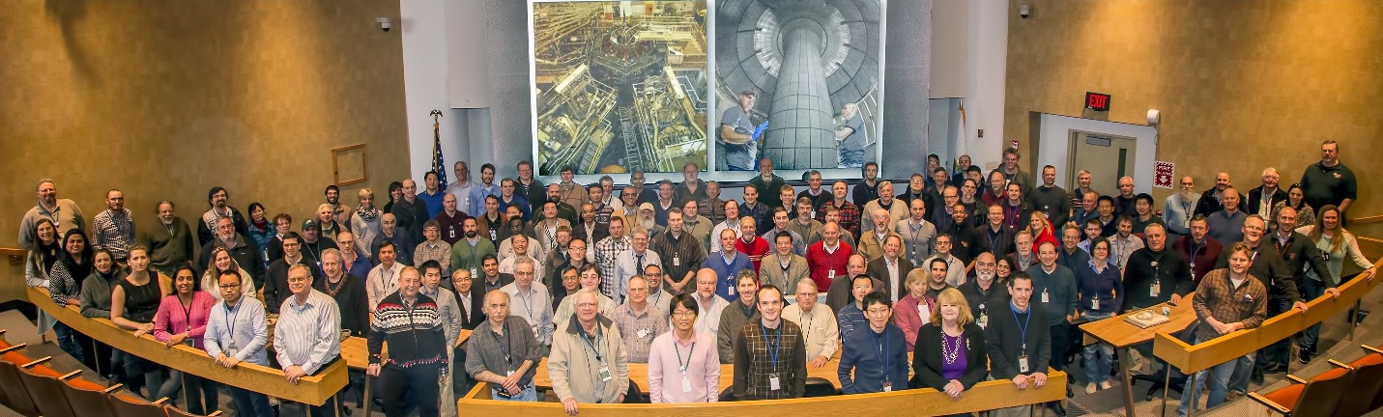
NSTX-U
Supported by
Introduction to the:
National Spherical Torus eXperiment - Upgrade
(NSTX-U)
Jon Menard, PPPL
NSTX-U Program Director
March 27, 2015

Slide 2
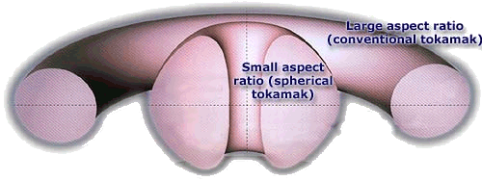
Aspect ratio is important geometric parameter for toroidal fusion devices
Aspect ratio A = R / a
R = major radius a = minor radius
R
a
Spherical torus/tokamak (ST) has A = 1.1 - 2
Conventional tokamak typically A = 3 - 4

Slide 3
STs have higher natural “elongation”
Elongation κ = b / a
b = vertical ½ height a = minor radius
b
a
Higher elongation improves stability & confinement

Slide 4
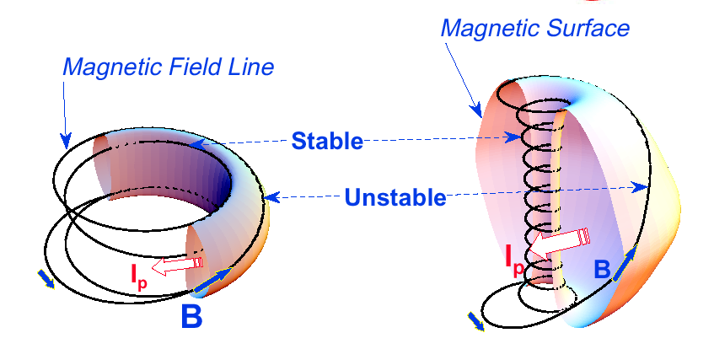
Magnetic field structure of ST increases
normalized pressure by factor of 3-4×
Normalized pressure: β = p / (B²/2μ₀) P_{fusion} ∝ β² B⁴
Tokamak
ST
Plasma spends less time in unstable “bad” curvature region
A ~ 3
κ = 1.5-2
β_{T} = 3-10%
A ~ 1.5
κ = 2-3
β_{T} = 10-40%
Notes:
A spherical tokamak is a low aspect ratio tokamak. Tokamak is a donut like aspect ratio of about 3 where as ST is aspect ratio of about 1.5. As the aspect ratio is reduced, the hole of the donut is reduced and it disappears entirely at A = 1. As the aspect ratio is reduced, the plasma elongate naturally takes on the spherical shape due to self fields. Another important property is the magnetic field line. The tokamak magnetic field line goes around torus at relatively constant pitch where as the ST geometry, the field line transit the outboard unstable region quickly but spend many toroidal transits in the inboard stable region. This makes ST plasma stable for high beta and also makes the edge safety factor high ~ 10 compared to ~ 3 for tokamak.
As a result, there are a number of new unique physics regimes which can be accessed at low aspect ratio, which can be utilized to enhance the understanding of toroidal confinement physics and improve predictive capabilities for ITER and future fusion facilities.

Slide 5
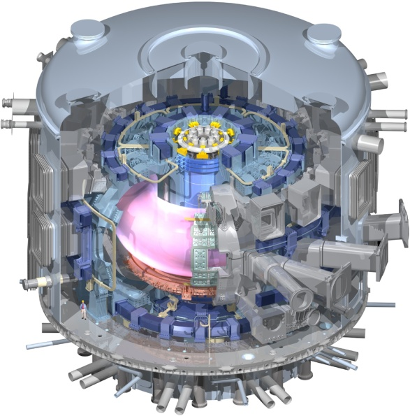
Low aspect ratio / ST extends predictive capability for ITER and toroidal science
  High β, shaping, rotation extend stability, transport knowledge
  NBI fast-ions in present STs mimic ITER DT fusion products → study burning plasma science
  STs can more easily study electron-scale turbulence at high temperature → important for all toroidal configurations
Burning Plasma Physics - ITER

Slide 6
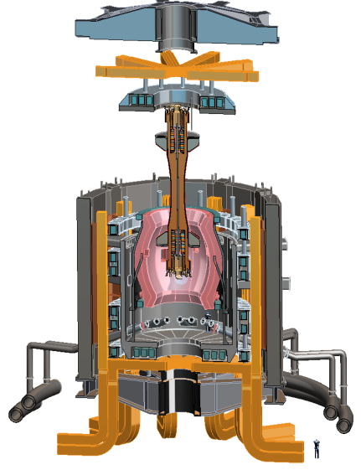
Design studies show ST potentially attractive
as “Fusion Nuclear Science Facility” (FNSF)
PPPL ST-FNSF concept
FNSF: Qualify fusion reactor components in device much smaller than reactor
High neutron wall loading
Modular, maintainable
Can be tritium self-sufficient
  Requires sufficiently large size

Slide 7

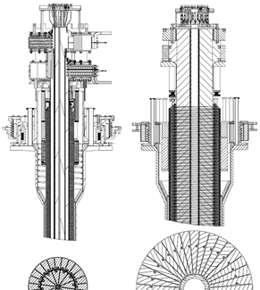
NSTX Upgrade: Two major new components
Will be most capable ST in world program
New center-stack:
  2×toroidal field (0.5→1T)
  2×plasma current (1→2MA)
  5×pulse-length (1→5s)
2nd more tangential neutral beam injector (NBI):
  2×current drive efficiency
  2×heating power (5→10MW)
Previous
center-stack
New
center-stack
Present NBI
New 2nd NBI
~5-10× increase in nTτ
NSTX-U average plasma pressure ~ tokamaks
TF OD = 20cm
TF OD = 40cm

Slide 8
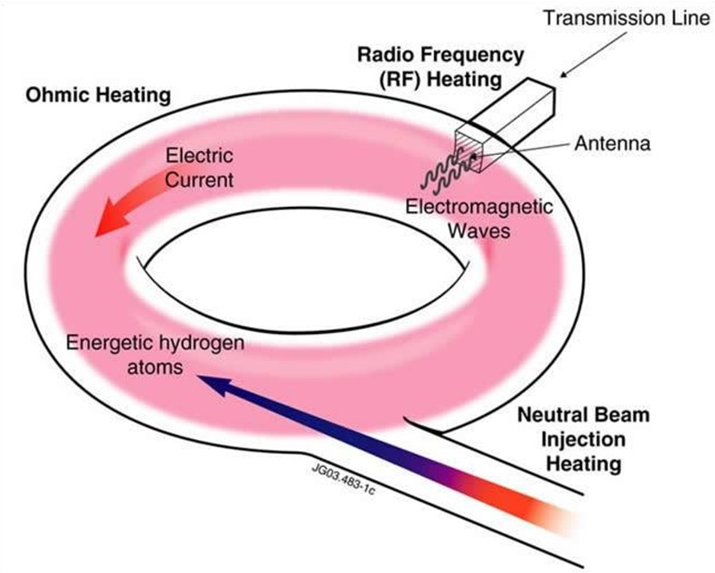
Steady-state tokamak / ST must drive plasma current without transformer
External: wave and beam current drive
Self-generated: high pressure plasmas make “bootstrap” current
Efficient tokamak power plant will need 70-90% self-generated current
NSTX: 70% transformer-less current drive NSTX-U: project 100%
Question: Can NSTX-U operate without using transformer?

Slide 9
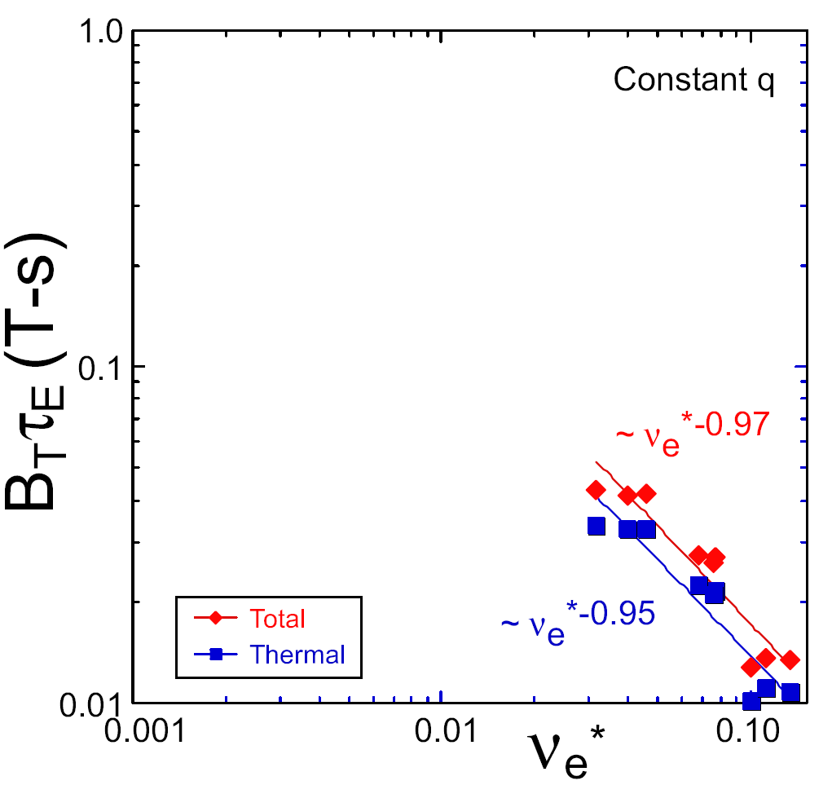
STs observe confinement increases at higher T_{e} (!)
Will confinement trend continue, or look like conventional A?
ST-FNSF
constant q, β, ρ∗
Normalized energy confinement
Bτ_{E} [T-s]
NSTX Upgrade
?
NSTX
ITER-like scaling
Normalized electron collisionality ν_{e}* ∝ n_{e} / T_{e}²
Question: Which instabilities cause electron energy transport?

Slide 10
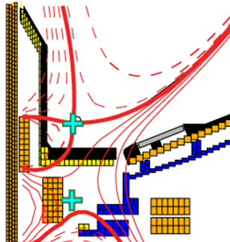
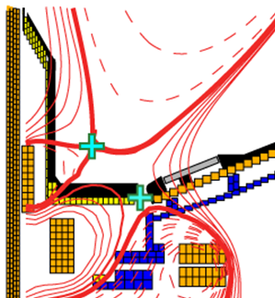
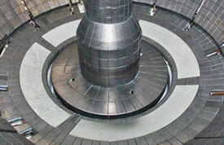
NSTX-U wall heat fluxes ~4× higher than NSTX
Near/above ITER values (40MW/m² unmitigated – 4× engineering limits)
Question: What are viable ways to protect reactor walls?
Expand / lengthen exhaust channel
Spread heat using radiative “cushion”
Liquid metal walls
Combinations?
Standard Divertor
Snowflake/X Divertor

Slide 11
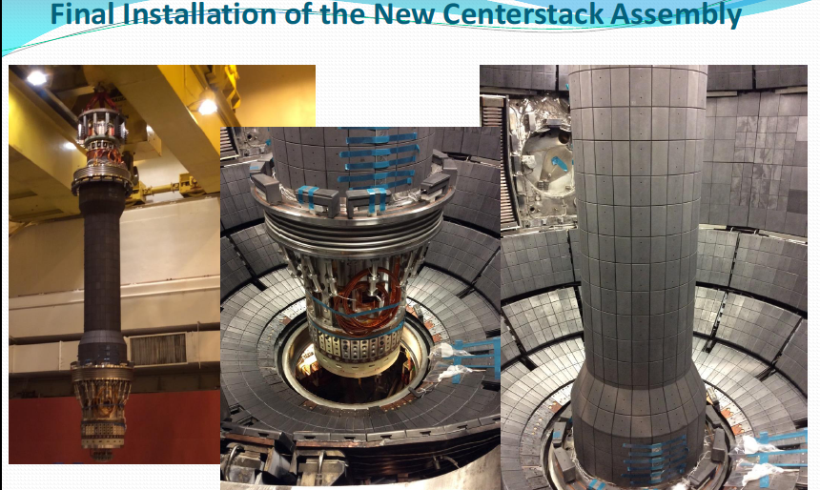
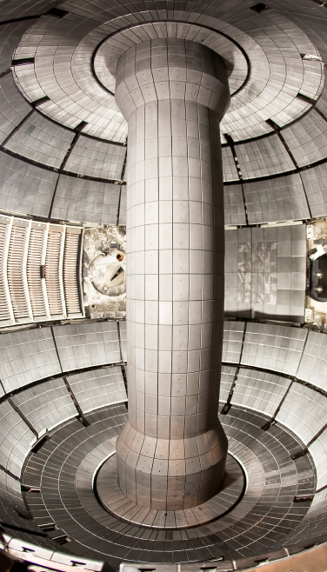
New Center-Stack installed in NSTX-U (!)
Vacuum pump-down achieved in January, 2015

Slide 12
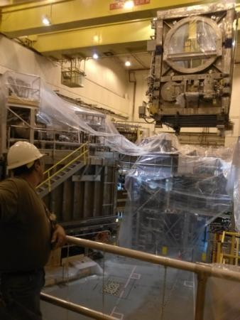
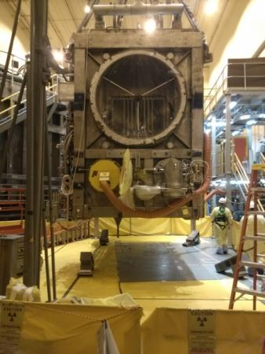
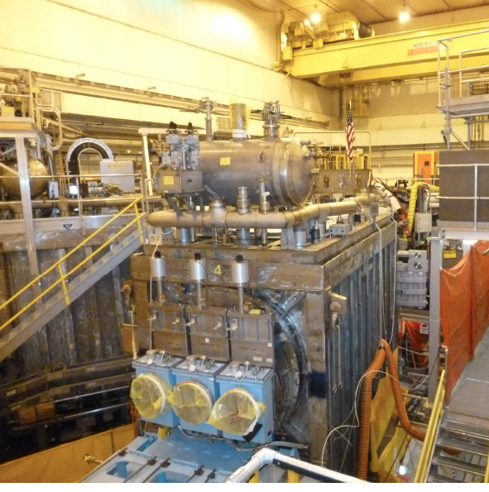
Relocated 2nd NBI beam line box from TFTR
Beam Box being
lifted over NSTX-U
Beam Box placed in its final location & aligned
Beam Box being populated with components

Slide 13
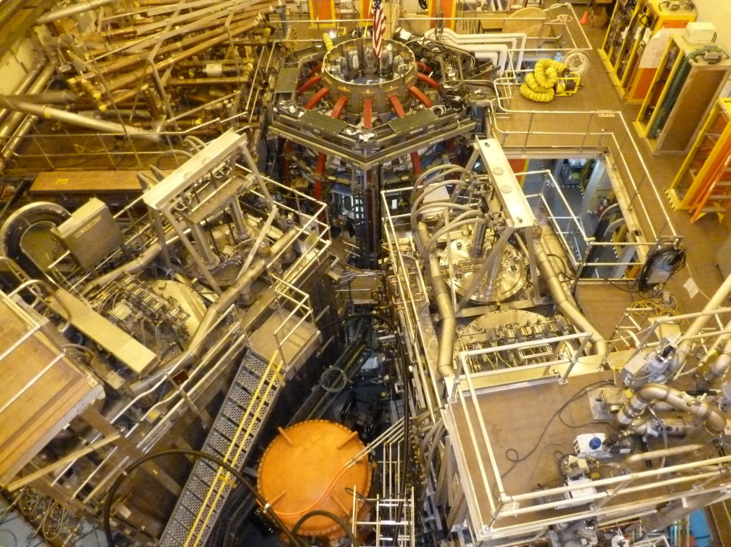
NSTX Upgrade Project nearly complete
Test plasmas expected in April, research plasmas in June
1st NBI
New 2nd NBI

Slide 14
There are many great research opportunities on NSTX-U!
Thank you!
Any questions?

