Slide 1
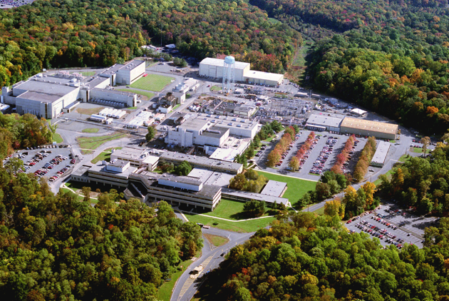



PPPL enabling a world powered by fusion energy, leading discoveries in plasma science and technology

Slide 2
PPPL experimental activities: broad and diverse
Magnetic fusion
Large tokamak facility: NSTX-U
Innovative tokamak: LTX (Lithium tokamak experiment)
Non-tokamak fusion: field reversed configuration
Plasma-material interface: surface science lab
Plasma physics (other than MFE) and applications
Plasma astrophysics: reconnection experiments
magnetorotational instability expt
Plasma nanotechnology
High energy density plasmas: reconnection in laser fusion facilities
X-ray spectroscopy: in laser and magnetic fusion facilities, worldwide
~ All activities are opportunities for grad students

Slide 3
PPPL experimental activities: broad and diverse
Magnetic fusion
Large tokamak facility: NSTX-U
Innovative tokamak: LTX (Lithium tokamak experiment)
Non-tokamak fusion: field reversed configuration
Plasma-material interface: surface science lab
Plasma physics (other than MFE) and applications
Plasma astrophysics: reconnection experiments
magnetorotational instability expt
Plasma nanotechnology
High energy density plasmas: reconnection in laser fusion facilities
X-ray spectroscopy: in laser and magnetic fusion facilities, worldwide
~ All activities are opportunities for grad students

Slide 4

NSTX-U: National Spherical Torus -Upgrade Experiment
317 researchers
Including 166 national users from 32 institutions
61 international users from 29 institutions
~ 33 grad students (from many universities)

Slide 5
Goals of NSTX
Solve physics problems for ITER and beyond
Develop solutions to the plasma-material interface
Advance NSTX as a prototype for the fusion power producing experiment in the US

Slide 6
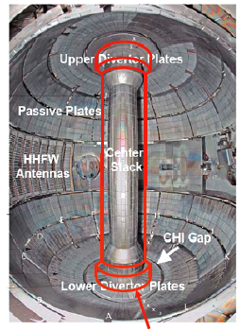
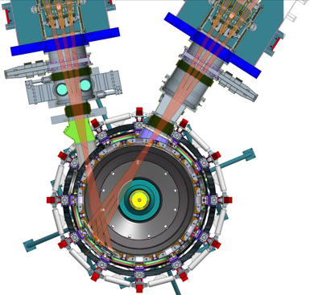
NSTX is undergoing a major upgrade
Double the current, double the heating power, quintuple the plasma duration
big boost to all NSTX science missions

Slide 7
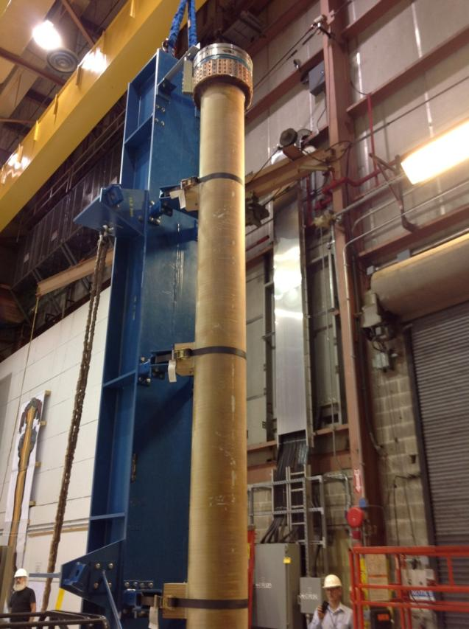
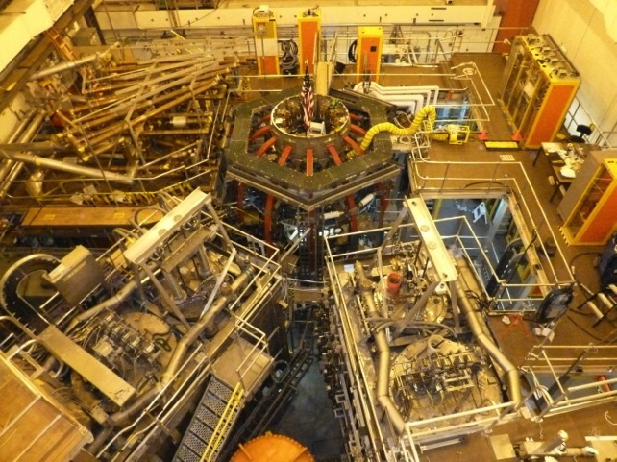
Central magnet
NSTX-U with second neutral beam
Plasma operations begin ~ June 2015

Slide 8
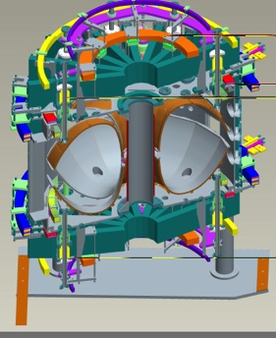
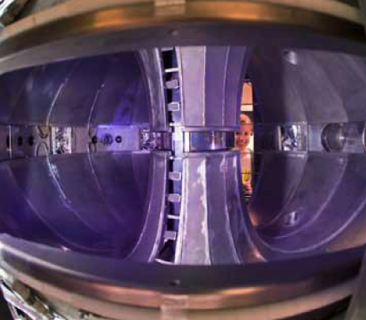
Lithium Tokamak Experiment
Lithium Tokamak Experiment (LTX)
exploratory tokamak with full liquid lithium surface coverage

Slide 9
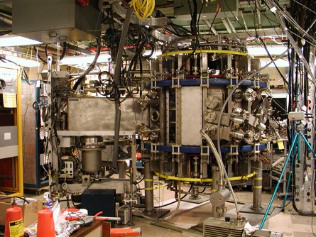
Lithium Tokamak Experiment
Lithium Tokamak Experiment (LTX)
exploratory tokamak with full liquid lithium surface coverage

Slide 10
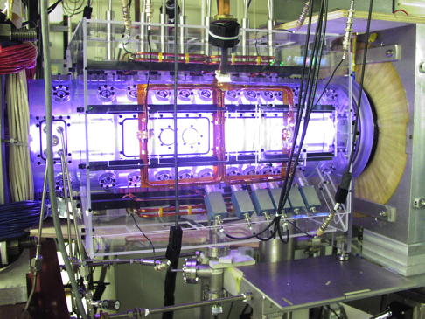
Compact tori for magnetic fusion
PFRC

Slide 11
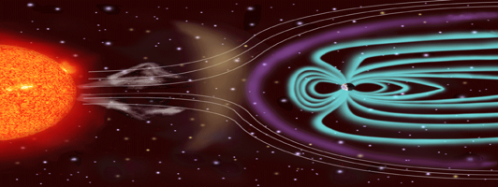
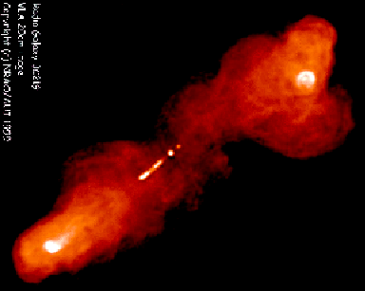
Magnetized plasmas in the universe
at all scales
solar wind
~ 10⁻⁴ light years
Extra-galactic jet
~ 10⁶ light years
Jet
black hole

Slide 12
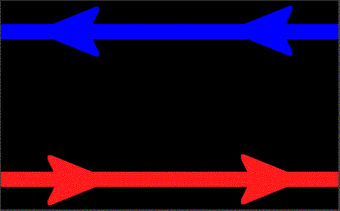
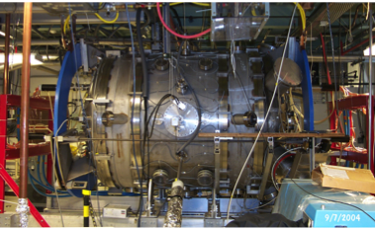
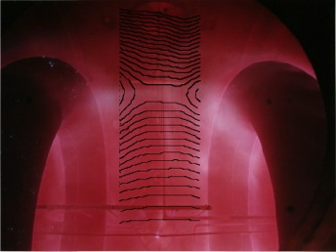
Magnetic Reconnection Experiment (MRX)
Plasma Astrophysics
MRX has made pioneering contributions to magnetic reconnection,

Slide 13
Based on MRX design concept
At larger size
Plasma operations begin ~ 2016
Increases the dimensionless size 10x,
Increases the dimensionless electrical conductivity 100x,
More astrophysically relevant

Slide 14
Momentum Transport
radial transport of toroidal angular momentum
rotation
accretion disk surrounding black hole
momentum transport
Accretion rate momentum transport exceeds classical rate

Slide 15
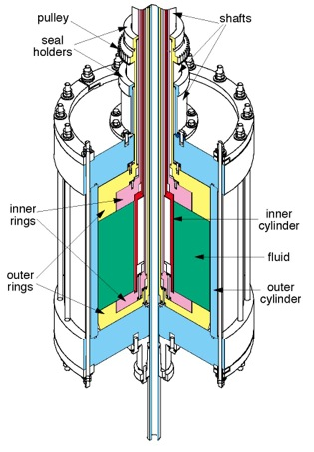
Theoretical explanation: magnetorotational instability
Experimental tests in rotating liquid Gallium

Slide 16
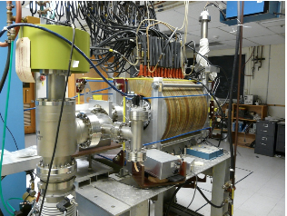
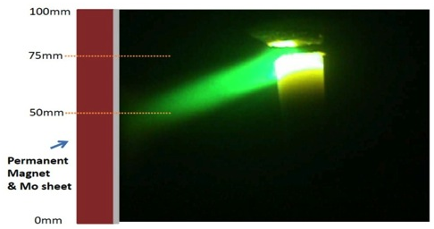
Plasma-based nanotechnology
New initiative recently funded
Merges plasma and materials science
Magnetically controlled arc

Slide 17
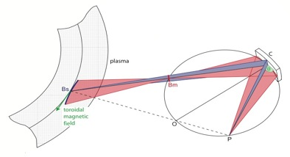
Applications of imaging x-ray spectroscopy
High resolution techniques developed at PPPL,
used on major fusion experiments worldwide
For HEDP: for experiments on OMEGA facility, U. Rochester (then to NIF, if successful)
For HEDP: Testing scheduled on LCLS Materials Under Extreme Conditions station

Slide 18
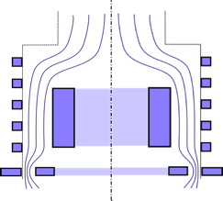
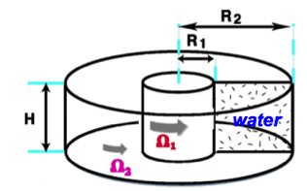
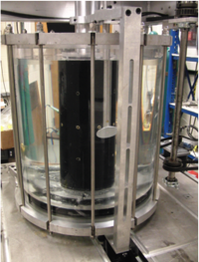
New mass separation techniques
Plasma mass filter
Advanced liquid centrifuge
Heavy ions
Light ions
Centrifugal force
Magnetic force
Based on magnetic confinement
Spin-off from plasma astrophysics!

Slide 19
New scientific links between
PPPL and Princeton University Departments
Collaborations/interactions with 5 astrophysics faculty
Max-Planck/Princeton Center for Plasma Physics
Collaborations with 6 materials scientists in the engineering school and Chemistry Department
Links to the Andlinger Center for Energy and Environment
Engineering faculty member applying control techniques to NSTX
Collaboration with professor in Woodrow Wilson School and engineering school on fusion energy socioeconomics
Collaboration with materials and laser scientists on plasma nanotechnology

Slide 20
Huge opportunities for collaboration
National and international
DIII-D at General Atomics
Tokamaks/Stellarators in China, S. Korea,
Germany, Japan…..

Slide 21
Closing comments
Grad students are a prized species at PPPL
The future of the field
Valued colleagues in research
Many mentors for experiment and theory
We wish we had many more grad students,
(limited by university quotas)
PPPL is a scientific feast for grad students
Experiment and theory

