Slide 1

Progress and plans for
Research on NSTX Upgrade
Jonathan Menard (PPPL)
On behalf of the NSTX-U Research Team
MIT Plasma Science and Fusion Center
December 9, 2016

Slide 2
Outline
NSTX-U mission
Research highlights
Progress on next-step ST concepts
Goals for next run
Summary

Slide 3

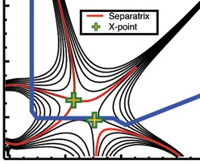
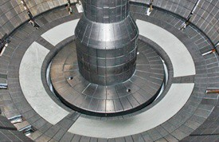
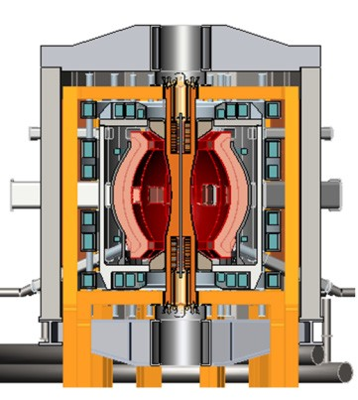
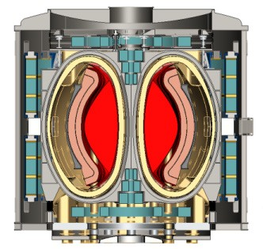
NSTX-U Mission Elements:
Explore unique ST parameter regimes to advance predictive capability - for ITER and beyond
ITER
Develop solutions for plasma- material interface (PMI)
Snowflake/X
Liquid metals / Li
ST-FNSF /
Pilot-Plant
Advance ST as Fusion Nuclear Science Facility and Pilot Plant

Slide 4
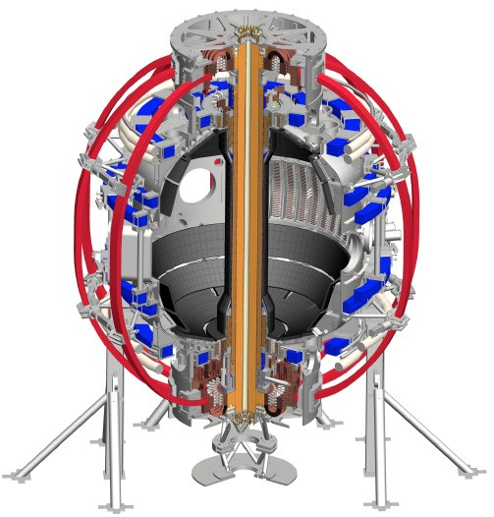
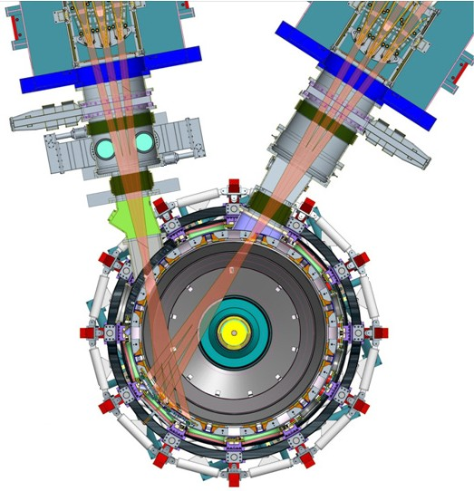
NSTX-U will access new physics with 2 major new tools:
1. New Central Magnet
2. Tangential 2nd Neutral Beam
Higher T, low ν* from low to high β
→ Unique regime, study new transport and stability physics
Full non-inductive current drive
→ Not demonstrated in ST at high-β_{T}
Essential for any future steady-state ST

Slide 5
NSTX-U will have major boost in performance
1. New Central Magnet
2. Tangential 2nd Neutral Beam
Performance goals:
➢2× heating power (5 → 10MW)
Tangential NBI → 2× current drive efficiency
➢4× divertor heat flux (→ ITER levels)
➢Up to 10× higher nTτ_{E} (~MJ plasmas)
➢2× toroidal field (0.5 → 1T)
➢2× plasma current (1 → 2MA)
➢5× longer pulse (1 → 5s)

Slide 6
NSTX-U had scientifically productive 1st year
Achieved H-mode on 8th day of 10 weeks of operation
Surpassed magnetic field and pulse-duration of NSTX
Matched best NSTX H-mode performance at ~1MA
Identified and corrected dominant error fields
Commissioned all magnetic and kinetic profile diagnostics
New 2nd NBI suppresses Global Alfven Eigenmodes (GAE)
Implemented techniques for controlled plasma shut down, disruption detection, commissioned new tools for mitigation
2016 run ended prematurely due to fault in divertor PF coil
  Coil + other issues → major reviews of design, fab, procedures
  Coil forensics complete, prep for new coil fab underway
  Aim to resume plasma operation during CY2018

Slide 7
NSTX-U Mission Elements:
Explore unique ST parameter regimes to advance predictive capability - for ITER and beyond
ITER
Topical science areas:
  Scenario Development
  Macroscopic Stability
  Transport and Turbulence
  Energetic Particles

Slide 8
NSTX-U Mission Elements:
Explore unique ST parameter regimes to advance predictive capability - for ITER and beyond
ITER
Topical science areas:
  Scenario Development
  Macroscopic Stability
  Transport and Turbulence
  Energetic Particles

Slide 9
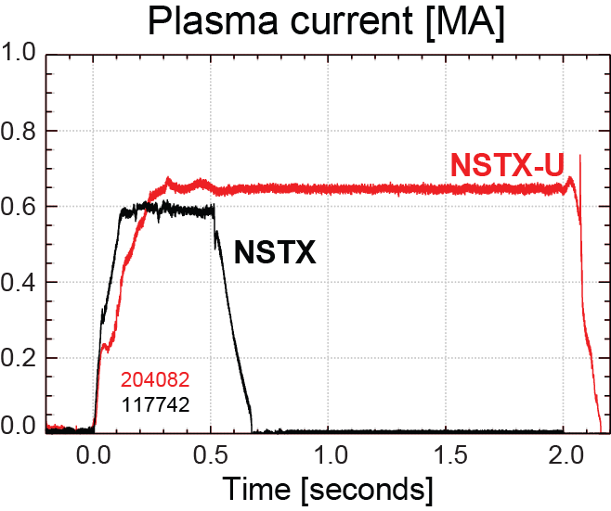
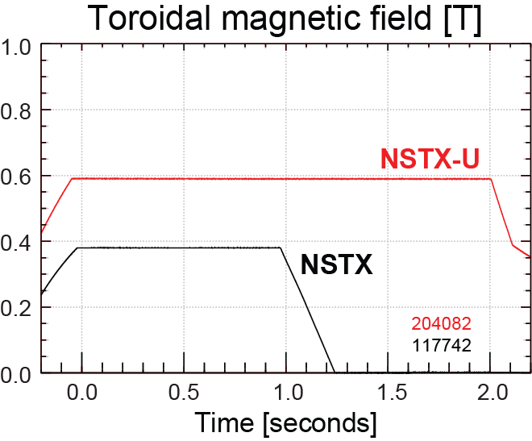
NSTX-U has surpassed maximum pulse duration and magnetic field of NSTX
Compare similar NSTX / NSTX-U Boronized L-modes, P_{NBI}=1MW
4x longer
NSTX-U L-mode duration
exceeds longest NSTX H-mode
NSTX-U B_{T} > highest NSTX B_{T}

Slide 10
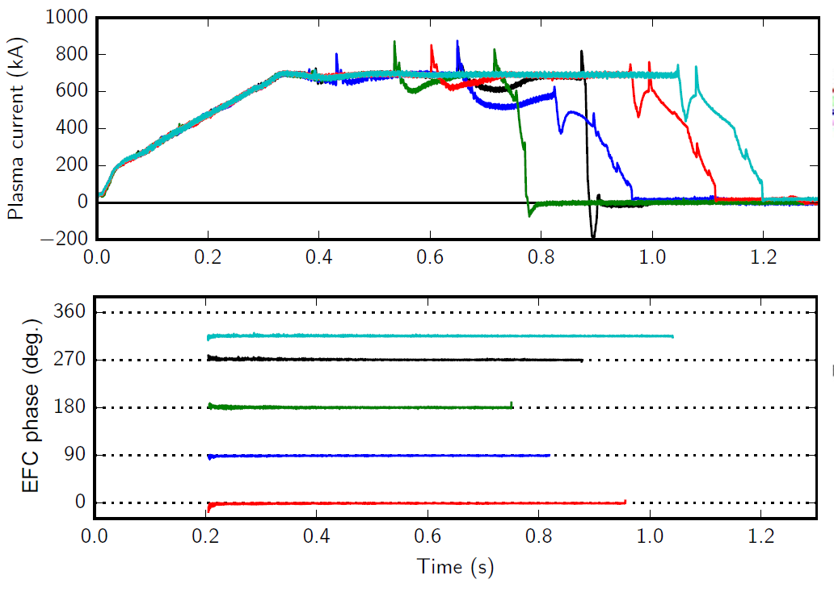
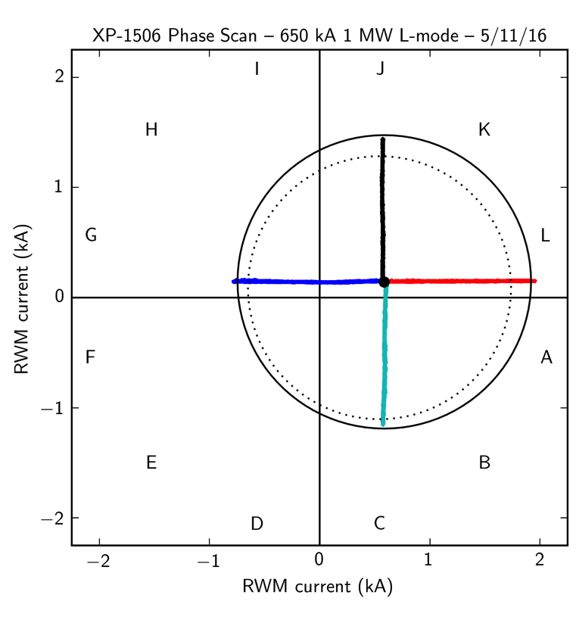
n=1 error field correction (EFC) optimized to maximize pulse length, discharge performance
L-modes used to identify optimal correction amplitude, phase
Multiple compass scans confirm optimal L-mode EFC in flattop
EFC current [kA]
n_{e} = 2.9 ×10¹³ (solid)
n_{e} = 1.4 ×10¹³ (dashed)
EFC current [kA]

Slide 11
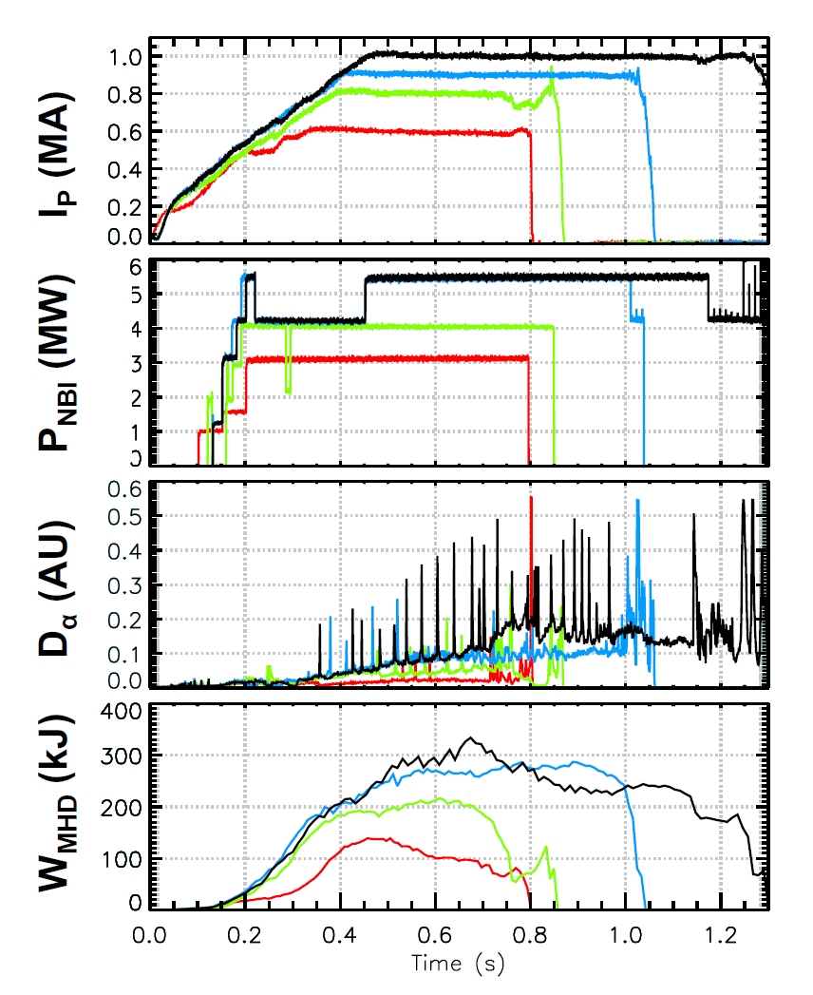
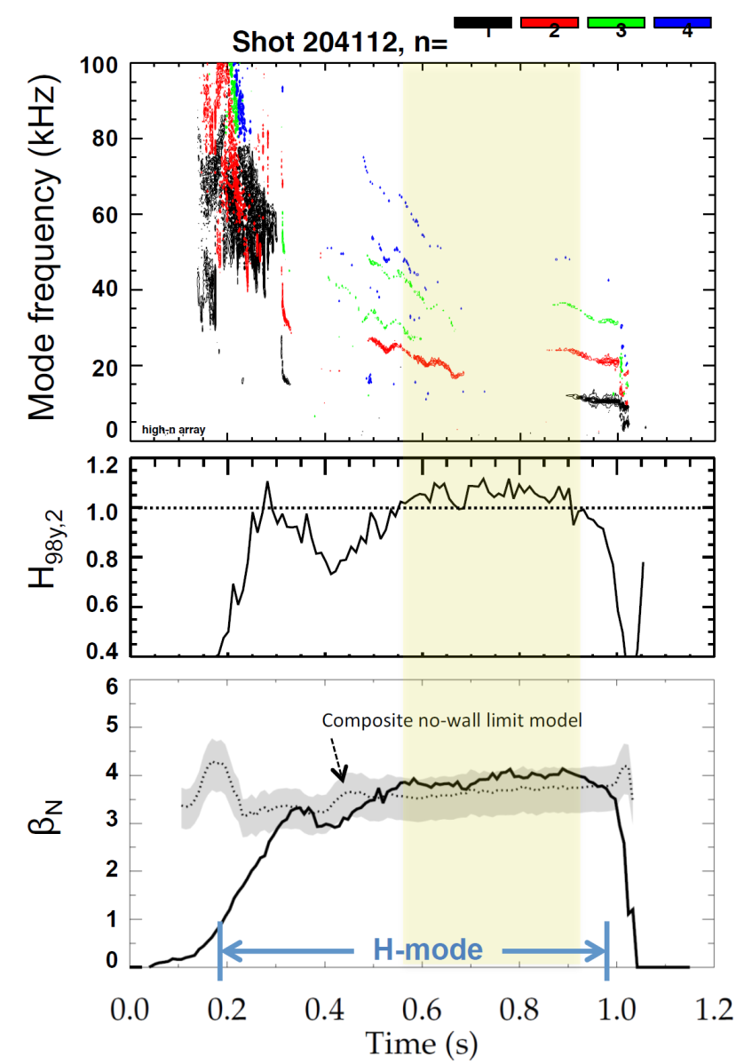
Recovered ~1MA H-modes with weak/no core MHD
202946 – no EFC 204112 – EFC v2
203679 – EFC v1 204118 – EFC v2
H₉₈ ≥ 1, β_{N} ≥ n=1 no-wall limit

Slide 12
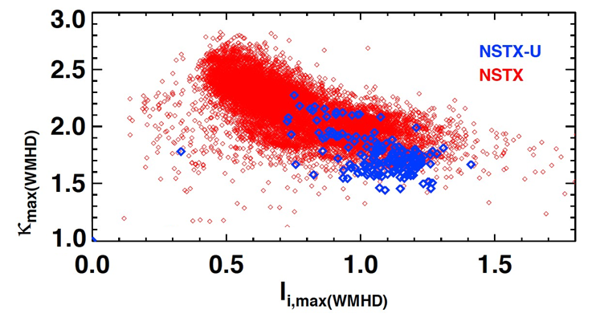
Accessed low l_{i} and high κ using progressively earlier H-mode and heating + optimized EFC
Future goal
NSTX-U (5 run weeks)
NSTX (10 years)
H-mode flattop
L-mode flattop
NSTX-U: Additional sensors improve estimation of Z, dZ/dt
Goals for next run:
  Access l_{i} = 0.5-0.7, κ=2.4-2.7, B_{T} = 0.75-1T, I_{P} = 1.5-2MA

Slide 13
NSTX-U experiments are using a significantly expanded plasma shutdown scheme
NSTX PCS: No means of detecting a disruption, or ramping down the plasma current based on events.
NSTX-U PCS: State machine orchestrates the shutdown.
SS=0:
Ramp-Up & Flat-Top
“SS” = “Shutdown State”
SS=1:
Slow I_{P} Rampdown
Disruption Imminent
Disruption Imminent
SS=2:
Fast I_{P} Rampdown
SS=3:
I_{OH} Loss of Control
SS=4: Insufficient I_{P}

Slide 14
“State-machine”-based automated ramp-down now used routinely during operations
Plasma control system detects loss of control
  OH solenoid near maximum current
  Vertical oscillations exceed threshold
  ABS (I_{p} - I_{p request} ) too large
Feedback control switches to new “states” that attempt to gently end the discharge
I_{P}
I_{P} Request
(including asynchronous transition to rampdown)
  Z_{P}(dZ_{P}/dt) threshold
  Z_{P}(dZ_{P}/dt)
“State”
Insufficient I_{P}
Fast I_{P} Rampdown
Normal
Typical Z_{P} w/o fast ramp-down
  Z_{P} from EFIT

Slide 15
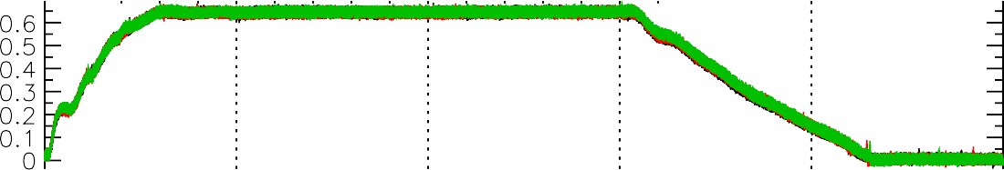
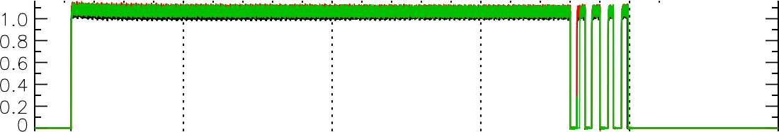
Shutdown handler used for well-controlled disruption-free L-mode ramp-down
Three morning fiducials
One operator waveform used to start ramp-down at t=1.5s
Ramp-down is inner-wall limited, power and current slowly ramped off
L-mode Rampdowns Triggered By a Single Switch
I [MA]
P
P_{inj} [MW]
Beam power ramped down
W_{MHD} [kJ]
204179
204163
204155
κ
n_{e} [10¹³ cm⁻³]

Slide 16
NSTX-U Mission Elements:
Explore unique ST parameter regimes to advance predictive capability - for ITER and beyond
ITER
Topical science areas:
  Scenario Development
  Macroscopic Stability
  Transport and Turbulence
  Energetic Particles

Slide 17
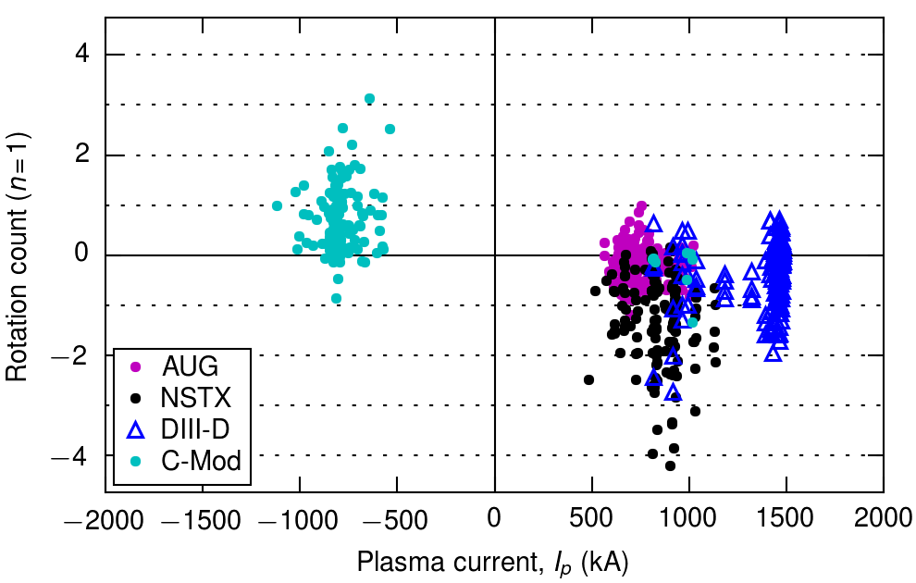
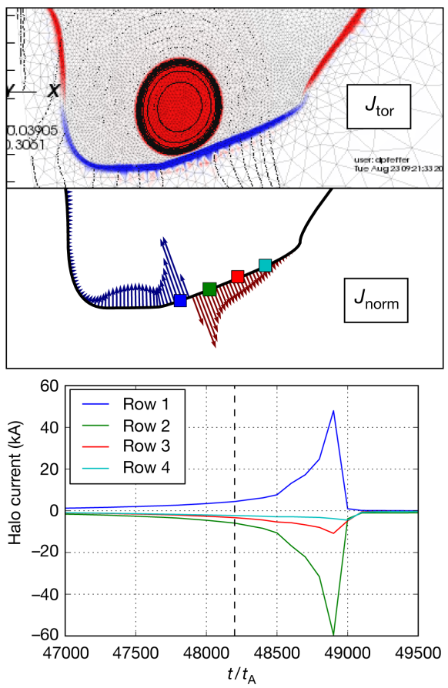
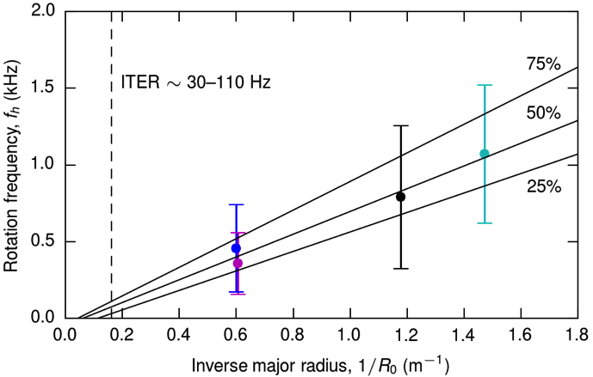
Leading studies of rotating halo currents through ITPA multi-machine analysis and M3D-C1 numerical simulations
ITPA multi-machine analysis (MDC WG-6):
Halo current data from C-Mod, DIII-D, AUG, NSTX
All measurements in lower divertor (> 400 shots)
Halo current rotation is predominantly counter-I_{p}
Consistent rotation velocity, v_{h} ~ 5 km/sec
M3D-C1 simulations:
NSTX(-U) geometry
Simulate in 2D while q >2
Switch to 3D to resolve halo rotation (in progress)
D. Pfefferlé et al. (PPPL)

Slide 18
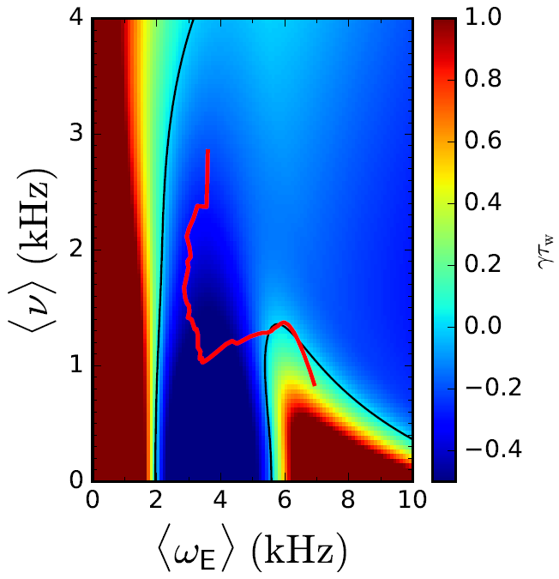
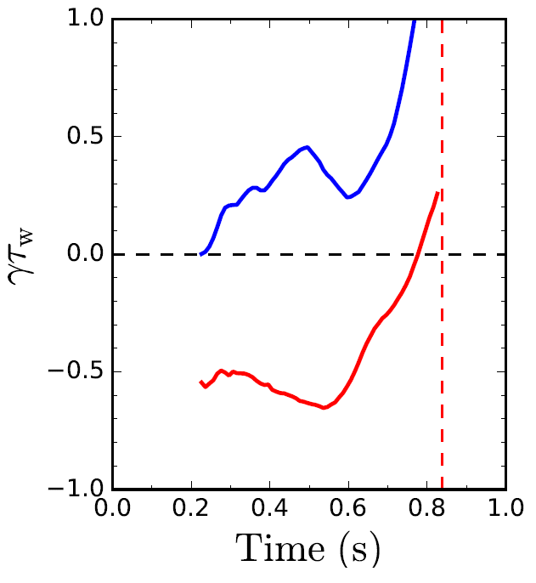

      Disruption characterization and forecasting capability started for NSTX-U as part of disruption avoidance plan
  New DECAF (Disruption Event Characterization And Forecasting) code written
    Identify disruption event chains and elements
      ex: vertical displacement, pressure peaking, tearing modes…
    Predict events in disruption chains
    Cues disruption avoidance system
  Example: Reduced kinetic resistive wall mode (RWM) model developed for calculating growth rate vs. time
γτ_{w} contours vs. ν and ω_{φ}
Normalized growth rate vs. time
Increasing time
ideal
γτ_{w}
unstable
stable
Ideal + kinetic
disruption
139514
predicted instability
Initial tests on NSTX RWM database
  86% of RWM shots are predicted unstable
Possible to predict growth rate in real time
J.W. Berkery et al., Poster EX/P4-34, Wednesday afternoon

Slide 19
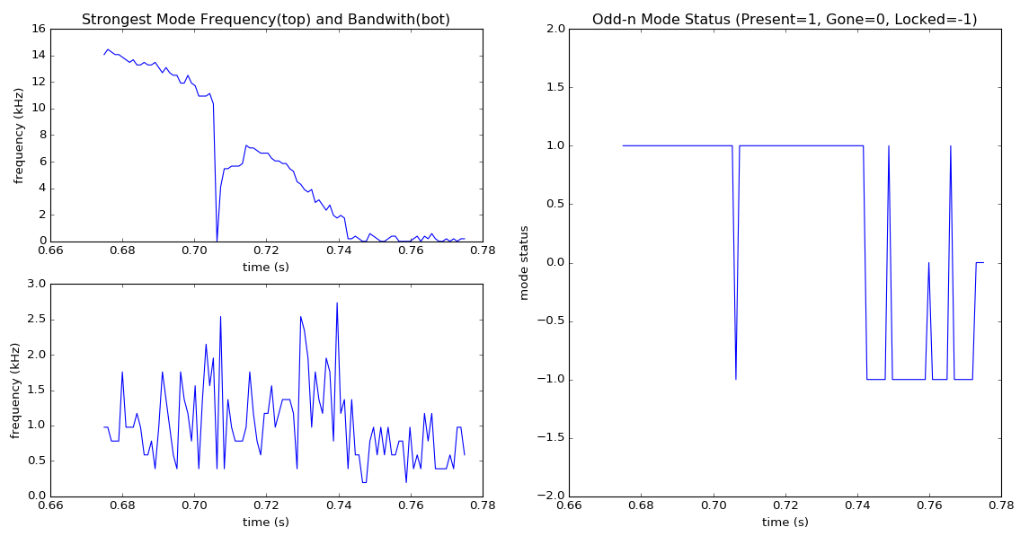
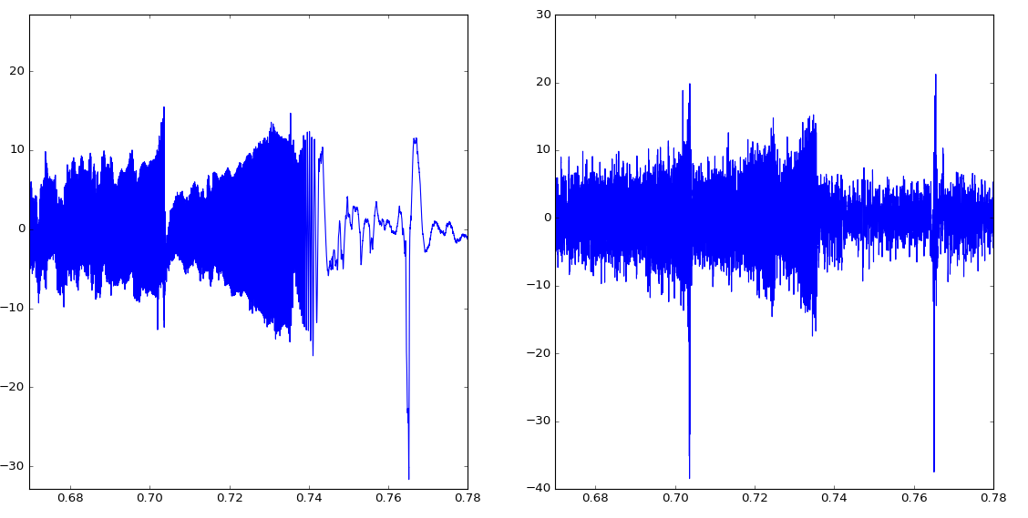
      Continuing analysis of rotating MHD for
      DECAF includes accurate analysis of mode “status”
Odd-n magnetic signal / analysis (mode locking / unlocking)
Frequency vs. time
DECAF mode status
1 = Mode present
0 = No mode
Signal
B (G)
-1 = Mode locked
204202
mode lock
t (s)

Slide 20
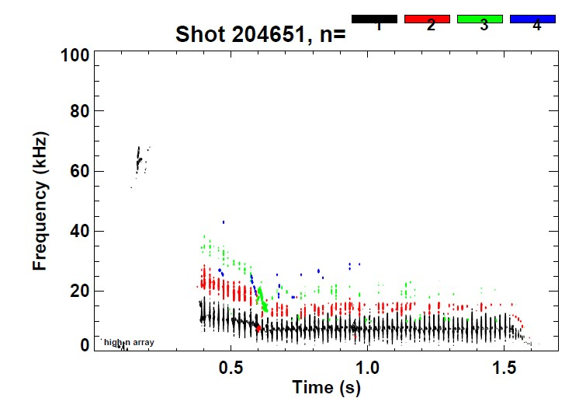
NSTX-U: Long-lived stationary sawtoothing discharges generated with core rotation f~15kHz
W. Guttenfelder
Previously very difficult to achieve in NSTX due to limited flat-top

Slide 21
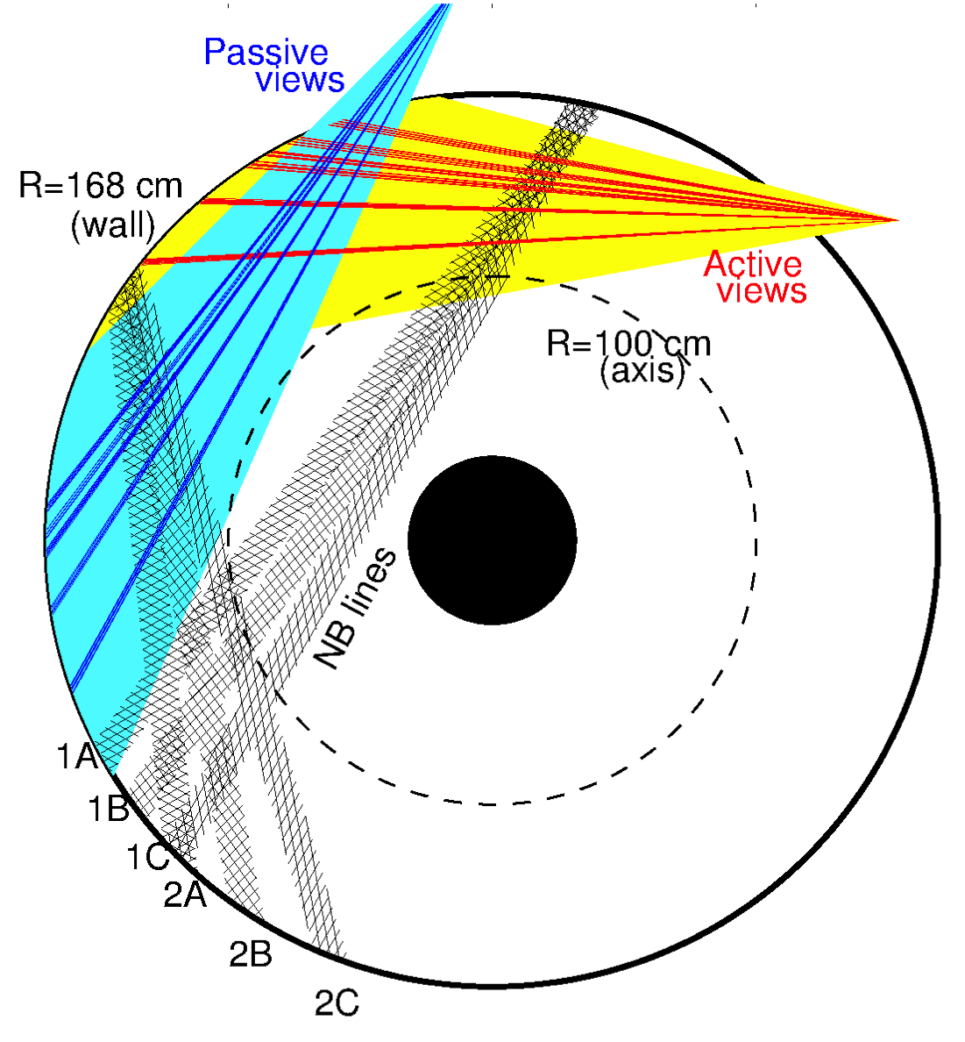
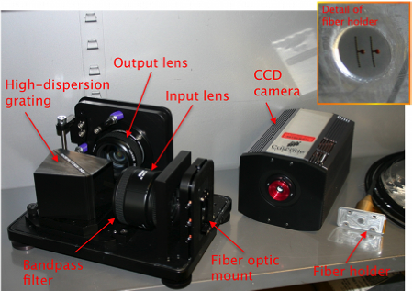
Real-Time Velocity (RTV) is a fast (up to 5kHz) system based on active spectroscopy
System based on active charge-exchange spectroscopy (NB1 line)
Monitor C VI, n=8-7 line @ 5291nm
RTV views interleaved with CHERS views at midplane
  4 views available
    R=112, 125, 132, 140cm
M. Podestá

Slide 22
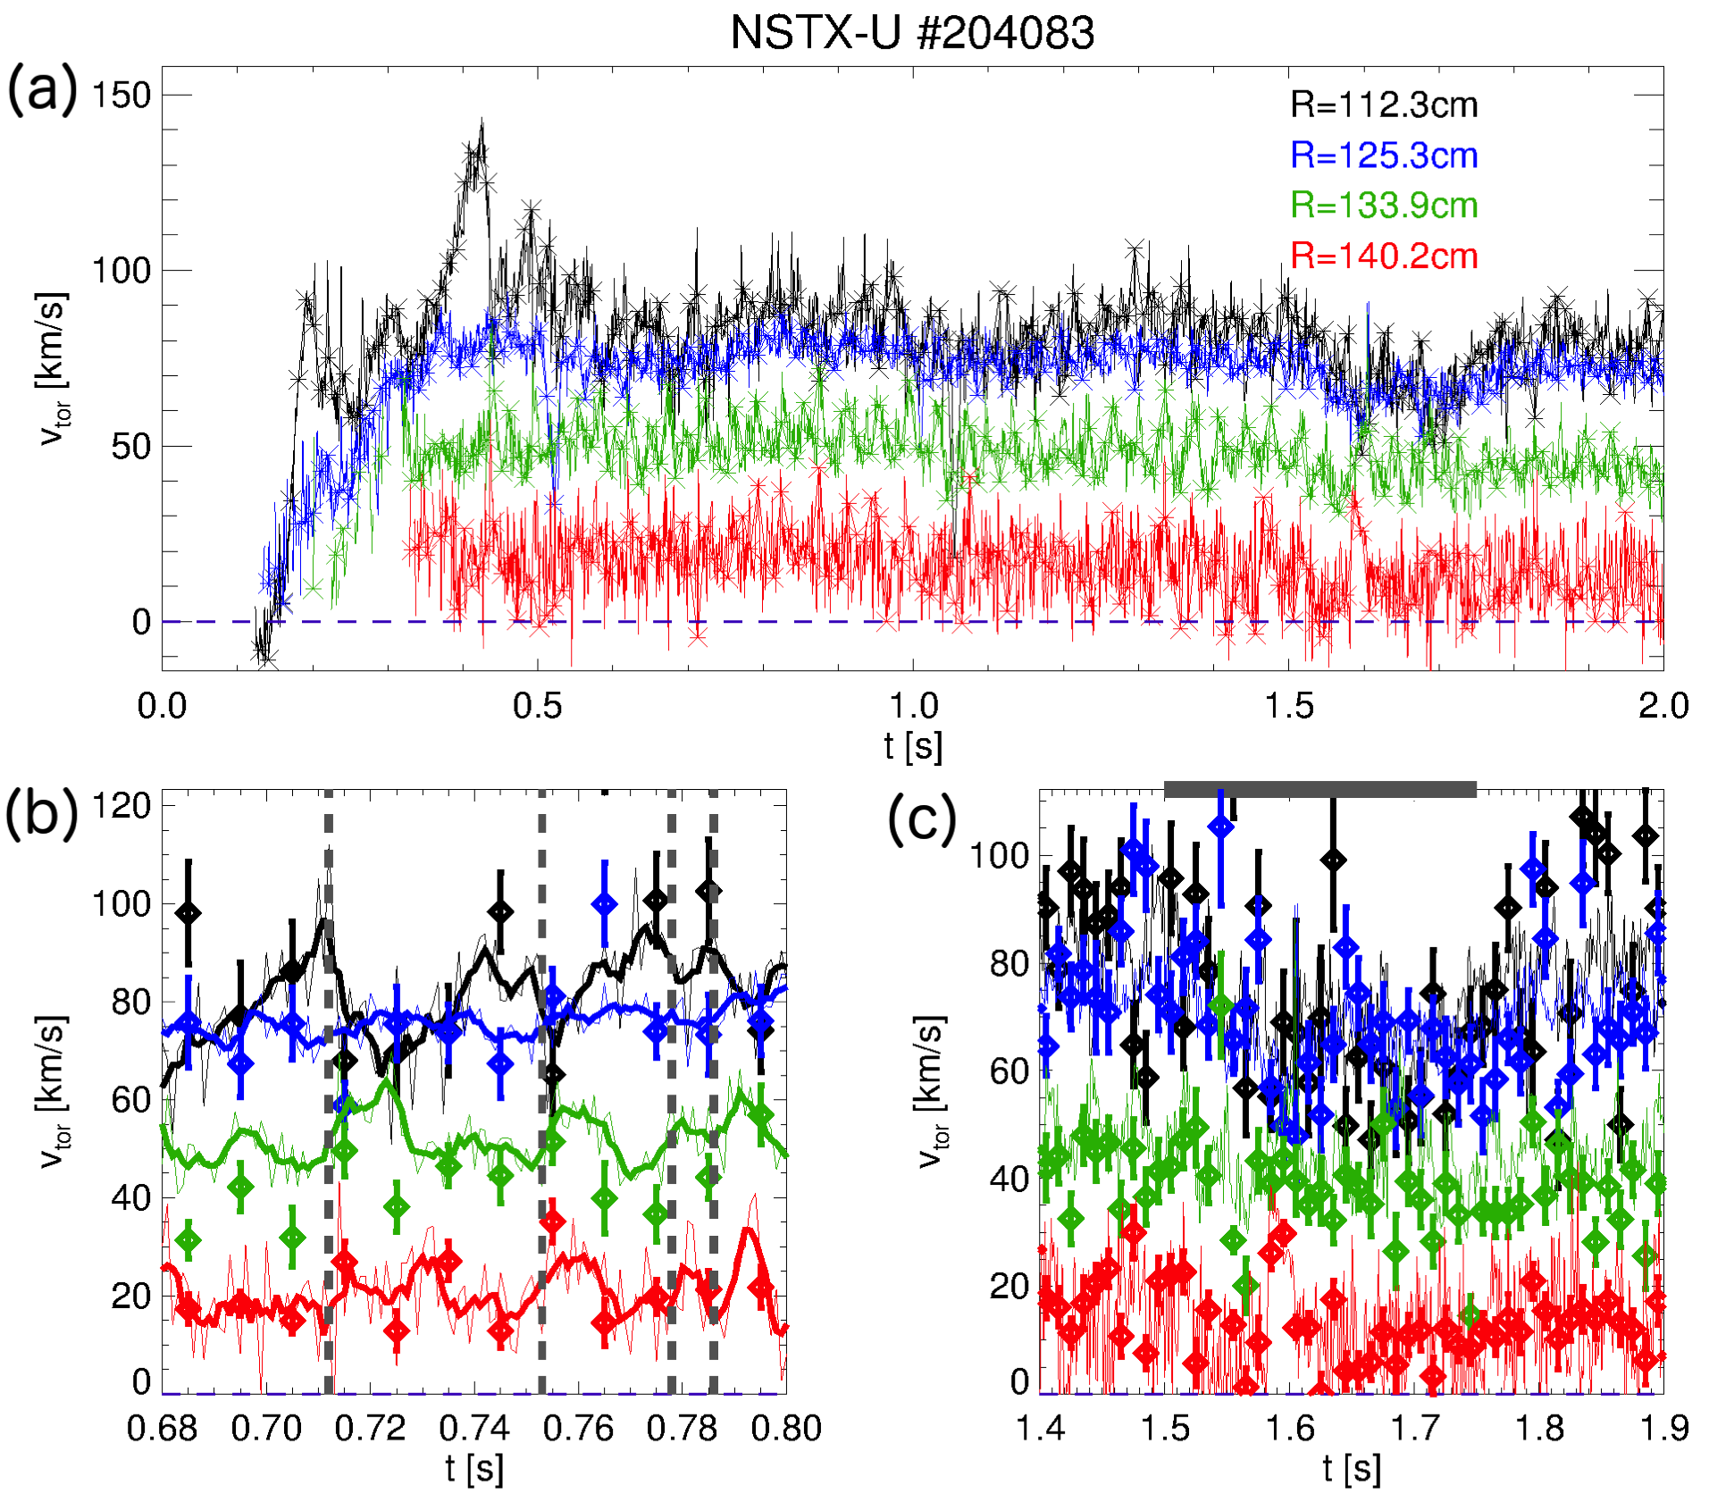
Sawteeth redistribute momentum, core v_{φ} decreases by ~20%
L-mode, P_{NB}~1MW
Sawteeth seen after t=0.5s
Crashes visible on v_{φ}(0), anti-correlate with increased v_{φ} at R>130cm
Large RMP pulse at 1.5s captured by RTV, CHERS
M. Podestá

Slide 23
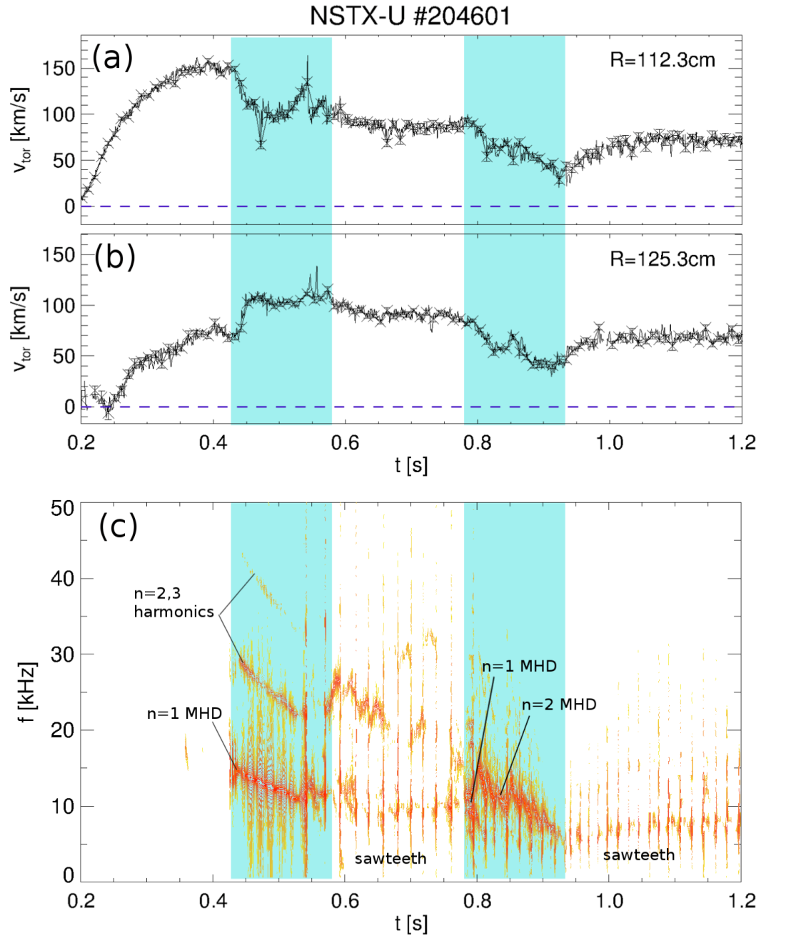
MHD, sawteeth compete in v_{φ} redistribution; different time scales, high f_{samp} or RTV enables separation
Complex scenario
  MHD n=1,2 modes act on ~10ms time scale
  Sawteeth act on ~1ms time scale
High f_{samp} of RTV allows to differentiate time scales
Complements high spatial resolution CHERS profiles
M. Podestá

Slide 24
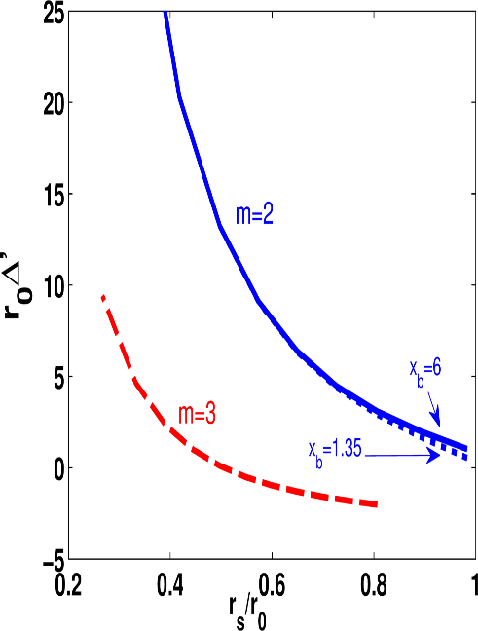
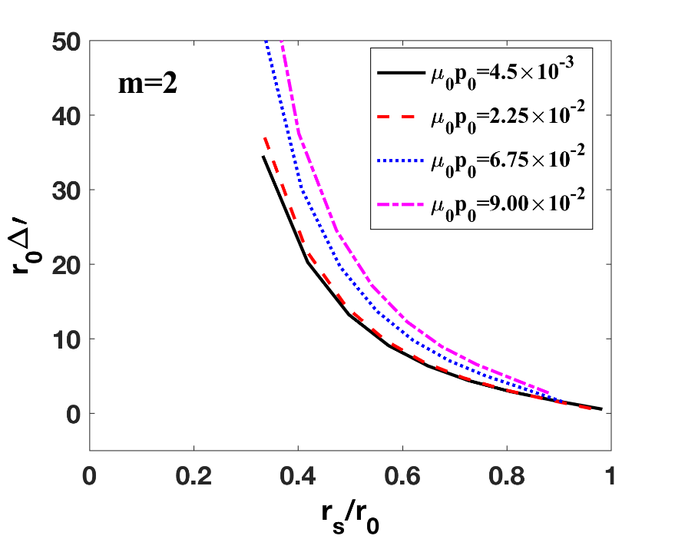

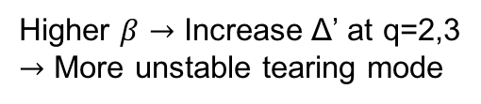
Resistive DCON Solves Reliable Outer Region Δ′ and Indicates Δ′ is Destabilized by Plasma Pressure
Resistive DCON reproduces Δ’ behavior in Furth, Rutherford and Selberg, Phys. Fluids 16, 1054(1973).
Higher $β$ $→$ Increase Δ’ at q=2,3
$→$ More unstable tearing mode
Resistive DCON solves Δ’ in full toroidal geometry.
n=1 m=2
$$β$$
n=1 m=3
Δ’ at q=2
First resistive DCON paper has been published.
Glasser, Wang and Park, Phys. Plasmas 23, 112506 (2016)
Z. Wang

Slide 25
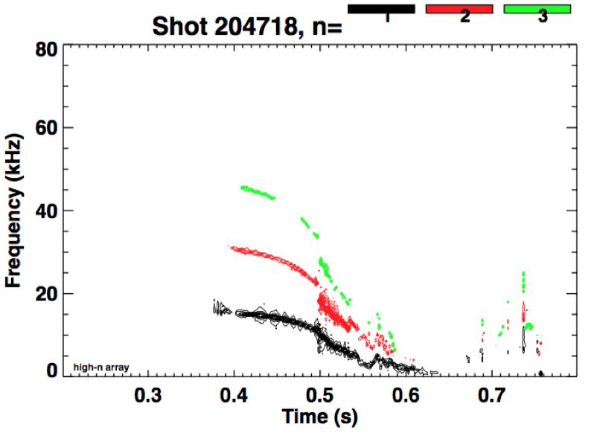
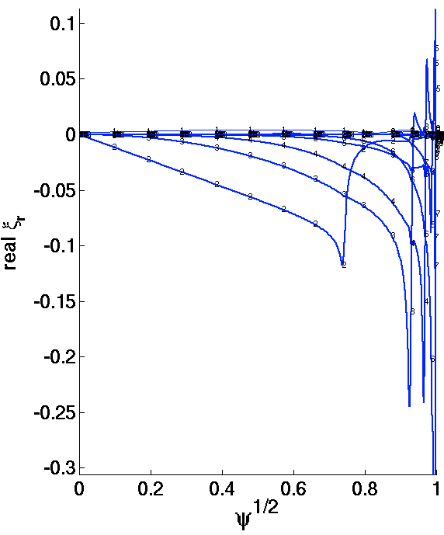
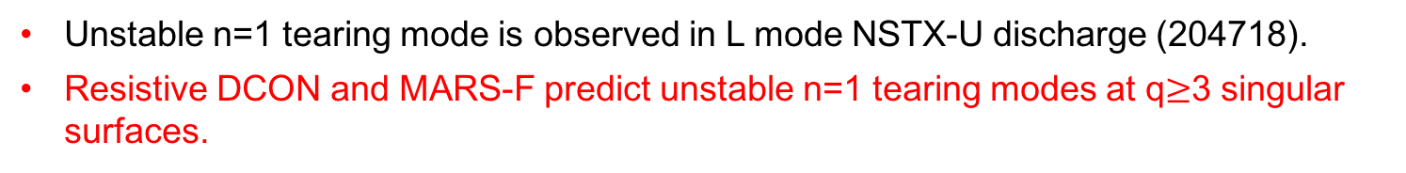
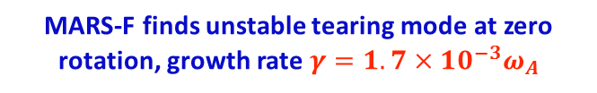
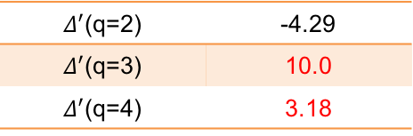
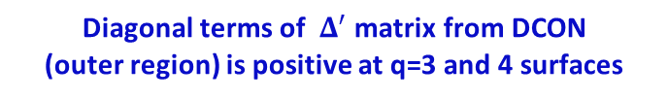
Preliminary result: Resistive DCON and MARS-F predict unstable n=1 tearing mode as observed in NSTX-U experiments
Unstable n=1 tearing mode is observed in L mode NSTX-U discharge (204718).
Resistive DCON and MARS-F predict unstable n=1 tearing modes at q$≥$3 singular surfaces.
Diagonal terms of $Δ^{′}$ matrix from DCON
(outer region) is positive at q=3 and 4 surfaces
CAVEATS: No MSE, n=1 mode may be 1/1 mode?
$Δ^{′}$(q=2) | -4.29
$Δ^{′}$(q=3) | 10.0
$Δ^{′}$(q=4) | 3.18
NSTX-U experiment observes n=1 unstable mode which drives n=2, 3 modes later
MARS-F finds unstable tearing mode at zero rotation, growth rate $γ=1.7×{10}^{−3}ω_{A}$
Odd parity
(Tearing)
n=2,3 modes driven by n=1 mode
Unstable n=1 mode
m=2
3
Even parity
4
Z. Wang

Slide 26
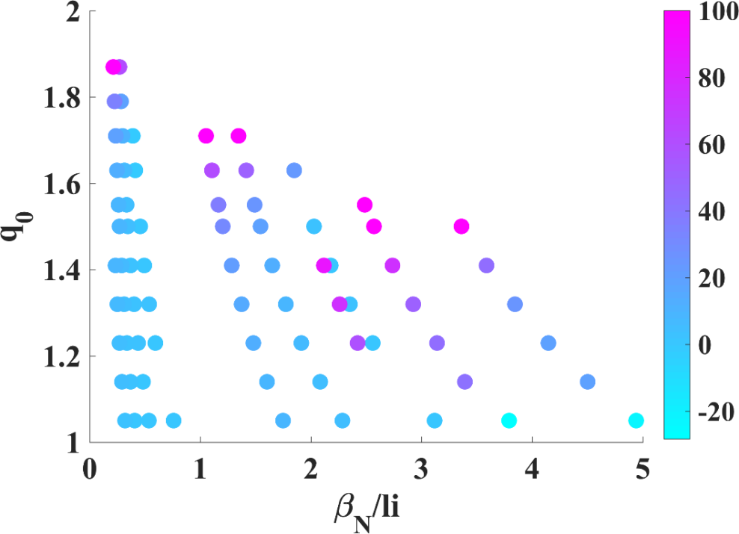
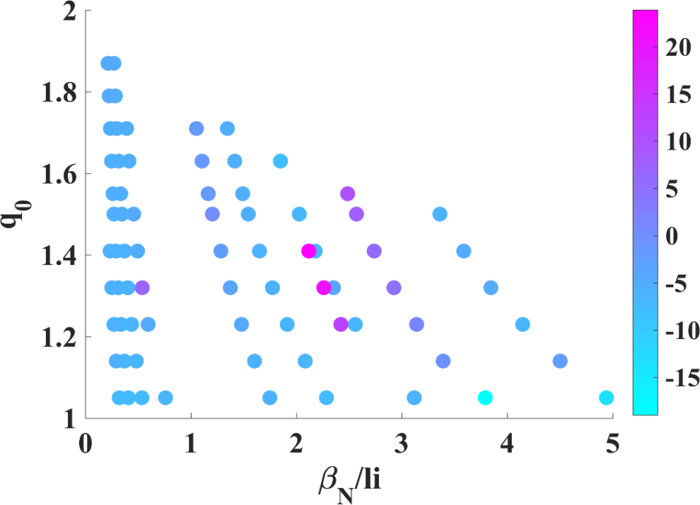


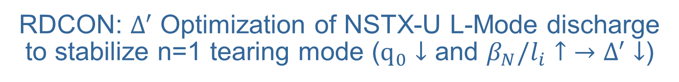
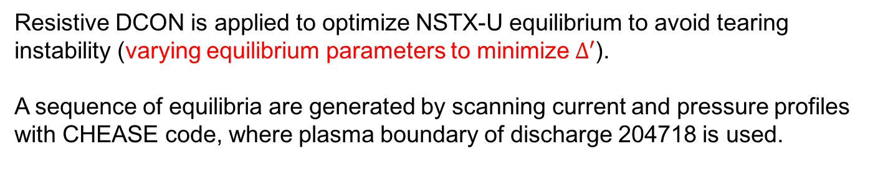


RDCON: $Δ^{′}$ Optimization of NSTX-U L-Mode discharge to stabilize n=1 tearing mode ($q_{0}↓$ and $β_{N}/l_{i}↑$ $→$ $Δ^{′}$ $↓$)
Resistive DCON is applied to optimize NSTX-U equilibrium to avoid tearing instability (varying equilibrium parameters to minimize $Δ^{′}$).
A sequence of equilibria are generated by scanning current and pressure profiles with CHEASE code, where plasma boundary of discharge 204718 is used.
For this scenario, reducing $q_{0}$ and increasing $β_{N}/l_{i}$ $→$ Decrease in $Δ^{′}$ at q=2,3
$Δ^{′}$ (q=2)
$Δ^{′}$ (q=3)
$$Δ^{′}$$
$$Δ^{′}$$
Z. Wang

Slide 27
NSTX-U Mission Elements:
Explore unique ST parameter regimes to advance predictive capability - for ITER and beyond
ITER
Topical science areas:
  Scenario Development
  Macroscopic Stability
  Transport and Turbulence
  Energetic Particles

Slide 28
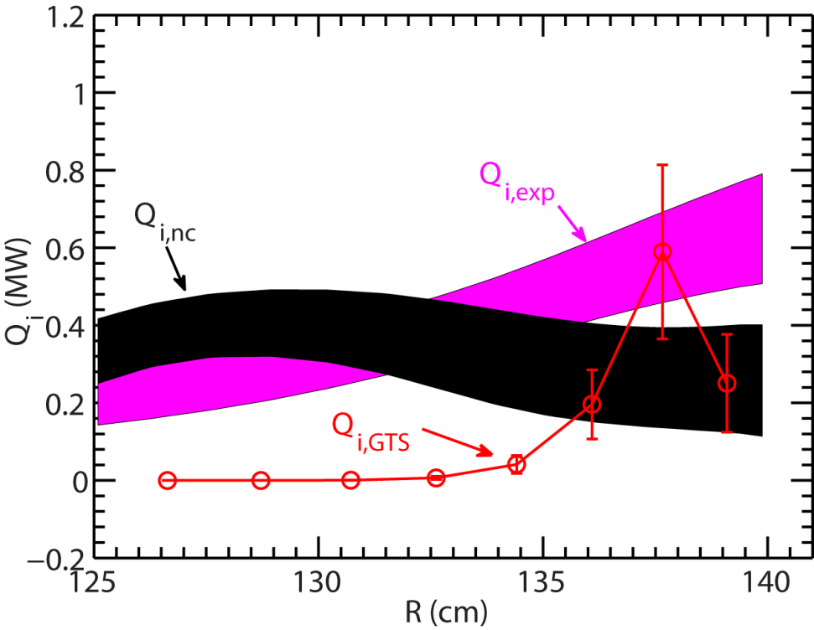
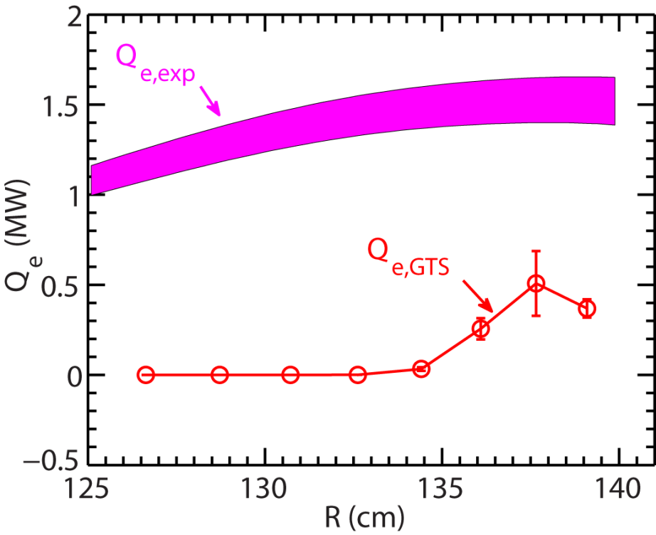
NSTX: Using global non-linear GTS gyrokinetic code to study multiple low-k turbulent transport mechanisms
Ion Temperature Gradient, Kelvin-Helmholtz modes + neoclassical, treat larger ρ*~0.01 of NSTX
NSTX NBI H-mode 141767, t=332ms, B_{T} =5.5 kG
Low-k turbulence contributes significantly for R > 135 cm
  Turbulence later suppressed by ExB shear
Total ion energy flux from GTS in agreement with experiment
GTS electron energy flux from only significant at R > 135 cm, and much smaller than experiment
Electron Temperature Gradient (ETG), electromagnetic effects important?

Slide 29
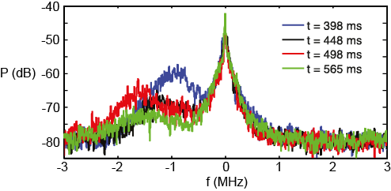
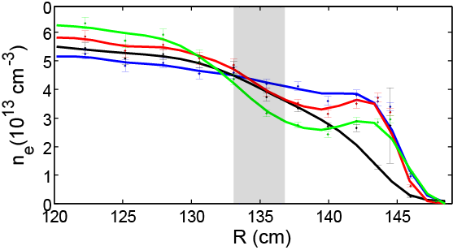
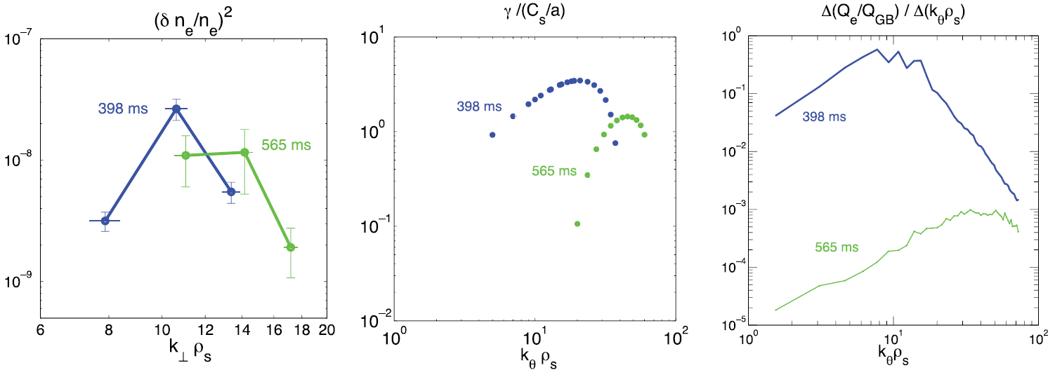

Linear and non-linear gyrokinetic simulations of Electron Temperature Gradient (ETG) modes show ∇n_{e} can be stabilizing
NSTX: Decrease in ETG turbulence amplitude w/ increasing ∇n_{e}
μ-wave
scattering
ETG
Scattering
region
NSTX 141767
∇T_{e} ~ constant
Measured δn/n, linear growth rates, non-linear Q_{e} all reduced by higher ∇n_{e}
(δn_{e}/n_{e})²
γ_{lin} / (c_{s}/a)
Low ∇n_{e}
High ∇n_{e}
Low ∇n_{e}
High ∇n_{e}
GS2
GYRO
k⊥/ρ_{s}
k_{θ} /ρ_{s}
k_{θ} /ρ_{s}
Non-linear GYRO under-predicts Q_{e} by 70-100% – need multi-scale GK?

Slide 30
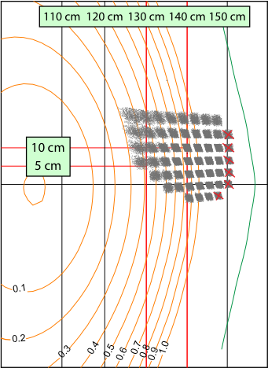
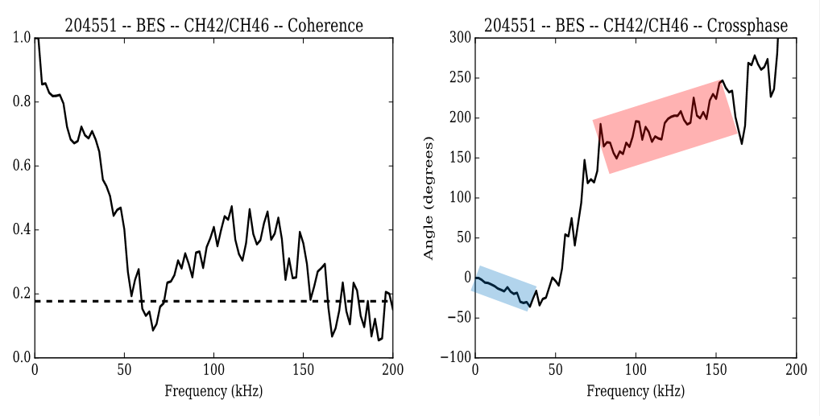

NSTX-U: Bimodal turbulence seen in some L-modes using upgraded 48 channel Beam Emission Spectroscopy (BES) system
ΔZ = 3 cm
R = 142 cm
Δt = 24 ms
11 km/s in ion
diamagnetic direction
13 km/s in electron
diamagnetic direction
Modes propagate in opposite directions
  Similar spectra seen with DIII-D and TFTR BES
  Potential link to grad B direction?
  Gyro-kinetic modelling underway

Slide 31
At ion scales (k_{θ}ρ_{s}<1), linear GYRO* simulations predict unstable spectra of ITG and microtearing modes (MTM)
ITG unstable R>135 cm, propagates in ion direction
  Propagation direction consistent with BES ion mode (need to consider Doppler shift, although also in ion direction)
MTM also unstable R>127 cm, propagates in electron direction
  Surprised to find MTM unstable ⇒ sufficient beta (4.1%) and large collisionality enhances MTM
e-direction
MTM
i-direction
ITG
*GYRO (Candy, Waltz, 2003)

Slide 32
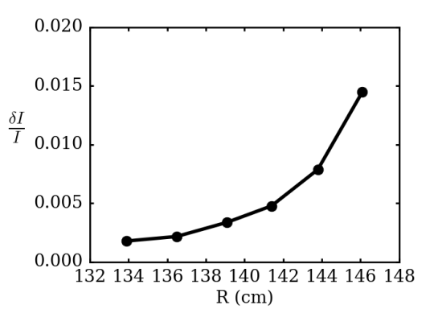
Strong variation in turbulence, stability and E×B shear over ≤ 30 ρ_{s} ⇒ motivates the need for global simulations
Strong local E×B shearing rates (γ_{E} > γ_{ITG}, γ_{MTM} at R=135 cm)
  BES amplitudes increasing where γ_{ITG} > γ_{E}
Significant variation over ~30 ρ_{s} (ρ* = ρ_{s}/a ~ 1/120, ρ_{s} / L_{T} ~ 1/35)
Motivates the need for global simulations
~30 ρ_{s}
BES δI/I
(50-200 kHZ)

Slide 33
Same NSTX-U L-modes: Nonlinear ETG simulations give significant transport (R=129-140 cm, r/a=0.47-0.67)
Q_{e,etg} large enough to account for Q_{e,exp} if Z_{eff}=Z_{eff,c}≈1.2
  Larger Z_{eff} (VB Z_{eff}≤2) → lower Q_{e,etg}
New high-k microwave scattering diagnostic (for 2018 run) will be ideal for probing region of ETG turbulence
May require multiscale simulations for validation
ρ ≈ 0.45 0.55 0.65 0.75
Notes:
Future new high-k scattering diagnostic will probe this
SOMETHING ABOUT MULTISCALE, HOWARD NF 2016, HOLLAND IAEA TH/6-1

Slide 34
NSTX-U Mission Elements:
Explore unique ST parameter regimes to advance predictive capability - for ITER and beyond
ITER
Topical science areas:
  Scenario Development
  Macroscopic Stability
  Transport and Turbulence
  Energetic Particles

Slide 35
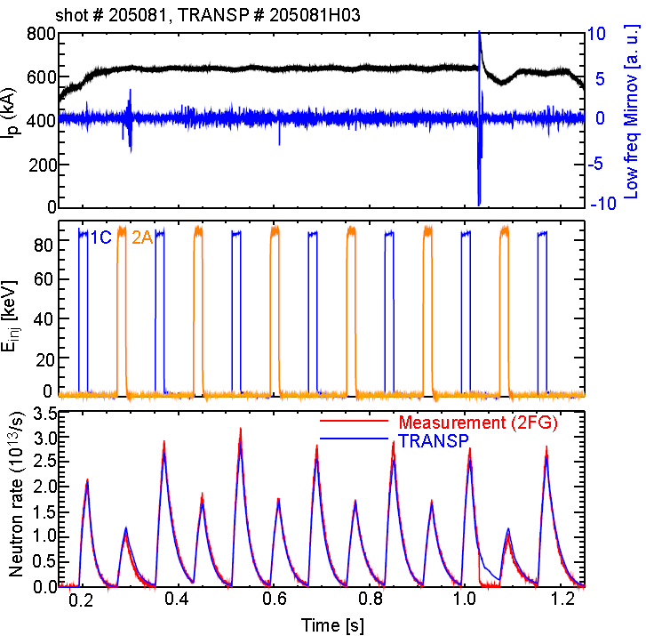
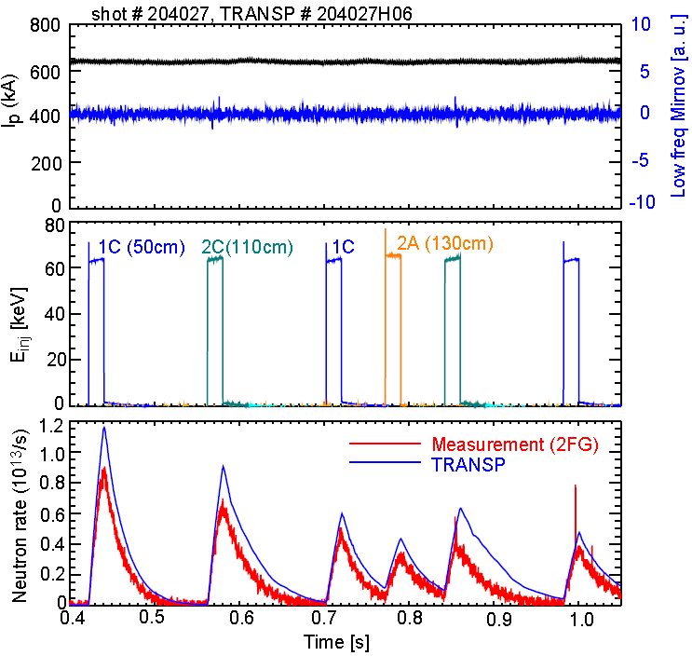
Explored fast-ion behavior with original and new NBI via beam blips with different NBI energies
E_{NBI} = 85keV
E_{NBI} = 65keV
Neutron rate
Good agreement between neutron measurement and TRANSP prediction
~20% discrepancy between data and TRANSP predictions
Exploring possible causes, including NBI source energy split

Slide 36

Agreement improved for E_{inj} = 65keV using small anomalous fast-ion diffusion
TRANSP decay time gets reasonable agreement with data when a small anomalous fast ion diffusivity (D_{af}=0.3m²/s) is used
→ Beam ion behavior is still close to classical theory

Slide 37

NSTX-U: Most tangential NBI generates counter-propagating Toroidal Alfvén Eigenmodes (TAEs)
Counter-propagating TAE predicted for hollow fast-ion profiles
H.V. Wong, H. Berk, Phys. Lett. A 251 (1999) 126.
TRANSP: As current builds up beam fast-ion beta profile predicted to become hollow
1st evidence of off-axis NBI in NSTX-U

Slide 38

NSTX-U tangential 2nd neutral beam suppresses Global Alfven Eigenmode (GAE) – consistent with HYM code
HYM #204707 t=0.44
HYM #204707, n=10
|δB_{n} |²
γ/ω_{ci}
t=0.44s
ω/ω_{ci}
t=0.47s
t ω_{ci}
n
Blue line: Doppler-shift corrected ω
Points/stars: experimental values
→ Data and simulation consistent
HYM shows suppression of n=10 counter-GAE by additional beam injection
Future modelling and experiments:
Explore impact on fast-ion and thermal electron transport

Slide 39
NSTX-U Mission Elements:
Explore unique ST parameter regimes to advance predictive capability - for ITER and beyond
ITER
Develop solutions for plasma- material interface (PMI)
Snowflake/X
Liquid metals / Li
ST-FNSF /
Pilot-Plant
Advance ST as Fusion Nuclear Science Facility and Pilot Plant

Slide 40




Improving understanding of SOL heat flux width trends in NSTX using XGC1 simulations
Experiment shows contraction of SOL heat flux width at midplane with I_{p} as well as influence of Li conditioning
XGC1 w/ collisions → similar trends
XGC-1:
20
Li dose 0 mg
150 mg
300 mg
Full-f, global PIC, kinetic ions and electrons
NSTX
Experiment
15
B_{P} scan
NSTX data and XGC-1: λ_{q} ~ 1 / I_{P}^{1.5}
Simulations for ITER presented at IAEA-FEC 2016 (C.-S. Chang) indicate turbulence can play significant role in setting heat-flux width
  Will SOL turbulence become important in NSTX-U at high current?
XGC1
Using 139047 at 665ms, 50 mg Li
λ_{q} (mm)
10
5
0
0.4 0.6 0.8 1 1.2 1.4
I_{P} (MA)
Heat flux width set primarily by neoclassical processes

Slide 41

NSTX-U: First systematic simulations of advanced divertors combined with 3D fields using EMC3-EIRENE
Standard Divertor
Near-Exact Snowflake
Snowflake Minus / X-divertor
Divertor heat-flux trends:
  Peaked heat loads in Near Exact Snowflake
  Lowest heat loads found for X-divertor-like configurations
  RMP fields do not significantly impact toroidal average heat-flux

Slide 42




Throughput-optimized camera and high-X-point L-modes enabled near-separatrix turbulence imaging in NSTX-U
Divertor turbulence imaging through different species/charge states provides information at different spatial locations
Throughput-optimized setup enabled turbulence imaging via C III (up to 140kHz)
  Filaments along divertor legs (vs. filament footprint on floor via Li I or Dα)
Reconstructed view + separatrix

Slide 43





Time delayed cross correlation shows opposite toroidal rotation for inner/outer leg filaments
Time-delayed cross correlation of single pixel with rest of image to show average filament propagation
Apparent poloidal motion for both inner and outer leg filaments towards X-point (also in C-Mod, J. Terry, JNME 2016)
  Or equivalently opposite toroidal directions
  Inconsistent with flux tube rigid rotation (as in J. Terry JNME 2016)
Poloidal velocity ~1km/s
Zero-delay cross correlation
Time-delayed cc
at different elevation
Inner-leg filament
Outer-leg filament

Slide 44




Material Analysis & Particle Probe (MAPP) providing new measurements of surface evolution in NSTX-U
Tracked C/B/O evolution, correlated with plasma performance
Implemented remote-control + between-shot MAPP analysis
Future: Use with Li, understand complex Li chemistry/evolution

Slide 45
NSTX-U Mission Elements:
Explore unique ST parameter regimes to advance predictive capability - for ITER and beyond
ITER
Develop solutions for plasma- material interface (PMI)
Liquid metals / Lithium
Snowflake/X
ST-FNSF /
Pilot-Plant
Advance ST as Fusion Nuclear Science Facility and Pilot Plant

Slide 46


Recent design studies show ST potentially attractive as
Fusion Nuclear Science Facility (FNSF) and Pilot Plant
FNSF: Provide neutron fluence for material/component R&D (+ T self-sufficiency?)
Pilot Plant: Electrical self-sufficiency: Q_{eng} = P_{elec} / P_{consumed} ≥ 1 (+ FNSF mission?)
FNSF with copper TF coils
A=1.7, R₀ = 1.7m, κ_{x} = 2.7, B_{T}=3T
Fluence = 6MWy/m², TBR ~ 1
FNSF / Pilot Plant with HTS TF coils
A=2, R₀ = 3m, κ_{x} = 2.5, B_{T} = 4T
6MWy/m², TBR ~ 1, Q_{eng} ~ 1
Designs integrate ST higher κ , β_{N} and advanced divertors (+ HTS TF for Pilot Plant)
J.E. Menard, et al., Nucl. Fusion 56 (2016) 106023

Slide 47

High current density HTS cable motivates consideration of lower-A tokamak pilot plants
ITER-like TF constraints:
  J_{WP}=20MA/m², B_{max} ≤ 12T
  P_{fusion} ≤ 130MW, P_{net} < -90MW
J_{WP} ~ 30MA/m², B_{max} ≤ 19T
  P_{fusion} ~ 400MW
  Small P_{net} at A=2.2-3.5
J_{WP} ≥ 70MA/m²,B_{max} ≤ 19T
  P_{fusion} ~500-600MW
  P_{net} = 80-100MW at A=1.9-2.3
J_{WP} [MA/m²]
(12T)
A ~ 2 attractive at high J_{WP}

Slide 48

A = 1.8-2.3 maximizes TF magnet utilization, and TF will be significant fraction of core cost
Eff. shield
thickness:
J_{WP} = 70MA/m²
0.3m
0.4m
0.5m
0.6m
0.7m
A=4 utilization ~1/3-1/2 of maximum at low A
Optimal range

Slide 49

A ≥ 3 maximizes blanket volume utilization
Eff. shield
thickness:
0.3m
0.4m
0.5m
0.6m
0.7m
J_{WP} = 70MA/m²
Is blanket volume vs. TF volume a good relative cost metric for liquid metal blankets?

Slide 50
Outline
NSTX-U mission
Research highlights
Progress on next-step ST concepts
Goals for next run
Summary

Slide 51
Goals for next NSTX-U run campaign
Only a subset, and will decide as a team via next Research Forum
Increase field to 0.8-1T, current to 1.6-2MA
Develop early H-mode / low-l_{i} / high-κ scenarios
Assess H-mode energy confinement, pedestal, and SOL characteristics with higher B_{T}, I_{P}, P_{NBI}
Complete assessment of effects of NBI parameters on fast ion distribution, neutral beam driven current profile
  Expand upon new physics already observed w/ tangential NBI
  Increase NBI current drive, non-inductive fraction
Key physics, operational tools for high-performance
  Developed shape & vertical control, new inboard gap control, EFC, HFS & LFS fueling under PCS, automated shutdown
  Need to commission: n=1 dynamic EFC, RWM control
  Test Impurity Granule Injector (IGI), MGI, Li evaporation

Slide 52
Expanding collaborations for outage period
Building upon and informing NSTX-U research
DIII-D: National Campaign – 2-3 weeks in multitude of research areas
EAST: Edge physics, plasma material interactions (high-Z, Li)
  Maingi + collaborators leading experiments this month / early next year
JET: Energetic particle studies and plasma ramp-down scenario development and modelling
  Podesta, Darrow, Poli
KSTAR: Core MHD and rotation physics, plasma control
  Sabbagh (Columbia) + group, J-K Park, J-W Ahn (ORNL)
MAST-U: Control, scenario modelling supporting 1st plasma
  Battaglia (+Boyer) tentatively planning visits/stays summer/fall 2017
W7-X: 3D confinement and stability
  Lunsford - alternate wall conditioning using boron powder dropper
WEST: start-up, RF physics, high-Z PMI, real-time wall protection
  Mueller going in spring, Reinke (ORNL) in fall, possibly PPPL RF physicists
LAPD at UCLA - RF coupling and heating physics, cavity modes
  R. Perkins leading RF development efforts
HL2A in China offering significant run-time
  Y. Ren will present capabilities/opportunities on 12/12

Slide 53
NSTX-U Program wants and needs MIT collaborator input on the upcoming 5 year plan
May have only 10 run weeks (mostly commissioning) for FY14-18 5YP
FY19-23 plan due spring 2018, peer-reviewed summer 2018
Begin brainstorming early 2017, then writing in summer / fall
Need to generate research goals, prioritize facility enhancements
Mission Elements and Present 5 Year Plan 5 Highest Priorities
Explore unique ST parameter regimes to advance predictive capability - for ITER and beyond
  Study energetic particle physics prototypical of ITER/FNSF burning plasmas
  Understand energy confinement and MHD stability at high normalized pressure
Develop solutions for PMI challenge
  Dissipate high edge heat loads using expanded magnetic fields + radiation
  Compare performance of solid vs. liquid metal plasma facing components
Advance ST as possible FNSF / DEMO
  Form and sustain plasma current without transformer for steady-state ST
Are these still the best missions and priorities for the next 5 year plan?

Slide 54
NSTX-U strongly supporting advancing predictive capability, ITER, PMI solutions, and next-step STs
Productive first year of operations on NSTX-U
  Rapid H-mode access, scenario development, error field correction
  Surpassed NSTX maximum magnetic field and pulse-duration
  New fast-ion physics with 2nd NBI – GAE stabilization, counter TAE
  Commissioned new advanced PMI diagnostics – MAPP
Developing advanced predictive capability
  New models for tearing stability, reduced models for RWM
  Global ion-scale turbulence (GTS), ∇n ETG stabilization
  GAE stabilization from 2nd NBI consistent with simulation
  Exploring SOL widths, advanced divertor interactions with 3D fields
Developed attractive Cu, HTS ST-FNSF, Pilot concepts
In 2017 will emphasize collaborations, 5YP prep
Aim to resume NSTX-U physics operation in CY2018

