Slide 1


Motivations for Spherical Torus research and initial results from NSTX Upgrade
Jonathan Menard (PPPL)
Thanks to many contributions from
ST community and NSTX-U Researchers
PPPL – MBG Auditorium
January 11, 2017

Slide 2
Outline
Introduction
Why spherical tori / tokamaks (STs)
NSTX-U initial results, long-term directions
Summary

Slide 3
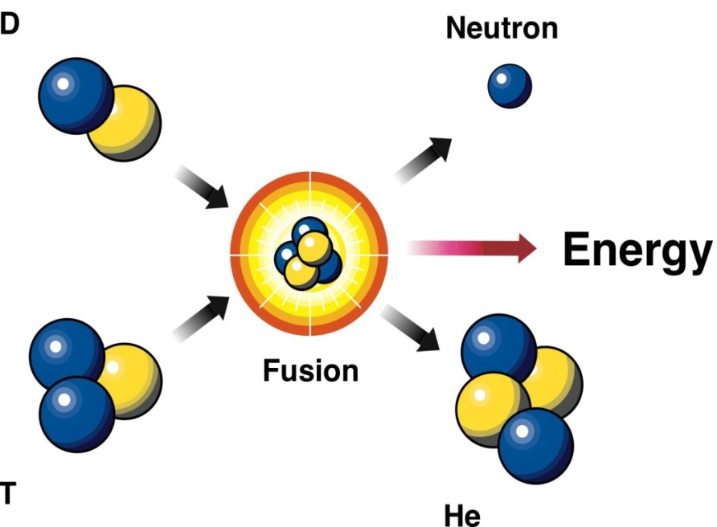
Why fusion?
“D-T” fusion reaction:
High energy gain ≈ 1000 ×
No runaway reactions
Abundant fuel supply
Waste short-lived, low-level
No CO₂ production
D: deuterium
n: neutron
T: tritium
α: helium
E = mc²

Slide 4
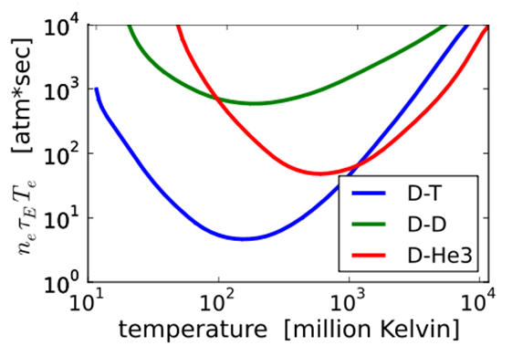
Fusion requires very high temperatures
Fusion difficulty
(pressure × confinement)
Fusion is easiest here at 200 million ^{ᵒ}C (!!) (350 million ^{ᵒ}F)
  Requires lowest pressure nT and energy confinement time τ_{E}
  Minimum fusion “triple-product” value: 8 atmosphere-seconds

Slide 5
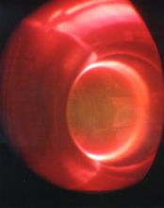
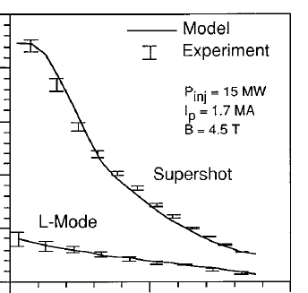
Magnetic fusion has already achieved the necessary very high temperatures!
TFTR at PPPL (1990’s)
~250 million C
core
boundary

Slide 6
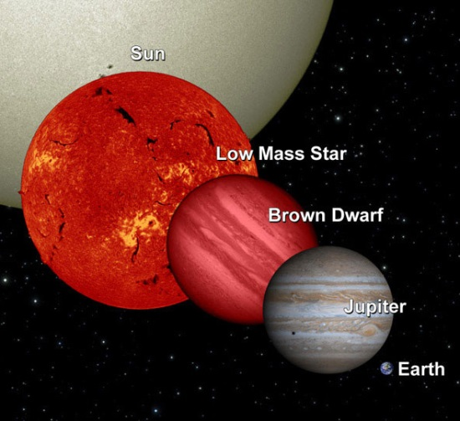
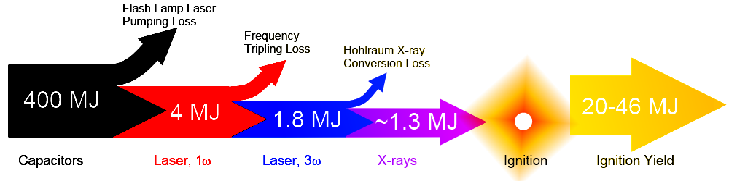

Magnetic fusion is arguably closest to ultimate goal of electricity generation
Gravitational confinement fusion requires large device
  Need 7-8% of mass of our sun
  Approximately 10× diameter of Earth
Laser fusion ala NIF at best has E_{fusion} / E_{electrical} ~ 5%
  So far, 0.006% efficient
Magnetic fusion in ITER:
  Goal: 500MW fusion power for
  ≤ 600MW electrical input for 400s
  Industrial levels of fusion power
Ryan Hamerly (Stanford)
~25kJ fusion yield achieved

Slide 7
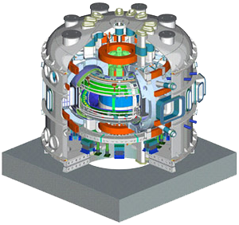
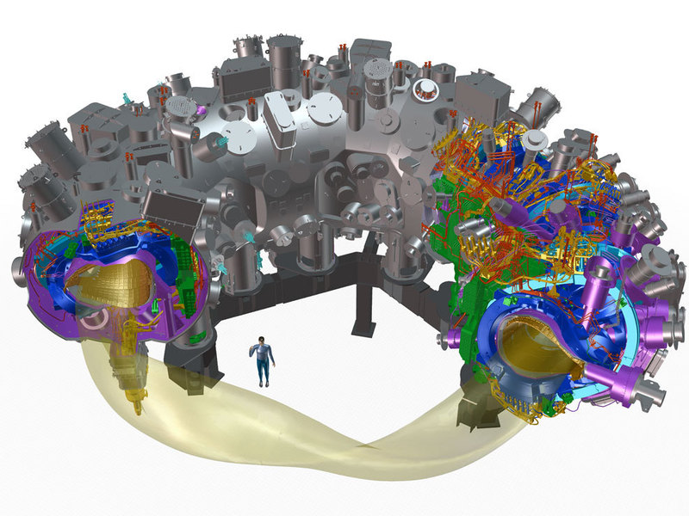
Tokamaks and stellarators are the leading configurations in magnetic fusion
Superconducting tokamak
Superconducting stellarator
KSTAR (South Korea)
W7-X (Germany) – 1st run campaign in 2016
Tokamak advantages:
  Best confinement, closest to “breakeven”
  Simpler planar coils and power/particle exhaust
Disadvantages:
  Must drive multi-mega-ampere plasma current
  More prone to rapid loss of plasma = “disruption”
    Potential show-stopper for tokamak power-plant
Stellarator advantages:
  No plasma current drive necessary
  More stable, steady-state
Disadvantages:
  More complex coils and exhaust
  Confinement < tokamaks (so far…)

Slide 8
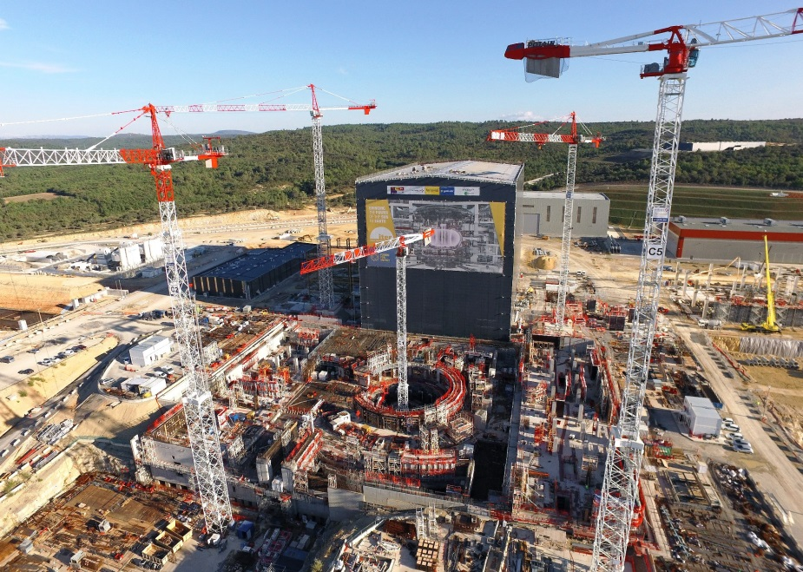
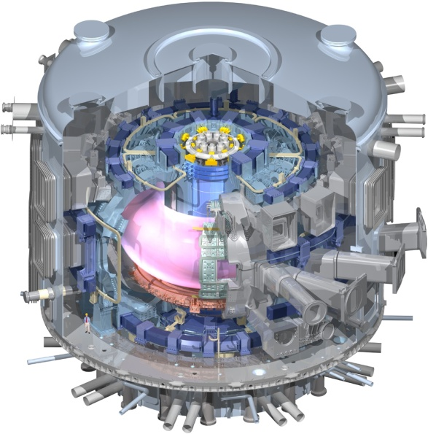
ITER will be first device to access “burning plasma”
Burning plasma: majority of plasma heating power comes from fusion alpha particles from DT reactions
  DT reaction energy split: 1/5 in alphas, 4/5 in neutrons
ITER goal Q = P_{fusion} / P_{external heating} = 10
Q = 10 → P_{alpha} / P_{external} = 2
P_{alpha} / P_{alpha + external} = 2 / 3 > 50%
A=3.1, R=6.2m, B_{T}=5.3T, I_{P}=15MA
ITER under construction in Cadarache, France

Slide 9
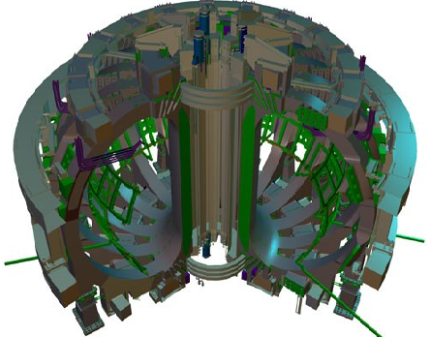
ITER magnets will be largest ever built
18 toroidal field magnets
12 Tesla at coil
Weight: 6500 tons
80,000 km of Nb3Sn superconducting strand in total length
These are large numbers
Plasma current:
15 million amps
Toroidal field current
165 million amps

Slide 10
Perspective
Studying burning plasmas is essential to fusion development, and ITER is presently the best approach
But as we look beyond plasma self-heating toward economical electricity production, how might we improve?

Slide 11
Assuming cost ∝ size → need higher fusion power / volume = high fusion power density
Fusion power density ∝ (plasma pressure)²
β ≡ plasma pressure / magnetic pressure = p/(B²/2μ₀)
Maximum β limited by MHD instabilities
B limited by magnet stress, cooling, quench
Fusion power density ∝ β² B⁴
Maximize / optimize this product

Slide 12
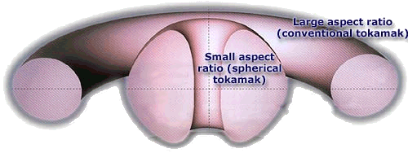
Aspect ratio is important free parameter
Aspect ratio A = R / a
R = major radius a = minor radius
R
a
Spherical torus/tokamak (ST) has A = 1.1-2
Conventional tokamak typically A = 2.5-4

Slide 13
STs have higher natural elongation
Elongation κ = b / a
b = vertical ½ height a = minor radius
b
a
Higher elongation improves stability, confinement

Slide 14
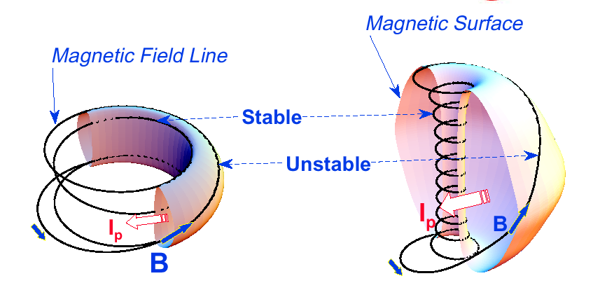
Favorable average curvature improves stability
Tokamak
ST
Plasma spends less time in unstable curvature region
A ~ 2.5-4
κ = 1.5-2
β_{T} = 3-10%
A ~ 1.3-2
κ = 2-3
β_{T} = 10-40%
Aspect Ratio A = R /a
Elongation κ = b/a
Toroidal beta β_{T} = ⟨p⟩ / (B_{T0}²/2μ₀)
Notes:
A spherical tokamak is a low aspect ratio tokamak. Tokamak is a donut like aspect ratio of about 3 where as ST is aspect ratio of about 1.5. As the aspect ratio is reduced, the hole of the donut is reduced and it disappears entirely at A = 1. As the aspect ratio is reduced, the plasma elongate naturally takes on the spherical shape due to self fields. Another important property is the magnetic field line. The tokamak magnetic field line goes around torus at relatively constant pitch where as the ST geometry, the field line transit the outboard unstable region quickly but spend many toroidal transits in the inboard stable region. This makes ST plasma stable for high beta and also makes the edge safety factor high ~ 10 compared to ~ 3 for tokamak.
As a result, there are a number of new unique physics regimes which can be accessed at low aspect ratio, which can be utilized to enhance the understanding of toroidal confinement physics and improve predictive capabilities for ITER and future fusion facilities.

Slide 15

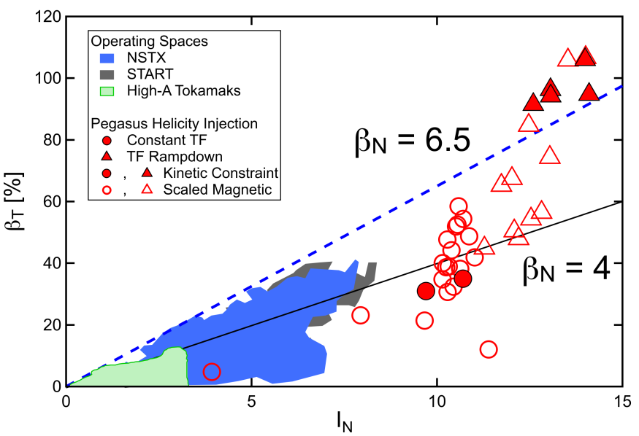
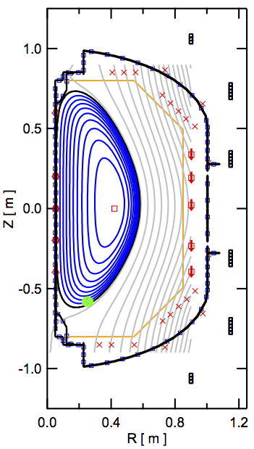
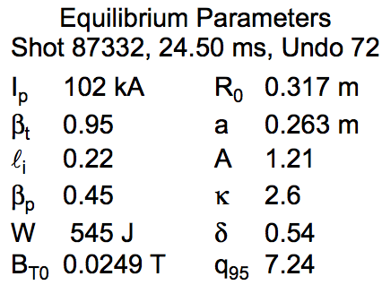
STs can access very wide range of β_{T}
Pegasus ST recently accessed β_{t} ~ 50-100%
120
100
80
60
β_{T} (%)
40
20
0
0
5
I_{N} = I_{P} / aB_{T}
10
15
β_{T} for sustained, low-ℓ_{i}, high-κ, LHI-driven plasmas
Notes:
TO SAY:
I’m showing a sample magnetic reconstruction here on the left hand side which uses these kinetic constraints, here for a plasma current of 0.1 MA and toroidal field of 25 mT.
These plasmas are highly elongated, and have an extremely low li. For this case, we obtain a toroidal beta of 95%.
On the right hand side I’m showing a Troyon plot, a scatter plot of toroidal beta versus normalized plasma current. Operating spaces of several other tokamaks are shown as shaded regions, and updated Pegasus discharges are highlight as individual points. I should mention that the filled-in symbols represent beta-values obtained directly from kinetically-constrained equilibrium reconstructions. The empty symbols are magnetics-only reconstructions that have been calibrated based on the constrained results.
We note that some of the highest beta values come directly from kinetically-constrained equilibria.
I should also point out, too, that all of these discharges used zero Ohmic drive. Every Pegasus plasma on this plot was produced using solely Local Helicity Injection.
TO DO:
- Get list / have list on hand of caveats from Ray’s IAEA talk…

Slide 16
Why explore spherical torus/tokamak?
Potentially attractive for electricity production
  Requires accompanying magnet innovations
High neutron wall loading in small device
  Well suited for fusion nuclear component R&D
Improve toroidal physics predictive capability
  High β and high temperature at low collisionality
  Understand confinement, fast-ion physics for ITER

Slide 17
Why explore spherical torus/tokamak?
Potentially attractive for electricity production
  Requires accompanying magnet innovations
High neutron wall loading in small device
  Well suited for fusion nuclear component R&D
Improve toroidal physics predictive capability
  High β and high temperature at low collisionality
  Understand confinement, fast-ion physics for ITER

Slide 18
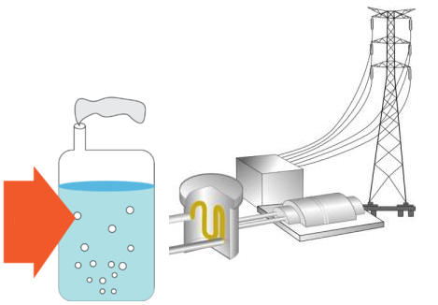

How would magnetic fusion make electricity?
Plasma
(100 million ^{ᵒ}C)
Magnets
(-270 - 100^{ᵒ}C)
Steam or hot helium
External heating
(10’s of MW)
Neutrons
α self heating
Heat
Spin turbines, generate electricity
Blanket
(350 - 1000^{ᵒ}C)
Tritium bred from lithium in blanket
helium and deuterium exhaust

Slide 19
Electricity gain Q_{eng} determined primarily by engineering efficiencies and fusion gain
Electricity produced
Electricity consumed
Q_{eng} ≡
=
Q_{eng} = η_{th} η_{aux} Q ×
η_{th} ≡ thermal power conversion efficiency
η_{aux} ≡ injected power wall plug efficiency
Q ≡ P_{fus} / P_{aux} = fusion power / auxiliary power
  Parameter Assumptions:
    M_{n} = 1.1, P_{pump} = 0.03×P_{th}
    P_{sub} + P_{control} = 0.04×P_{th}
    η_{aux} = 0.3
    η_{CD} = I_{CD}R₀n_{e}/P_{CD} ≈ 0.3×10²⁰A/W/m²
For more details see J. Menard, et al., Nucl. Fusion 51 (2011) 103014

Slide 20
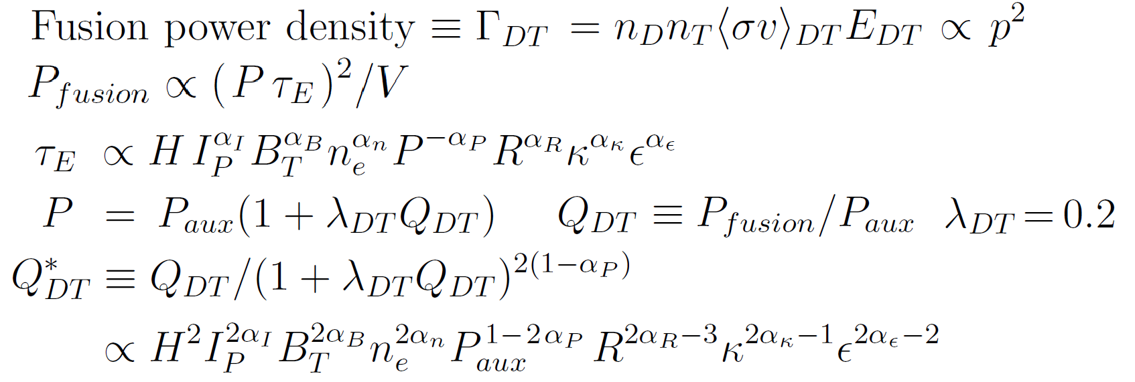
Gain is very strong function of confinement:
Q_{DT} ∝ H^{2→5} from low → high gain
ε ≡ A⁻¹
Fix current, field, density, geometry, auxiliary power, α_{P} = 0.7:
Q_{DT} ≤1 → Q_{DT} ≈ Q*_{DT} ∝ H² Q_{DT} >>1 → Q_{DT} ∝ Q*_{DT}^{2.5} ∝ H⁵

Slide 21
Gain vs. physics & engineering constraints
Steady-state tokamaks: current-driven kink limit less relevant
Normalized β (β_{N}) and “bootstrap” fraction (f_{BS}) more important
Relevant variables are β_{N} / f_{BS} and normalized density f_{gw} →
Use electrostatic gyro-Bohm τ_{E} scaling with no β degradation (NSTX, JET, DIII-D)
C. Petty, et al., Phys. Plasmas 15 (2008) 080501
External current drive fraction
Need to optimize this product vs. aspect ratio

Slide 22
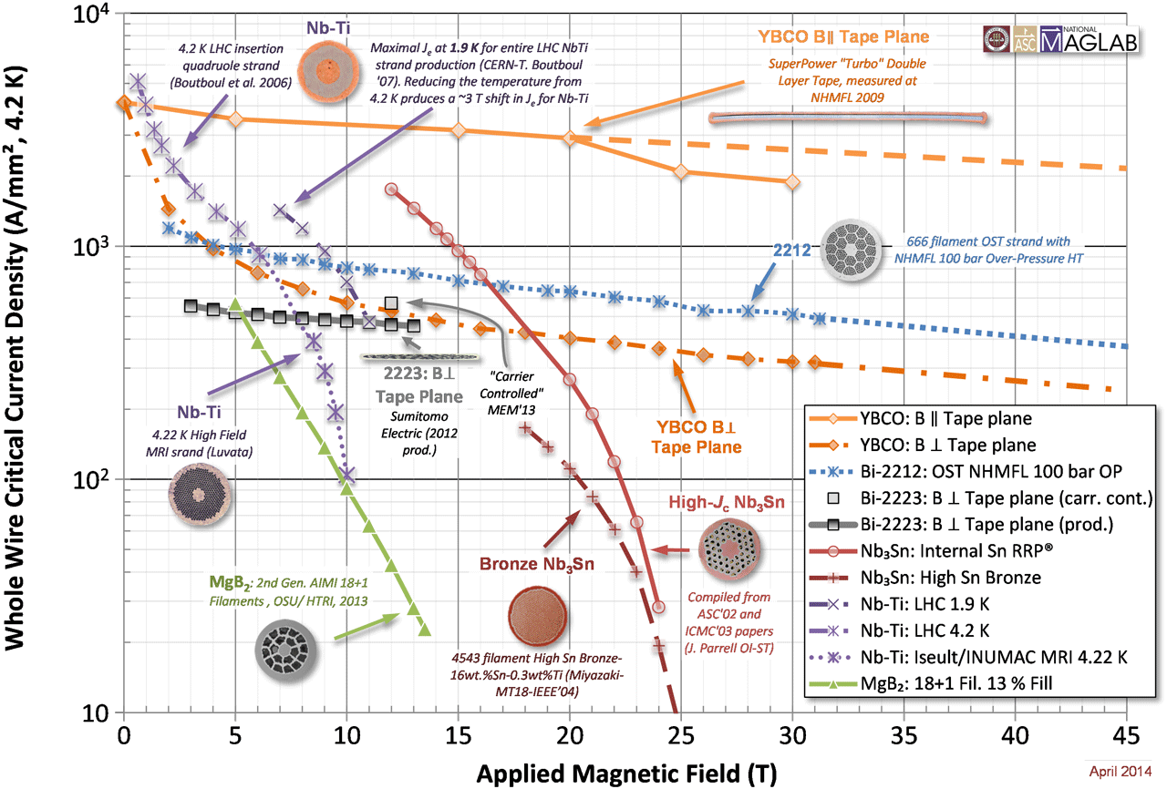
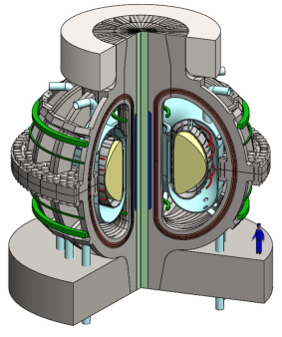
High temperature superconductors (HTS) could substantially expand fusion magnet performance
ARC (MIT)
HTS
Current Density
ITER CS
LTS
http://magnet.fsu.edu/~lee/plot/plot.htm
Applied Magnetic Field (T)

Slide 23
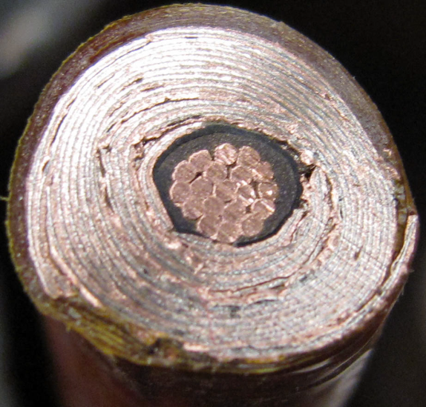
Cables formed from HTS tapes achieving high winding pack current density at high B
10 mm
Conductor on Round Core Cables (CORC)
J_{WP} ~ 70MA/m² 19T
6 mm
10 mm
7 kA CORC (4.2K, 19 T) cable
Base cable: 50 tapes YBCO Tapes with 38 mm substrate (Van Der Laan, HTS4Fusion, 2015)
7 mm
Base Conductor
He Gas Cooled
8kA,
J_{WP} ~ 160MA/m²
Higher J_{cable} HTS cable concepts under development:
Copper
7 mm
SS conductor jacket for strength

Slide 24
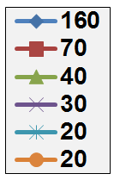
High current density HTS cable motivates consideration of lower-A tokamak pilot plants
Fix plasma major radius R₀=3m, heating power P_{NNBI}=50MW
ITER-like TF magnets:
  J_{WP}=20MA/m², B_{max} ≤ 12T
  P_{fusion} ≤ 130MW, P_{net} < -90MW
J_{WP} ~ 30MA/m², B_{max} ≤ 19T
  P_{fusion} ~ 400MW
  Small P_{net} at A=2.2-3.5
J_{WP} ≥ 70MA/m²,B_{max} ≤ 19T
  P_{fusion} ~500-600MW
  P_{net} = 80-100MW at A=1.9-2.3
J_{WP} [MA/m²]
(12T)
A ~ 2 attractive at high J_{WP}

Slide 25
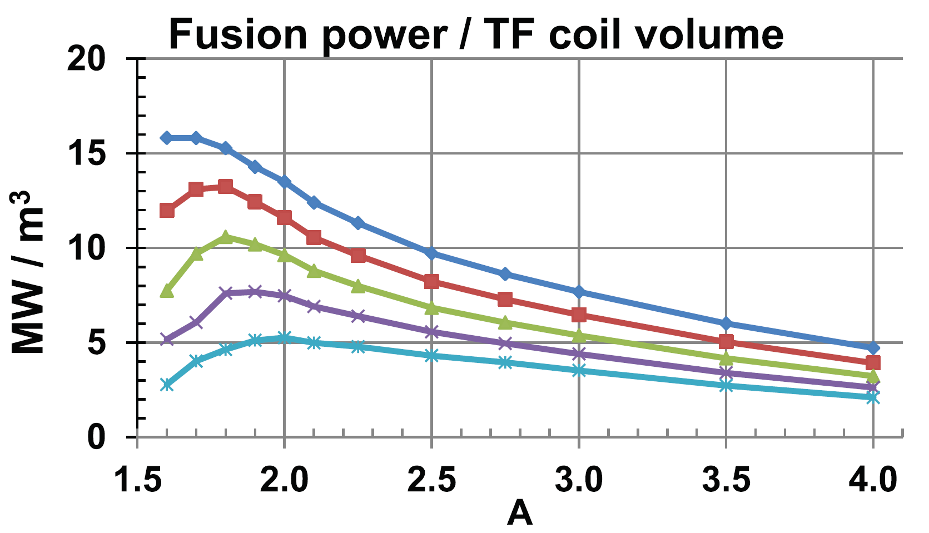
A = 1.8-2.3 maximizes TF magnet utilization, and TF will be significant fraction of core cost
Eff. shield
thickness:
J_{WP} = 70MA/m²
0.3m
0.4m
0.5m
0.6m
0.7m
A=4 utilization ~1/3-1/2 of max at low A
Optimal range

Slide 26
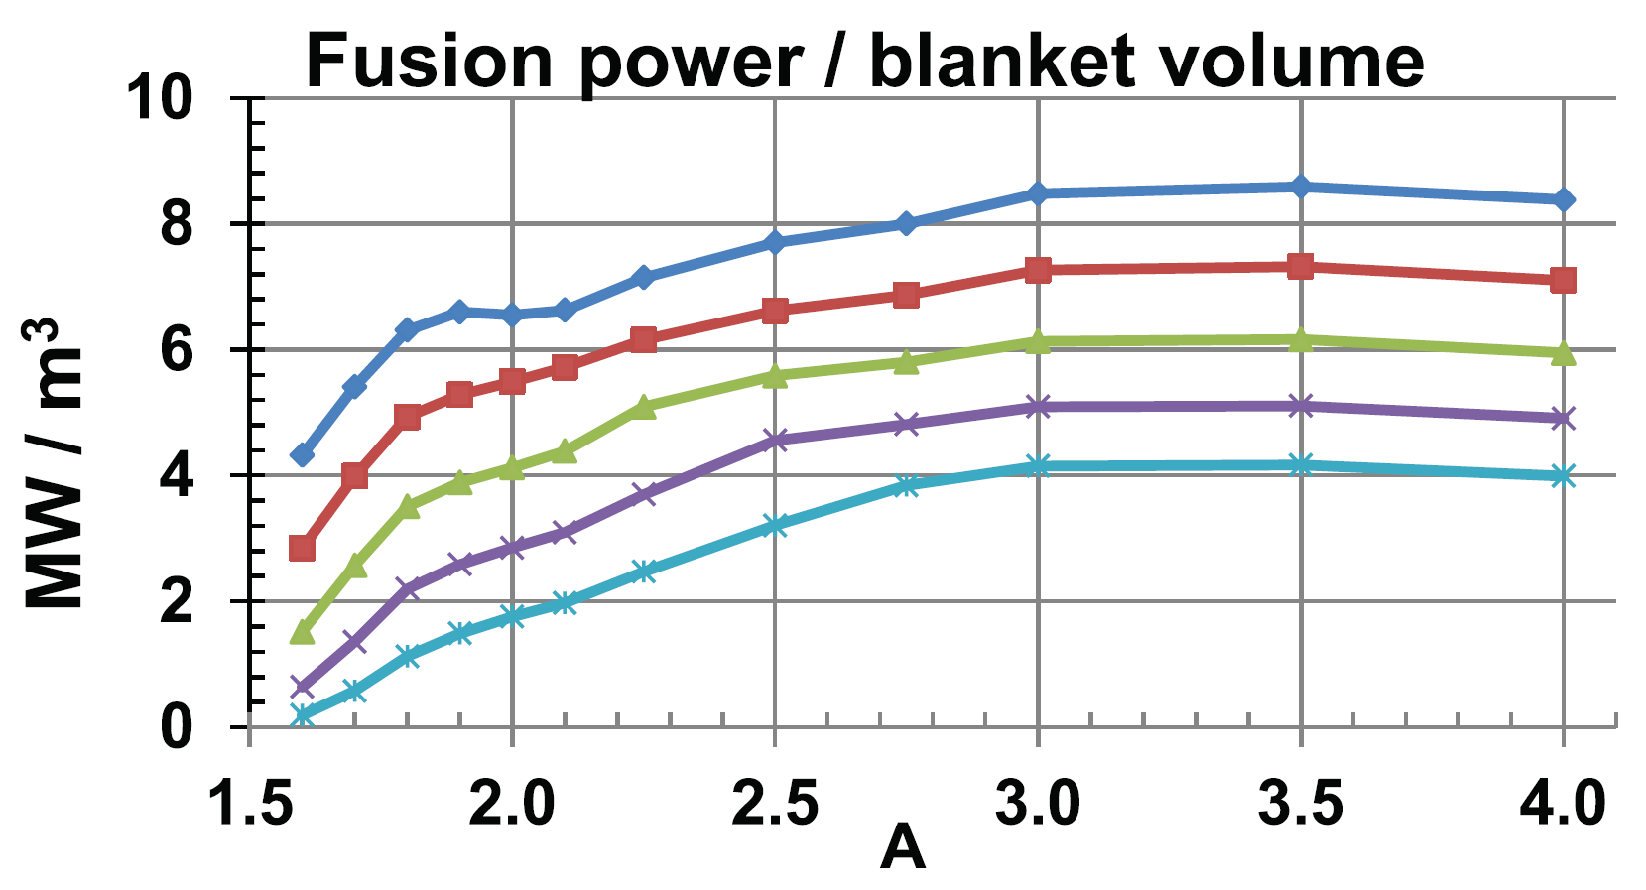
A ≥ 3 maximizes blanket volume utilization
Eff. shield
thickness:
0.3m
0.4m
0.5m
0.6m
0.7m
J_{WP} = 70MA/m²
Which components - magnets, blankets, ... dominate cost ?
Costing of these (never-been-built) objects has large uncertainty

Slide 27
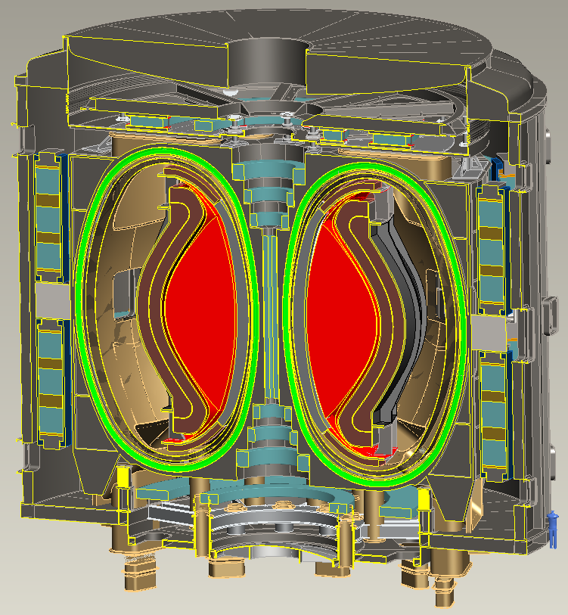
A=2, R₀ = 3m HTS-TF FNSF / Pilot Plant
B_{T} = 4T, I_{P} = 12.5MA
κ = 2.5, δ = 0.55
β_{N} = 4.2, β_{T} = 9%
H₉₈ = 1.8, H_{Petty-08} = 1.3
f_{gw} = 0.80, f_{BS} = 0.76
Startup I_{P} (OH) ~ 2MA
J_{WP} = 70MA/m²
B_{T-max} = 17.5T
No joints in TF
Vertical maintenance
P_{fusion} = 520 MW
P_{NBI} = 50 MW, E_{NBI} = 0.5MeV
Q_{DT} = 10.4
Q_{eng} = 1.35
P_{net} = 73 MW
⟨W_{n}⟩ = 1.3 MW/m²
Peak n-flux = 2.4 MW/m²
Peak n-fluence = 7 MWy/m²
Cryostat volume ~ 1/3 of ITER

Slide 28
Why explore spherical torus/tokamak?
Potentially attractive for electricity production
  Requires accompanying magnet innovations
High neutron wall loading in small device
  Well suited for fusion nuclear component R&D
Improve toroidal physics predictive capability
  High β and high temperature at low collisionality
  Understand confinement, fast-ion physics for ITER

Slide 29
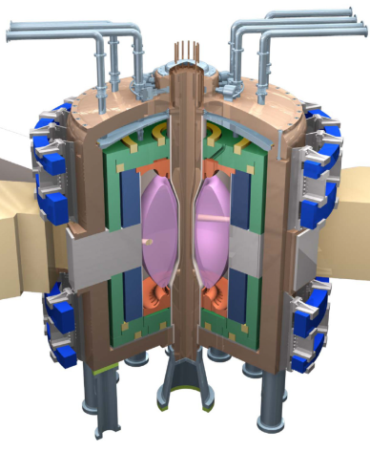
Fusion technology development is major challenge
Fusion Nuclear Science Facility (FNSF) could aid development
Need to develop reliable and qualified nuclear components unique to fusion:
Divertor and plasma facing components
Blanket and first wall
Vacuum vessel and shielding
Tritium fuel cycle
Remote maintenance
ST-FNSF
Y.-K.M. Peng (ORNL)
Without R&D, fusion components could fail prematurely, requiring long repair/down time.
This would cripple power plant operation
FNSF can help develop reliable fusion components
Such FNSF facilities must be: modest cost, low T, reliable

Slide 30
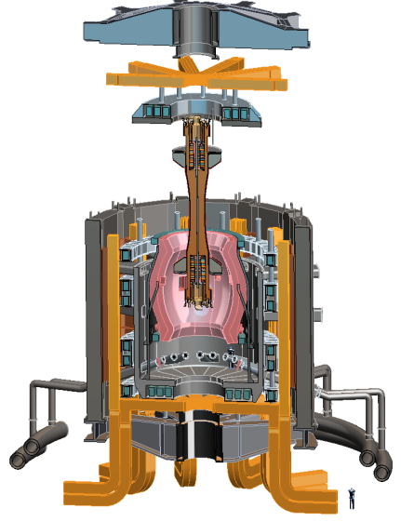
Design studies show ST potentially attractive as FNSF
PPPL ST-FNSF concept
Projected to access high neutron wall loading at moderate R, P_{fusion}
  W_{n} ~ 1-2 MW/m²
  P_{fus} ~ 50-200MW
  R ~ 0.8-1.8m
Modular design, maintenance
Tritium breeding ratio (TBR) near 1
  Requires sufficiently large R
  Careful layout / design

Slide 31
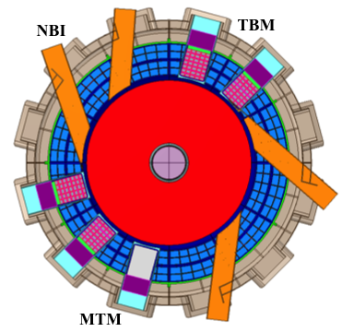
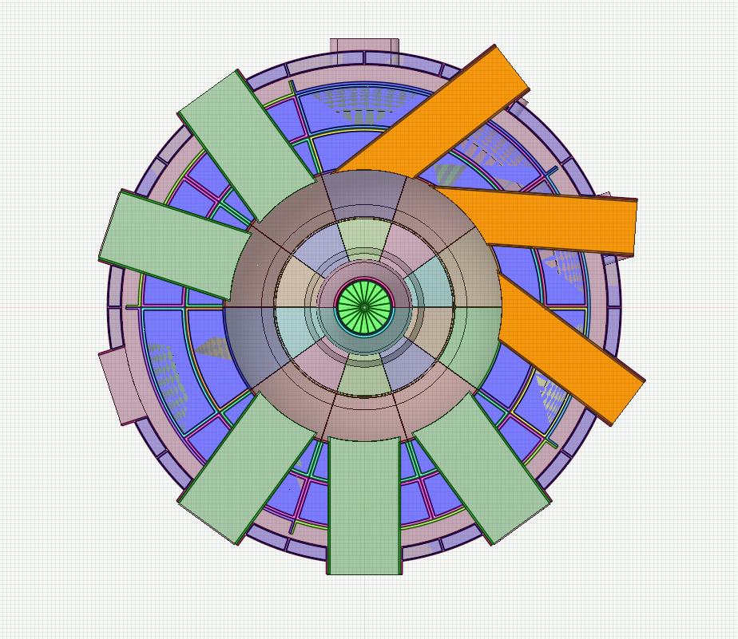



R ≥ 1.7m necessary for net breeding at A=1.7
R=1.7m: TBR ≥ 1
R=1.0m: TBR < 1 (≈ 0.9)
TBM
NBI
NBI
TBM
MTM
Need to purchase Tritium from outside sources:
  $12-55M / full power year (FPY)
MTM
TBM = Test Blanket Module
MTM = Materials Testing Module

Slide 32
Why explore spherical torus/tokamak?
Potentially attractive for electricity production
  Requires accompanying magnet innovations
High neutron wall loading in small device
  Well suited for fusion nuclear component R&D
Improve toroidal physics predictive capability
  High β and high temperature at low collisionality
  Understand confinement, fast-ion physics for ITER

Slide 33
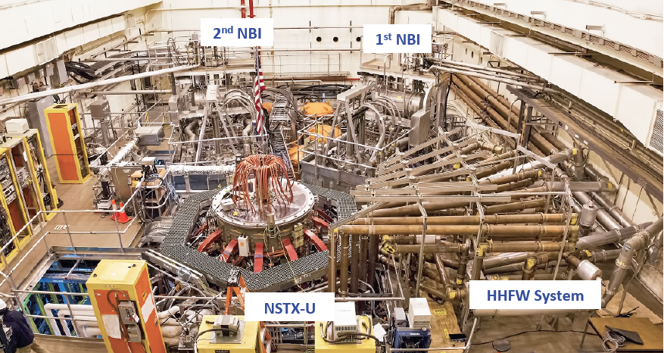
NSTX Upgrade Device and Test Cell – Aerial View

Slide 34
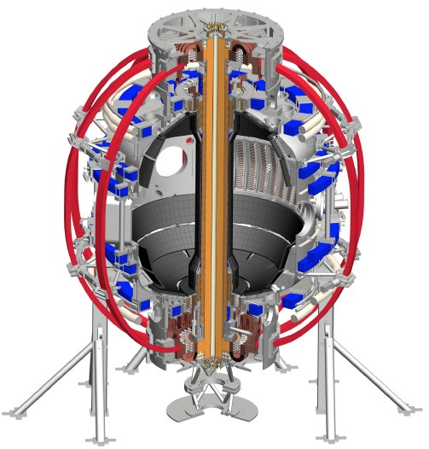
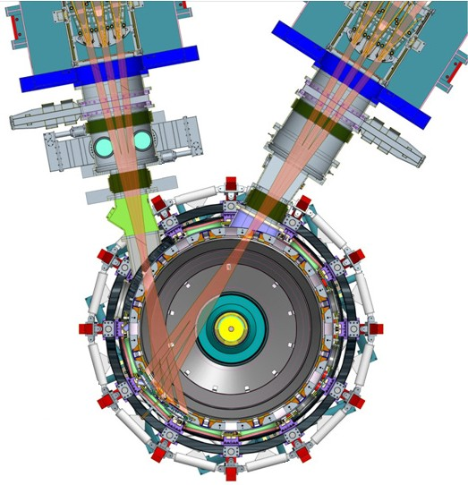
NSTX Upgrade will access new physics with 2 major new tools:
1. New Central Magnet
2. Tangential 2nd Neutral Beam
Higher T, low ν* from low to high β
→ Unique regime, study new transport and stability physics
Full non-inductive current drive
→ Not demonstrated in ST at high-β_{T}
Essential for any future steady-state ST

Slide 35
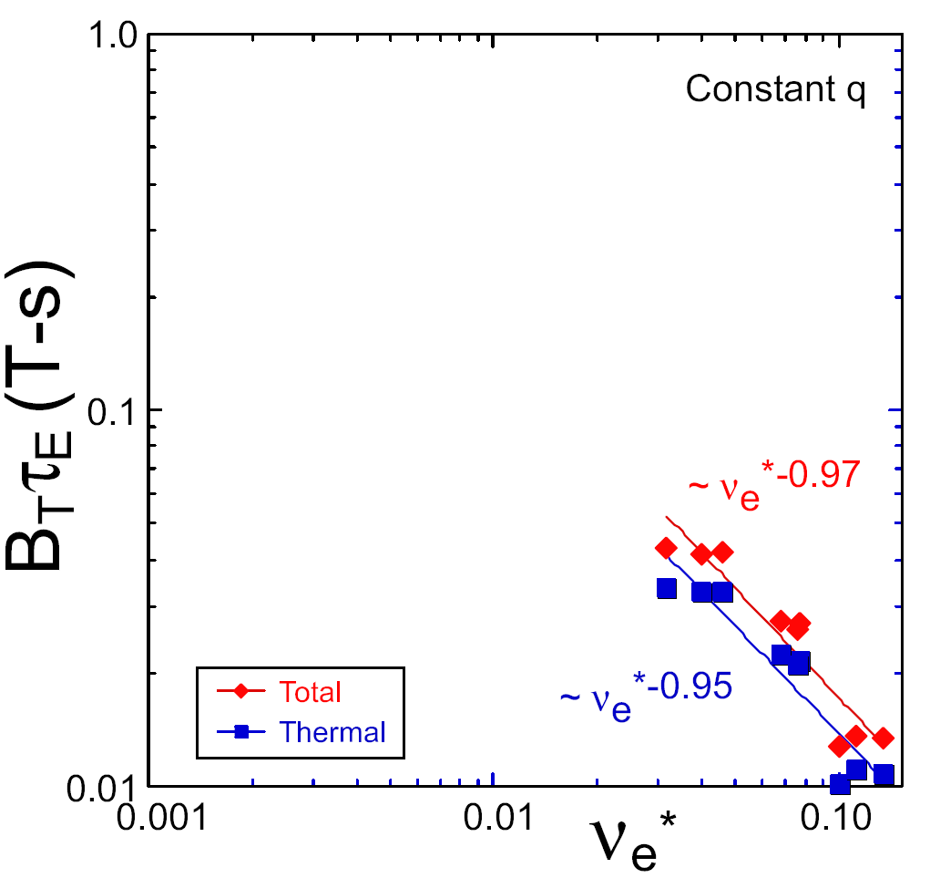
NSTX / MAST confinement increased at higher T_{e} (!)
Will confinement trend continue, or look like conventional A?
ST-FNSF
constant q, β, ρ∗
NSTX Upgrade
?
Favorable confinement results could lead to more compact ST reactors
NSTX
ITER-like scaling
Normalized electron collisionality ν_{e}* ∝ n_{e} / T_{e}²
Low ν* → need higher plasma current, toroidal field, heating power, density control

Slide 36
NSTX achieved 70% “transformer-less” current drive
Will NSTX-U achieve 100% as predicted by simulations?
TRANSP Contours of Non-Inductive Fraction
H_{98y2}
ITER H-mode confinement scaling multiplier
I_{P}=1 MA, B_{T}=1.0 T, P_{NBI}=12.6 MW
Steady-state operation required for ST, tokamak, or stellarator FNSF

Slide 37
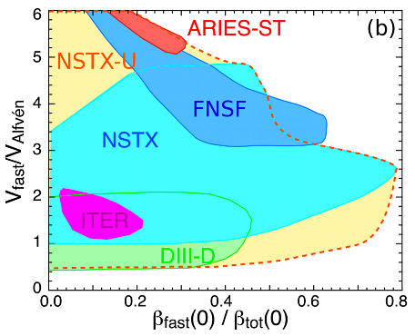
NBI-heated STs excellent testbed for α-particle physics
NSTX-U: large fast-ion dynamic range spanning ST and conventional A
  Toroidal field 2× NSTX → V_{fast} < V_{A} → stabilize modes
  Tangential 2nd NBI → very flexible fast-ion distribution
    Vary pitch angle, pressure profile
Can we find TAE-quiescent, high-performance regimes in NSTX-U?
And predict fast-ion confinement for ITER scenarios?

Slide 38
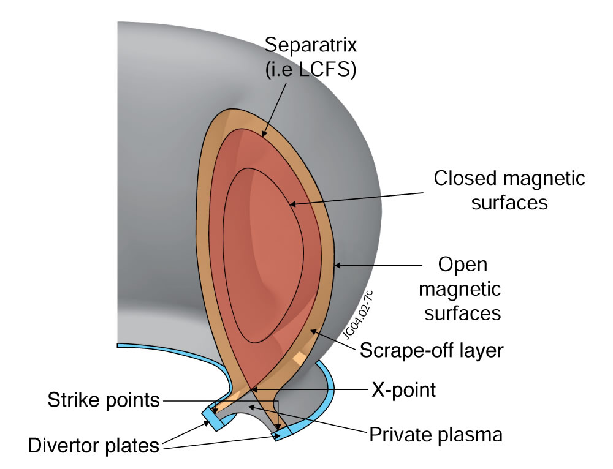
All modern tokamaks / STs use a “divertor” to control where power and particles are exhausted
Power exhaust width outside main plasma can be very narrow (few mm)
Power / particles contact target plates here

Slide 39
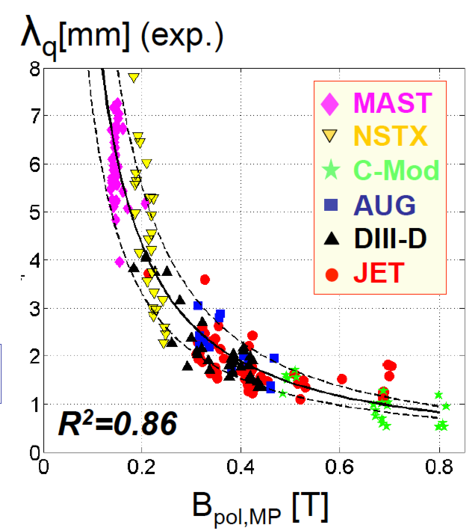
Tokamak + ST data: power exhaust width varies as 1 / B_{poloidal}
Will previous ST trend continue at 2× I_{P} , B_{P} , B_{T}, power?
ST data breaks aspect ratio degeneracy of data set
Issue: If peak heat flux in divertor region exceeds ~10 MW/m² → material damage
Wider heat-flux width may offset smaller R → maybe better than tokamak

Slide 40
NSTX-U will have major boost in performance
1. New Central Magnet
2. Tangential 2nd Neutral Beam
Performance goals:
➢2× heating power (5 → 10MW)
Tangential NBI → 2× current drive efficiency
➢4× divertor heat flux (→ ITER levels)
➢Up to 10× higher nTτ_{E} (~MJ plasmas)
➢2× toroidal field (0.5 → 1T)
➢2× plasma current (1 → 2MA)
➢5× longer pulse (1 → 5s)

Slide 41
Outline
Introduction
Why spherical tori / tokamaks (STs)
NSTX-U initial results, long-term directions
Summary

Slide 42
NSTX-U had scientifically productive 1st year
Achieved H-mode on 8th day of 10 weeks of operation
Surpassed magnetic field and pulse-duration of NSTX
Matched best NSTX H-mode performance at ~1MA
Identified and corrected dominant error fields
Commissioned all magnetic and kinetic profile diagnostics
Injected up to 12MW NBI power into armor by end of run
Discovered new 2nd NBI modifies several fast-ion modes
Implemented techniques for controlled plasma shut down, disruption detection, commissioned new tools for mitigation
2016 run ended prematurely due to fault in divertor PF coil
  Coil forensics, Extent of Condition → new coil fab, other repairs
  Aim to resume plasma operation during 2018 – but timing still TBD

Slide 43
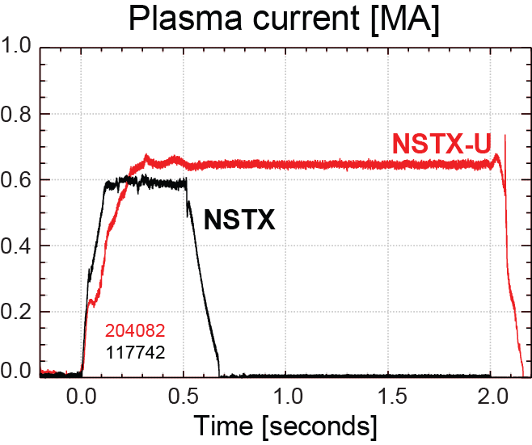
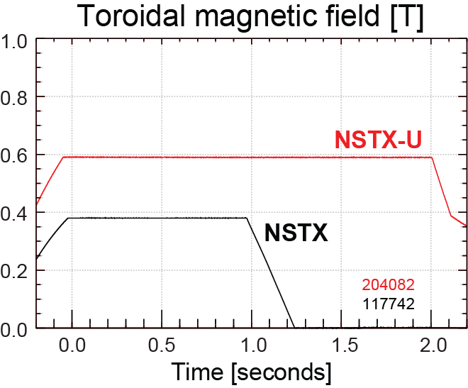
NSTX-U has surpassed maximum pulse duration and magnetic field of NSTX
Compare similar NSTX / NSTX-U Boronized L-modes, P_{NBI}=1MW
4x longer
NSTX-U L-mode duration
exceeds longest NSTX H-mode
NSTX-U B_{T} > highest NSTX B_{T}

Slide 44
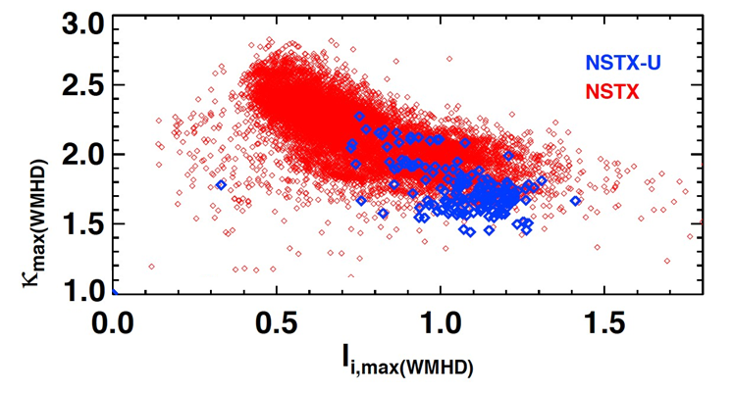
Accessed high elongation κ using progressively earlier H-mode and heating + optimized EFC
Future goal
NSTX-U (5 run weeks)
NSTX (10 years)
H-mode flattop
L-mode flattop
Goal: Internal inductance l_{i} = 0.5-0.7 → κ = 2.4-2.7

Slide 45
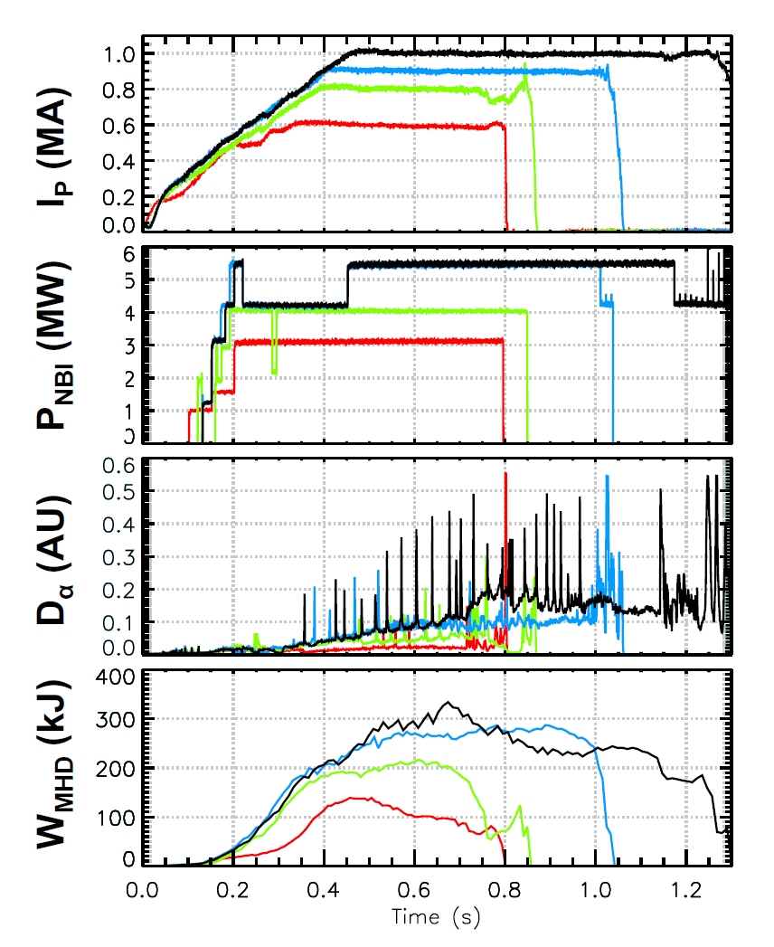
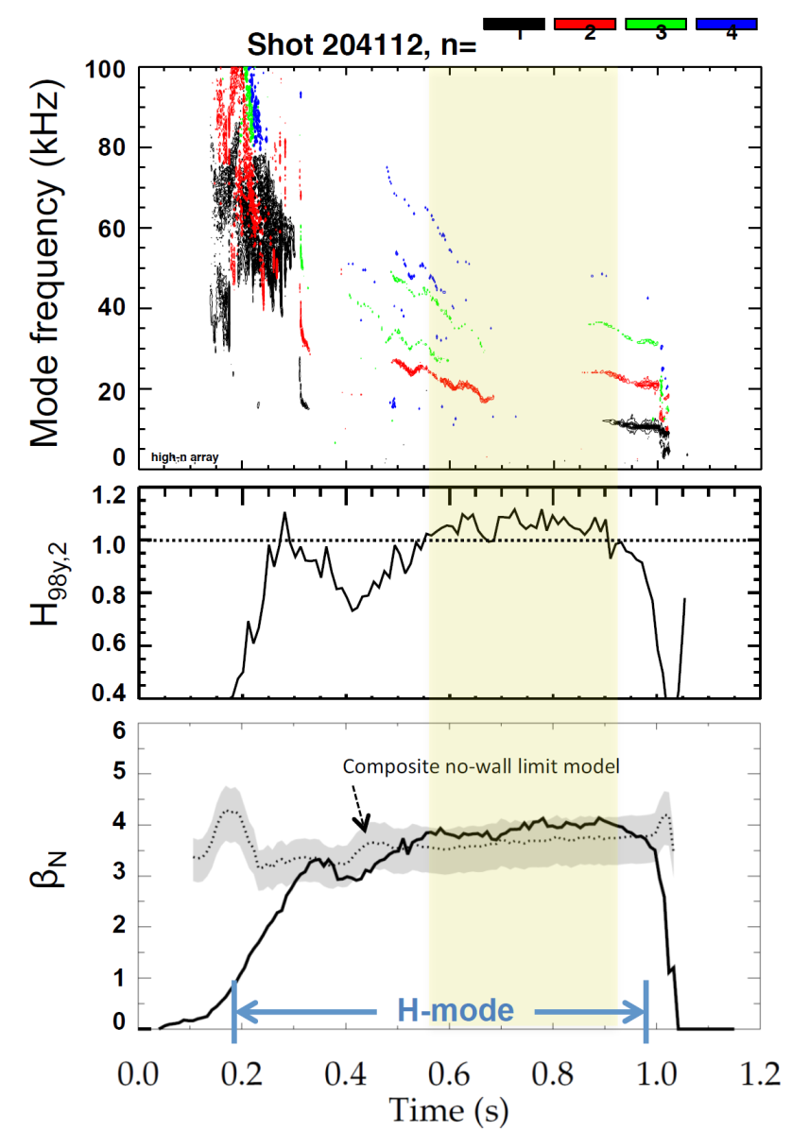

Recovered ~1MA H-modes with performance comparable to best NSTX plasmas at similar current
202946 – no EFC 204112 – EFC v2
203679 – EFC v1 204118 – EFC v2
H₉₈ ≥ 1, β_{N} ~ 3.5-4 ≥ n=1 no-wall limit

Slide 46
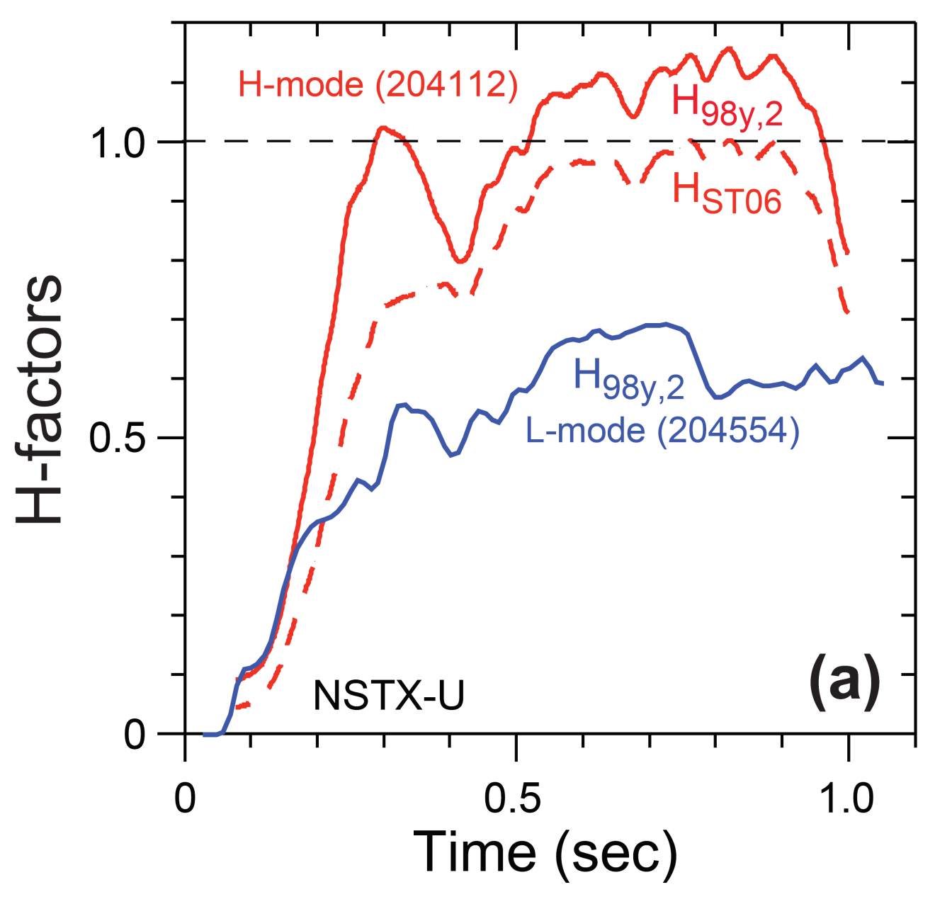
H-mode confinement > ITER scaling, consistent with ST scaling (so far) – need higher I_{P}, B_{T} to test

Slide 47
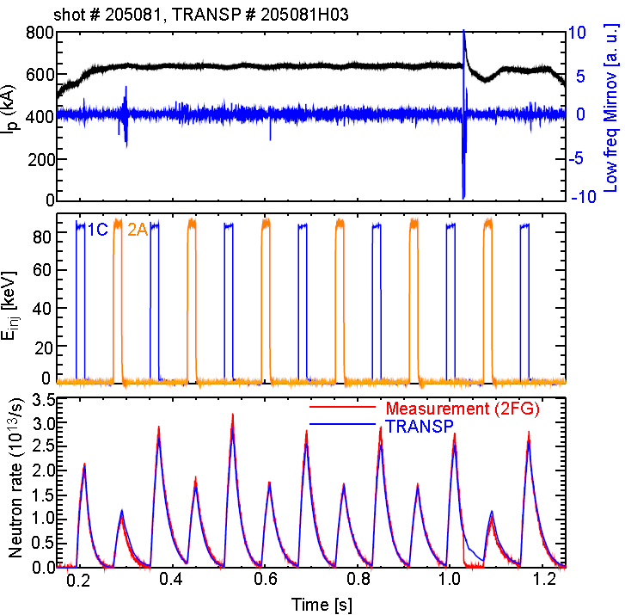
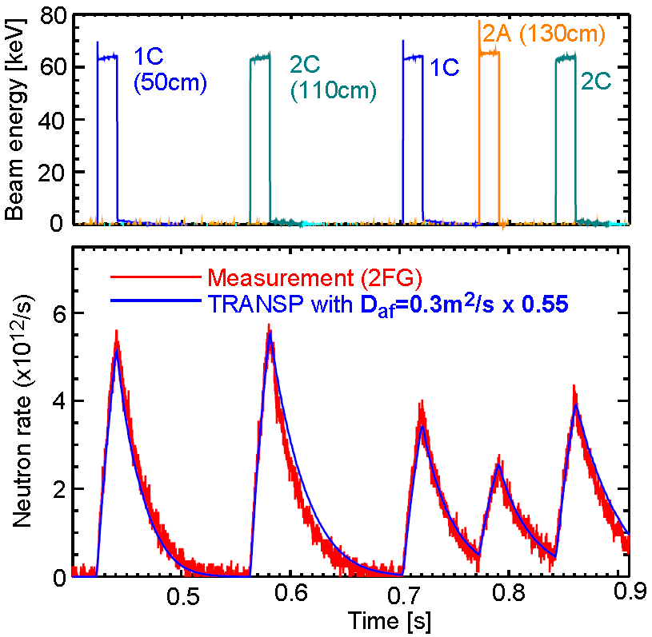

Fast-ion confinement measured to be at / near predicted values at low total NBI power ~1-2MW
E_{NBI} = 85keV
E_{NBI} = 65keV
Neutron rate
Good agreement between neutron measurement and TRANSP prediction
Need small anomalous fast ion diffusivity (D_{af}=0.3m²/s) for agreement

Slide 48
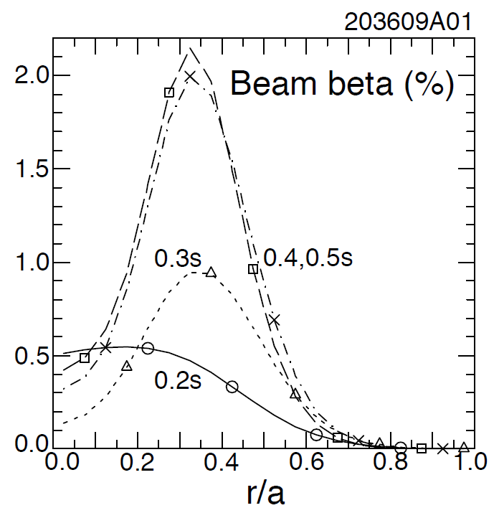
New: Most tangential NBI generates counter-propagating Toroidal Alfvén Eigenmodes (TAEs)
Counter-propagating TAE predicted for hollow fast-ion profiles
H.V. Wong, H. Berk, Phys. Lett. A 251 (1999) 126.
TRANSP: As current builds up beam fast-ion beta profile predicted to become hollow
1st evidence of off-axis NBI in NSTX-U

Slide 49
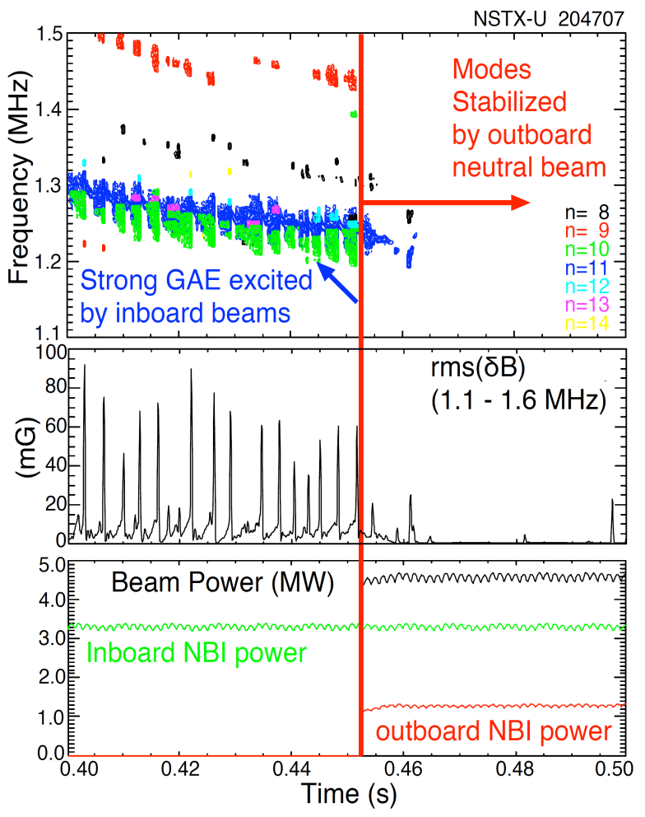
New: Tangential 2nd neutral beam suppresses Global Alfven Eigenmode (GAE) – consistent with simulation
HYM code simulation of #204707, n=10
|δB_{n} |²
t=0.44s
t=0.47s
t ω_{ci}
HYM code: growth of n=10 counter-GAE from 1st NBI
HYM: suppression of n=10 counter-GAE by 2nd NBI
Most unstable n-number, mode ω consistent with HYM
New 2nd NBI already powerful tool for fast-ion mode physics

Slide 50
Goals for future NSTX-U operation
Increase field to 0.8-1T, current to 1.6-2MA, extend flat-top duration (H-mode) to 2-5s
Assess global stability, energy confinement, pedestal height/structure, edge heat-flux width
Characterize 2nd beam: heating, current drive, torque / rotation profiles, fast-ion instabilities
Push toward full non-inductive current drive
Test advanced divertor heat flux mitigation

Slide 51
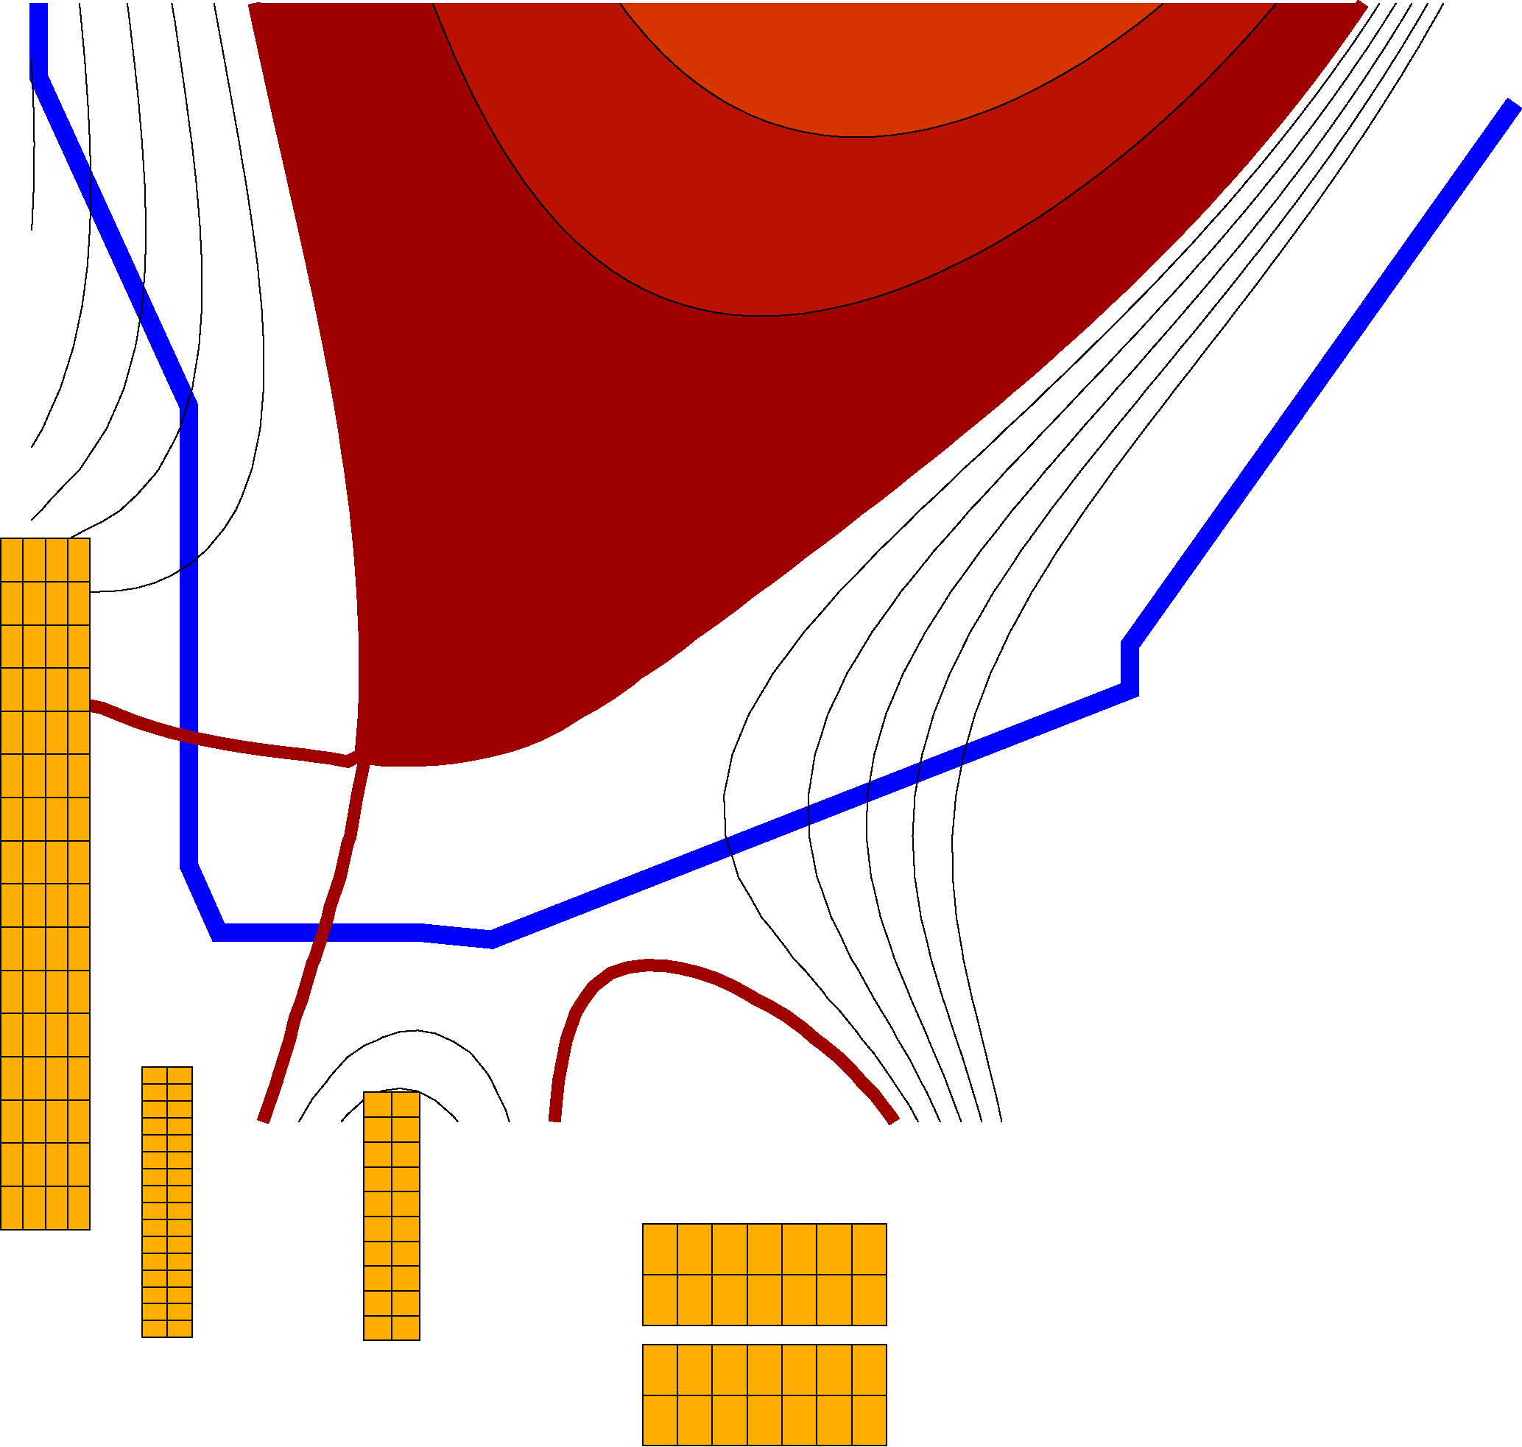
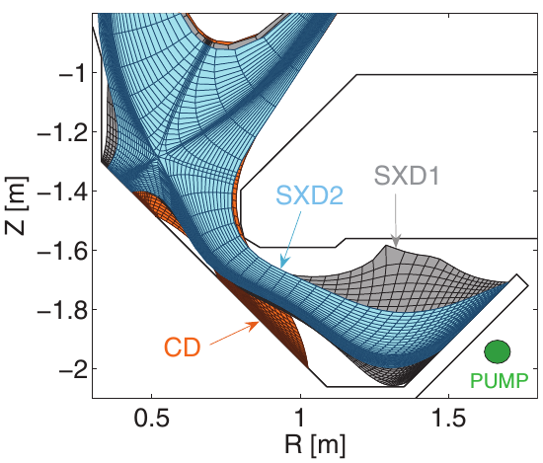
STs leading advanced divertor development
NSTX-U / MAST-U will collaborate on 1st plasma, scenarios, divertors
NSTX-U: Flared divertor using “snowflake/X” + radiation
MAST-U will test range of divertors:
  Conventional, snowflake (not shown)
  Long-leg “Super-X” with variable flaring
New PF coils in NSTX-U central magnet
E. Havlickova, et al., Plasma Phys. Control. Fusion 56 (2014) 075008

Slide 52
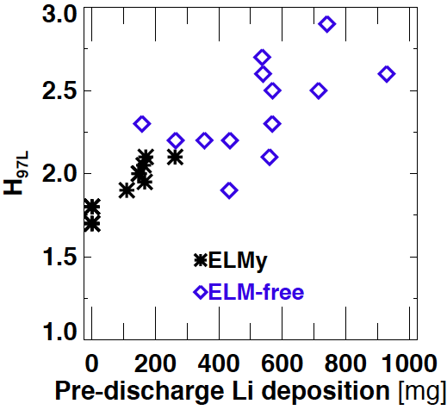
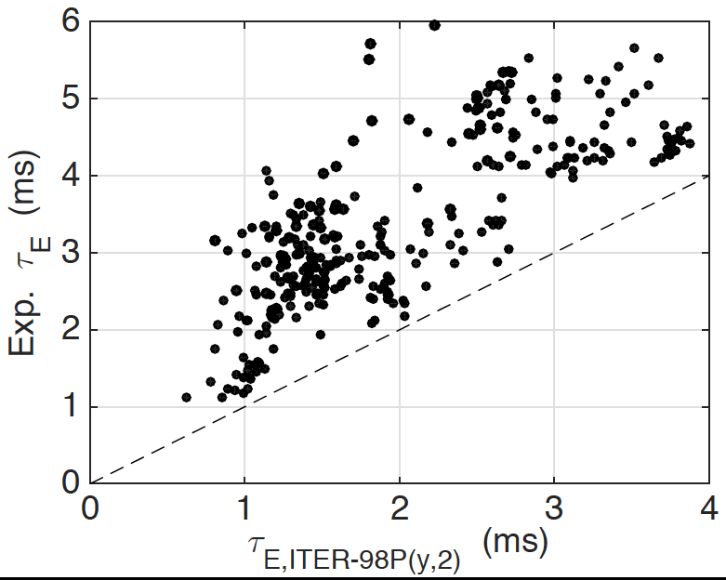
STs investigating lithium (solid and liquid) walls to significantly increase energy confinement
NSTX (wider → higher pedestals)
LTX (flatter → higher T profiles)
H = 0.8 → 1.4 × ITER98P(y,2)
H = 2-4 × ITER98P(y,2)
H₉₈~1
D.P. Boyle, et al., J. Nucl. Mater. 438 (2013) S979
J.C. Schmitt, et al., Phys. Plasmas 22 (2015) 056112

Slide 53
NSTX-U long-term goals
5 year: Integrate high confinement + β_{T} + full non-inductive
10 year: Assess compatibility with high-Z & liquid Li PFCs
Possible progression of in-vessel / plasma-facing components:
High-Z tile row
B+C BN
Li High-Z
Near-term
Lower ν*
LTX-like
or
C walls + Li coatings on bottom ½ of wall
Add divertor cryo-pump
+ full-wall Li coatings
Heatable C→ high-Z
for liquid Li divertor
Flowing LM module? + heatable (?) high-Z walls

Slide 54
Summary
STs broaden our understanding of toroidal physics and enhance predictive capability for ITER & beyond
ST potentially attractive as FNSF and Pilot Plant
NSTX-U designed to be highest performance ST in world program - this is why the project is challenging
Team is working very hard to ensure NSTX-U can run reliably at high performance & get back into operation!

Slide 55

Thank you!
Any questions?

