Slide 1




NSTX-U
Supported by
NSTX-U FY2013 3rd Quarter Report Presentation
Coll of Wm & Mary
Columbia U
CompX
General Atomics
FIU
INL
Johns Hopkins U
LANL
LLNL
Lodestar
MIT
Lehigh U
Nova Photonics
Old Dominion
ORNL
PPPL
Princeton U
Purdue U
SNL
Think Tank, Inc.
UC Davis
UC Irvine
UCLA
UCSD
U Colorado
U Illinois
U Maryland
U Rochester
U Tennessee
U Tulsa
U Washington
U Wisconsin
X Science LLC
Ron Strykowsky
Jon Menard
Masa Ono
Culham Sci Ctr
York U
Chubu U
Fukui U
Hiroshima U
Hyogo U
Kyoto U
Kyushu U
Kyushu Tokai U
NIFS
Niigata U
U Tokyo
JAEA
Inst for Nucl Res, Kiev
Ioffe Inst
TRINITI
Chonbuk Natl U
NFRI
KAIST
POSTECH
Seoul Natl U
ASIPP
CIEMAT
FOM Inst DIFFER
ENEA, Frascati
CEA, Cadarache
IPP, Jülich
IPP, Garching
ASCR, Czech Rep
FES Room G258
PPPL Room B205
July 16, 2013

Slide 2
Agenda
NSTX Upgrade progress report – R. Strykowsky
  20 minutes
5 year plan overview - including FY13 collaboration highlights relevant to 5 year plan – J. Menard
  55 minutes
NSTX-U facility and diagnostic highlights – M. Ono
  45 minutes

Slide 3
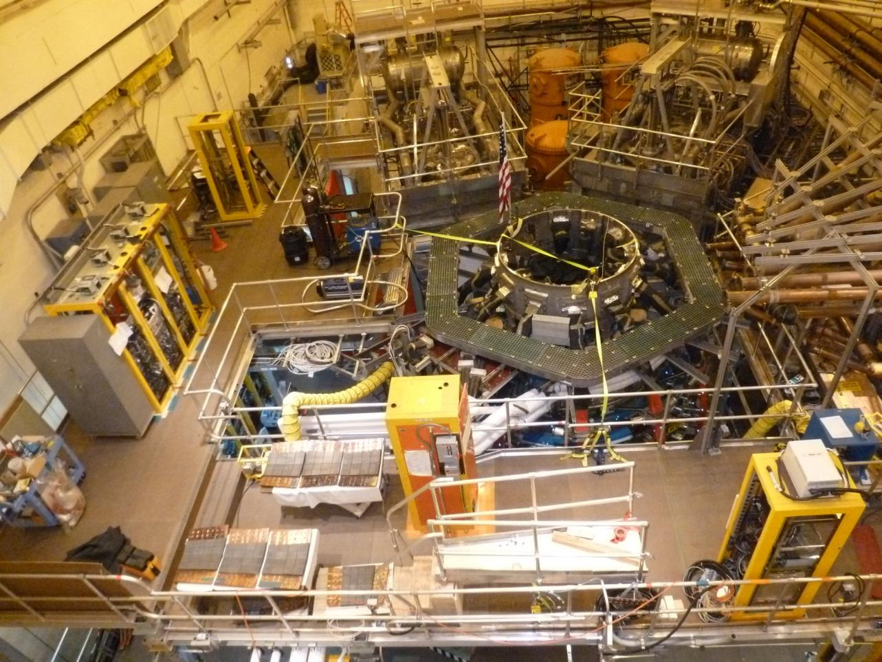
Significant progress continues to be made
Excellent safety record
Good technical Progress
On schedule and cost

Slide 4
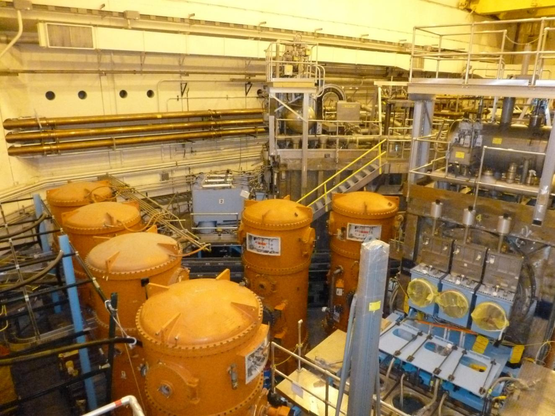
Neutral beam installation
All 3 High Voltage Enclosures (HVE’s) relocated to the NSTX-U Test Cell !
NB water piping installation underway
Electrical cable installation contract in procurement
4

Slide 5
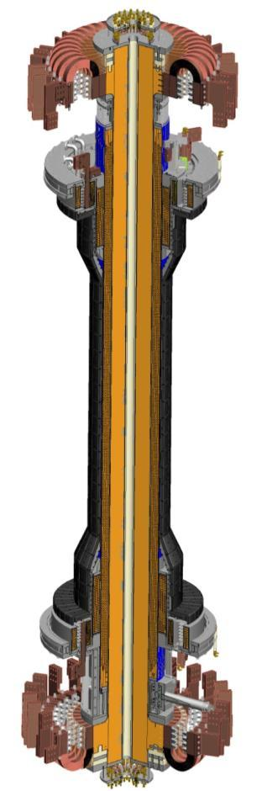
Centerstack is the critical path and highest risk
Components & Hardware
  Flex connectors delivered
  PF 1b,a,c coils- Awarded.
  PFC Tiles-delivered and being machined
  Casing - delivered
Inner TF Bundle
  VPI 4 Quadrants- Completed
  VPI Full Bundle- August 2013
OH Solenoid
  OH Conductor delivered
  Begin winding OH solenoid- September 2013
  OH Mold - Delivery August
  VPI OH – January 2014
Centerstack Assembly-
  Delivery to NSTX TC May 2014

Slide 6
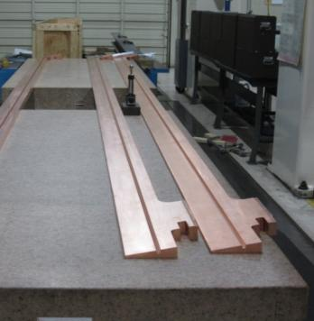
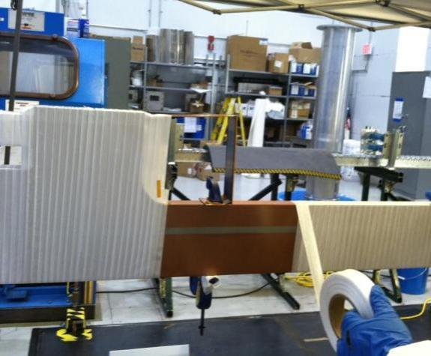
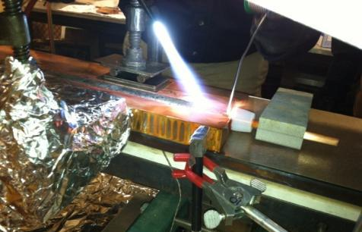
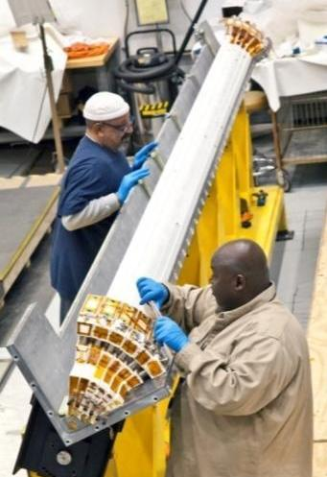
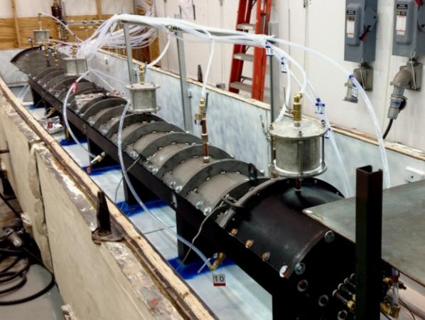
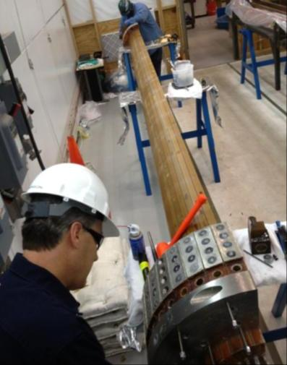
Center Stack Fabrication and Assembly Proceeding Well
Machined conductor by Major Tool
Cooling tube soldered into inner TF conductor
Conductor being wrapped with fiberglass insulation
100% COMPLETE
100% COMPLETE
100% COMPLETE
Insulated conductor being placed into mold
100% complete
Assembled TF mold ready for Vacuum Pressure Impregnation (VPI)
All 4 Quadrants successfully VPI’d and tested!

Slide 7
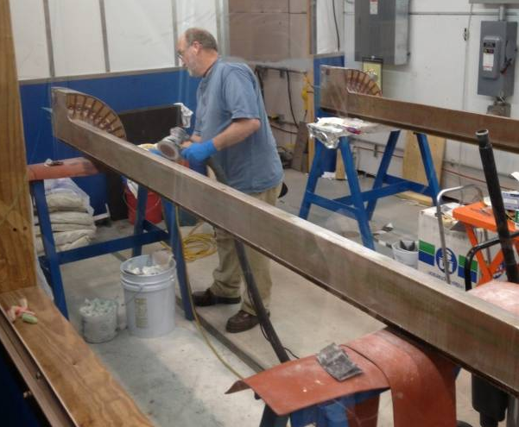
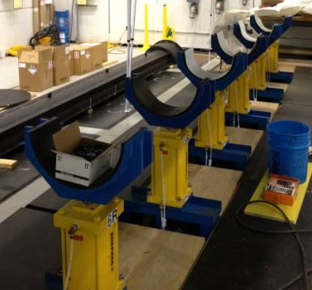
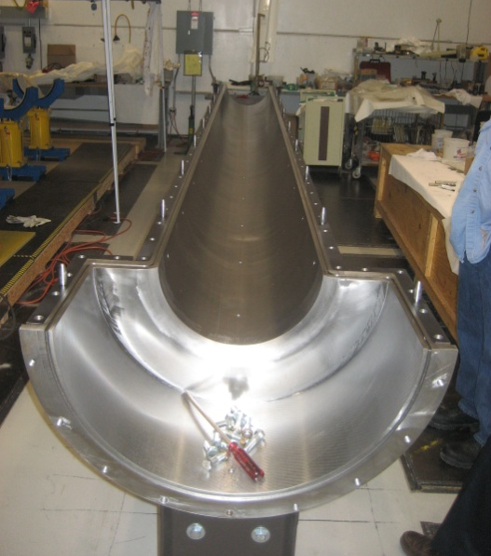
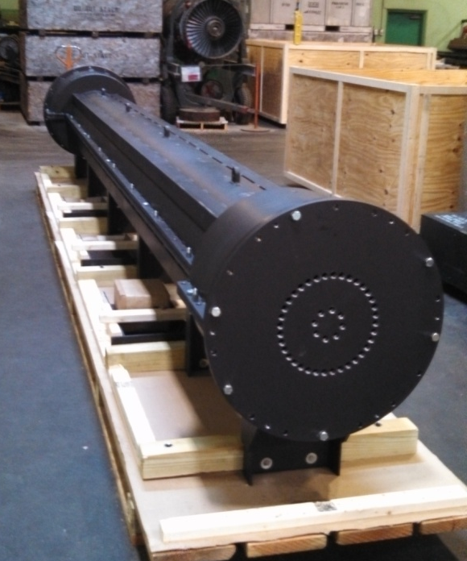
Next step - CS Inner bundle assembly
Two of the 4 quadrants being sanded for final assembly
The assembly stand ready to receive the 4 quadrants
The full Inner TF mold positioned and leveled
The TF mold shown with the lid installed

Slide 8
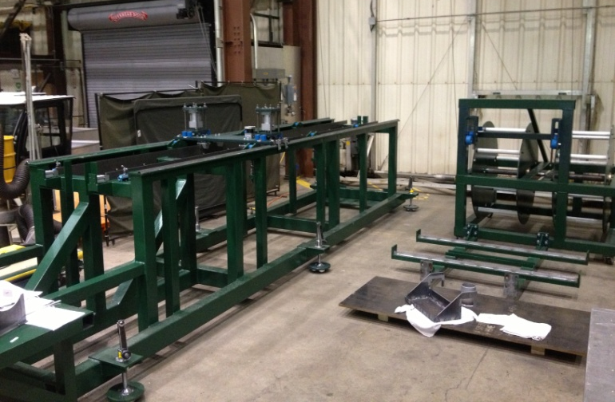
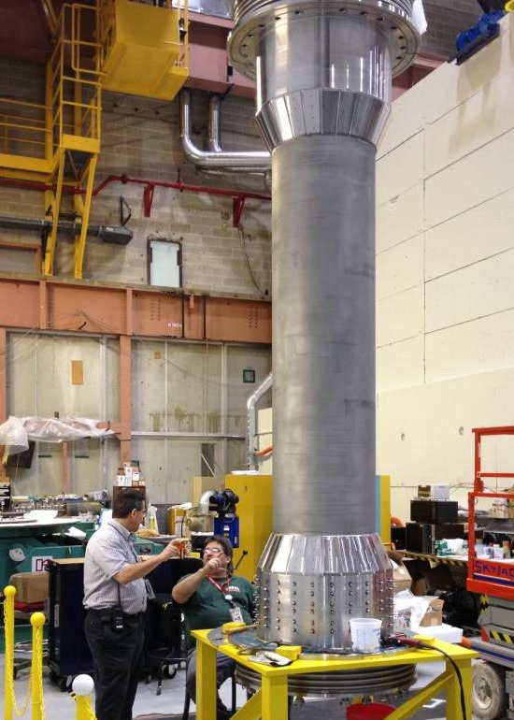
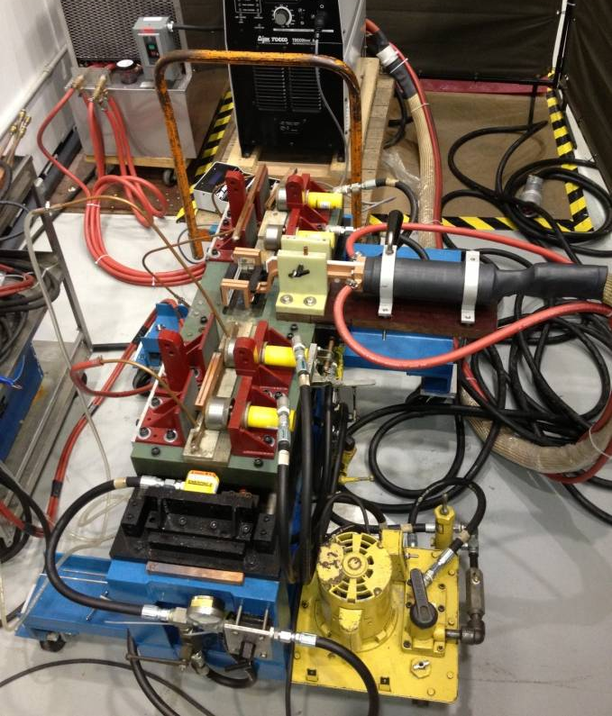
OH Winding Assembly & Casing tile studs
The OH winding assembly being assembled for testing
The casing forms the inner part of the vacuum vessel and houses the inner TF/OH magnet.
500 Inconel studs being added to the outside surfaces.
696 Tiles with diagnostics will then be mounted.
The OH in-line braze unit tested and ready for use

Slide 9
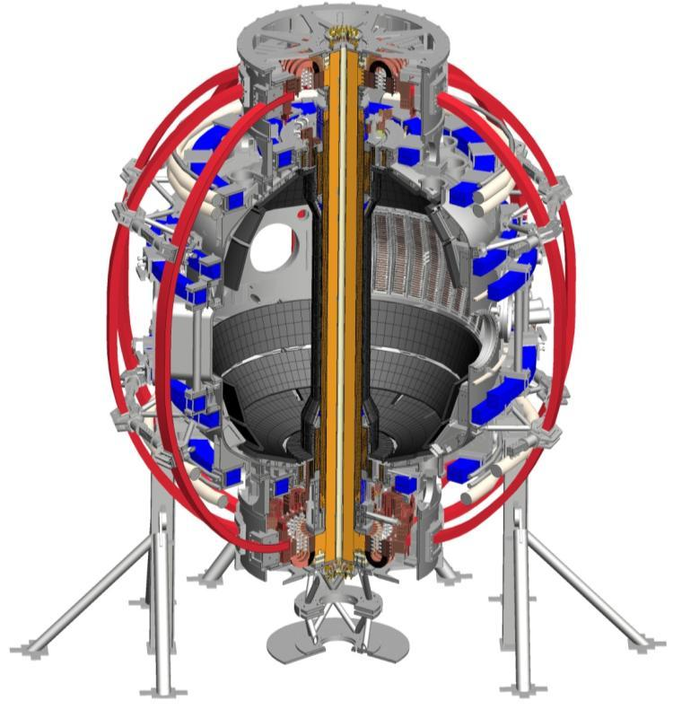
New CS Installation one year away!
Completed center-stack assembly installed in the vacuum vessel
Planned for May 2014
Outer TF Coils (Red)
PF Coils (blue)
Passive Plates
Vacuum Vessel Legs
Center Stack Pedestal
Lower Umbrella structure

Slide 10
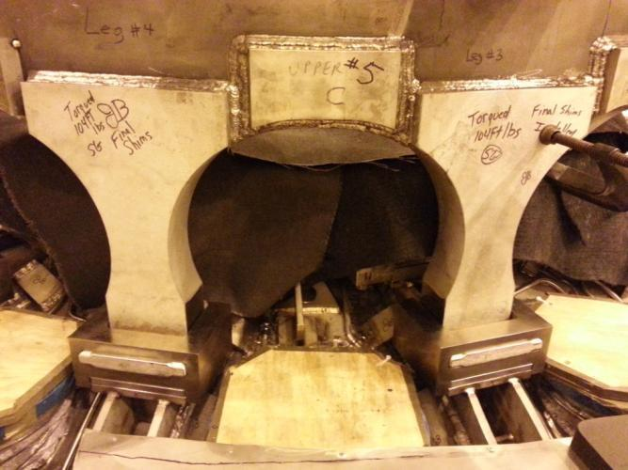
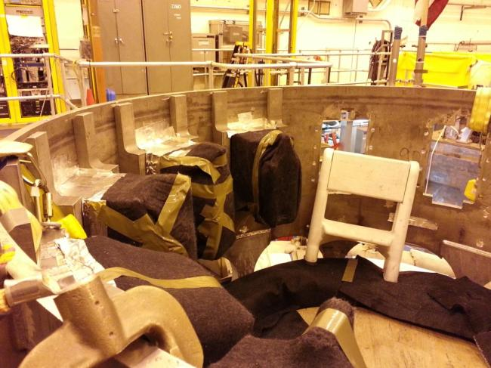
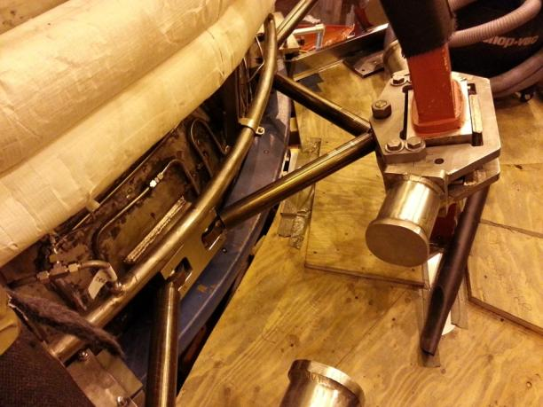
Machine modifications making good progress
Umbrella Legs and Arch Reinforcement
Umbrella/TF Reinforcements
TF Outer Leg Supports
10

Slide 11
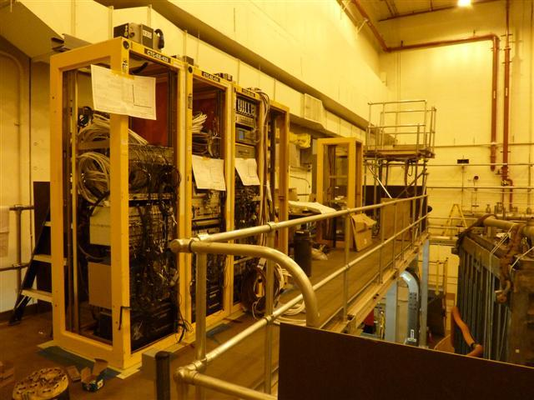
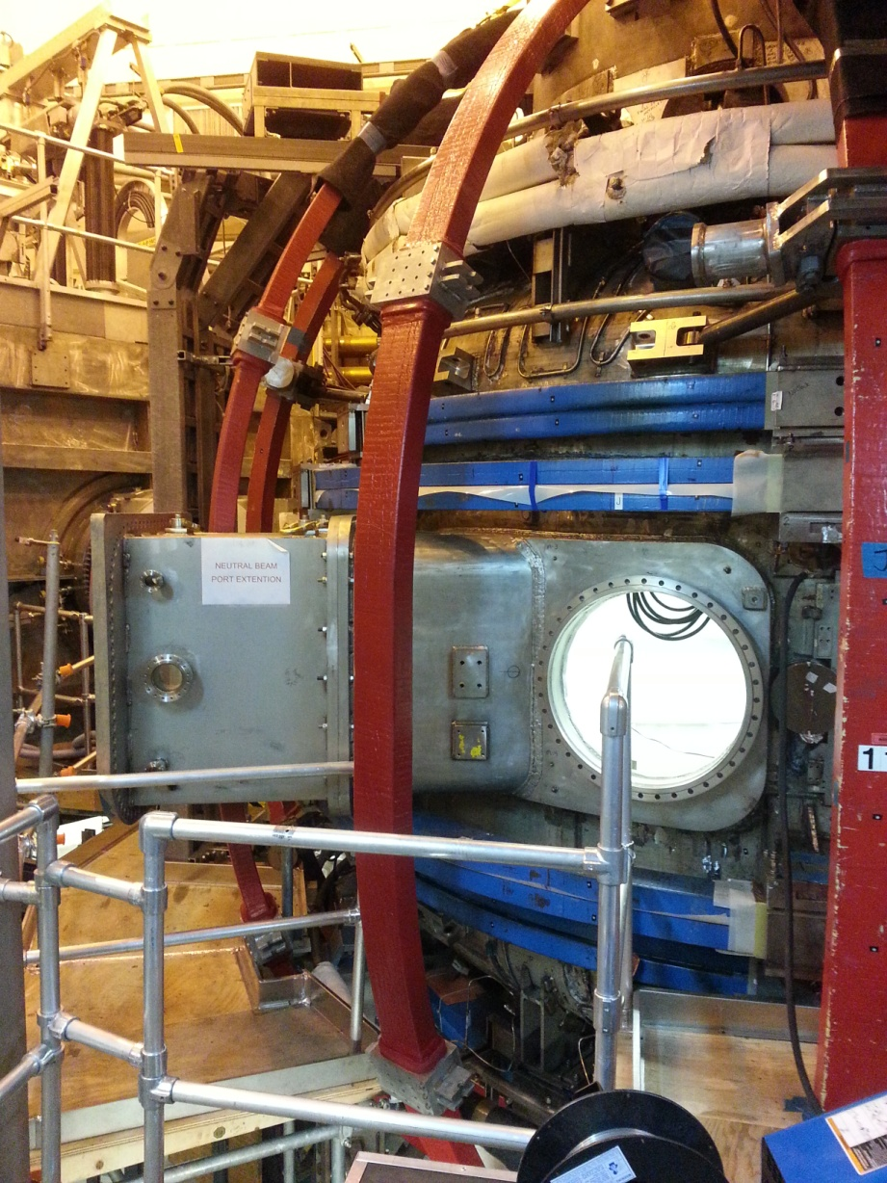
Other field work progressing well
Re-installation of cable trays and racks underway
Cable tray installations on the north wall and labyrinth underway.
Fabrication and leak checking of NB LHe cryo lines underway.
Installation of new gas injection ports underway
Fabrication of NB/TVPS duct components underway.
  2 New Outer TF Coils installed
11

Slide 12
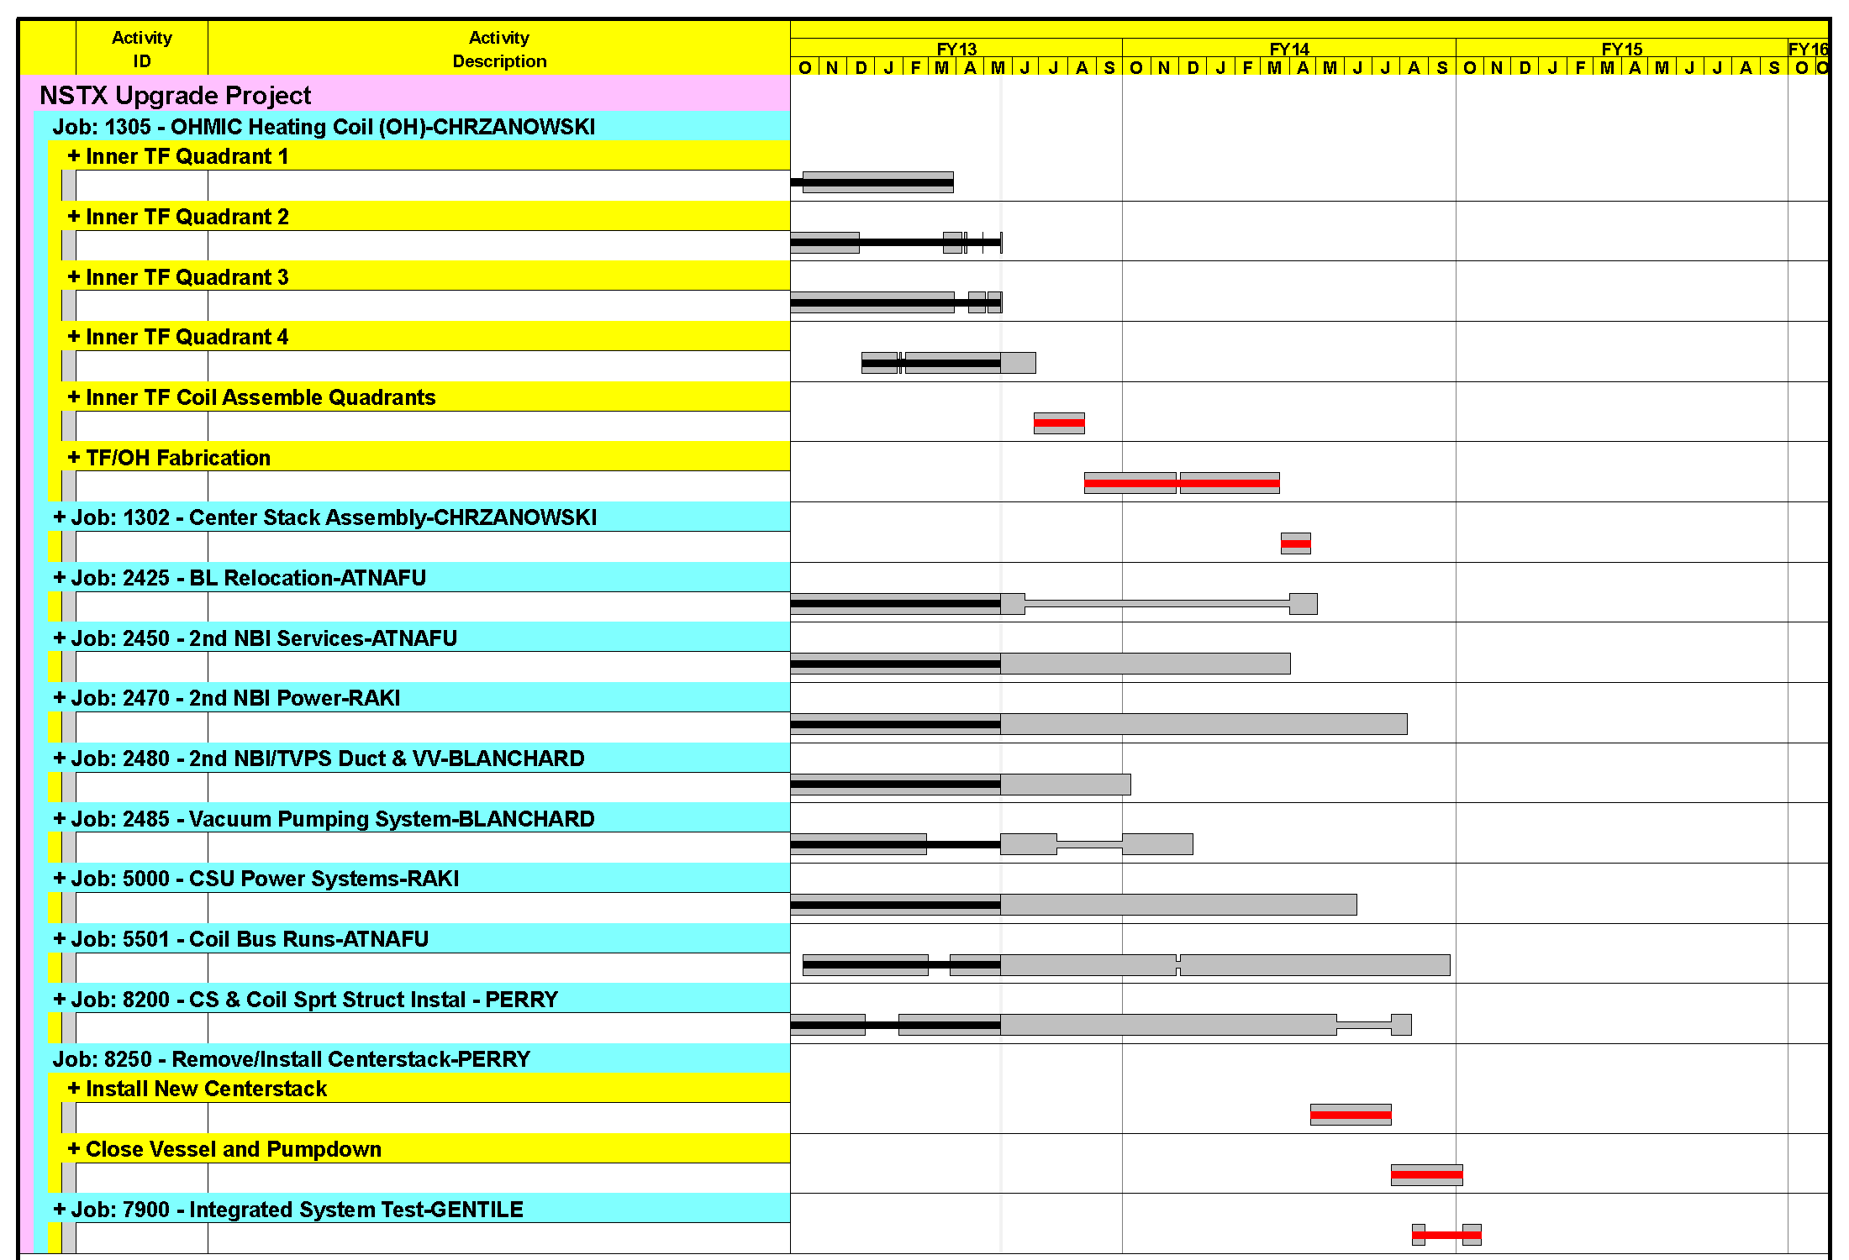
Project on track for October completion
Critical path through the centerstack fabrication and installation
Key Operations Milestones
Begin Diagnostic Installation – August 1st, 2013
Complete in-vessel construction work October 1st 2013.
Complete Diagnostic installation & calibration – December 1st, 2013
Rough Pump down – January 1st, 2014
Forecast Finish October 2014
CD-4 Finish September 2015

Slide 13
Performance metrics good
Performance CPI = 0.97 SPI = 0.99
Completion
  Forecast = October 2014
  CD-4 DOE Milestone (Late Finish) = September 2015
BAC =$84.9 TPC = $94.3M
Cost to date = $59.2 M 68% complete
Contingency balance = 29% ($8M remaining) (26.6% at CD-2)
(1) Through March 2013

Slide 14
Near Term Risks & Uncertainties
SCHEDULE –
Center Stack Assembly
Vendor deliveries
TECHNICAL –
Centerstack VPI operations.
  First 4 VPI’s successful!
  2 more to follow (full TF, OH coil)

Slide 15
NSTX Upgrade Summary
Project risks identified and being worked
The project continues to make good technical progress.
The project is currently on schedule and cost.
Planning for start-up underway

Slide 16
Agenda
NSTX Upgrade progress report – R. Strykowsky
  20 minutes
5 year plan overview - including FY13 collaboration highlights relevant to 5 year plan – J. Menard
  55 minutes
NSTX-U facility and diagnostic highlights – M. Ono
  45 minutes
Key collaborations will be highlighted in light blue boxes

Slide 17
Maintaining strong team and publication and conference participation, development of early career researchers
 | PPPL/PU | National Team (non-PPPL/PU) | International | Total |  | Number of institutions
Total Researchers | 79 | 166 | 61 | 306 |  | Total | 61
Post-Docs | 5 | 9 | 0 | 14 |  | Domestic | 32
Students | 3 | 26 | 4 | 33 |  | International | 29
Calendar Year | Refereed Publications | PRLs | APS Invited | IAEA Papers
2009 | 45 | 6 | 5
2010 | 63 | 5 | 10 | 25
2011 | 58 | 5 | 8
2012 | 56 | 1 | 4 | 30
2013 | 34 so far | 3 so far | 6
Ahmed Diallo (PPPL) received 2013 DOE Early Career Research Program (ECRP) award for: “Edge Pedestal Structure Control for Maximum Core Fusion Performance”
NSTX snowflake divertor team featured in October 2012 FES Science Highlights, led by V. Soukhanovskii (LLNL - 2010 ECRP) – also leading DIII-D snowflake expts.

Slide 18
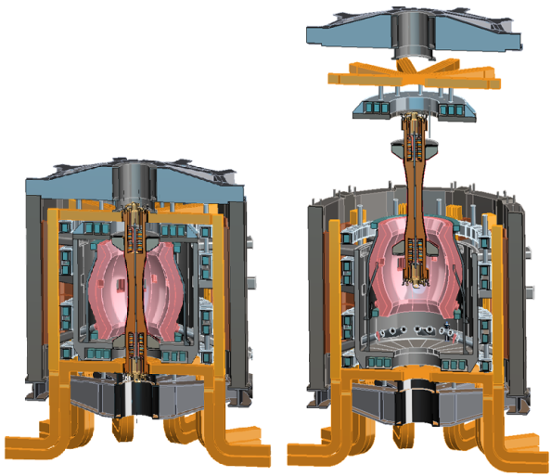
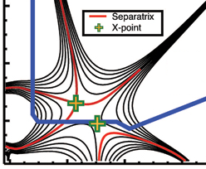
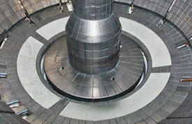

NSTX Upgrade mission elements
Advance ST as candidate for Fusion Nuclear Science Facility (FNSF)
Develop solutions for the plasma-material interface challenge
Explore unique ST parameter regimes to advance predictive capability - for ITER and beyond
Develop ST as fusion energy system
ST-FNSF
“Snowflake”
Lithium
ITER

Slide 19
Major assessments of NSTX-U since Q1 review:
March: FESAC Subcommittee on the Prioritization of Proposed Scientific User Facilities for the Office of Science
  Ranked importance of NSTX-U as “A” for “absolutely central”
May: Positive debrief report of NSTX-U 5 year plan (2014-18)
  “The quality of the proposed research is excellent, employing state-of-the-art diagnostics to obtain data that will be compared to theory using a wide variety of numerical models.”
  “The proposed research addresses fundamental problems in magnetic fusion and will advance the state of knowledge in a number of areas.”
  “The proposed research is essential for advancing the ST to a nuclear science mission.”
  “NSTX-U will be a leading facility in the world fusion program, exploring unique physics of a low aspect ratio spherical tokamak, accessing high beta, large non-inductive current fractions, compact magnetic geometry, pushing to parameters not accessible to conventional tokamaks.”
19

Slide 20
Highest priority research goals for 5 year plan:
Demonstrate 100% non-inductive sustainment at performance that extrapolates to ≥ 1MW/m² neutron wall loading in FNSF
Access reduced ν* and high-β combined with ability to vary q and rotation to dramatically extend ST physics understanding
Develop and understand non-inductive start-up and ramp-up
(overdrive) to project to ST-FNSF with small/no solenoid
4. Develop and utilize high-flux-expansion “snowflake” divertor
and radiative detachment for mitigating very high heat fluxes
5. Begin to assess high-Z PFCs + liquid lithium to develop high-duty-factor integrated PMI solutions for next-steps
Longer-term (5-10 year) goal:
Integrate 100% non-inductive + high β and τ_{E} + divertor solution + metal walls

Slide 21

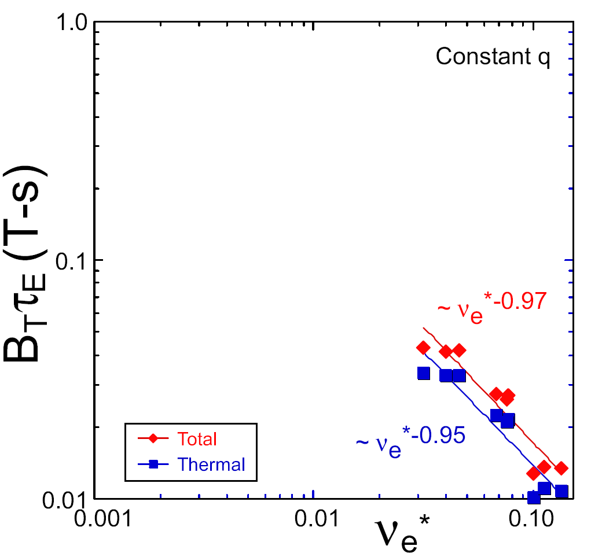
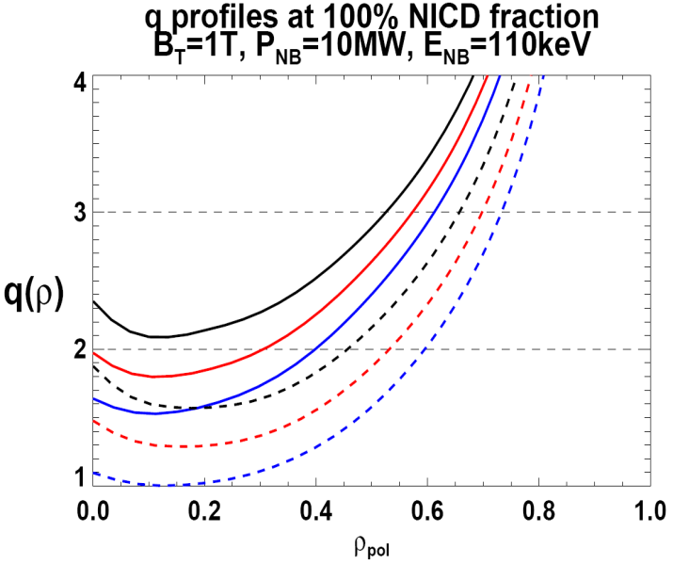

NSTX Upgrade incorporates 2 new capabilities:
Previous
center-stack
New
center-stack
ST-FNSF
Expect 2x higher T by doubling B_{T}, I_{P}, and NBI heating power
  Reduces ν* → ST-FNSF values to understand ST confinement
  5x longer pulse-length
  q(r,t) profile equilibration
  Test non-inductive ramp-up
constant q, β, ρ∗
NSTX Upgrade
?
NSTX
ITER-like scaling
TF OD = 20cm
TF OD = 40cm
Normalized e-collisionality ν_{e}* ∝ n_{e} / T_{e}²
I_{P}=0.95MA, H_{98y2}=1.2, β_{N}=5, β_{T} = 10%, B_{T} = 1T, P_{NBI} = 10MW, P_{RF} = 4MW
  2x higher CD efficiency from larger tangency radius R_{TAN}
100% non-inductive CD with core q(r) profile controllable by:
  NBI tangency radius
  Plasma density, position (not shown)
n
e
/
n
Greenwald
0.95
0.72
R_{TAN} [cm]
__________________
50, 60, 70, 130
60, 70,120,130
70,110,120,130
Present NBI
New 2nd NBI

Slide 22
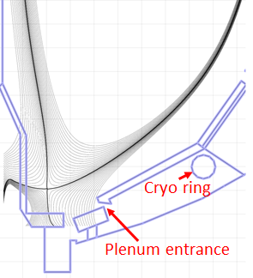
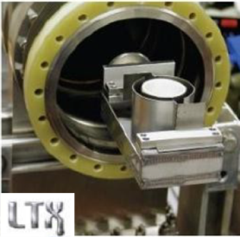
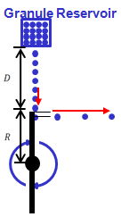
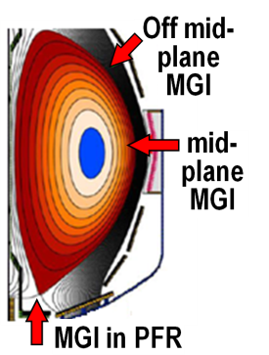

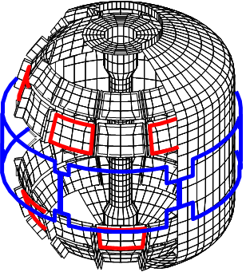
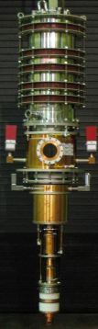
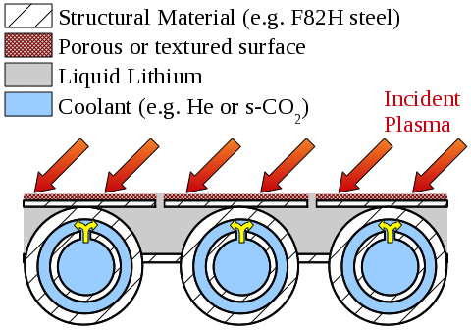
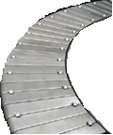
5 year plan also includes longer-term facility enhancements to fully utilize Upgrade capabilities, support ITER and FNSF
Improved particle control tools
  Control deuterium inventory and trigger rapid ELMs to expel impurities
  Access low ν*, understand role of Li
Disruption avoidance, mitigation
  3D sensors & coils, massive gas injection
ECH to raise start-up plasma T_{e} to enable FW+NBI+BS I_{P} ramp-up
  Also EBW-CD start-up, sustainment
Begin transition to high-Z PFCs, assess flowing liquid metals
  Plus divertor Thomson, spectroscopy
Upward Li evaporator
Divertor cryo-pump
Li granule injector (LGI)
Midplane + off-midplane non-axisymmetric control coils (NCC)
Extended low-f MHD sensor set
1-2MW
28 GHz
gyrotron
High-Z tiles
Actively-supplied, capillary-restrained, gas-cooled LM-PFC

Slide 23
Highest priority research goals for 5 year plan:
Demonstrate 100% non-inductive sustainment at performance that extrapolates to ≥ 1MW/m² neutron wall loading in FNSF
Access reduced ν* and high-β combined with ability to vary q and rotation to dramatically extend ST physics understanding
Develop and understand non-inductive start-up and ramp-up
(overdrive) to project to ST-FNSF with small/no solenoid
4. Develop and utilize high-flux-expansion “snowflake” divertor
and radiative detachment for mitigating very high heat fluxes
5. Begin to assess high-Z PFCs + liquid lithium to develop high-duty-factor integrated PMI solutions for next-steps

Slide 24
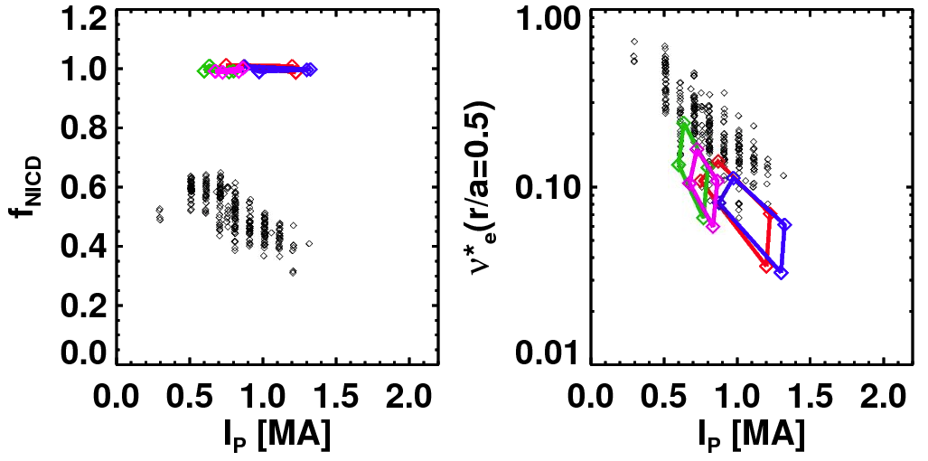
TRANSP simulations support goal of accessing and controlling 100% non-inductive plasma operation
NSTX achieved:
NSTX-U projections (TRANSP):
Maximum sustained non-inductive fractions of 65% w/NBI at I_{P} = 0.7 MA
70-100% non-inductive transiently with HHFW current-drive + bootstrap
100% non-inductive at I_{P} = 0.6-1.3MA for range of power, density, confinement
I_{P}=1 MA, B_{T}=1.0 T, P_{NBI}=12.6 MW
Contours of Non-Inductive Fraction
NSTX-U projections
Total non-inductive current fraction
NSTX Results
H_{98y2}
via high harmonic FW
I_{p} (MA)

Slide 25
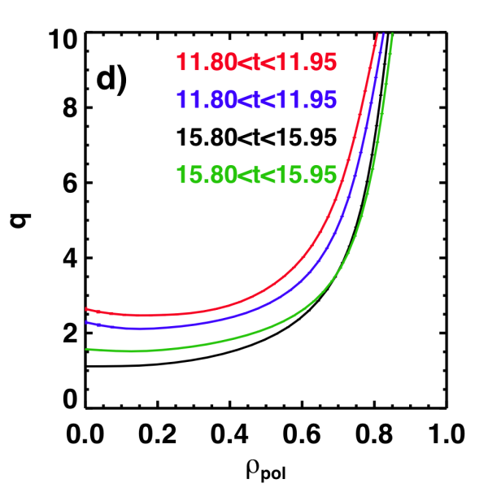
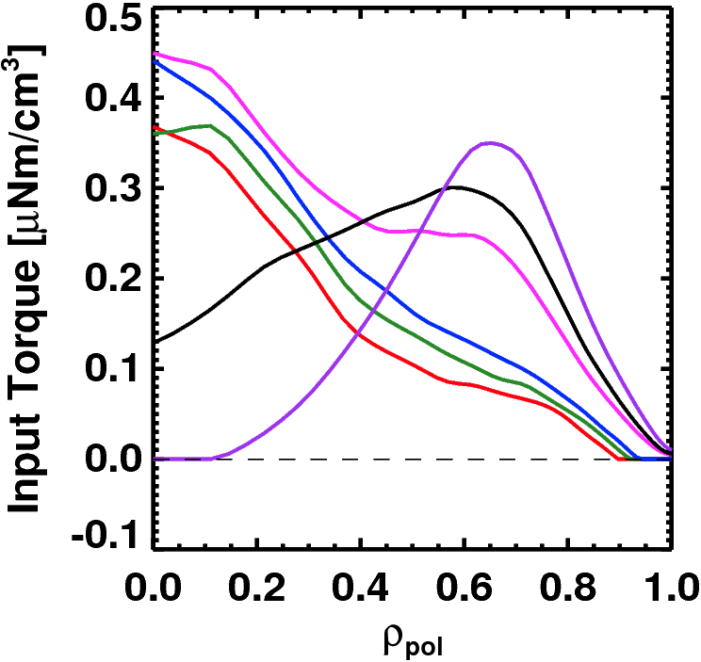
NSTX-U is developing a range of profile control actuators for detailed physics studies, scenario optimization for FNSF
q-Profile Actuators
Rotation Profile Actuators
Variations in Beam Sources
Torque Profiles From
6 Different NB Sources
800 kA and 1 T
[50,60,70,130] cm
[50,60,120,130] cm
[60,70,110,120] cm
[70,110,120,130] cm
Largest R_{tan}
Neutral
Beams
(TRANSP)
800 kA Partial Inductive, 87% < f_{NI} < 100%
Smallest R_{tan}
Also density and outboard gap
Also torques from 3D fields
Lehigh, General Atomics, Nova Photonics
(Lehigh: grad student + ORISE fellow)
Princeton Univ., Columbia Univ.
(Princeton: MAE grad student)

Slide 26
Advanced Scenarios and Control (ASC) 5 Year Goal:
Develop basis for steady-state operation/control for next-step STs, help resolve key scenario and control issues for ITER
ASC Thrusts:
Develop and assess new physics scenarios
  100% non-inductive operation
  Lower ν*: high-current, partial-inductive scenarios, extend to long-pulse
Implement axisymmetric control algorithms and tools
  Current and rotation profile control
  Improved shape and vertical position control
  Heat flux control for high-power scenarios
Develop disruption avoidance by controlled plasma shutdown
Assess scenario physics for next-step devices
Snowflake divertor physics, control on DIII-D: V. Soukhanovskii (LLNL), Kolemen (PPPL)
Radiative divertor control on DIII-D: E. Kolemen (PPPL)
D. Battaglia, E. Kolemen (PPPL) are physics operators on DIII-D – maintaining skills for NSTX-U ops

Slide 27
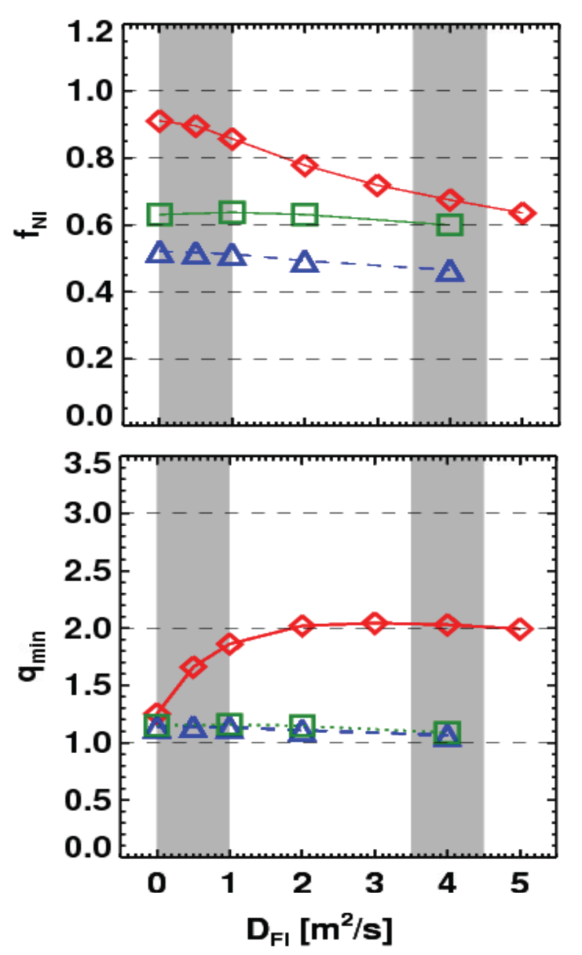
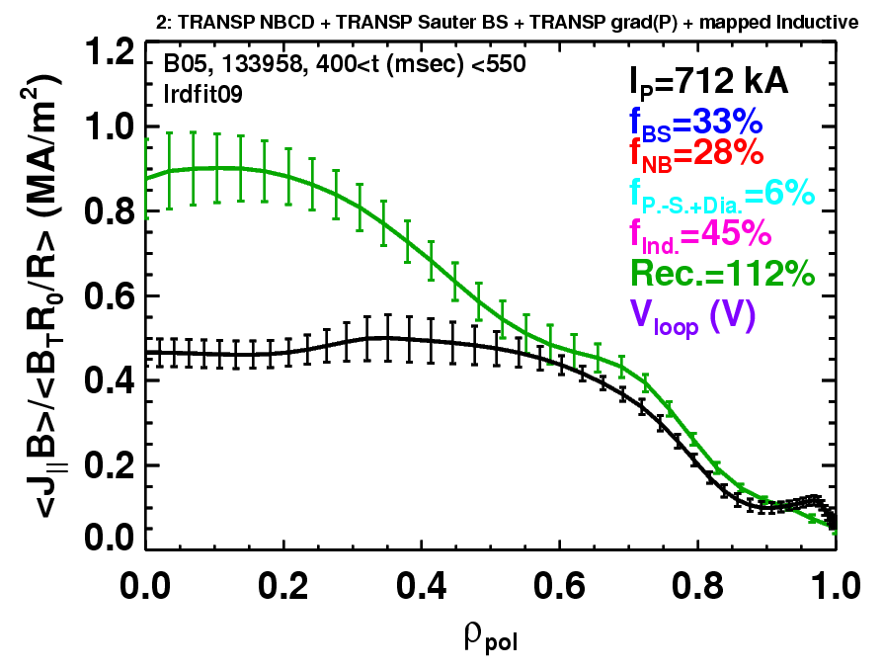
Rapid TAE avalanches could impact NBI current-drive in advanced scenarios for NSTX-U, FNSF, ITER AT
NSTX-U TRANSP simulations
NSTX: rapid avalanches can lead to
redistribution/loss of NBI current drive
Discrepancy between reconstruction and total assuming
classical J_{NBCD}
1 MA, 1T, H₉₈=1, near non-inductive
1.6 MA, 1T, partial inductive
1.2 MA, 0.55T, high β_{T}
All: f_{GW}=0.7, H₉₈=1
Minor radius
700kA high-β_{P} plasma with rapid
TAE avalanches has time-average D_{FI} = 2-4m²/s

Slide 28
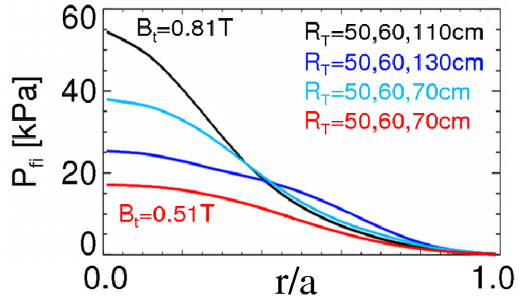
Energetic Particle (EP) 5 Year Goal:
Develop predictive capability for fast-ion transport caused by Alfven Eigenmodes (AEs), explore control of AE modes
EP Thrusts:
Develop predictive tools for projections of *AE-induced fast ion transport in FNSF and ITER
  Compare data to simulation, develop reduced models
    ORBIT, NOVA-K, M3D-K, HYM to understand mode-induced transport
Vary fast-ion instability drive using NBI, q, rotation, 3D fields
Measure *AE mode structure
  Magnetics, BES, reflectometry
Characterize fast ion transport vs. *AE type
DD fusion product/rate profile measurements on MAST: W. Boeglin (FIU), D. Darrow (PPPL)
TAE avalanche physics on MAST, DIII-D: E. Fredrickson and M. Podestá (PPPL)
Assess requirements for fast-ion phase-space engineering
  AE spectroscopy, also stability control using NBI, q, rotation, 3D fields

Slide 29
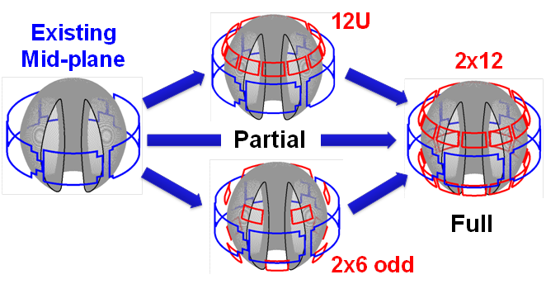
NSTX/NSTX-U is making leading contributions to high-β_{N} stability physics, and assessing possible 3D coil upgrades
n=1 MHD spectroscopy: high β_{N} can be more stable
  Combination of rotation and current profile effects at high beta
  Important for advanced scenarios
Resonant Field
Amplification (G/G)
Identified several off-midplane 3D coil sets favorable for profile and mode control
  ~40% increase in n=1 RWM β_{active} / β_{no-wall}
  ~5x reduction in n=1 EF resonant torque
  ~10-100x variation in ratio of non-resonant to resonant n=3 torque in edge
    Important for control, understanding of RMP ELM control, NTV rotation profile control
NCC options:

Slide 30
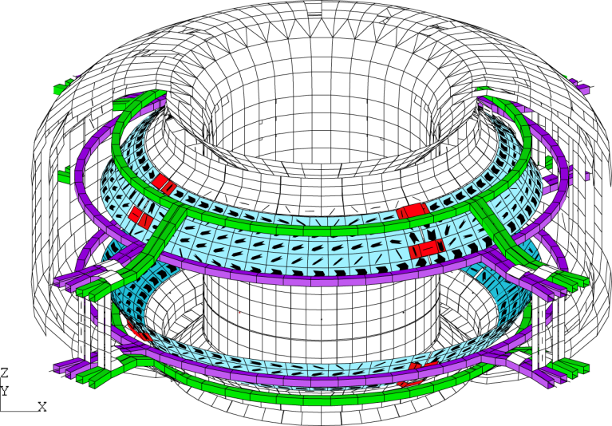
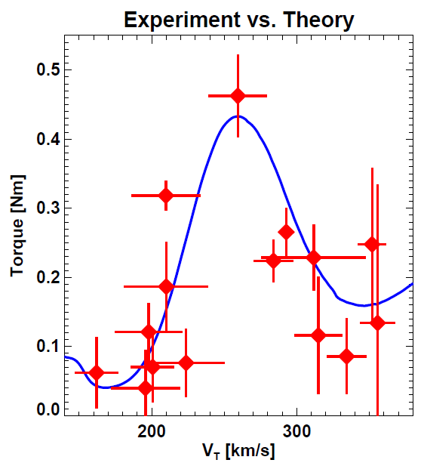
NSTX experience in scenario development, high-beta, and 3D physics is having significant impact on KSTAR research
Improved shape control, improved access to low l_{i} + high κ: D. Mueller, D. Battaglia, E. Kolemen (PPPL)
Studying MHD stability near no-wall beta limit: S. Sabbagh (CU)
Bounce-harmonic resonance in NTV observed in KSTAR for the first time in tokamak, and compared to theory/IPEC: J-K Park (PPPL – 2010 ECRP)
submitted to PRL

Slide 31
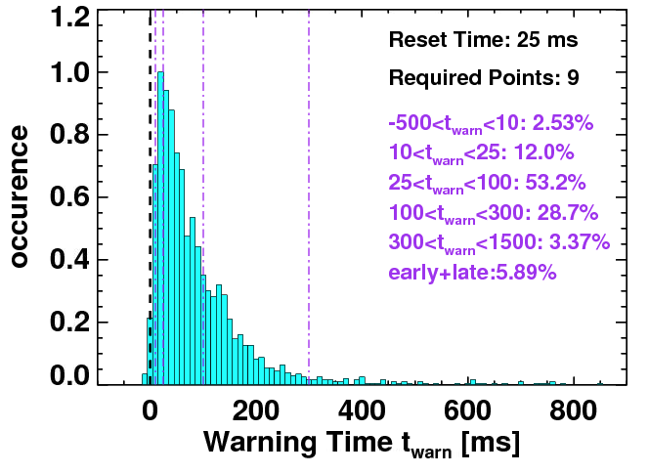
NSTX has also making leading contributions to disruption warning research in support of ITER, FNSF
Disruption warning algorithms:
  Based on sensors + physics-based variables (not neural net)
  < 4% missed, 3% false positives
  ITER requires 95-98% prediction success for VDE, thermal quench
  Will also assess for ST-FNSF
Will use to trigger ramp-down and/or mitigation in NSTX-U
Neutron emission
RWM growth
Model locking
V_{loop}, v_{φ}, τ_{E}
dZ/dt
f_{p}, l_{i}
False positives
Will assess applicability to ITER through ITPA Joint Activity – S. Gerhardt
Major topic at this week’s PPPL-led workshop on Theory and Simulation of Disruptions

Slide 32
Macroscopic Stability (MS) 5 Year Goal:
Establish the physics and control capabilities needed for sustained stability of high performance ST plasmas
MS Thrusts:
Understand and advance passive and active feedback control to sustain macroscopic stability
  Study effects of reduced ν*, also q and rotation on LM, RWM, NTM
  Advance RWM state-space control for EF, RWM for ITER, next-steps
Assess 3D field effects to provide basis for optimizing stability through rotation profile control by 3D fields
  EF penetration, rotation damping, ELM triggering and suppression
Understand disruption dynamics, develop prediction and detection, avoidance, mitigation
  Enhance measurements of disruption heat loads, halos
  Develop novel particle delivery techniques for mitigation:
    MGI in private-flux-region (PFR), electromagnetic particle injector
R. Raman (U. Washington) collaborating on DIII-D MGI experiments

Slide 33
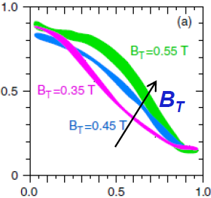
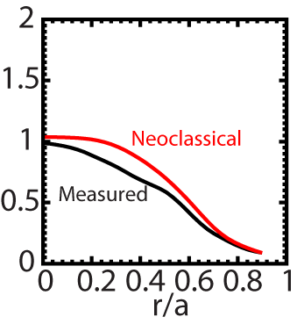
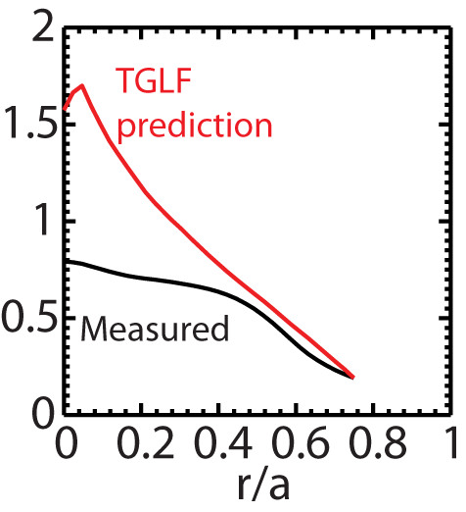
Beginning to test/utilize transport models to predict NSTX temperature profiles, identify possible missing physics
NSTX H-modes showed broadening of T_{e} profile as B_{T} was increased
  Similar broadening trend observed with increased lithium deposition
  B_{T}τ_{E} scales as ~1/ν* in both datasets
T_{e} (keV)
r/a
Utilizing neoclassical + drift wave models to simulate NSTX T_{i} and T_{e} profiles (collaboration with GA)
  Need model for χ in edge region
  Discrepancy in core T_{e} prediction for beam-heated H-modes
T_{i} (keV)
T_{e} (keV)
Over-prediction of core T_{e} in NSTX may be due to transport from GAE/CAE modes not included in gyro-Landau-fluid model

Slide 34


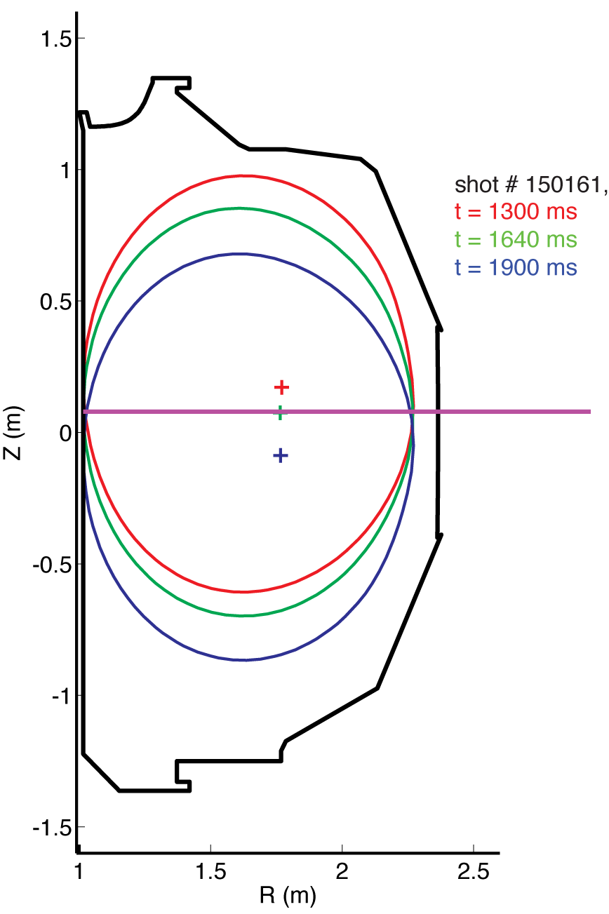


UCLA successfully tested 288 GHz polarimeter for NSTX-U on DIII-D
UCLA Graduate Student: J. Zhang – Thesis Project
Dedicated DIII-D run time to test polarimeter over wide range of conditions: phase response predicted to vary strongly with vertical position and B_{T}.
  Moving plasma vertically → Faraday rotation due to horizontal B ranges from weak to strong
  Wide range of B_{T} → elliptization (Cotton-Mouton effect) ranges from weak to strong
Synthetic diagnostic calculations agree with measured phase over wide range of B_{T} (0.75-2.0 T), plasma height
polarimeter beam
mirror
0.75 T
2.0 T
Faraday rotation dominated
Cotton-Mouton effect dominated
Polarimetry planned to be used to measure μ-tearing δB in NSTX-U

Slide 35
Transport and Turbulence (TT) 5 Year Goal:
Establish predictive capability for transport in next-step devices focusing on the ST high-β + low-collisionality regime
TT Thrusts:
Characterize H-mode global energy confinement scaling in the lower collisionality regime of NSTX-U
Identify modes causing anomalous electron thermal, momentum, particle/impurity transport
  Exploit scaling dependencies of modes
    Example: μ-tearing χ_{e} ~ ν¹, ETG χ_{e} ~ ν⁰
  Relate predicted turbulence to data:
    Low-k (BES), δB (polarimetry), high k_{r} & k_{θ} (μ-wave)
  Builds on identification of ETG w/ novel high-k_{r} scattering in NSTX
Establish and validate reduced transport models

Slide 36
Highest priority research goals for 5 year plan:
Demonstrate 100% non-inductive sustainment at performance that extrapolates to ≥ 1MW/m² neutron wall loading in FNSF
Access reduced ν* and high-β combined with ability to vary q and rotation to dramatically extend ST physics understanding
Develop and understand non-inductive start-up and ramp-up
(overdrive) to project to ST-FNSF with small/no solenoid
4. Develop and utilize high-flux-expansion “snowflake” divertor
and radiative detachment for mitigating very high heat fluxes
5. Begin to assess high-Z PFCs + liquid lithium to develop high-duty-factor integrated PMI solutions for next-steps

Slide 37


Simulations support non-inductive start-up/ramp-up strategy
TSC code (2D) successfully simulates CHI I_{P} ~200kA achieved in NSTX
TRANSP: NSTX-U more tangential NBI → 3-4x higher CD at low I_{P} (0.4MA)
TSC: non-inductive ramp-up from 0.4MA to 1MA possible w/ BS + NBI
1.0 ms
1.6 ms
2.7 ms
2
1
Z (m)
0
-1
-2
0
1
2
0
1
2
0
1
2
R (m)
R (m)
R (m)
TSC + tools included in 5 year plan support CHI I_{P} → 400kA in NSTX-U
  Higher injector flux, toroidal field, CHI voltage
  1MW 28GHz ECH (increases T_{e})
But, RF heating (ECH and/or HHFW) of CHI likely required to couple to NBI

Slide 38

CHI design for QUEST supports NSTX-U research
(Collaboration with Kyushu University - Japan)
Preliminary design completed (January 2013)
  Now working on finalizing design and cost estimates
Electrode mounted on top of divertor plate
  Insulators not part of vacuum structure
  CHI operation at up to 3kV
  Metallic electrodes (SS + Mo/W)
    Provides data for NSTX-U metal electrodes (high-Z tiles)
  Also informs ST-FNSF CHI design
Collaboration led by R. Raman – Univ. Washington

Slide 39

Plasma Start-up and Ramp-up (PSR) 5 Year Goal:
Develop and understand non-inductive start-up/ramp-up to project to ST-FNSF operation with small or no solenoid
PSR Thrusts:
Initial years: Establish, extend solenoid-free plasma start-up, test NBI+BS over-drive ramp-up
  Assess impact of new gap geometry, PF coil positions
  Increase CHI closed-flux I_{P} from 200kA → 300-400kA
  Assess NBI H&CD in 300-400kA ohmic target
  Attempt NBI + bootstrap ramp-up: ΔI_{P} ~ 100-400kA
Later years: Ramp-up CHI plasma using ECH + HHFW + NBI, test “plasma gun” (point-helicity source) start-up
  Maximize levels of CHI-produced I_{P}, extend with ECH and HHFW
  Test NBI coupling to heated CHI, attempt full non-solenoidal start-up
  Commission, test plasma guns (being developing on Pegasus) on NSTX-U

Slide 40



HHFW can efficiently heat low I_{P} targets for plasma start-up
NSTX high-harmonic fast-wave (HHFW) antenna will also be utilized on NSTX-U
  12 strap, 30MHz, P_{RF} ≤ 6MW
  HHFW: highest ST T_{e}(0) ~ 6keV
T_{e}(0)=3keV RF-heated H-mode at I_{P} = 300kA with only P_{RF} = 1.4MW
Non-inductive fraction ≥ 70%
  f_{BS} ~50%, f_{RFCD} ~ 20-35%

Slide 41



MAST: 28 GHz EBW start-up campaign in 2013 used new
low-loss transmission line to achieve record plasma current
  Grooved reflecting polarizer machined into center column in MAST
28 GHz O-mode weakly absorbed (< 2%) below n_{e} ~ 1 x 10¹⁹ m⁻³ cut off
Polarizer on center column converts to X-Mode that then 100% converts to EBWs
Previously achieved I_{p}~33 kA but arcs in waveguide limited RF power [Sept 2009]
During two one-week EBW start-up campaigns in 2013 coupled 70-100 kW for 300-400 ms achieving I_{p} = 50-75 kA
G. Taylor (PPPL), with ORNL
41

Slide 42


Radio-frequency Heating and Current Drive (RF) 5 Year Goal:
Provide and understand heating and current-drive for full non-inductive (NI) start-up and ramp-up in support of FNSF
RF Thrusts:
Develop HHFW and EC heating for fully non-inductive plasma current start-up and ramp-up
  Extend HHFW to higher power (3-4MW), demonstrate HHFW-driven 100% non-inductive at 300-400kA
    Goal: maintain I_{P} to confine 2nd NBI fast-ions
Validate advanced RF codes for NSTX-U, predict RF performance in ITER and FNSF
  Use ECH (~1MW, 28GHz), then HHFW to increase T_{e} of CHI plasmas for NBI
  Test high-power EBW to generate start-up current - builds on MAST results

Slide 43
Highest priority research goals for 5 year plan:
Demonstrate 100% non-inductive sustainment at performance that extrapolates to ≥ 1MW/m² neutron wall loading in FNSF
Access reduced ν* and high-β combined with ability to vary q and rotation to dramatically extend ST physics understanding
Develop and understand non-inductive start-up and ramp-up
(overdrive) to project to ST-FNSF with small/no solenoid
4. Develop and utilize high-flux-expansion “snowflake” divertor
and radiative detachment for mitigating very high heat fluxes
5. Begin to assess high-Z PFCs + liquid lithium to develop high-duty-factor integrated PMI solutions for next-steps

Slide 44

Pedestal width scaling differs from conventional aspect ratio
Pedestal width scaling
0.16
Pedestal width scaling β_{θ}^{α} applies to multiple machines
NSTX pedestal width is larger
  Data → stronger scaling: ~β_{θ} vs. β_{θ}^{0.5}
  Preliminary EPED calculations: ~β_{θ}^{0.8}
  Measured low-k turbulence correlation lengths consistent with XGC1 turbulence predictions
0.4 (β_{θ}^{ped})
^{1.05}
NSTX
0.12
Pedestal width (ψ_{N})
C-Mod
0.08
DIII-D
0.04
^{0.5}
~ 0.08 (β_{θ}^{ped})
0.00
0.1
0.3
0.5
0.7
0.9

Slide 45


Synthetic diagnostics linked to XGC0 confirm kinetic effects in high-T_{i} pedestals (QH-mode on DIII-D)
Kinetic effects drive non-Maxwellian ion energy distributions in a high-T_{i} pedestal
  Ion temperature anisotropy
  T_{i} > T_{e} in SOL
  Increasing impurity T_{i} in SOL
  Poloidal asymmetry in flows, temperatures and densities
Improved interpretation of diagnostics modifies inferred pedestal pressure and transport
  Important for equilibrium reconstructions, pedestal stability and transport calculations
Measurement: CER C⁺⁶ T_{i}
CER Vert
Vert fit
CER Tang
Tang fit
Simulation: XGC0 C⁺⁶ T_{i}
keV
T_{perp}
Solid: Outboard
Dotted: Inboard
T_{para}
APS-DPP 2013 invited talk on XGC0 kinetic neoclassical for DIII-D and NSTX – D. Battaglia, C-S Chang (PPPL)
ψ_{N}
45

Slide 46



Snowflake divertor effective for heat flux mitigation
NSTX: can reduce heat flux by 2-4× via partial detachment
Snowflake → additional x-point near primary x-point
  NSTX: High flux expansion = 40-60 lowers incident q⊥
  Longer field-line-length promotes temperature drop, detachment
Standard Divertor
Snowflake Divertor

Slide 47



Developing snowflake and radiative detachment control on DIII-D in preparation for usage on NSTX-U
Significant heat flux reduction between and during ELMs in DIII-D snowflake
New expts scheduled for July
  1st tests of magnetic feedback control
Real-time divertor radiation / detachment control developed, sustained detachment achieved
Detached - Standard Snowflake
Real-time diagnostics: bolometry, D_{β}, interferometry, Thomson (divertor, core, tangential)
Actuators: D₂ and Ne gas puffing to obtain desired level of detachment and/or radiation.
n_{e} / n_{G} = 0.60
Peak ELM
E. Kolemen (PPPL)
V. Soukhanovskii (LLNL)
47

Slide 48

Boundary Physics (BP) 5 Year Goal:
Develop and understand integrated plasma exhaust solutions compatible with high core performance for FNSF and ITER
BP Thrusts:
Assess, optimize, control pedestal structure, transport, stability
Assess and control divertor heat fluxes
  Measure SOL widths at lower ν, higher B_{T}, I_{P}, P_{SOL}
    Compare data to fluid and gyro-kinetic models
  Assess, control, optimize snowflake divertor
  Develop highly-radiating divertor w/ feedback control
  Assess impact of high-Z tile row(s) on core impurities
Establish and compare long-pulse particle control methods
  Validate cryo-pump physics design, assess density control
  Compare cryo to lithium coatings for n_{e}, impurity, ν* control

Slide 49


Plasma confinement increases continuously with increasing lithium coatings; Li may also be means of heat flux mitigation
150 mg
300 mg
ELM-free discharges
I_{P} = 0 .8 MA, P_{NBI} ~ 4 MW
High δ, f_{exp} ~20
Energy Confinement Time (ms)
Pre-discharge lithium evaporation (mg)
R. Maingi, et al., PRL 107 (2011) 145004
Global parameters improve
  H98(y,2) increases from ~0.9 → 1.3-1.4
  No core Li accumulation
ELM frequency declines to zero
Edge transport declines
High τ_{E} critical for FNSF, next-steps
Increased Li deposition may be advantageous for power handling
  Lower peak divertor heat flux and T_{surface}
  Increased divertor radiation
May require threshold Li level
Motivates “vapor-shielding” research
What is τ_{E} upper bound?

Slide 50


Materials and PFCs (MP) 5 Year Goal:
Initiate comparative assessment of high-Z and liquid metal PFCs for long-pulse high-power-density next-step devices
MP Thrusts:
Understand Li surface-science at extended PFC operation
  “Atoms to tokamaks” collaboration with PU
Assess tokamak-induced material migration and evolution
  QCMs, marker-tiles, MAPP + QCM for shot-to-shot analysis of migration
  Materials Analysis Particle Probe (MAPP) (Purdue - J.P. Allain, 2010 ECRP) to identify in-situ between-shot surface composition (LTX→NSTX-U)
Establish the science of continuous vapor-shielding
  Continue studies of Li vapor-shielding in linear plasma device Magnum-PSI
  Extend Magnum results to NSTX-U
Magnum-PSI collaboration: M. Jaworski, T. Abrams (grad student) (PPPL)
Lab-based R&D: flowing Li loops, capillary-restrained Li surfaces

Slide 51

Collaboration plans have been developed to utilize MIT expertise in boundary, RF, transport, disruptions on NSTX-U
51

Slide 52
Summary: NSTX-U 5 year plan goals embody world-leading research in support of ITER and FNSF
Demonstrate 100% non-inductive sustainment at performance that extrapolates to ≥ 1MW/m² neutron wall loading in FNSF
Access reduced ν* and high-β combined with ability to vary q and rotation to dramatically extend ST physics understanding
Develop and understand non-inductive start-up and ramp-up
(overdrive) to project to ST-FNSF with small/no solenoid
4. Develop and utilize high-flux-expansion “snowflake” divertor
and radiative detachment for mitigating very high heat fluxes
5. Begin to assess high-Z PFCs + liquid lithium to develop high-duty-factor integrated PMI solutions for next-steps
NSTX-U will be ST leader, complement AT approach (DIII-D)
Low ν* + high β + turbulence diagnostics unique in world
Unique helicity injection + RF + NBI start-up/ramp-up techniques
With MAST Super-X, STs leading development of novel divertors
Aiming to lead development of replenishable / liquid metal PFCs

Slide 53
Agenda
NSTX Upgrade progress report – R. Strykowsky
  20 minutes
5 year plan overview - including FY13 collaboration highlights relevant to 5 year plan – J. Menard
  55 minutes
NSTX-U facility and diagnostic highlights – M. Ono
  45 minutes

Slide 54
Talk Outline
NSTX-U Operational Preparation Status
NSTX-U Facility / Diagnostic Five Year Plans
Summary

Slide 55
Successful Implementation of FY13 Milestones
Mainly Through Data Analyses, Theory/Modeling, and Collaborations
FY 2013 NSTX-U Facility Joint Research Milestone
Conduct experiments on major fusion facilities, to evaluate stationary enhanced confinement regimes without large Edge Localized Modes (ELMs), and to improve understanding of the underlying physical mechanisms that allow increased edge particle transport while maintaining a strong thermal transport barrier. … Candidate regimes and techniques have been pioneered by each of the three major US facilities (C-Mod, D3D and NSTX). … Exploiting the complementary parameters and tools of the devices, joint teams will aim to more closely approach key dimensionless parameters of ITER, and to identify correlations between edge fluctuations and transport. The role of rotation will be investigated. The research will strengthen the basis for extrapolation of stationary high confinement regimes to ITER and other future fusion facilities, for which avoidance of large ELMs is a critical issue. Stefan Gerhardt is coordinating the FY 2013 JRT and the Q3 report has been submitted.
Notes:
55

Slide 56


Engineering and Research Operations Activities
In Preparation for the NSTX-U Operations
  • Improving the PFC geometry in the vicinity of the CHI gap to protect the vessel and coils due to ~ 10x higher divertor heat loads
New gap overhung tiles to provides necessary protection. Gap tiles being fabricated by the vendor.
Improved Tile Design
  • Replacing electronics that control rectifiers - The new Firing Generator (FG) will deliver firing pulses with greater resolution, precision, and repeatability, critical for the new 8-parallel, 130kA TF system configuration.
Transrex AC/DC Convertors
More than half of the 68 FG production units have now undergone power testing in rectifiers, and test results for all units have been identical, giving us confidence that we can rely on bench testing for the remaining ones. Power testing will continue to confirm current balancing on multiple rectifiers. Target completion date of Nov. 2013.

Slide 57
NSTX-U Plasma Control System Upgrade
Enables real time up-down symmetric divertor control
NSTX-U PF Coil Power System Upgrade
The first-year power supply capabilities of NSTX-Upgrade will yield considerable experimental flexibility, via up-down symmetric PF-1C coils
By powering upper and lower PF-1A & PF-1C coils, it will be possible to generate up-down symmetric snowflake divertors
The new configuration should provide better control for the CHI absorber region.
Plasma Control System Upgrade
Analog Inputs
Coil Currents
Power Supplies
Magnetics
(including upgrades)
Neutral Beams
(1st and 2nd BLs)
Gas Injection
Vacuum
Rotation data
Pitch angle data
Sample rate: 5 → 20 KHz
Added 32 channels
PC Links replaced with much faster “Firing Generator” Serial Links
FPDP: 1 → 4 links
Analog Inputs
416 channels
PC Links
Power Supplies
(inc. 3 new coils)
Neutral Beams
(including new BL)
Gas Injection
Real-Time
Computer
New computer: cores: 8 → 32
Digital Inputs
12 words
FPDP
FPDP
Digital Outputs
Time Stamp
micro seconds
Analog Outputs

Slide 58
Repair of the Motor Generator
(MG#1)
In 2004, Magnetic Particle Inspections identified cracking in the weld fillet of multiple joints between the radial arms of MG#1. Cracks were in primary load paths, taking that set out of service. MG#2 is in limited operations (run and monitor at reduced parameters) with cracks in “stiffener” welds intended to limit elastic deformation (not in primary load paths).
  Over 250” of welds in 19 rotor spider joints will be ground out and replaced to restore MG#1 to its original design configuration.
  A jacking system has been engineered to relieve all loads on the rotor assembly during the repair.
  PPPL and GE engineering collaborated on the detailed repair procedure (D/NSTX-RP-MG-07).
Status: Target completion date of Jan. 2014
A Statement of Work to perform the scope described in the repair procedure has been reviewed and approved.
Fixed-price proposals for the weld repairs have been received. A WAF capturing all project costs (PPPL and Sub-contractor) is being generated.
A draft Project Management Plan has been developed.

Slide 59
NSTX-U diagnostics to be installed during first 2 years
Half of NSTX-U Diagnostics Are Led by Collaborators
MHD/Magnetics/Reconstruction
  Magnetics for equilibrium reconstruction
  Halo current detectors
  High-n and high-frequency Mirnov arrays
  Locked-mode detectors
  RWM sensors
Profile Diagnostics
  MPTS (42 ch, 60 Hz)
  T-CHERS: T_{i}(R), V_{φ}(r), n_{C}(R), n_{Li}(R), (51 ch)
  P-CHERS: V_{θ}(r) (71 ch)
  MSE-CIF (18 ch)
  MSE-LIF (20 ch)
  ME-SXR (40 ch)
  Midplane tangential bolometer array (16 ch)
Turbulence/Modes Diagnostics
  Poloidal Microwave high-k scattering
  Beam Emission Spectroscopy (48 ch)
  Microwave Reflectometer,
  Microwave Polarimeter
  Ultra-soft x-ray arrays – multi-color
Energetic Particle Diagnostics
  Fast Ion D_{α} profile measurement (perp + tang)
  Solid-State neutral particle analyzer
  Fast lost-ion probe (energy/pitch angle resolving)
  Neutron measurements
Edge Divertor Physics
  Gas-puff Imaging (500kHz)
  Langmuir probe array
  Edge Rotation Diagnostics (T_{i}, V_{φ}, V_{pol})
  1-D CCD H_{α} cameras (divertor, midplane)
  2-D divertor fast visible camera
  Metal foil divertor bolometer
  AXUV-based Divertor Bolometer
  IR cameras (30Hz) (3)
  Fast IR camera (two color)
  Tile temperature thermocouple array
  Divertor fast eroding thermocouple
  Dust detector
  Edge Deposition Monitors
  Scrape-off layer reflectometer
  Edge neutral pressure gauges
  Material Analysis and Particle Probe
  Divertor VUV Spectrometer
Plasma Monitoring
  FIReTIP interferometer
  Fast visible cameras
  Visible bremsstrahlung radiometer
  Visible and UV survey spectrometers
  VUV transmission grating spectrometer
  Visible filterscopes (hydrogen & impurity lines)
  Wall coupon analysis
New capability, Enhanced capability

Slide 60




New Port Covers Have Been Designed For Bays E, I, J, and L
Detailed Design to Accommodate Enhanced NSTX-U Diagnostic Access Needs
Bay E Supports 3
UV Spectrometers (LoWEUS, XEUS, MonaLisa) and MIG1
Bay J Supports
IR and Visible Cameras, UT-K and Divertor Spectrometers, Upward LITER, UCLA Reflectometer and Polarimeter, LBO, RF Probe.
Bay I Supports
XCS, TGS, IR & Visible Cameras, SSNPA, SGI, 1D CCD & EIES, Microwave Imaging, QMB, Bolometers
Design is very close to done.
Bay-L Cap (not shown) Supports
MPTS exit window, High-k exit, plasma TV+GPI view, SSNPA, spectroscopy & CHERS view, GDC feedthroughs, magnetics feedthroughs.

Slide 61


Multi-Point Thomson Scattering Upgrade and
Materials Analysis and Particle Probe – MAPP
Modification of the MPTS system is needed to accommodate the larger diameter NSTX-U Center Stack - Re-aim the laser beam, the light collection optics, redesign the beam dump, and calibration probe to be ready for the first plasma.
MPTS Midplane Cross Section
• Ahmed Diallo recently received an Early Career Research Program award - will install a fast rep rate (10-15 kHz) burst mode (5 ms) third laser for studies of ELMs and other fast phenomena in FY15.
• MAPP to relate PFC surface conditions and plasma behavior in “real time”.
• PFC analysis after run is difficult to relate to plasma behavior.
• MAPP refurbished at Purdue and baseline data obtained at PPPL/LTX
• X-ray photoelectron spectroscopy (XPS) provides information on elemental composition of PFC’s.
MAPP XPS Spectrum for SS Sample
Oxygen
Carbon

Slide 62
Transition into operations- planning underway
NSTX-U Start-up Process Similar to NSTX
NSTX-U ISTP, Commissioning, and Startup will follow the same process as NSTX initial commissioning and startup from February 1999.
Pre-operational test of subsystems (PTP’S)
Activity Certification Committee (ACC) review
DOE Readiness Assessments (RA)
Integrated system test procedure (ISTP) (per OP-NSTX-02 rev 14)
CD-4 Demonstrated
Performance
Key Operations Milestones
Begin Diagnostic Installation – August 1st, 2013
Complete in-vessel construction work October 1st 2013.
Complete Diagnostic installation & calibration – December 1st, 2013
Rough Pump down – January 1st, 2014
Commence Operations and run XP’s
NSTX-U Team Development of XPs for FY 2015 run
Shake-down
NSTX-U Operations Team Similar to NSTX
Notes:
ACC > ORA >
PTP’s >>>ISTP OP-NSTX-02

Slide 63
Plans to Rapidly Recover Physics Operations Capabilities
Plasma Operations with:
I_{p}≤1.0 MA, B_{T}≤0.5
Develop:
Breakdown and current ramp scenarios
Shape & position control
Reliable H-mode
Diagnostic operations
Continue to add diagnostic & control capabilities while initiating physics experiments.
ISTP:
(Integrated Systems Test Procedure)
Establishes facility in state of readiness for operations.
I_{p}≤1.5-1.6 MA
B_{T}≤0.75-0.8
July-Sept. 2014
ISTP-1 & CD-4 Prep
MPTS Calibrations, Bake Out, CD-4
Operations
Commissioning
Phys. Ops
ISTP-2
Phys.
Ops
~ 2-3 Months
ISTP-2
Required to increase the field and current for later research phase
Attempt 50 kA CD-4 plasma before bake-out. If water in PFCs prevents success, then repeat after bake-out.

Slide 64
Formulating Strategy Toward Full NSTX-U Parameters
After CD-4, the plasma operation could enter quickly into new regimes
 | NSTX (Max.) | Year 1 NSTX-U Operations (2015) | Year 2 NSTX-U Operations (2016) | Year 3 NSTX-U Operations (2017) | Ultimate Goal
I_{P} [MA] | 1.2 | ~1.6 | 2.0 | 2.0 | 2.0
B_{T} [T] | 0.55 | ~0.8 | 1.0 | 1.0 | 1.0
Allowed TF I²t [MA²s] | 7.3 | 80 | 120 | 160 | 160
I_{P} Flat-Top at max. allowed I²t, I_{P}, and B_{T} [s] | ~0.4 | ~3.5 | ~3 | 5 | 5
1st year goal: operating points with forces up to ½ the way between NSTX and NSTX-U, ½ the design-point heating of any coil
  Will permit up to ~5 second operation at B_{T}~0.65
2nd year goal: Full field and current, but still limiting the coil heating
  Will revisit year 2 parameters once year 1 data has been accumulated
3rd year goal: Full capability

Slide 65


10 year plan tools with 5YP incremental funding
1.1 × (FY2012 + 2.5% inflation)
2014 | 2015 | 2016 | 2017 | 2018 | 2019 | 2020 | 2021 | 2022 | 2023
Upgrade Outage
1.5 → 2 MA, 1s → 5s
Metallic PFCs, 5s → 10-20s
Run Weeks:
20
16
16
20
22
6
18
22
22
New
center-stack
Start-up and Ramp-up
Upgraded CHI for ~0.5MA
0.5-1 MA CHI
up to 1 MA plasma gun
Extend NBI duration to 10-20s and/or implement 2-4 MW off-axis EBW H&CD
1 MW ECH/EBW
2 MW
Boundary Physics
Lower divertor cryo-pump
Divertor Thomson
Upper divertor cryo-pump
Inform U.S. next-step conceptual
design to optimize: aspect ratio, divertor, and PFCs
Materials and PFCs
High-Z tile row on lower OBD
High-Z first-wall + lower OBD tiles
High-Z PFC diagnostics
All high-Z PFCs
Hot high-Z FW PFCs using bake-out system
Liquid
metals / lithium
Upward
LiTER
LLD using bakeable cryo-baffle
Flowing Li divertor
or limiter module
Full toroidal flowing Li lower OBD
Li granule injector
MGI disruption mitigation
Partial NCC
NCC SPA upgrade
Full NCC
MHD
Enhanced MHD sensors
Transport & Turbulence
δB polarimetry
DBS, PCI, or other intermediate-k
High k_{θ}
Waves and Energetic Particles
HHFW limiter upgrade
HHFW straps to excite EHO
High-power AE antenna
2nd NBI
1 coil AE antenna
4 coil AE antenna
Charged fusion product, neutron-collimator
Scenarios and Control
Establish control of:
Control integration, optimization
Control integration, optimization with long-pulse and full metal wall
n_{e}
q_{min}
Divertor P_{rad}
Snowflake
Rotation

Slide 66
5 year plan tools with 5YP base funding
(FY2012 + 2.5% inflation)
2014 | 2015 | 2016 | 2017 | 2018
Upgrade Outage
1.5 → 2 MA, 1s → 5s
Run Weeks:
16
14
14
16
Cryo-pump, high-Z tile row on cryo-baffle, and partial NCC would be installed in-vessel during ~1 year outage between FY2016 and FY2017
  NSTX-U would operate 1st half of FY2016 and 2nd half of FY2017
New
center-stack
Start-up and Ramp-up
Upgraded CHI for ~0.5MA
up to 0.5 MA plasma gun
0.5-1 MA CHI
1 MW ECH/EBW
Boundary Physics
Lower divertor cryo-pump
Divertor Thomson
Materials and PFCs
High-Z tile row on lower OBD
High-Z tile row on cryo-baffle
High-Z PFC diagnostics
All high-Z PFCs
Delayed scope
Liquid
metals / lithium
Upward
LiTER
LLD using bakeable cryo-baffle
Flowing Li divertor
or limiter module
Reduced scope
Li granule injector
Deferred scope
MGI disruption mitigation
Partial NCC
NCC SPA upgrade
MHD
Enhanced MHD sensors
Transport & Turbulence
δB polarimetry
DBS, PCI, or other intermediate-k
High k_{θ}
Waves and Energetic Particles
HHFW limiter upgrade
HHFW straps to excite EHO
2nd NBI
1 coil AE antenna
4 coil AE antenna
Charged fusion product, neutron-collimator
Scenarios and Control
Establish control of:
Control integration, optimization
n_{e}
q_{min}
Divertor P_{rad}
Snowflake
Rotation

Slide 67

Solenoid-free Start-up
High priority goal for NSTX-U in support of FNSF
CHI Start-Up
PEGASUS Point Source
• Inj. Flux in NSTX-U is about 2.5 times higher than in NSTX
• NSTX-U coil insulation greatly enhanced for higher voltage ~ 3 kV operation
PEGASUS Plasma Gun
U. Washington
U. Wisconsin
FY 2013-14 Non-Inductive Start-up Systems Design for Post-Upgrade Operations
• CHI will start with the present 2 kV capability then enhanced to ~ 3 kV higher voltage as needed.
• PEGASUS gun start-up producing exciting results Ip ~ 160 kA. The PEGASUS gun concept is technically flexible to implement on NSTX once fully developed. High current gun for the NSTX-U will be developed utilizing the PEGASUS facility in collaboration with University of Wisconsin.

Slide 68




Strengthen HHFW Antenna Feeds for Disruption Load
A MW-Class 28 GHz ECH System for Non-Inductive Operation
New Compliant Antenna Feeds
Will allow HHFW antenna feedthroughs to tolerate 2 MA disruptions
28 GHz, 1.5 MW Tsukuba Gyrotron
C-Mod antenna electroformed compliant section
28 GHz ECH/EBWH waveguide and mirror concept
Successful CDR conducted, prototype feeds being procured.
Feeds to be tested in the RF test-stand before FDR, installation in spring 2014.
• FY 2013/15 – Start MW-class ECH/EBW system conceptual design for non-inductive operations (MOU with Tsukuba University)

Slide 69



NSTX-U Lithium Capability During Initial Two Years
Lithium Evaporators and Granular Injector
Existing LITERS
New Upward Evaporating LITER
• Upward Evaporating LITER to increase Li coverage for increased plasma performance
NSTX-U lithium granular injector
for ELM pacing
• High frequency ELM pacing with a relatively simple tool.
• ELM pacing successfully demonstrated on EAST (D. Mansfield, IAEA 2012)
Granule Reservoir
Struck Granule Horizontally
Redirected at 70 m/s
t = 800 μs

Slide 70









Baseline Capability for PMI Research
Supporting divertor and lithium research
Divertor fast eroding thermocouples
Two fast 2D visible and IR cameras with full divertor coverage
Divertor Imaging
Spectrometer
ORNL
LLNL, ORNL, UT-K
LLNL
Li I
  Lithium CHERS
ORNL
C II
Divertor fast pressure gauges
MAPP probe for between-shots surface analysis
Dual-band fast IR Camera
(see back-up slides # 53 and 54)
Purdue U.
Notes:
With the NSTX PAC recommendation, we have been increasing the LLD diagnsotic capabilities including lithium CHERS, PMI probe, Lyman Alpha LLD recycling diode array, three view divertor bolometer, and two color fast IR divertor camera.

Slide 71

Boundary Facility Capability Evolution
NSTX-U will have very high divertor heat flux capability of ~ 40 MW/m²
2015
2016
2017
2018
C
BN
Li
High-Z
Lower
OBD
high-Z row of tiles
Cryo + high-Z FW and OBD
+ liquid Li divertor (LLD)
Cryo + high-Z FW and OBD
PFCs
High-Z tile row
Cryo-pump
Bakeable cryo-baffle for liquid Li
NSTX Moly Tiles
ORNL

Slide 72
New MHD and Plasma Control Tools for NSTX-U
Sustain β_{N} and Understand MHD Behavior Near Ideal Limit
Partial NCC option (2 x 6 odd parity)
Full NCC
Existing
RWM
coils
Non-axisymmetric Control Coils (NCC)
Columbia U., GA
• NCC can provide expanded RWM, NTV, RMP, and EF physics studies with more flexible field spectrum (n ≤ 6, or n ≤ 3 depending on set).
• 2nd 3-channel Switching Power Amplifier (SPA) commissioned in July 2011 to power 6 independent currents in existing midplane RWM and NCC coils.
• An extended MHD sensor set to measure theoretically predicted poloidal mode structure and to improve mode control.
• A Real-Time Velocity (RTV) diagnostic in a new plasma rotation control system for active instability avoidance by controlling rotation profile.
• Multi-poloidal location massive gas injector system will be implemented.

Slide 73





Transport and Turbulence
BES together with high-k to provide comprehensive turbulence diagnostic
Modes
0.1
1
k⊥(cm⁻¹)
10
100
μTEARING
ITG/TEM
ETG
BES, pol
BES
BES, Polarimeter
μwave Scattering
48 ch BES available for NSTX-U
(24 ch BES available in 2011)
New high-k scattering system for allowing
2-D k spectrum
Optical fibers
UCD
Neutral Beam
field lines
red-shited
Dα emission
High throughput collection optics
U. Wisconsin
A 288 GHz polarimetry system for magnetic fluctuation measurements is being tested on DIII-D.
UCLA

Slide 74

Energetic Particle Research Capabilities
For NBI fast ion transport and current drive physics
FIDA Views
Fast Ion D-Alpha Diagnostics
UCI
• Vertical FIDA system measures trapped or barely passing (co-going) particles.
• New tangential FIDA system measures co-passing fast ions
• Both FIDA systems have time resolution of 10 ms, spatial resolution ≈ 5 cm and energy resolution ≈ 10 keV.
Vertical
Tangential
FY 2013 - 14 Energetic Particle Conceptual Design and Diagnostic Upgrade
  Solid State-NPA enhancement
  Charged Fusion Product Array
  Proto-type active TAE antenna
UCI
FIU
5-turn radial active TAE antenna installed in 2011

Slide 75
NSTX Five Year Plan Budget Summary ($M)
FY 2014-15: transition years from construction to operation
 | FY14 |  | FY15 |  | FY16 |  | FY17 |  | FY18
Budget Cases | Base | 10% Incr | Base | 10% Incr | Base | 10% Incr | Base | 10% Incr | Base | 10% Incr
Run Weeks | 0 | 0 | 16 | 4 | 14 | 2 | 14 | 2 | 16 | 4
Facility Ops | $12.7 |  | $26.6 | $1.0 | $29.0 | $0.5 | $29.7 | $0.5 | $30.9 | $1.0
Facility Enhancements | $0.7 | $4.2 | $2.8 | $2.3 | $5.0 | $2.8 | $5.1 | $3.0 | $4.9 | $2.5
NSTX-U | $23.2 |  | $3.8
Facility Total | $36.6 | $4.2 | $33.1 | $3.3 | $34.0 | $3.3 | $34.9 | $3.5 | $35.7 | $3.5
PPPL Research | $10.5 |  | $12.9 | $0.9 | $13.2 | $0.9 | $13.5 | $0.9 | $13.9 | $0.9
Collab Interface | $0.5 | $0.5 | $0.7 | $0.5 | $0.7 | $0.5 | $0.8 | $0.5 | $0.8 | $0.5
Collaborators | $6.2 | $0.6 | $6.4 | $0.6 | $6.6 | $0.7 | $6.7 | $0.7 | $6.9 | $0.7
Science Total | $17.2 | $1.1 | $20.0 | $2.0 | $20.5 | $2.1 | $21.0 | $2.1 | $21.6 | $2.2
NSTX-U Total | $53.8 | $5.3 | $53.2 | $5.3 | $54.5 | $5.4 | $55.9 | $5.6 | $57.3 | $5.7
• Research and Operations team budget for NSTX-U is similar to that of NSTX FTEs of FY 2010 level.
• For FY 15 and beyond, the budget facility operations and PPPL/Collaboration research are based on similar operations and research staff coverage to NSTX.
• Base funding enables preparation and operation of NSTX-U while completing the Upgrade Project on schedule.
• Significant post upgrade facility/diagnostic enhancements can only start in FY 2016.
• Incremental scenario will enable full NSTX-U operation and timely implementation of the five year plan major facility and diagnostic enhancements.

Slide 76
Base NSTX-U Five Year Plan Budget Summary
Base DOE Guidance Budget – Inflation adjusted flat FY 2012 budget
• FY12 budget + 2.5% inflation
Collaborations
Collaboration Diagnostic Interface
PPPL Research
Upgrade Project
Facility Enhancement
Facility Ops
0
16
14
14
16
Run Weeks
FY 14
FY 15
FY 16
FY 17
FY 18
In FY 14-15, the Upgrade Project needs to be completed.
                In FY 14-15, only modest budget is available for 5 year plan long lead facility enhancements (e.g., ECH, Cryo-pump, and NCC).
                FY 14-15 incremental budget is therefore particularly critical to start timely design and procurements for the long-lead facility enhancements.

Slide 77
NSTX-U Operation Preparation Well Underway
Exciting Opportunities and Challenges Ahead
• NSTX upgrade outage activities are progressing well
  Diagnostics were stored and secured for the upgrade activities. Collaborator diagnostics are being refurbished and enhanced.
  Researchers are working productively on data analysis, collaboration, next five year plan and preparation for the NSTX-U operation.
  NSTX operations technical staff were shifted to the Upgrade Project tasks in FY 2012 – 13. They will be shifted back to the NSTX-U operational preparation in FY 2014 as the Upgrade Project scopes are completed.
  NSTX Upgrade Project is thus far progressing on budget and on schedule.
  NSTX-U operational preparation is well underway.
  Diagnostic reinstallation will be starting this coming fall.
  Various engineering operations tools are being refurbished / upgraded including CHI gap, rectifier control, motor generator, plasma control system, and PF control.
• Exciting 5 Year Plan (FY 2014 – 18) has been developed
  Aiming to provide necessary data base for FNSF design and construction.
  Strong contribution to toroidal physics, ITER, and fusion energy development.
  10% incremental budget would enable timely implementation of facility capabilities to support the exciting NSTX-U Five Year Plan.

Slide 78
Back-up Slides

Slide 79

Substantial Increase in NSTX-U Device / Plasma Performance
Higher performance requires facility / infrastructure enhancements
Previous
center-stack
New
center-stack
TF OD = 20cm
TF OD = 40cm
NSTX
 | R₀ (m) | A_{min} | I_{p} (MA) | B_{T} (T) | T_{TF} (s) | R_{CS} (m) | R_{OB} (m) | OH flux (Wb)
NSTX | 0.854 | 1.28 | 1 | 0.55 | 1 | 0.185 | 1.574 | 0.75
NSTX-U | 0.934 | 1.5 | 2 | 1 | 6.5 | 0.315 | 1.574 | 2.1
Present NBI
New 2nd NBI

Slide 80


Surface Analysis Facilities to Elucidate Plasma-Surface Interactions
PPPL Collaboration with B. Koel et al., Princeton University
The Surface Science and Technology Laboratory (SSTL) with three surface analysis systems and an ultrahigh vacuum deposition chamber.
The Surface Imaging and Microanalysis Laboratory (SIML) with a Thermo VG Scientific Microlab 310-F High Performance Field Emission Auger and Multi-technique Surface Microanalysis Instrument.
Recently solid lithium and Li coated TZM were examined using X-ray photoelectron spectroscopy (XPS), temperature programmed desorption (TPD), and Auger electron spectroscopy (AES) in ultrahigh vacuum conditions and after exposure to trace gases.
Experiment on SSTL determined that lithiated PFC surfaces in tokamaks will be oxidized in about 100 s in the expected NSTX-U vacuum conditions. (C. H. Skinner et al., J. Nucl. Mater. 438 (2013) S647)
X-ray photo-electron spectroscopy
Lithium coated TZM being examined by TPD and AES.

Slide 81

NSTX-U facility/diagnostics port assignment
Port flanges designed and being procured

Slide 82




NSTX Budget Overview for FY 08, 10, & 15
(Excluding collaborators)
• NSTX indirect % of budget increased from 44 % in FY 08 to 51% in FY 15.
• FY 10 budget was helped by the start of the NSTX upgrade project and the ARRA funding.
• The laboratory management change (and new contract) has occurred during FY 09.
• The overall %s of the laboratory indirect cost increased from 41% in FY 08-10 to 48% in FY 15 due partly to the overall reduction of PPPL budget and implementation of new contract.
• NSTX indirect % is greater than the lab average because of lower % indirect projects such as ITER.

Slide 83


NSTX Operations and Research Budget Comparison
(Excluding Collaborators)
• NSTX Science + Operations budget increased from $30M in FY 08 to $40M in FY 15, an increase of $10M.
• The indirect budget has increased from $13.2 M in FY 08 to $20.4 M in FY 15, an increase of $7.2 M.
• The direct budget has increased from $16.8 M in FY 08 to $19.51 M in FY 15, an increase of $2.7 M.
• The direct budget increased roughly with inflation of 2% per year. The modest direct budget growth is due to hiring of junior researchers and technical staff together with senior staff retirement even though the total FTEs increased by ~ 9 to support enhanced NSTX-U facility and diagnostic capabilities.
• The greater than inflationary increase in Science + Operations budget can be explained by the 55% increase in the indirect cost.

Slide 84
NSTX Five Year Plan Budget Summary ($M)
PPPL Facility/Diagnostic Enhancement Budget Highlighted
 | FY14 |  | FY15 |  | FY16 |  | FY17 |  | FY18
Budget Cases | Base | 10% Incr | Base | 10% Incr | Base | 10% Incr | Base | 10% Incr | Base | 10% Incr
Run Weeks | 0 | 0 | 16 | 4 | 14 | 2 | 14 | 2 | 16 | 4
Facility Ops | $12.7 |  | $26.6 | $1.0 | $29.0 | $0.5 | $29.7 | $0.5 | $30.9 | $1.0
Facility Enhancements | $0.7 | $4.2 | $2.8 | $2.3 | $5.0 | $2.8 | $5.1 | $3.0 | $4.9 | $2.5
NSTX Upgrade Project | $23.2 |  | $3.8
Facility Total | $36.6 | $4.2 | $33.1 | $3.3 | $34.0 | $3.3 | $34.9 | $3.5 | $35.7 | $3.5
PPPL Research | $10.5 |  | $12.9 | $0.9 | $13.2 | $0.9 | $13.5 | $0.9 | $13.9 | $0.9
Collab Interface | $0.5 | $0.5 | $0.7 | $0.5 | $0.7 | $0.5 | $0.8 | $0.5 | $0.8 | $0.5
Collaborators | $6.2 | $0.6 | $6.4 | $0.6 | $6.6 | $0.7 | $6.7 | $0.7 | $6.9 | $0.7
Science Total | $17.2 | $1.1 | $20.0 | $2.0 | $20.5 | $2.1 | $21.0 | $2.1 | $21.6 | $2.2
NSTX-U Total | $53.8 | $5.3 | $53.2 | $5.3 | $54.5 | $5.4 | $55.9 | $5.6 | $57.3 | $5.7
• Highlighted #s represent PPPL facility/diagnostic enhancement budget.
• Design and procurement for significant enhancements will be performed in FY 2014 – 2015.
• Construction activities will starts in FY 2016 to be ready for in-vessel work for the FY 2016 – 2017 outage.
• Incremental budget increases facility enhancement budget significantly by ~ $17M enabling timely implementation of planned enhancements.

Slide 85

Divertor Cryo-pump for particle control
Particle pumping for broad range of divertor parameters
Basis for Divertor Cryo-Pump Budget:
• Divertor cryo-pump is well developed. DIII-D has a long history of cryo-pump implementation.
• NSTX-U will adopt DIII-D cryo-pump design.
• Utilize DIII-D cryo-pump actual cost and adapt it to NSTX-U.
Cost Estimate Assumptions:
• No credit taken for smaller radius of NSTX-U
• SWIP cryo-pump system design achieved 14,000 hours design effort reduction. NSTX-U will take 50% of the credit.

Slide 86


1 MW 28 GHz Gyrotron System
For bridging the start-up temperature gap and EBW research
Basis for 1 MW 28 GHz Gyrotron Budget:
• System is well defined. Similar system working in Japan (Tsukuba and QUEST).
• PPPL has a collaboration with DIII-D on ECH. Some internal ECH expertise.
• ~ 50% of budget is procurement
• Antenna and waveguide is costed elsewhere.
• But with some implementation uncertainties:
- Actual location is not finalized.
- Power supply configuration not finalized. Utilize NBI power supply? Need for a polarity switch. Procure a new power supply?

Slide 87

Partial NCC Coils - New MHD and Plasma Control Tools Sustain high β_{N}, control rotation, modify edge transport
Basis for Partial NCC Budget:
• NCC utilized the cost actuals from the DIII-D I-Coil work.
• Actual hours spent on the I-coil tasks are the same for the NCC coils by the PPPL personnel with similar skills ($).
• M&S cost is inflation adjusted.
• DIII-D spent significant R&D and Testing of I-Coils. Assume the same level of effort for the NCC coil R&D and Testing. This may generate savings.
Partial NCC option (2 x 6 odd parity)
Cost Estimate Assumptions:
• The # of coils are the same for NCC and I-Coil systems.
• No credit taken for the NCC coil size to be half that of the I-Coil.
• NCC (RWM) diagnostics are separately funded.

Slide 88

Divertor Thomson Scattering System
For divertor and SOL heat and particle transport studies
Basis for Divertor Thomson Budget:
• Relatively detailed engineering study was performed in 2008.
• A base-up cost estimate developed.
• There are two main components: Thomson scattering laser system related items and related vacuum vessel modifications and utilities.
Divertor Thomson Scattering Geometry
Beam path
Collection optics
Cost Estimate Assumptions:
• Laser components and related items are estimated to cost ~ $950k. This includes computer, laser optics, laser safety, cooling, and 10% contingency.
• Device modification estimate is ~ $3,550k. This includes system design, laser room, AC power, interlocks, E-stop, diagnostic racks, light collection optics, laser focusing optics, vacuum vessel modification, cable tray, flight tube. We assume ~ 35% contingency due to relative complexity of the in-vessel work.
• The total cost estimate is $5.6M with overall 30% contingency.

