Slide 1

NSTX-U Program
FY2016 Q2 Report
Jon Menard, Masa Ono (PPPL)
For the NSTX-U Team
PPPL and FES
May 3, 2016

Slide 2
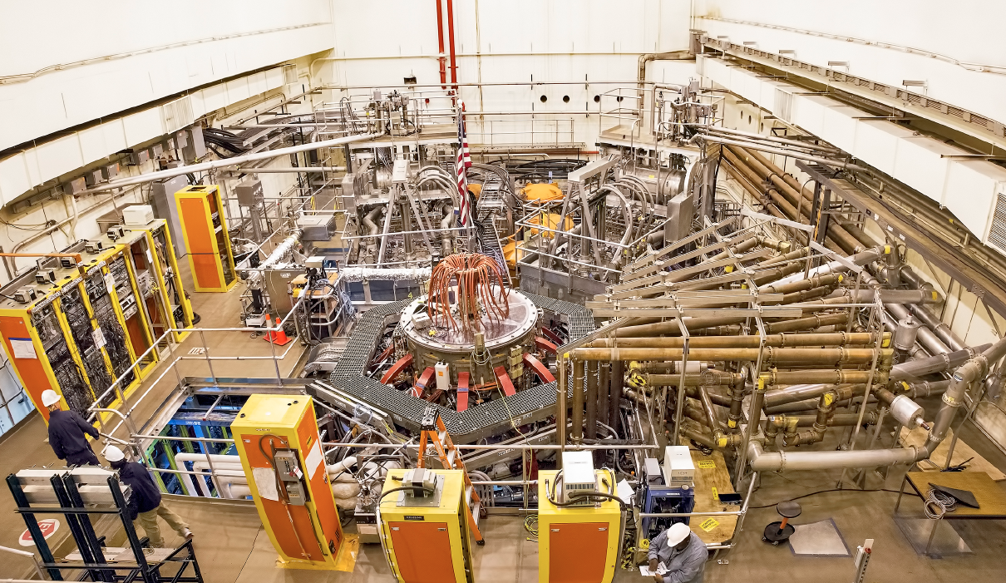
NSTX-U is a Functioning Research Facility
2nd NBI
1st NBI
NSTX-U
All six NBI sources are now operational, supporting high performance experiments

Slide 3
A Sequence of eXperiment Machine Proposals (XMPs) Has Been Defined to Commission the Machine
Arrow = Planned Before Run
Green = Complete
Blue = Ongoing
Black=No Started
XMP-101: Breakdown Optimization (Battaglia)
XMP-126: I_{P} & R Control (Mueller)
XMP-105: Software Tests for n=0 Control (Boyer)
XMP-115: ISOFLUX Commissioning (Boyer)
XMP-116: Initial H-Mode Development (Battaglia)
XMP-127: Neutral Beam Commissioning (Boyer)
XMP-107: Neutron Calibration Transfer (Darrow)
XMP-120: Strikepoint & X-Point Control (Boyer)
XMP-128: Increase L-Mode Elongation (Battaglia)
XMP-132: Fast Rampdown Sequence Commissioning (Gerhardt)
XMP-137: Increase κ and I_{P} in L- and H- Mode (Battaglia)
XMP-138: Improved Vertical Control Checkout (Boyer)
XMP-121: SPA & RWM Control Checkout (Gerhardt, Myers)
XMP-140: PF-5 Proportional EFC Test (Gerhardt)
XMP-141: Proportional EFC Tests (Myers)
XMP-142: Reduced MHD H-Mode Development (Battaglia)
XMP-146: Higher-Order Feed Forward EFC in L-Mode (Myers)
XMP-147: Improve L-Mode Fiducial (Boyer)
XMP-148: Between-Shot TRANSP Validation (Kaye)
XMP-110: ssNPA & FIDA checkout (Liu)
XMP-150: He Density Scan for Z_{eff} Calibration (Skinner)
XMP-151: L-Mode Development for Cora and Boundary XPs (Guttenfelder)
XMP-114: CHERS Modulation Study (Bell)
XMP-125: MSE-CIF 2nd NB Interference Study (Levinton)
XP-1506: Low Beta n=1 EFC (Myers)
This is the complete commissioning list…almost done!

Slide 4
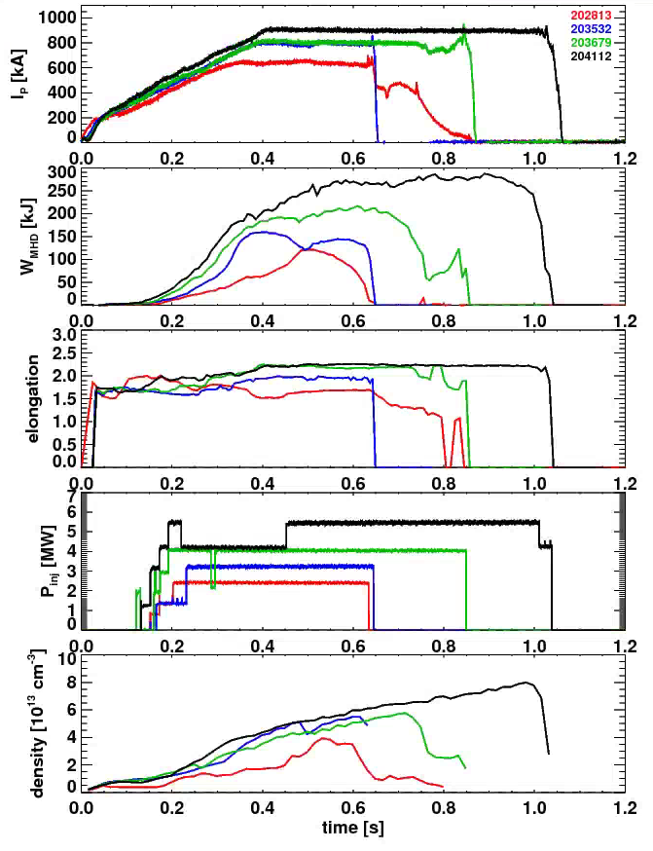
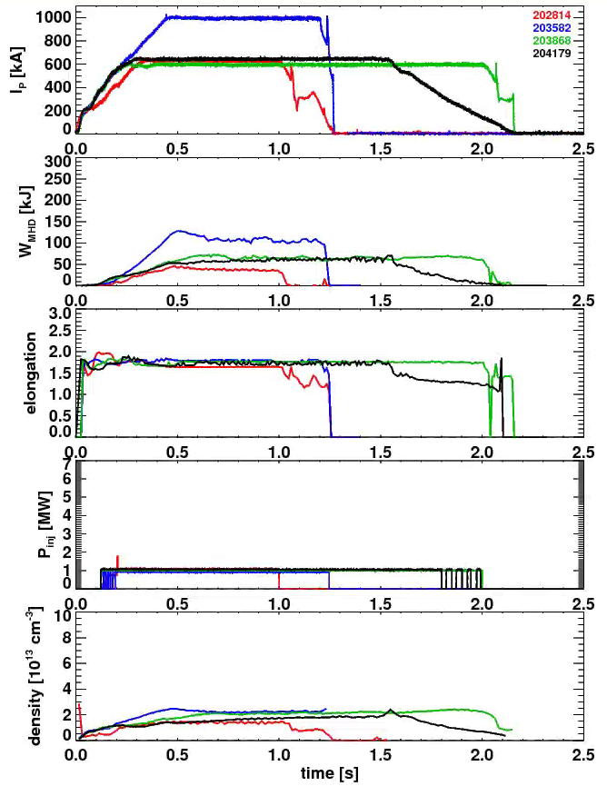
Substantial Progress in Developing L- and H-Mode Scenarios
H-Mode Development
L-Mode Development
First H-Mode
“Best” Shots From
January
February
March
April
NSTX Longest Shot

Slide 5
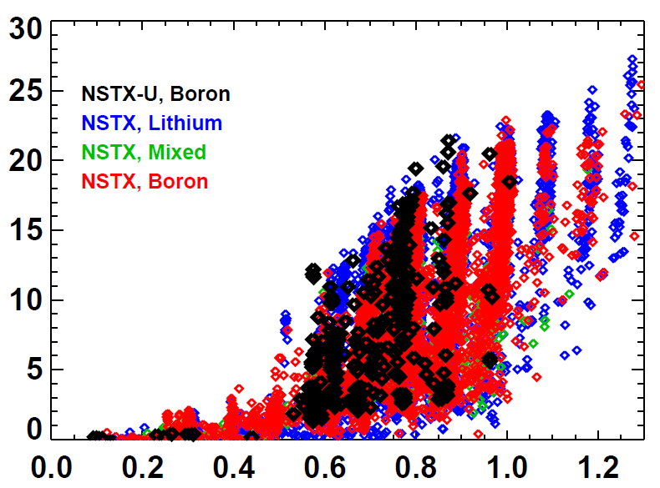
NSTX-U has matched NSTX highest flat-top pressures for plasma currents up to 0.9MA
NSTX-U, Boronized
NSTX, Lithium
NSTX, Mixed
NSTX, Boronized
Volume Average Pressure [kPa]
Plasma Current [MA]
Near-term: I_{P} → 1.1 – 1.3MA

Slide 6
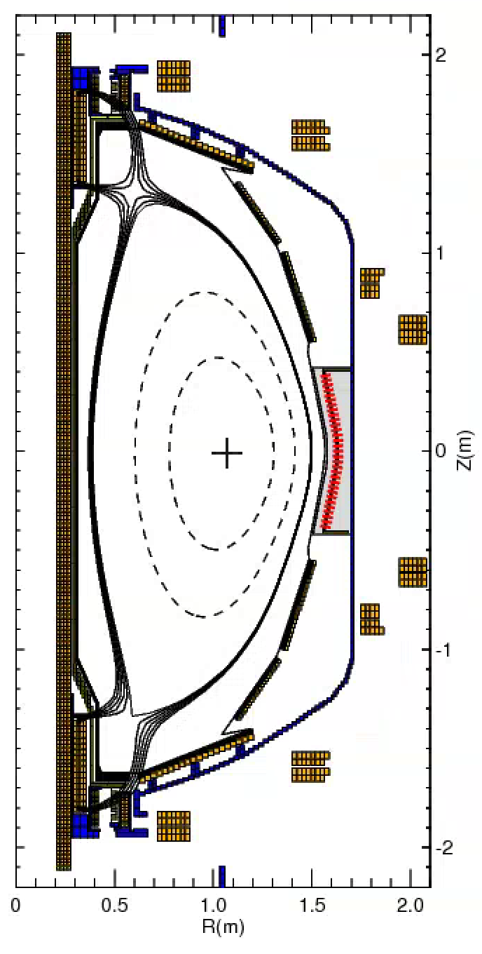
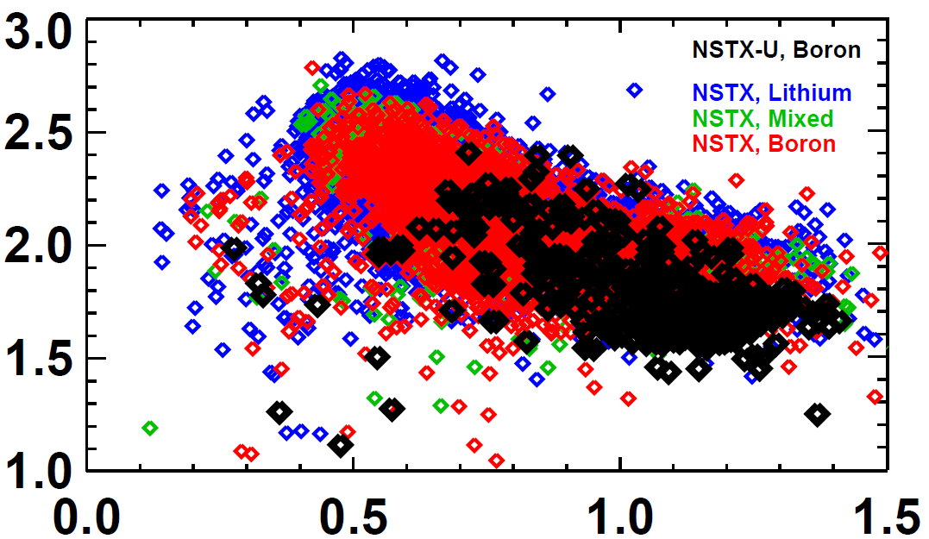
Shape and Vertical Position Control Are In Good Position to Support the Future Experiments
rtEFIT/ISOFLUX control established for the plasma radius, vertical position, X-points.
  NSTX didn’t routinely do closed loop X-point control.
  Now multi-threaded rtEFIT with greater capabilities
New vertical control sensors & algorithms -> matching the NSTX elongation for the same l_{i}, but at higher A.
NSTX-U, Boronized
NSTX, Lithium
NSTX, Mixed
NSTX, Boronized
Elongation
Internal Inductance

Slide 7
rtEFIT/ISOFLUX commissioned to control gaps and x-point/strike-point locations
rtEFIT upgraded to 65x65 grid size
Demonstrated ability to control steps in the strike-point location at fixed x-point height and outer gaps
Demonstrated feedback control of drSep to produce upper/lower biased shapes
203879
t=0.4s
t=0.5s
t=0.7s
t=0.8s

Slide 8
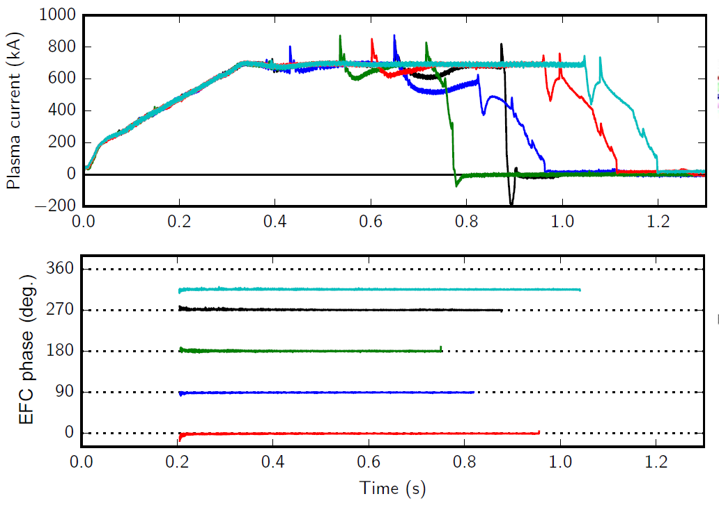
Discharge Development Aided by n=1 Error Field Correction
Dominant error-field source: vertical field coils
Long-pulse L-modes used to identify optimal correction amplitude, phase
Use this EFC on every shot now
Will soon deploy feedback-based error field correction

Slide 9
NSTX-U Experiments Are Using a Significantly Expanded Plasma Shutdown Scheme
NSTX PCS: No means of detecting a disruption, or ramping down the plasma current based on events.
NSTX-U PCS: State machine orchestrates the shutdown.
SS=0:
Ramp-Up & Flat-Top
“SS” = “Shutdown State”
SS=1:
Slow I_{P} Rampdown
Disruption Imminent
Disruption Imminent
SS=2:
Fast I_{P} Rampdown
SS=3:
I_{OH} Loss of Control
SS=4: Insufficient I_{P}

Slide 10
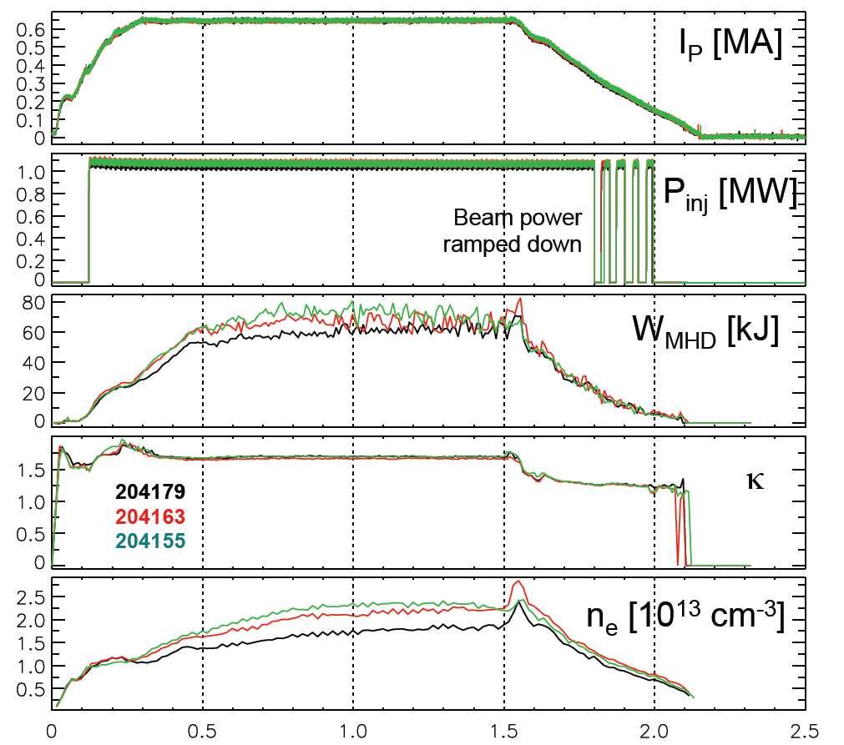
NSTX-U Experiments Are Using a Significantly Expanded Plasma Shutdown Scheme
NSTX PCS: No means of detecting a disruption, or ramping down the plasma current based on events.
NSTX-U PCS: State machine orchestrates the shutdown.
Rampdown Development and Disruption Detection/Avoidance are Key Parts of our JRT & ITER support contributions

Slide 11

New NSTX-U result (preliminary): 2nd NBI fast-ion behavior consistent with classical slowing-down theory
R_{Tan}:
1C: 50cm
2C: 110cm
2A: 130cm
The magnitude, rise and decay rates of neutron signal reasonably agree with the TRANSP prediction which assumes fast ions behave classically
  Some discrepancy in decay rates → need to further refine the kinetic profile measurements

Slide 12
Good First Data Obtained on
SSNPA and fast-ion D_{α} (FIDA) Diagnostics
2A
V-FIDA
tangential-SSNPA
viewing NB Line #2
radial-SSNPA
viewing NB Line #1
SSNPA and FIDA diagnostics response to NB line #1 and line #2, as expected
Active & passive responses are clearly observed
Detailed analysis and quantitative comparison with classical theory are underway

Slide 13
New NSTX-U result: Suppression of counter-propagating GAE observed for large R_{TAN} 2nd NBI
Top panel:
  GAE excited by inboard sources 1B / 1C (blue / cyan, lower panel)
Injection of outboard source 2B starts at 0.192s results in suppression of GAE.
  Suppression time ~10ms
  Suppression also with 2A, 2C
Observations consistent with model of cyclotron-resonant drive of GAE
Will investigate whether GAE absence impacts electron thermal transport
→ 2nd NBI already powerful new tool for Fast Ion and AE physics

Slide 14
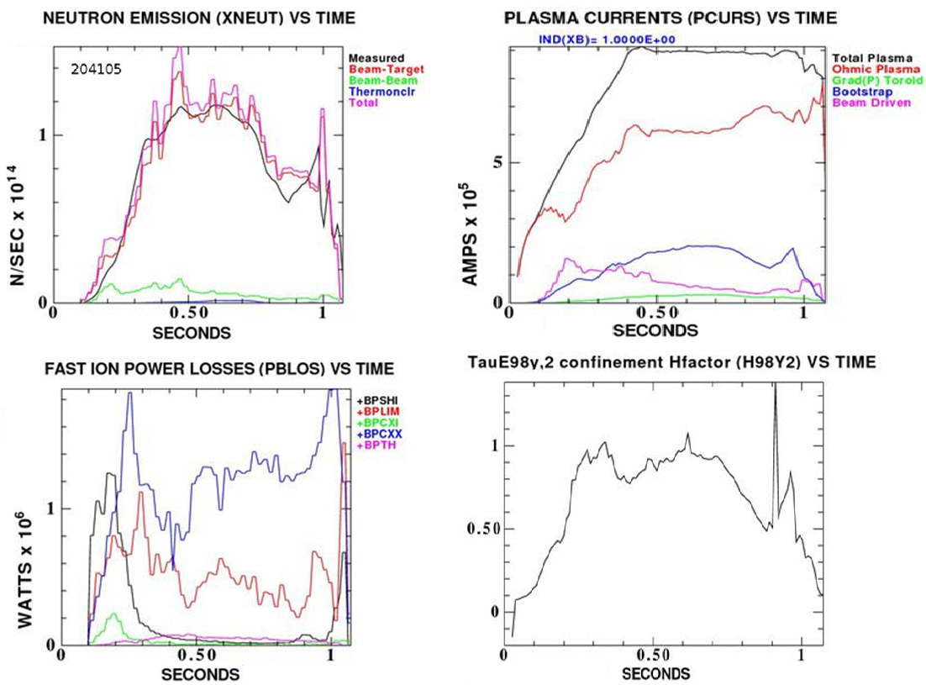
New NSTX-U tool: Between and Among
Shot TRANSP (BEAST) will aid experiment execution
NSTX-U BEAST TRANSP run (no CHERS)
Typical BEAST run completed in 8 mins
  NSTX-U has 15-20 mins between shots
In preparation for next shot, session leader can gauge:
  Non-inductive fraction
  Beam loss
  Confinement quality
  Any TRANSP quantity…

Slide 15
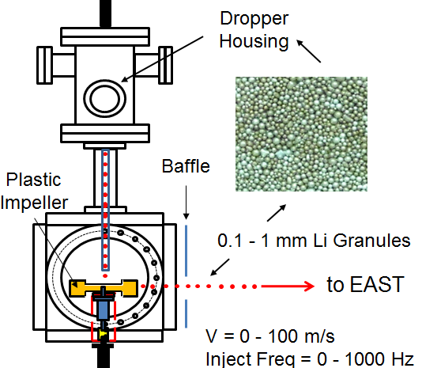
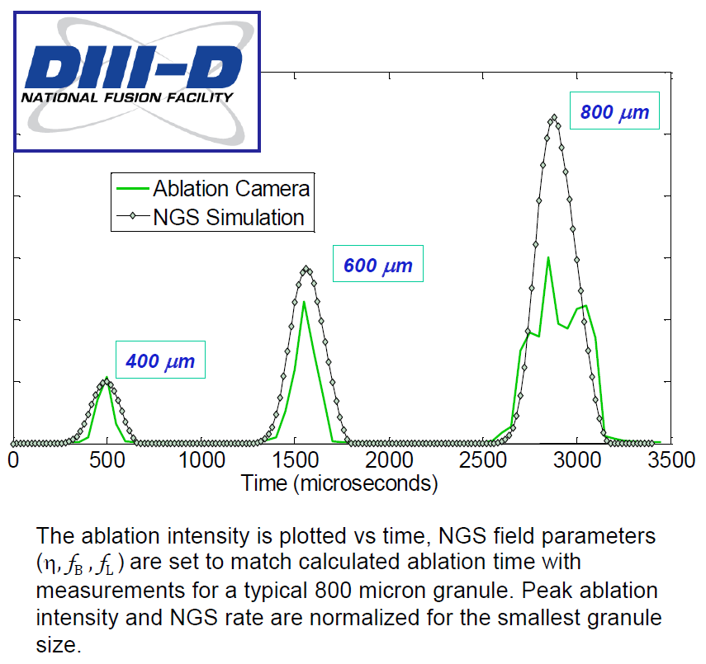
Impurity Granule Injector (IGI) will be used on NSTX-U for pedestal / ELM /density control, scenario optimization
Successful EAST and DIII-D demonstrations / collaborations
  Capable of up to 0.5 kHz injection
IGI will be tested on NSTX-U for high-frequency ELM pacing
  Possible density control technique:
    Combine Li coatings for D pumping with LGI for ELM-expulsion of carbon
  Goal: reduce Z_{eff} to ~2-2.5
  Injection of Li granules could also potentially replenish PFC Li coatings
Using Neutral Gas Shielding (NGS) model to interpret granule ablation and penetration depth vs. mass
to tokamak

Slide 16
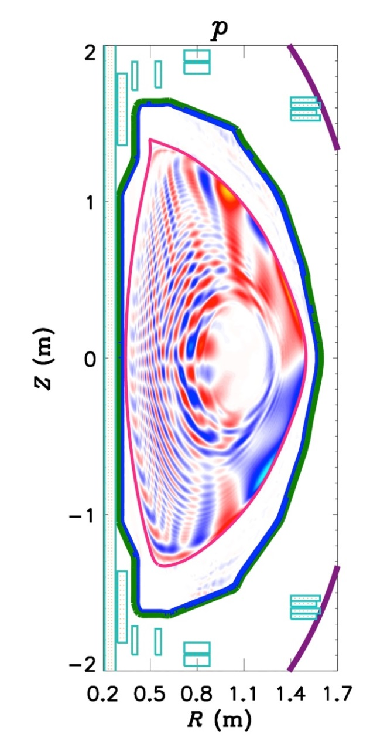
NSTX-U / STs will improve understanding of
RMP ELM mitigation / suppression physics
ELMs in STs and tokamaks respond to applied 3D fields in different ways
  RMP ELM suppression not achieved in STs (yet)
    3D fields triggered ELMs in NSTX
  Understanding such differences could greatly improve confidence in scaling RMP ELM mitigation to ITER
NSTX-U (with MAST-U) offer a unique capability to validate ELM suppression models across the ST and tokamak regimes
Modeling goal: Combine models of 3D perturbed equilibrium (M3D-C1) and transport (XGC) to yield a quantitative, predictive model for transport in 3D fields
M3D-C1 is being used to predict and optimize plasma response to NCC coils in NSTX-U

Slide 17
Making Good Progress on Milestones (I)
R16-1: Assess H-mode energy confinement, pedestal, and SOL characteristics with higher B_{T}, I_{P} and NBI heating power.
  All key diagnostics are taking data, except MSE (waiting for NB1A at full voltage)
  Checking data consistency via TRANSP and awaiting final H-mode scenarios.
R16-2: Assess effects of NBI parameters on fast ion distribution function and neutral beam driven current profile.
  Neutron, FIDA, ssNPA diagnostics all functional
  Started studies of fast ion confinement vs. R_{tan} & effect of NB#2 on *AE modes.
R16-3: Develop physics and operational tools for high-performance discharges.
  Developed shape & vertical control, EFC, HFS & LFS fueling, automated shutdown.
  Will soon commission n=1 RWM control, V_{loop} dependent EFC
Notable Outcome: Perform experimental research …at magnetic field, I_{P}, pulse length beyond that achieved in NSTX….
  Using discharges that exceed NSTX durations, at field exceeding the NSTX field.
  Increasing I_{P} > NSTX I_{P} requires improved H-mode scenarios, under development.

Slide 18
Making Good Progress on Milestones (II)
The JRT overlaps with a Notable Outcome:
  JRT: Conduct research to detect and minimize the consequences of disruptions in present and future tokamaks
  Notable Outcome: Conduct NSTX-U experiments and data analysis to support the FES joint research target ….
We are making good progress on these tasks:
  Automatic shutdown algorithms developed
  Detecting disruptions in real-time via the I_{P} error, vertical motion, and (soon) the n=1 locked mode signature.
  MGI will use an electromagnetic valve similar to ITER design
    MGI valves are installed on the machine
    Associated electronics are in pre-operational testing.

Slide 19
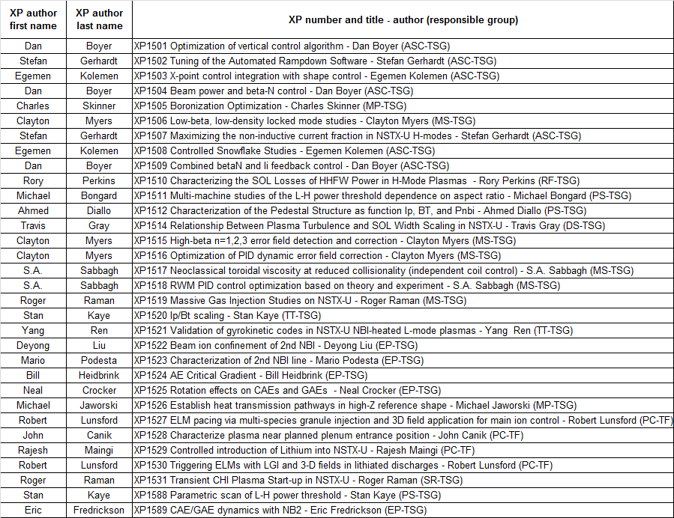
32 Priority 1 eXperimental Proposals (XPs) prepared/in-prep to complete research milestones
Will run soon / next
Already had run time

Slide 20
Summary
Already exceeded NSTX field & pulse-length records
Physics operations commissioning (XMPs) nearly complete – on verge of routine low/mid-l_{i} H-mode
  Pre-requisite for accessing high current + long-pulse
Implemented new disruption detection and plasma shutdown algorithms – contributes to JRT and ITER
2nd NBI already exhibiting interesting new physics w.r.t. fast-ion-driven instabilities
Dedicated physics experiments will ramp up during near-term / upcoming run periods
On track to complete research milestones for this FY

