Slide 1

Strike point evolution in NSTX-U scenarios
Devon Battaglia
High Z Tile Discussion
August 11, 2016

Slide 2
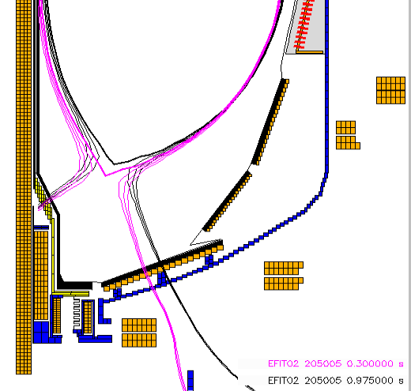
Legend for plots
Blue line: Map upper X-point flux
Red line: Map lower X-point flux
Black points: Map separatrix flux
over red: LSN
over blue: USN
otherwise: not diverted
Outboard Tile Row 4
Outboard Tile Row 3
Outboard Tile Row 2
Outboard Tile Row 1
GAP
Inboard divertor

Slide 3
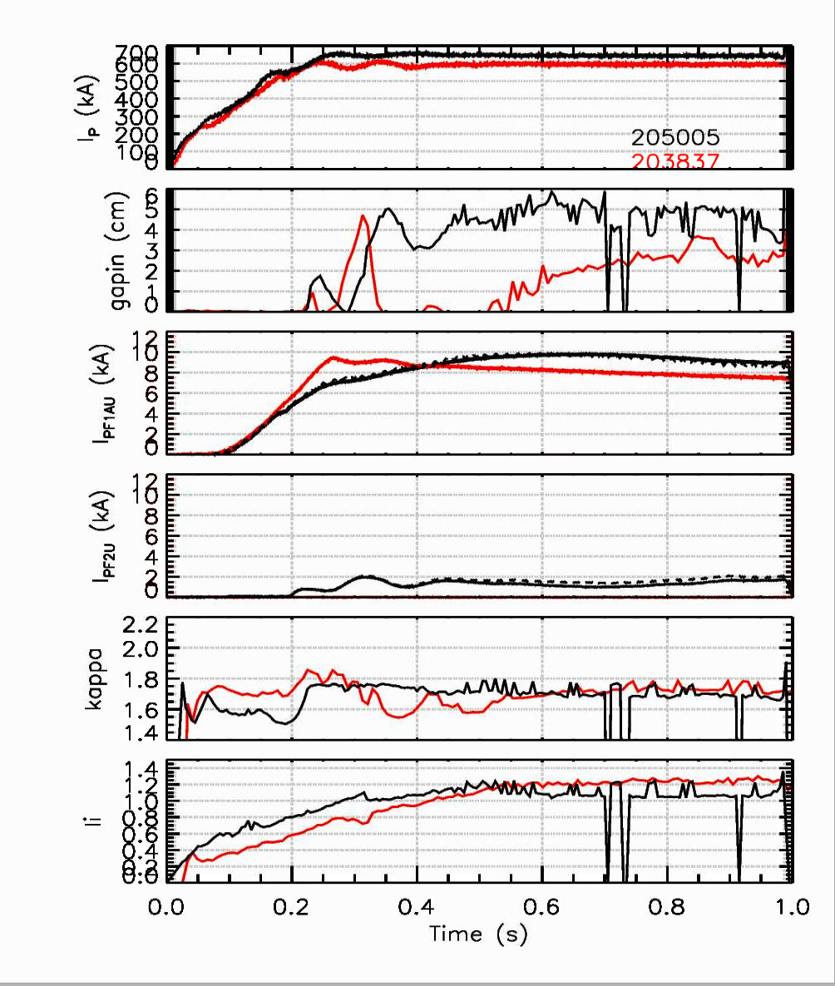
L-mode scenario has strike point that sweeps over row 2
203837 Ohmic L-mode
Feed-forward PF1A only
205005 L-mode 1MW fiducial
ISOFLUX PF1A and PF2
Tile row 2
Inboard plate
Red lines in plots
Black lines in plots

Slide 4
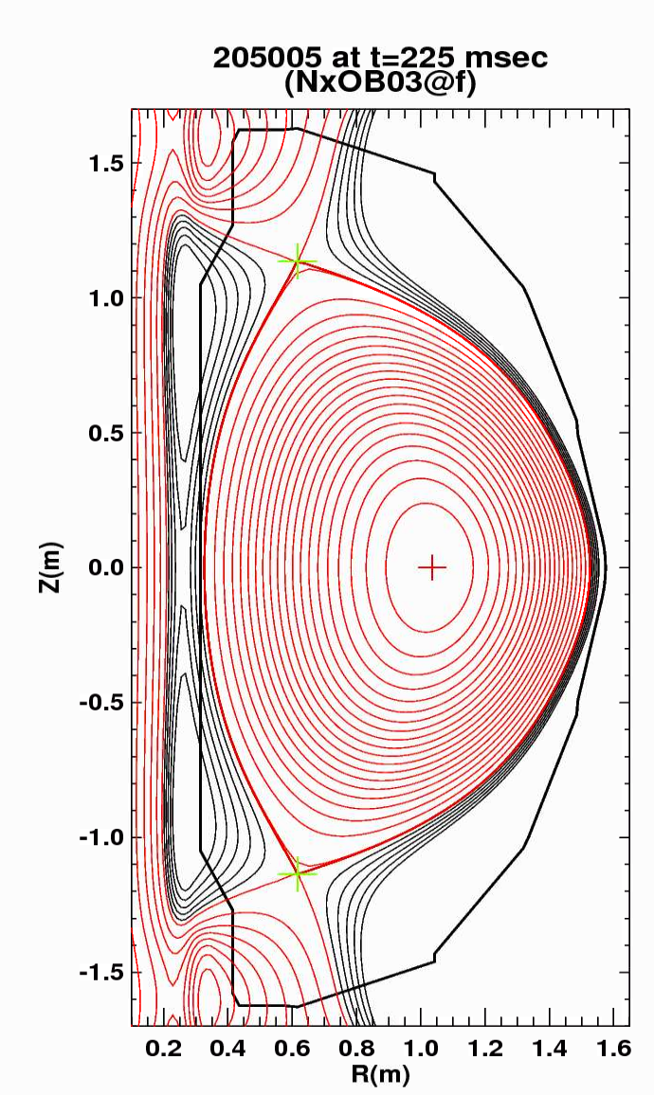
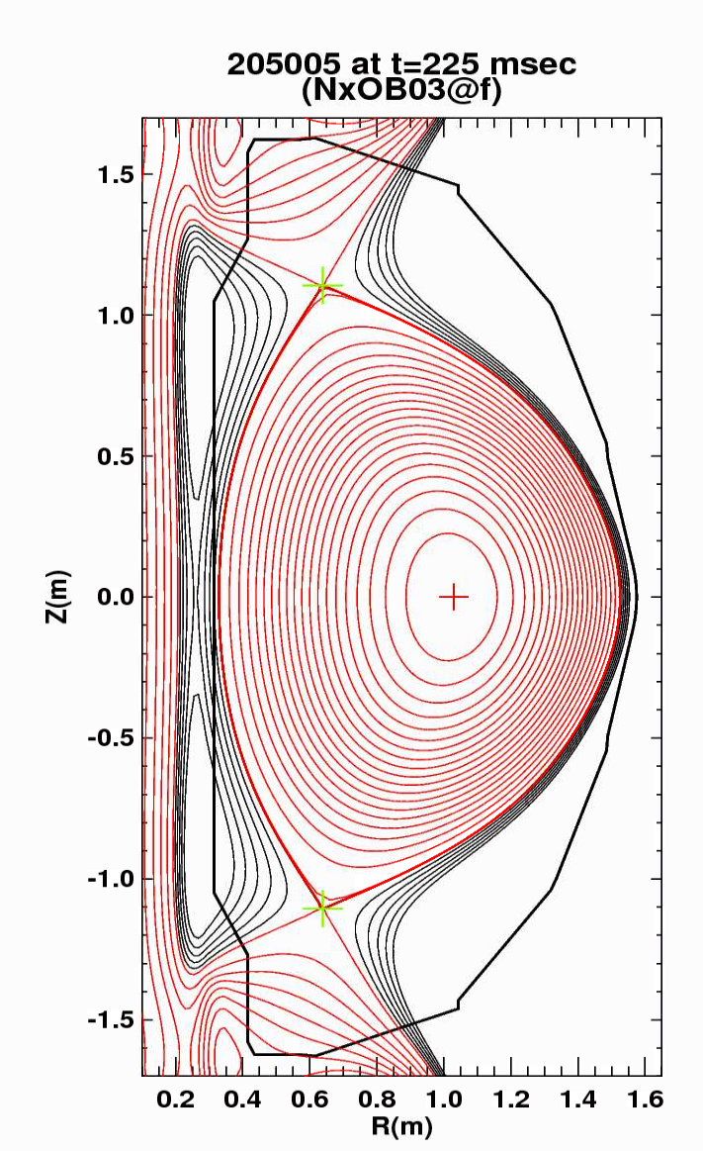
Initial evaluation: L-mode startup with strike point outside row 2 is doable
Typical L-mode startup
Example of L-mode start up with X-point outboard of row 2
Matched elongation and triangularity
PF2 ~ 1 kA
PF2 ~ 6 kA

Slide 5
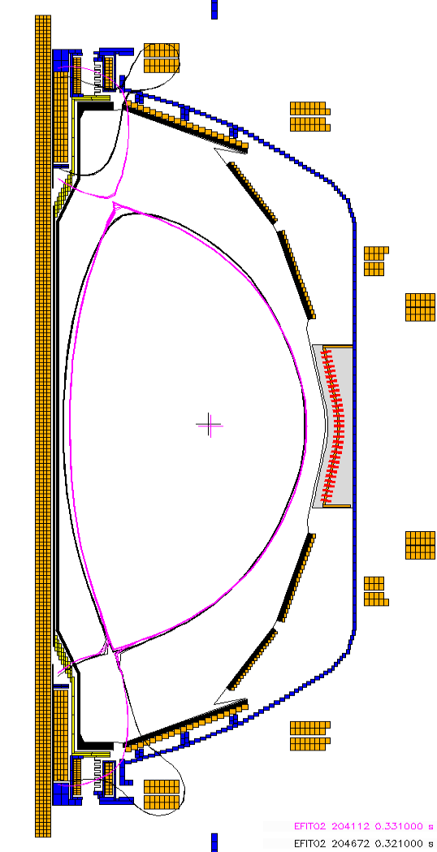
Strike point position in H-mode scenarios
After our best shots in April, we focused on establishing active X-point control prior to the time of diverting
  Improve resilience of diverting time to variations in beams and wall conditions
  Increases efficiency of future shot development
ISOFLUX “likes” to turn on PF2 to achieve the X-point target position
  These discharges had the strike points at larger major radius
  I don’t know why … but we should know by the next run

Slide 6
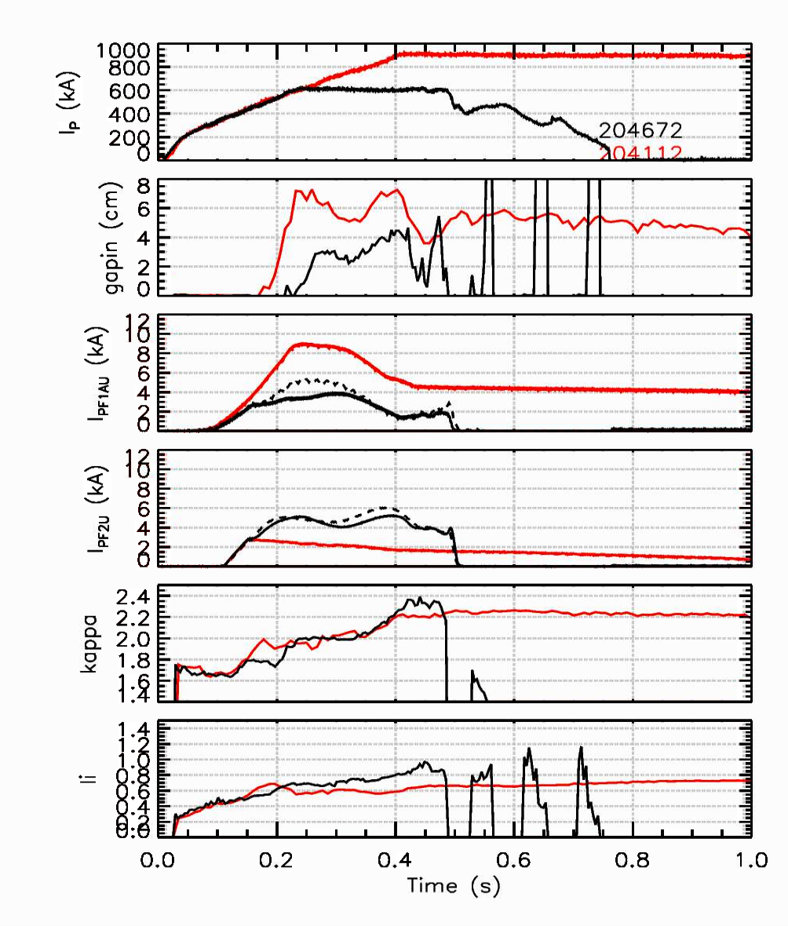
Strike point locations in H-modes depends on divertor coil control scheme
204112 H-mode
Feed-forward div coils
204672 H-mode
ISOFLUX div coils
Red lines in plots
Black lines in plots

Slide 7
To answer Jon’s questions
Do our present operating scenarios avoid putting power on the high-Z tiles? → Yes and No
  Yes: H-mode discharges when the divertor currents were feed-forward
  No: Present L-mode scenarios, H-mode ramp-up using ISOFLUX control of the X-point and inner gap
Can we develop scenarios to avoid high-Z tile row? → I think so
  L-mode: Develop new scenario that diverts at low triangularity
    Keep the strikepoint outside the high-Z tile row
  H-mode: Develop new scenario using ISOFLUX control of the divertor coils that resembles feed-forward scenario
    Keep the strikepoint inside the high-Z tile row
    We were working on this prior to the coil failure

