Slide 1
Impurity Transport Differences between NSTX and DIII-D
 | DIII-D^{[1]} | NSTX^{[2][3]}
Delivery method, Rate | Dropper, 18 mg/s | Inter-shot evaporation, 150-300 mg
ELMs | Delayed | Eliminated
P_{RAD}, Impurities without ELMs | Steady | Increasing
D recycling | Unchanged | Reduced
Core Li | High | Low
Edge fluctuations | Increased | Decreased
Pedestal Width | Increased | Increased
Pedestal Height | Increased | Increased
H-factor | Increased | Increased
National campaign is an excellent opportunity to explore the impurity transport differences between NSTX and DIII-D.
NSTX Lithiated ELM Free H-modes:
Carbon density starts at ~1% builds to 10%
n_{Li} ~ .01n_{C} ^{[3]}
DIII-D Li Enhanced H-Modes:
300 msec Elm free pedestal enhancements
n_{C} in core lower than ELMy H-mode levels
n_{Li} ~ 8n_{C} ^{[1]}
Both results were found to be consistent with neoclassical transport theory
Preliminary XGC calculations show both results could be explained with a carbon threshold effect [C.S. Chang private communication with R. Maingi]
Li “clump”
[1] T.H. Osborne et al., Nucl. Fusion 55 (2015) 063018
[2] R. Maingi et al., Nucl. Fusion 52 (2012) 083001
[3] F. Scotti et al., Nucl. Fusion 53 (2013) 083001

Slide 2
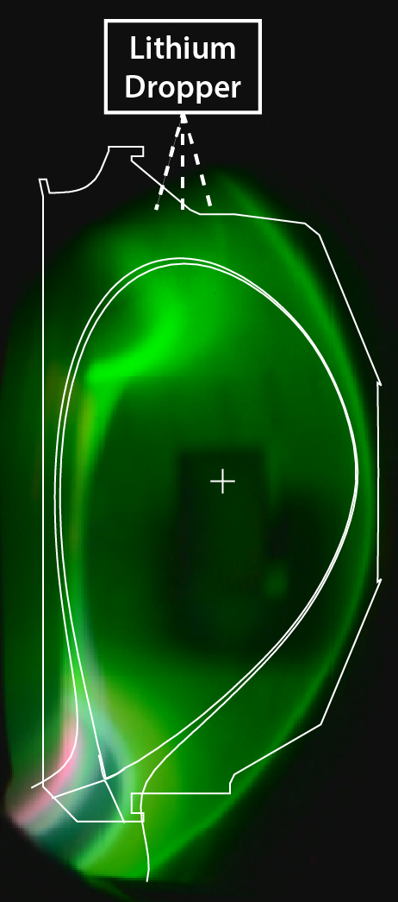
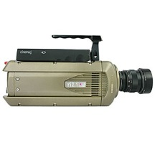

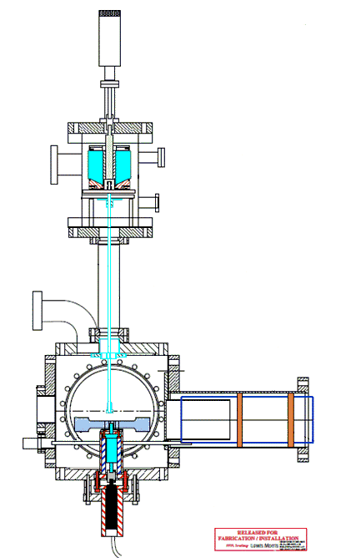
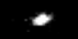
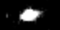
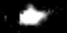

Granule Injector Studies of Ablation Rate, Mass Deposition and Impurity Transport
Experimental Plan :
Perform B_{T} and ν* scan over NSTX-U range
Seed discharge with lithium powder
Inject small carbon granules, attempt to drive lithium from the core
Stop granule injection and see if the Li reenters the core
Additional PPPL cameras observing ablation provide NGS model validation for solid impurity granules
Data used to expand understanding of native and injector driven impurity transport in NSTX-U, DIII-D, and EAST.
Li “clump”
DIII-D image : S. Allen, APS 2014

Slide 3
Backup

Slide 4
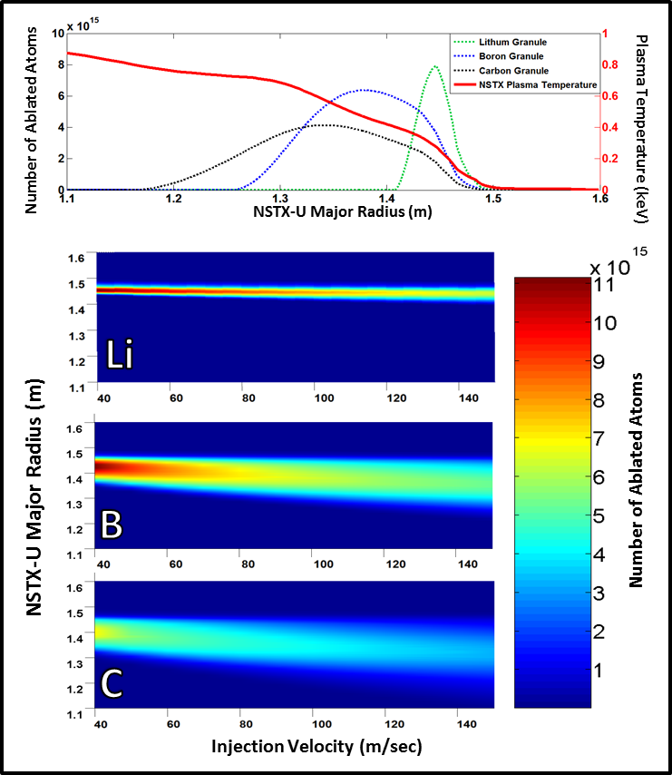
Multi-species injection profiles
Utilizing different materials and injection velocities should allow us to tailor the pacing effect for maximum plasma performance
 | Lithium | Boron Carbide | Carbon (Vitreous)
Density | .534 g/cm ³ | 2.52 g/cm ³ | 2.09 – 2.23 g/cm ³
Mass in a 1mm sphere (mg) | 0.279 | 1.319 | 1.131
Number of atoms/molecules | 2.426E+19 | 1.438E+19 | 5.670E+19
Sublimation Energy (eV/atom) | 1.65 | 5.3 (B) | 7.5
Sublimation Energy Per Granule (J) | 6.415 | 61.070 | 68.154
First Ionization Energy (eV) | 5.3917 | 8.2980 (B) | 11.2603

Slide 5
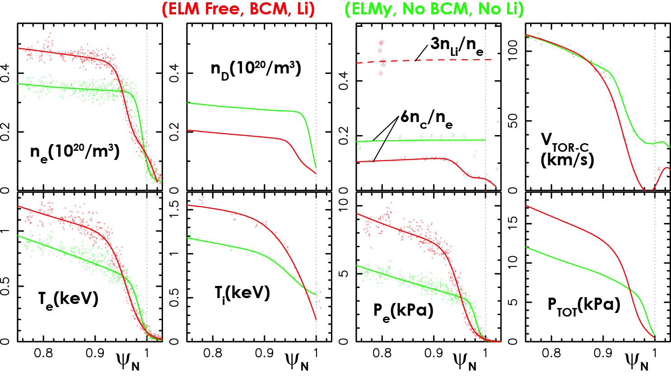
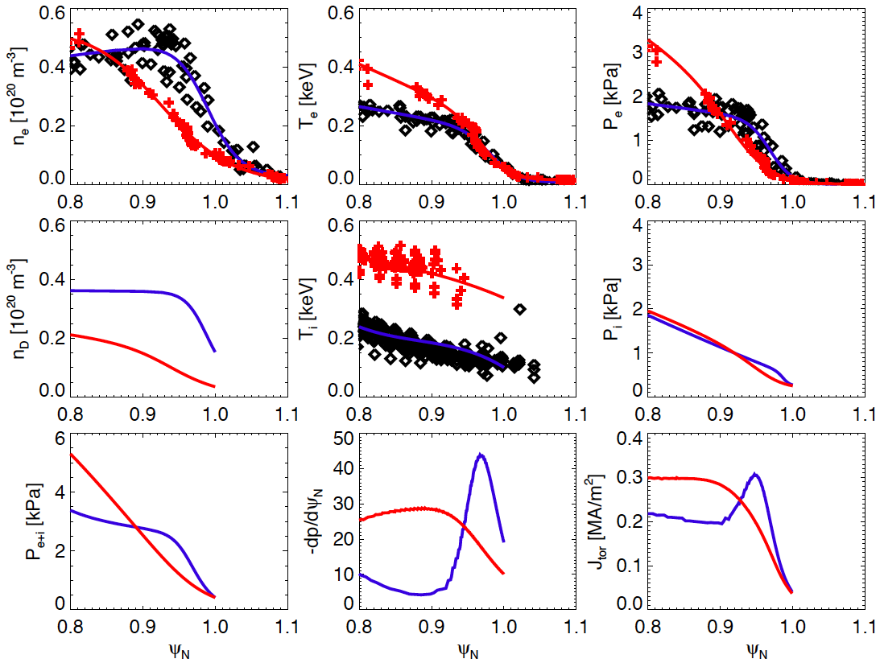
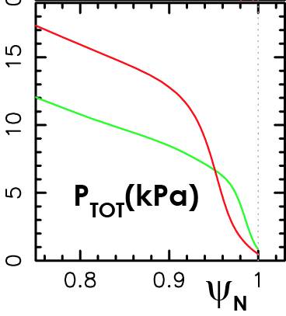
Profile changes in DIII-D in ELM-free H-mode qualitatively similar to NSTX ELM-free H-mode with inter-shot Li evaporation
Shifting gradients away from separatrix improved edge stability in both DIII-D and NSTX
DIII-D
NSTX
No Li
With Li
No Li
With Li
NSTX: Maingi, NF 2012

Slide 6
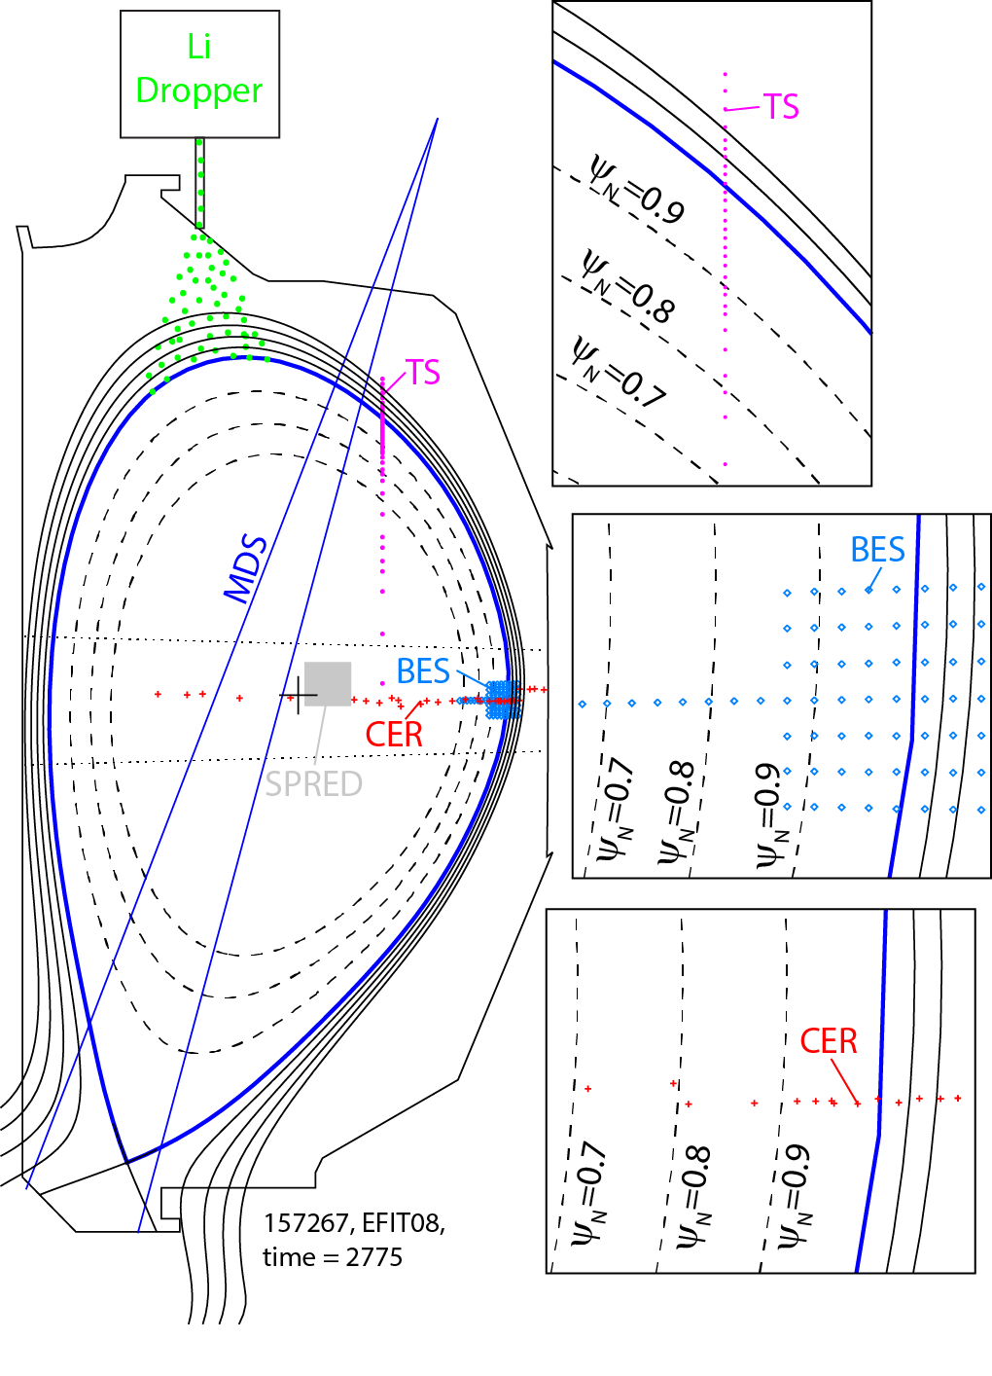
Discharge characteristics and diagnostics
I_{P} = 1.2MA, B_{T}=2T, q₉₅= 4.4
1.4 < P_{NBI} < 4MW, 1.2 < β_{N}<2
∇B drift toward X-point
0.35 < n_{e}/n_{GW}<0.5, pumping of outboard divertor strike
n_{e},T_{e} from high resolution 10 laser TS system (w_{ped} ~ 0.1)
n_{C}, n_{L}, T_{i}, v_{TOR}, v_{POL} from CER
Longer wavelength (k┴ <3cm⁻¹) n_{e} fluctuations from BES
Low to high Z central impurity lines from SPRED
Low to medium Z divertor impurity lines with MDS; filtered photodiodes.
IRTV for divertor heat flux; bolometers for radiated power

Slide 7
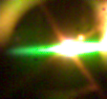
Neutral Gas Shielding (NGS) Model
600 μm
Neutral Ablatant Cloud
Ionized Material
Solid Granule
magnetic field
Electron influx sublimates the pellet surface
High density neutral cloud forms around the granule
Heat transfer ionizes the cloud which streams along magnetic field lines
The locally overdense region of the plasma becomes unstable and generates an ELM

Slide 8
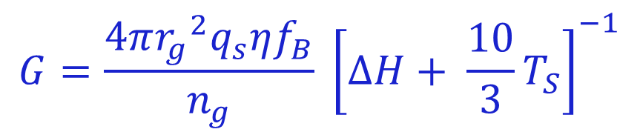
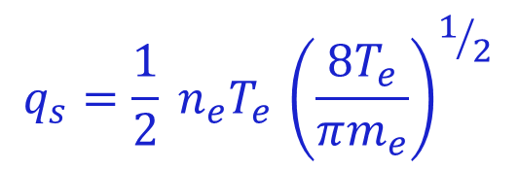
Granule Ablation Model
Ablation Rate of the injected granule :
η : Cloud Shielding Parameter
f_{B} : Field directed heating anisotropy
ΔH_{Li} : Sublimation Energy
T_{S} : Granule Surface Temperature
$$G=\frac{4π{r_{g}}^{2}q_{s}ηf_{B}}{n_{g}} {\left[∆H+ {\frac{10}{3}T}_{S}\right]}^{−1}$$
$$q_{s}=\frac{1}{2} {n_{e}^{}T}_{e }{\left(\frac{8T_{e}}{πm_{e}}\right)}^{1/2}$$
800 μm
600 μm
Camera saturation results in clipping of the intensity
400 μm
Adapted from Parks et al. Nucl. Fusion 34 (1994) & Kocsis et al. PPCF 41 (1999)

Slide 9
Granule Ablation Depth
Calculated Granule Diameter
v_{G} = 90 m/sec
Granules ablate rapidly upon entering the pedestal region
While some portion of the granule does penetrate deeply, the primary mass deposition is located further out
Ablatant Deposition
Major Radius (m)

Slide 10
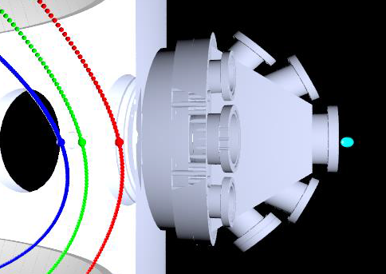
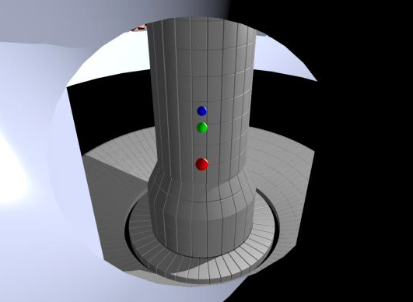

Extended imaging suite will measure penetration depth
Camera
Location
Camera View
Ψ_{N}=0.6
Separatrix
Limiter
Diagnostic Implementation: F. Scotti LLNL
Additional cameras will be fielded on NSTX-U during LGI experiments through diagnostic collaboration with LLNL
This allows direct measurement of injection velocity and penetration depth.

