Slide 1
Impact of polar region design changes on DivSOL TSG research
V. A. Soukhanovskii and J.-W. Ahn
NSTX-U DivSOL TSG Meeting
Princeton, NJ
12 May 2017

Slide 2
NSTX-U Program charge
Get team-wide input on how the polar region changes impact your TSG. Use the 5 year plan goals as a guide, and also the research goals (including draft or approved XPs) from the FY16-17 planned research campaigns.
Document the plasma shapes (A, R0, kappa, delta, squareness, DRSEP, Rstrike), plasma current ranges, magnetic fields, power/heating levels and/or NB voltages, and min and max pulse or flat-top durations … you require driven by either physics goals and/or diagnostic requirements.

Slide 3
NSTX-U Five Year Plan defined three Boundary research thrusts
BP-1: Assess and control pedestal structure, edge transport and stability
Pedestal structure, transport and turbulence studies
ELM characterization and control
BP-2: Assess and control divertor heat and particle fluxes
SOL transport and turbulence, impurity transport
Divertor heat flux mitigation with impurity seeding and divertor geometry
BP-3: Establish and compare long-pulse particle control methods
Validate cryo-pump physics design, assess density control and recycling
Compare cryo to lithium coatings for particle (collisionality) control

Slide 4
Experiments proposed in 2015
1557 | Interaction of applied 3D fields with detachment | Ahn
1514 | Relationship Between Plasma Turbulence and SOL Width Scaling in NSTX-U | Gray
1538 | Radiative divertor experiments | Soukhanovskii
 | Relationship between lambda_q, S and Connection Length | Gray
1539 | Clarifying Snowflake divertor configuration physics | Soukhanovskii
1558 | Toroidal divertor flux deposition asymmetries due to localized gas injection | Lore
 | Obtain 2D divertor density image using lithium emission | Schmitz
1559 | Assessment of 3D field effects on the properties of the snowflake divertor | Canal
1569 | Testing divertor performance metrics for X-divertors on NSTX-U | TBD
1580 | Effect of Lithium on SOL Power Balance | Gray
 | Detachment comparison study for Snowflake, X-divertor, Standard Divertor and long/short divertor leg | Eldon
 | Compare alternative advanced divertor configurations: X-divertor, Snowflake | Kolemen
 | S parameter under 3D perturbations | Kolemen
 | Transport and radiation in the high flux expansion divertor configuration with cusp-like fields. | Soukhanovskii
1560 | Parallel Correlation of SOL Turbulence | Zweben
 | Role of plasma response in the formation of lobe structures by 3D fields | Ahn
 | Performance optimization of divertor detachment | Ahn
 | Distinguishing between 3d magnetic field structures and transport | Canik
 | Investigation of ELM heat flux footprints with the variation of ELM regime | gan
 | Relaxation of the interchange instability and effect on SOL width with Li wall conditioning | Gray
 | Relation between the midplane SOL pressure width and the divertor heat flux width | Hager
 | SOL Width Scaling: Goldston's Heuristic Drift Model vs Critical Pressure Gradient Model | Kolemen
 | Divertor conditions and detachment characteristics in plasmas with 3-D fields | Loarte
 | Studies of low- and high-Z dust transport in NSTX-U | Smirnov
 | Boundary diagnostic-optimized configuration (BDOC) for model comparisons. | Soukhanovskii
 | Initial NSTX-U edge characterization. | Soukhanovskii
 | ENDD Midplane Neutral Density Profiles in NSTX-U | Stotler

Slide 5
Plan for SOL and divertor research from Five Year Plan
Year 1 of 5 Year Plan
Continue analysis of SOL width database and comparison with models
Collaboration with DIII-D on snowflake and radiative divertor experiments
Years 2-3 of 5 Year Plan
Establish SOL width and divertor database vs. engineering and physics parameters
Re-establish edge turbulence measurements (GPI, BES, cameras, probes)
Initial radiative divertor experiments with D₂, CD₄ and Ar seeding and lithium
Develop snowflake divertor magnetic control and assess pedestal stability, divertor power balance, turbulence, 3D fields as functions of engineering parameters
Comparison with multi-fluid and gyro-kinetic models
Years 4-5 of 5 Year Plan
Compare SOL width data with theoretical models and in the presence of 3D perturbations of various types, e.g. RMP coils, HHFW heating, NBI injection
Combine snowflake configurations with pedestal control scenarios and tools, cryo
Implement radiative divertor control, demonstrate long-pulse H-mode scenario
Develop experiment-based model projections for ST-FNSF

Slide 6
Impact on critical SOL and divertor diagnostics
Measurements | Nature of impact | Comments
Magnetics (equilibria reconstructions, sensor locations and proximity to plasma) | New sensor design and new locations
Midplane kinetic profiles | No impact
GPI | No impact
Heat flux measurements (IR cameras, thermocouples, Langmuir probes) | Surface non-uniformity and shadowing due to mardenblocks. Spatial resolution for cameras
Radiated power (bolometers, radiometers) | Potential impact on sightlines?
Particle flux and recycling (probes, spectroscopy) | Surface non-uniformity and shadowing due to mardenblocks. Spatial resolution for spectrometers and cameras
Impurity flux measurements (spectroscopy) | Surface non-uniformity and shadowing due to mardenblocks. Spatial resolution for spectrometers and cameras
Neutral pressure measurements | No impact

Slide 7
NSTX-U engineering and plasma parameters for main DivSOL research areas
SOL transport and turbulence (SOL width, Edge/SOL turbulence, divertor database vs. engineering and physics parameters, etc)
1-2 MA,1 T, P_{NBI}≤5 MW, flattop 1-2 s, highly shaped
Impact of 3D fields on divertor
1-2 MA,1 T, P_{NBI}≤5 MW, flattop 1-2 s, highly shaped
Boron to Lithium transition
1 MA,1 T, P_{NBI}≤5 MW, flattop 1-2 s, highly shaped
Radiative divertor experiments with D₂, CD₄, N₂, Ar seeding and/or lithium
1-2 MA,1 T, P_{NBI}≤5-10 MW, flattop 1-2 s, highly shaped
Advanced divertor configurations (cusp/X, long leg, high flux expansion, etc)
1-2 MA,1 T, P_{NBI}≤5-10 MW, flattop 1-2 s, highly shaped, need to consider field angles and R_{sp}
Snowflake divertor
1-2 MA,1 T, P_{NBI}≤5-10 MW, flattop 1-2 s, need to consider R_{sp}

Slide 8
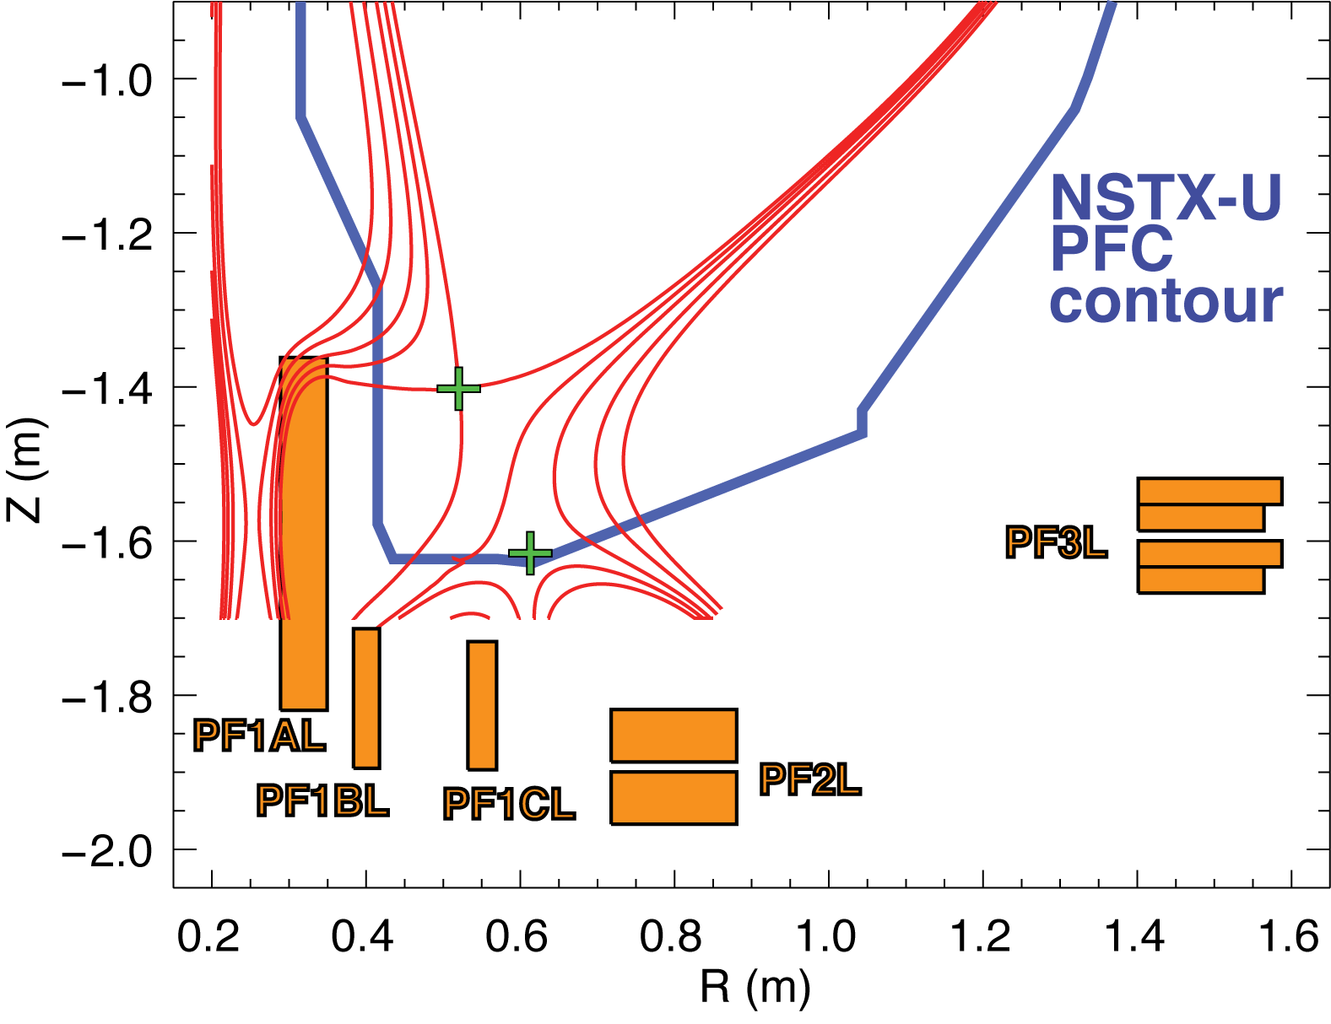
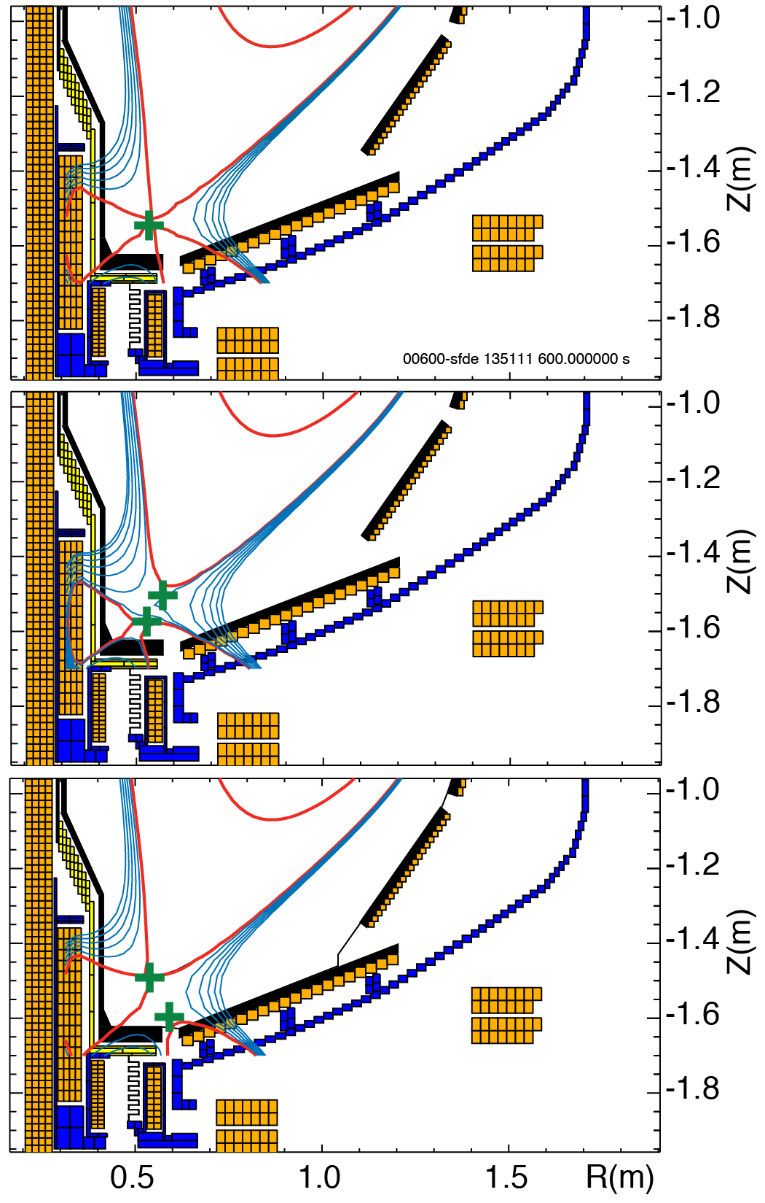
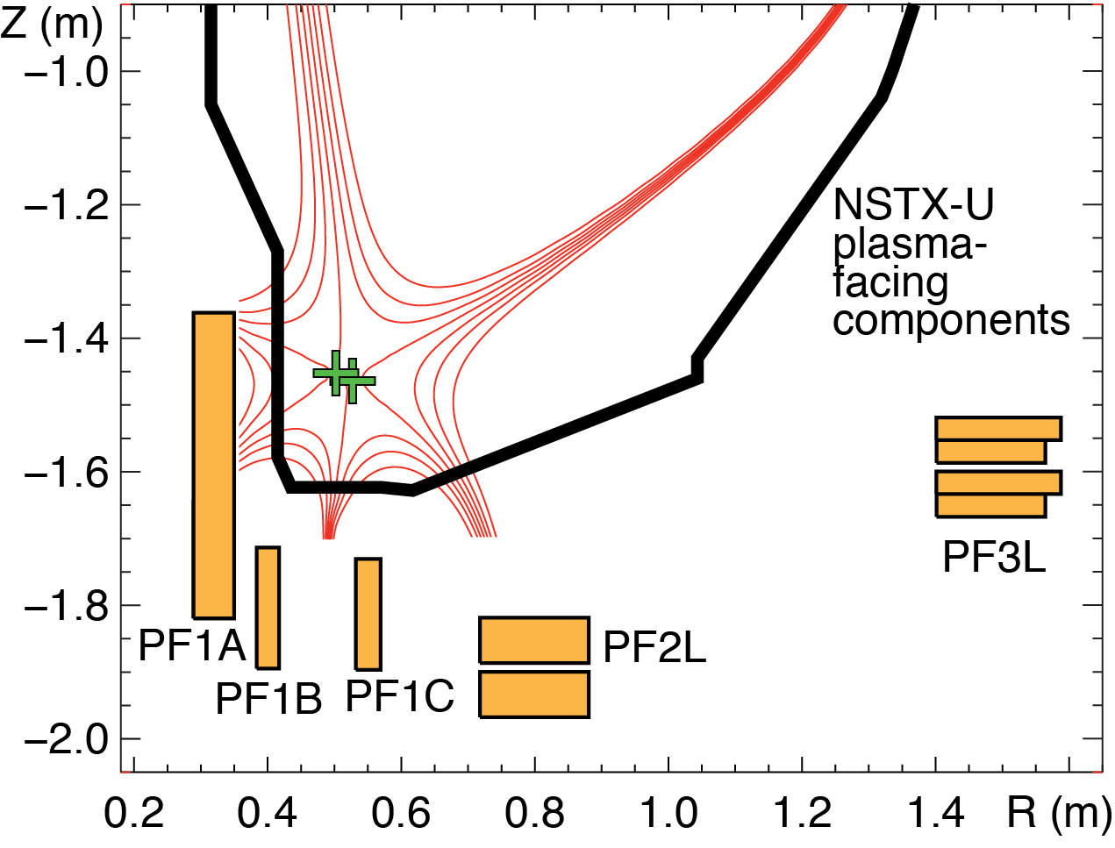
Snowflake divertor configuration
Impact of divertor coil set
Impact of PFC fish-scaling
Snowflake divertor configurations for NSTX-U
With PF1B Without PF1B

