Slide 1
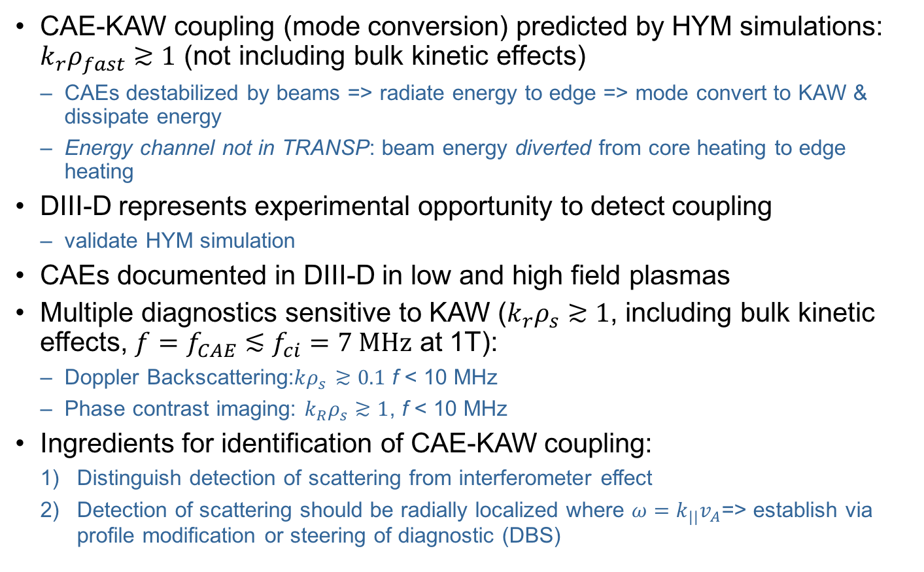
CAE-KAW coupling potentially important channel for energy transport from plasma core but coupling not yet experimentally observed – perform expt on DIII-D to identify and quantify
CAE-KAW coupling (mode conversion) predicted by HYM simulations: $k_{r}ρ_{fast}≳1$ (not including bulk kinetic effects)
  CAEs destabilized by beams => radiate energy to edge => mode convert to KAW & dissipate energy
  Energy channel not in TRANSP: beam energy diverted from core heating to edge heating
DIII-D represents experimental opportunity to detect coupling
  validate HYM simulation
CAEs documented in DIII-D in low and high field plasmas
Multiple diagnostics sensitive to KAW ($k_{r}ρ_{s}≳1$, including bulk kinetic effects, $f=f_{CAE}≲f_{ci}=7 \text{MHz}$ at 1T):
  Doppler Backscattering:$kρ_{s}$ $≳0.1$ f < 10 MHz
  Phase contrast imaging: $k_{R}ρ_{s}$ $≳1$, f < 10 MHz
Ingredients for identification of CAE-KAW coupling:
  Distinguish detection of scattering from interferometer effect
  Detection of scattering should be radially localized where $ω=k_{||}v_{A}$=> establish via profile modification or steering of diagnostic (DBS)

