Slide 1
Ideas for DIII-D National Campaign
Y. Ren, W. Guttenfelder, W. Wang

Slide 2
Background
The ST confinement scaling with inverse dependence on electron collisionality, first found on NSTX, has been yet been explained
Microtearing mode is the natural candidate
Able to reproduce experimental confinement scaling with experimental equilibrium using nonlinear GYRO simulations
Strong suppression by experimental amount ExB shear shown by simulations
Does ETG have similar collisionality dependence?
Suggested by nonlinear GTS simulations showing strong coupling between ETG turbulence and electron GAM/zonal flow which can be damped by e-i collisions (Wang et al., PoP 2015) and also GS2 simulations with adiabatic ions (Colyer et al., arxiv 2015)
Such dependence not obvious in a dedicated collisionality scan on NSTX (Ren et al., PoP 2012)
Collisionality only changed by a factor about 2.5
More sensitive to other equilibrium quantities.
More recently, dissipative trapped electron mode (DTEM) was found to be able to reproduce the experimental confinement scaling (Wang et al., NF 2015)
However, DIII-D plasmas may not have a dominant DTEM region from discussion with Weixing and CTEM usually dominates

Slide 3
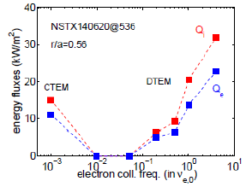
Idea Is to Pursuing Collisionality Study on DIII-D
Exploiting the range of collisionality that can be achieved on DIII-D and comprehensive turbulence diagnostics
Find a operational scenario in which ETG is unstable with guidance from gyrokinetic simulations and carry out collisionality scan (hopefully an order of magnitude change in collisionality)
Find a operational scenario in which C-TEM is unstable with guidance from gyrokinetic simulations and carry out collisionality scan
The collisionality scan should try to keep other dimensionless parameters as consistent as possible
Can we show this?

