Slide 1


Real-time plasma event monitoring and supervisory control on TCV
T.C. Blanken¹, F. Felici¹, C. Galperti², T. Vu²,
M. Kong², O. Sauter², F. Pesamosca²,
F. Carpanese², the TCV Team and the EUROfusion MST1 Team
1) Eindhoven University of Technology, the Netherlands
2) SPC-EPFL, Lausanne, Switzerland
t.c.blanken@tue.nl
22nd Workshop on MHD Stability and Control, Madison, WI
November 1, 2017

Slide 2
Disruption avoidance, prediction and mitigation: integrated scenario monitoring
Advanced algorithms in the Plasma Control System should provide a first line of defense,
avoiding disruptions when the plasma parameters leave a ‘trusted zone’ in the operating space.
These zones is where PCS is commissioned by simulations and experimental validation.
F. Felici, IAEA 2016, EX/P8-33

Slide 3
Envisioned future plasma control system
This approach requires:
estimation of the plasma state evolution based on multiple diagnostics.
control of the plasma state to remain in the desired envelope.
monitoring of the estimated plasma evolution (1.) w.r.t. the RT predicted evolution.
monitoring of the plasma state evolution (1. & 3.) w.r.t. physics limits.
RT plasma monitoring → off-normal event classification → supervised control actions
F. Felici, IAEA 2016, EX/P8-33

Slide 4
Motivation for supervisory control and actuator allocation in reactors
Multiple control tasks using ECHCD
  NTM control (suppression and preemption)
  Profile control (pressure and safety factor)
  Impurity control (accumulation prevention)
  ST control
Limited resources: ECHCD system
  Constraints on available power, mirror angle range and motion
  Hardware failure (e.g. EC trips)
Control task priority depends on plasma state and hardware status
  Which actuators can each controller use?
Prioritizing tasks and allocating actuators to control tasks is nontrivial in off-normal situations!

Slide 5
Outline
Disruption avoidance: a real-time control perspective
Overview of real-time tools on TCV PCS
First results of real-time tools for integrated control
  Plasma state monitor for MHD
  Supervisory control of multiple tasks
  Actuator management for ECHCD system

Slide 6
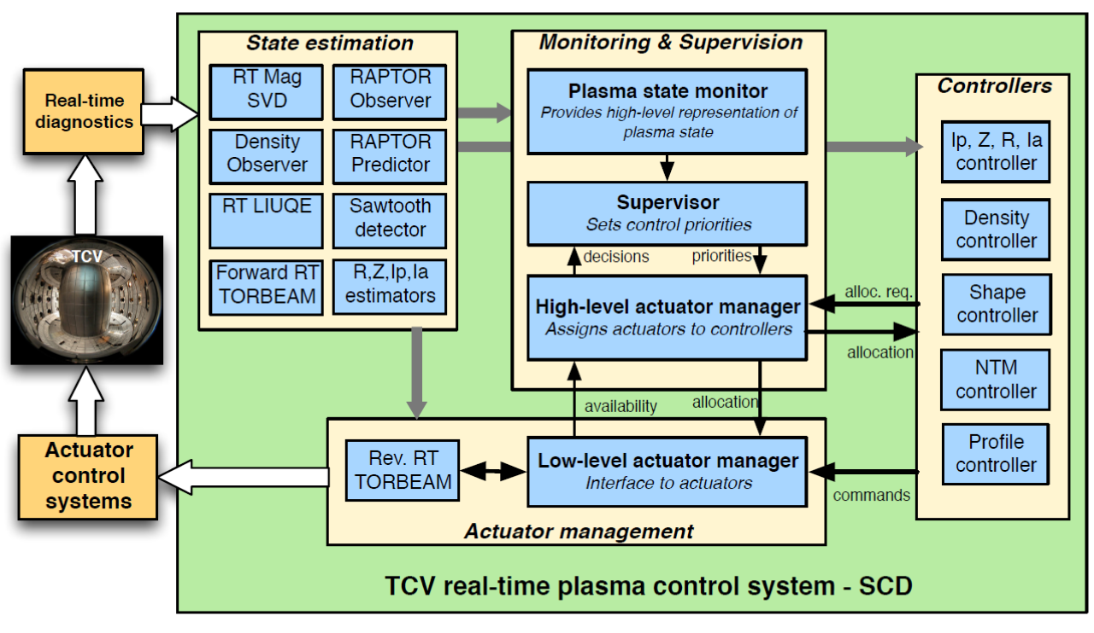
Real-time control tools on TCV PCS

Slide 7
Real-time MHD analysis
TCV #54642
SVD analysis of
Bpol measurement
Sub-ms cycle time
Figure adapted from
C. Galperti et al,
IEEE Trans. on Nucl. Sci.,
vol 64, (2017)

Slide 8
Plasma state monitor
Goal: forms a finite-state representation of the plasma
Receives plasma current, NTM m/n likelihood+frequency+amplitude, LM amplitude,
(to be done) profiles, control references, reconstructed equilibrium
Returns active states of finite-state machine
  Plasma current state
  NTM amplitude state (m/n = 2/1, 3/2, 3/1)
  NTM frequency state
  LM amplitude state (n=1, n=2, n=3)
  Observed vs. Reference profile discrepancy
  Observed vs. Prediction profile discrepancy
  Proximity to physics limits
  Vertical control state

Slide 9
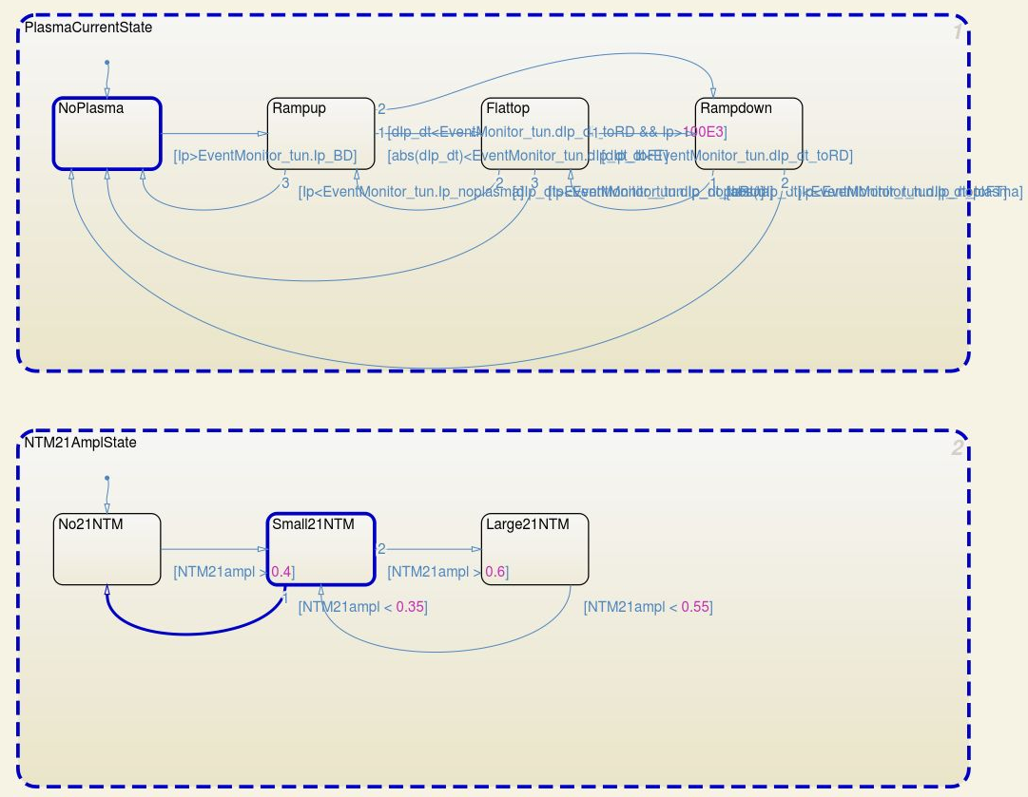
Finite-state machine implementation using MATLAB Simulink Stateflow
Finite-state machines
‘Clean’ way for high-level system representation
Script-based generation of finite-state machine

Slide 10
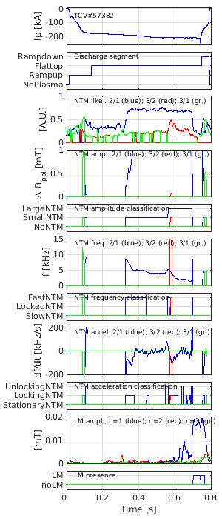
State monitoring on TCV #57382
[Blanken et al, APS 2017]

Slide 11
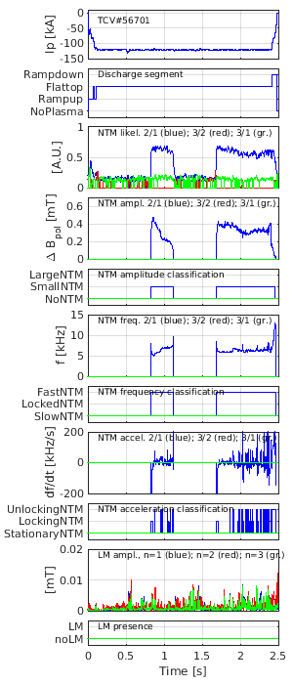
State monitoring on TCV #56969
figure

Slide 12
Real-time control tools on TCV PCS

Slide 13
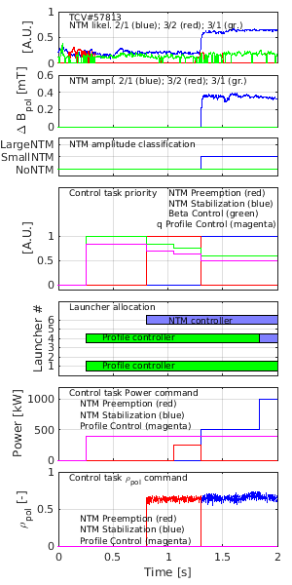
Supervisory control of control tasks
Goal: assign priorities to all control tasks
Method: program decision logic based on timed triggers and plasma events
[Blanken et al, APS 2017]

Slide 14
Actuator management and allocation
Goal: assign actuators to control tasks
  Satisfy requests of power, current drive and deposition location
  Minimize requests vs. allocation mismatch, weighted by priority
  Minimize launcher movement
  Constrained to actuator availability and capabilities
[E. Maljaars et al, Fus. Eng. Des. (2017)]

Slide 15
Actuator management and allocation
Goal: assign actuators to control tasks
  Satisfy requests of power, current drive and deposition location
  Minimize requests vs. allocation mismatch, weighted by priority
  Minimize launcher movement
  Constrained to actuator availability and capabilities
Various possible architectures [E. Maljaars et al, Fus. Eng. Des. (2017)]
  Pre or post allocation
Actuator allocation as constrained optimization
  Brute force optimization for AUG [C. Rapson et al, Fus. Eng. Des. 96-97 (2015)]
  Mixed-integer programming for ITER [E. Maljaars et al, Fus. Eng. Des. (2017)]

Slide 16







Hybrid AM on TCV: present
1/z
TORBEAM
Plasma states
Total requested
P, $ρ_{dep}$, $I_{CD}$
High level AM
NTM controller
Requested
P, $ρ_{dep}$, $I_{CD}$
Low level AM
Actuator commands
PA, PB
$θ$1,…, $θ$6
Plasma state
Allocated ranges
P, $ρ_{dep}$, $I_{CD}$
Supervisor
Profile controller
Requested
P, $ρ_{dep}$, $I_{CD}$
EC system
Task priorities
Allocated ranges
P, $ρ_{dep}$, $I_{CD}$
Requested $ρ_{dep}$
1/z
Requested ranges
P, $ρ_{dep}$, $I_{CD}$
REVERSETORBEAM
Poloidal
mirror
angles
Controller activation

Slide 17


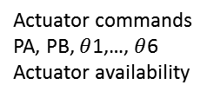
Hybrid AM on TCV: more complete
TORBEAM
Actuator commands
PA, PB, $θ$1,…, $θ$6
Cluster/launcher availability
1/z
Actuator states
Actual
P, $ρ_{dep}$, $I_{CD}$
Plasma states
Cluster/launcher
availability
High level AM
NTM controller
Requested
P, $ρ_{dep}$, $I_{CD}$
Low level AM
Actuator commands
PA, PB, $θ$1,…, $θ$6
Actuator availability
Plasma state
Allocated ranges
P, $ρ_{dep}$, $I_{CD}$
Supervisor
Profile controller
Requested
P, $ρ_{dep}$, $I_{CD}$
EC system
Task priorities
Allocated ranges
P, $ρ_{dep}$, $I_{CD}$
Requested $ρ_{dep}$
1/z
Requested ranges
P, $ρ_{dep}$, $I_{CD}$
REVERSETORBEAM
Poloidal
mirror
angles
Controller activation

Slide 18
State monitoring, control supervision and actuator allocation on TCV #57813
[Blanken et al, APS 2017]

Slide 19
Outlook: further development of real-time plasma monitoring
Add more states in Plasma State Monitor:
  VDE and vertical position control faults/oscillations
  Elongation and internal inductance limits
  Density limits
  Expected LM time from NTM frequency extrapolation
  Confinement mode and ELM frequency
  Discrepancies between observed (RAPTOR-observer) and predicted (RAPTOR-predictive) profiles
Parametrization of physics limits for RT evaluation
Faster than RT prediction with hazard assessment
Test in conjunction with disruption avoidance strategies

Slide 20
Conclusions
We present a first implementation of the integration of high-level plasma supervision, control and actuator management on TCV.
Conflicting requirements of low detection delay and avoiding false detection may cause problems in the presence of signal noise.
Systematic definitions of component interfaces is challenging, both conceptually and in a real-time implementation!

Slide 21
Real-time control tools on TCV PCS

Slide 22
Back-up slides

Slide 23
Disruption avoidance, prediction and mitigation: signal/detection-based
Most tokamaks employ disruption prediction and mitigation only as a last line of defense.
This approach is not advised for ITER and other large tokamaks, where use of DMS should be minimized.
F. Felici, IAEA 2016, EX/P8-33

Slide 24
PCS functions for disruption avoidance
F. Felici, IAEA 2016, EX/P8-33

Slide 25

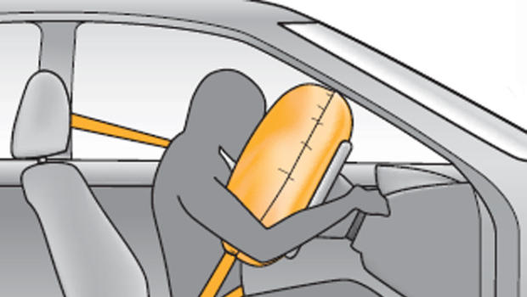


Disruption avoidance, prediction and mitigation: integrated scenario monitoring

Slide 26
TCV
X2 ECHCD system
  Presently 3 gyrotrons/launchers on 2 power supplies
  RT control over power supplies and poloidal mirror angles

Slide 27
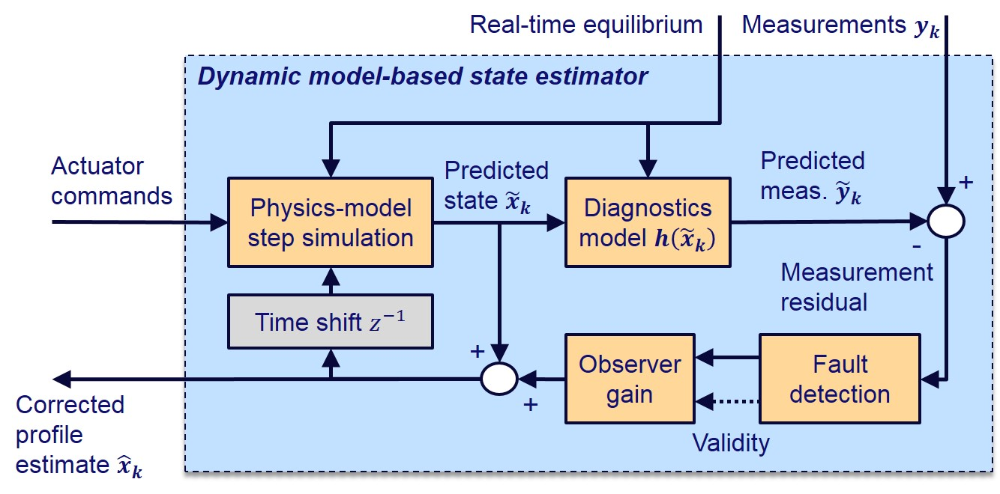
Handling with disruption causes
P.C. de Vries et al, Nuclear Fusion 51 (2011) 053018
Physics origins
Technology origins

