Slide 1
Low-density Start-up
D. Mueller, M. Bell, S. Gerhardt, J. Menard, R. Raman, S. Sabbagh
NSTX FY12 low density discussion: May 12, 2011

Slide 2
Historically, fueling and heating help avoid MHD during start-up
Long experience with goal of achieving long, stable, high-performance discharges has led to the present prescription
both low-field and high-field side gas puffing
Rapid Ip ramp-rate
Low l_{i} used
High dI_{p}/dt
large aperture start-up
early heating
Most of these also increase the plasma density

Slide 3
New approach is needed for low density
Simply turning off gas and/or heating does not work to produce stable plasmas
Partial existence proof: CHI initiated discharges had low density, low l_{i} , larger R, OH(0)=0 and were stable (but no flattop and L-Mode)
Error fields are more likely to cause locked modes (or other MHD?) at low density (does low l_{i} help?)
Use zero OH precharge to minimize error fields
Use high V_{loop} like CHI did
Try low voltage start-up and low dI_{p}/dt
Use RWM coils early to correct for error fields
(In H-Mode, n_{e}l increases about 1X10¹⁵/cm² per 0.1s)

Slide 4
Strategy
Use zero OH precharge to investigate if OHXTF is source of error fields
This at least starts with only eddy currents contributing to error (ramping coils, ramping errors?)
If this is successful, investigate error –field reduction with RWM coils next (if not try this later)
Try high initial V_{loop}, with larger R and kappa with low gas fueling, like the low l_{i}, low n_{e} CHI shots
Try low voltage start-up with slow dI_{p}/dt with low gas fueling and low NBI
Attack early error field correction
In all cases, compare n_{e} evolution to a 2 NB source, 700 kA fiducial plasma to evaluate success

Slide 5
Zero OH pre-charge
Starting up is straight-forward, plasma shape like fiducial
Goal 600 or 700 kA (to have a bit of flattop)
Use only prefill, early NBI timing like 2-source fiducial
Introduce flat spot in Ip ramp to get H-Mode
Add some LFS gas if needed to get H-Mode
If LFS gas does not work add some HFS gas
Compare to same Ip, shape and gas programming, but with full OH precharge

Slide 6
High loop Voltage (low early l_{i} )
Try about 4V/turn, about double standard
Use lower PF5 to get larger R
Reduce PF3/PF5 ratio like CHI case (taller plasma)
Will require tweaking of PF1AU&L to avoid hitting top
Make R 10cm bigger in first 70 ms
Flattop at 600-700 kA
Use only prefill, early NBI timing like 2 source fiducial
Introduce flat spot in Ip ramp to get H-Mode
Add some LFS gas if needed to get H-Mode
Add blip of 3rd NB source
If that does not work add some HFS

Slide 7
Low loop voltage
During the slow ramp-up (~5 – 7 MA/s), we normally use ~2V/turn for L-Mode or ~ 1.5 V/turn in H-Mode.
Try to use <1.5 V for breakdown (will require lower prefill and PF5). Ramp to 700 kA at ~ 0.6s
Larger plasma size at start-up generally leads to lower l_{i} ; May need this to offset the faster current penetration due to lower T_{e} from lower input power. Start with the usual PF3/PF5 ratio and lower it as needed to get lower l_{i}
Use only prefill, use plasma shape similar to fiducial, but taller early on
Inject beams early similar to 2 source fiducial
Use usual tricks of flat-spot in Ip ramp, LFS gas, 3rd NB source, or some HFS gas to get H-Mode

Slide 8
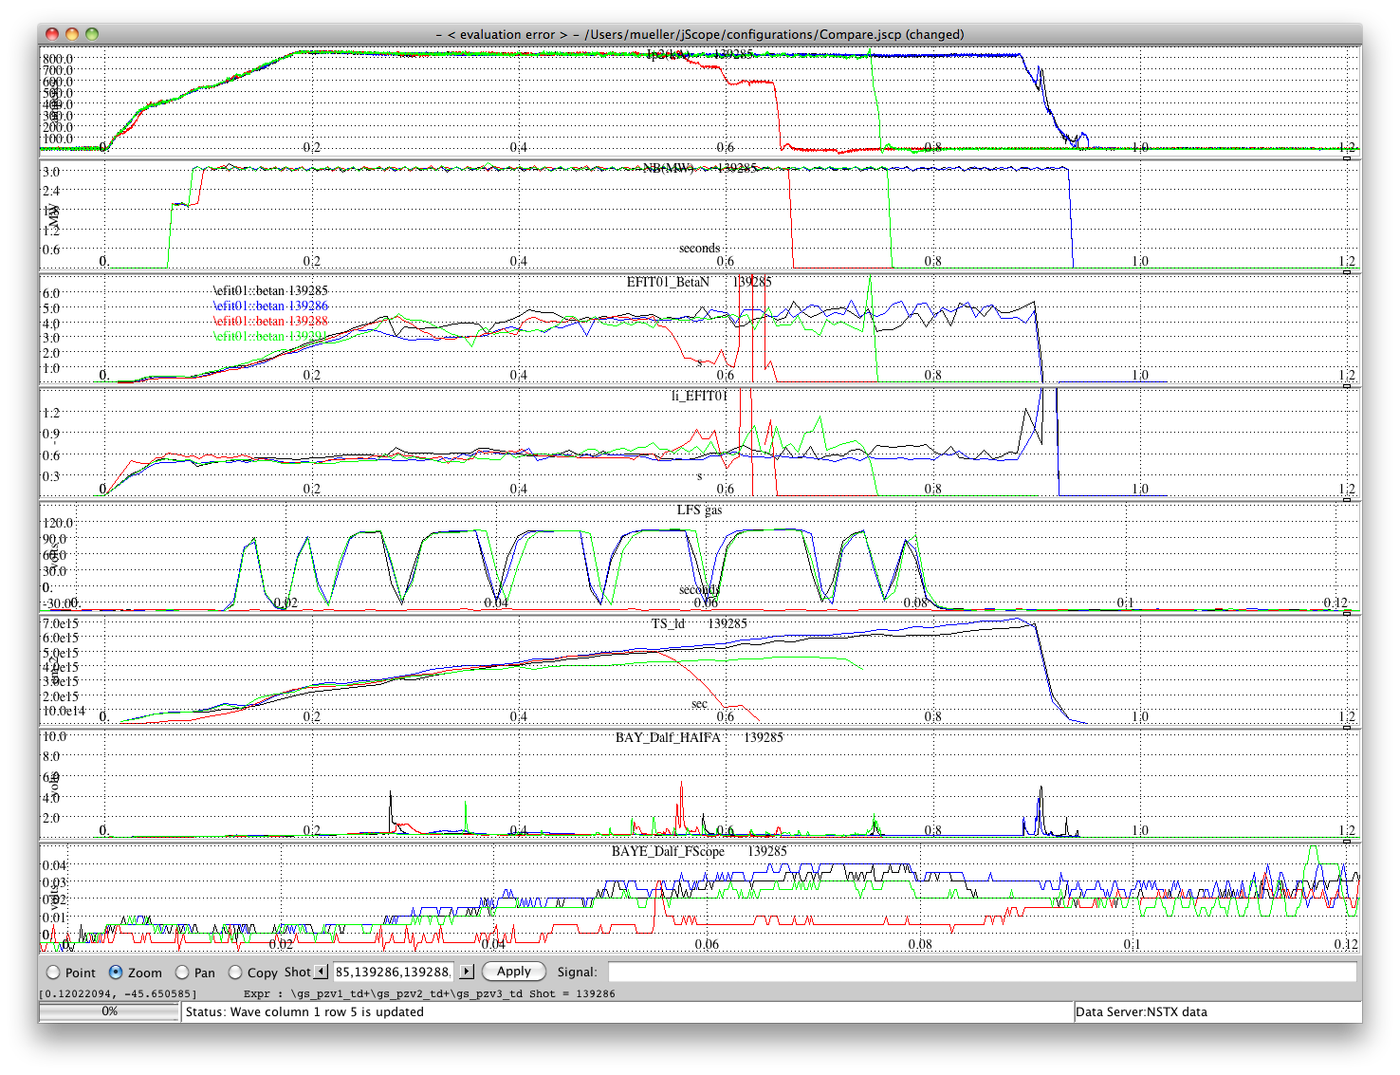
No LFS gas - early H_{α} spikes and higher l_{i}, then shorter duration

