Slide 1


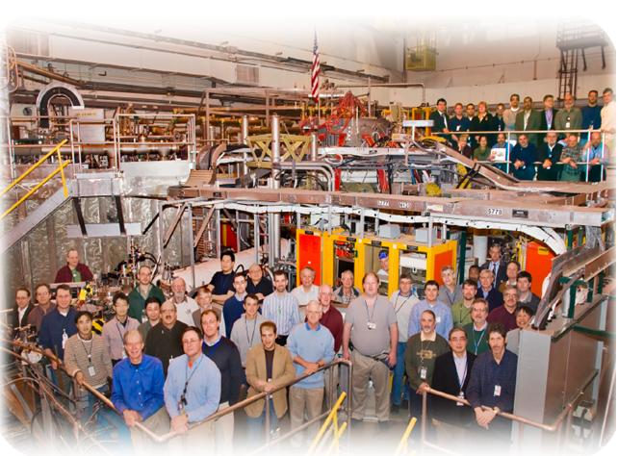

NSTX
Supported by
Overview
College W&M
Colorado Sch Mines
Columbia U
CompX
General Atomics
INL
Johns Hopkins U
LANL
LLNL
Lodestar
MIT
Nova Photonics
New York U
Old Dominion U
ORNL
PPPL
PSI
Princeton U
Purdue U
SNL
Think Tank, Inc.
UC Davis
UC Irvine
UCLA
UCSD
U Colorado
U Illinois
U Maryland
U Rochester
U Washington
U Wisconsin
SPG
Culham Sci Ctr
U St. Andrews
York U
Chubu U
Fukui U
Hiroshima U
Hyogo U
Kyoto U
Kyushu U
Kyushu Tokai U
NIFS
Niigata U
U Tokyo
JAEA
Hebrew U
Ioffe Inst
RRC Kurchatov Inst
TRINITI
KBSI
KAIST
POSTECH
ASIPP
ENEA, Frascati
CEA, Cadarache
IPP, Jülich
IPP, Garching
ASCR, Czech Rep
U Quebec
ASC TSG Meeting, 5/12/09

Slide 2
Milestone Text
"The high performance scenarios targeted in NSTX Upgrade and next-step ST devices are based on operating at lower Greenwald density fraction and/or lower collisionality than routinely accessed in NSTX. Collisionality plays a key role in ST energy confinement, non-inductive current drive, pedestal stability, RWM stability, and NTV rotation damping. Lower density and/or higher temperature is required to access lower nu*. HHFW is a potential means of increasing electron temperature and reducing nu*, and reduced fueling and/or Li pumping are effective and readily available tools for lowering nu* through lower density. However, while D pumping from lithium has been observed, additional gas fueling is typically required to avoid plasma disruption during the current ramp and/or in the high beta phase of the highest performance (i.e. highest confinement, beta, non-inductive fraction, etc) plasmas of NSTX . The goal of this milestone is to identify the stability boundaries, characterize the underlying instabilities responsible for disruption at reduced density, and to develop means to avoid these disruptions. Possible methods for stability improvement include changes in current ramp-rate (li and q(r) evolution), H-mode transition timing, shape evolution, heating/beta evolution and control, optimized RWM control and error field correction, fueling control (SGI, shoulder injector), and optimized Li pumping. This milestone will also aid development of MISK and VALEN stability models and TRANSP and TSC integrated predictive models for NSTX Upgrade and next-step STs."

Slide 3
Where the Forum Left Off
ASC:
  Combined 3 proposals into a single XP lead by D. Mueller
    Mueller, Sabbagh, Raman, Jarboe, Bell, Battaglia, Gerhardt,…
    3 days allocated.
    3 different strategies proposed.
  Additional 0.5 days for early error field correction optimization.
    Menard, et al.
    Dedicated optimization of the OHxTF correction algorithm.
    Probably needs to focus on a specific scenario.
MHD:
  Single proposal to study early rotating MHD that often disrupts shots.
    S.P. Gerhardt, et al.
  Was shifted to 1 day of cross-cutting and enabling.

Slide 4
NSTX
Supported by
“Controlling” MHD During the Plasma Start-Up
College W&M
Colorado Sch Mines
Columbia U
CompX
General Atomics
INL
Johns Hopkins U
LANL
LLNL
Lodestar
MIT
Nova Photonics
New York U
Old Dominion U
ORNL
PPPL
PSI
Princeton U
Purdue U
SNL
Think Tank, Inc.
UC Davis
UC Irvine
UCLA
UCSD
U Colorado
U Illinois
U Maryland
U Rochester
U Washington
U Wisconsin
Culham Sci Ctr
U St. Andrews
York U
Chubu U
Fukui U
Hiroshima U
Hyogo U
Kyoto U
Kyushu U
Kyushu Tokai U
NIFS
Niigata U
U Tokyo
JAEA
Hebrew U
Ioffe Inst
RRC Kurchatov Inst
TRINITI
KBSI
KAIST
POSTECH
ASIPP
ENEA, Frascati
CEA, Cadarache
IPP, Jülich
IPP, Garching
ASCR, Czech Rep
U Quebec
ASC TSG Meeting, 5/12/09

Slide 5
Overview
“Low-density startup” should include surviving the entrance of q=4,3, & 2 into the H-mode plasma.
  typically some few hundred msec. after SOFT.
MHD associated with those surfaces often locks to the wall, leading to large β collapse or disruption.
  Important for SGI shots, S. Sabbagh’s reduced n_{e} discharges
Any of the current profile, plasma β, rotation, or rotation shear may impact the amplitude locking of these modes.
  Also all the early EPM/TAE activity.
We should optimize the discharge to ride through early modes with reduced density. Options include:
  β: Feed forward or feedback control of NB heating.
  Current profile: heating timing, ramp rate.
  Rotation: H-mode timing.
Results may be un-optimal for NSTX, but useful for NSTX upgrade.
  Upgrade has 3x the solenoid flux, off-axis NBCD.

Slide 6
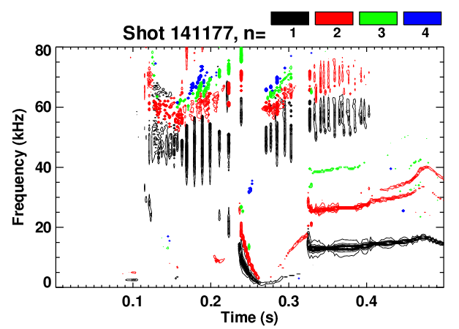
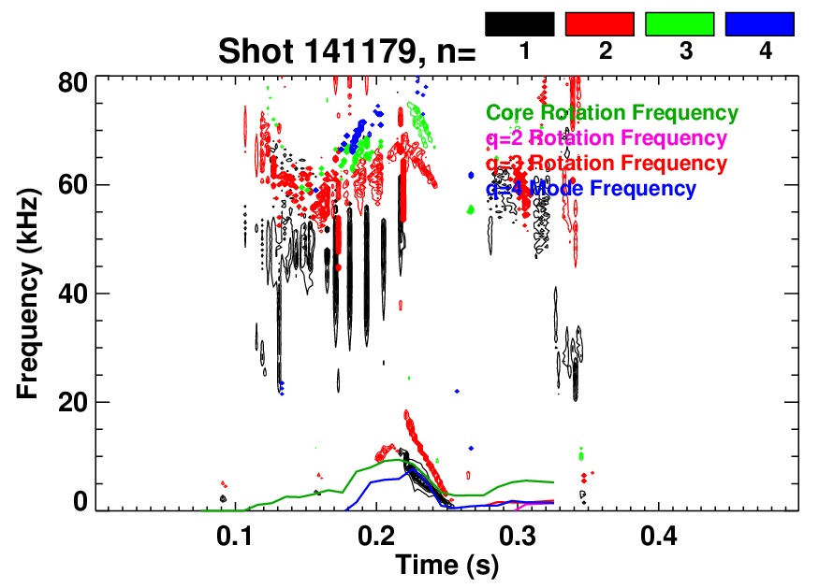
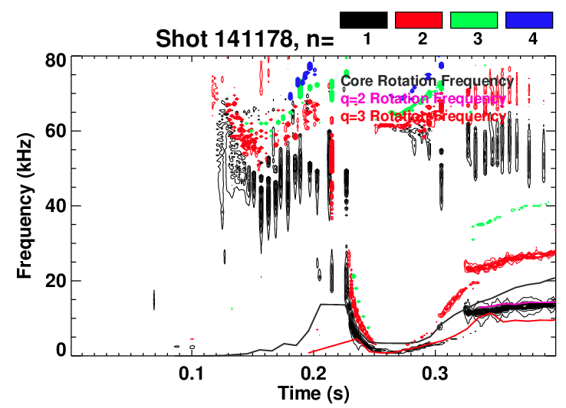
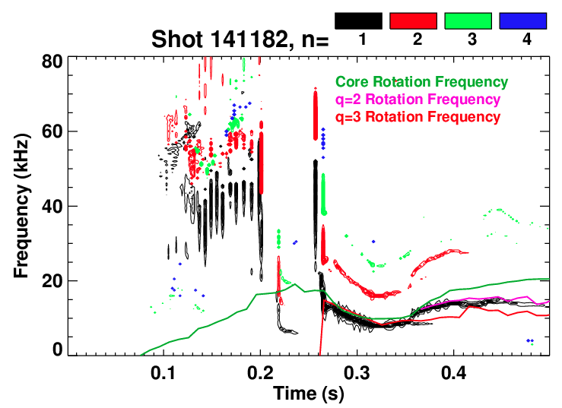
S. Sabbagh’s Low n_{e} Shots Failed When Rotating Modes Started to Lock
“Good Low
Density Shot”
“Bad Shot”
Mode at q=4 locks to wall
Chirping?
Chirping?
“Good Low Density Shot”
Fixed the gas.
Good high
density shot.

Slide 7
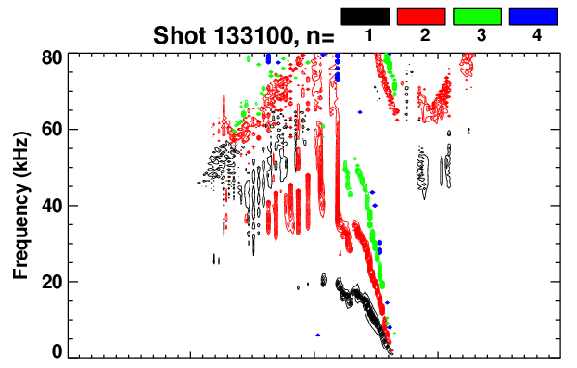
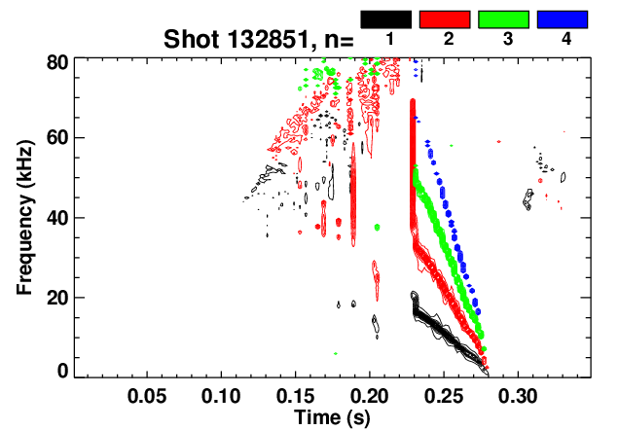
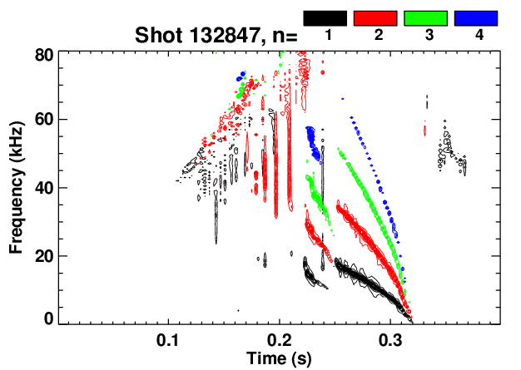
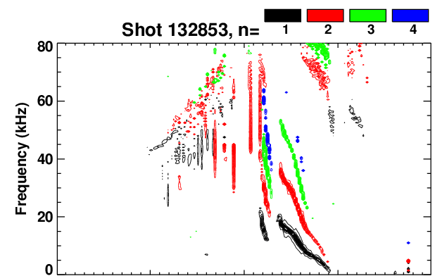
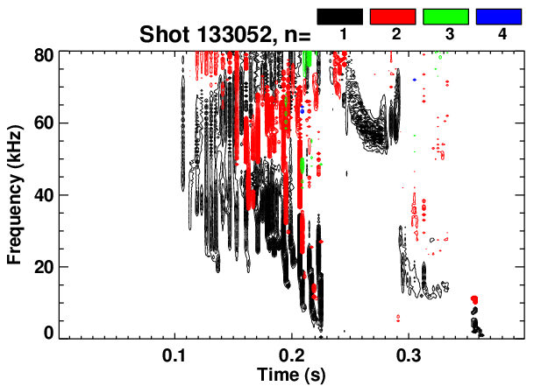
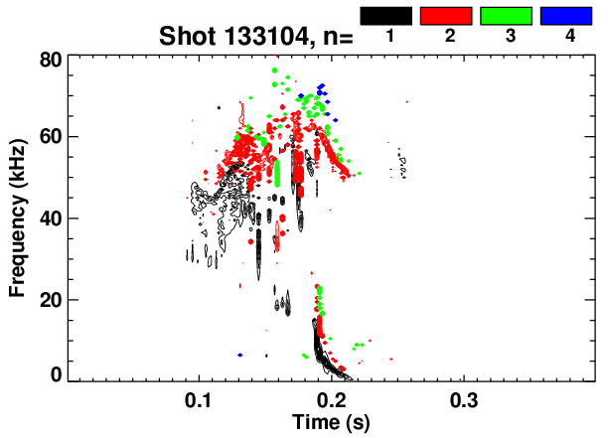
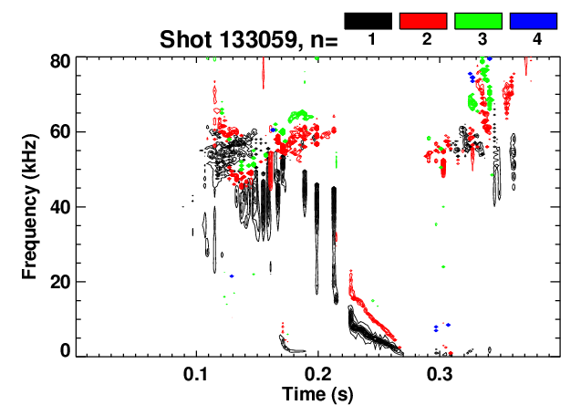
Same Physics Leads to Disruption in Many SGI
Optimization Discharges
Shots from XP-912
  Thanks Vlad.
Majority of H-mode “failures” in that XP were of this type.
  Some shots failed to get into H-mode, consequently disrupted

Slide 8
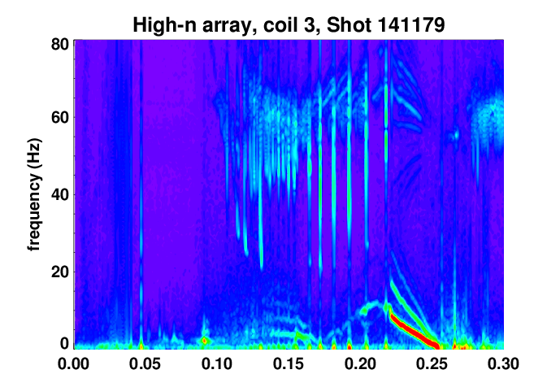
Appears that EPM May Have Triggered the q=4 Mode That Ultimately Locks During Sabbagh’s Day
q=4 enters the plasma at ~0.19, but mode does not strike till 0.22.
Mode strike coincident with large EMP.
Does some triggering physics explain why previous shots didn’t have large q=4 modes?

Slide 9
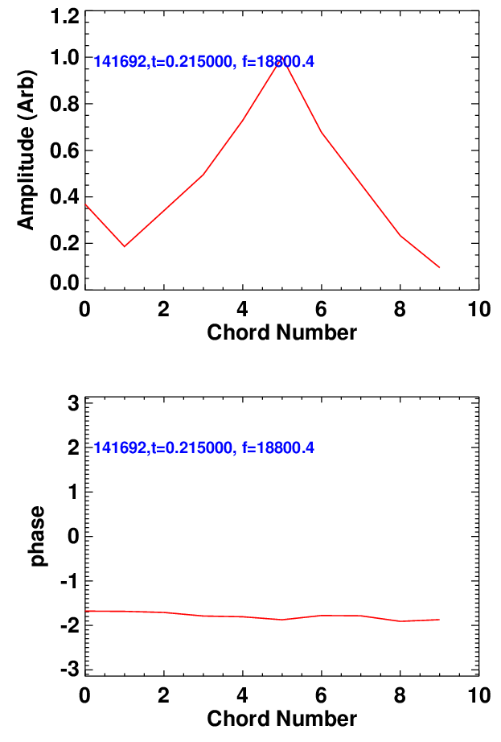
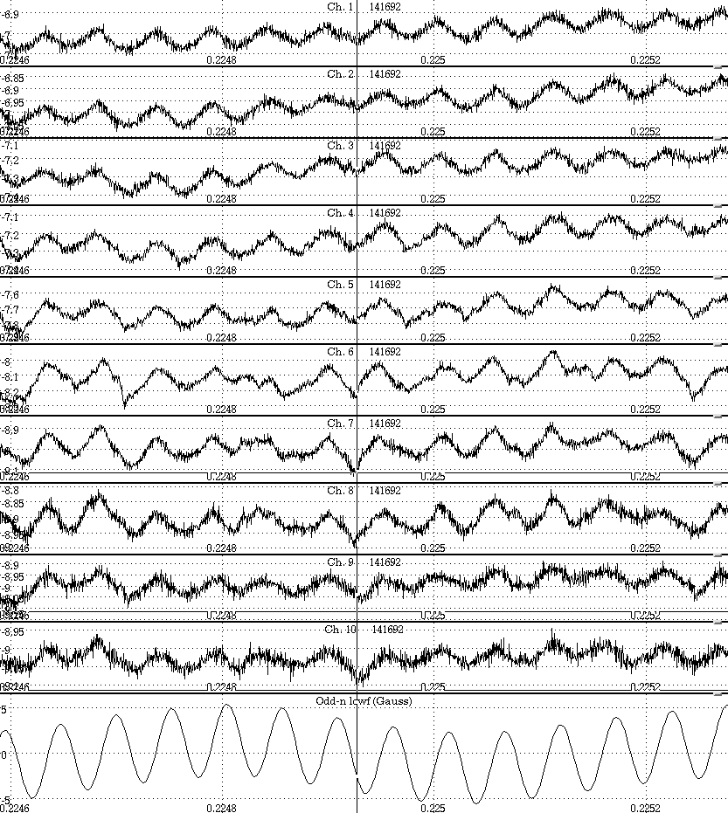
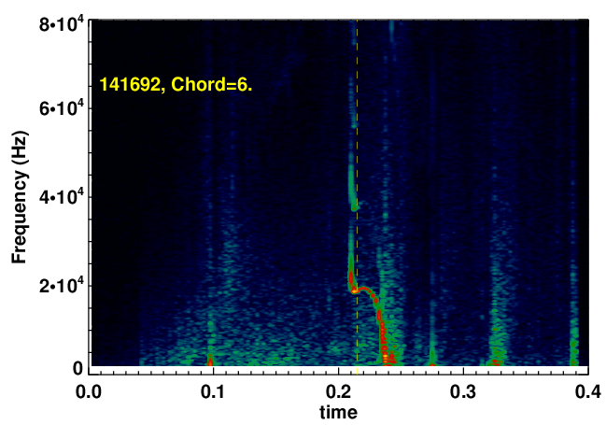
BES Shows That There is No Inversion Radius…Appears Not to be (double) Tearing…
Thanks D. Smith, E. Fredrickson
R=128 cm
asd
R=150 cm

Slide 10
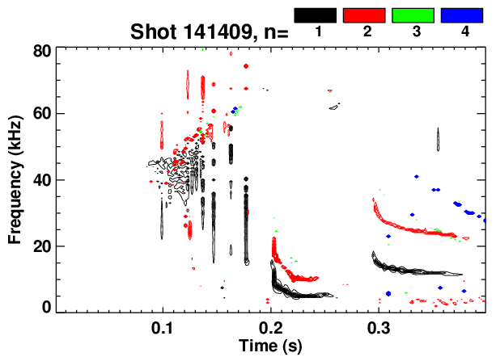
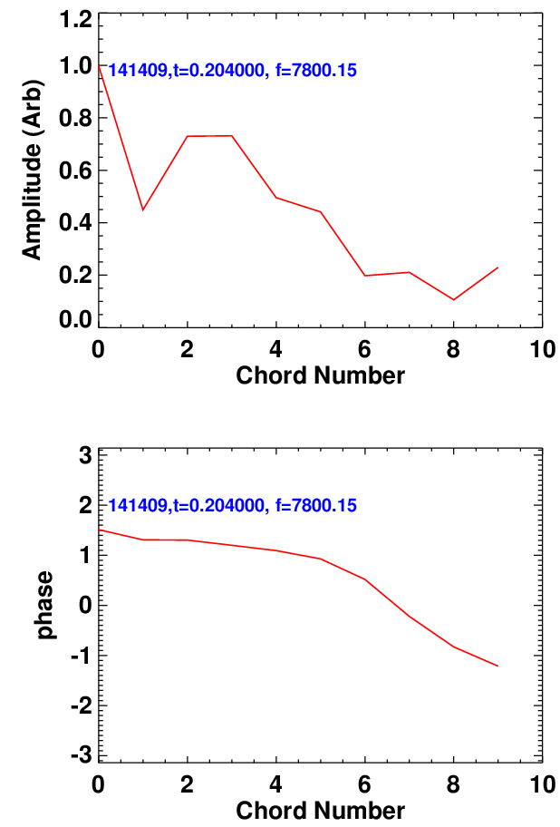
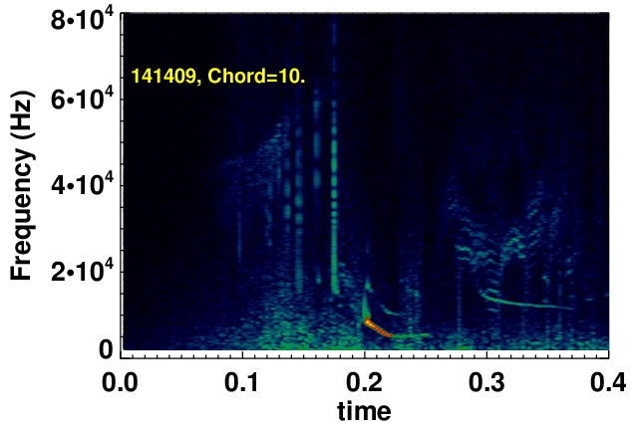
BES Shows That the Modes Are Global, Without Sharp Inversion Layer
ME-USXR Data Also Implies That the Mode is a Large Kink

Slide 11
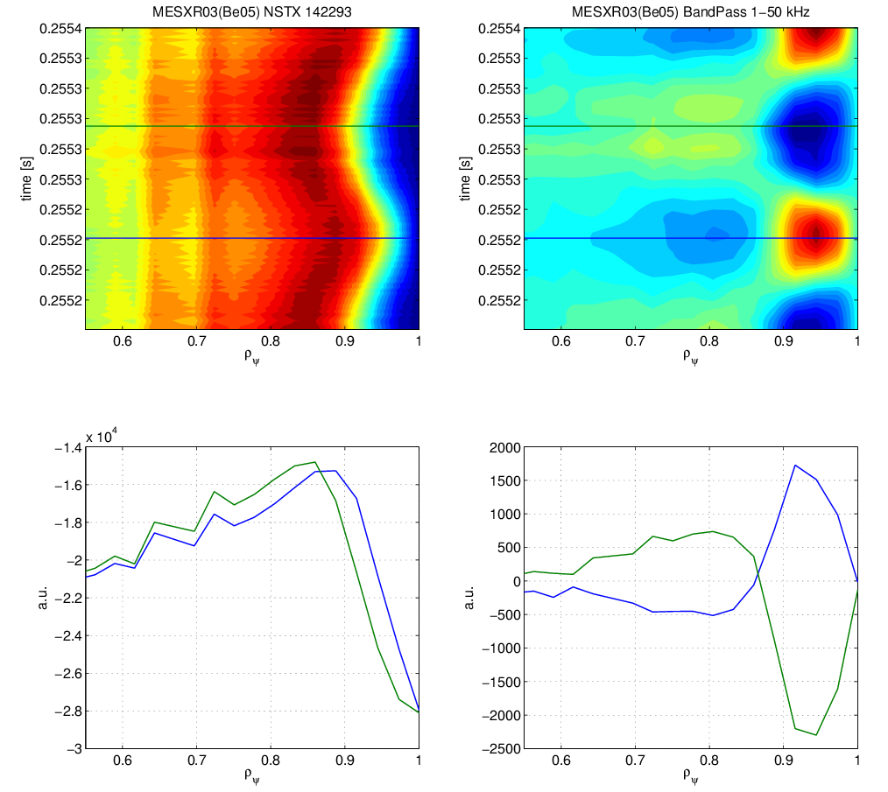
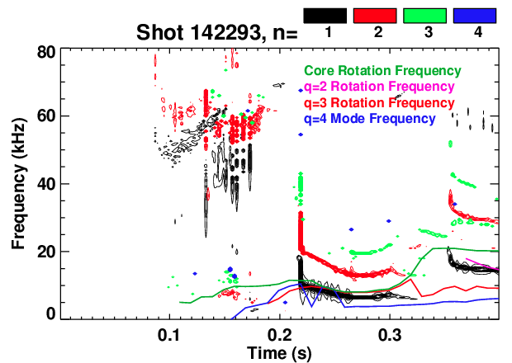
Preliminary Assessment for ME-USXR Corroborates Kink Explanation
JHU Multi-Energy Tangential X-ray diagnostic.
Analysis by A. Bortolon.
Again, key rational present before mode-strike.
  EPM critical?

Slide 12
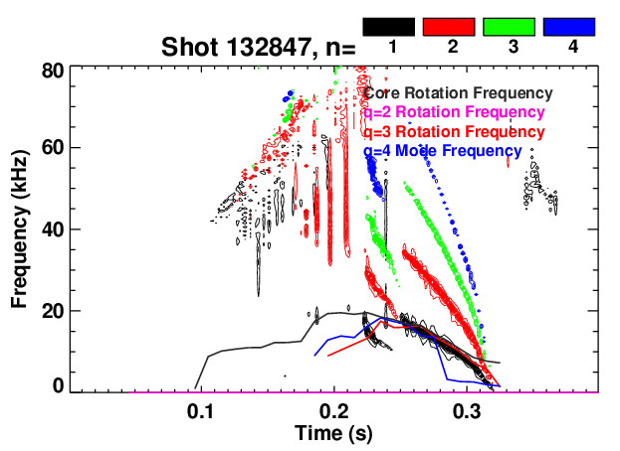
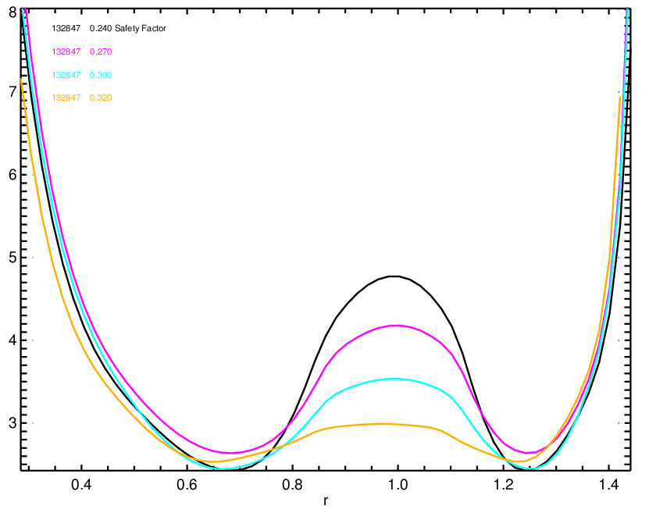
Reversed Shear May Play a Role in Setting the Mode Size?
0.24
0.27
0.3
0.32
Are larger modes more likely to coencide with flatter q-profiles?
  BES may tell us.
Provides a mechanism for heating timing to impact evolution.

Slide 13
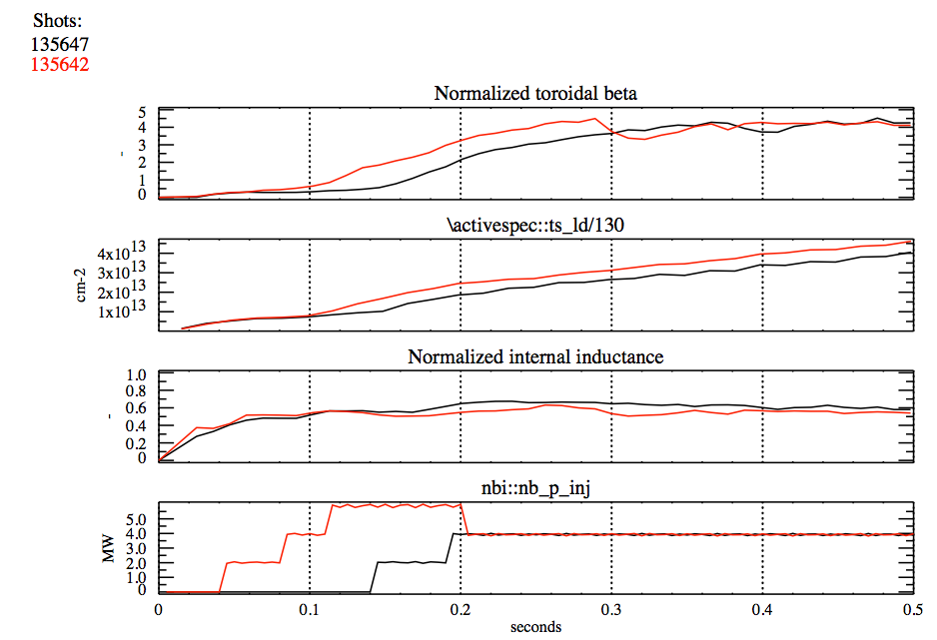
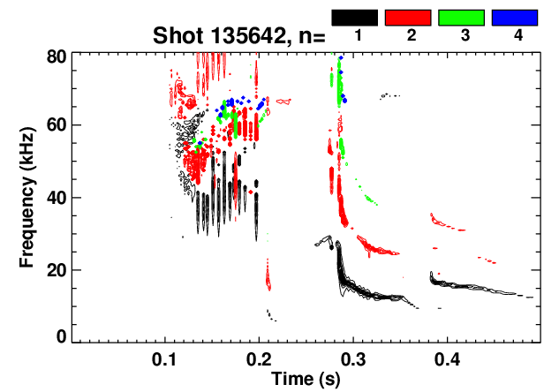
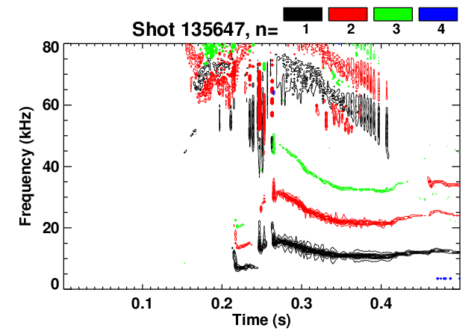
We Have Evidence That Changing the Heating Profile Can Impact the Evolution of These Modes.
Tried early and late heating.
  Delay of H-mode as well.
  Substantial changes in EP/TAE
Rotating n=1 mode amplitudes are modified.
  Need to look more carefully at m-number identification.
Observation: Modes don’t start till B comes on in these examples
135642: Early P_{inj} 135647: Late P_{inj}
135647: Late P_{inj}
135642: Early P_{inj}

Slide 14
Possible shotlist needs refinement, but basics are…
Reload a scenario such as 141178 (S. Sabbagh’s reduced density target).
  Don’t change early ramp-rate, shape evolution.
  Develop robust mode evolution with reduced fuelling.
Study the space of rotation, β, and n_{e} vs. mode dynamics.
  Test low power early, delayed H-mode.
    Reduced β and density with single source will allow surfaces in quickly, should have strong rotation.
    Elimination of EPMs may be important…lower voltage pre-heating beam?
  Study timing of β (P_{inj}) ramp.
    When is the earliest time that we can ramp β without EPMs and large modes.
    Can we prevent too-rapid J evolution if we only heat strongly after q=3 enters?
  Vary the ramp rate:
    If we slow the ramp rate, can we prevent some unstable current profiles?
    And eliminate some irreproducibility of the modes?
    Target the q=2 & 3 surfaces entering just after the I_{OH} zero crossings?
  What is the impact of reduced input power?
    Onset of “IREs” will be unacceptable.
    Unsustainably high l_{i} will be unacceptable.
    Earlier onset of RWMs or the “late” rotating MHD is OK…
      not in scope of XP
Diagnostic considerations.
  Need source A for important MSE and BES measurements.
  Tangential USXR Camera, ME-USXR and Hup/Hdown for USXR mode identification.

Slide 15
Backup

Slide 16
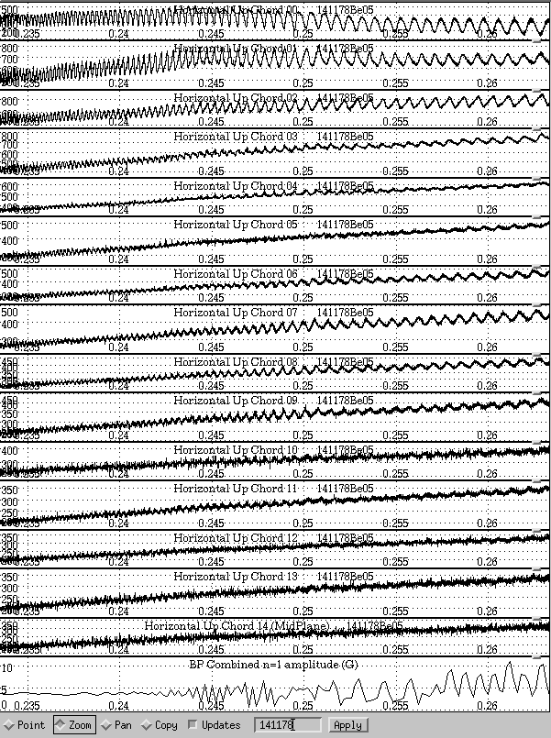
Chirping q=3 Mode Settles With Inversion Radius In the Outer Plasma
Mode chirps down.
Inversion layer develops in the outer plasma.
q=3 island?…need bit more analysis.
Core kink-like component as well?
ME-USXR may be quite useful analyzing this data.

Slide 17
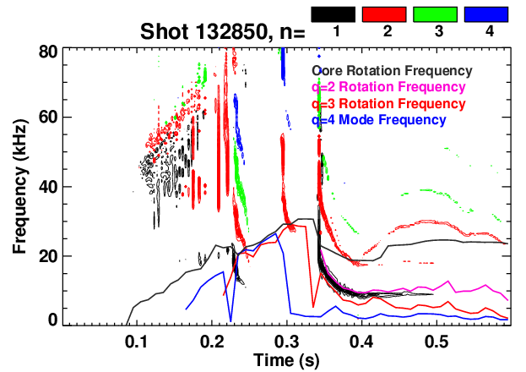
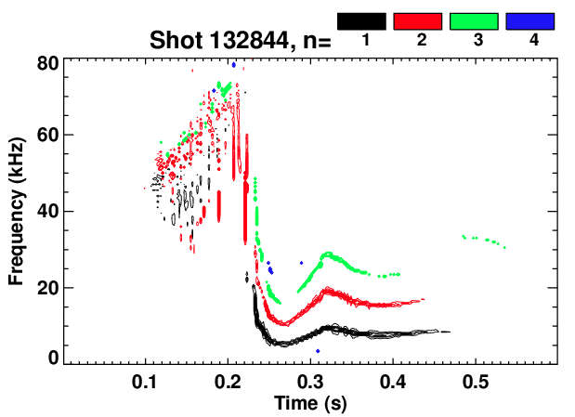
Difference Between “Good” and “Bad” SGI Shots
dsf

Slide 18
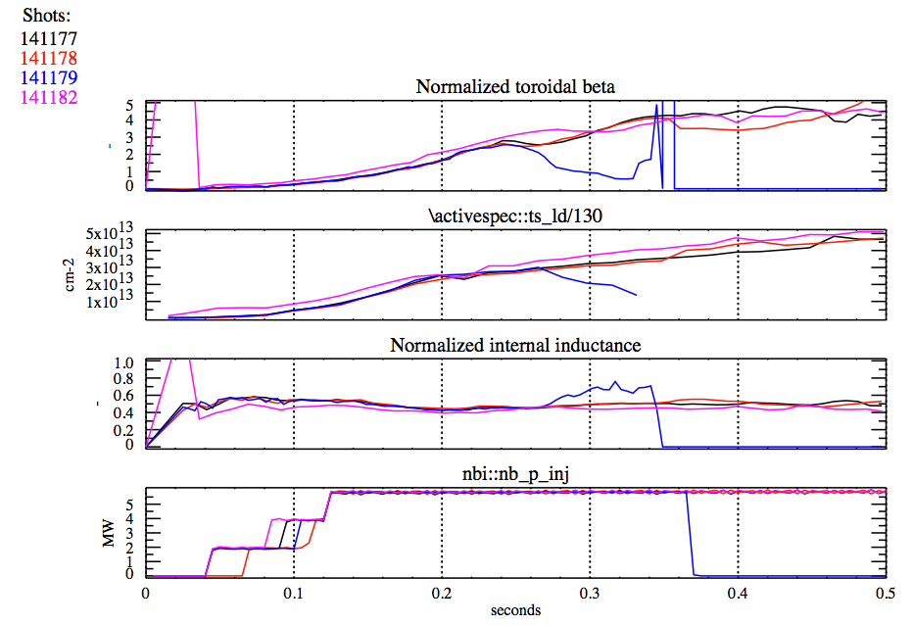
Not Easy To Find Difference Between Shots Using
0D Parameters
Long-Pulse Lower Density
Disrupting Lower Density
Long Pulse Higher Fuelling

