Slide 1

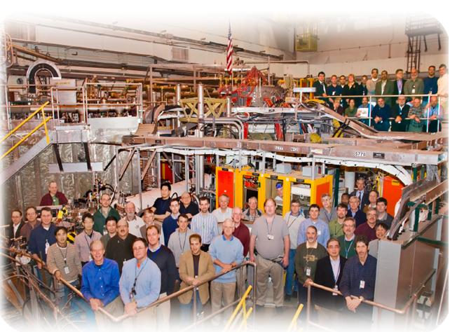

NSTX
Supported by
Taming the Plasma-Material Interface with the Snowflake Divertor in NSTX
College W&M
Colorado Sch Mines
Columbia U
CompX
General Atomics
INEL
Johns Hopkins U
LANL
LLNL
Lodestar
MIT
Nova Photonics
New York U
Old Dominion U
ORNL
PPPL
PSI
Princeton U
Purdue U
SNL
Think Tank, Inc.
UC Davis
UC Irvine
UCLA
UCSD
U Colorado
U Illinois
U Maryland
U Rochester
U Washington
U Wisconsin
V. A. Soukhanovskii
Lawrence Livermore National Laboratory
Culham Sci Ctr
U St. Andrews
York U
Chubu U
Fukui U
Hiroshima U
Hyogo U
Kyoto U
Kyushu U
Kyushu Tokai U
NIFS
Niigata U
U Tokyo
JAEA
Hebrew U
Ioffe Inst
RRC Kurchatov Inst
TRINITI
KBSI
KAIST
POSTECH
ASIPP
ENEA, Frascati
CEA, Cadarache
IPP, Jülich
IPP, Garching
ASCR, Czech Rep
U Quebec
JI2.00002
52nd Annual Meeting of the APS DPP
Chicago, IL
Tuesday, November 9, 2010

Slide 2
Acknowledgements
D. D. Ryutov, T. D. Rognlien, M. V. Umansky (LLNL),
R. E. Bell, D. A. Gates, A. Diallo, S. P. Gerhardt, R. Kaita,
S. M. Kaye, E. Kolemen, B. P. LeBlanc, R. Maqueda,
J. E. Menard, D. Mueller, S. F. Paul, M. Podesta,
A. L. Roquemore, F. Scotti (PPPL),
J.-W. Ahn, R. Maingi, A. McLean (ORNL),
D. Battaglia, T. K. Gray (ORISE),
R. Raman (U Washington),
S. A. Sabbagh (Columbia U)
Supported by the U.S. DOE under Contracts
DE-AC52-07NA27344, DE AC02-09CH11466,
DE-AC05-00OR22725, DE-FG02-08ER54989.

Slide 3
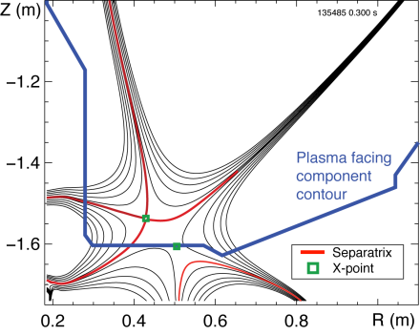
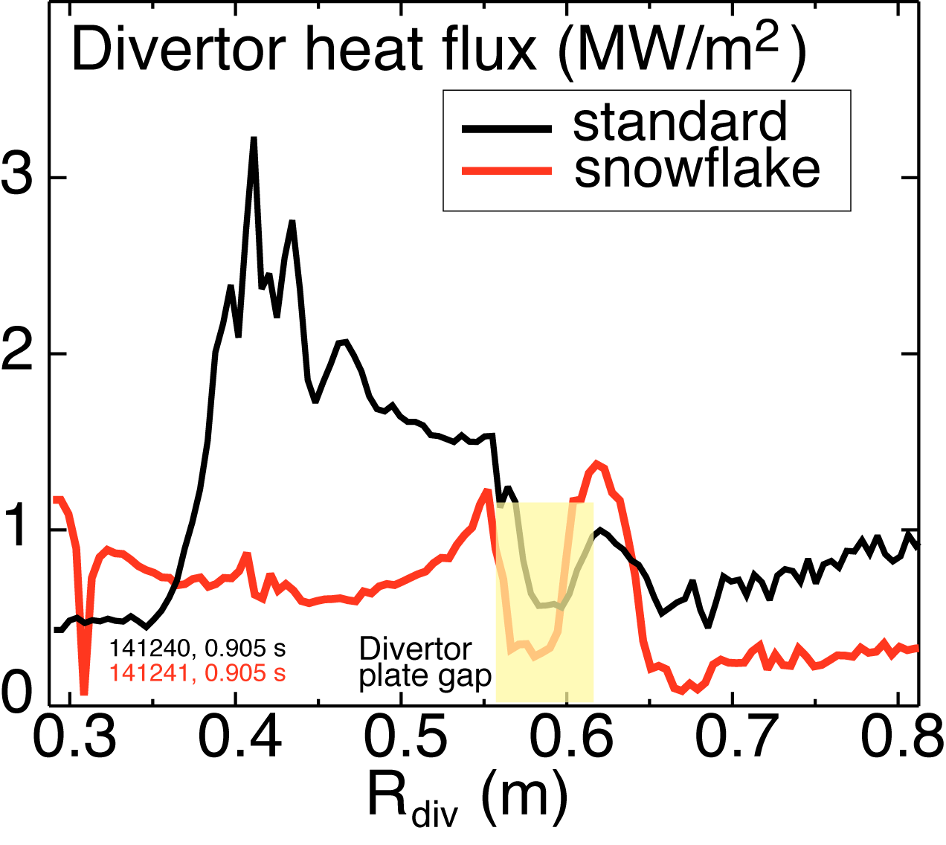
Outline: Experimental studies of snowflake divertor in NSTX
Tokamak divertor challenge
Snowflake divertor configuration
Snowflake divertor in NSTX
  Magnetic properties and control
  Core and divertor plasma properties
  Comparison with standard and radiative divertors
  2D transport model
Conclusions

Slide 4
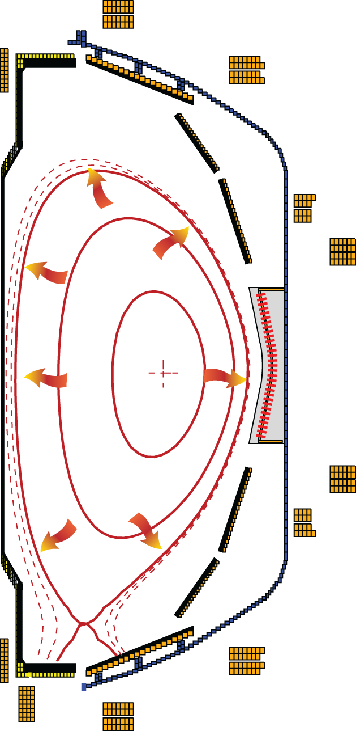
Poloidal divertor concept enabled progress in magnetic confinement fusion in the last 30 years
Divertor challenge
  Steady-state heat flux
      present limit q_{peak} ≤ 10 MW/m²
      projected to q_{peak} ≤ 80 MW/m² for future devices
  Density and impurity control
  Impulsive heat and particle loads
  Compatibility with good core plasma performance
Spherical tokamak: additional challenge - compact divertor
NSTX (Aspect ratio A=1.4-1.5)
  I_{p} ≤ 1.4 MA, P_{in} ≤ 7.4 MW (NBI), P / R ~ 10
  q_{peak} ≤ 15 MW/m², q|| ≤ 200 MW/m²
  Graphite PFCs with lithium coatings
National Spherical
Torus Experiment

Slide 5



Various techniques developed for reduction of heat fluxes q|| (divertor SOL) and q_{peak} (divertor target)
Promising divertor peak heat flux mitigation solutions:
  Divertor geometry
    poloidal flux expansion
    divertor plate tilt
    magnetic balance
  Radiative divertor
Recent ideas to improve standard divertor geometry
  X-divertor (M. Kotschenreuther et. al, IC/P6-43, IAEA FEC 2004)
  Snowflake divertor (D. D. Ryutov, PoP 14, 064502 2007)
  Super-X divertor (M. Kotschenreuther et. al, IC/P4-7, IAEA FEC 2008)

Slide 6
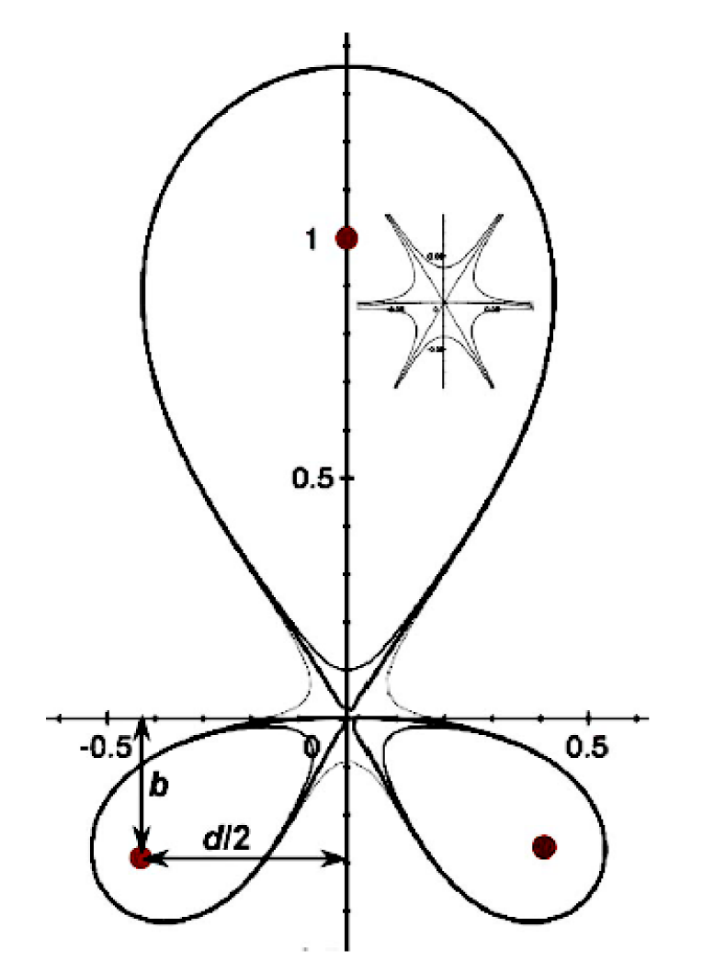
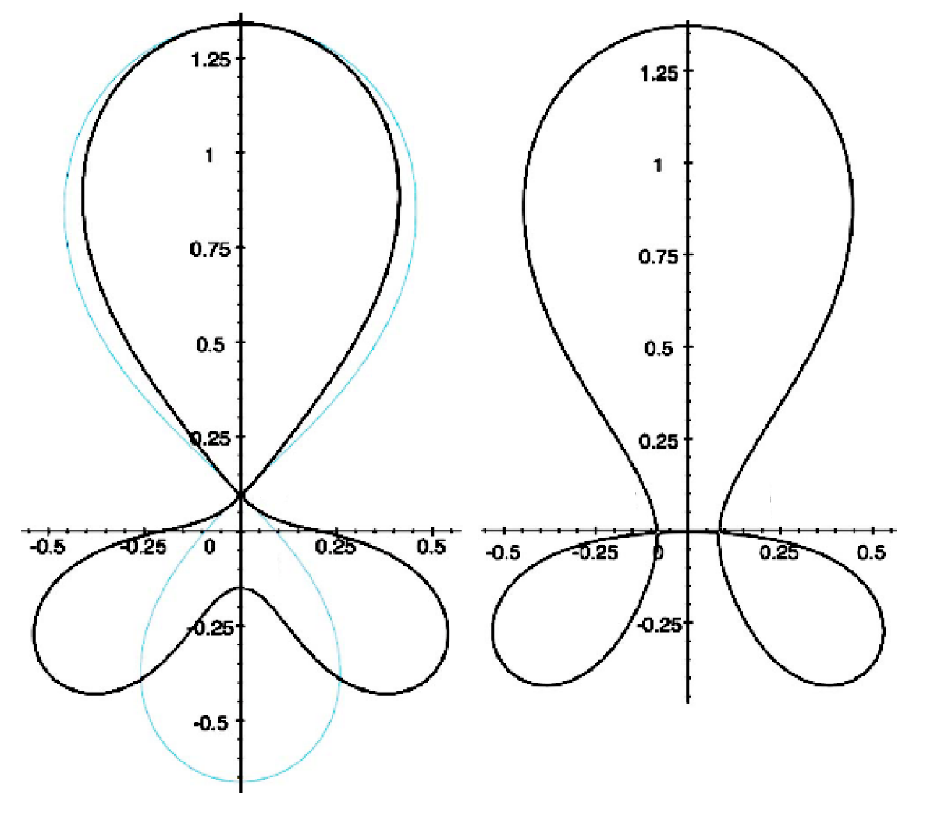
Attractive divertor geometry properties predicted by theory in snowflake divertor configuration
Snowflake divertor
  Second-order null
      B_{p} ~ 0 and grad B_{p} ~ 0; B_{p} ~ r²
      (Cf. first-order null: B_{p} ~ 0; B_{p} ~ r)
  Obtained with existing divertor coils (min. 2)
  Exact snowflake topologically unstable
Predicted properties (cf. standard divertor)
  Larger low B_{p} region around X-point
  Larger plasma wetted-area A_{wet} (flux expansion f_{exp})
  Larger X-point connection length L_{x}
  Larger effective divertor volume V_{div}
  Increased edge magnetic shear
Experiments
  TCV (F. Piras et. al, PRL 105, 155003 (2010))
Exact
snowflake
divertor
snowflake-minus
snowflake-plus
D. D. Ryutov, PoP 14, 064502 2007

Slide 7
Outline: Experimental studies of snowflake divertor in NSTX
Tokamak divertor challenge
Snowflake divertor configuration
Snowflake divertor in NSTX
  Magnetic properties and control
  Core and divertor plasma properties
  Comparison with standard and radiative divertors
  2D transport model
  Conclusions

Slide 8
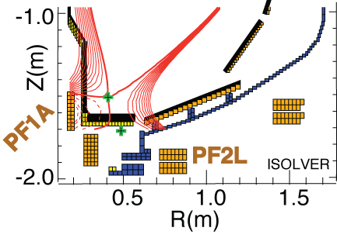
Possible snowflake divertor configurations were modeled with ISOLVER code
ISOLVER - predictive free-boundary axisymmetric Grad-Shafranov equilibrium solver
  Input: normalized profiles (P, I_{p}), boundary shape
  Match a specified I_{p} and β
  Output: magnetic coil currents
Standard divertor discharge below:
B_{t}=0.4 T, I_{p}=0.8 MA, δ_{bot}~0.6, κ∼2.1
Quantity | Standard divertor | Simulated snowflake
X-point to target parallel length L_{x} (m) | 5-10 | 10
Poloidal magnetic flux expansion f_{exp} at outer SP | 10-24 | 60
Magnetic field angle at outer SP (deg.) | 1-2 | ~1
Plasma-wetted area A_{wet} (m²) | ≤ 0.4 | 0.95

Slide 9
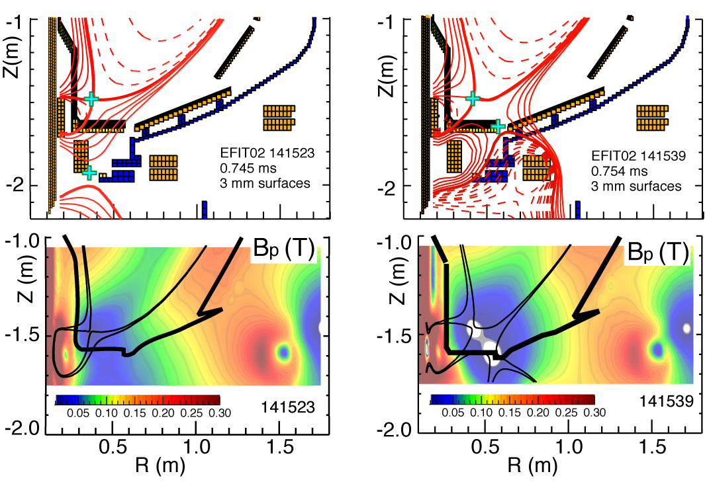
Snowflake divertor configurations obtained in NSTX confirm analytic theory and modeling
Standard
Snowflake
f_{exp}
B_{p}

Slide 10
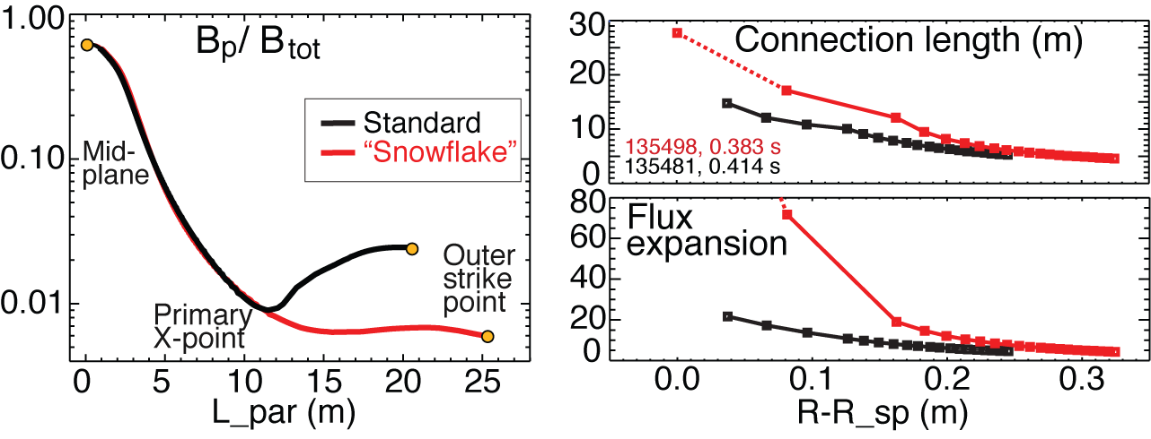
Plasma-wetted area and connection length are increased by 50-90 % in snowflake divertor
These properties observed in first 2-3 mm of SOL λ_{q} ~ 6-7 mm when mapped to midplane
Magnetic characteristics derived from EFIT and LRDFIT equilibria

Slide 11
Outline: Experimental studies of snowflake divertor in NSTX
Tokamak divertor challenge
Snowflake divertor configuration
Snowflake divertor in NSTX
  Magnetic properties and control
  Core and divertor plasma properties
  Comparison with standard and radiative divertor
  2D transport model
Conclusions

Slide 12
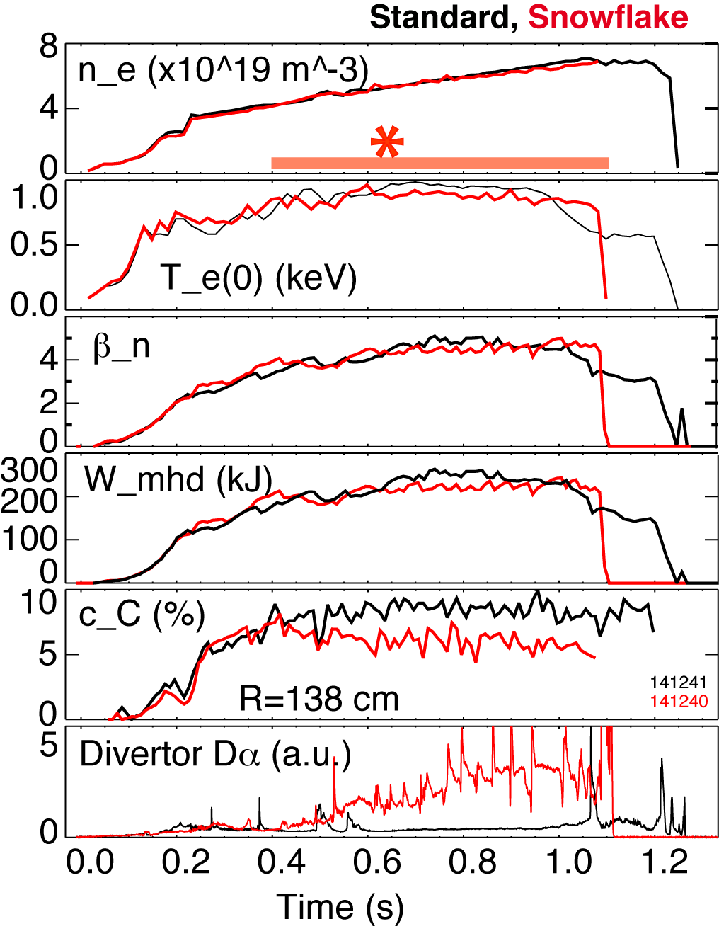
  Significant core impurity reduction and good H-mode confinement properties with snowflake divertor
0.8 MA, 4 MW H-mode
κ=2.1, δ=0.8
Core T_{e} ~ 0.8-1 keV, T_{i} ~ 1 keV
β_{N} ~ 4-5
Plasma stored energy ~ 250 kJ
H98(y,2) ~ 1 (from TRANSP)
Core carbon reduction due to
  Medium-size Type I ELMs
  Edge source reduction

Slide 13
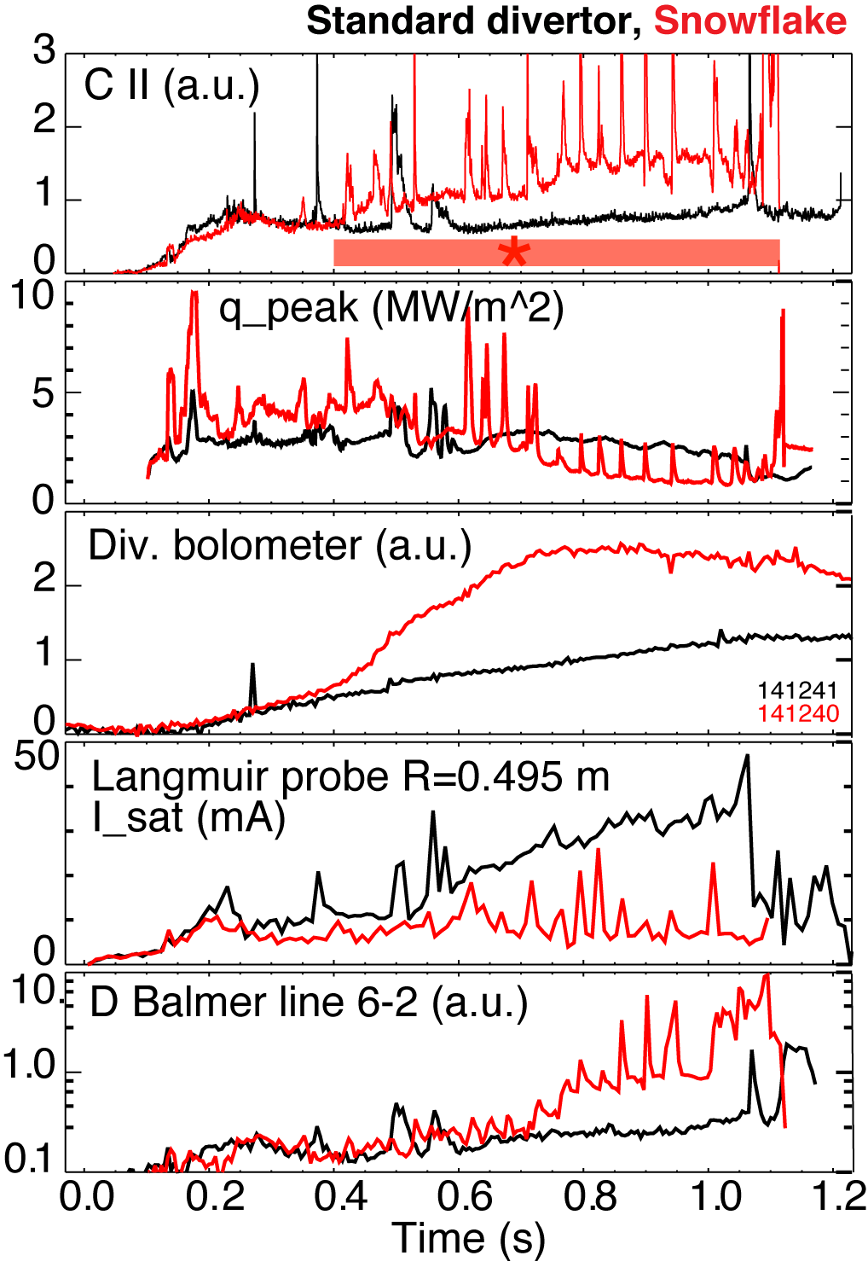
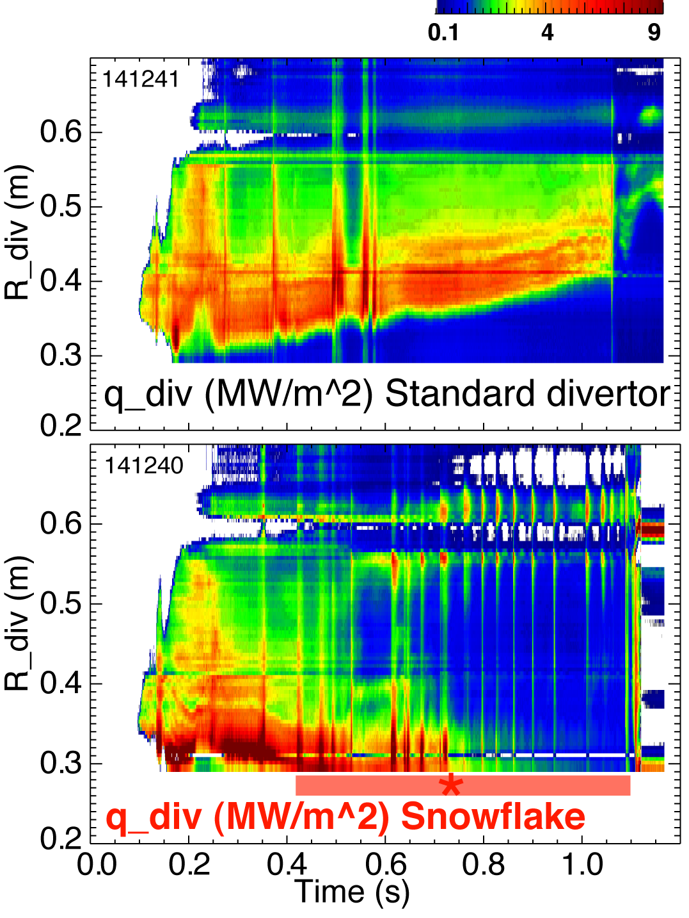
Strong signs of partial strike point detachment are observed in snowflake divertor
Heat and ion fluxes in the outer SP region decreased
Divertor recombination rate and radiated power are increased

Slide 14
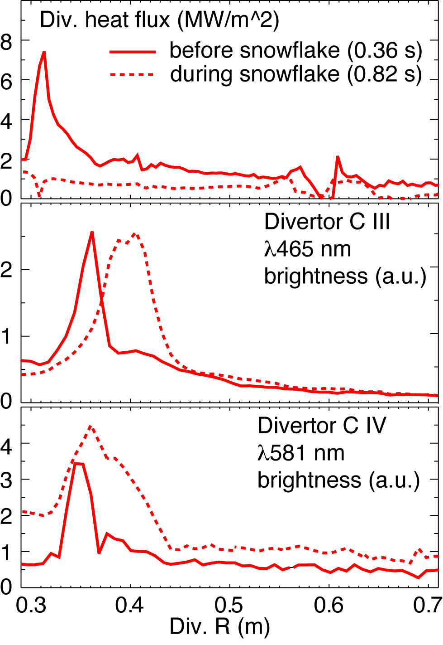
Divertor profiles show low heat flux, broadened C III and
C IV radiation zones in the snowflake divertor phase
Heat flux profiles reduced to nearly flat low levels, characteristic of radiative heating
C III and C IV emission profiles broaden
High-n Balmer line spectroscopy and CRETIN code modeling confirm outer SP detachment with T_{e} ≤ 1.5 eV, n_{e} ≤ 5 x 10²⁰ m⁻³
  Also suggests a reduction of carbon physical and chemical sputtering rates

Slide 15
Outline: Experimental studies of snowflake divertor in NSTX
Tokamak divertor challenge
Snowflake divertor configuration
Snowflake divertor in NSTX
  Magnetic control
  Core and divertor plasma properties
  Comparison with standard divertor and radiative divertor
  2D transport model
  Conclusions

Slide 16
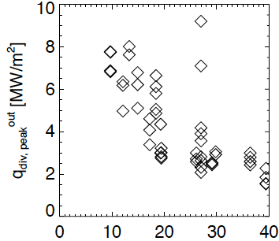
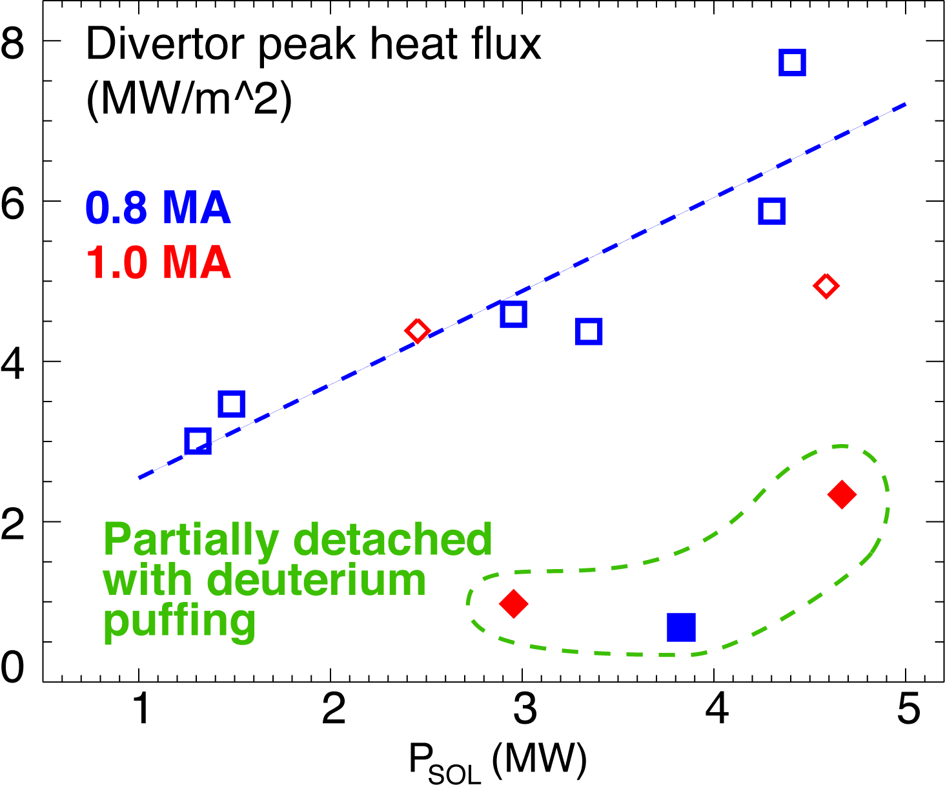
Snowflake divertor heat flux consistent with NSTX divertor heat flux scalings
0.8 MA
*
*
*
flux expansion
Snowflake divertor (*): P_{SOL}~3-4 MW, f_{exp}~40-80, q_{peak}~0.5-1.5 MW/m²
T. K. Gray et. al, EX/D P3-13, IAEA FEC 2010
V. A. Soukhanovskii et. al, PoP 16, 022501 (2009)

Slide 17
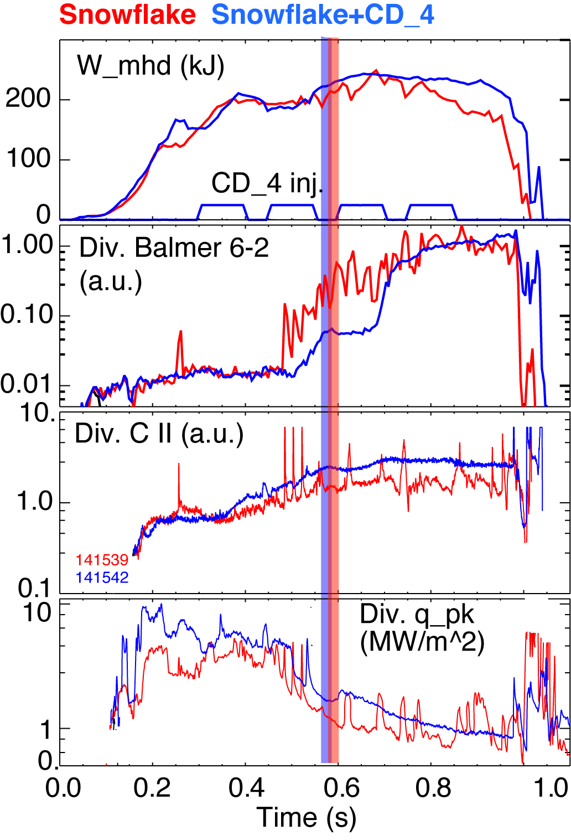
Snowflake divertor with CD₄ seeding leads to increased divertor carbon radiation
I_{p}=0.9 MA, P_{NBI}=4 MW, P_{SOL}=3 MW
Snowflake divertor (from 0.6 ms)
  Peak divertor heat flux reduced from 4-6 MW/m² to 1 MW/m²
Snowflake divertor (from 0.6 ms)
+ CD₄
  Peak divertor heat flux reduced from 4-6 MW/m² to 1-2 MW/m²
  Divertor radiation increased further

Slide 18
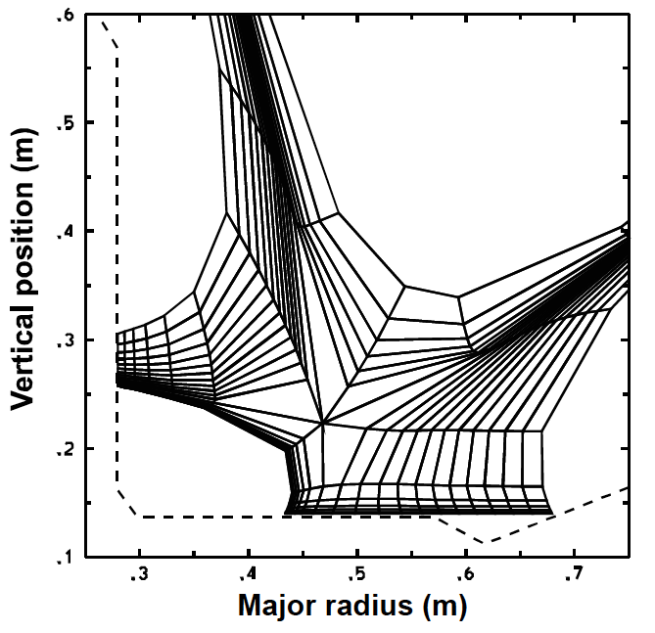
Outline: Experimental studies of snowflake divertor in NSTX
Tokamak divertor challenge
Snowflake divertor configuration
Snowflake divertor in NSTX
  Magnetic control
  Core and divertor plasma properties
  Comparison with standard divertor
  and radiative divertor
  2D transport model
  Conclusions

Slide 19
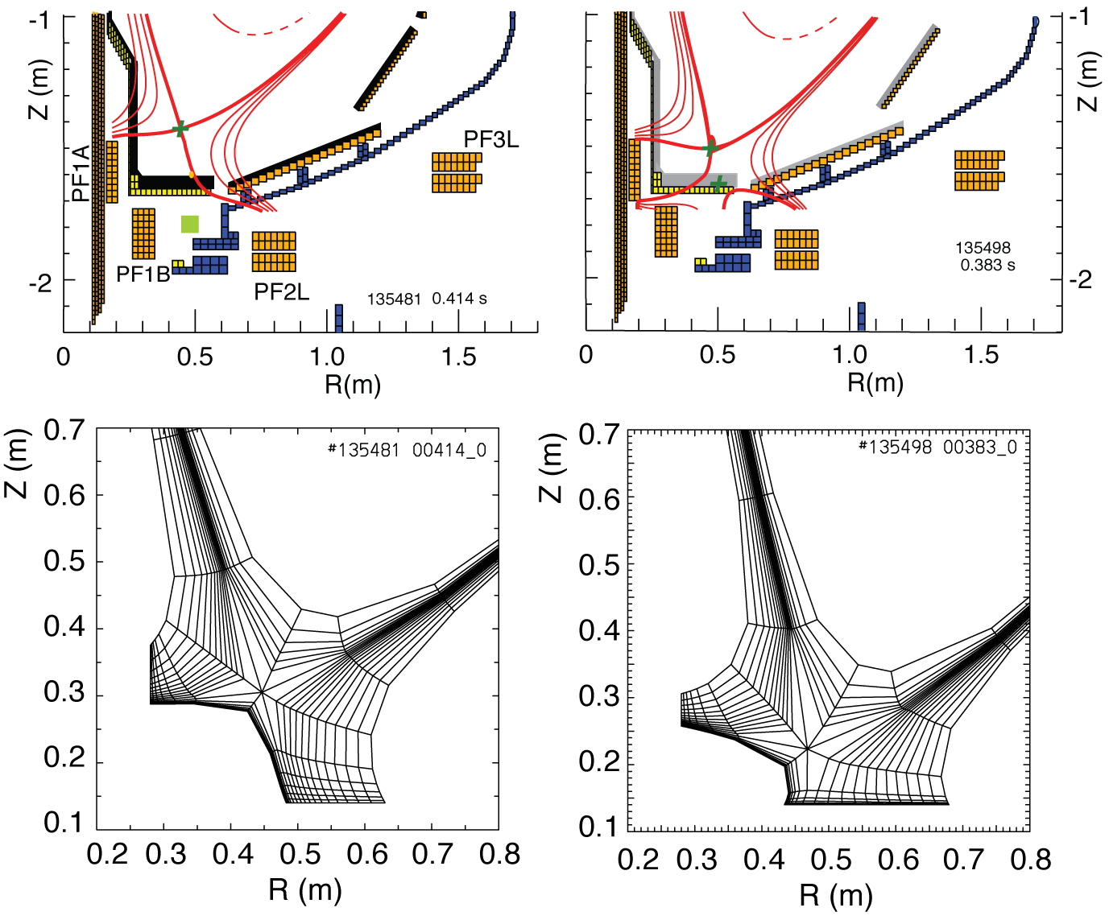
2D multi-fluid edge transport code UEDGE is used to study snowflake divertor properties
Fluid (Braginskii) model for ions and electrons
Fluid for neutrals
Classical parallel transport, anomalous radial transport
Core interface:
  T_{e} = 120 eV
  T_{i} = 120 eV
  n_{e} = 4.5 x 10¹⁹
D = 0.25 m²/s
χ_{e,i} = 0.5 m²/s
R_{recy} = 0.95
Carbon 3 %
Standard Snowflake

Slide 20
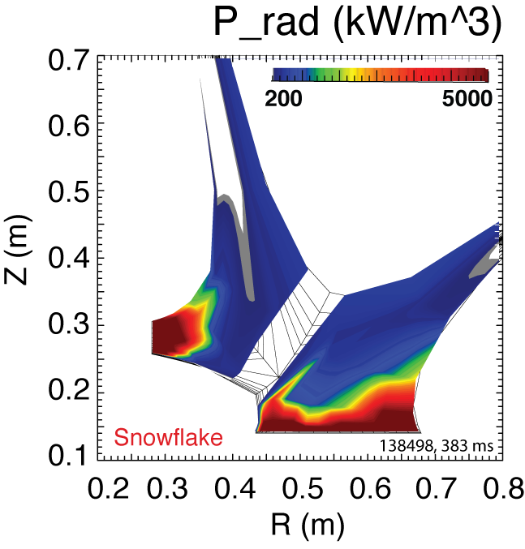
Radiated power is broadly distributed in the outer leg of snowflake divertor
UEDGE model

Slide 21
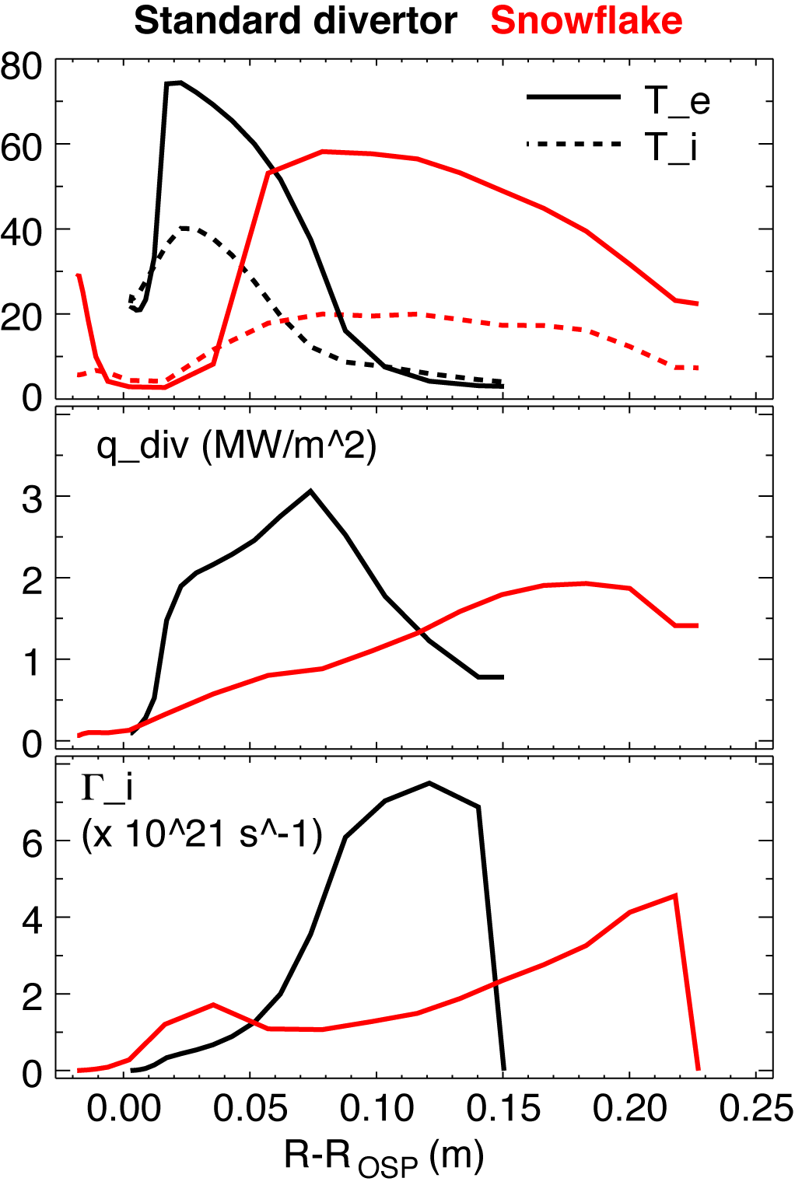
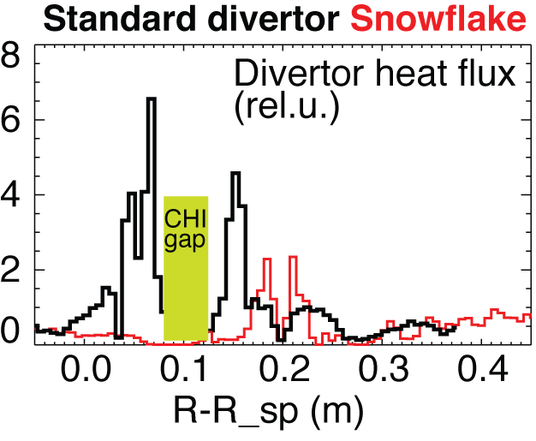
UEDGE model shows a trend toward detachment in snowflake divertor outer leg (cf. standard divertor)
In the snowflake divertor outer strike point region:
T_{e} and T_{i} reduced
Divertor peak heat flux reduced
Particle flux low
UEDGE model
Experiment

Slide 22
NSTX studies suggest the snowflake divertor configuration may be a viable divertor solution for present and future tokamaks
Steady-state snowflake (up to 600 ms,
many τ_{E}’s)
Good H-mode confinement
Reduced core carbon concentration
Significant reduction in peak divertor heat flux
Potential to combine with radiative divertor for increased divertor radiation
This talk focused on divertor results. Planned future efforts with the snowflake divertor:
  Improved magnetic control
  Pedestal peeling-balooning stability
  ELM heat and particle deposition profiles
  Divertor impurity source distribution
  Divertor and upstream turbulence (blobs)

Slide 23

Session PP9: Poster Session VI, 10 November, Wednesday PM - Snowflake divertor presentations
PP9.00149 : D. D. Ryutov et. al, General properties of the magnetic field in a snowflake divertor
PP9.00152 : M. V. Umansky et. al, Ion orbit loss effects on radial electric field in tokamak edge for standard and snowflake divertor configurations
  PP9.00136 : F. Piras et. al, H-mode Snowflake Divertor Plasmas on TCV

Slide 24
Backup slides

Slide 25
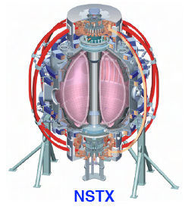
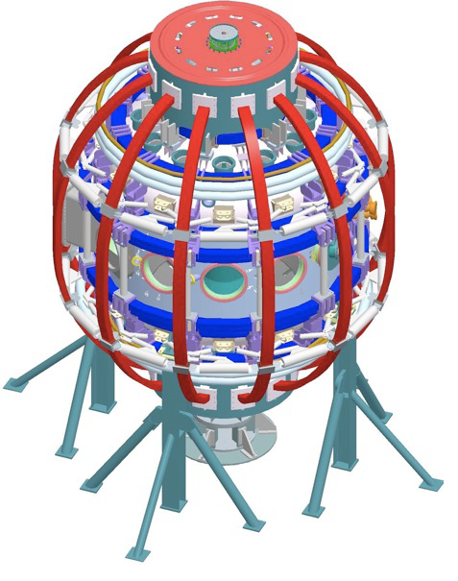
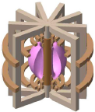
Divertor heat flux mitigation is key for present and future fusion plasma devices
ST / NSTX goals:
  Study high beta plasmas at reduced collisionality
  Access full non-inductive start-up, ramp-up, sustainment
  Prototype solutions for mitigating high heat & particle flux
In an ST, modest q|| can yield high divertor q_{pk}
  in NSTX, q||= 50-100 MW/m² and q_{pk}=6-15 MW/m²
  Large radiated power and momentum losses are needed to reduce q||
In NSTX, partially detached divertor regime is accessible only
  in highly-shaped plasma configuration with high flux expansion divertor (high plasma plugging efficiency, reduced q||)
  modest divertor D₂ injection still needed
NSTX
NSTX-U
ST-based Plasma Material Interface (PMI) Science Facility
ST-based Fusion Nuclear Science (FNS) Facility

Slide 26
Heat flux mitigation is more challenging in compact divertor of spherical torus
NSTX
  I_{p} = 0.7-1.4 MA, t_{pulse} < 1.5 s, P_{in} ≤ 7.4 MW (NBI)
  ATJ and CFC graphite PFCs
  P / R ~ 10
  q_{pk} ≤ 15 MW/m²
  q|| ≤ 200 MW/m²
Quantity | NSTX | DIII-D
Aspect ratio | 1.4-1.5 | 2.7
In-out plasma boundary area ratio | 1:3 | 2:3
X-point to target parallel length L_{x} (m) | 5-10 | 10-20
Poloidal magnetic flux expansion f_{exp} at outer SP | 5-30 | 3-15
Magnetic field angle at outer SP (deg.) | 1-10 | 1-2

Slide 27
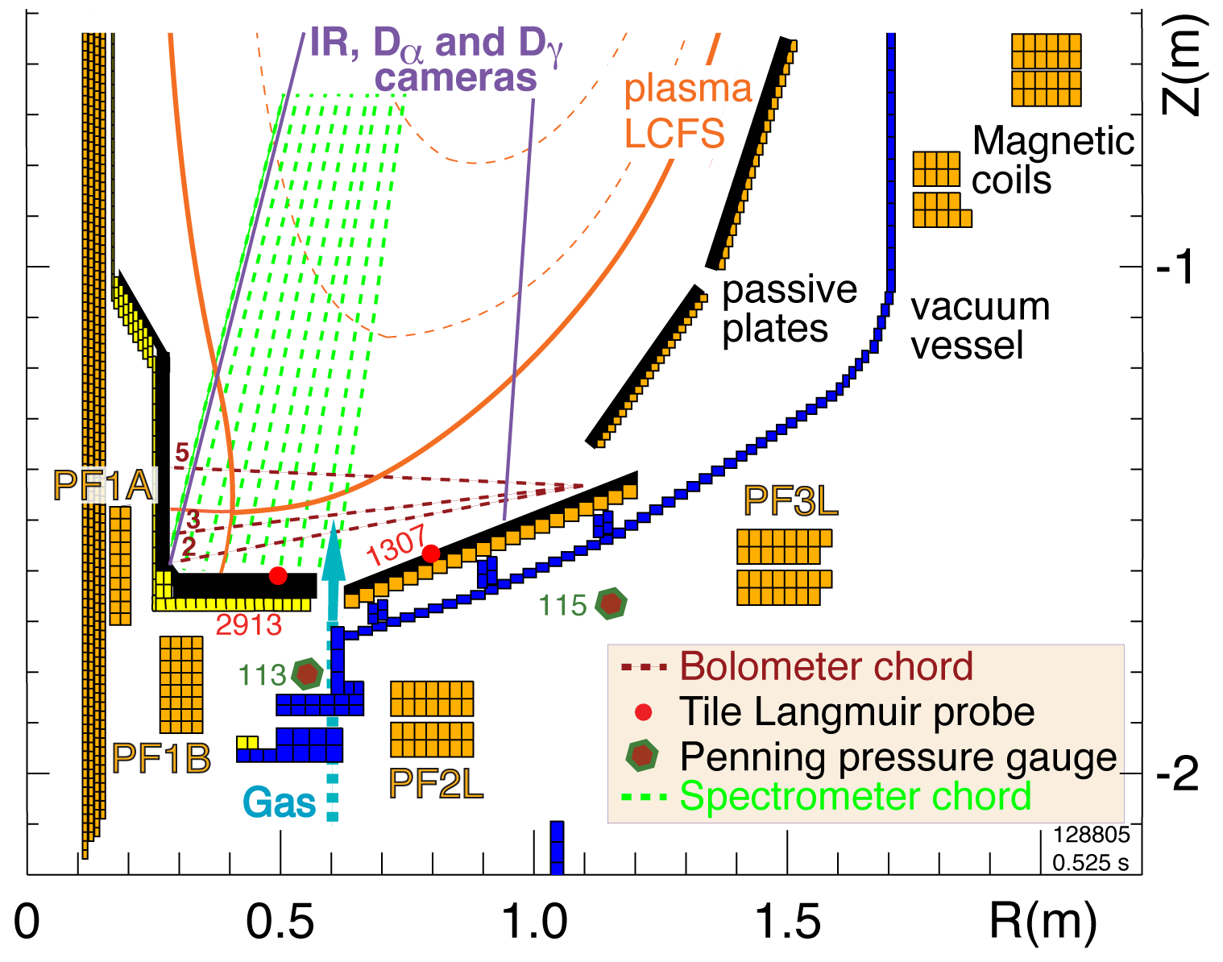
Open divertor geometry, three existing divertor coils and a good set of diagnostics enable divertor geometry studies in NSTX
I_{p} = 0.7-1.4 MA
P_{in} ≤ 7.4 MW (NBI)
ATJ and CFC graphite PFCs
Lithium coatings from lithium evaporators
Three lower divertor coils with currents 1-5, 1-25 kA-turns
Divertor gas injectors (D₂, CD₄)
Extensive diagnostic set

Slide 28
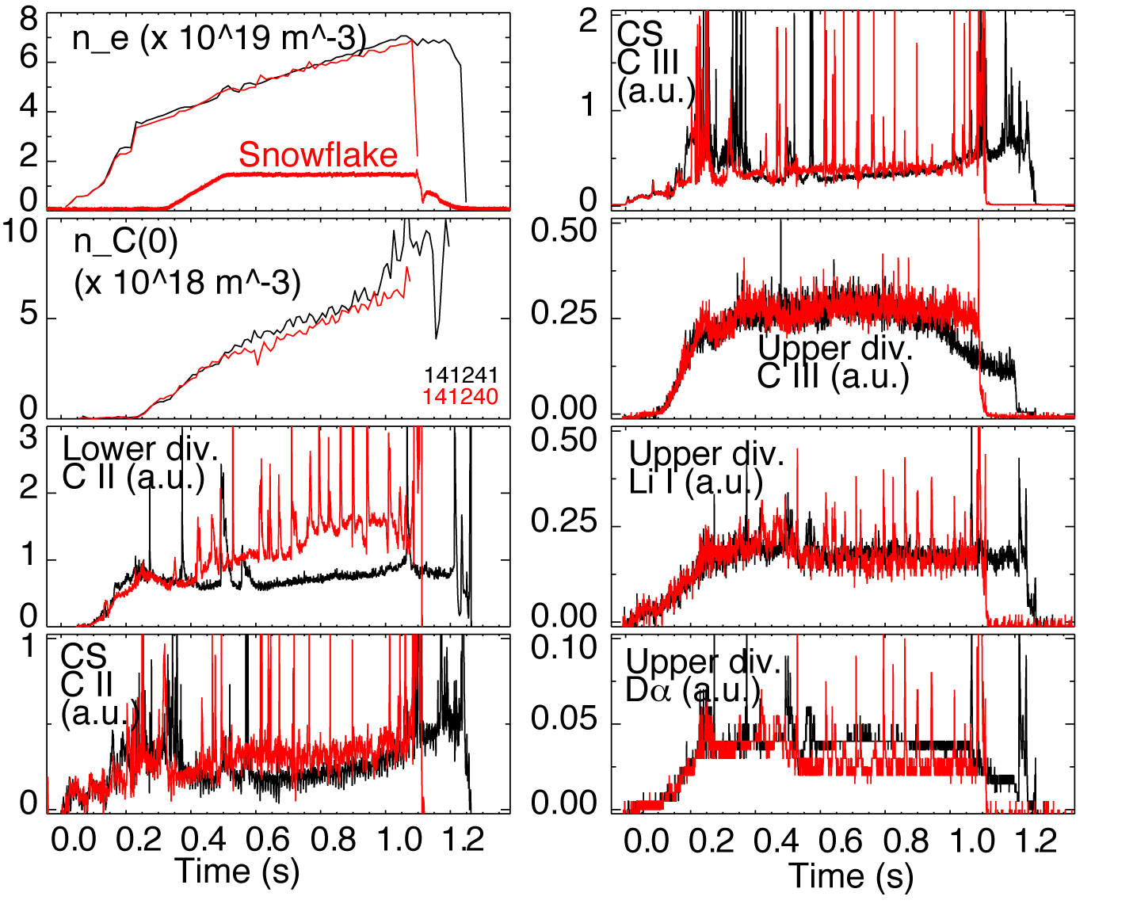
Upper divertor is unaffected by lower divertor snowflake configuration

Slide 29
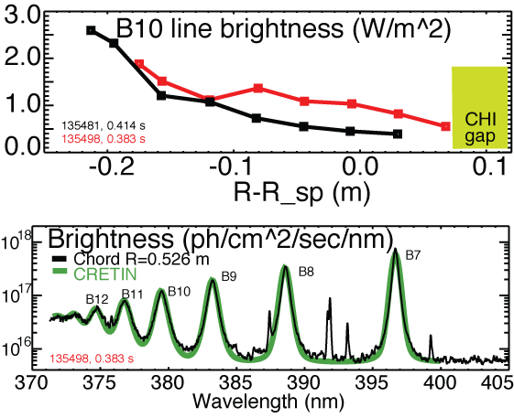
High-n Balmer line emission measurements suggest high divertor recombination rate, low T_{e} and high n_{e}
Balmer series spectra modeled with CRETIN; Spectra sensitive to
  Line intensity <-> Recombination rate
  T_{e} <-> Boltzman population distribution
  n_{e} <-> Line broadening due to linear Stark effect from ion and electron microfield
T_{e}=0.8-1.2 eV, n_{e}=2-7 x 10²⁰ m⁻³ inferred from modeling

Slide 30
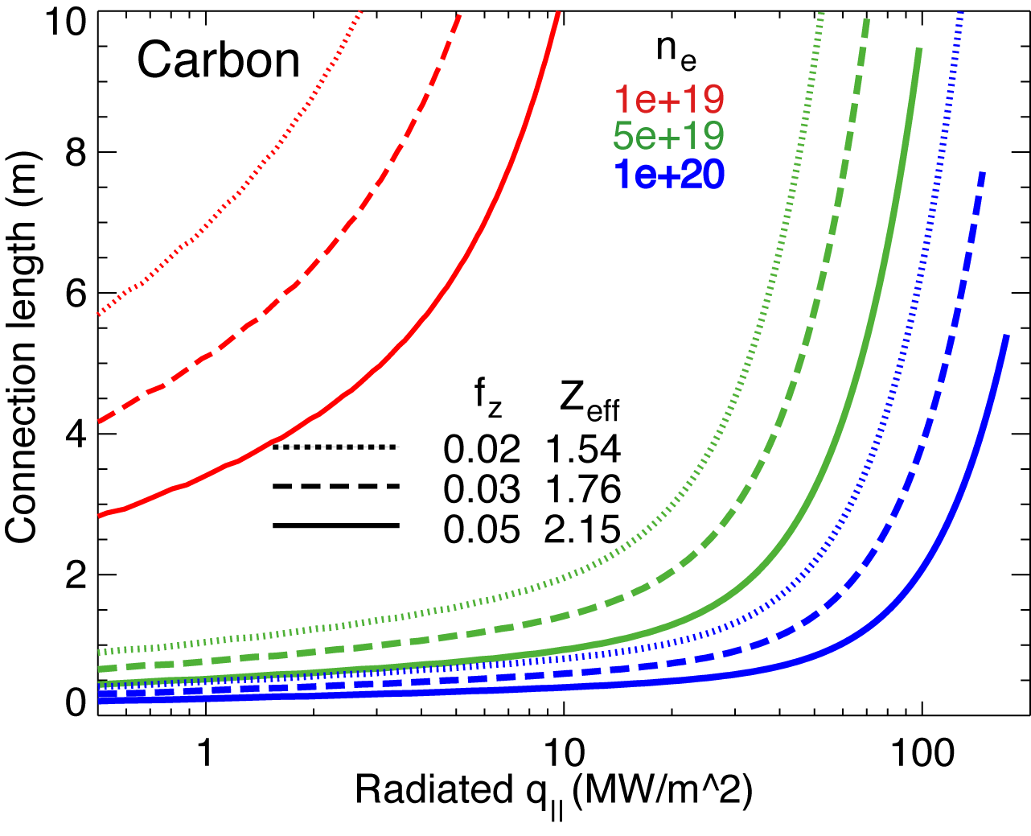
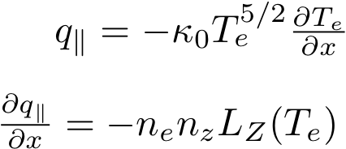
1D estimates indicate power and momentum losses are increased in snowflake divertor
1D divertor detachment model by Post
  Electron conduction with non-coronal carbon radiation
  Max q|| that can be radiated as function of connection length for range of f_{z} and n_{e}
Three-body electron-ion recombination rate depends on divertor ion residence time
  Ion recombination time: τ_{ion}~ 1−10 ms at T_{e} =1.3 eV
  Ion residence time: τ_{ion} ≤ 3-6 ms in standard divertor, x 2 in snowflake

