Slide 1
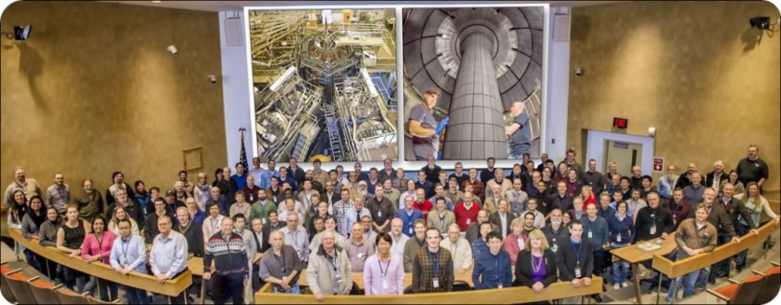
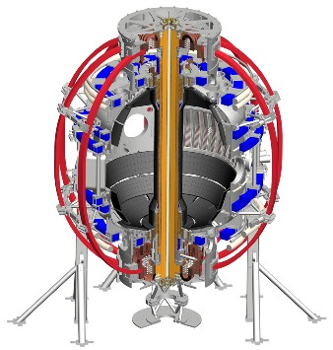

Results of using the NSTX-U plasma control system for scenario development
58th APS-DPP , Results of using the NSTX-U Plasma Control System for scenario development, M.D. Boyer, 11/01/16 1
M.D. Boyer¹, D.J. Battaglia¹, D.A. Gates¹, S. Gerhardt¹,
J. Menard¹, D. Mueller¹, C.E. Myers¹,
J. Ferron², S. Sabbagh³, F. Scotti⁴
¹PPPL, ²General Atomics, ³Columbia University, ⁴LLNL
58th Annual Meeting of the APS Division of Plasma Physics Oct 31 – Nov 4, 2016, San Jose, California

Slide 2
Advanced control will be required for achieving many of the research goals of NSTX-U
High-beta operation and non- inductive scenarios
  Maximizing elongation
  Shaping and profile control
Heat flux handling
  X-point, strike point control
  Snowflake control
Disruption detection/mitigation
  Real-time plasma monitoring
  Event-handling
This talk will cover:
Vertical control
Shape control
Plasma shutdown handler
Near-term plans

Slide 3
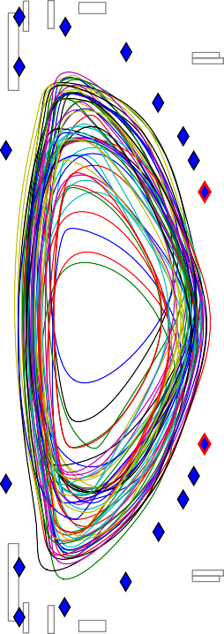
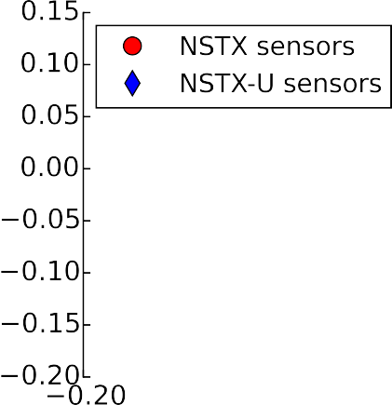
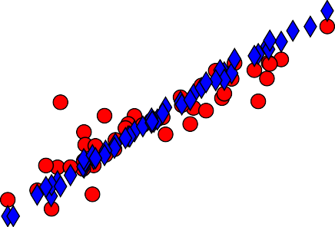





Increased aspect ratio of NSTX-U makes vertical control more challenging
Added sensors and noise rejection to improve estimation of vertical position/velocity
Sensor weights determined by least squares fit to IpZp
of free boundary equilibria
Filtering removes noise, power supply ripple, and spurious signal due to MHD events
Mueller
NP10.00003

Slide 4
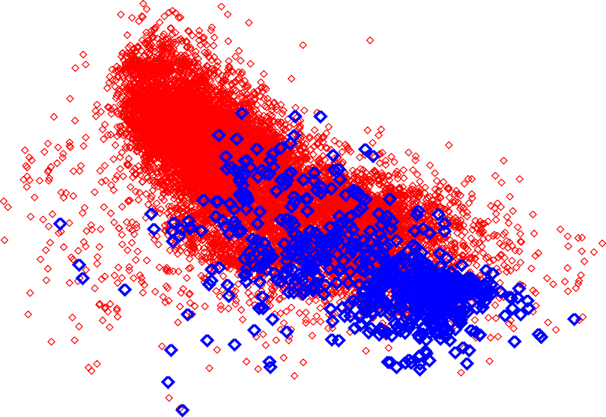
Scenarios similar to NSTX were achieved at higher aspect ratio using new vertical position/velocity estimator
NSTX-U (10 run weeks) NSTX (10 years)

Slide 5
Scenarios similar to NSTX were achieved at higher aspect ratio using new vertical position/velocity estimator
NSTX-U (10 run weeks) NSTX (10 years)
Vertical control tuned at very high l_{i}

Slide 6
Scenarios similar to NSTX were achieved at higher aspect ratio using new vertical position/velocity estimator
NSTX-U (10 run weeks) NSTX (10 years)
Vertical control tuned at very high l_{i}
Settled into an L-mode scenario used for many commissioning activities
L-mode flattop

Slide 7
Scenarios similar to NSTX were achieved at higher aspect ratio using new vertical position/velocity estimator
NSTX-U (10 run weeks) NSTX (10 years)
H-mode flattop
Vertical control tuned
at very high l_{i}
Settled into an L-mode scenario used for many commissioning activities
H-mode scenarios enabled access to lower l_{i}, higher kappa
L-mode flattop

Slide 8
Scenarios similar to NSTX were achieved at higher aspect ratio using new vertical position/velocity estimator
Vertical stability limit
not reached in the H-modes
➔➔room to grow.
NSTX-U (10 run weeks) NSTX (10 years)
H-mode flattop
Vertical control tuned at very high l_{i}
Settled into an L-mode scenario used for many commissioning activities
H-mode scenarios enabled access to lower l_{i}, higher kappa
L-mode flattop

Slide 9

Scenarios similar to NSTX were achieved at higher aspect ratio using new vertical position/velocity estimator
Vertical stability limit
not reached in the H-modes
➔➔room to grow.
NSTX-U (10 run weeks) NSTX (10 years)
Future goal
H-mode flattop
Vertical control tuned at very high l_{i}
Settled into an L-mode scenario used for many commissioning activities
H-mode scenarios enabled access to lower l_{i}, higher kappa
L-mode flattop

Slide 10
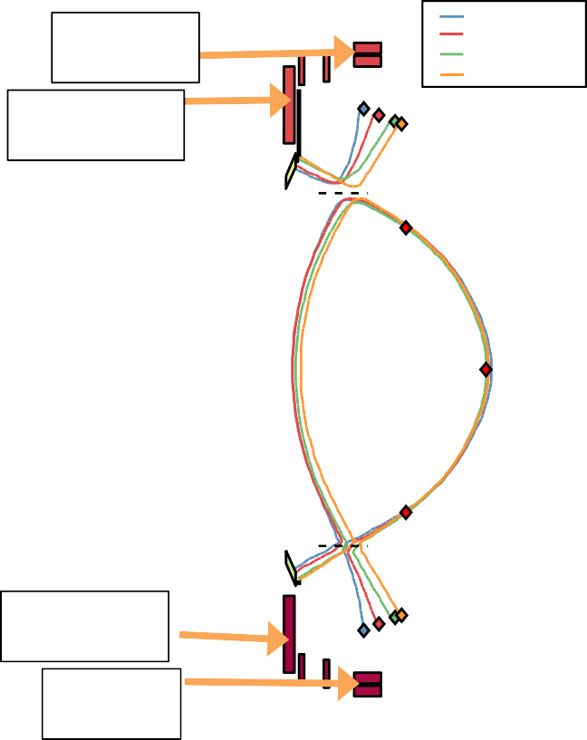
rtEFIT/ISOFLUX updated to enable precise, reproducible control of shape, x-points, drsep, and strikepoints
PF2U PF1AU
t=0.399s t=0.498s t=0.697s t=0.799s
Real-time EFIT upgraded to more closely match offline magnetics-only EFIT:
  Enable more precise x-point, snowflake control
  65x65 grid size
  Vessel current fitting
  Enabled by use of multiple cores to meet calculation time requirements
▪▪ Only single core used previously
X-point and strikepoint control with PF1A and PF2
– Used multi-input-multi-output control structure to account for actuator coupling
▪▪ Improves transient response
PF1AL
PF2L
10

Slide 11
rtEFIT/ISOFLUX updated to enable precise, reproducible control of shape, x-points, drsep, and strikepoints
PF2U PF1AU
t=0.399s t=0.498s t=0.697s t=0.799s
Good tracking of step requests in strikepoint radial location
– Fast response, little overshoot, no oscillations
203879
1.1
1
0.9
0.8
Outer strikepoint R [m]
Lower Strike point
Upper Strike point
Target
0.7
PF1AL
PF2L
0.3
0.4
0.5 0.6
Time [s]
0.7
0.8
0.9

Slide 12
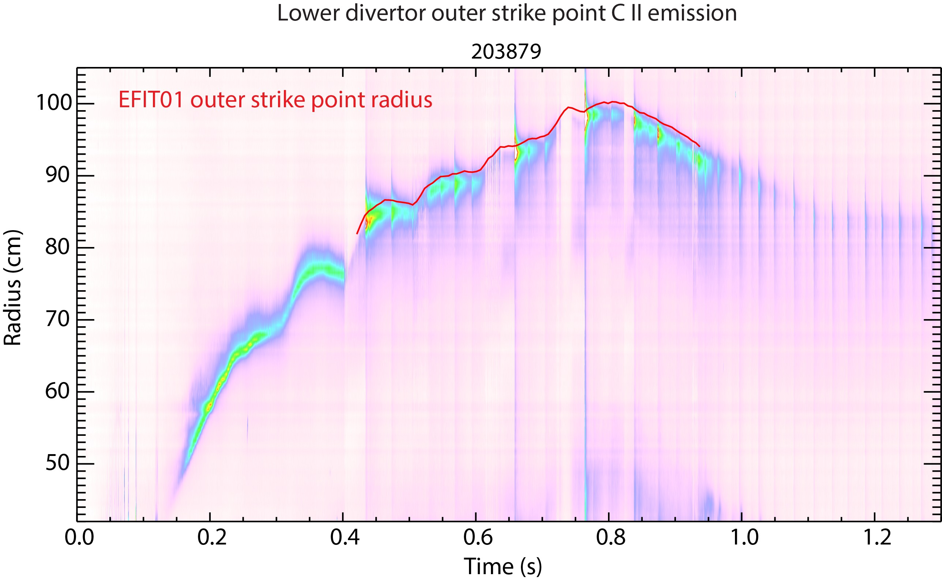
rtEFIT/ISOFLUX updated to enable precise, reproducible control of shape, x-points, drsep, and strikepoints
PF2U PF1AU
t=0.399s t=0.498s t=0.697s t=0.799s
Strikepoint tracking results confirmed by peak of CII emission
PF1AL
PF2L
[F. Scotti]

Slide 13
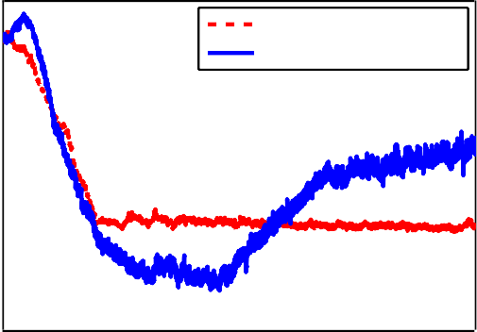
A method for inner gap control
(a challenge for ST’s) has also been tested
No way to independently control the inner gap
  No shaping coils on inboard side, available coils already assigned…
Approach:
  Automatically adjust other shaping parameters based on operator provided weight matrix to achieve desired inner gap
Upper outer gap R target [m]
1.035 0.72
1.2
1.2
204737 (control off)
204742 (control on)
Upper outer gap R target
 | X-point R target
 |  | 204737 (control off) 204742 (control on)
0.08
Inner gap
X−point R target [m]
0.7
1.03
0.06
0.68
Inner gap [m]
1.025
0.66
0.04
1.02
0.64
204737 (control off)
204742 (control on)
Target
1.015
0.02
0.62
1.01
0.6
0
0.4 0.6 0.8 1
Time [s]
0.4
0.6 0.8
Time [s]
1
0.4
0.6 0.8
Time [s]
1
1.2

Slide 14
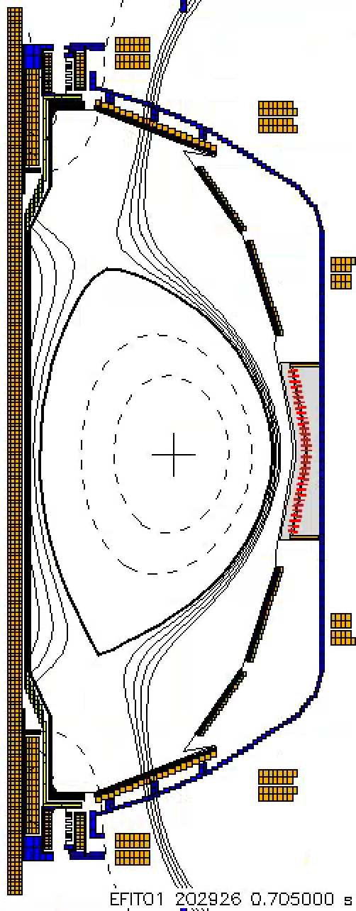




State-machine-based automated ramp-down now used routinely to limit forces and avoid disruptions
Plasma control system detects loss of control
  OH near max current
  Vertical oscillations exceed threshold
  ABS (I_{p} - I_{p request} ) too
t=0.705
I [kA]
P
I_{P} Request
(including asynchronous transition to rampdown)
Z_{P}(dZ_{P}/dt) threshold
large
– Locked mode detected
Z_{P}(dZ_{P}/dt) [m²/s]
Feedback control
switches to new “states” that attempt to gently end the discharge
“State”
Nor | al
m
Gerhardt NP10.00005
Time [s]

Slide 15
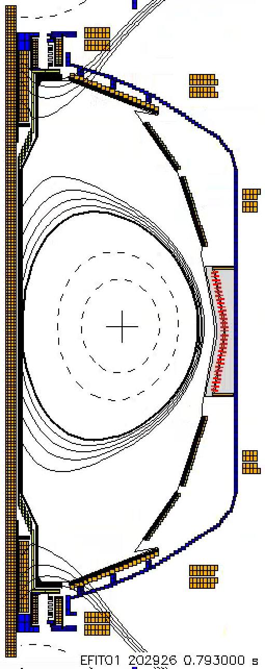

State-machine-based automated ramp-down now used routinely to limit forces and avoid disruptions
Plasma control system detects loss of control
  OH near max current
  Vertical oscillations exceed threshold
  ABS (I_{p} - I_{p request} ) too
t=0.705 t=0.793
I [kA]
P
I_{P} Request
(including asynchronous transition to rampdown)
Z_{P}(dZ_{P}/dt) threshold
large
– Locked mode detected
Z_{P}(dZ_{P}/dt) [m²/s]
Feedback control
switches to new “states” that attempt
“State”
 | Fast I_{P} R | ampdo | wn
Nor | al
to gently end the discharge
Gerhardt NP10.00005
m
Time [s]
15

Slide 16
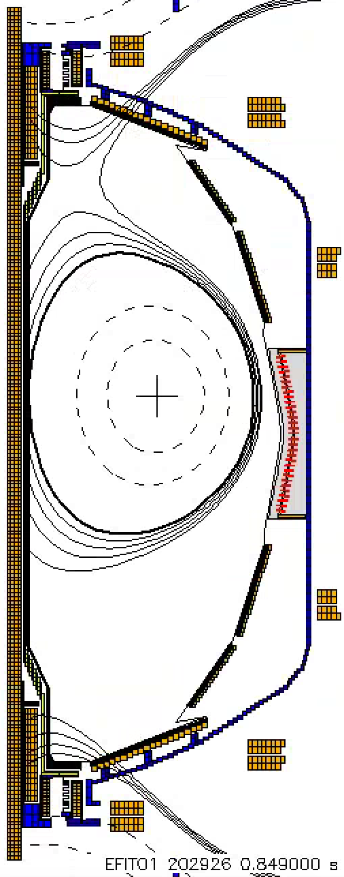
State-machine-based automated ramp-down now used routinely to limit forces and avoid disruptions
Plasma control system detects loss of control
  OH near max current
  Vertical oscillations exceed threshold
  ABS (I_{p} - I_{p request} ) too
t=0.705 t=0.793
I [kA]
P
I_{P} Request
(including asynchronous transition to rampdown)
Z_{P}(dZ_{P}/dt) threshold
large
– Locked mode detected
t=0.849
Z_{P}(dZ_{P}/dt) [m²/s]
Feedback control switches to new
“State”
 | Fast I_{P} R | ampdo | wn
Nor | al
“states” that attempt to gently end the discharge
Gerhardt NP10.00005
m
Time [s]

Slide 17
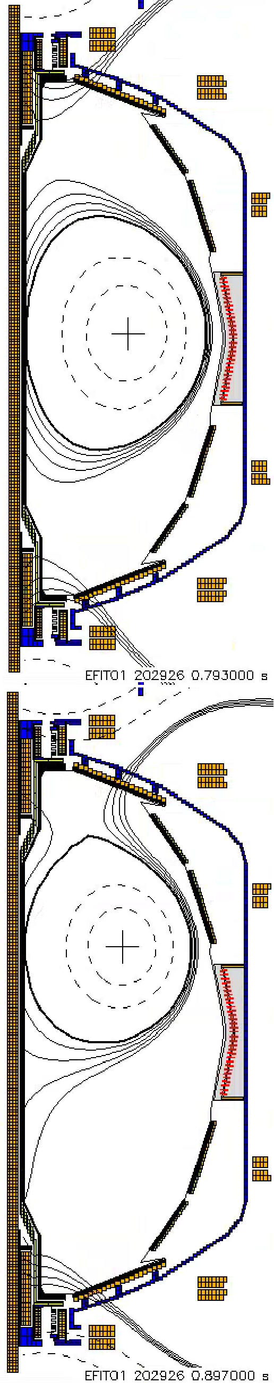

State-machine-based automated ramp-down now used routinely to limit forces and avoid disruptions
Plasma control system detects loss of control
  OH near max current
  Vertical oscillations exceed threshold
  ABS (I_{p} - I_{p request} ) too
t=0.705 t=0.793
I [kA]
P
I_{P} Request
(including asynchronous transition to rampdown)
Z_{P}(dZ_{P}/dt) threshold
large
– Locked mode detected
t=0.849
t=0.897
Z_{P}(dZ_{P}/dt) [m²/s]
Feedback control switches to new
“State” | Ins | ufficien | t I_{P}
 | Fast I_{P} R | ampdo | wn
Nor | al
“states” that attempt to gently end the discharge
Gerhardt NP10.00005
m
Time [s]

Slide 18
New plasma control capabilities enabled rapid development of high-performance plasmas on NSTX-U
Early scenario development enabled by improvements in vertical control, and shape control
  Commissioned tools to facilitate experiments (strikepoint/inner gap control)
New event handler for reducing stress on machine and facilitating disruption detection/avoidance/mitigation studies
Poised to support future scientific goals with new capabilities:
  Snowflake divertor control for studying heat flux management
▪▪ Algorithm tested in hardware-in-the-loop simulations
– Stored energy and l_{i} control, rotation and current profile control for high-
beta and non-inductive scenario development
▪▪ Approaches tested in TRANSP simulations, PCS algorithms being implemented
18

