Slide 1

Initial transport validation studies using NSTX-U L-mode plasmas
W. Guttenfelder¹, S.M. Kaye¹, M. Kriete², D. Battaglia¹, R.E. Bell¹,
M.D. Boyer¹, N. Crocker³, A. Diallo¹, N. Ferraro¹, S.P. Gerhardt¹, B.P. LeBlanc¹,
D. Liu¹, G.R. McKee², J.E. Menard¹, D. Mueller¹, C. Myer¹, M. Podesta¹,
R. Raman⁴, Y. Ren¹, S.A. Sabbagh⁵, D. Smith²
¹PPPL, ²U. Wisconsin-Madison, ³UCLA, ⁴U. Washington, ⁵Columbia
APS-DPP, San Jose CA
Nov. 1, 2016

Slide 2
Spherical tokamaks (STs) provide extended range of β, R/a and ρ* over which to validate theory and simulation
Previous NSTX L-mode analysis using local and non-local gyrokinetic codes predict different results from relatively large ρ*=ρ_{i}/a~1/120
  Local GYRO ion-scale (k⊥ρ_{s}<1) simulations predict wide variation of fluxes with radius compared to exp. (Ren, Nucl. Fusion 2013)
  Global GTS ion-scale simulations get close to predicting Q_{i,sim}≈Q_{i,exp} but Q_{e,sim} remains far too small (Wang, Phys. Plasmas 2015; Ren, IAEA FEC 2016, EX/P4-35)
  Limited fluctuation data available
GOAL: develop NSTX-U L-mode discharges for code benchmarking & validating finite-ρ*/non-local effects at low A=R/a using global gyrokinetic simulations (GTS, GENE, XGC, GYRO…)
  Ultimately want to do this for high-β H-modes but electromagnetic simulations are very challenging
  Start with low-β L-mode for electrostatic simulations

Slide 3
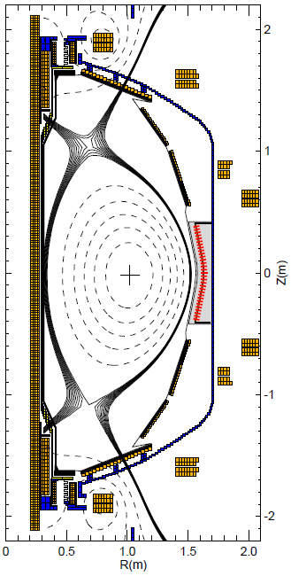
Using stationary, sawtoothing L-modes established during NSTX-U commissioning for validation study
EFIT reconstruction
Focus here is on I_{P}=0.8 MA, 4×10¹⁹ m⁻³, P_{NBI}=2.6 MW discharge
  Used HFS fueling to raise density and avoid L-H transition
EFIT reconstruction gives
Using time-average between 0.9-1.2 s for transport analysis and simulations

Slide 4
Kinetic profiles illustrate sawteeth, low carbon impurity, and strong local flow shear in region of interest
Sawtooth inversion radius R≈125 cm, ψ_{N}≈0.27 consistent with EFIT (no MSE measurements)
Rotation locked outside 140 cm (likely from 2/1 mode)
n_{e}
n_{D}
6×n_{C}

Slide 5
Kinetic profiles illustrate sawteeth, low carbon impurity, and strong local flow shear in region of interest
Sawtooth inversion radius R≈125 cm, ψ_{N}≈0.27 consistent with EFIT (no MSE measurements)
Rotation locked outside 140 cm (likely from 2/1 mode)
Very strong local flow shear in region of interest (R=125-140 cm, ψ_{N}=0.27-0.73, ρ=0.37-0.68)
n_{e}
n_{D}
6×n_{C}

Slide 6
Ion transport ~ neoclassical,
~0.5 MW uncertainty in heat fluxes from collisional coupling
S.M. Kaye, NP10.01 (Wed AM)

Slide 7
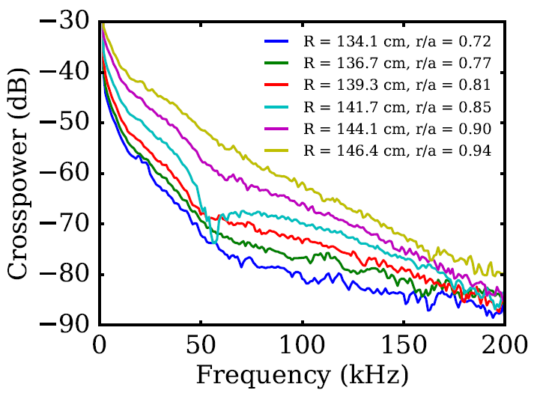
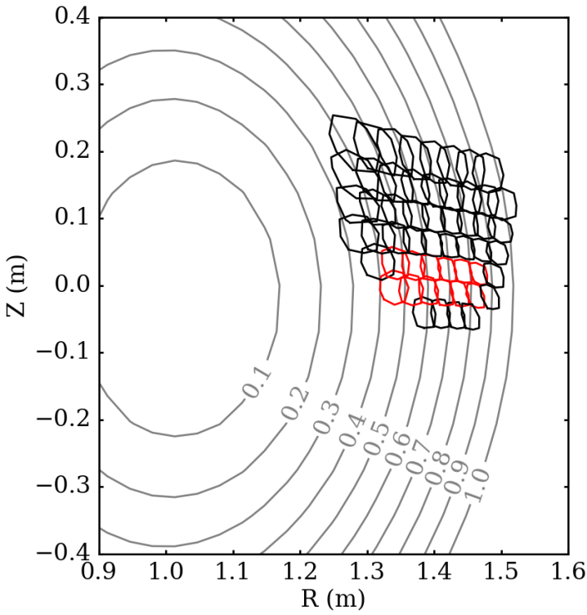
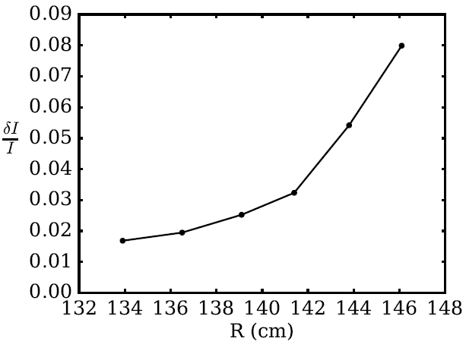
48 channel BES system shows broadband (f<200 kHz), large amplitude (2-8%) ion-scale density fluctuations
BES sightlines (UW-Madison)
BES δI/I
(1-200 kHZ)
D.M. Kriete, NP10.14
(Wed AM)

Slide 8
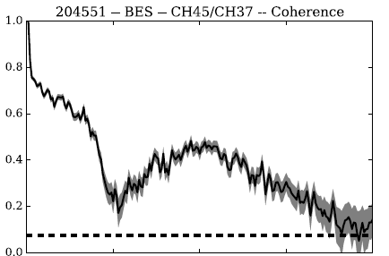
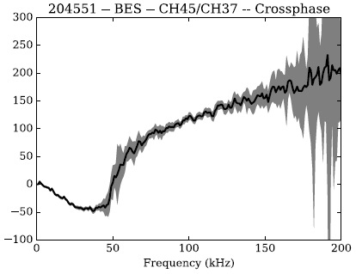
BES poloidal cross-phase shows dual-mode propagation
Ion mode found R=134-144 cm
Low frequency (f<50 kHz) electron mode found at all radii (R=134-146 cm)
  Outer most radii has strong electron mode only
Concern that electron mode could be due to shadowing from large amplitude edge fluctuations (see D.M Kriete poster NP10.14)
Coherence (R=139 cm)
noise
floor
Crossphase (R=139 cm)
i-direction
e-direction
frequency (kHz)

Slide 9
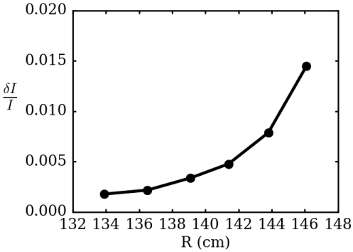
BES poloidal cross-phase shows dual-mode propagation
Ion mode found R=134-144 cm
Low frequency (f<50 kHz) electron mode found at all radii (R=134-146 cm)
  Outer most radii has strong electron mode only
Concern that electron mode could be due to shadowing from large amplitude edge fluctuations (see D.M Kriete poster NP10.14)
Fluctuation amplitude of only ion-directed modes (50-200 kHz) much smaller (0.1-1.5%)
  Analysis of UCLA 16 channel reflectometer ongoing
BES δI/I
(50-200 kHZ)

Slide 10
At ion scales (k_{θ}ρ_{s}<1), linear GYRO* simulations predict unstable ion temperature gradient (ITG) _
ITG modes propagates in ion direction
  Propagation direction consistent with BES ion mode (need to consider Doppler shift, although also in ion direction)
Linear growth rates, γ (c_{s}/a)
R (cm)
*GYRO (Candy, Waltz, 2003)
Notes:
Progression plots, gamma_ITG, gamma_MTM, gamma_E (no u’ reference)

Slide 11
At ion scales (k_{θ}ρ_{s}<1), linear GYRO* simulations predict unstable ion temperature gradient (ITG) and microtearing modes (MTM)
ITG modes propagates in ion direction
  Propagation direction consistent with BES ion mode (need to consider Doppler shift, although also in ion direction)
MTM propagates in electron direction
  Surprised to find MTM unstable ⇒ sufficient beta (4.1%) and large collisionality enhances MTM
Linear growth rates, γ (c_{s}/a)
R (cm)
*GYRO (Candy, Waltz, 2003)

Slide 12
At ion scales (k_{θ}ρ_{s}<1), linear GYRO* simulations predict unstable ion temperature gradient (ITG) and microtearing modes (MTM)
ITG modes propagates in ion direction
  Propagation direction consistent with BES ion mode (need to consider Doppler shift, although also in ion direction)
MTM propagates in electron direction
  Surprised to find MTM unstable ⇒ sufficient beta (4.1%) and large collisionality enhances MTM
Strong local E×B shearing rates (γ_{E}>γ_{ITG},γ_{MTM} at R=135 cm)
  BES amplitudes increasing where γ_{ITG} > γ_{E}
Linear growth rates, γ (c_{s}/a)
R (cm)
*GYRO (Candy, Waltz, 2003)

Slide 13
Strong variation in turbulence, stability and E×B shear over ≤30 ρ_{s} ⇒ motivates the need for global simulations
ITG modes propagates in ion direction
  Propagation direction consistent with BES ion mode (need to consider Doppler shift, although also in ion direction)
MTM propagates in electron direction
  Surprised to find MTM unstable ⇒ sufficient beta (4.1%) and large collisionality enhances MTM
Strong local E×B shearing rates (γ_{E}>γ_{ITG},γ_{MTM} at R=135 cm)
  BES amplitudes increasing where γ_{ITG} > γ_{E}
Linear growth rates, γ (c_{s}/a)
~30 ρ_{s}
*GYRO (Candy, Waltz, 2003)

Slide 14
Electron scale (k⊥ρ_{s}>>1) ETG also linearly unstable (γ_{ETG}>>γ_{E}) in region of strong E×B shear
ITG modes propagates in ion direction
  Propagation direction consistent with BES ion mode (need to consider Doppler shift, although also in ion direction)
MTM propagates in electron direction
  Surprised to find MTM unstable ⇒ sufficient beta (4.1%) and large collisionality enhances MTM
Strong local E×B shearing rates (γ_{E}>γ_{ITG},γ_{MTM} at R=135 cm)
  BES amplitudes increasing where γ_{ITG} > γ_{E}
Linear growth rates, γ (c_{s}/a)
~30 ρ_{s}
*GYRO (Candy, Waltz, 2003)

Slide 15
Nonlinear ETG simulations give significant transport around mid-radius (R=129-140 cm, ρ=0.47-0.67)
Q_{e,etg} large enough to account for Q_{e,exp} if Z_{eff}=Z_{eff,c}≈1.2
  Larger Z_{eff} (VB Z_{eff}≤2) would lower Q_{e,etg}
New high-k microwave scattering diagnostic will be ideal for probing region of ETG turbulence
May require multiscale simulations for validation
ρ ≈ 0.45 0.55 0.65 0.75
Notes:
Future new high-k scattering diagnostic will probe this
SOMETHING ABOUT MULTISCALE, HOWARD NF 2016, HOLLAND IAEA TH/6-1

Slide 16
Summary: L-modes established during NSTX-U commissioning being used for transport validation
Experiment
Electrons carry majority of heat flux, ion transport ~ neoclassical
BES measures strong, broadband (f≤200 kHz) ion-scale turbulence with bi-modal propagation (caveat of possible edge shadowing)
Simulation
ITG & MTM are unstable at ion scales (k_{θ}ρ_{s}<1), E×B shearing is strong with significant radial variation → motivates global GK benchmarking and validation
Significant electron-scale (k_{θ}ρ_{s}>1) ETG transport predicted at midradius where γ_{E}>(γ_{ITG},γ_{MTM}) → may also require multiscale simulations
Acknowledgements: This research used resources of the National Energy Research Scientific Computing Center, a DOE Office of Science User Facility supported by the Office of Science of the U.S. Department of Energy under Contract No. DE-AC02-05CH11231.

Slide 17
At ion scales (k_{θ}ρ_{s}<1), linear GYRO* simulations predict unstable spectra of ITG and microtearing modes (MTM)
Real frequencies, ω_{r} (c_{s}/a)
e-direction
MTM
ITG modes propagates in ion direction
  Propagation direction consistent with BES ion mode (need to consider Doppler shift, although also in ion direction)
MTM propagates in electron direction
  Surprised to find MTM unstable ⇒ sufficient beta (4.1%) and large collisionality enhances MTM
i-direction
ITG
Growth rates, γ (c_{s}/a)
*GYRO (Candy, Waltz, 2003)

Slide 18
NSTX-U L-modes established over range of density, plasma current, neutral beam power & tangency radii
Established stationary, stable L-modes during commissioning (spring 2016)
  ⟨n_{e}⟩=1-4×10¹⁹ m⁻³
  I_{p}=0.65-1.0 MA (B_{T}=0.65 T)
  P_{NBI}=1-3 MW
  2nd NBI sources (bigger R_{tan}) had noticeable effect on rotation, tearing stability, locked modes
Sustained shots up to 1.5 sec with 2.5-2.9 MW, β_{N}≤2 with different combination of beam sources
  Used HFS fueling to raise density and avoid L-H transition
  Tried up to 4.3 MW but H-mode or disruptions occur (β_{N}~2.5)
All shots sawtoothing (R_{inv}~125 cm, Δt~25-35 ms depending on NBI source and plasma density)

Slide 19
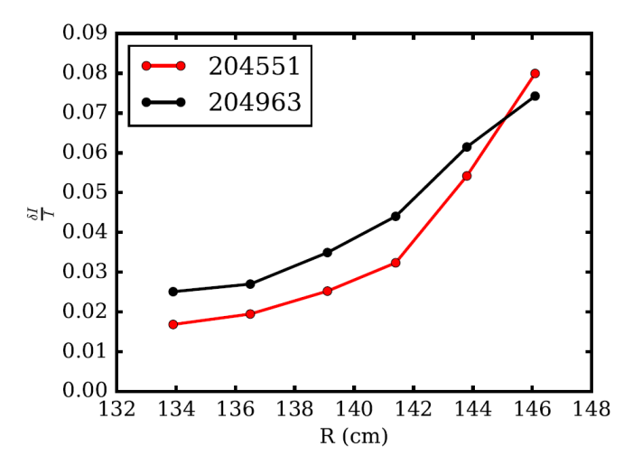
Have repeated analysis on lower I_{p}, n_{e}, P_{nbi} discharge 204963,
Qualitative similarity ion scale fluctuations and microstability
Larger low-k fluctuation amplitudes in 204963, cross-phases similar to 204551
  16 channel UCLA reflectometer data also available for this shot
γ_{ITG} larger due to reduced T_{i}/T_{e} & γ_{E} reduced (less beam torque)
γ_{MTM} weaker (lower β_{e})
γ_{ETG} weaker (reduced T_{i}/T_{e}, R/L_{Te})

Slide 20
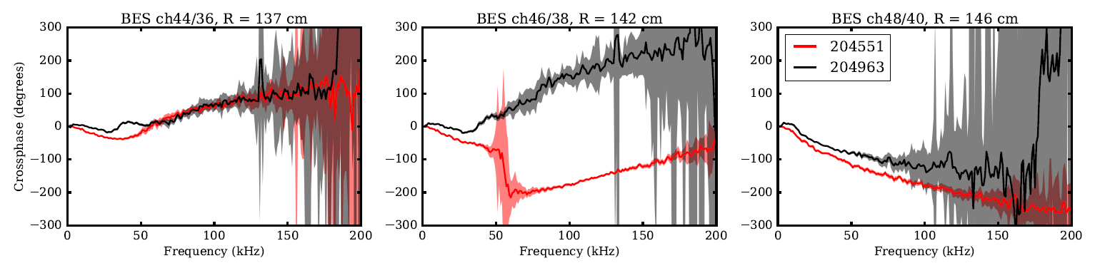
Evidence for dual-modes found in multiple discharges

Slide 21
Shot parameters
Shot | Time (s) | B_{T} (T) | I_{p} (MA) | P_{NBI} (MW) | n_{e} | W_{MHD} (kJ) | q₉₅ | β_{N} | β_{T} (%) | κ | l_{i}
204551 | 0.9-1.2 | 0.63 | 0.79 (0.8) | 2.6 (1A+1B) | 4.3 | 95 (105) | 4.8 (4.5) | 2.0 (2.1) | 4.1 (4.4) | 1.7 (1.8) | 1.3 (1.1)
204651 | 0.9-1.1 | 0.63 | 0.64 (0.65) | 1.0 (1C) | 3.1 | 42 (63) | 5.1 (5.2) | 1.1 (1.6) | 1.9 (2.8) | 1.7 (1.7) | 1.5 (1.2)
204963 | 0.9-1.1 | 0.63 | 0.64 (0.65) | 0.94 (1B) | 3.1 | 62 (80) | 5.5 (5.5) | 1.7 (2.1) | 2.8 (3.6) | 1.7 (1.7) | 1.3 (1.1)
EFIT01 (EFIT02)

