Slide 1
Electron Temperature Evolution During Local Helicity Injection on the Pegasus Toroidal Experiment
D.J. Schlossberg,
J.L. Barr, G.M. Bodner, M.W. Bongard, R.J. Fonck,
J.M. Perry, J.A. Reusch, and C. Rodriguez Sanchez
58th Annual Meeting of the APS Division of Plasma Physics
San Jose, CA
November 1, 2016

Slide 2
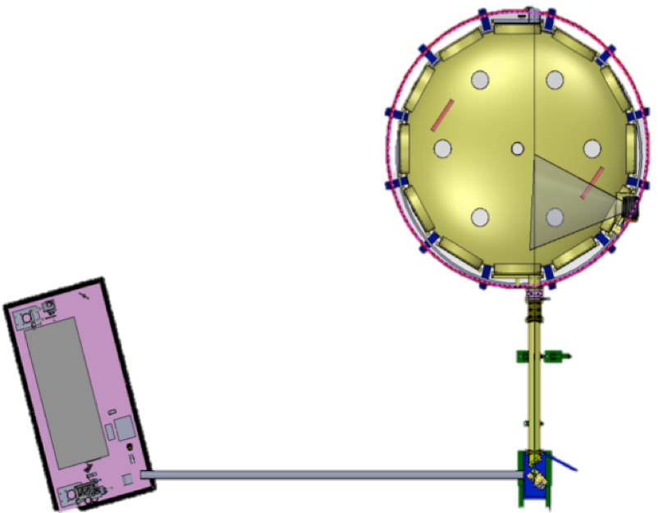
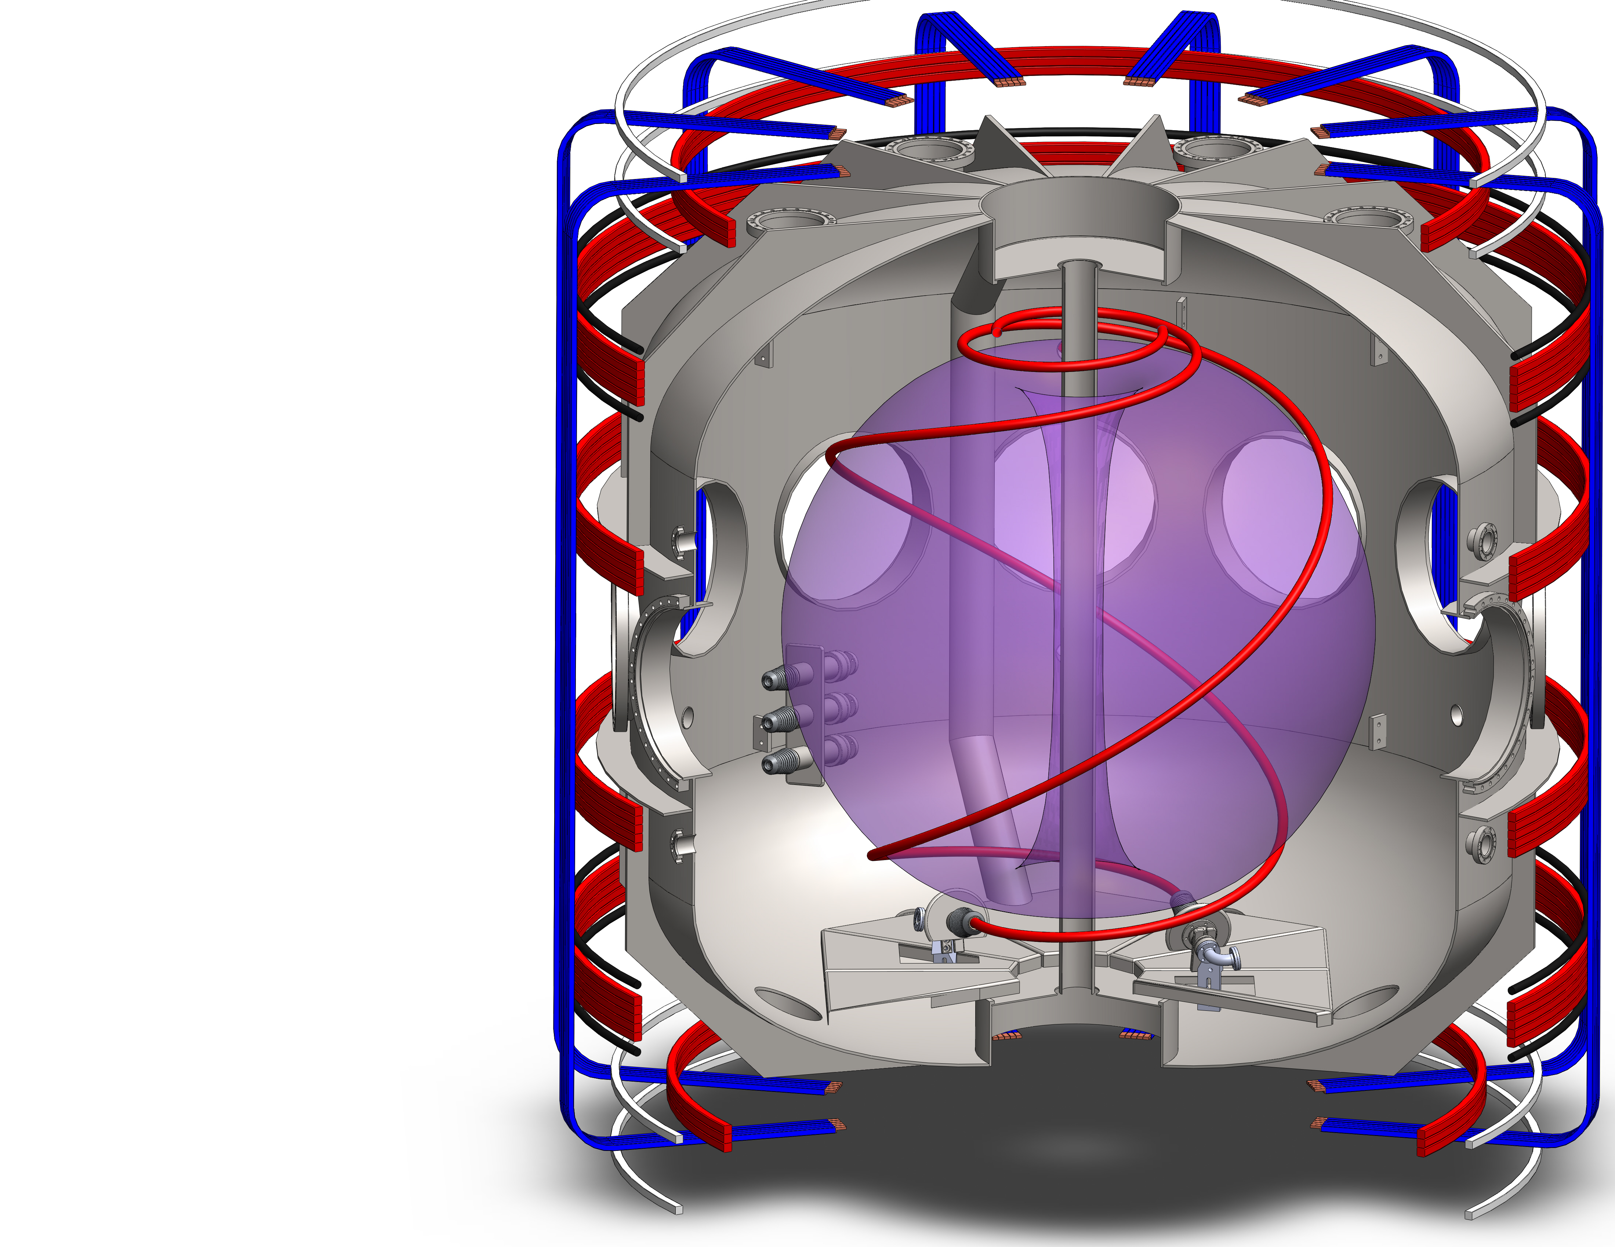
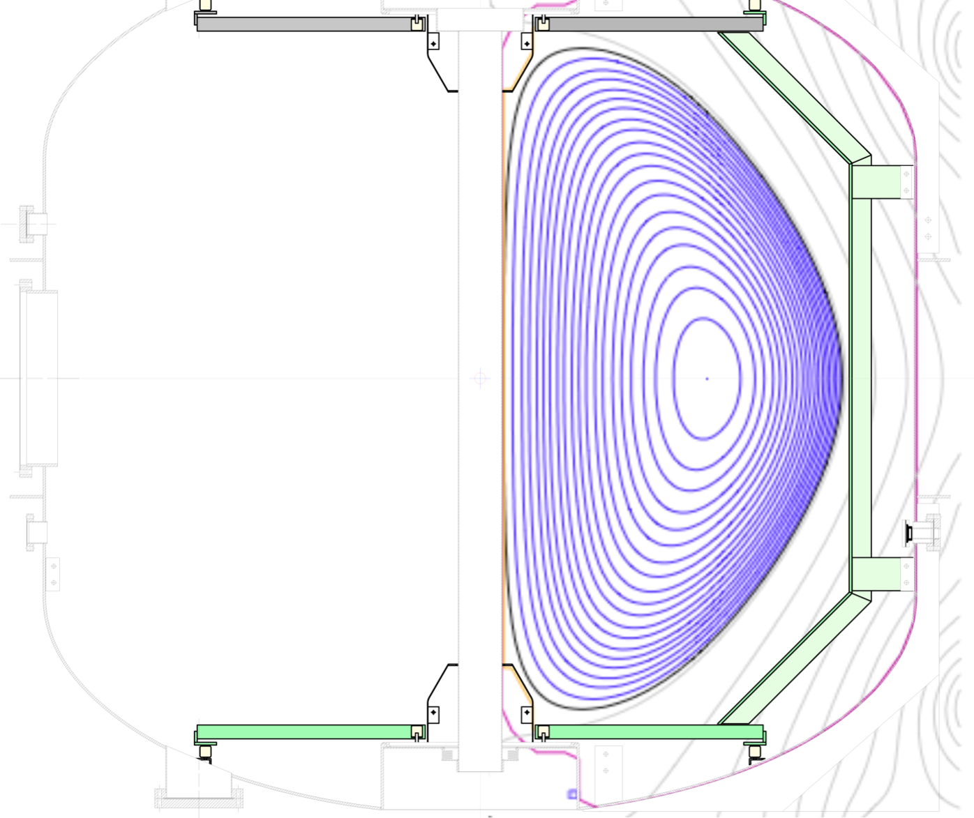
Pegasus is a Compact, Ultralow Aspect Ratio Spherical Tokamak
Thomson Sightline in Typical Plasma
1 m
Research presented here includes:
1st Thomson scattering T_{e}(R), n_{e}(R) in LHI plasmas
Kinetic measurements for high β_{t}
80 cm viewing
region
LFS Local Helicity Injectors
1 m
HFS Local Helicity Injectors
Experimental Parameters
A
R(m)
I_{p} (MA)
κ
β_{t} (%)
1.15 – 1.3
0.2 – 0.45
≤ .21
1.4 – 3.7
≤ 100
Thomson Diagnostic Layout
Notes:
TO SAY:
As you saw in the previous talk, Pegasus is a compact, ultralow aspect ratio tokamak.
It has a roughly 1 m major radius, and uses a technique called local helicity injection to start up plasmas without using the central solenoid.
There are two locations from which we inject helicity, one on the low-field side and one on the high-field side of the plasma.
I’d like to tell you about first results from Thomson scattering of electron temperatures and densities from these plasmas; specifically, this talk will compare results from the LFS and HFS locations.
Additionally, I’ll detail the kinetic measurements from Thomson scattering that went into calculating recent results of very high toroidal beta.

Slide 3
I_{p} Projections for LHI Depend Strongly on Electron Confinement Scaling
Rapid improvement with V_{LHI} under favorable scalings
  Possible reduction in injector requirements
Current projections: I_{p}~1 MA on NSTX-U accessible
Will need V_{LHI} ~ V_{IND}
  Confinement studies needed when sustained by V_{LHI}
  -From RJF IAEA
0-D power-balance model¹ predicts
I_{p}(t) from Local Helicity Injection (LHI):
I_{p}[ V_{LHI}+V_{IR}+V_{IND} ] = 0
Projected T_{e}, I_{p}, may vary if:
  Helicity drive dominates (V_{LHI} >> V_{IND})
  Inductive drive dominates (V_{LHI} << V_{IND})
Exploring T_{e} behavior as dominant drive method varies
NSTX-U: Projected I_{p} Scaling with V_{LHI}
ITER-97L
Scaling
RR Stochastic Scaling
∝ T_{e}^{-3/2}
<T_{e}>=150eV
<T_{e}>=75eV
Pegasus: V_{LHI} < V_{IND}
NSTX-U: V_{LHI} ~ V_{IND}
Pegasus: V_{LHI} ≳ V_{IND}
Strongly T_{e}-dependent
¹ J.L. Barr, et al. NP10.55, Poster session Wed morning
Notes:
TO SAY:
First, the motivation for this study is that plasma current predictions for Local Helicity Injection depend strongly on electron confinement scaling during injection.
If we were to scale up this technique to a larger system, here NSTX-U for example, we can see here the steady-state plasma current achieved for a given drive voltage from LHI, depends strongly on the dominant confinement during helicity injection. Plotted here are the steady state plasma currents you can expect from a given drive voltage, assuming different confinement scalings.
As you move to better confinement, we see a large increase in plasma current for a small increase in the necessary drive. This reduces the hardware and power supply demands to produce high drive voltages, and makes the system quite attractive at larger scale.
Now, these predictions are for a steady-state driven current. We model the plasma current evolution to this steady state value with a 0-D power balance model. There's a lot of complexity and detailed analysis involved in the components of this model, and I encourage you to check out Jayson Barr's poster tomorrow to learn more.
For our purposes here, we can grossly simplify things down to 3 voltages driving our plasma: a drive voltage from LHI, an anti-drive term from resistive losses, and an inductive term from changes in the product of inductance times current.
The resistive term scales like Te^-3/2, which is gives a fairly strong dependence of plasma current on Te. Furthermore, the dominant confinement scaling may change depending on which drive term is largest → we may get largely different confinement if helicity drive dominates or if inductive drive dominates.
In fact, these predictions for NSTX-U assume a mix of LHI and Inductive drive. So in order to accurately scale this technique up to larger systems, it’s quite important to understand and explore how electron temperature varies as the type of drive voltage is scanned. I’ll show here results from the 2 extremes: one case when inductive-drive dominates, and two cases for LHI-dominant drive. In order to vary the drive source in this manner, both LFS and HFS injection were used.
TO ASK:
What assumptions went into the scaling plot:
Aspect ratio
Major radius
Core radius
Plasma height
Eta factor (what’s this again??)
Delta
P_aux (MW)
Z_eff
Greenwald fraction
P_rad fraction
H factor
Ne exponent
Te exponent
Ti/Te ratio
Ion mass
B_tf (T)
Where are we NOW in terms of V_LHI?
Have backup slide with all the operative terms in the power balance model

Slide 4
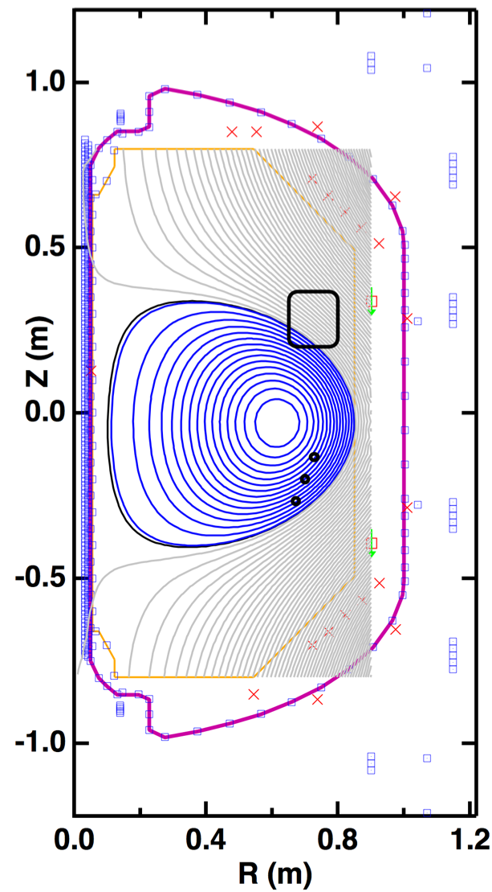
LFS Local Helicity Injection Produces Core T_{e} > 100 eV
Plasma position and shape evolve inward from outboard injectors
  Shape evolution generates V_{IND}
  V_{IND} > V_{LHI} during high-I_{p} phase
Peaked T_{e}(R) during drive phase (connected)
  Not strongly stochastic
  After disconnect radial compression drives skin current
Core n_{e} > 10¹⁹ m⁻³, T_{e} ≥ 100 eV provides target for subsequent CD
Peaked T_{e}(R) while Connected to Injectors
Connected
Disconnected
150
23.0 ms
24.2 ms
100
T_{e} (eV)
50
0
I_{p}=0.08 MA
I_{p}=0.10 MA
0
R_{maj} (m)
1
0
.5
R_{maj} (m)
1
.5
.15
.10
I_{p} (MA)
.05
0
3
-V_{IR}
2
V_{LHI}
System
Voltages (V)
1
V_{IND}
0
20
Time (ms)
25
30
Notes:
In Low-field side injection, the drive mechanism is dominantly inductive for 2 main reasons:
First, as the plasma position and shape evolve inward from the LFS injectors, the shape evolution drives an inductive voltage. I'm showing a cartoon of the plasma shape evolution here on the lower RHS, where the LCFSs at several times are drawn.
The second reason inductive drive dominates in LFS injection is that as the plasma grows away from the injectors LHI becomes less effective. Eventually the plasma moves far enough inward it disconnects from the injection drive.
These effects lead to Vind > VLHI during the high ip phase of the discharge. In this regime we observe a peaked electron temperature profile while the discharge is connected to the injection drive source. Here the plasma major radius is noted by a dashed gray line.
Eventually the plasma moves inboard enough that it disconnects from the LFS-located injectors, and we see the temperature profile collapse
However, while connected to the drive source these plasmas maintain densities > 1019 m-3 and temperatures >100 eV for several confinement times, and so would be good candidates for subsequent direct current drive.
TO ASK:
- What is estimated energy confinement time for these discharges?

Slide 5
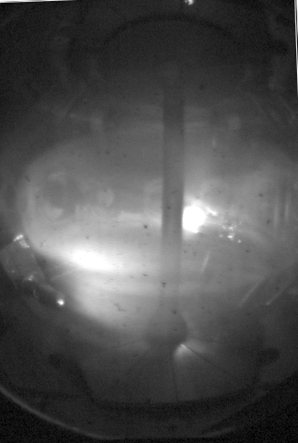
T_{e} (R_{maj},t) Remains Peaked for LFS LHI when V_{IND} Small
Even with small plasma, ~no V_{IND},
LHI sustains ~80 eV core T_{e}
Plasma evolution tailored so R₀(t) ~ 0.6 m
  Minimizes V_{IND}
Plasmas are small, circular plasmas at large R_{major}
T_{e}(R) > 85 eV with majority LHI-drive
Same injection location but static, circular plasmas at large R_{maj}
  Lower performance due to shape constraints
V_{IND} = 0, T_{e}(0) ~ 80 eV
T_{e}(R) remains peaked while driven solely by edge LHI
150
23.03 ms
28.03 ms
100
T_{e} (eV)
50
I_{p}=46.7 kA
I_{p}=48 kA
0
0
.5
1
0
R_{maj} (m)
1
R_{maj} (m)
.5
.15
I_{p} (MA)
.10
.05
0
3
2
V_{LHI}
-V_{IR}
System
Voltages (V)
1
V_{IND}
0
20
25
30
35
Time (ms)
I_{p} and I_{inj} for LHI shot, maybe overplot Ind I_{p} as well?
Notes:
TO SAY:
Now when we switch to dominantly helicity-driven discharges we find a similar result that Te remains peaked when the inductive-drive component is small.
For the most direct comparison, we used the same LFS injectors but developed a discharge that remained roughly fixed in space, at large major radius. Again, shown here on the lower RHS.
By necessity these discharges were lower performance due to the shape constraints, but we were able to reproduce many instances when helicity-injection drive was larger than the inductive drive.
I’m showing electron temperatures from two such time points here, where now the major radius is shifted to the right side of the screen and we’re looking at the inboard-half of the plasma with our Thomson system. Temperature profiles remain peaked and have maxima near 80 eV.
These results validate the hypothesis that Te(R) remains peaked and not largely stochastic when the plasma is driven solely by edge LHI.
However, we needed to validate this hypothesis with higher performance plasmas, and for that reason, among others, we installed helicity injectors in the HFS region of the plasma.

Slide 6
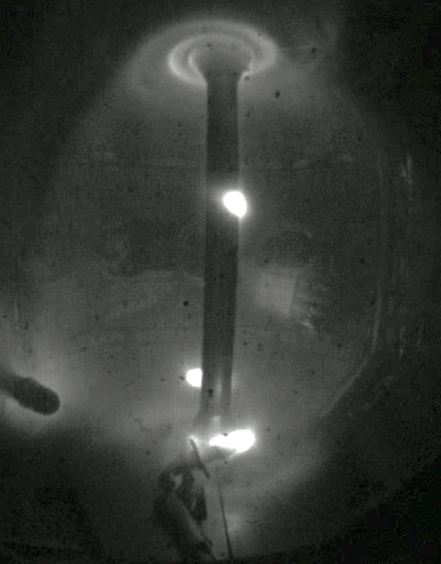
HFS Injection Gives Peaked T_{e}(R) for Sustained, Highly Elongated Discharge
150
T_{e}(0) ≥ 100 eV
n_{e} increasing to ~1.2 x 10¹⁹ m⁻³
T_{e}, n_{e} comparable to Ohmic plasmas in Pegasus
V_{LHI}-driven throughout
100
T_{e} (eV)
50
0
0
.5
1
0
.5
1
R_{major} (m)
R_{major} (m)
V_{LHI}
-V_{IR}
V_{IND}
see also: J.M. Perry, et al. NP10.53, Poster session Wed morning
Notes:
TO SAY:
For HFS injection, we’re able to develop higher-plasma current, higher-elongated plasmas that reach peaked Te’s greater than 100 eV
Similarly to the previous case, these discharges are driven predominantly by helicity injection. However, dissimilarly, these plasmas have higher plasma currents & performance, and much higher helicity-to-inductive drive ratios.
Also, we're able to push the density a bit higher, and achieve temperatures & densities that are comparable to Ohmic plasmas in Pegasus. This is suggestive that confinement during LHI may be on the order of Ohmic-confinement.
And here, this is a clear example of LHI drive dominating throughout the discharge.
//----------------------------------------------------------------------
An important subtlety to mention is that while these discharges have higher helicity-to-inductive drive ratios, the overall amount of drive needed is significantly less than the LFS case. This matches our expectations that injection from the HFS divertor region would be more effective. [and so may be ideal for scaling up to larger devices]
TO DO:
Consider calculating ne bar by using time-evolving minor radius, not just cherry-picking the minor radius from the end of the shot (not nec. representative of early development…)

Slide 7
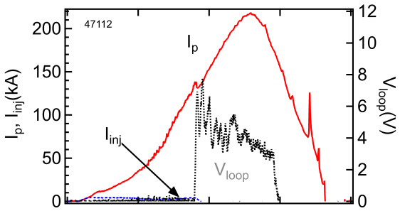
LHI Plasmas Provide Targets for Subsequent Current Drive Schemes
LHI-to OH Handoff Examples
(Pre-Thomson Scattering)
Coupling to aux. drive is sensitive to
I_{p} ramp-rate:
  J(ψ) too hollow: ineffective coupling
  J(ψ) too peaked: MHD unstable
Pegasus aux. drive = Ohmic
Upcoming campaign: characterize
T_{e}, n_{e} through LHI-OH transition
0.20
0.15
I_{p} (MA)
0.10
0.05
0
LHI
OH (H-mode)
Notes:
TO SAY:
Given these substantive densities and temperatures, these plasmas should provide good targets for subsequent current drive schemes.
We've previously optimized handoff to auxiliary current drive and found that coupling to auxiliary drive is quite sensitive to the plasma current ramp rate –> from equilibrium reconstructions and MHD analysis our supposition is this has to do with the resultant current profile evolution.
In Pegasus the available auxiliary drive is Ohmic, and shown here in the UR is an example when we start the plasma with LHI and transition to Ohmic drive. We're able to smoothly catch the evolving plasma current, here where the drive voltage from the Ohmic solenoid turns on and the small amount of injected current turns off, and ramp it up for as long as our power supplies allow.
Additionally, we’ve had cases where LHI-initiated discharges transition directly to H-mode upon application of the solenoid, bypassing any L-mode or lower confinement regime.
These examples were from campaigns prior to operation of Thomson scattering, and so an upcoming campaign is to characterize Te and ne through the LHI-OH transition. In doing so, we might evaluate the viability of using LHI to couple directly to Neutral Beam Injection on a larger device.
Now, I’d like to switch gears a bit and highlight some results obtained as a natural outgrowth of our main LHI-development program.

Slide 8
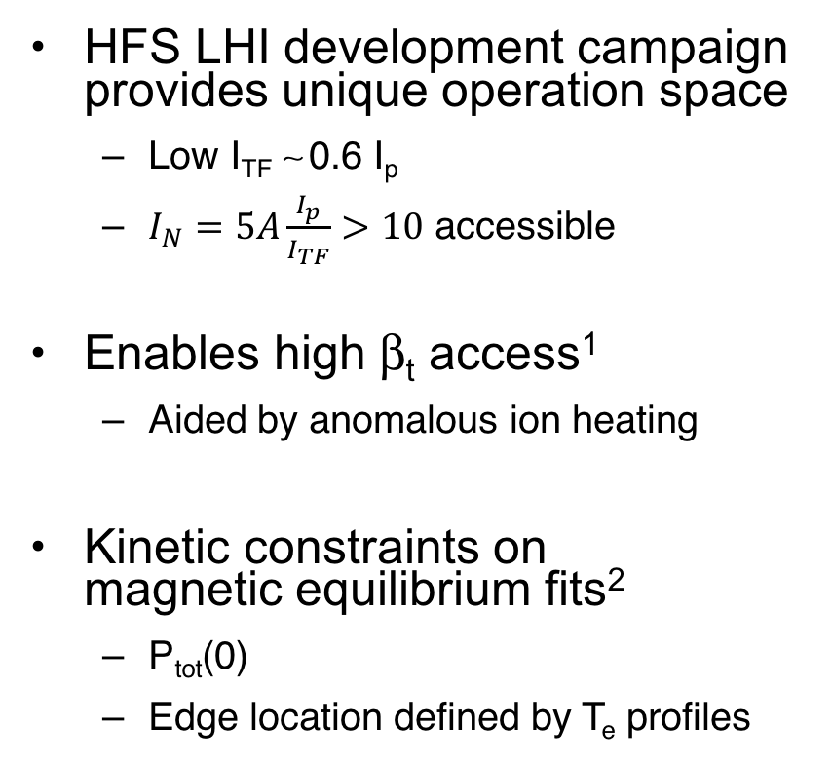
HFS Injection at low TF Provides Non-Solenoidal Sustainment at High I_{N}
I_{N} = 15
HFS LHI development campaign provides unique operation space
  Low I_{TF} ∼ 0.6 I_{p}
  $I_{N}=5A\frac{I_{p}}{I_{TF}}>10$ accessible
Enables high β_{t} access¹
  Aided by anomalous ion heating
Kinetic constraints on
magnetic equilibrium fits²
  P_{tot}(0)
  Edge location defined by T_{e} profiles
120
80
I_{p} (kA)
40
0
60
30
I_{TF} (kA)
0
18
22
26
Time (ms)
150
T_{i}
1.5
100
1.0
T_{e} (eV)
n_{e} (10¹⁹ m⁻³)
T_{e} (eV)
n_{e}(10¹⁹ m⁻³)
0.5
50
0.0
0
0
0.4
0.8
0
0.4
0.8
R_{maj} (m)
R_{maj} (m)
¹ M.W. Bongard, et al. NP10.52 Poster Wed morning
² G.M. Bodner, et al. NP10.54, Poster Wed. morning
Notes:
As it turns out, HFS injection at low toroidal field provides a unique operating space for non-solenoidal sustainment at High normalized current.
You heard previously that Plasma Material Interactions in our HFS injection campaign limited the magnitude of toroidal field we could apply.
When we pushed this space to its limits, ultimately here a toroidal field current only 60% our plasma current (shown here on the second trace), we were able to access and sustain plasmas in an operating space with very high normalized currents, at times with values 10-15.
Coupled with high densities and temperatures, shown here on the bottom right versus major radius, this enables access to very high beta toroidal values. A key feature I don’t have time to go into detail on, and that we’re still actively investigating, is the role of anomalous ion heating due to reconnection in the edge during LHI. I’m showing here the electron temperature profile in red, which interestingly shows a sharp gradient region in the edge. Regarding the ion temperatures, at this time point we measure the core ion temperature to be ~1.5 times the core electron temperature. This provides a significant contribution to the total plasma pressure.
Now, in order to accurately calculate toroidal beta, we’ve done kinetically-constrained magnetic equilibrium fits using the Thomson profiles. Specifically, we’ve constrained the total core pressure as measured by Thomson and our ion temperature diagnostic, and we’ve constrained the edge location as defined by the electron temperature profiles.

Slide 9
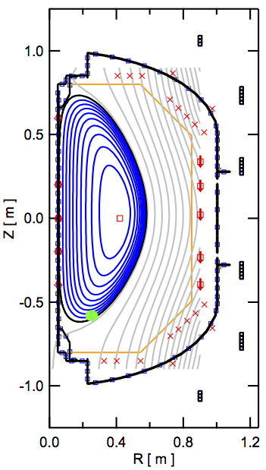
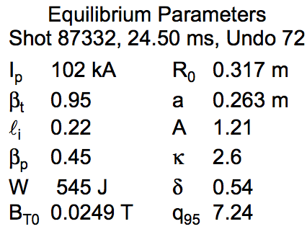
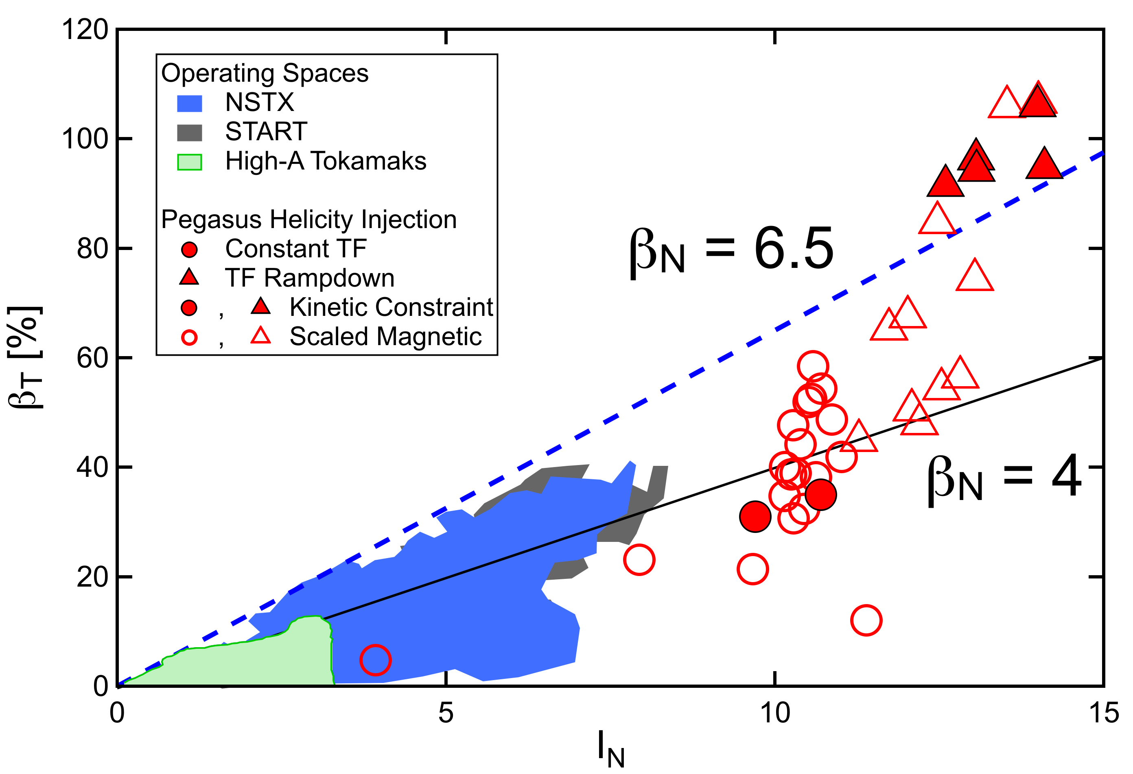
LHI-Produced Plasmas at low B_{t} Provide High β_{t}
Sample magnetic reconstruction at
t = 24.5 ms, using kinetic constraints
β_{T} for sustained, low-ℓ_{i}, high-κ,
LHI-driven plasmas
120
100
80
β_{t} (%)
60
40
20
0
0
5
I_{N}
10
15
¹ M.W. Bongard, et al. NP10.52 Poster Wed morning
Notes:
TO SAY:
I’m showing a sample magnetic reconstruction here on the left hand side which uses these kinetic constraints, here for a plasma current of 0.1 MA and toroidal field of 25 mT.
These plasmas are highly elongated, and have an extremely low li. For this case, we obtain a toroidal beta of 95%.
On the right hand side I’m showing a Troyon plot, a scatter plot of toroidal beta versus normalized plasma current. Operating spaces of several other tokamaks are shown as shaded regions, and updated Pegasus discharges are highlight as individual points. I should mention that the filled-in symbols represent beta-values obtained directly from kinetically-constrained equilibrium reconstructions. The empty symbols are magnetics-only reconstructions that have been calibrated based on the constrained results.
We note that some of the highest beta values come directly from kinetically-constrained equilibria.
I should also point out, too, that all of these discharges used zero Ohmic drive. Every Pegasus plasma on this plot was produced using solely Local Helicity Injection.
TO DO:
- Get list / have list on hand of caveats from Ray’s IAEA talk…

Slide 10
LHI-Driven Plasmas Have T_{e}(0) ~100 eV and
Provide Access to High β_{t}, High I_{N} Operating Space
Local Helicity Injection (LHI) sustains ~100 eV T_{e}, moderately-high n_{e}
No strong T_{e}(R_{maj}) dependence on LHI location and ratio of LHI-to-inductive drive
Effective startup target for direct OH coupling (Pegasus); Future to NBI (NSTX-U)?
Very high β_{t} confirmed by kinetic measurements
Notes:
So in summary, here are the take home points from this research:
READ ‘EM WITH FEELING BUDDY!!

Slide 12
Backups: Taylor Relaxation & Helicity Balance
Backups:
Taylor Relaxation & Helicity Balance

Slide 13
Physics Models Provide a Predictive Understanding for LHI Startup
Taylor Relaxation
Helicity Conservation
Taylor relaxation, helicity conservation
  Steady-state maximum I_{p} limits
0-D power-balance I_{p}(t)
  V_{LHI} for effective LHI current drive
3D Resistive MHD (NIMROD)
  Physics of LHI current drive mechanism
;
Reconnecting LHI Current Stream
D.J. Battaglia, et al. Nucl. Fusion 51 (2011) 073029.
N.W. Eidietis, Ph.D. Thesis, UW-Madison, 2007.
J. O’Bryan, Ph.D. Thesis, UW-Madison, 2014.
J. O’Bryan, C.R. Sovinec, Plasma Phys. Control. Fusion 56 064005 (2014)

Slide 14
Helicity evolution and related plasma current depends strongly on T_{e}
In a tokamak, fields and currents are oriented such that helicity injection drives toroidal current:
      Formulation analogous to Poynting’s Theorem for energy
Helicity dissipation term depends on resistivity¹, which in turn depends on T_{e}:
Thomson scattering will be used to quantify T_{e}, and thereby helicity dissipation
¹Spitzer, Lyman, Jr. et al. Phys. Rev. 1953.
3/36
Notes:
Poynting’s Theorem states: dW/dt = -d/dt int_V(1/2 * eps0 * E^2 + B^2 / mu0) d^3x – int_S 1/mu0 * ExB dot n^hat d^2x
Also, recall definition of gauge: dA/dt = E + gradV
----- Meeting Notes (12/11/14 11:12) -----
Need more of a link prior to this between helicity injection and plasma current
----- Meeting Notes (12/11/14 11:49) -----
Again, clearer link btwn helicity & plasma current
----- Meeting Notes (12/11/14 20:46) -----
injeciton spelled wrong!!!

Slide 15
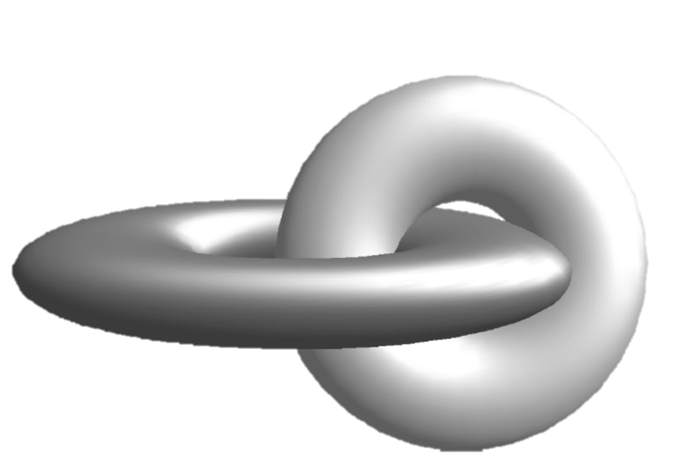
Helicity is a conserved quantity in magnetic systems, and directly relates to current drive
Poloidal flux
Helicity describes linkage between magnetic flux
tubes:
Helicity is conserved on resistive time scales even
when magnetic energy is not
Toroidal flux
System’s minimum energy state, given constant helicity constraint, can be represented by:
  λ represents system eigenstates (“Taylor states”)
  Unstable systems relax to this minimum energy state
J.B. Taylor, Phys. Rev. Lett., 1974.
Woltjer, L., Proc. Natl. Acad. Sci., 1958.
Brown, M.R. et al. Geophys. Monograph, 1999.
2/36
Notes:
Curl(A) = B
Magnetic energy ~ (1 / 2µ₀) int_{V} B² d³x ~ B²L³ while
Helicity ~ int_{V} A*B ~ B²L⁴

Slide 16
Backups: Power Balance Model
Backups:
Power Balance Model

Slide 17
Power-Balance, Taylor Relaxation
Applied to Predict LHI I_{p}(t)
0-D LHI model predicts I_{p}(t) based on lowest of two limits:
Poynting’s Theorem at plasma boundary sets I_{p}(t):
Taylor relaxation limit strictly enforced as maximum I_{p}
Plasma
surface-voltage
Resistive
Dissipation
Non-inductive
current drive (LHI)
Internal magnetic energy storage
J.L. Barr, APS DPP 2015

Slide 18
Power Balance Model Incorporates
Analytic Plasma Inductance Formulae
  Analytic low-A descriptions of L_{p}*, B_{z}**
V_{IND}
LHI
* S.P. Hirshman and G.H. Nielson 1986 Phys. Fluids 29 790
** O. Mitarai and Y. Takase 2003 Fusion Sci. Technol.
S. Ejima et al 1982 Nucl. Fusion 22 1313
J.A. Romero and JET-EFDA Contributors 2010 Nucl. Fusion 50 115002
J.L. Barr, APS DPP 2015

Slide 19
0-D Model Takes Plasma,
Injector Parameters as Inputs
Initial condition: I_{p}(t₀)=I_{TL}
Shape(t)
  R₀(t), a(t), κ(t), δ(t)
  Vertical symmetry
<η>(t), l_{i}(t), β_{p}(t)
  Constant <η> assumed
    Spitzer
  β_{p} = 0
  l_{i} dropping: 0.5 → 0.2
Injector Inputs:
  A_{inj}(t), V_{inj}(t), R_{inj}(t)
l_{i}
κ: 1→ 2
δ: 0→ 0.5
J.L. Barr, APS DPP 2015

Slide 20
ShapeFIT: Fast Boundary Reconstruction
Code Provides Shape(t)
Filament Model
KFIT Equilibrium
Plasma treated as 4-6 filaments
  Positions, currents fit to magnetics
Wall currents modeled
  Same model used in KFIT equilibrium code
Validating against reconstructions
    R₀ ± 1.5 cm
    a ± 1.5 cm
    κ ± 15%
    δ ± 25%
ShapeFIT
KFIT
J.L. Barr, APS DPP 2015

Slide 21
Power Balance Model Provides
Predictive Tool for I_{p}(t)
Model reasonably recreates I_{p}(t)
  V_{LHI}: effective drive
  V_{IR}: resistive dissipation
  V_{IND}: analytic, from shape(t)
  Taylor relaxation limit: I_{p} ≤ I_{TL}
<T_{e}> = 60eV
Shape
Evolution
System Voltages [V]
V_{IND} dominates current drive
Eidietis et al., J. Fusion Energ. 26, 43 (2007)
S.P. Hirshman and G.H. Nielson 1986 Phys. Fluids 29 790
O. Mitarai and Y. Takase 2003 Fusion Sci. Technol.
Battaglia et al., Nucl. Fusion 51, 073029 (2011)

Slide 22
Understanding Confinement Scaling in LHI is
Critical for Predicting to NSTX-U and Beyond
NSTX-U: Confinement Scalings
Rapid improvement with V_{LHI} under favorable scalings
  Possible reduction in injector requirements
Current projections: I_{p}~1 MA on NSTX-U accessible
Will need V_{LHI} ~ V_{IND}
  Confinement studies needed when sustained by V_{LHI}
ITER-97L
Scaling
<T_{e}>=
100eV
R-R
Stochastic
<T_{e}>=30eV
Pegasus: V_{LHI} < V_{IND}
NSTX-U: V_{LHI} ~ V_{IND}
V_{LHI}
-V_{IR}
LHI
-V_{IR}
V_{IND}
V_{IND}

Slide 23
Backups: High Beta
Backups:
High Beta

Slide 24
LHI Provides Access to High-β_{T} at A ~ 1 with Non-Solenoidal Sustainment and Anomalous Ion Heating
Initial Exploration of High-β_{T} Space
Equilibrium reconstructions estimate β_{T} (~<P>/B_{T0}²)
  Matches external magnetics, P_{tot}(0), and edge in T_{e}(R)
  Includes anomalous T_{i}(0)
  Some caveats for these initial results
    Assumes closed flux surfaces inboard of injectors
    Role of SOL edge current
    Magnetics-only reconstructions scaled via comparison to those with kinetic constraints
    Need full kinetic profiles in future
High β_{T} plasmas often terminated by disruption
  n = 1, low-m precursors
Expands accessible high I_{N}, β_{T} space for tokamak stability studies at extreme toroidicity
  Campaign underway to document, extend to higher I_{p}
  Improved LHI injector hardware to increase I_{p}, B_{TF} access

Slide 25
Backups: Ion Heating
Backups:
Ion Heating

Slide 26
Reconnection-driven Ion Heating
Gives T_{i} > T_{e} During LHI
Ion heating correlated with high frequency MHD fluctuations, not with discrete reconnection between helical streams
Impurity T_{i}(0) ~ 100 – 500 eV > T_{e} routinely observed during LHI
Continuous ion heating from reconnection between collinear current streams
  No effect on current drive efficiency
  Significant ion heating (~ few 0.1 MW)
Ion heating consistent with
2-fluid reconnection theory

