Slide 1
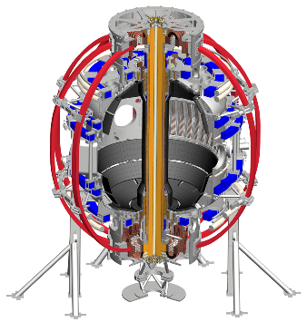

Suppression of Alfvénic modes through modification of the fast ion distribution
E D Fredrickson,
E Belova, N N Gorelenkov and NSTX-U Team
59th APS-DPP Meeting
Milwaukee, Wisconsin
Oct. 23 – 27, 2017

Slide 2
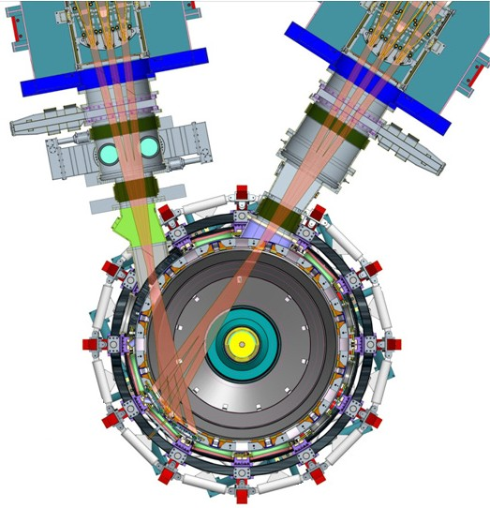
NSTX upgrade added a 2nd neutral beam and increased the toroidal field
Motivation:
Current profile control
  off-axis beam to broaden current profile
Non-inductive current drive
  Tangential NBI → 2× current drive efficiency
Higher field, higher plasma current
  support increased heating power
Transport, power handling and stability studies…

Slide 3
New capabilities also impact mission to study energetic particle driven instabilities
Higher field
  extends V_{fast}/V_{Alfvén} range to sub-Alfvénic (conventional tokamak space).
New beams allow control of fast-ion distribution function
  hollow fast ion density profiles (TAE*)
  control of fast-ion pitch distribution.
M Podestà – PP11 50, Wed. afternoon

Slide 4
ITER, fusion reactors will operate with super-Alfvénic fast ions => fast-ion driven instabilities
Spherical Tokamaks routinely operate in this regime
Lower frequency -
  Fishbones (EPM)
  BAAE
  BAE
  Toroidal Alfvén eigenmodes
Intermediate frequency are ctr-propagating:
  Global Alfvén eigenmodes
  Compressional Alfvén eigenmodes
Near the ion cyclotron frequency are:
  co-Compressional Alfvén eigenmodes (CAE)
  Ion Cycl. emission (ICE)

Slide 5
Early in NSTX-U operation it was seen that adding beam power could suppress GAE
Each new source can suppress Global Alfvén eigenmodes (GAE).
Suppression occurs within milliseconds, e.g., it’s the fast ions.
Addition of source 2a
Addition of source 2b
Addition of source 2c

Slide 6
Strong anti-correlation between GAE activity and heating with BL-2 sources
Transition events show clearest demonstration of suppression,
  reduction of ctr-GAE amplitude with turn-on of outboard source
  or, growth of ctr-GAE amplitude with turn-off of outboard source.
More than 120 examples of transition events;
  BL-2 source turning on or off, during a plasma heated by BL-1.
In most cases, complete suppression is seen with BL-2,
  however, particularly with the on axis source, GAE may persist.
Observations are qualitatively consistent with an analytic model of Doppler-shifted ion-cyclotron-resonance drive of GAE.
HYM-code simulations, with more complete physics model, also predict new, off-axis, beams can suppress GAE.

Slide 7
New sources added to provide more power and current profile control are aimed off-axis
Tangency radii of new beams for current profile control outside magnetic axis.
Fast ions deposited with high pitch (V||/V), velocity nearly parallel to magnetic field.
Suppression of GAE discovered on NSTX-U with injection of new neutral beams.

Slide 8
New sources added to provide more power and current profile control are aimed off-axis
Tangency radii of new beams for current profile control outside magnetic axis.
Fast ions deposited with high pitch (V||/V), velocity nearly parallel to magnetic field.
Suppression of GAE discovered on NSTX-U with injection of new neutral beams.

Slide 9
Suppression can occur in msec; fast ion distribution, not equilibrium changes, responsible
Suppression occurs in msecs,
  only a few BL-2 fast ions added.
Typical fast-ion slowing down time is of order >25 ms
  full-energy BL-2 fast ions responsible for suppression?
Blue curve is total BL-1 source power, red curve is BL-2.
2b

Slide 10
Even if suppression isn’t complete, there is a strong reduction in mode amplitude
Happens most commonly early in the plasma, probably when q is still high, density is low.
Incomplete suppression is also more common the deepest of the new sources (closest to BL-1 sources).
This is a fairly extreme example with only ≈15% of the total power coming from a BL-2 source.

Slide 11
Database constructed from NSTX-U shots shows BL-2 is very effective for suppressing GAE
Database constructed from 2016 shots where BL-2 source injected during strong GAE activity.
Histogram of fractional drop in mode amplitude 25ms after injection of a BL-2 source;
  comparison of amplitude averaged over 10 ms before, to 20-30 ms after injection.
Counts in red all from 2-day XP focused on H-mode access;
  unique characteristic of these shots hasn’t been identified.

Slide 12
Strong anti-correlation between GAE activity and heating with BL-2
Transient events show clearest demonstration of suppression,
  reduction of ctr-GAE amplitude with turn-on of outboard source
  or, growth of ctr-GAE amplitude with turn-off of outboard source.
More than 120 examples of transient events; BL2 source turning on or off, during a plasma heated by BL1.
In most cases, complete suppression is seen with BL-2 on,
  however, particularly with the most inboard source, GAE may persist.
Observations are qualitatively consistent with analytic model of cyclotron-resonance drive of GAE.
HYM-code simulations, with more complete physics model, also predict new, off-axis, beams can suppress GAE.

Slide 13
An example with strong GAE activity before suppression is chosen for analysis
GAE appear after BL-2 source turns off.
Modes evolve from dominantly n=-9 to dominantly n=-11.
GAE suppressed again, late in discharge, when BL-2 comes back on.
BL-2 provides roughly 25% of total power.
Plasma is in L-mode, but suppression is also seen for H-mode plasmas.

Slide 14
Analytic model evaluated and HYM simulations done before and after BL-2 turns on.
GAE bursting before modes are suppressed.
Analysis done at two times:
  0.44s,during GAE activity (w/o 2c),
  0.47s, after 2c on.
GAE suppression noticeable within milliseconds.
BL-2 (source 2c) only adds ≈1.2MW out of 4.6MW, ≈26%.

Slide 15
Reflectometer array* shows mode structure as expected for global Alfvén eigenmodes
Reflectometer response combines “interferometer” response and cut-off layer displacement,
Reflectometer data inverted with iterative model,
  trial function
Structure peaks near minimum in q, as expected for GAE.
  nearly constant phase over radius.
*N A Crocker, S Kubota, UCLA

Slide 16
Analytic model* qualitatively predicts low k⊥ρ_{L}
(high pitch) fast ions will stabilize GAE
Fast ions can be stabilizing/destabilizing depending on their k⊥ρ_{L}:
Stable :
Unstable:
Resonant outboard beam ions with pitch > 0.9 have small ρ_{L}, are stabilizing by this theory.
Gorelenkov, NF 43 (2003) 228.

Slide 17
Local dispersion relation and experimental parameters are used to deduce k|| and k⊥
Experimental mode frequency used to estimate k|| from dispersion relation:
Experimental inputs are q, density, rotation profiles and mode frequency, toroidal mode number.

Slide 18
Analytic theory predicts GAE amplitude to peak near minimum in continuum
Experimental mode frequency used to estimate k|| from dispersion relation:
Experimental inputs are q, density, rotation profiles and mode frequency, toroidal mode number.

Slide 19
TRANSP modeling predicts that beam fast ions are resonant with the GAE
The parallel beam ion velocity for resonant fast ions is estimated from the resonance condition:
  the sidebands arise from particle drifts
Two side-band fast ion resonances are indicated by black lines in the figures.
  lines show fast ions at constant parallel velocity.
  gaining/losing perpendicular energy moves fast ions along black resonance lines.

Slide 20
Addition of BL-2 (2c) deposits resonant fast ions that are predicted to damp the GAE
k|| estimated above is used to calculate k⊥:
  The boundary between fast ions that drive vs damp the mode is:
…where ρ_{L} is calculated from the perpendicular fast ion energy.
  The boundary between damping and drive is shown by the dashed blue lines.
The BL2 sources add primarily fast ions with high pitch (Fig. b).

Slide 21
HYM* code predicts mode instability at 0.44s, stable at 0.47s
HYM is an initial value, hybrid code in toroidal geometry
  beam ions treated with full-orbit, δf scheme
  thermal plasma is one-fluid MHD
Code can run non-linear, but only linear results shown here.
Growth rate positive at 0.44s, negative at 0.47s with added source 2c.
Simulated growth rates sensitive to fast ion distribution.
*Belova, PoP 10 (2003) 3240

Slide 22
HYM predicts frequencies of observed modes
Top figure shows positive growth rates for n = -7 to -12
  strong n = -8 to -11 shown above
  weak n = -7 and -12 are also seen.
Agreement with the experimentally observed frequencies is also good
  frequencies corrected with a simple estimate for the Doppler shift.

Slide 23
GAE suppression with increased
NBI power is robustly observed
Experiments on NSTX-U with new neutral beam sources have found that the GAE can be completely suppressed with ≈25% of the beam power supplied by one of the new beam sources.
A qualitative explanation is found in an analytic model for GAE drive through the Doppler-shifted cyclotron resonance.
Quantitative simulations with the hybrid MHD code, HYM, find excellent agreement with the experimental observations.
Extension of similar techniques to other instabilities may provide an efficient method of improving fusion reactor efficiency.

Slide 24
Related posters
For more information on HYM-code simulations, please see at the NSTX-U poster session this afternoon:
  Numerical simulations of GAE stabilization in NSTX- U
    E. Belova PP11-45
  Energetic-particle-modified global Alfvén Eigenmodes
    J. Lestz PP11-46
  Destabilization of counter-propagating TAEs by off- axis, co-current Neutral Beam Injection
    M Podestà PP11 50

Slide 25
GAE frequency and toroidal mode number increase with toroidal field
Frequencies of GAE on NSTX-U consistent with this scaling.

Slide 26
‘Similar’ 1MA, 6MW NSTX-U H-mode
6.5 kG toroidal field.
One 90 kV beam, 3 - 70 kV beams
Two outboard sources.
Density similar
Note minimal hfAE activity

Slide 27
GAE grows during 2a beam block
Top panel shows GAE excited by inboard sources 1b and 1c (blue and cyan, lower panel).
Outboard source 2a has block from 0.437s to 0.454s.
GAE amplitude grows during 2a off-time, suppressed after.

Slide 28
Database supports anecdotal evidence
Significant amplitude in GAE frequency range only with no Beam Line 2 power.
A few exceptions are mostly from early GAE when q was probably high (no MSE data yet).
  High q means high m_{eff}, means large k⊥, and Beam Line 2 could be destabilizing.

Slide 29
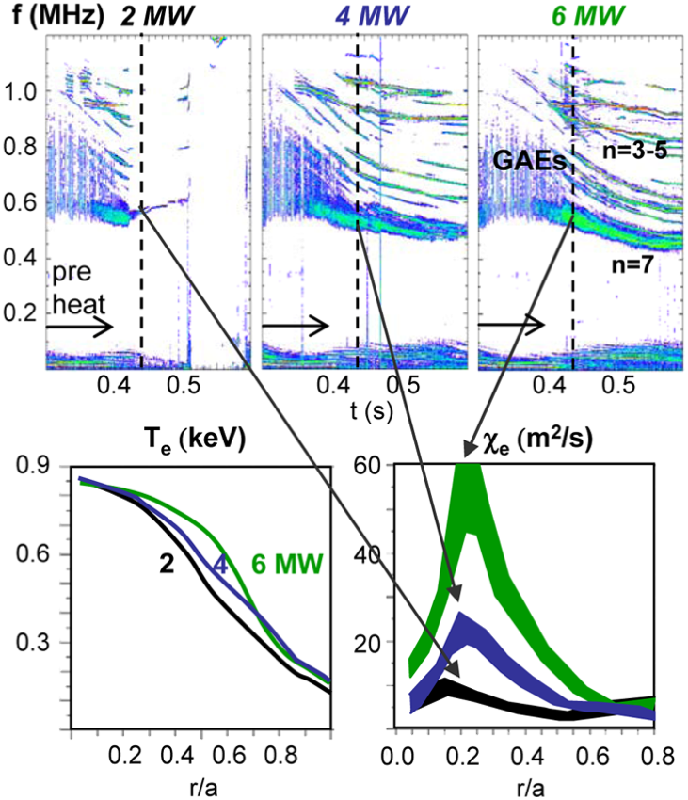
Global Alfvén eigenmodes on NSTX are an example of (possibly) deleterious EP modes
GAE resonant with trapped electrons:
  direct electron heat transport…
…or, GAE ‘channel’ energy through GAE away from core:
  less core electron heating.
Control of GAE could help answer open questions about electron heat transport in STs.

