Slide 1

Snowflake Divertor Studies in DIII-D and NSTX Aimed at the Power
Exhaust Solution for the Tokamak
V. A. Soukhanovskii
Lawrence Livermore National Laboratory, Livermore, California, USA
for the NSTX-U and DIII-D Research Teams
Oral O2.101

Slide 2
Co-authors and Acknowledgements
S. L. Allen¹, E. Kolemen², T. H. Osborne³, J. A. Boedo⁴,
M. E. Fenstermacher¹, R.J. Groebner³, D.N. Hill¹, A.W. Hyatt³,
C. J. Lasnier¹, A. W. Leonard³, M. A. Makowski¹, W.H. Meyer¹,
A.G. McLean¹, T.W. Petrie³, D. D. Ryutov¹, J.G. Watkins⁵,
R.E. Bell², A. Diallo², S. Gerhardt², R. Kaita², S. Kaye², B.P. LeBlanc²,
R. Maingi², E. T. Meier¹, J.E. Menard², M. Podesta², R. Raman⁶,
A.L. Roquemore², and F. Scotti²
    ¹Lawrence Livermore National Laboratory, Livermore, CA 94550, USA
    ²Princeton Plasma Physics Laboratory, Princeton, NJ 08543-0451, USA
    ³General Atomics, San Diego, CA 92186-5608, USA
    ⁴University of California San Diego, La Jolla, CA 92093-0417, USA
    ⁵Sandia National Laboratories, Livermore, CA 94550, USA
    ⁶University of Washington, Seattle, WA 98105, USA
Work supported in part by the US DoE under DE-AC52-07NA27344, DE-AC52-07ER27344, DE-FC02-04ER54698, DE-AC02-09CH11466, and DE-FG02-07ER54917.

Slide 3
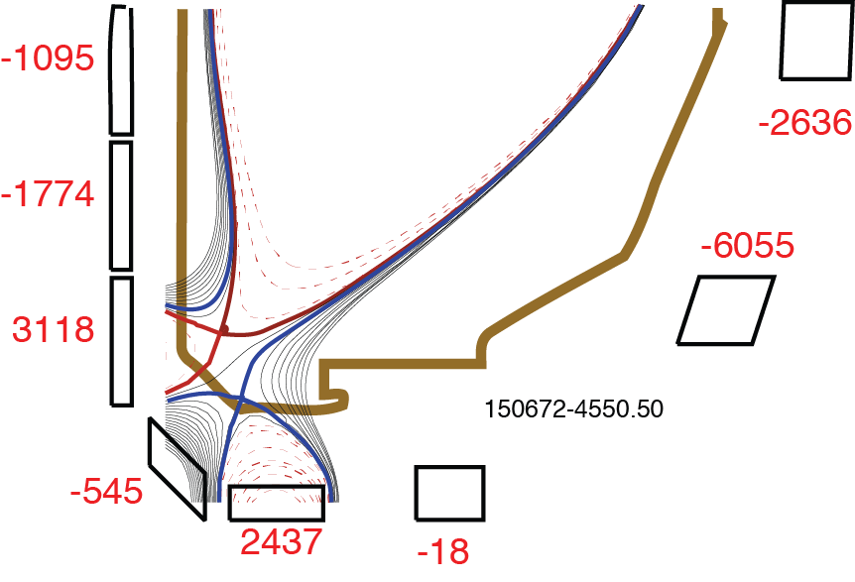

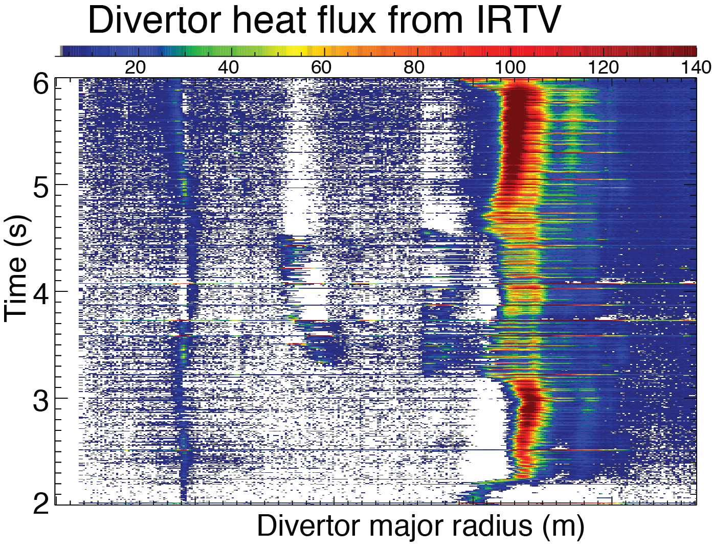
Significant heat flux reduction between and during ELMs observed in NSTX and DIII-D snowflake divertors
Outline of talk
Snowflake divertor configuration
Snowflake divertor in NSTX
  Facilitated access to detachment
  Heat flux reduction compatible with H-mode
Snowflake divertor in DIII-D
  Heat flux reduction compatible with H-mode
  Cryopump density control within
  n_{e}/n_{G} = 0.4-0.75
  Detachment and ELM heat flux
Projections for NSTX-Upgrade
Conclusions
*

Slide 4
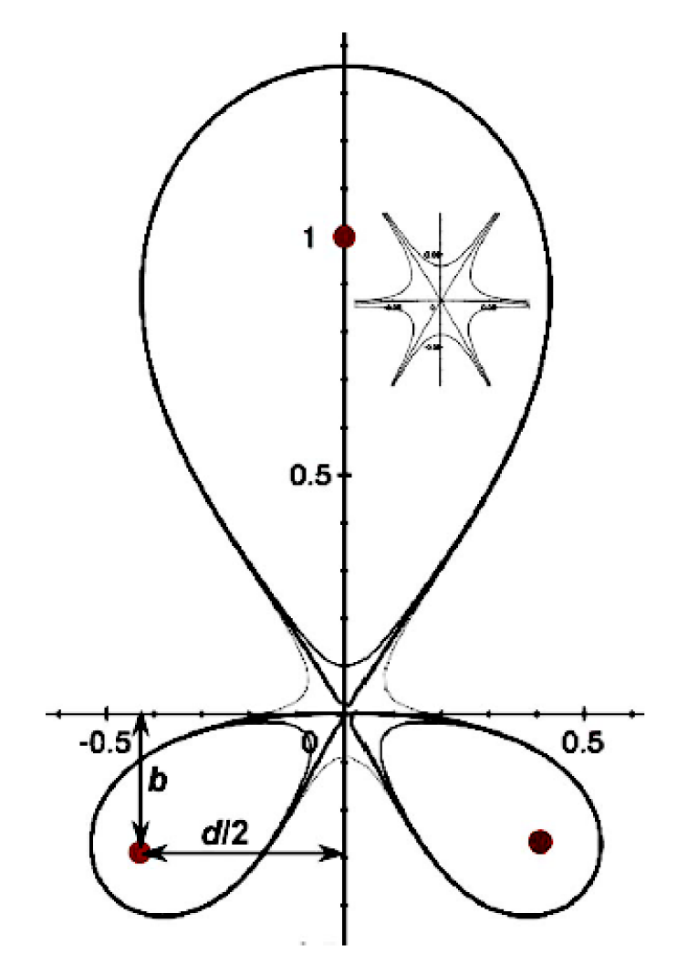
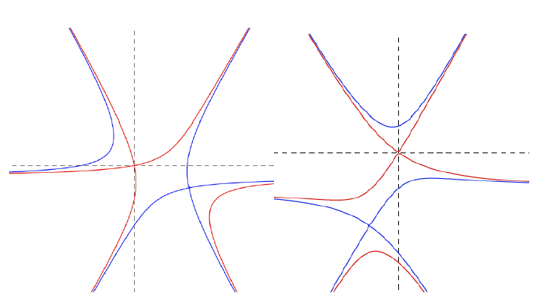
Snowflake divertor geometry takes advantage of B_{p} structure in second-order null region
Snowflake divertor configuration
  Second-order null
      B_{p} ~ 0 and grad B_{p} ~ 0 (Cf. first-order null: B_{p} ~ 0)
  Exact snowflake topologically unstable
  Deviation from exact snowflake
    d ≤ a (λ_{q} / a)^{1/3} where d – distance between nulls, a – plasma minor radius, λ_{q} – SOL width
Exact
snowflake
*
Predicted properties
  Increased edge shear: ped. stability
  Add’l null: H-mode power threshold, ion loss
  Larger plasma wetted-area A_{wet} : reduce q_{div}
  Four strike points : share q_{II}
  Larger X-point connection length L_{x} : reduce q_{II}
  Larger effective divertor volume V_{div} : incr. P_{rad}
  High β_{p} convective zone D* ≤ a (a β_{pm} / R)^{1/4}
+
+
+
+
Snowflake-minus
Snowflake-plus
D. D. Ryutov, PoP 14, 064502 2007;
EPS 2012 Invited, PPCF 54, 124050 (2012)

Slide 5
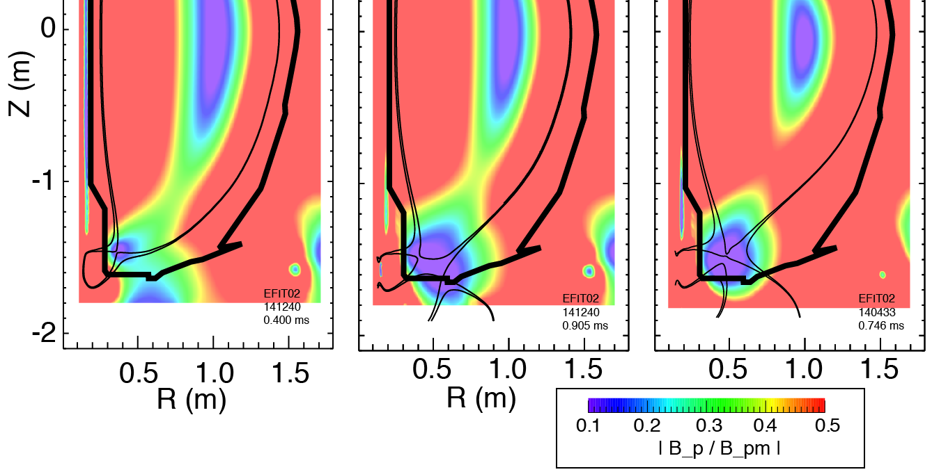

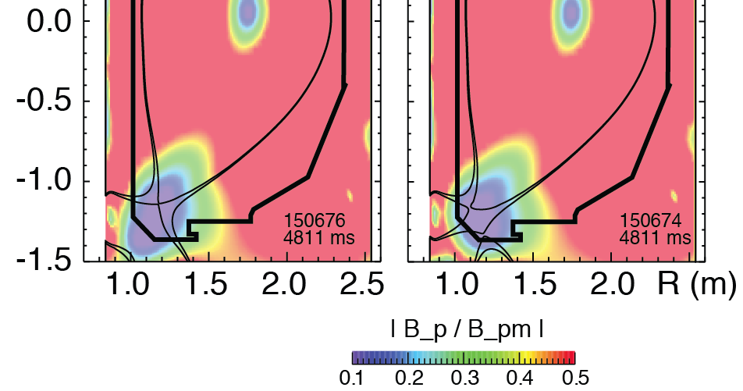
Snowflake configurations sustained in NSTX and DIII-D for many τ_{E}’s with divertor coil currents within safety margins
Standard divertor Snowflake-minus Exact snowflake
Standard divertor Snowflake-minus
Divertor coil currents 0.5-4 kA within safety margins
Steady-state snowflake configurations
  NSTX: 0.5 s
  DIII-D: 3 s

Slide 6
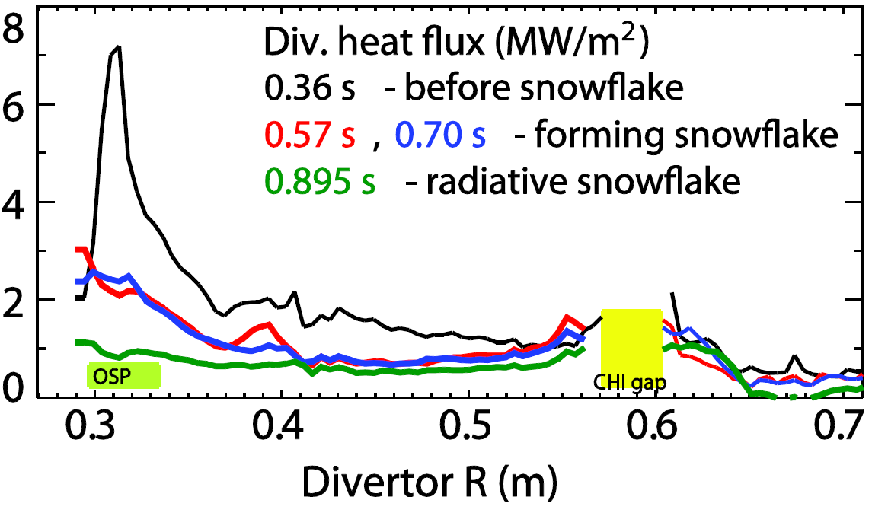
Snowflake divertor in NSTX compatible with H-mode confinement, facilitated access to partial detachment
  Graphite PFCs with lithium coatings
I_{p} = 0.9 MA, P_{NBI} = 4 MW, P_{SOL} ~ 3 MW
q_{peak} ≤ 8 MW/m², q|| ≤ 100 MW/m²
With snowflake divertor
H-mode confinement unchanged
  W_{MHD}~250 kJ, H98(y,2)~ 1, β_{N}~5
Core impurity reduced by up to 50 %
Suppressed ELMs re-appeared
Divertor heat flux significantly reduced
  Between ELMs
  During Type-I ELMs (ΔW/W ~ 5-15 %)

Slide 7
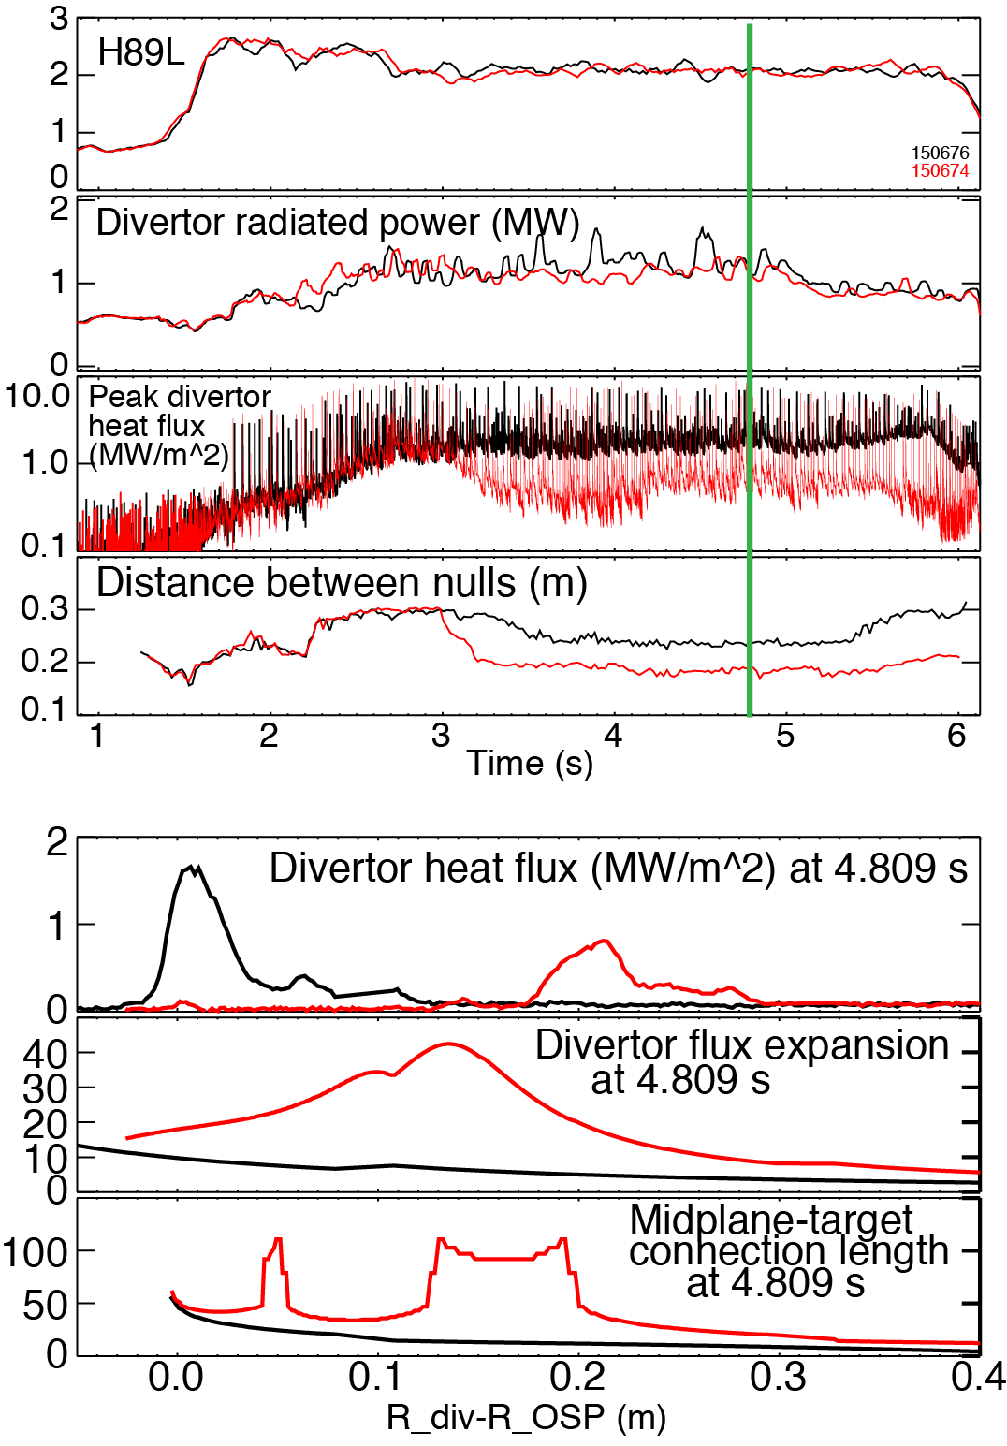
In DIII-D, peak divertor heat flux reduction by 50-60 % between ELMs due to geometry
Standard, Snowflake
  Graphite PFCs
I_{p} = 1.2 MA, P_{NBI} = 5 MW, P_{SOL} ~ 3 MW
q_{peak} ≤ 2 MW/m², q|| ≤ 100 MW/m²
Obtained snowflake-minus for up to 3 s duration over n_{e}/n_{G} = 0.4 – 0.75 using cryo-pump for density control
In lower-density snowflake H-mode
  Confinement unaffected
  Divertor attached
    Divertor P_{rad} similar to standard div.
  Divertor heat flux reduced
    Plasma-wetted area increased up to 80 %
    Connection length increased up to 75 %

Slide 8
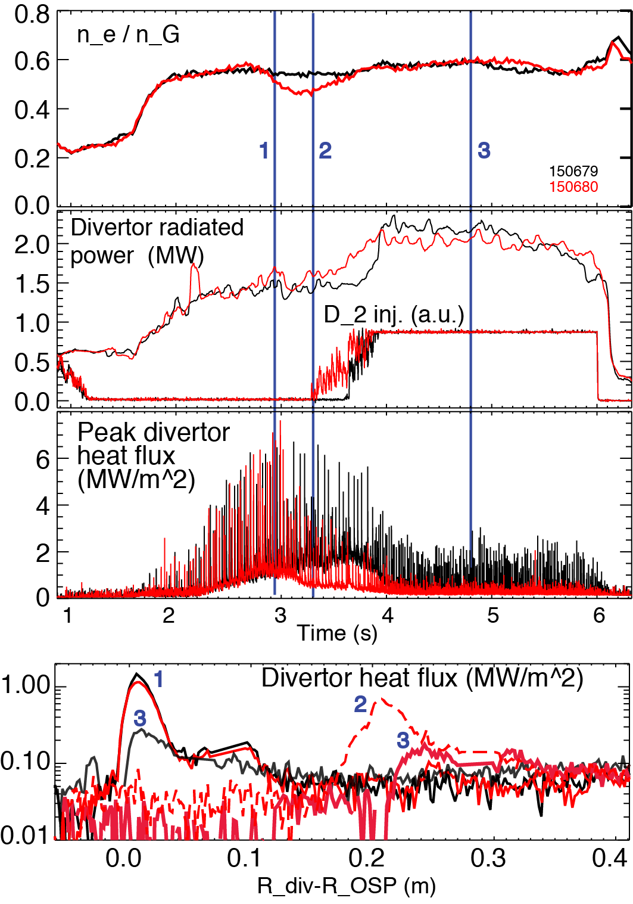
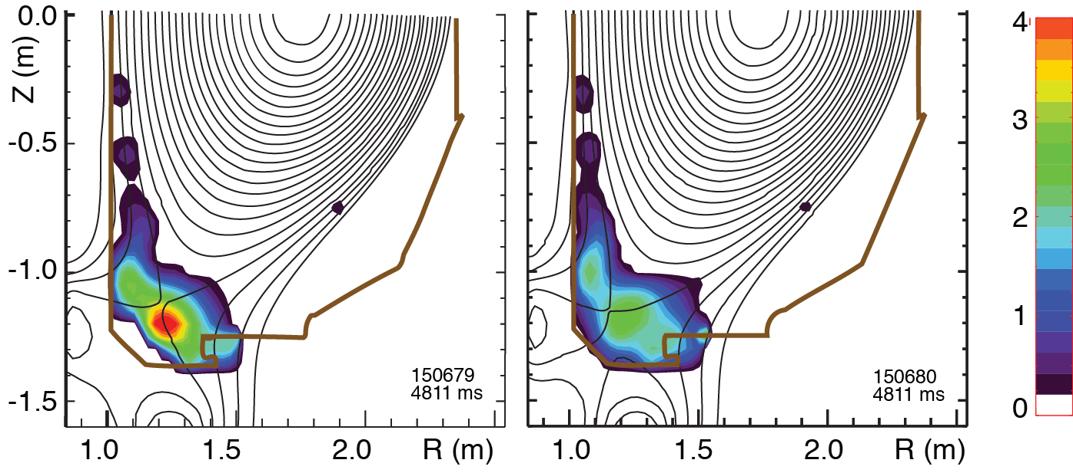
Heat flux in snowflake divertor is further reduced during partial detachment in DIII-D
Standard, Snowflake
In higher-density snowflake H-mode
  Density n_{e}/n_{G} = 0.55-0.75
  Partial detachment onset (n_{e}) similar in standard and snowflake (preliminary)
  Peak heat flux is up to 50 % lower in partially detached snowflake vs partially detached standard divertor
  Lower divertor rad. power broadly distributed in partially detached snowflake
  No MARFEs
Standard Snowflake

Slide 9
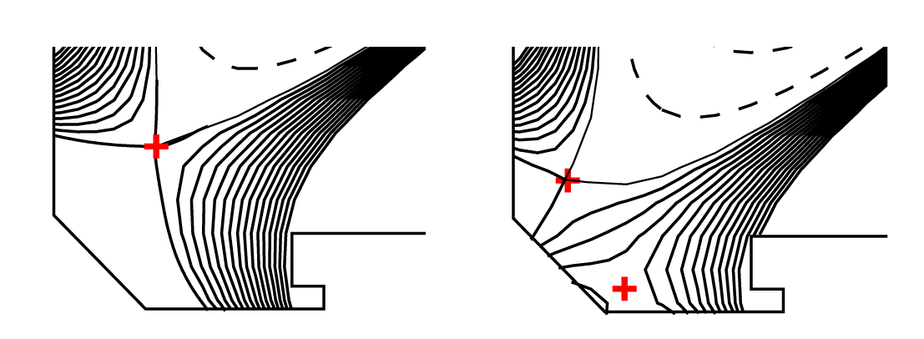
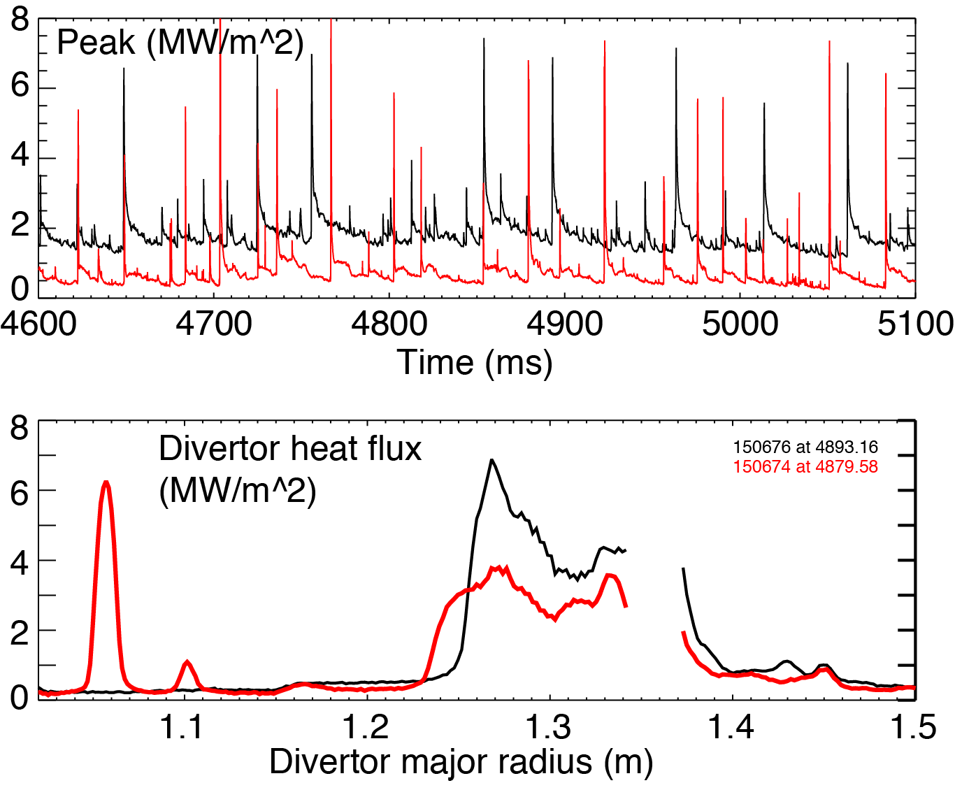
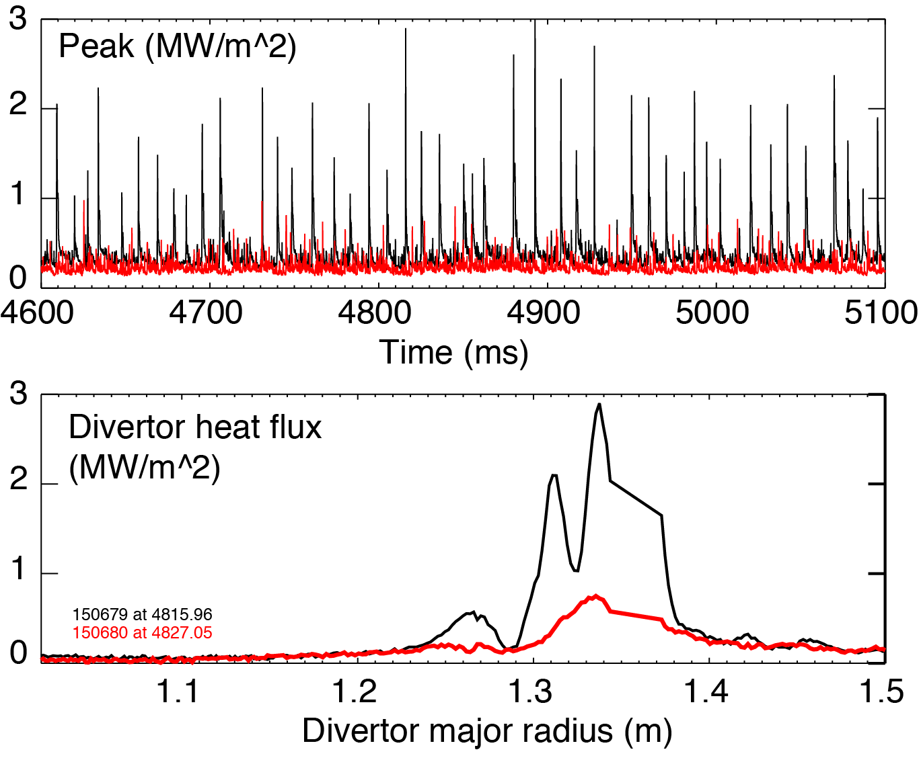
In DIII-D, Type-I ELM heat loads reduced in
D₂-seeded (partially detached) snowflake divertor
Standard Snowflake
At lower density, heat flux channels close to primary and second separatrices during ELMs
  Additional strike points
At high density (partial detachment), ELM heat flux significantly reduced
  50-75 % lower than in standard partially detached
n_{e}/n_{G} = 0.45
Standard Snowflake
n_{e}/n_{G} = 0.60
Snowflake

Slide 10



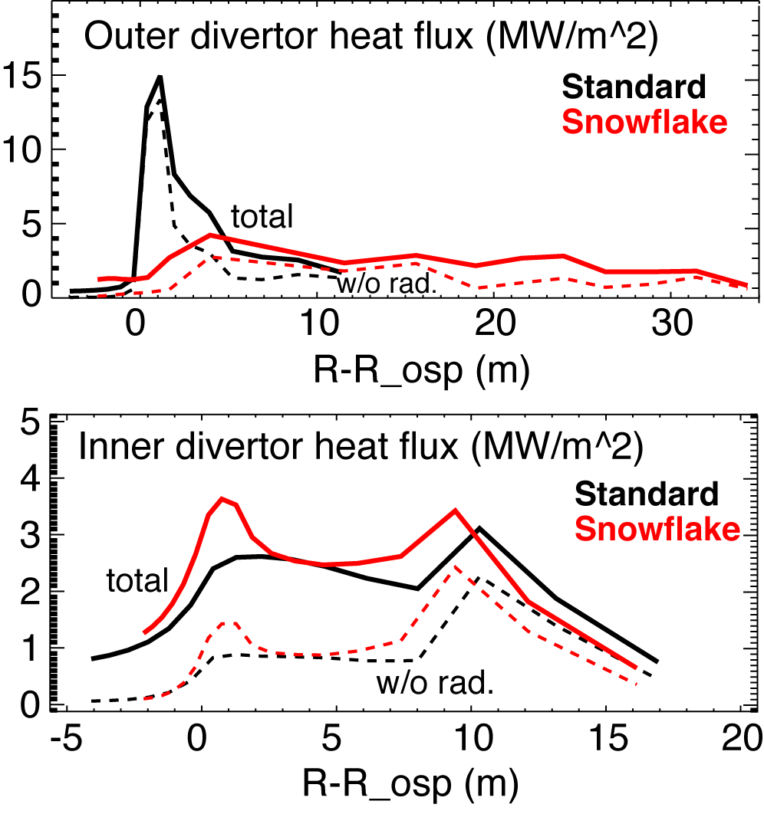
Snowflake divertor is a leading heat flux mitigation candidate for NSTX-Upgrade
Predictions for 12 MW NBI
  2D multifluid code UEDGE
  P_{SOL}=9 MW, 4 % carbon
  D, χ to match λ_{q}
  Outer divertor attached
    T_{e}, T_{i} ≤ 80 eV
New center-stack
2nd neutral beam
B_{T}
I_{p}
1 T
P_{NBI}
pulse
12 MW
2 MA
5 s
NSTX-U Mission elements:
  Advance ST as candidate for Fusion Nuclear Science Facility
  Develop solutions for the plasma-material interface challenge
  Explore unique ST parameter regimes to advance predictive capability for ITER
  Develop ST as fusion energy system

Slide 11
Developing the Power Exhaust Solution for the Tokamak with the Snowflake Divertor in NSTX and DIII-D
  Large zone of low poloidal field in divertor resulting in significant geometry benefits for heat exhaust
  Steady-state configurations with existing divertor coils
  Significant peak divertor heat flux reduction between and during Type I ELMs compatible with high H-mode confinement
Initial confirmation of compatibility with cryo-pump density control
  Potential to combine with radiative divertor solution
Favorable projections for NSTX-Upgrade with 12 MW NBI power

Slide 12
Backup slides

Slide 13
Bibliography
Theory
D. D. Ryutov, PoP 14 (2007), 064502
D. D. Ryutov et al., Plasma Phys. Control. Fusion 52 (2010) 105001.
D. D. Ryutov, Contrib. Plasma Phys. 52 (2012) 539.
D. D. Ryutov et al., Plasma Phys. Control. Fusion 54 (2012) 124050
D. D. Ryutov et al., Paper TH/P4-18, IAEA FEC 2012
DIII-D
S. L. Allen et al., Paper PD/1-2, IAEA FEC 2012.
NSTX
V. A. Soukhanovskii et al., Nucl. Fusion 51 (2011) 012001.
V. A. Soukhanovskii et al., Phys. Plasmas 19 (2012) 082504.
V. A. Soukhanovskii et al., Paper EX/P5-21, IAEA FEC 2012.

Slide 14
Various techniques developed for reduction of heat fluxes q|| (divertor SOL) and q_{peak} (divertor target)
Recent ideas to improve standard divertor geometry
  Snowflake divertor (D. D. Ryutov, PoP 14, 064502 2007)
  X-divertor (M. Kotschenreuther et. al, IC/P6-43, IAEA FEC 2004)
  Super-X divertor (M. Kotschenreuther et. al, IC/P4-7, IAEA FEC 2008)

Slide 15
Heat flux mitigation is more challenging in compact divertor of spherical torus
NSTX
  I_{p} = 0.7-1.4 MA, t_{pulse} < 1.5 s, P_{in} ≤ 7.4 MW (NBI)
  ATJ and CFC graphite PFCs
  P / R ~ 10
  q_{pk} ≤ 15 MW/m²
  q|| ≤ 200 MW/m²
Quantity | NSTX | DIII-D
Aspect ratio | 1.4-1.5 | 2.7
In-out plasma boundary area ratio | 1:3 | 2:3
X-point to target parallel length L_{x} (m) | 5-10 | 10-20
Poloidal magnetic flux expansion f_{exp} at outer SP | 5-30 | 3-15
Magnetic field angle at outer SP (deg.) | 1-10 | 1-2

Slide 16
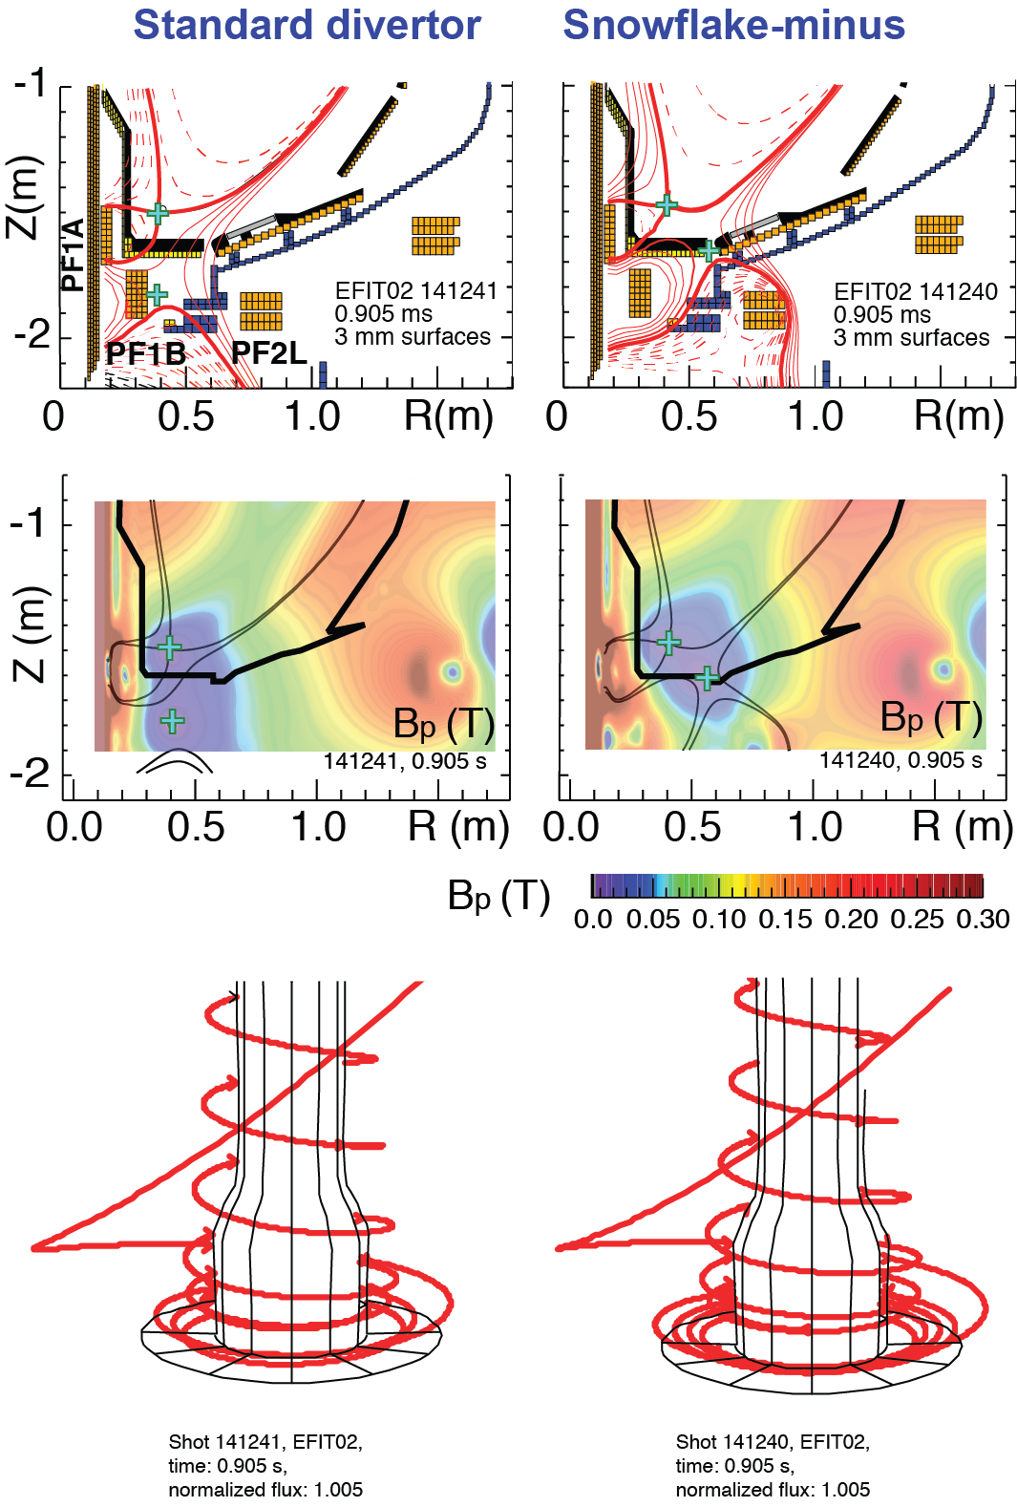
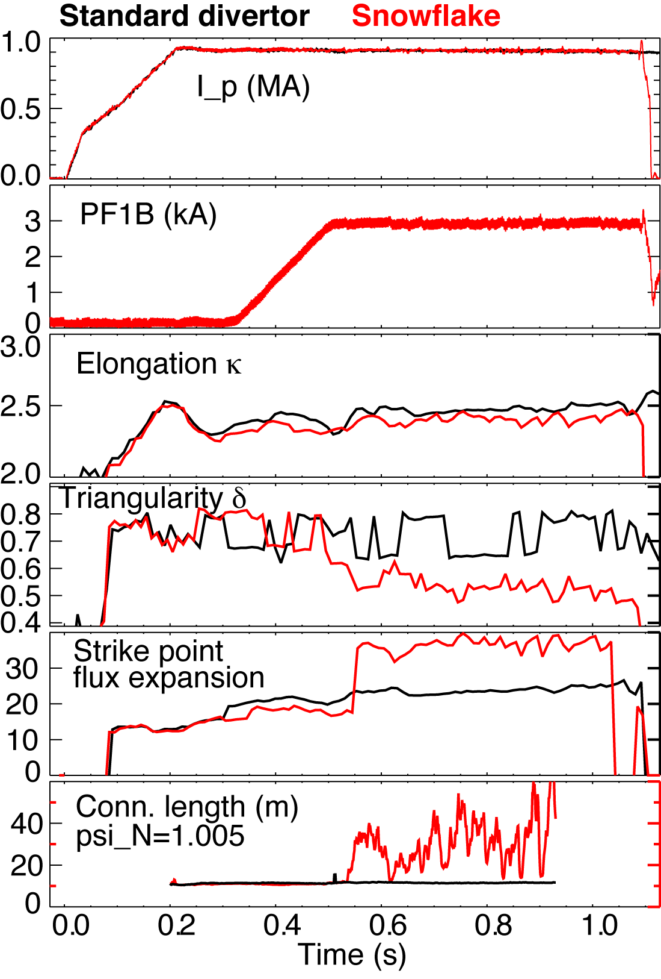
Snowflake divertor configurations obtained with existing divertor coils in NSTX

Slide 17
Snowflake divertor configurations obtained with existing divertor coils, maintained for up to 10 τ_{E}

Slide 18
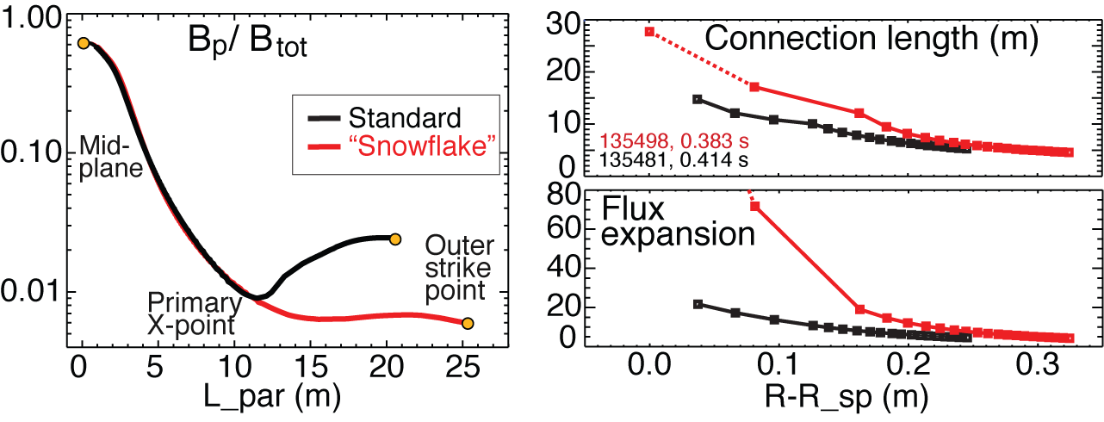
NSTX: Plasma-wetted area and connection length are increased by 50-90 % in snowflake divertor
These properties observed in first 30-50 % of SOL width (λ_{q}~6 mm)
B_{tot} angles in the strike point region: 1-2º, sometimes < 1º
  Concern for hot-spot formation and sputtering from divertor tile edges
  Can be alleviated by q|| reduction due to radiative detachment and power partitioning between strike points

Slide 19
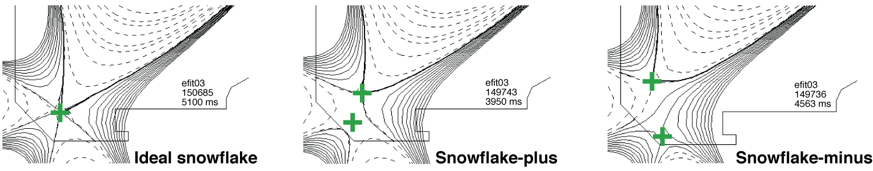
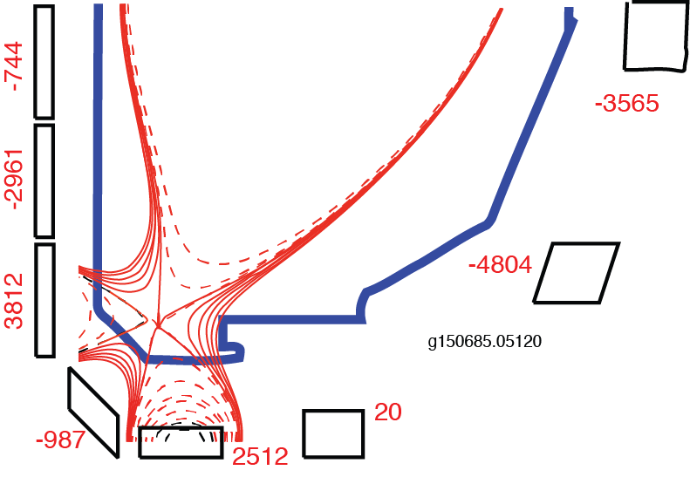
Snowflake divertor configurations obtained with existing divertor coils in DIII-D

Slide 20
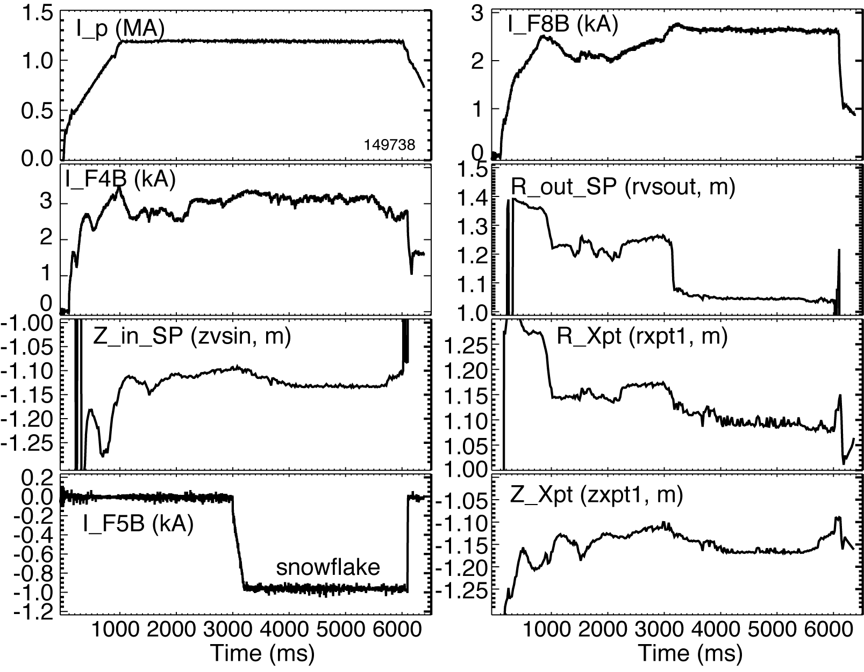
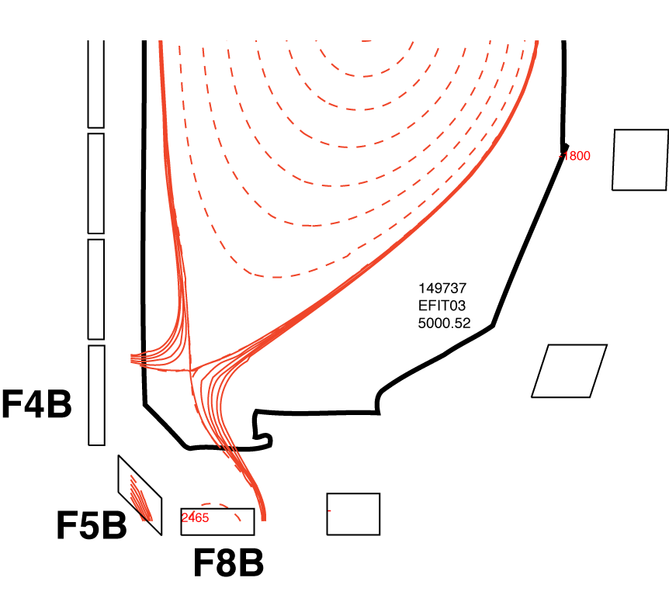
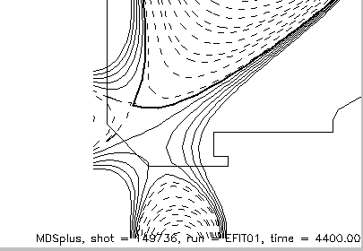
Snowflake configurations obtained from the standard divertor using an algorithm developed at NSTX
+
Grad-Shafranov equilibria modeling of possible configurations
Inner and outer strike point positions controlled by PCS using F4B and F8B coils
Secondary null-point formed and pushed in using F5B
+
+

Slide 21
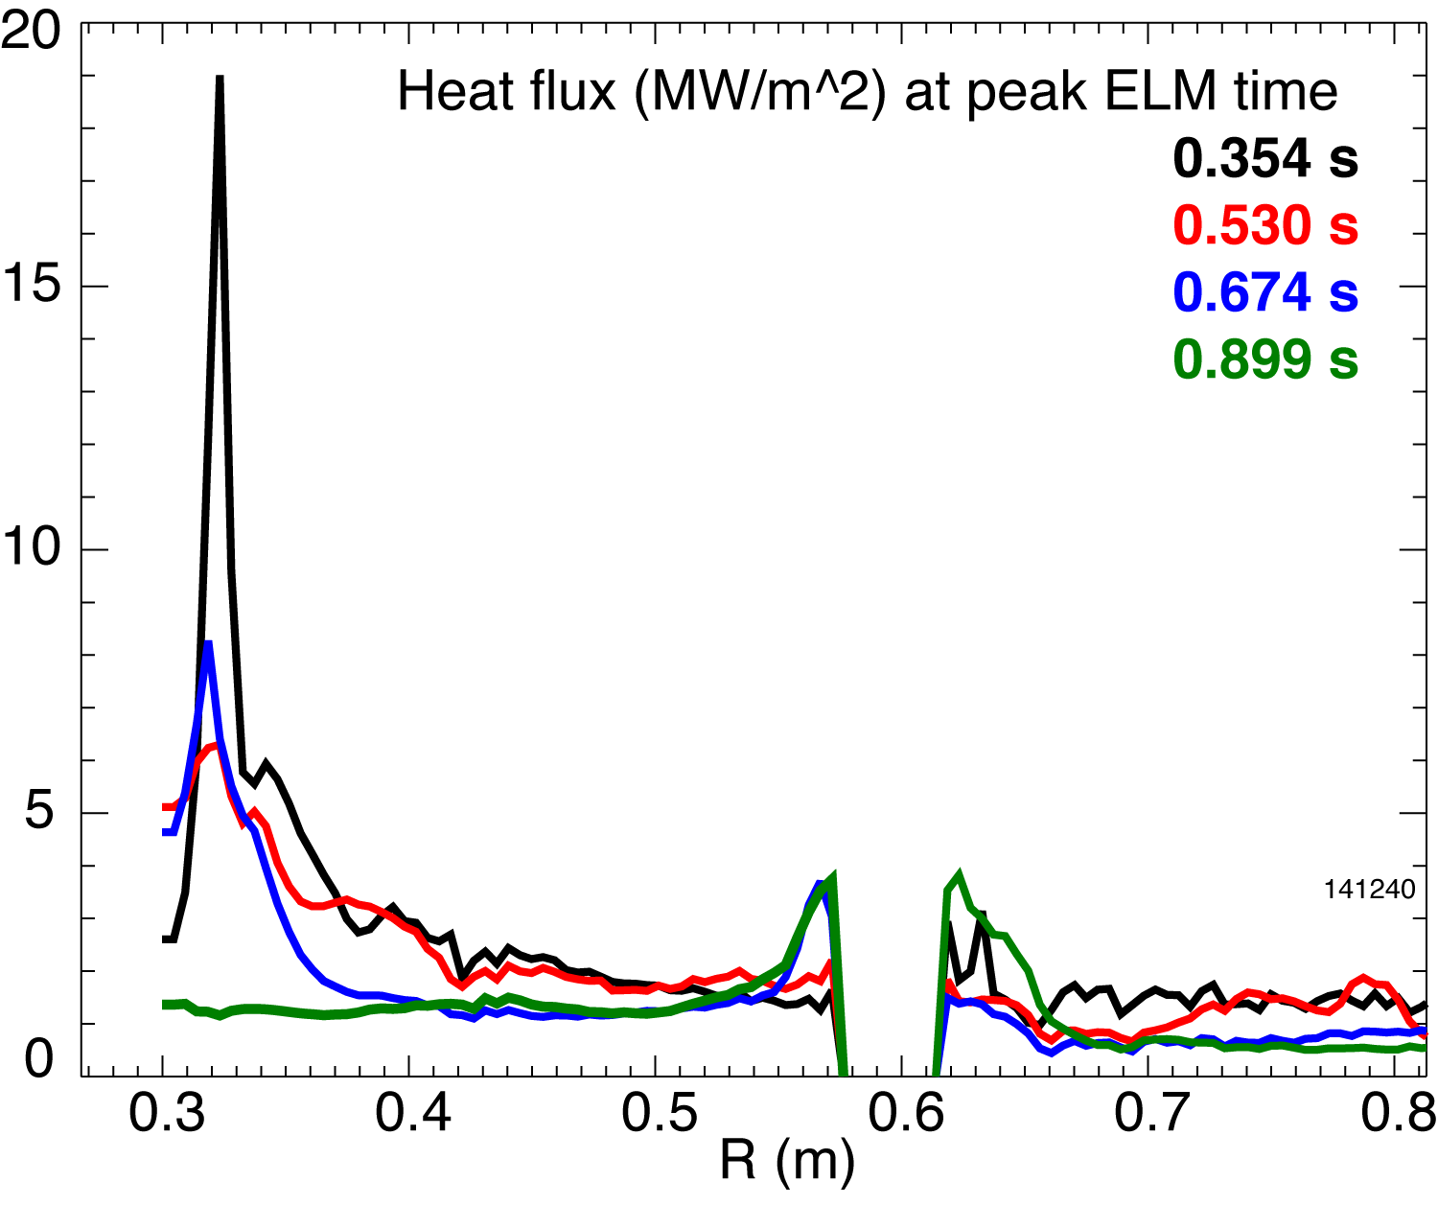
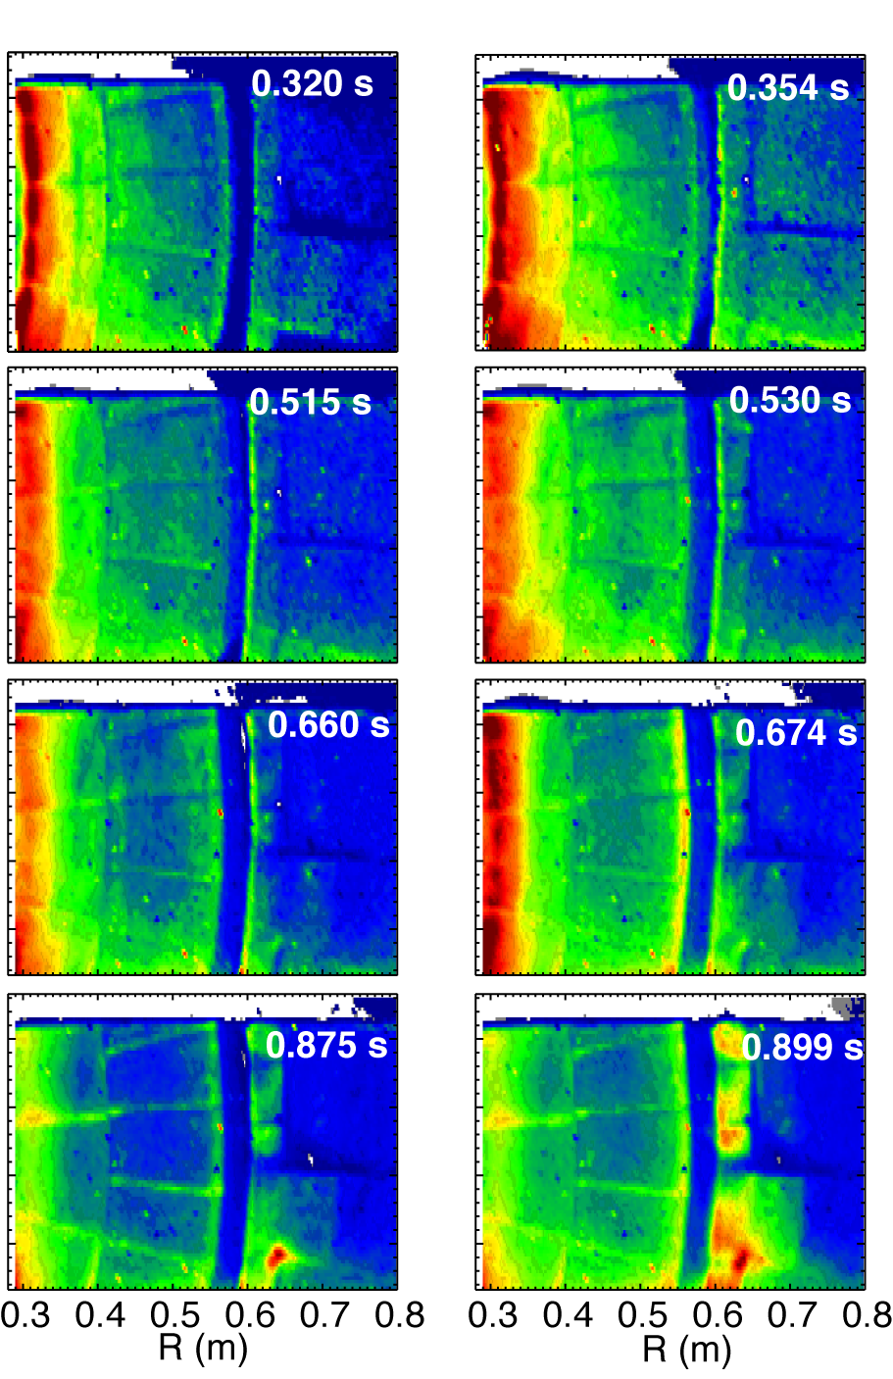

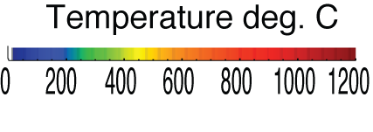
Impulsive heat loads due to Type I ELMs are mitigated in snowflake divertor
Steady-state At ELM peak
H-mode discharge, W_{MHD} ~ 220-250 kJ
  Type I ELM (W/ΔW ~ 5-8 %)

Slide 22
  Good H-mode confinement properties and core impurity reduction obtained with snowflake divertor
0.9 MA, 4 MW H-mode
κ=2.1, δ=0.8
Core T_{e} ~ 0.8-1 keV, T_{i} ~ 1 keV
β_{N} ~ 4-5
Plasma stored energy ~ 250 kJ
H98(y,2) ~ 1 (from TRANSP)
ELMs
  Suppressed in standard divertor H-mode via lithium conditioning
  Re-appeared in snowflake H-mode
Core carbon reduction due to
  Type I ELMs
  Edge source reduction
    Divertor sputtering rates reduced due to partial detachment

Slide 23
Core carbon density significantly reduced with snowflake divertor
Standard divertor Snowflake

Slide 24
  Good H-mode confinement properties retained or slightly reduced with CD₄-seeded snowflake divertor
Standard
Snowflake
Radiative divertor w/ CD₄
Snowflake+CD₄

Slide 25
Divertor profiles show enhanced radiation and recombination zone in snowflake divertor w/ and w/o CD₄
Standard
Snowflake
Radiative divertor w/ CD₄
Snowflake+CD₄

Slide 26
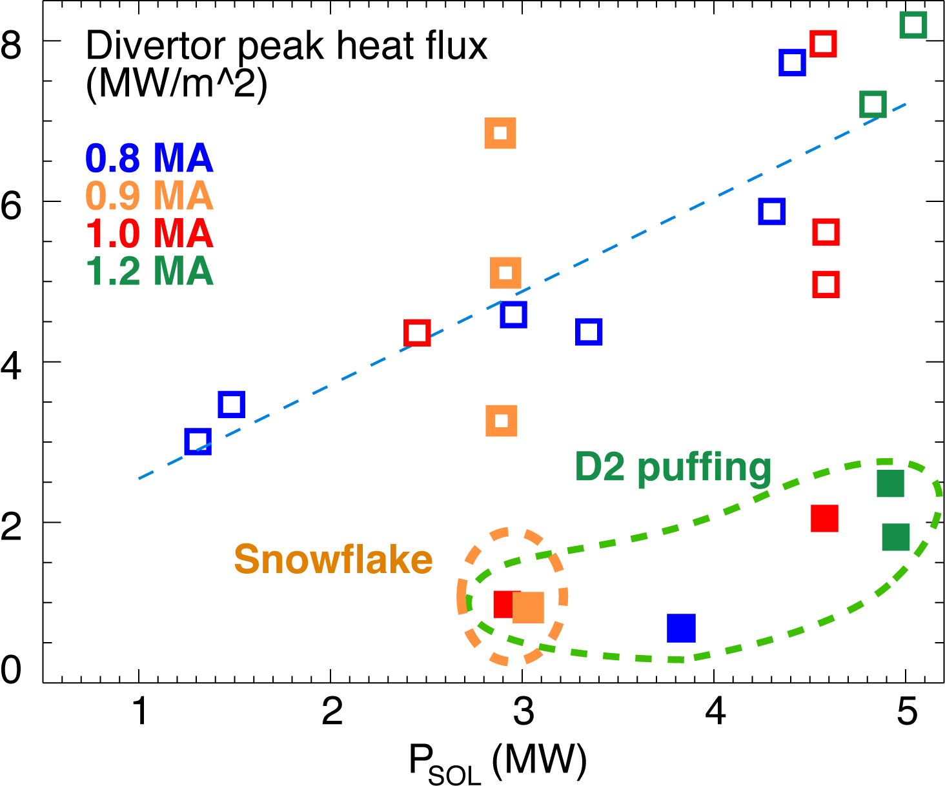
NSTX: Access to radiative detachment with intrinsic carbon in snowflake divertor facilitated
Snowflake divertor (*): P_{SOL}~3-4 MW, f_{exp}~40-60, q_{peak}~0.5-1.5 MW/m²
  Low detachment threshold
  Detachment characteristics comparable to PDD with D₂ or CD₄ puffing

Slide 27
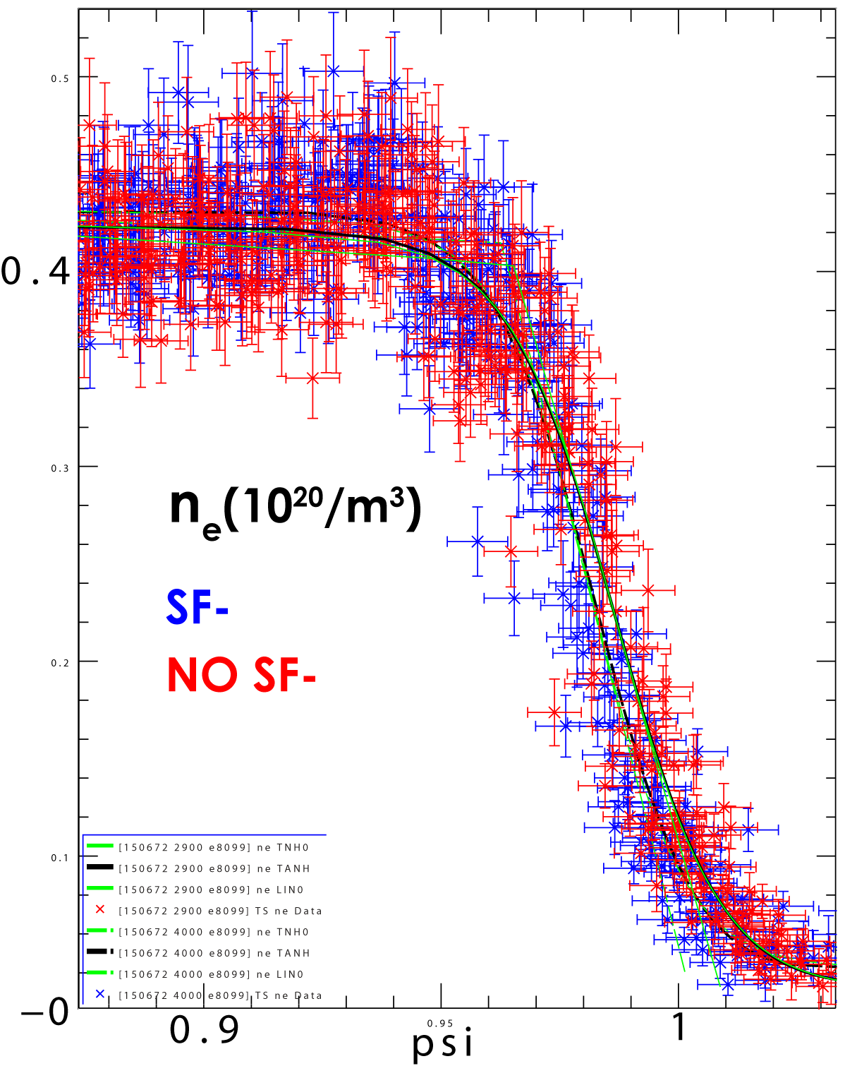
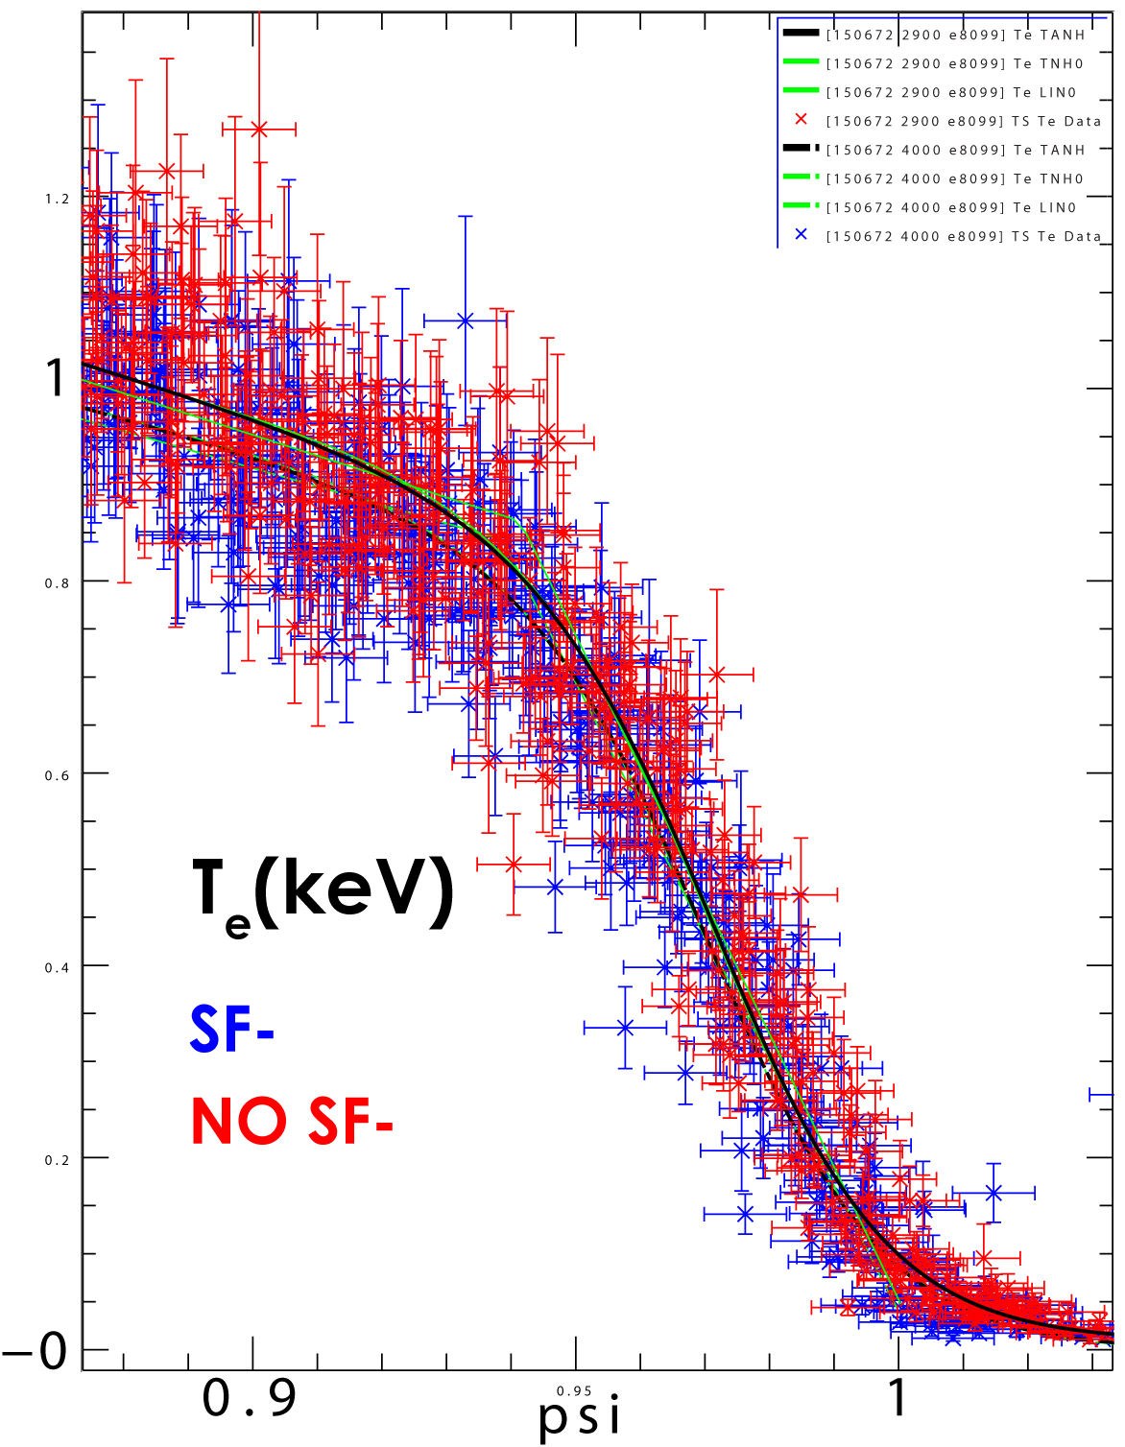
Pedestal profiles very similar with and without SF(-)
Slightly steeper and higher n_{e}, lower and flatter T_{e} with SF-
Electron Density n_{e}
Electron Temperature T_{e}
S. L. Allen et al., Paper PD/1-2, IAEA FEC 2012.

Slide 28
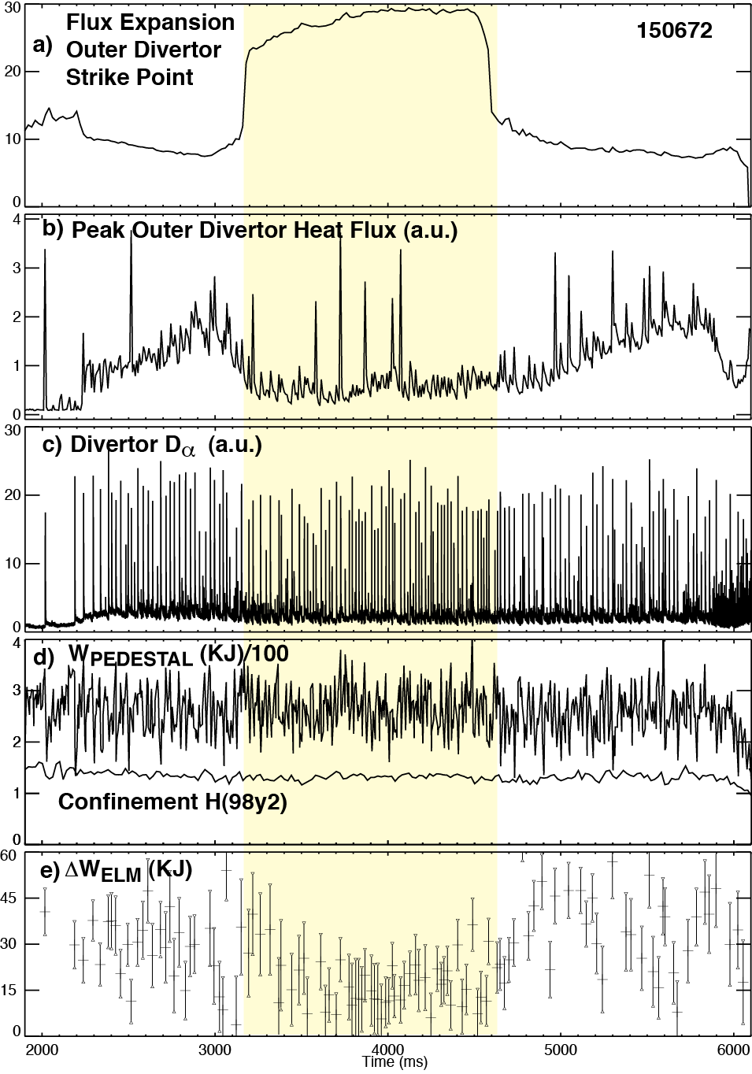
Detailed ELM Analysis: ΔW(ELM) decreased,
W pedestal constant in SF
Detailed ELM analysis before/during SF shows:
Pedestal Energy (W_{PEDESTAL}) Constant
Confinement Constant
Change in stored energy lost per ELM (ΔW_{ELM}) is reduced
Consistent with Loarte connection length scaling
S. L. Allen et al., Paper PD/1-2, IAEA FEC 2012.

