Slide 1










Studies of ST-FNSF mission and performance dependence on device size
J. Menard¹, T. Brown¹,
J. Canik², L. El Guebaly³, S. Gerhardt¹, S. Kaye¹,
M. Ono¹, R. Raman⁴, S. Sabbagh⁵, V. Soukhanovskii⁶,
P. Titus¹, G. Voss⁷, A. Zolfaghari¹
¹Princeton Plasma Physics Laboratory, Princeton, NJ 08543
²Oak Ridge National Laboratory, Oak Ridge, TN, USA
³University of Wisconsin, Madison, WI, USA
⁴University of Washington, Seattle, WA, USA
⁵Columbia University, New York, NY, USA
⁶Lawrence Livermore National Laboratory, Livermore, CA, USA
⁷Culham Centre for Fusion Energy, Abingdon, Oxfordshire, UK
1st IAEA DEMO Programme Workshop
UCLA - Faculty Center, California Room
Los Angeles, CA U.S.A.
15-18 October 2012
This work supported by the US DOE Contract No. DE-AC02-09CH11466

Slide 2
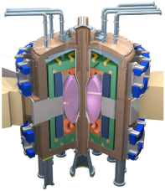
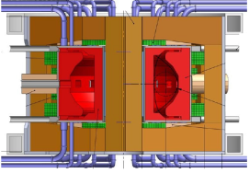

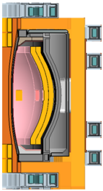
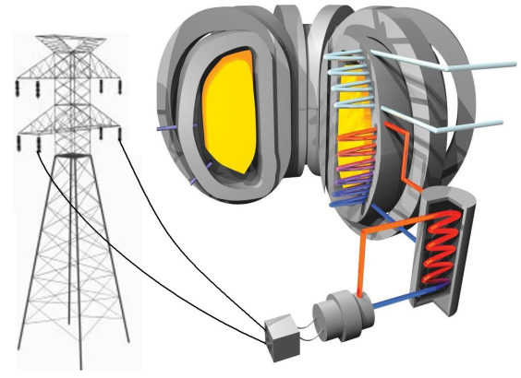
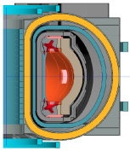
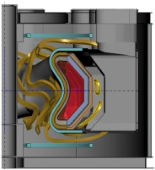
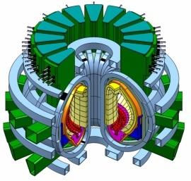
There are many possible pathways from ITER to commercial fusion power plant
FNSF = Fusion Nuclear Science Facility
CTF = Component Test Facility
ITER
FNSF/CTF
Blanket R&D, T self-sufficiency
First of a kind
Power Plant
Pilot Plant
FNSF/CTF with power-plant like maintenance, Q_{eng} ≥ 1
Supporting Physics and Technology
Core Physics
Materials R&D
Plasma Material Interface
Q_{eng} = 3-5
e.g. EU Demo

Slide 3
This talk focuses on possible spherical tokamak (ST) contributions ranging from FNSF to Pilot Plant
FNSF = Fusion Nuclear Science Facility
CTF = Component Test Facility
ITER
FNSF/CTF
Blanket R&D, T self-sufficiency
First of a kind
Power Plant
Pilot Plant
FNSF/CTF with power-plant like maintenance, Q_{eng} ≥ 1
Supporting Physics and Technology
Core Physics
Materials R&D
Plasma Material Interface
Q_{eng} = 3-5
e.g. EU Demo

Slide 4
Outline
Motivation for study
Physics basis for operating points
Performance vs. device size
Tritium breeding ratio calculations
Divertor poloidal field coil layout and design
Power exhaust calculations
Maintenance strategies
Summary

Slide 5
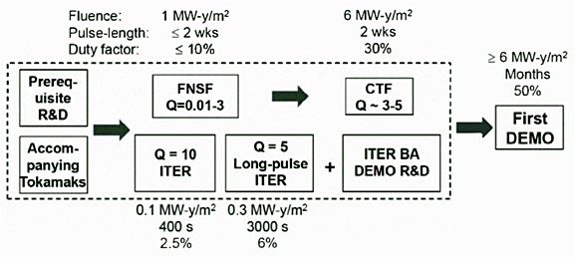
Successful operation of upgraded STs (NSTX-U/MAST-U) could provide basis for design, operation of ST-based FNSF
Fusion Nuclear Science Facility (FNSF) mission:
  Provide continuous fusion neutron source to develop knowledge-base for materials and components, tritium fuel cycle, power extraction
FNSF → CTF would complement ITER path to DEMO
M. Peng et al., IEEE/NPSS Paper S04A-2 - 24th SOFE Conf. (2011)
Studying wide range of ST-FNSF configurations to identify advantageous features, incorporate into improved ST design
Investigating performance vs. device size
  Require: W_{neutron} ≥ 1 MW/m², test area ≥ 10 m², volume ≥ 5 m³
M. Abdou et al. Fus. Technol. 29 (1996) 1

Slide 6
Outline
Motivation for study
Physics basis for operating points
Performance vs. device size
Tritium breeding ratio calculations
Divertor poloidal field coil layout and design
Power exhaust calculations
Maintenance strategies
Summary

Slide 7


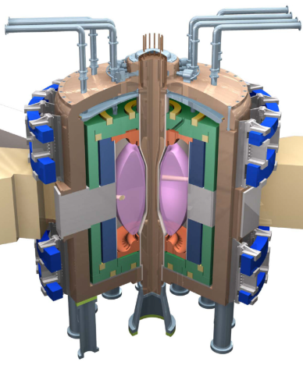
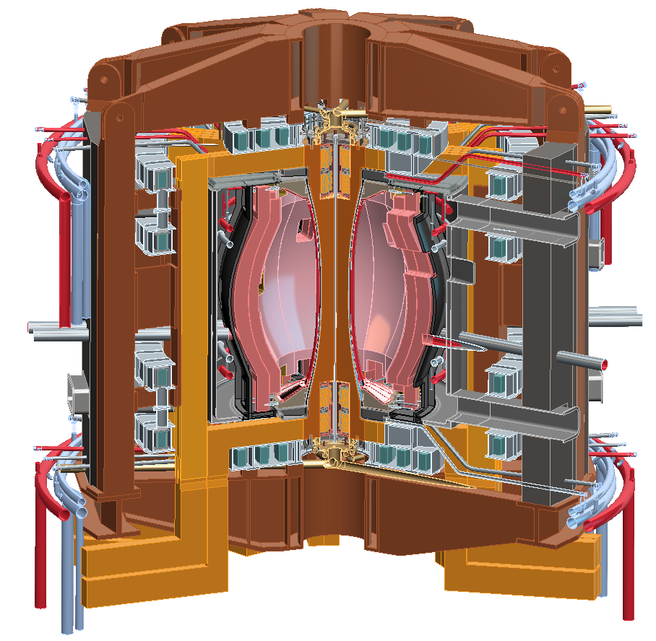
NSTX-U will access next factor of 2 increase in performance to reduce extrapolation to ST-based FNSF/CTF/Pilot
Parameter | NSTX | NSTX Upgrade | Fusion Nuclear Science Facility | Pilot Plant
Major Radius R₀ [m] | 0.86 | 0.94 | 1.3 | 1.6 – 2.2
Aspect Ratio R₀ / a | ≥ 1.3 | ≥ 1.5 | ≥ 1.5 | ≥ 1.7
Plasma Current [MA] | 1 | 2 | 4 – 10 | 11 – 18
Toroidal Field [T] | 0.5 | 1 | 2 – 3 | 2.4 – 3
Auxiliary Power [MW] | ≤ 8 | ≤ 19* | 22 – 45 | 50 – 85
P/R [MW/m] | 10 | 20 | 30 – 60 | 70 – 90
P/S [MW/m²] | 0.2 | 0.4 | 0.6 – 1.2 | 0.7 – 0.9
Fusion Gain Q |  |  | 1 – 2 | 2 – 10
* Includes 4MW of high-harmonic fast-wave (HHFW) heating power
Achievable confinement
Non-inductive ramp-up and sustainment
Divertor solutions for mitigating high heat flux
Radiation-tolerant magnets
Key issues to
resolve for FNSF

Slide 8
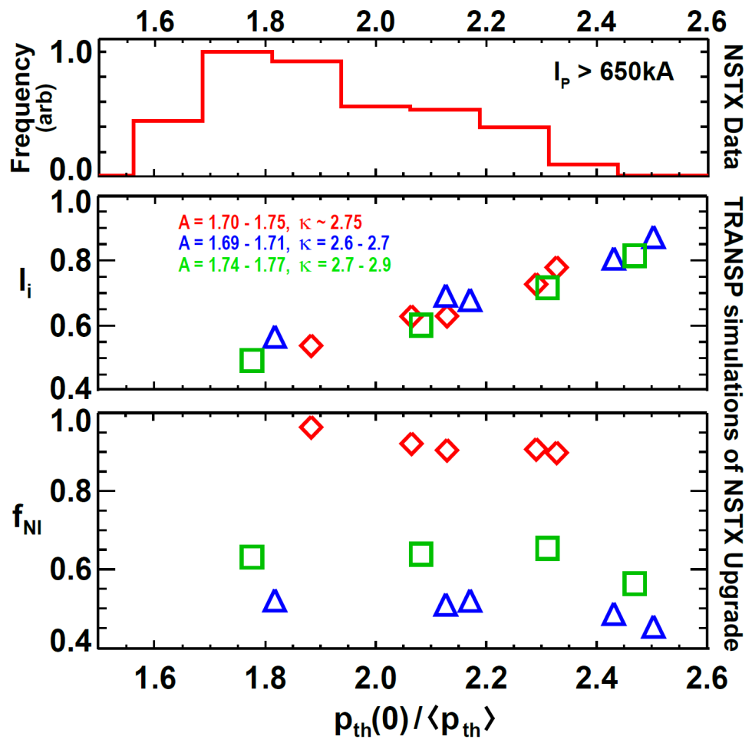
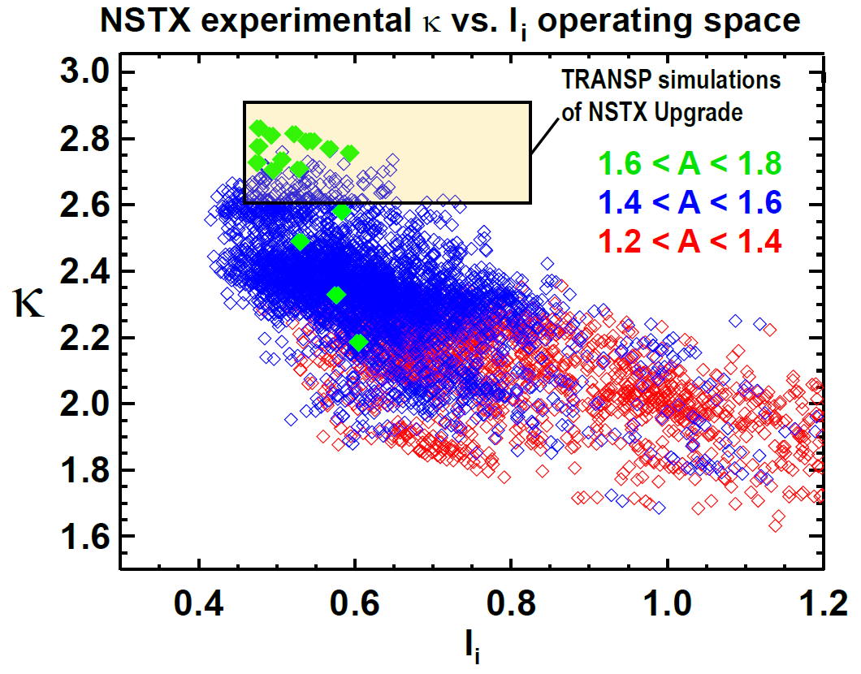
ST-FNSF operating point of A=1.7, l_{i} = 0.5, and κ=3 chosen to be at/near values anticipated for NSTX-U
Most probable NSTX thermal pressure peaking factor ~1.8
  If similar in NSTX-U/FNSF → full non-inductive l_{i} ~ 0.5 (BS + NBI)
NSTX A=1.7, l_{i} = 0.5 plasmas can operate stably at κ ~ 2.8
  Expect to improve n=0 control in NSTX-U → anticipate κ~3 possible in NSTX-U/FNSF

Slide 9
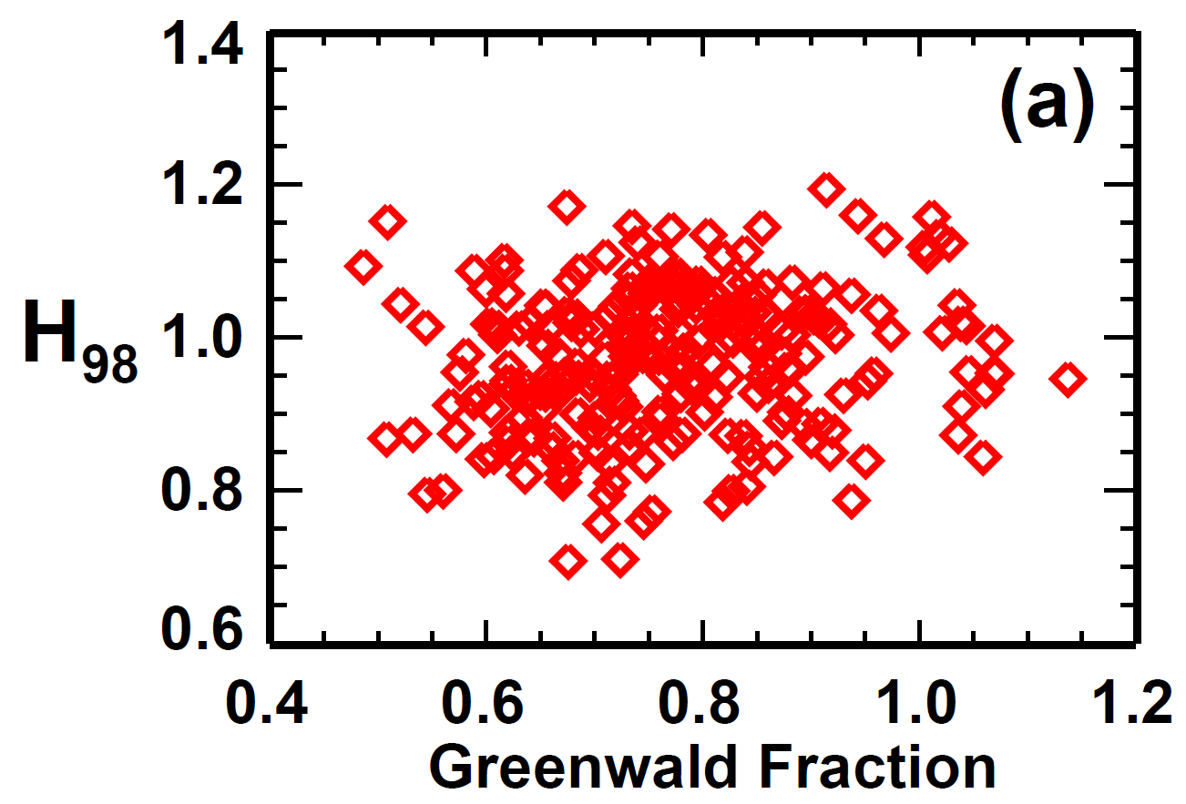
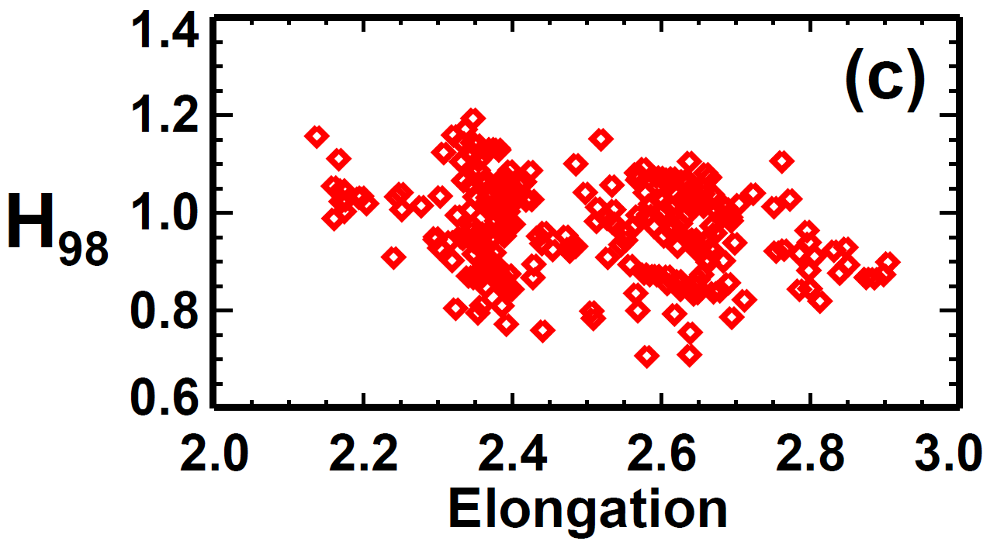
ST-FNSF operating point of f_{Greenwald} = 0.8, H_{98y,2}=1.2 chosen to be at/near values anticipated for NSTX-U
H_{98y,2} ~ 1.2 has been accessed for a range of Greenwald fractions
  However, much more research needs to be carried out in NSTX-U to determine if HH=1.2 can be achieved reliably
Also need to assess feasibility of routine access to H_{98y,2} ~ 1.2 at κ~3 in NSTX-U
Note: there is sufficient shaping margin to reduce κ to 2.7-2.9 for FNS mission, but H_{98y,2} ~ 1 would require much higher P_{aux} (~1.8×)

Slide 10
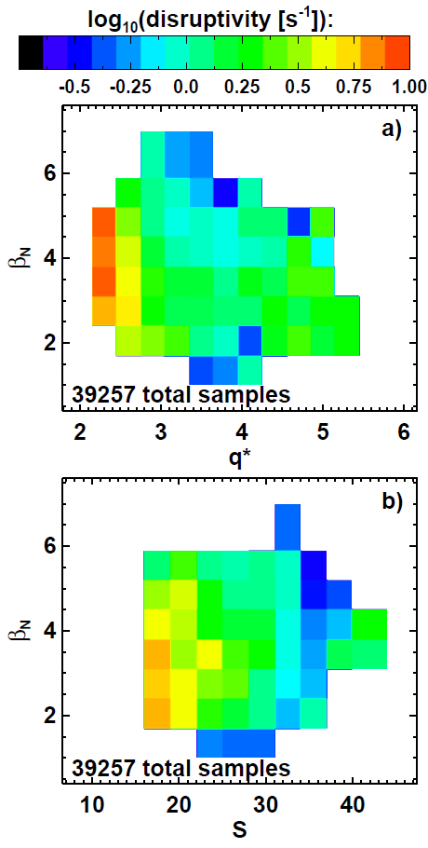
NSTX disruptivity data informs FNSF operating point with respect to global stability
Increased disruptivity for q* < 2.7
  Significantly increased for q* < 2.5
Lower disruptivity for β_{N} = 4-6 compared to lower β_{N}
  Higher β_{N} increases f_{BS}, broadens J profile, elevates q_{min}
  Operation above no-wall limit aided by:
    NBI co-rotation
    Close-fitting conducting wall
    Active error-field and RWM control
Strong shaping also important
  S ≡ q₉₅ I_{P}/aB_{T}
  S > 30 provides strongest stabilization
  S > 22-25 good stability
  S < 22 unfavorable
Gerhardt
IAEA FEC EX/9-3

Slide 11
Outline
Motivation for study
Physics basis for operating points
Performance vs. device size
Tritium breeding ratio calculations
Divertor poloidal field coil layout and design
Power exhaust calculations
Maintenance strategies
Summary

Slide 12
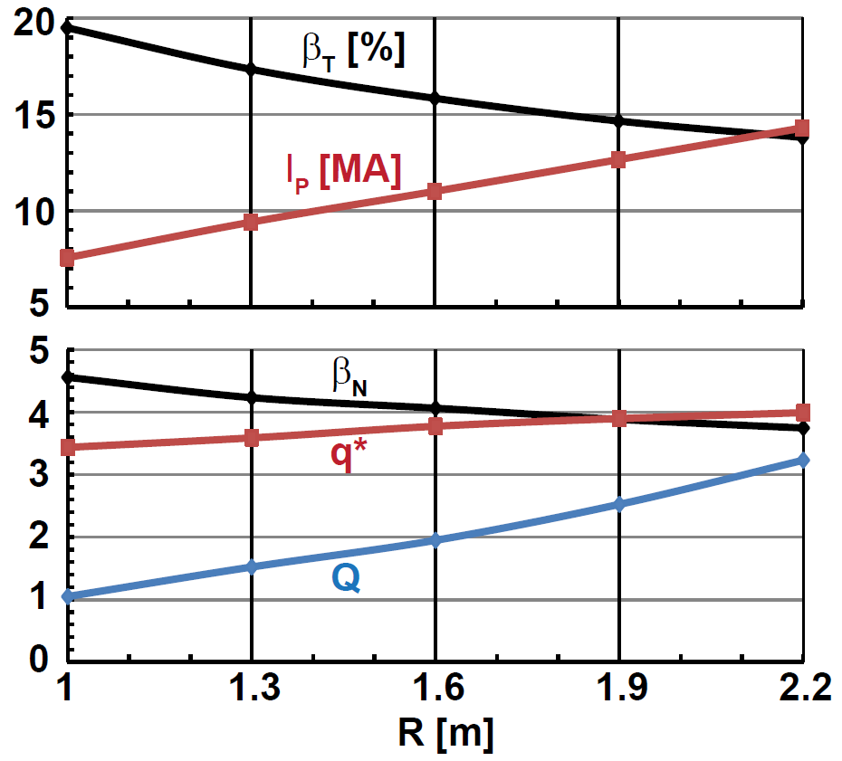
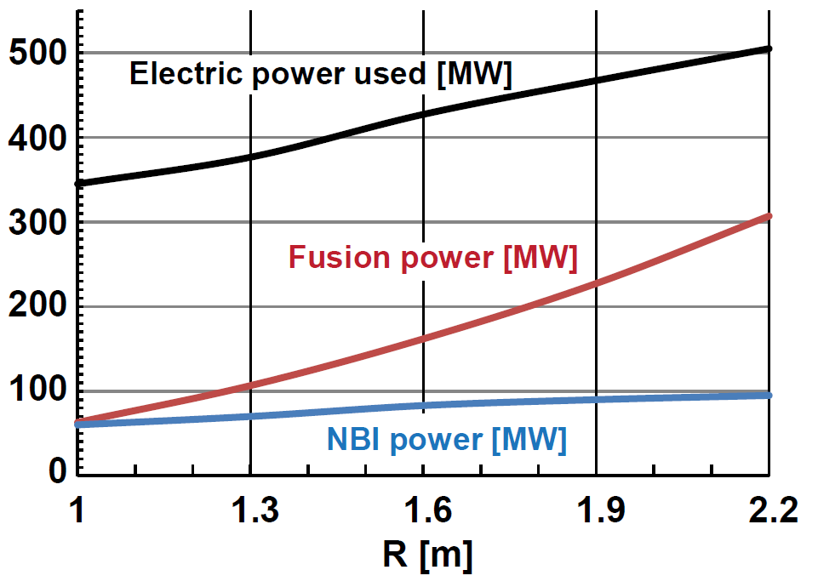
Increased device size provides modest increase in stability, but significantly increases tritium consumption
Scan R = 1m → 2.2m (smallest FNSF → pilot plant with Q_{eng} ~ 1)
Fixed average neutron wall loading = 1MW/m²
B_{T} = 3T, A=1.7, κ=3, H₉₈ = 1.2, f_{Greenwald} = 0.8
100% non-inductive: f_{BS} = 75-85% + NNBI-CD (E_{NBI}=0.5MeV JT60-SA design)
Larger R lowers β_{T} & β_{N}, increases q*
Comparable/higher β_{T} and β_{N} values already sustained in NSTX
Q = 1 → 3, P_{fusion} = 60MW → 300MW → 5× increase in T consumption

Slide 13
In addition to neutron wall loading and tritium breeding,
FNSF study also tracking overall electrical efficiency: Q_{eng}
Electricity produced
Electricity consumed
η_{th} = thermal conversion efficiency
η_{aux} = injected power wall plug efficiency
Q = fusion power / auxiliary power
M_{n} = neutron energy multiplier
P_{n} = neutron power from fusion
P_{α} = alpha power from fusion
P_{aux} = injected power (heat + CD + control)
P_{pump} = coolant pumping power
P_{sub} = subsystems power
P_{coils} = power lost in coils (Cu)
P_{control} = power used in plasma or plant control that is not included in P_{inj}
P_{extra} = P_{pump} + P_{sub} + P_{coils} + P_{control}
Note: blanket and auxiliary heating and current-drive efficiency + fusion gain largely determine Q_{eng}
    FNSF assumptions (from Pilot study):
    M_{n} = 1.1
    P_{pump} = 0.03×P_{th}
    P_{sub} + P_{control} = 0.04×P_{th}
    η_{aux} = 0.4 (presently unrealistically high)
    η_{CD} = I_{CD}R₀n_{e}/P_{CD} = 0.3 × 10²⁰A/Wm²
For more details see J. Menard, et al., Nucl. Fusion 51 (2011) 103014

Slide 14
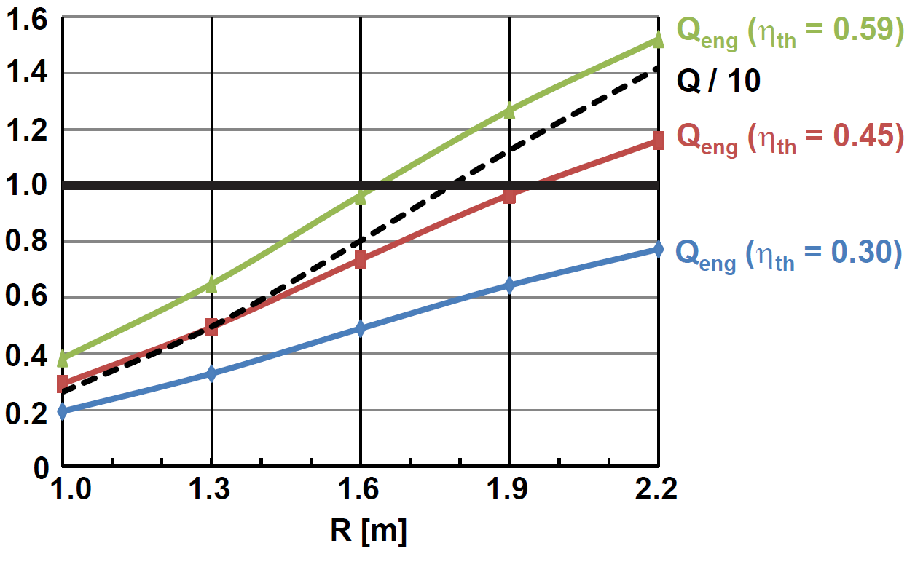
High performance scenarios can access increased neutron wall loading and engineering gain > 1 for sufficiently large R
Decrease B_{T} = 3T → 2.6T, increase H₉₈ = 1.2 → 1.5
Fix β_{N} = 6, β_{T} = 35%, q* = 2.5, f_{Greenwald} varies: 0.66 to 0.47
P_{electric} produced
P_{electric} consumed
Q_{eng} ≡
Note: Outboard PF coils are superconducting
Size scan: Q increases from 3 (R=1m) to 14 (R=2.2m)
Average neutron wall loading increases from 1.8 to 3 MW/m² (not shown)
Smallest ST for Q_{eng} ~ 1 is R=1.6m → requires very efficient blankets

Slide 15
Outline
Motivation for study
Physics basis for operating points
Performance vs. device size
Tritium breeding ratio calculations
Divertor poloidal field coil layout and design
Power exhaust calculations
Maintenance strategies
Summary

Slide 16
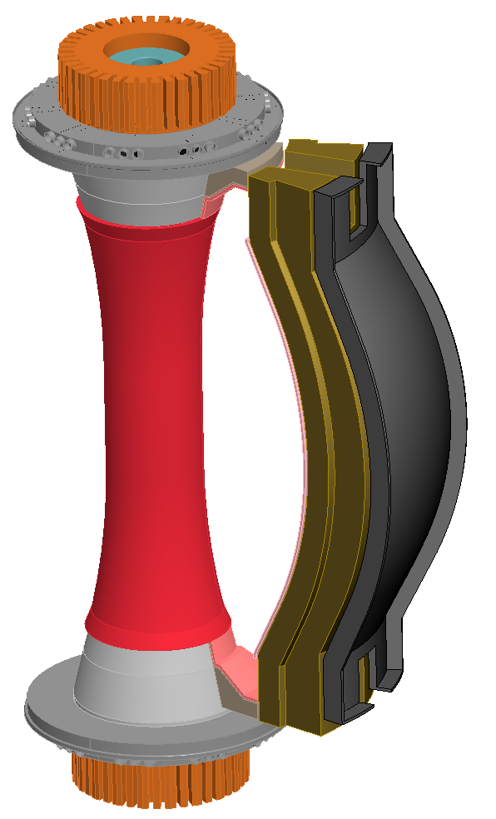
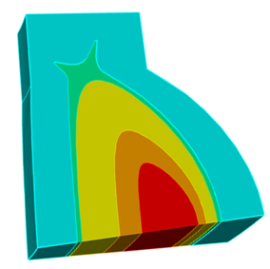
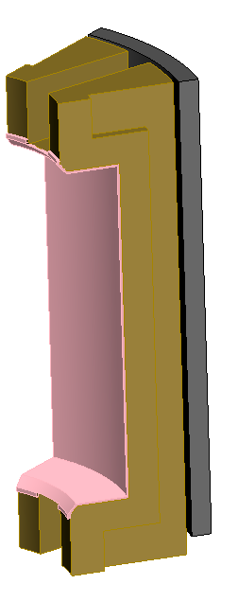
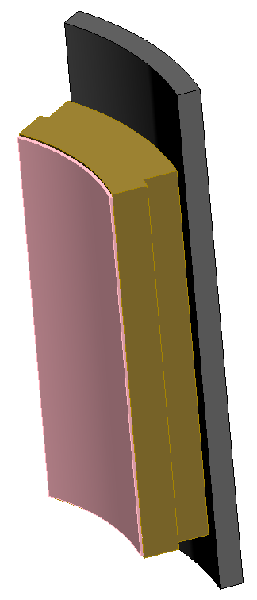
Cost of tritium and need to demonstrate T self-sufficiency motivate analysis of tritium breeding ratio (TBR)
Example costs of T w/o breeding at $0.1B/kg for R=1 → 1.6m
  FNS mission: 1MWy/m² $0.33B → $0.9B
  Component testing: 6MWy/m² $2B → $5.4B
Implications:
  TBR << 1 likely affordable for FNS mission with R ~ 1m
  Component testing arguably requires TBR approaching 1 for all R
Performing initial analysis of R=1.6m FNSF using conformal and straight blankets, ARIES-ST neutron source profiles:
5%
32%
Neutron Source
63%

Slide 17
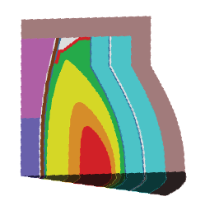
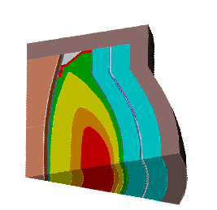
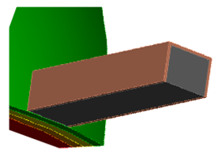
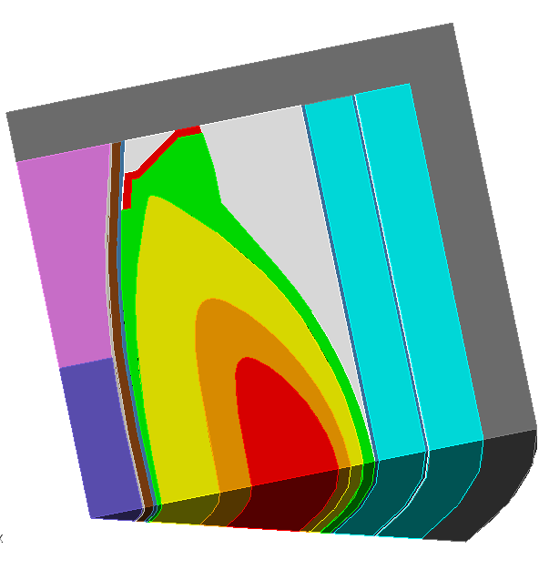
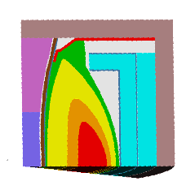
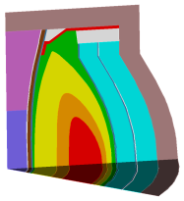
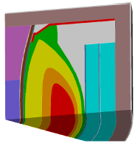
R=1.6m TBR calculations highlight importance of shells, penetrations, and top/bottom blankets
Extended
conformal blanket
+ 3cm thick stabilizing shell
Extended conformal + 3cm shell + NBI
NBI penetration at midplane
Stabilizing
shell
TBR = 1.02
10 NBI penetrations
TBR = 1.1
TBR = 1.07
Extended
straight blanket
Straight blanket
with flat top
Conformal blanket
Straight blanket
TBR = 1.046
TBR = 1.0
TBR = 0.8
TBR = 1.047

Slide 18
Outline
Motivation for study
Physics basis for operating points
Performance vs. device size
Tritium breeding ratio calculations
Divertor poloidal field coil layout and design
Power exhaust calculations
Maintenance strategies
Summary

Slide 19
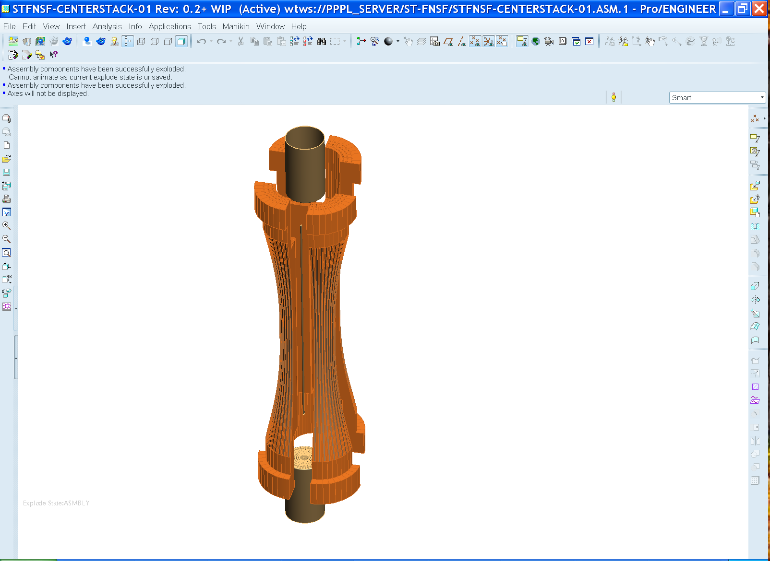
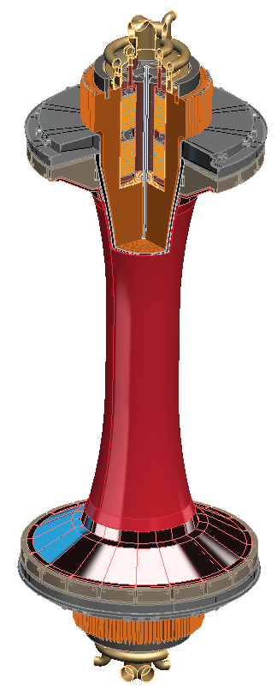
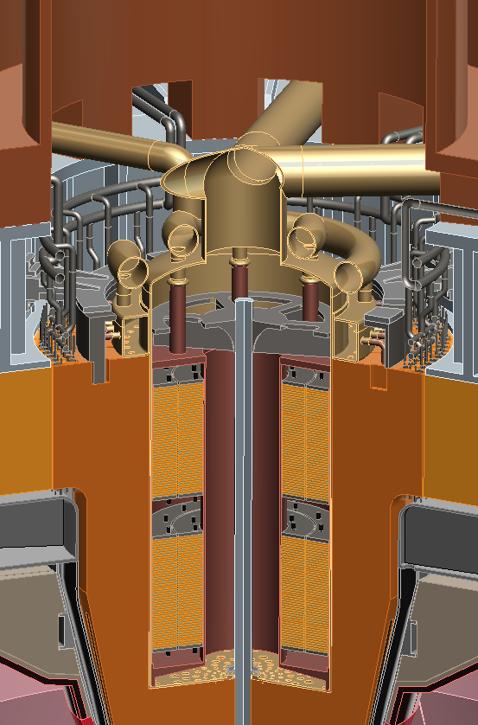
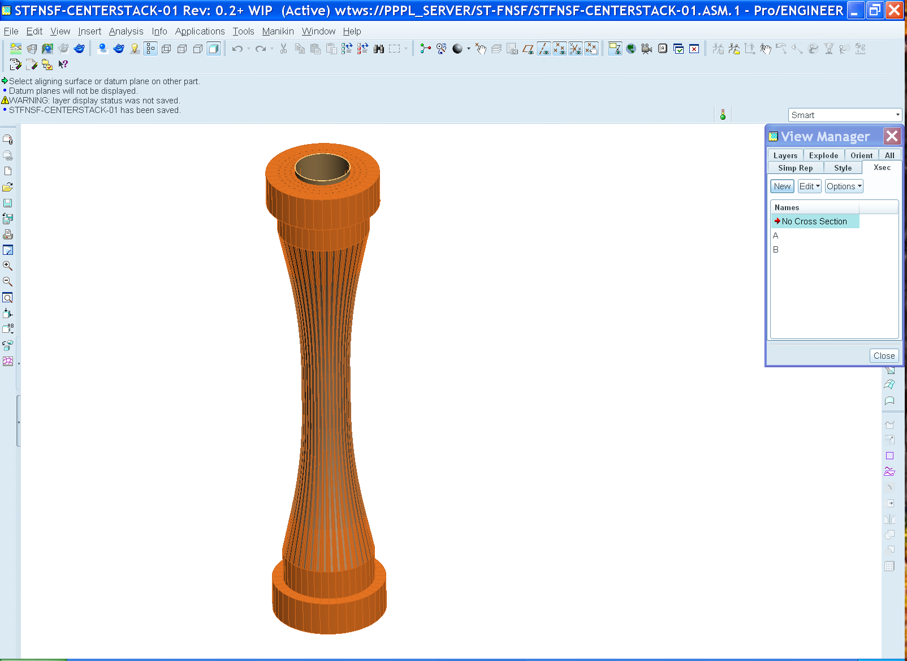
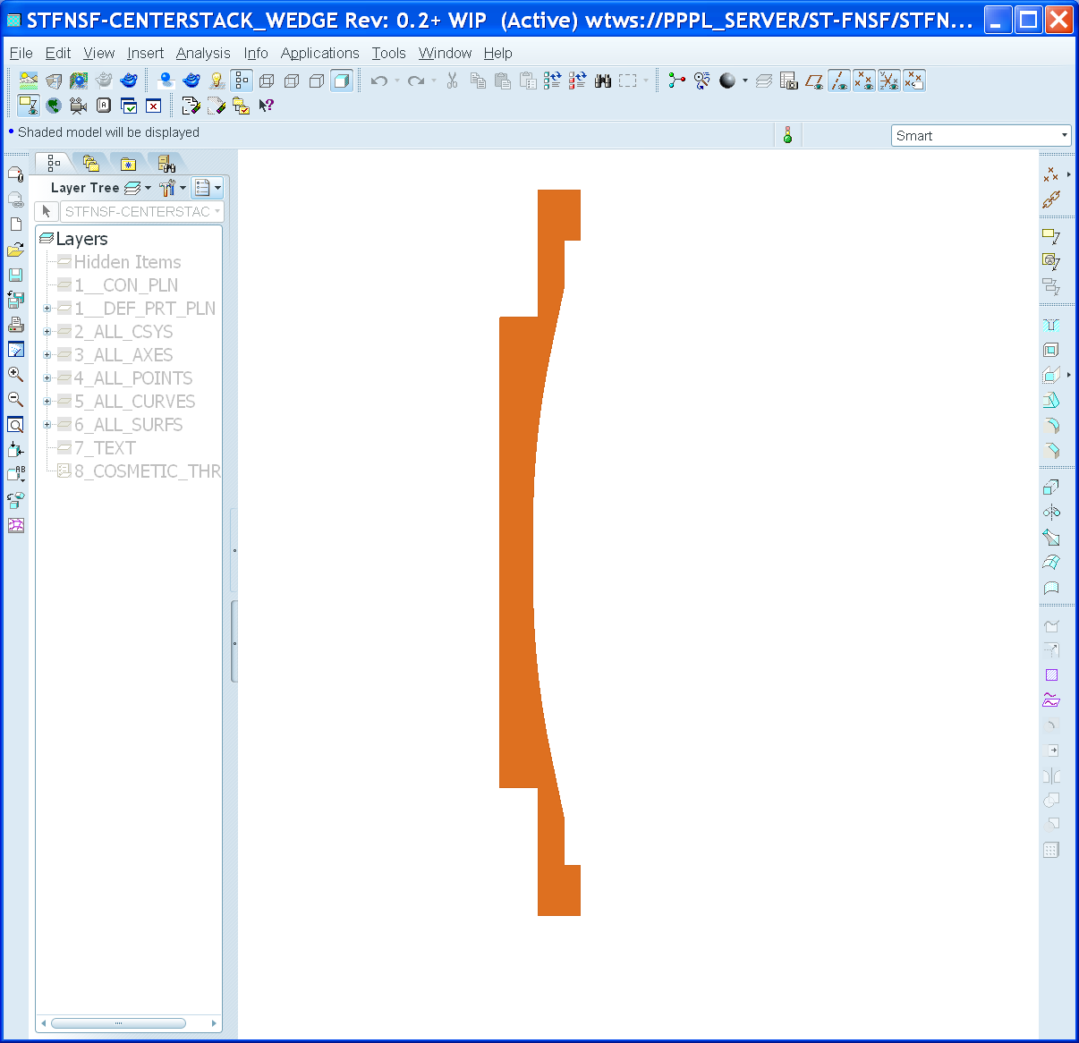
FNSF center-stack can build upon NSTX-U design and is incorporating NSTX stability results
Like NSTX-U, use TF wedge segments (but brazed/pressed-fit together)
  Coolant paths: gun-drilled holes or NSTX-U-like grooves in wedge + welded tube
Bitter-plate divertor PF magnets in ends of TF enable high triangularity
  NSTX data: High δ > 0.55 and shaping S ≡ q₉₅I_{P}/aB_{T} > 25 minimizes disruptivity
  Neutronics: MgO insulation can withstand lifetime (6 FPY) radiation dose

Slide 20
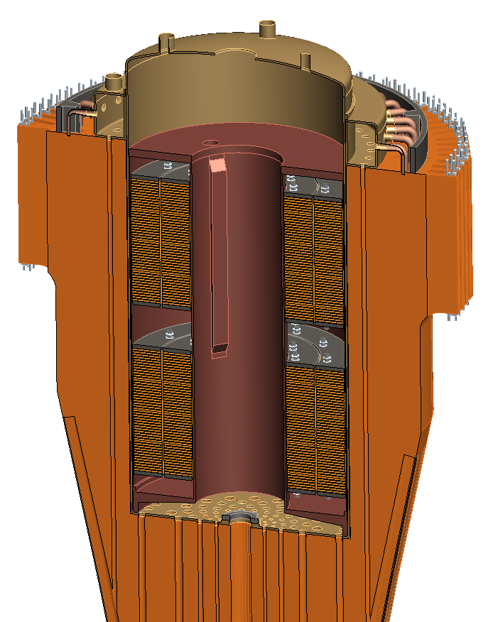
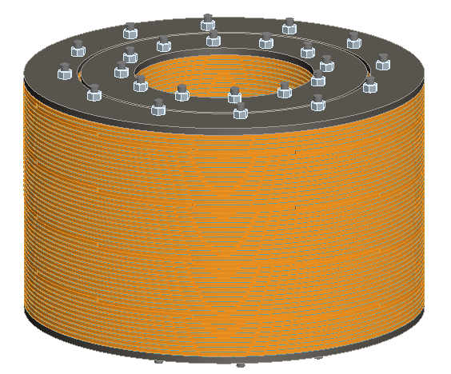
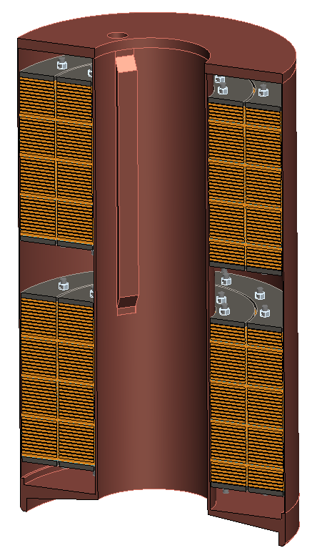
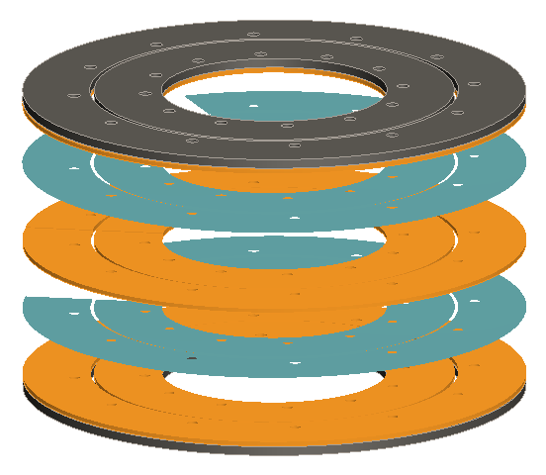
Bitter coil insert for divertor coils in ends of TF
Insulator
Glidcop plates

Slide 21
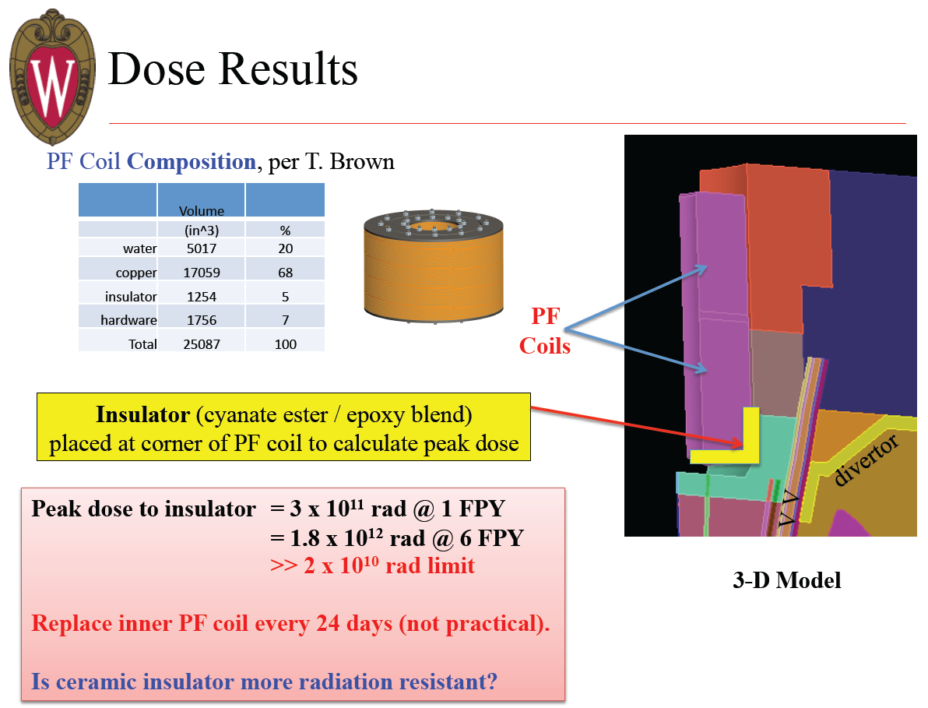
Neutronics analysis indicates organic insulator for divertor PF coils unacceptable

Slide 22
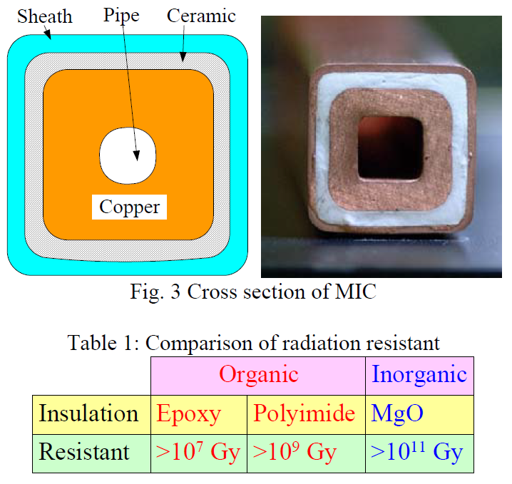
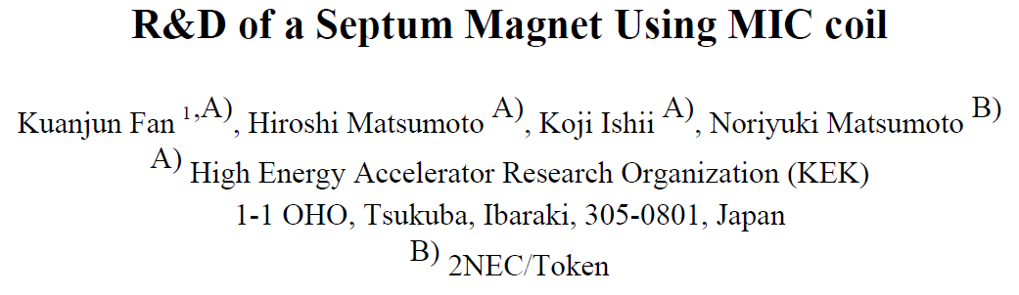
MgO insulation appears to have good radiation resistance for divertor PF coils
UW analysis of divertor PFs
  1.8x10¹² rad = 1.8x10¹⁰ Gy at 6FPY for P_{fus} = 160MW
Pilot mission for R=1.6m:
  P_{fus} = 420MW vs. 160MW → 2.6x higher → 4.7x10¹⁰ Gy
  Even for Pilot mission, dose is < limit of 10¹¹ Gy
Limiting factor may be Cu
Need to analyze CS lifetime
Revisit option for multi-turn TF and small OH solenoid

Slide 23
Outline
Motivation for study
Physics basis for operating points
Performance vs. device size
Tritium breeding ratio calculations
Divertor poloidal field coil layout and design
Power exhaust calculations
Maintenance strategies
Summary

Slide 24
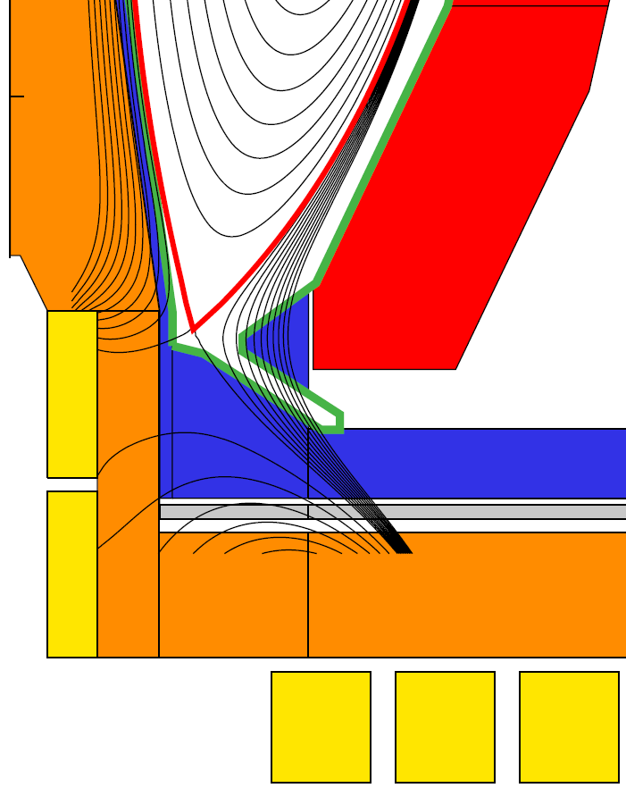
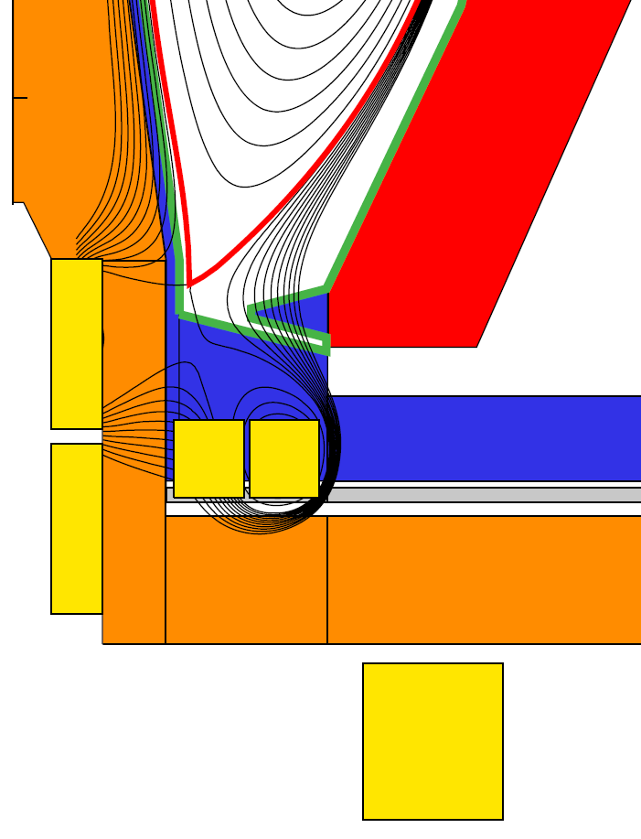
Divertor PF coil configurations identified to achieve high δ while maintaining peak divertor heat flux < 10MW/m²
Field-line angle
of incidence at
strike-point = 1˚
Conventional
Snowflake
Flux expansion = 15-25, δ_{x} ~ 0.55
1/sin(θ_{plate}) = 2-3
Detachment, pumping questionable
  Future: assess long-leg, V-shape divertor (JA)
Flux expansion = 40-60, δ_{x} ~ 0.62
1/sin(θ_{plate}) = 1-1.5
Good detachment (NSTX data) and cryo-pumping (NSTX-U modeling)
Will also test liquid metal PFCs in NSTX-U for power-handling, surface replenishment
Jaworski - IAEA FEC EX/P5-31

Slide 25
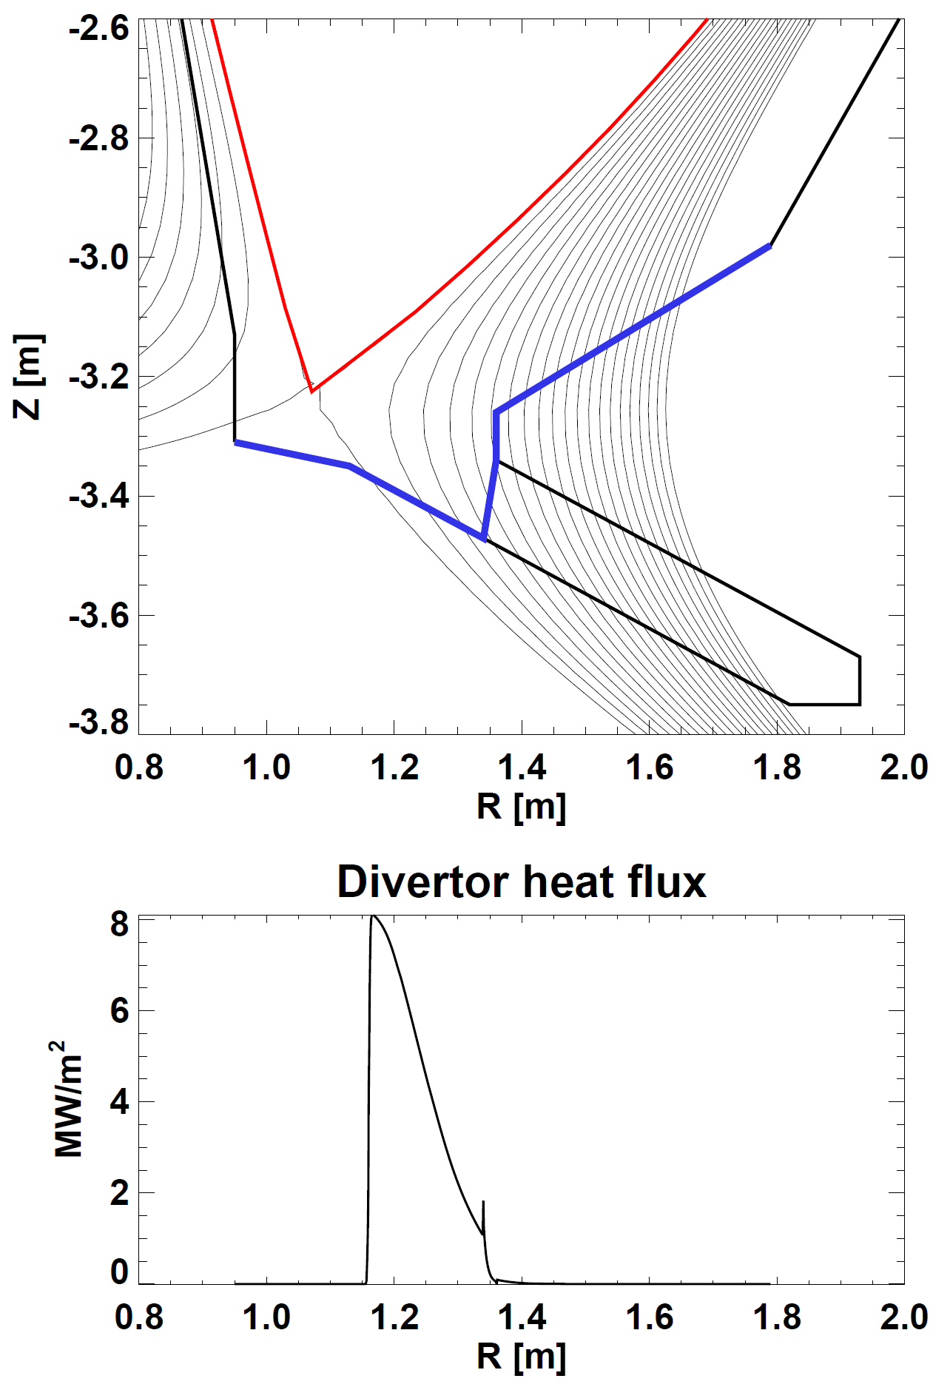
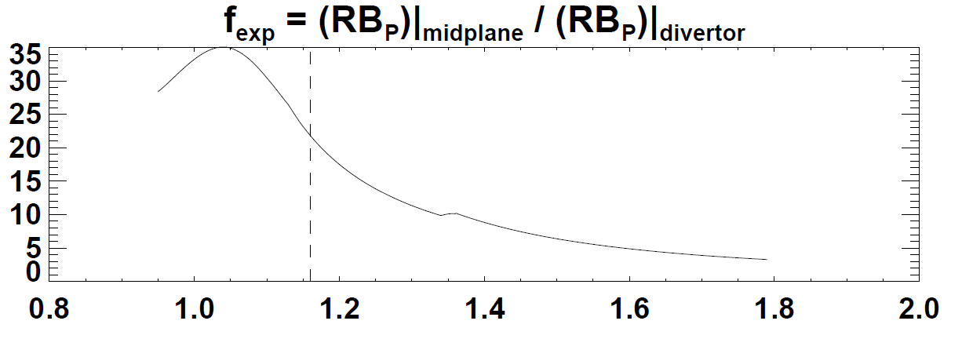
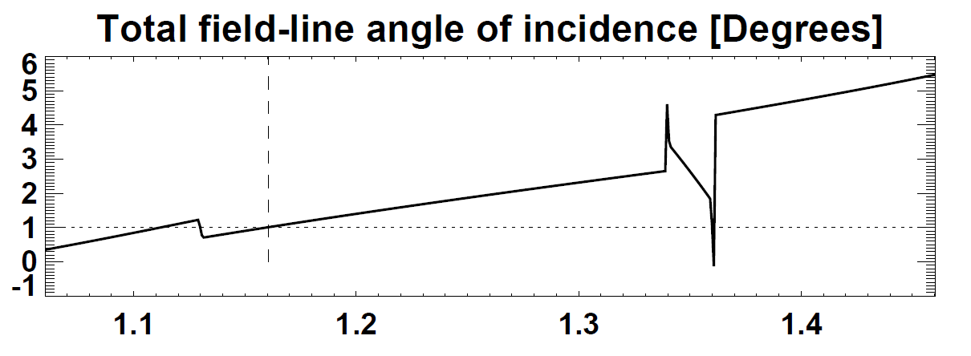
Parameters and profiles for conventional divertor
(using simple exponential heat-flux profile in R=1.6m ST-FNSF)
Strike point radius
P_{heat} (1-f_{rad}) f_{obd} sin(θ_{pol})
2πR_{strike} f_{exp} λ_{q-mid} N_{div}
Peak q_{⊥-div} ≈
P_{heat} = 115MW, f_{rad}=0.8, f_{obd}=0.8, sin(θ_{pol}) = 0.39
R_{strike} = 1.16m, f_{exp} = 22, λ_{q-mid} =2.7mm, N_{div} = 2
NSTX-U simulations find q⊥ at pump entrance should be ≥ 1-2MW/m² for efficient pumping → guesstimate R_{entrance} ~ 1.3m for R=1.6m ST-FNSF

Slide 26
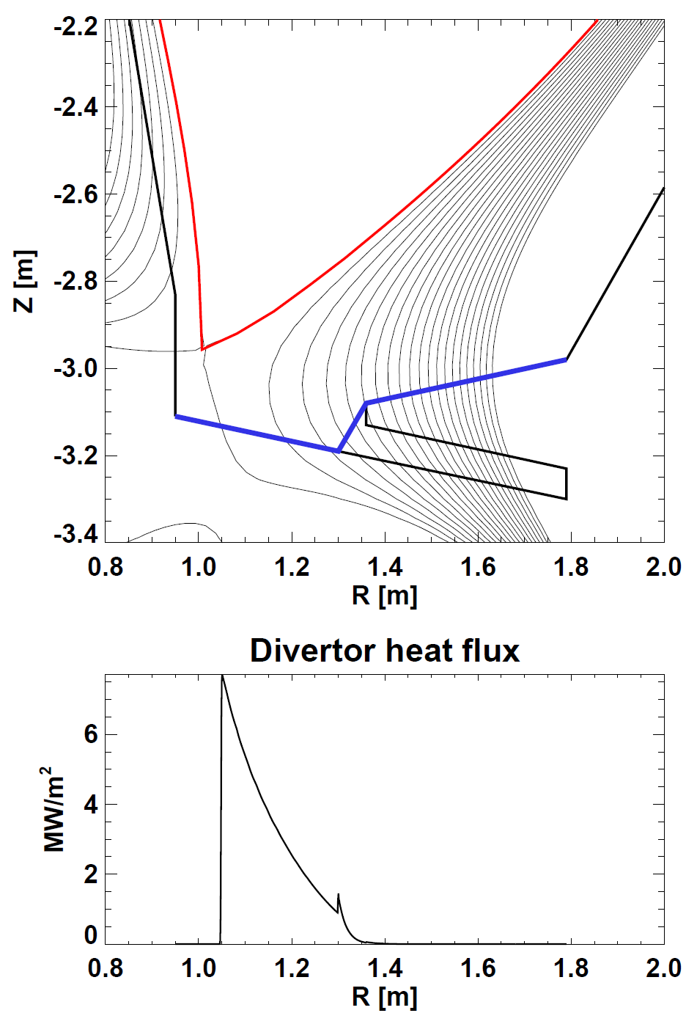
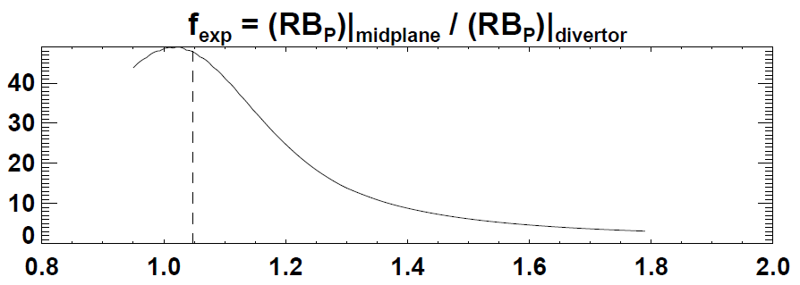
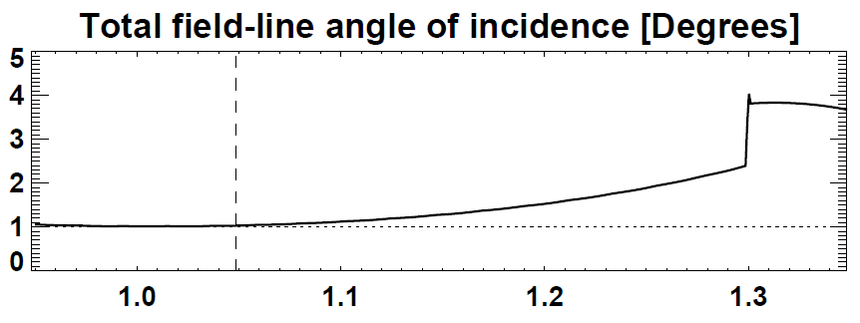
Parameters and profiles for snowflake divertor
(using simple exponential heat-flux profile in R=1.6m ST-FNSF)
Strike point radius
P_{heat} (1-f_{rad}) f_{obd} sin(θ_{pol})
2πR_{strike} f_{exp} λ_{q-mid} N_{div}
Peak q_{⊥-div} ≈
P_{heat} = 115MW, f_{rad}=0.8, f_{obd}=0.8, sin(θ_{pol}) = 0.87
R_{strike} = 1.05m, f_{exp} = 50, λ_{q-mid} =2.7mm, N_{div} = 2
Snowflake would also want divertor cryo-plenum entrance radius R_{entrance} ~ 1.3m for R=1.6m ST-FNSF

Slide 27
Outline
Motivation for study
Physics basis for operating points
Performance vs. device size
Tritium breeding ratio calculations
Divertor poloidal field coil layout and design
Power exhaust calculations
Maintenance strategies
Summary

Slide 28
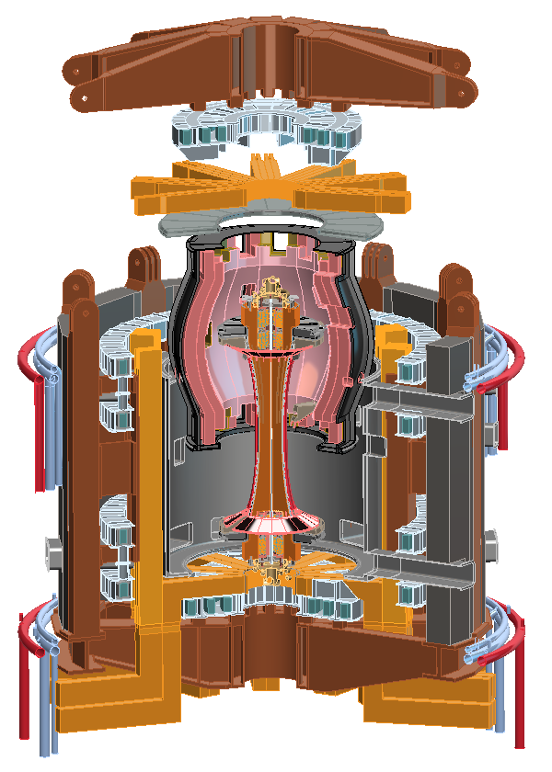

Flexible and efficient in-vessel access important for testing, replacing, improving components, maximizing availability
Several maintenance approaches under consideration:
Vertically remove entire blanket and/or center-stack
  Better for full blanket replacement?
Translate blanket segments radially then vertically
  Better for more frequent blanket module replacement and/or repair?
Radial ports
for divertor
maintenance
or pumping
May be possible to combine features of both approaches

Slide 29


Assembly and maintenance schemes with snowflake divertor and vertical ports
Full Blanket Assembly Removed
Centerstack Assembly Removed

Slide 30


Possible divertor module maintenance scheme using radial installation and vertical translation through vertical ports

Slide 31

Large cylindrical vessel of R=1.6m FNSF could be used for PMI R&D (hot walls, Super-X?), other blanket configurations
NOTE: TBR values do not include stabilizing shells or penetrations
Straight blanket
TBR = 0.8
Straight blanket
with flat top
TBR = 1.047

Slide 32
Summary
Present STs (NSTX/MAST) providing preliminary physics basis for ST-FNSF performance studies
  Upgraded devices will provide more extensive and definitive basis
Neutron wall loading of 1MW/m² feasible for range of major radii for β and H₉₈ values at/near values already achieved
  High wall loading and/or pilot-level performance require β_{N} ~ 6 and H₉₈ ~ 1.5 which are at/near maximum values attained in present STs
TBR ~ 1 possible if top/bottom neutron losses are minimized
Divertor PF coils in ends of TF bundle enable high δ, shaping
Conventional and snowflake divertors investigated, PF coils incorporated to reduce peak heat flux < 10MW/m²
Vertical maintenance strategies for either full and/or toroidally segmented blankets being investigated

Slide 33
Future work
(a highly incomplete list!)
Physics basis for operating points
  Perform sensitivity study of achievable performance vs. baseline configuration assumptions: A, κ, H_{98y,2}, ST vs. tokamak τ_{E} scaling
  TRANSP calculations of NBI heating, current drive, neutron production
Performance vs. device size
  Could/should overall machine configuration change at smaller R?
  Example questions: could/should vessel take more load?, is there sufficient shielding for divertor PF coils at smaller R?
Tritium breeding ratio calculations
  Extend calculations to smaller R, include 3D effects and final machine layout
Divertor poloidal field coil layout and design
  Assess radiation induced conductivity (RIC) in ceramic insulators
Power exhaust calculations
  Perform pumping and detachment calculations, include Super-X divertor
Maintenance strategies
  Assess space/lifting requirements above machine for vertical maintenance

Slide 34
Backup

Slide 35

R=1.6 m ST FNSF with JT-60SA NNBI system

