Slide 1
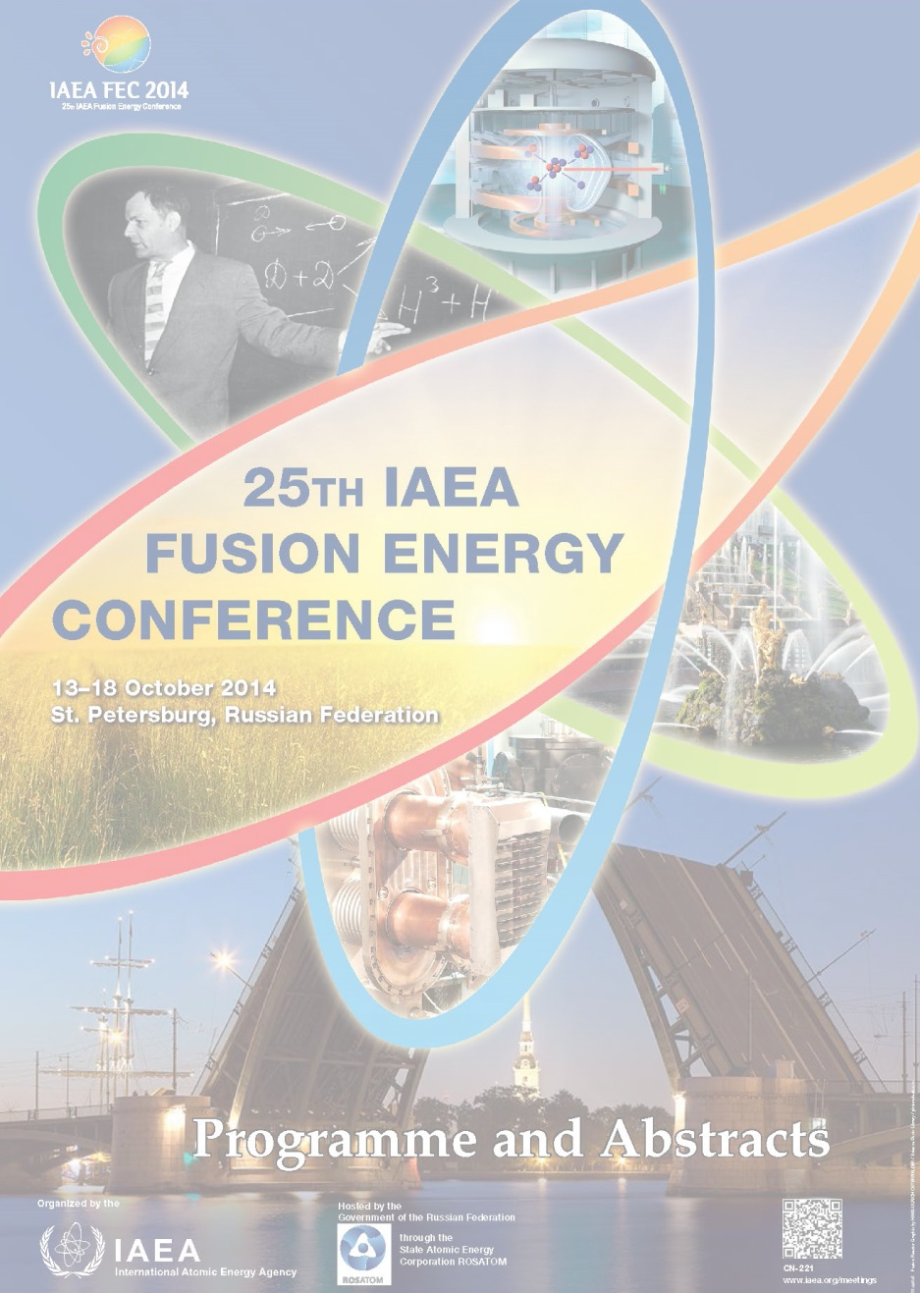
IAEA FEC 2014 Meeting – Brief Summary (Movie Clip)
S.A. Sabbagh
Department of Applied Physics and Applied Mathematics, Columbia University, New York, NY, USA
presented at the
November 2014 PPPL Research Meeting
PPPL
Princeton, NJ
November 10th, 2014
v1.0

Slide 2
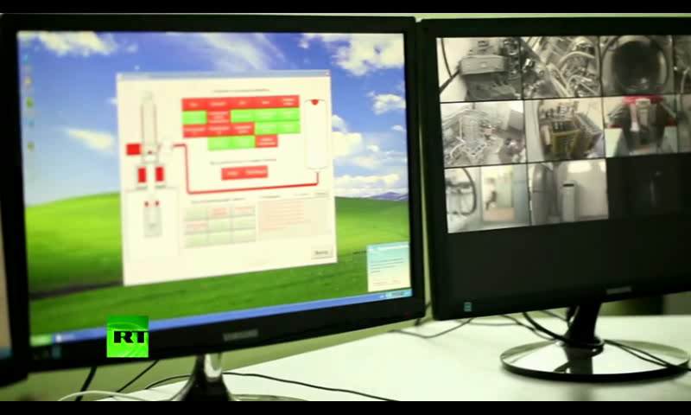
…But Until Then, Enjoy The Ride
ITER video distributed by IAEA (26 mins): http://nstx.pppl.gov/DragNDrop/
Scientific_Conferences/IAEA/IAEA_2014/Summary_Talk_etc/
Latest estimate for final cost of ITER:13B Euro
  Huge investment for the future energy security of the entire world
ITER: A sterling example of international cooperation at it’s best
  Peaceful use of nuclear power for advancement of mankind / protection of the environment
Project is an endeavor into the unknown, but…
Given the progress so far, I’m sure fusion has a bright future…

