Slide 1

Overview of First Results from NSTX-U and Analysis Highlights from NSTX
Jonathan Menard (PPPL)
On behalf of the NSTX-U Research Team
26th IAEA Fusion Energy Conference
Kyoto, Japan
17–22 October 2016

Slide 2
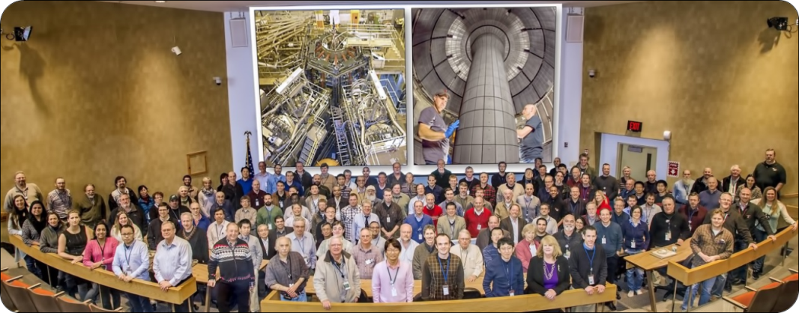
NSTX-U Program is Highly Collaborative
Domestic (33)
International (22)
350+ data users
55 institutions
22 US Universities

Slide 3
Outline
NSTX-U mission
Research highlights
Progress on next-step ST concepts
Summary

Slide 4

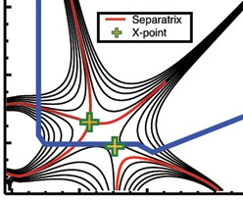
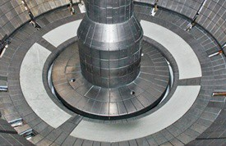
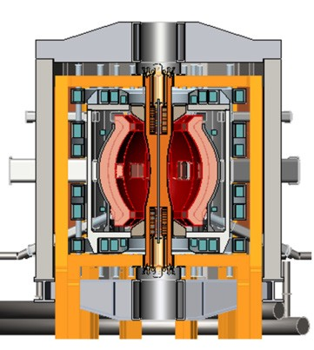
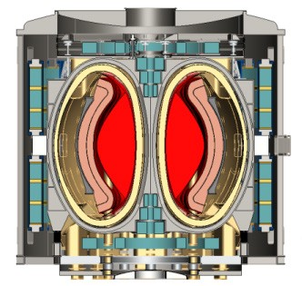
NSTX-U Mission Elements:
Explore unique ST parameter regimes to advance predictive capability - for ITER and beyond
ITER
Develop solutions for plasma- material interface (PMI)
Snowflake/X
Liquid metals / Li
ST-FNSF /
Pilot-Plant
Advance ST as Fusion Nuclear Science Facility and Pilot Plant

Slide 5
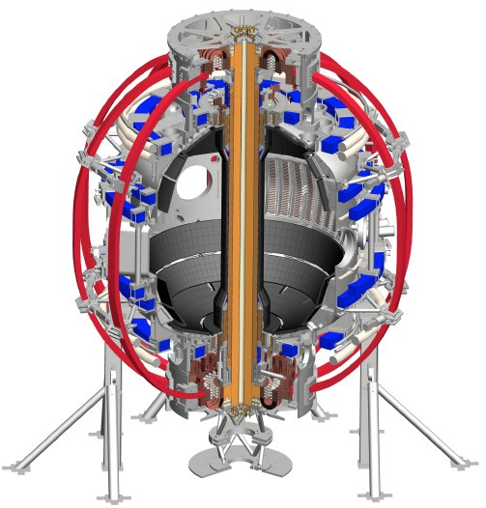
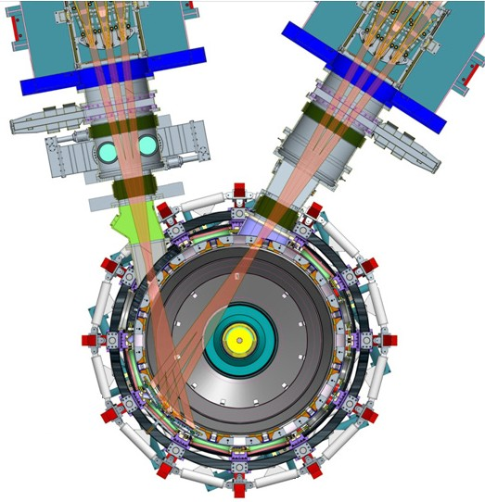
NSTX-U will access new physics with 2 major new tools:
1. New Central Magnet
2. Tangential 2nd Neutral Beam
Higher T, low ν* from low to high β
→ Unique regime, study new transport and stability physics
Full non-inductive current drive
→ Not demonstrated in ST at high-β_{T}
Essential for any future steady-state ST

Slide 6
NSTX-U will have major boost in performance
1. New Central Magnet
2. Tangential 2nd Neutral Beam
Performance goals:
➢2× heating power (5 → 10MW)
Tangential NBI → 2× current drive efficiency
➢4× divertor heat flux (→ ITER levels)
➢Up to 10× higher nTτ_{E} (~MJ plasmas)
➢2× toroidal field (0.5 → 1T)
➢2× plasma current (1 → 2MA)
➢5× longer pulse (1 → 5s)

Slide 7
NSTX-U had scientifically productive 1st year
Achieved H-mode on 8th day of 10 weeks of operation
Surpassed magnetic field and pulse-duration of NSTX
Matched best NSTX H-mode performance at ~1MA
Identified and corrected dominant error fields
Commissioned all magnetic and kinetic profile diagnostics
New 2nd NBI suppresses Global Alfven Eigenmodes (GAE)
Implemented techniques for controlled plasma shut down, disruption detection, commissioned new tools for mitigation
2016 run ended prematurely due to fault in divertor PF coil
  Coil forensics, design (re)-reviews, preparing for new coil fabrication
  Aim to resume plasma operation end of 2017 / early 2018

Slide 8
NSTX-U Mission Elements:
Explore unique ST parameter regimes to advance predictive capability - for ITER and beyond
ITER
Topical science areas:
  Scenario Development
  Macroscopic Stability
  Transport and Turbulence
  Energetic Particles

Slide 9
NSTX-U Mission Elements:
Explore unique ST parameter regimes to advance predictive capability - for ITER and beyond
ITER
Topical science areas:
  Scenario Development
  Macroscopic Stability
  Transport and Turbulence
  Energetic Particles

Slide 10
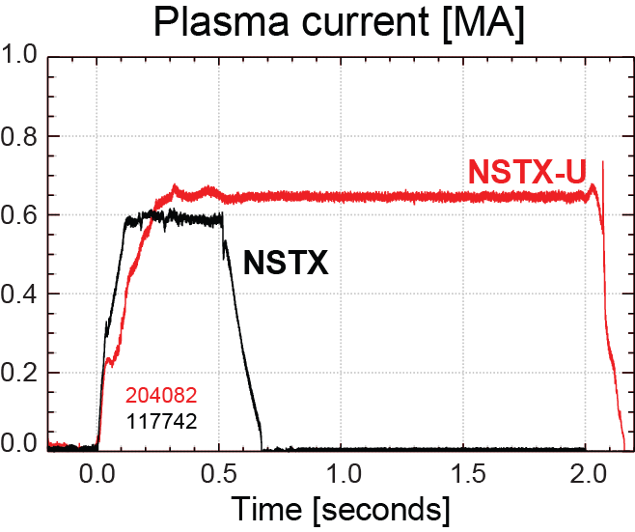
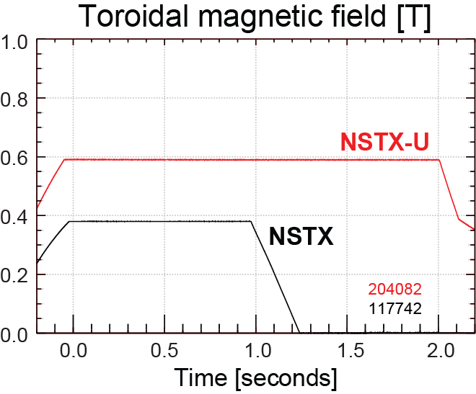
NSTX-U has surpassed maximum pulse duration and magnetic field of NSTX
Compare similar NSTX / NSTX-U Boronized L-modes, P_{NBI}=1MW
4x longer
NSTX-U L-mode duration
exceeds longest NSTX H-mode
NSTX-U B_{T} > highest NSTX B_{T}

Slide 11
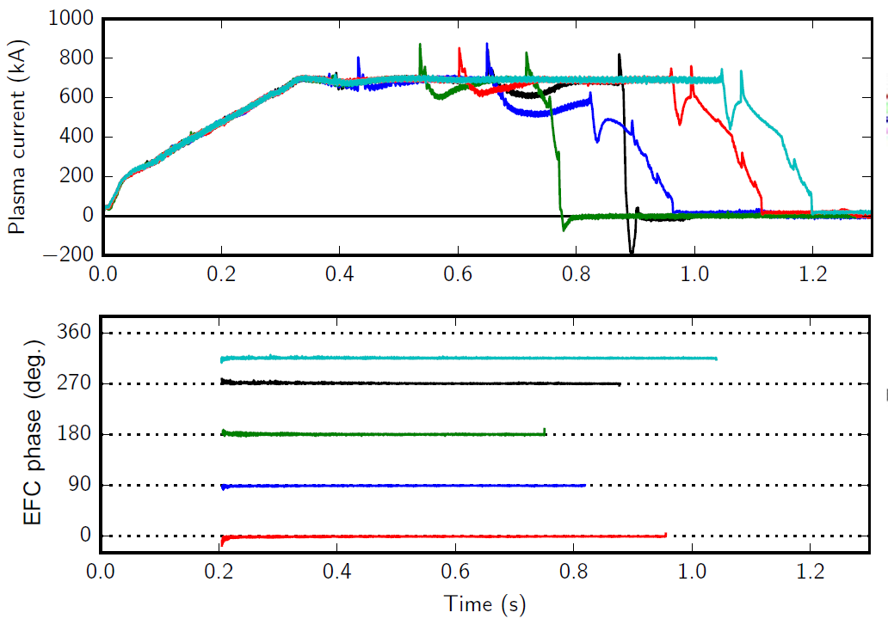
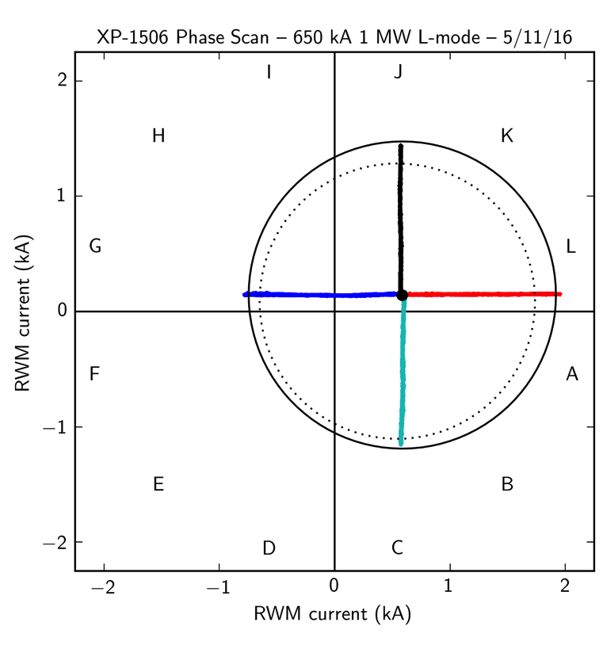
n=1 error field correction (EFC) optimized to maximize pulse length, discharge performance
L-modes used to identify optimal correction amplitude, phase
Multiple compass scans confirm optimal L-mode EFC in flattop
EFC current [kA]
n_{e} = 2.9 ×10¹³ (solid)
n_{e} = 1.4 ×10¹³ (dashed)
EFC current [kA]

Slide 12
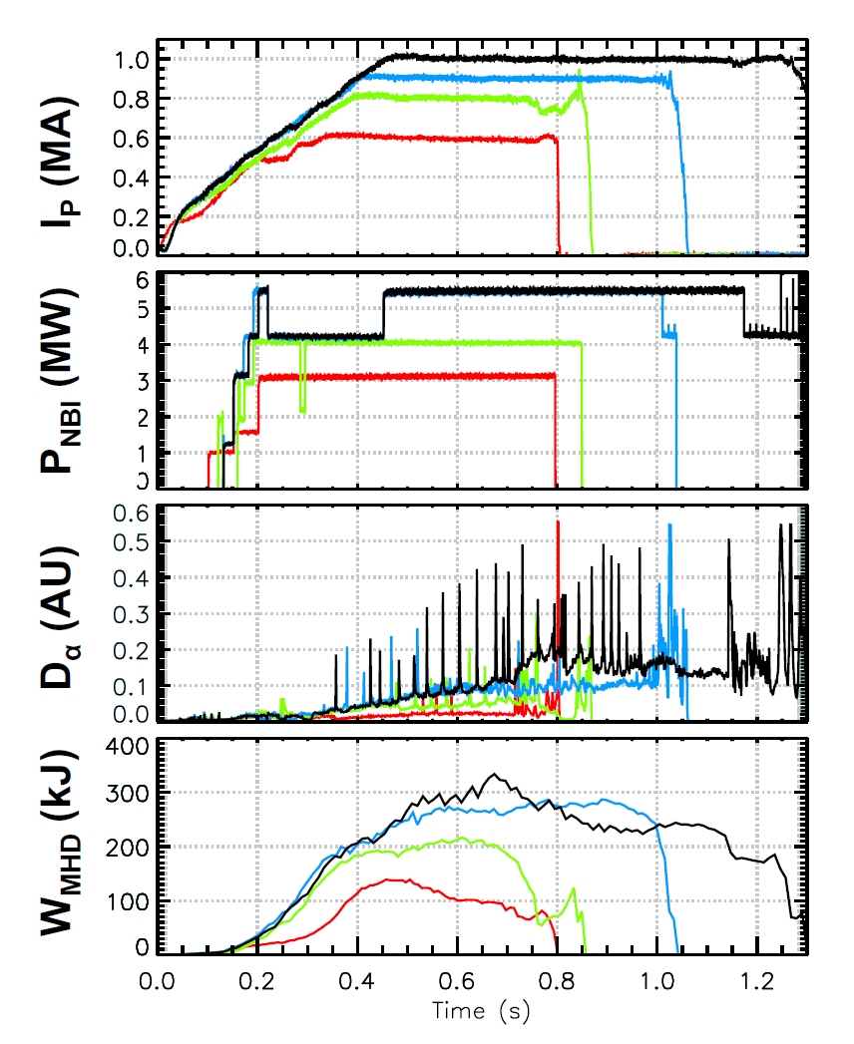
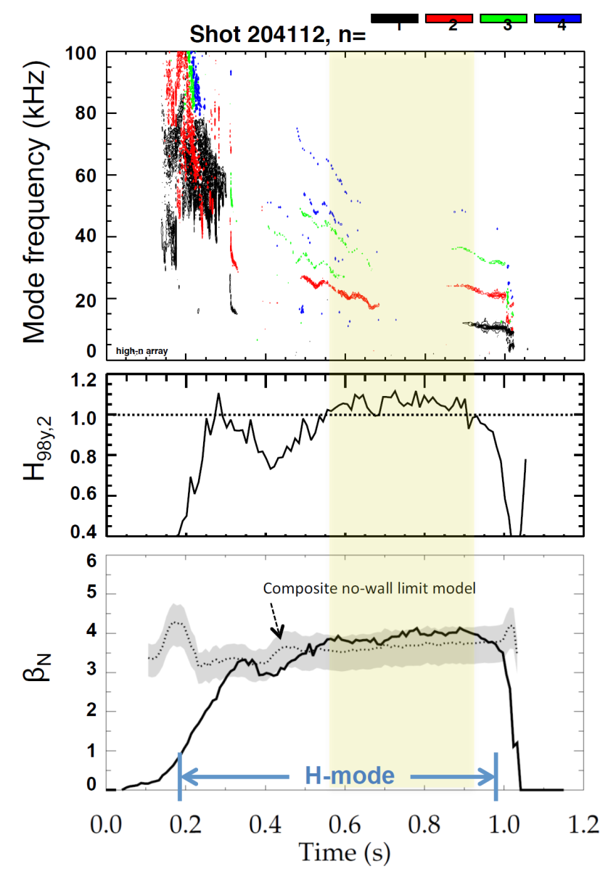
Recovered ~1MA H-modes with weak/no core MHD
(comparable to best NSTX plasmas at similar plasma current)
202946 – no EFC 204112 – EFC v2
203679 – EFC v1 204118 – EFC v2
H₉₈ ≥ 1, β_{N} ~ 3.5-4 ≥ n=1 no-wall limit

Slide 13
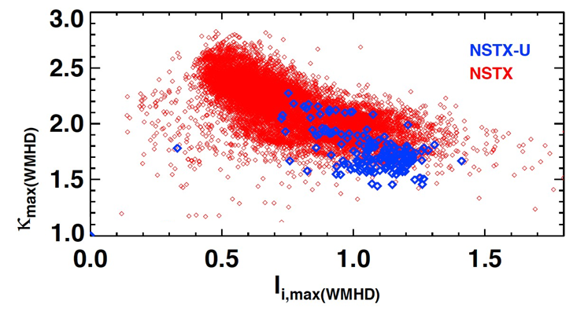
Accessed low l_{i} and high κ using progressively earlier H-mode and heating + optimized EFC
Future goal
NSTX-U (5 run weeks)
NSTX (10 years)
H-mode flattop
L-mode flattop
NSTX-U: Additional sensors improve estimation of Z, dZ/dt
Goals for next run:
  Access l_{i} = 0.5-0.7, κ=2.4-2.7, B_{T} = 0.75-1T, I_{P} = 1.5-2MA

Slide 14
NSTX-U Mission Elements:
Explore unique ST parameter regimes to advance predictive capability - for ITER and beyond
ITER
Topical science areas:
  Scenario Development
  Macroscopic Stability
  Transport and Turbulence
  Energetic Particles

Slide 15
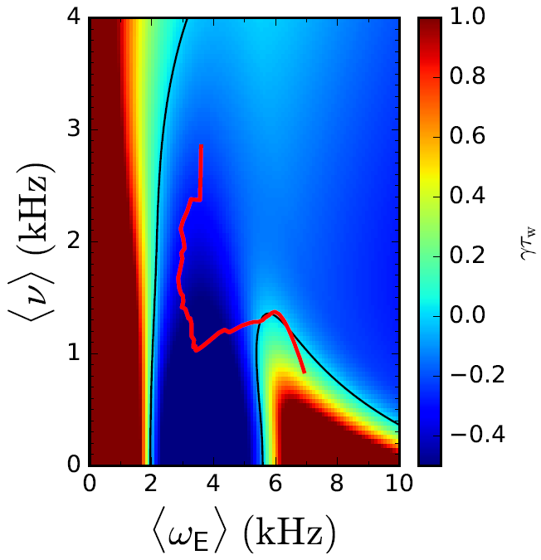
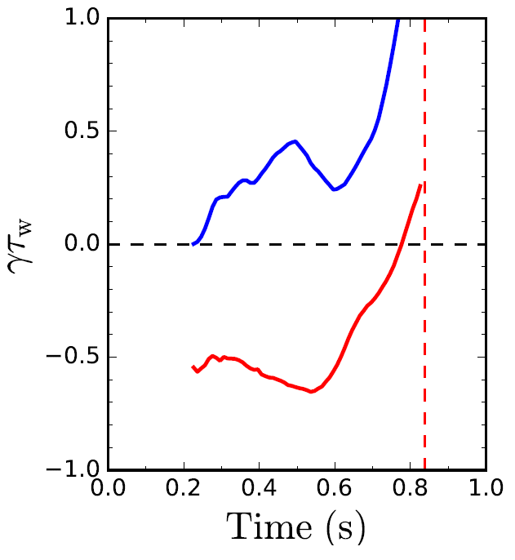

      Disruption characterization and forecasting capability initiated for NSTX-U as part of disruption avoidance plan
  New DECAF (Disruption Event Characterization And Forecasting) code written
    Identify disruption event chains and elements
      ex: vertical displacement, pressure peaking, tearing modes…
    Predict events in disruption chains
    Cues disruption avoidance system
  Example: Reduced kinetic resistive wall mode (RWM) model developed for calculating growth rate vs. time
γτ_{w} contours vs. ν and ω_{φ}
Normalized growth rate vs. time
Increasing time
ideal
γτ_{w}
unstable
stable
Ideal + kinetic
disruption
139514
predicted instability
Initial tests on NSTX RWM database
  86% of RWM shots are predicted unstable
Possible to predict growth rate in real time
J.W. Berkery et al., Poster EX/P4-34, Wednesday afternoon

Slide 16
Implemented automated ramp-down for NSTX-U
Plasma control system detects loss of control
  Central solenoid coil near maximum allowed current
  Vertical oscillations exceed threshold
  ABS(I_{p}–I_{p request} ) above threshold
“State-machine” based:
  Feedback control switches to new “states” that attempt to stably ramp-down the plasma
I_{P}
I_{P} Request
(including asynchronous transition to rampdown)
  Z_{P}(dZ_{P}/dt) threshold
  Z_{P}(dZ_{P}/dt)
“State”
Insufficient I_{P}
Fast I_{P} Rampdown
Normal
Typical Z_{P} w/o fast ramp-down
  Z_{P} from EFIT

Slide 17
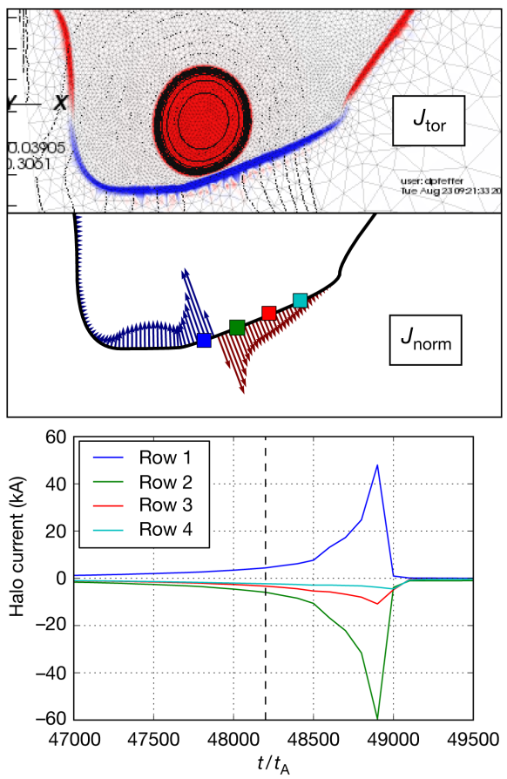
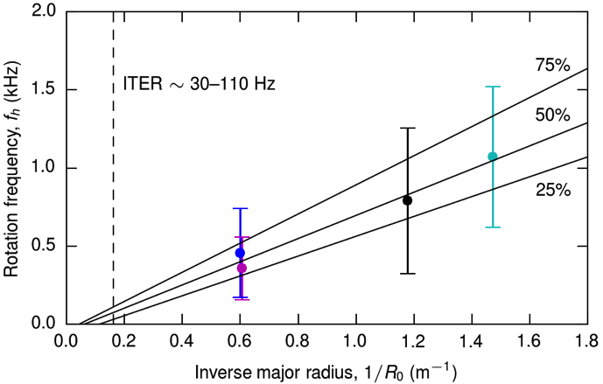
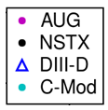
Leading studies of rotating halo currents through ITPA multi-machine analysis and M3D-C1 simulations
ITPA multi-machine analysis (MDC WG-6):
Halo current data from C-Mod, DIII-D, AUG, NSTX
All measurements in lower divertor (> 400 shots)
Halo current rotation predominantly counter-I_{p} (not shown)
Consistent rotation velocity, v_{h} ~ 5 km/sec
M3D-C1 simulations:
NSTX(-U) geometry
Simulate in 2D while q >2
Switch to 3D to resolve halo rotation (in progress)
D. Pfefferlé et al. (PPPL)
C.E. Myers et al., Poster EX/P6-46, Thursday afternoon

Slide 18
NSTX-U Mission Elements:
Explore unique ST parameter regimes to advance predictive capability - for ITER and beyond
ITER
Topical science areas:
  Scenario Development
  Macroscopic Stability
  Transport and Turbulence
  Energetic Particles

Slide 19
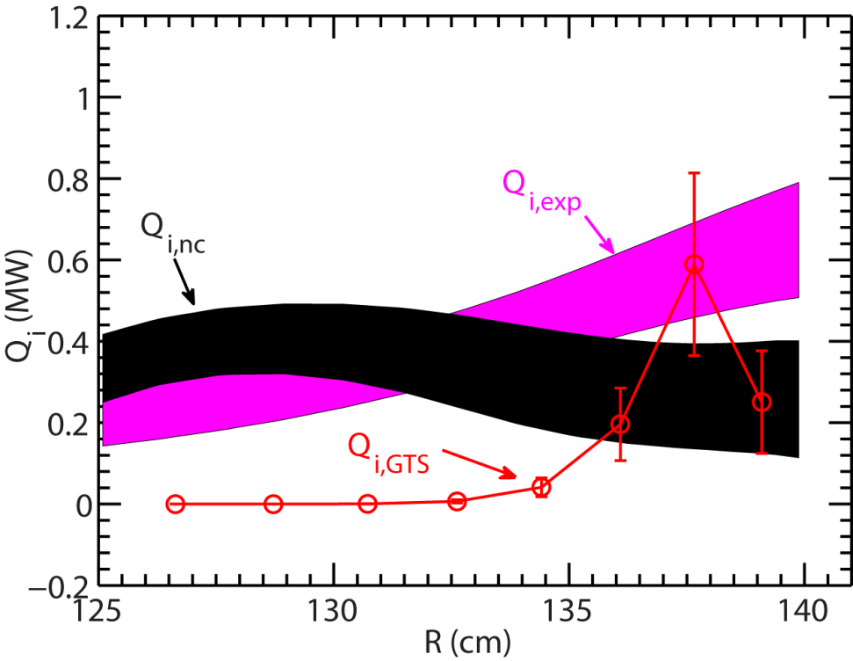
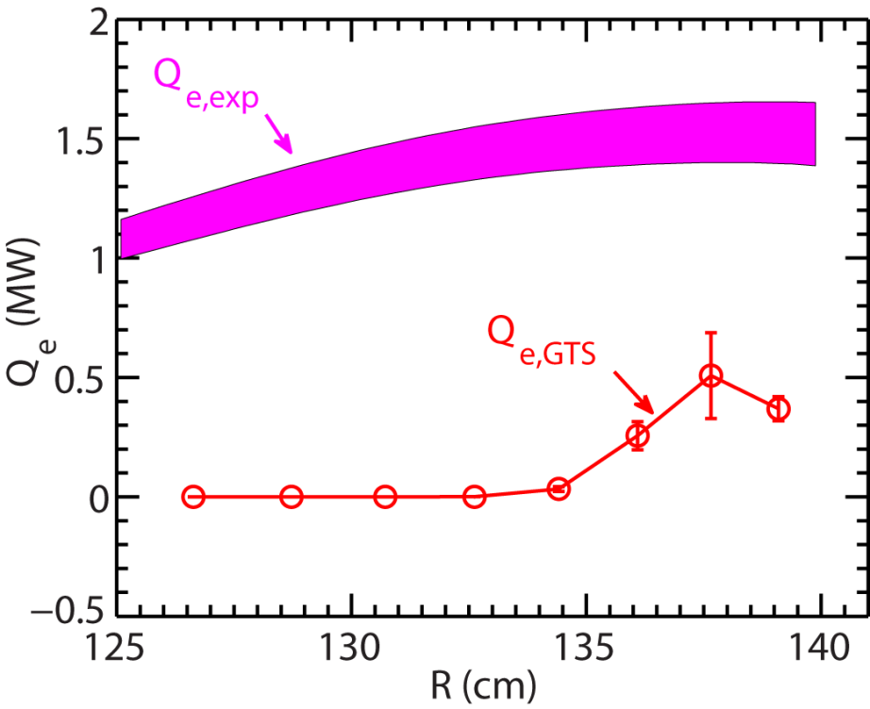
NSTX: Using global non-linear GTS gyrokinetic code to study low-k ion and electron transport
GTS global capability important for treating larger ρ*~0.01 of NSTX
NSTX NBI H-mode 141767, t=332ms, B_{T} =5.5 kG
Low-k turbulence for r/a~0.7-0.85
  Turbulence later suppressed by ExB shear
Total ion energy flux Q_{e} from GTS generally agrees with experiment
Electron energy flux Q_{e} from GTS only significant for r/a~0.7-0.85
But GTS Q_{e} << experimental Q_{e}
  Electron Temperature Gradient (ETG) or electromagnetic (EM) effects important?
Y. Ren et al., Poster P4-35, Wednesday afternoon

Slide 20
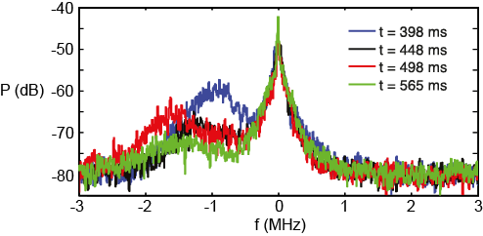
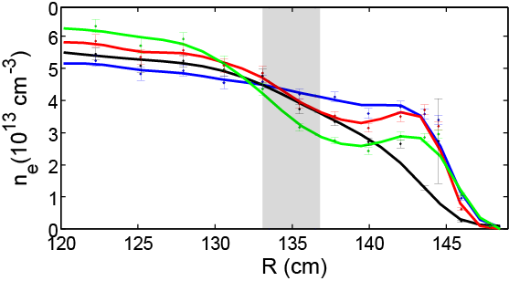
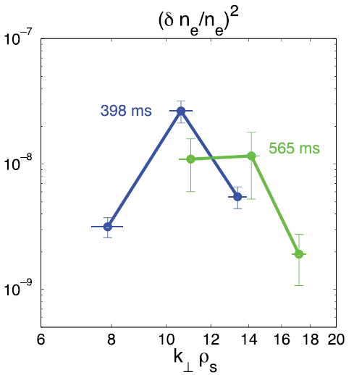
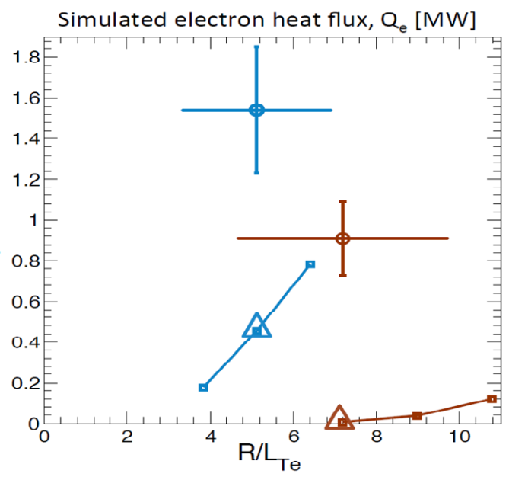

GYRO simulations of high-k Electron Temperature Gradient (ETG) turbulence find ∇n_{e} stabilizing
NSTX: Decrease in ETG turbulence amplitude w/ increasing ∇n_{e}
High-k
μ-wave
scattering
ETG
Scattering
region
NSTX 141767
∇T_{e} ~ constant
Experiment ~(δn_{e}/n_{e})²
Simulated electron heat flux Q_{e} [MW]
Low ∇n_{e}
High ∇n_{e}
Low ∇n_{e}
High ∇n_{e}
Non-linear
GYRO Q_{e}
(Juan Ruiz Ruiz)
GYRO Q_{e} << experimental Q_{e} → Need EM, Alfvénic, low-k + high-k effects?

Slide 21
NSTX-U Mission Elements:
Explore unique ST parameter regimes to advance predictive capability - for ITER and beyond
ITER
Topical science areas:
  Scenario Development
  Macroscopic Stability
  Transport and Turbulence
  Energetic Particles

Slide 22
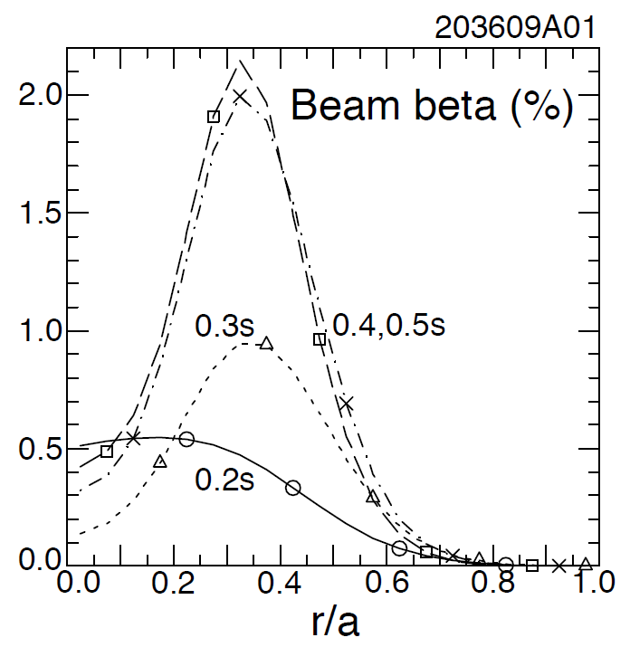
NSTX-U: Most tangential NBI generates counter-propagating Toroidal Alfvén Eigenmodes (TAEs)
Counter-propagating TAE predicted for hollow fast-ion profiles
TRANSP: As current builds up beam fast-ion beta profile predicted to become hollow
1st evidence of off-axis NBI deposition

Slide 23
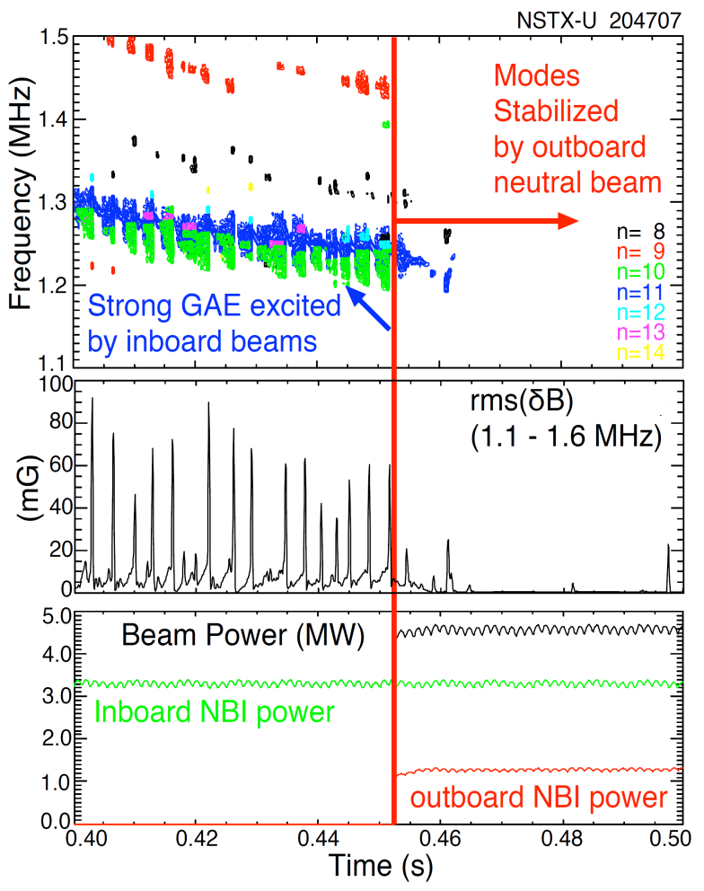
NSTX-U tangential 2nd neutral beam suppresses Global Alfven Eigenmode (GAE) – consistent with simulation
HYM code simulation of #204707, n=10
|δB_{n} |²
t=0.44s
t=0.47s
t ω_{ci}
HYM code: growth of n=10 counter-GAE from 1st NBI
HYM: suppression of n=10 counter-GAE by 2nd NBI
Most unstable n-number, mode ω consistent with HYM
New 2nd NBI already powerful tool for fast ion, AE physics

Slide 24
NSTX-U Mission Elements:
Explore unique ST parameter regimes to advance predictive capability - for ITER and beyond
ITER
Develop solutions for plasma- material interface (PMI)
Snowflake/X
Liquid metals / Li
ST-FNSF /
Pilot-Plant
Advance ST as Fusion Nuclear Science Facility and Pilot Plant

Slide 25




Improving understanding of SOL heat flux width trends in NSTX using XGC1 simulations
Experiment shows contraction of SOL heat flux width at midplane with I_{p} as well as influence of Li conditioning
XGC1 w/ collisions → similar trends
XGC-1:
20
Li dose 0 mg
150 mg
300 mg
Full-f, global PIC, kinetic ions and electrons
NSTX
Experiment
15
B_{P} scan
NSTX data and XGC-1: λ_{q} ~ 1 / I_{P}^{1.5}
How will NSTX-U λ_{q} scale?
Will SOL turbulence become important?
XGC1
Using 139047 at 665ms, 50 mg Li
λ_{q} (mm)
10
5
C.S. Chang et al., Talk TH/2-1, Wednesday morning
0
0.4 0.6 0.8 1 1.2 1.4
I_{P} (MA)
Heat flux width determined primarily by neoclassical processes

Slide 26
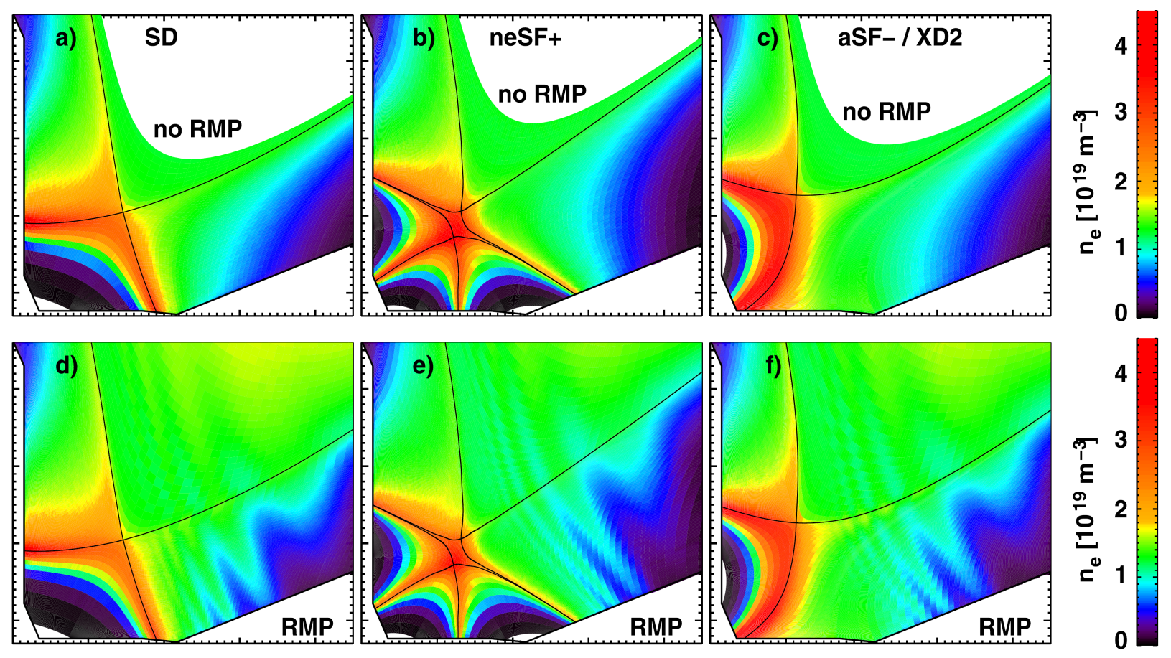
NSTX-U: First systematic simulations of advanced divertors combined with 3D fields with EMC3-EIRENE
Standard Divertor
Near-Exact Snowflake
Snowflake Minus / X-divertor
Divertor heat-flux trends:
  Peaked heat loads in Near Exact Snowflake
  Lowest heat loads found for X-divertor-like configurations
  RMP fields do not significantly impact toroidal average heat-flux
Related snowflake results from DIII-D and NSTX:
Poster EX/P3-30 - V. Soukhanovskii, Wednesday

Slide 27
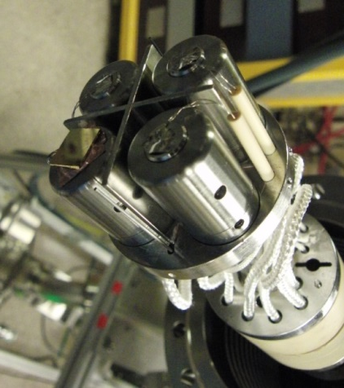
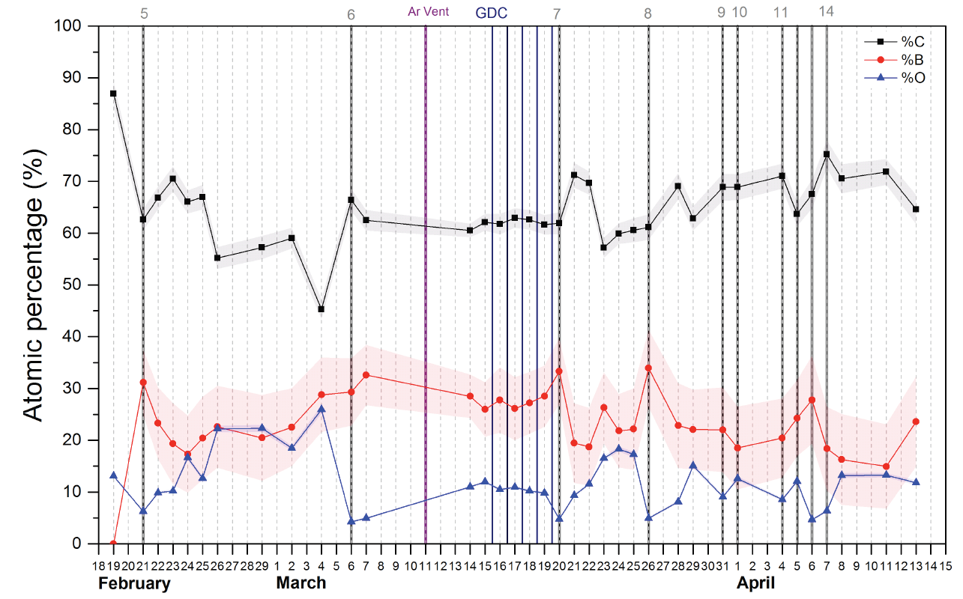

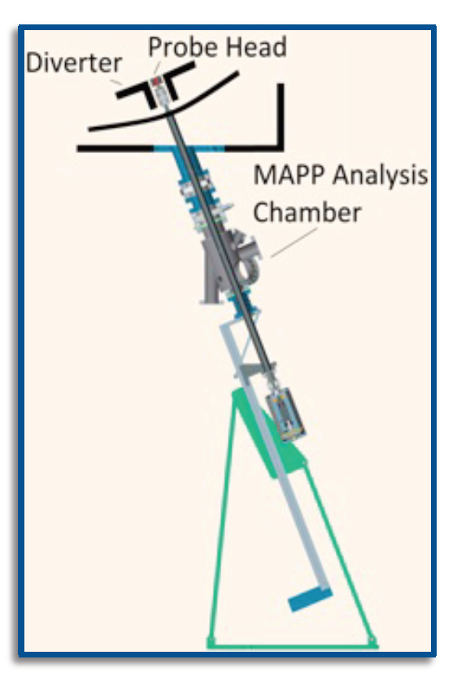

Material Analysis & Particle Probe (MAPP) providing new measurements of surface evolution in NSTX-U
Tracked C/B/O evolution, correlated with plasma performance
Implemented remote-control + between-shot analysis
Future: Use to understand complex Li chemistry and evolution

Slide 28
NSTX-U Mission Elements:
Explore unique ST parameter regimes to advance predictive capability - for ITER and beyond
ITER
Develop solutions for plasma- material interface (PMI)
Liquid metals / Lithium
Snowflake/X
ST-FNSF /
Pilot-Plant
Advance ST as Fusion Nuclear Science Facility and Pilot Plant

Slide 29
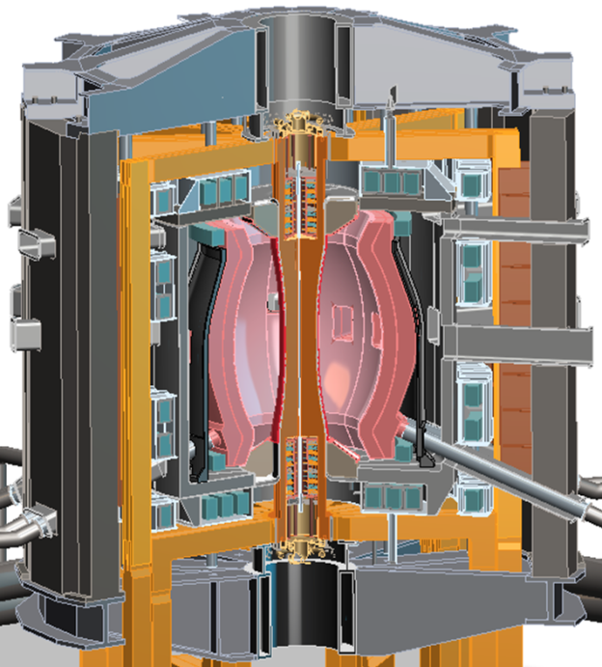
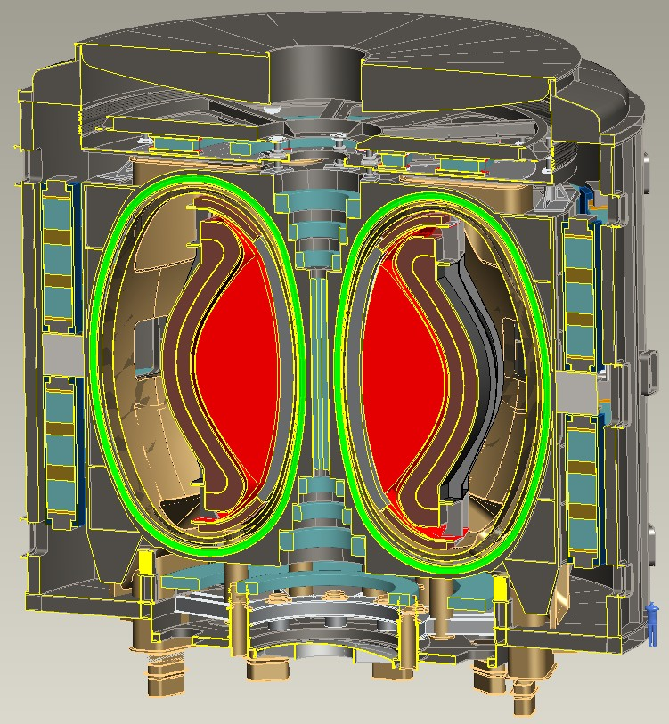
Recent design studies show ST potentially attractive as
Fusion Nuclear Science Facility (FNSF) and Pilot Plant
FNSF: Provide neutron fluence for material/component R&D (+ T self-sufficiency?)
Pilot Plant: Electrical self-sufficiency: Q_{eng} = P_{elec} / P_{consumed} ≥ 1 (+ FNSF mission?)
Designs integrate ST higher κ, β_{N} + advanced divertors + HTS TF for Pilot Plant
FNSF with copper TF coils
A=1.7, R₀ = 1.7m, κ_{x} = 2.7, B_{T}=3T
Fluence = 6MWy/m², TBR ~ 1
FNSF / Pilot Plant with HTS TF coils
A=2, R₀ = 3m, κ_{x} = 2.5, B_{T} = 4T
6MWy/m², TBR ~ 1, Q_{eng} ~ 1
FIP/P7-1 - T. Brown, Friday morning
J.E. Menard, et al., Nucl. Fusion 56 (2016) 106023

Slide 30
NSTX-U strongly supporting advanced predictive capability, ITER, PMI solutions, and next-step STs
Productive first year of operations on NSTX-U
  Rapid H-mode access, scenario development, error field correction
  Surpassed NSTX maximum magnetic field and pulse-duration
  New fast-ion physics with 2nd NBI – GAE stabilization, counter TAE
  Commissioned new advanced PMI diagnostics – MAPP
Advancing predictive capability for core, edge, PMI
  Developing reduced models for RWM, understanding of halo rotation
  Global ion-scale turbulence (GTS), ∇n ETG stabilization
  GAE stabilization from 2nd NBI consistent with simulation (HYM)
  Exploring SOL widths, advanced divertor interactions with 3D fields
Developed attractive ST-FNSF / Pilot Plant concepts
Aim to resume NSTX-U physics operation in ~1+ years

Slide 31
IAEA-FEC presentations from NSTX-U
Tuesday, October 18
  OV/5-2 - J. Menard, “Overview of First Results from NSTX-U and Analysis Highlights from NSTX”
  TH/P1-2 - F. Ebrahimi, “Physics of Flux Closure during Plasmoid-Mediated Reconnection in Coaxial Helicity Injection”
  TH/P1-6 - J.-K. Park, “Self-Consistent Optimization of Neoclassical Toroidal Torque with Anisotropic Perturbed Equilibrium in Tokamaks”
  TH/P1-7 - S. C. Jardin, “Nonlinear 3D M3D-C1 Simulations of Tokamak Plasmas Crossing a MHD Linear Stability Boundary”
  TH/P1-10 - A. Fil, “Modelling and Simulation of Pedestal Control Techniques for NSTX-U”
  TH/P1-21 - Z. R.Wang, “Nyquist Analysis of Kinetic Effects on the Plasma Response in NSTX and DIII-D Experiments”
Wednesday, October 19
  FIP/2-5 - M. Ono. “Liquid Lithium Loop System to Solve Challenging Technology Issues for Fusion Power Plant”
  EX/P3-30 - V. Soukhanovskii, “Snowflake Divertor Configuration Effects on Pedestal Stability and Edge Localized Modes in NSTX and DIII-D”
  TH/P3-14 - W. Guttenfelder, “Analysis and Prediction of Momentum Transport in Spherical Tokamaks”
  EX/P4-30- J.-W. Ahn “Shielding and Amplification of Nonaxisymmetric Divertor Heat Flux by Plasma Response to Applied 3D Fields in NSTX and KSTAR”
  EX/P4-33 - S. A. Sabbagh, “Isolation of Neoclassical Toroidal Viscosity Profile under Varied Plasma and 3D Field Conditions in Low and Medium Aspect Ratio Tokamaks”
  EX/P4-34 - J.W. Berkery, “Characterization and Forecasting of Unstable Resistive Wall Modes in NSTX and NSTX-U”
  EX/P4-35 - Y. Ren, “Exploring the Regime of Validity of Global Gyrokinetic Simulations with Spherical Tokamak Plasmas”
  EX/P4-36 - F. Scotti, “Kinetic Profiles and Impurity Transport Response to 3D-Field Triggered ELMs in NSTX”
  EX/P4-38 - R. Maingi. “Comparison of Helium Glow and Lithium Evaporation Wall Conditioning Techniques in Achieving High Performance H-Mode Discharges in NSTX”
  EX/P4-40 - D. Smith, “Identification of Characteristic ELM Evolution Patterns with Alfvén-Scale Measurements and Unsupervised Machine Learning Analysis”
  EX/P4-41 - E. Fredrickson, “Parametric Dependence of EPMs in NSTX”
  EX/P4-42 - R. Perkins, “….A Proposed Mechanism for the Anomalous Loss of RF Power to the SOL of NSTX”
  EX/P4-43 - M. D. Boyer, “Feedback Control Design for Noninductively Sustained Scenarios in NSTX-U Using TRANSP”
  TH/P4-16 - G. Fu, “Hybrid Simulations of Beam-Driven Fishbone and TAEs in NSTX”
  TH/P4-17 - E. Belova, “Coupling of Neutral-Beam-Driven Compressional Alfvén Eigenmodes to Kinetic Alfvén Waves in NSTX and Energy Channelling”
Thursday, October 20
  EX/5-3 - A. Diallo, “Energy Exchange Dynamics across L-H Transitions in NSTX”
  MPT/P5-30 - M. A. Jaworski, “High-Temperature, Liquid Metal Plasma-Facing Component Research and Development for the NSTX-U”
  EX/P6-46 - C. Myers, “A Multimachine Analysis of Non-axisymmetric and Rotating Halo Currents”
  TH/P6-12 - J. Lore, “Pedestal-to-Wall 3D Fluid Transport Simulations on DIII-D and NSTX”
Friday, October 21
  FIP/P7-1 - T. Brown, “Development of a 3 m HTS FNSF Device and the Qualifying Design and Engineering R&D Needed to Meet the Low AR Design Point”
  FIP/P7-36 - R. Lunsford, “ELM Pacing with High Frequency Multispecies Impurity Granule Injection in NSTX-U H-Mode Discharges”
  FIP/P7-42 - R. Raman, “NSTX-U Contributions to Disruption Mitigation Studies in Support of ITER”

Slide 32
Backup

Slide 33
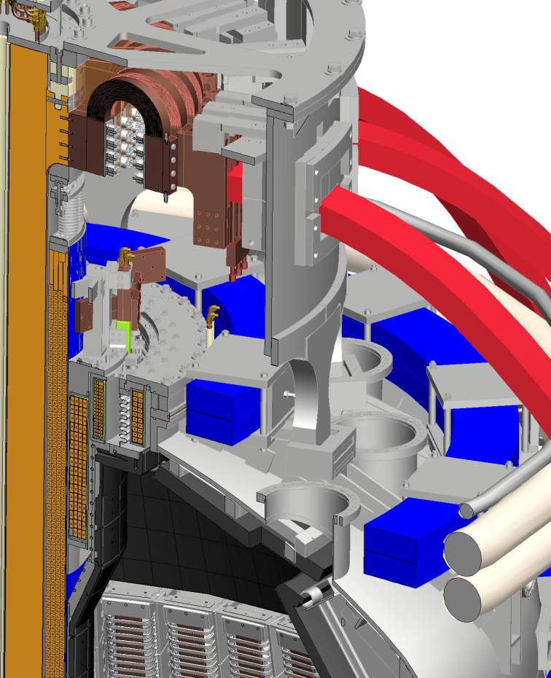
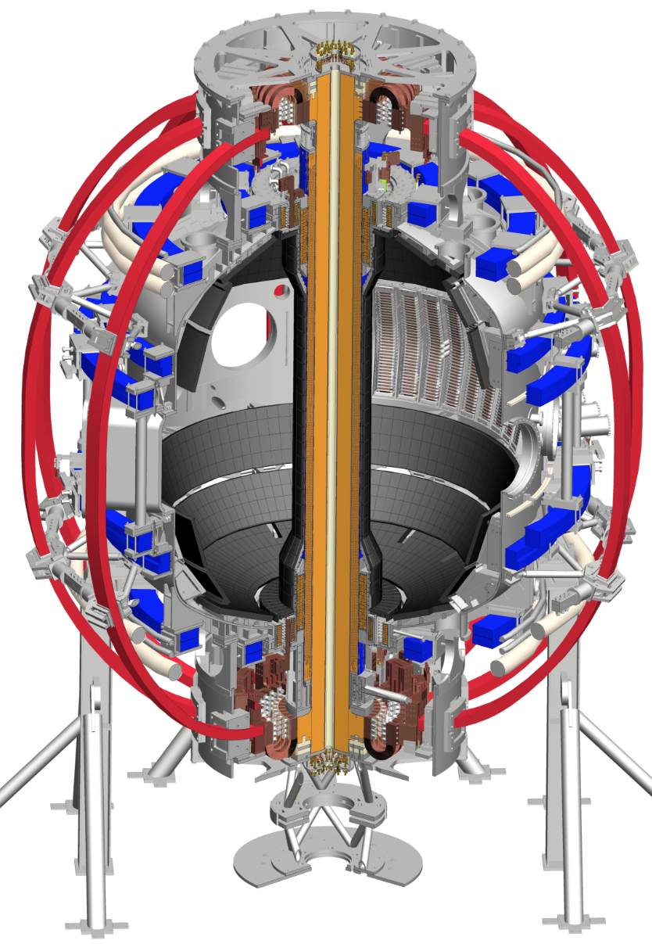
PF1AU coil developed turn-to-turn short(s)
TF
OH
PF1CU
PF1BU
PF2U
PF1AU
PF3U

Slide 34
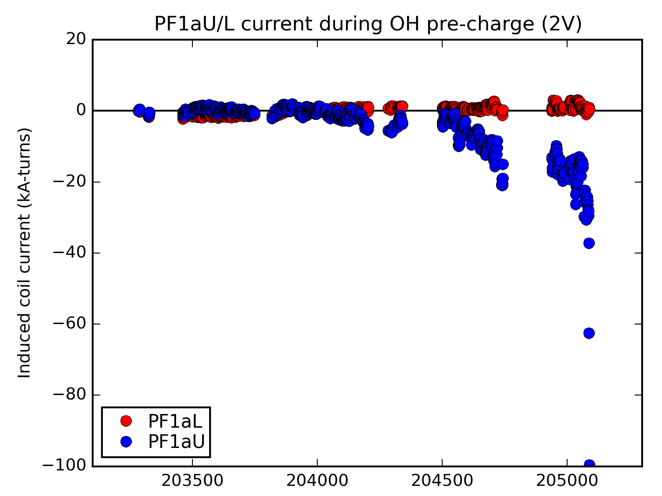
Evolution of induced current in PF1AU
Coil carries current when open circuited (open circuited every shot before plasma is produced)
→ turn-to-turn short
PF1AU first starts to conduct current at the end of the March / April run period
Very fast degradation on the final run day in June
May
June
PF1AL shows no anomalies, but will pre-emptively be replaced

Slide 35
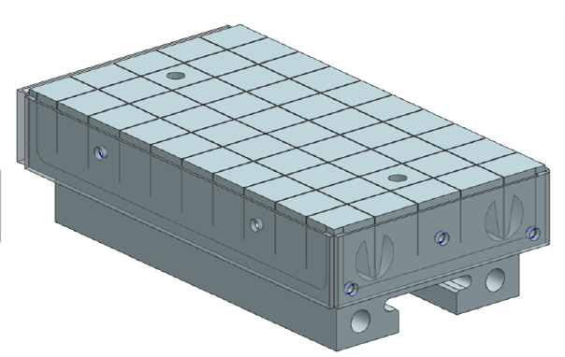
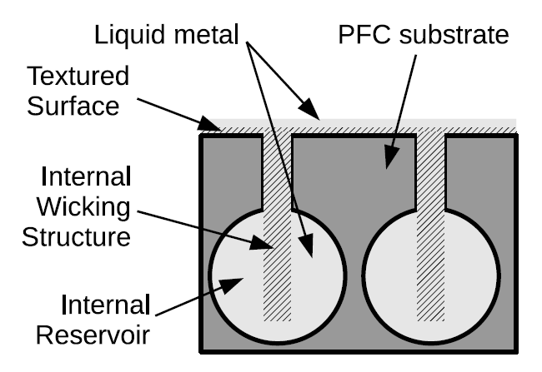


NSTX-U plans for initiating conversion to high-Z PFCs and studying flowing liquid metal PFCs
Base high-Z tiles without Li reservoir will be tested first
  Full toroidal row on OB divertor
  Utilizes wire-EDM fabrication to obtain complex geometry
2. Later test pre-filled Li tiles:
  Similar to capillary porous system (CPS) but applicable as divertor PFC
  Passive surface replenishment
  Bakeout → erodible high-Z layer/film
  Test when technically ready

