Slide 1

NSTX
Supported by
“Snowflake” divertor configuration in NSTX*
College W&M
Colorado Sch Mines
Columbia U
CompX
General Atomics
INEL
Johns Hopkins U
LANL
LLNL
Lodestar
MIT
Nova Photonics
New York U
Old Dominion U
ORNL
PPPL
PSI
Princeton U
Purdue U
SNL
Think Tank, Inc.
UC Davis
UC Irvine
UCLA
UCSD
U Colorado
U Illinois
U Maryland
U Rochester
U Washington
U Wisconsin
V. A. Soukhanovskii (LLNL)
D. D. Ryutov, H. A. Scott (LLNL),
J.-W. Ahn, R. Maingi, A. McLean (ORNL),
R. Bell, D. A. Gates, S. Gerhardt, R. Kaita, E. Kolemen, B. P. LeBlanc, J. E. Menard, D. Mueller, S. F. Paul, A. L. Roquemore (PPPL),
R. Raman (U Washington), R. Maqueda (Nova Photonics)
Culham Sci Ctr
U St. Andrews
York U
Chubu U
Fukui U
Hiroshima U
Hyogo U
Kyoto U
Kyushu U
Kyushu Tokai U
NIFS
Niigata U
U Tokyo
JAEA
Hebrew U
Ioffe Inst
RRC Kurchatov Inst
TRINITI
KBSI
KAIST
POSTECH
ASIPP
ENEA, Frascati
CEA, Cadarache
IPP, Jülich
IPP, Garching
ASCR, Czech Rep
U Quebec
Poster P 1-28
24 May 2010
* Supported by the U.S. DOE under Contracts DE-AC52-07NA27344, DE AC02-09CH11466, DE-AC05-00OR22725, DE-FG02-08ER54989.

Slide 2
Abstract
Spherical tokamaks (STs), a magnetic fusion confinement concept with low aspect ratio (A < 2), are viewed as potentially attractive devices for fusion development applications complementary to large aspect ratio tokamaks. The compact geometry of the ST divertor and the requirement of low normalized density (~ (0.5-0.7) x n_{G}) operation for increased neutral beam current drive efficiency define a unique edge transport regime with much greater demands on divertor and first-wall particle and heat flux handling. At present, candidate strategies for steady-state mitigation of divertor heat and particle loads in tokamaks include both the passive techniques, such as divertor geometry and magnetic balance, and active techniques, such as radiative divertors, field ergodization and strike point sweeping.
A novel divertor configurtion, called the “snowflake“ divertor (SFD), has been recently proposed and shown theoretically to offer significant benefits for the plasma material interface [1-4]. The SFD uses a second-order X-point created by merging, or bringing close to each other, two first-order X-points of a standard divertor (SD) configuration. The possibility of SFD has been demonstrated through modeling for DIII-D and NSTX [4] and in experiments on TCV [5]. We report on the first experiments in NSTX that obtained the SFD for periods of 50-150 milliseconds and confirmed many of the predicted SFD benefits. When compared to the high-triangularity (δ=0.7-0.8) SD configuration in NSTX [6], the obtained SFD configuration with medium triangularity (δ~0.65) had a connection length longer by factors of 1.5-2, and a poloidal magnetic flux expansion at the outer strike point higher by factors of 2-3. The 4-6 MW NBI-heated discharges with SFD maintained H-mode properties withoutl degradation of stored energy and confinement. Divertor heat flux profiles showed a large reduction in peak heat flux during the SFD periods. Divertor radiation due to carbon impurity was significantly increased in the SFD. A large volume recombination region with T_{e} ~ 1.5 eV, n_{e} > 2-6 x 10²⁰ m⁻³ developed, while ion flux to the divertor plate reduced, suggesting a partial detachment of the strike point region. As in previous divertor detachment experiments in NSTX [6], the core carbon density was reduced by up to 50 %. A critical SFD issue is magnetic control of the positions of the two X-points [1-4]. The experiments on NSTX provided insights on further SFD magnetic control optimization.
[1] D. D. Ryutov, 34th EPS Conf. on Plasma Phys., Warsaw, 2 - 6 July 2007 ECA Vol.31F, D-1.002 (2007)
[2] D. D. Ryutov, Phys. Plasmas 14, 64502 (2007)
[3] D. D. Ryutov et al., Phys. Plasmas 15, 092501 (2008)
[4] D. D. Ryutov et al., Paper IC/P4-8, 22st IAEA FEC, Geneva, Switzerland, 10/2008
[5] F. Piras et al., Plasma Phys. Control. Fusion 51 (2009) 055009
[6] V. A. Soukhanovskii et al., Phys. Plasmas 16, (2009); V. A. Soukhanovskii et al., Nuc. Fusion 49, 095025 (2009)

Slide 3
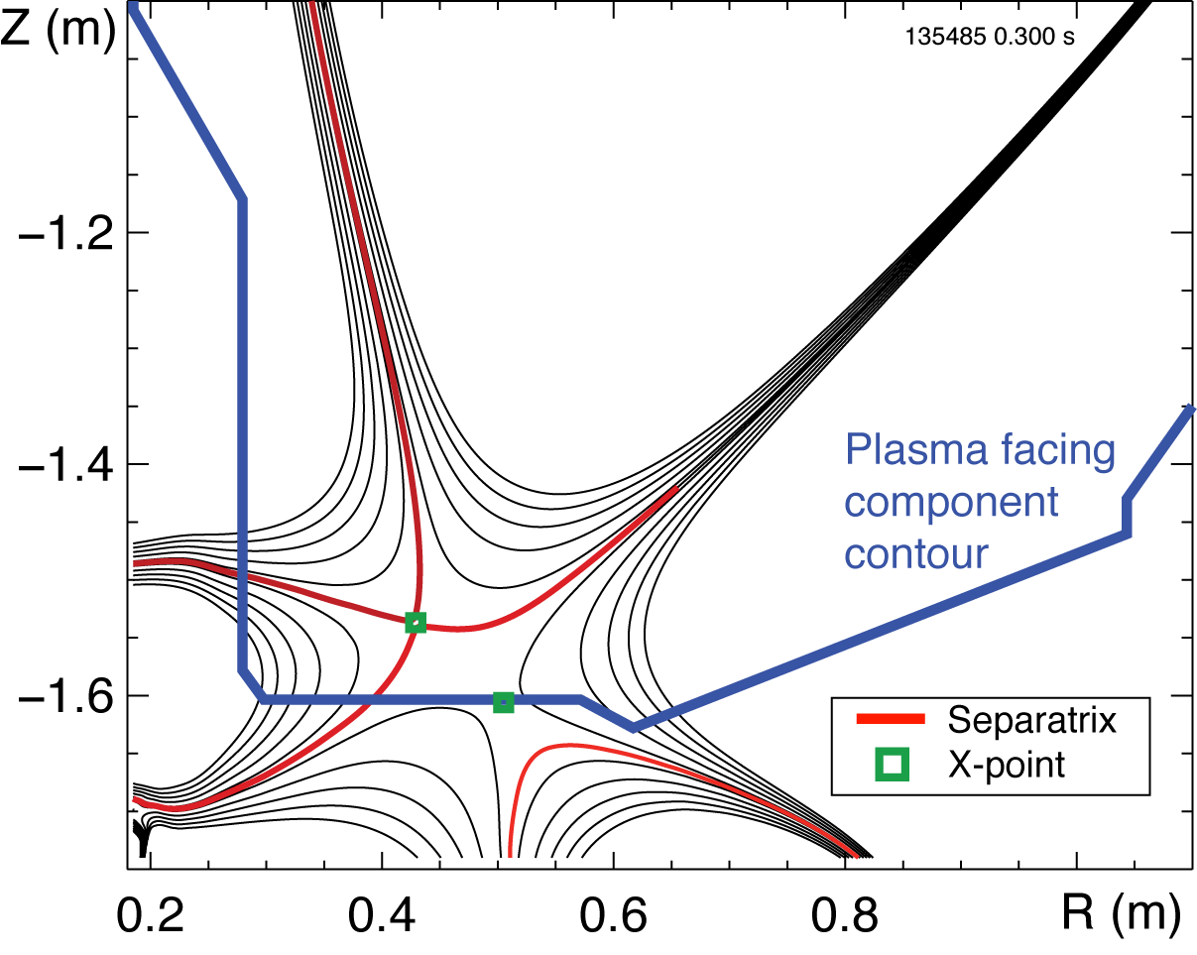

Overview and Summary
“Snowflake” divertor configuration – a promising solution for divertor heat flux mitigation in future fusion plasma devices
“Snowflake” divertor configuration (cf. standard divertor)
  Higher flux expansion (increased divertor A_{wet} )
  Higher divertor volume (increased P_{rad}, R_{rec}, …)
  Magnetic control
In recent NSTX experiments
  “snowflake” divertor was generated with 2 divertor coils
  all predicted “snowflake” divertor geometry properties confirmed
  H-mode confinement maintained
  “snowflake” divertor led to outer strike point partial detachment
    significant reduction in peak heat flux
    reduction of core impurities

Slide 4



Various techniques considered for SOL / divertor q|| and q_{pk} control
Divertor heat flux mitigation solutions:
  Divertor geometry (poloidal flux expansion)
  Strike point sweeping
  Radiative divertor (or radiative mantle)
  Divertor plate tilt and divertor magnetic balance
Candidate solutions
  be compatible with good core plasma performance (H-mode confinement, MHD, ELM regime, density) and particle control
  scale to very high q_{peak} (15 - 80 MW/m²) for future devices

Slide 5
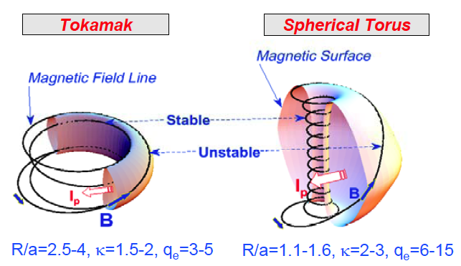
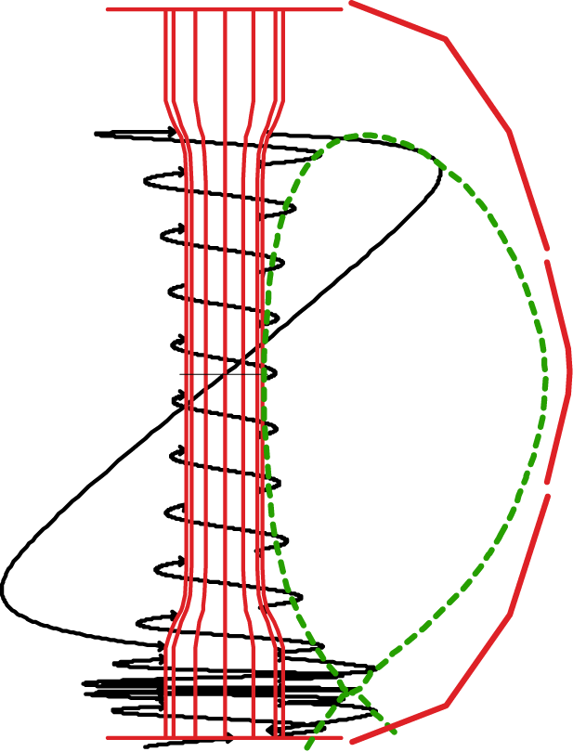
SOL / divertor geometric properties are different in spherical tori and large aspect ratio tokamaks
 | NSTX high κ, δ | Tokamak
Aspect ratio | 1.4-1.5 | 2.7
In-out SOL area ratio | 1:3 | ~ 2:3
Parallel connection length L||, MP to target (m) | 8-12 | 30-80
L|| , X-point to target (m) | 5-8 | 10-20
Angle at target (deg) | 2-5 | 1-2

Slide 6
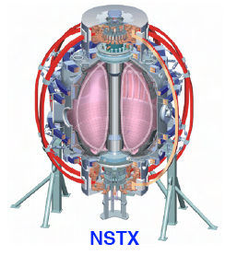
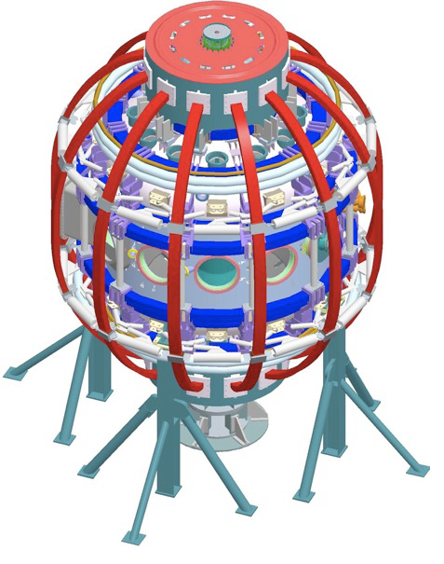
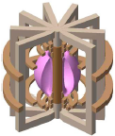
Divertor heat flux mitigation is key for present and future fusion plasma devices
ST / NSTX goals:
  Study high beta plasmas at reduced collisionality
  Access full non-inductive start-up, ramp-up, sustainment
  Prototype solutions for mitigating high heat & particle flux
In an ST, modest q|| can yield high divertor q_{pk}
  in NSTX, q||= 50-100 MW/m² and q_{pk}=6-15 MW/m² (Poster P2-65 by T. Gray, R. Maingi)
  Large radiated power and momentum losses are needed to reduce q||
In NSTX, partially detached divertor regime is accessible only
  in highly-shaped plasma configuration with high flux expansion divertor (high plasma plugging efficiency, reduced q||)
  modest divertor D₂ injection still needed
NSTX
NSTX-U
ST-based Plasma Material Interface (PMI) Science Facility
ST-based Fusion Nuclear Science (FNS) Facility

Slide 7
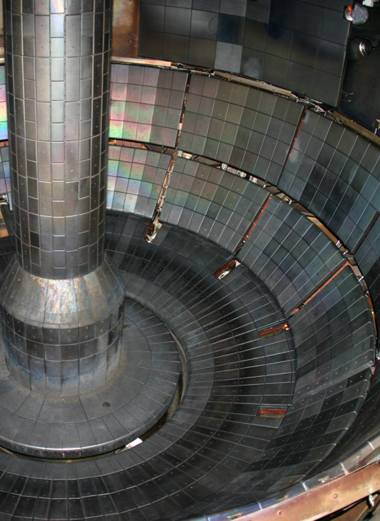
Open geometry enables flexibility in divertor configurations and plasma shaping in NSTX
Plasma facing components
  ATJ and CFC tiles
  Carbon - erosion, sputtering
  Max P_{rad} fraction limited by carbon radiation efficiency
  Typical divertor tile temperature in 1 s pulses T < 500 C
  (q_{peak} ≤ 10-15 MW/m²)
No active divertor pumping
  Evaporated lithium coatings 80-100 g per discharge for reduced recycling and performance improvements

Slide 8
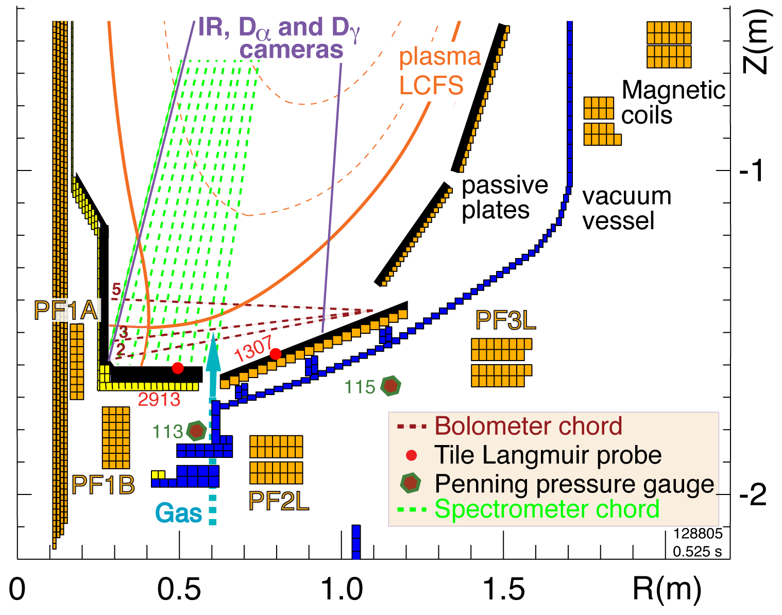
Multiple diagnostic measurements are analyzed to elucidate on divertor physics in NSTX
Diagnostic set for divertor
studies:
  IR cameras
  Bolometers
  Neutral pressure gauges
  Tile Langmuir probes
  Dα, Dγ filtered CCD arrays
  UV-VIS spectrometer
  (10 divertor chords)
Midplane Thomson scattering and CHERS systems
Divertor gas injector
Γ_{gas} = 20-200 Torr l / s

Slide 9
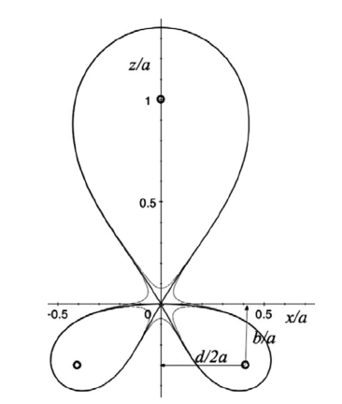
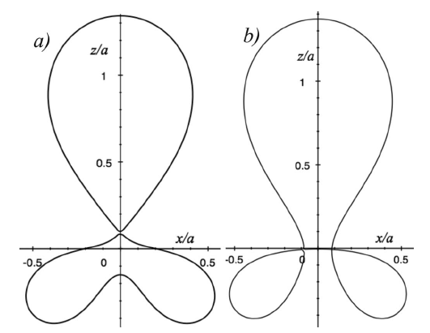
Theory predicts attractive divertor geometry properties in “snowflake” divertor configuration
“Snowflake” divertor (SFD) configuration proposed and studied theoretically by D. D. Ryutov (LLNL)
  Phys. Plasmas 14, 064502 (2007)
  Phys. Plasmas, 15, 092501 (2008)
  34th EPS Conference on Plasma Phys. Warsaw, 2 - 6 July 2007 ECA Vol.31F, D-1.002 (2007)
  Paper IC/P4-8 at IAEA FEC 2008
SFD is obtained by creating a second-order poloidal null in the (lower) divertor with existing divertor coils
Predicted properties
  Low B_{p} in X-point region
  Large A_{wet} , f_{exp}
  Large L_{x}, V_{div}
  Null-point flux tube squeezing – barrier for turbulence?
  ELM control (increased edge magn. shear) ?
Ideal SFD
SFD-plus and SFD-minus

Slide 10
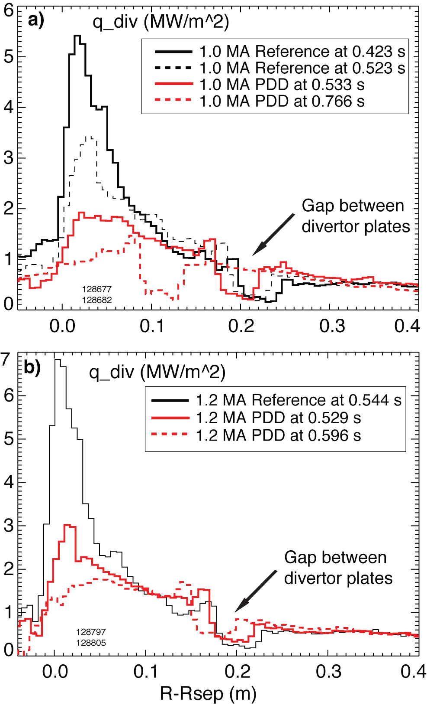
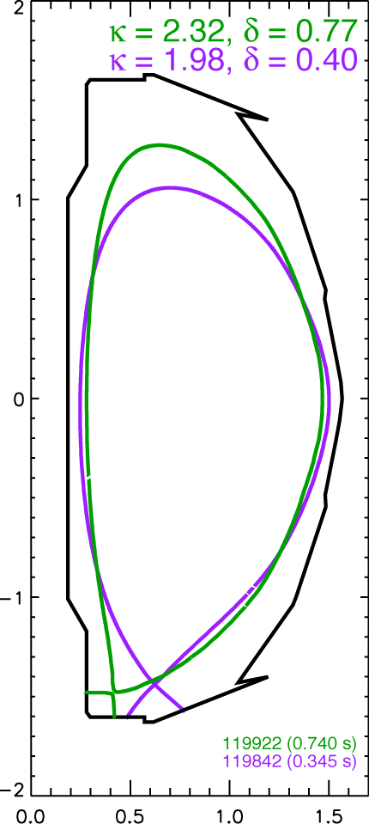
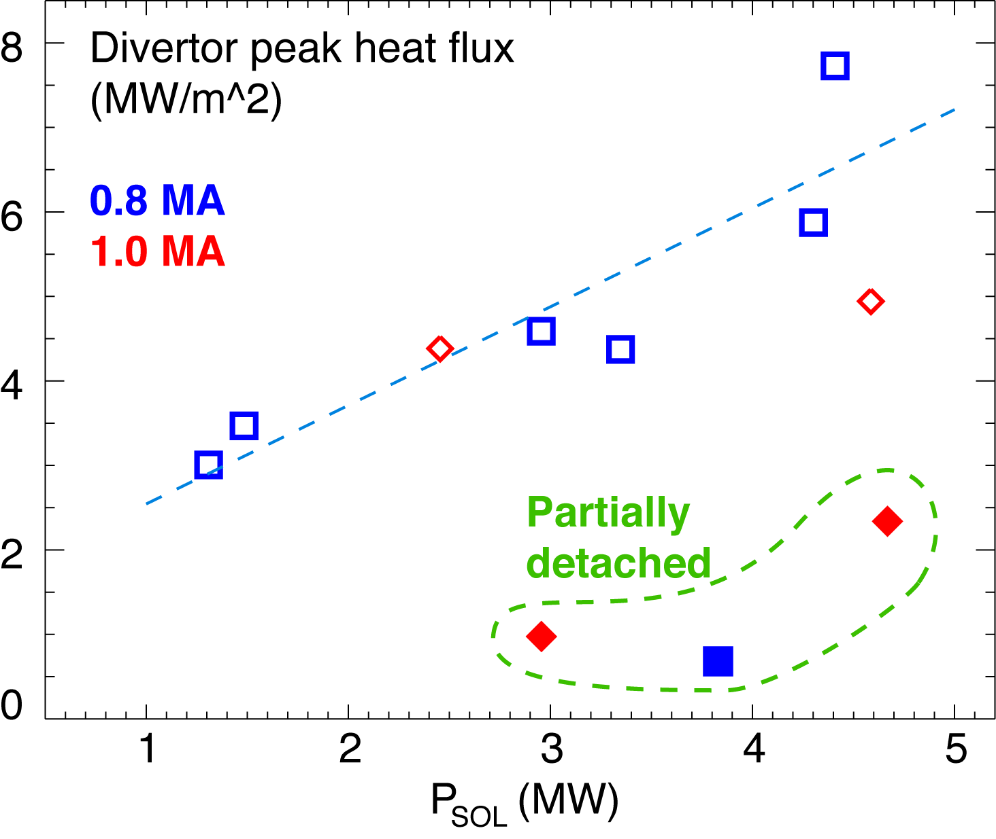
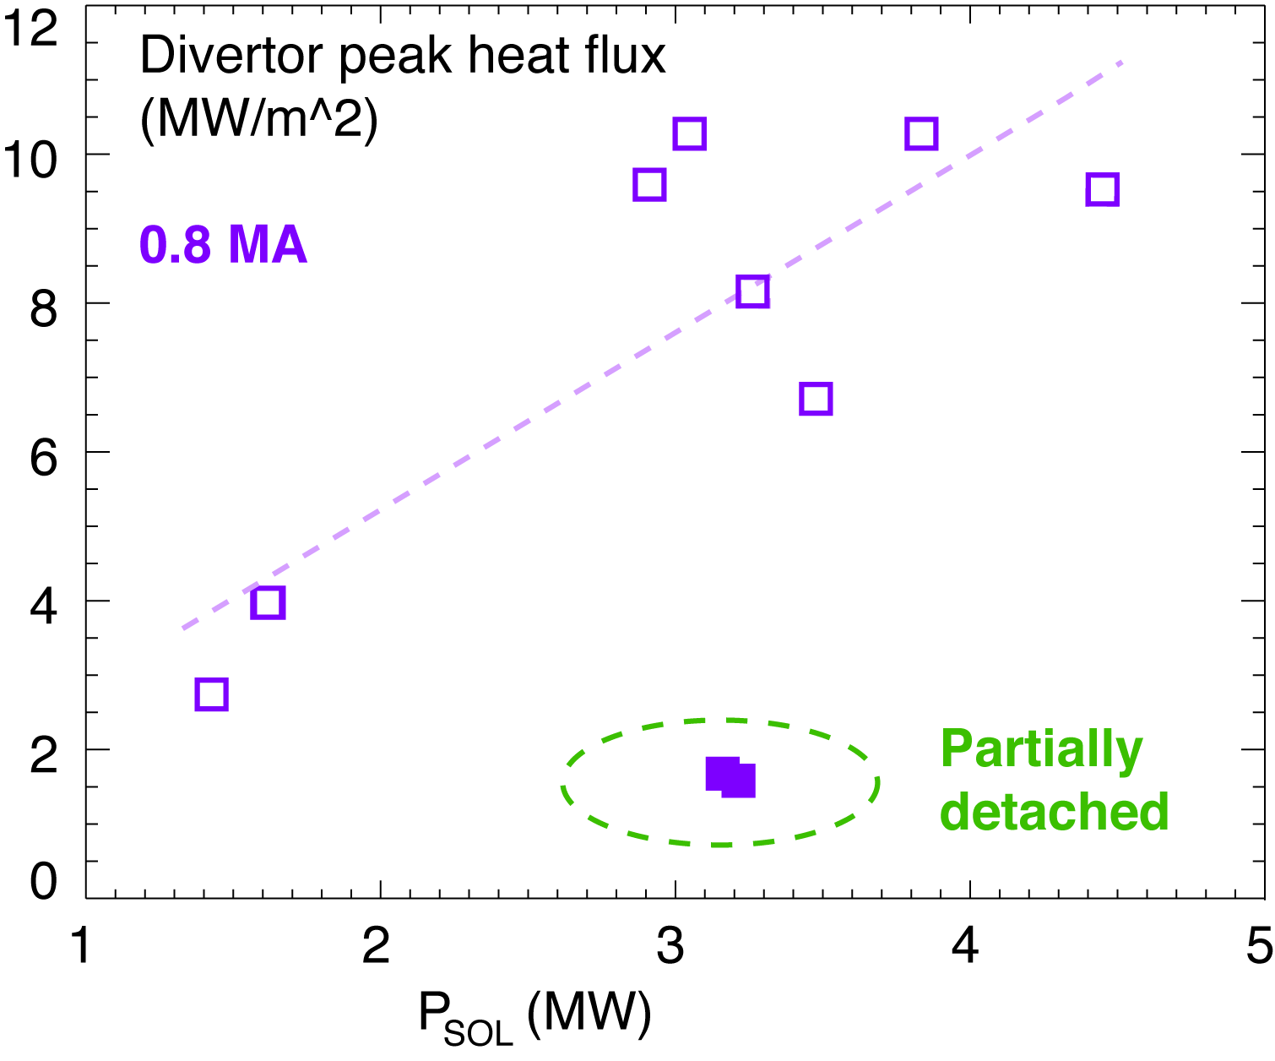
NSTX experiments have already demonstrated benefits of high flux expansion divertor
Poster P2-65 by T. Gray, R. Maingi
SOUKHANOVSKII, V. A. et al., Phys. Plasmas 16 (2009) 022501
SOUKHANOVSKII, V. et al., Nucl. Fusion 49 (2009) 095025

Slide 11
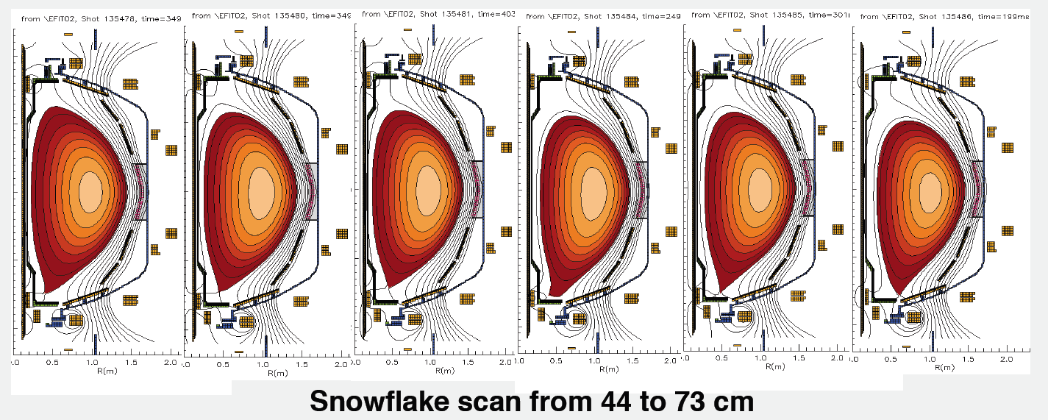
Three lower divertor coils can be used for divertor configurations with various δ, X-pt, R_{OSP}
Presently use two divertor coils in PCS
  PF1A for inner strike point control
  PF2L for outer strike point control

Slide 12
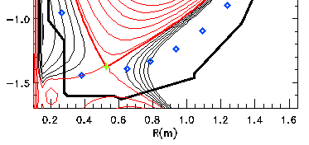
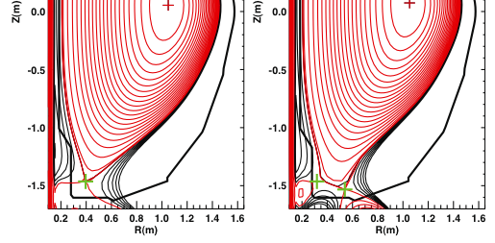
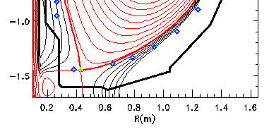
ISOLVER code was used to scan strike point positions and divertor coil currents for “snowflake” configuration
ISOLVER - predictive free-boundary axisymmetric equilibrium solver developed by J. E. Menard
  normalized pressure and current profiles and boundary shape as input
  matches a specified plasma current and β,
  computes coil currents as output
PF1AL: 11 kA
PF2L: 0 kA
PF1AL: 11 kA
PF2L: 5 kA

Slide 13
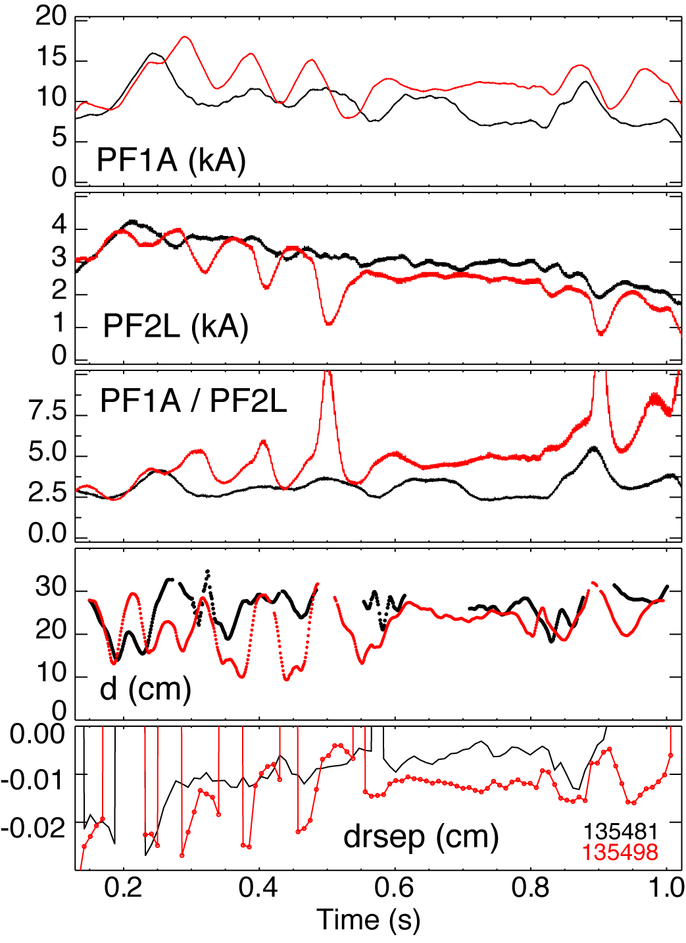
In experiment, controlled outer strike point scan produced “snowflake” divertor configurations
Scanned OSP between 0.44 to 0.73 m
Best “snowflake” configurations were obtained with requested R_{OSP} ~ 0.55 m (not necessarily actual R_{OSP})
“Snowflake” configuration was obtained when null-point separation d decreased to below 20 cm

Slide 14
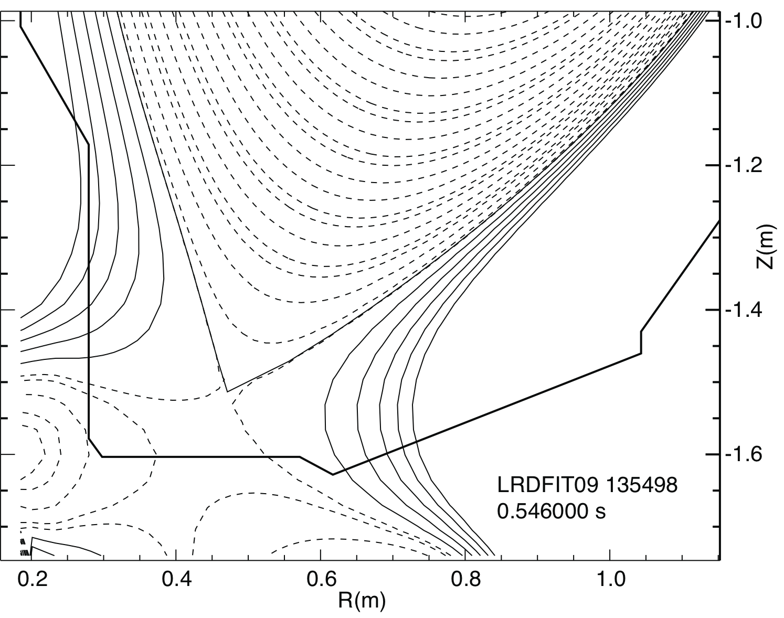
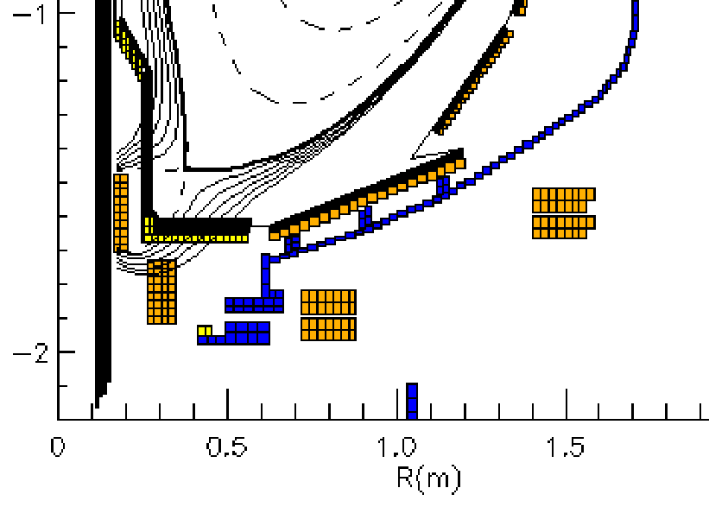
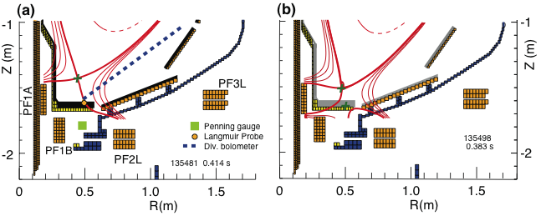
“Snowflake” divertor favorably compares to medium-δ and high-δ standard divertors

Slide 15
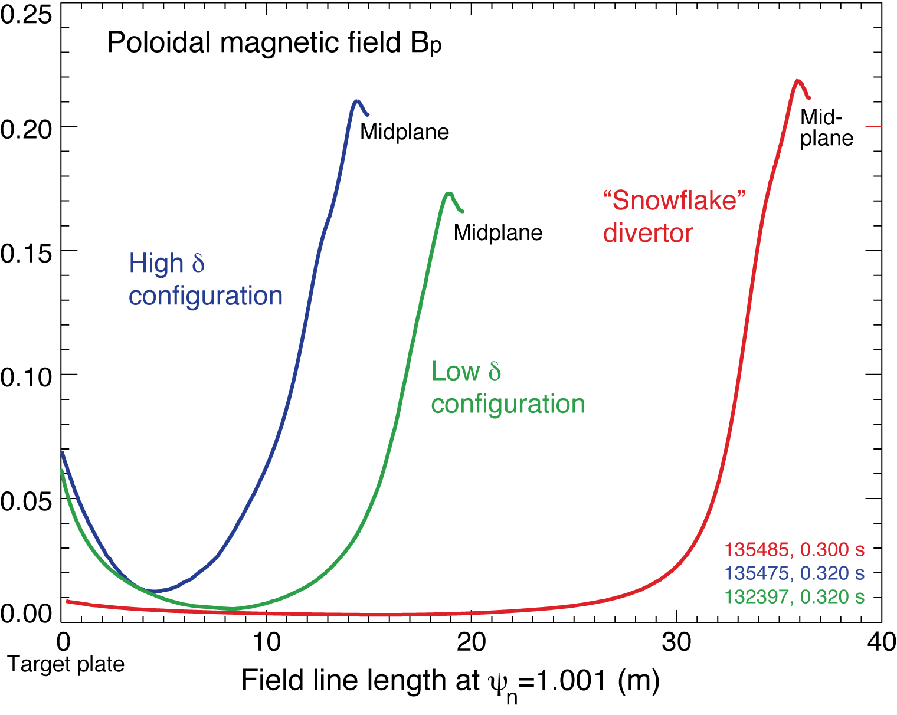
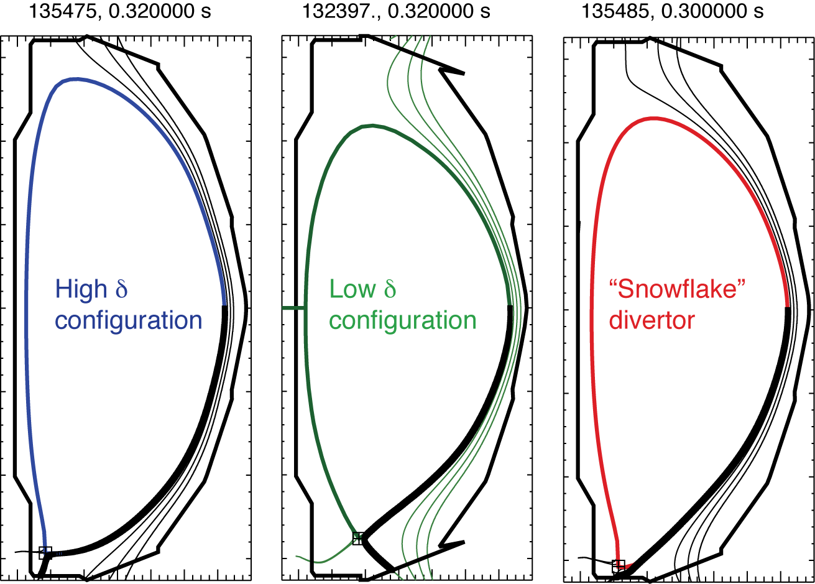
SFD configuration shows highest flux expansion at strike point and longest connection length
Configuration | Flux expansion | L_{x} (m) | L_{tot} (m)
SFD | 68 | 16.3 | 36.5
Low δ | 4.5 | 8.4 | 19.5
High δ | 10 | 4.5 | 15.0

Slide 16
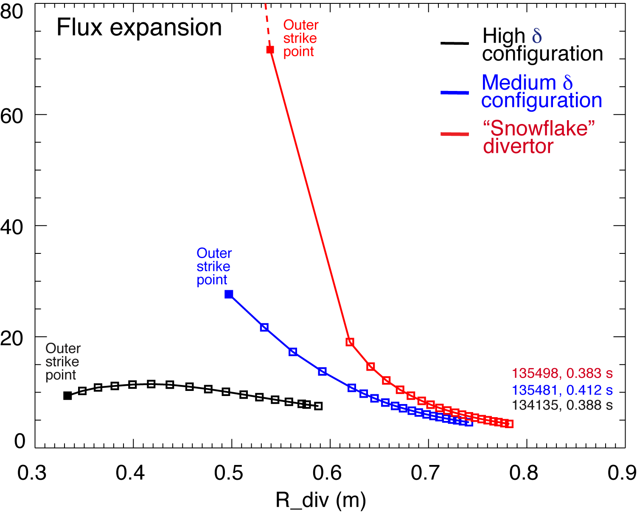
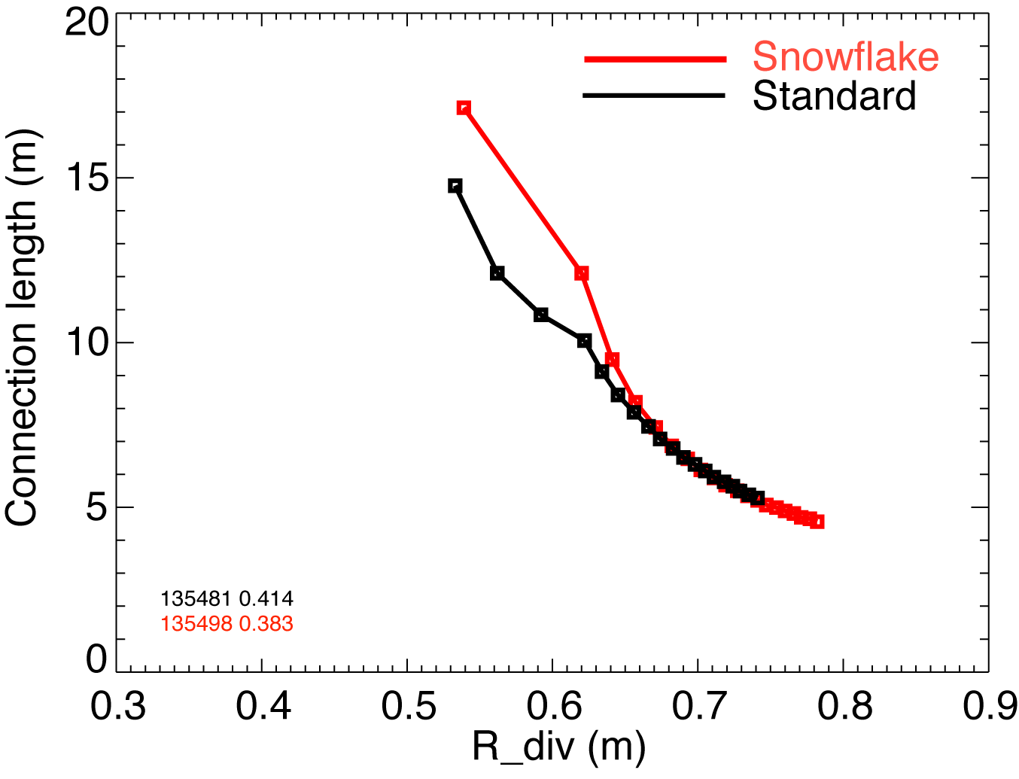
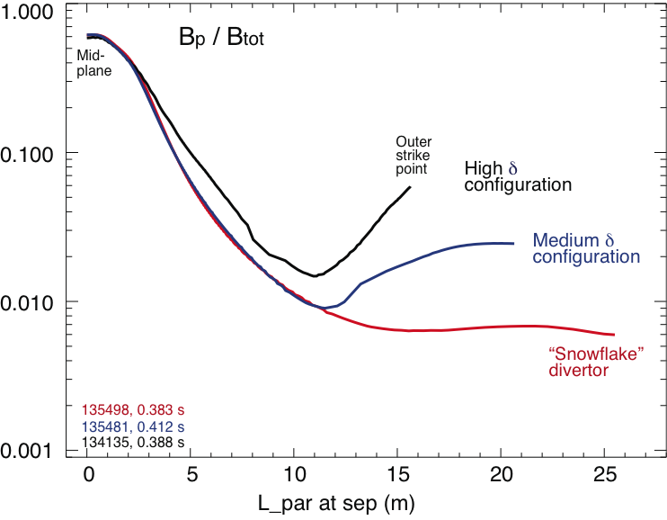
Theoretically predicted geometrical properties of the snowflake divertor configuration are confirmed in NSTX
In “snowflake” divertor
  Plasma-wetted area (flux expansion) higher
  L_{x} longer (thus f_{PFR} and V_{div} higher)
These properties observed in first 2-3 mm of SOL λ_{q}

Slide 17
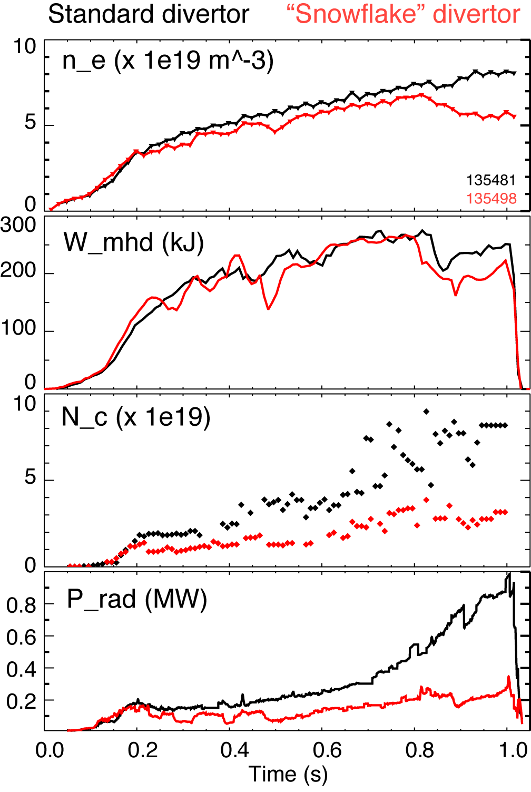
H-mode confinement retained with “snowflake” divertor, core P_{rad} and n_{C} reduced by up to 75 %
Used 80-100 g evaporated lithium per discharge for wall conditioning
ELM-free H-mode discharges had impurity accumulation
In “snowflake” divertor discharges
  Divertor sputtering source reduction (?)
  Edge confinement degradation (?)

Slide 18
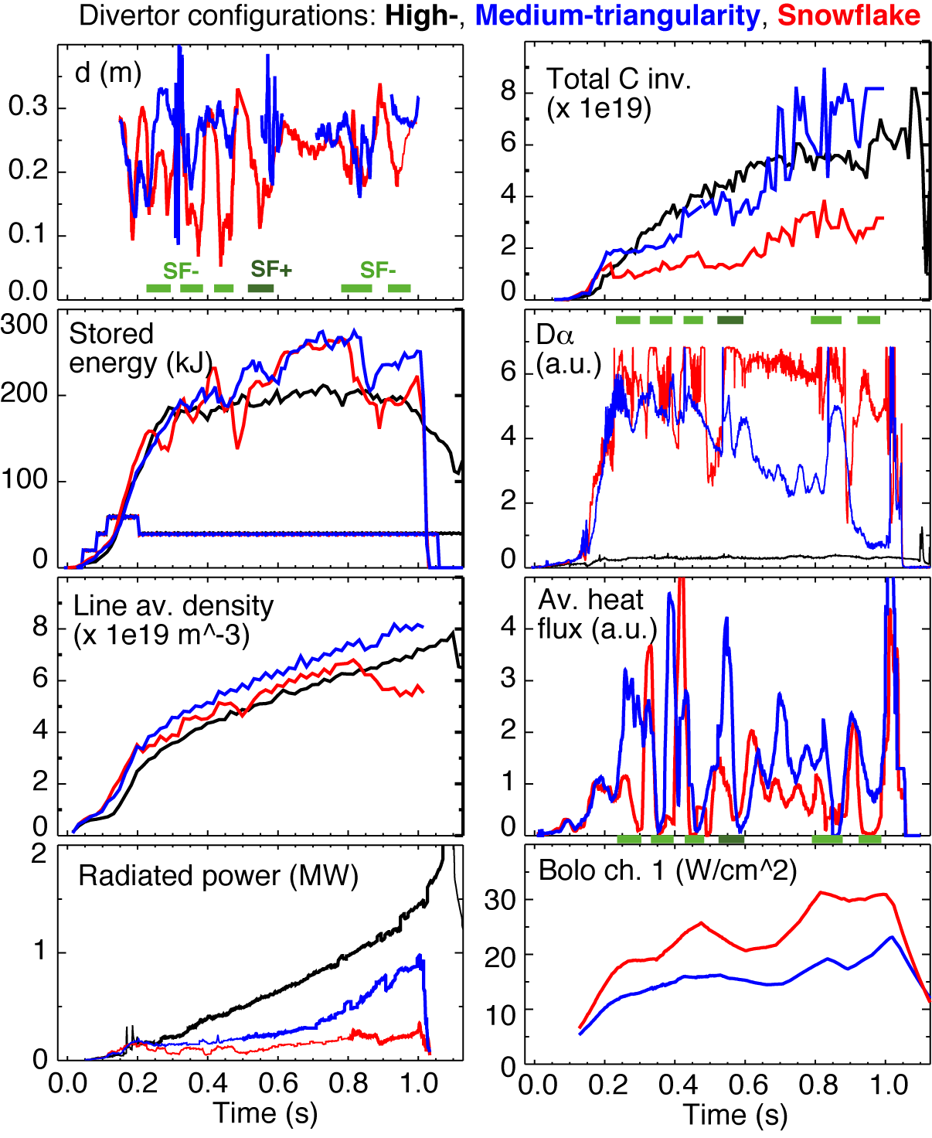
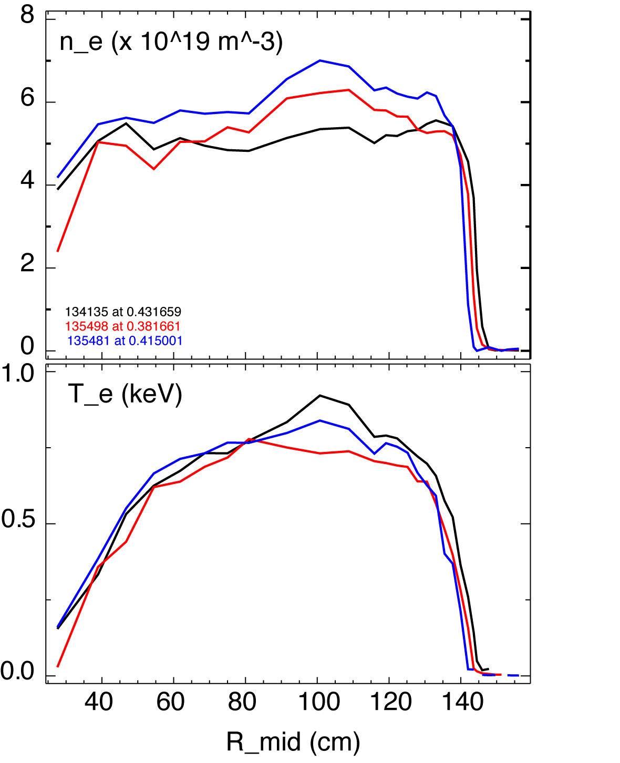
Less carbon accumulation and lower n_{e} in H-mode “ears” in “snowflake” divertor discharges
Different edge n_{e}(R) due to significant n_{C} reduction
Future work – edge stability analysis

Slide 19
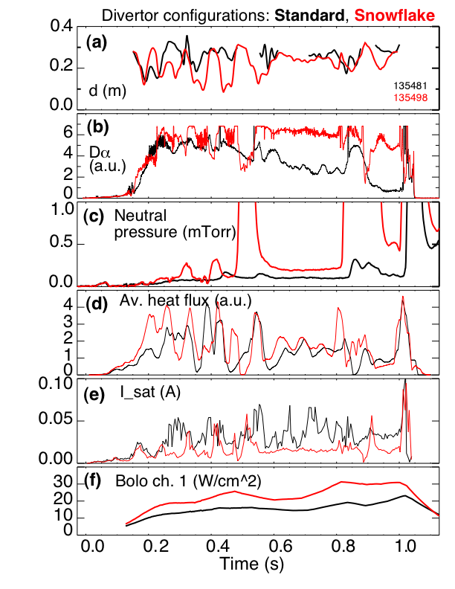
Partial detachment of outer strike point region observed in “snowflake” divertor discharges
Signs of partial detachment observed in “snowflake” divertor
  Loss of parallel pressure
  Heat and particle flux reduction at the plate
  T_{e} ≤ 1.6 eV, n_{e} ≥ 2e14 m⁻³
  Increase in divertor P_{rad}
  Increase in 3-body recombination rate
  Increase in neutral pressure

Slide 20
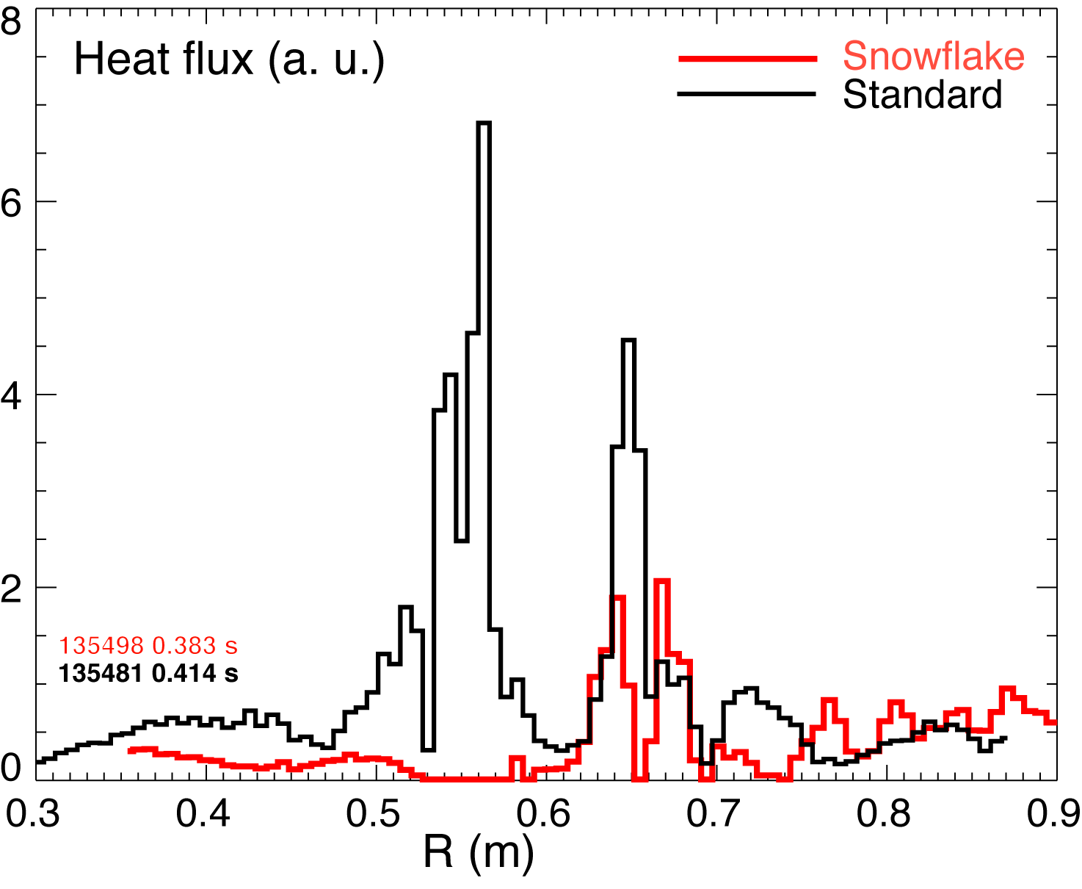
Significant reduction of heat flux observed in “snowflake” divertor
Divertor peak heat flux well correlated with null-point separation d
Reduction observed in 2-3 mm region (mapped to midplane) adjacent to separatrix
Uncalibrated IR camera data due to lithium coatings

Slide 21
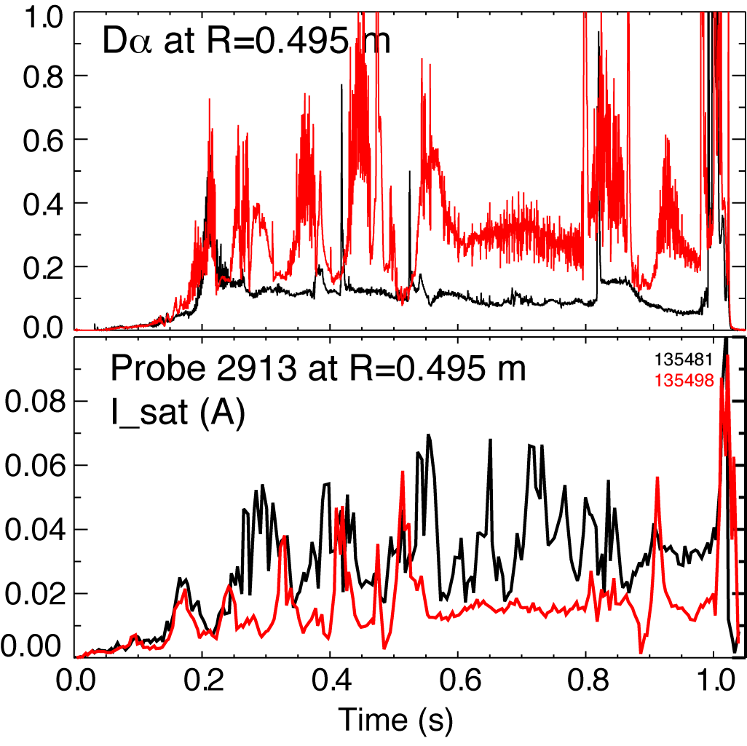
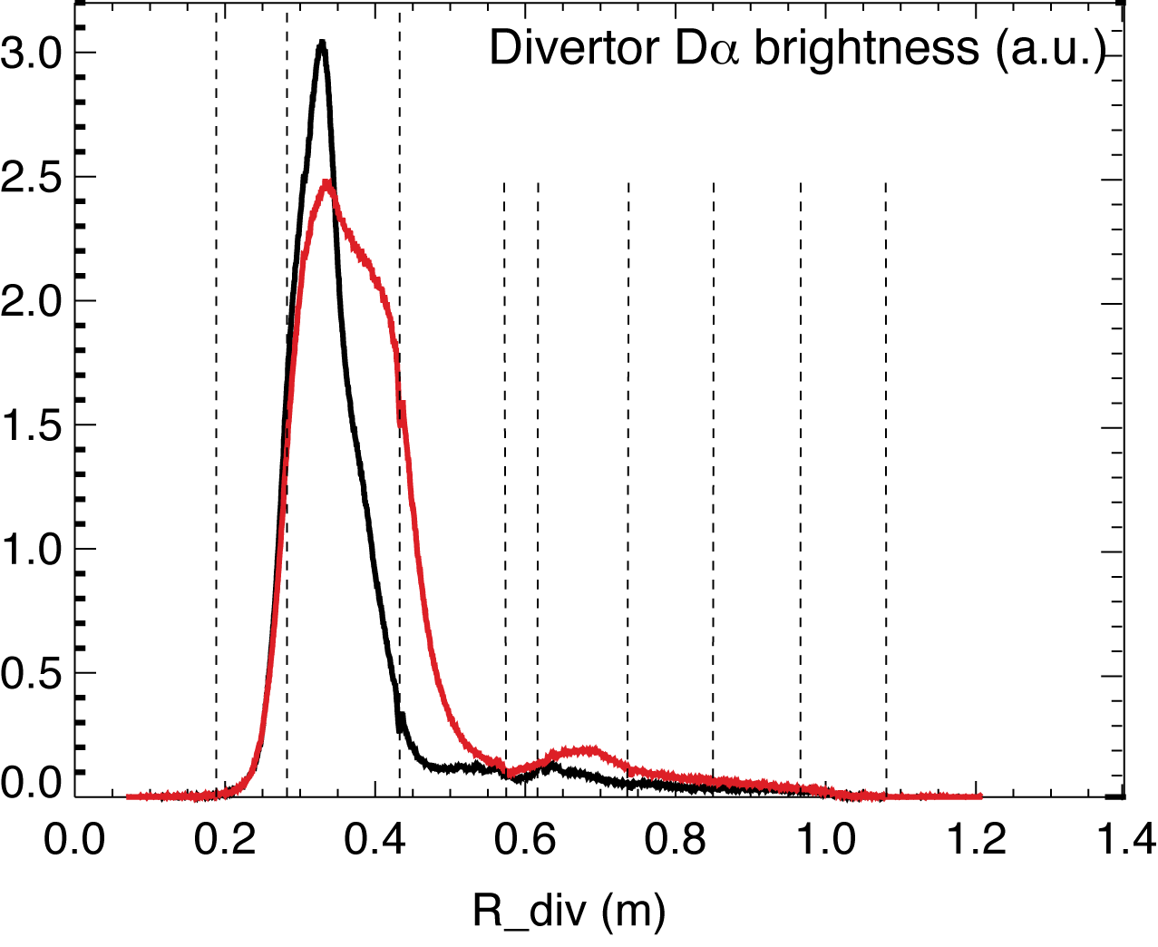
Balmer line emissions suggest large increase in recombination rate in “snowflake” divertor
Divertor D_{α} emission
  Increase in radiating zone width
  Brightness increase (due to recombination) correlated with Langmuir probe I_{sat} decrease (due to particle flux reduction)

Slide 22
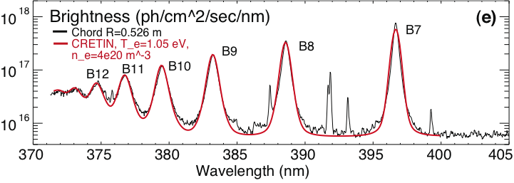
High-n Balmer line emission measurements suggest high divertor recombination rate, low T_{e}, high n_{e}
Balmer series spectra modeled with CRETIN; Spectra sensitive to
  Line intensity <-> Recombination rate
  Te <-> Boltzman population distribution
  ne <-> Line broadening due to linear Stark effect from ion and electron microfield
T_{e}=0.8-1.2 eV, n_{e}=2-7 x 10²⁰ m⁻³ inferred from modeling

Slide 23
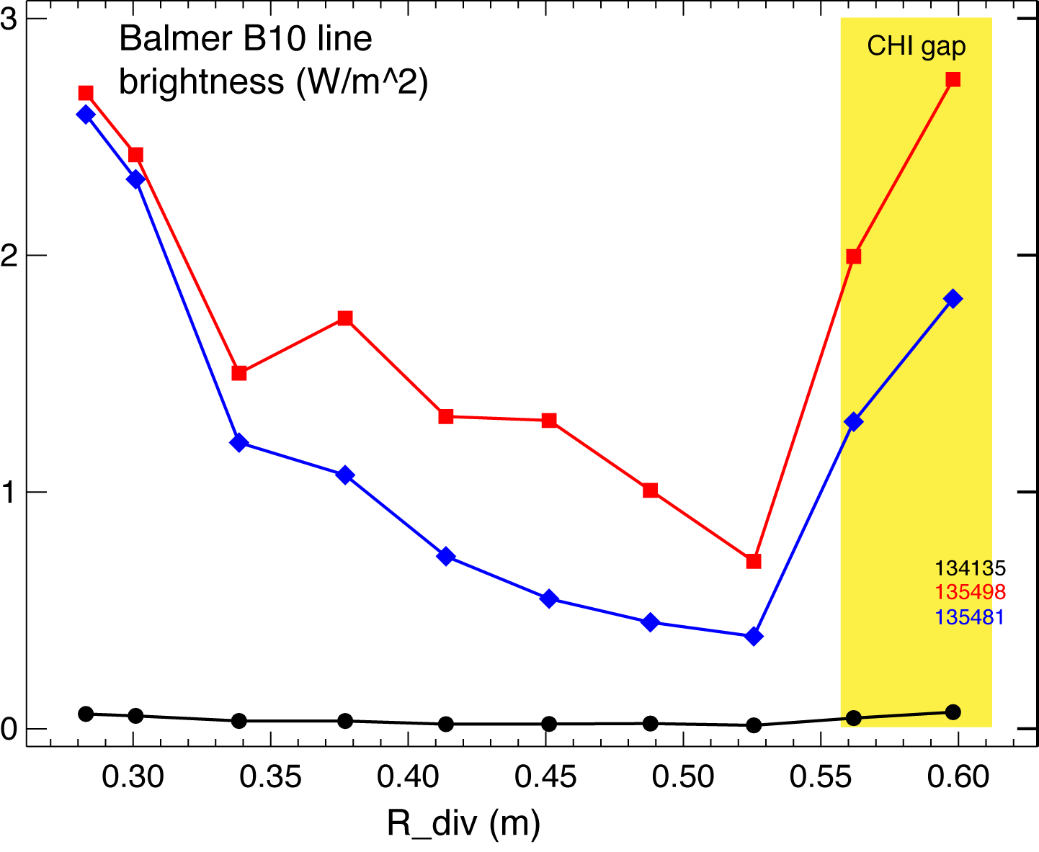
High-n Balmer line emission measurements suggest high divertor recombination rate, low T_{e}, high n_{e}
In “snowflake” divertor and high-δ configurations, B10 emission is from outer SOL, in medium-δ configuration, B10 emission is mostly from PFR region
Increase in divertor n_{e} despite lithium conditioning that reduces recycling

Slide 24
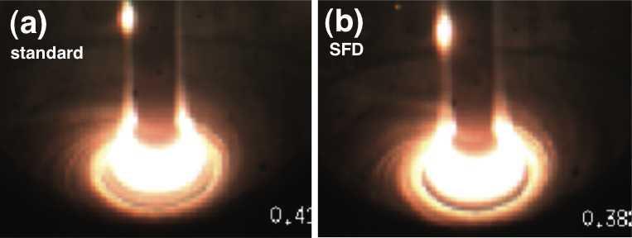
Divertor camera images show formation of extended radiation zone in “snowflake” divertor
Visible camera images
Zone extent correlated with divertor configuration

Slide 25
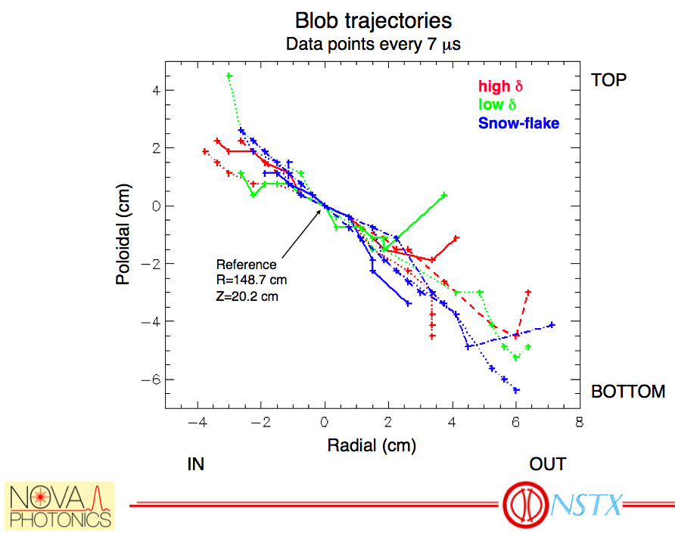
SOL blobs move radially at the same velocity regardless of divertor configuration
Data from gas puff imaging diagnostic
The "average" trajectories from the time-delayed cross correlations: each data point is the location of the maximum in the delayed cross correlation (relative to the reference point in the SOL).
The time delays used are integer multiples of the framing time (7us).

Slide 26
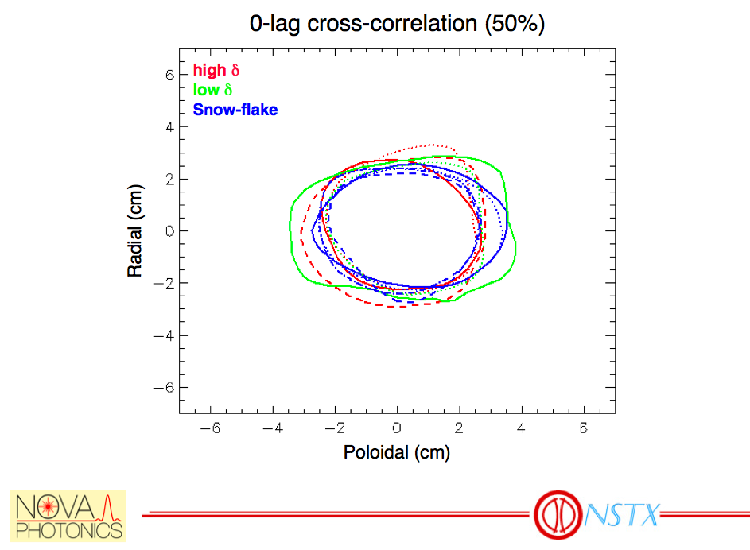
Blob sizes appear to be similar in “snowflake” and standard divertor configurations
The first page is 50% contour plot of the 0-lag cross-correlation between a reference point in the SOL and all other points in the images.
The poloidal and radial auto-correlation lengths are a sub-set of this data.
The net result: in all cases blobs are ~4cm FWHM in both radial and poloidal dimension.

Slide 27
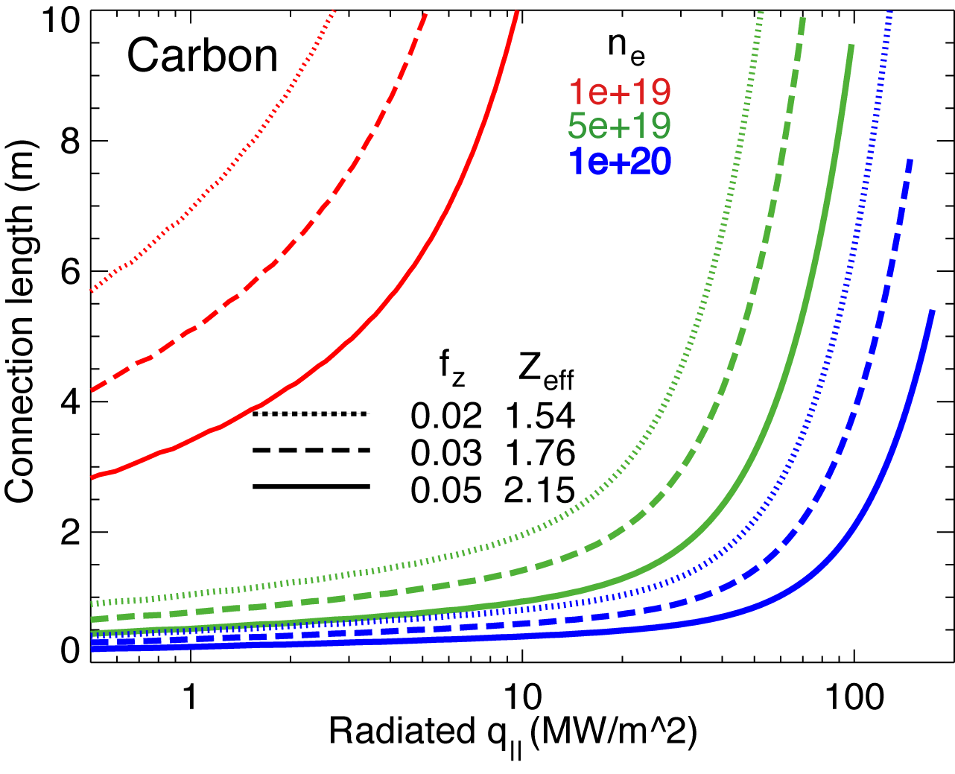
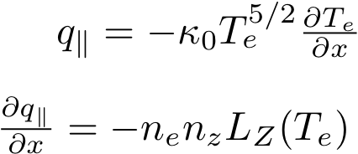
High f_{rad} can be achieved with carbon in “snowflake” divertor at high n_{e} and longer L_{x}
Hulse-Post non-coronal radiative cooling curves for low Z impurities for n₀/n_{e}, n_{e}-τ_{recy}
Calculate max q|| that can be radiated
Express max q|| as function of distance from heat source for range of f_{z}
(Post JNM 220-222, 1014 (1995) )
Power losses due to deuterium P_{rad} and ionization not considered
For NSTX, use n₀ = 0.1 % and n_{e}-τ_{recy} = n_{e} x 1e-3 s

Slide 28
Volumetric power and momentum losses are increased due to geometry in “snowflake” divertor
Fraction of q|| to be radiated is a function of L_{x} for given impurity
  high f_{rad} only where L_{x} longest
Electron-ion recombination rate depends on divertor ion residence time
  Ion recombination time: τ_{ion}~ 1−10 ms at T_{e} =1.3 eV
  Ion residence time: τ_{ion} ≤ 1 ms
Parallel momentum and power balance:
CX & elastic recombination
Rad. power

Slide 29
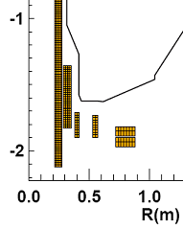
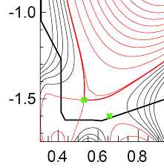
Future plans
Magnetic control of “snowflake” divertor
  RT-control of 2nd null-point with PCS
  Use of PF1B for control
Transport and turbulence characterization
Edge stability characterization
Scaling with power
Plans for NSTX-U
  Additional divertor coil PF1C
    flux expansion variation with fixed X-point height
    and strike-point location
  Development of PMI solutions to address
    2-3x higher input power
    30-50% reduction in Greenwald fraction
    3-5x longer pulse duration

