Slide 1




NSTX-U
Supported by
Towards Identifying the Mechanisms Underlying Field-Aligned Edge Losses of HHFW Power on NSTX
Coll of Wm & Mary
Columbia U
CompX
General Atomics
FIU
INL
Johns Hopkins U
LANL
LLNL
Lodestar
MIT
Lehigh U
Nova Photonics
ORNL
PPPL
Princeton U
Purdue U
SNL
Think Tank, Inc.
UC Davis
UC Irvine
UCLA
UCSD
U Colorado
U Illinois
U Maryland
U Rochester
U Tennessee
U Tulsa
U Washington
U Wisconsin
X Science LLC
Culham Sci Ctr
York U
Chubu U
Fukui U
Hiroshima U
Hyogo U
Kyoto U
Kyushu U
Kyushu Tokai U
NIFS
Niigata U
U Tokyo
JAEA
Inst for Nucl Res, Kiev
Ioffe Inst
TRINITI
Chonbuk Natl U
NFRI
KAIST
POSTECH
Seoul Natl U
ASIPP
CIEMAT
FOM Inst DIFFER
ENEA, Frascati
CEA, Cadarache
IPP, Jülich
IPP, Garching
ASCR, Czech Rep
Rory J. Perkins, J.-W Ahn, R.E. Bell, N. Bertelli, A. Diallo, S. Gerhardt, T.K. Gray, D.L. Green, J.C. Hosea, E.F. Jaeger, M.A. Jaworski, G.J. Kramer, B.P. LeBlanc, R. Maingi, A. McLean, C.K. Phillips, L. Roquemore, P.M. Ryan, S. Sabbagh, F. Scotti, G. Taylor, J.R. Wilson,
and the NSTX Research Team
Radio-Frequency Power in Plasmas
Sorrento, Italy
Jun 28, 2012

Slide 2
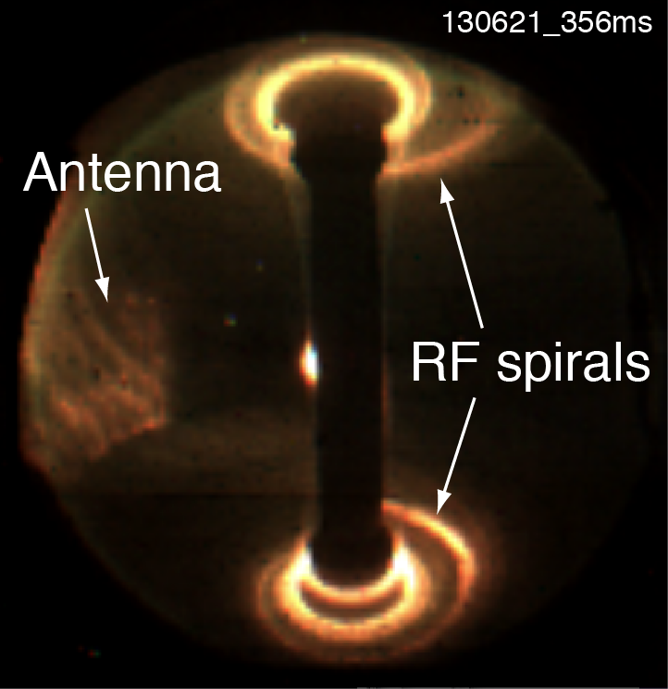
HHFW power lost directly to divertor regions
along SOL field lines on NSTX
RF power deposited in bright spirals on upper and lower divertor
Occurs as waves propagate away from antenna prior to LCFS
  Large single-pass absorption (high beta)
  Negligible multi-pass dampening

Slide 3
Outline
NSTX exhibits field-aligned loss in SOL
        Deposits power in spirals on divertor
        Losses occur along all SOL field lines around antenna
        Loss amplitude peaks near antenna and also LCFS
Field-aligned losses are significant
    Account for large portion of total losses
    Other loss mechanisms may be significant too
Fast-wave propagation in SOL may be responsible
    Losses are related to onset density for perpendicular fast-wave propagation
    Codes show signs of large RF fields in SOL but need proper edge damping.
Notes:
3

Slide 4
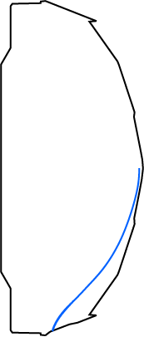
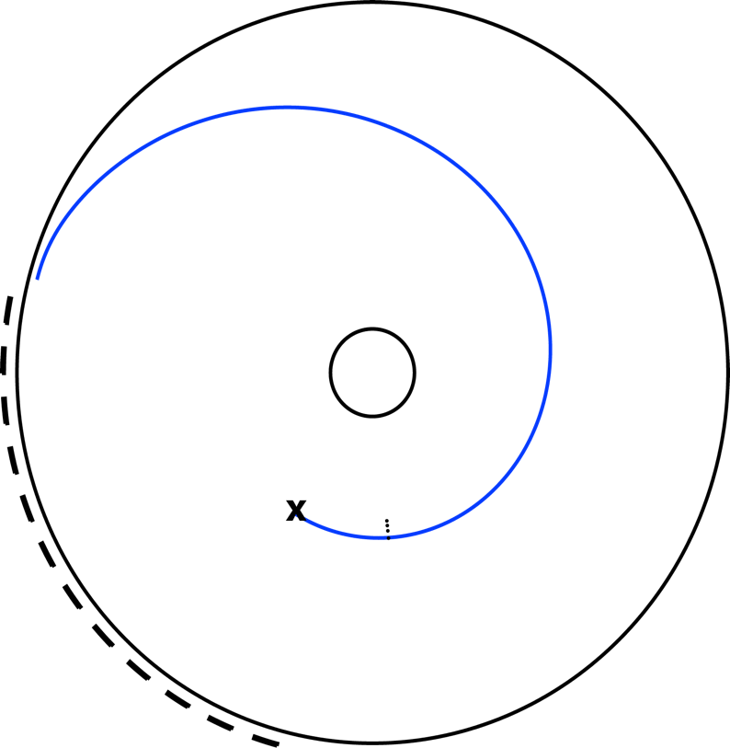
Field-line mapping models
flow of lost HHFW power
Start field lines at midplane between antenna and separatrix
Track field lines until they strike divertor
Track field lines using SPIRAL code
Midplane Starting Radius
Strike Point
G.J. Kramer et al., 22 IAEA FEC (Geneva, 2008) CD-ROM file IT/P6-3,
G.J. Kramer et al., submitted to Plasma Phys. Cont. F. (2012)
4
Notes:
4
4

Slide 5
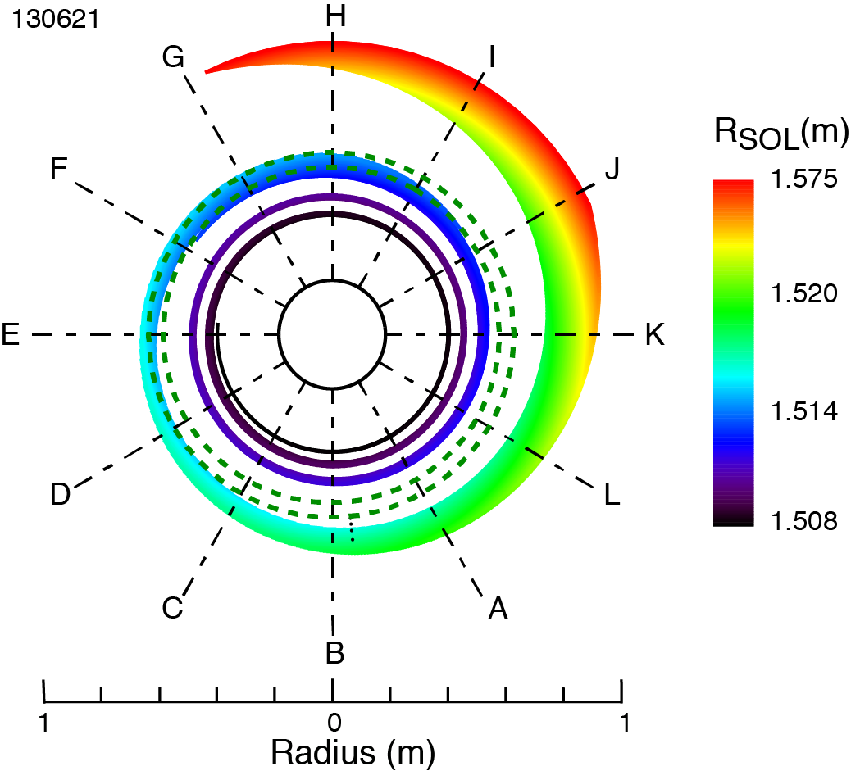
Computed strike points form a spiral
that closely matches the observed RF spiral
Strike points on divertor for field lines started at midplane…
Started close to antenna
G
Started close to LCFS
K
Shot 141888
5

Slide 6
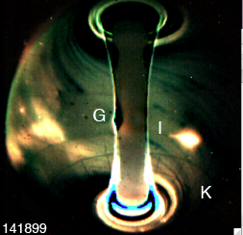
Computed strike points form a spiral
that closely matches the observed RF spiral
Strike points on divertor for field lines started at midplane…
… create spiral pattern close to camera images
Started close to antenna
G
Started close to LCFS
K
Shot 141888
R.J. Perkins et al., Phys. Rev. Lett.
109 (2012) 045001
6

Slide 7
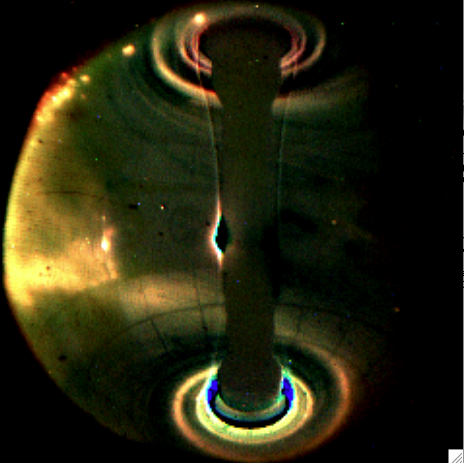
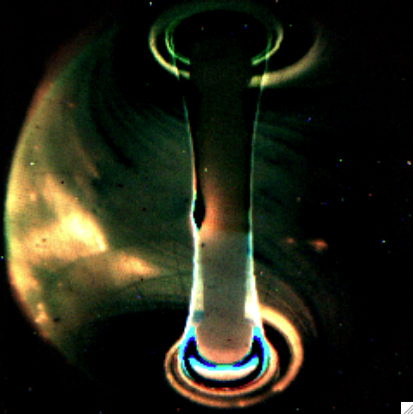
B_{T} = 5.5 kG I_{P} = 0.8 MA
Spiral location moves when magnetic field pitch changes
Radius shifts by ~ 15 cm inward with increased pitch
  Low pitch: I_{P}/B_{T} = 0.8 MA / 5.5 kG (31°)
  High pitch: I_{P}/B_{T} = 1 MA / 4.5 kG (42°)
Can sweep RF spiral across diagnostics
  Langmuir probes
  Instrumented divertor tiles
141888
B_{T} = 4.5 kG I_{P} = 1.0 MA
141888 time = 0.312s - bkg 0.247s
141899 time = 0.319s - bkg 0.247s
141899
Notes:
7

Slide 8
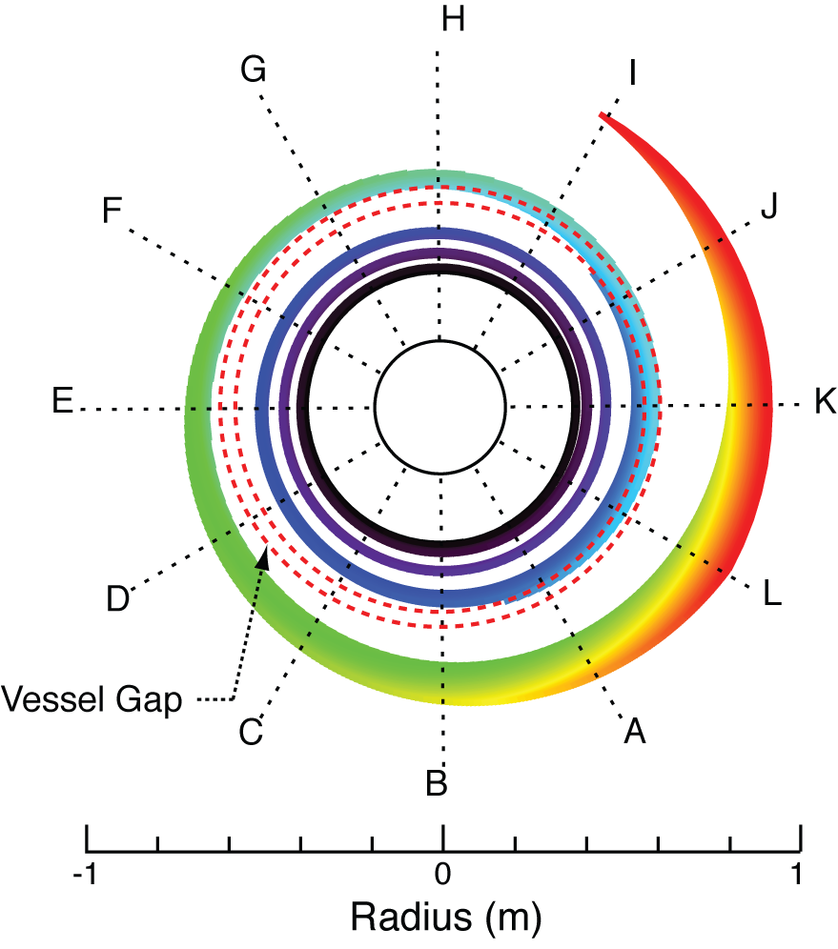
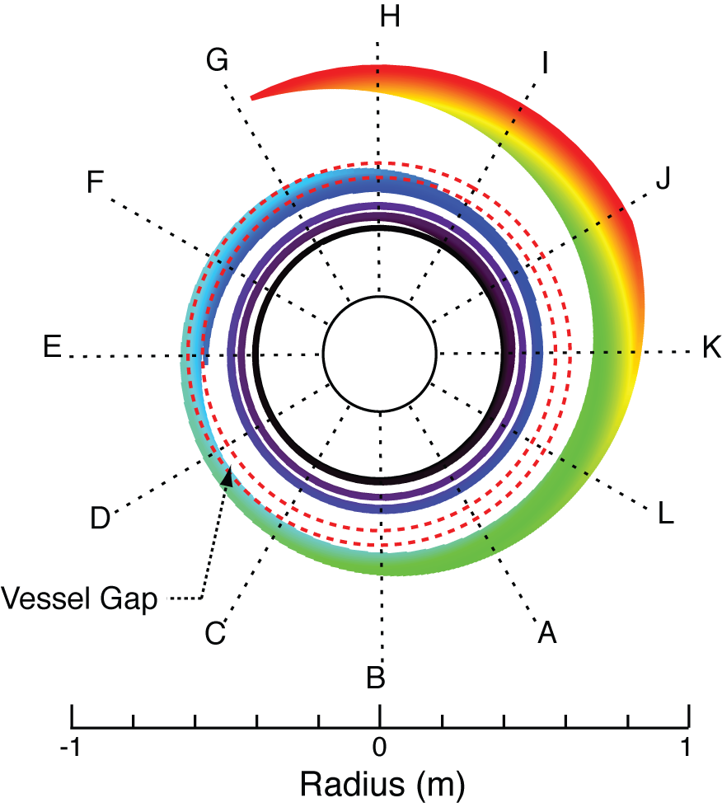
B_{T} = 5.5 kG I_{P} = 0.8 MA
141888
B_{T} = 4.5 kG I_{P} = 1.0 MA
141899
Notes:
8

Slide 9
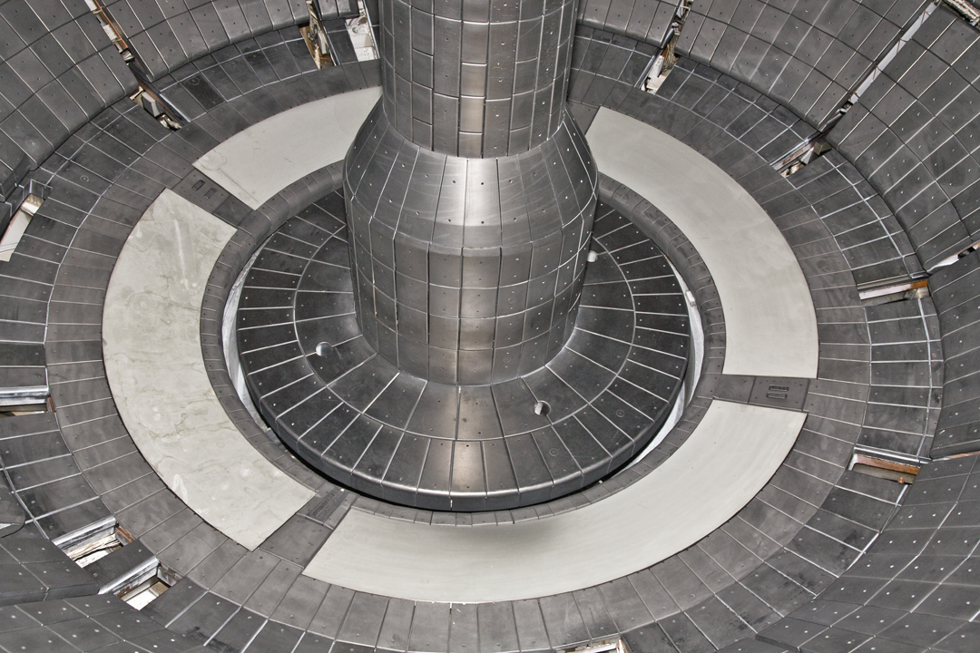
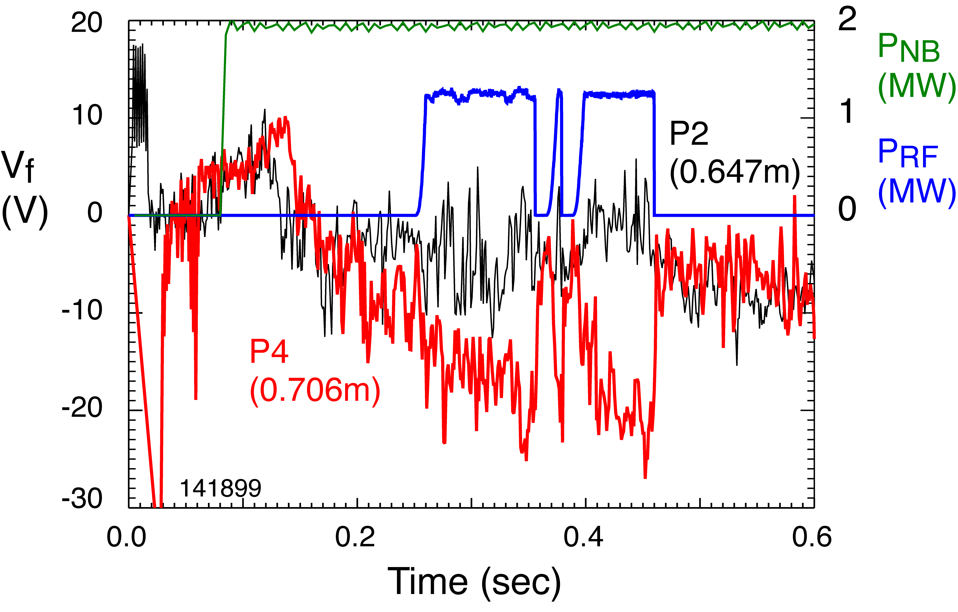
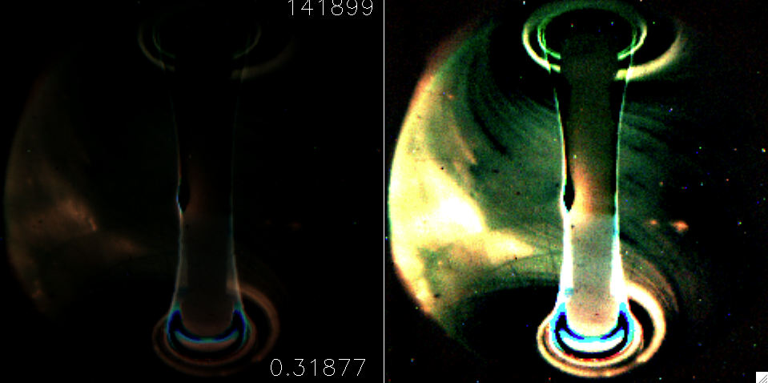
High field pitch puts spiral over Langmuir probe* 4 but not on other probes a few cm in
Bay G
Bay I
Bay K
Probe Array
Tile I3
Tile K3
Langmuir probe P4 floating potential responds strongly to RF
Langmuir probe P2, 6 cm inboard, has a much weaker response
RF-induced effects are localized
141899
0.319 - 0.247

Slide 10
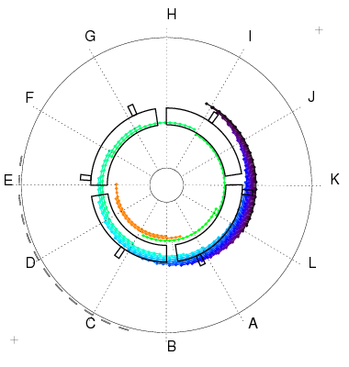
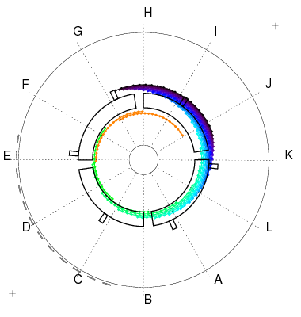
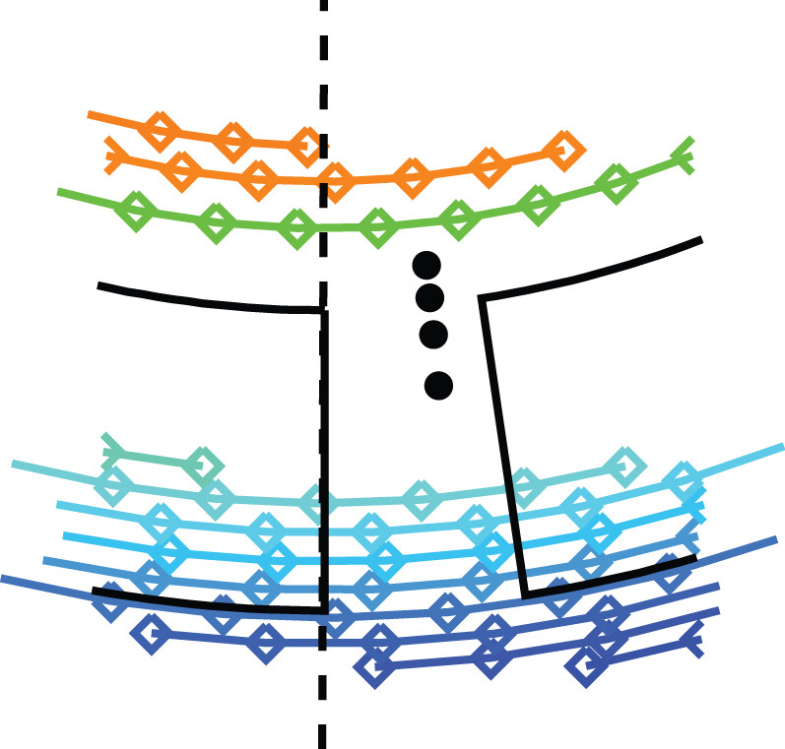
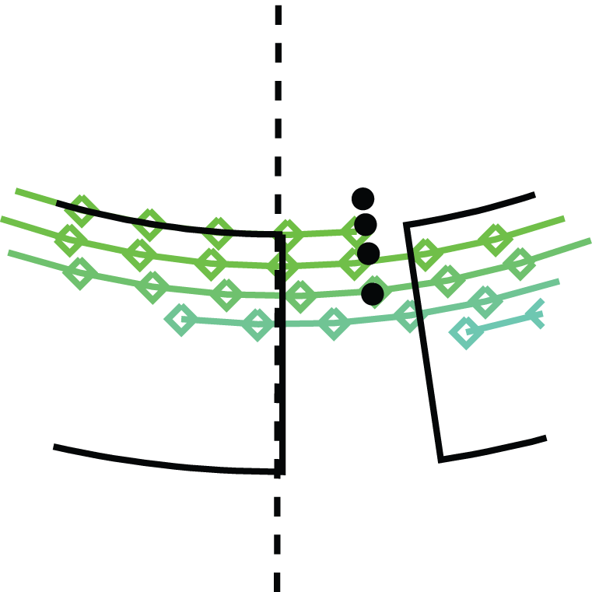
Modeling indicates that edge RF power
propagates along field lines
Low Pitch
High Pitch
Langmuir Probes
P4
P4
Computed strike point spirals match tile and probe measurements
High field pitch places spiral at probe 4 location
  Probe connected to SOL 4 cm away from antenna
10

Slide 11
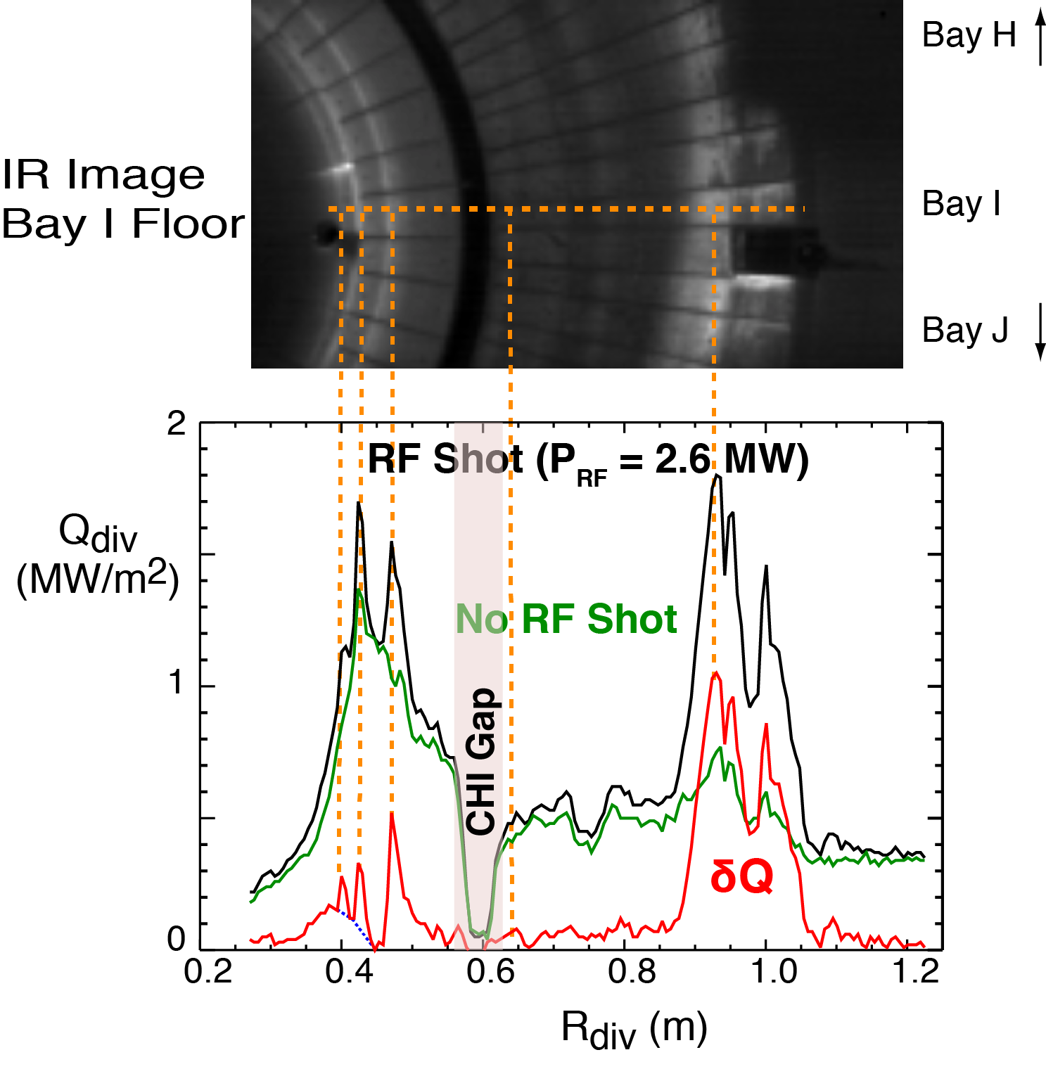
Divertor IR camera measures
strong RF-induced heating
RF spiral appears in IR image
Heat profile taken along horizontal line
RF-induced divertor heating (δQ) in red
  Shot 135333 with RF (ELMy H-mode)
  Shot 135334 no RF
  Difference gives RF heat
Several RF-induced heat peaks clearly resolved
11

Slide 12
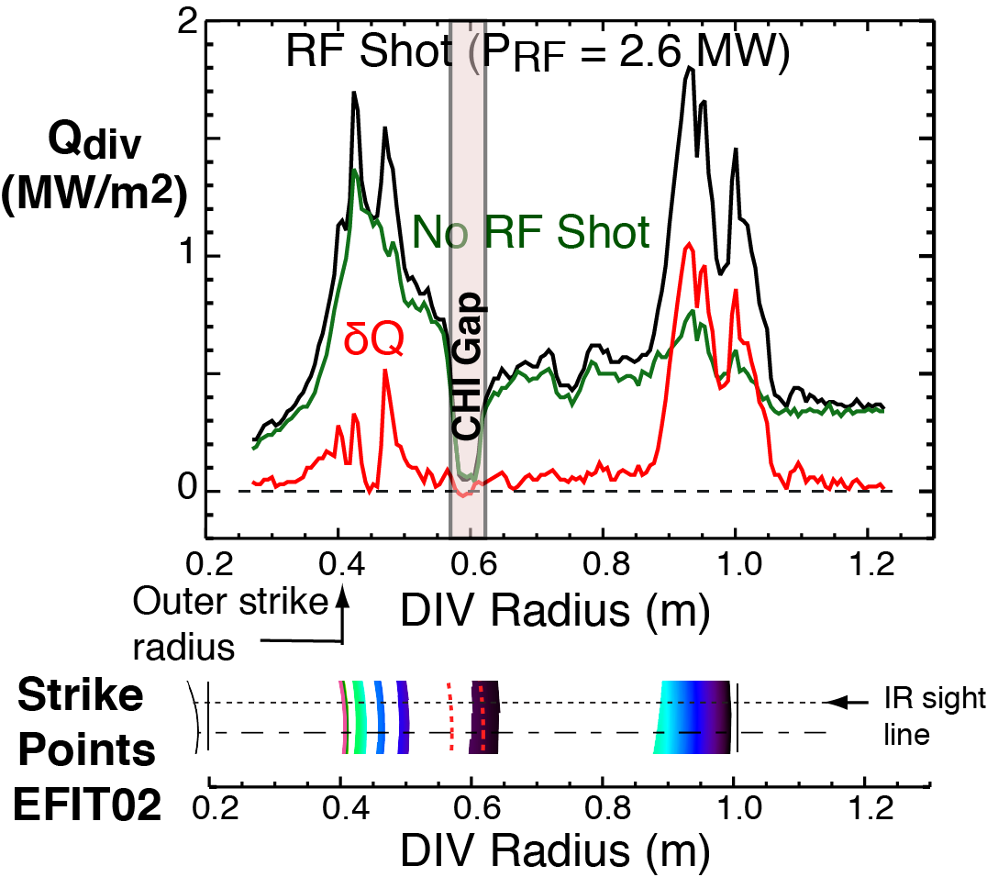
IR camera data agree with
calculated strike points
RF deposits heat at Bay I regions at several radii
Measured radii of RF heat peaks coincide with strike points computed by SPIRAL
12

Slide 13
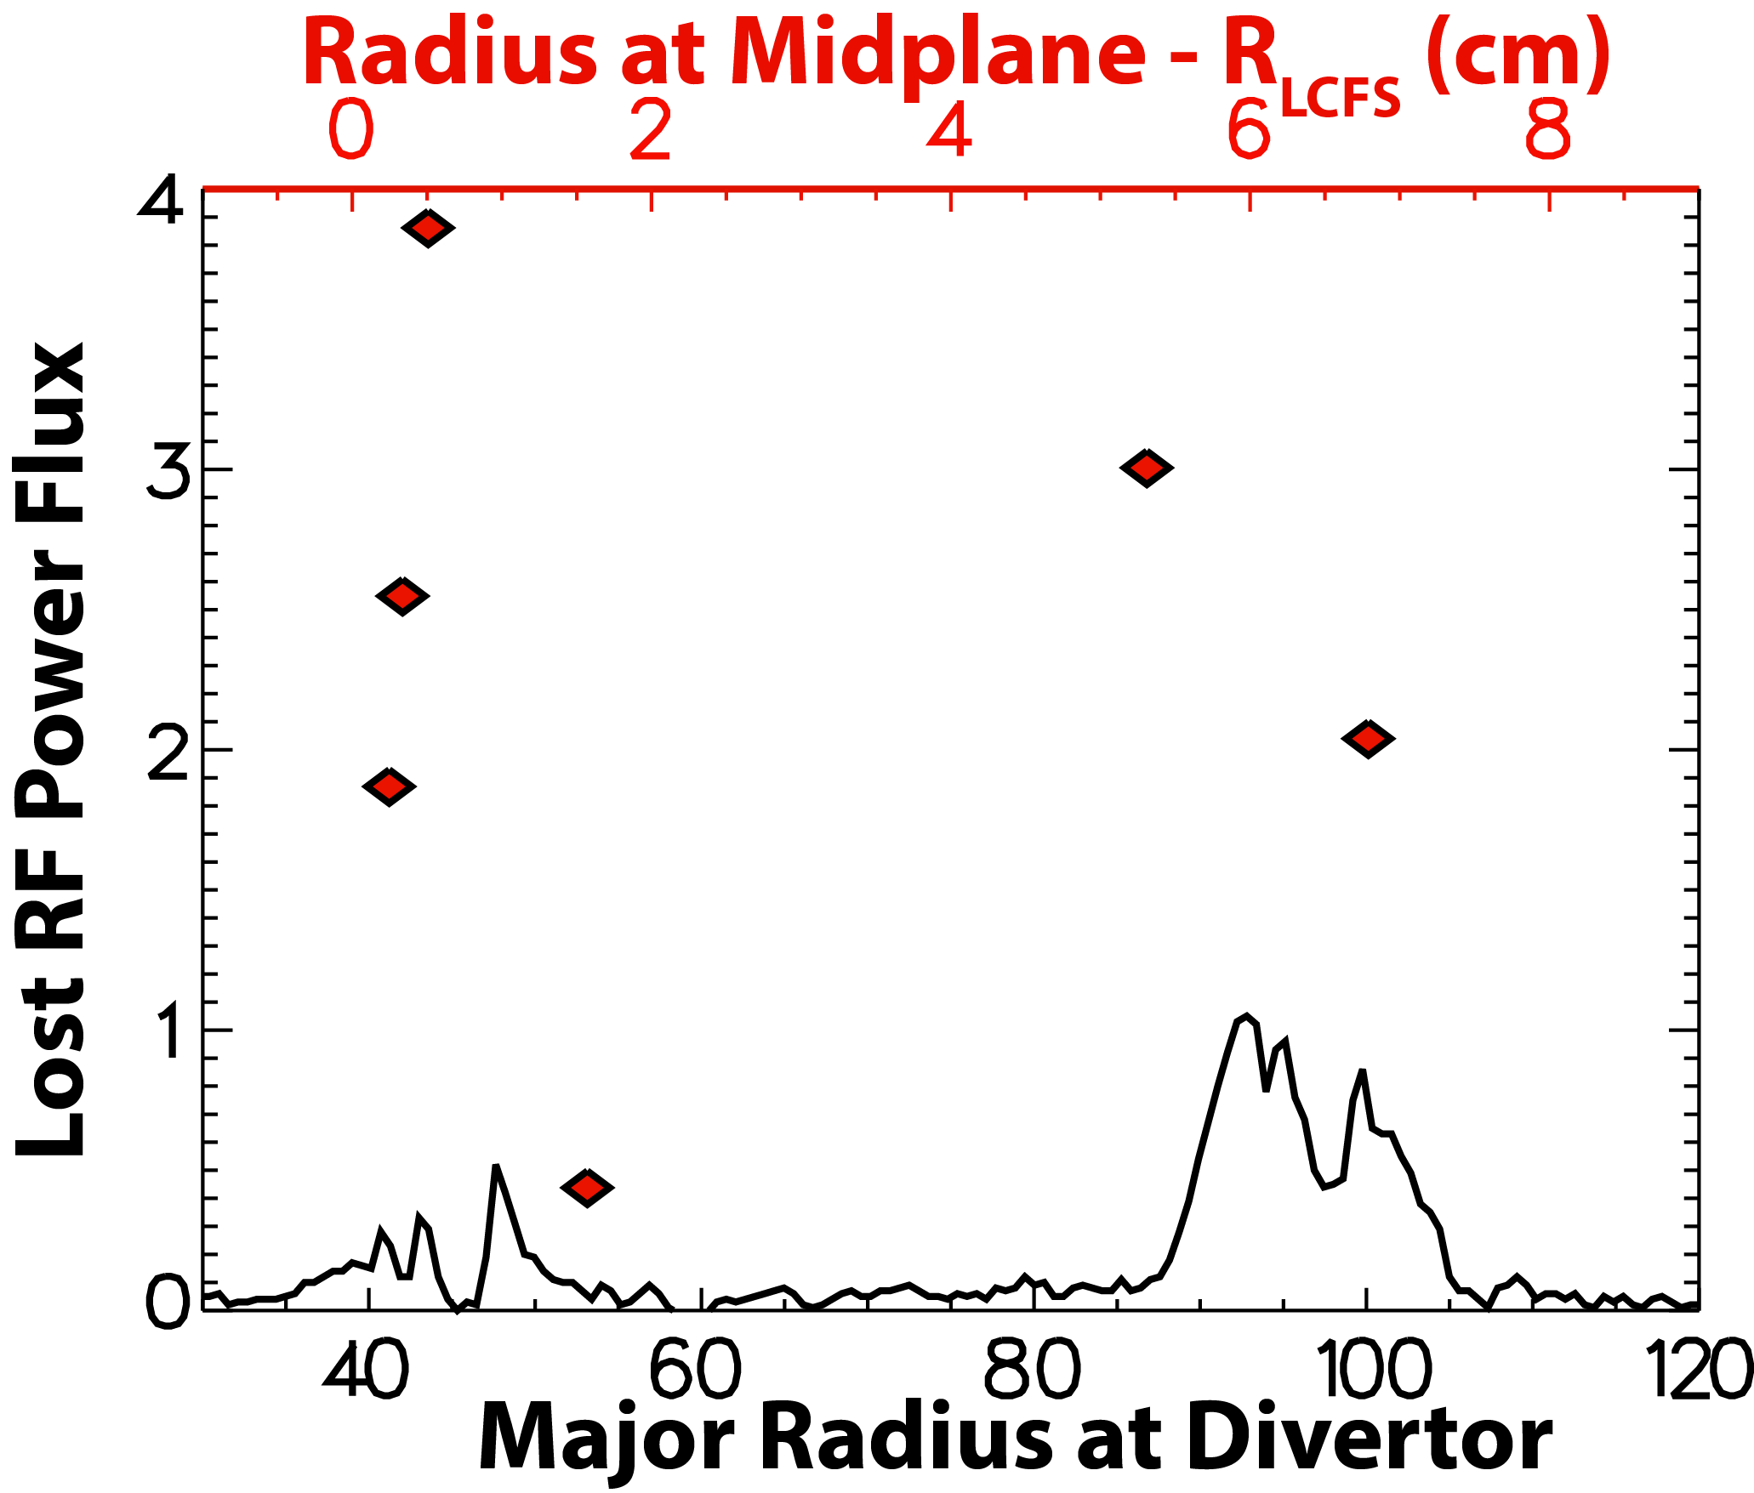
Lost-HHFW-power profile at midplane
is large near LCFS as well as antenna
Midplane profile shows two-peak structure:
  Peaking of power coupled close to antenna and LCFS
  Relatively low coupling in between
Loss mechanism cannot be localized to antenna
Midplane
(mapped)
divertor δQ
13

Slide 14
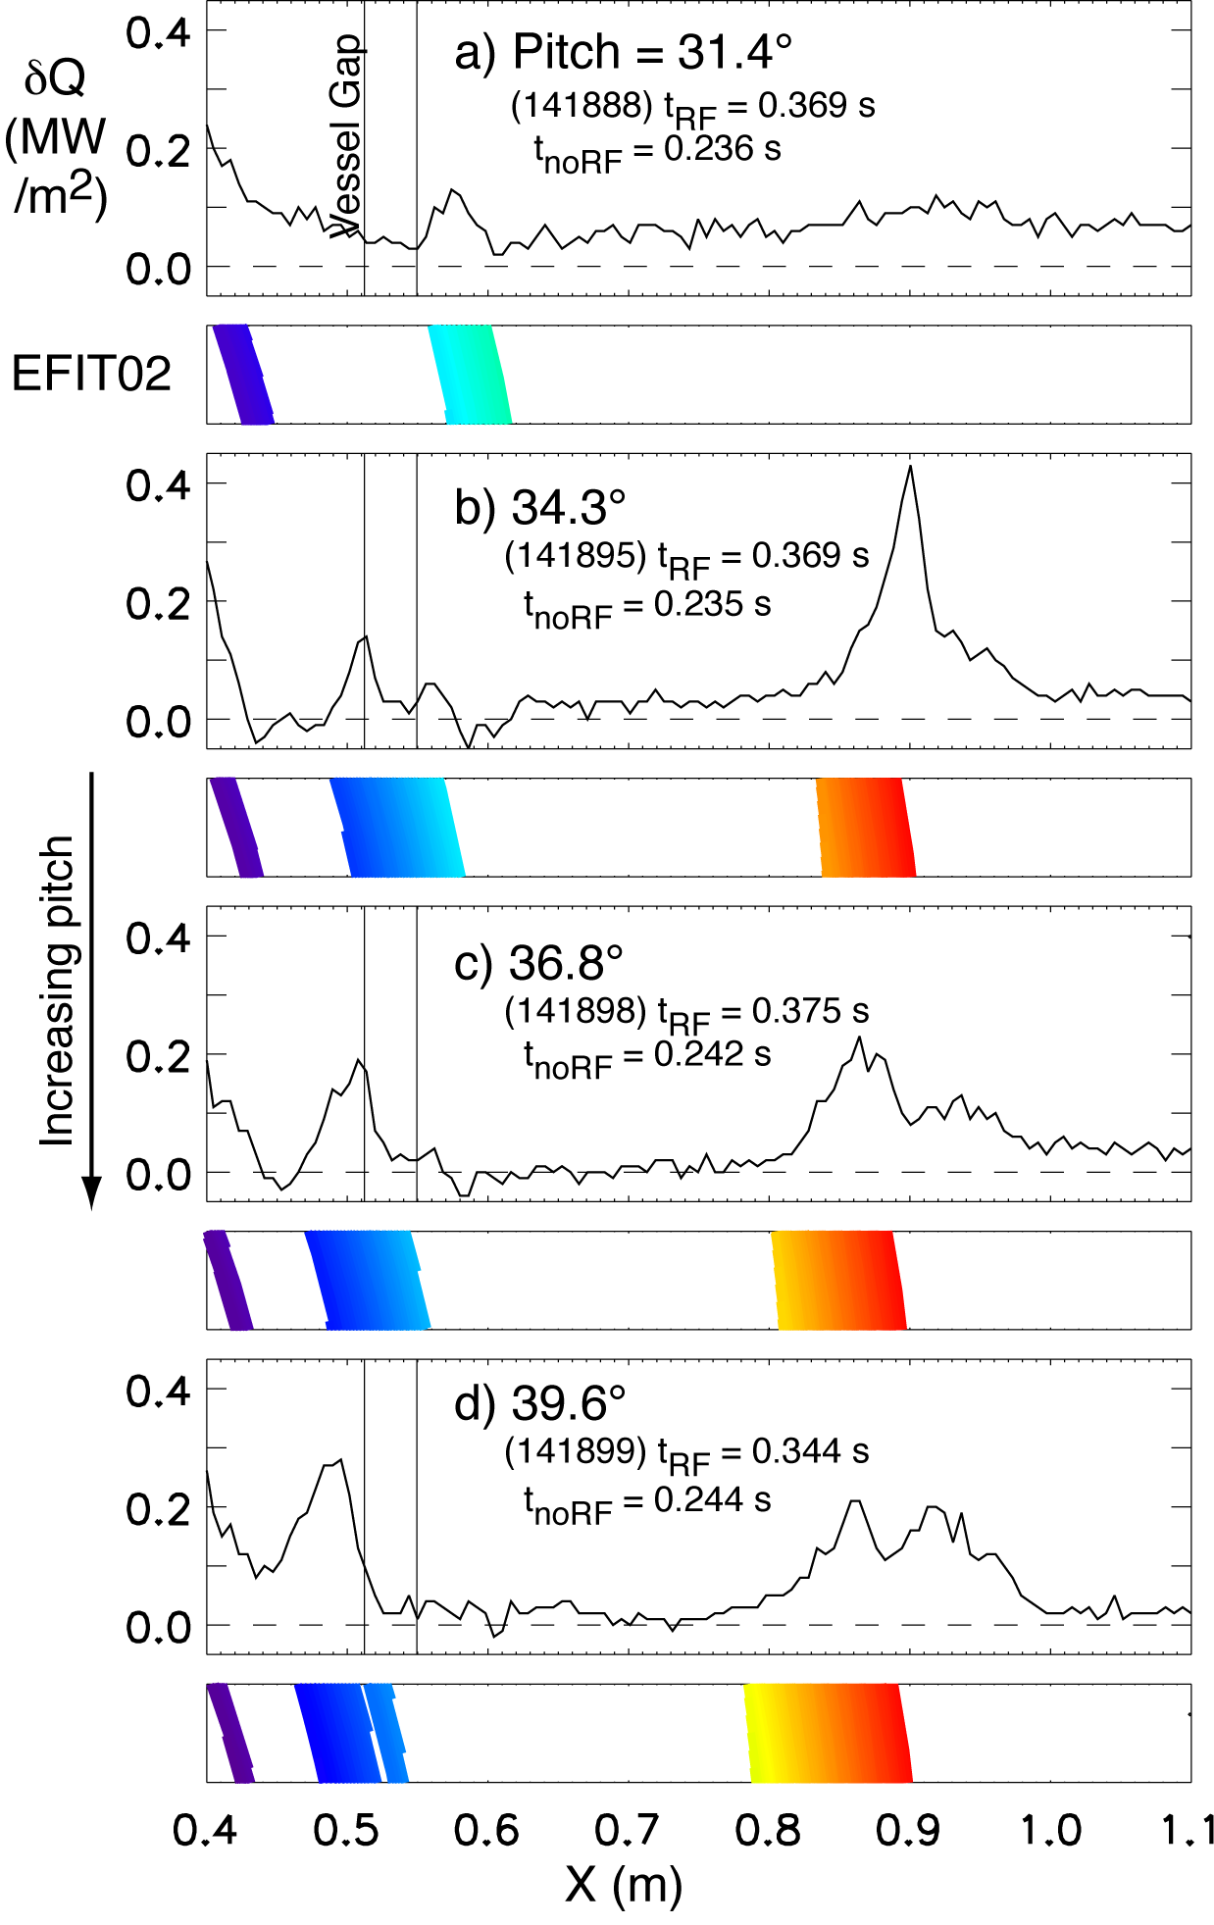
SPIRAL strike points generally agree
with Qdiv for pitch scan
SPIRAL strike points agree with heat peak
Second heat peak moves inward with increasing pitch
  Also grows in amplitude
  Strike points track this motion
A portion of heat falls outside range of strike points from midplane
14

Slide 15
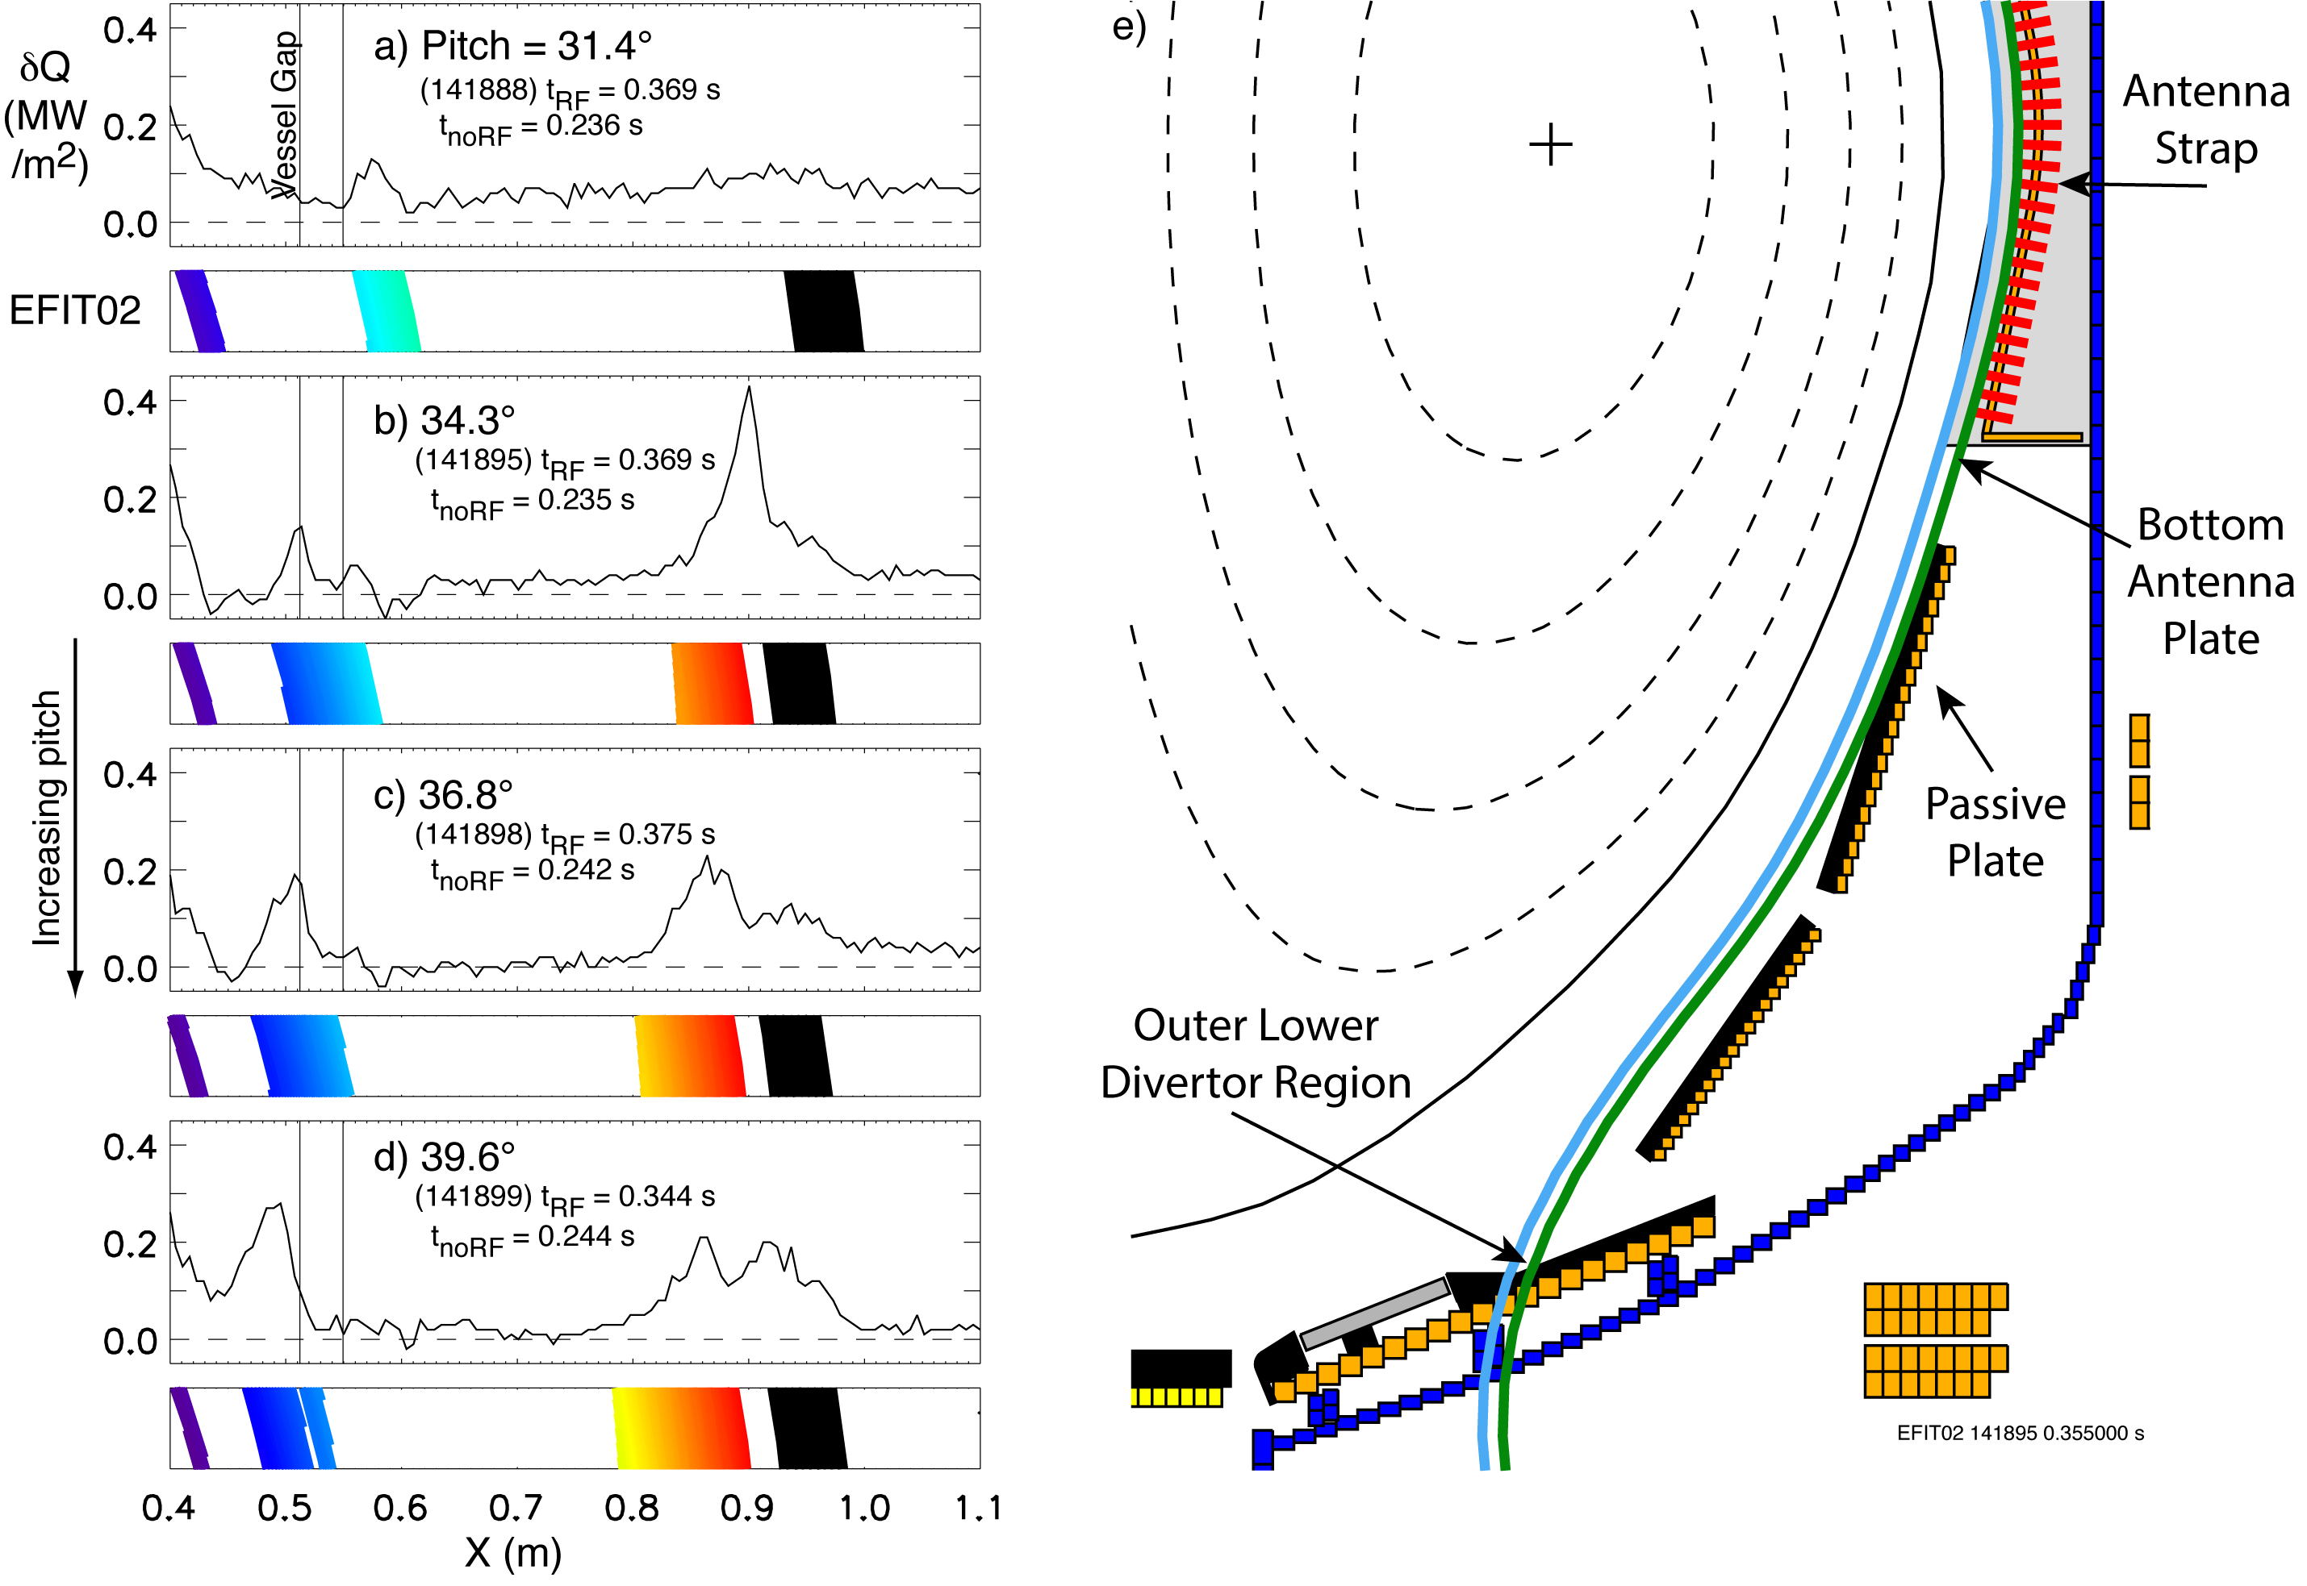
Outer heat appears to come from field lines linking the edge of bottom antenna plate
Black strike points connect to edge of antenna bottom plate.
15

Slide 16
Estimating losses in the spirals is important
Determines the overall magnitude of field-aligned losses to divertor
Decides whether other loss mechanisms are significant
Losses in spiral cannot yet be determined
  IR camera coverage is limited
  Power deposited has strong toroidal variation along spiral
  NSTX-U will have improved IR coverage
16

Slide 17
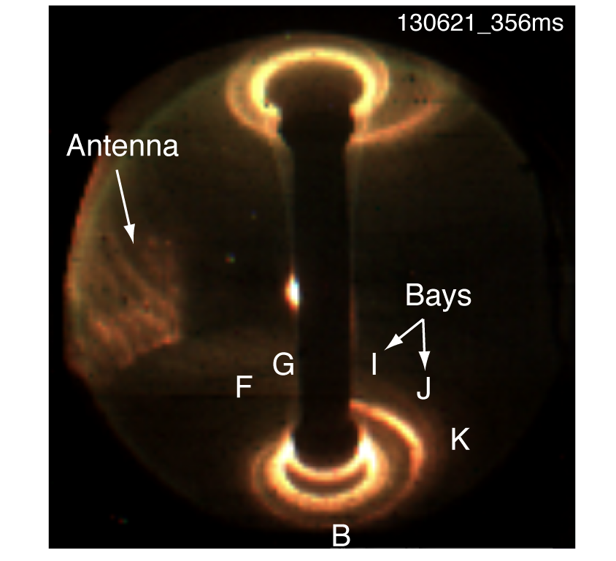
Use red-pixel intensity as a rough proxy for
toroidal variation of heat flux
Red light emission available from wide-angle midplane camera
Red light emission is subject to spectroscopic issues and is not a perfect representation of heat flux
However, red emission decays after RF pulse on time scale consistent with heat diffusion
17

Slide 18
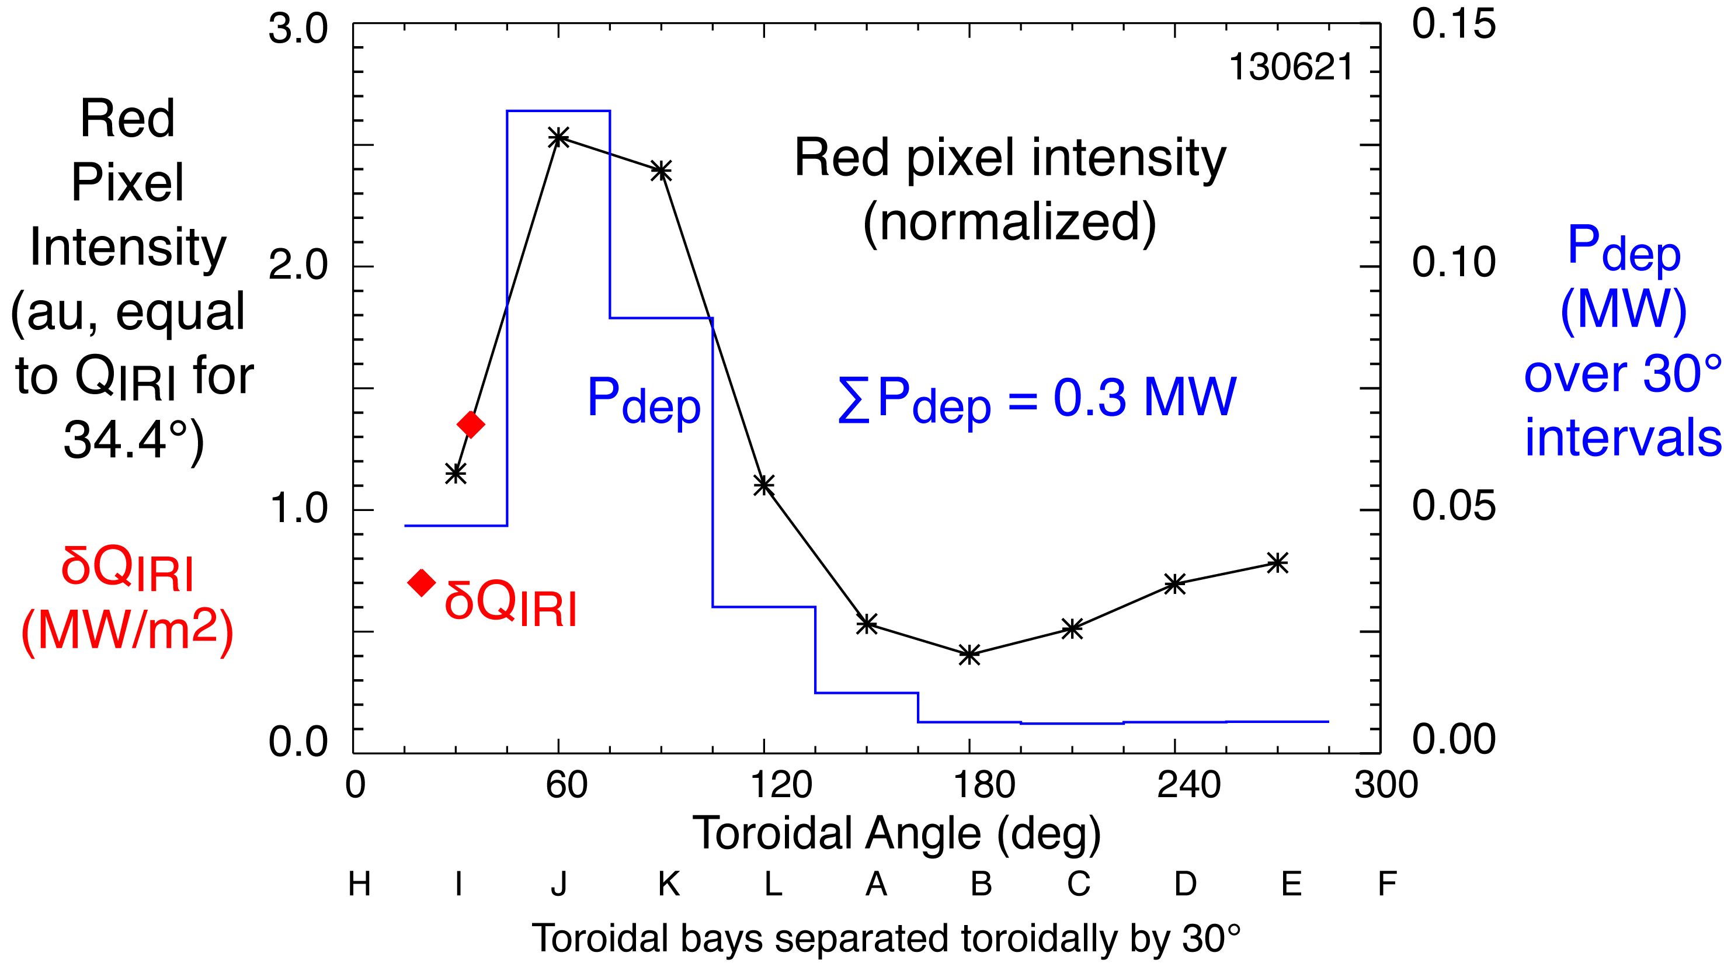
Rough estimate of power deposited
in lower spiral
18

Slide 19
Estimated losses in spirals are significant but other losses may be playing a role
Spiral losses estimated around 0.6 MW
  Assuming top/bottom symmetry
Total losses estimated around 1.1 MW
    Amount of power missing from the core plasma
Other losses are probably contributing
  Parametric decay instability heats edge impurity ions
  Sheath losses to antenna components and magnetically connected structures
19

Slide 20
The critical question: what is the mechanism behind these field-aligned losses to divertor?
Fast-wave propagation in SOL is leading candidate
  Dissipation could occur via RF sheaths formed on divertor tiles
  Dissipation could also occur via nonlinear saturation of RF currents
Core heating efficiency related onset density of perpendicular fast-wave propagation (righthand cutoff)
    If cutoff is too far from antenna, coupling is poor
    Moving cutoff too close to antenna leads to poor heating efficiency on NSTX
    Possibly due to significant wave propagation and dissipation in SOL
20

Slide 21
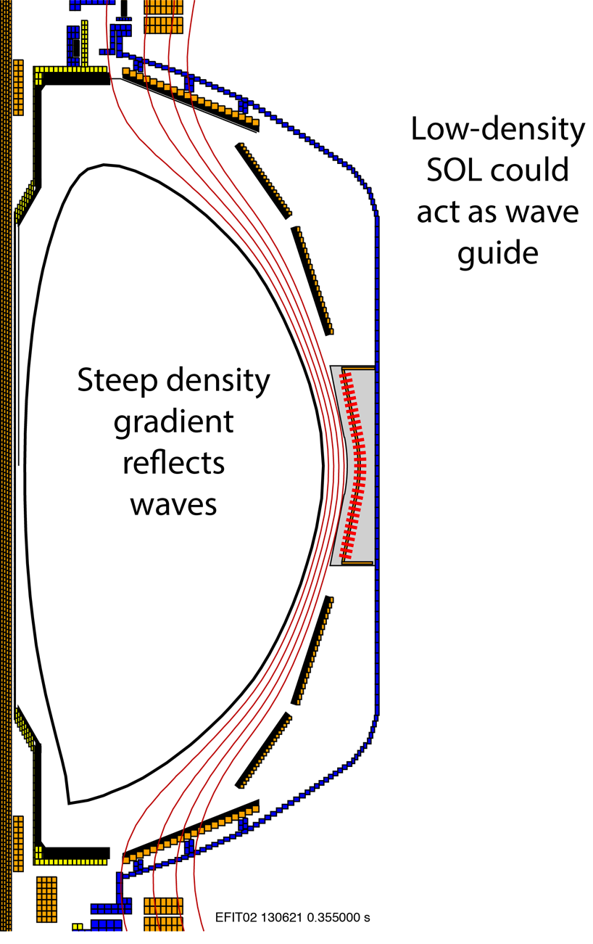
Fast-wave propagation in SOL
might explain loss profile
Wave reflection off pedestal gradient is likely
Loss profile at midplane could be standing-wave patterns in SOL
Midplane
(mapped)
divertor δQ
Notes:
21

Slide 22
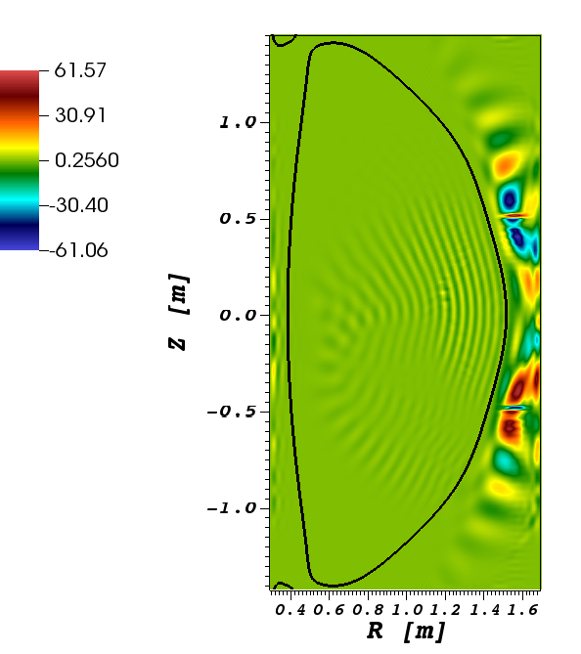
AORSA with SOL shows
significant RF fields outside of LCFS
Possible indication of FW propagation in SOL
  N. Bertelli, this conference
  NSTX-U equilibrium, Bt = 1 T
Edge field amplitudes vary with k
  P. M. Ryan, this conference
  D.L. Green et al., Phys. Rev. Lett. 107 (2011) 145001
  Onset density also a strong function of k
Notes:
22

Slide 23
Adding relevant loss mechanisms in SOL
is vital for RF codes
Without edge damping physics:
  Absorption weak in relatively cold SOL plasma
  Field-amplitudes grow until Poynting flux to core balances antenna input
  No real indication of field-aligned power flux in SOL to divertor
Edge damping competes with Poynting flux to core!
Notes:
23

Slide 24
Future work
Preparations for NSTX-U
  RF probes needed to confirm presence of RF fields in divertor region
  Improved IR coverage
  Field-line mapping predicts optimal location for probes
Results provide a benchmark for RF codes
  Codes must reproduce field-aligned loss to divertor
  May use various edge damping
  Important for predicting impact on ITER
Develop cylindrical cold-plasma model
    Search for densities and magnetic fields combinations that give significant wave-propagation in SOL
24

Slide 25
Summary
NSTX exhibits field-aligned losses to the divertor
  Losses occur across width of SOL
  Losses peak close to antenna and also the LCFS
  Field lines connected to antenna bottom plate are involved
Field-aligned losses are significant but may not account for total RF losses
Fast-wave propagation in SOL may be responsible
  Measurements on NSTX-U will confirm or deny presence of RF fields in divertor region
  Edge damping models must be added to RF codes
25

Slide 26
Various diagnostics detect RF-effects
in divertor regions
Spiral moves with changing pitch
Langmuir probes respond strongly to RF when under spiral
Current to divertor tiles increase when under spiral
IR cameras show strong divertor heating under spiral
IR Camera View
Tile I3
Probe Array
Tile K3

Slide 27
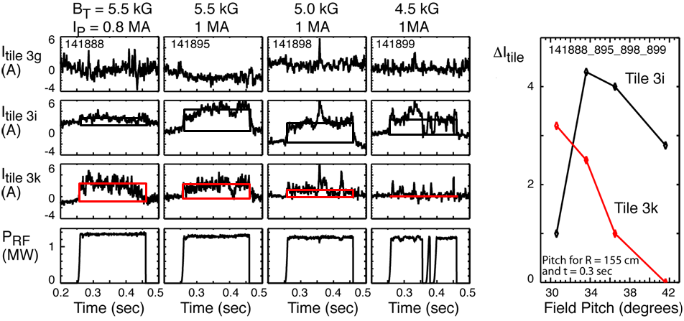
Current-sensor tiles track movement of RF spiral
(k_{φ} =-8 m⁻¹/φ_{Ant} =-90°, D₂, P_{NB} = 2 MW)
Bay K tile current decreases as RF spiral moves inward…
… while Bay I tile current rises
Notes:
27

Slide 28
Modeling indicates that edge RF power
propagates along field lines
Low Pitch
High Pitch
Instrumented Tiles
3i
3i
3g
3g
3k
Langmuir Probes
3k
P4
P4
Computed strike point spirals match tile and probe measurements
Spiral goes over tile 3i and off of tile 3k with increasing pitch
28

