Slide 1




NSTX-U
Supported by
Overview of Research Plans for NSTX Upgrade*
Jon Menard (PPPL)
NSTX-U Program Director
Coll of Wm & Mary
Columbia U
CompX
General Atomics
FIU
INL
Johns Hopkins U
LANL
LLNL
Lodestar
MIT
Lehigh U
Nova Photonics
ORNL
PPPL
Princeton U
Purdue U
SNL
Think Tank, Inc.
UC Davis
UC Irvine
UCLA
UCSD
U Colorado
U Illinois
U Maryland
U Rochester
U Tennessee
U Tulsa
U Washington
U Wisconsin
X Science LLC
Culham Sci Ctr
York U
Chubu U
Fukui U
Hiroshima U
Hyogo U
Kyoto U
Kyushu U
Kyushu Tokai U
NIFS
Niigata U
U Tokyo
JAEA
Inst for Nucl Res, Kiev
Ioffe Inst
TRINITI
Chonbuk Natl U
NFRI
KAIST
POSTECH
Seoul Natl U
ASIPP
CIEMAT
FOM Inst DIFFER
ENEA, Frascati
CEA, Cadarache
IPP, Jülich
IPP, Garching
ASCR, Czech Rep
17th International Spherical Torus Workshop
University of York
16-19 September 2013
*This work supported by the US DOE Contract No. DE-AC02-09CH11466

Slide 2
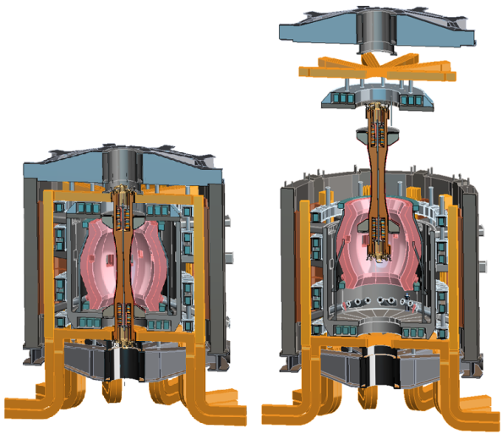
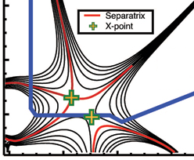
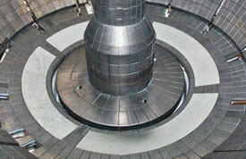

NSTX Upgrade mission elements
Advance ST as candidate for Fusion Nuclear Science Facility (FNSF)
Develop solutions for the plasma-material interface challenge
Explore unique ST parameter regimes to advance predictive capability - for ITER and beyond
Develop ST as fusion energy system
ST-FNSF
“Snowflake”
Lithium
ITER

Slide 3

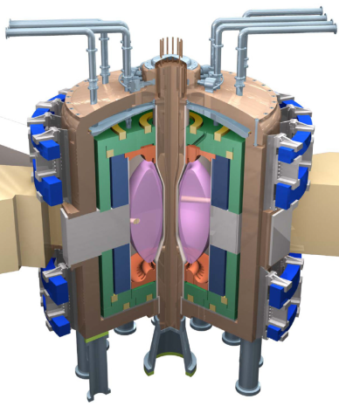
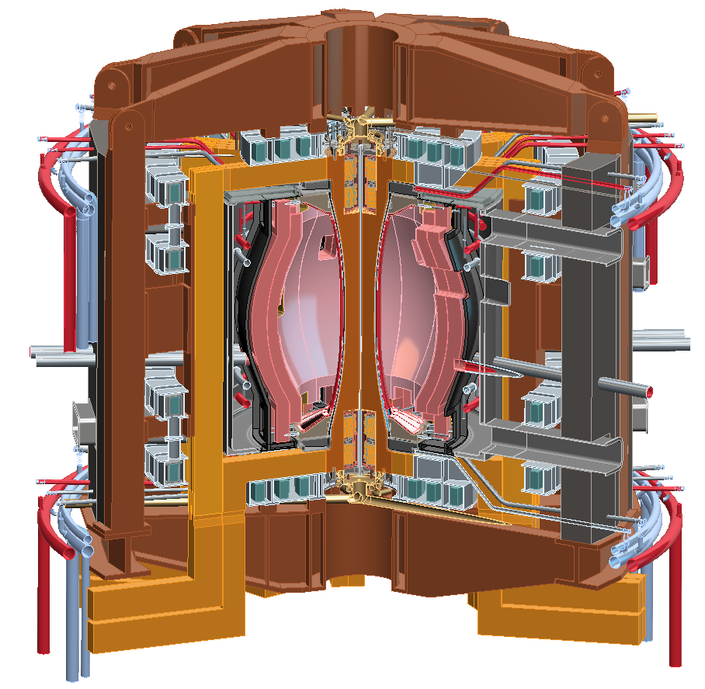
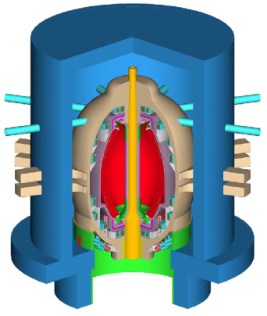
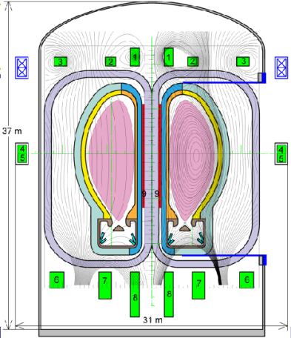
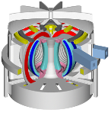
NSTX Upgrade will access next factor of two increase in performance to bridge gaps to next-step STs
Low-A
Power Plants
Parameter | NSTX | NSTX Upgrade | Fusion Nuclear Science Facility | Pilot Plant
Major Radius R₀ [m] | 0.86 | 0.94 | 1.3 | 1.6 – 2.2
Aspect Ratio R₀ / a | ≥ 1.3 | ≥ 1.5 | ≥ 1.5 | ≥ 1.7
Plasma Current [MA] | 1 | 2 | 4 – 10 | 11 – 18
Toroidal Field [T] | 0.5 | 1 | 2 – 3 | 2.4 – 3
Auxiliary Power [MW] | ≤ 8 | ≤ 19* | 22 – 45 | 50 – 85
P/R [MW/m] | 10 | 20 | 30 – 60 | 70 – 90
P/S [MW/m²] | 0.2 | 0.4-0.6 | 0.6 – 1.2 | 0.7 – 0.9
Fusion Gain Q |  |  | 1 – 2 | 2 – 10
ARIES-ST (A=1.6)
JUST (A=1.8)
* Includes 4MW of high-harmonic fast-wave (HHFW) heating power
VECTOR (A=2.3)
Non-inductive start-up, ramp-up, sustainment
Confinement scaling (esp. electron transport)
Stability and steady-state control
Divertor solutions for mitigating high heat flux
Key issues to resolve for next-step STs

Slide 4
NSTX-U aims to access performance levels of next-steps, approach Pilot-Plant regimes
Requirements for ST / tokamak next-steps:
1.0
Bootstrap fraction
0.9
ST-Pilot
Full non-inductive (NI) current drive for steady-state operation
  ST requires NI start-up/ramp-up
High confinement to minimize auxiliary heating, device size
Sustained high β to minimize magnet size, forces, power
Divertor/first-wall survival with intense power/particle fluxes
f_{BS}
0.8
ST-FNSF
0.7
NSTX-U
0.6
NSTX
0.5
2.0
Normalized Confinement
1.8
ST-Pilot
H_{98y2}
1.6
1.4
ST-FNSF
1.2
NSTX
NSTX-U
1.0
8.0
Normalized Beta
β_{N}
7.0
ST-Pilot
6.0
NSTX
5.0
NSTX-U
ST-FNSF
4.0
3.0
1.0
ST-FNSF
ST-Pilot
P/S
0.8
0.6
NSTX-U
[MW/m²]
0.4
0.2
NSTX
0.0
Power exhaust challenge

Slide 5

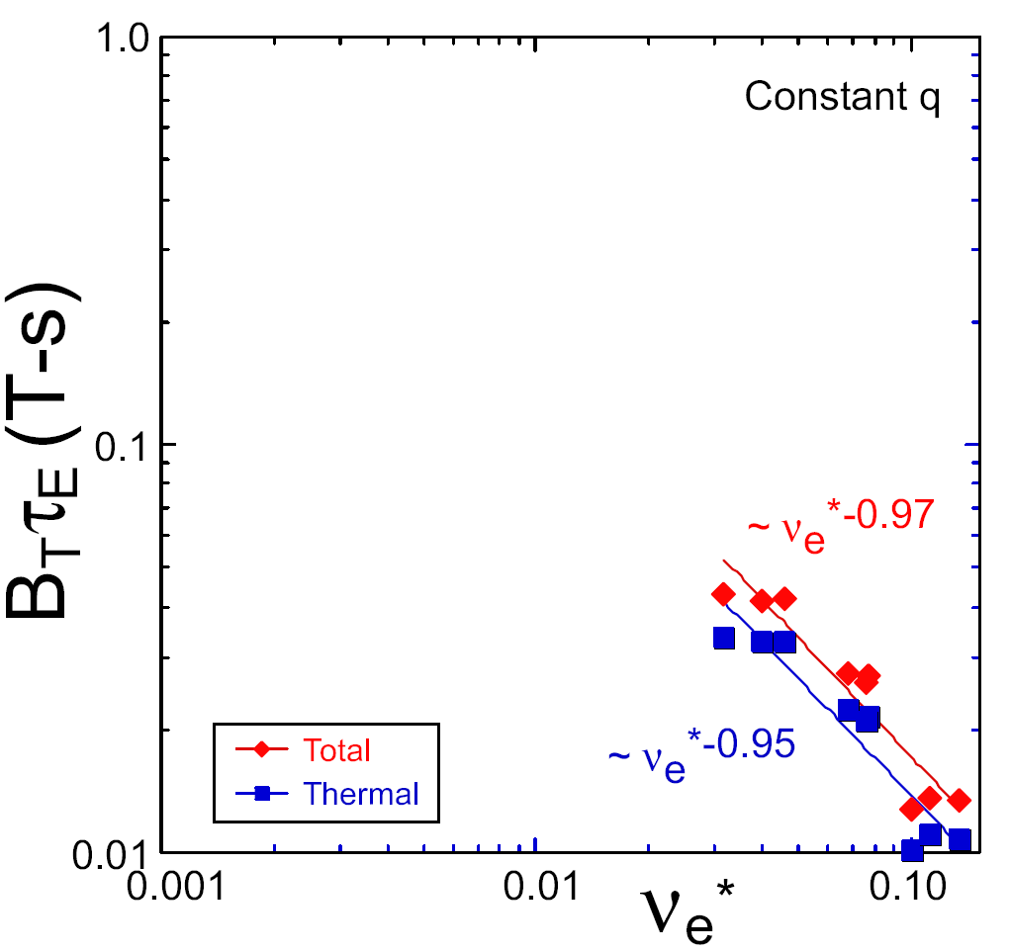
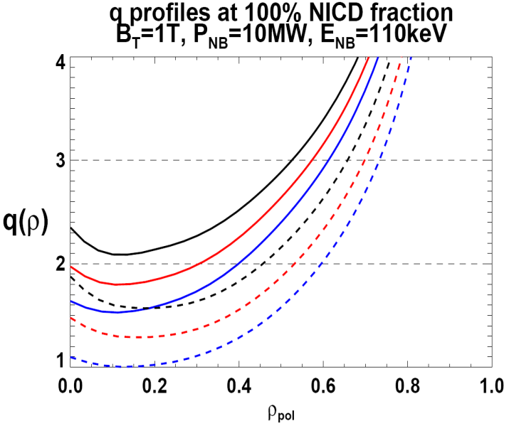

NSTX Upgrade incorporates 2 new capabilities:
Previous
center-stack
New
center-stack
ST-FNSF
Reduces ν* → ST-FNSF values to understand ST confinement
  Expect 2x higher T by doubling B_{T}, I_{P}, and NBI heating power
  5x longer pulse-length
  q(r,t) profile equilibration
  Test non-inductive ramp-up
constant q, β, ρ∗
NSTX Upgrade
?
NSTX
ITER-like scaling
TF OD = 20cm
TF OD = 40cm
Normalized e-collisionality ν_{e}* ∝ n_{e} / T_{e}²
I_{P}=0.95MA, H_{98y2}=1.2, β_{N}=5, β_{T} = 10%, B_{T} = 1T, P_{NBI} = 10MW, P_{RF} = 4MW
  2x higher CD efficiency from larger tangency radius R_{TAN}
100% non-inductive CD with core q(r) profile controllable by:
  NBI tangency radius
  Plasma density, position (not shown)
n
e
/
n
Greenwald
0.95
0.72
R_{TAN} [cm]
__________________
50, 60, 70, 130
60, 70,120,130
70,110,120,130
Present NBI
New 2nd NBI

Slide 6
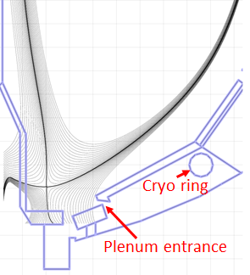
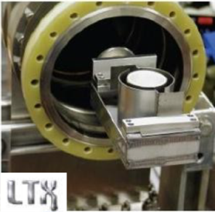
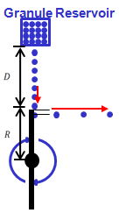
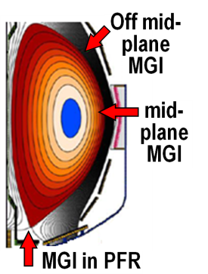

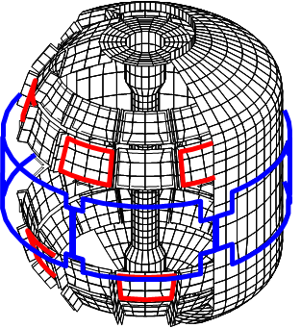
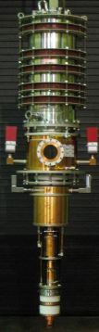
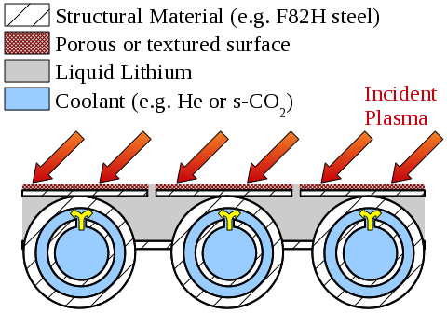
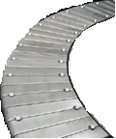
Proposed longer-term facility enhancements:
(2014-2018)
Improved particle control tools
  Control deuterium inventory and trigger rapid ELMs to expel impurities
  Access low ν*, understand role of Li
Disruption avoidance, mitigation
  3D sensors & coils, massive gas injection
ECH to raise start-up plasma T_{e} to enable FW+NBI+BS I_{P} ramp-up
  Also EBW-CD start-up, sustainment
Begin transition to high-Z PFCs, assess flowing liquid metals
  Plus divertor Thomson, spectroscopy
Upward Li evaporator
Divertor cryo-pump
Li granule injector (LGI)
Midplane + off-midplane non-axisymmetric control coils (NCC)
Extended low-f MHD sensor set
1-2MW
28 GHz
gyrotron
High-Z tiles
Actively-supplied, capillary-restrained, gas-cooled LM-PFC

Slide 7
NSTX-U team developed 5 year plan for FY2014-18
Highest priority goals:
Demonstrate 100% non-inductive sustainment at performance that extrapolates to ≥ 1MW/m² neutron wall loading in FNSF
Access reduced ν* and high-β combined with ability to vary q and rotation to dramatically extend ST physics understanding
Develop and understand non-inductive start-up and ramp-up
(overdrive) to project to ST-FNSF with small/no solenoid
4. Develop and utilize high-flux-expansion “snowflake” divertor
and radiative detachment for mitigating very high heat fluxes
5. Begin to assess high-Z PFCs + liquid lithium to develop high-duty-factor integrated PMI solutions for next-steps
5 year plan successfully peer-reviewed in May 2013

Slide 8
Highest priority research goals for NSTX-U:
Demonstrate 100% non-inductive sustainment
Access reduced ν* and high-β combined with ability to vary q and rotation
Develop/understand non-inductive start-up, ramp-up
(overdrive) for ST-FNSF with small/no solenoid
4. Develop high-flux-expansion “snowflake” divertor +
radiative detachment to mitigate high heat fluxes
5. Assess high-Z + liquid Li plasma facing components

Slide 9
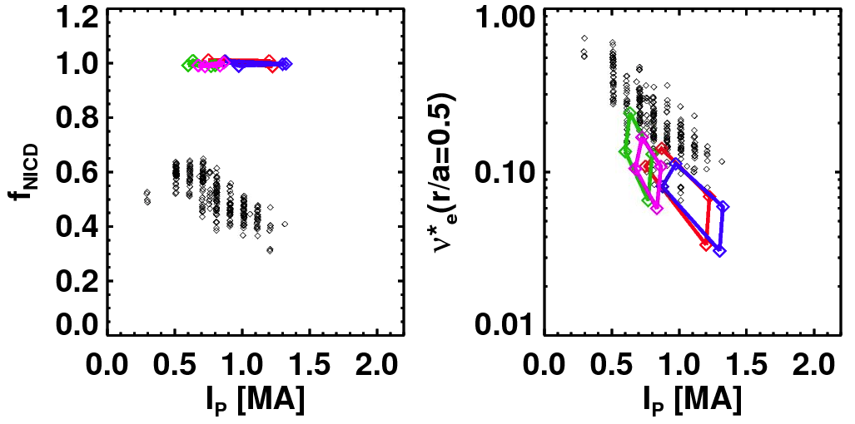
TRANSP simulations support goal of accessing and controlling 100% non-inductive plasma operation
NSTX achieved:
NSTX-U projections (TRANSP):
Maximum sustained non-inductive fractions of 65% w/NBI at I_{P} = 0.7 MA
70-100% non-inductive transiently with HHFW current-drive + bootstrap
100% non-inductive at I_{P} = 0.6-1.3MA for range of power, density, confinement
I_{P}=1 MA, B_{T}=1.0 T, P_{NBI}=12.6 MW
Contours of Non-Inductive Fraction
NSTX-U projections
Total non-inductive current fraction
NSTX Results
H_{98y2}
via high harmonic FW
I_{p} (MA)

Slide 10
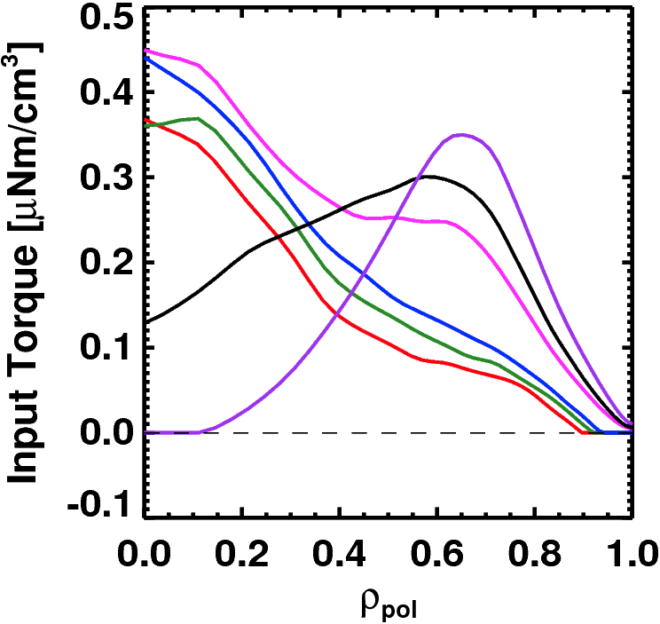
Advanced Scenarios and Control 5 Year Goals:
Rotation Profile Actuators
100% non-inductive operation
Lower ν*: high-current, partial-inductive scenarios, extend to long-pulse
Implement axisymmetric control algorithms and tools
  Current and rotation profile control
  Improved shape and vertical position control
  Heat flux control for high-power scenarios
Develop disruption avoidance by controlled plasma shutdown
Torque Profiles From
6 Different NB Sources
Largest R_{tan}
Neutral
Beams
(TRANSP)
Smallest R_{tan}
Also torques from 3D fields

Slide 11
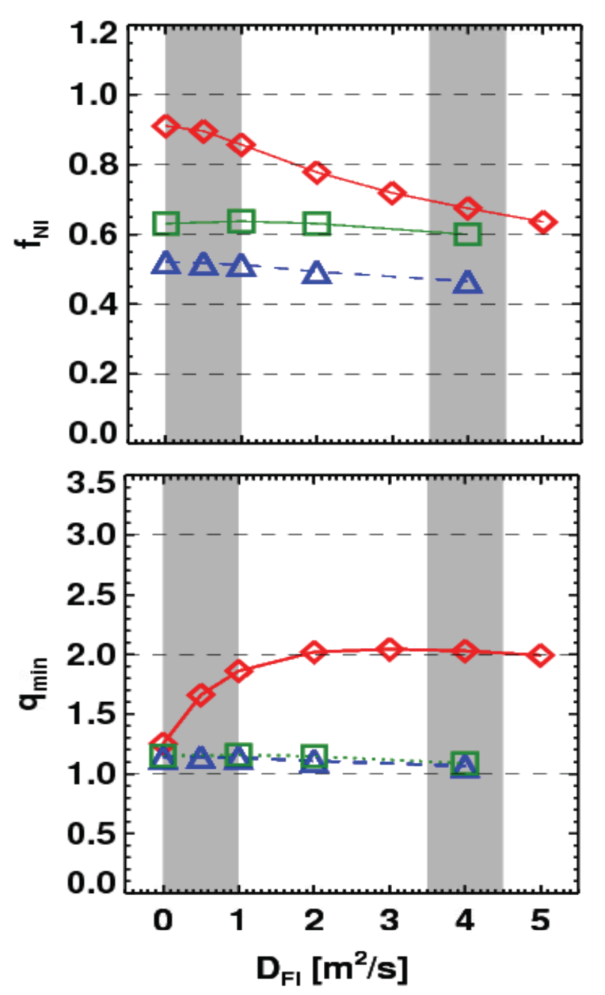
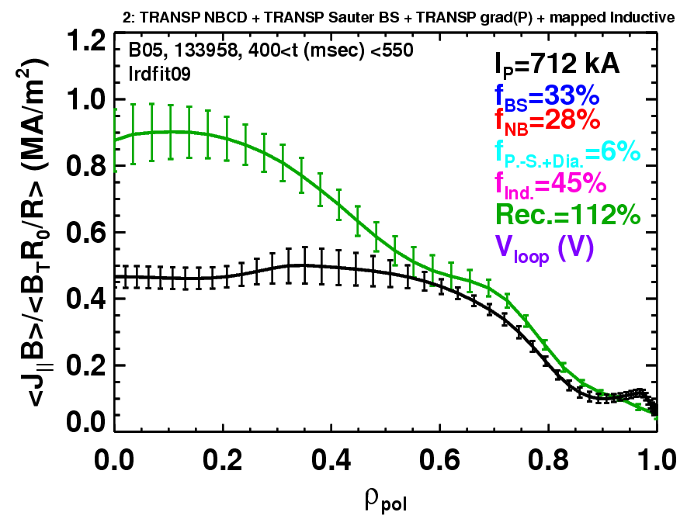
Rapid TAE avalanches could impact NBI current-drive in advanced scenarios for NSTX-U, FNSF, ITER AT
NSTX-U TRANSP simulations
NSTX: rapid avalanches can lead to
redistribution/loss of NBI current drive
Discrepancy between reconstruction and total assuming
classical J_{NBCD}
1 MA, 1T, H₉₈=1, near non-inductive
1.6 MA, 1T, partial inductive
1.2 MA, 0.55T, high β_{T}
All: f_{GW}=0.7, H₉₈=1
Minor radius
700kA high-β_{P} plasma with rapid
TAE avalanches has time-average D_{FI} = 2-4m²/s

Slide 12
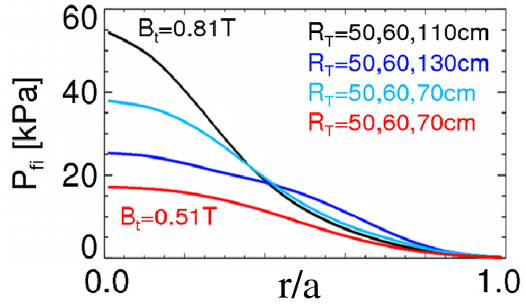
Energetic Particle 5 Year Goals:
Develop predictive tools for projections of *AE-induced fast ion transport in FNSF and ITER
  Compare data to simulation, develop reduced models
    ORBIT, NOVA-K, M3D-K, HYM to understand mode-induced transport
Vary fast-ion instability drive using NBI, q, rotation, 3D fields
Measure *AE mode structure
  Magnetics, BES, reflectometry
Characterize fast ion transport vs. *AE type
Assess requirements for fast-ion phase-space engineering
  AE spectroscopy, also stability control using NBI, q, rotation, 3D fields

Slide 13
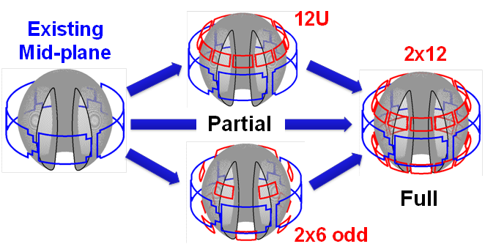
NSTX/NSTX-U is making leading contributions to high-β_{N} stability physics, and assessing possible 3D coil upgrades
n=1 MHD spectroscopy: high β_{N} can be more stable
  Combination of rotation and current profile effects at high beta
  Important for advanced scenarios
Resonant Field
Amplification (G/G)
Identified several off-midplane 3D coil sets favorable for profile and mode control
  ~40% increase in n=1 RWM β_{active} / β_{no-wall}
  ~5x reduction in n=1 EF resonant torque
  ~10-100x variation in ratio of non-resonant to resonant n=3 torque in edge
    Important for control, understanding of RMP ELM control, NTV rotation profile control
NCC options:

Slide 14
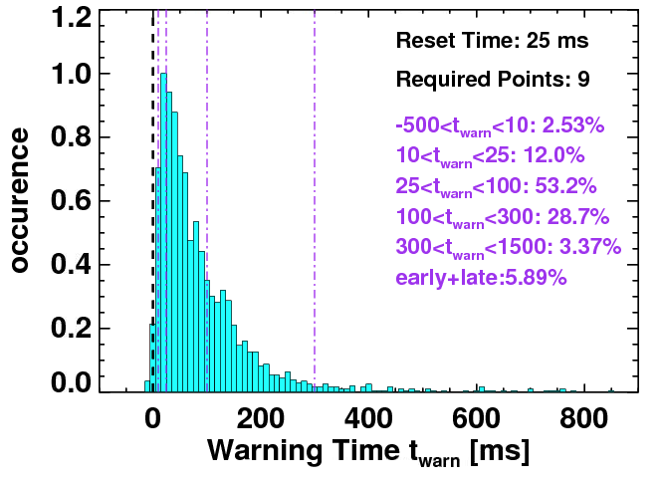
NSTX has also made leading contributions to disruption warning research
Disruption warning algorithms:
  Based on sensors + physics-based variables (not neural net)
  < 4% missed, 3% false positives
  ITER requires 95-98% prediction success for VDE, thermal quench
  Will assess applicability to ITER through ITPA Joint Activity
  Will also assess for ST-FNSF
Will use to trigger ramp-down and/or mitigation in NSTX-U
Neutron emission
RWM growth
Model locking
V_{loop}, v_{φ}, τ_{E}
dZ/dt
f_{p}, l_{i}
False positives

Slide 15
Macroscopic Stability 5 Year Goals:
Study effects of reduced ν*, q and rotation on LM, RWM, NTM
Test state-space control for EF, RWM for ITER, next-steps
Assess 3D field effects to provide basis for optimizing stability through rotation profile control by 3D fields
  EF penetration, rotation damping, ELM triggering and suppression
Understand disruption dynamics, develop prediction and detection, avoidance, mitigation
  Enhance measurements of disruption heat loads, halos
  Develop novel particle delivery techniques for mitigation:
    MGI in private-flux-region (PFR), electromagnetic particle injector

Slide 16
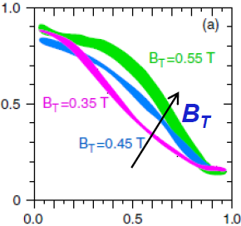
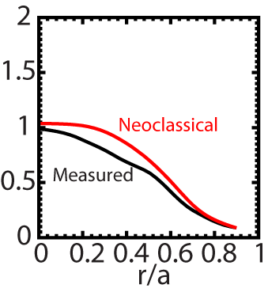
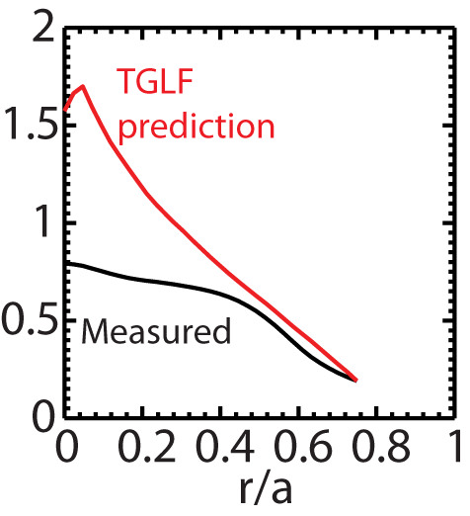
Beginning to test/utilize transport models to predict NSTX temperature profiles, identify possible missing physics
NSTX H-modes showed broadening of T_{e} profile as B_{T} was increased
  Similar broadening trend observed with increased lithium deposition
  B_{T}τ_{E} scales as ~1/ν* in both datasets
T_{e} (keV)
r/a
Utilizing neoclassical + drift wave models to simulate NSTX T_{i} and T_{e} profiles (collaboration with GA)
  Need model for χ in edge region
  Discrepancy in core T_{e} prediction for beam-heated H-modes
T_{i} (keV)
T_{e} (keV)
Over-prediction of core T_{e} in NSTX may be due to transport from GAE/CAE modes not included in gyro-Landau-fluid model

Slide 17
Transport and Turbulence 5 Year Goals:
Characterize H-mode global energy confinement scaling in the lower collisionality regime of NSTX-U
Identify modes causing anomalous electron thermal, momentum, particle/impurity transport
  Exploit scaling dependencies of modes
    Example: μ-tearing χ_{e} ~ ν¹, ETG χ_{e} ~ ν⁰
  Relate predicted turbulence to data:
    Low-k (BES), δB (polarimetry), high k_{r} & k_{θ} (μ-wave)
  Builds on identification of ETG w/ novel high-k_{r} scattering in NSTX
Establish and validate reduced transport models

Slide 18
Highest priority research goals for NSTX-U:
Demonstrate 100% non-inductive sustainment
Access reduced ν* and high-β combined with ability to vary q and rotation
Develop/understand non-inductive start-up, ramp-up
(overdrive) for ST-FNSF with small/no solenoid
4. Develop high-flux-expansion “snowflake” divertor +
radiative detachment to mitigate high heat fluxes
5. Assess high-Z + liquid Li plasma facing components

Slide 19

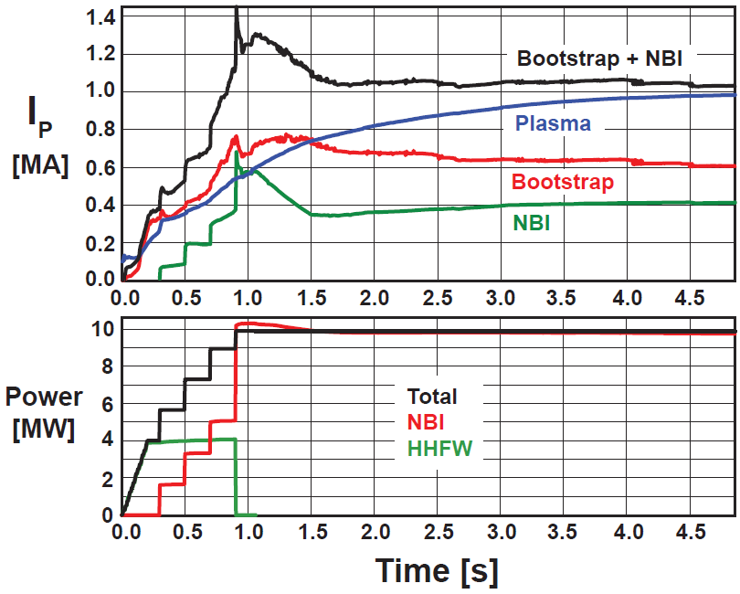
Simulations support non-inductive start-up/ramp-up strategy
TSC code (2D) successfully simulates CHI I_{P} ~200kA achieved in NSTX
TRANSP: NSTX-U more tangential NBI → 3-4x higher CD at low I_{P} (0.4MA)
TSC: non-inductive ramp-up from 0.4MA to 1MA possible w/ BS + NBI
1.0 ms
1.6 ms
2.7 ms
2
1
Z (m)
0
-1
-2
0
1
2
0
1
2
0
1
2
R (m)
R (m)
R (m)
TSC + tools included in 5 year plan support CHI I_{P} → 400kA in NSTX-U
  Higher injector flux, toroidal field, CHI voltage
  1MW 28GHz ECH (increases T_{e})
But, RF heating (ECH and/or HHFW) of CHI likely required to couple to NBI

Slide 20
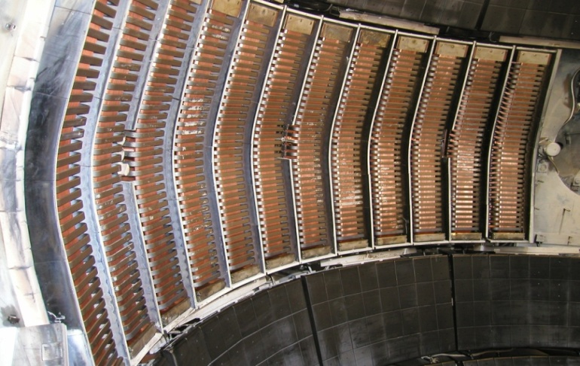
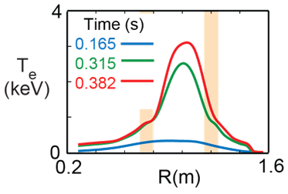
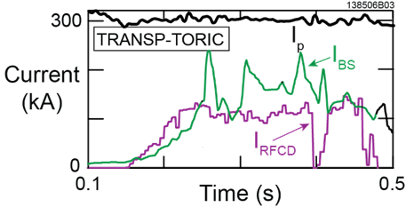
HHFW can efficiently heat low I_{P} targets for plasma start-up
NSTX high-harmonic fast-wave (HHFW) antenna will also be utilized on NSTX-U
  12 strap, 30MHz, P_{RF} ≤ 6MW
  HHFW: highest ST T_{e}(0) ~ 6keV
T_{e}(0)=3keV RF-heated H-mode at I_{P} = 300kA with only P_{RF} = 1.4MW
Non-inductive fraction ≥ 70%
  f_{BS} ~50%, f_{RFCD} ~ 20-35%

Slide 21
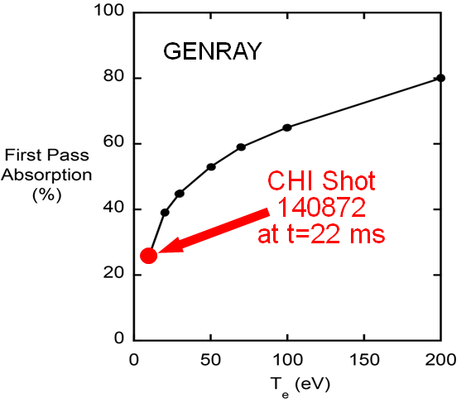
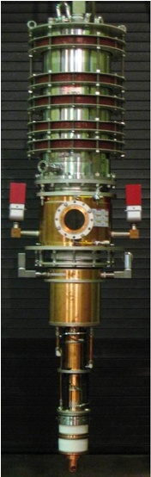
Start-up/Ramp-up + RF Heating/Current Drive Goals:
Test higher-current CHI start-up (~400kA)
Test NBI + bootstrap current overdrive/ramp-up
Develop HHFW and EC heating for fully non-inductive plasma current start-up and ramp-up
  Extend HHFW to higher power (3-4MW), demonstrate HHFW-driven 100% non-inductive at 300-400kA
    Goal: maintain I_{P} to confine 2nd NBI fast-ions
Validate advanced RF codes for NSTX-U, predict RF performance in ITER and FNSF
  Use ECH (~1MW, 28GHz), then HHFW to increase T_{e} of CHI plasmas for NBI
  Test high-power EBW to generate start-up current - builds on MAST results

Slide 22
Highest priority research goals for NSTX-U:
Demonstrate 100% non-inductive sustainment
Access reduced ν* and high-β combined with ability to vary q and rotation
Develop/understand non-inductive start-up, ramp-up
(overdrive) for ST-FNSF with small/no solenoid
4. Develop high-flux-expansion “snowflake” divertor +
radiative detachment to mitigate high heat fluxes
5. Assess high-Z + liquid Li plasma facing components

Slide 23
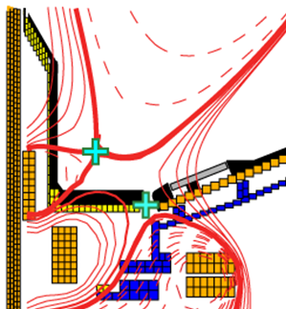
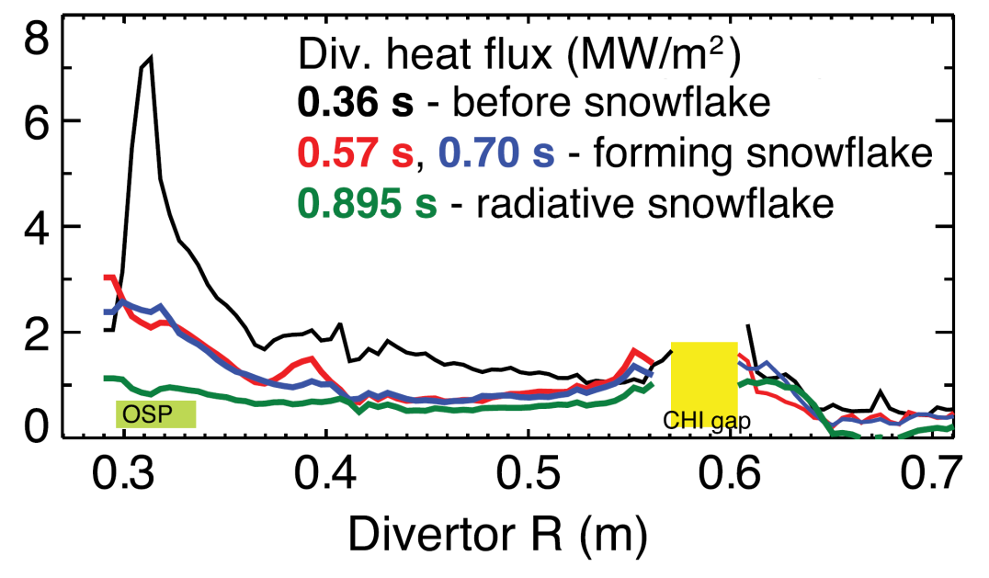
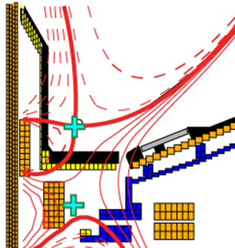
Snowflake divertor effective for heat flux mitigation
NSTX: can reduce heat flux by 2-4× via partial detachment
Snowflake → additional x-point near primary x-point
  NSTX: High flux expansion = 40-60 lowers incident q⊥
  Longer field-line-length promotes temperature drop, detachment
Standard Divertor
Snowflake/X Divertor

Slide 24
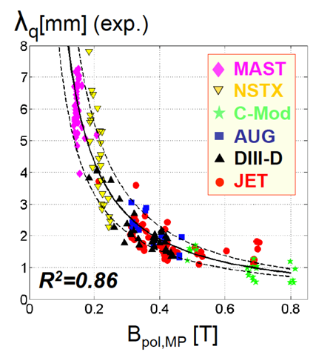
Boundary Physics, SOL/Divertor, PMI 5 Year Goals:
Assess, optimize, control pedestal structure, transport, stability
Assess and control divertor heat fluxes
  Measure SOL widths at lower ν, higher B_{T}, I_{P}, P_{SOL}
    Compare data to fluid and gyro-kinetic models
  Assess, control, optimize snowflake/X-divertor
  Develop highly-radiating divertor w/ feedback control
  Assess impact of high-Z tile row(s) on core impurities
Establish, compare particle control methods
  Validate cryo-pump physics design, assess density control
  Compare cryo to lithium coatings for n_{e}, impurity, ν* control
Explore Li/liquid-metal plasma material interactions
  Li surface-science, continuous vapor-shielding, material migration and evolution, lab R&D: flowing Li loops, capillary-restrained Li surfaces

Slide 25
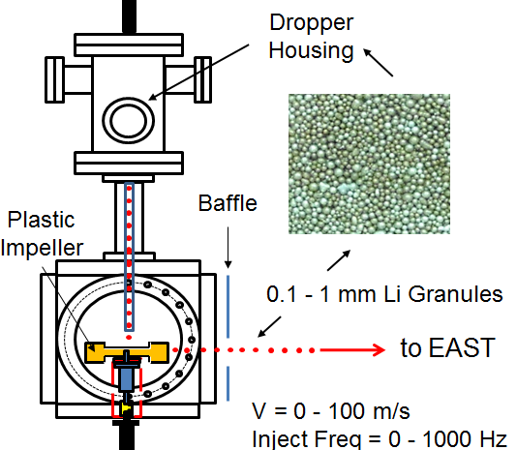
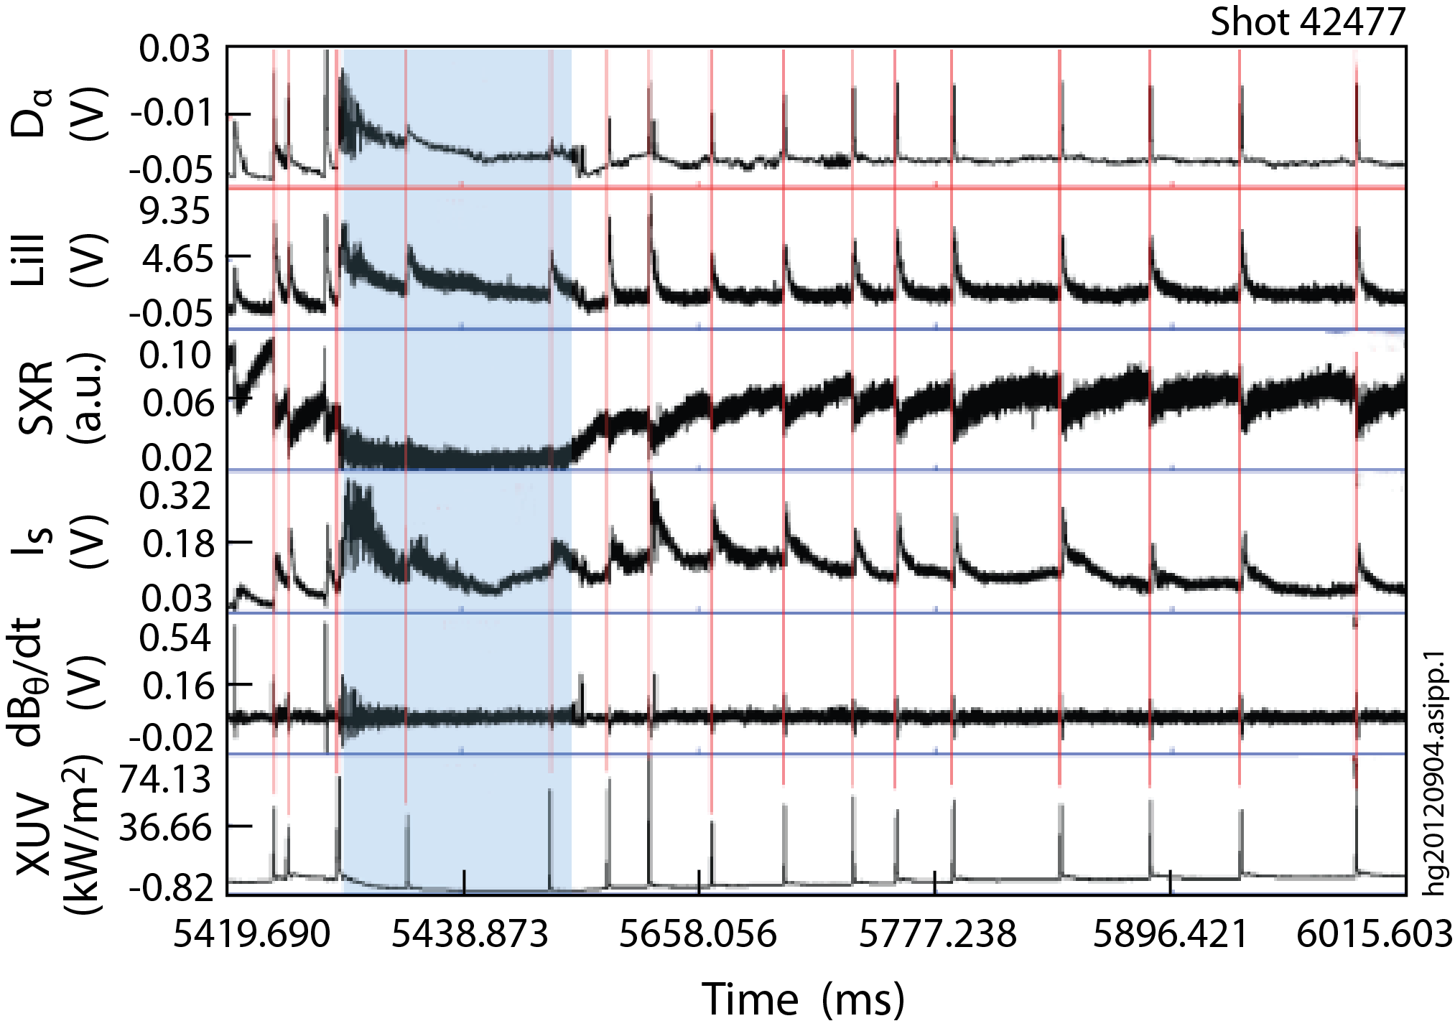
Lithium Granule Injector (LGI) developed for NSTX is promising tool for pedestal control and scenario optimization
Successful EAST collaboration
  Demonstrated LGI ELM-pacing at 25 Hz with nearly 100% triggering reliability
  Capable of up to 1 kHz injection
LGI will be tested on NSTX-U for high-frequency ELM pacing
  Possible density control technique:
    Combine Li coatings for D pumping with LGI for ELM-expulsion of carbon
  Goal: reduce Z_{eff} to ~2-2.5
  Injection of Li granules could also potentially replenish PFC Li coatings
JET/ITER: potentially interested in testing Be granules for ELM pacing
EAST data

Slide 26
Summary: NSTX-U aims to carry out leading research in support of FNSF/next-steps and ITER
Non-inductive sustainment: NSTX-U aims to be the ST leader, will complement AT approach (DIII-D, KSTAR, EAST)
Aim to make major advancements in transport understanding: Low ν* + high β + turbulence diagnostics unique in world
NSTX-U will advance non-inductive start-up/ramp-up using unique combination of helicity injection + RF + NBI techniques
With MAST-U, STs will lead development of novel divertors:
  Snowflake / X-divertor, Super-X
  NSTX-U aiming to lead development of replenishable / liquid metal PFCs

Slide 27
Backup

Slide 28
NSTX-U internal component staging supports goal to assess compatibility of high τ_{E} and β + 100% NICD with metallic PFCs
Base budget case
Nominal 2014-18 5 year plan steps for implementation of cryo-pump + high-Z PFCs + LLD
2015
2016
2017
2018-19
2021
2022-23
All
high-Z FW + divertors
+ flowing LLD module
C
BN
Li
High-Z
Cryo +
full lower
outboard high-Z divertor
Cryo + high-Z FW and OBD
+ liquid Li divertor (LLD)
Lower
OBD
high-Z row of tiles
Cryo + U+L OBD
high-Z rows of tiles
High-Z tile row
Cryo-pump
Bakeable cryo-baffle for liquid Li
Flowing Li module

Slide 29
NSTX-U internal component staging supports goal to assess compatibility of high τ_{E} and β + 100% NICD with metallic PFCs
Incremental budget case
Nominal 2014-18 5 year plan steps for implementation of cryo-pump + high-Z PFCs + LLD
2015
2016
2017
2018
2019-20
Cryo-pump
2021
Upper cryo + all
high-Z & higher-T PFCs
+ full toroidal LLD
Cryo + high-Z FW and OBD
+ liquid Li divertor (LLD)
All
high-Z FW + divertors
+ flowing LLD module
C
BN
Li
High-Z
Lower
OBD
high-Z row of tiles
Cryo + high-Z FW and OBD
PFCs
High-Z tile row
Cryo-pump
Bakeable cryo-baffle for liquid Li
Flowing liquid Li divertor (LLD) module
Full toroidal flowing Li

Slide 30
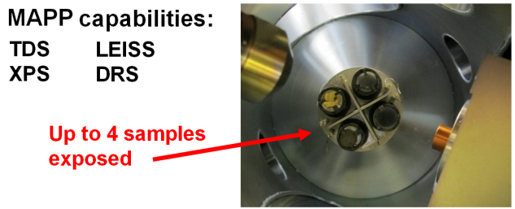
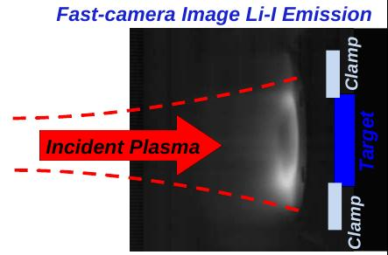
Materials and PFCs 5 Year Goal:
Initiate comparative assessment of high-Z and liquid metal PFCs for long-pulse high-power-density next-step devices
MP Thrusts:
Understand Li surface-science at extended PFC operation
  “Atoms to tokamaks” collaboration with PU
Assess tokamak-induced material migration and evolution
  QCMs, marker-tiles, MAPP + QCM for shot-to-shot analysis of migration
  Materials Analysis Particle Probe (MAPP) (Purdue - J.P. Allain, 2010 ECRP) to identify in-situ between-shot surface composition (LTX→NSTX-U)
Establish the science of continuous vapor-shielding
  Continue studies of Li vapor-shielding in linear plasma device Magnum-PSI
  Extend Magnum results to NSTX-U
Magnum-PSI collaboration: M. Jaworski, T. Abrams (grad student) (PPPL)
Lab-based R&D: flowing Li loops, capillary-restrained Li surfaces

Slide 31
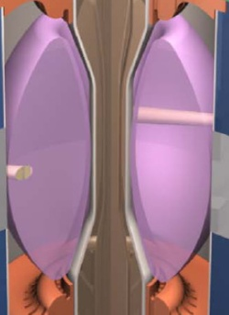
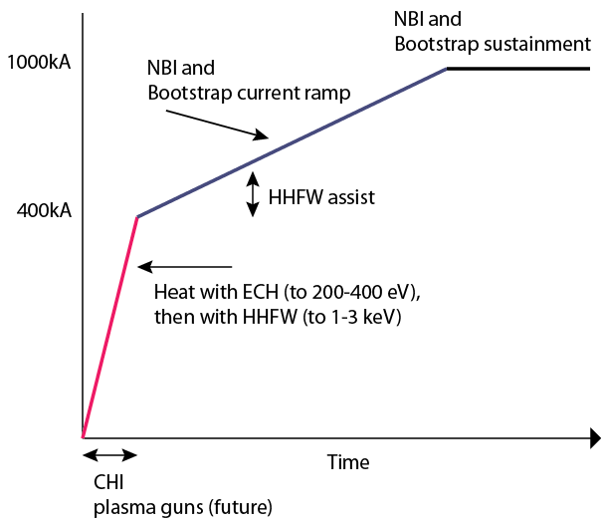
Plasma initiation with small or no transformer is unique challenge for ST-based Fusion Nuclear Science Facility
ST-FNSF has no/small central solenoid
NSTX-U Non-Inductive Strategy:

Slide 32


NSTX-U goal staging: first establish ST physics + scenarios, transition to long-pulse + PMI integration (5YP incremental)
2014 | 2015 | 2016 | 2017 | 2018 | 2019 | 2020 | 2021 | 2022 | 2023
Upgrade Outage
Establish ST physics, scenarios
Integrate long-pulse + PMI solutions
Increase CHI closed-flux current
Achieve NI start-up/ramp-up
New
center-stack
Start-up and Ramp-up
Assess plasma gun start-up at increased device size
Increase/extend ramp-up heating and off-axis current-drive for advanced scenarios
Develop/understand ECH/EBW H&CD for ST
Boundary Physics
Establish main-ion density and ν* control
Understand snowflake divertor performance
Understand high-Z first-wall erosion, migration, particle sources & sinks
Materials and PFCs
Assess baseline graphite PFC performance
Assess high-Z tile/divertor impact and performance
Assess high-Z divertor and/or first-wall
Assess impact of high-temperature first-wall
Inform choice
of FNSF:
aspect ratio, divertor, and PFCs
Liquid
metals / lithium
Establish low impurities / Z_{eff} , assess increased Li coverage, replenishment
Test flowing liquid metal for heat-flux mitigation, surface replenishment
Assess flowing LM PFC with full toroidal coverage
MHD
Understand kinetic MHD, extend mode and disruption detection, develop mitigation
Enhance non-axisymmetric field spectrum and capabilities with off-midplane coils for control of: RWM, EF, RMP, rotation, NTM, EP
Transport & Turbulence
Understand ES and EM turbulence at high β, low ν*, emphasizing e-transport
Extend wave-number coverage of turbulence measurements
Waves and Energetic Particles
Characterize AE stability, fast-ion transport, NBI-CD, support plasma start-up, assess effectiveness of fast-wave in NBI H-modes
Prototype driving edge-harmonic oscillations (EHOs) and/or *AE
2nd NBI
Scenarios and Control
Demonstrate full non-inductive, high I_{P} & P_{AUX} operation Control: boundary, β, divertor heat flux, Ω & q profiles
Assess integrated control of long-pulse / high-performance

Slide 33
10 year plan tools with 5YP incremental funding
1.1 × (FY2012 + 2.5% inflation)
2014 | 2015 | 2016 | 2017 | 2018 | 2019 | 2020 | 2021 | 2022 | 2023
Upgrade Outage
1.5 → 2 MA, 1s → 5s
Metallic PFCs, 5s → 10-20s
Run Weeks:
20
16
16
20
22
6
18
22
22
New
center-stack
Start-up and Ramp-up
Upgraded CHI for ~0.5MA
0.5-1 MA CHI
up to 1 MA plasma gun
Extend NBI duration to 10-20s and/or implement 2-4 MW off-axis EBW H&CD
1 MW ECH/EBW
2 MW
Boundary Physics
Lower divertor cryo-pump
Divertor Thomson
Upper divertor cryo-pump
Materials and PFCs
High-Z tile row on lower OBD
High-Z first-wall + lower OBD tiles
High-Z PFC diagnostics
All high-Z PFCs
Hot high-Z FW PFCs using bake-out system
Inform choice
of FNSF:
aspect ratio, divertor, and PFCs
Liquid
metals / lithium
Upward
LiTER
LLD using bakeable cryo-baffle
Flowing Li divertor
or limiter module
Full toroidal flowing Li lower OBD
Li granule injector
MGI disruption mitigation
Partial NCC
NCC SPA upgrade
Full NCC
MHD
Enhanced MHD sensors
Transport & Turbulence
δB polarimetry
DBS, PCI, or other intermediate-k
High k_{θ}
Waves and Energetic Particles
HHFW limiter upgrade
HHFW straps to excite EHO
High-power AE antenna
2nd NBI
1 coil AE antenna
4 coil AE antenna
Charged fusion product, neutron-collimator
Scenarios and Control
Establish control of:
Control integration, optimization
Control integration, optimization with long-pulse and full metal wall
n_{e}
q_{min}
Divertor P_{rad}
Snowflake
Rotation

Slide 34
5 year plan tools with 5YP base funding
(FY2012 + 2.5% inflation)
2014 | 2015 | 2016 | 2017 | 2018
Upgrade Outage
1.5 → 2 MA, 1s → 5s
Run Weeks:
16
14
14
16
Cryo-pump, high-Z tile row on cryo-baffle, and partial NCC would be installed in-vessel during ~1 year outage between FY2016 and FY2017
  NSTX-U would operate 1st half of FY2016 and 2nd half of FY2017
New
center-stack
Start-up and Ramp-up
Upgraded CHI for ~0.5MA
up to 0.5 MA plasma gun
1 MW ECH/EBW
Boundary Physics
Lower divertor cryo-pump
High-Z PFC diagnostics
Materials and PFCs
High-Z tile row on lower OBD
High-Z tile row on cryo-baffle
Full high-Z lower OBD
Liquid
metals / lithium
Upward
LiTER
LLD using bakeable cryo-baffle
Li granule injector
MHD
MGI disruption mitigation
Partial NCC
Enhanced MHD sensors
Transport & Turbulence
δB polarimetry
High k_{θ}
Waves and Energetic Particles
Charged fusion product
2nd NBI
1 coil AE antenna
4 coil AE antenna
Scenarios and Control
Establish control of:
n_{e}
q_{min}
Snowflake
Rotation
Divertor P_{rad}

Slide 35
NSTX-U 5 year plan aims to develop ST physics and scenario understanding necessary for assessing ST viability as FNSF
2015 | 2016 | 2017 | 2018 | 2019 | 2020 | 2021 | 2022 | 2023
Establish ST physics, scenarios
Integrate long-pulse + PMI
Maximum
B_{T} [T] and I_{P} [MA]
0.8, 1.6
1, 2
Structural force
and coil heating
limit fractions
0.5, 0.5
1.0, 0.75
1.0, 1.0
Extend NBI, plasma duration from 5s to 10-20s
Nominal τ_{pulse} [s]
1 – 2
2 – 4
4 – 5
Sustained β_{N}
3 – 5
4 – 6
NCC
5 – 6
ν* / ν* (NSTX)
0.6
0.4
Cryo
0.3 – 0.2
0.2 – 0.1
Inform choice
of FNSF
aspect ratio
and divertor
Inform choice
of FNSF plasma facing components
Non-inductive
fraction (Δt ≥ τ_{CR})
70 – 90%
80 – 110%
90 – 120%
100 – 140%
NBI+BS I_{P} ramp-up: initial → final [MA]
0.6 → 0.8
0.5 → 0.9
0.4 → 1.0
CHI closed-flux
current [MA]
0.15 – 0.2
0.2 – 0.3
ECH
0.3 – 0.5
0.4 – 0.6
P_{heat} [MW] with
q_{peak} < 10MW/m²
8
10
15
20
Snowflake and radiative divertor exhaust location
Divertor heat-flux control
Lower
Lower or Upper
Lower + Upper
High-Z tile row
High-Z tile rows
High-Z outboard divertor
High-Z first-wall
All high-Z
High-Z and
lithium PFCs
Increased Li coating coverage
Liquid Li on high-Z divertor tiles
Flowing Li module
Flowing Li divertor

