Slide 1
Welcome to ISTW 2015!

Slide 2
Internet and laptop logistics
Wireless network: “puvisitor”
There is no password
Power strips are provided at back of the auditorium for charging laptops
Charge during breaks or over lunch
Very likely one of Joanne, Carol Ann, or Jennifer will be here during lunch
If so, you can leave your stuff during lunch

Slide 3
Please: No food or drink in auditorium (maybe top secret water is ok)

Slide 4
Local Organizing Committee
Dr. Jonathan Menard (Chair)
jmenard@pppl.gov
Dr. Stanley Kaye
The people really doing the work:
Carol Ann Austin (caustin@pppl.gov)
Joanne Savino (jsavino@pppl.gov)
Jennifer Jones
Questions? Ask them at registration desk

Slide 5
Thanks to Program Committee!
Dr. Brian Lloyd - Culham Centre for Fusion Energy (UK) - Chair
Dr. Franco Alladio - ENEA (Italy)
Prof. Raymond Fonck - University of Wisconsin - Madison (USA)
Prof. Zhe Gao - Tsinghua University (China)
Prof. Kazuaki Hanada - Kyushu University (Japan)
Prof. Yong-Seok Hwang - Seoul National University (Korea)
Dr. Masayuki Ono - Princeton Plasma Physics Lab (USA)
Dr. Alan Sykes - Tokamak Energy, LLC (UK)
Prof. Yuichi Takase - University of Tokyo (Japan)
Prof. Howard Wilson - University of York (UK)

Slide 6
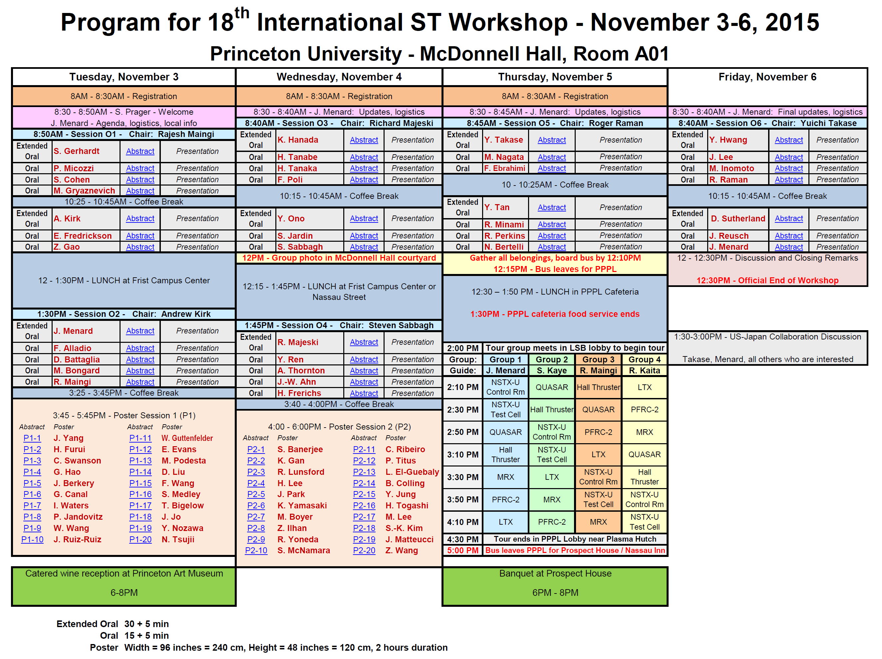
~100 registrants, 10 Overviews, 28 orals, 40 posters ~50% international covering CTs, start-up, EP, core/edge transport, MHD, boundary, RF
3 events during workshop:
Reception at Art Museum
NSTX-U / PPPL tour
Banquet at Prospect House

Slide 7
PPPL / NSTX-U Tours
Please confirm that you are signed up with Carol Ann / Joanne / Jen
Buses leave campus ~12:15PM Thursday
Eat lunch in PPPL cafeteria
Food served until 1:30PM
Meet in PPPL lobby at 1:45PM sharp for tour
Split into 4 groups for guided tour
Return to lobby by 4:30PM
Buses leave from PPPL no later than 5PM
Returning to Nassau Inn, Lot 21, or Prospect House

Slide 8
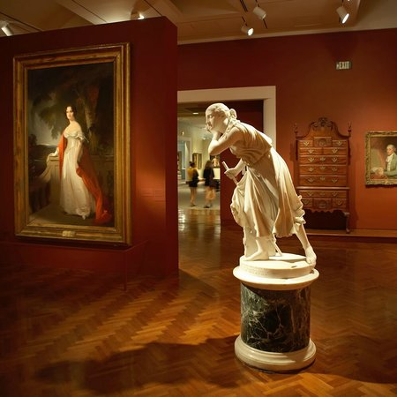
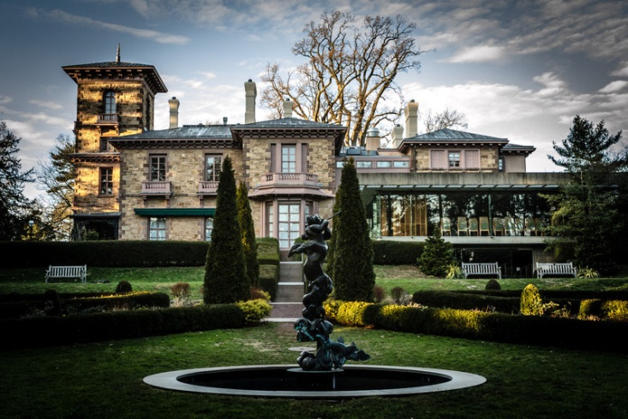
Reception & banquet tickets still available
All participants must register
http://istw-2015.pppl.gov/registration-and-payment
We have ~45-50 reception and banquet participants each
Would like to get ~60 banquet participants to use “Garden Room” at Prospect House
Sign up and pay ASAP online or at registration desk:
https://ppplconfreg.pppl.gov/istw2015-reg/dinnerreg.aspx
Today is last day!
Art Museum Wine Reception - $30
Prospect House Banquet - $70

Slide 9
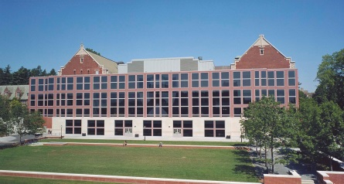
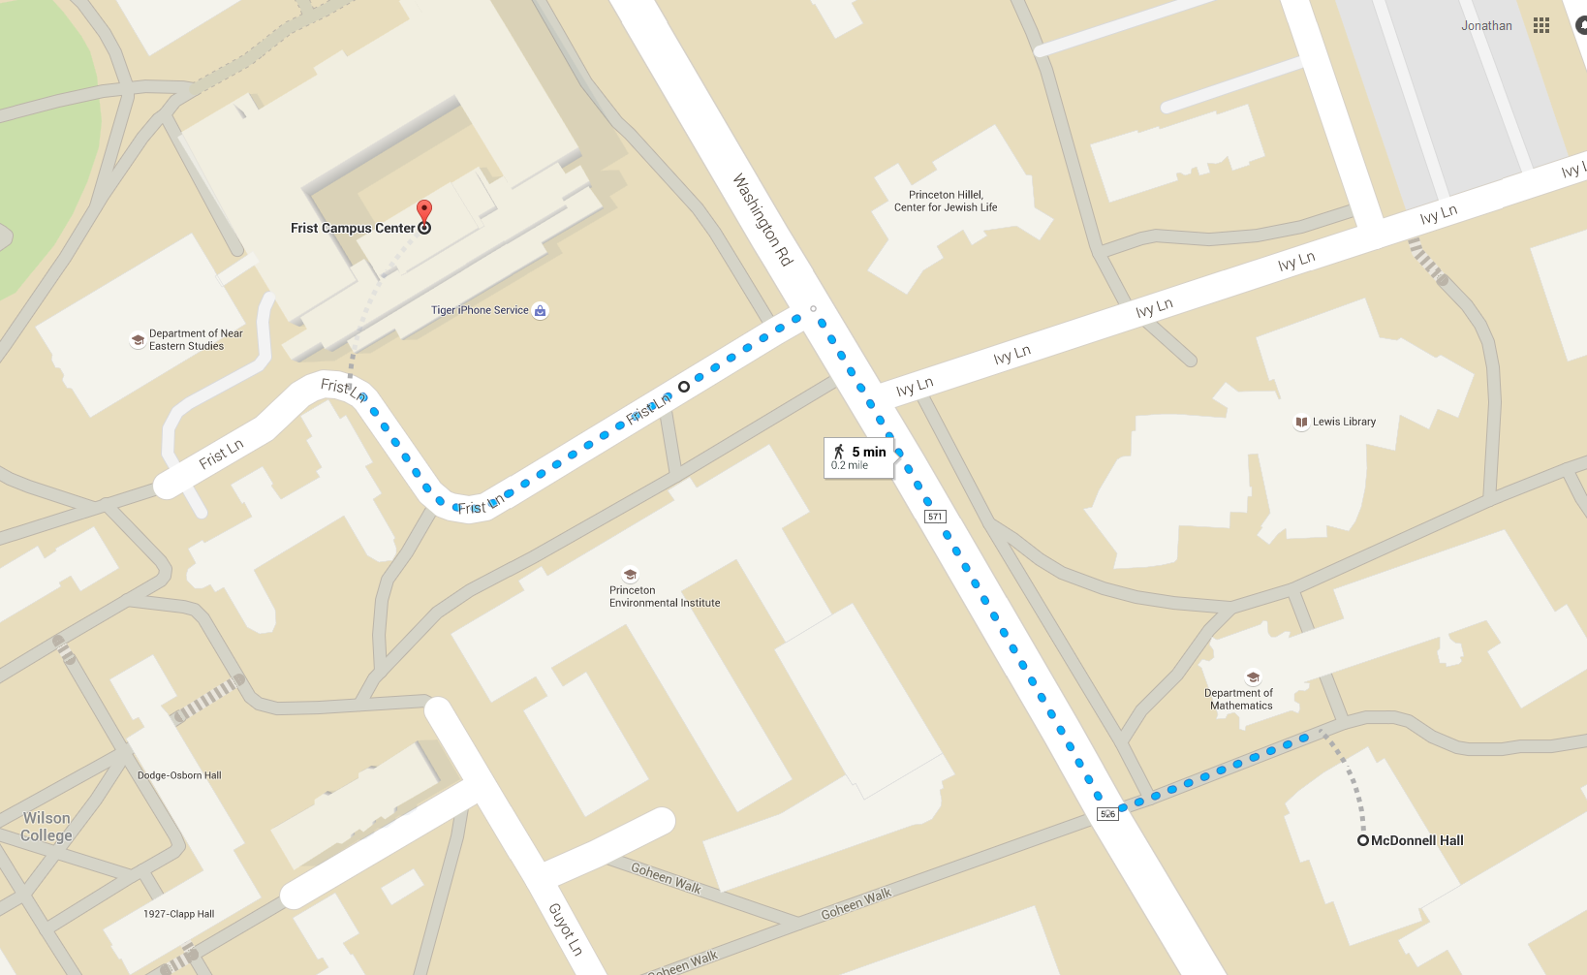
Map for walking from McDonnell Hall to Frist Campus Center for Lunch
Frist Lane
Washington Road

Slide 10
Restaurants on Nassau Street near Palmer Square / Nassau Inn

Slide 11
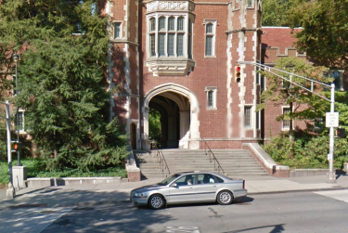
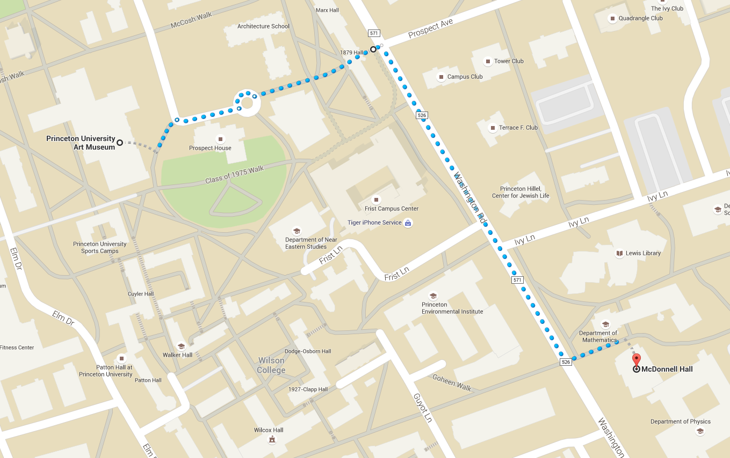
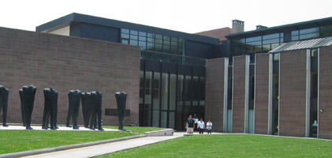
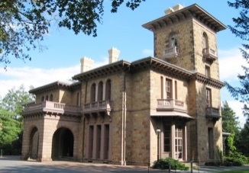
Map for walking from McDonnell Hall to Art Museum (Reception) & Prospect House (Banquet)
Prospect Avenue
Art Museum
Prospect House

Slide 12
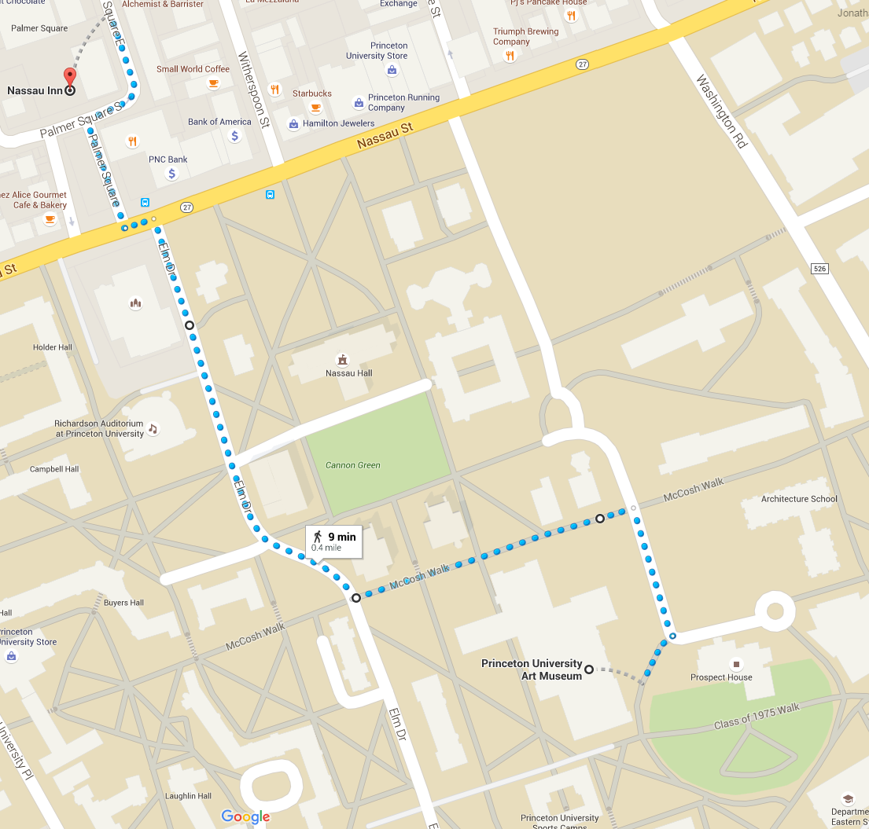
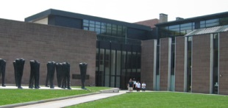
Map for walking from Nassau Inn to/from Art Museum (Reception) & Prospect House (Banquet)
Elm Drive
McCosh Walk

Slide 13
If you are not staying at Nassau Inn, do you need transportation back to your hotel?
Options:
Jon has PPPL van – can take 5-6 people from Lot 21 to somewhere…
Get your hotel’s van to pick you up
Share a taxi
See Carol Ann, Joanne, Jen for assistance!

Slide 14
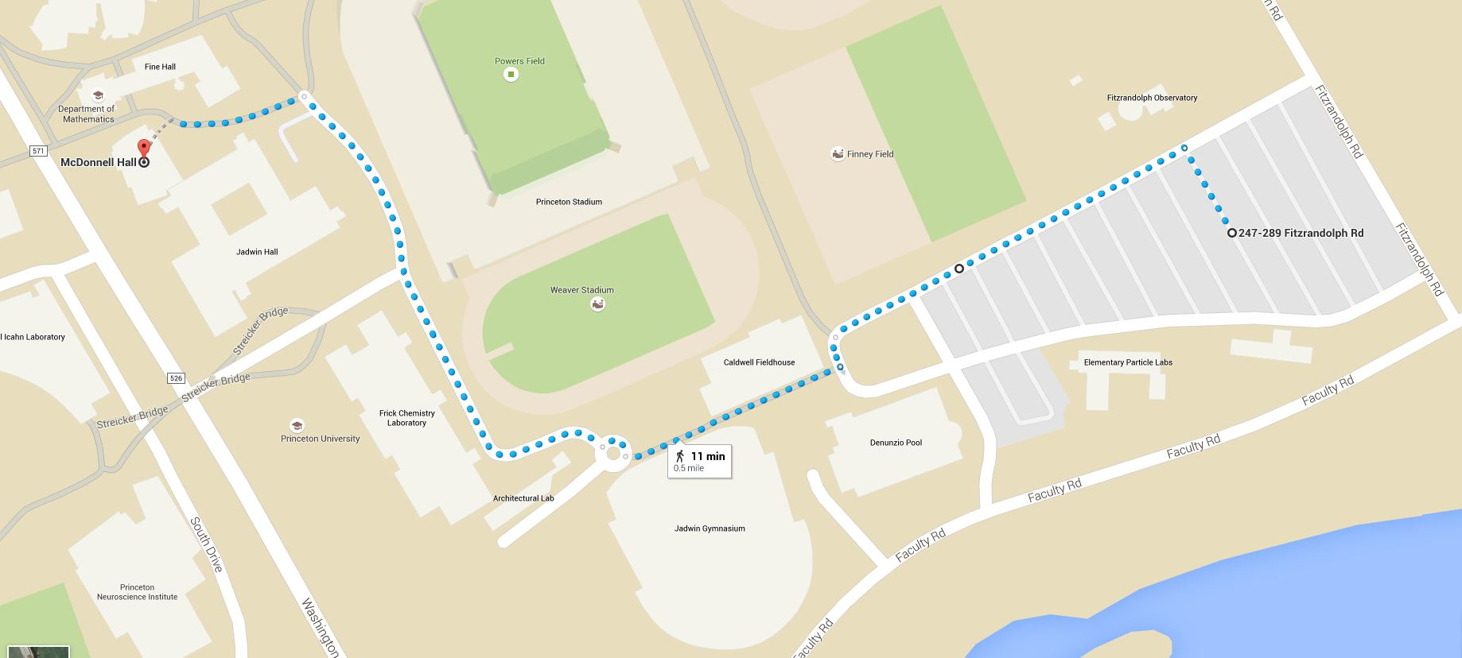
Map for walking from Lot 21 to McDonnell Hall
Lot 21 Tiger Transit bus stop
Visitor Parking Area
Lot 21

Slide 15
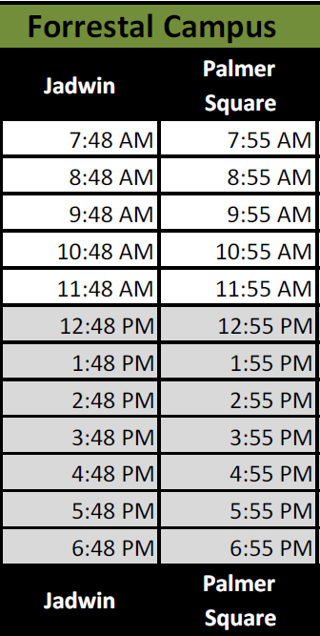
Timetable for Tiger Transit bus from Lot 21 to Jadwin (next to McDonnell)
Real-time bus tracking webpage: http://princeton.transloc.com/
Phone apps: http://princeton.transloc.com/info/mobile
Timetable for Tiger Transit bus from Jadwin back to Palmer Square / Nassau Inn

Slide 16
For PPPL /NSTX-U employees wishing to take Tiger Transit Bus from PPPL to/from Jadwin Hall, here is Forrestal Campus timetable:
Timetable for Tiger Transit bus from Jadwin back to Palmer Square / Nassau Inn

