Slide 1
Welcome to ISTW 2015!

Slide 2
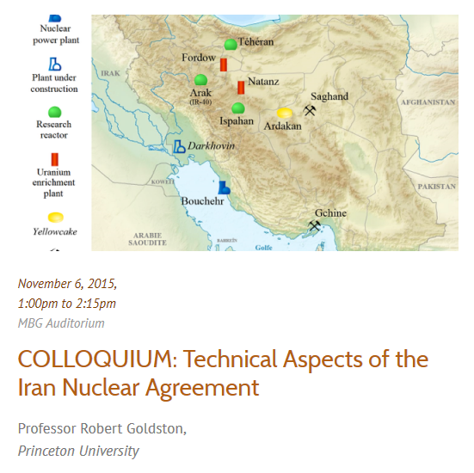
We will broadcast Rob Goldston’s PPPL colloquium here in McDonnell A01 at 1PM

Slide 3
US-Japan collaboration discussion will start at 2:15 (or 2:30) instead of 1:30PM

