Slide 1

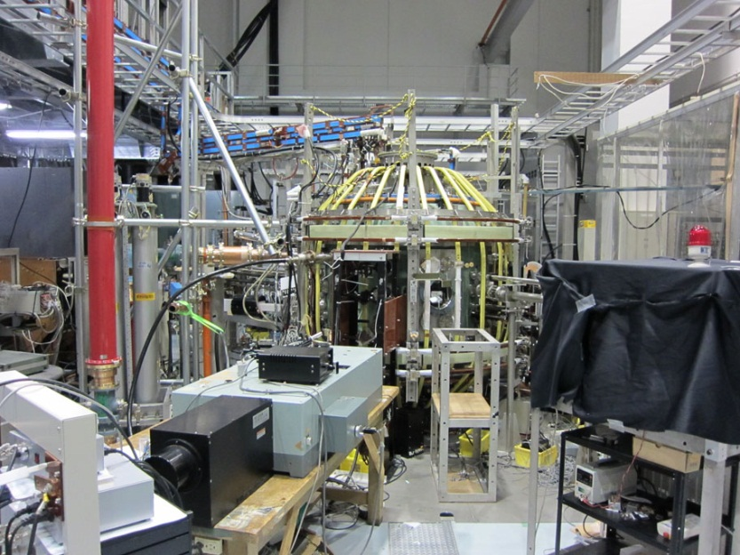
Non-inductive plasma start-up experiments on the TST-2 spherical tokamak
R₀ = 0.36 m
a = 0.23 m
A = R₀/a > 1.5
B_{t} = 0.3 T
I_{p} = 0.1 MA
R₀
a
Y. Takase for the TST-2 Group
Graduate School of Frontier Sciences
The University of Tokyo
18th International Spherical Torus Workshop (ISTW 2015)
and 2015 US-Japan Workshop on ST Plasmas
Princeton University, Princeton, NJ, USA
3-6 November 2015

Slide 2
Outline
Motivation / Objective
4-WG array (grill) antenna experiments
  n|| dependence, polarization / wavenumber measurements
Capacitively-coupled combline (CCC) antenna experiments
  improved n|| spectrum
  comparison of current drive with other antennas
  characterization of LH driven plasma
    HX, SX, TS, ion Doppler, impurity
    equilibrium
    density limit
Planned improvements
  top-launch CCC antenna
  TF power supply upgrade
Diagnostic developments
  Multi-pass TS, local j, microwave scattering

Slide 3
Outline
Motivation / Objective
4-WG array (grill) antenna experiments
  n|| dependence, polarization / wavenumber measurements
Capacitively-coupled combline (CCC) antenna experiments
  improved n|| spectrum
  comparison of current drive with other antennas
  characterization of LH driven plasma
    HX, SX, TS, ion Doppler, impurity
    equilibrium
    density limit
Planned improvements
  top-launch CCC antenna
  TF power supply upgrade
Diagnostic developments
  Multi-pass TS, local j, microwave scattering

Slide 4
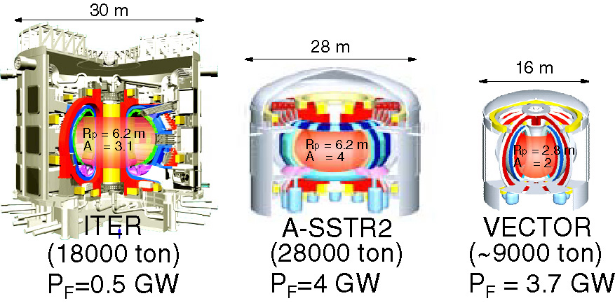

Motivation and Goal of Research
Economically competitive tokamak reactor may be realized at low aspect ratio (A = R₀/a) by eliminating the central solenoid (CS)
CS
$$P_{\text{fusion}}∝\left\langle p^{2}\right\rangle ∝{β_{\text{t}}}^{2}{B_{\text{t}}}^{4}$$
no CS
higher B_{t}
lower A → higher β_{t}
S. Nishio, et al., in Proc. 20th IAEA Fusion Energy Conf., FT/P7-35 (Vilamoura , 2004).

Slide 5
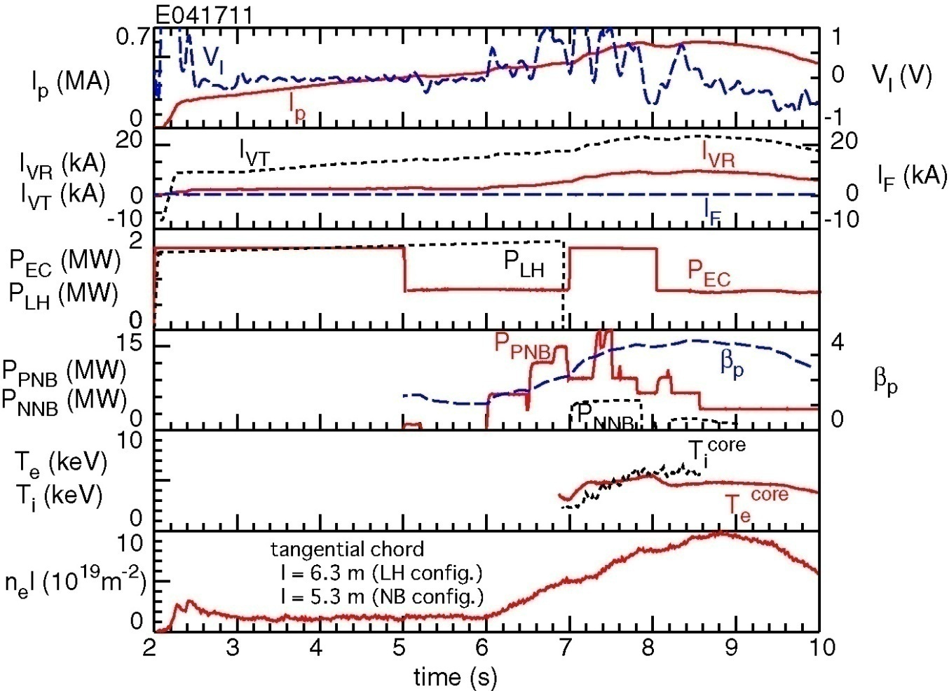
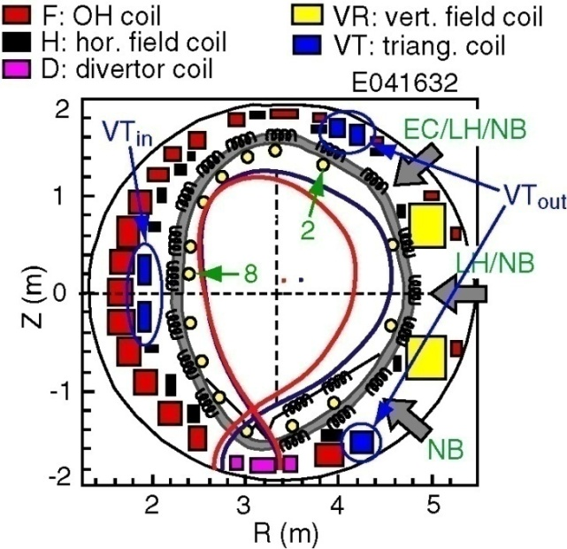
Formation of Advanced Tokamak Plasma without CS was Achieved on JT-60U
Is plasma current (I_{p}) ramp-up by LHW possible in ST?
→ Demonstrate on TST-2
Noninductive
ramp-up (LH)
Start-up and initial ramp-up
Transition to
self-driven phase
2002.06.21
advanced tokamak
S. Shiraiwa, et al., Phys. Rev. Lett. 92 (2004) 035001.
Y. Takase, IAEA FEC 2002

Slide 6
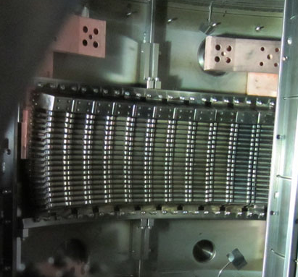
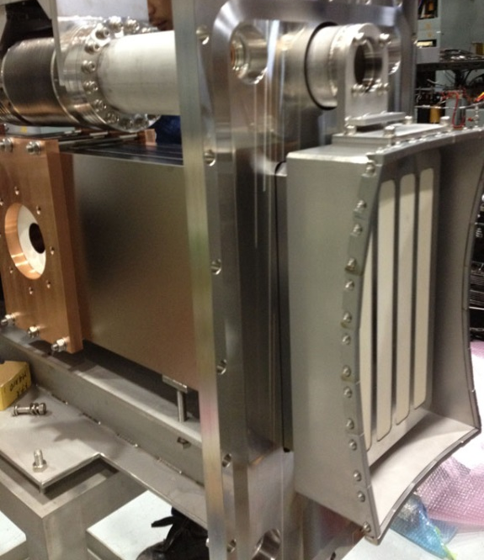
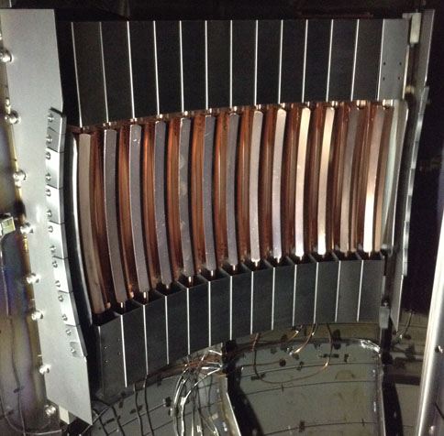
Three Antennas used on TST-2
Inductively-Coupled Combline (ICC) Antenna
Capacitively-Coupled Combline
Grill Antenna
(CCC) Antenna
traveling wave
traveling wave
traveling
wave
excites traveling FW
I_{p} driven by SW (LHW)
requires mode conversion
from FW to SW
excites traveling SW
n|| = ck||/ω can be varied
excites traveling SW
sharper n|| spectrum
& higher directivity
Developed in collaboration with
C. P. Moeller (General Atomics, US)

Slide 7
Outline
Motivation / Objective
4-WG array (grill) antenna experiments
  n|| dependence, polarization / wavenumber measurements
Capacitively-coupled combline (CCC) antenna experiments
  improved n|| spectrum
  comparison of current drive with other antennas
  characterization of LH driven plasma
    HX, SX, TS, ion Doppler, impurity
    equilibrium
    density limit
Planned improvements
  top-launch CCC antenna
  TF power supply upgrade
Diagnostic developments
  Multi-pass TS, local j, microwave scattering

Slide 8
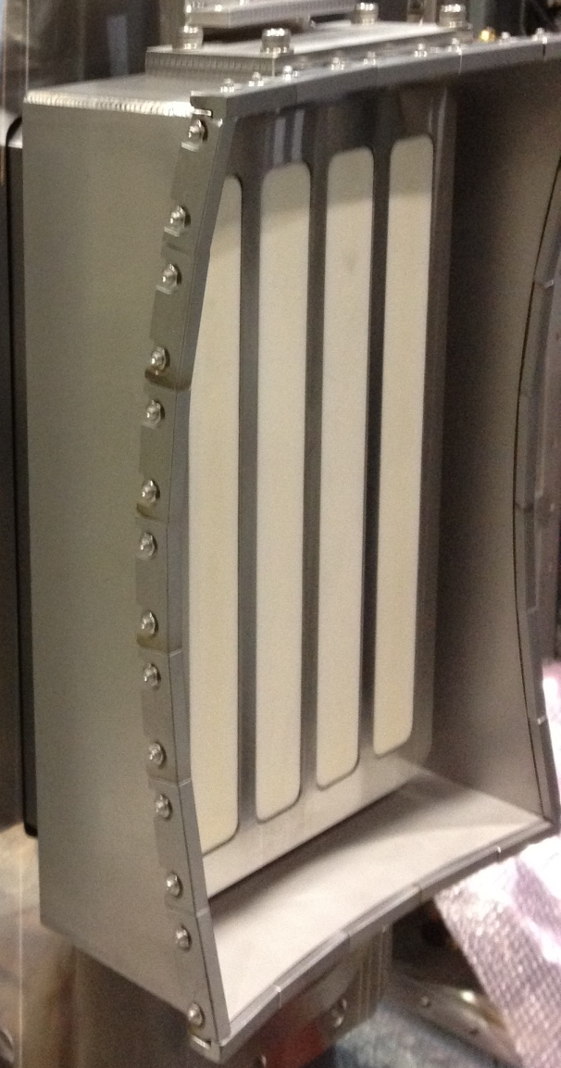

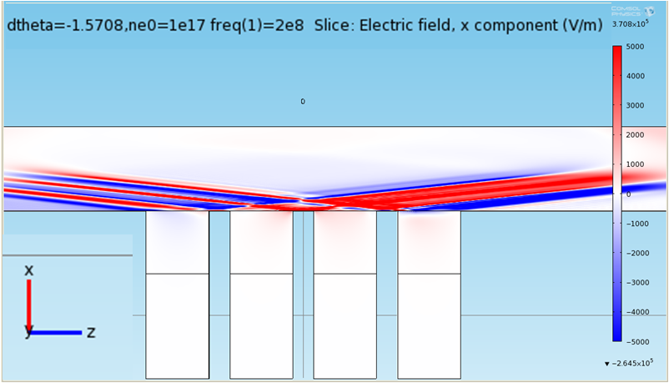
Grill Antenna
220 mm
Alumina
A Ni-plated Alumina block was used as a dielectric-loaded waveguide
LHW is excited directly by RF electric field in the toroidal direction
n|| = ck||/ω of the excited LHW can be varied by adjusting the phase difference between adjacent waveguides
340 mm
B_{t}
Movable private limiter
Grill Antenna
T. Wakatsuki
Notes:
グリルアンテナは私が設計したアンテナで、200MHzの導波管サイズを小さくするために、誘電体を用いた導波管を用いました。1mを超える巨大なアルミナのブロックに隙間なく金属板をろう付けすることは難しく、アルミナの表面にNiメッキを施したものを導波管として運用することでこの問題を克服しました。
このアンテナでは4本の導波管に入射するRFの位相差を独立に変更可能なので、励起するnparaを変化させることができます
また、このアンテナではコムラインアンテナと違い、トロイダル方向の電場によって、LHWを直接励起可能であるという利点があります。

Slide 9
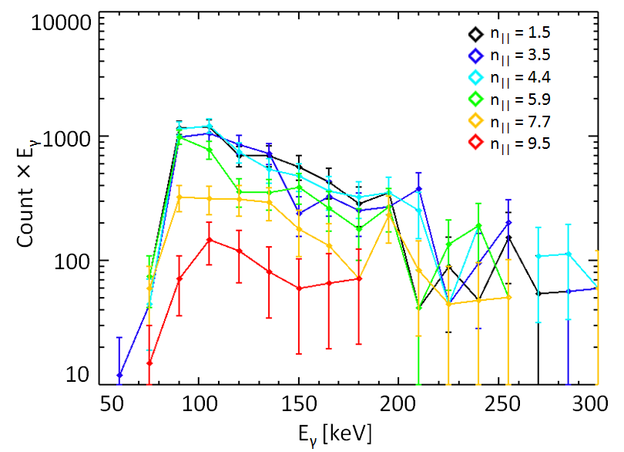
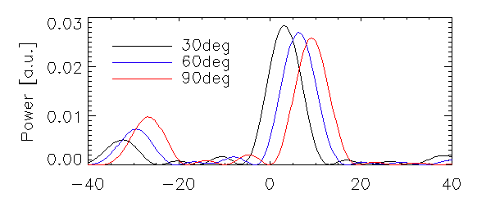
n|| Dependence of I_{p} and HX Spectrum
(Grill Antenna)
[kA]
Highest plasma current was obtained for
1.5 < n|| < 4.5
Count rate of high energy photons was lower when
n|| > 7.5
n||
fixed P_{RF}
n||
T. Wakatsuki

Slide 10
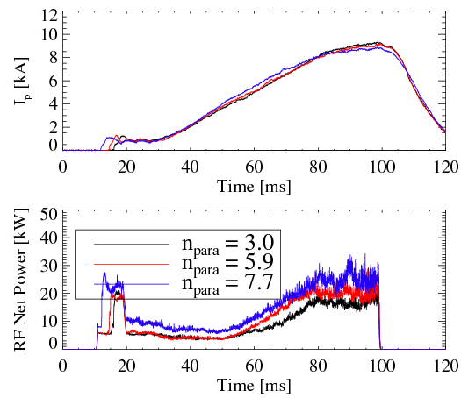
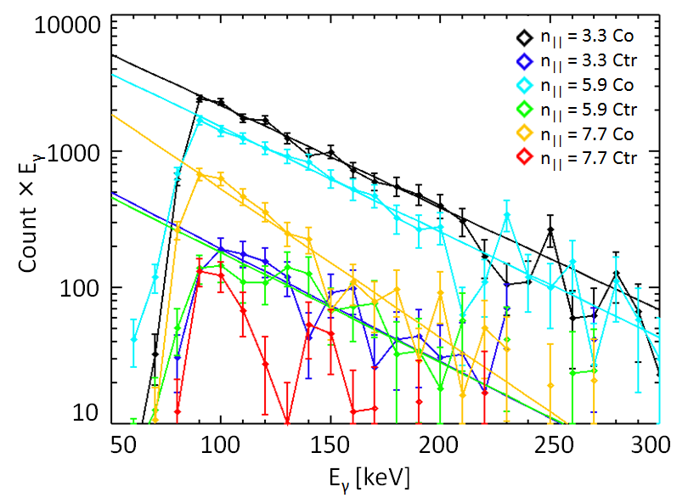
n|| Dependence of I_{p} and HX Spectrum
(Grill Antenna)
HX spectra were compared with I_{p} held constant （but with different RF powers）.
HX flux decreased for n|| > 6 even with constant I_{p}.
→ 1.5 ≦ n|| ≦ 6 are suitable for generating energetic electrons
HX flux is larger in the co-direction at any n||
→ asymmetric velocity distribution is formed
fixed I_{p}
n|| |  | 3.3 | 5.9 | 7.7
T_{eff_co} [keV] |  | 58±3 | 56±3 | 40±7
T. Wakatsuki
Notes:
そこで今度はIpを同じレベルにして、ただしその代わりにnparaが大きいときにはより多いパワーを入射することで、おなじIpでのHXスペクトルを比較した。
すると、やはりこの時でもnparaが６より大きいときにHX放射が減少することから、1.5から6が高速電子の駆動に適していることが分かりました。
この時のHXの放射温度は3.3,5.9のとき、コムラインアンテナの結果と同程度になります。
また、この場合にもやはりCo方向の温度がCtr方向に比べて高くなり、非対称な速度分布が形成されていることが分かりました。

Slide 11
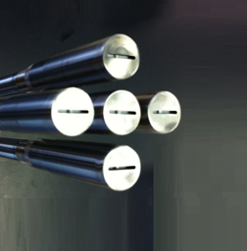
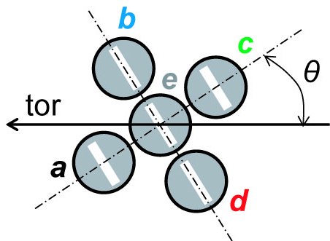
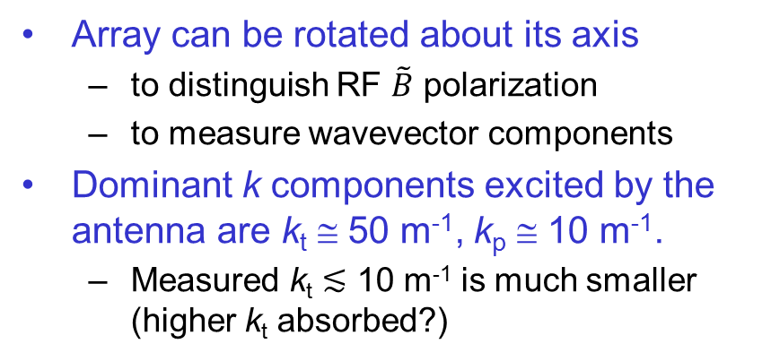
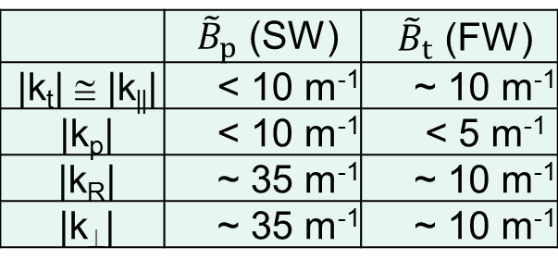
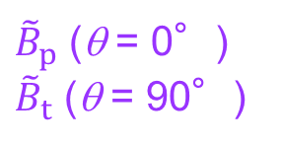
RF Magnetic Probe Array for k Measurement
(Grill Antenna, ~ 1kA)
a
30 mm
e
b
d
${\tilde{B}}_{p}$ (θ = 0°)
${\tilde{B}}_{t}$ (θ = 90°)
c
rotation
radial
translation
Array can be rotated about its axis
  to distinguish RF $\tilde{B}$ polarization
  to measure wavevector components
Dominant k components excited by the antenna are k_{t} ≅ 50 m⁻¹, k_{p} ≅ 10 m⁻¹.
  Measured k_{t} ≲ 10 m⁻¹ is much smaller (higher k_{t} absorbed?)
 | ${\tilde{B}}_{p}$ (SW) | ${\tilde{B}}_{t}$ (FW)
|k_{t}| ≅ |k||| | < 10 m⁻¹ | ~ 10 m⁻¹
|k_{p}| | < 10 m⁻¹ | < 5 m⁻¹
|k_{R}| | ~ 35 m⁻¹ | ~ 10 m⁻¹
|k⊥| | ~ 35 m⁻¹ | ~ 10 m⁻¹
k|| = 10 m⁻¹ corresponds to n|| = 2.4
T. Shinya

Slide 12
Outline
Motivation / Objective
4-WG array (grill) antenna experiments
  n|| dependence, polarization / wavenumber measurements
Capacitively-coupled combline (CCC) antenna experiments
  improved n|| spectrum
  comparison of current drive with other antennas
  characterization of LH driven plasma
    HX, SX, TS, ion Doppler, impurity
    equilibrium
    density limit
Planned improvements
  top-launch CCC antenna
  TF power supply upgrade
Diagnostic developments
  Multi-pass TS, local j, microwave scattering

Slide 13
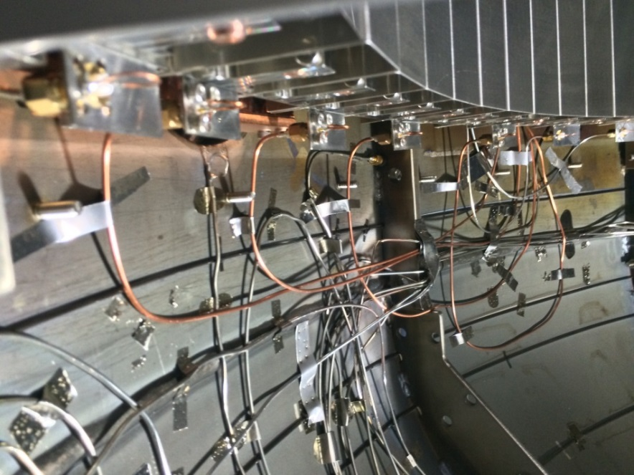
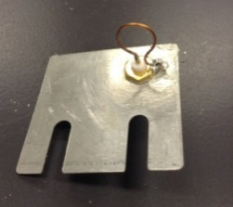
LH Traveling Wave Antenna Based on a New Concept
Capacitively-Coupled Combline
(CCC) Antenna
Power and phase are monitored at 7 out of 13 elements
traveling wave
sharper k spectrum
higher wave directivity
coil diameter: 8 mm
monitored elements:
1, 2, 4, 6, 9, 11, 13
T. Shinya

Slide 14
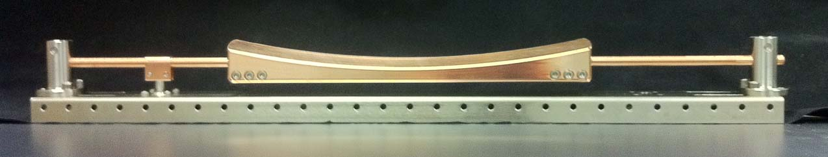
CCC Antenna Element
280 mm
feeder at 50Ω input impedance
Radiating element
  house shaped cross section
  chosen to reduce the stationary spatial harmonic field
Inductive rods + rod supports
  covered by shields to reduce inductive coupling and excitation of the fast wave
Antenna consists of 13 elements
Exhibits a band-pass filter characteristic
L_{13U}
L_{13L}
#13
C₁₃
L_{Ｒ}
C_{12,13}
Output feeder
・
・・
L_{2U}
L_{2L}
#2
C₂
L_{1U}
C_{1,2}
L_{1L}
#1
L_{L}
C₁
Input feeder
C. Moeller

Slide 15
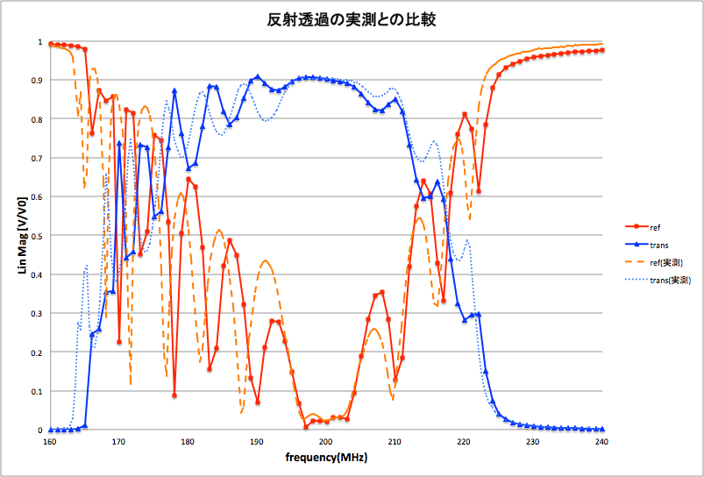
Measured and Calculated Pass-Band Characteristics
Without Plasma
reflection
{
reflection
measured
transmission
200 MHz
{
reflection
calculated
transmission
(COMSOL)
transmission
C. Moeller / T. Inada

Slide 16
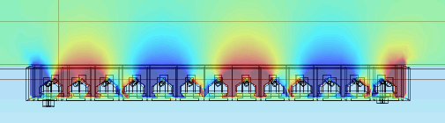
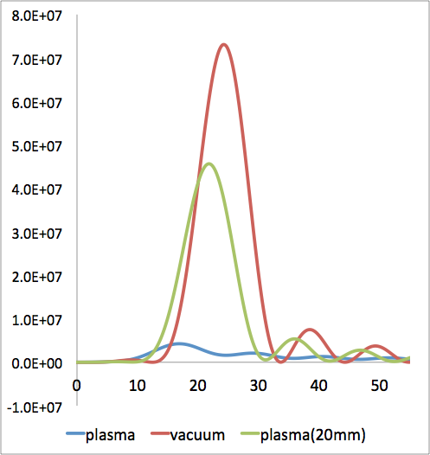
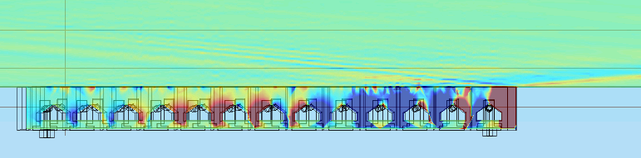
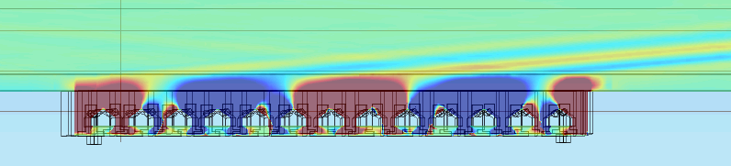
Numerical Simulation of LHW by COMSOL
(CCC Antenna)
Antenna midplane cross section
Wavenumber spectra
Fourier transform of Ez(z) 5mm in front of antenna
Vacuum
Ez (red: positive, blue: negative)
|Ek|²
vacuum
Plasma
plasma
vacuum
Plasma (with 20mm vacuum gap)
plasma
x
vacuum
k [m⁻¹]
z
・ Wavenumber spectrum deteriorates in the presence of plasma (depends on antenna-plasma distance)
T. Inada
16
Notes:
次に、真空及びプラズマ中への入射のシミュレーションを行いました。
プラズマについては一様の磁場、密度を仮定し冷たいプラズマの比誘電率テンソルを適用しました。
左上段は真空入射時のトロイダル方向の電場Ezの分布を示しています。
エレメントあたりの位相差も約60度と実際のアンテナと一致しています。
左中段は冷たいプラズマ中への入射、左下段は中段の状態からさらにプラズマをアンテナから20mm離してシミュレーションを行いました。
プラズマ境界をアンテナから離したほうがよりプラズマ中にLHWが伝播していることがわかります。
右図はそれぞれの場合でアンテナ前面から5.5mmの位置でのEzをフーリエ変換した波数スペクトルです。
赤、青、緑はそれぞれ真空、プラズマ、プラズマを20mm離した時のスペクトルです。
プラズマの存在下で波数スペクトルが劣化し、その劣化の度合はアンテナとプラズマとの距離に依存していることがわかりました。
(次スライドへ)%%%%%%%%%%%%%%%%%%%%%%%%%%%%%

Slide 17
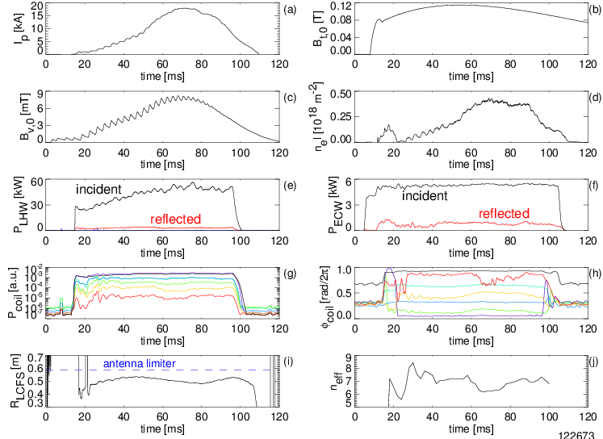
Typical I_{p} Ramp-up with LHW+ECH
(CCC Antenna)
T. Shinya

Slide 18
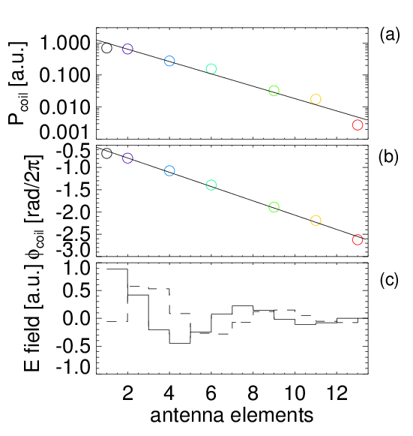
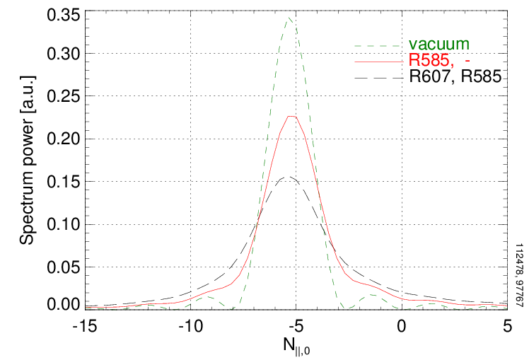
Improvement of Excited N|| Spectrum (CCC Antenna)
Excited N|| spectrum was calculated from RF powers and phases measured by magnetic probes installed on the antenna.*
Excited N|| spectrum was sharpened while maintaining 100% radiation efficiency by adjusting the limiter position.
measured data (R585, -)
improved N|| spectrum
antenna
limiter,
main
limiter
improvement
antenna
at R = 621mm
*T. Shinya et al., Nucl. Fusion 55, 073003(2015).

Slide 19
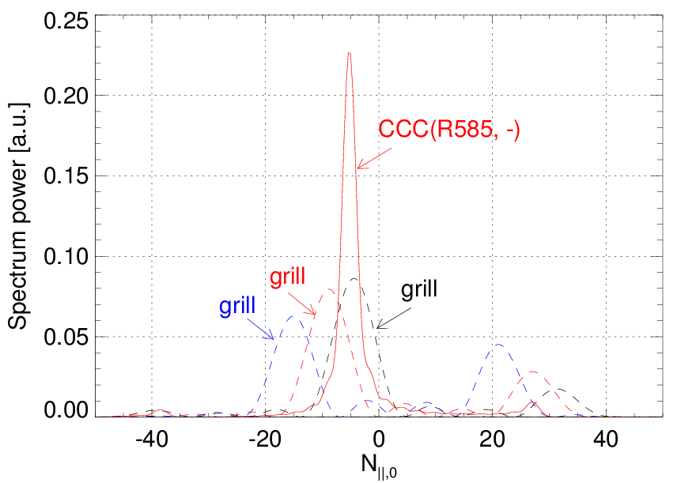
Improved N|| Spectrum is Excited by the CCC Antenna
The CCC antenna excites a sharp, highly uni-directional N|| spectrum compared to the 4-waveguide grill antenna.

Slide 20
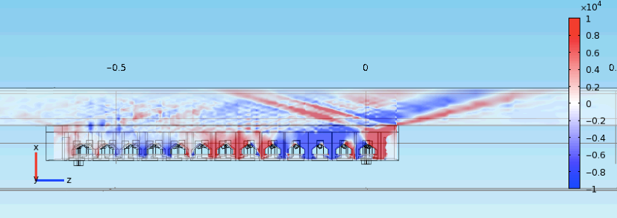
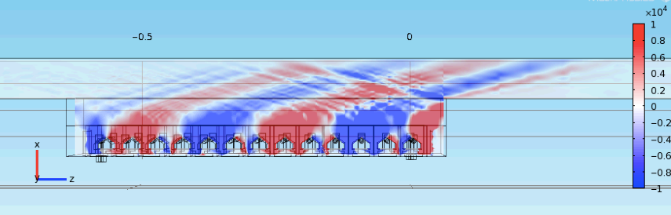
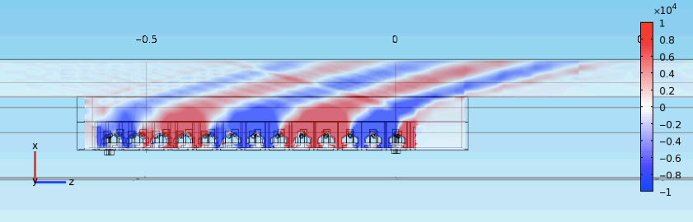
Further Improvement Expected
by Avoiding Reflection from the Limiter
R = 585 mm
(present limiter position)
reflected LHW
LHW
R = 550 mm
R = 550 mm
(limiter moved in z
direction by 75 mm)
75 mm
T. Inada
20
Notes:
次に、励起されるLHWについてトロイダル方向の電場Ezの分布を比較します。
上段は現在のリミター端の位置R-585mmであり、中段が今回最適化されたリミター位置であるR-550mmの場合です。
現在のリミター位置ではパワーが減衰しきって数エレメント程度からしか波を励起できておらずさらにリミターでの反射も発生しているのに対し、R=550mmでは最後のエレメントまで波を励起できている様子がわかります。
また、波数スペクトルをみるかぎりR-550mmのとき反射波は1/10以下で無視できる程度ですが仮にこの微小な反射波も抑えたいならばリミターをz方向に7.5cm程度移動させればよいことがわかりました。

Slide 21


Scaling of I_{p} with B_{v} and B_{t}
$${I_{p}∝B}_{v}$$
$${I_{p}max∝B}_{t}$$
CCC
ICC
Grill
CCC
ICC
Grill
co-drive
counter-drive
I_{p} increases with B_{v} (equilibrium).
Upper bound of I_{p} increases with B_{t} (wave accessibility).
T. Shinya

Slide 22
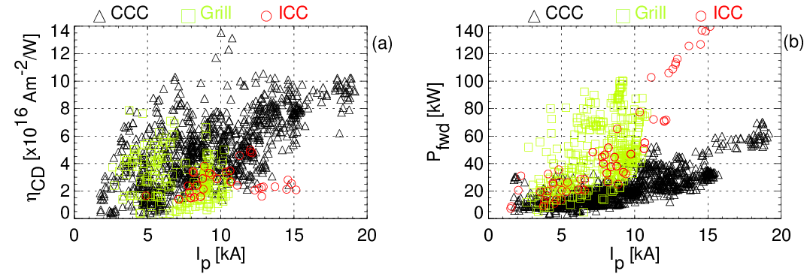
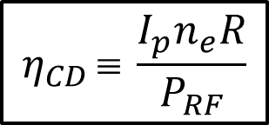
Comparison with Grill and ICC antennas
Highest η_{CD} is obtained with the CCC antenna.
An order of magnitude improvement in η_{CD} may be possible by suppression of edge wave power loss and fast electron loss
→ operation at higher B_{t}, n_{e}, I_{p} , P_{RF}, T_{e}
_
$$η_{CD }≡ \frac{I_{p}n_{e}R}{P_{RF}}$$
T. Shinya

Slide 23
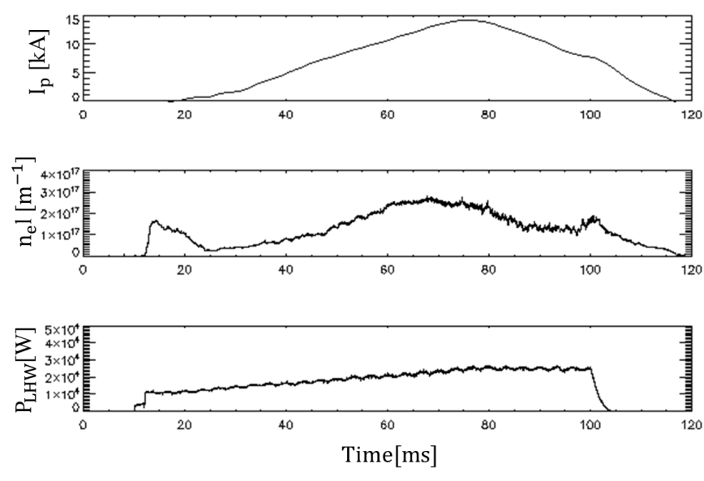
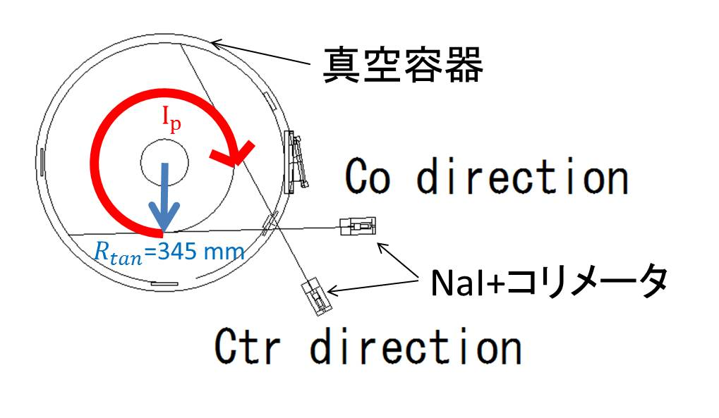
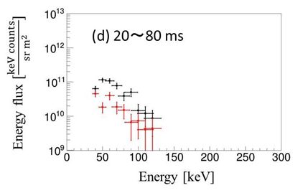
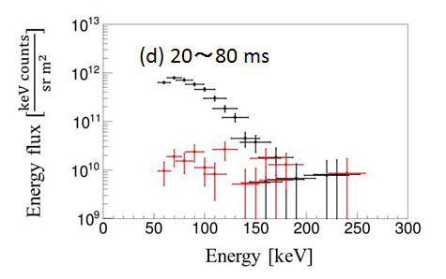
Co/Ctr X-ray Spectra for Grill/CCC Antenna
Plasma current
vacuum vessel
Line integrated electron density
NaI + collimator
LH power
Grill Antenna
CCC Antenna
■: Co
■: Ctr
■: Co
■: Ctr
Co/Ctr asymmetry is more pronounced for the CCC antenna.
K. Imamura
Notes:
まずグリルアンテナとCCCアンテナでの電流駆動、反電流駆動の測定を行いました。
左上の図は測定の概念図で、2方向同時測定型硬X線測定装置で、プラズマ中心を測定しています。
右上が測定した際の典型的な放電波形です。
上からプラズマ電流、線積分電子密度、LHWパワーを表します。
下の図はそれぞれグリルアンテナとCCCアンテナの放射のエネルギースペクトルです。
黒色が電流駆動方向、赤色が反電流駆動方向を表しています。
グリルアンテナでは、Co方向とCtr方向で、2倍程度の差で、CCCアンテナでは10倍以上の放射量の差があります。
これはグリルアンテナではアンテナの特性上反電流駆動方向に進む波が存在するため、反電流駆動方向にも高速電子が存在することを示しており、
CCCアンテナでは反電流駆動方向の高速電子はほぼ存在せずに、相対論的効果によって放射される電流駆動方向に動いている電子が出す硬X線を測定していると考えられます。
よって、CCCアンテナの方が電流駆動効率は良いと考えられます。

Slide 24
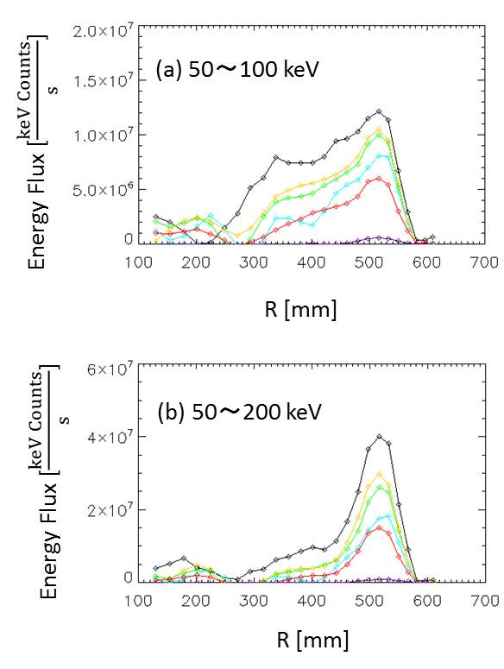
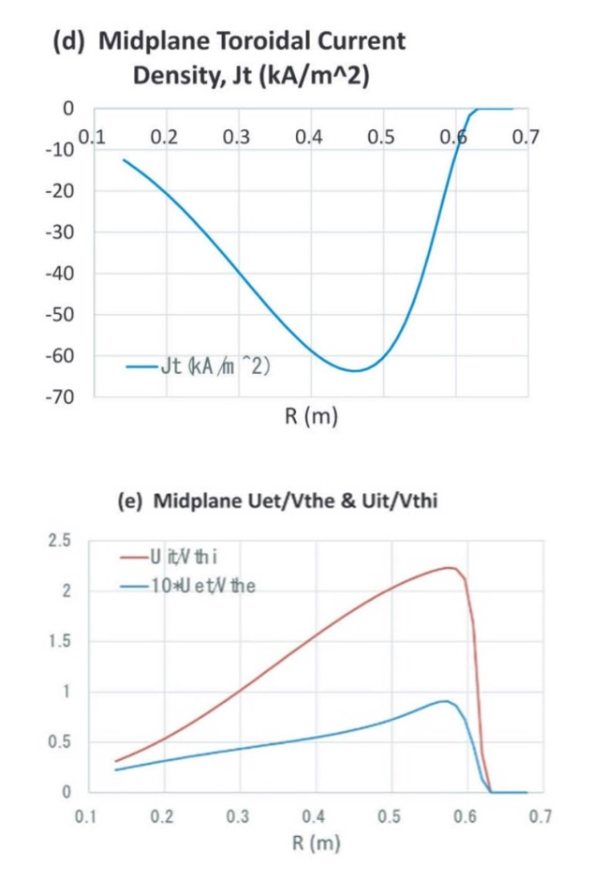
Spatial X-ray Profiles (CCC Antenna)
Example of
two-fluid equilibrium
Higher energy
X-ray profile is
peaked on the
outboard side.
◇:20～30 ms
◇:30～40 ms
◇:40～50 ms
◇:50～60 ms
◇:60～70 ms
◇:70～80 ms
Yueng-Kay Martin PENG, et al., Plasma and Fusion Research 9 3403146 (2014)
K. Imamura
Notes:
25点の硬X線の分布計測のアーベル変換後の結果を左側に示します。
右側に示したTST-2プラズマの平衡計算の電流密度と電子とイオンの流速と熱速度の比の結果を示します。
まずエネルギー範囲を変えて測定を行っていますが、時間発展によって放射量は増加しますが、放射の分布に変化はありません。
そして50～100keVの結果で、520 mm付近に放射が多くそこからプラズマの内側に行くに従って、滑らかに低下しています。
次に50～200keVで解析した結果を見ると径方向外側の放射が更に大きくなっています。
前スライドで話した分解能の悪化による放射量の増加も多少あるかもしれませんが、一番外側や内側の部分の放射が少ないことから
この520mm付近の上昇に対する寄与は大きくないと考えられます。
ここで右側に示したTST-2プラズマの平衡計算の結果と比較してみると、
平衡計算では電流密度のピークは450 mm付近にあり、電子の流速と熱速度の比は550mm付近にあります。
この結果は電流駆動を担う電子の中でも高速な成分は径方向の外側に存在するということを示します。
ここで実際の測定結果と比較をしてみると、高いエネルギー範囲での測定結果は径方向外側の放射が顕著に大きい
というのはつまり電流駆動を担う電子の中でも高いエネルギーを持つものは外側に多く存在することを示唆していると考えられ、
平衡計算の結果と一致します。
よってこの硬X線の計測によって電流を担っている高速電子の計測が出来たと考えられます。

Slide 25
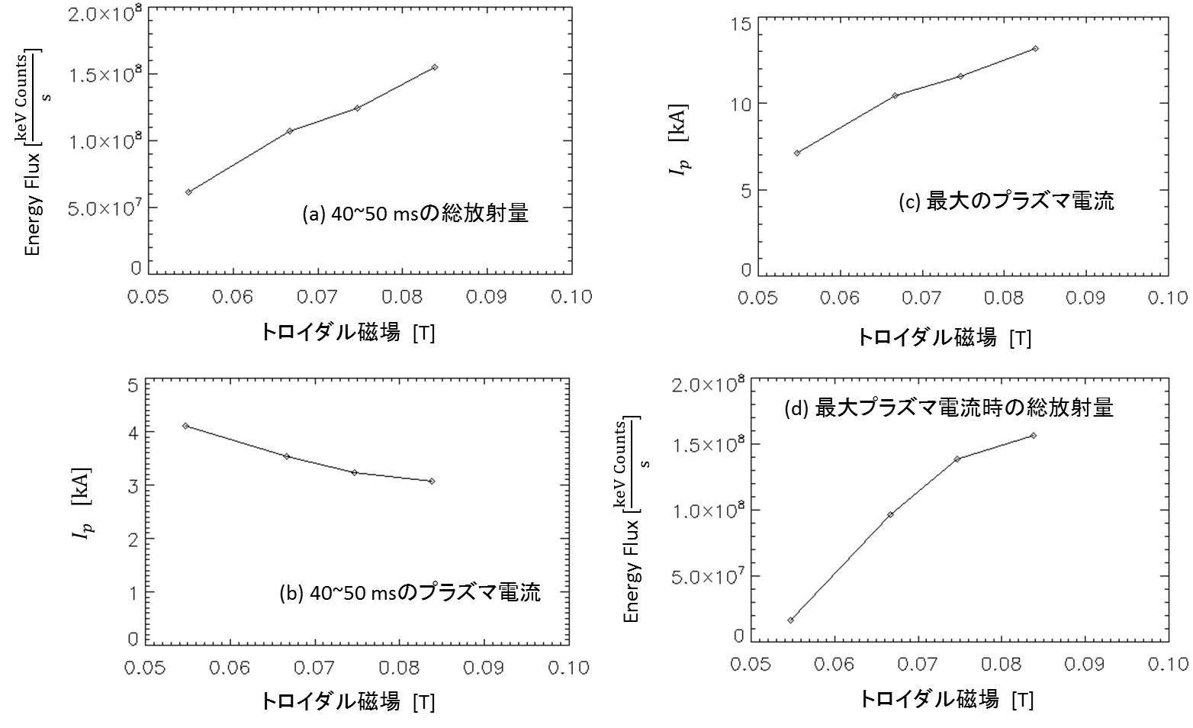
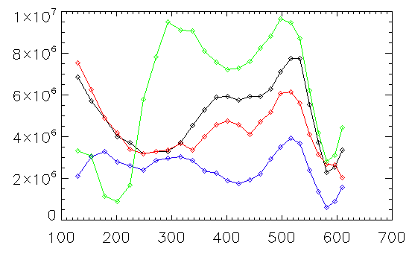

Toroidal Field Dependence of X-ray Profile (CCC Antenna)
Wave propagation improves at high B_{t}.
(a) X-ray flux
(40-50 ms)
(c) max I_{p}
B_{t} [T]
B_{t} [T]
Fast electron population and I_{p} increase at high B_{t}.
(d) X-ray flux
at max I_{p}
magnetic axis
(b) I_{p} (40-50 ms)
Energy Flux [$\frac{keV Counts}{s}$]
B_{t} [T]
B_{t} [T]
◇:0.0838 T
◇:0.0747 T
◇:0.0667 T
◇:0.0547T
Radial profile shows stronger radiation from the plasma core at higher B_{t}.
LHW propagates to the core and accelerate electrons.
R [mm]
K. Imamura
Notes:
次にトロイダル磁場を変化させた時の測定結果を示します。
左下がトロイダル磁場を変化させた時の25点径方向分布です。
右上に40～50 msの硬X線放射量、プラズマ電流、
最大プラズマ電流、その時の硬X線の放射量のグラフを示します。
この測定結果から次の２点が分かります。
トロイダル磁場が大きいほど硬X線の放射量は増加する。
最大プラズマ電流もトロイダル磁場が大きいほど大きくなる。
よってトロイダル磁場の増加により波の伝搬が良くなり高速電子が増加し、その高速電子によって最大のプラズマ電流も増加すると考えられます。
更に特にプラズマ中心で顕著に放射量が増加しているのは、中心までLHWが伝播しプラズマ中心付近で高速電子を生成するというLHWの
近接性の向上が観測されたと考えられます。

Slide 26
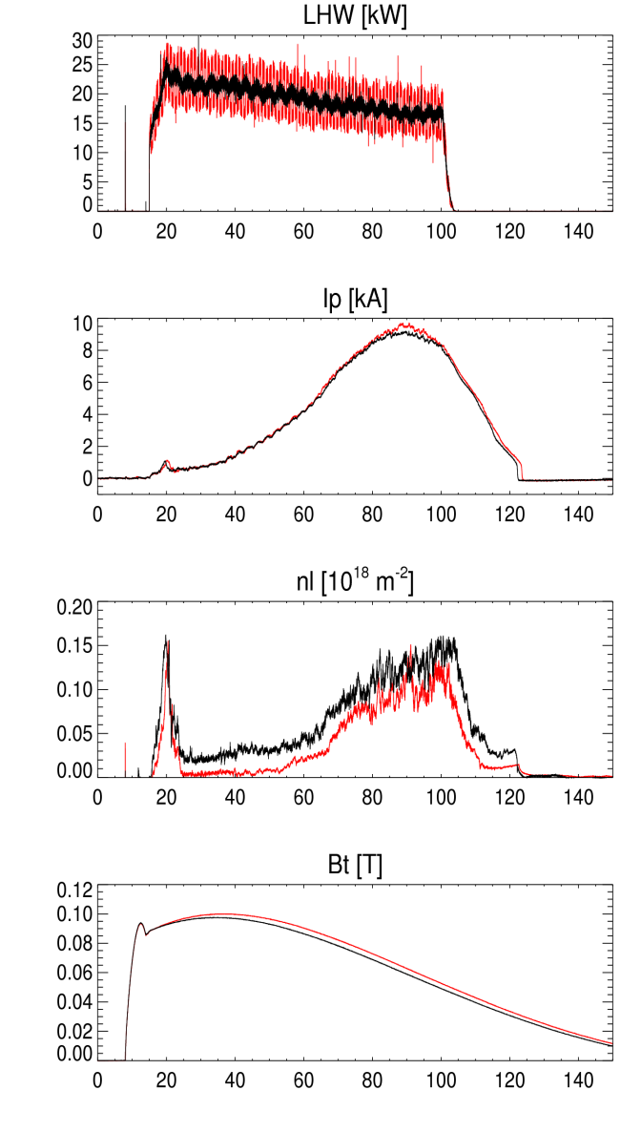
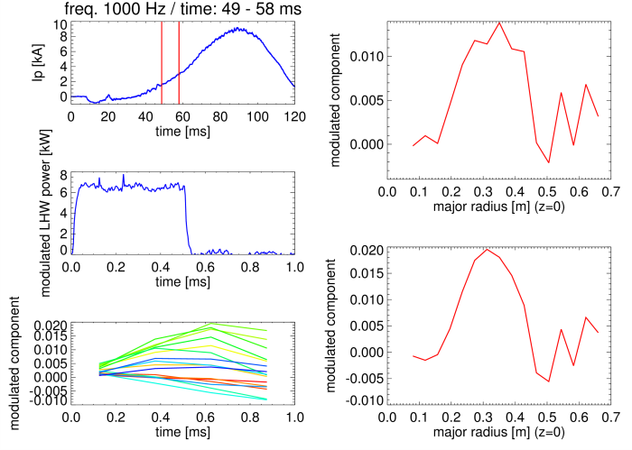
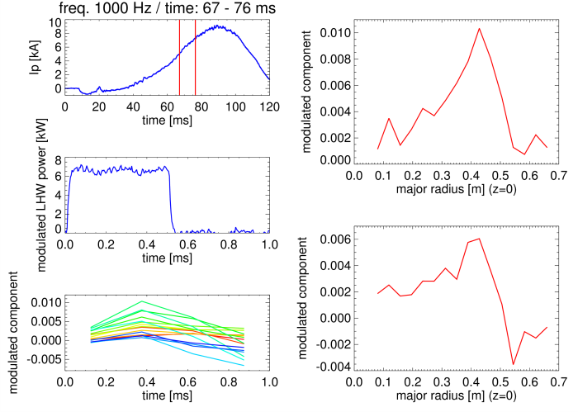
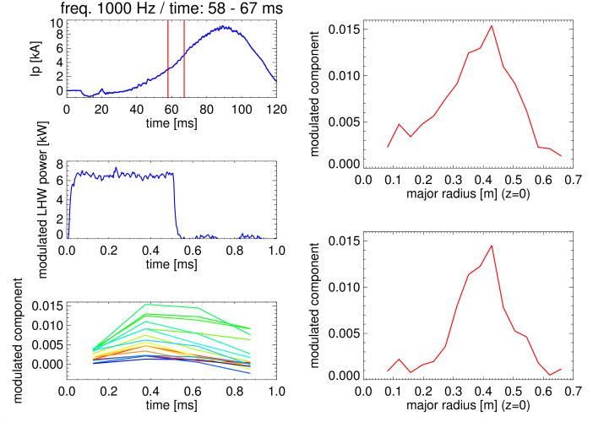
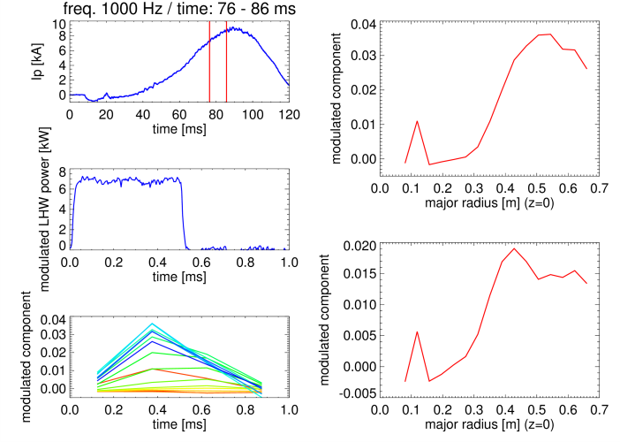
Modulation Experiment Shows
Evolution of Absorption Profile
1. t = 49-58ms
3. t = 67-76ms
no modulation
modulation
core absorption
1
2
3
4
2. t = 58-67ms
4. t = 76-86ms
@ R = 0.39 m (l = 0.6 m)
modulation amplitude profile of visible to SX emission
edge absorption
t [ms]
S. Yajima

Slide 27
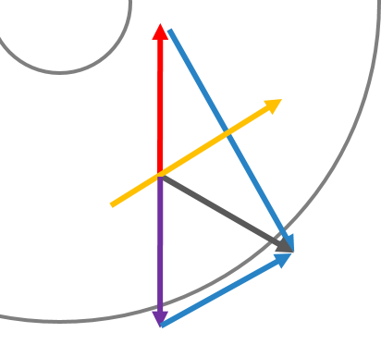
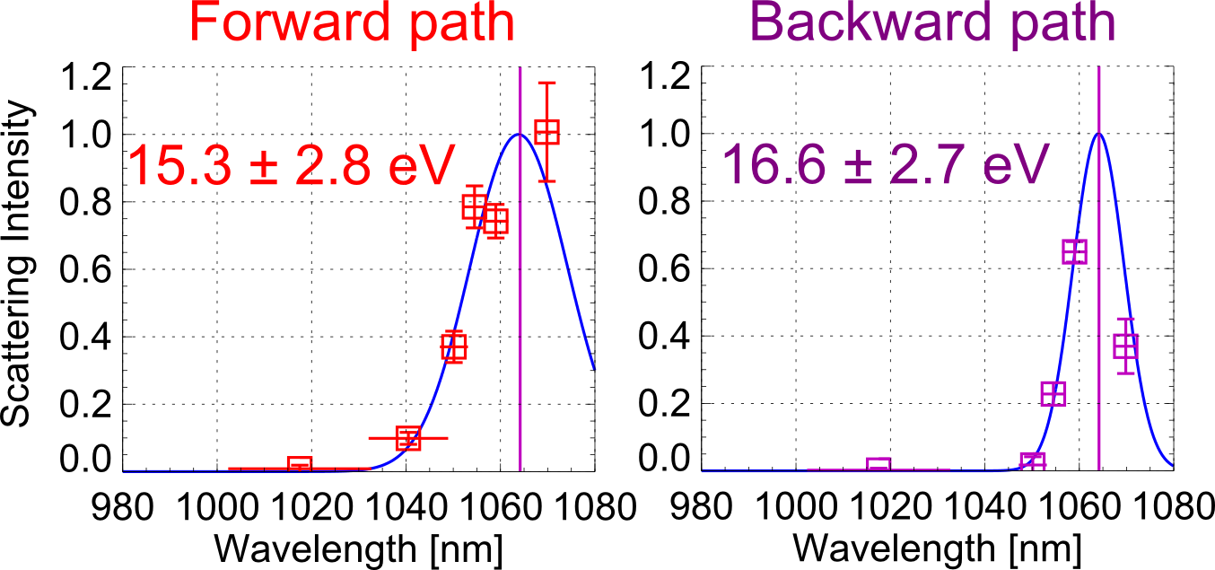
Measurement of T_{e} Anisotropy in LH Start-up Plasma
Measurement result (near the plasma center)
T_{e} in the direction of Δk (= k_{s} - k_{i}) is measured by TS.
Δk for forward and backward paths are nearly perpendicular and parallel to the magnetic field B, respectively
_
n_{e} = 3 x 10¹⁷ m⁻³
P_{RF} = 70 kW
B_{t} = 0.1 T
I_{p} = 15 kA
Maxwellian fits
T_{e⊥}
T_{e||}
forward
path
Δk
B
k_{i}
backward
path
k_{s}
k_{i}
Δk
Collection
optics
Significant anisotropy was not found
TST-2 TS system
H. Togashi

Slide 28


T_{e} and n_{e} Profiles Measured by TS
Profiles measured by Thomson scattering (TS) in TST-2 discharges with I_{p} = 5 kA maintained by LHW alone.
Bulk T_{e} in the plasma core is low (hollow T_{e} profile). Bulk electron heating by the LHW is limited.
p_{e}(TS) << p_{MHD} → pressure dominated by energetic electrons.
limiter
LCFS
limiter
LCFS
I_{p} = 5 kA
measurement limit
H. Togashi

Slide 29



Measurements of T_{i} and Flow in RF Driven Plasmas in TST-2 and LATE
Impurity (C²⁺) T_{i} and flow velocity were measured in TST-2 and LATE plasmas with similar plasma currents (~ 9 kA), but sustained by different waves (LHW, ECW).
Lines of sight in TST-2 (a) and LATE (b)
Collimator lens and fiber bundle
Rotatable fiber holder with multiple holes
Typical errors of T_{i} and flow are ΔT_{i} ~2 eV and ΔV <1 km/s.
Wavelength spectra for two symmetric sightlines at R_{tan} = ±310 mm in LATE
S. Tsuda, et al., Plasma Fusion Res. 10, 1202064 (2015).

Slide 30
TST-2
LATE
P_{LHW} ~ 20 kW
n_{e} ~ 1 x 10¹⁷ m⁻³, T_{i} ~ 3–5 eV
V_{φ} ~ 1 ± 0.5 km/s (Co I_{p}), V_{θ} ~ ±0.5 km/s
P_{ECW} ~ 50 kW
n_{e} ~ 1 .4 x 10¹⁷ m⁻³, T_{i} ~ 10 eV.
V_{φ} ~ 4 ± 0.5 km/s (Co I_{p}), V_{θ} ~ 5±1 km/s (Diam.)
E_{r} ~ +290 ± 60 V/m

Slide 31



Spectroscopic Identification of Cu Impurity Source
Profile of Cu^{I} emission
Cu^{I} emission is stronger on the side viewing in front of the CCC antenna.
→ Antenna is the source of Cu impurity
Cu^{I} emission intensity increases as the plasma approaches the antenna, and increases with RF power.
consistent with Cu impurity generation by RF sheath sputtering
The observed amount of Cu does not affect the current drive efficiency.

Slide 32


LH Start-up Discharge
EFIT reconstruction

Slide 33


3-Fluid Axisymmetric Equilibrium Model Applied to TST-2 LHW Sustained Plasma
n_{i}
n_{el}
[10¹⁸m⁻³]
n_{eh}
A three fluid (i, high energy e, low energy e) equilibrium reconstruction method was developed, and applied to a TST-2 LHW sustained plasma
(I_{p} ~ 9 kA, T_{e0} ~ 10 eV, T_{i} ~ 5 eV, n_{e0} ~ 4x10¹⁷m⁻³,
V_{φ} ~ 0.5 km/s).
T_{el} [eV]
[eV], [keV], [V]
T_{eh}[keV]
T_{i} [eV]
φ [V]
4
ions
0
Radial force balance
Force [Nm⁻³]
ions:
-4
20
low energy electrons
low energy electrons:
0
Force [Nm⁻³]
high energy electrons:
-20
100
high energy electrons
Flux function and
Flux + toroidal flow effect
for high energy electron fluid
0
Force [Nm⁻³]
-100
0.1
0.2
0.3
0.4
0.5
0.6
0.7
A. Ishida, et al., Plasma Fusion Res. 10 (2015) (in press).
R [m]

Slide 34

GENRAY/CQL3D Calculation
B_{t} = 0.1 T; I_{p} = 12 kA; f_{RF} = 200 MHz; P_{RF} = 25 kW; T_{e0} = 0.1 keV
n_{e0} = 0.3 × 10¹⁸ m⁻³
n_{e0} = 1 × 10¹⁸ m⁻³
n_{e0} = 2 × 10¹⁸ m⁻³
P_{CQL} = 22 kW
I_{CD} = 67 kA
P_{CQL} = 24 kW
I_{CD} = 98 kA
P_{CQL} = 0.5 kW
I_{CD} = 0.5 kA
j (ρ)
f (v||, v⊥)
Y. Takase / J. Wright

Slide 35


Is Density Limit Due to Accessibility?
Experiment
GENRAY + CQL3D
Abrupt limit
Gradual degradation
Ave. n_{e} = n_{e}l (R = 390 mm) / 0.5
Ray-tracing (GENRAY)
Accessibility: N|| > N_{a}
7
8
  $$N_{a}=ω_{pe}{/ω}_{ce}+\sqrt{ϵ_{⊥}}$$
  $ϵ_{⊥}=1+{\left(ω_{pe}{/ω}_{ce}\right)}^{2}−{\left(ω_{pi}/ω\right)}^{2}$,
  $ω_{pe}^{2}={\tilde{n}}_{e}q^{2}{/ε}_{0}m_{e}$, $ω_{ce}=qB/m_{e}$
2
Fixed: B_{t} = 0.08 [T], N|| = 5.5, shot=111821
4
5
Density scan:
N_{a} = 2, 4, 5, 6, 7, 8
Ave. n_{e} = 0.034, 0.24, 0.38, 0.56, 0.77, 1.0
x 10¹⁸ m⁻³
N_{a}=6
T. Shinya

Slide 36




Is Density Limit Due to Parametric Decay?
2-channel RF mag. probe
(R, z) = (580 mm, 250 mm)
Pump (199.9-200.1 MHz)
LFS (180-199.9 MHz)
UFS (200.1-220 MHz)
toroidal
poloidal
112299
LH resonance frequency
for TST-2 RF plasma
  $$f_{LH}≈\frac{ω_{pi}^{}}{2π\sqrt{1+ω_{pe}^{2}/Ω_{e}^{2}}}$$
  $$≈30∼40 MHz<200 MHz$$
density limit
T. Shinya

Slide 37
Outline
Motivation / Objective
4-WG array (grill) antenna experiments
  n|| dependence, polarization / wavenumber measurements
Capacitively-coupled combline (CCC) antenna experiments
  improved n|| spectrum
  comparison of current drive with other antennas
  characterization of LH driven plasma
    HX, SX, TS, ion Doppler, impurity
    equilibrium
    density limit
Planned improvements
  top-launch CCC antenna
  TF power supply upgrade
Diagnostic developments
  Multi-pass TS, local j, microwave scattering

Slide 38




Calculated Wave Field and Driven Current Profiles
iteration
full wave code
Fokker-Planck code
n_{e} =10¹⁸ m⁻³
B_{t} =0.3 T
T_{e} = 200 eV
P_{RF} = 100 kW
Edge current
n|| = 8.9
B_{t} must be higher to ensure LHW accessibility to the plasma core.
n|| = ck||/ω must be lower to avoid edge absorption of LHW.
-300 kA total
center
edge
Core current
n|| = 5.9
-300 kA total
collaboration with
Bonoli, Wright (MIT, US)
center
edge
T. Wakatsuki

Slide 39


Orbit Loss is Important at Low I_{p}
CQL3D Fokker-Planck code calculation shows that the orbit loss is the dominant loss for ρ ≥ 0.2 at I_{p} = 10kA.
Orbit loss from the core is greatly reduced at I_{p} = 50kA.
This will require TF power supply upgrade (maintain B_{t} = 0.3T for
> 100ms) and density control (keep density low during I_{p} ramp-up).
T. Wakatsuki
Notes:
SXモジュレーションの位相から推定される速いロスは、本当に軌道損失であるかどうかを考察します。
Fokker-Planckコードで軌道損失の大きさを計算すると、10kAのプラズマ電流では、規格化した小半径で0.2以上という広い範囲で軌道損失が支配的になっていることが分かり、速いロスは軌道損失であることを強く示唆しています。
このロスはプラズマ電流が50kAまで増えればかなり小さくできることもわかります。

Slide 40

TF Power Supply Upgrade
?
B_{t}
I_{p}
In order to demonstrate ramp-up to higher I_{p}, power supply upgrade is needed to sustain higher B_{t} (~ 0.3 T) for longer duration (> 0.1 s).

Slide 41


Top-launch CCC Antenna
3 advantages of top-launch based on GENRAY analyses
1
Accessible to the plasma core even at high density
2
Absorption (Landau damping) in the plasma core
3
Reduction of losses in the SOL (outside LCFS)
Top-launch CCC antenna is being developed jointly with GA
low density
high density
top-launch CCC antenna
top-launch
LCFS
bad
good
good
midplane-launch
bad

Slide 42
Outline
Motivation / Objective
4-WG array (grill) antenna experiments
  n|| dependence, polarization / wavenumber measurements
Capacitively-coupled combline (CCC) antenna experiments
  improved n|| spectrum
  comparison of current drive with other antennas
  characterization of LH driven plasma
    HX, SX, TS, ion Doppler, impurity
    equilibrium
    density limit
Planned improvements
  top-launch CCC antenna
  TF power supply upgrade
Diagnostic developments
  multi-pass TS, local j, microwave scattering

Slide 43
Multi-Pass TS is Being Developed
Mirror #2
A laser pulse is confined between two mirrors and passes through the plasma many times
Plasma
Mirror #1
ON OFF
Laser
Polarization
beam splitter
Pockels cell
Accumulate these TS signals
1st pass
2nd pass
3rd pass
4th pass
#1
#2
#1
・・・
ON
OFF
OFF
OFF
PBS
PC
Plasma
H. Togashi

Slide 44



Local Current Measurement by Rogowski Probe
B_{p}
Langmuir probes
open hole
closed hole
I_{p}
B_{t}
B_{r}
Rogowski probe consists of two multi-layer Rogowski coils, five pick-up coils and two Langumuir probes.
Local current was measured successfully.
H. Furui, et al., Rev. Sci. Instrum. 85, (2014) 11D813

Slide 45

Measurement of Current Filament at IRE
I_{p} spike due to IRE (internal reconnection event)
power spectra of
plasma current
local current
ion saturation current
@ v.v. wall
1. Fluctuations of j, I_{is}, dB/dt start at −0.2 ms.
2. j and I_{is} at the plasma edge start to increase at −0.2 ms
3. After 2, high frequency components of j and I_{is} can be seen.
4. I_{p} shows a positive spike with the decrease of j and I_{is}.

Slide 46

Microwave Scattering Diagnostic is
Being Prepared to Measure LH Waves
12-40 GHz covered with Ku, K and Ka band
N. Tsujii

Slide 47

Scattered Amplitude is Appreciable
at Typical RF Power on TST-2
Density fluctuation increases as the wave propagates inwards
Typical density fluctuation 2x10¹⁶ m⁻³ at 20 kW
Scattered amplitude ~3%
  Detectable with proper focusing
Electron density fluctuation simulated by AORSA (Maxwellian at 500 eV, 1W)
N. Tsujii

Slide 48
Conclusions
ST plasma initiation and I_{p} ramp-up by waves in the LH frequency range were demonstrated on TST-2.
  Inductively-coupled combline antenna (FW launch), dielectric-loaded waveguide array (“grill”) antenna (LHW launch), and capacitively-coupled combline antenna (LHW launch) were used.
    Similar I_{p} was obtained with different antennas for similar B_{v} and P_{RF}, but η_{CD} is higher with the CCC antenna (improved n|| spectrum).
  Grill antenna (variable n||)
    Current drive maximizes for n|| = 2~4
    Wavenumber/polarization measured by a magnetic probe array
  CCC antenna (fixed n||)
    I_{p} initiated and ramped up to 25 kA
    HX/SX indicate deterioration of accessibility at low B_{t} and high n_{e}
  Characteristics of LH driven plasmas
    p_{e} dominated by energetic electrons
    ion flow is in the co- I_{p} direction
    3-fluid equilibrium model was developed
    density limit (a little lower than accessibility limit?)
    orbit loss of high energy electrons is important at low I_{p}

Slide 49
Near-Future Plans
Coil Power Supply Upgrade
  Sustained high field (B_{t} = 0.3 T for > 0.1 s) for further I_{p} ramp-up.
Antenna Upgrade
  Top-launch CCC antenna.
Wave/Turbulence Diagnostics
  Electrostatic probe array
  Microwave scatteriing
Plasma diagnostics
  Multi-pass Thomson scattering
  Current profile measurement by Rogowski probe / magnetic probe
  Ion flow measurement
  EBW emission

