Slide 1
Status of non-inductive startup via the electrostatic helicity injection in Versatile Experiment Spherical Torus
JongYoon Park
Jeongwon Lee, Kyoung-Jae Chung, Yong-Su Na and Y.S. Hwang *
Department of Nuclear Engineering Seoul National University
NUPLEX, Dept. of Nuclear, Seoul National University, San 56-1, Shillim-dong, Gwanak-gu, Seoul 151-742, Korea
jongblues@snu.ac.kr

Slide 2
Contents
1. Introduction
2. DC Helicity Injection with Electron Gun
3. The Helicity Injection System of VEST
4. Experiment results and Discussions
5. Conclusion & Future Work

Slide 3
1. Introduction 1-1 ST, VEST and DC Helicity Injection
ST and VEST
ST requires non-inductive start up and current sustainment
Non-inductive startup can expands VEST capability
VEST Device Specifications
Very elongated vacuum chamber
Enough space for Helicity Injection
Partial Solenoid (PF2)
Capability to apply various startup scenario
DC Helicity Injection with electron gun
Start-up without null field
It can be applied with various location and configuration
VEST is suitable for/need Helicity injection startup

Slide 4
2. DC Helicity Injection with Electron Gun 2-1 Magnetic Helicity and DC Helicity Injection
Gauge invariant Magnetic Helicity definition in a toroidal system
${ K}_{0}≡\int{A∙BdV−ΦΨ}$where$Φ\text{=∫}\text{B}\text{∙}\text{dS}\text{ : }\text{toroidal} \text{flux}$ $Ψ$=∮$\text{A}\text{∙}\text{dl}$: poloidal flux
→ Proper definition in an arbitrary, time-dependent, bounded region of space.
Time derivative of Helicity${}_{}^{1}{}$
DC Helicity Injection (electrostatic)
$${\dot{K}}_{DC}=−2\int{V_{inj}\vec{B}∙\vec{dS}}=2V_{inj}B_{⊥}A_{inj}$$
$\frac{dK_{0}}{dt}=−2\int{\vec{E}∙\vec{B}dV}−2\frac{∂ψ}{∂t}Φ−2\int{V_{inj}\vec{B}∙\vec{dS}}$
Max $I_{P}$ determined by Taylor relaxation${}_{}^{2}{}$
$$∇×B=μ_{0}J=λB$$
$$λ_{P}{≤λ}_{inj} → I_{P}≤f_{g}\sqrt{\frac{{{κA}_{P}I}_{TF}I_{inj}}{2πR_{0}w}}$$
$λ$: A current viscosity which determines the current density profile.
[1] Boozer, A.H., Phys. Fluids, 29,12 (1986)
[2] J. B. Taylor Rev. Mod. Phys. 58, 741–763 (1986)
Notes:
A schematic diagram of pulsed electron source is depicted in figure 1. As the size of the arc channel is defined by the washer stacks, the length and diameter of the typical arc channel formed in the electron source are 26 mm and 10mm, respectively.

Slide 5
3. The Helicity Injection System of VEST 3-1 The Electron Gun and Pulse Forming Network
The Electron Gun [*]
The arc discharge – High electron current
Low impurity – Plasma as a cathode
Washer stacks
To define the arc discharge channel between electrodes [2]
composed of alternating insulating material and metal washers
Each metal washer is electrically isolated by insulating washers
Ceramic cup
Cover plasma washer gun
Pulse Forming Network (PFN)
Composed of circuits consist of capacitor and inductor
The discharge characteristics of PFN[**]
Determined by impedance matching between the PFN and load
A square current/voltage waveform for a designed pulse duration.
PFN Specification
$Z$ [$Ω$] | 0.5
$τ$ [ms] | 5
$C$ [mF] | 0.94
$L$ [mH] | 0.23
[*] Fiksel, G., et al. "High current plasma electron emitter." Plasma sources science and technology 5.1 (1996): 78.
[**] JongYoon, Park, et al. “Design and development of the helicity injection system in Versatile Experiment Spherical Torus." Accepted to Fusion Engineering and Design

Slide 6
3. The Helicity Injection System of VEST 3-2 Single Power System
The discharge characteristics of PFN are determined by impedance matching between the PFN and load [*]
The condition for maximum efficiency : $Z_{PFN}=Z_{load}=0.5Ω$
System circuit using single power for both arc discharge and injection
Phase 1
Before
arc discharge
Phase 2
After
arc discharge
$$Z_{arc}≫R_{div}$$
$$R_{div}≫Z_{inj}$$
[*] JongYoon, Park, et al. “Design and development of the helicity injection system in
Versatile Experiment Spherical Torus." Accepted to Fusion Engineering and Design

Slide 7
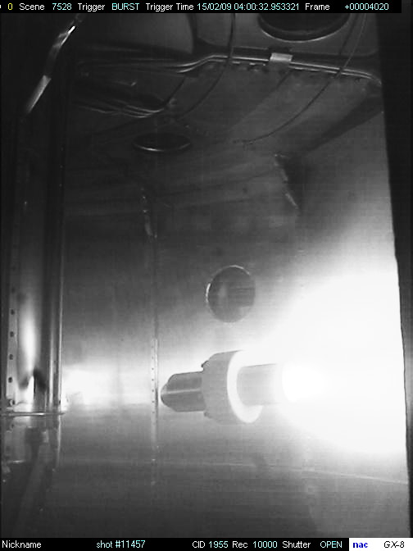
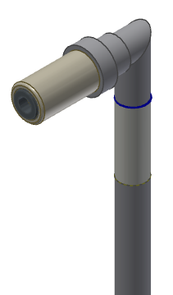
3. The Helicity Injection System of VEST 3-3 The Location of Guns
The location of the electron gun
The electron gun as a helicity injector is installed in lower chamber of VEST
Assembled into a stainless steel pipe & ceramic breaker
Wilson-seal vacuum boundary
Designed to adjust the radial location
B_{T}
B_{V}
Lower Gun
Z = - 0.98 m
R = 0.25 m
Upper Single Gun Operation
Electron current of ~1.2 kA

Slide 8
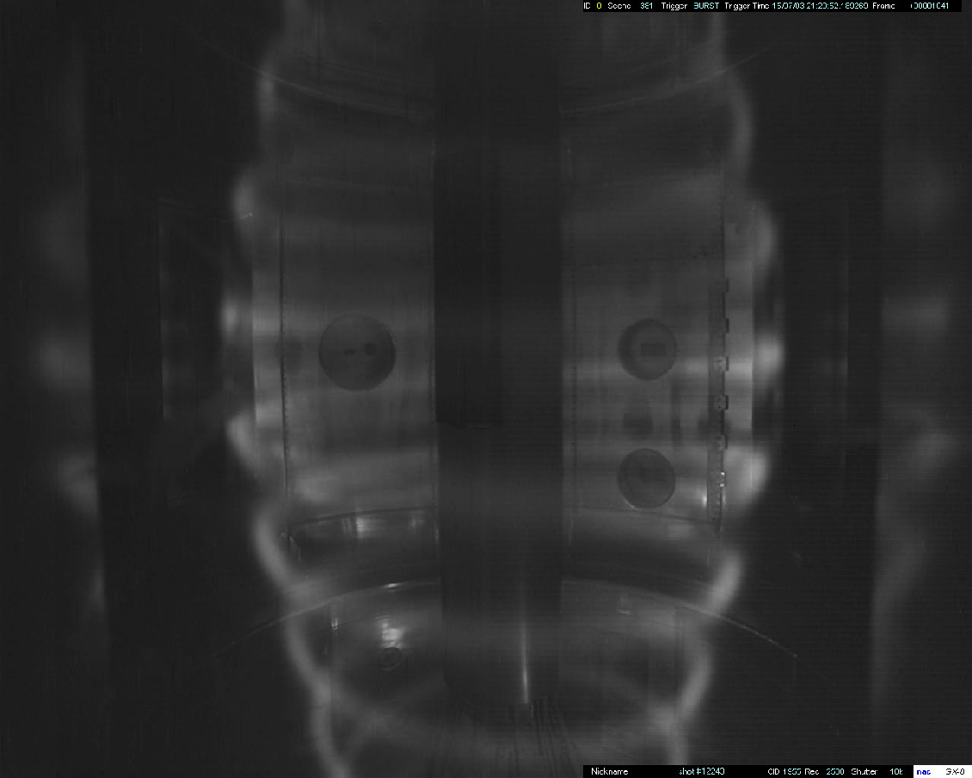
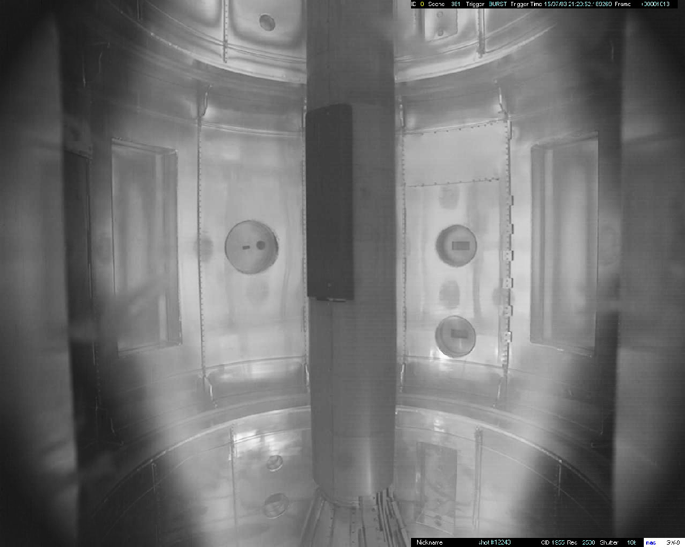
4. Results and Discussions 4-1 3 Stage of DC helicity injection w/ Electron gun[*]
Initial injection
Simple geometric stacking : Helical structure
Injection current flows along the field lines
2. Filament Reconnection
Uniform shell plasma formation
Very dynamic plasma state ~ Injection voltage and Current
Present Study w/ single power system
3. Relaxation to tokamak-like state
Closed flux surface
[*] N.W. Eidietis, APS-DPP, Denver, CO, October 2005

Slide 9
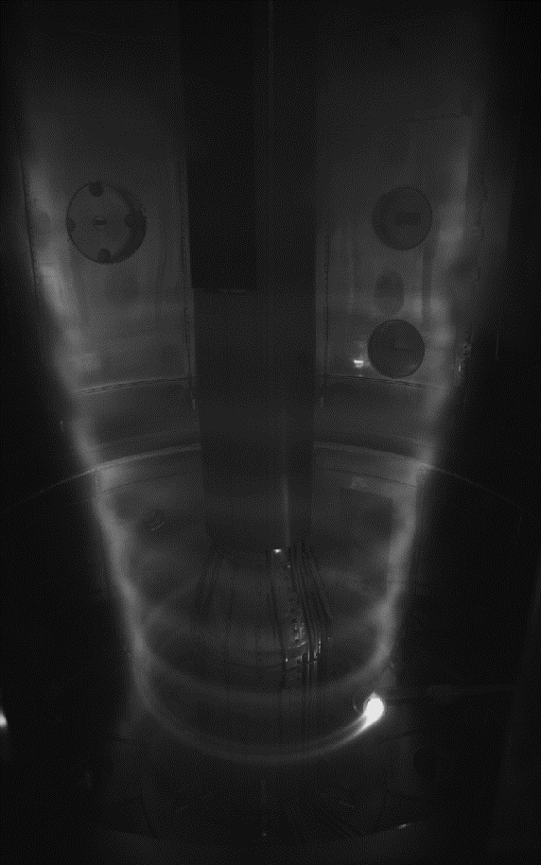
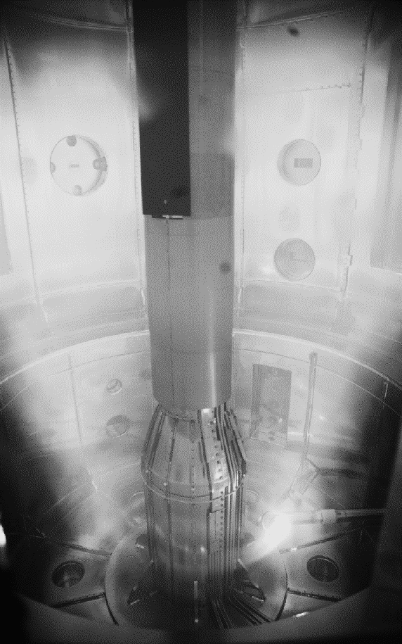
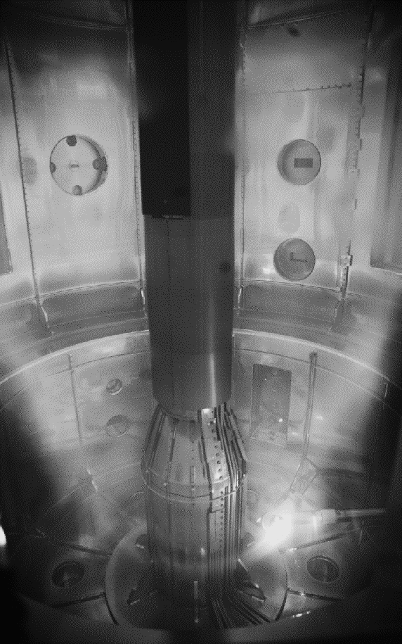
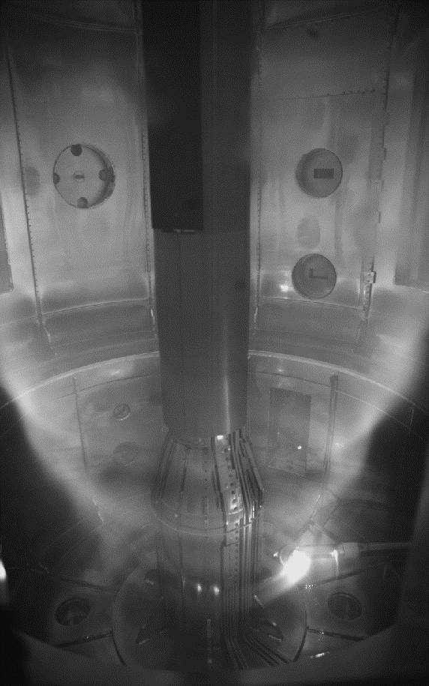
4. Results and Discussions of Single Power System 4-2 Very Dynamic Plasma Behavior : Shot 13768
400.4 ms
401 ms
402 ms
403 ms
Lower Gun Location
R = 0.25 m
Z = - 0.804 m
Magnetic Field Structure
Stacking ratio, G = 7 ~ 8
Multiplication, M = ~ 16
A toroidal current of up to ~20 kA has been generated by the electron gun.
Increased multiplication confirmed as current streams reconnect.
It is not radial force balanced and relaxed to tokamak like plasma.
Very dynamic states of current sheet are observed.
According to plasma state and the characteristics of PFN, $V_{inj}$and $I_{inj}$ are determined.
The toroidal current is very sensitive to injection voltage than injection current.

Slide 10
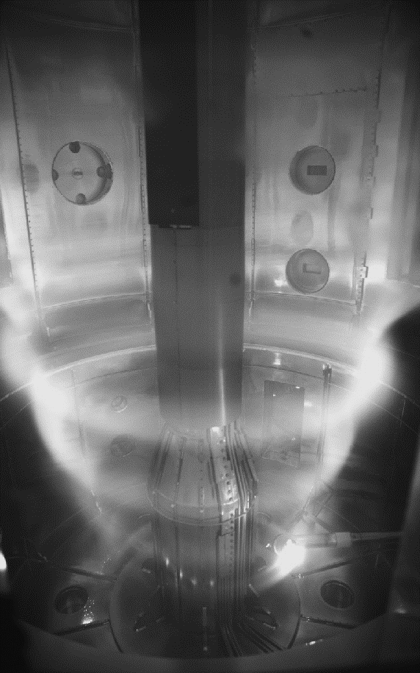
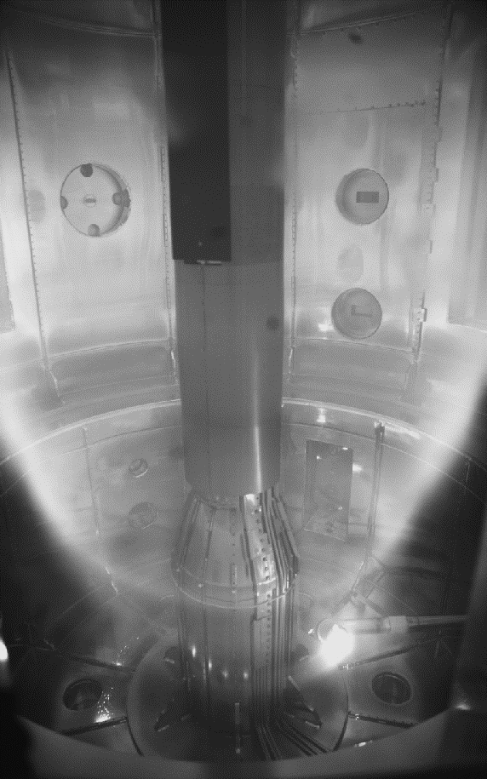
4. Results and Discussions of Single Power System 4-3 Relation between Injection Current and Voltage
1
2
1 : Low V_{inj} / High I_{inj} ~ Filaments
2 : High V_{inj} / Low I_{inj} ~ Reconnection
407.6 ms
408.4 ms
While injecting same power, the higher toroidal current observed with higher injection voltage than current.
It is also confirmed that plasma current ramp-up during increasing V_{inj}.
The high V_{inj} is more attractive solution to achieve overwhelmed magnetic field near inboard side under limited injection current than high current injection.

Slide 11
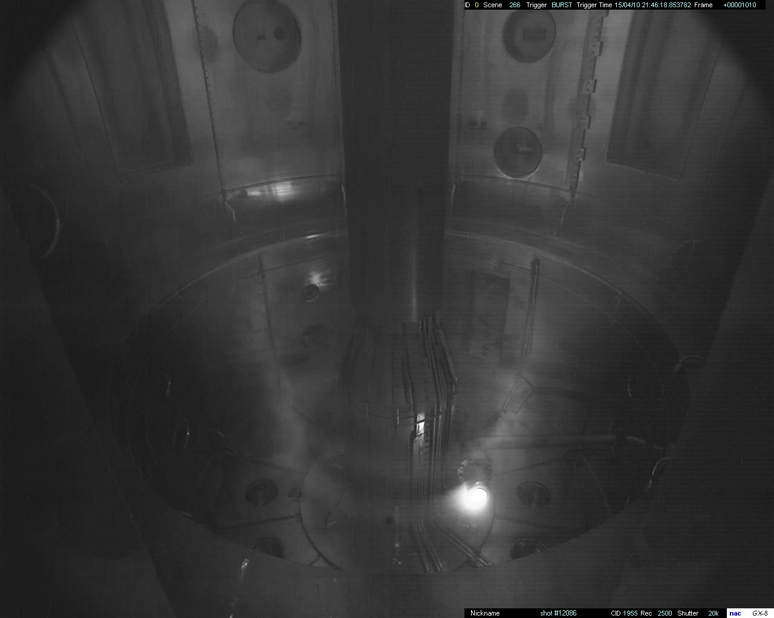
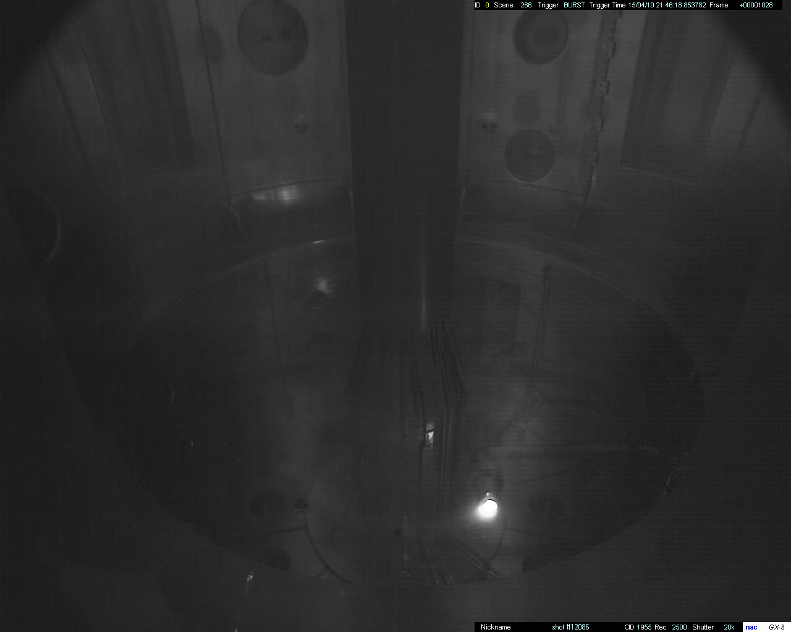
4. Results and Discussions of Single Power System 4-4 Formation of Current Sheet : Shot 12086
Two distinct phases of current evolution has been confirmed.
Gradual rise of plasma current during reconnection of injection current steam (@ 404ms) and injection voltage
The calculated results show the current distributions are sheet-like plasma.
During the calculation, Average error between plasma current and element current is 14.5% and average error between measured magnetic signal and element magnetic signal is 4.7%.
404 ms
404 ms
405 ms
406 ms
407 ms
408 ms
409 ms
410 ms
411 ms
411 ms
Notes:
This is also indicated by the appearance of the outer upper limiter current at the same time of plasma current decrease as shown in same figure.

Slide 12
5. Conclusion & Future work
Conclusion
DC helicity injection is one of the powerful non-inductive start up method for STs, also Non-inductive startup can expands VEST capability and performance.
The toroidal current is very sensitive to injection voltage than injection current. While relatively higher injection voltage of ~0.4kV are applied, gradual rise of toroidal plasma current also confirmed. The high V_{inj} may be promising solution to achieve closed flux surface during dc helicity injection startup.
The plasma current density distributions have been calculated using element fitting based on limited numbers of magnetic signals. The sheet-like plasma current confirmed.
Future Work
Power system upgrade for closed flux surface and high DC helicity injection rate ~${ V}_{inj}$
Development of experiment scenario for proper DC helicity in VEST
Development of more reliable electron gun under high injection voltage

