Slide 1

Overview of NSTX Upgrade Initial Results and Modelling Highlights
J.E. Menard (PPPL)
for the NSTX-U Research Team
International Spherical Torus Workshop - 2017
Seoul National University, Seoul, South Korea
September 19-22, 2017

Slide 2
Outline
NSTX-U mission
Research highlights
Progress on next-step ST concepts
Summary

Slide 3

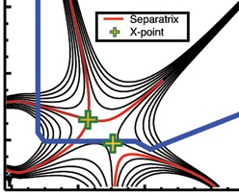
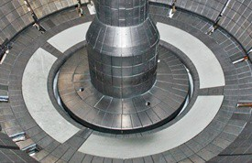
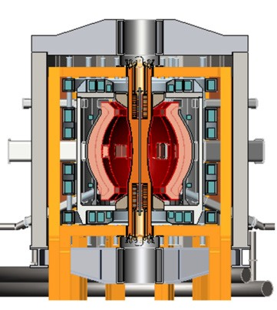
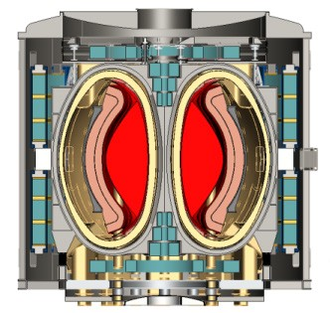
NSTX-U Mission Elements:
Explore unique ST parameter regimes to advance predictive capability - for ITER and beyond
ITER
Develop solutions for plasma- material interface (PMI)
Snowflake/X
Liquid metals / Li
ST-FNSF /
Pilot-Plant
Advance ST as Fusion Nuclear Science Facility and Pilot Plant

Slide 4
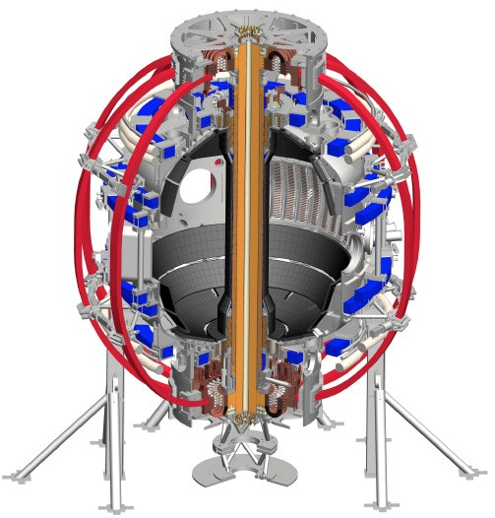
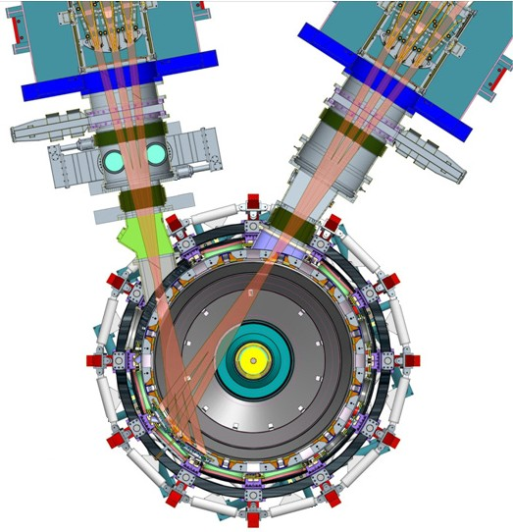
NSTX-U will access new physics with 2 major new tools:
1. New Central Magnet
2. Tangential 2nd Neutral Beam
Higher T, low ν* from low to high β
→ Unique regime, study new transport and stability physics
Full non-inductive current drive
→ Not demonstrated in ST at high-β_{T}
Essential for any future steady-state ST

Slide 5
NSTX-U will have major boost in performance
1. New Central Magnet
2. Tangential 2nd Neutral Beam
Performance goals:
➢2× heating power (5 → 10MW)
Tangential NBI → 2× current drive efficiency
➢4× divertor heat flux (→ ITER levels)
➢Up to 10× higher nTτ_{E} (~MJ plasmas)
➢2× toroidal field (0.5 → 1T)
➢2× plasma current (1 → 2MA)
➢5× longer pulse (1 → 5s)

Slide 6
NSTX-U had scientifically productive 1st year
Achieved H-mode on 8th day of 10 weeks of operation
Surpassed magnetic field and pulse-duration of NSTX
Matched best NSTX H-mode performance at ~1MA
Identified and corrected dominant error fields
Commissioned all magnetic and kinetic profile diagnostics
New 2nd NBI suppresses Global Alfven Eigenmodes (GAE)
Implemented techniques for controlled plasma shut down, disruption detection, commissioned new tools for mitigation
2016 run ended prematurely due to fault in divertor PF coil
  Coil + other issues → major reviews of design, fab, procedures

Slide 7
NSTX-U Mission Elements:
Explore unique ST parameter regimes to advance predictive capability - for ITER and beyond
ITER
Topical science areas:
  Scenario Development
  Macroscopic Stability
  Transport and Turbulence
  Energetic Particles

Slide 8
NSTX-U Mission Elements:
Explore unique ST parameter regimes to advance predictive capability - for ITER and beyond
ITER
Topical science areas:
  Scenario Development
  Macroscopic Stability
  Transport and Turbulence
  Energetic Particles

Slide 9
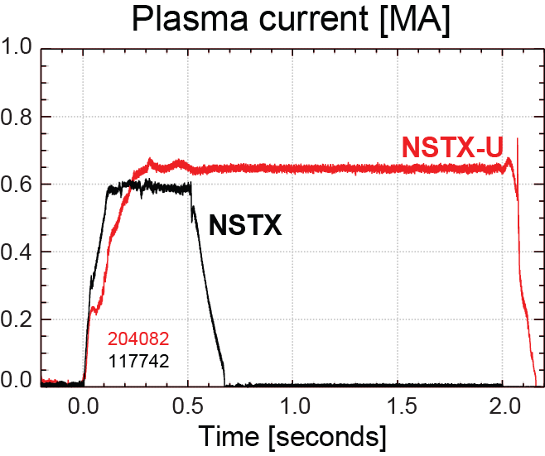
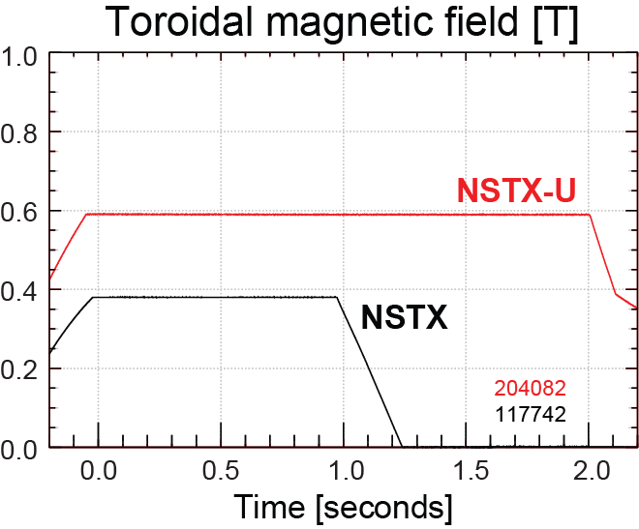
NSTX-U has surpassed maximum pulse duration and magnetic field of NSTX
Compare similar NSTX / NSTX-U Boronized L-modes, P_{NBI}=1MW
4x longer
NSTX-U L-mode duration
exceeds longest NSTX H-mode
NSTX-U B_{T} > highest NSTX B_{T}

Slide 10
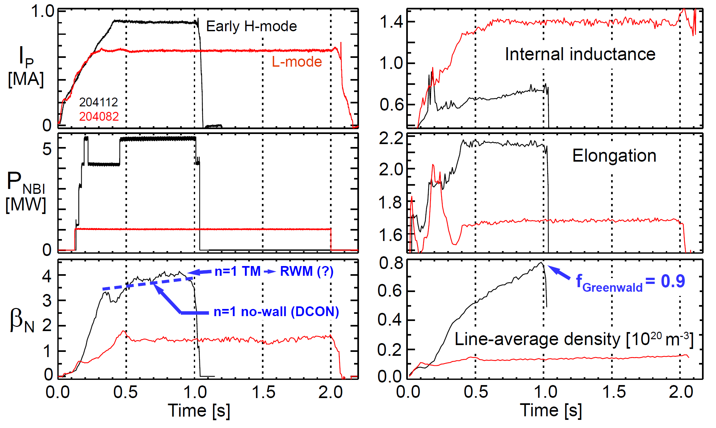
Examples of highest-performance
L and H-modes achieved thus far in NSTX-U
(motivates future cryo-pump)

Slide 11
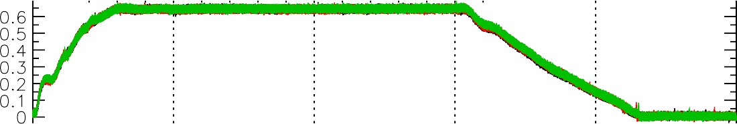
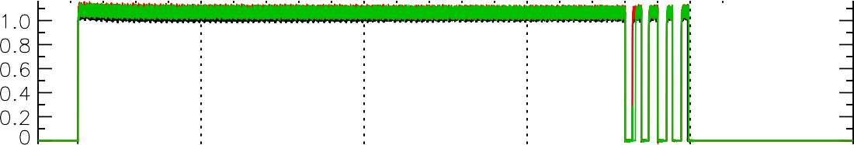
Shutdown handler used for well-controlled disruption-free L-mode ramp-down
Three morning fiducials
One operator waveform used to start ramp-down at t=1.5s
Ramp-down is inner-wall limited, power and current slowly ramped off
L-mode Rampdowns Triggered By a Single Switch
I [MA]
P
P_{inj} [MW]
Beam power ramped down
W_{MHD} [kJ]
204179
204163
204155
κ
n_{e} [10¹³ cm⁻³]
See D. Mueller presentation for more details

Slide 12
NSTX-U Mission Elements:
Explore unique ST parameter regimes to advance predictive capability - for ITER and beyond
ITER
Topical science areas:
  Scenario Development
  Macroscopic Stability
  Transport and Turbulence
  Energetic Particles

Slide 13
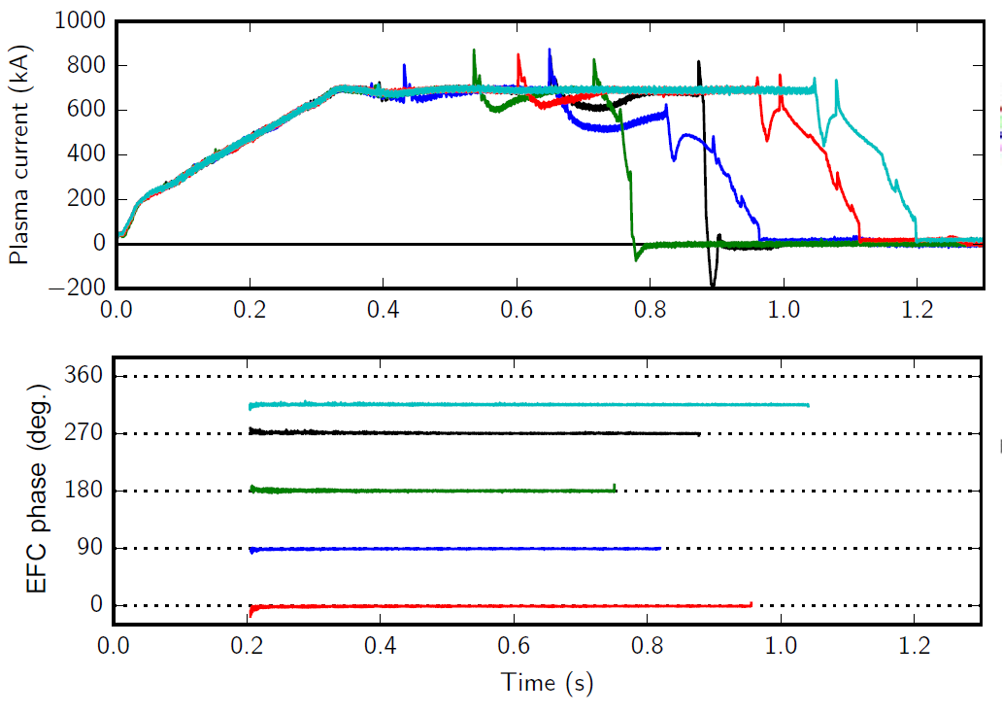
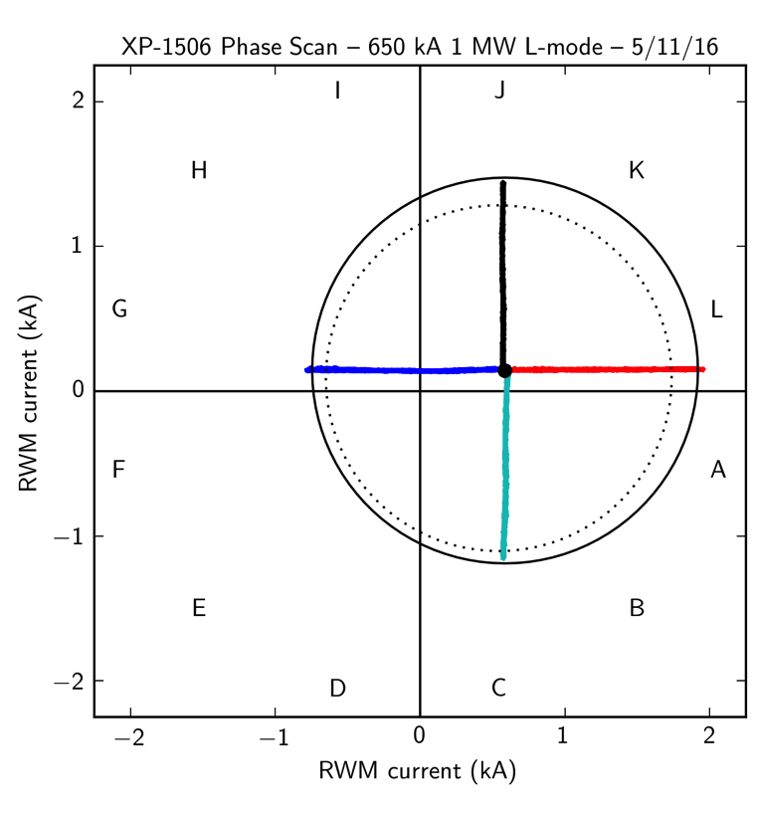
n=1 error field correction (EFC) optimized to maximize pulse length, discharge performance
L-modes used to identify optimal correction amplitude, phase
Multiple compass scans confirm optimal L-mode EFC in flattop
EFC current [kA]
n_{e} = 2.9 ×10¹³ (solid)
n_{e} = 1.4 ×10¹³ (dashed)
EFC current [kA]

Slide 14
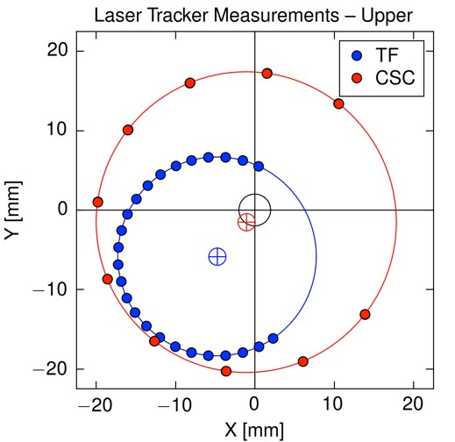
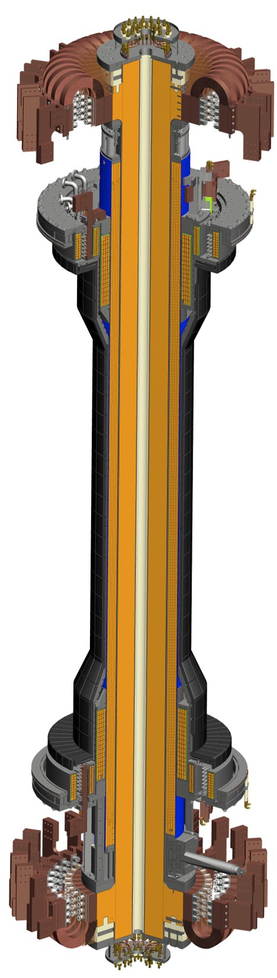
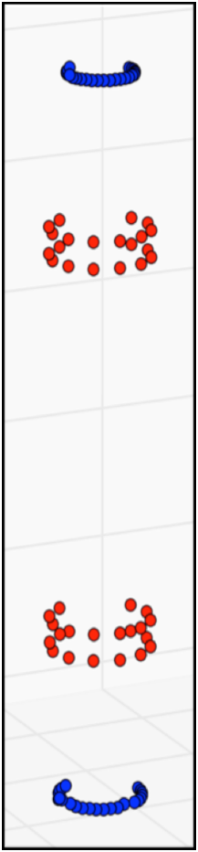
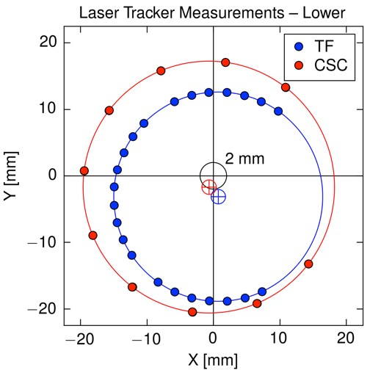
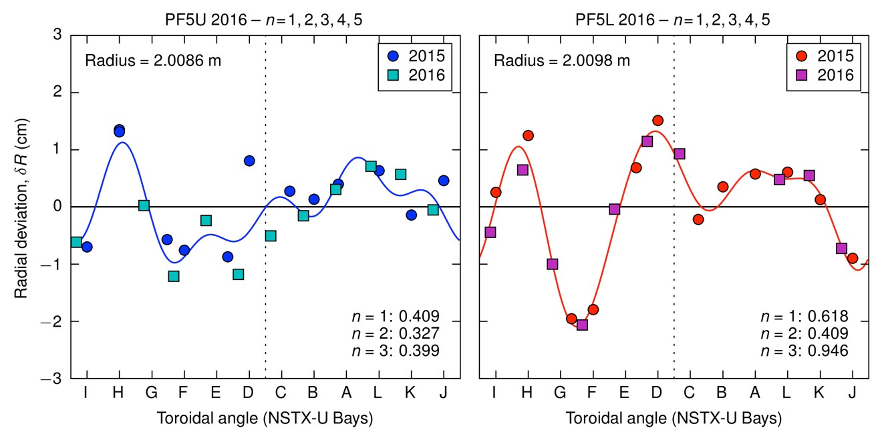
Coil metrology conducted on
TF rod, center-stack casing (CSC), and PF5 coil
Combine metrology techniques: ruler, ROMER arm, laser tracker
PF5 n = 1 amplitude and phase:
  δR ~ 6 mm at ϕ = 16°
TF rod shift and tilt:
  Shift = 4.9 mm at ϕ = 246°
  Tilt = 1.2 mrad at ϕ = 206° (6 mm)

Slide 15
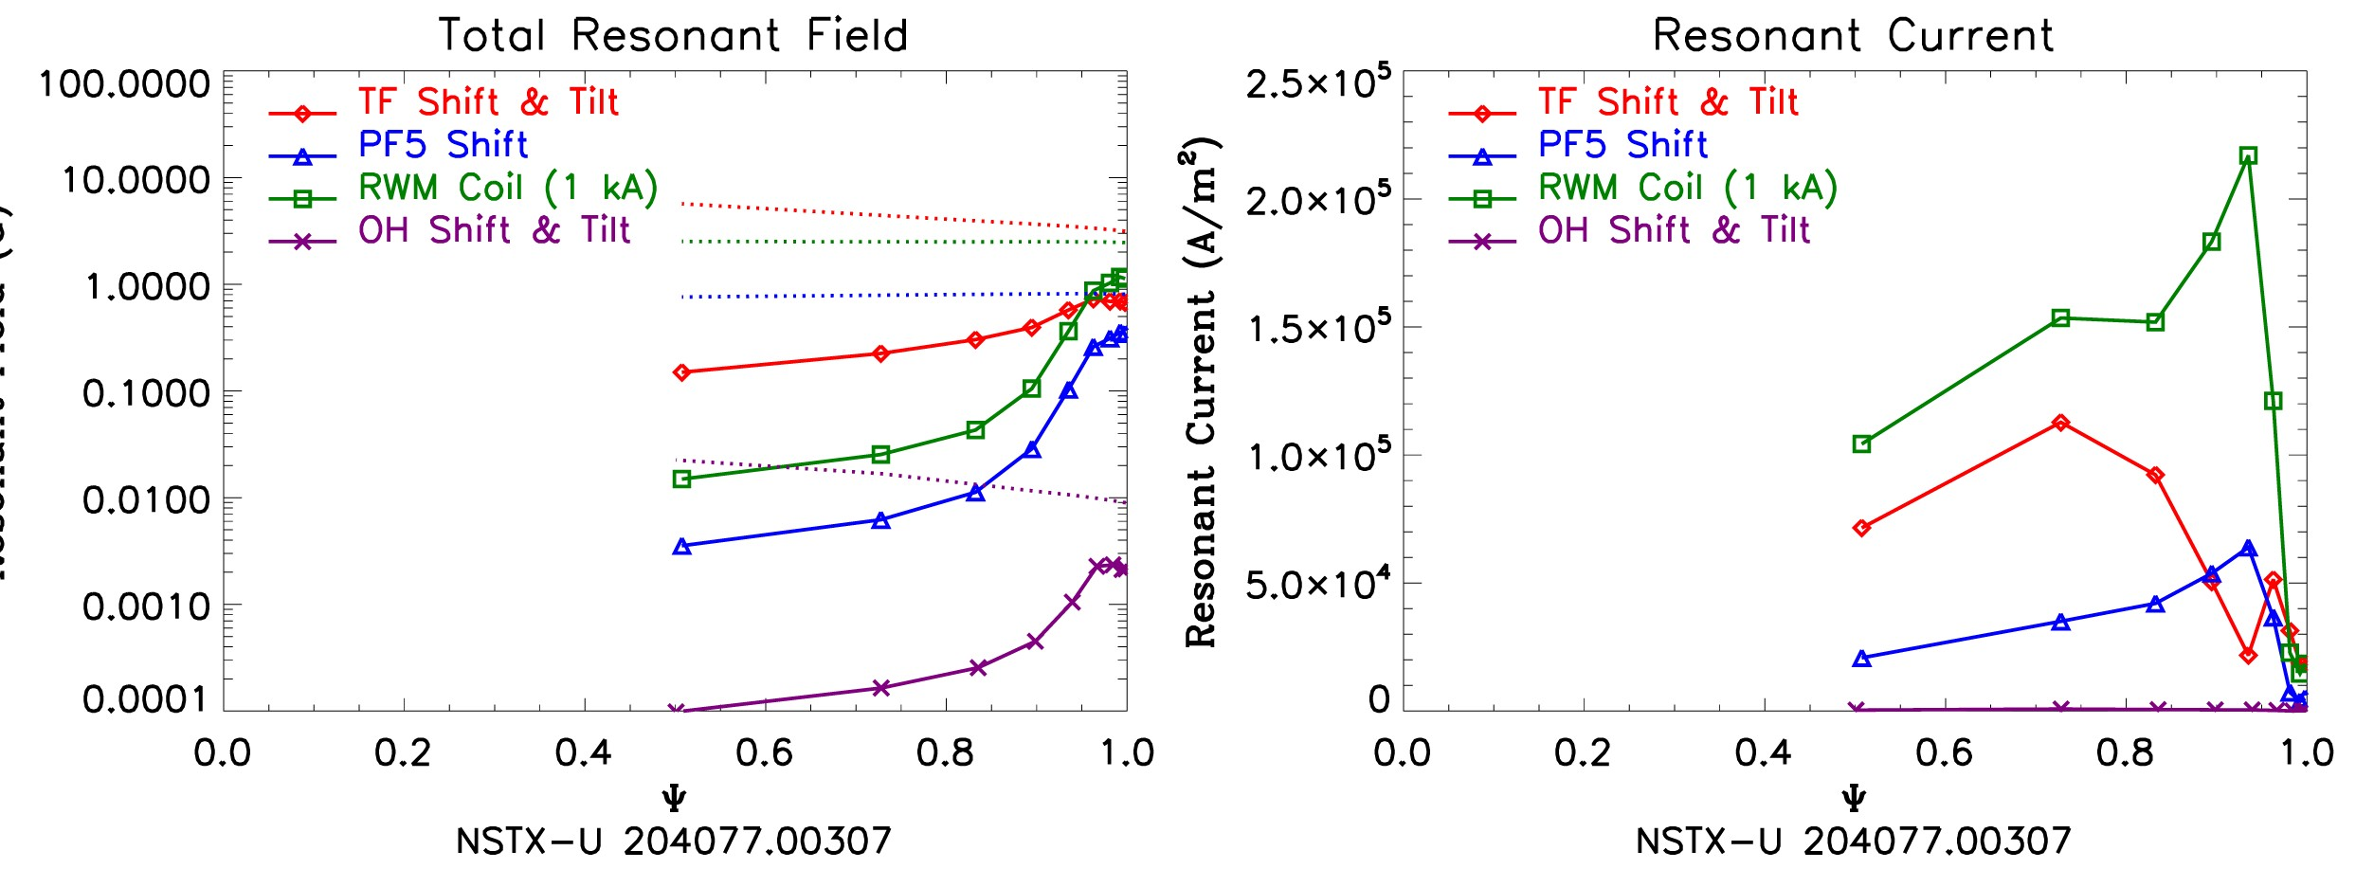
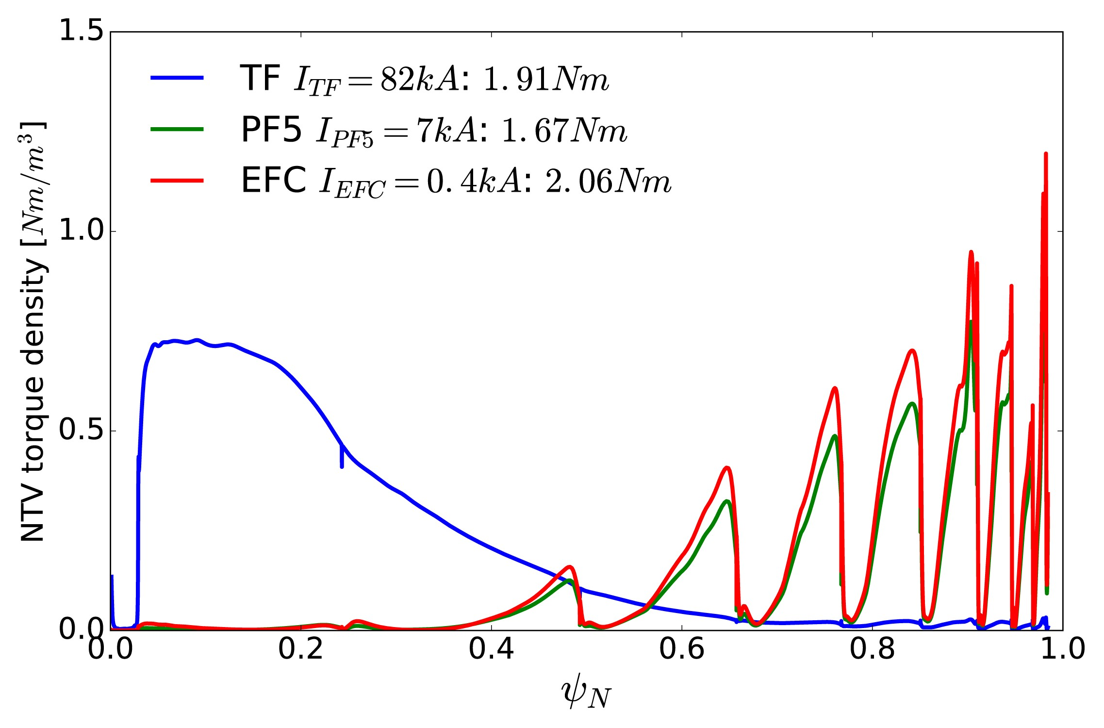
Modeling results → need to impose 2 mm tolerance for TF alignment to mitigate TF error field effects
Metrology → coil shape models
  Feed to IPEC & M3D-C1
Resonant fields and currents:
  TF error field is dominant
  TF EF phase not constant
  Difficult to correct
Neoclassical toroidal viscosity:
– RWM coils are poorly matched to TF NTV spectrum
Model H-mode
142301
Tolerance of 2 mm:
  Resonant fields below locking threshold without EFC
  Reduces TF NTV by 10×
See J.-K. Park presentation for more details

Slide 16
NSTX-U Mission Elements:
Explore unique ST parameter regimes to advance predictive capability - for ITER and beyond
ITER
Topical science areas:
  Scenario Development
  Macroscopic Stability
  Transport and Turbulence
  Energetic Particles

Slide 17
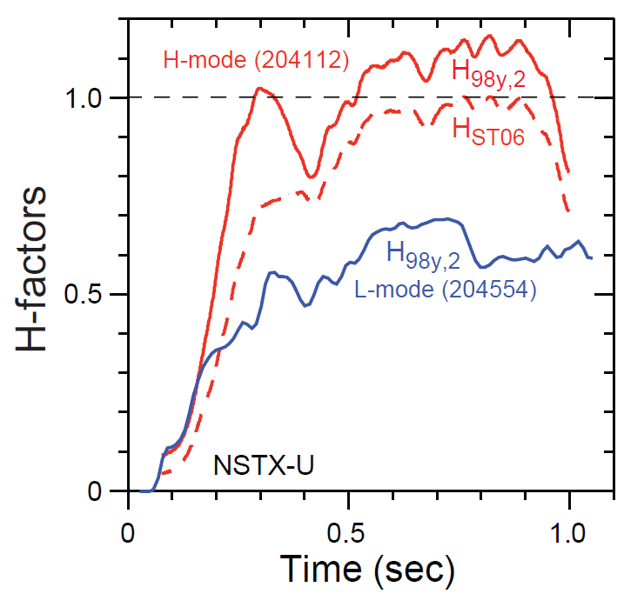
H-mode confinement so far consistent with “ST” scaling

Slide 18
Reduction in χ_{e} Going From L- to H-;
RLW model consistent with T_{e}
Caveat: Linear GYRO indicates
microtearing is NOT dominant
μ-instability

Slide 19
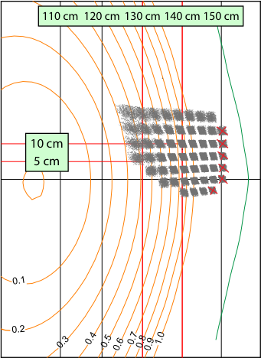
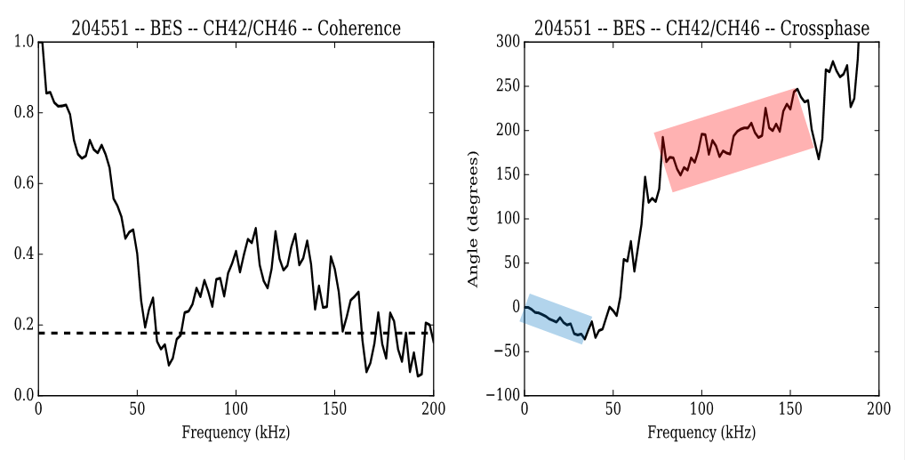

NSTX-U: Bimodal turbulence seen in some L-modes using upgraded 48 channel Beam Emission Spectroscopy (BES) system
ΔZ = 3 cm
R = 142 cm
Δt = 24 ms
11 km/s in ion
diamagnetic direction
13 km/s in electron
diamagnetic direction
Modes propagate in opposite directions
  Similar spectra seen with DIII-D and TFTR BES
  Potential link to grad B direction?
  Gyro-kinetic modelling underway

Slide 20
At ion scales (k_{θ}ρ_{s}<1), linear GYRO* simulations predict unstable spectra of ITG and microtearing modes (MTM)
ITG unstable R>135 cm, propagates in ion direction
  Propagation direction consistent with BES ion mode (need to consider Doppler shift, although also in ion direction)
MTM also unstable R>127 cm, propagates in electron direction
  Surprised to find MTM unstable ⇒ sufficient beta (4.1%) and large collisionality enhances MTM
e-direction
MTM
i-direction
ITG
*GYRO (Candy, Waltz, 2003)

Slide 21
Same NSTX-U L-modes: Nonlinear ETG simulations give significant transport (R=129-140 cm, r/a=0.47-0.67)
Q_{e,etg} large enough to account for Q_{e,exp} if Z_{eff}=Z_{eff,c}≈1.2
  Larger Z_{eff} (VB Z_{eff}≤2) → lower Q_{e,etg}
New high-k microwave scattering diagnostic (for 20** run) will be ideal for probing region of ETG turbulence
May require multiscale simulations for validation
ρ ≈ 0.45 0.55 0.65 0.75
See W. Guttenfelder presentation for more details
Notes:
Future new high-k scattering diagnostic will probe this
SOMETHING ABOUT MULTISCALE, HOWARD NF 2016, HOLLAND IAEA TH/6-1

Slide 22
NSTX-U Mission Elements:
Explore unique ST parameter regimes to advance predictive capability - for ITER and beyond
ITER
Topical science areas:
  Scenario Development
  Macroscopic Stability
  Transport and Turbulence
  Energetic Particles

Slide 23
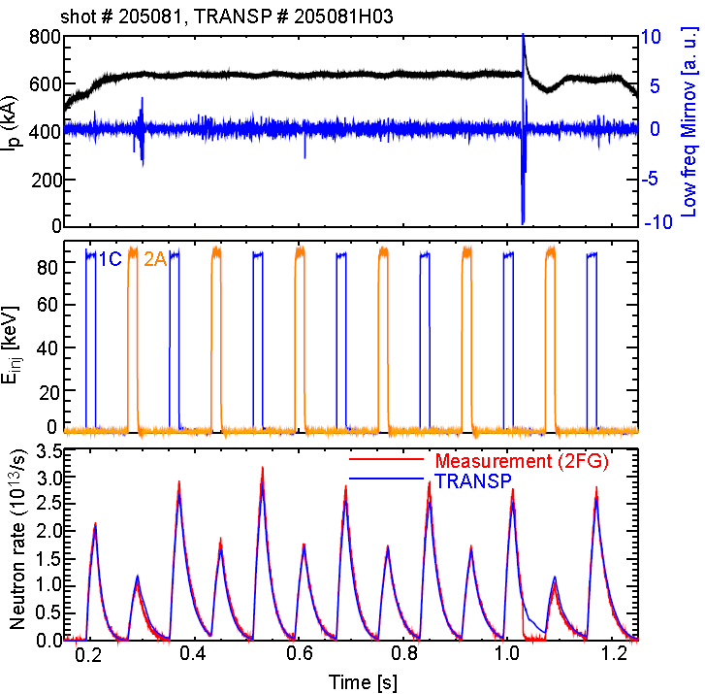
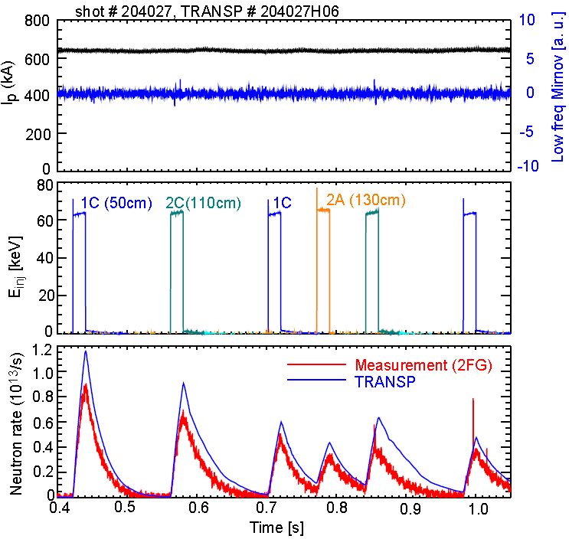
Explored fast-ion behavior with original and new NBI via beam blips with different NBI energies
E_{NBI} = 85keV
E_{NBI} = 65keV
Neutron rate
Good agreement between neutron measurement and TRANSP prediction
~20% discrepancy between data and TRANSP predictions
Exploring possible causes, including NBI source energy split

Slide 24
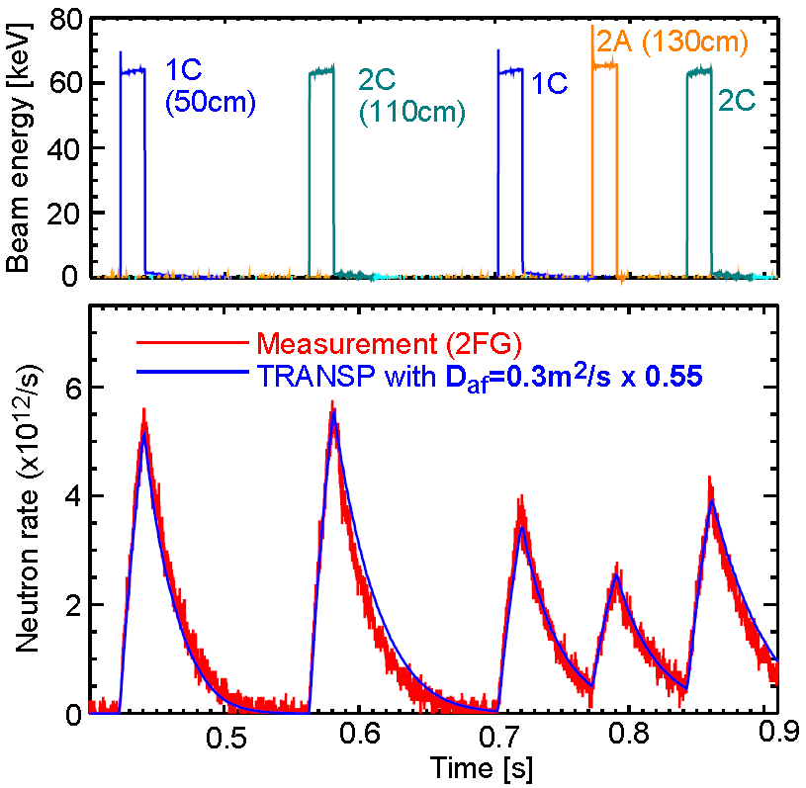
Agreement improved for E_{inj} = 65keV using small anomalous fast-ion diffusion
TRANSP decay time gets reasonable agreement with data when a small anomalous fast ion diffusivity (D_{af}=0.3m²/s) is used
→ Beam ion behavior is still close to classical theory

Slide 25
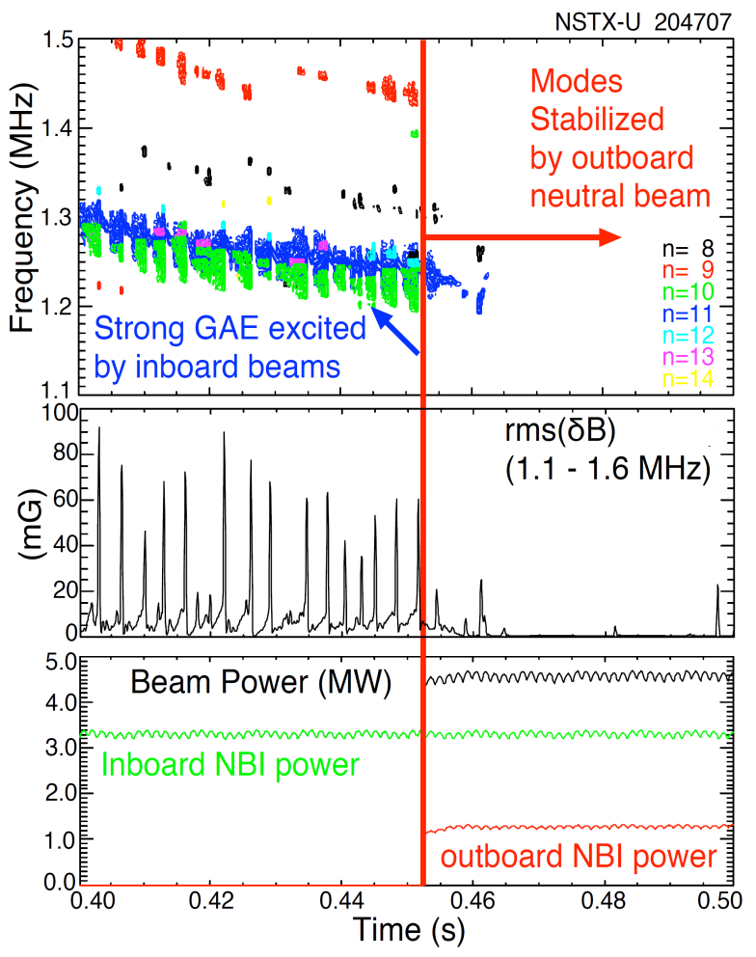
NSTX-U: Tangential 2nd neutral beam suppresses Global Alfven Eigenmode (GAE) – consistent with simulation
HYM code simulation of #204707, n=10
|δB_{n} |²
No outboard NBI (t=0.44s)
With outboard NBI (t=0.47s)
t ω_{ci}
HYM code: growth of n=10 counter-GAE from 1st NBI
HYM: suppression of n=10 counter-GAE by 2nd NBI
Most unstable n-number, mode ω consistent with HYM
See E. Belova presentation for more details
Published in PRL in June 2017 - E. Fredrickson et al.

Slide 26
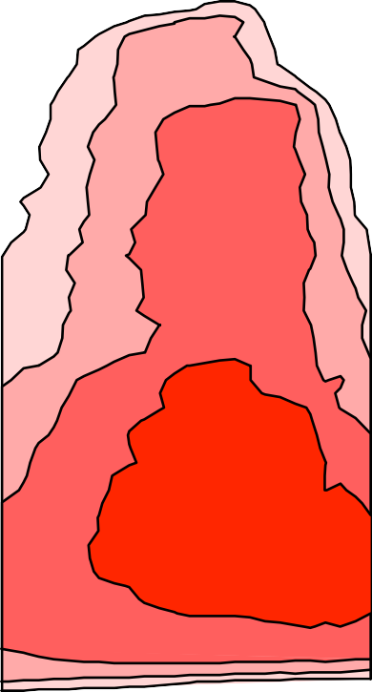
Analytic theory providing insight into HYM simulations of GAE stability
Fast ions can be stabilizing/ destabilizing depending:
NSTX-U 204707A02
100
Stable : Unstable:
a) 0.44s
Resonant
b) 0.47s
0 ≤ k⊥ρ⊥ ≤ 1.9
1.9 ≤ k⊥ρ⊥ ≤ 4
Resonant
Energy (keV)
2
2
Resonant outboard beam ions with pitch > 0.9 have small ρ⊥, are stabilizing by this theory.
Estimates based on dispersion relation and resonant condition suggest that 65keV outboard beam ions might be just marginal to reach resonant condition.
NSTX (low field) parameter regime might be very different.
50
5
10
5
10
k⊥ρ>1.9
k⊥ρ>1.9
20
20
k ρ<1.9
k ρ<1.9
⊥
⊥
0
0.0 0.5 1.0 0.0 0.5
Pitch (V||/V)
(Gorelenkov, NF 2003)
1.0

Slide 27
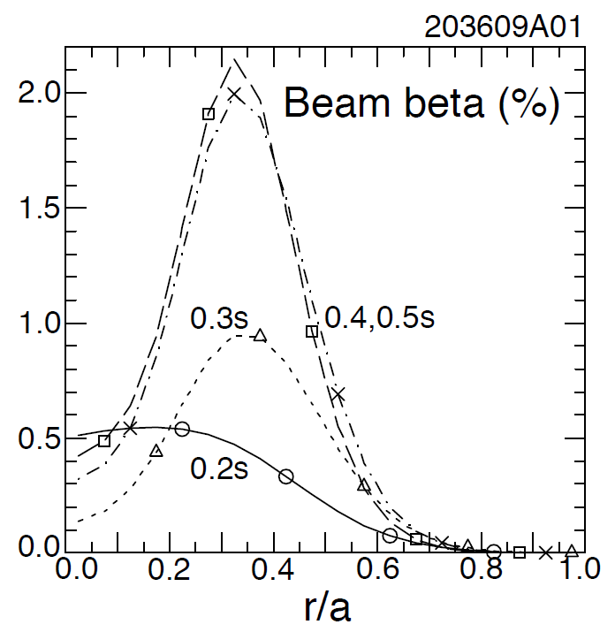
NSTX-U: Off-axis co-NBI destabilizes counter-propagating Toroidal Alfvén Eigenmodes (TAEs)
Hollow fast ion profile reduces stabilization of counter-propagating TAEs
H.V. Wong, H. Berk, Phys. Lett. A 251 (1999) 126.
Preliminary analysis reveals important role of large orbit width, FLR effects
TRANSP: as current builds up, fast-ion beta profile predicted to become hollow
  1st evidence of off-axis NBI in NSTX-U
Co-TAEs are stabilized, but cntr-TAEs become unstable with only 1MW NBI

Slide 28
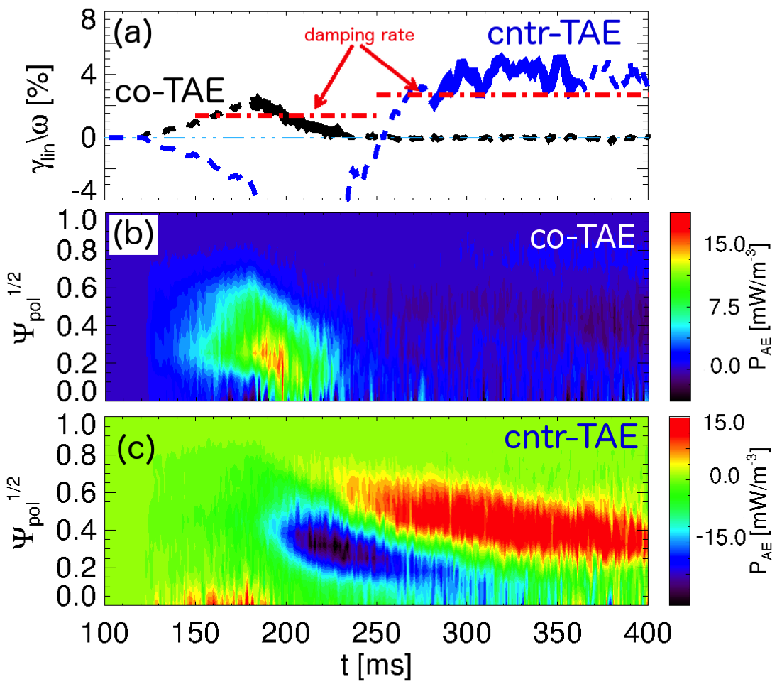
Linear TAE stability vs time from TRANSP + kick model is consistent with NSTX-U experiments
Compute power from fast ions to mode
  Infer growth rate
  Using damping rate from NOVA-K
Timing of most unstable |n|=1 TAE modes compares well with experiments
Stability related to gradients in both radius & energy
  Not the usual “universal drive”
M. Podesta
[Podestà, PPCF 2017]
Flexibility of TRANSP + kick model approach enables scenario development for realistic geometry
  Example: ~0.5MW “blips” with 1st NBI predicted to stabilize cntr-TAEs

Slide 29
NSTX-U Mission Elements:
Explore unique ST parameter regimes to advance predictive capability - for ITER and beyond
ITER
Develop solutions for plasma- material interface (PMI)
Snowflake/X
Liquid metals / Li
ST-FNSF /
Pilot-Plant
Advance ST as Fusion Nuclear Science Facility and Pilot Plant

Slide 30
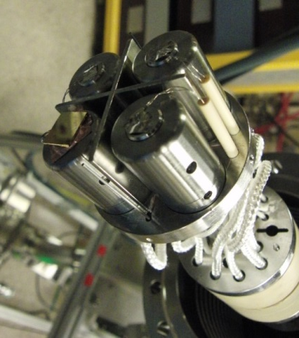
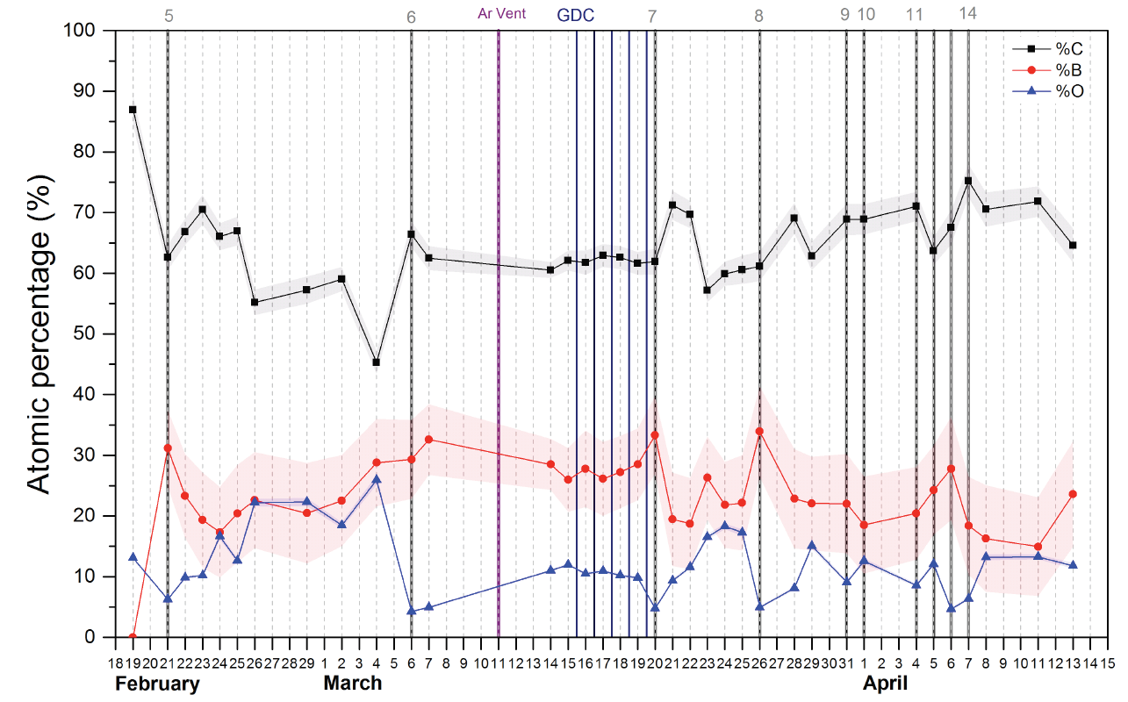
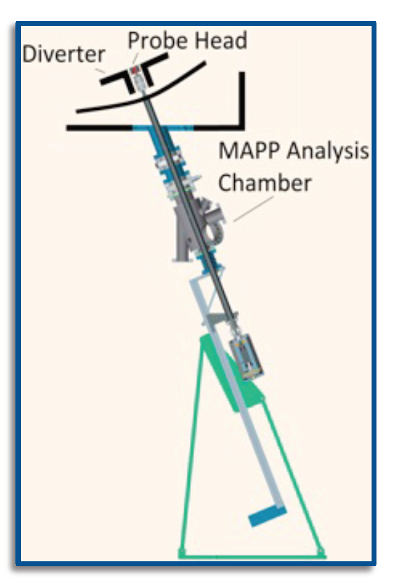

Material Analysis & Particle Probe (MAPP) providing new measurements of surface evolution in NSTX-U
Tracked C/B/O evolution, correlated with plasma performance
Implemented remote-control + between-shot MAPP analysis
Future: Use with Li, understand complex Li chemistry/evolution

Slide 31
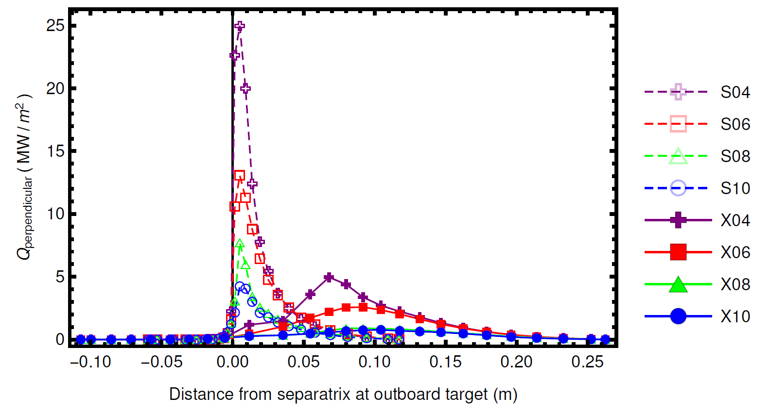
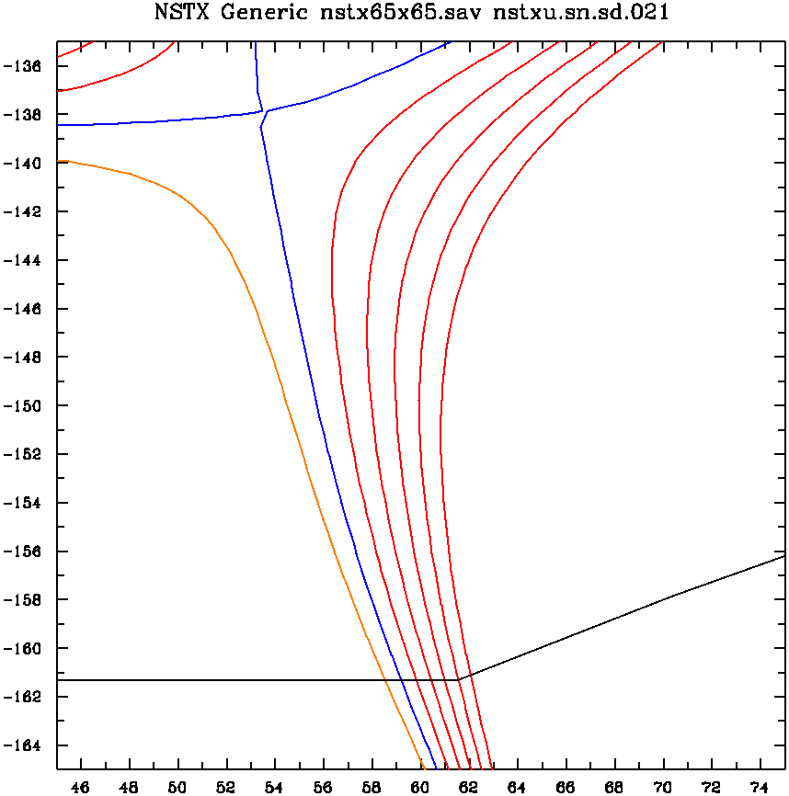
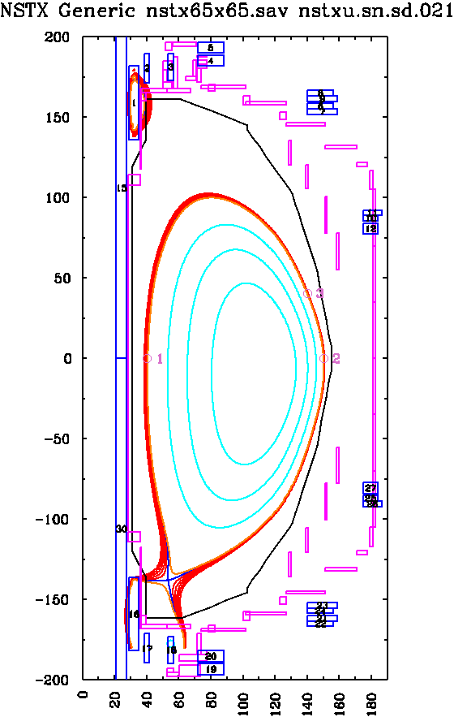
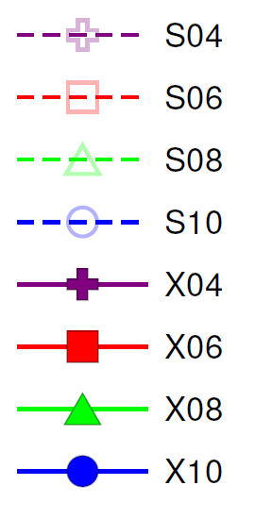
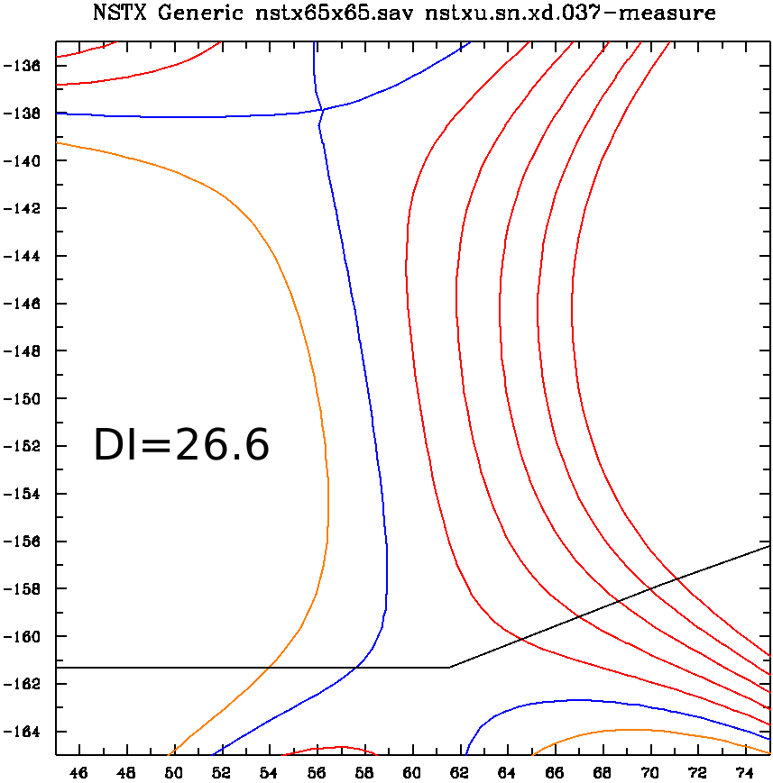
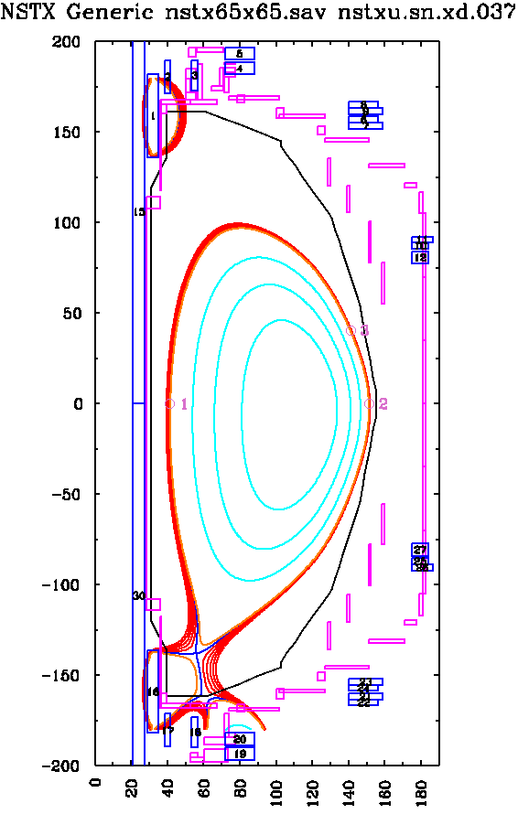
Designed controlled experiment for NSTX-U to assess heat flux and detachment vs. flaring (UT Austin)
Can hold core fixed while varying divertor (CORSICA+SOLPS)
  I_{P} = 1.1MA, B_{T} = 0.74T, A~1.73, q₉₅~6, κ=2, δ_{L} = 0.47, P_{SOL} = 2.9MW
X-divertor (2nd x-point under target plate) promotes detachment
  Gas-puff scan: 4, 6, 8, 10 ×10²¹ particles / second
Standard divertor
X-divertor

Slide 32
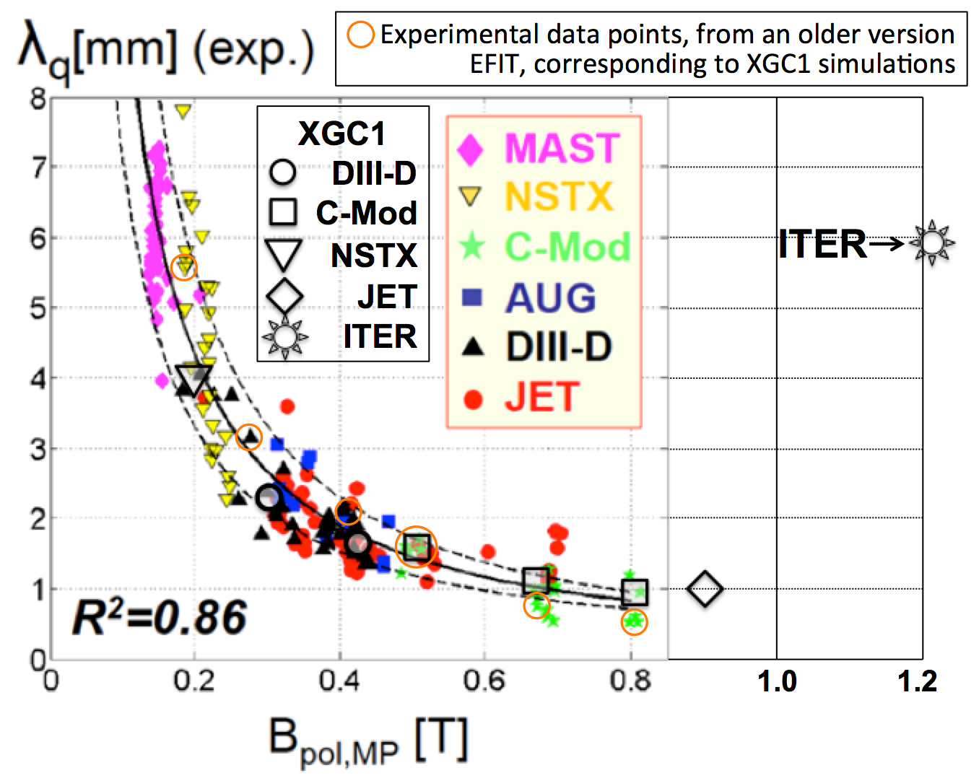
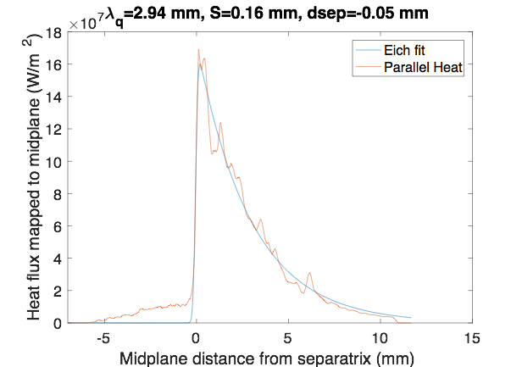
XGC1 predicts SOL heat-flux width significantly larger than Eich-Goldston scaling for 2MA NSTX-U
An up-scaled NSTX-U plasma equilibrium from NSTX #139047 is used.
  Similar magnetic equilibrium shape, B_{p}=0.58 T, heat input = 7.8MW
  XGC1 finds that λ_{q}^{Eich} for lower divertor in NSTX-U is ≈ 3 mm → ~1.5-2x larger than the Eich-Goldston scaling prediction.
  Electron contribution (turbulence) becomes significantly higher than the ion contribution (neoclassical), potentially indicating enhanced role of turbulence
Physics bifurcation
2MA NSTX-U
See S. Ku presentation for more details

Slide 33
NSTX-U Mission Elements:
Explore unique ST parameter regimes to advance predictive capability - for ITER and beyond
ITER
Develop solutions for plasma- material interface (PMI)
Liquid metals / Lithium
Snowflake/X
ST-FNSF /
Pilot-Plant
Advance ST as Fusion Nuclear Science Facility and Pilot Plant

Slide 34
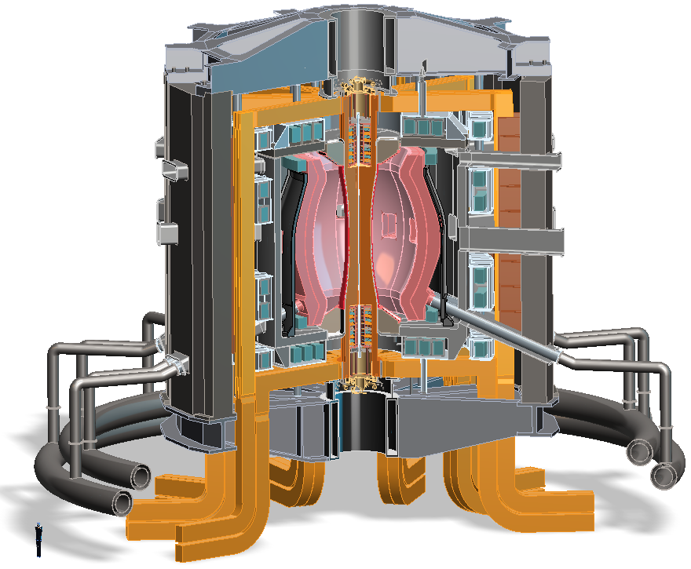
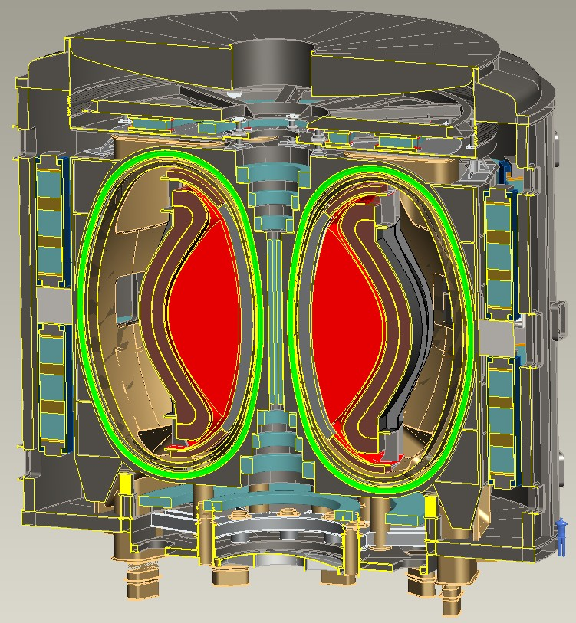
Recent design studies show ST potentially attractive as
Fusion Nuclear Science Facility (FNSF) and Pilot Plant
FNSF: Provide neutron fluence for material/component R&D (+ T self-sufficiency?)
Pilot Plant: Electrical self-sufficiency: Q_{eng} = P_{elec} / P_{consumed} ≥ 1 (+ FNSF mission?)
FNSF with copper TF coils
A=1.7, R₀ = 1.7m, κ_{x} = 2.7, B_{T}=3T
Fluence = 6MWy/m², TBR ~ 1
FNSF / Pilot Plant with HTS TF coils
A=2, R₀ = 3m, κ_{x} = 2.5, B_{T} = 4T
6MWy/m², TBR ~ 1, Q_{eng} ~ 1
Designs integrate ST higher κ , β_{N} and advanced divertors (+ HTS TF for Pilot Plant)
See Menard presentation for more details
J.E. Menard, et al., Nucl. Fusion 56 (2016) 106023

Slide 35
Summary
Productive first (partial) year of NSTX-U operations
  Rapid H-mode access, control development, EF correction
  Surpassed NSTX maximum magnetic field and pulse-duration
  First glimmer of new data for H-mode confinement scaling
  New fast-ion physics: 2nd NBI – GAE stabilization, counter TAE
Run halted due to failed divertor PF coil + other issues
2017: Major reviews to identify issues, corrective actions
  12 Design Validation and Verification reviews of entire machine
  2 Extent of Condition reviews
  Conceptual Design Review (CDR) + cost and schedule review
Aim to resume plasma ops in late 2019 / early 2020
See M. Ono presentation for more details
See M. Reinke presentation for PFC details

Slide 36
Thank you!
Any questions?

Slide 37
Backup

Slide 38
Enhanced collaborations during NSTX-U outage
Targets NSTX-U research goals
DIII-D, HL-2A (China): Dedicated campaigns – several run weeks
MAST-U: Break-down/scenario modeling supporting first plasma
  D. Battaglia (on-site for several months this summer), D. Boyer
QUEST: Coaxial Helicity Injection (CHI) + ECH/EBW heating
  R. Raman (UW), M. Ono, G. Taylor, N. Bertelli
EAST: edge physics, plasma materials interactions (high-Z, Li)
  R. Maingi + collaborators leading expts
JET: EP studies, plasma ramp-down scenarios and modeling
  M. Podesta, F. Poli
KSTAR: Core MHD, rotation physics, plasma control
  Columbia Univ (Sabbagh, Berkery, Park et al.), J-K Park, J-W Ahn (ORNL)
W7-X: wall conditioning using boron powder dropper
  R. Lunsford
WEST: RF physics, high-Z PMI, real-time wall protection
  RF physicists, M. Reinke (ORNL)
LAPD: RF coupling and heating physics, cavity modes
  R. Perkins

Slide 39
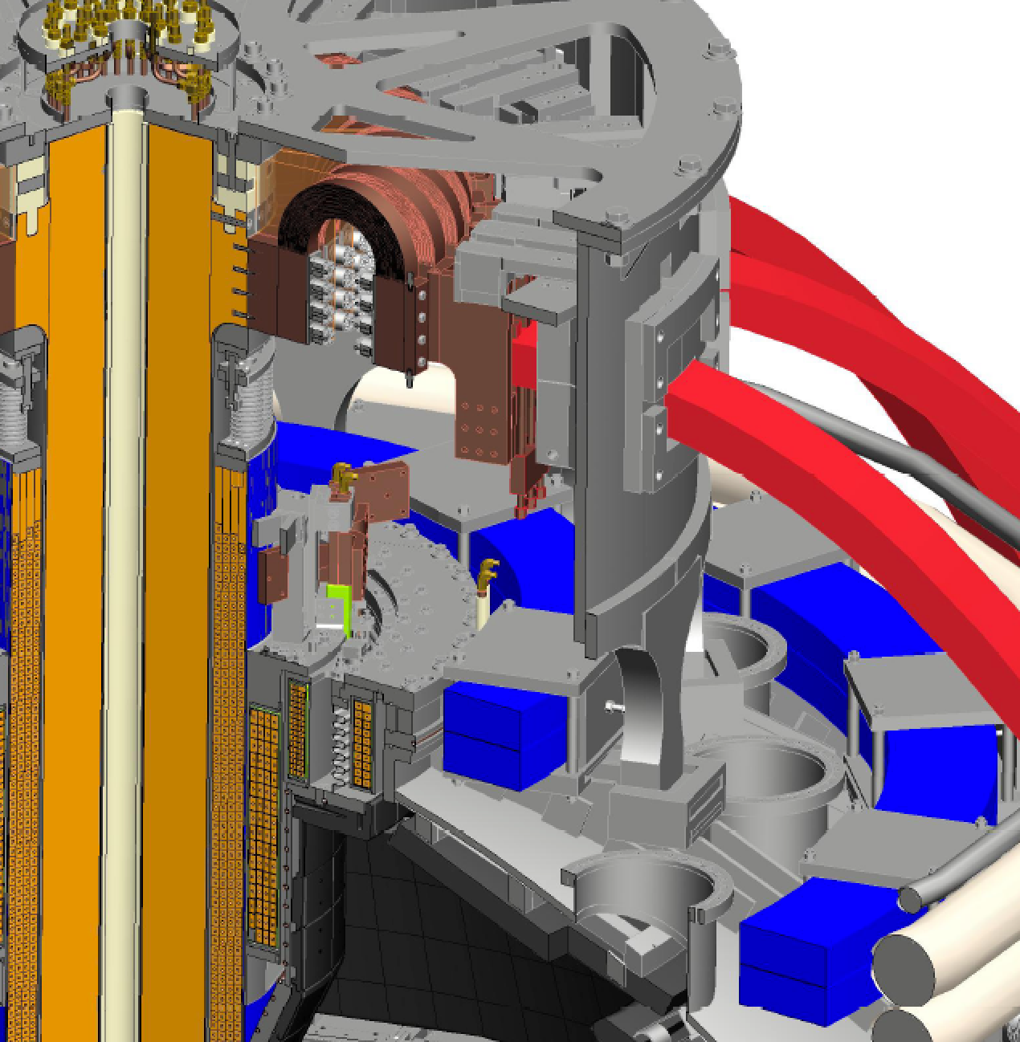
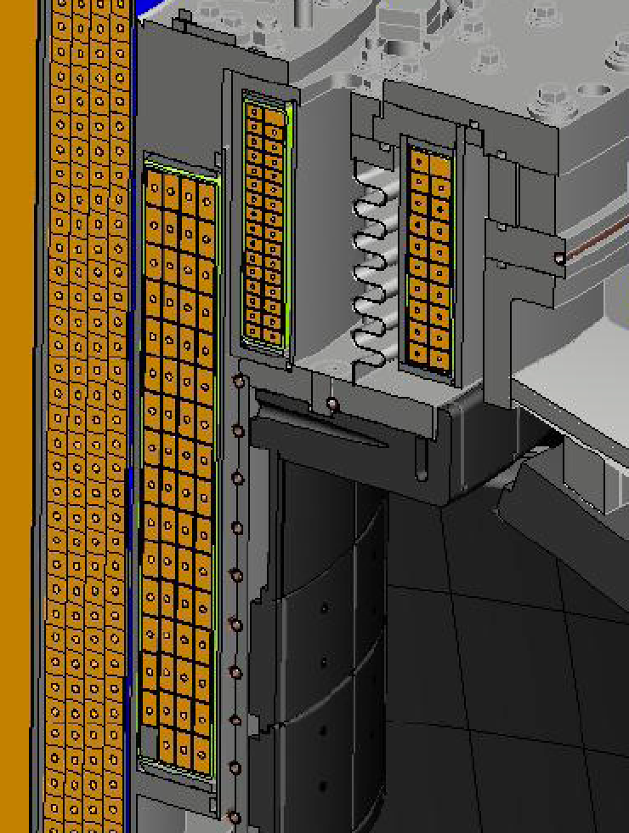
Region where problems have occurred
OH Grounding
PF1B
PF1C
PF1A
Copper Tubes
Horizontal Inboard Divertor

Slide 40
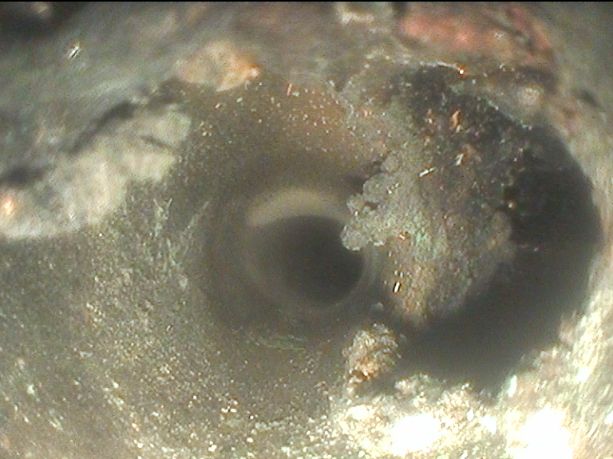
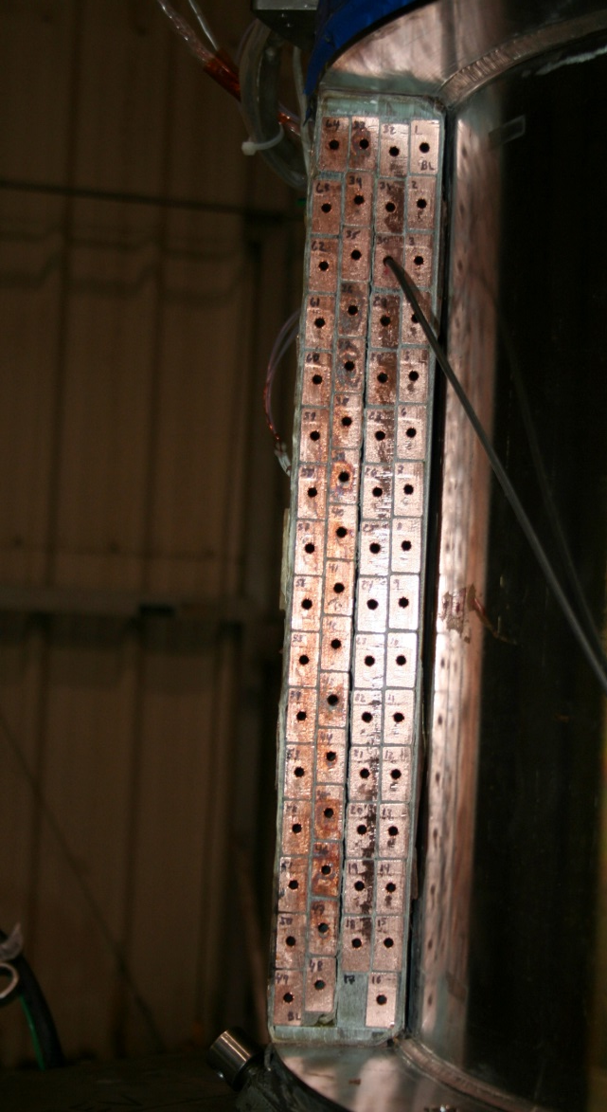
Boroscopy and sectioning of failed PF1AU
Shorted Turns
Region of Shorted Turns
Section A-B, Layer 3, Row 9 Void Anomaly
Large Void on This Turn

Slide 41
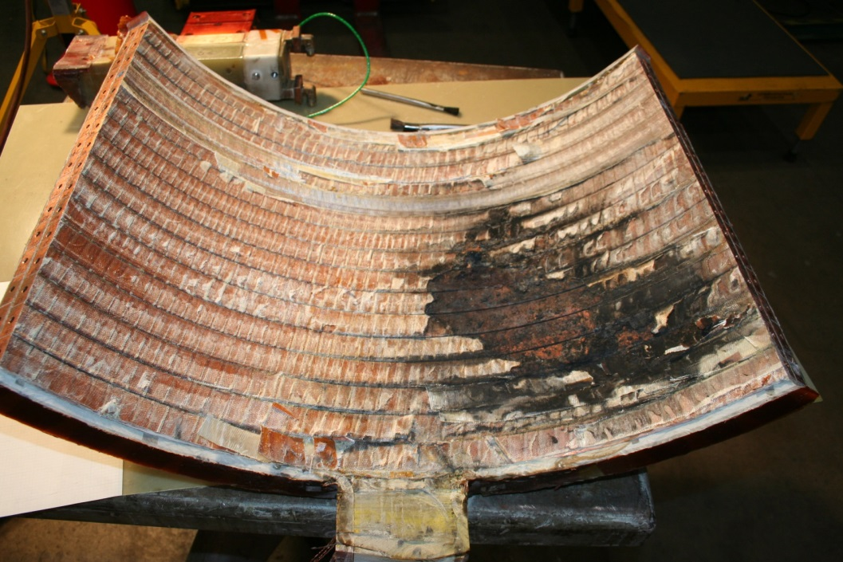
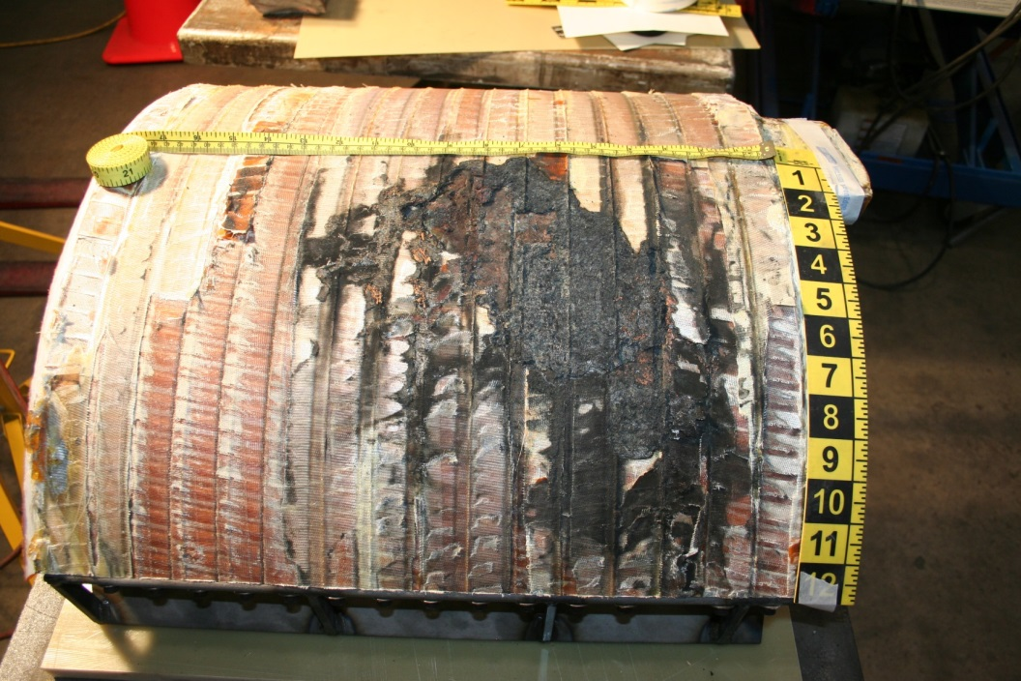
PF1AU insulation damaged between layers

Slide 42
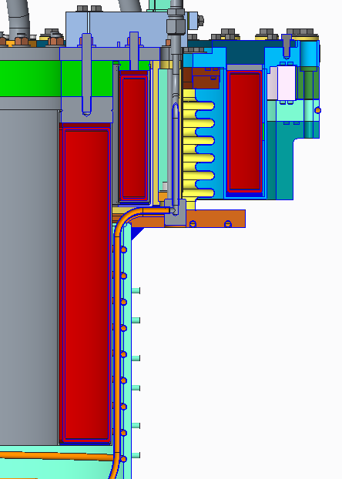


NSTX-U “Recovery” Project includes significant rebuild of components in ends of center-stack
PF1 coil improvements (6 new coils):
  No mandrels to improve turn-to-turn testing
  No joints, pure spiral windings for no joggles
  PF1B thermally isolated (attached at cold end)
Vacuum improvements
  All coils air-side (PF1C was in vacuum can)
  Single → pumped double O-rings
  Improved divertor cooling / heating tubes
  Lower ceramic break removed to reduce # of O-rings, reduce risk of fracture, lithium contact → NO Coaxial Helicity Injection
  Future: consider bias-plate and/or plasma guns
New divertor PFCs for higher heat flux handling
New castellated design to increase stress margins

Slide 43




Investigating newly observed Ion Cyclotron Emission (ICE) from NSTX-U discharges
Spatially coherent → argues for mode
Bursty rather than CW → unstable mode - what defines mode f ?
Doesn’t follow Alfvénic scaling - not Alfvén eigenmode?
Like conventional ICE, higher harmonics largest amplitudes
5.0
NSTX-U 204645
Strongest ICE correlated with source 1C – the most perpendicular source
Amplitude decreases with increasing density
TRANSP runs started to study β_{fast} dependence
Can ICE be correlated with confined fast-ion distribution parameters?
Needs theory support
4
7
Frequency (MHz)
4.0
1
3.0
2
6
5
3
2.0
1.0
0.0
6
4
2
0
0.15
0.20
0.25
Time (s)
0.30
0.35

Slide 44

Strong variation in turbulence, stability and E×B shear over ≤ 30 ρ_{s} ⇒ motivates the need for global simulations
Strong local E×B shearing rates (γ_{E} > γ_{ITG}, γ_{MTM} at R=135 cm)
  BES amplitudes increasing where γ_{ITG} > γ_{E}
Significant variation over ~30 ρ_{s} (ρ* = ρ_{s}/a ~ 1/120, ρ_{s} / L_{T} ~ 1/35)
Motivates the need for global simulations
~30 ρ_{s}
BES δI/I
(50-200 kHZ)

Slide 45

Granule Injector Commissioned on NSTX-U
Granule sizes :
900μm, 700μm, 500μm, 300μm
Injection Species : Li, B₄C, C
Injection Velocity : 50 – 150 m/sec
Granule to Granule Injection Frequency : 50 – 500 Hz
Particle drop rates are controlled by a piezoelectric disk.
Granules driven into the plasma by a pneumatic rotary impeller
NSTX-U Granule Injector

Slide 46


Materials Analysis Particle Probe fully commissioned
Full remote operation (EPICS and LabView® Interface) now possible for in between plasma discharges measurements
Flush with LD tiles at bay J
(boronization, lithiumization, D⁺ plasma exposures)
Sequence of operation
XPS, ISS, DRS
measurements

Slide 47

MAPP used to track effect of boronization on PFCs
Supported PhD Thesis, will be vital to understanding Li surface chemistry
Boron oxidation due to plasma exposure measured with MAPP via X-ray Photoelectron Spectroscopy (XPS)
3. ATJ post boronization post plasma exposure
High oxygen % Low % of B in metallic state
Days after boronization
D⁺ fluence increasing
XPS data obtained at the end of each plasmas operations day
Low oxygen % High % of B in metallic state
2. ATJ post boronization
1. ATJ graphite

Slide 48

Static EFC scan early in time → different EFC phase
Static EFC scan early in the discharge shows different optimum correction phase
Flattop phase of 15° is counter-productive early on
Phase asymmetry visible in density, neutrons, and core rotation
Search for the time-evolving error field source is ongoing
  Tilted TF, vessel currents?

Slide 49
Extended-MHD Modeling Is Being Used to Understand Tearing Modes in NSTX(-U)
Modeling tearing modes in NSTX-U is challenging
  Strong coupling among rational surfaces
  Strong rotation and rotation shear
Extended-MHD codes are being developed and used to address this challenge
  Resistive DCON, M3D-C1, MARS
M3D-C1
M3D-C1 calculations find unstable TM in NSTX discharge with 2/1 TM
δB_{norm}
M3D-C1
N. Ferraro

Slide 50
Leading halo current propagation studies
C. Myers (PPPL)
The concern for ITER:
  Concern is for asymmetric halo currents during unmitigated disruptions
  Forces are dynamically amplified if N_{rot} > 2-3
  Critical mechanical resonances in the 3-8 Hz range [Schioler FED 2011]
  Overall response is broader (10-20 Hz) [Bachmann FED 2011 & Lehnen]
Could halo current forces be dynamically amplified in ITER?
  Could the halo currents rotate at frequencies below 20 Hz?
  Could the rotation last long enough to complete 2-3 rotations?
Substantial halo current rotation observed in a number of devices:
  JET Noll 1996, Riccardo 2004 & 2009, Gerasimov 2014 & 2015
  C-Mod Granetz et al. Nucl. Fusion 36, 545 (1996)
  DIII-D Evans et al. J. Nucl. Mater. 241-243, 606 (1997)
  AUG Pautasso et al. Nucl. Fusion 51, 043010 (2011)
  NSTX Gerhardt Nucl. Fusion 53, 023005 (2013)

Slide 51




Leading studies of rotating halo currents through ITPA multi-machine analysis and M3D-C1 numerical simulations
ITPA multi-machine analysis (MDC WG-6):
Halo current data from C-Mod, DIII-D, AUG, and NSTX
All measurements in lower divertor (> 400 shots)
Halo current rotation is predominantly counter-I_{p}
Consistent rotation velocity, v_{h} ~ 5 km/sec
C. E. Myers et al. (EX/P6-46)
M3D-C1 simulations:
NSTX(-U) geometry
Simulate in 2D while q >2
Switch to 3D to resolve halo rotation (in progress)
D. Pfefferlé et al. (PPPL)

Slide 52

Simple rotation frequency scaling: ⟨f_{h}⟩ ~ 1/R
Cannot rule out dynamic force amplification in ITER
Key quantities:
  N_{rot} = number of rotations
  t_{rot} = rotation duration
  ⟨f_{h}⟩ = N_{rot} / t_{rot} = rotation frequency
Carry out regression using two parameters → R, t_{rot}
Additional parameters do not improve regression (e.g., I_{p}, B_{T})
  ⟨f_{h}⟩ ~ 1/R ~ constant ⟨v_{h}⟩
ITER projection:
  Rotation at ⟨f_{h}⟩ < 20 Hz probable
  Rotation duration analysis → Cannot rule out dynamic force amplification in ITER
C. E. Myers, et al. (Manuscript submitted to Nuclear Fusion)

Slide 53




Resistive DCON Solves Reliable Outer Region Δ′ and Indicates Δ′ is Destabilized by Plasma Pressure
Resistive DCON reproduces Δ’ behavior in Furth, Rutherford and Selberg, Phys. Fluids 16, 1054(1973).
Higher $β$ $→$ Increase Δ’ at q=2,3
$→$ More unstable tearing mode
Resistive DCON solves Δ’ in full toroidal geometry.
n=1 m=2
$$β$$
n=1 m=3
Δ’ at q=2
First resistive DCON paper has been published.
Glasser, Wang and Park, Phys. Plasmas 23, 112506 (2016)
Z. Wang

Slide 54








RDCON: $Δ^{′}$ Optimization of NSTX-U L-Mode discharge to stabilize n=1 tearing mode ($q_{0}↓$ and $β_{N}/l_{i}↑$ $→$ $Δ^{′}$ $↓$)
Resistive DCON is applied to optimize NSTX-U equilibrium to avoid tearing instability (varying equilibrium parameters to minimize $Δ^{′}$).
A sequence of equilibria are generated by scanning current and pressure profiles with CHEASE code, where plasma boundary of discharge 204718 is used.
For this scenario, reducing $q_{0}$ + increasing $β_{N}/l_{i}$ $→$ Decrease in $Δ^{′}$ at q=2,3
$Δ^{′}$ (q=2)
$Δ^{′}$ (q=3)
$$Δ^{′}$$
$$Δ^{′}$$
Z. Wang

