Slide 1
Recent activities on TST-2
19th International Spherical Torus Workshop (ISTW 2017)
Seoul National University, 18-22 September 2017
Ejiri¹, Y. Takase¹, N. Tsujii¹, S. Yajima¹, H. Yamazaki¹, Y. Takei¹, Y. Tajiri¹, B. Roidl¹, Y. Yoshida¹, A. Kitayama¹, A. Sato¹,
N. Matsumoto¹ Y. Iida¹, K. Iwasaki¹, Y. Kawamata¹, S. Sakamoto¹, C.P. Moeller², K. Saito³, T. Seki³, H. Kasahara³, S. Kamio³
and O. Mitarai⁴
¹The University of Tokyo, Kashiwa 277-8561, Japan
²General Atomics, San Diego, CA 92186, U.S.A.
³National Institute for Fusion Science, Toki 509-5292, Japan
⁴Kyushu Tokai University, Kumamoto 862-8652, Japan

Slide 2
Outline
TST-2 device
Lower hybrid wave (LHW) start-up experiment
AC-Ohmic coil operation experiment
Summary and future plan
Background and objectives
Two capacitively-coupled combline (CCC) antennas are used in TST-2 to study the start-up by LHW [1, 2]. B_{t} and n_{e} dependences are investigated. The performances of the two antennas are compared.
AC Ohmic coil operation is a pre-ionization method and has a potential ability of DC current drive with a quite small flux swing capability [3]. Features of the pre-ionization [4] and applications are presented.
[1] T. Shinya, et al., Nucl. Fusion 57 (2016) 073003.
[2] N. Tsujii, et al., Nucl. Fusion 58 (2017) in press.
[3] A. Ejiri, et al., Plasma Fusion Res. 11 (2016) 1202004.
[4] A. Ejiri, et al., submitted to Nucl. Fusion.

Slide 3
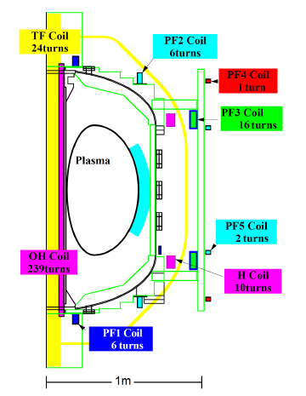
TST-2 device and the heating systems
Major radius R ～ 0.36 m
Minor radius a ～ 0.23 m
Aspect ratio A = R/a > 1.5
Toroidal field B_{t} < 0.3 T
For OH/RF(LHW) operation
Plasma current
I_{p} < 120 kA/26 kA
Discharge duration
Δt < 25 ms/120 ms
CCC antenna
for LHW (200 MHz)
AC Ohmic coil operation
X/O-mode horn for ECH
2.45 GHz, Up to 5 kW

Slide 4
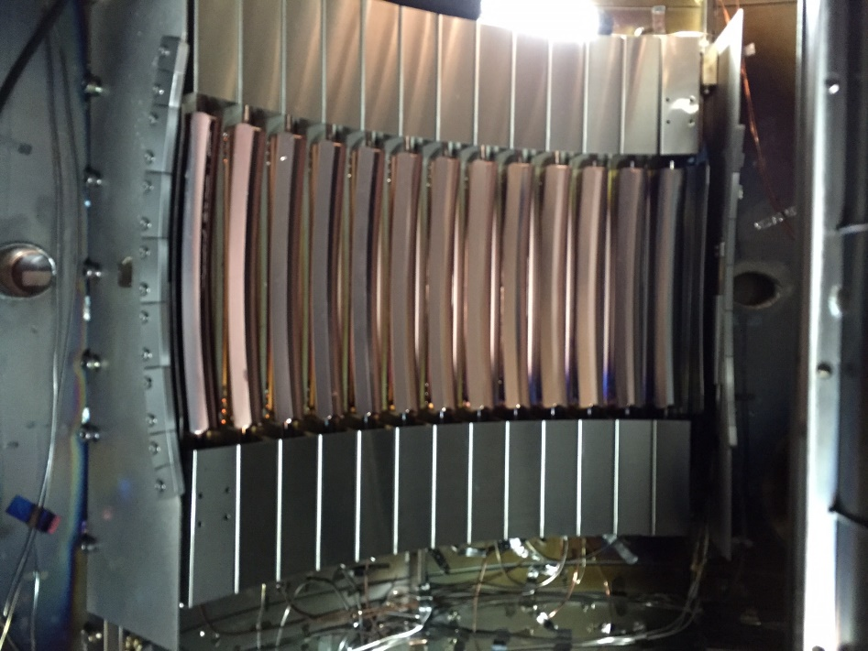
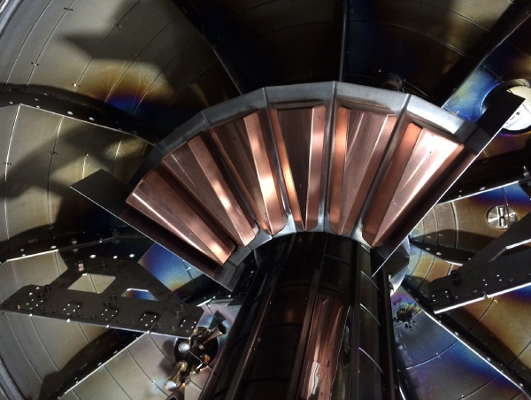
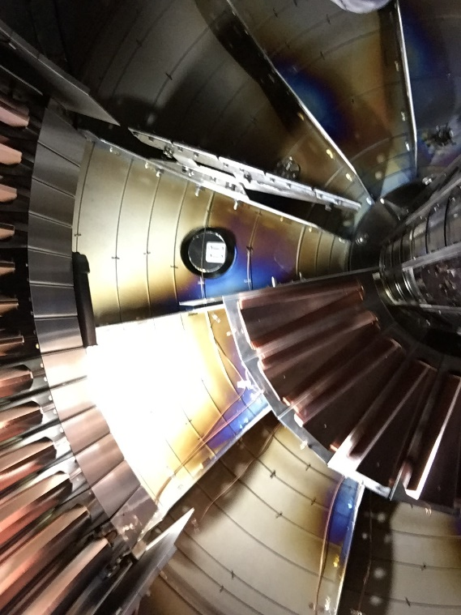
Outboard-launch and Top-launch capacitively coupled combline (CCC) antennas for LHW current drive
Traveling SW is excited directly
Sharp n|| spectrum & high directivity
Developed in collaboration with C.P. Moeller (GA, US)

Slide 5
B_{t} and n_{e} dependences
(for the outboard antenna)
Fig. 10 from [2]
I_{p} increases with n_{e}, and higher B_{t} is necessary to sustain higher n_{e}

Slide 6
Explanation of the n_{e} dependence using the GENRAY/CQL3D chord (I)
Better accessibility for low n|| waves
Lower density
(& weak n|| up-shift)

Slide 7
Explanation of the n_{e} dependence using the chord GENRAY/CQL3D (II)
For detail,
visit Poster-19 by
N. Tsujii (Y. Takase).

Slide 8
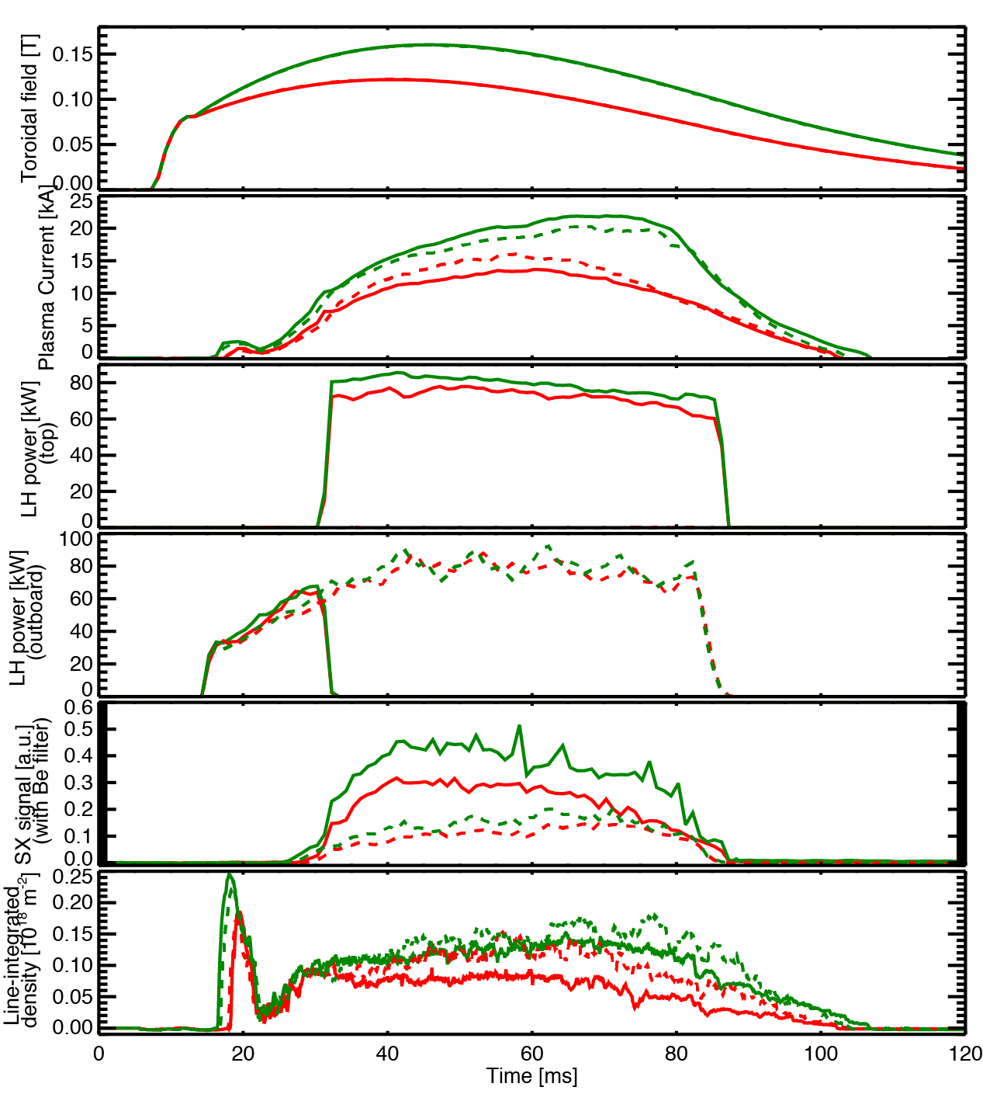
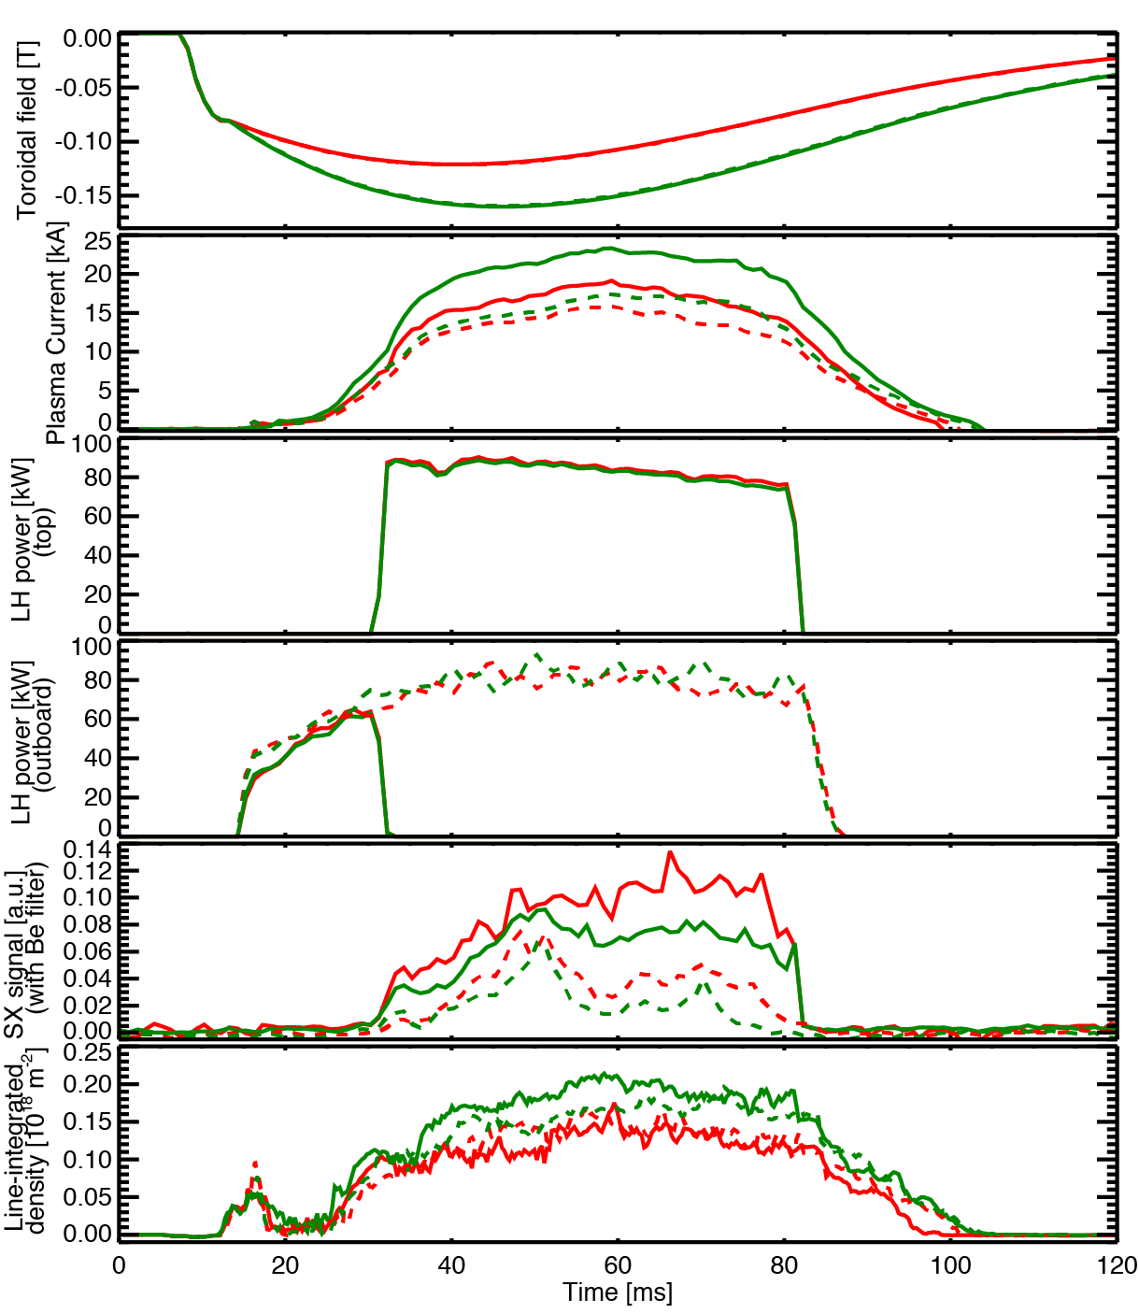
Comparison of the performances (I)
High Bt/ Low Bt
Top (solid)/Outboard (dotted)
Bt:CW(left)/CCW(right)
8 discharges:
Bt : CW
Bt : CCW
B_{t} [T]
I_{p} [kA]
Top
P_{LHW} [kW]
Outboard
P_{LHW} [kW]
SX [a.u.]
n_{e}l [10¹⁸m⁻²]
Outboard is better at the initial phase (to increase I_{p}).
To achieve higher I_{p} higher B_{t} (and higher n_{e}) is better, and Top is better.

Slide 9
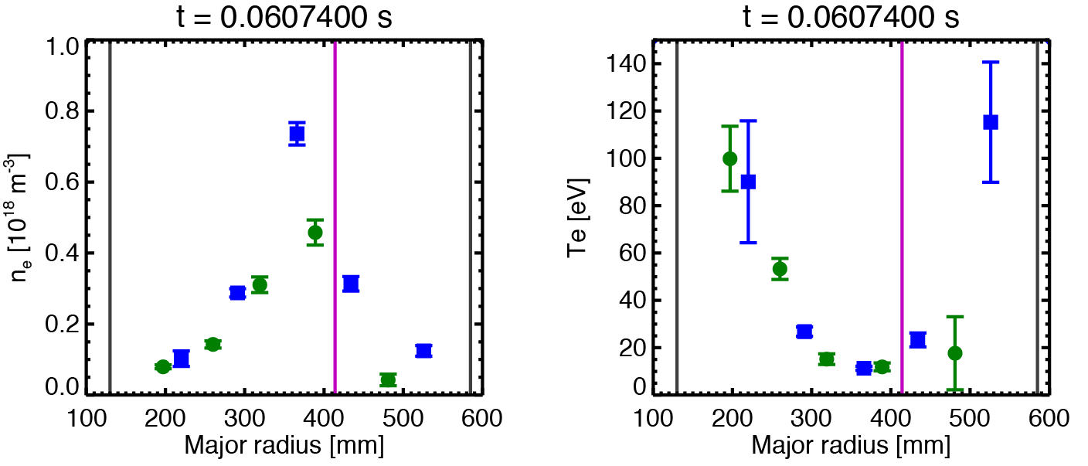
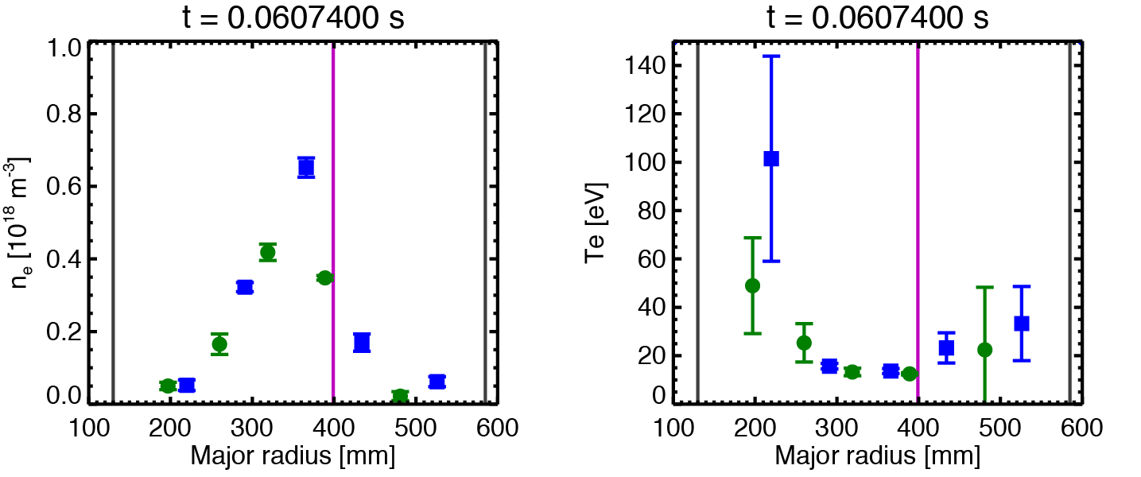
Comparison of the performances (II)
Measurements by
Thomson scattering
Outboard
Top
Low bulk T_{e}, hollow T_{e} profile, peaked n_{e} profile.
Slightly higher edge T_{e} for Outboard.

Slide 10
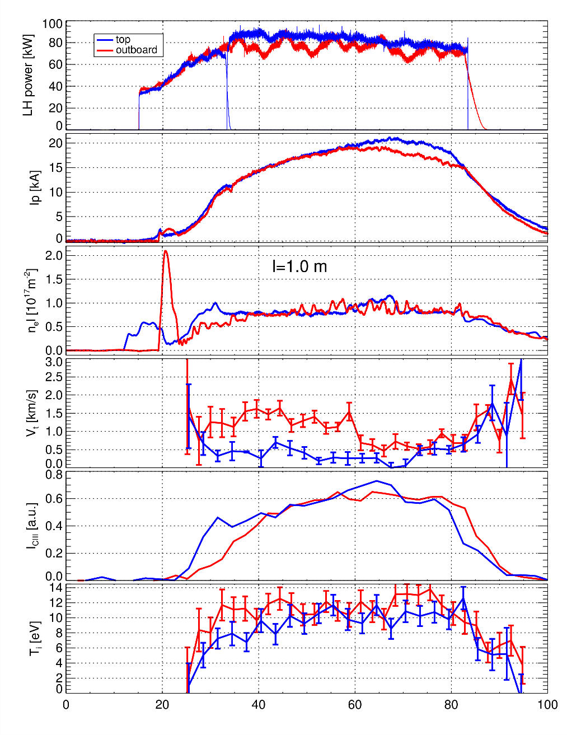

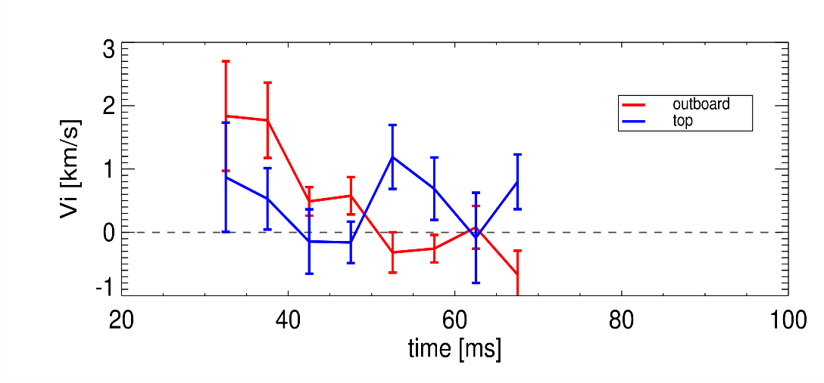
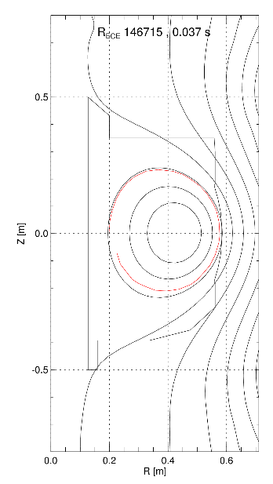
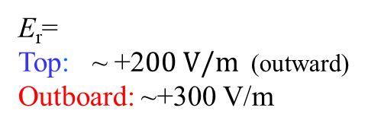
Comparison of the performances (III)
Ion temperature and flow of CIII (C²⁺)
Top/Outboard
Line of sight: R_{tan}=300 mm
Near magnetic axis
P_{LHW} [kW]
Poloidal flow
I_{p} [kA]
n_{e}l [10¹⁷m⁻²]
Toroidal flow
Intensity of CIII
E_{r}=
Top: ~ +2$00 V/m$ (outward)
Outboard: ~+300 V/m
V_{p}
I_{p}
B_{t}
Intensity of CIII

Slide 11
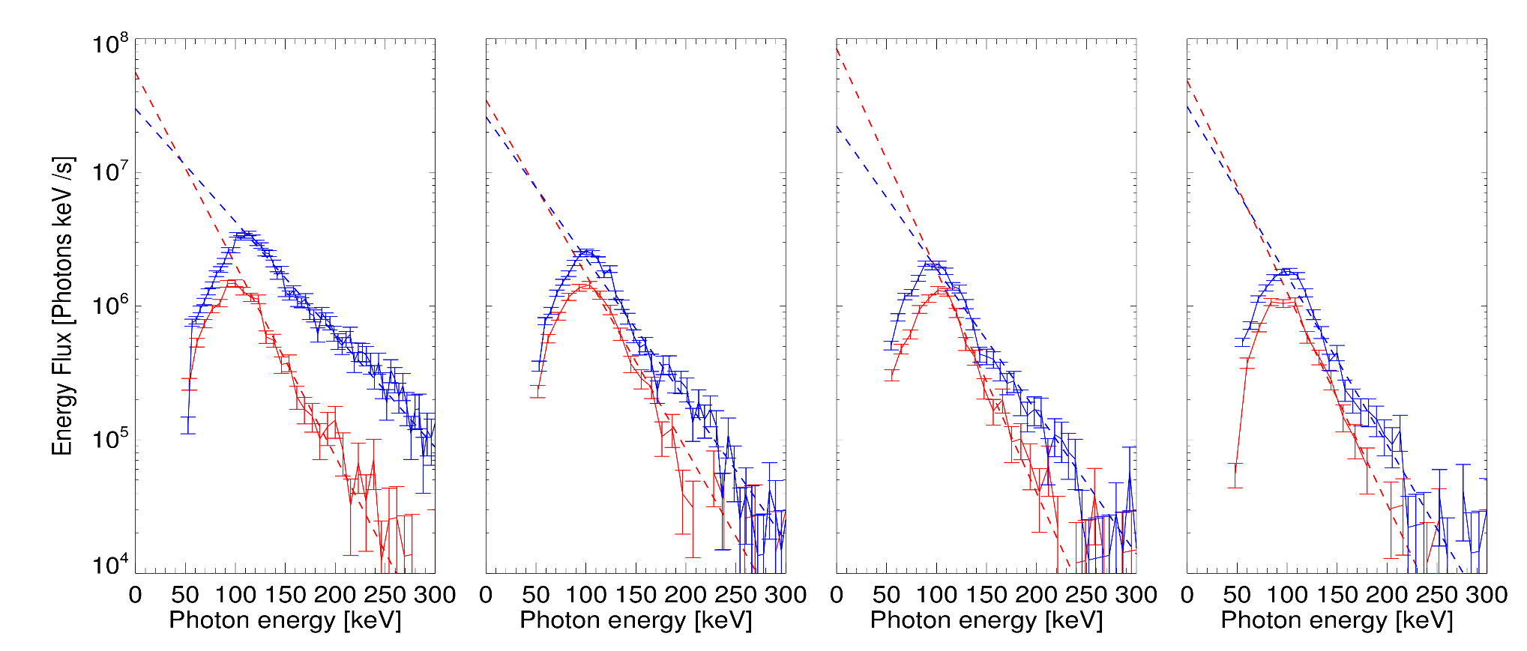
Comparison of the performances (IV)
Hard X-ray spectra measured by an NaI(TI) scintillator
Top/Outboard
Line of sight:R_{tan}=260 mm
R_{tan}=360 mm
R_{tan}=560 mm
Inboard side
Near magnetic axis
Outboard edge
T_{eff} ~ 51 keV
T_{eff} ~ 41 keV
T_{eff} ~ 34 keV
T_{eff} ~ 30 keV
T_{eff} ~ 33 keV
T_{eff} ~ 27 keV
A larger energy flux and a higher T_{eff} for Top.
High at the inboard side Top.

Slide 12
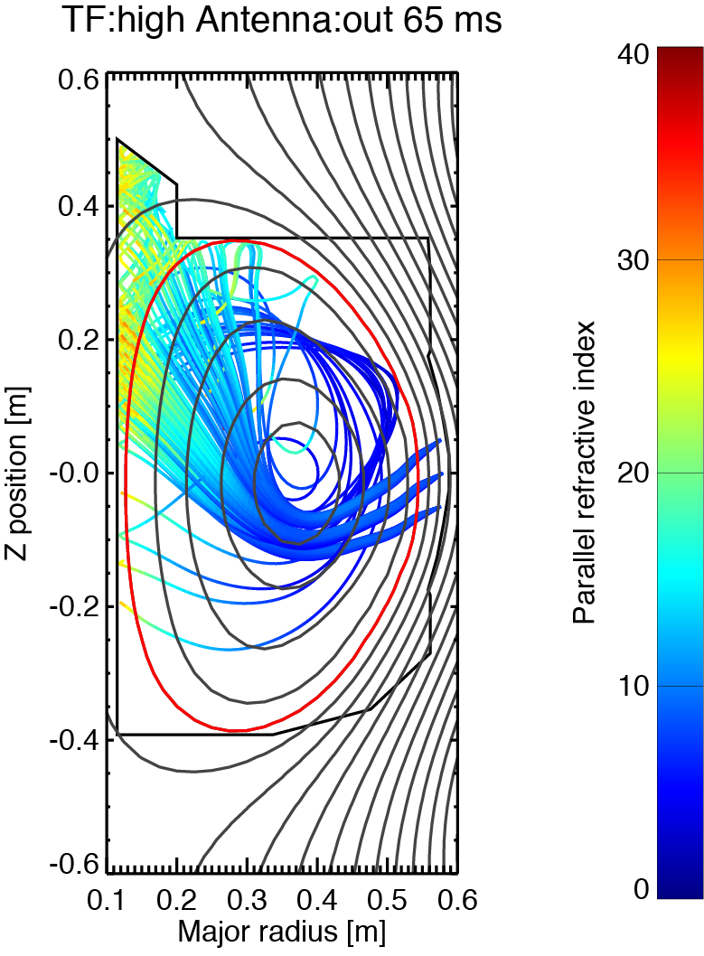
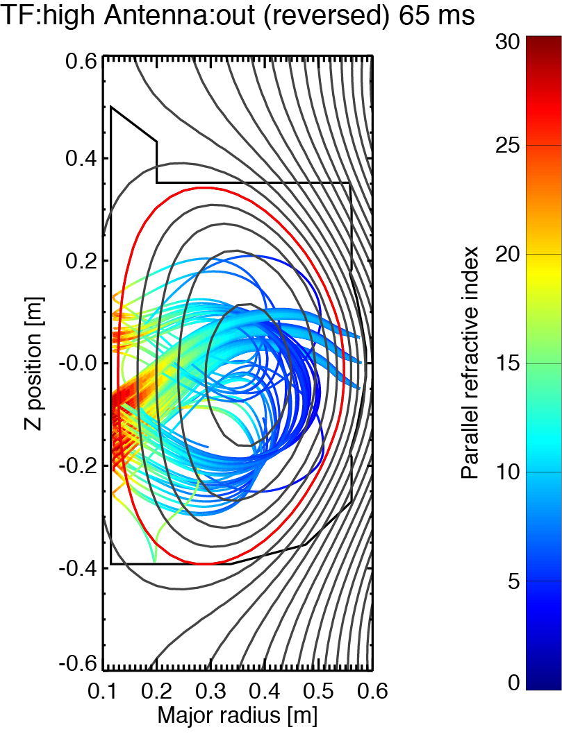
Comparison of the GENRAY results
Bt : CW
Bt : CCW
Outboard
In the case of Outboard, both CW and CCW Bt should show similar rays as long as the plasmas have up-down symmetry.
In the case of Top, CW Bt should be better because of the core accessibility and the upshift in n||.
The experimental high I_{p} for Top+CCW Bt, requires further understanding.
Top

Slide 13
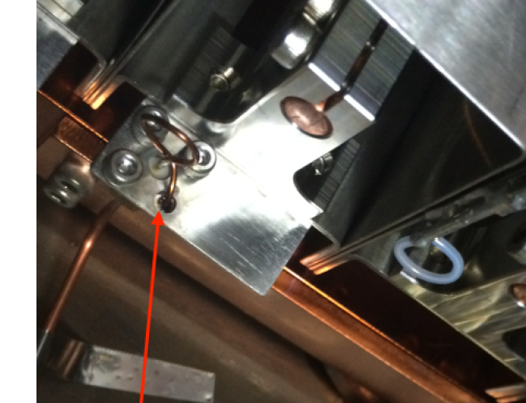
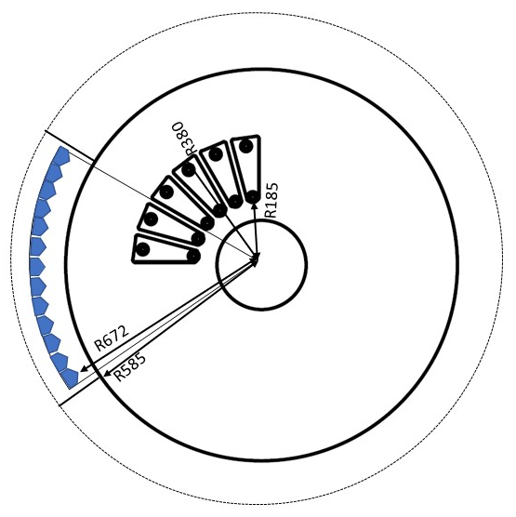
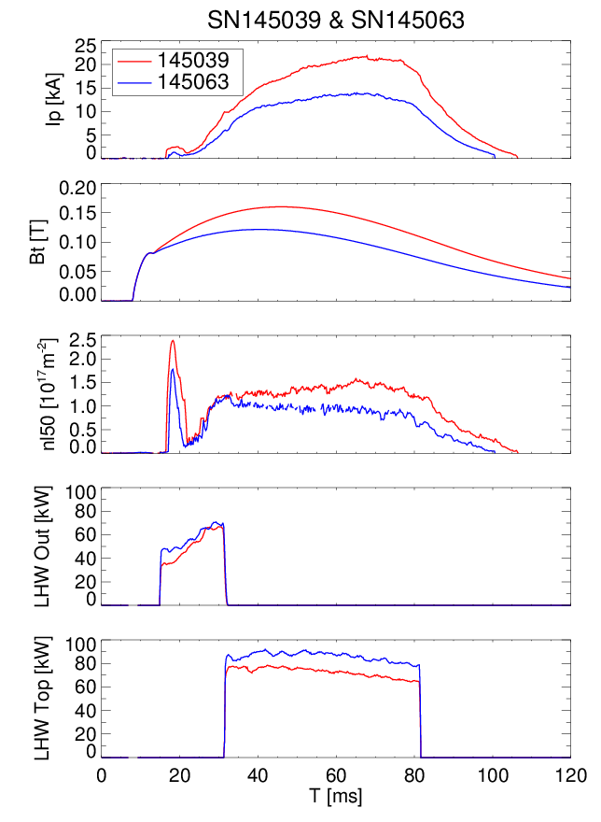
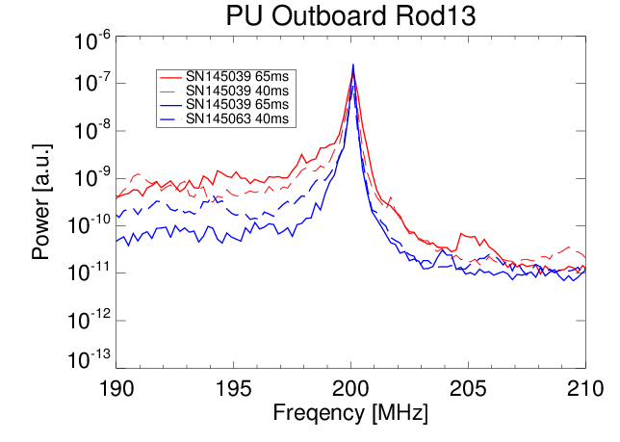
Spectrum obtained by an RF pickup coil
B_{t,} I_{p}
RF pickup coil:1-turn loop
High B_{t}
Low B_{t}
Asymmetric spectrum broadening (parametric decay instability?) of the injected wave

Slide 14
AC Ohmic coil operation for pre-ionization, current ramp-up and heating
Square AC V_{L} with frequencies < 10 kHz
V_{L}
t
Small flux swing capability
Ψ
t
Resistive V.V. INCONEL625
(t=1.57mm)
1/e Frequency: 133 kHz
I_{p} ?
t
Cumulative effect to increase n_{e} (i.e., pre-ionization)?
Heating power: <I_{p}V_{L}> → DC current drive?
IGBT
H-bridge
DC
Capacitance
PS
Targets:
a reliable pre-ionization method for reactors
a new current start-up tool

Slide 15
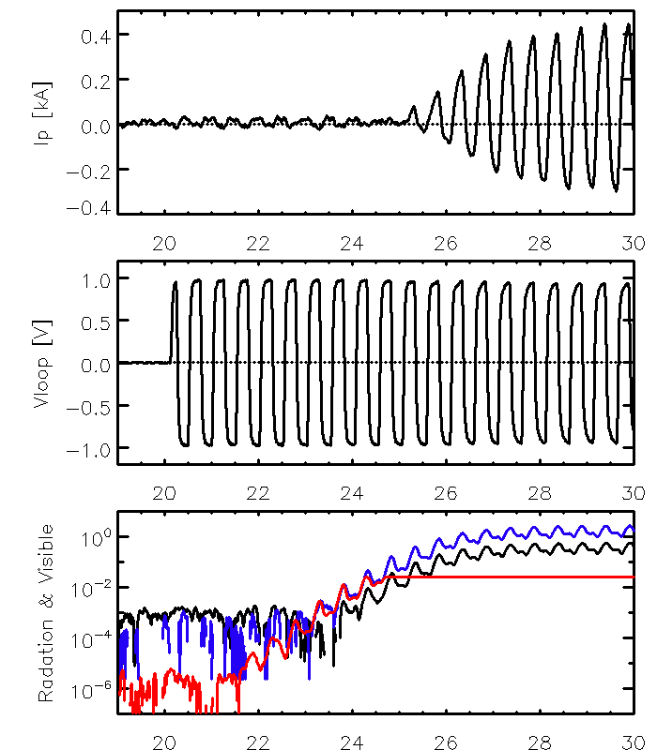
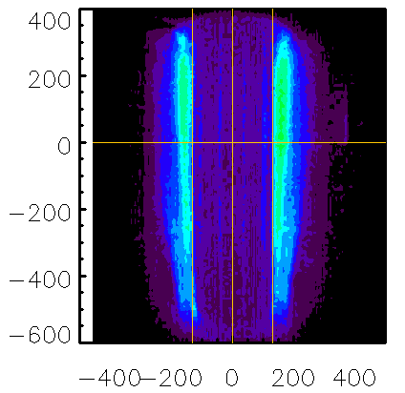
Discharges without vertical field ramp-up
to study pre-ionization
After a certain time, I_{p}, n_{e}, light emissions grows exponentially and saturate at a level. A thin plasma attached to the inboard wall is formed
#137292
0.4
I_{p} [kA]
0
Z [mm]
~800 mm
-0.4
1
V_{L} [V]
0
-1
R [mm]
130 mm
10⁰
Vis PD
~130 mm
Radiation & Visible [a.u.]
Rad
Visible emissions, radiation n_{e} are nearly proportional.
Growth rate, appearance time and saturation level of visible emissions characterize the pre-ionization.
10⁻²
Vis. PMT
10⁻⁴
10⁻⁶
20
22
24
26
28
30
Time [ms]

Slide 16
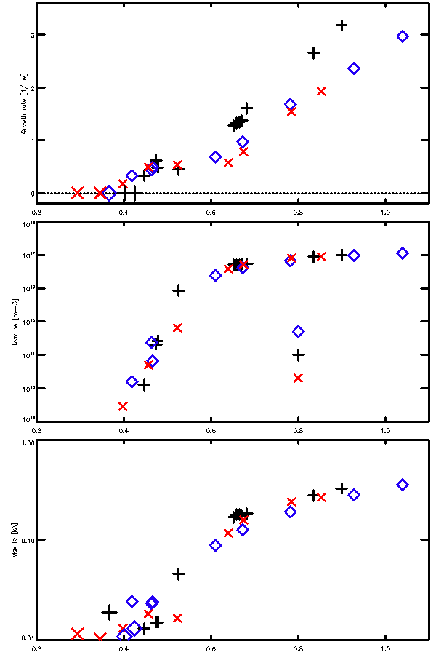
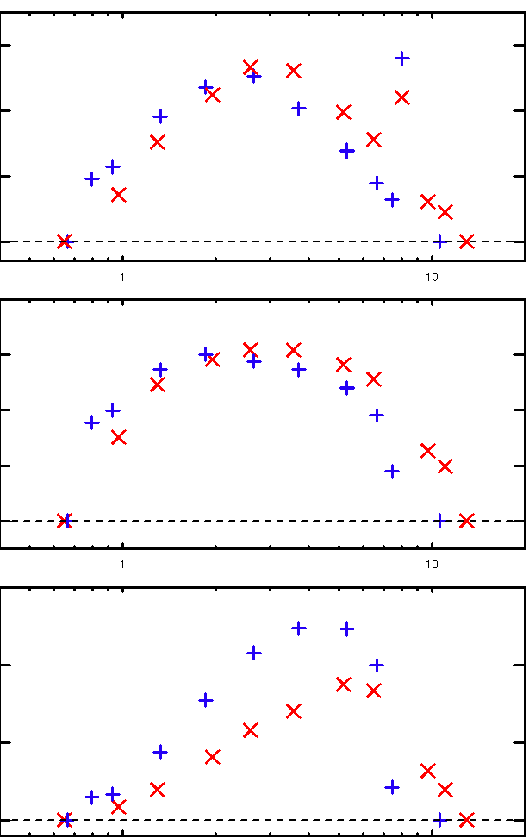
Loop voltage V_{L} dependence
Filling pressure (D₂, H₂) dependence
(f_{AC}=2 kHz/p_{G}=3.9x10⁻⁵ Torr/B_{t}=0.41 T/B_{Zext}=-0.52, 0, +0.08 mT)
(|V_{L}|=0.94 V/f_{AC}=2 kHz/B_{t}=0.41 T/B_{Zext}=0)
3.0
(a)
3.0
(a)
H₂
Growth rate [1/ms]
D₂
Growth rate [1/ms]
0.0
0.0
10¹⁸
(b)
0.4
(b)
Saturation level of radiation [a.u.]
B_{Zext}=
Saturation level of
I_{p} [kA]
-0.52 mT
0 mT
+0.08 mT
0.0
10¹²
1
(c)
(c)
0.1
Saturation level of radiation [a.u.]
Saturation level of I_{p} [kA]
0.01
0.2
0.4
0.6
0.8
1.0
1
p_{G} [10⁻⁵ Torr]
10
|V_{L}| [V]
Minimum |V_{L}|~0.4 V = 0.5 V/m

Slide 17
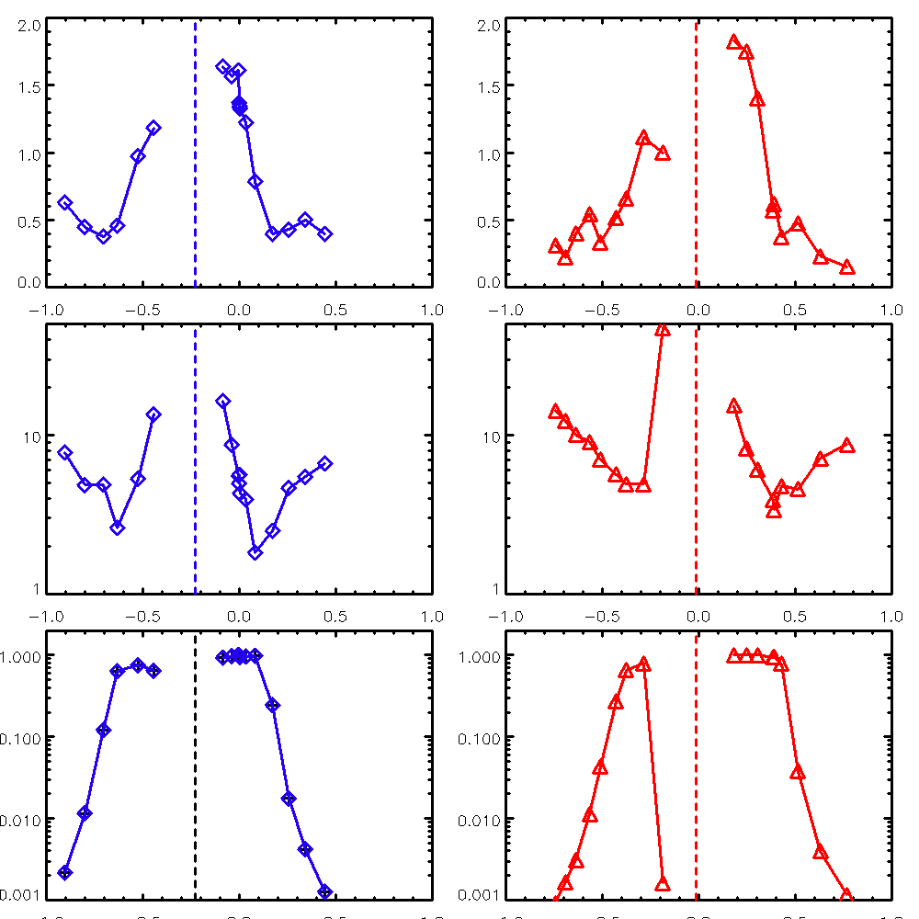
External B_{Z} dependence
(|V_{L}|=0.67, 0.72 V/f_{AC}=2 kHz/p_{G}=3.9x10⁻⁵ Torr/B_{t}=+0.41, -0.41T)
-B_{ZTF}-0.12 [mT]
-B_{ZTF}-0.12 [mT]
2
(a)
(d)
Growth rate [1/ms]
1
0
50
(b)
(e)
10
Appearance time [ms]
5
1
1
(c)
(f)
Saturation level of radiation [a.u.]
0.1
0.01
0.001
-1.0
-0.5
0
+0.5
+1.0
-1.0
-0.5
0
+0.5
+1.0
B_{Zext} [mT]
B_{Zext} [mT]

Slide 18
0-dimensional model
Equation of motion
Evolution of density

Slide 19
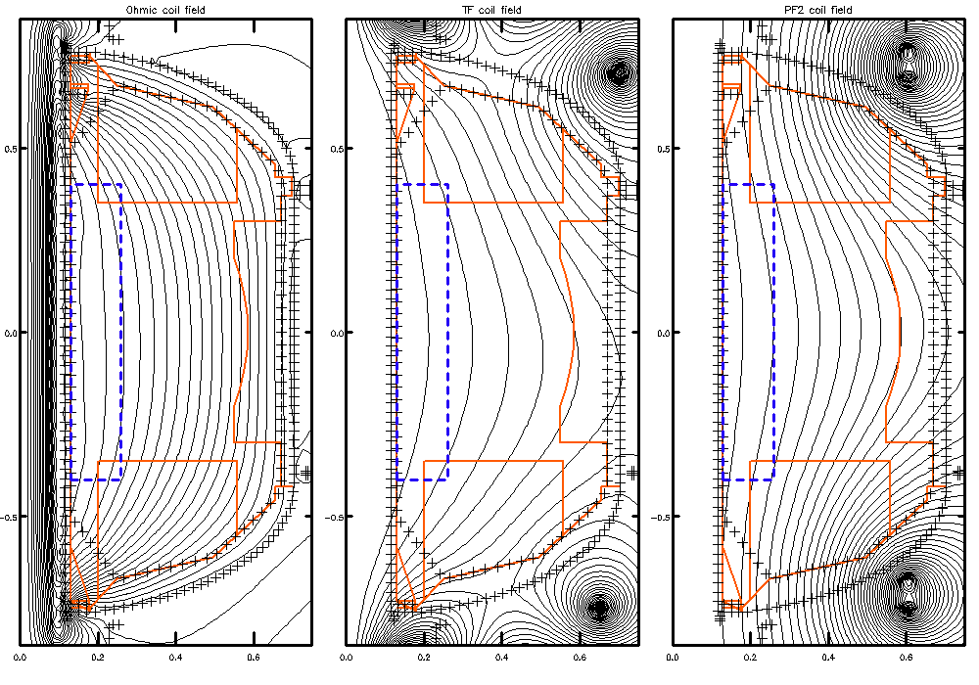
Magnetic configuration in the AC Ohmic coil operation
(a)
Plasma region
(b)
Field line
Z
R_{in}=0.13 m
B_{Z}, B_{R}
V_{t}
Reconstructed flux surfaces
R
L_{c}
B_{t}
0
2Z_{limit} =0.8 m
Thin INCONEL wall
Ohmic coil
Ohmic coil
Thick SUS wall
(c)
(d)
(VF)
2R_{Width}=0.13 m
0.5
(c)
(d)
(e)
Leak field by Ohmic coil
Error field by TF coil
Self field by I_{p}
Z [mm]
0
I_{p}
B_{ZOH}
B_{ZP}
-0.5
B_{ZTF}
0
0.2
0.4
0.6
0
0.2
0.4
0.6
0
0.2
0.4
0.6
R [mm]
R [mm]
R [mm]

Slide 20
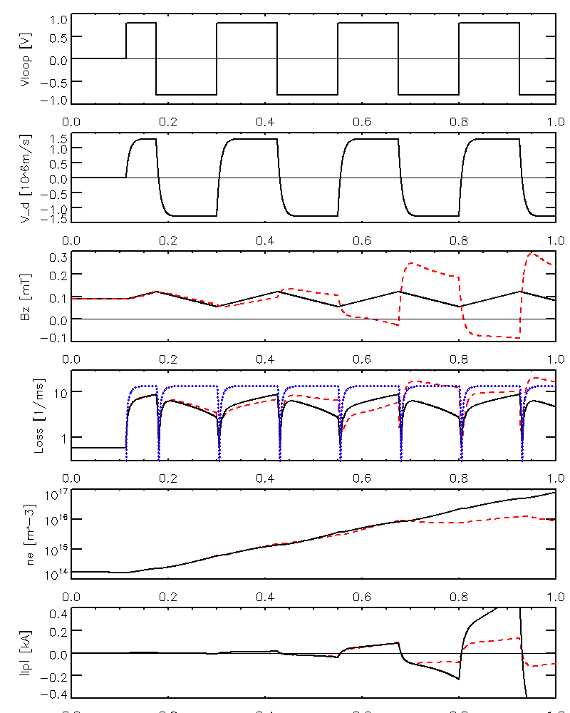
Time evolution calculated by the 0-dimensional model
(|V_{L}|=0.8 V/f_{AC}=4 kHz/p_{G}=3x10⁻⁵ Torr/B_{t}=0.34T/T_{e}=10 eV)
Linear growth, saturation of Ip and various dependences can be reproduced by the model.
Quantitative agreements between the model and experiments are typically within a factor of 10.
However, D2/H2 and Bz dependence of the appearance time can not be reproduced.
In addition, 0-dimensional model is not appropriate theoretically due to the diffusive loss and the impossibility in ambipolar diffusion state. -> development of 1-dimensional model
1
(a)
0
V_{L} [V]
-1
1.5
(b)
V_{t}
[10⁶ m/s]
0
-1.5
0.3
(c)
B_{Z} [mT]
0
-0.1
Birth rate
Birth & loss rate
[1/ms]
(d)
10
1
loss rate
10¹⁷
(e)
n_{e}
[m⁻³]
10¹⁴
0.4
(f)
I_{p} [kA]
0
-0.4
0
0.2
0.4
0.6
0.8
1
Time [ms]

Slide 21
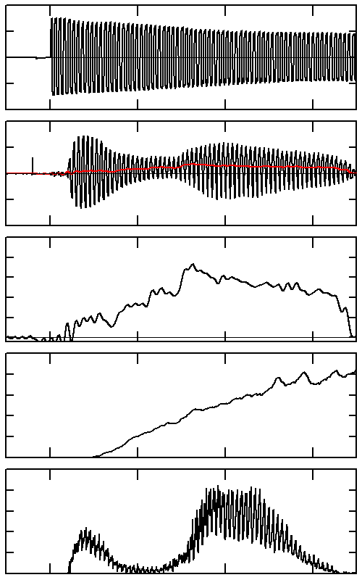
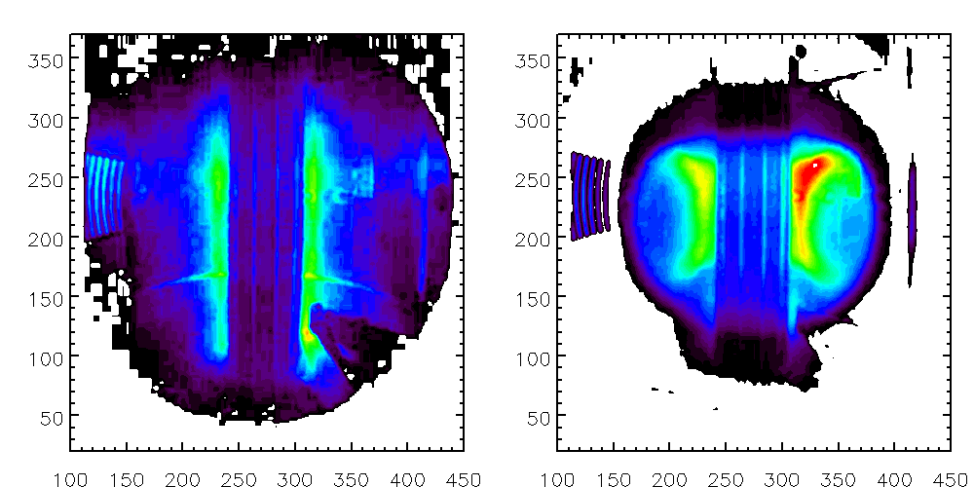
Application of external B_{Z} induces a DC component in I_{p}
Time averaged camera image
+10
(a)
(f)
V_{L} [V]
0
-10
+10
(b)
I_{p} [kA]
Thin cylindrical plasma
0
-10
2
(c)
Enlarged
0.26 m
I_{p} [kA]
(<1.2 kHz)
1
0
(g)
2
(d)
B_{Z} ramp up
ST-like shape
B_{z} [mT]
1
0
0.8
(e)
0.4
n_{e} [10¹⁸m⁻³]
0.26 m
0
10
20
30
40
Time [ms]
Gas puff

Slide 22
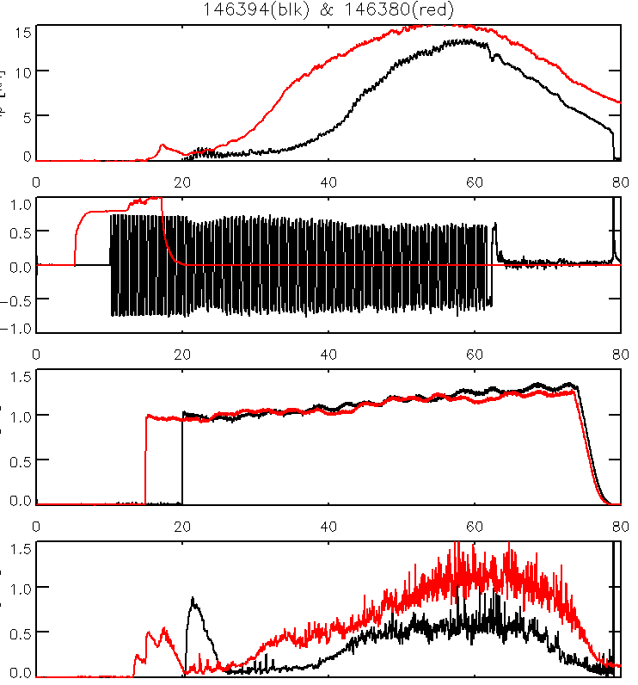
Pre-ionization by ECH and AC Ohmic coil operation for LHW start-up
I_{p} [kA]
P_{ECH}~2.5 kW
|V_{L}|=0.7 V, f_{AC}=2 kHz
P_{ECH} & V_{L} [V]
Successful pre-ionization by AC Ohmic coil operation
for LHW plasma
P_{LHW} [a.u.]
Radiation [a.u.]
0
20
40
60
80
Time [ms]

Slide 23
Summary
LHW current drive
Two capacitively coupled combline (CCC) antennas at the outboard side and the top of the plasma were used.
I_{p} increases with B_{t} and n_{e}. The top launch antenna seems to be slightly better in achieving higher I_{p}.
AC Ohmic coil operation
AC Ohmic operation experiments has been performed and it was shown that it can be used as a reliable pre-ionization tool.
A 0-dimensional model was developed, and it can reproduce various experimental dependences, but 1-dimensional model is preferable for better understanding of the physics of the AC Ohmic coil operation.
External B_{Z} induces a DC component in I_{p}
This work is supported by JSPS Grant-in-Aid for Scientific Research 21226021 and 23360409, NIFS Collaboration Research Program NIFS14KOCR001 and NIFS12KUTR078, JSPS A3 Foresight Program.

Slide 24
Future plan and targets
According to experimental and numerical studies, improvements in the current drive efficiency and in I_{p} is expected by the following methods.
Optimization of antenna position and n|| spectrum.
3-D control of wavevector
Combination of 200 MHz and 450 MHz (core heating)
I_{p} Reduction of SOL losses
Higher B_{t}
0.5
In order to understand boundary effects (e.g. secondary electron emission) in AC Ohmic operation
A new short coil at the center would be useful
Z [mm]
0
-0.5
0
0.2
0.4
0.6
R [mm]

Slide 25
Backup

Slide 26
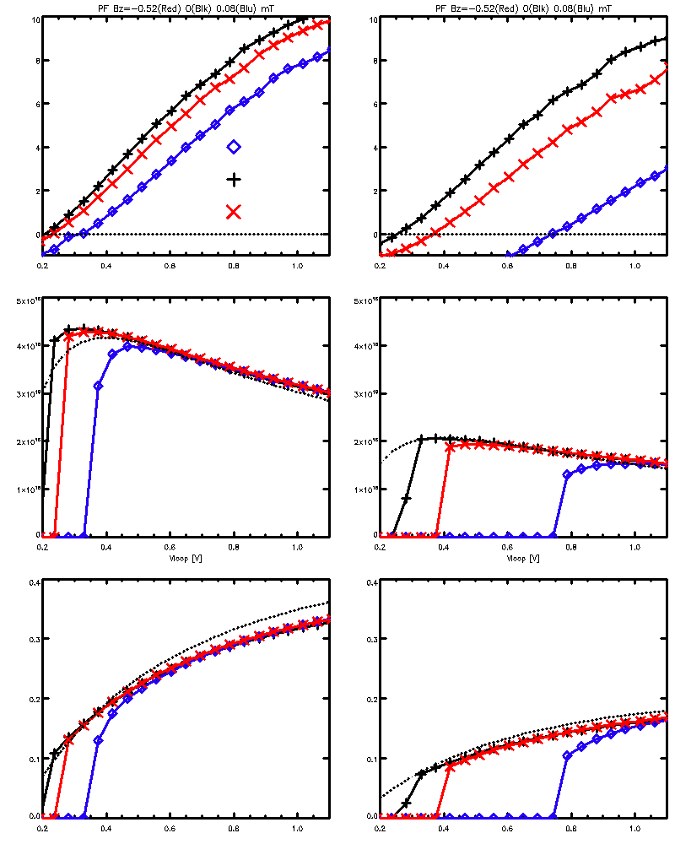
Comparison between experiment and 0-dimensional model
(f_{AC}=2 kHz/p_{G}=3.9x10⁻⁵ Torr/B_{t}=0.41 T/T_{e}=10 eV)
(f_{AC}=2 kHz/p_{G}=3.9x10⁻⁵ Torr/B_{t}=0.41 T/B_{Zext}=-0.52, 0, +0.08 mT)
10
(a)
(a)
(d)
3.0
Growth rate [1/ms]
B_{Zext}=
Growth rate [1/ms]
-0.52 mT
0 mT
0
+0.08 mT
0.0
10¹⁸
5
(b)
(e)
(b)
Saturation level of n_{e} [10¹⁶ m⁻³]
n_{e0}/4
Saturation level of radiation [a.u.]
B_{Zext}=
-0.52 mT
0 mT
+0.08 mT
10¹²
0
1
0.4
(c)
(f)
(c)
Saturation level of
I_{p} [kA]
I_{p0}/8
0.1
0.2
Saturation level of I_{p} [kA]
0.01
0
0.2
0.4
0.6
0.8
1.0
0.2
0.4
0.6
0.8
1.0
0.2
0.4
0.6
0.8
1.0
|V_{L}| [V]
|V_{L}| [V]
|V_{L}| [V]

Slide 27
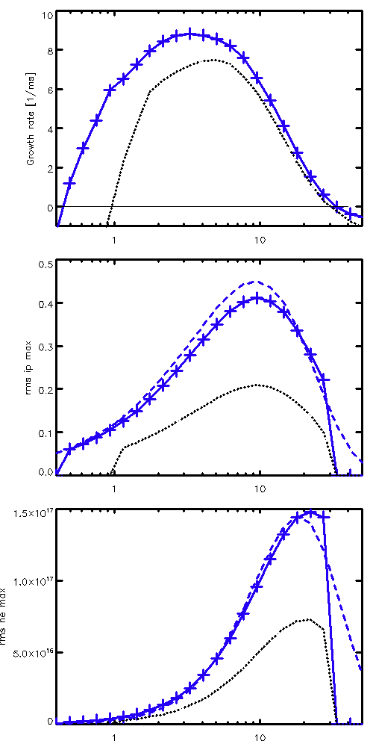
Comparison between experiment and 0-dimensional model
(|V_{L}|=0.94 V/f_{AC}=2 kHz/B_{t}=0.41 T/B_{Zext}=0)
(|V_{L}|=0.94 V/f_{AC}=2 kHz/B_{t}=0.41 T
/B_{zext}=0 /T_{e}=10 eV)
3.0
(a)
10
H₂
(a)
D₂
C₀=1
Growth rate [1/ms]
Growth rate [1/ms]
C₀=1/2
0.0
0
0.4
(b)
0.5
(b)
C₀=1
Saturation level of
I_{p} [kA]
Saturation level of
I_{p} [kA]
I_{p0}/8
0.0
C₀=1/2
0.0
(c)
2.0
(c)
C₀=1
Saturation level of radiation [a.u.]
Saturation level of n_{e} [10¹⁷ m⁻³]
n_{e0}/4
C₀=1/2
1
p_{G} [10⁻⁵ Torr]
10
0.0
1
10
p_{G} [10⁻⁵ Torr]

Slide 28
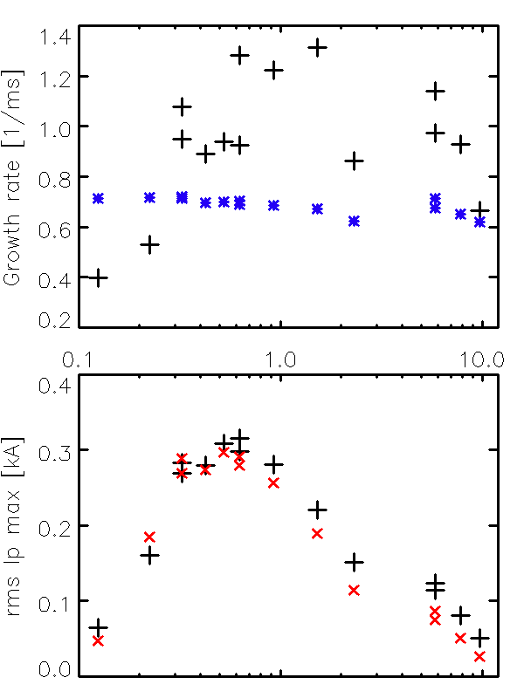
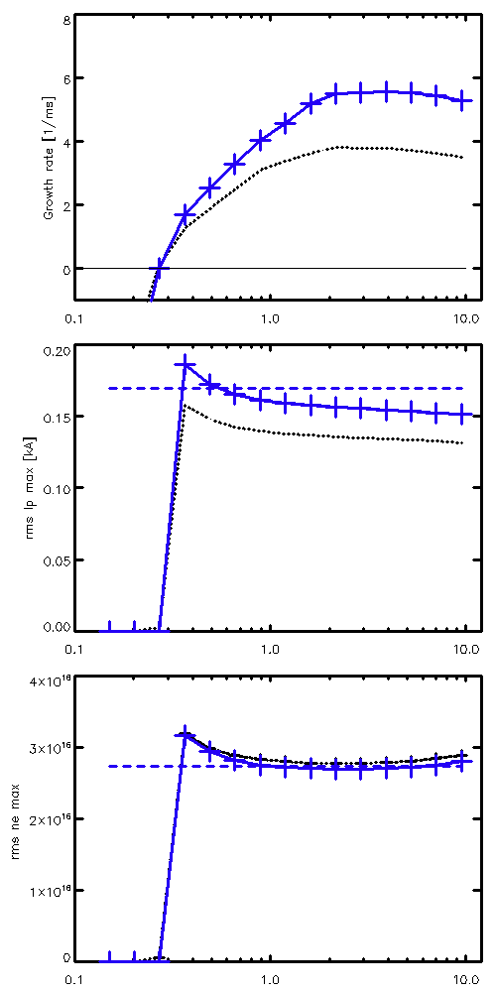
Comparison between experiment and 0-dimensional model
(p_{G}=5.2x10⁻⁵ Torr/B_{t}=0.42 T
/B_{zext}=0 /T_{e}=10 eV)
(V_{Lrms}=0.62-0.72 V/p_{G}=5.2x10⁻⁵ Torr/B_{t}=0.42 T/B_{Zext}=0)
1.4
(a)
(d)
|V_{L}|=0.72 V
Growth rate [1/ms]
C₀=1/2
1.0
Growth rate [1/ms]
& V_{Lrms} [V]
|V_{L}|=0.6 V
0.6
V_{Lrms}
0.2
(e)
0.4
Saturation level of
I_{p} [kA]
(b)
Saturation level of I_{p} [kA]
and radiation [a.u.]
0.2
I_{p}
(f)
radiation
Saturation level of n_{e} [10¹⁷ m⁻³]
0.0
0.1
1
10
Frequency [kHz]
0.1
1
10
f_{AC} [kHz]

Slide 29
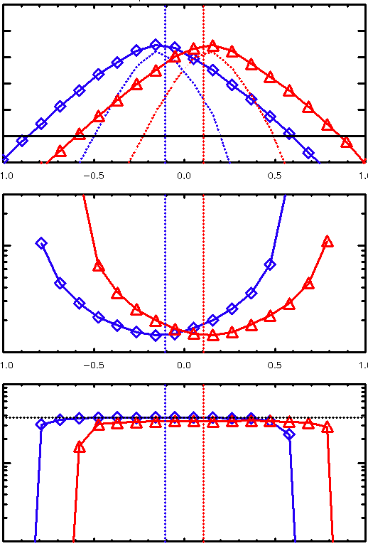
Comparison between experiment and 0-dimensional model
(|V_{L}|=0.68 V/f_{AC}=2 kHz/p_{G}=3.9x10⁻⁵ Torr/T_{e}=10 eV)
(|V_{L}|=0.67, 0.72 V/f_{AC}=2 kHz/p_{G}=3.9x10⁻⁵ Torr/B_{t}=+0.41, -0.41T)
B_{ZTF}
-B_{ZTF}-0.12 [mT]
-B_{ZTF}-0.12 [mT]
10
(a)
2
(a)
(d)
B_{t}=-0.41 T
B_{t}=+0.41 T
Growth rate [1/ms]
Growth rate [1/ms]
1
C₀=1
0
C₀=1/2
0
-2
50
(b)
(e)
3.0
(b)
Appearance time [ms]
10
1.0
5
Inverse growth rate [ms]
1
1
(c)
(f)
0.1
Saturation level of radiation [a.u.]
10¹⁷
0.1
(c)
n_{e0}/4
0.01
Saturation level of n_{e} [m⁻³]
0.001
10¹⁶
-1.0
-0.5
0
+0.5
+1.0
-1.0
-0.5
0
+0.5
+1.0
B_{Zext} [mT]
B_{Zext} [mT]
10¹⁵
-1.0
-0.5
0
+0.5
+1.0
B_{Zext} [mT]

Slide 30
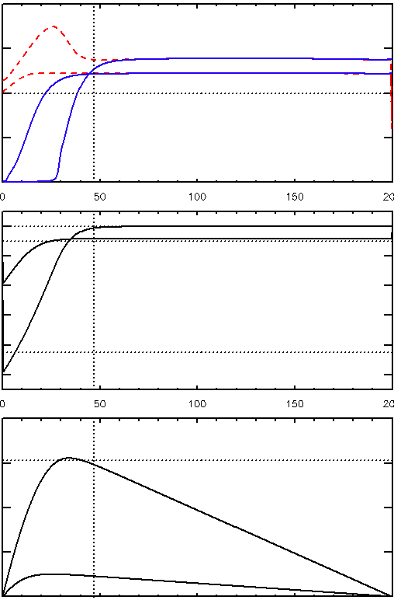
1-dimensional model
(b)
(E_{ext}=-1 V/m / x_{l}=200 m /p_{G}=1x10⁻⁴ Torr /
kT_{e}=kT_{i}=5 eV / γ_{s}=1)
(a)
Z
Limiter
Z
Limiter
2
500 μs
n_{i}
40 μs
(a)
n_{e}
500 μs
Plasma region
40 μs
1
2Z_{limit}
n_{e} & n_{i} [10⁷ m⁻³]
Field line
0 μs
R
Toroidal angle
0
0
2π
0
0000
0
Wall
(b)
x
0 μs
+
+
+
+
+
+
E [V/m]
40 μs
ρ_{i}
Limiter
Limiter
500 μs
2R_{Width}
-10
200
(c)
Reproduction of ambipolar diffusion state.
Secondary electron emission by ion impact at the walls are candidate mechanism to mitigate or destroy the ambipoloar state.
φ [V]
500 μs
40 μs
0
0
100
200
x [m]

