Slide 1

Gyrokinetic heat-flux footprint in NSTX and NSTX-U plasmas
Seung-Hoe Ku¹, C-S Chang¹, R.M. Churchill¹, G.P. Canal¹,
J.-W. Ahn², T. K. Gray², R. Hager¹, J. Menard¹, E. Yoon³,
and the SciDAC EPSI/BPS team
¹Princeton Plasma Physics Laboratory, NJ, USA
²Oak Ridge National Laboratory, TN, USA
³Rensselaer Polytechnic Institute, NY, USA
*Computing resources supported by NERSC
19th International Spherical Torus Workshop
Seoul National University, Seoul, Korea, September 18 – 22 2017

Slide 2
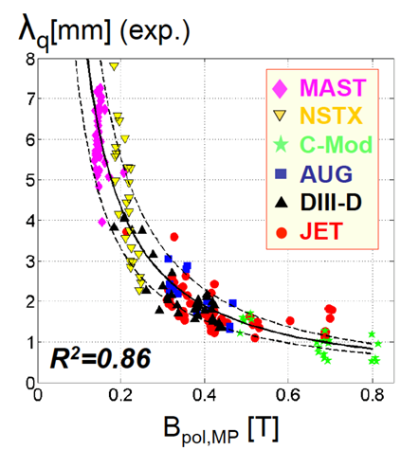
Divertor Heat-load width
  Neoclassical-ion dominant models, by XGC0 [‘10 US JRT] and Goldston, gave
      λ_{q}∝1/B_{p}^{γ}, γ~1
    Appears to be working for the present-day tokamaks. But, high B_{p} cases?
  Will this be true in the large-size ITER?
    Use XGC for “validated” predictive simulations
    Code validations on present tokamaks
    Predictive simulations for ITER and NSTX-U
T. Eich et al., NF 2013;
PRL 107, 215001 (2011)

Slide 3
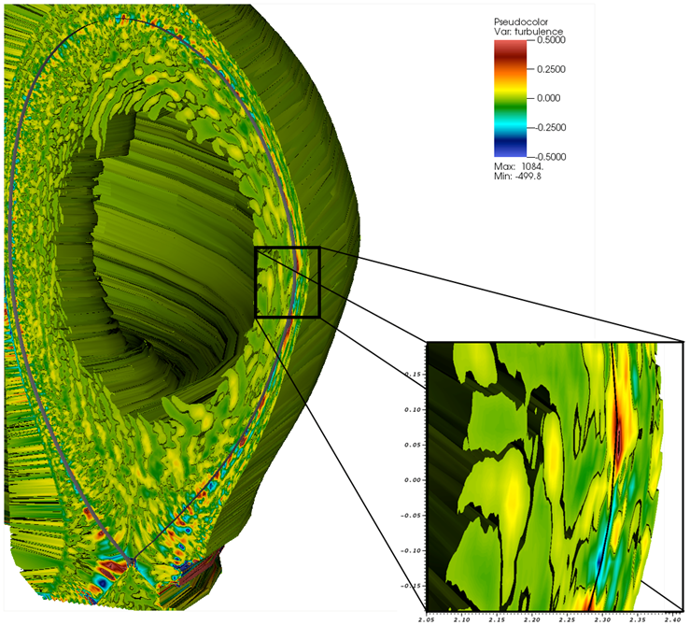
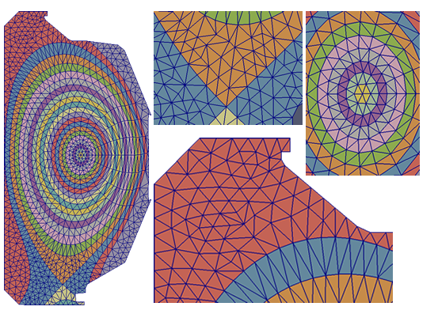
XGC: X-point included Gyrokinetic Code
XGC is the world’s first, and the only, gyrokinetic code that simulates the boundary plasma across the magnetic separatrix into the scrape-off layer with neutral recycling.
Particle-in-cell
Unstructured triangular mesh
Fully nonlinear Coulomb Collisions
Built-in Monte-Carlo neutrals
Logical sheath boundary
Options for Electron models & perturbed field:
  Adiabatic electron with ES turbulence
  Kinetic electrons with ES turbulence
  Fluid electrons with EM turbulence
  Fully implicit kinetic electrons with EM turbulence

Slide 4
XGC uses leadership class computers
Discover physics that are only possible through extreme scale computing
  XGC has been selected for all 3 pre-exascale and exascale programs: CAAR (ORNL-Summit), NESAP (NERSC-Cori), and Aurora ESP (ANL-Aurora, 1st US Exascale Computer)
    For validations and predictions,
      XGC contains gyrokinetic ions, drift-kinetic electrons, neoclassical orbits, MC neutrals, non-linear collisions, and orbit losses.
      Simulation is until heat-load width saturates; t≫R/C_{s}
    Extreme scale computing: 1 ITER case uses the whole Titan (world #4, 27PF) for ≥3 days. NSTX-U case uses 1/4 of 28PF Cori pre-exascale machine for 2 days.

Slide 5
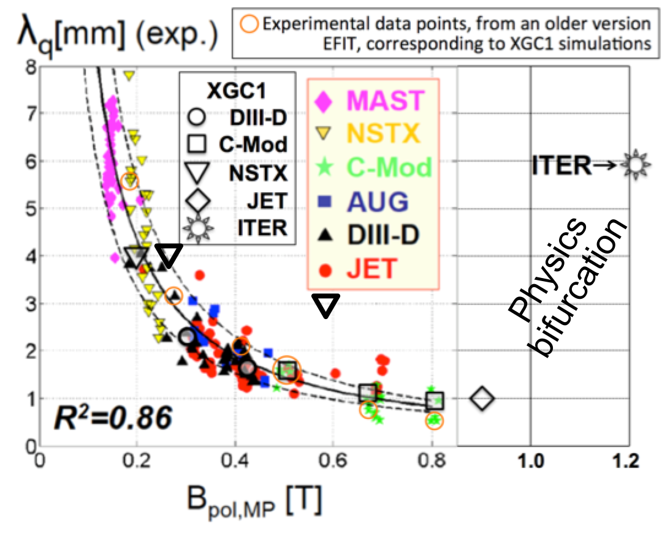
Validation on present Tokamaks and Prediction for ITER
[Chang, Ku et al NF2017; Invited Talk, IAEA2016]
The same code that reproduces existing tokamak experimental results predicts λ_{q}≈ 6mm instead of <1mm, using a model ITER edge profile
Different edge physics in ITER: blobs in the present tokamaks, but streamers in ITER
NSTX
high triangularity
NSTX-U (2MA)
Notes:
Triangularity: 0.72

Slide 6
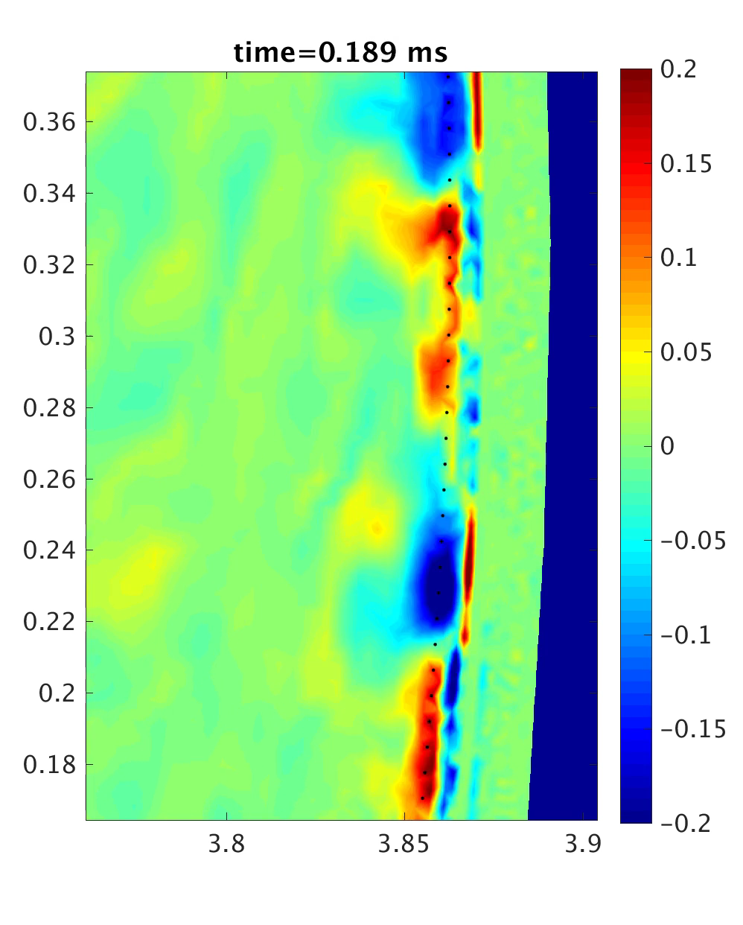
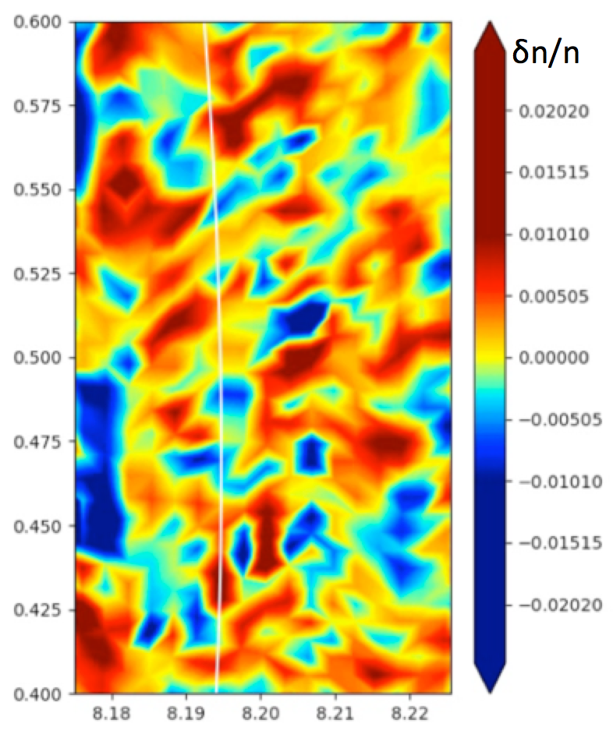
There appears to be a “bifurcation” from Blob- to Streamer-type
edge turbulence somewhere between JET and ITER
JET
ITER
Other present tokamaks show much better defined blob structure
Plan for the “turbulence-type bifurcation:”
Study numerical tokamaks whose sizes are between JET and ITER.

Slide 7
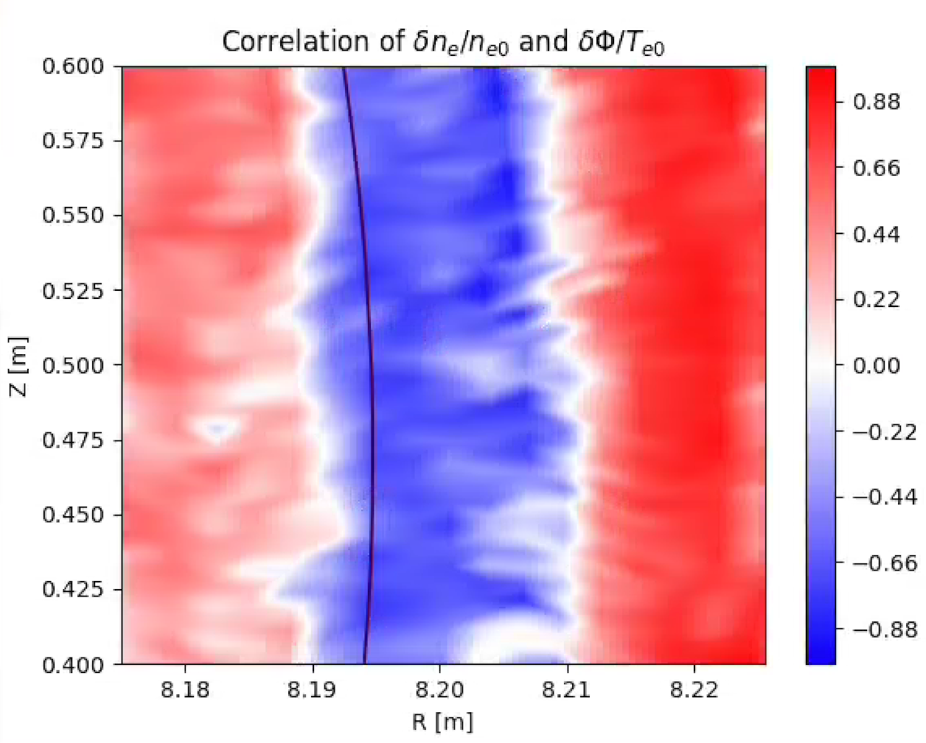
Strong anti-correlation (high particle transport) between δn and δΦ across separatrix → large radial transport
ITER

Slide 8
NSTX-U equilibrium profile setup
Aim for high triangularity shots for better stability and transport
NSTX-U magnetic
Geometry
NSTX-U
NSTX
Choose a high triangularity base NSTX case: #139047
  B_{p,mid}=0.25T, B₀=0.38T, P=3.8MW, Ip=0.96MA
Model an NSTX-U plasma keeping similar shape
  similar q-profile and β_{N}, 17% lower Greenwald density at pedestal top (n_{ped}/n_{G}=0.5)
  B_{p,mid}=0.58T, B₀=0.91T, P=7.8MW, Ip=2MA
  What will the weaker neoclassical effect do?
How will λ_{q} behave?

Slide 9
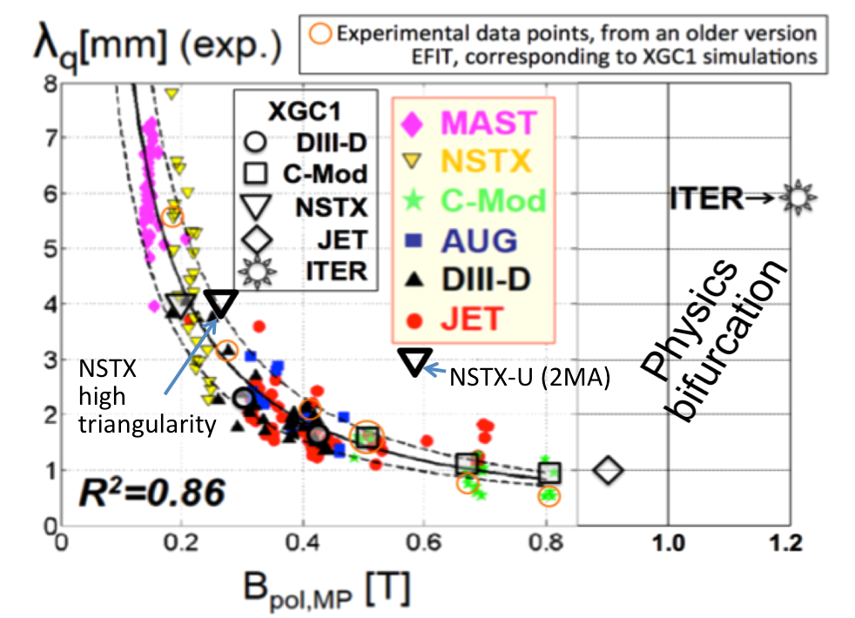
NSTX-U 2MA case show 2.3 times greater heat-load width than Eich fit → lower power density
NSTX-U
λ_{q} for the NSTX case (3.87mm) is about 1.3 time greater than Eich fit (within error bar)
λ_{q} for the NSTX-U 2MA case (2.90mm) is about 2.3 times greater than Eich fit.
High triangular shape gives weaker spread of grad-B driven neoclassical ion orbit into private region → smaller S parameter

Slide 10
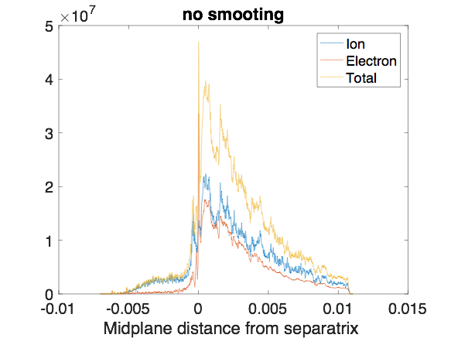
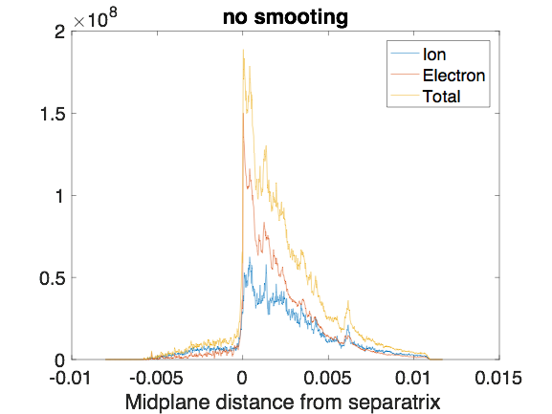
High field NSTX-U (2MA) shows turbulence dominant electron heat-load footprint
NSTX
NSTX-U
Electron contribution (mostly from turbulence) becomes higher than the ion contribution (mostly from neoclassical orbit)
  Suggests enhanced role of turbulence in high-field, high-triangularity NSTX-U plasma
What is the connection to ITER edge turbulence?

Slide 11
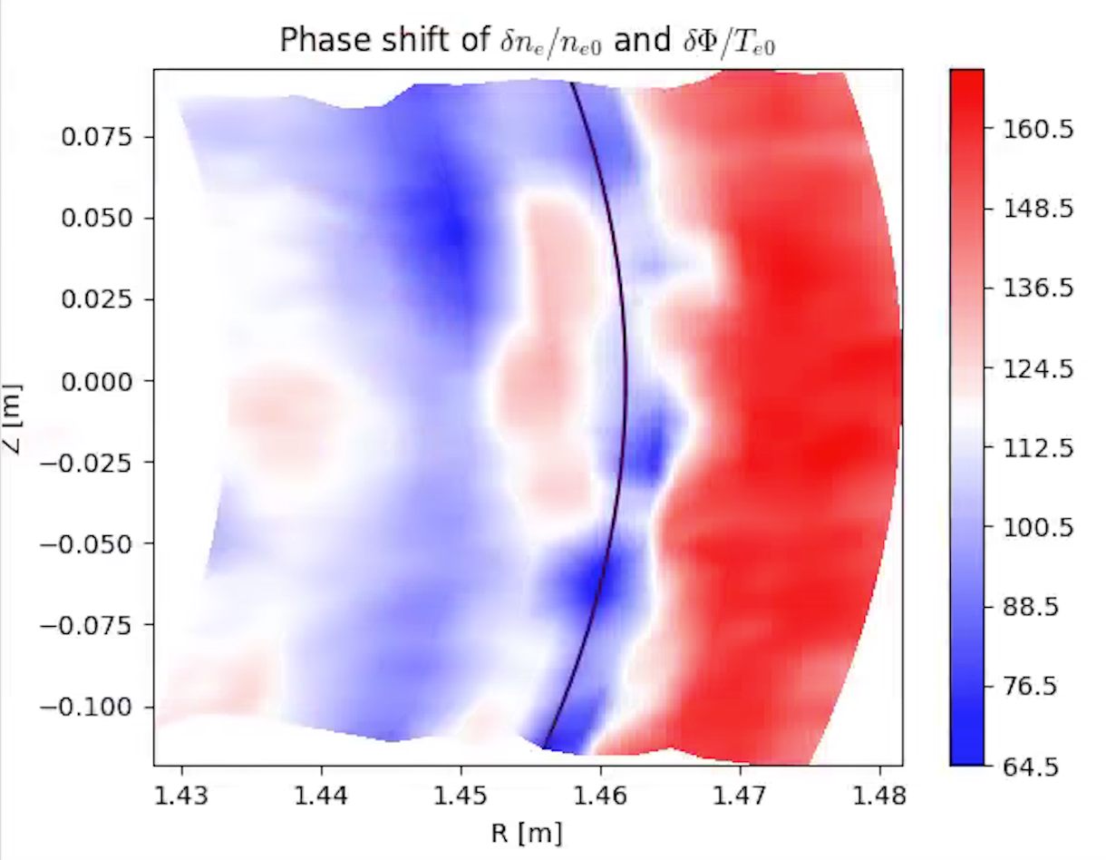
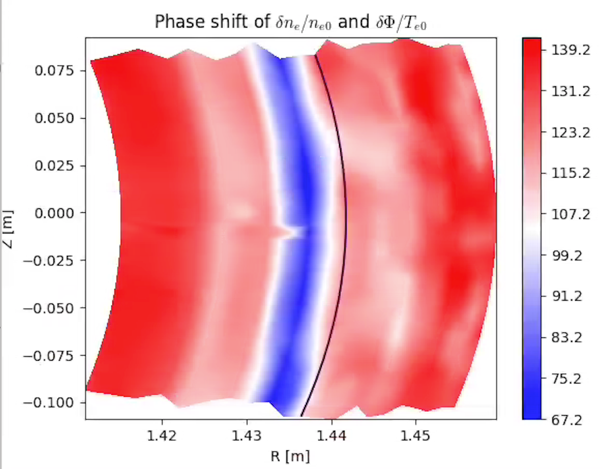
Stronger phase shift between density and potential fluctuations in NSTX-U
Higher non-adiabatic electron response
Higher turbulent radial transport
NSTX
NSTX-U

Slide 12
Heat-load comparison between Inner and Outer legs
Outer leg
NSTX-U
Inner leg
NSTX-U
λ_{q} at inner leg is about 2/3 of the outer leg λ_{q} for both cases.
The heat-load ratio “inner-leg/outer-leg” is about 1/2 in both NSTX and NSTX-U cases.
Thus, power density on the inner leg is lower, but not by much, than that on outer leg

Slide 13
Summary
First-principles-based XGC-modeling reproduced Eich _{q} within error bar in present-day tokamaks: edge turbulence is of “blob type.”
  _{q}(ITER) < 1mm
  XGC predicts that _{q}(ITER) ~ 6mm
    Edge turbulence in ITER shows “streamer-type” behavior, with a strong anti-correlation between density and potential fluctuations
Higher triangularity NSTX-U plasma shows about 2.3X greater _{q} than Eich value
  Weaker neoclassical effect than in NSTX
  Higher electron heat-flux, thus turbulence effect than in NSTX
  Strong decorrelation between density and potential is seen
Relation between the observation in ITER and NSTX-U?

