Slide 1
Status of the Lower Hybrid Fast Wave Research on VEST 2017 ISTW Workshop @ SNU
S. H. Kimª, B. K. Jungª, S. H. Jeongª, H. W. Lee^{b}, B. J. Lee^{b}, J. G. Jo^{c}, J. I. Wang^{c}, H. Y. Lee^{c},
and Y. S. Hwang^{c}
ªKorea Atomic Energy Research Institute
^{b}Kwangwoon University
^{c}Seoul National University
20th. Sep. 2017
Notes:
I will present the status of LHFW research at KAERI.

Slide 2
Contents
Introduction to LHFW (Lower Hybrid Fast Wave)
- LHFW on CMA / Dispersion relation / Propagation boundary
- Advantages & Disadvantages
Simulation of LHFW on VEST
- Ray tracing simulation (Genray)
- Coupling efficiency simulation (1D full wave)
RF System development & Installation & Coupling experiment
- Klystron / Antenna & Integration Test
- Installation & Antenna S-parameter measurement
- Coupling experiment at low power
Summary & Future Plans
Notes:
Then, let’s move on LHFW.

Slide 3
Introduction to LHFW(0)
The continuous current drive is one of the key issues toward steady-state operation of tokamak fusion reactors.
Though the current drive by using bootstrap is the main strategy in tokamak, the external current drive is still required to control pressure profile and fill the gap between the bootstrap and target current.
Most efficient current drive ever is the LHCD which is a scheme by using slow wave in lower hybrid resonance frequency range.
However, LHCD has density limit and it is hard to propagate into the central region in high temperature due to highly damping.
Therefore, new ways to improve LHCD or alternatives to LHCD are required.
LHFW could be an alternative.
Notes:
Then, let’s move on LHFW.

Slide 4
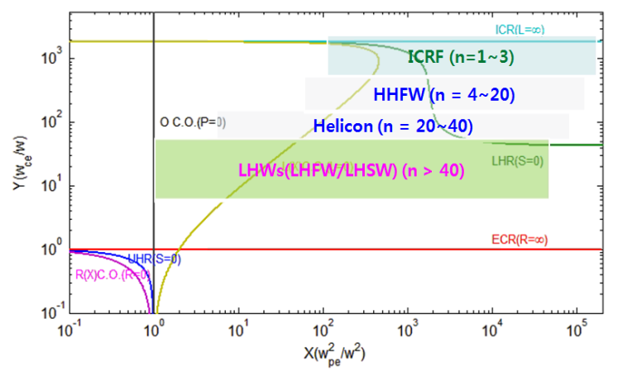
Introduction to LHFW(1) Lower Hybrid Fast Wave(LHFW) on CMA diagram
<H plasmas>
LHFW is a fast wave between lower hybrid resonance frequency and electron cyclotron resonance frequency.
Notes:
Then, let’s move on LHFW.

Slide 5
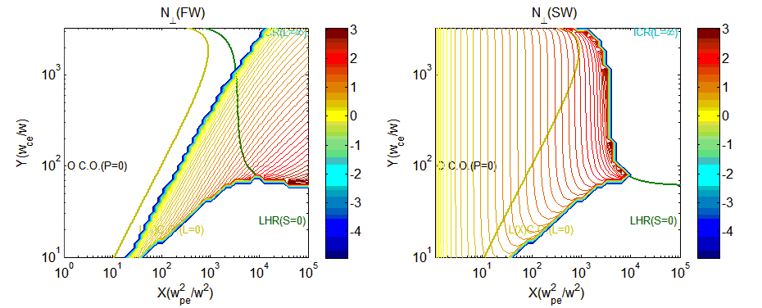
Introduction to LHFW(2)
Dispersion & Propagation Boundary
Dispersion Relation
The perpendicular wave number of LHFW is less than that of slow wave in this frequency range(LHSW).
The imaginary wave number of LHFW becomes higher as the density increases.
Propagation Boundary
Notes:
Then, let’s move on LHFW.

Slide 6
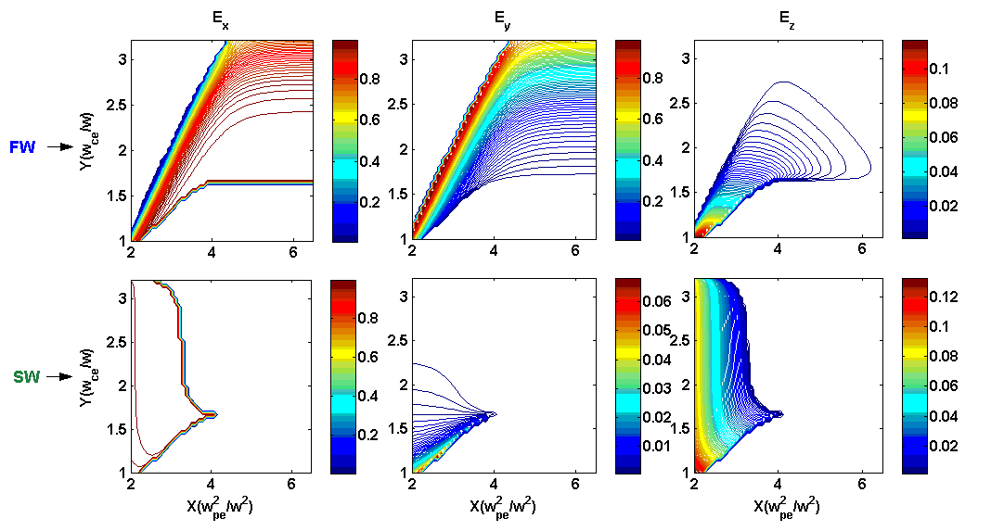
Advantages of LHFW(1)
Parallel electric field E_{z} to B
<Polarization of FW and SW on CMA>
It has favorable polarization for current drive compared to FWs in other frequency range.
Notes:
The dispersion relation in lower hybrid resonance frequency range can be expressed like this. The left is the real perpendicular refractive index which represent the propagation. And the right is the imaginary part which represent damping or absorption. There are two wave branches, Slow and fast waves. And the slow wave has large wave number as wave approaches the resonance S=0. On the contrary, fast wave has small wave number compared to slow wave. For the damping, once the Landau damping condition is satisfied, the slow wave can be efficiently absorbed. In contrast, fast wave depends on the plasma density.
If the plasma density is low, as in the edge region of plasmas, the denominator becomes very large so that the damping becomes very low. But, if the density is as high as it becomes order of one, fast wave can efficiently absorbed as well as slow wave.
Unfortunately, the LHFW has two limiting conditions, launching and accessibility condition. The launching density of LHFW is proportional to the driving frequency. It is several to several tens times of that of HHFW or ICRF, so the launching density is actually very large compared to that of the fast waves in ICRF or HHFW. It makes the LHFW to start to propagate into plasmas compared to fasts waves in other frequency range. The confluence density, It is more generalized accessibility condition of Stix-Golant. The LHWs should avoid the density as they propagates into the plasmas. Otherwise, the fast and slow wave mode converted each other at the confluence density. The two limiting conditions make a density window interior of plasmas in 1D configuration.

Slide 7
Advantages of LHFW(2)
More perpendicular V_{g} to B
V_{g}
<Angle of Group Velocity V_{g} to magnetic field of LHFW and LHSW>
B
It has deep penetration property in high density.
Notes:
The dispersion relation in lower hybrid resonance frequency range can be expressed like this. The left is the real perpendicular refractive index which represent the propagation. And the right is the imaginary part which represent damping or absorption. There are two wave branches, Slow and fast waves. And the slow wave has large wave number as wave approaches the resonance S=0. On the contrary, fast wave has small wave number compared to slow wave. For the damping, once the Landau damping condition is satisfied, the slow wave can be efficiently absorbed. In contrast, fast wave depends on the plasma density.
If the plasma density is low, as in the edge region of plasmas, the denominator becomes very large so that the damping becomes very low. But, if the density is as high as it becomes order of one, fast wave can efficiently absorbed as well as slow wave.
Unfortunately, the LHFW has two limiting conditions, launching and accessibility condition. The launching density of LHFW is proportional to the driving frequency. It is several to several tens times of that of HHFW or ICRF, so the launching density is actually very large compared to that of the fast waves in ICRF or HHFW. It makes the LHFW to start to propagate into plasmas compared to fasts waves in other frequency range. The confluence density, It is more generalized accessibility condition of Stix-Golant. The LHWs should avoid the density as they propagates into the plasmas. Otherwise, the fast and slow wave mode converted each other at the confluence density. The two limiting conditions make a density window interior of plasmas in 1D configuration.

Slide 8
Disadvantages of LHFW
Coupling Issue
Launching density condition
* High density is required to launch LHFW compared to LHSW.
☞ Coupling Problem
Accessibility condition.
< Propagation Boundary >
* The same accessibility condition as LHSW should satisfy. (Stix-Golant)
* The confluence density condition is a generalized accessibility condition.
Notes:
Then, let’s move on LHFW.

Slide 9
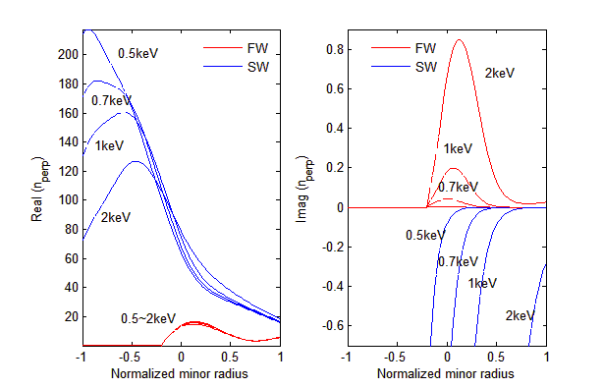
Propagation and Absorption of LHFW (VEST)
Real and Imaginary perpendicular wave number (0.2T/ 500 MHz /3x10¹⁸#/m³/ N||=4)
Notes:
Then, let’s move on LHFW.

Slide 10
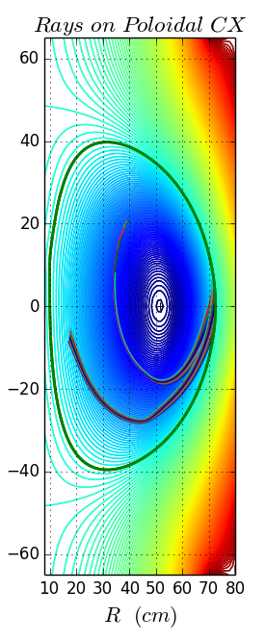
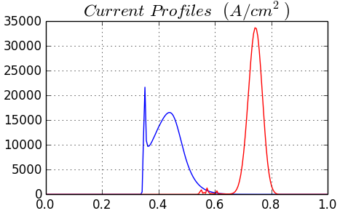
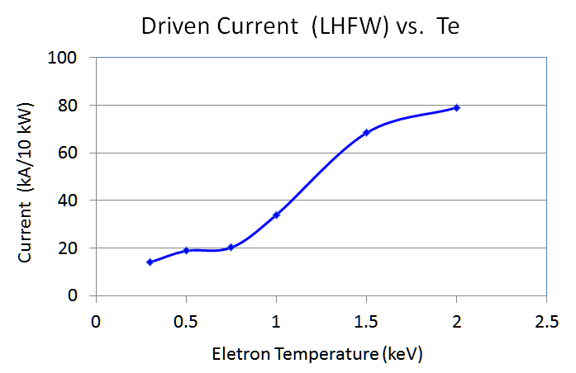
RAY tracing simulation on VEST (GENRAY)
Comparison between LHFW and LHSW launching
(0.2T/ 500 MHz / 3x10¹⁸ #/m³/ 3 keV/ N||=4)
LHFW
launching
LHSW
launching
100 kA / 10kW
125 kA / 10kW
LHFW launching
Normalized radius
LHSW launching
10
Notes:
Then let’s compare the LHFW launching with LHSW launching cases. As shown in this figure, LHFW can propagated into more central region. In addition, the current drive is comparable to LHSW.

Slide 11
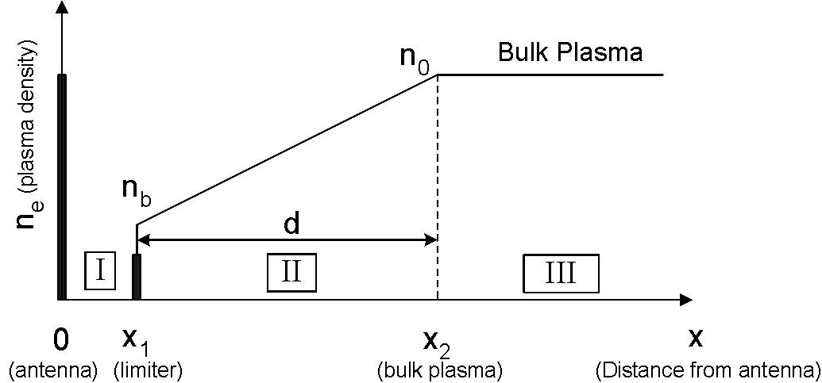
Coupling efficiency (1) 1D full wave code
Governing Equation
Edge density profile model
: Pedestal top-density
Pedestal
a
: Pedestal width
(d)
A system of ordinary differential equation
Boundary condition
LHS : E_{y} (poloidal) = 1,
E_{z}(toroidal) = 0
RHS : No reflection from bulk
plasmas (WKB boundary)
11
Notes:
As I explained before, the launching density of LHFW is very large compared to that of fast waves in other frequency range and even larger than that of LHSW. It means that it could be very difficult to couple the input power to LHFW. So, we need to estimate the coupling efficiency of LHFW. In lower density than about 3x10¹⁷#/m3 which is close to FW launching density, the coupling of LHSW is superior to LHFW. And even for Ey exciaton, all power is coupled to LHSW. However, the density is greater than the launching density, it is reversed. The coupling efficiency of LHFW is almost 10 times greater than that of LHSW. Interesting thing is that in both cases, a part of the input power is coupled to other branches. And the density gradient increases, the ratio increases. It is because that it is impossible to separate two wave branch in high density gradient region. The most power coupling theory is based on WKB approximation, but the approximation breaks in high density gradient region.

Slide 12
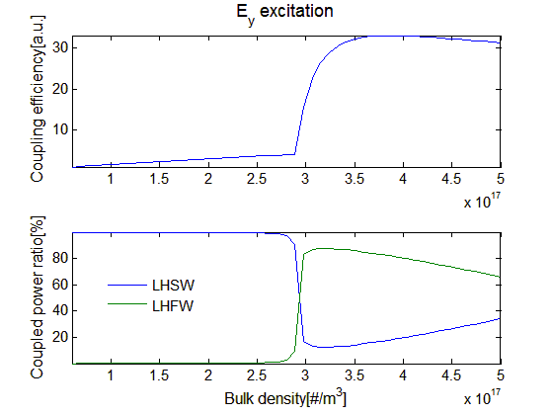
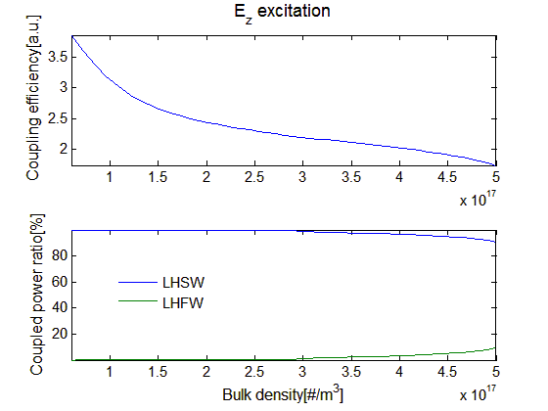
Coupling efficiency (2) Density effect
: Pedestal top-density
Parameters | Values
B₀ | 0.2 T
Frequency | 500 MHz
N∥ | 4.0
n₀ | 6x10¹⁵ ~ 5x10¹⁷ #/m³
n_{b} | 4x10¹⁵ #/m³
d(X₂-X₁) | 3 cm
X₁ | 2 cm
Pedestal
: Pedestal width
for LHFW launching
for LHSW launching
12
Notes:
As I explained before, the launching density of LHFW is very large compared to that of fast waves in other frequency range and even larger than that of LHSW. It means that it could be very difficult to couple the input power to LHFW. So, we need to estimate the coupling efficiency of LHFW. In lower density than about 3x10¹⁷#/m3 which is close to FW launching density, the coupling of LHSW is superior to LHFW. And even for Ey exciaton, all power is coupled to LHSW. However, the density is greater than the launching density, it is reversed. The coupling efficiency of LHFW is almost 10 times greater than that of LHSW. Interesting thing is that in both cases, a part of the input power is coupled to other branches. And the density gradient increases, the ratio increases. It is because that it is impossible to separate two wave branch in high density gradient region. The most power coupling theory is based on WKB approximation, but the approximation breaks in high density gradient region.

Slide 13
RF System for LHFW experiment on VEST
Schematic of LHFW RF System
- Frequency : UHF
- Power : 10 kW(Klystron)
- Antenna : Comb-line type

Slide 14
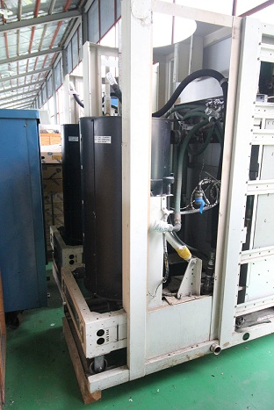
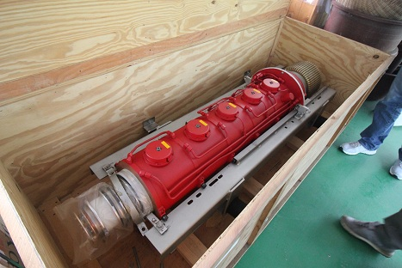
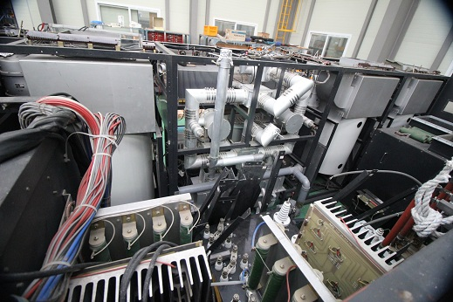
Klystron (1)
Klystron
- Old klystron system for UHF broadcasting has been refurbished.
 | Varian
Frequency | 470~700 MHz
Output | 37.5 kW
Drive Power | 600 mW
Gain | 48 dB
Beam voltage | 19.5 kV
Beam current | 5.4 A
Electrode voltage | 19.5 kV
Heater voltage | 7 V
Heater current | 17 A
Body current | 50 mA
Magnet Voltage | 145 V
Magnet Current | 32 A
Magnet Cooling | Water 2.0 gal/min
Cooling(Collector) | Water 1.5 gal/min
Cooling(Body) | Water 2.0 gal/min
Cooling(Gun/Heater) | Forced Air 50 ft³/min
Varian Tube (SNU/KAPRA)
Harris transmitter frame(SNU)
NEC Beam P/S(KAPRA)
Harris UHF transmitter Specification

Slide 15
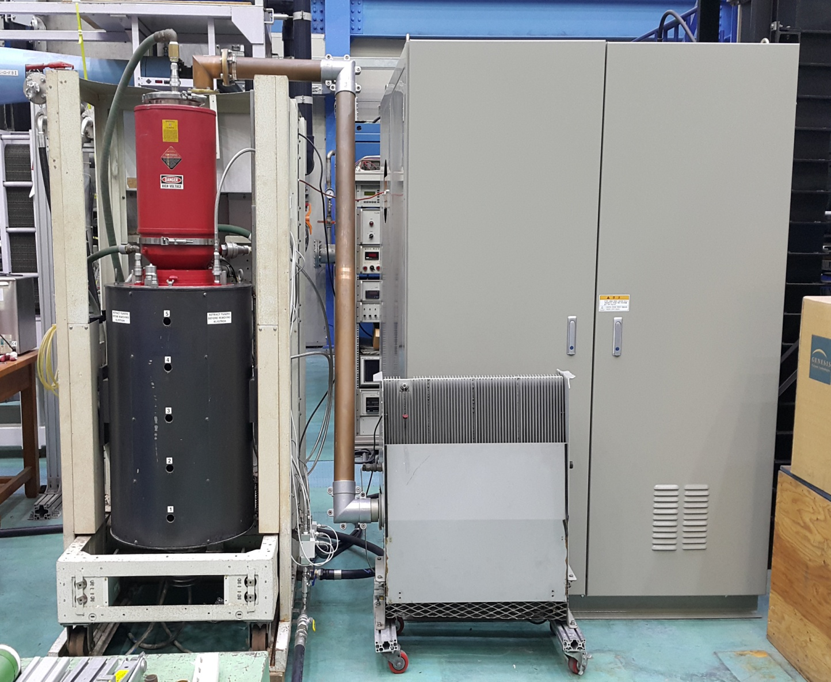
Klystron (2)
Integration of Klystron System
Collector
DC P/S
15kV-6A
T/L
3-1/8 EIA
Magnet
Dummy Load
(10kW CW)
H/V, Filament
Connector
Cooling
Water
Inlet
15

Slide 16
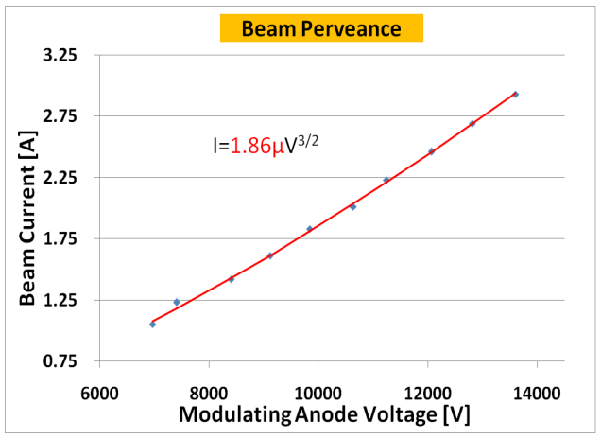
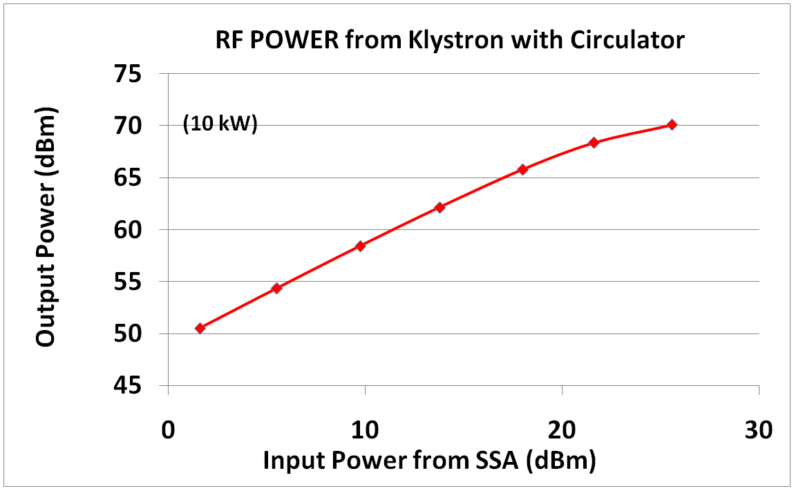
Klystron (3)
Beam perveance & RF power Test
Beam Perveance
Klystron Output Power (@ ~500 MHz)
16

Slide 17
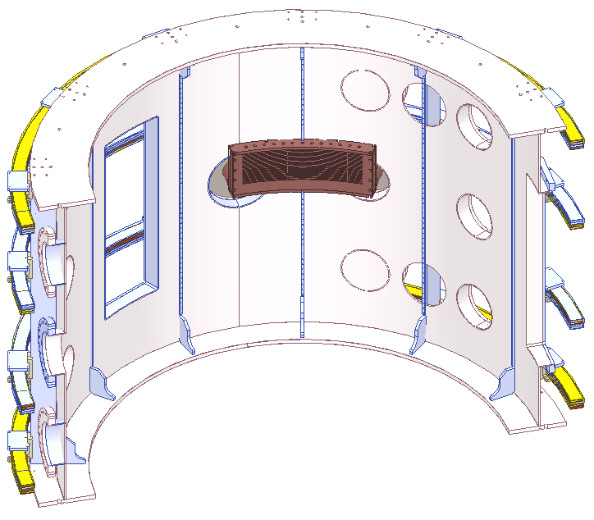
LHFW Antenna (1)
Research Objective |  | Consideration Points
Frequency | UHF | Antenna Length | ~ 418 mm
Bandwidth | < 50 MHz | Antenna width | < 200 mm
VSWR | < 3 | E-field ratio(E_{y}/E_{z}) | 4~6
Peak n∥ | 3 ~ 5 | Peak E-field | < 30 kV/cm
<Combline type Antenna>
designed by KWU
<VEST>

Slide 18
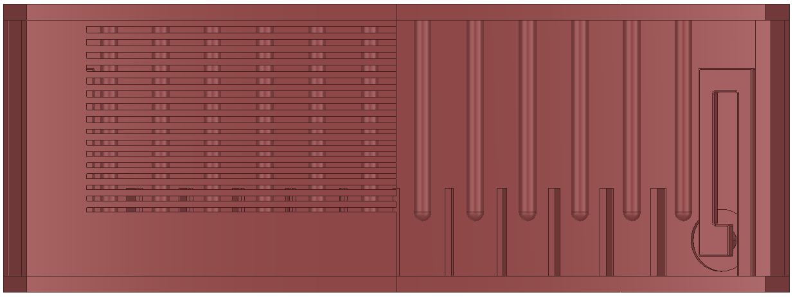
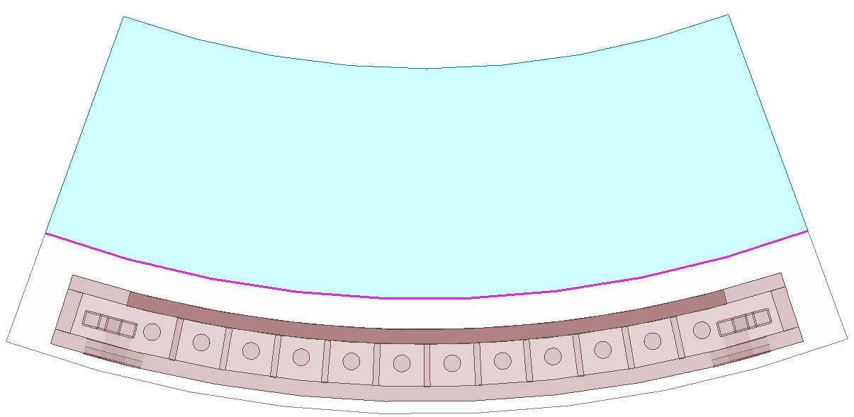
LHFW Antenna (2)
Antenna Structure
Faraday shield
Radiating strap
Port 2 : dummy
(back side)
Field isolator
Exciting strap
Port 1 : Feeding
Simulation Domain for Design(HFSS / COMSOL)
Perfect Matched Layer
Periodic B.C.
Periodic B.C.
Plasmas or Vacuum
Antenna in Vacuum

Slide 19
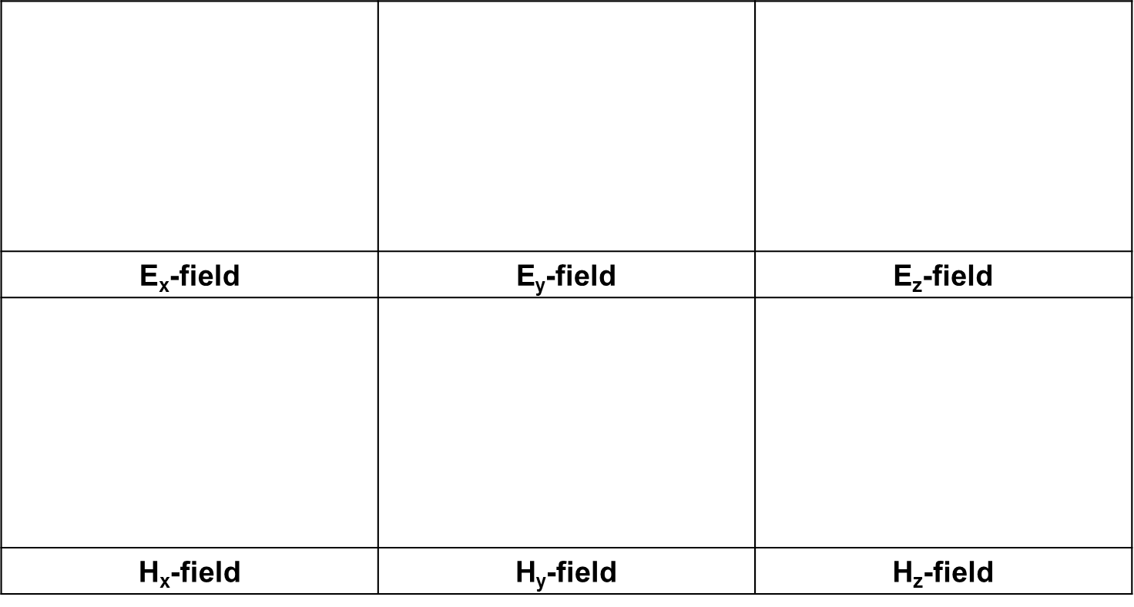
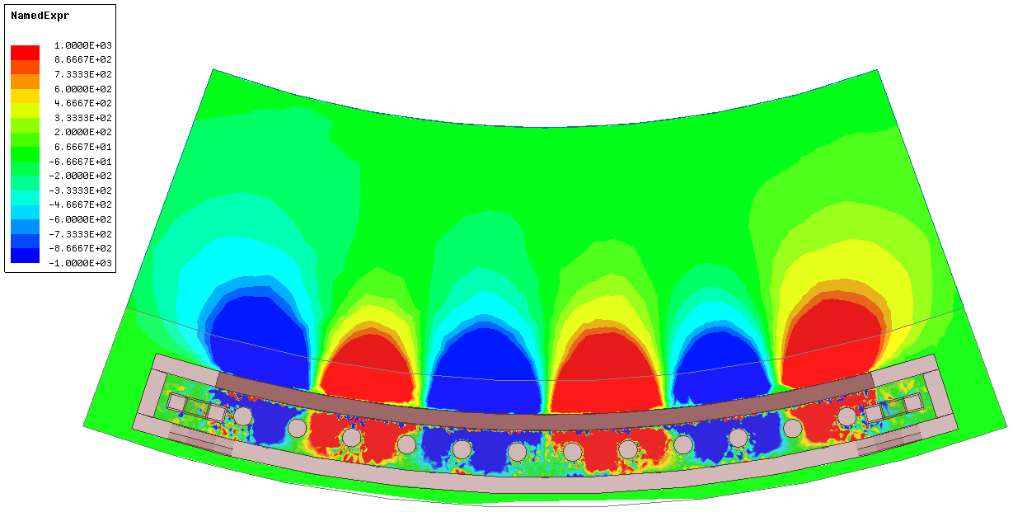
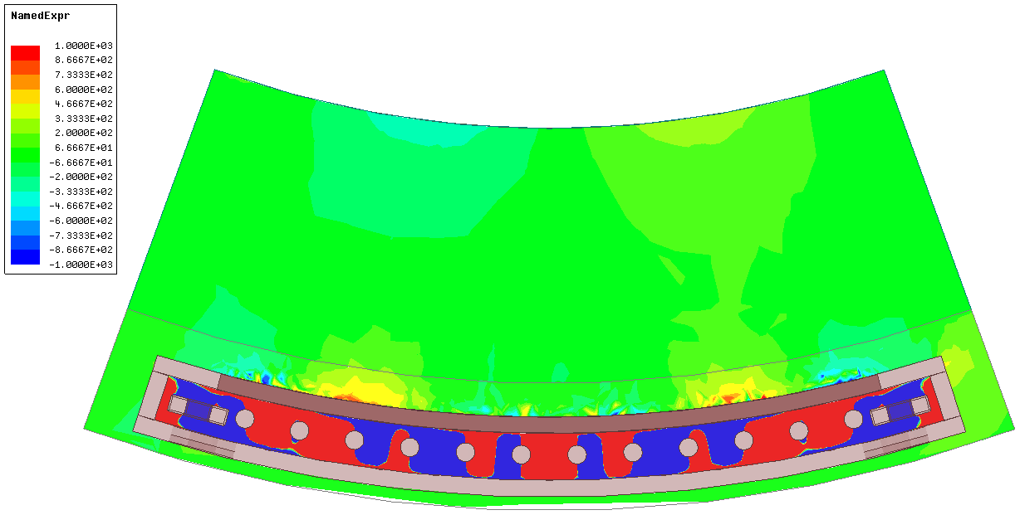
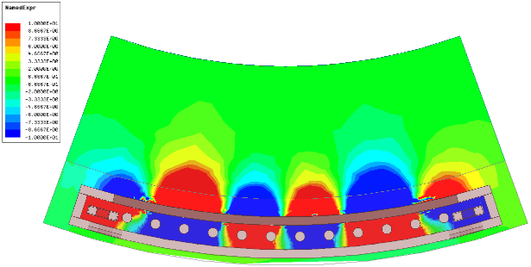
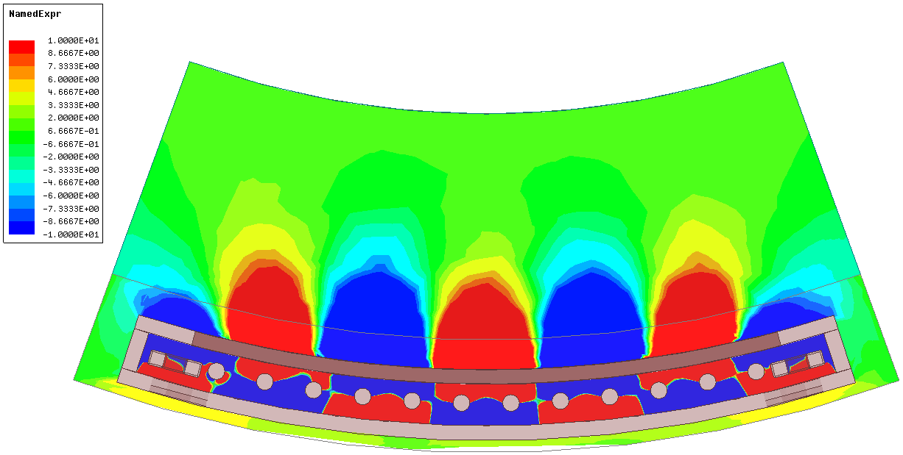
LHFW Antenna (3)
Field distribution & S-parameters (Vacuum load- HFSS)
- Vacuum load
- Frequency : 500 MHz
Condition
S₁₁ = -19.65 dB
S₂₁ = -0.06 dB
S-parameters

Slide 20
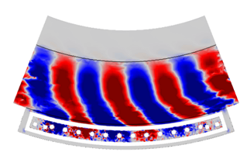
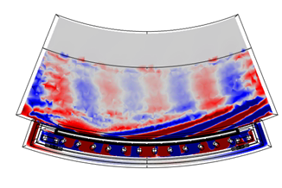
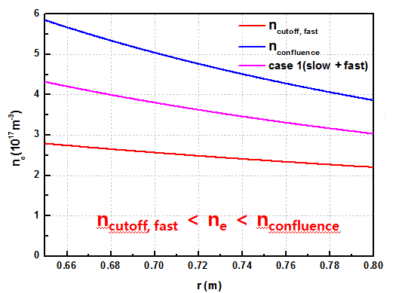
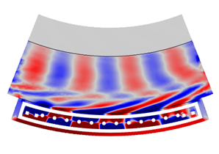
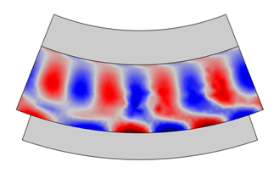
LHFW Antenna (4)
Field distribution & S parameters (Plasma load - COMSOL)
- Plasma load(gap : 0.5cm)
- Frequency : 500 MHz
- B₀ : 0.2 T
S₁₁ = -14.9 dB
S₂₁ = -15.0 dB
Condition / S-parameters
Density Profile

Slide 21
LHFW Antenna (5)
Antenna Parallel wave number N|| (Plasma load)
475~510 MHz
N|| : 3.5 ~ 5

Slide 22
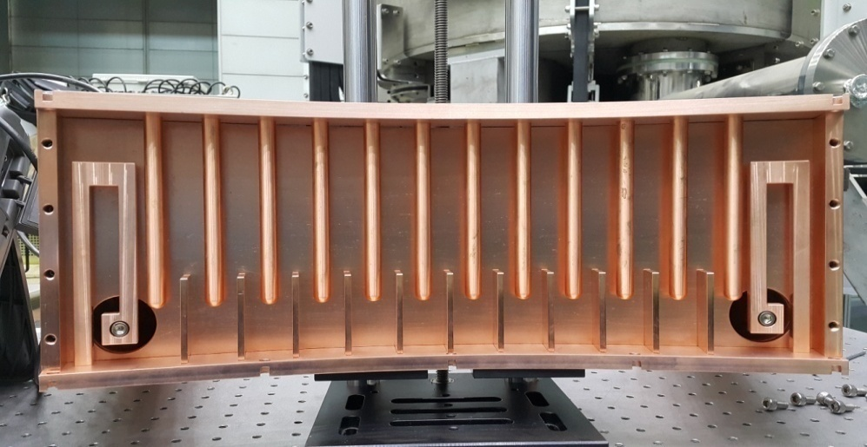
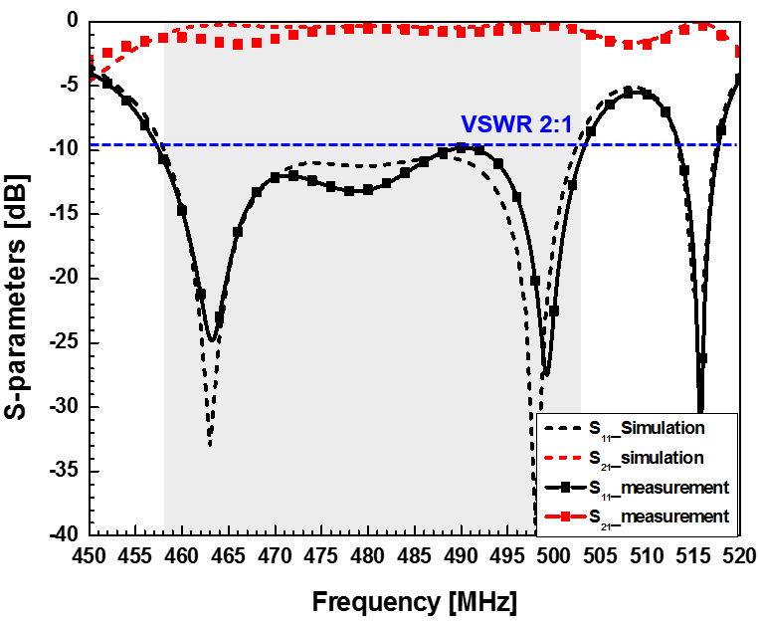
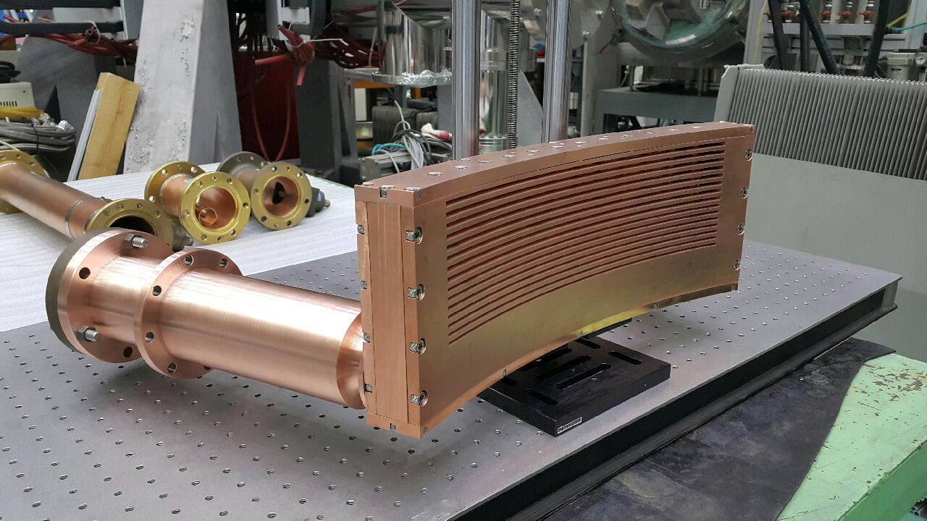
Antenna Fabrication & Test
Comb-line Antenna Inside
Comparison between S-parameters measured and simulated(HFSS)
Current
Straps
Port 2
Dummy
Port 1
Feeder
Comb-line Antenna with FS + Internal TR
Faraday
Shield(FS)
Internal Transformer
22

Slide 23
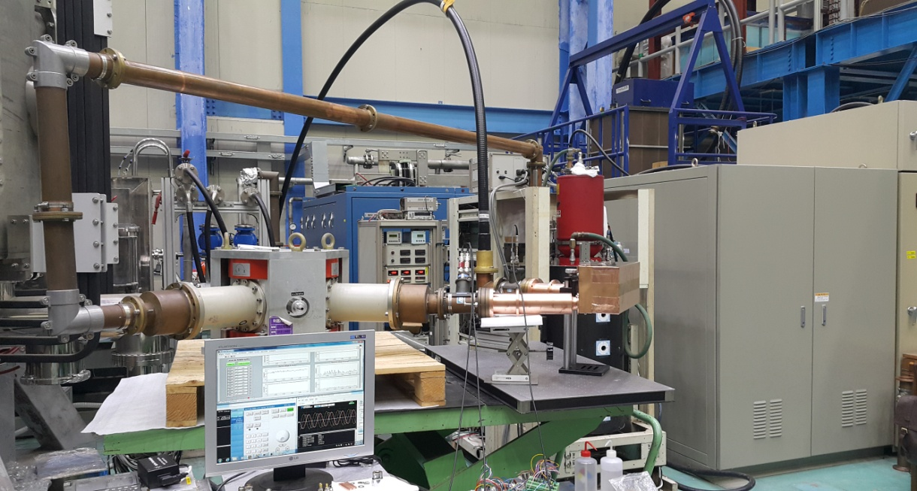
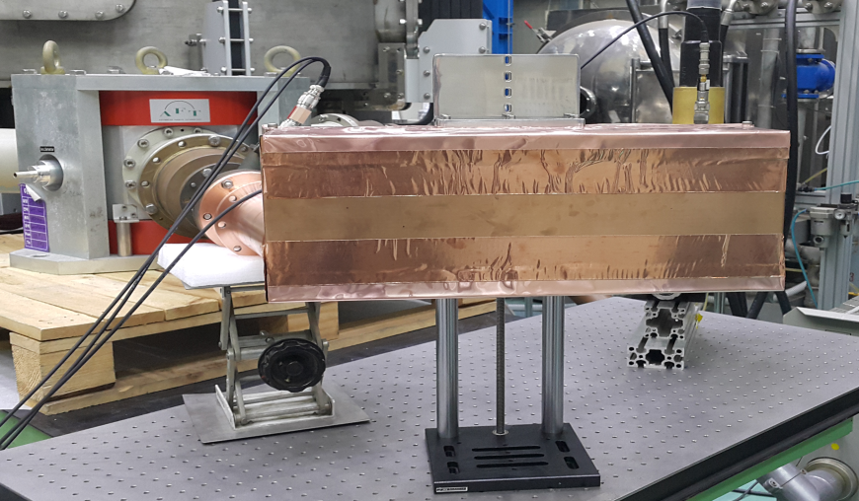
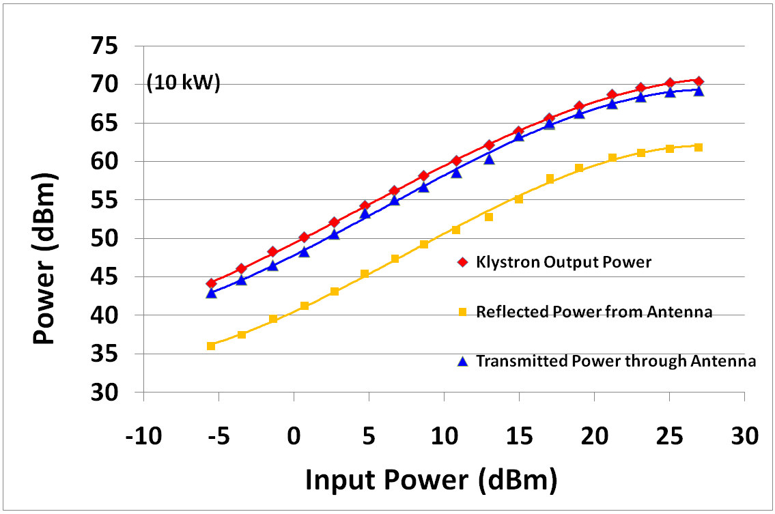
RF System Integration & Test
Integrated RF system
Comb-line Antenna
Transmission Line
Antenna with RF shield
Klystron
Dummy
Output Power (10 kW@496.5MHz)
Circulator
Antenna
Remote
Control & Monitor
DC
Beam P/S
SSA
23

Slide 24
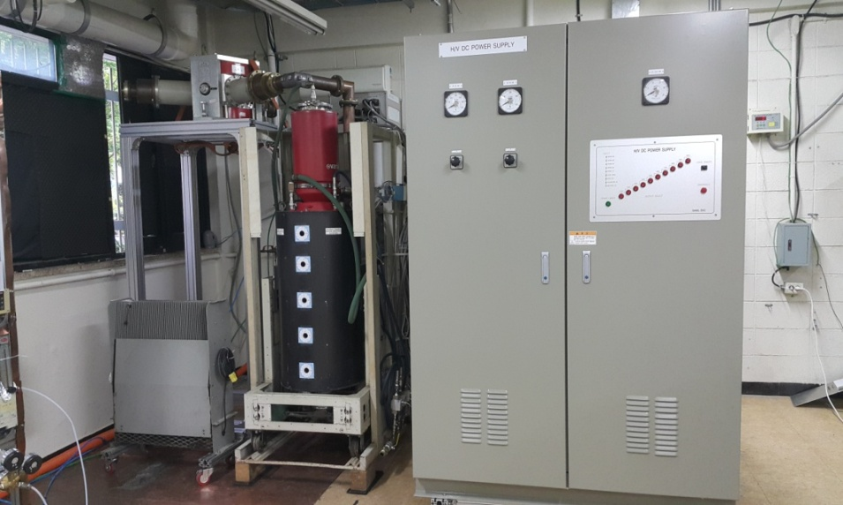
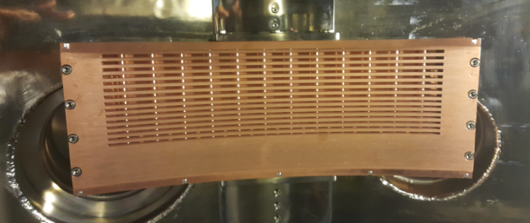
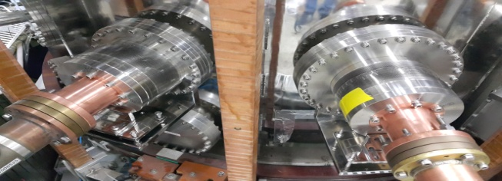
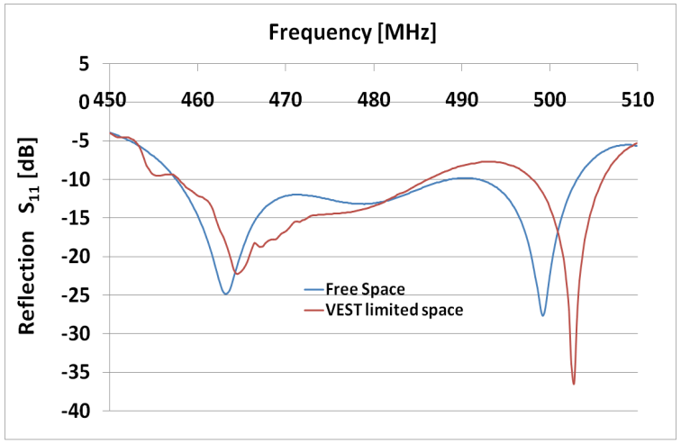
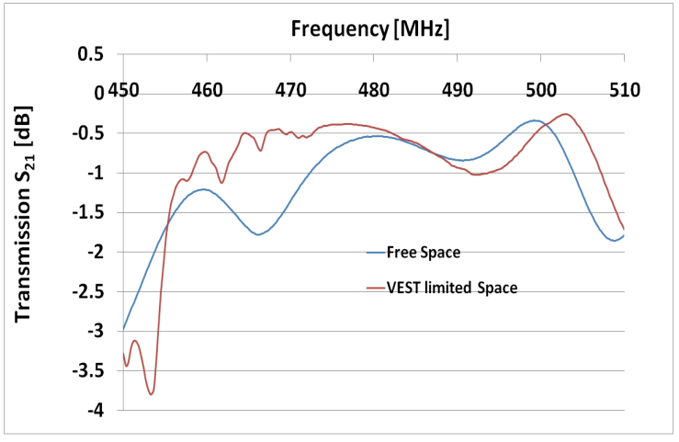
Installation on VEST
RF System installed on VEST site
Antenna installed in VEST chamber
Circulator
DC
P/S
Chamber
inside
Klystron
Dummy
Load
Chamber
outside
Reflection coefficient (S₁₁)
Transmission coefficient (S₂₁)
* Feeding power lines for DC P/S, Cooling system, and Transmission lines are under construction.
24

Slide 25
Plasma Coupling Experiment @ Low Power (Signal Generator)
#15355
20
~38 kA
~18 kA
~5 kA
LHFW launching density range
Notes:
Then, let’s move on LHFW.

Slide 26
Summary
Summary
The steady-state operation is one of the key issues of tokamak fusion reactors.
A current drive by using a fast wave in lower hybrid frequency range(LHFW) was suggested and the proof of principle experiment was planned on VEST.
Because it has favorable parallel electric field for current drive and good penetration property in high density, though it has coupling issue due to its high launching density.
==========================================================================
RF power have been prepared by refurbishing an old broadcasting klystron system through collaboration with SNU and KAPRA. It is successfully integrated and proved to generate RF power up to10 kW stably.
As a LHFW launcher, a compact comb-line antenna has been designed with COMSOL /HFSS codes by KWU. It is turned out that the design and fabrication is successful through the S-parameter measurement & 10 kW power test.
All the RF system are finally installed on VEST except transmission lines and utilities for the system.
Notes:
Then, let’s move on LHFW.

Slide 27
Summary & Future Plan
Summary
A series of coupling experiments are progressing at low power with a signal generator.
The first experiment result shows that the comb-line antenna works normally in plasma environment at low power.
It seems that the RF power is coupled to Lower Hybrid Fast Wave(LHFW) because the power coupling increases dramatically in relation to LHFW launching density.
==========================================================================
Coupling characterization experiment.
High power LHFW H&CD experiment based on coupling characterization.
(after completion of utilities and transmission lines)
TF upgrade to 0.2 T to increase upper density boundary limit by confluence and make current drive possible in higher density.
Future Plan
Notes:
Then, let’s move on LHFW.

