Slide 1

Merging Formation of High-β STs in UTST
19th International Spherical Torus Workshop (ISTW 2017)
M. Inomoto, T. Ushiki, X. Guo, T. Sugawara,
K. Kondo, T. Mihara, Y. Minami, Y. Inai,
H. Tanabe and Y, Ono
Graduate School of Frontier Sciences, The University of Tokyo
This work is supported by A3 Foresight Program, JSPS KAKENHI 16K14525, 15H05750, 15K14279, 26287143 and NIFS collaboration program NIFS15KBAR012, NIFS15KNTR001, NIFS16KOAP030, NIFS17KNWP006.

Slide 2
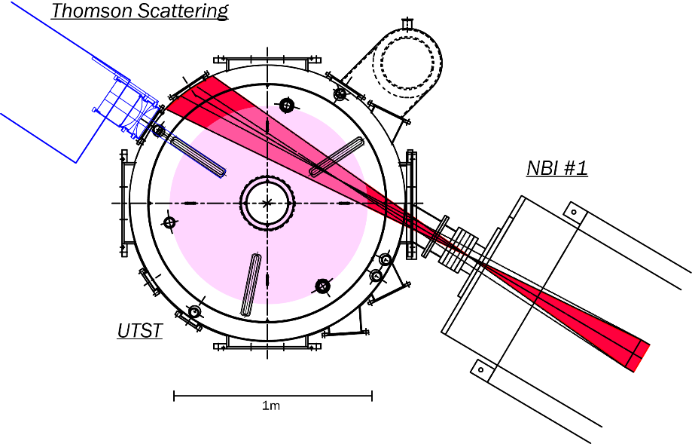




Goal of UTST Research
To demonstrate ST start-up without use of center-solenoid (CS) coil.
1) Formation of two STs by using outer (ex-vessel) poloidal field (PF) coils
2) Axial merging of two STs providing reconnection heating to form high-β plasma
Dynamic formation within ~1 ms
3) NBI H&CD
Merging start-up
demonstrated in
TS-3/TS-4/START/MAST
TS-U/ST40

Slide 3
Required performance for UTST start-up scheme
Outer PF coil start-up
Initial density + compression
+fueling
ST plasma with high-I_{p}, high-n_{e} and high-T_{e} should be formed to apply NBI H&CD.
Reconnection heating
Since outer PF coil start-up cannot sustain the plasma current for a long period, Ohmic heating is not expected in this start-up scheme.
Utilization of MW-order reconnection heating is essential to form high-β equilibrium

Slide 4
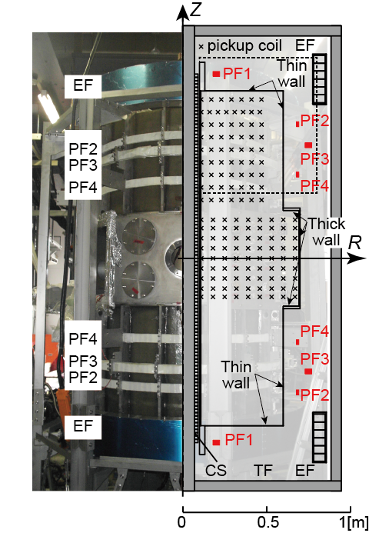
Present status of UTST
Four pairs of outer PF coils are energized by total 1 MJ capacitor banks.
Typical parameters (merging start-up)
R ~ 0.35 [m] / a ~ 0.2 [m]
I_{p} < 120 [kA]
B_{t} ~ 0.2 [T]
n_{e} < 5 x 10¹⁹ [m⁻³] ~ 0.5 x n_{G}
T_{e}, T_{i} ~ 10 [eV] (initial plasma)
T_{e} < 30 [eV], T_{i} < 50 [eV] (after merging)
These parameters are not sufficient as a target plasma for 500 kW/25 keV NBI.

Slide 5
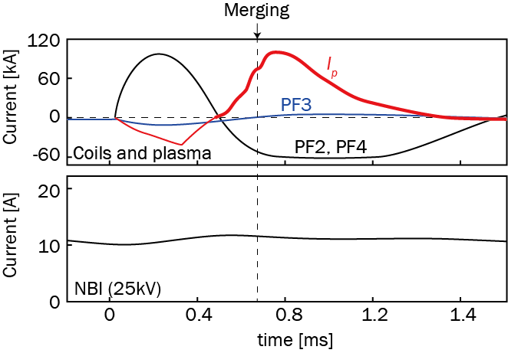
UTST-NBI initial experiment in 2016-17
T. Sugawara
NBI was applied on the ST plasma produced by recently-developed longer-pulse discharge without CS current drive.

Slide 6
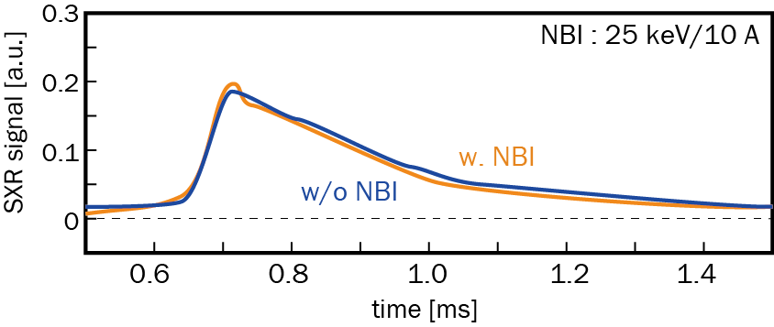
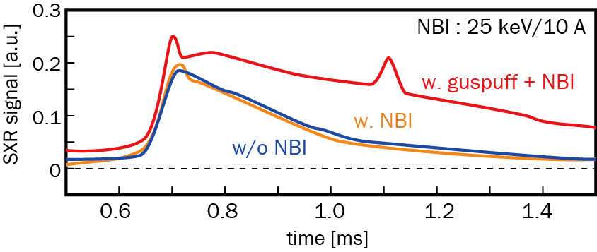
Density increase is required for effective NBI
T. Sugawara
I_{p} and SXR waveforms showed no significant change by NBI.
Expected shine-through loss was as high as 40 % for peak density of 5x10¹⁹ [m⁻³].
Gas puffing is helpful to reduce the shine-though loss.
SXR signal (Filter : Mylar 1μm (>200eV))
Improvement of plasma performance is needed.

Slide 7
Necessary improvement for effective NBI heating
Three plasma parameters, I_{p}, T_{e} and n_{e} should be improved. Particularly the plasma current is essential because it determines the reconnection heating power, density limit, and fast ion orbit loss.
Ion heating by merging
~B_{p}
H. Tanabe, et al., Nucl. Fusion 2017.

Slide 8
Electron heating in merging start-up period
Electron heating mechanism in merging process is still unclear. Localized electron heating was observed in MAST experiment.
Peak T_{e} depends strongly on B_{t}, while B_{t} does not reconnects.
X-point?
T. Yamada, et al., Nucl. Fusion 2016.

Slide 9

UTST current tasks
Increase initial plasma current driven by outer PF coils.
  Optimization of pre-ionization and coil waveform
Improve reconnection heating effect in merging period.
  Well balanced merging
  Efficient electron heating
  Compression
Density increase.
  Gas puffing or compact torus injection
Increase initial plasma current driven by outer PF coils.
  Optimization of pre-ionization and coil waveform
Improve reconnection heating effect in merging period.
  Well-balanced merging
  Efficient electron heating
  Compression
Density increase.
  Gas puffing or compact torus injection

Slide 10
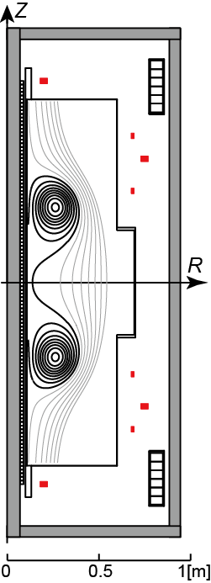
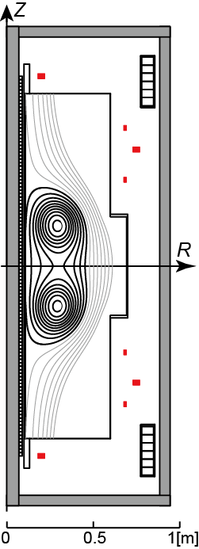
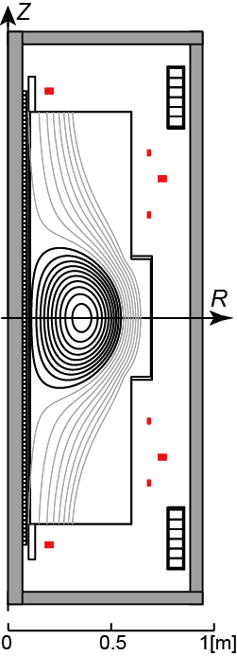
For well-balanced merging…

Slide 11
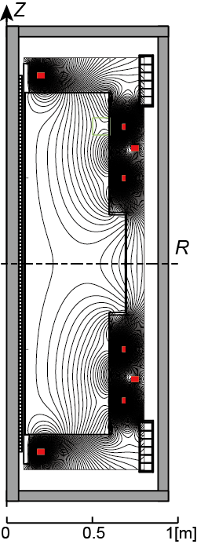
Well-balanced merging
Generate two “identical” initial ST plasmas and control their motion precisely to merge on the center of the device.
Reconstruction of shape and current of each initial STs is required.
Since large eddy current flows on the vessel wall in the start-up period, development of fine reconstruction scheme with eddy current estimation is needed.

Slide 12
Modified-Cauchy Condition Surface
(M-CCS) method applied to merging STs
Three boundary integral functions are solved by truncated singular value decomposition (TSVD) technique.
Magnetic flux at sensors
Magnetic field at sensors
Magnetic flux on CCS
Contributions from plasma current (CCS)
Contributions from eddy current
Advantage of M-CCS method is that it can estimate the plasma and eddy current in a single manner.
CCS : K. Kurihara, Fusion Eng. Des. 51-52, 1049 (2000).
M-CCS : M. Itagaki, et al., Plasma and Fusion Res. 9, 1402046 (2014).

Slide 13
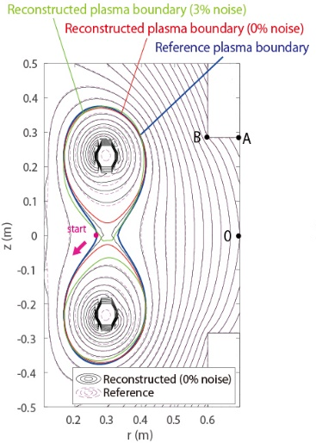
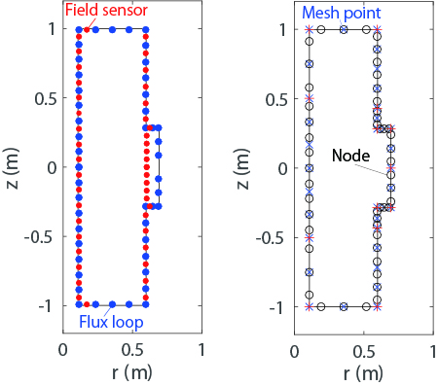
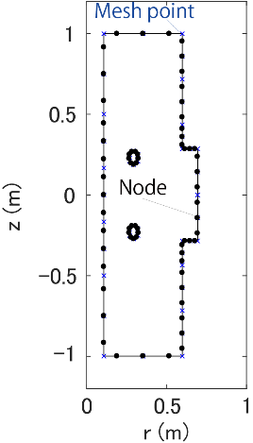
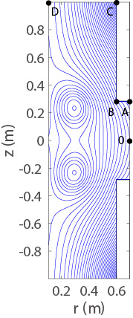
Modified-Cauchy Condition Surface
(M-CCS) method applied to merging STs
T. Ushiki, et al., submitted to Fusion Eng. Des.
Magnetic sensors : 43
Flux loops : 47
Nodes on CCS : 18 (unknowns : 36)
Nodes (unknowns) on the wall : 51
Flux surfaces with two magnetic axes are accurately reconstructed by M-CCS method.
Reference data
Reconstructed profile

Slide 14
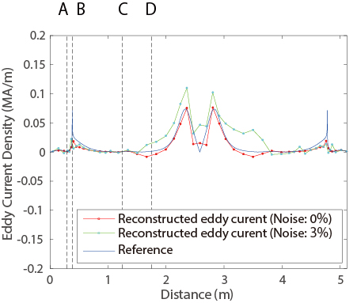
Eddy current profile is well estimated by M-CCS method
T. Ushiki, et al., submitted to Fusion Eng. Des.
The M-CCS method well reconstructs the eddy current profile as well as the plasma current and LCFS.

Slide 15
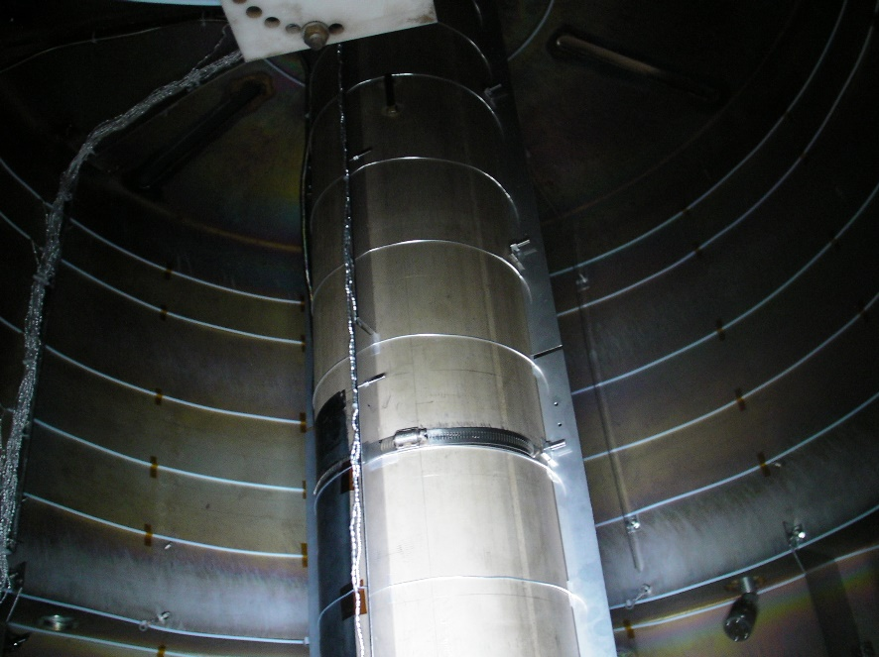
Limiters and flux loops installed
Based on the analytic results of reconstruction, limiters and flux loops were installed on the UTST vessel wall.
Other upgrades for start-up improvement, such as pre-ionization and fueling, are ongoing.

Slide 16
Electron heating by reconnection

Slide 17
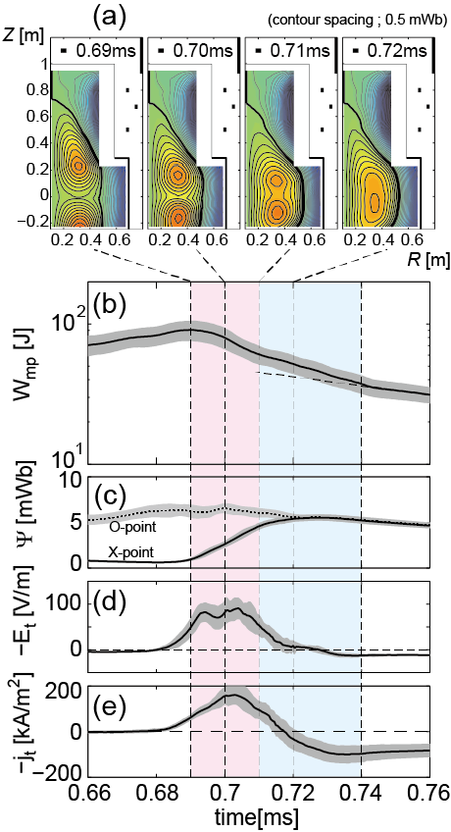
Electron heating by reconnection
Magnetic reconnection converts magnetic energy to plasma kinetic/thermal energy within a short period, resulting in >MW order (30J/20μs) heating power.
It is believed that the released magnetic energy largely energizes ions at the downstream region in MHD regime due to ion’s heavy mass.
Inomoto+, NF 2015

Slide 18
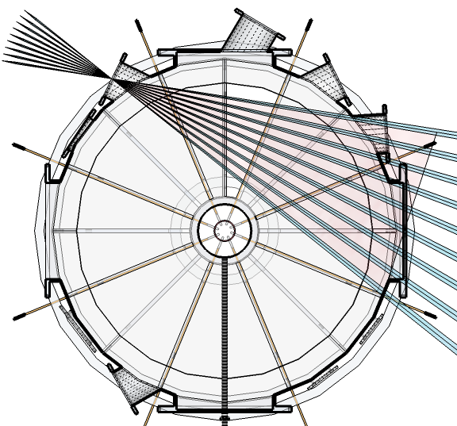
Ion heating in UTST merging
H. Tanabe
Reconstructed temperature
T_{i} measurement (CIII 464.74nm, 46 chords and z-scan) showed that ion heating up to 50 eV localized at the downstream region in UTST merging start-up.

Slide 19
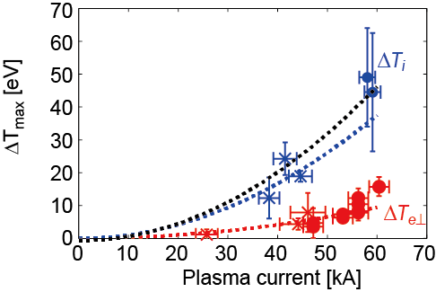
Reconnection heating in UTST
Small heating effect was achieved in UTST because the initial two STs with low I_{p} contain small poloidal magnetic energy that is partially converted to the plasma thermal energy.
Inomoto+, NF 2015

Slide 20
Reconnection heating on ions and electrons
In MHD picture of anti-parallel reconnection, ions and electrons flow with same velocity out from the X-point by ExB drift. Thus, ions are dominantly energized by reconnection.
On the other hand, the localized electron heating observed in MAST, could be provided by another mechanism of direct electron energization.

Slide 21
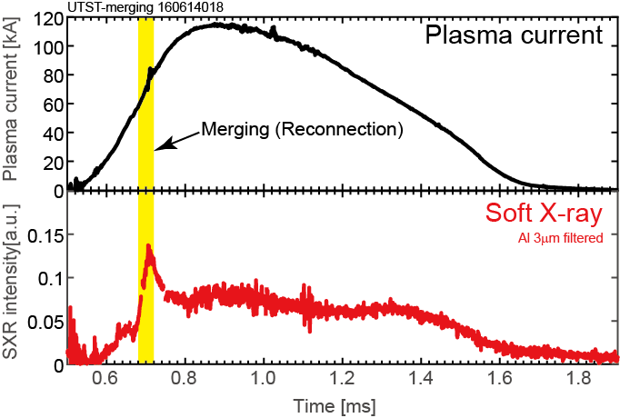
Soft X-ray burst found in reconnection period
SXR signal indicates that energetic electrons were generated during reconnection event.
Non-thermal energetic component could be generated by parallel electron acceleration.

Slide 22
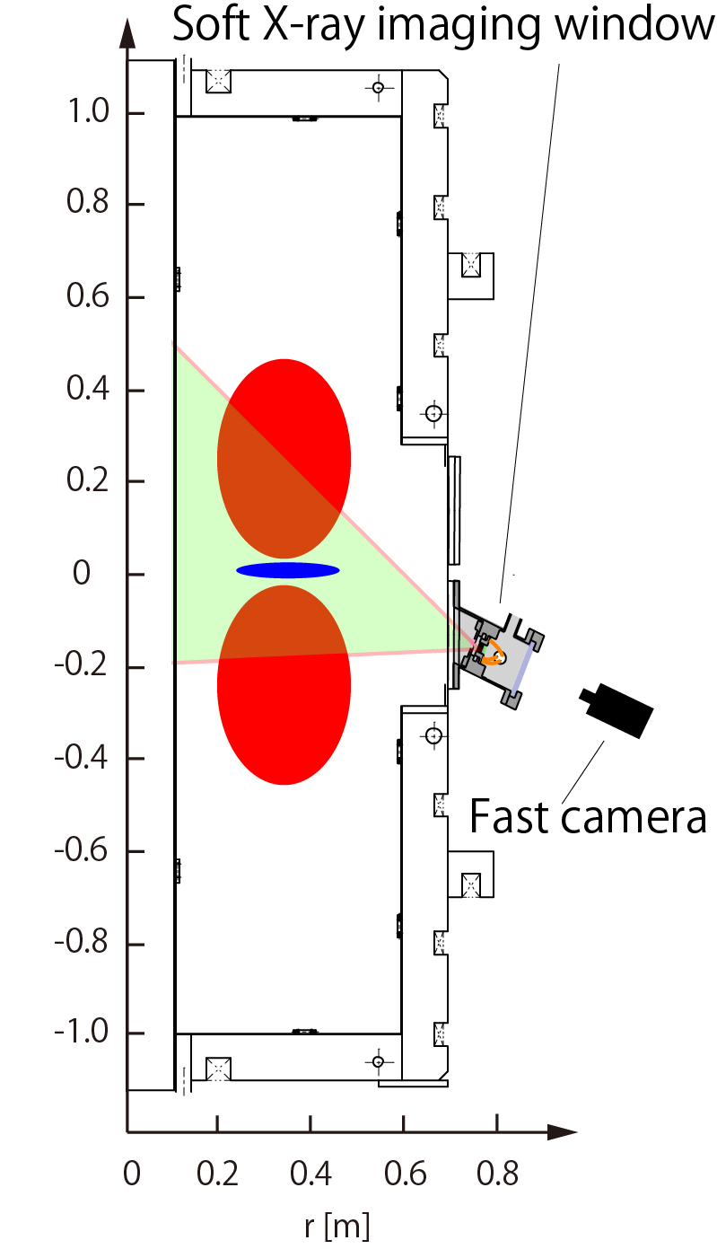
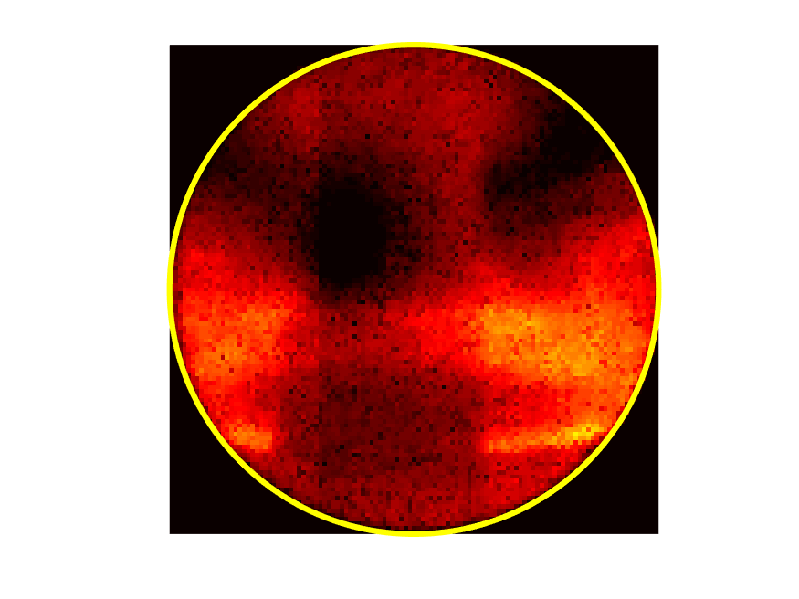
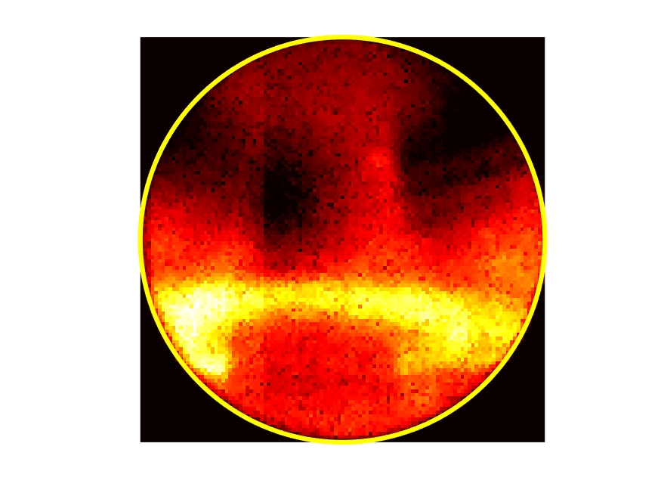
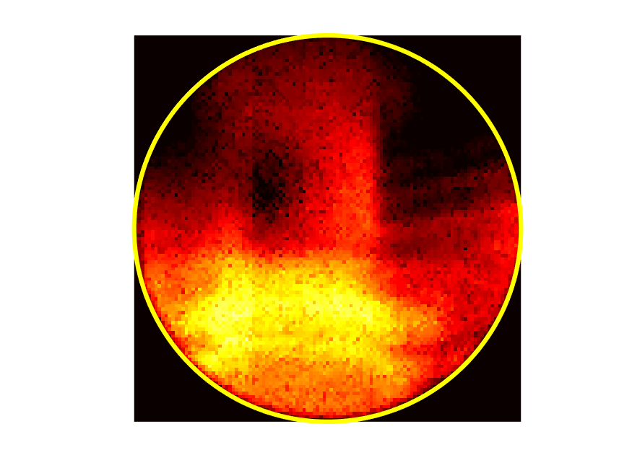
Ring-shaped SXR emission formed in early reconnection phase
T. Ushiki
9.516msec
9.520msec
9.525msec
Center stack
SXR image (Filter : Mylar 1μm (>100eV))
Measurement system looking up at the reconnection region.

Slide 23
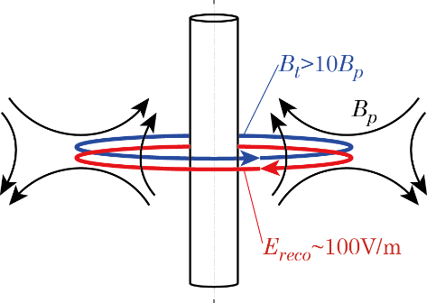
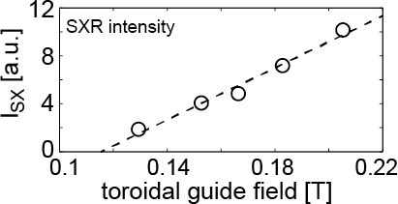
Non-thermal electrons rotate toroidally at the X-point?
CIII (464nm)
Slim ring-shape emission from the X-point seen by SXR and visible line spectra.
T_{e⊥} and n_{e} slightly increase near the X-point but do not peak so sharply (UTST Thomson scattering).
Electrons with high toroidal velocity are likely to rotate near the X-point where B_{p} is negligible.
Center stack

Slide 24
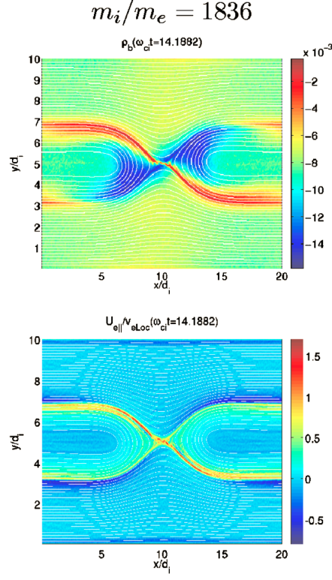
Electron acceleration in high guide field reconnection
Lapenta+ POP 2010.
B_{guide} / B_{reco} ~ 1
In non-relativistic regime, the peak electron velocity v// is given by
and the accelerated electrons flow out from the reconnection region and accumulate in the downstream region.
In UTST experiments with high guide field (B_{t}/B_{p}>10), accelerated electrons stays longer at the reconnection point to form a ring-shaped emission region.
Drake+ PRL 2005.
L_{c} : cavity length along B_{reco}

Slide 25
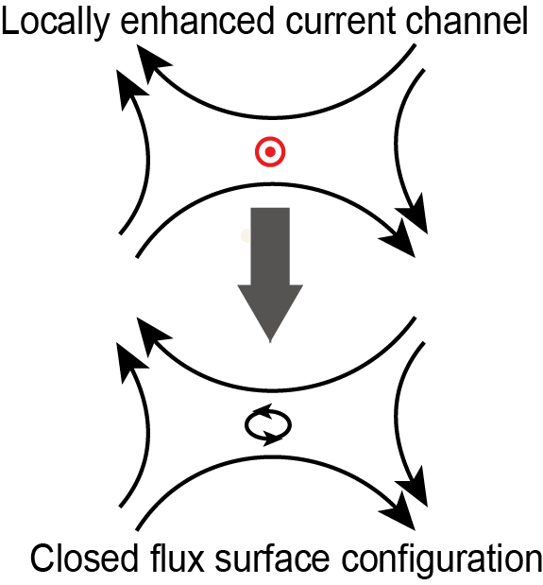
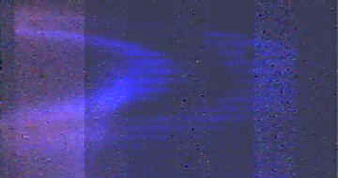
Why fast electrons stay near the X-point?
Since strong toroidal field exists at the X-point, electrons are well confined when the poloidal closed surface is formed.
Even though the number of the fast electrons is smaller than the bulk electrons, they might carry significant current and modify the magnetic structure.
Double- or Triple-ring emission is sometimes observed. Multiple closed flux surfaces may be formed.

Slide 26
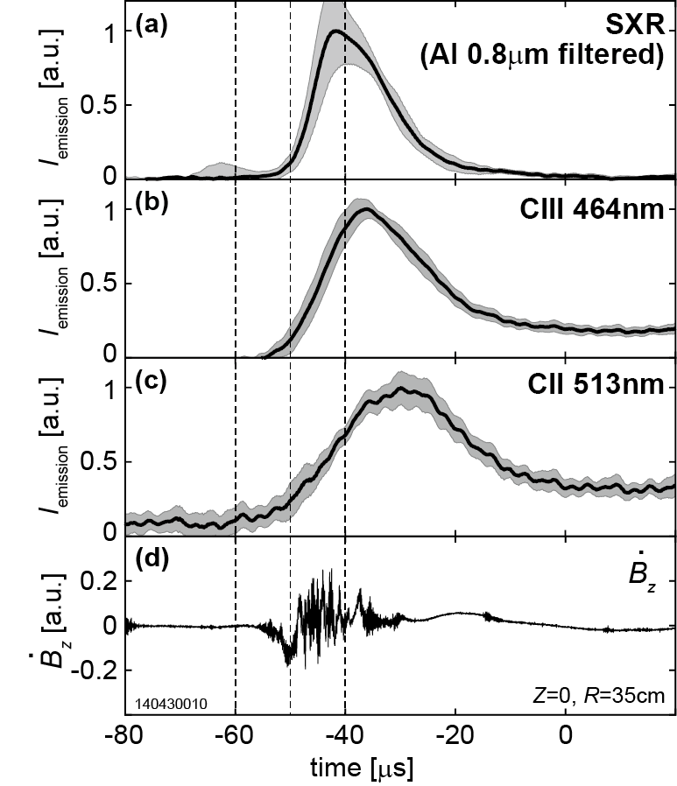
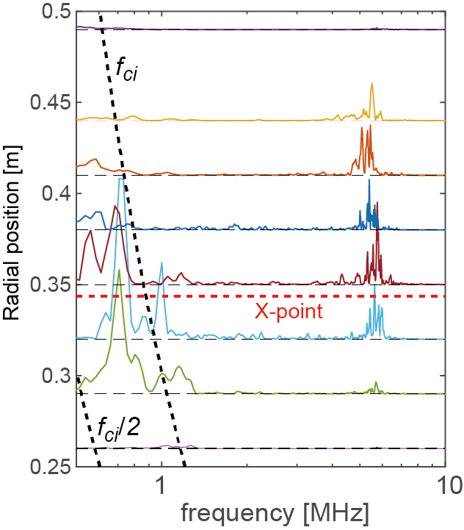
The SXR burst and magnetic fluctuations were observed in the early phase
Fluctuation Spectra
Fluctuation signals consist of two components, (1) ~f_{ci}, (2) ~10f_{ci}.
merging
SXR emission and fluctuation occur only in the early phase of merging.

Slide 27
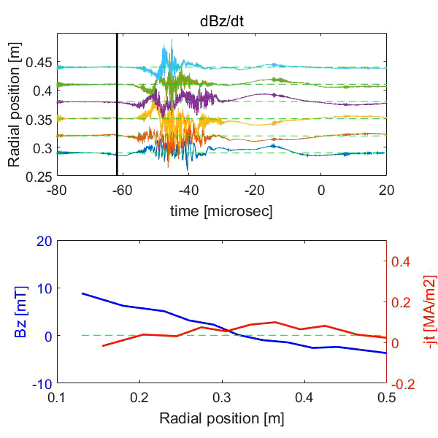
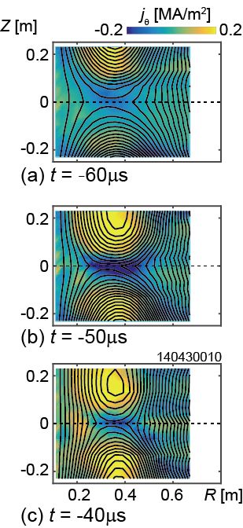
~ f_{ci} fluctuation modifies the magnetic field structure in current layer
Shot:140430010
Once a single-peaked current layer is formed, then locally-enhanced current modifies the magnetic structure to confine fast electrons.

Slide 28
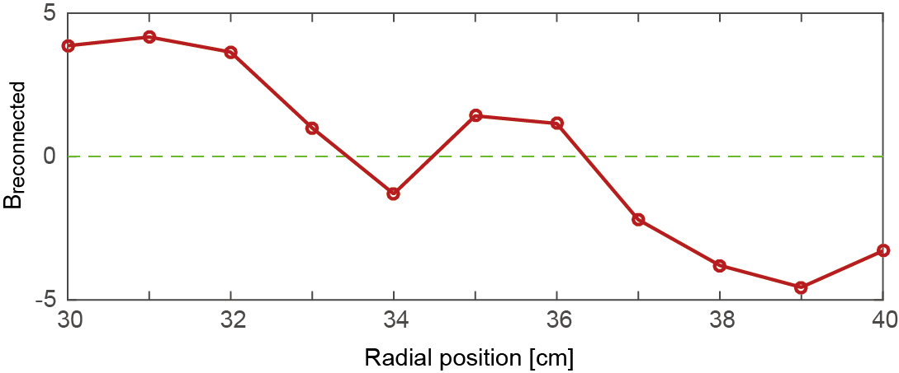
Closed flux surface inside the current layer
Closed flux surface inside the reconnection current layer helps to confine electrons to reach high energy range by parallel electric field.
Long-lived closed flux surfaces will enhance the conversion ratio to electron energy although they are radially unstable.
VIS/SXR emission, ~10 f_{ci} fluctuation

Slide 29


Summary
For effective NBI heating, improvements of ST formation scheme are in preparation (reconstruction, pre-ionization, waveform optimization, fueling, etc.).
To achieve high electron temperature, reconnection heating mechanism has been investigated.
Assumed mechanism
  Magnetic reconnection with strong guide field involves significant electron acceleration by parallel reconnection electric field.
  The accelerated electrons rotate toroidally near the X-point, forming current channel.
  The enhanced current modifies magnetic field profile inside the current layer to confine fast electrons.
Need further investigation on thermalization/transport process.

Slide 30
Thanks for listening

Slide 31
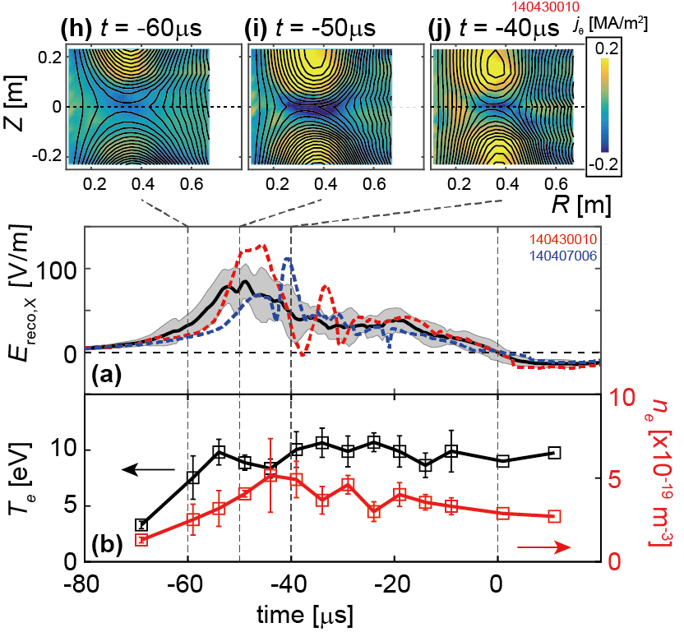
Reconnection electric field largely fluctuates
Global magnetic structure changes within 60 μs,
The reconnection electric field revealed large fluctuation in the early phase of merging.

Slide 32
Extreme high-β plasma (so-called “FRC”) was sustained only by NBI
The FRC is a torus plasma confined only by poloidal magnetic field, Recent experiments show that the FRC is sustained quasi-steadily only by 10 MW-NBI.
H. Gota, et al., 26th IAEA-FEC EX/P3-41

Slide 33
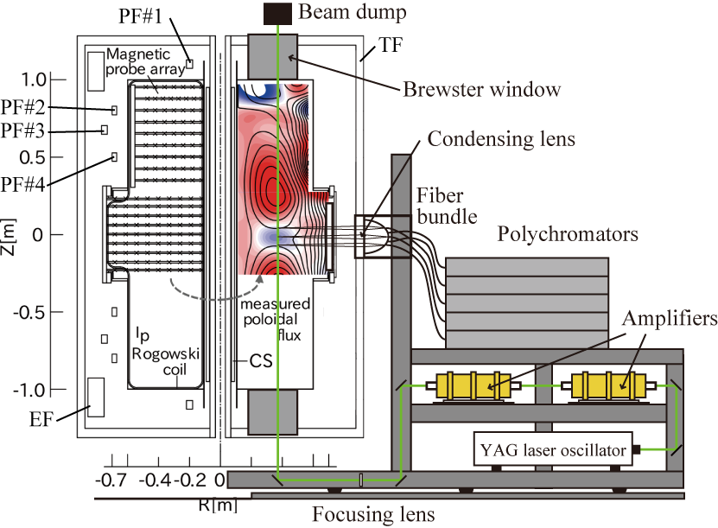
UTST Thomson scattering
T. Sugawara
Since laser is injected along axial direction and radially-directed scattered light is collected, poloidal electron temperature is measured.

